Slide 1
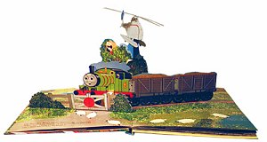
Single-view 3D Reconstruction
10/11/19
Computational Photography
Derek Hoiem, University of Illinois
Some slides from Alyosha Efros, Steve Seitz

Slide 2
Notes about Project 4 (Image-based Lighting)
You can work with a partner and submit a joint project
You will need a mirrored sphere (see Piazza post)
  I have a few which I will be able to loan out for a couple days at a time, but I’d like to reserve them for emergencies

Slide 3
Baby is coming!
Due date Oct 24, so sometime in next 2-3 weeks, Derek will miss ~2 lectures
  TA will fill in

Slide 4
Single-view 3D Reconstruction
Computational Photography
Derek Hoiem, University of Illinois
Some slides from Alyosha Efros, Steve Seitz

Slide 5
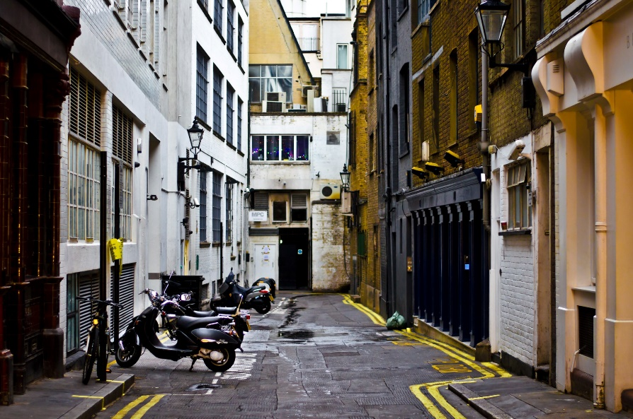
Take-home question
Suppose you have estimated finite three vanishing points corresponding to orthogonal directions:
  How to solve for intrinsic matrix? (assume K has three parameters)
    The transpose of the rotation matrix is its inverse
    Use the fact that the 3D directions are orthogonal
  How to recover the rotation matrix that is aligned with the 3D axes defined by these points?
    In homogeneous coordinates, 3d point at infinity is (X, Y, Z, 0)
VP_{y}
.
VP_{x}
VP_{z}
Photo from Garry Knight

Slide 6
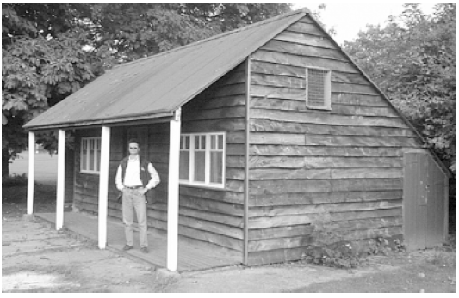
Take-home question
Assume that the man is 6 ft tall.
  What is the height of the front of the building?
  What is the height of the camera?

Slide 7
Take-home question
Assume that the man is 6 ft tall.
  What is the height of the front of the building?
  What is the height of the camera?
(0.92+1.55)/1.55*6=9.56
~5’7
0.92
1.55

Slide 8
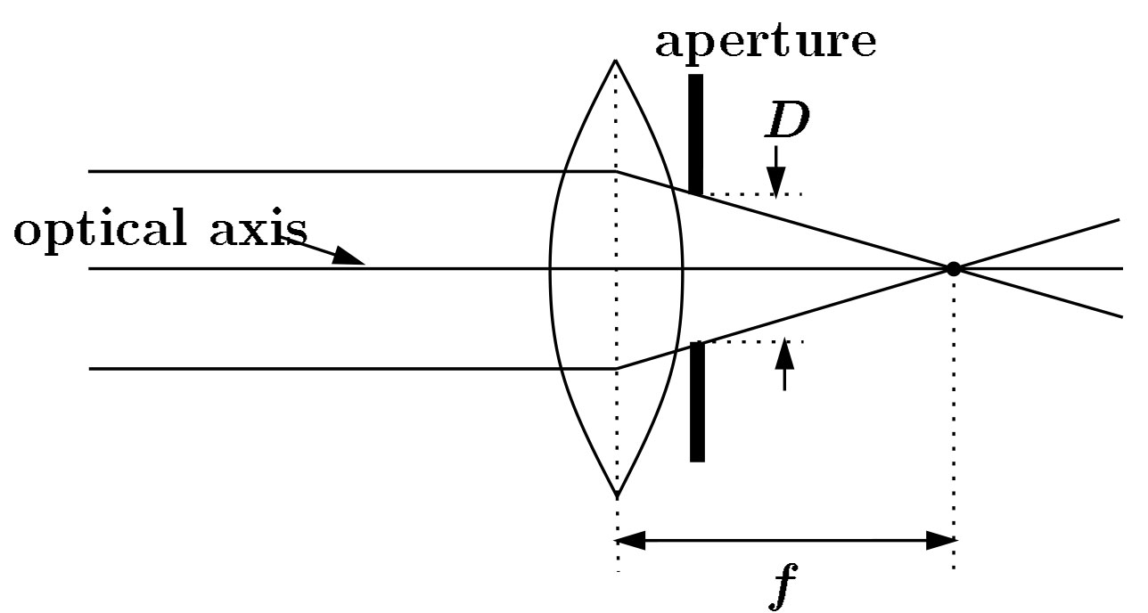
Focal length, aperture, depth of field
F
focal point
optical center
(Center Of Projection)
Increase in focal length “zooms in”, decreasing field of view (and light per pixel), increasing depth of field (less blur)
Increase in aperture lets more light in but decreases depth of field

Slide 9
Increasing focal length decreases field of view because smaller range of rays to scene can hit sensor
Scene
Barrier
Sensor
FoV

Slide 10
Decreasing aperture increases depth of field because lens refocuses rays from smaller range of angels
Scene
Barrier
Sensor
FoV

Slide 11
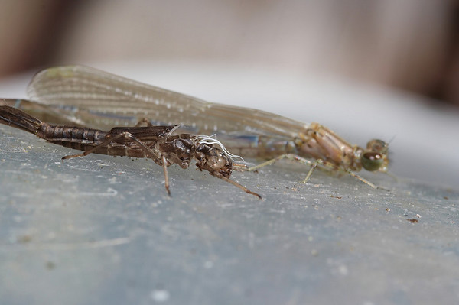
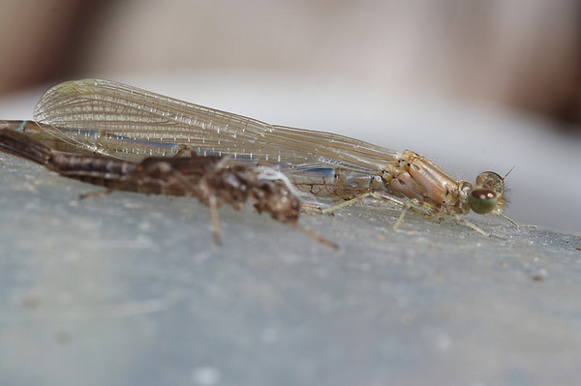
Difficulty in macro (close-up) photography
For close objects, we have a small relative DOF
Can only shrink aperture so far
How to get both bugs in focus?

Slide 12
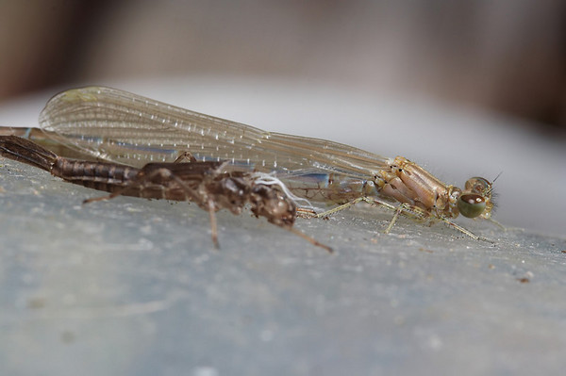
Solution: Focus stacking
Take pictures with varying focal length
Example from
http://www.wonderfulphotos.com/articles/macro/focus_stacking/

Slide 13
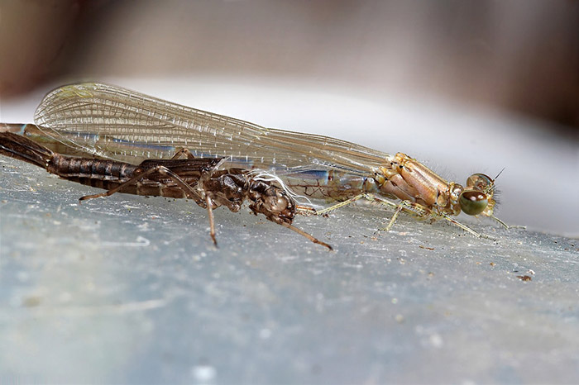
Solution: Focus stacking
Take pictures with varying focal length
Combine

Slide 14

Focus stacking
http://www.wonderfulphotos.com/articles/macro/focus_stacking/

Slide 15
Focus stacking
How to combine?
Align images (e.g., using corresponding points)
Two ideas
  Mask regions by hand and combine with pyramid blend
  Gradient domain fusion (mixed gradient) without masking
Automatic solution would make an interesting final project
Recommended Reading:
http://www.digital-photography-school.com/an-introduction-to-focus-stacking
http://www.zen20934.zen.co.uk/photography/Workflow.htm#Focus%20Stacking

Slide 16
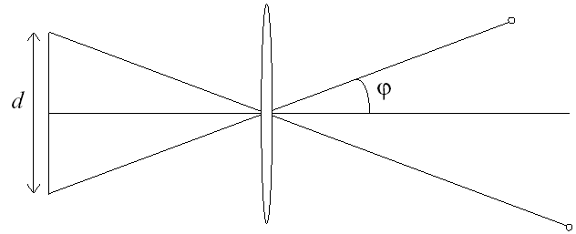
Relation between field of view and focal length
Field of view (angle width)
Film/Sensor Width
Focal length

Slide 17
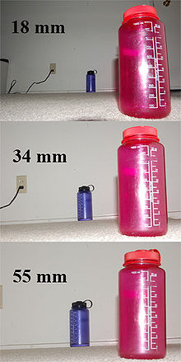
Dolly Zoom or “Vertigo Effect”
http://www.youtube.com/watch?v=NB4bikrNzMk
How is this done?
Zoom in while moving away
http://en.wikipedia.org/wiki/Focal_length

Slide 18
Dolly zoom (or “Vertigo effect”)
Field of view (angle width)
Film/Sensor Width
Focal length
width of object
Distance between object and camera

Slide 19
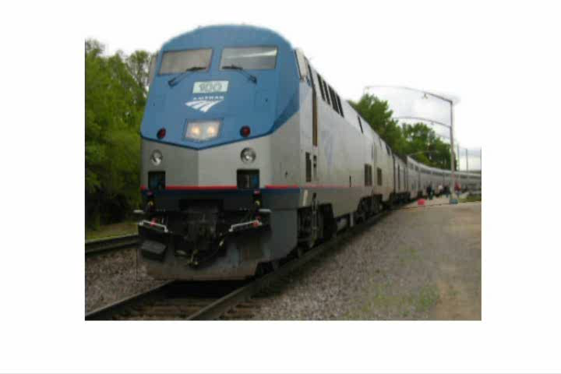
Today’s class: 3D Reconstruction

Slide 20
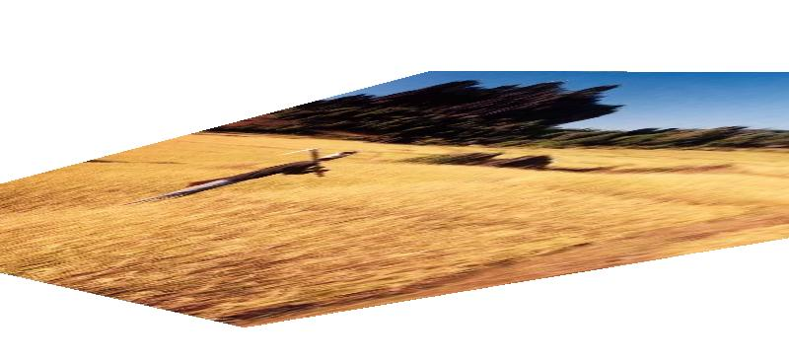
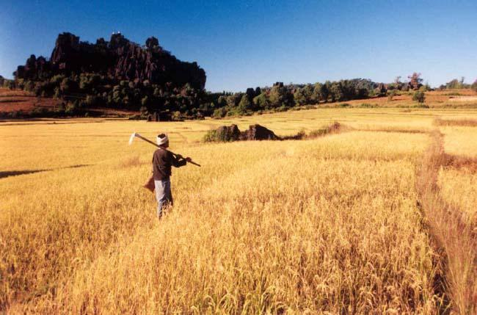
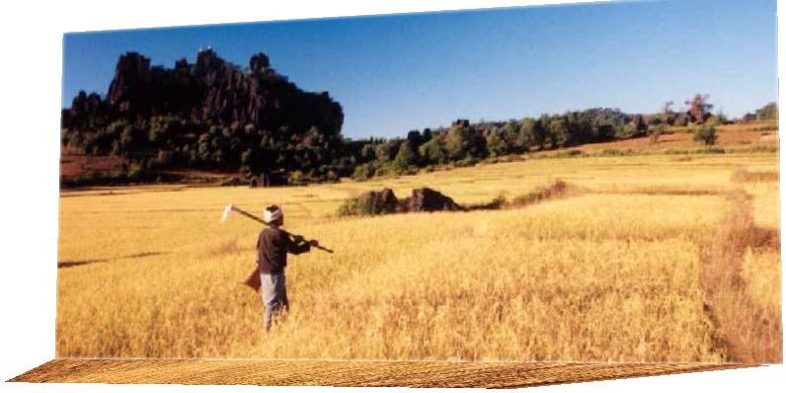
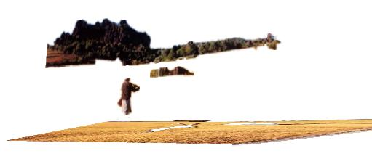
The challenge
One 2D image could be generated by an infinite number of 3D geometries
?
?
?

Slide 21
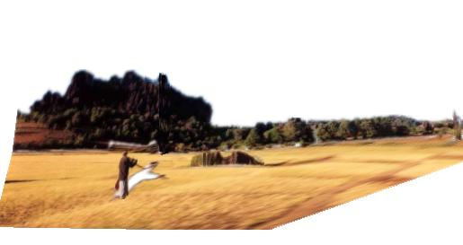
The solution
Make simplifying assumptions about 3D geometry
Unlikely
Likely

Slide 22
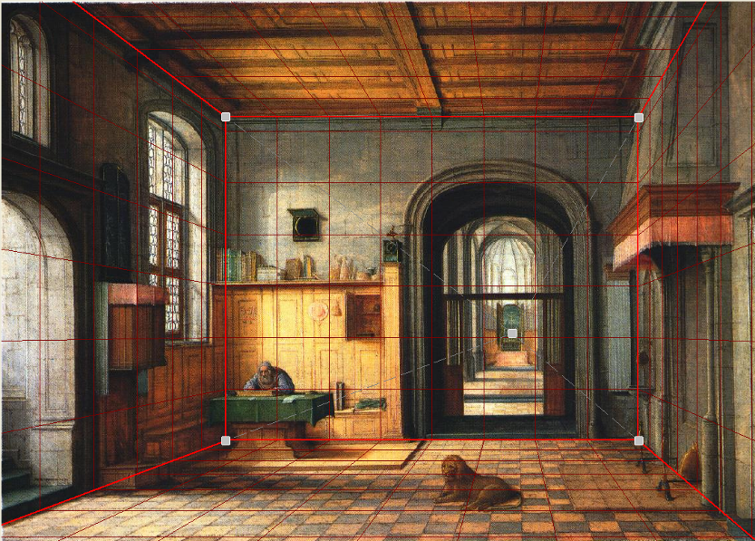
Today’s class: Two Models
Box + frontal billboards
Ground plane + non-frontal billboards

Slide 23
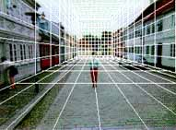
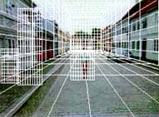
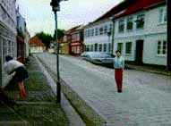
“Tour into the Picture” (Horry et al. SIGGRAPH ’97)
Create a 3D “theatre stage” of five planes
Specify foreground objects through bounding polygons
Use camera transformations to navigate through the scene
Following slides modified from Efros

Slide 24
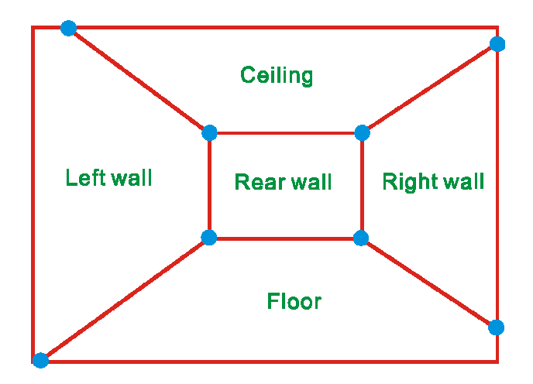
The idea
Many scenes can be represented as an axis-aligned box volume (i.e. a stage)
Key assumptions
All walls are orthogonal
Camera view plane is parallel to back of volume
How many vanishing points does the box have?
Three, but two at infinity
Single-point perspective
Can use the vanishing point
to fit the box to the particular
scene

Slide 25
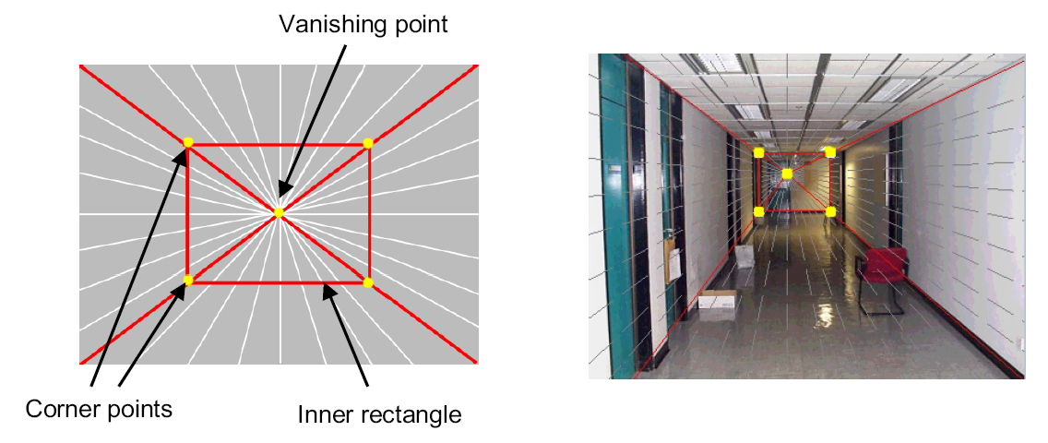
Step 1: specify scene geometry
User controls the inner box and the vanishing point placement (# of DOF?)
Q: If we assume camera is looking straight at back wall, what camera parameter(s) does the vanishing point position provide?
A: Vanishing point direction is perpendicular to image plane, so the vp is the principal point

Slide 26
Example of user input: vanishing point and back face of view volume are defined
High
Camera

Slide 27
Example of user input: vanishing point and back face of view volume are defined
Low
Camera

Slide 28
Comparison of how image is subdivided based on two different camera positions. You should see how moving the box corresponds to moving the eyepoint in the 3D world.
High Camera
Low Camera

Slide 29
Another example of user input: vanishing point and back face of view volume are defined
Left
Camera

Slide 30
Another example of user input: vanishing point and back face of view volume are defined
Right
Camera

Slide 31
Comparison of two camera placements – left and right. Corresponding subdivisions match view you would see if you looked down a hallway.
Left Camera
Right Camera

Slide 32
Question
Think about the camera center and image plane…
  What happens when we move the box?
  What happens when we move the vanishing point?

Slide 33
2D to 3D conversion
Use ratios
Box height
vanishing
point
back
plane
Camera height
Box width / height in 3D is proportional to width over height in the image because back plane is parallel to image plane

Slide 34
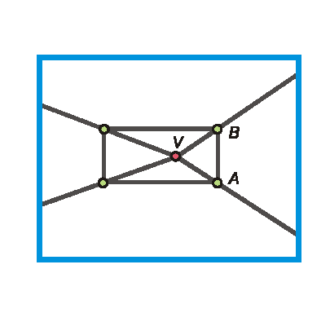
Get depth using similar triangles
f
d
v₀
v_{a}
H
f / (v_{a}-v₀) = d / H
Can compute by similar triangles (CVA vs. CV’A’)
Need to know focal length f (or FoV)
Note: can compute position of any object on the ground
  Simple unprojection
  What about things off the ground?

Slide 35
Get depth using similar triangles
f
d_{i}
v₀
v_{a}
v_{t}
v_{b}
h_{i}
H
f / (v_{a}-v₀) = d / h
h_{i} = (v_{t}-v_{b}) / (v₀-v_{a})*H
f / (v_{b}-v_{t}) = d_{i} / h_{i}
Can compute by similar triangles (CVA vs. CV’A’)
Need to know focal length f (or FoV)
Can compute 3D position of any object on the ground w/ unprojection
  What about things off the ground?

Slide 36
Step 2: map image textures into frontal view
2d coordinates
3d plane coordinates
A
B’
A’
C
D
B
C’
D’

Slide 37
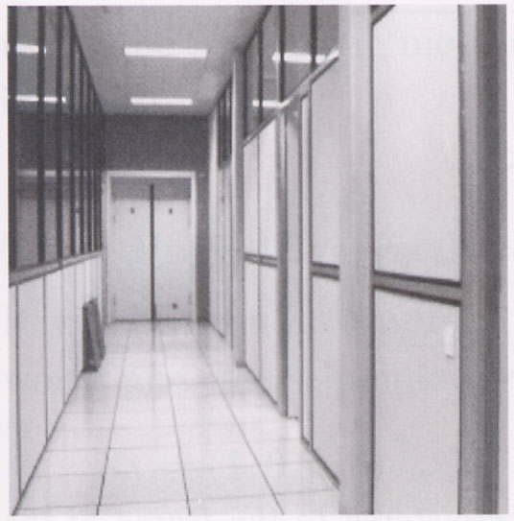
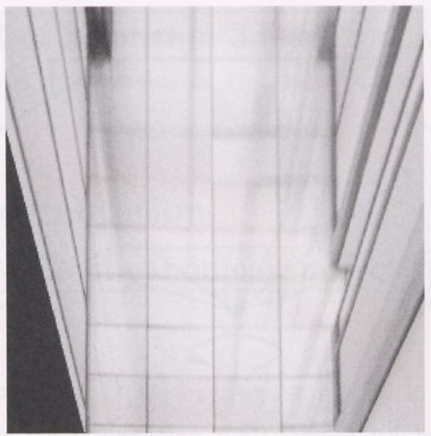
Image rectification by homography
p’
p
To unwarp (rectify) an image solve for homography H given p and p’: wp’=Hp

Slide 38
Computing homography
Assume we have four matched points: How do we compute homography H?
Direct Linear Transformation (DLT)

Slide 39
Computing homography
Direct Linear Transform
Apply SVD: USV^{T} = A
h = V_{smallest} (column of V^{T} corresponds to smallest singular value)
Python
U, S, Vt = scipy.linalg.svd(A)
# last column corr. to smallest singular value
h = Vt[:,-1];
Explanation of SVD, solving systems of linear equations, derivation of solution here
Notes:
SVD gives the homogeneous least squares solution constrained to have a norm of 1

Slide 40

Solving for homography (another formulation)
A
h
0
2n × 9
9
2n
Defines a least squares problem:
  Since h is only defined up to scale, solve for unit vector ĥ
  Solution: ĥ = eigenvector of A^{T}A with smallest eigenvalue
    Can derive using Lagrange multipliers method
  Works with 4 or more points

Slide 41
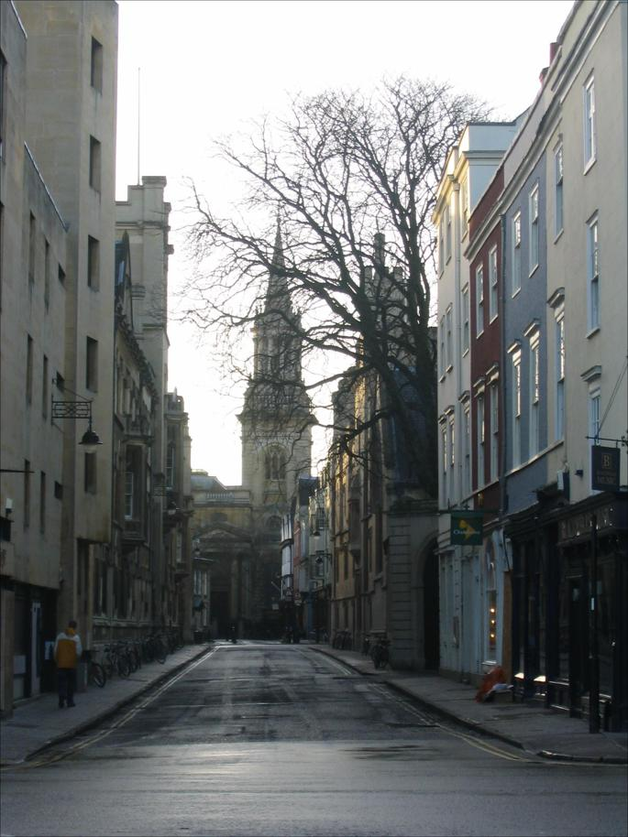
Tour into the picture algorithm
Set the box corners

Slide 42
Tour into the picture algorithm
Set the box corners
Set the VP
Get 3D coordinates
  Compute height, width, and depth of box
Get texture maps
  homographies for each face
Create file to store plane coordinates and texture maps
x

Slide 43
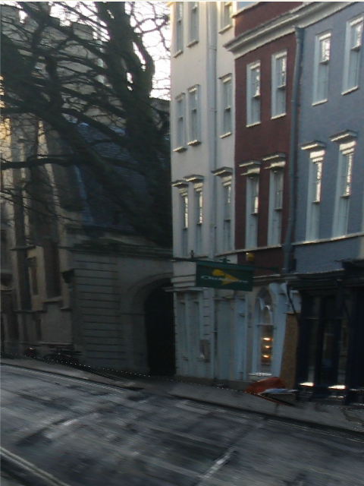
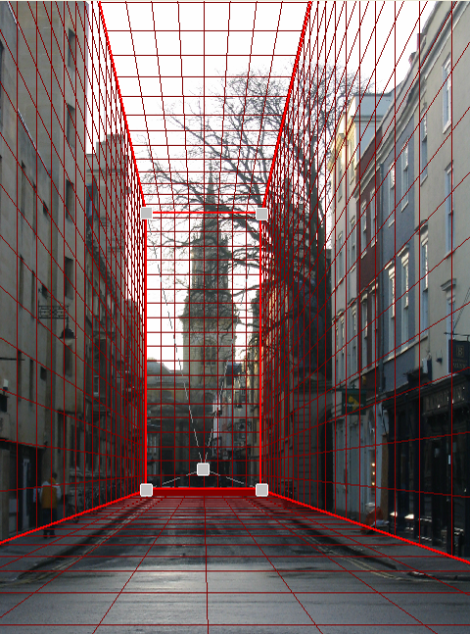
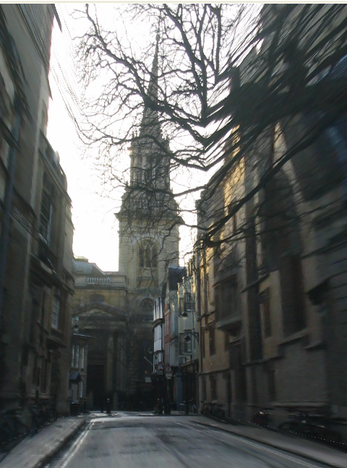
Result
Render from new views
http://www.cs.cmu.edu/afs/cs.cmu.edu/academic/class/15463-f08/www/proj5/www/dmillett/

Slide 44
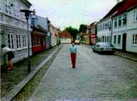

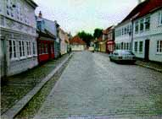
Foreground Objects
Use separate billboard for each
For this to work, three separate images used:
  Original image.
  Mask to isolate desired foreground images.
  Background with objects removed

Slide 45
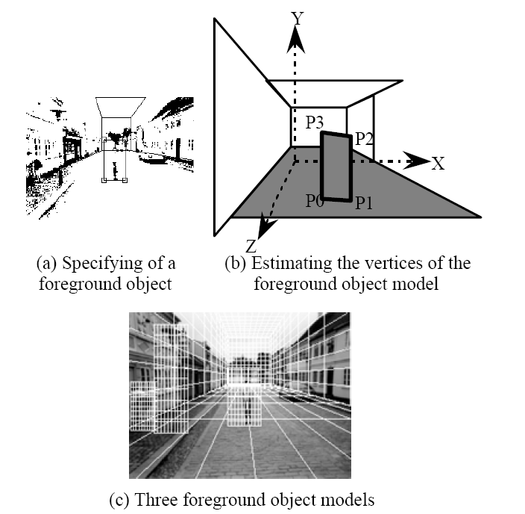
Foreground Objects
Add vertical rectangles for each foreground object
Can compute 3D coordinates P0, P1 since they are on known plane.
P2, P3 can be computed as before (similar triangles)

Slide 46
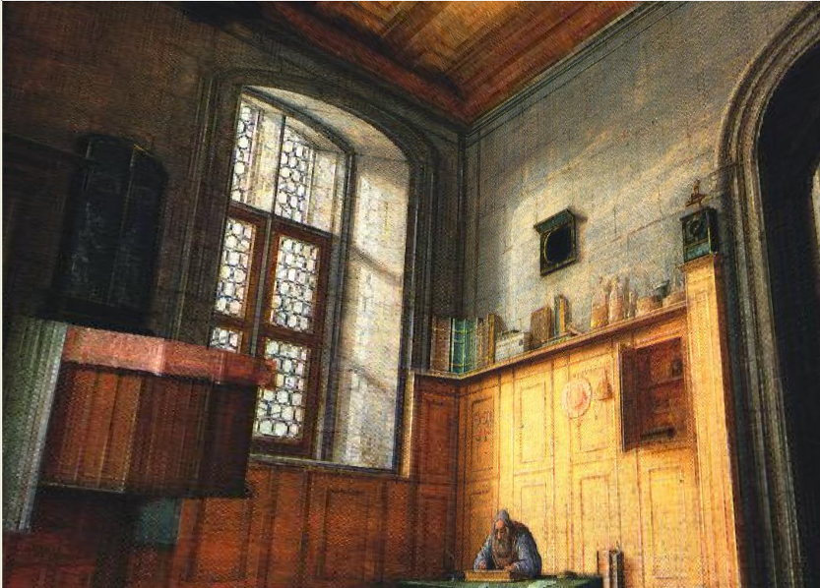
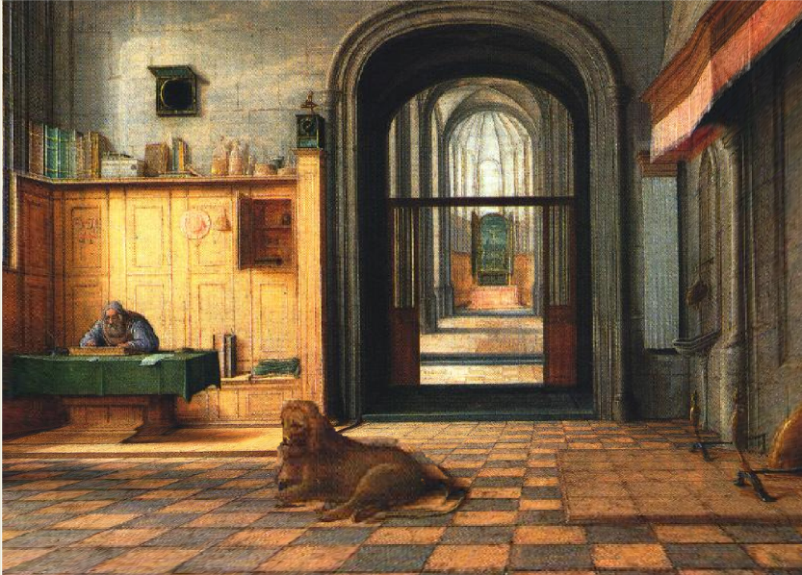
Foreground Result
Video from CMU class: http://www.youtube.com/watch?v=dUAtdmGwcuM

Slide 47
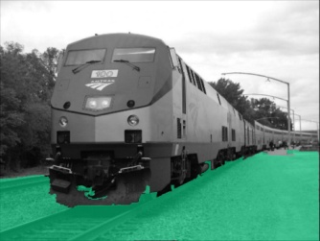
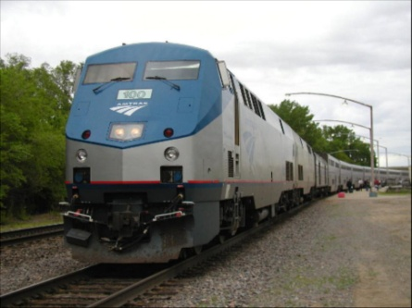
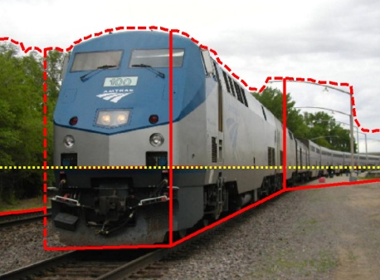
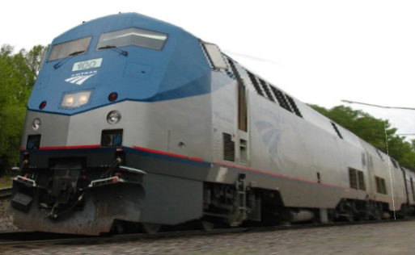
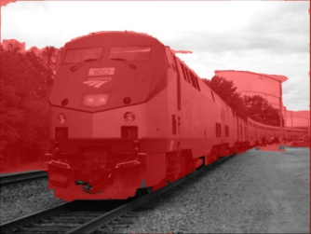












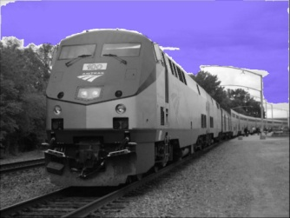
Automatic Photo Pop-up
Input
Geometric Labels
Cut’n’Fold
3D Model
Ground
Image
Vertical
Learned Models
Sky
Hoiem et al. 2005

Slide 48
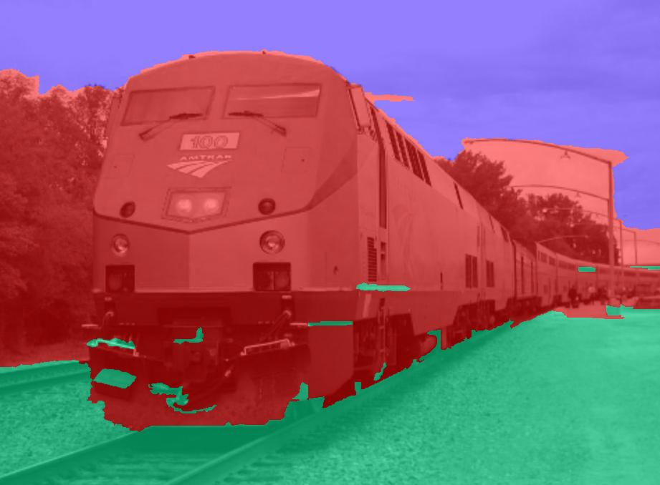
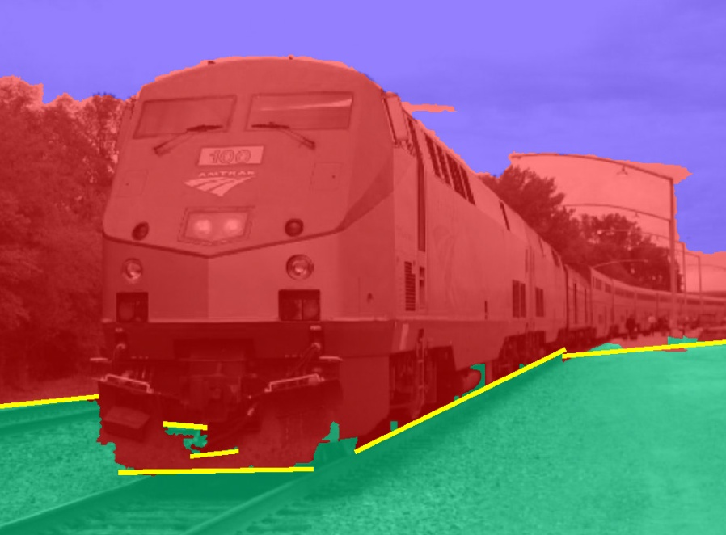
Cutting and Folding
Fit ground-vertical boundary
  Iterative Hough transform

Slide 49
Cutting and Folding
Form polylines from boundary segments
  Join segments that intersect at slight angles
  Remove small overlapping polylines
Estimate horizon position from perspective cues

Slide 50

Cutting and Folding
``Fold’’ along polylines and at corners
``Cut’’ at ends of polylines and along vertical-sky boundary

Slide 51
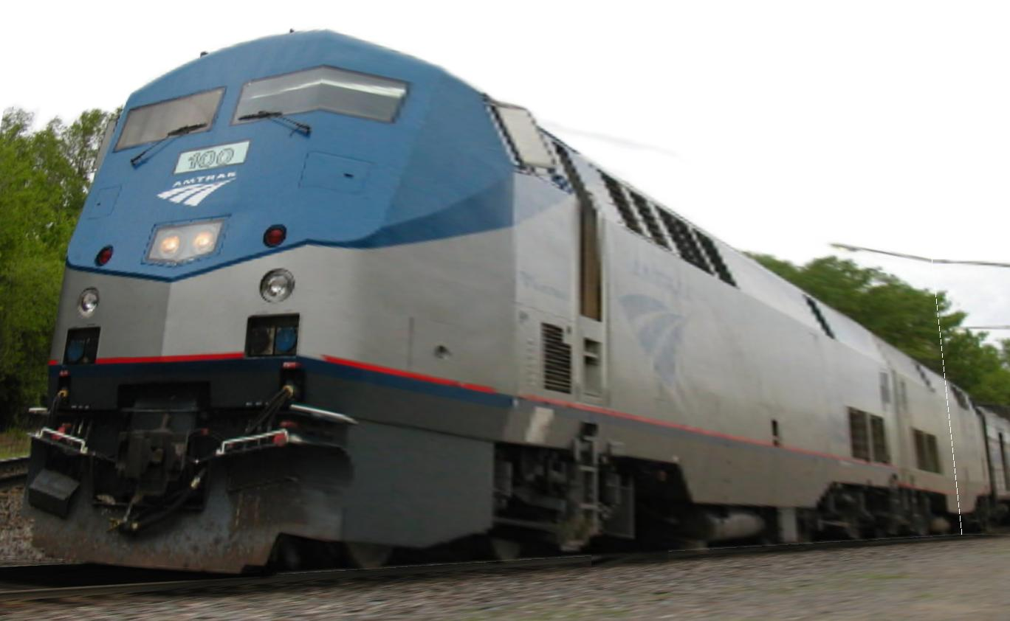
Cutting and Folding
Construct 3D model
Texture map

Slide 52
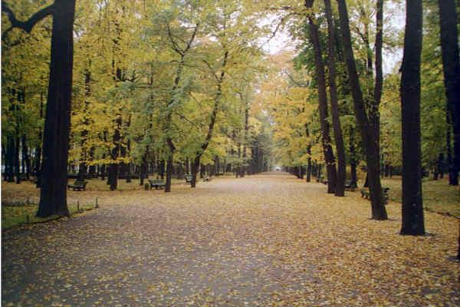
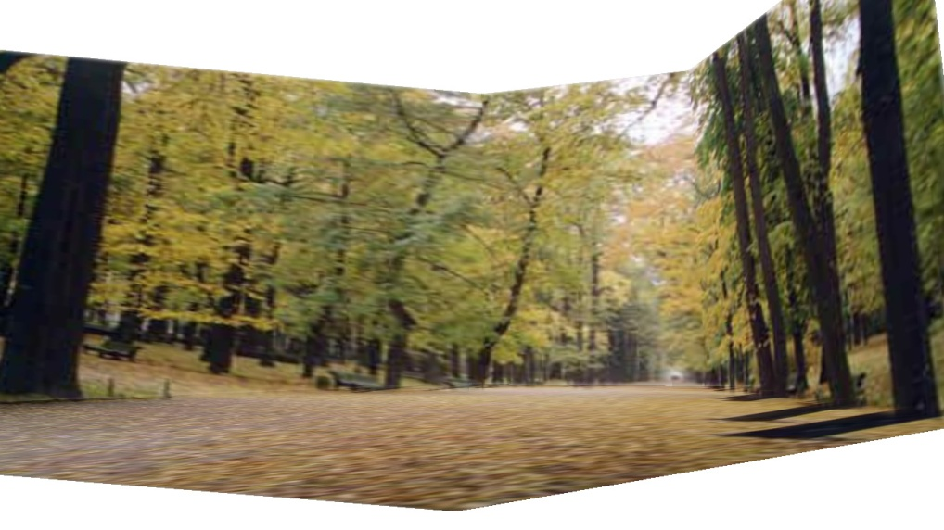
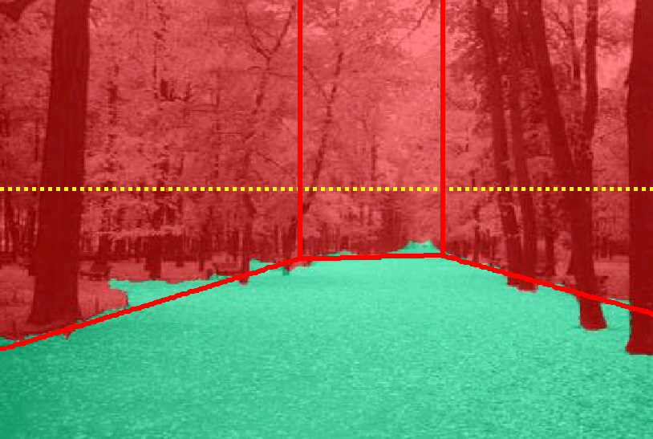
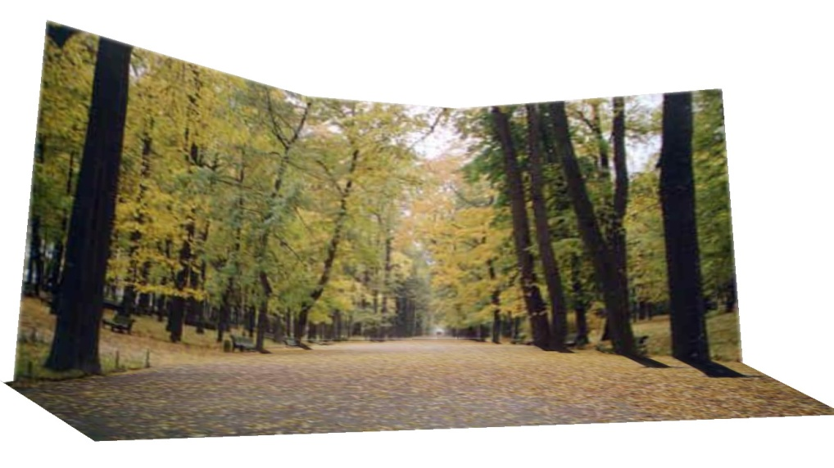
Results
http://www.cs.illinois.edu/homes/dhoiem/projects/popup/
Input Image
Cut and Fold
Automatic Photo Pop-up

Slide 53
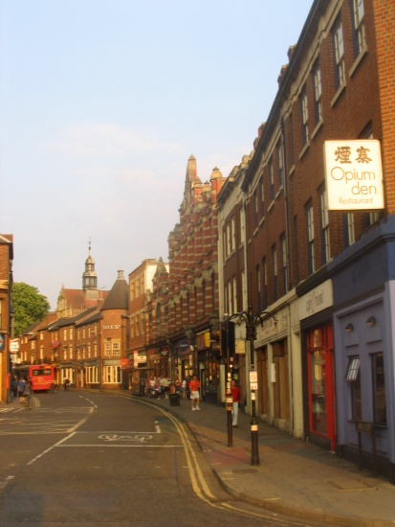
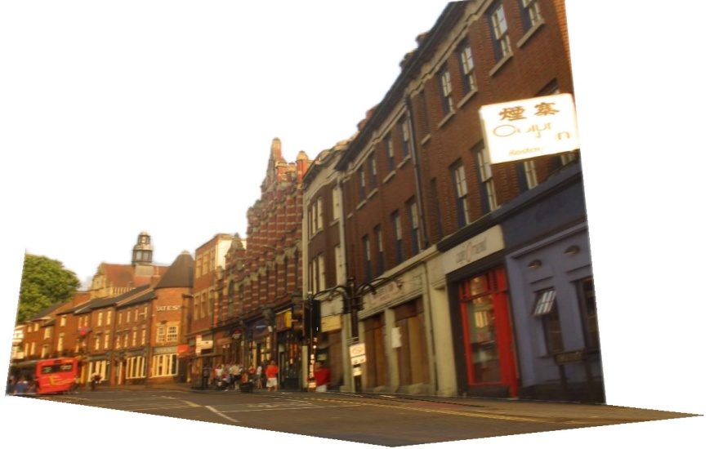
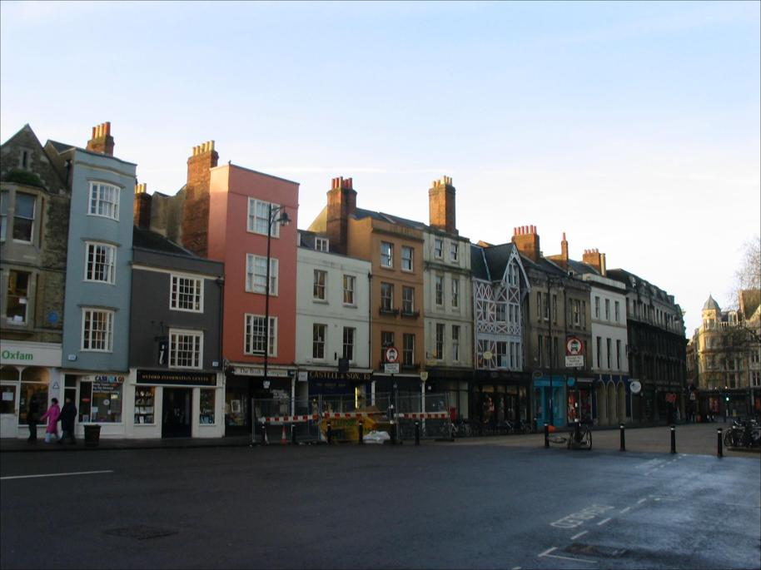

Results
Input Image
Automatic Photo Pop-up

Slide 54


Comparison with Manual Method
[Liebowitz et al. 1999]
Input Image
Automatic Photo Pop-up (15 sec)!
Notes:
From the results of Liebowitz et al. As you can see, their model is slightly better in that the roof is slanted, but our method is fully automatic requiring none of the user’s time, while their method requires extensive manual labeling.

Slide 55



Failures
Labeling Errors

Slide 56




Failures
Foreground Objects

Slide 57

Adding Foreground Labels
Recovered Surface Labels +
Ground-Vertical Boundary Fit
Object Boundaries + Horizon

Slide 58

Notes:
Explain holes

Slide 59

Fitting boxes to indoor scenes
Wall
Sofa
Table
Floor

Slide 60




Box Layout Algorithm
Hedau et al. 2010
Detect edges
Estimate 3 orthogonal vanishing points
Apply region classifier to label pixels with visible surfaces
  Boosted decision trees on region based on color, texture, edges, position
Generate box candidates by sampling pairs of rays from VPs
Score each box based on edges and pixel labels
  Learn score via structured learning
Jointly refine box layout and pixel labels to get final estimate
+

Slide 61






Experimental results
Detected Edges
Surface Labels
Box Layout
Detected Edges
Surface Labels
Box Layout

Slide 62






Experimental results
Detected Edges
Surface Labels
Box Layout
Detected Edges
Surface Labels
Box Layout

Slide 63



Complete 3D from RGBD
Zou et al. IJCV 2018

Slide 64













Complete 3D from RGBD
RGB-D Input
Layout Proposals
Composing
Object Proposals
Exemplar Region Retrieval
3D Model Fitting
Annotated Scene
...
Retrieved Region
Source 3D Model
Transferred Model
Retrieved Region
Source 3D Model
Transferred Model
Notes:
3D Layout: Detection. 3D Object: transfer. Composition: integer programming

Slide 65


Complete 3D from RGBD

Slide 66
Final project ideas
Interactive program to make 3D model from an image (e.g., output in VRML, or draw path for animation)
  Add tools for cutting out foreground objects and automatic hole-filling

Slide 67
Summary
2D→3D is mathematically impossible
  (but we do it without even thinking)
Need right assumptions about the world geometry
Important tools
  Vanishing points
  Camera matrix
  Homography

Slide 68
Next Week
Project 3 is due Tuesday
Next three classes: image-based lighting
  How to model light
  Recover HDR image from multiple LDR images
  Recover lighting model from an image
  Render object into a scene with correct lighting and geometry

