Slide 1
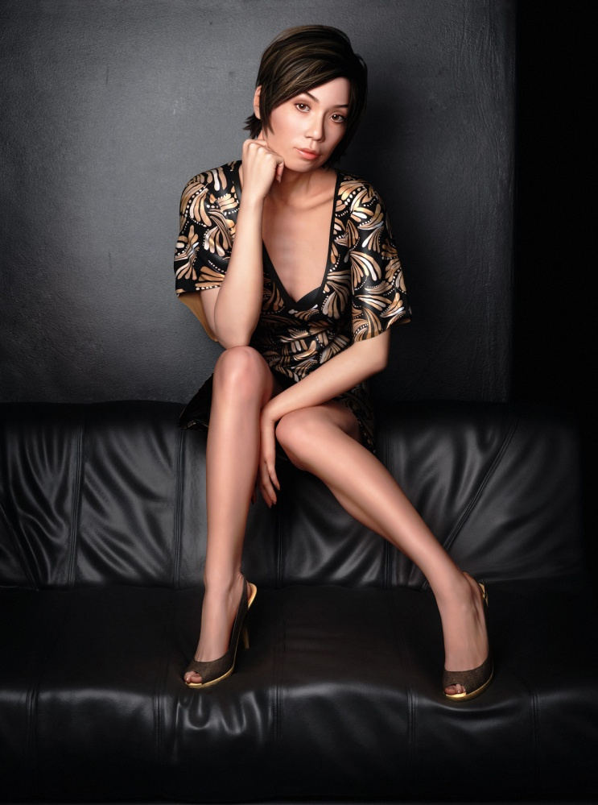
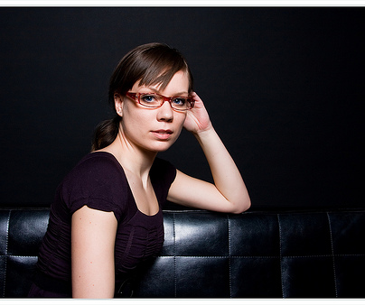
Detecting Fakes
11/14/17
http://www.flickr.com/photos/kjmeow/2320759046/
Bernadette by Stephen Molyneaux
Computational Photography
Derek Hoiem, University of Illinois

Slide 2
Project 4 results: notable projects
http://xle2.web.engr.illinois.edu/cs445/proj4/: great before/after visualizations
http://lavisha2.web.engr.illinois.edu/cs445/proj4/: Nice Project, Tone Mapping Results
http://shubham9.web.engr.illinois.edu/cs445/proj4/: Photographer Removal
http://mfalota2.web.engr.illinois.edu/cs445/proj4/: use of mirrors in the rendering
http://damir2.web.engr.illinois.edu/cs445/proj4/
- Nice renderings and panoramic transformations
http://gluo2.web.engr.illinois.edu/cs445/proj4/ and http://hoyinau2.web.engr.illinois.edu/cs445/proj4/
- Portal Weighted Companion Cube Rendering
http://schen149.web.engr.illinois.edu/cs445/proj4/ and http://xle2.web.engr.illinois.edu/cs445/proj4/
- Nice project pages with high resolution images
http://jtang38.web.engr.illinois.edu/cs445/proj4/ and http://blim7.web.engr.illinois.edu/cs445/proj4/
- Nice results testing multiple objects and parameters and Tone Mapping looks nice
http://jdrynld2.web.engr.illinois.edu/cs445/proj4/ and http://vjdixit2.web.engr.illinois.edu/cs445/proj4/
- Nice renderings and Panoramic transformations
http://cshen19.web.engr.illinois.edu/cs445/proj4/ and http://xwu68.web.engr.illinois.edu/cs445/proj4 /
- Nice website and presentation, nice results, and nice photographer removal! http://xshi27.web.engr.illinois.edu/cs445/proj4/
- Only person that successfully completed all extra credit parts
http://dsun18.web.engr.illinois.edu/cs445/proj4/
- nice website, results, and tone mapping

Slide 3
Detecting Fakes
Detecting photorealistic graphics
Detecting manipulated images

Slide 4
CG vs. Real: Can you do it?
http://area.autodesk.com/fakeorfoto/
I got 4 out of 10 right

Slide 5
CG vs. Real -- Why It Matters: Crime
1996 Child Pornography Prevent Act made certain types of “virtual porn” illegal
Supreme court over-ruled in 2002
To prosecute, state needs to prove that child porn is not computer-generated images
Real Photo
CG

Slide 6
Automatically Detecting CG
Sketch of approach
  Intuition: natural images have predictable statistics (e.g., power law for frequency); CG images may have different statistics due to difficulty in creating detail
  Decompose the image into wavelet coefficients and compute statistics of these coefficients
Lyu and Farid 2005: “How Realistic is Photorealistic?”

Slide 7
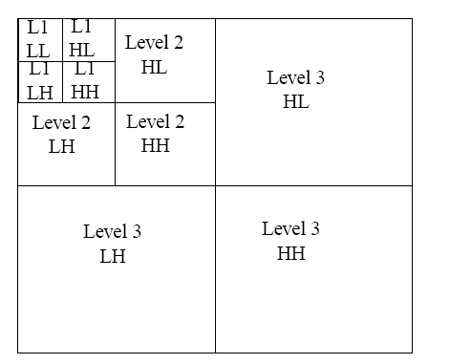
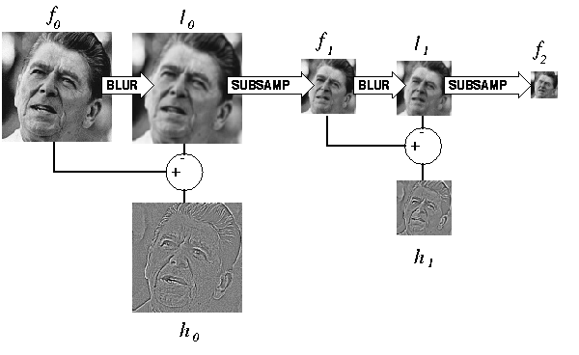
2D Wavelets
Kind of like the Laplacian pyramid, except broken down into horizontal, vertical, and diagonal frequency
Laplacian Pyramid
Wavelet Pyramid

Slide 8
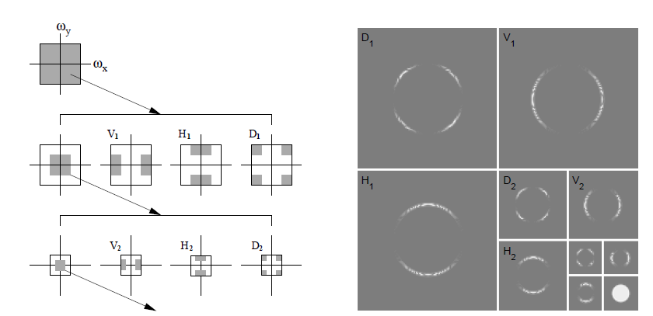
2D Wavelet Transform
Illustration of procedure
Wavelet decomposition of disc image
Figure from Lyu and Farid 2005: “How Realistic is Photorealistic?”

Slide 9
Automatically Detecting CG
Sketch of approach
  Intuition: natural images have predictable statistics (e.g., power law for frequency); CG images may have different statistics due to difficulty in creating detail
  Decompose the image into wavelet coefficients and compute statistics of these coefficients
  Train a classifier to distinguish between CG and Real based on these features
    Train RBF SVM with 32,000 real images and 4,800 fake images
    Real images from http://www.freefoto.com
    Fake images from http://www.raph.com and http://www.irtc.org/irtc/
Lyu and Farid 2005: “How Realistic is Photorealistic?”

Slide 10
Results
98.8% test accuracy on real images
66.8% test accuracy on fake images
10/14 on fakeorfoto.com
Lyu and Farid 2005: “How Realistic is Photorealistic?”

Slide 11
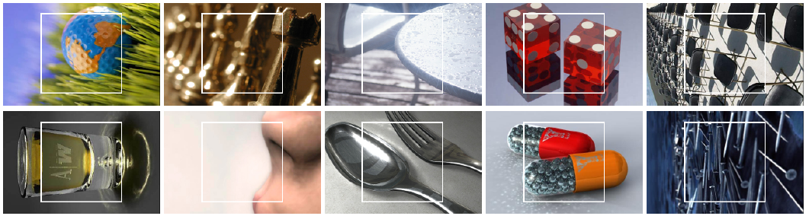
Results
Fake-or-photo.com: Correct
Real Photos
CG
Lyu and Farid 2005: “How Realistic is Photorealistic?”

Slide 12
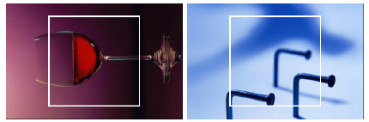
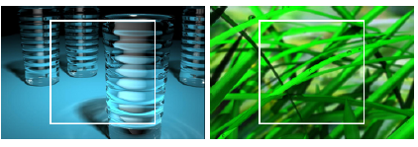
Results
Fake-or-photo.com: Wrong
Real photos misclassified as CG
CG misclassified as real photos
Lyu and Farid 2005: “How Realistic is Photorealistic?”

Slide 13
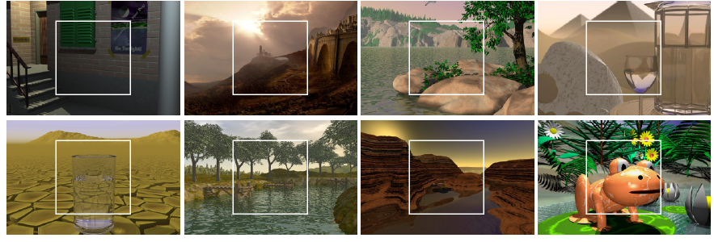
Results
Fakes, confidently labeled as fake
Lyu and Farid 2005: “How Realistic is Photorealistic?”

Slide 14
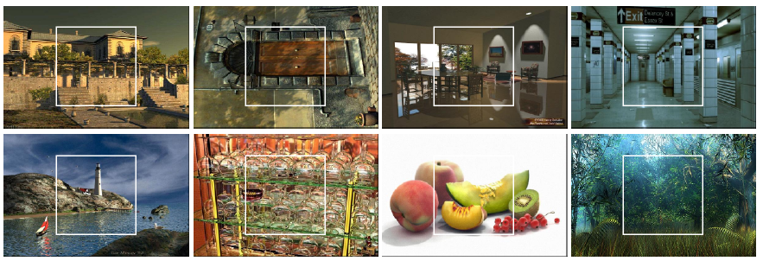
Results
Fake images thought to be real
Lyu and Farid 2005: “How Realistic is Photorealistic?”

Slide 15
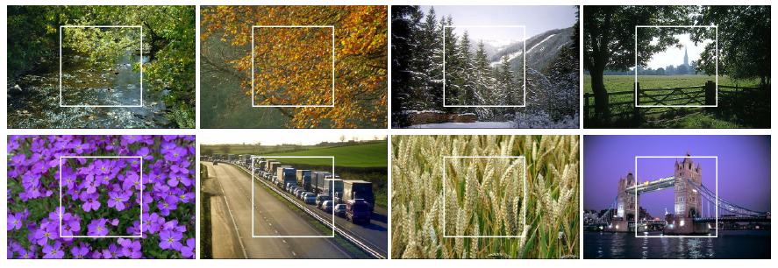
Results
Real photographs, confidently labeled as real
Lyu and Farid 2005: “How Realistic is Photorealistic?”

Slide 16
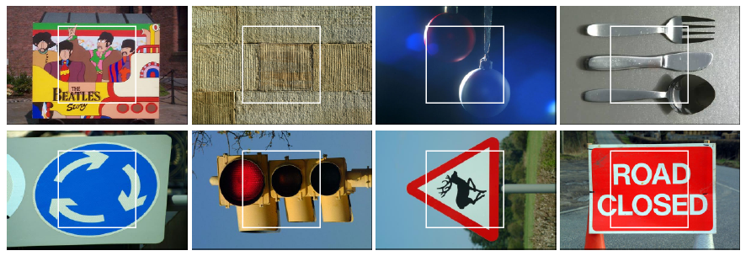
Results
Real photos, incorrectly thought to be fake
Lyu and Farid 2005: “How Realistic is Photorealistic?”

Slide 17
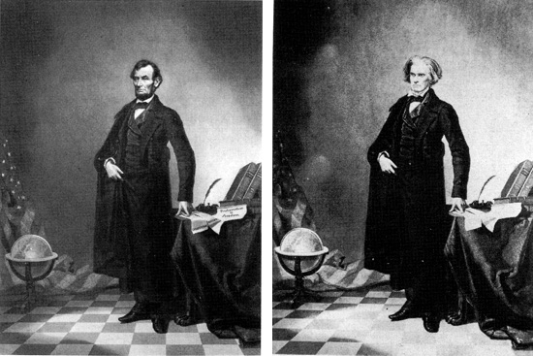
Detecting Forgery -- Why It Matters: Trust
Examples collected by Hany Farid: http://www.fourandsix.com/photo-tampering-history/
Iconic Portrait of Lincoln (1860)

Slide 18
“While photographs may not lie, liars may photograph.”
Lewis Hine (1909)

Slide 19
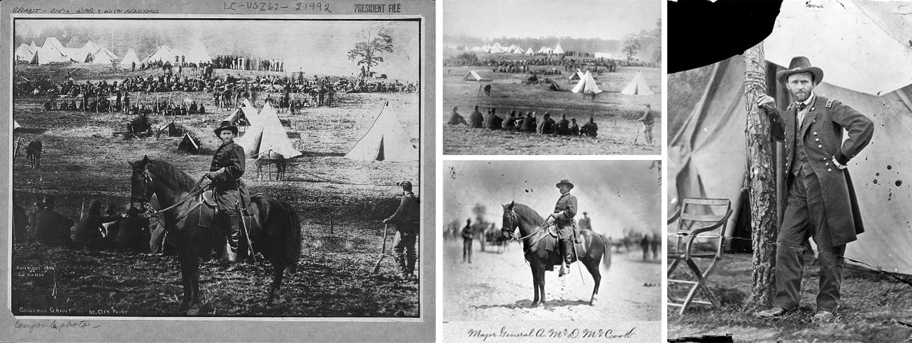
General Grant in front of Troops (1864)

Slide 20
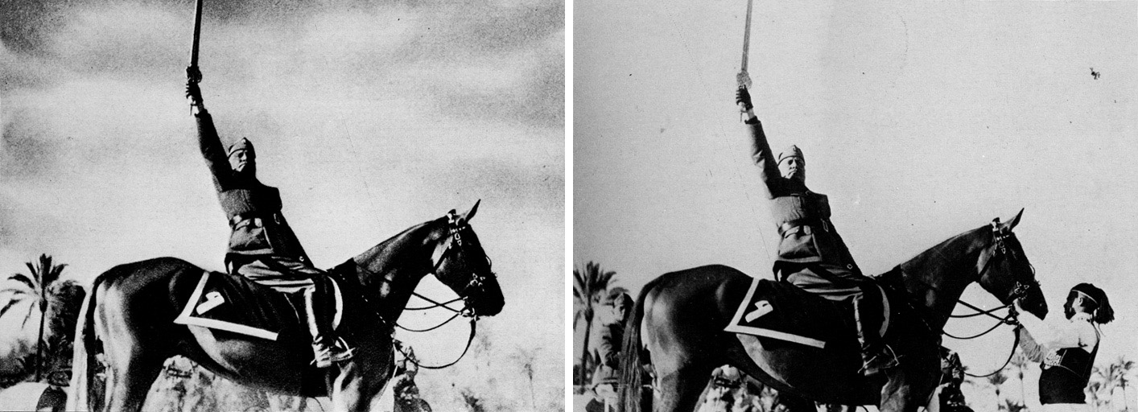
Mussolini in a Heroic Pose (1942)

Slide 21
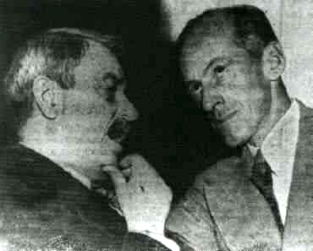
1950: Doctored photo of Senator Tydings talking with Browder, the leader of the communist party, contributed to Tydings’ electoral defeat

Slide 22
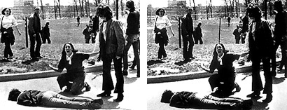
Pulitzer Prize winning photograph of Kent State killing (1970)

Slide 23
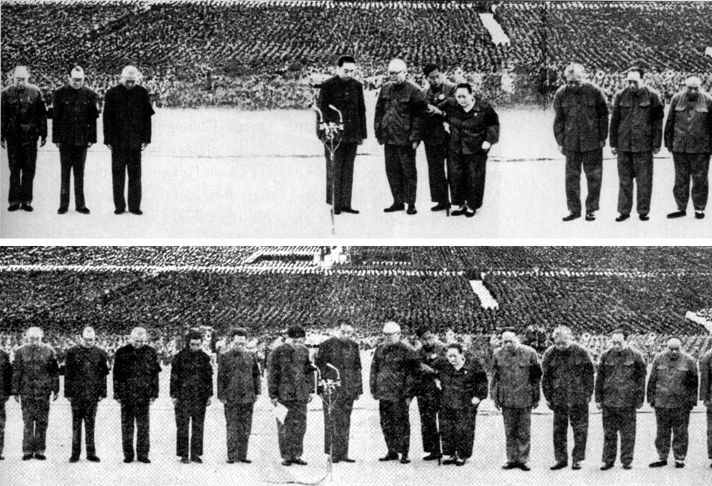
Gang of Four are removed (1976)

Slide 24
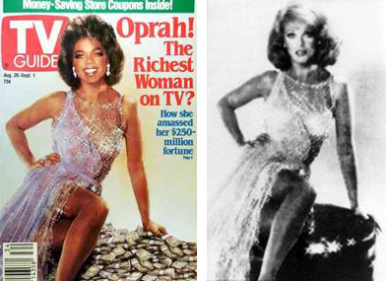
1989 composite of Oprah and Ann-Margret (without either’s permission)

Slide 25
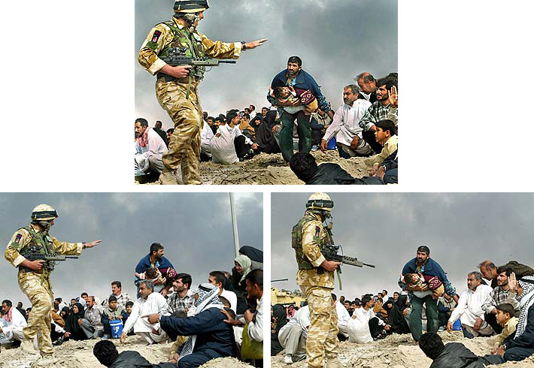
Published photo
2003: Long-time staff photographer for LA Times was fired for this one

Slide 26
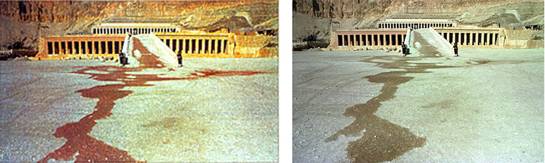
Photo from terrorist attack in 1997 in Hatshepsut, Egypt

Slide 27
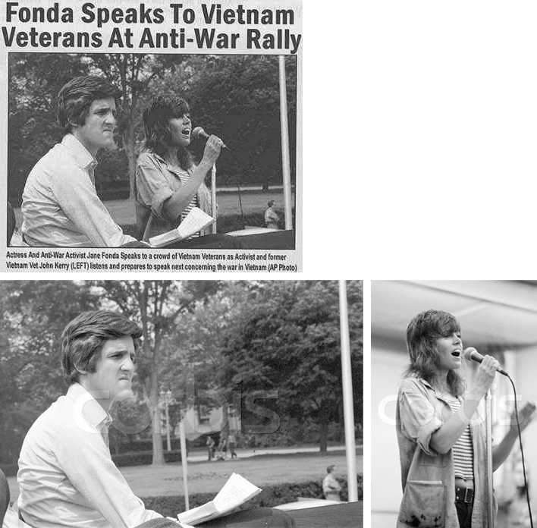
Caption: “Actress and Anti-war activist Jane Fonda speaks to a crowd of Vietnam veterans, as activist and former Vietnam vet John Kerry listens and prepares to speak next concerning the war in Vietnam.” (AP Photo)
Kerry at Rally for Peace 1971
Fonda at rally in 1972

Slide 28
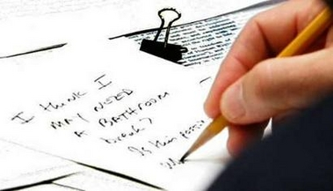
2005: Pres Bush scribbles a note to C. Rice during UN Security Council Meeting

Slide 29
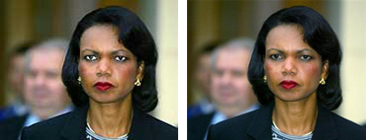
2005: USA Today SNAFU

Slide 30
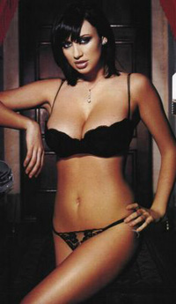
2006: “Women you will never see in Maxim” – movie star Khushboo’s head on a model’s body; Maxim got sued.

Slide 31
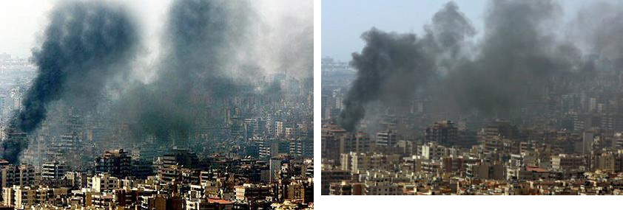
2006: Photo by Adnan Hajj of strikes on Lebanon (original on right)
Later, all of Hajj’s photos were removed from AP and a photo editor was fired.

Slide 32

2007 Retouching is “completely in line with industry standards”

Slide 33
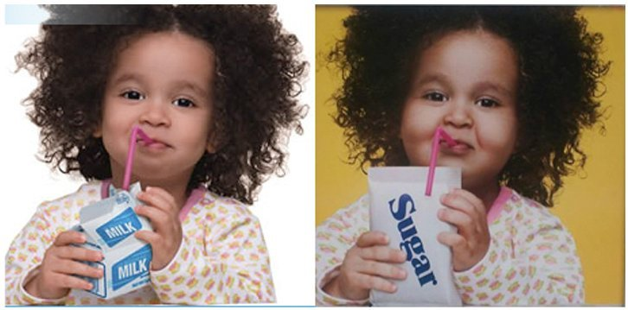
2013: Fake fattening

Slide 34
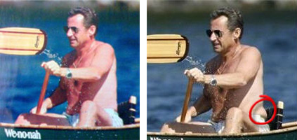
The French Magazine Paris Match altered a photograph of French President Nicolas Sarkozy by removing some body fat. (2007)

Slide 35
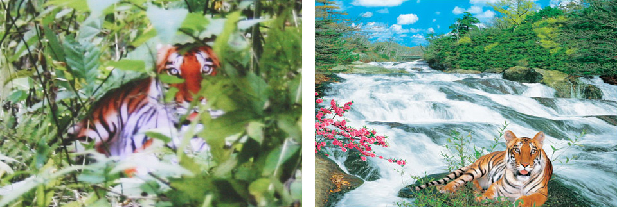
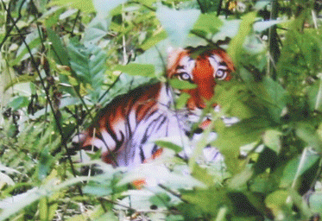
Claimed Photo
Poster
Overlay
2007: Zhou Zhenglong claimed to take 71 photos of the nearly extinct South China tiger

Slide 36
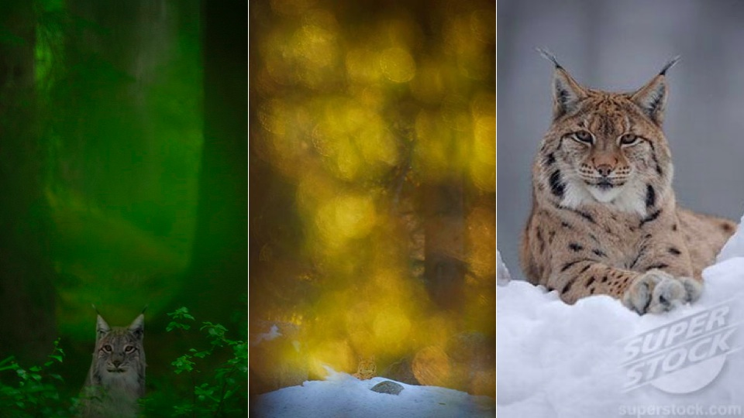
Similar scandal in 2011 from Terje Helleso who won Swedish Env. Prot. award

Slide 37
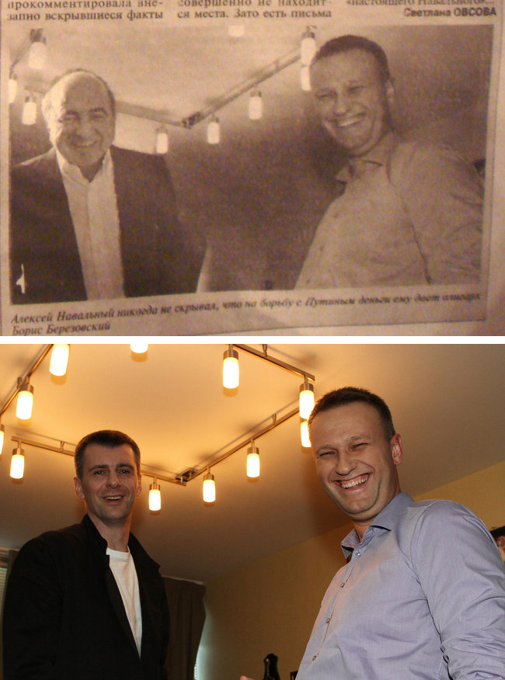
(2012) A Russian newspaper distributed by a pro-Kremlin group printed a photograph showing blogger/activist Aleksei Navalny standing beside Boris A. Berezovsky, an exiled financier being sought by Russian police.

Slide 38
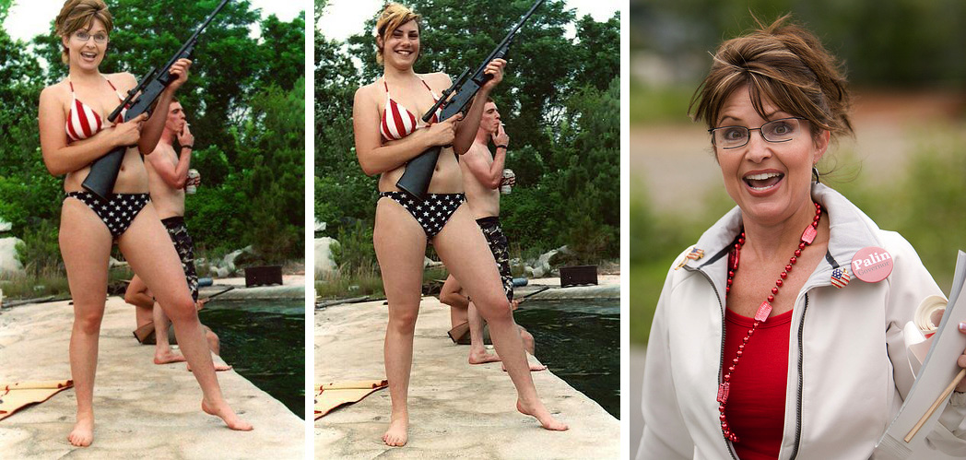
2008

Slide 39

2009: Digital diversity

Slide 40
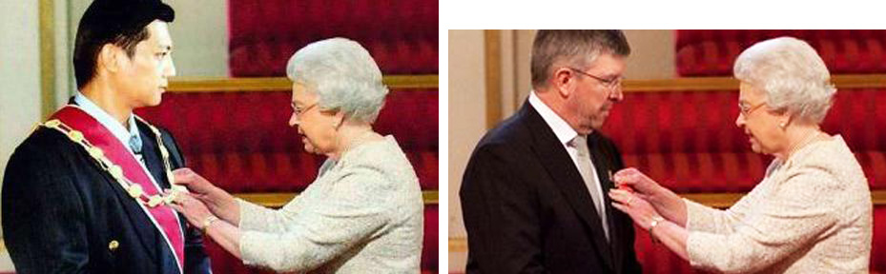
“Evidence” that Malaysian politician Jeffrey Wong Su En was knighted by the Queen (2010)

Slide 41
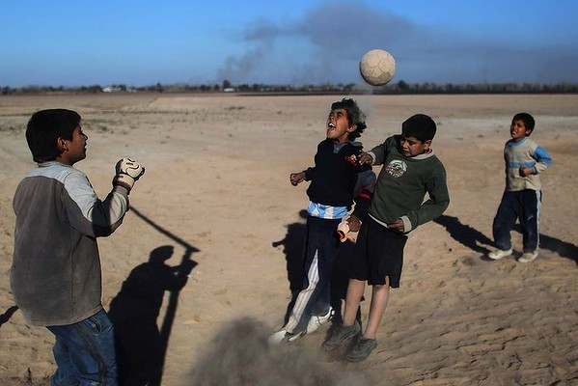
Cloning sand to remove shadow. Miguel Tovar – banned from AP, all his photos removed (2011)

Slide 42
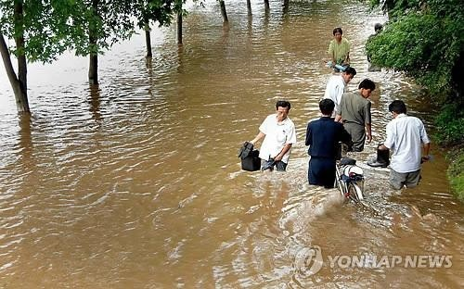
Photo from Korean Central News Agency, determined to be composite (people don’t appear wet) – was attempt to get sympathy for North Korea to get more international aid

Slide 43
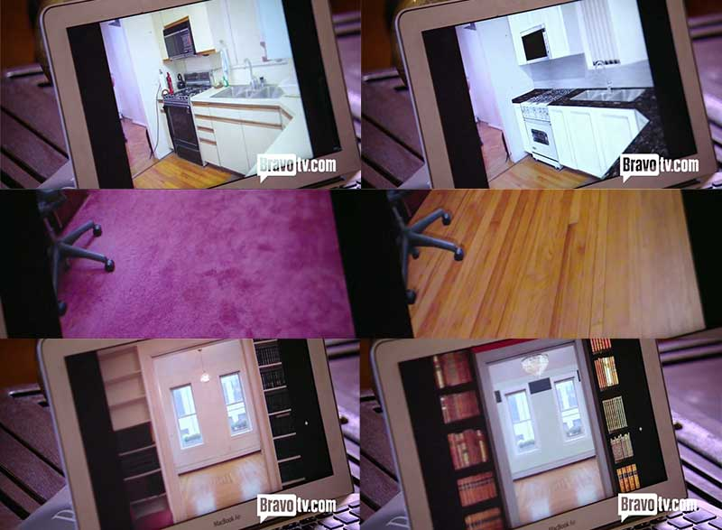
2013: fake floors, counter, appliances digitally added for listing in Luis Ortiz’s show “Million Dollar Listing New York”

Slide 44
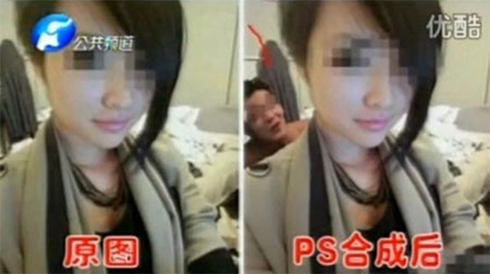
A farmer from Hunan province, China was sentenced to 12 years in prison and fined 500,000 yuan after receiving 453,00 yuan (US$73,000) in blackmail payments out of an attempted 9.47 million yuan. He had mailed to more than 200 officials pornographic photos into which he had inserted them using photo editing software. He threatened to publicize the photos unless he was paid. One of the victims claimed that he made the demanded payment before he “sensed later on that the man inside the photo was actually not me.”

Slide 45
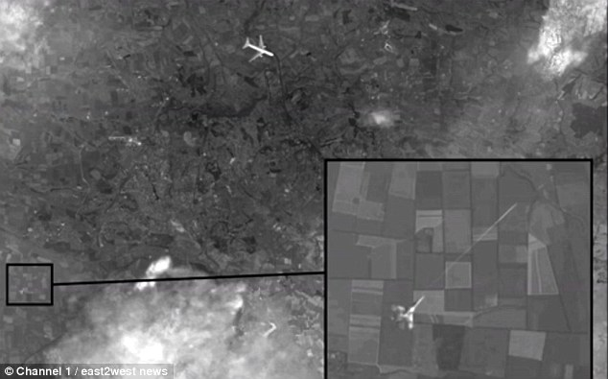
Nov 2014: Russian state media ran a story with “proof” that a Ukranian jet shot down the Malaysian airlines plane. Photo is composed of Google Earth imagery, Yandex maps, and a stock photo of a Boeing jet.
Notes:
After months of denying any responsibility for the downing of Malaysian Air’s flight MH17 over Ukraine, Russian state media ran a story featuring supposedly new satellite imagery it said proved that MH17 had been shot down by a Ukrainian fighter jet. It took very little time, however, for experts and online commentors to debunk the photo. The photo, in fact appears to have been composed of pieces of Google Earth imagery from 2012, a portion from Yandex maps, and a stock photo of a Boeing jet. Furthermore, careful analysis also showed that the location of the plane in the photo does not exactly correspond to the known path that MH17 took.

Slide 46
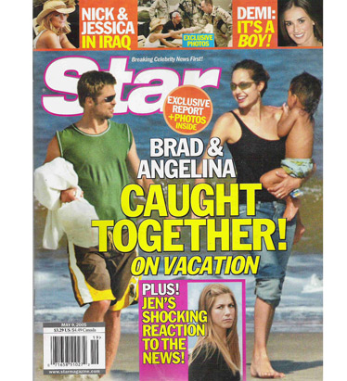
Detecting forgeries
Work by Hany Farid and colleagues
Method 1: 2D light from occluding contours

Slide 47
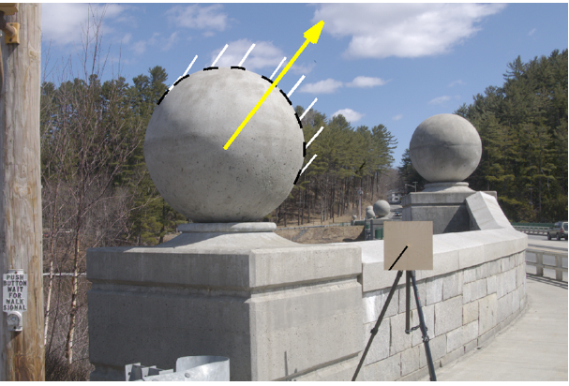
Estimating lighting direction
Method 1: 2D direction from occluding contour
Provide at least 3 points on occluding contour (surface has 0 angle in Z direction)
Estimate light direction from brightness
Estimate
Ground Truth

Slide 48
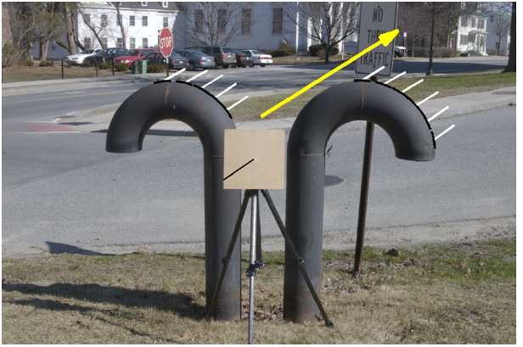
Estimating lighting direction

Slide 49
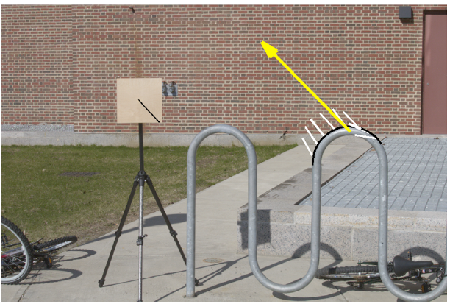
Estimating lighting direction
Average error: 4.8 degrees

Slide 50
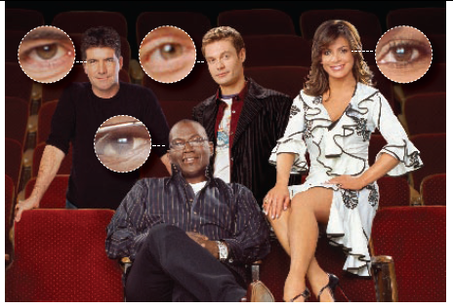
Method 2: Light from Eyes
Farid – “Seeing is not believing”, IEEE Spectrum 2009

Slide 51
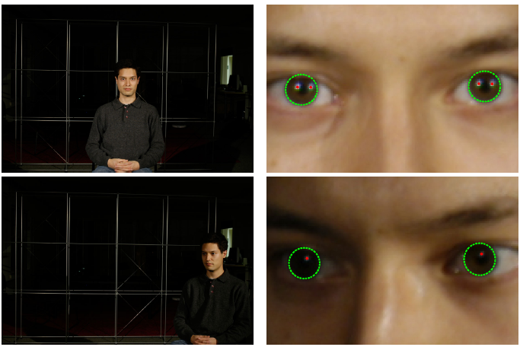
Estimating Lighting from Eyes

Slide 52
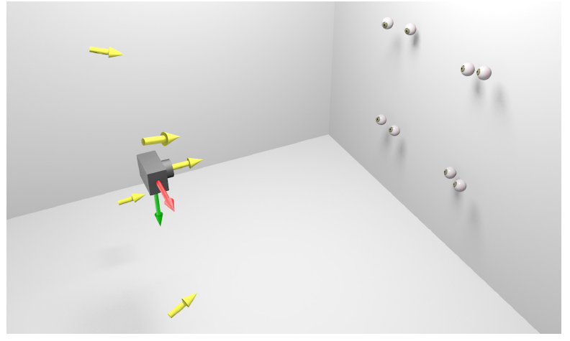
Method 2: Light from Eyes

Slide 53
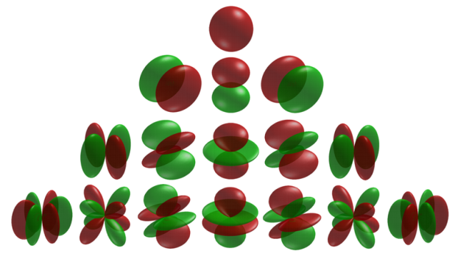
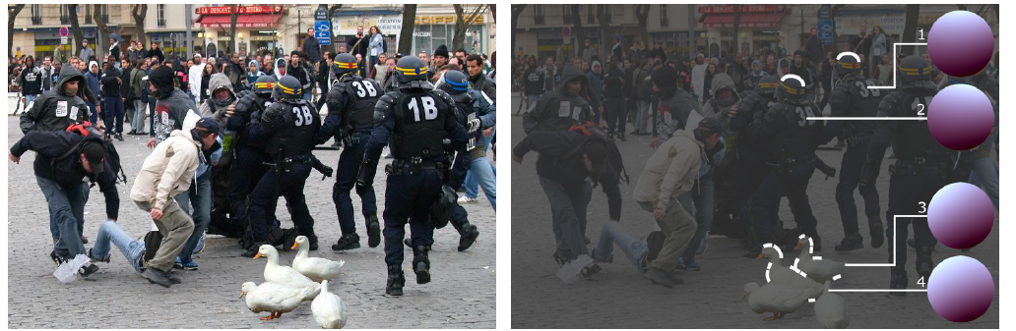
Method 3: Complex light with spherical harmonics
Spherical harmonics parameterize complex lighting environment
Same method as occluding contours, but need 9 points

Slide 54
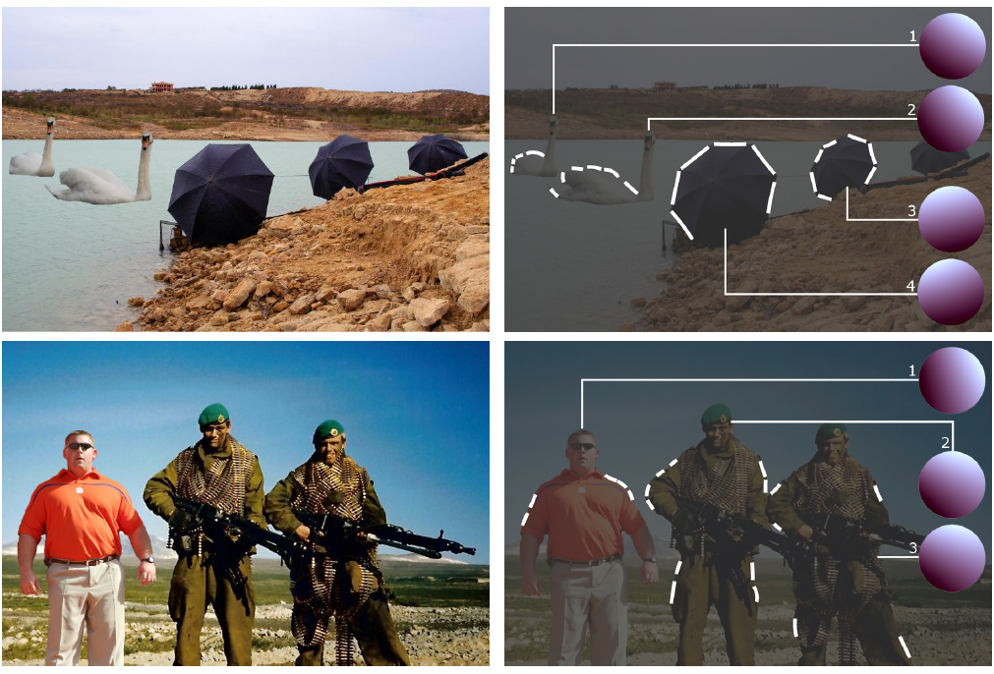
Method 3: Complex light with spherical harmonics

Slide 55
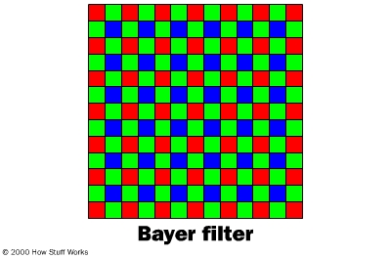
Method 4: Demosaicking Prediction
In demosaicking, RGB values are filled in based on surrounding measured values
Filled in values will be correlated in a particular way for each camera
Local tampering will destroy these correlations
Farid: “Photo Fakery and Forensics” 2009

Slide 56

Demosaicking prediction
Upside: can detect many kinds of forgery
Downside: need original resolution, uncompressed image
Original Tampered
Error in pixel prediction from a linear interpolation
FFT of error in each window (periodic for untampered case)

Slide 57
Method 5: JPEG Ghosts
JPEG compresses 8x8 blocks by quantizing DCT coefficients to some level
  E.g., coefficient value is 23, quantization = 7, quantized value = 3, error = 23-21=2
Resaving a JPEG at the same quantization will not cause error, but resaving at a lower or higher quantization generally will
  Value = 21; quantization = 13; error = 5
  Value = 21; quantization = 4; error = 1
Farid: “Photo Fakery and Forensics” 2009

Slide 58

JPEG Ghosts
Original is saved at 85 quality, center square is cut out and compressed at 65 quality; then image is resaved at given qualities
Pixel error for image saved at various JPEG qualities

Slide 59

JPEG Ghosts
If there is enough difference between the quality of the pasted region and the final saved quality, the pasted region can be detected with high accuracy

Slide 60

JPEG Ghosts
original
manipulated
Pixel error for manipulated image saved at various JPEG qualities

Slide 61

JPEG Ghosts
original
manipulated
Pixel error for manipulated image saved at various JPEG qualities

Slide 62
Summary
Digital forgeries are an increasingly major problem as it becomes easier to fake images
A variety of automatic and semi-automatic methods are available for detection of well-done forgeries
  Checking lighting consistency
  Checking demosaicking consistency (for high quality images)
  Checking JPEG compression level consistency (for low quality images)

Slide 63
Upcoming
Thursday: Computational approaches to cameras

