Slide 1
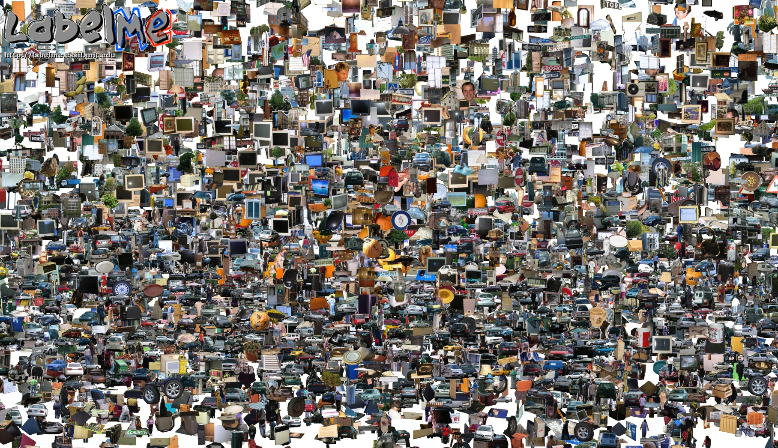
Opportunities of Scale
11/07/17
Computational Photography
Derek Hoiem, University of Illinois
Most slides from Alyosha Efros
Graphic from Antonio Torralba
Notes:
Note: this takes 50 minutes. Could add content

Slide 2
Today’s class
Opportunities of Scale: Data-driven methods
  Scene completion
  Im2gps
  3D reconstruction
  Colorizing
  Infinite zoom/panorama
  and much more…

Slide 3
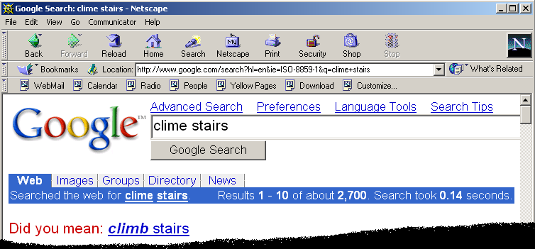
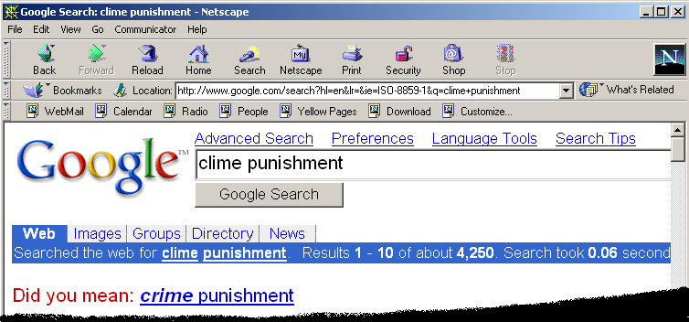
Google and massive data-driven algorithms
A.I. for the postmodern world:
  all questions have already been answered…many times, in many ways
  Google is dumb, the “intelligence” is in the data

Slide 4

Google Translate

Slide 5
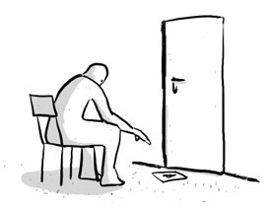
Chinese Room
John Searle (1980)

Slide 6
Image Completion Example
[Hays and Efros. Scene Completion Using Millions of Photographs. SIGGRAPH 2007 and CACM October 2008.]

Slide 7
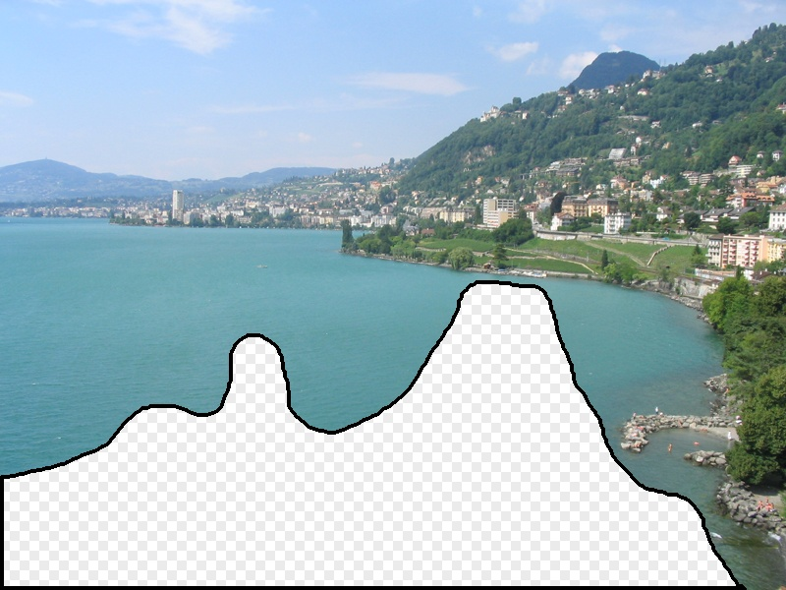
What should the missing region contain?
Notes:
7
What should go here and why?

Slide 8
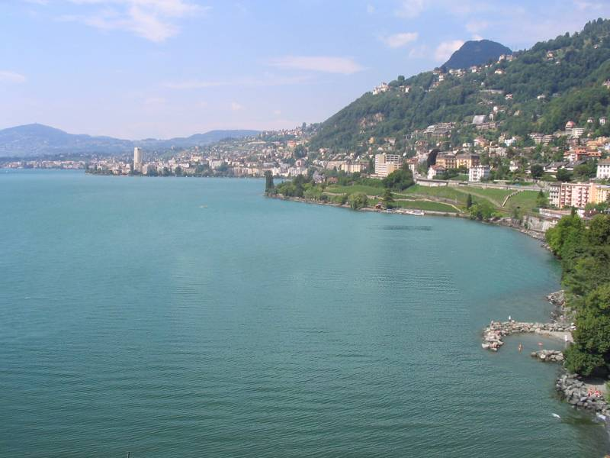

Slide 9
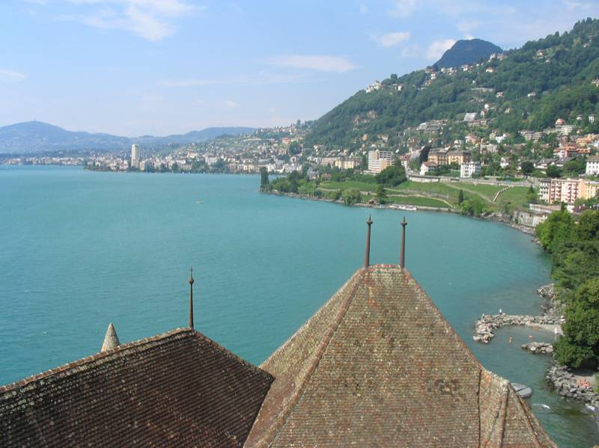
Notes:
9
Introduce gist.

Slide 10
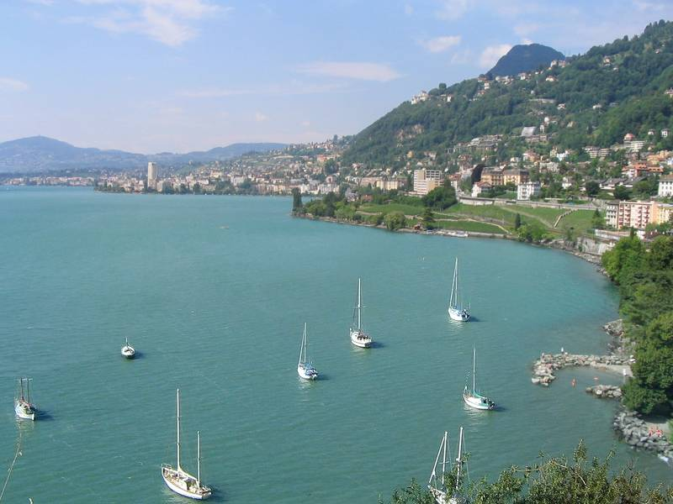

Slide 11
Which is the original?
(a)
(c)
(b)

Slide 12
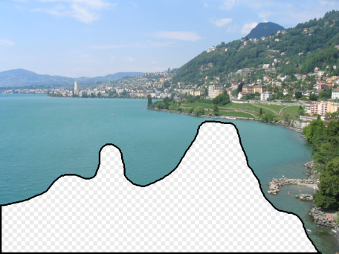
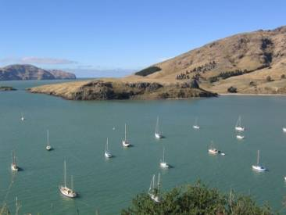
How it works
Find a similar image from a large dataset
Blend a region from that image into the hole
Dataset

Slide 13
General Principal
Huge Dataset
Images
image
matching
Info from Most Similar Images
Input Image
Associated Info
Trick: If you have enough images, the dataset will contain very similar images that you can find with simple matching methods.

Slide 14
How many images is enough?

Slide 15
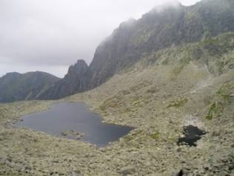
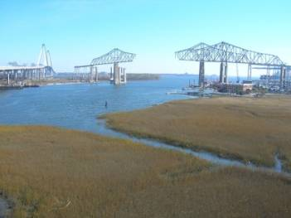
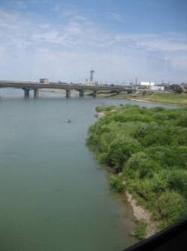

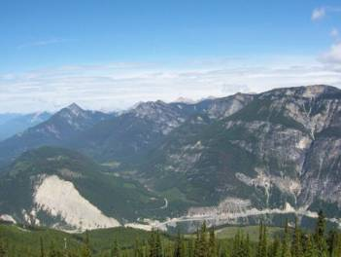
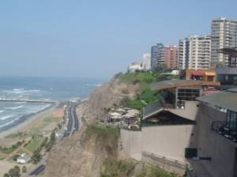
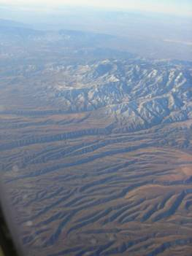
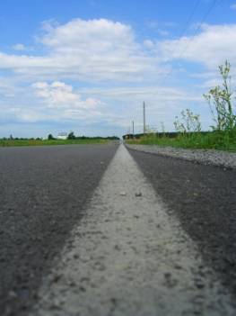

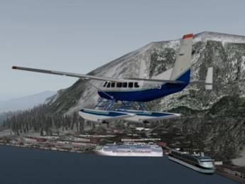
Nearest neighbors from a
collection of 20 thousand images
Notes:
15

Slide 16
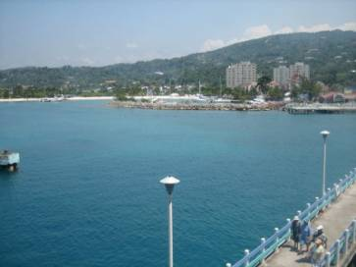
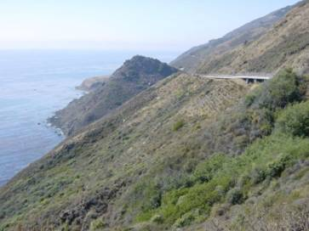
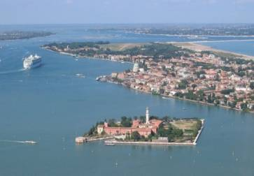
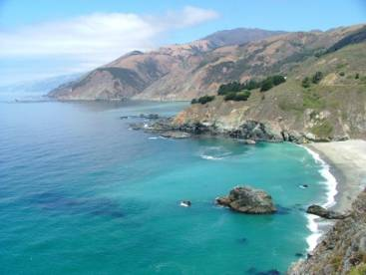

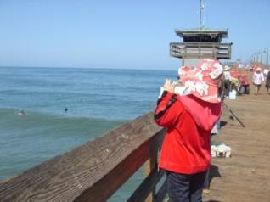
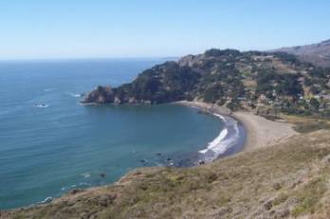
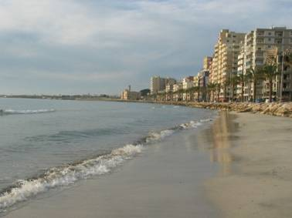
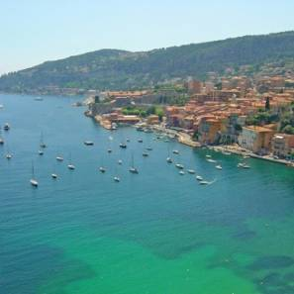
Nearest neighbors from a
collection of 2 million images
Notes:
16

Slide 17
Image Data on the Internet
Facebook (2014)
  250 billion total, +350 million per day
Facebook (2011)
  6 billion images per month
  More than 100 petabytes of images/video
Flickr (2010)
  5 billion photographs
  100+ million geotagged images
Imageshack (as of 2009)
  20 billion
Facebook (as of 2009)
  15 billion
http://royal.pingdom.com/2010/01/22/internet-2009-in-numbers/

Slide 18
Image completion: how it works
[Hays and Efros. Scene Completion Using Millions of Photographs. SIGGRAPH 2007 and CACM October 2008.]

Slide 19
The Algorithm
Notes:
19
Introduce gist.

Slide 20
Scene Matching
Notes:
20
Introduce gist.

Slide 21
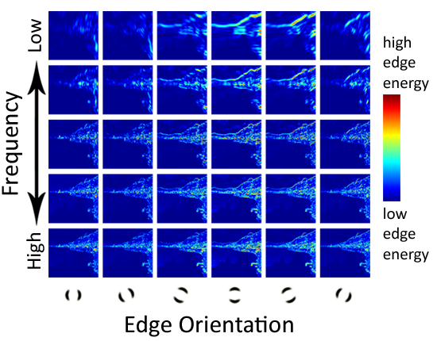
Scene Descriptor
Notes:
Edge energy is just the magnitude of directional derivatives of image intensity.
21

Slide 22
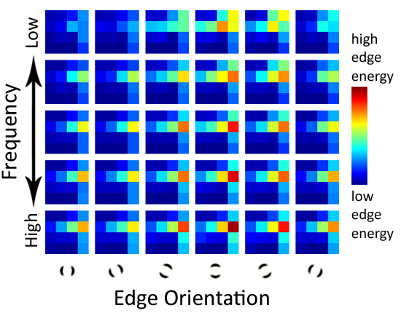
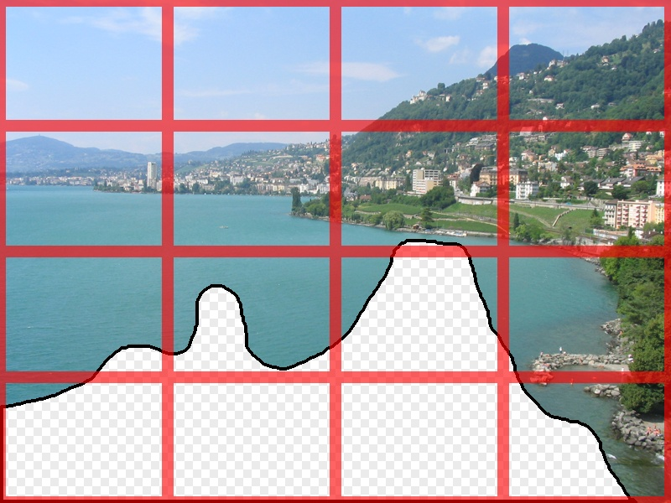
Scene Descriptor
Scene Gist Descriptor
(Oliva and Torralba 2001)

Slide 23

Scene Descriptor
+
Scene Gist Descriptor
(Oliva and Torralba 2001)

Slide 24

2 Million Flickr Images
Notes:
24
Now we take our gist (and mask and color image) and find it’s L2 nearest neighbors in the database of 2.3 million images, and here they are

Slide 25
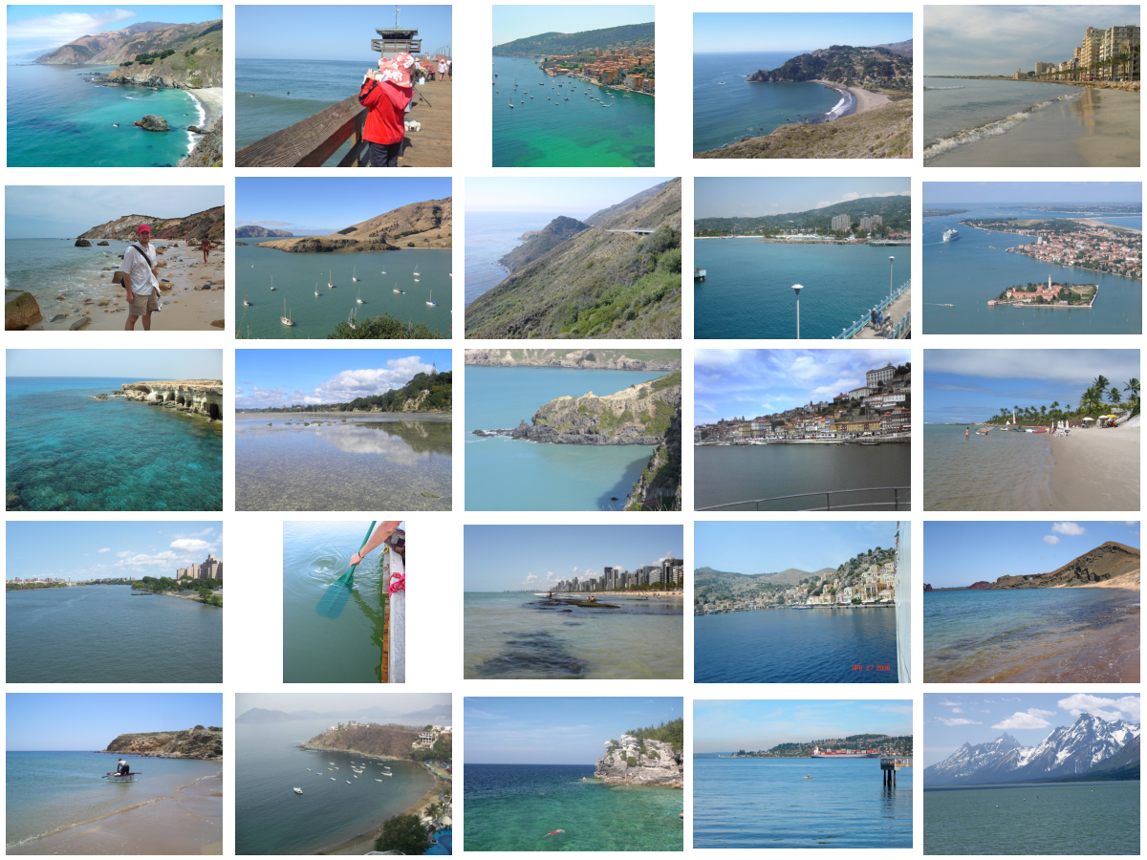
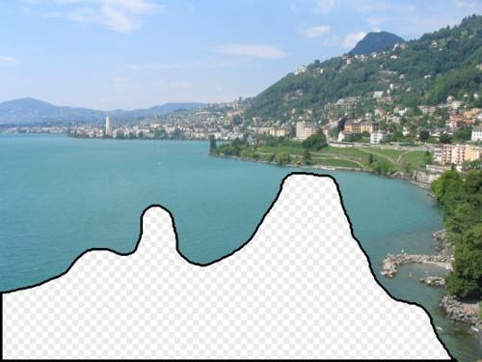
… 200 total
Notes:
25

Slide 26
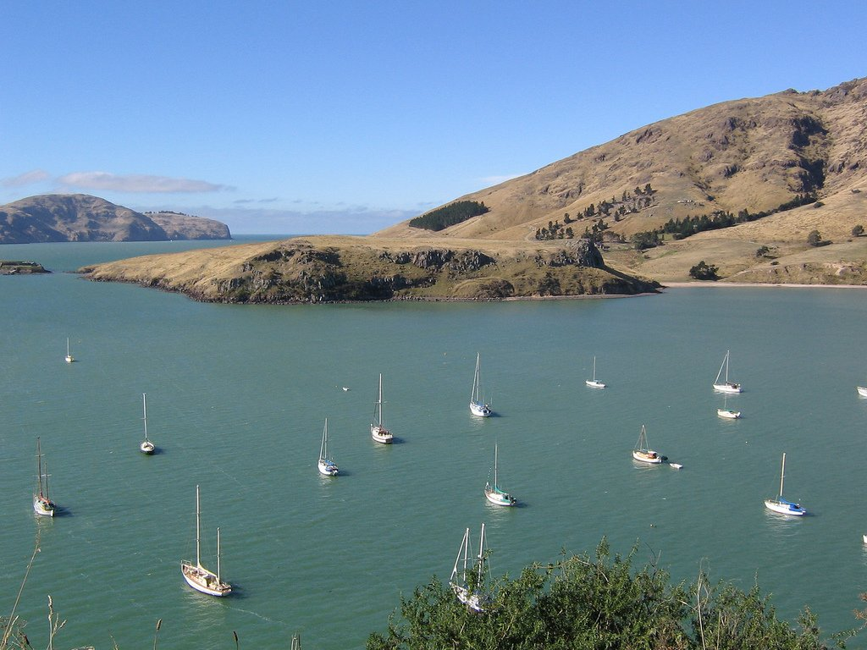

Context Matching

Slide 27
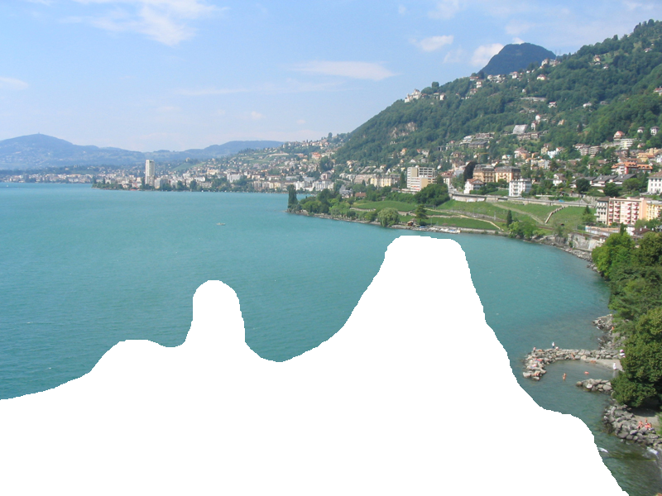

Graph cut + Poisson blending

Slide 28




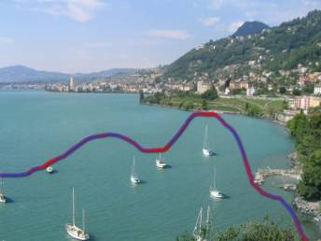
Result Ranking
We assign each of the 200 results a score which is the sum of:
The scene matching distance
The context matching distance
(color + texture)
The graph cut cost
Notes:
28
Johnson et al. used the graph cut cost to sort results for users in Semantic Photo Synthesis

Slide 30
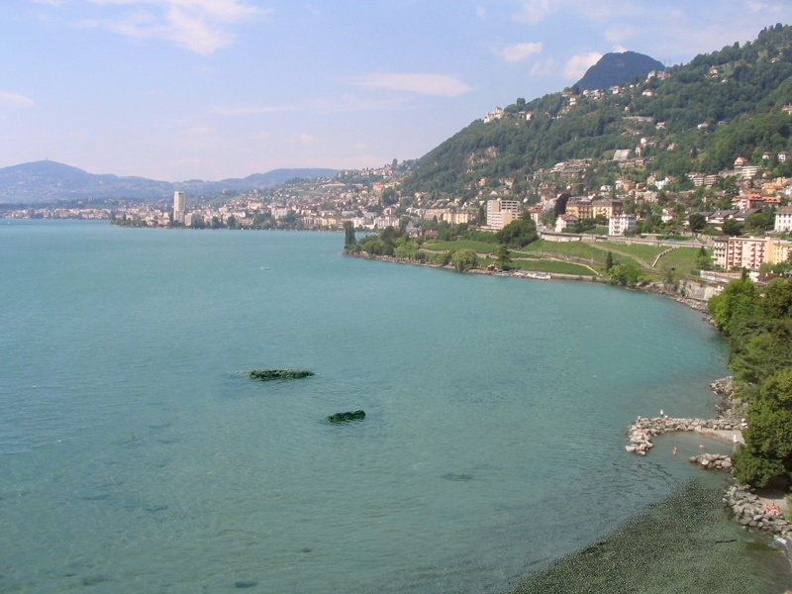

Slide 31
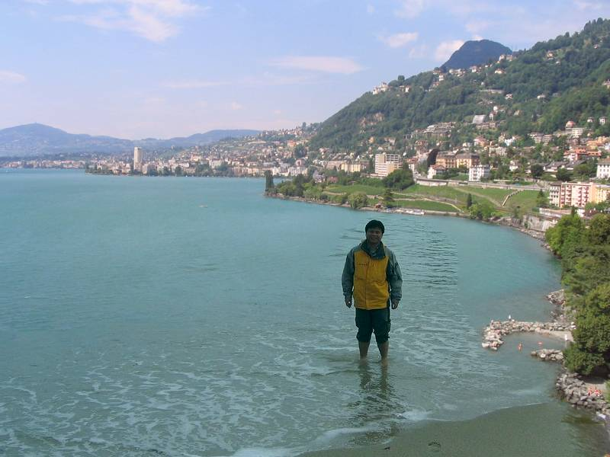

Slide 33
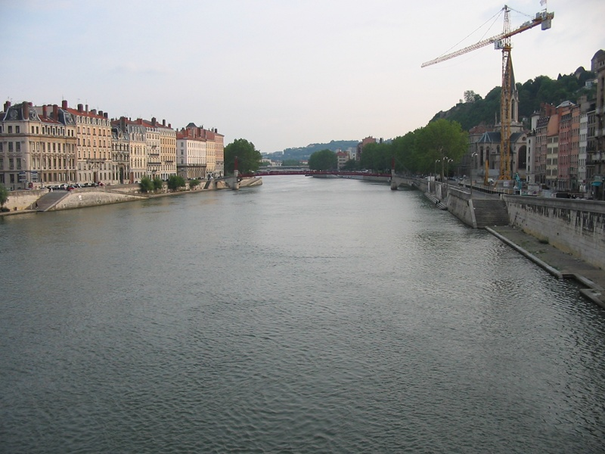
Notes:
33

Slide 34
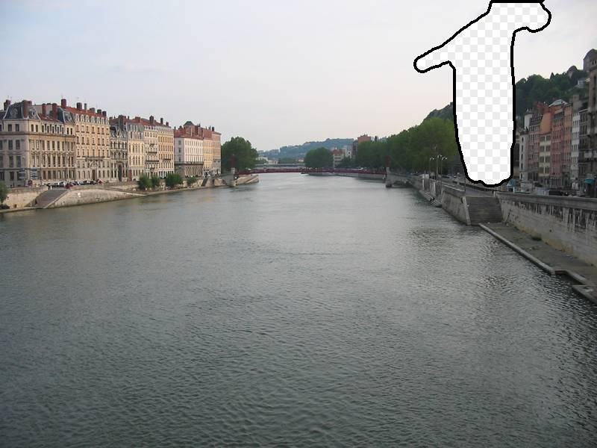
Notes:
34

Slide 35
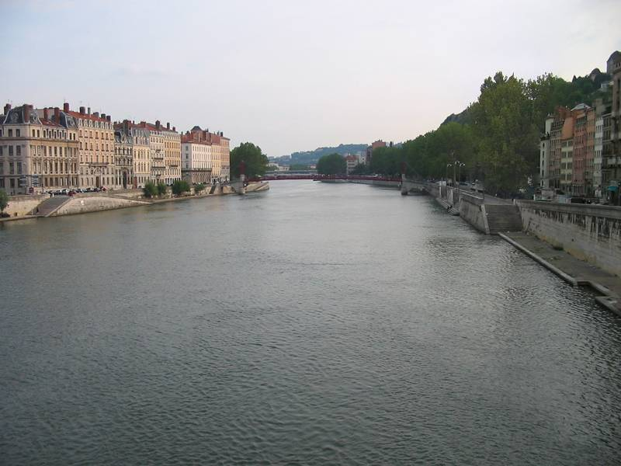
Notes:
35

Slide 36
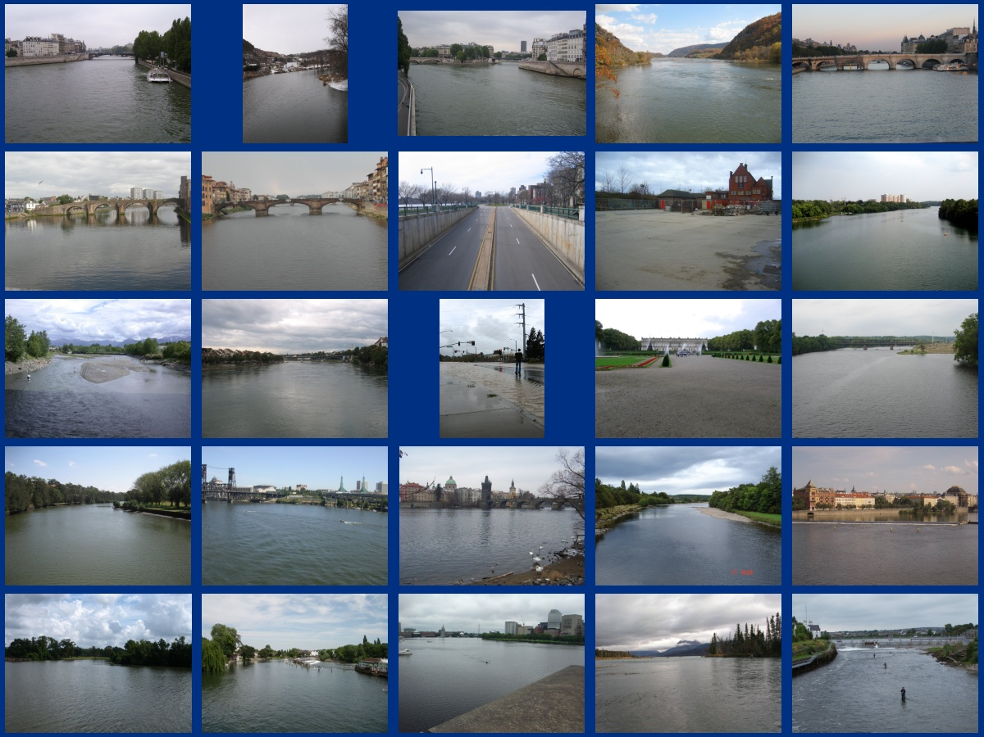
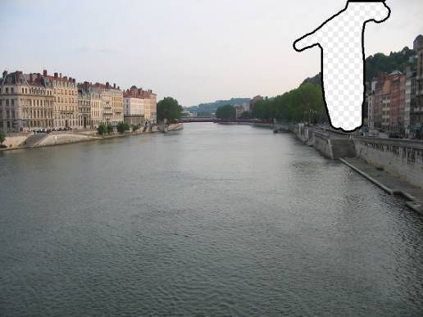
… 200 scene matches
Notes:
36

Slide 37
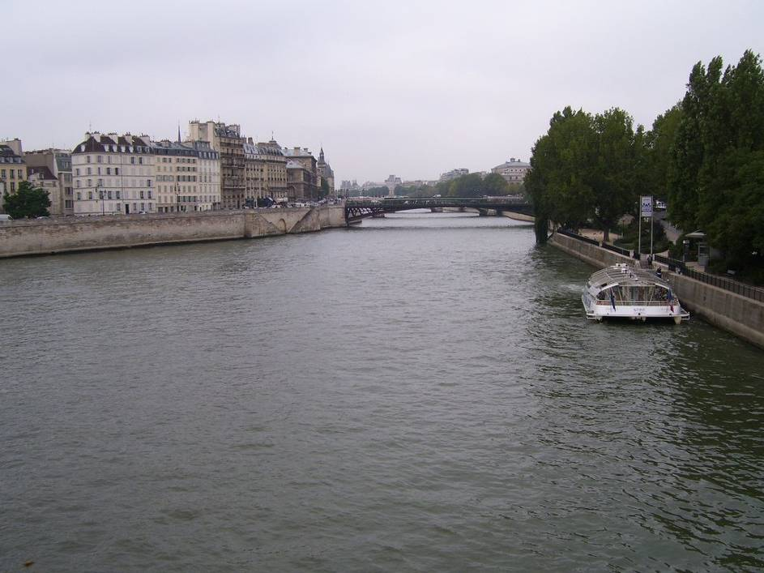
Notes:
37
Not actually the same scene, even though they’re startlingly similar

Slide 39
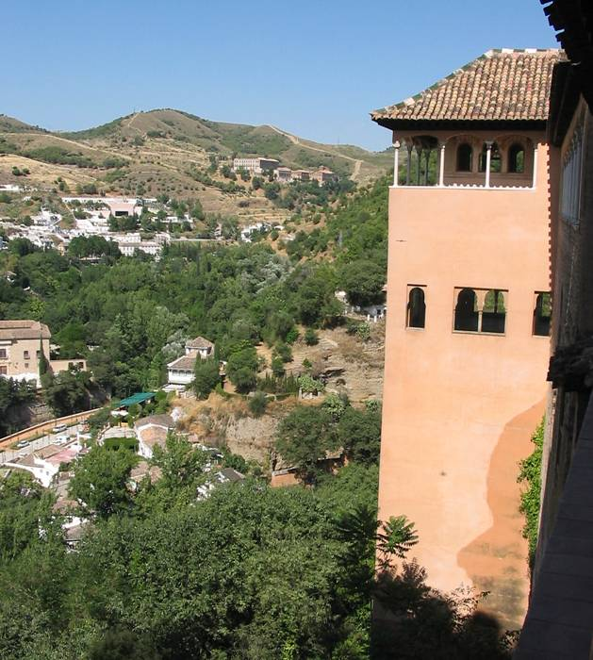

Slide 40
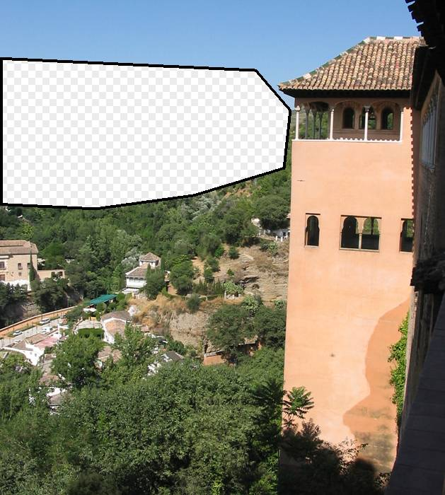

Slide 41
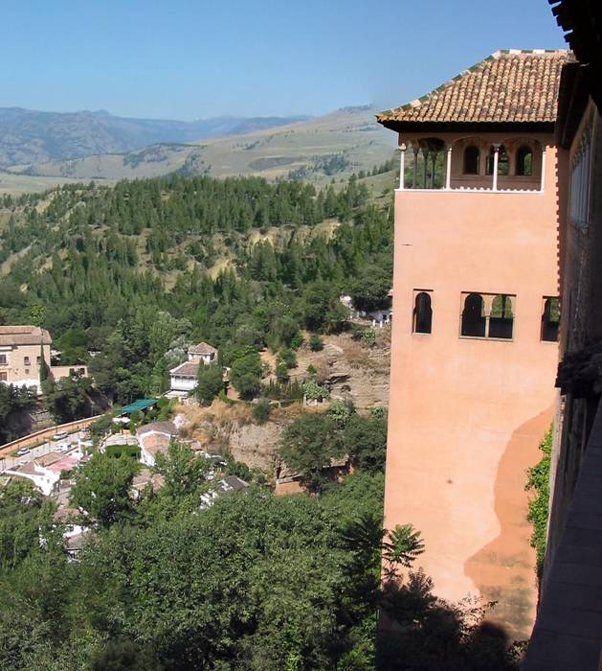

Slide 42
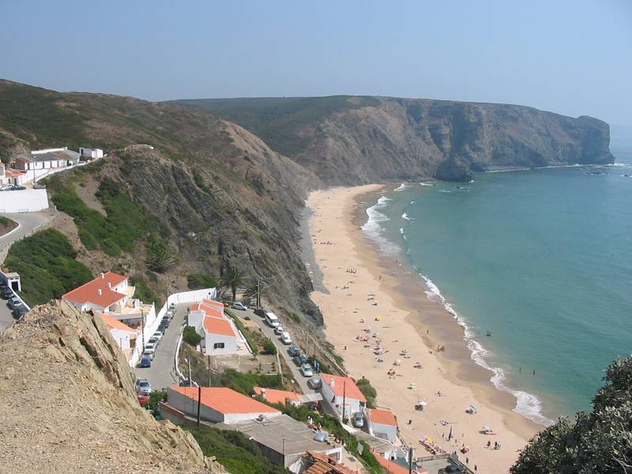
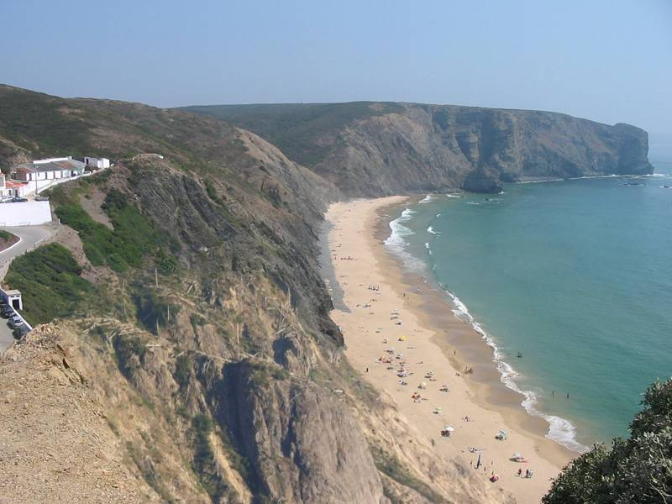
Which is the original?

Slide 43
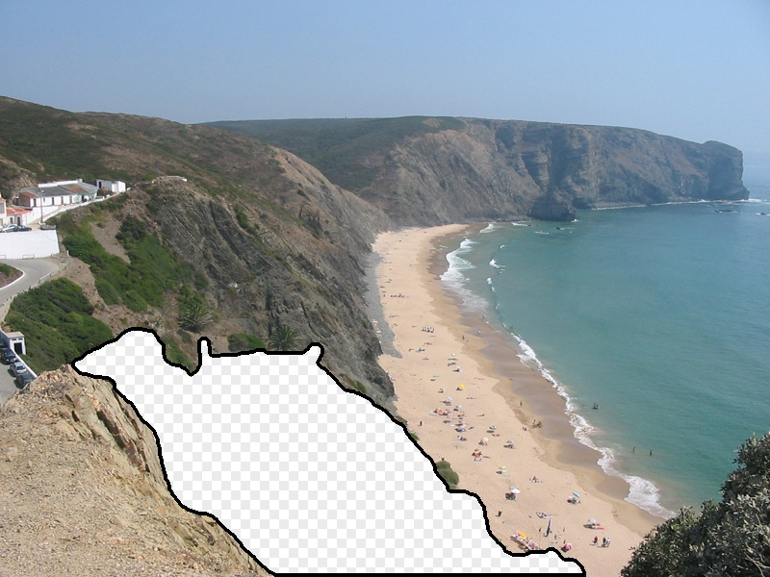

Slide 44
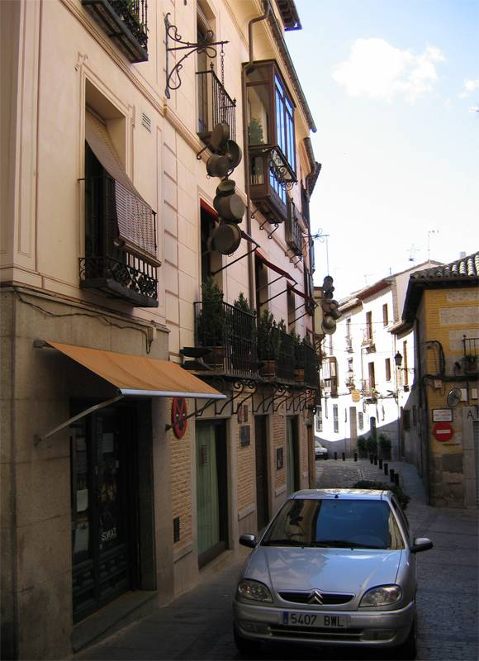
Notes:
44

Slide 45
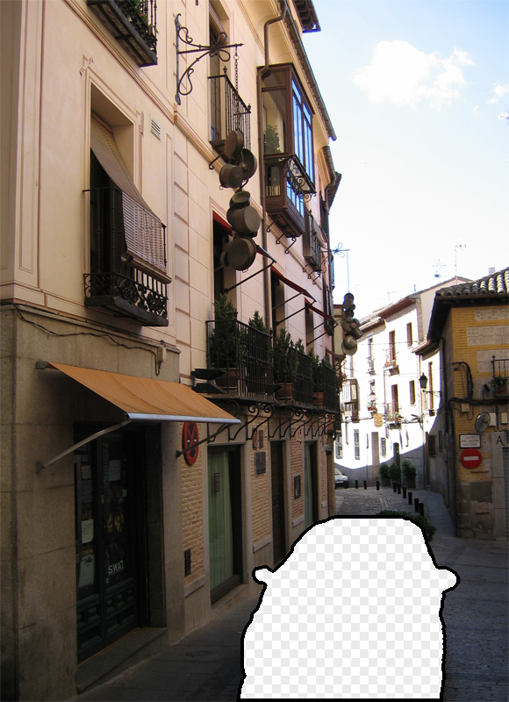
Notes:
45
Can justify broader use of image completion here

Slide 46

Diffusion Result
Notes:
46

Slide 47

Efros and Leung result
Notes:
47
Efros and leung result

Slide 48
Notes:
48
We don’t want to manually specify any semantics- contours or region labels.
We want to try and get our semantics (and our data) from other images
What semantics? This should be road, the building stops here, the vanishing point is in that direction.

Slide 49



Scene Matching for Image Completion
Notes:
49
How does a human do it? Interesting point – we don’t use labels.
We don’t want to manually specify any semantics- contours or region labels.
We want to try and get our semantics (and our data) from other images
What semantics? This should be road, the building stops here, the vanishing point is in that direction.
But can you find such a close match? That is the biggest question, and we certainly didn’t know the answer when we set out.
------
We’re going to try and find a similar scene and steal content from it
But this doesn’t answer any questions yet. Is scene matching good enough?
How big is the space of images?
Can we really expect to find a match that’s good enough for a generic image?

Slide 50

Scene Completion Result

Slide 51
Other uses of lots of data

Slide 52

im2gps (Hays & Efros, CVPR 2008)
6 million geo-tagged Flickr images

Slide 53

How much can an image tell about its geographic location?

Slide 54


Slide 55


Slide 56

Im2gps

Slide 57

Example Scene Matches

Slide 58

Voting Scheme
Notes:
Probability map for that same image
Explain the green circles and how they relate to evaluation
58

Slide 59

im2gps

Slide 60


Slide 61


Slide 62

Population density ranking

Slide 63

Where is This?
[Olga Vesselova, Vangelis Kalogerakis, Aaron Hertzmann, James Hays, Alexei A. Efros. Image Sequence Geolocation. ICCV’09]
Notes:
63

Slide 64

Where is This?

Slide 65

Where are These?
15:14,
June 18th, 2006
16:31,
June 18th, 2006
Notes:
Individually each photograph is 16%, but together they reinforce each other well
65

Slide 66

Where are These?
15:14,
June 18th, 2006
16:31,
June 18th, 2006
17:24,
June 19th, 2006
Notes:
If you know that brits love to vacation in greece…
66

Slide 67
Results
im2gps – 10% (geo-loc within 400 km)
temporal im2gps – 56%

Slide 68



3D Reconstruction from Flickr
Create detailed 3D scenes from thousands of consumer photographs
Challenges include variations in season, lighting, occluding objects, etc.

Slide 69


3D Reconstruction from Flickr: How it works
Download ~10,000 images, convert to grayscale, compute SIFT keypoints
Match images
  Get similar images with vocabulary tree (like in recognition from last class)
  Match keypoints across similar images and perform geometric verification with RANSAC (similar to photo stitching)
Form a graph of matched images
3D Reconstruction by triangulating points, bundle adjustment

Slide 70
Large-scale 3D Reconstruction
Useful references
Dense reconstruction: “Towards Internet-scale Multi-view Stereo”, Furukawa et al., CVPR 2010 http://grail.cs.washington.edu/software/cmvs/
Sparse reconstruction: “Building Rome in a Day”, Goesler et al., ICCV 2009 http://grail.cs.washington.edu/projects/rome/
Code: Bundler Software, OpenMVG

Slide 71




Photo Clip Art [SG’07]
Inserting a single object -- still very hard!
object size, orientation
scene illumination
Lalonde et al, SIGGRAPH 2007

Slide 72


Photo Clip Art [SG’07]
Use database to find well-fitting object
Lalonde et al, SIGGRAPH 2007
Notes:
Instead of trying to solve this impossibly hard problem, we observe that object insertion becomes much easier if we have a database of objects, and we try to insert AN object instead of THIS object. One major contribution of this work is to pose the problem of image compositing in a data-driven way: instead of creating new appearance, query a large database. It’s a bit like visual google for compositing.

Slide 73
CG2Real
CG2Real: Improving the Realism of Computer Generated Images using a Large Collection of Photographs, Johnson, Dale, Avidan, Pfister, Freeman, Matusik, Tech. Rep. MIT-CSAIL-TR-2009-034

Slide 74
Image Restoration using Online Photo Collections [ICCV’09]
Dale, Johnson, Sunkavalli, Matusik, Pfister, ICCV’09

Slide 75

Tour from a single image
Scene matching with camera transformations

Slide 76





Tour from a single image
Navigate the virtual space using intuitive motion controls

Slide 77
Video
http://www.youtube.com/watch?v=E0rboU10rPo

Slide 78

Tiny Images
80 million tiny images: a large dataset for non-parametric object and scene recognition Antonio Torralba, Rob Fergus and William T. Freeman. PAMI 2008.
http://groups.csail.mit.edu/vision/TinyImages/

Slide 79


Slide 80

Human Scene Recognition

Slide 81





Powers of 10
Number of images on my hard drive: 10⁴
Number of images seen during my first 10 years: 10⁸
(3 images/second * 60 * 60 * 16 * 365 * 10 = 630720000)
Number of images seen by all humanity: 10²⁰
106,456,367,669 humans¹ * 60 years * 3 images/second * 60 * 60 * 16 * 365 =
1 from http://www.prb.org/Articles/2002/HowManyPeopleHaveEverLivedonEarth.aspx
Number of photons in the universe: 10⁸⁸
Number of all 32x32 images: 10⁷³⁷³
256 ^{32*32*3} ~ 10⁷³⁷³
Notes:
so don’t listen to anyone claiming to brute force image space
But most of image space is empty, never observed

Slide 82



Scenes are unique
Notes:
Scene and object recognition at human performance is very hard because we are able to deal with so many different kinds of scenes…
Scenes are so unique.

Slide 83









But not all scenes are so original
Notes:
But most scenes are not really like that. Most of the time, scenes are boring places in which nothing really surprising happens. For instance, this street… there is nothing really special about it. In fact, I can easily find thousands of other street pictures that look just like this. Of course, these scenes are different in the details, just as two faces are different, but at a coarser level they are form by similar objects arranged in a similar spatial configuration.

Slide 84
Lots
Of
Images
A. Torralba, R. Fergus, W.T.Freeman. PAMI 2008

Slide 85
Lots
Of
Images
A. Torralba, R. Fergus, W.T.Freeman. PAMI 2008

Slide 86
Lots
Of
Images

Slide 87






Automatic Colorization
Input
Color Transfer
Color Transfer
Matches (gray)
Matches (w/ color)
Avg Color of Match

Slide 88






Automatic Colorization
Input
Color Transfer
Color Transfer
Matches (gray)
Matches (w/ color)
Avg Color of Match

Slide 89
How Deep Networks Work
Learn better features to match regions or images
High capacity to make good use of lots of data
“Revisiting Im2GPS in the Deep Learning Era”, Vo, Jacobs, Hays 2017

Slide 90
SIGGRAPH 2017

Slide 91
Summary
Many questions have been asked before, photos have been taken before
Sometimes, we can shortcut hard problems by looking up the answer

Slide 92
Next class
How the Kinect works

