Slide 1
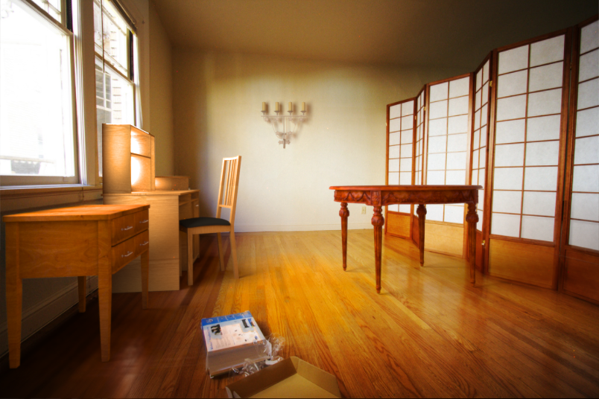
The image as a virtual stage
10/24/17
Computational Photography
Derek Hoiem
Adapted from slides by Kevin Karsch, presented by Aditya Deshpande

Slide 2
Upcoming
Thurs: Derek out of town, Daeyun will present
Next Mon: Project 4 is due

Slide 3
Today
Inserting objects into legacy photos
  Uses single-view geometry and image-based lighting concepts
Using Blender

Slide 4
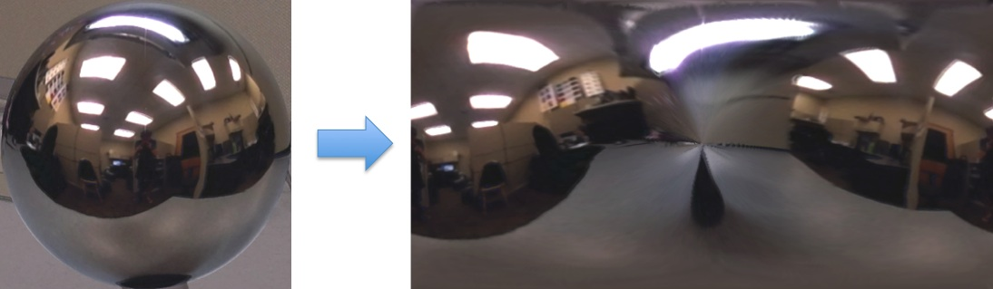
Mirror ball -> equirectangular

Slide 5
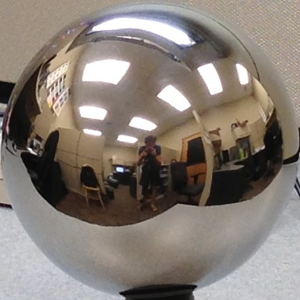



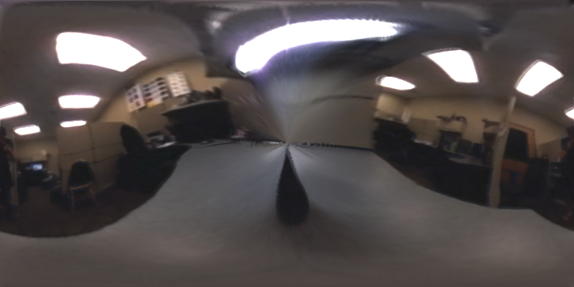

Mirror ball -> equirectangular
Mirror ball
Normals
Reflection
vectors
Phi/theta of reflection vecs
Equirectangular
Phi/theta equirectangular domain

Slide 6
Mirror ball -> equirectangular
Domain transformation in matlab
  Create an interpolation function F with TriScatteredInterp
  Compute values for each pixel in new domain
Pseudocode:
for i=1:d
F = TriScatteredInterp(phi_ball, theta_ball, mirrorball(:,:,i));
latlon(:,:,i) = F(phi_latlon, theta_latlon);
end

Slide 7
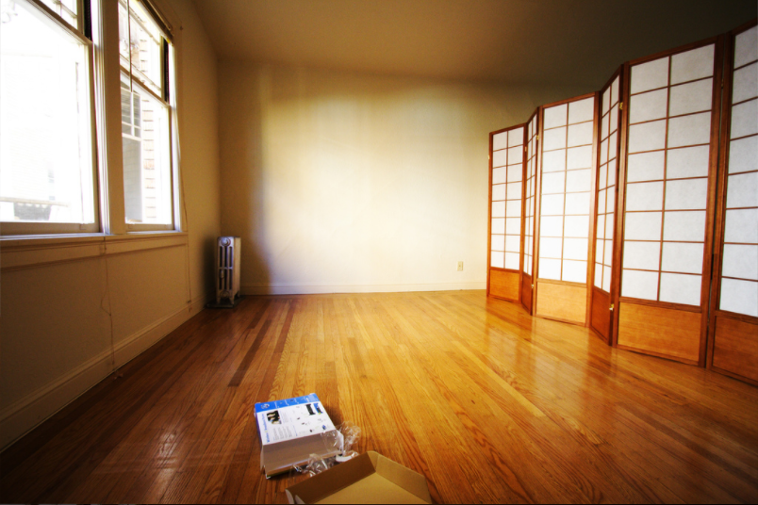

Slide 8
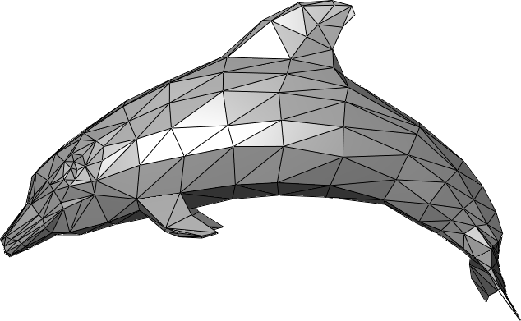
The polygonal mesh
Discrete representation of a surface
  Represented by vertices -> edges -> polygons (faces)

Slide 9
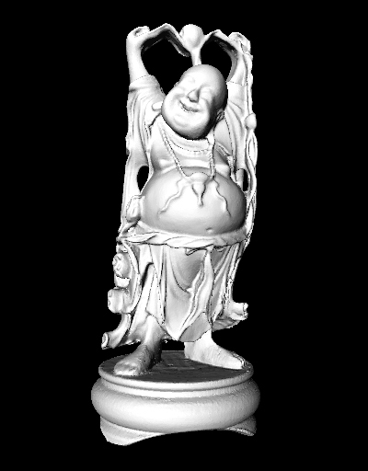
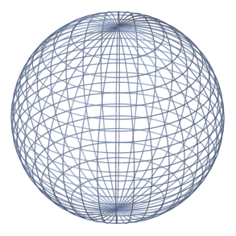
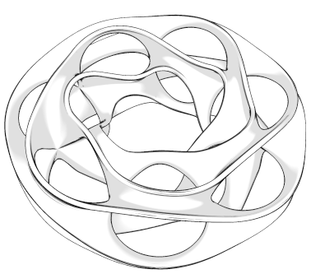
Insert these…

Slide 10
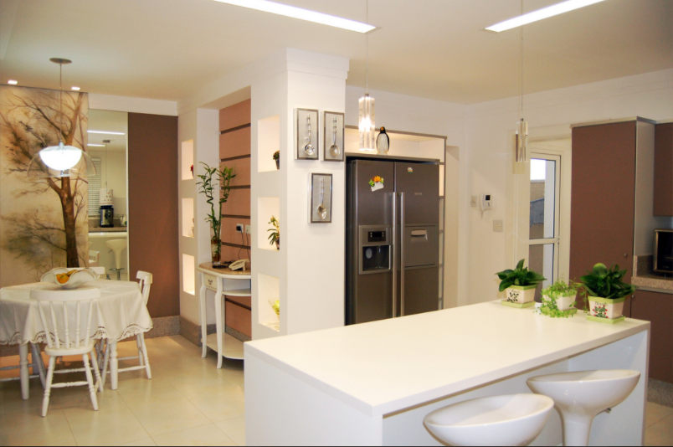
…into this

Slide 11
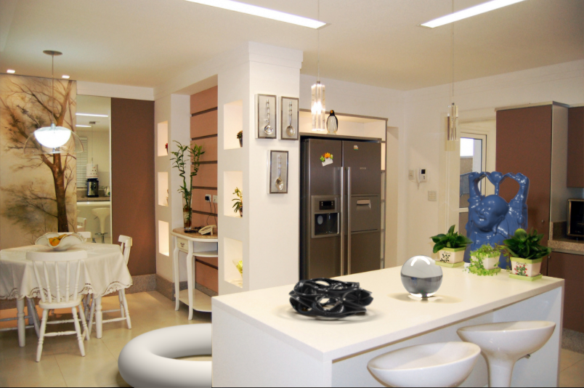
…into this

Slide 12
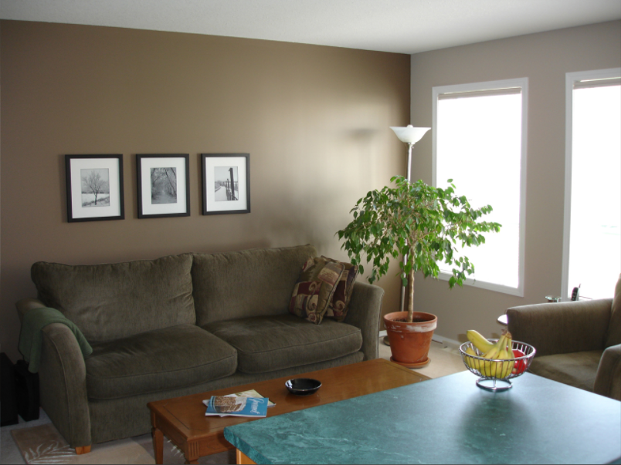
Or, remove this

Slide 13
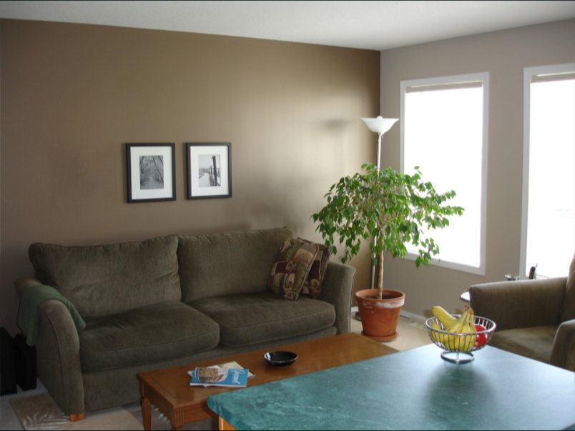
Or, remove this

Slide 14
Problem statement
From a single image, seamlessly insert and delete objects from an image while semi-automatically handling perspective, occlusion, collision, and lighting

Slide 15
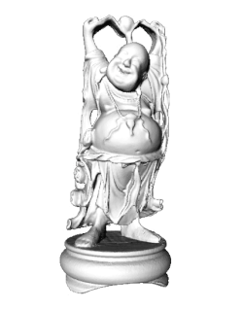

Inserting 3D objects into photographs
Goal: Realistic insertion using a single LDR photo
Arbitrary lighting environments
Intuitive, quick and easy to create content
  Home planning/redecoration
  Movies (visual effects)
  Video games
Notes:
Building on past techniques, the primary goal of our paper is to allow users with minimal photo editing experience to insert objects into legacy images without requiring access to the scene.
2) Handle a host of lighting environments
3) Quick and easy to use
4) Create results like this one in minutes
Ideally, our method without scene access should be as realistic as methods with scene access, in essence making this system less painstaking than others.
This tool can bring about new applications in film and advertising, and also allow homeowners to virtually redecorate their living rooms, or users to create video game content with their own pictures.

Slide 16
Challenges
Estimate a physical scene model including:
  Geometry
  Surface properties
  Lighting info
  Camera parameters
Walls/floor
Lights
Table
Camera
Notes:
And we need to know the camera parameters to accurately render objects into the scene

Slide 17
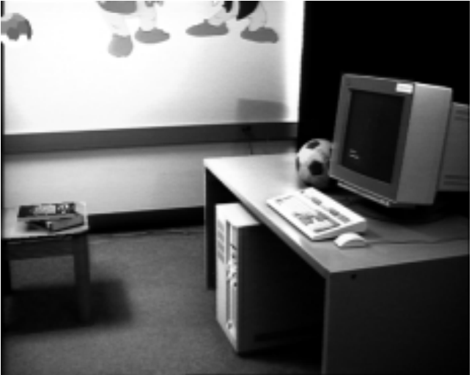
Earlier approaches with scene access
Manual authoring
[Fournier et al. ’93]
Notes:
There’s currently, a few ways to obtain this representation.
One way is to manually author or measure the scene.
This can be difficult, and it takes a a great deal of time to get things looking right.
Lighting is especially hard to get right with only visual feedback, and takes a lot of trial and error.

Slide 18
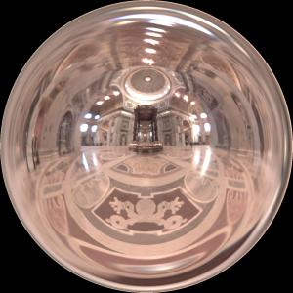
Earlier approaches with scene access
Manual authoring
Light probe, Inverse GI
[Fournier et al. ’93]
[Debevec ’98, Yu et al. ‘99]
Notes:
In 98, Debevec made a breakthrough with his idea of capturing the lighting environment using a light probe.
The light probe method simplified the authoring steps and enabled photorealistic results by capturing HDR lighting information from all angles of a scene.
However, the downside is that it requires access to the scene and some knowledge of image based lighting.
Inverse global illumination also allowed for physical material acquisition, but required multiple scene photos.

Slide 19
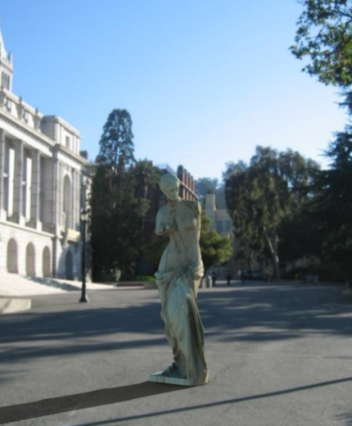

Earlier approaches without scene access
Outdoor illumination
Point source detection
[Wang and Samaras ’03,
Lopez-Moreno et al. ‘10]
[Lalonde et al. ‘09]
Notes:
What if we have a picture that we want to insert objects into, but we don’t have access to the scene?
Well, there’s been a couple approaches for handling this case, which are essentially interested in estimating one or more point lights from a picture.
Still, scene geometry, surface properties, or camera parameters must be estimated manually.
Also, if the lighting environment is more complex than a couple point lights, then an alternative method is required.

Slide 20
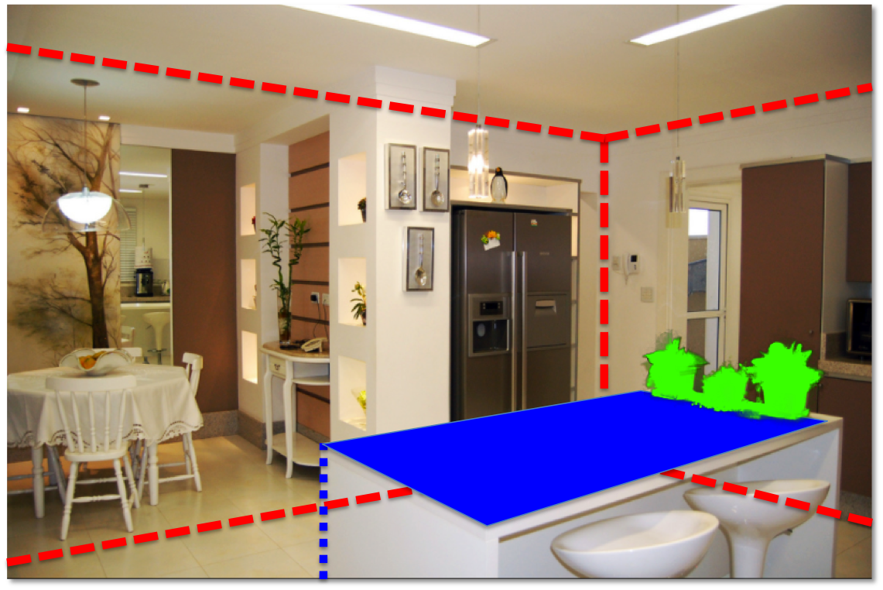
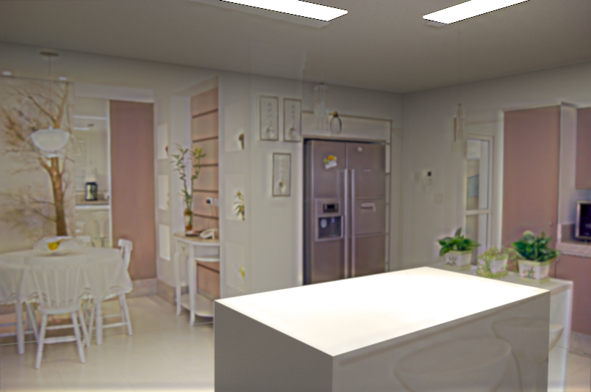
System overview
Input image
Object insertion
Scene authoring
Scene synthesis
Notes:
Our approach is to recover the 3D scene interactively, using a small amount of user guidance.
The user gives some information about the scene by clicking in the image, and we synthesize estimates of geometry, materials, and lighting automatically.
Our estimates of geometry and materials aren’t exact, and we developed an optimization that adjusts initial lighting estimates to account for imperfections in the rest of our model.
This is crucial, as it allows for our method to tolerate a coarse model of geometry and inexact material estimates.
We also ensure that the model produced by our system can be imported into standard 3D modeling tools, and rendered with any off the shelf physical renderer.

Slide 21
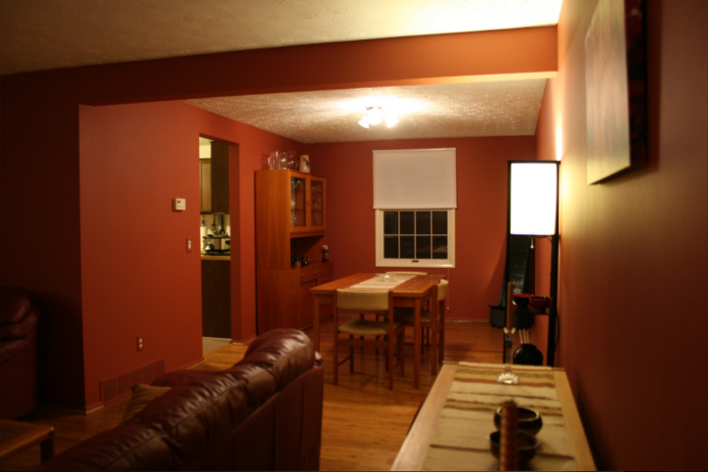
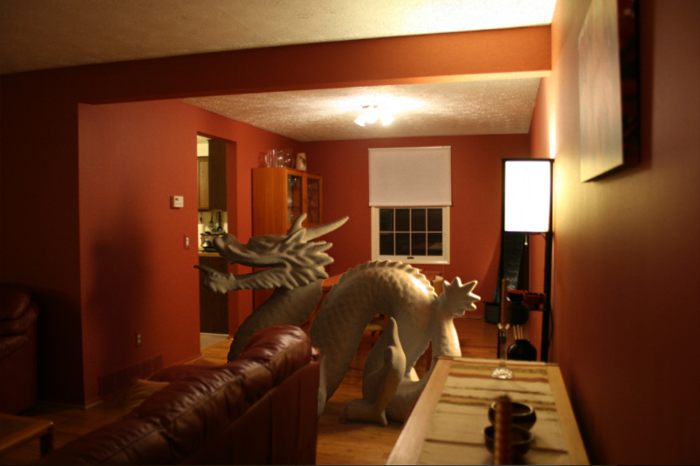
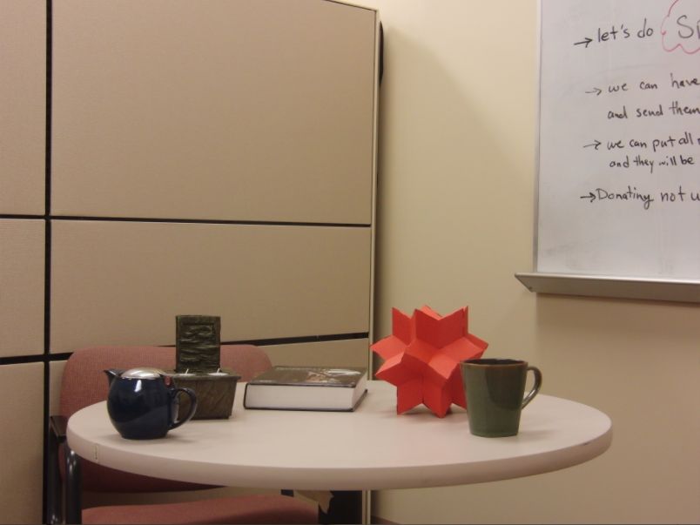
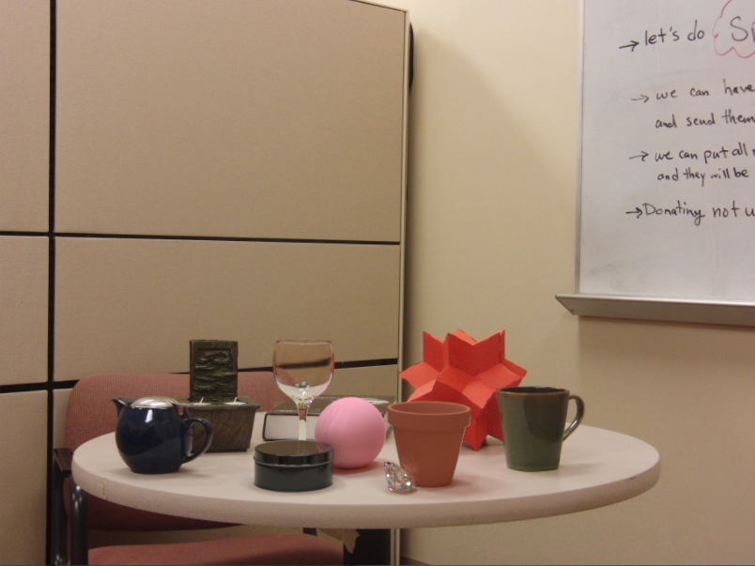
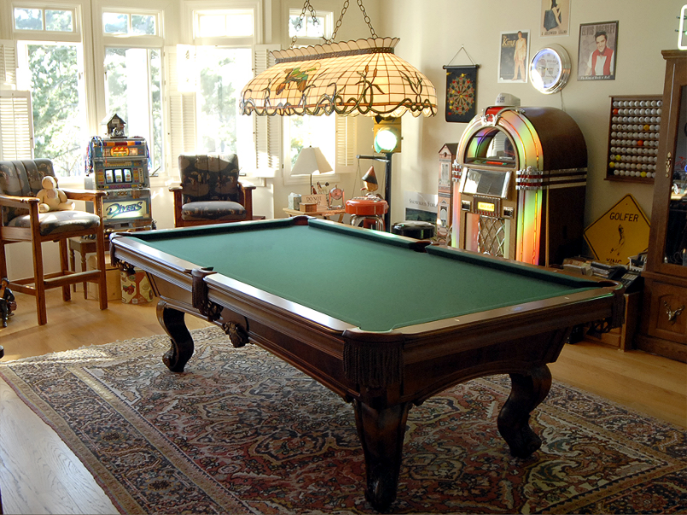
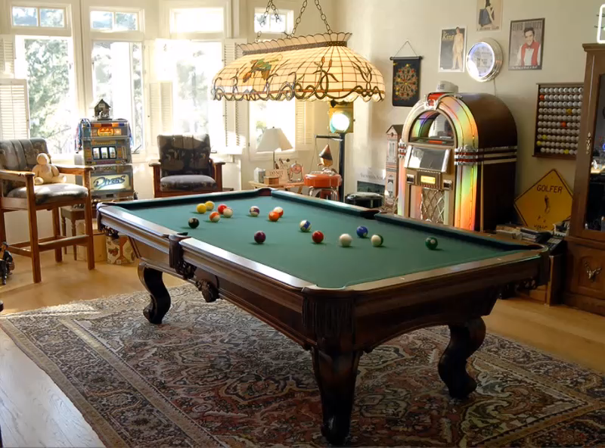
Notes:
Wouldn’t it be nice to interact with a picture as if it were a 3D scene?
You could insert objects into the photo with proper perspective and lighting,
or place objects realistically on surfaces.

Slide 22
Overview of getting geometry and lighting

Slide 23
Bounding geometry
Spatial Layout [Hedau et al. ’09]
Remember Tour into the Picture? This is also a box model, but camera doesn’t have to face the back wall
- Three vanishing points
Notes:
Given an input image, we first estimate scene boundaries using the spatial layout method of Hedau et al.
This method estimates vanishing points as well as the ceiling, floor, and walls in an image.
Our interface allows these estimate to be corrected if there are any errors.

Slide 24
Bounding geometry
Supporting geometry
Spatial Layout [Hedau et al. ’09]
Manual input
Notes:
The user can add to this initial geometric representation by extruding what we call supporting geometry from the floor.
This type of geometry generally consists of planar surfaces, and can be used to quickly model things like tables, chairs, and other common scene elements.
To specify supporting geometry, the user clicks the surface boundary in the image as well as its contact point with the floor.

Slide 25

Bounding geometry
Supporting geometry
Spatial Layout [Hedau et al. ’09]
Occluding geometry
Spectral matting[Levin et al. ’09]
Manual input
Notes:
We also allow the user to add more complex occluding geometry by segmenting parts of the image and modeling them as cardboard cutouts.
These cutouts will occlude any objects inserted behind them.
We use the interactive spectral matting approach to robustly determine the object boundaries.

Slide 26
Manual input
Bounding geometry
Supporting geometry
Spatial Layout [Hedau et al. ’09]
Occluding geometry
Light sources
Spectral matting[Levin et al. ’09]
Manual input
Notes:
Finally, any visible light sources in the scene are marked, and I’ll describe our procedure to automatically estimate intensity and other lighting parameters a little bit later in the talk.

Slide 27
Area lights
Textured billboard
(with transparency)
Bounding cuboid
Extruded polygon
Notes:
By applying some well known single-view metrology and reconstruction techniques, we can recover a rough 3D layout for this image using these annotations.

Slide 28
What the spatial layout provides

Slide 29
Extruded geometry, billboards enable occlusion
Notes:
Here’s another result.

Slide 30
Box, supporting surfaces enable object placement
Notes:
Here’s another result.

Slide 31
Box, extruded geometry, lighting enables shadows, inter-reflections, caustics
Notes:
Here’s another result.

Slide 32
Camera geometry ensures correct perspective
Notes:
Here’s another result.

Slide 33
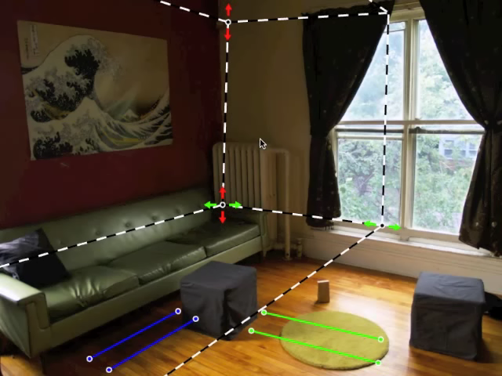
Notes:
Getting this input is quick and easy, here’s a quick video showing the markup process in our interface.
We start with an estimate of the bounding geometry, then the user corrects any errors in the estimate by adjusting scene corners and vanishing points.
We parameterize vanishing points with a pair of line segments, and here you can see the user adjusting two of the horizontal vanishing points.
Now the light sources are marked; for this scene there’s only one source.
Finally, pieces of occluding geometry are indicated by scribbling.
All in all, authoring this scene took about a minute, and this is the result.

Slide 34
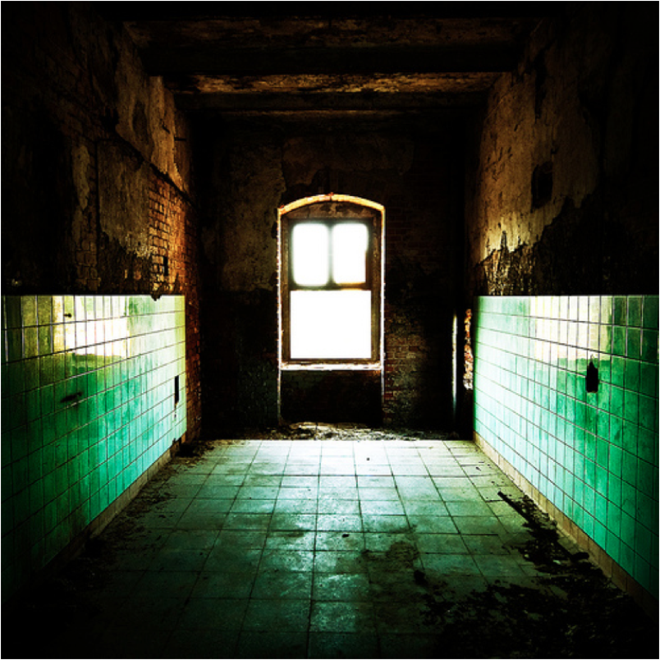
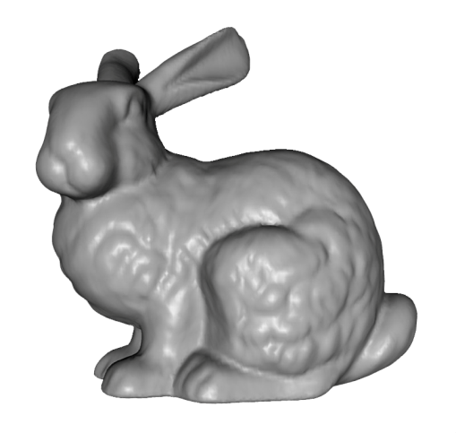
We need scene geometry to provi

Slide 35

That’s better, sort of…

Slide 36
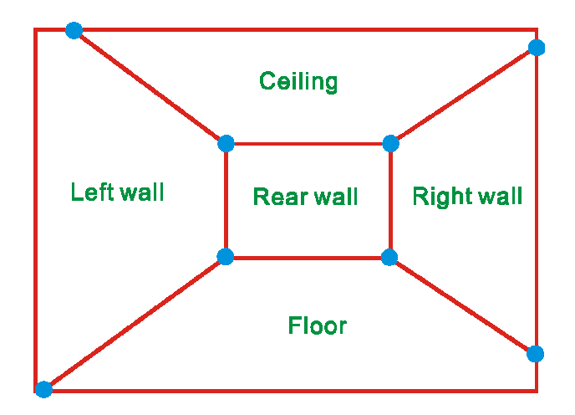
Single view reconstruction
Many scenes can be represented as an axis-aligned box volume

Slide 37
Single view reconstruction
Many scenes can be represented as an axis-aligned box volume

Slide 38
Ideal example

Slide 39
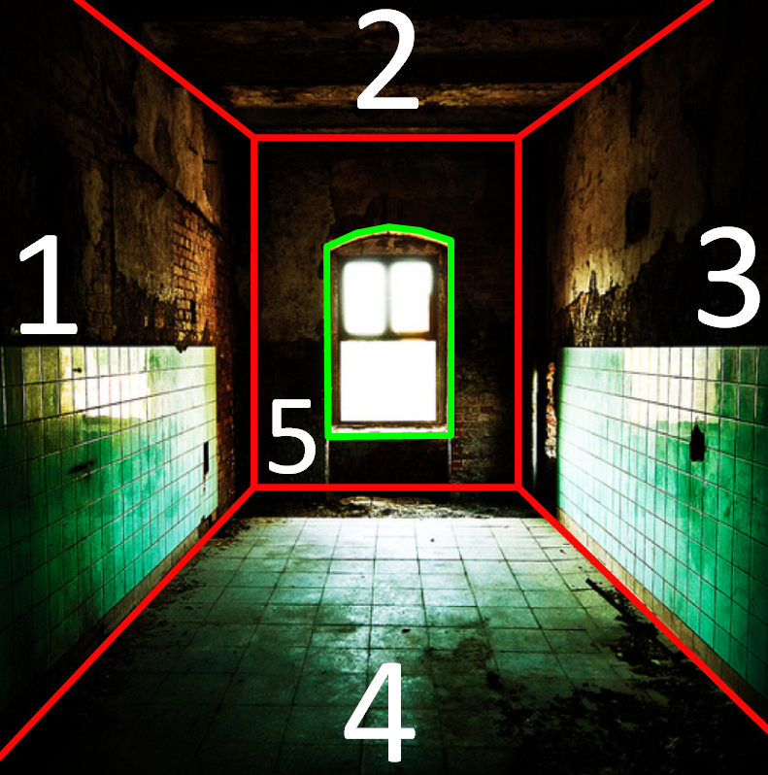
Example

Slide 40

Solving for camera viewpoint
Given 3 orthogonal VPs (at least two finite), can compute projection operator
${λp}_{2}=KRP_{3}$
2D point in homogeneous coordinates
3D point in Cartesian coordinates
Intrinsic camera matrix
Rotation matrix

Slide 41
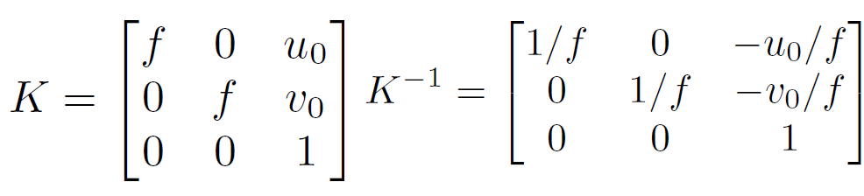
Solving for camera viewpoint
Given 3 orthogonal VPs (at least two finite), can compute projection operator: intrinsic matrix

Slide 42
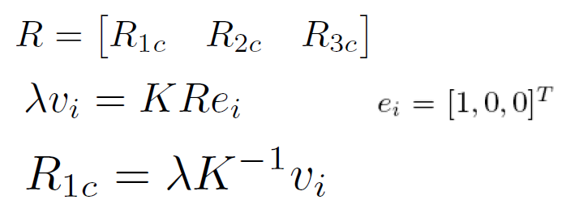
Solving for camera viewpoint
Given 3 orthogonal VPs (at least two finite), can compute projection operator

Slide 43
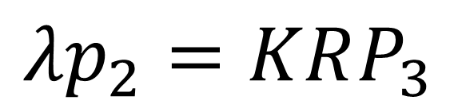
Projecting to image space
Given K, R, and a position in 3D, we can find its corresponding 2D image location:
$${λp}_{2}=KRP_{3}$$

Slide 44
What about the reverse?
Given K, R, and a 2D position on the image, what do we know about its 3D location?

Slide 45
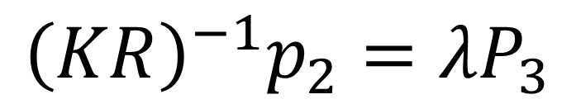
What about the reverse?
Given K, R, and a 2D position on the image, what do we know about its 3D location?
Implies a line along which the 3D point lies
Points on known surfaces can be localized
$${{\left(KR\right)}^{−1}p}_{2}={λP}_{3}$$
Notes:
Draw ray example on board

Slide 46
Homographies
A
B’
A’
C
D
B
C’
D’
(Projective warping from one domain to another)

Slide 47
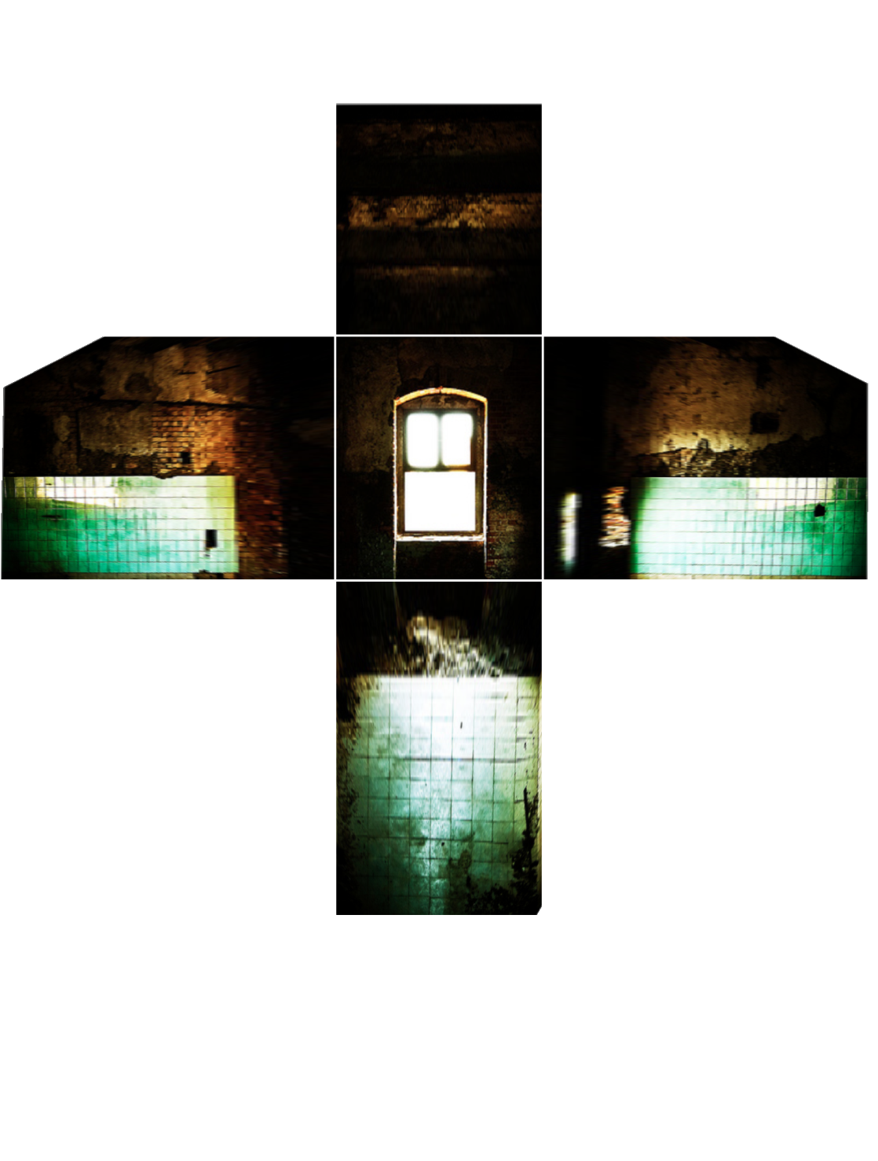
Image Rectification

Slide 48
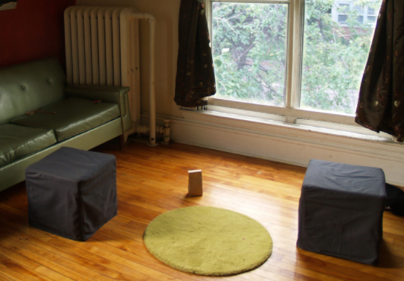
Modeling occlusions

Slide 49
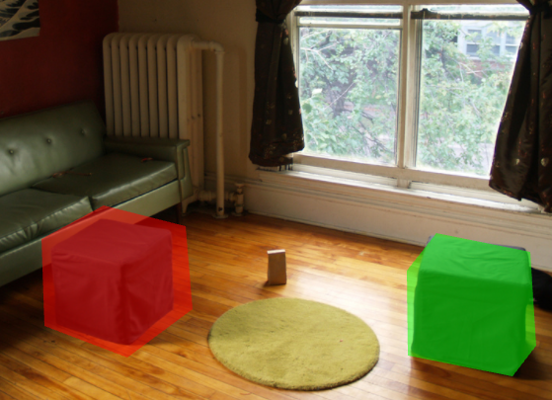
User-defined boundary
Tedious/inaccurate
How can we make this better?

Slide 50
Segmentation with graph cuts
Source (Label 0)
Cost to assign to 0
Cost to split nodes
Cost to assign to 1
Sink (Label 1)
Notes:
- Explanation with user initialization + pixel colors

Slide 51
Segmentation with graph cuts
Source (Label 0)
Cost to assign to 0
Cost to split nodes
Cost to assign to 1
Sink (Label 1)

Slide 52
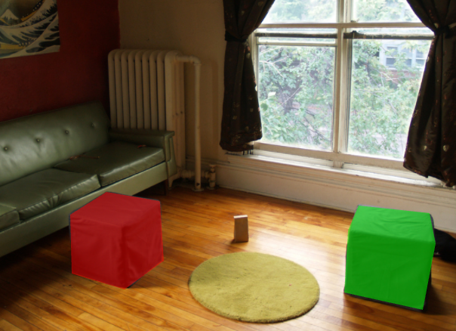
Refined segmentation

Slide 53
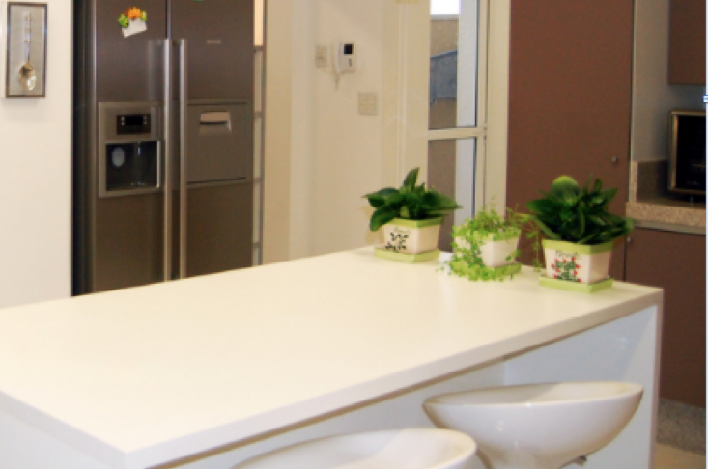
Spectral Matting

Slide 54
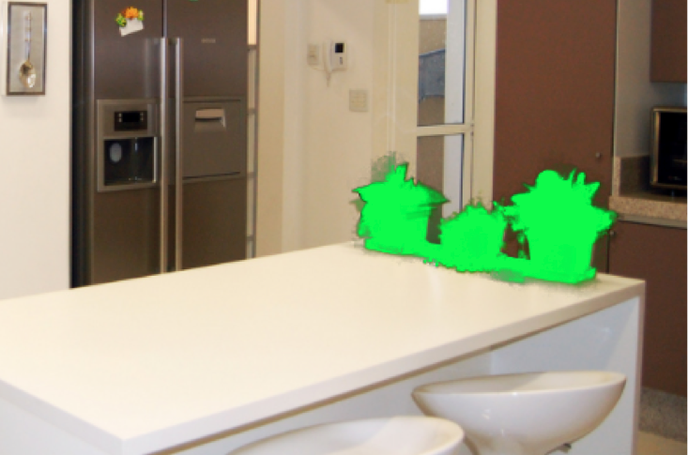
Spectral matting

Slide 55
Spectral Matting
Create NxN matrix describing neighboring pixel similarity (Laplacian matrix, L)
Extract “smallest” eigenvectors of L
Soft segmentation defined by linear combination of eigenvectors
  Scribbles provide constraints to assign to foreground
[“Spectral Matting” Levin Rav-Acha Lischinski 2008]

Slide 56
Spectral Matting
image
spectral components

Slide 57
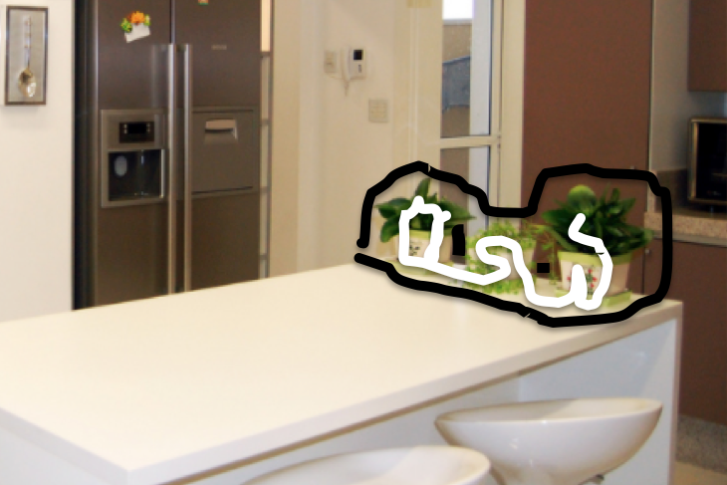
Spectral matting

Slide 58
Spectral matting

Slide 59
Segmentations as “billboards”

Slide 60
Segmentations as “billboards”

Slide 61
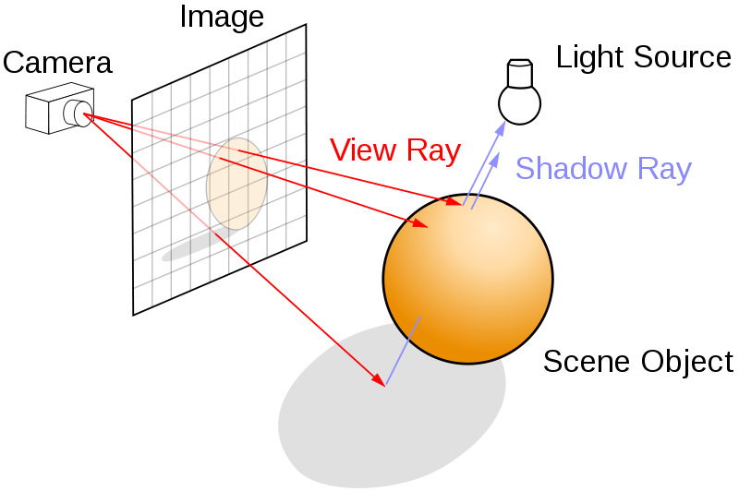
Rendering via ray tracing

Slide 62
Rendering via ray tracing

Slide 63
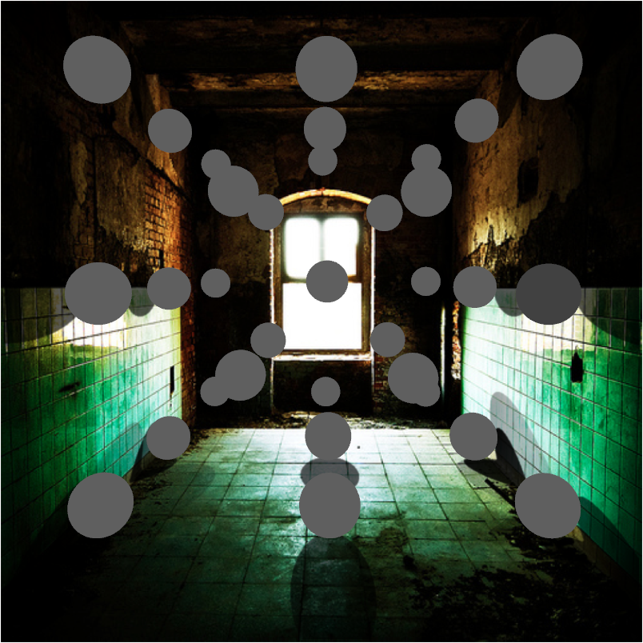
Insertion without relighting

Slide 64
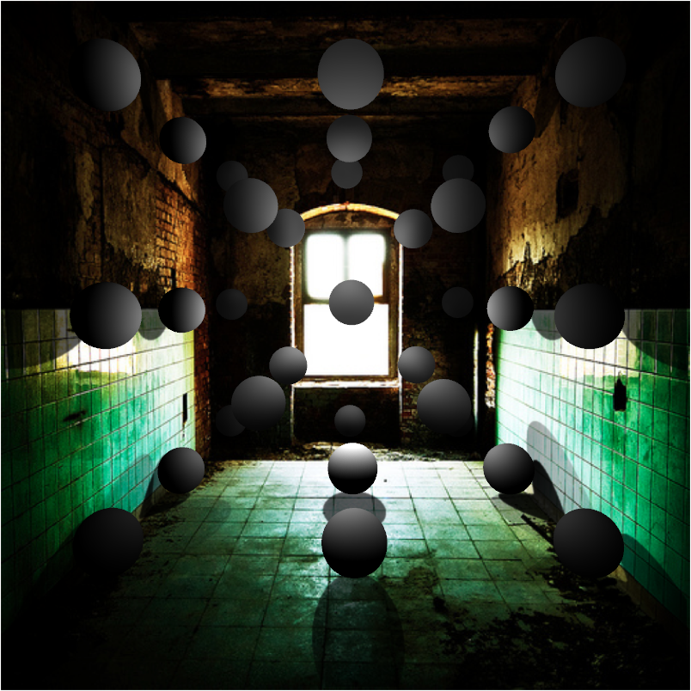
…with relighting

Slide 65
Estimating light
Hypothesize physical light sources in the scene
  Physical → CG representations of light sources found in the real world (area lights, etc)
Visible sources in image marked by user
  Refined to best match geometry and materials
User annotates light shafts; direction vector
  Shafts automatically matted and refined

Slide 66
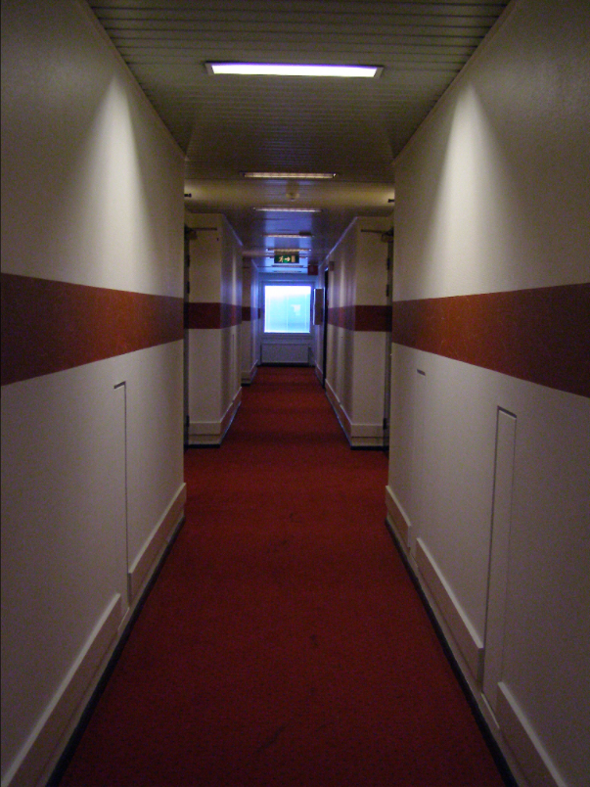
Lighting estimation

Slide 67
Lighting estimation
Actual light position

Slide 68
Lighting estimation
Actual light position
User-initialized light position

Slide 69
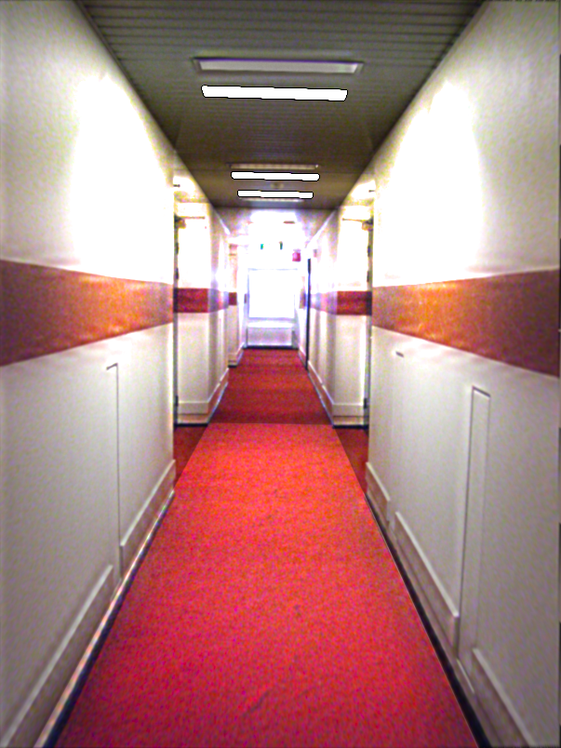
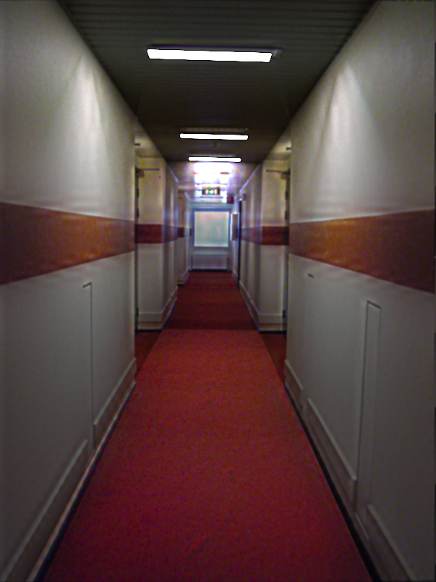
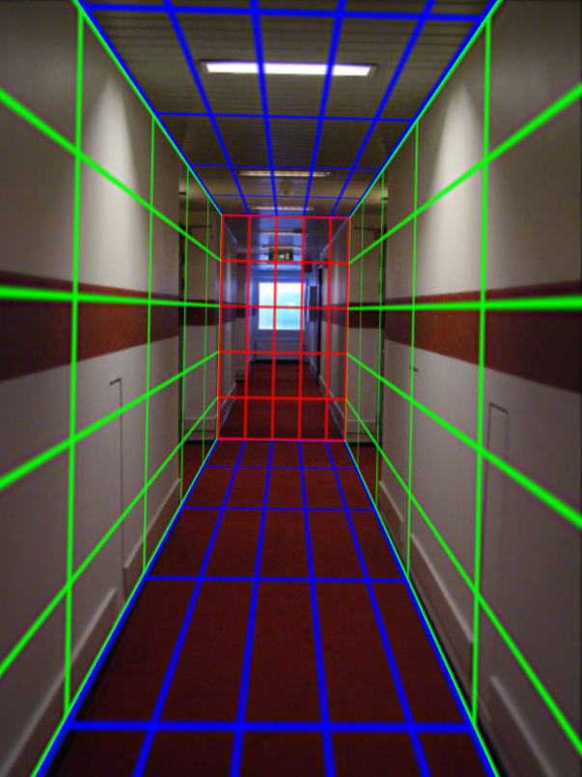
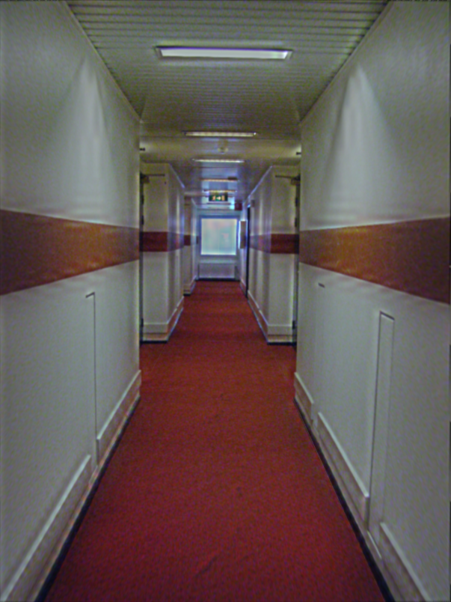
Light refinement
Match original image to rendered image
Match rendered image with input
Trust initial
light parameters

Slide 70

Initial light parameters

Slide 71

Refined light parameters

Slide 72

External light shafts

Slide 73
External light shafts
Source bounding box
Shaft bounding box

Slide 74


External light shafts
Shadow matting via Guo et al. [2011]

Slide 75
External light shafts
How to set direction of the shaft in 3D?
Shaft direction

Slide 76
Setting light shaft direction

Slide 77

Light shaft result

Slide 78
Inserting objects
Representation of geometry, materials and lights is now compatible with 3D modeling software
Two methods of insertion/interaction
  Novice: image space editing
  Professional: 3D modeling tools (e.g. Maya)
Scene rendered with physically based renderer (e.g. LuxRender, Blender’s Cycles)

Slide 79
Blender demo

Slide 80





Final composite
Additive differential technique [Debevec 1998]
composite = M.*R + (1-M).*I + (1-M).*(R-E)*c
effect multiplier
I (background)
composite
R (rendered)
E (empty)
M (mask)

Slide 81
Putting it all together
Video

Slide 82
Research directions
Can we do better with
  Multiple images?
  Videos?
  Depth?
Better scene understanding?
How to insert image fragments?

Slide 83
Most recent version
Karsch et al. 2014: http://vimeo.com/101866891

Slide 84
Summary
We can accurately predict how a 3D object would look in a depicted scene by recovering
  Viewpoint: camera matrix, single view geometry
  Scene geometry: single-view geometry
  Material: “intrinsic image approaches”
  Lighting: solve for lights such that rendering reproduces image
Next classes: interest points, alignment, and stitching

