Slide 1
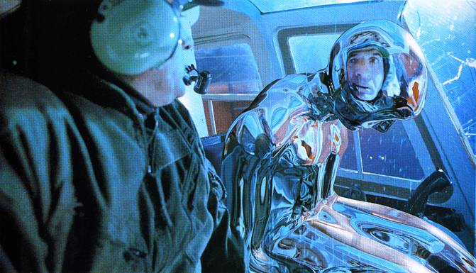
Image-based Lighting
10/17/15
T2
Computational Photography
Derek Hoiem, University of Illinois
Many slides from Debevec, some from Efros

Slide 2
Next week
Derek away for ICCV (Venice)
  Zhizhong and Aditya will teach and hold office hours, etc.
Joe is away this week and next

Slide 3
Next two classes
Today
Start on ray tracing, environment maps, and relighting 3D objects (project 4 topics)
Thursday
More HDR, light probes, etc.

Slide 4
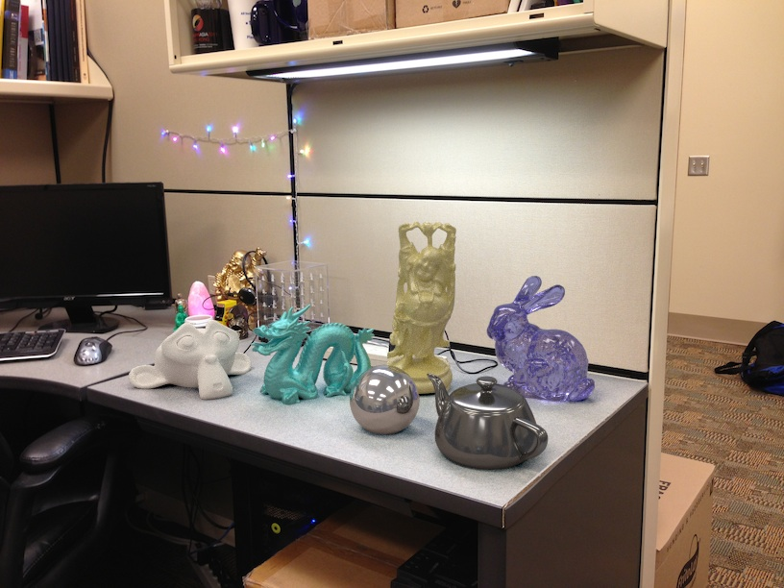
Project 4

Slide 5
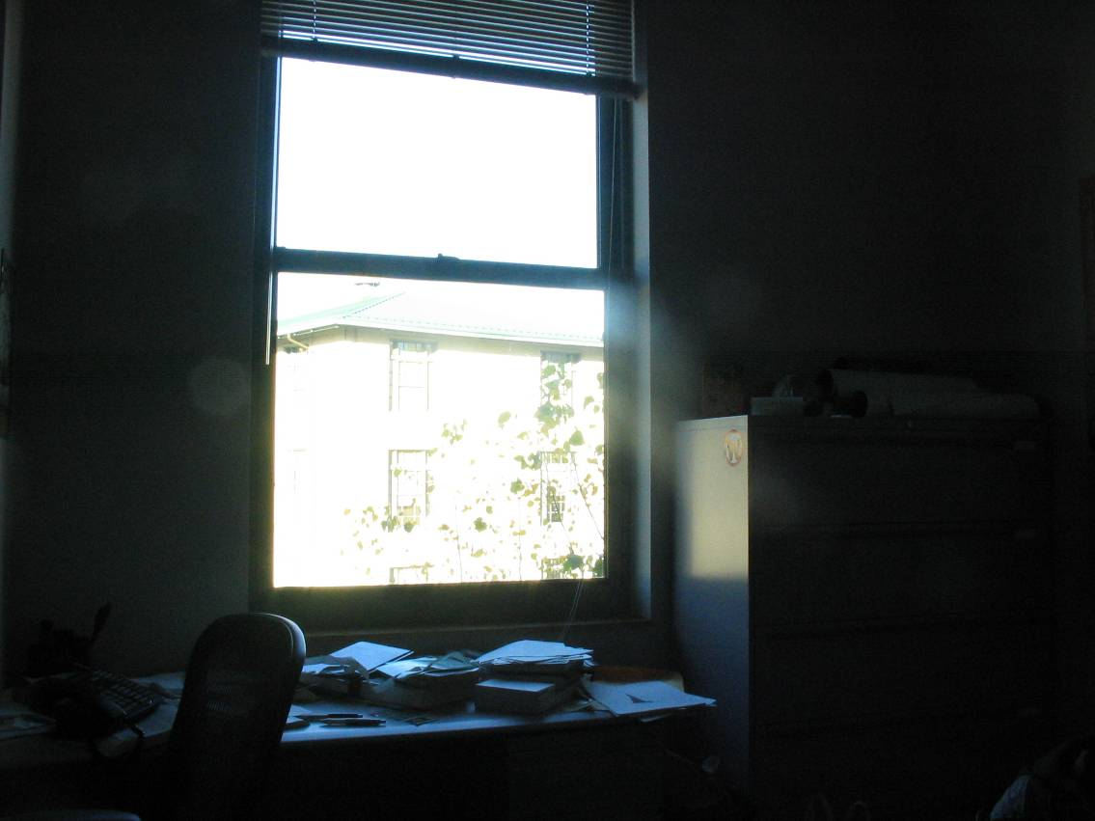
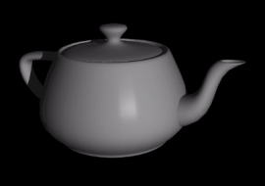
How to render an object inserted into an image?
What’s wrong with the teapot?
Notes:
Lighting, no shadows, blending, etc.

Slide 6
Relighting is important!
http://smashinghub.com/8-of-the-most-epic-government-photoshop-fails-ever.htm
http://petapixel.com/2013/10/13/another-north-korean-photoshop-fail/

Slide 7
How to render an object inserted into an image?
Traditional graphics way
Manually model BRDFs of all room surfaces
Manually model radiance of lights
Do ray tracing to relight object, shadows, etc.
Notes:
Lighting, no shadows, blending, etc.

Slide 8
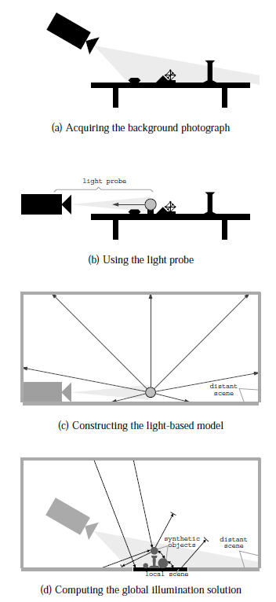
How to render an object inserted into an image?
Image-based lighting
Capture incoming light with a “light probe”
Model local scene
Ray trace, but replace distant scene with info from light probe
Debevec SIGGRAPH 1998

Slide 9


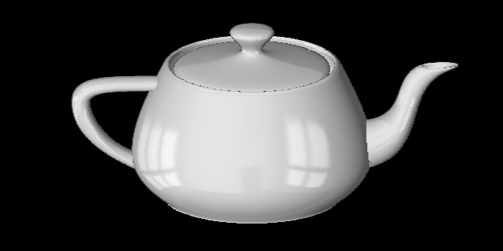
Key ideas for Image-based Lighting
Environment maps: tell what light is entering at each angle within some shell
+

Slide 10
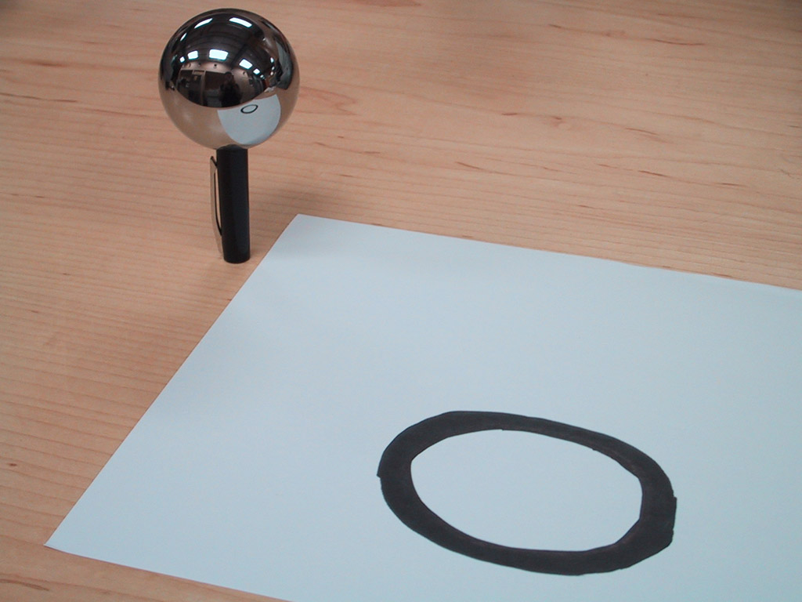
Key ideas for Image-based Lighting
Light probes: a way of capturing environment maps in real scenes

Slide 11
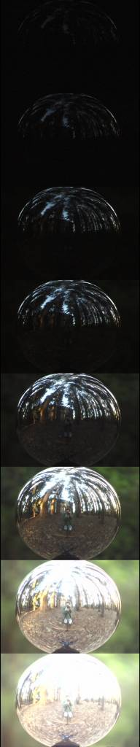
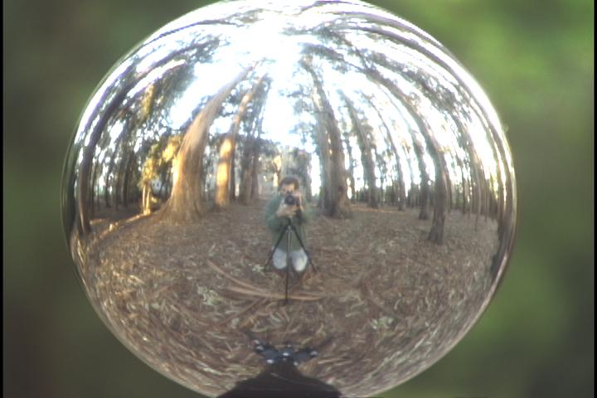
Key ideas for Image-based Lighting
Capturing HDR images: needed so that light probes capture full range of radiance

Slide 12
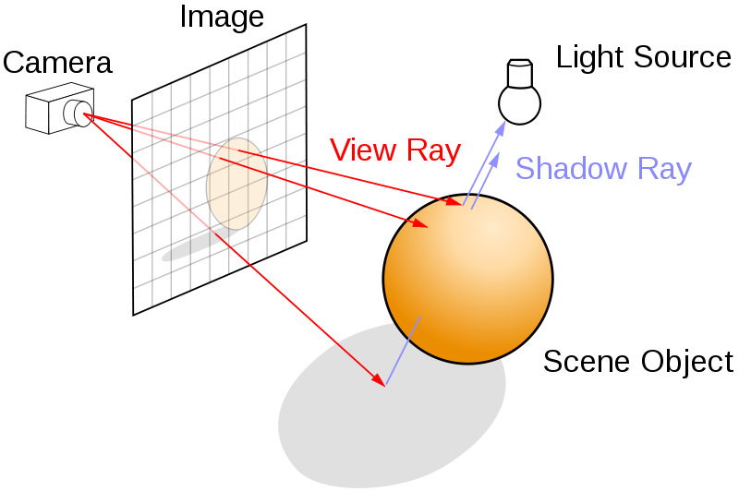
Key ideas for Image-based Lighting
Ray tracing: synthesize light paths between camera and light sources

Slide 13
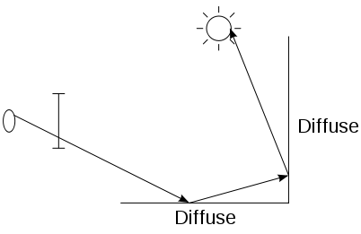
Key ideas for Image-based Lighting
Ray tracing: determining pixel intensity by shooting out rays from the camera

Slide 14
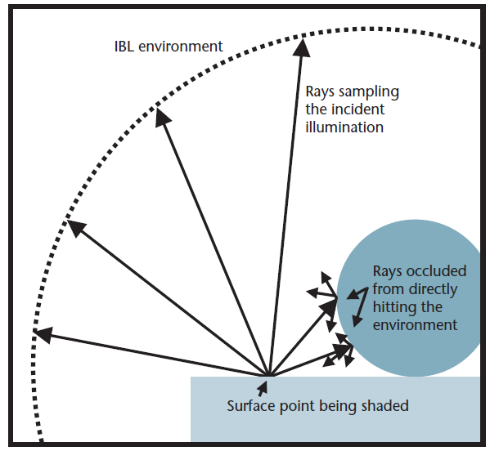
Key ideas for Image-based Lighting
Relighting: environment map acts as light source, substituting for distant scene

Slide 15
Today
Ray tracing
Capturing environment maps

Slide 16
A photon’s life choices
Absorption
Diffusion
Reflection
Transparency
Refraction
Fluorescence
Subsurface scattering
Phosphorescence
Interreflection
light source
λ
?

Slide 17
A photon’s life choices
Absorption
Diffusion
Reflection
Transparency
Refraction
Fluorescence
Subsurface scattering
Phosphorescence
Interreflection
light source
λ

Slide 18
A photon’s life choices
Absorption
Diffuse Reflection
Reflection
Transparency
Refraction
Fluorescence
Subsurface scattering
Phosphorescence
Interreflection
light source
λ

Slide 19
A photon’s life choices
Absorption
Diffusion
Specular Reflection
Transparency
Refraction
Fluorescence
Subsurface scattering
Phosphorescence
Interreflection
light source
λ

Slide 20
A photon’s life choices
Absorption
Diffusion
Reflection
Transparency
Refraction
Fluorescence
Subsurface scattering
Phosphorescence
Interreflection
light source
λ

Slide 21
A photon’s life choices
Absorption
Diffusion
Reflection
Transparency
Refraction
Fluorescence
Subsurface scattering
Phosphorescence
Interreflection
light source
λ

Slide 22
A photon’s life choices
Absorption
Diffusion
Reflection
Transparency
Refraction
Fluorescence
Subsurface scattering
Phosphorescence
Interreflection
light source
λ₁
λ₂

Slide 23
A photon’s life choices
Absorption
Diffusion
Reflection
Transparency
Refraction
Fluorescence
Subsurface scattering
Phosphorescence
Interreflection
light source
λ

Slide 24
A photon’s life choices
Absorption
Diffusion
Reflection
Transparency
Refraction
Fluorescence
Subsurface scattering
Phosphorescence
Interreflection
light source
t=1
t=n

Slide 25
A photon’s life choices
Absorption
Diffusion
Reflection
Transparency
Refraction
Fluorescence
Subsurface scattering
Phosphorescence
Interreflection
light source
λ
(Specular Interreflection)

Slide 26
A photon’s life choices
Absorption
Diffusion
Reflection
Transparency
Fluorescence
Interreflection
Subsurface scattering
Phosphoresence
image plane
light source
camera center
λ
?

Slide 27
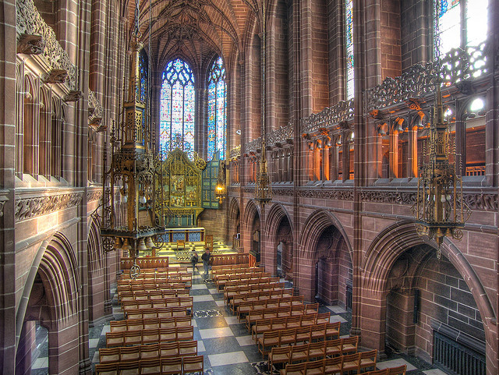
Where are the light sources are in this room?
http://www.flickr.com/photos/chrisdonbavand/493707413/sizes/z/in/photostream/

Slide 28
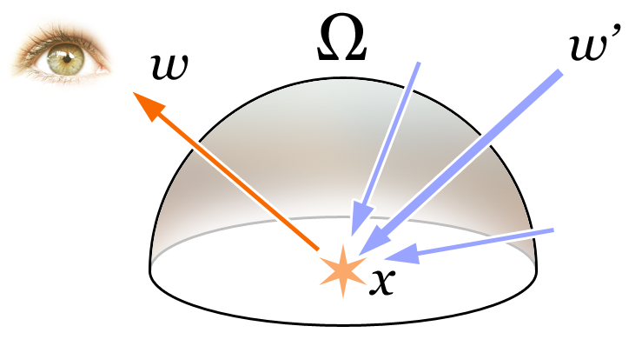
Rendering Equation
Total reflected light
Outgoing light
Generated light
BRDF
Incoming Light
Incident angle

Slide 29
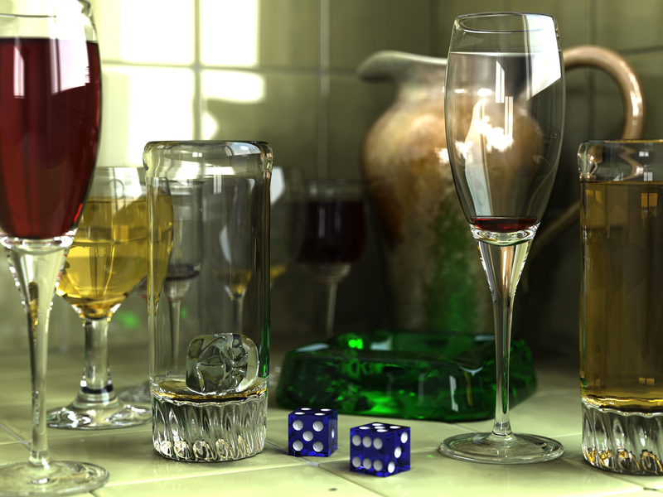
Rendering a scene with ray tracing
http://en.wikipedia.org/wiki/File:Glasses_800_edit.png

Slide 30
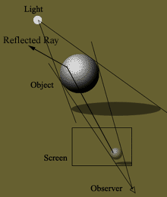
Ray tracing: basics
image plane
light source
camera center
λ

Slide 31
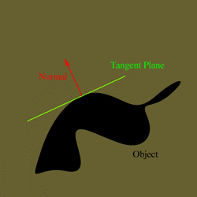
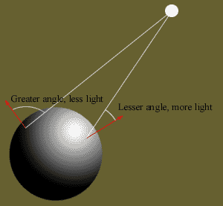
Diffuse shading
http://www.groovyvis.com/other/raytracing/basic.html

Slide 32
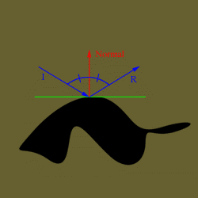
Reflections

Slide 33
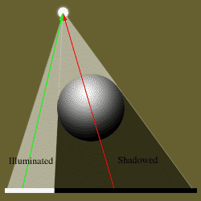
Shadows

Slide 34
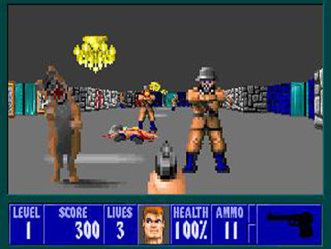
Ray casting
Store colors of surfaces, cast out rays, see what colors each ray hits
Wolfenstein 3D (1992)

Slide 35
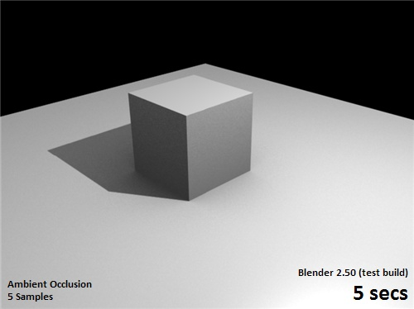
Ray tracing: fast approximation
Upon hitting a surface
Cast reflection/refraction ray to determine reflected or refracted surface
Cast shadow ray: go towards light and see if an object is in the way
http://en.wikipedia.org/wiki/File:Ray_trace_diagram.svg

Slide 36
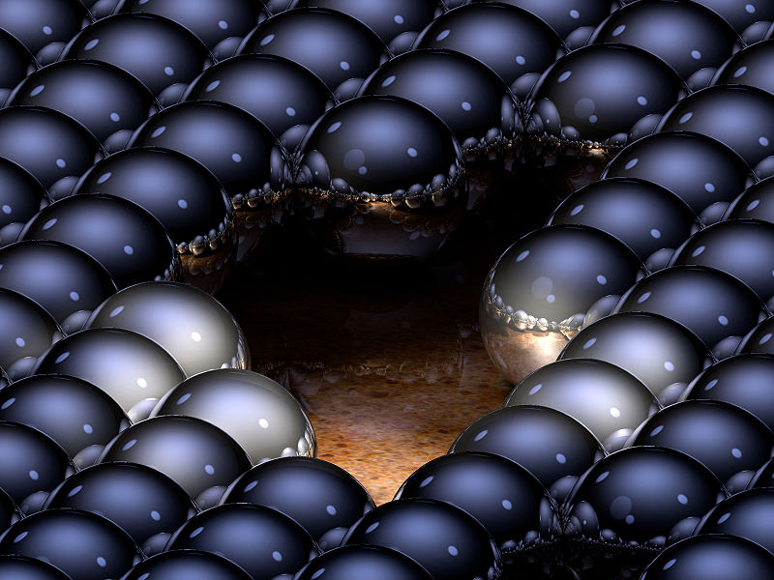
Ray tracing: interreflections
Reflect light N times before heading to light source
N=2
N=16
http://en.wikipedia.org/wiki/Ray_tracing_(graphics)#mediaviewer/File:Ray-traced_steel_balls.jpg

Slide 37
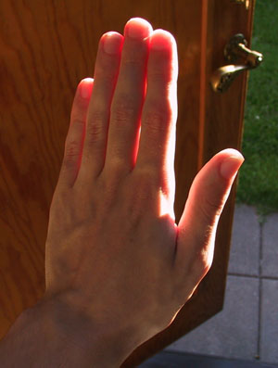
Ray tracing
Conceptually simple but hard to do fast
Full solution requires tracing millions of rays for many inter-reflections
Design choices
  Ray paths: Light to camera vs. camera to light?
  How many samples per pixel (avoid aliasing)?
  How to sample diffuse reflections?
  How many inter-reflections to allow?
  Deal with subsurface scattering, etc?

Slide 38
Environment Maps
The environment map may take various forms:
  Cubic mapping
  Spherical mapping
  other
Describes the shape of the surface on which the map “resides”
Determines how the map is generated and how it is indexed

Slide 39
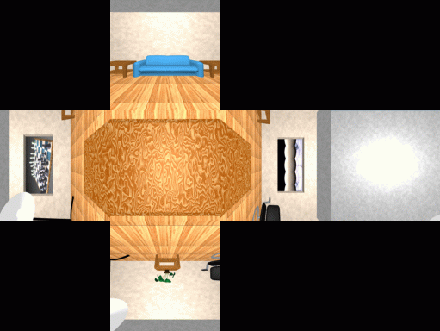
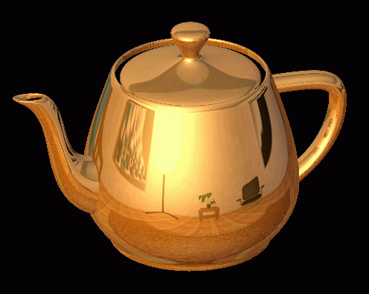
Cubic Map Example

Slide 40
Cubic Mapping
The map resides on the surfaces of a cube around the object
  Typically, align the faces of the cube with the coordinate axes
To generate the map:
  For each face of the cube, render the world from the center of the object with the cube face as the image plane
    Rendering can be arbitrarily complex (it’s off-line)
To use the map:
  Index the R ray into the correct cube face
  Compute texture coordinates

Slide 41
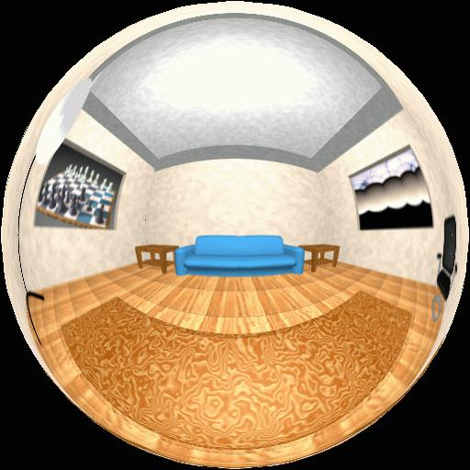
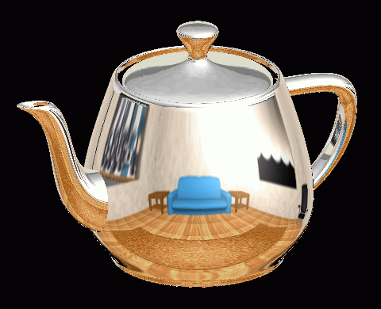
Spherical Map Example

Slide 42
Sphere mapping
Map lives on a sphere
To generate the map:
  Render a spherical panorama from the designed center point
Rendering with environment map:
  Use the orientation of the R ray to index directly into the sphere

Slide 43
What approximations are made?
The map should contain a view of the world with the point of interest on the object as the Center of Projection
  We can’t store a separate map for each point, so one map is used with the COP at the center of the object
  Introduces distortions in the reflection, but we usually don’t notice
  Distortions are minimized for a small object in a large room
The object will not reflect itself (based on the environment map)

Slide 44
Rendering with environment maps and local models
image plane
camera center

Slide 45
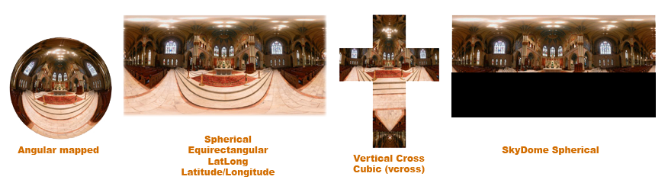
Storing spherical environment maps

Slide 46
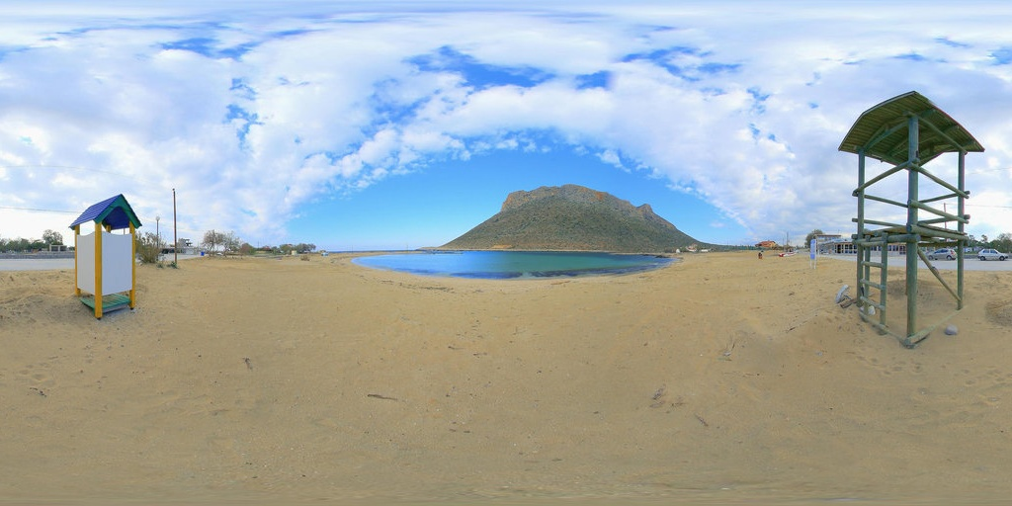
Equirectangular (latitude-longitude) projection

Slide 47
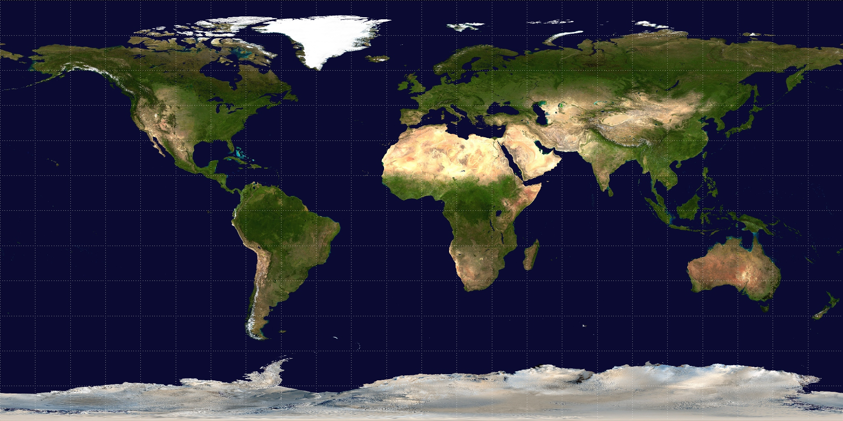
Equirectangular (latitude-longitude) projection

Slide 48
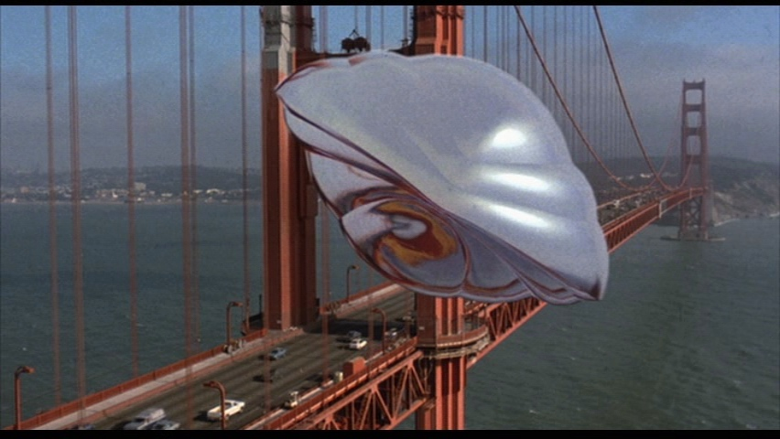
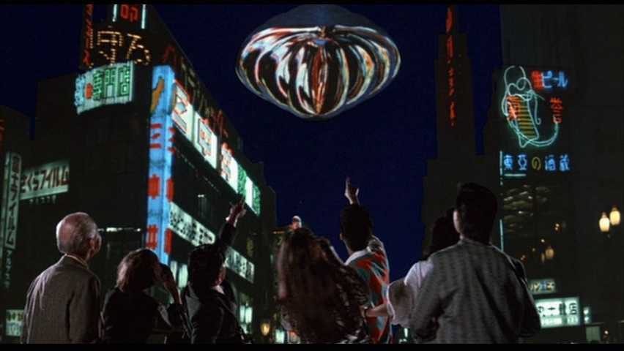
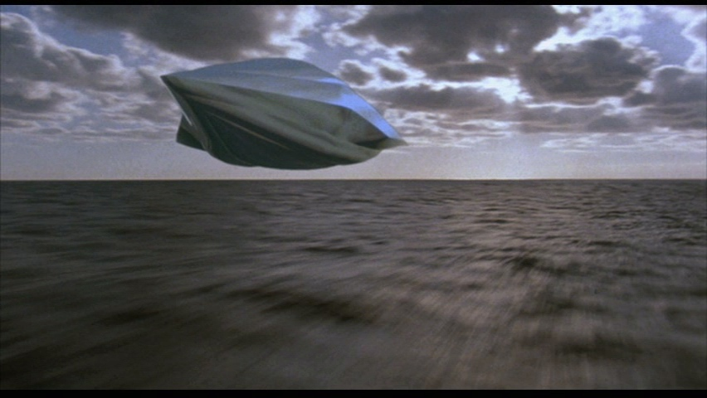
How to capture light in real scenes?
From Flight of the Navigator

Slide 49
How to capture light in real scenes?
from Terminator 2

Slide 50
Real environment maps
We can use photographs to capture environment maps
  The first use of panoramic mosaics
  Fisheye lens
  Mirrored balls (light probes)

Slide 51
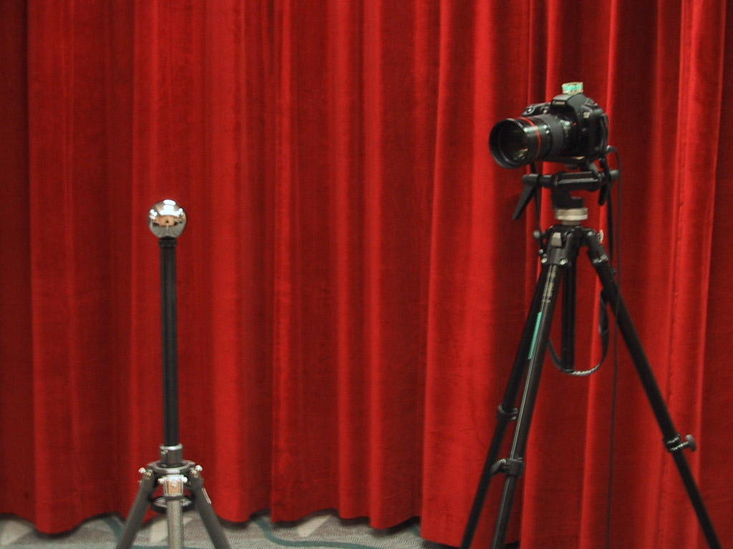
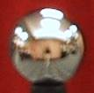
Mirrored Sphere

Slide 52
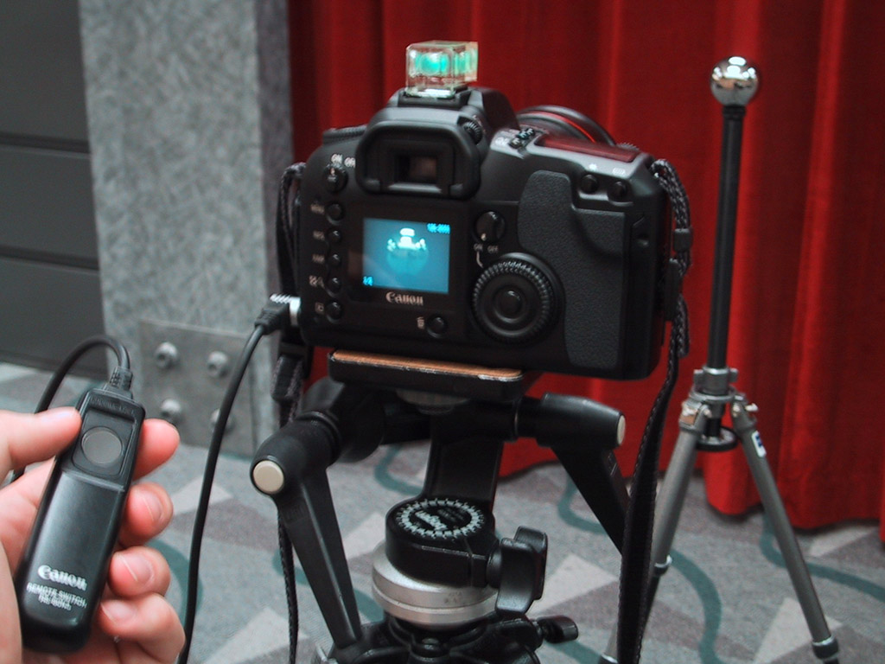

Slide 53
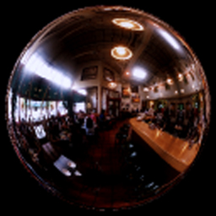
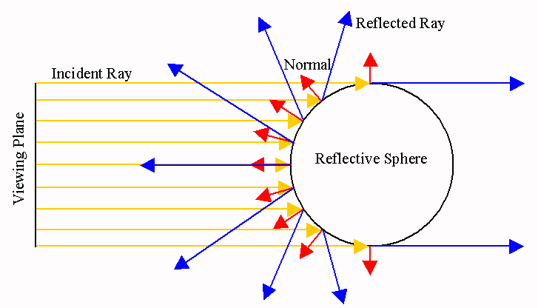

Slide 54
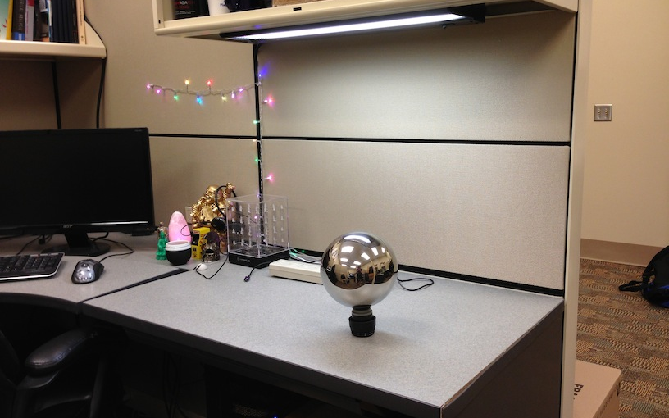
Mirror balls for image-based lighting

Slide 55
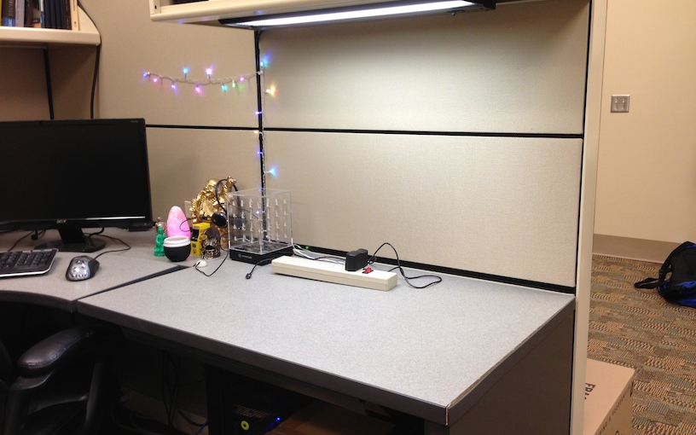
Mirror balls for image-based lighting

Slide 56
Mirror balls for image-based lighting

Slide 57
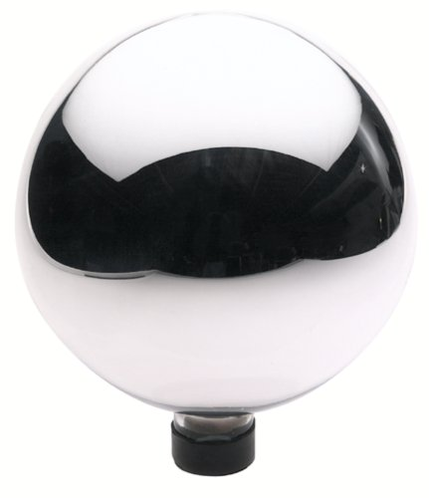
Sources of Mirrored Balls
2-inch chrome balls ~ $20 ea.
  McMaster-Carr Supply Company
  www.mcmaster.com
6-12 inch large gazing balls
  Baker’s Lawn Ornaments
  www.bakerslawnorn.com
Hollow Spheres, 2in – 4in
  Dube Juggling Equipment
  www.dube.com
FAQ on www.debevec.org/HDRShop/

Slide 58
0.34
=> 59% Reflective
Calibrating Mirrored Sphere Reflectivity
0.58

Slide 59
Spherical map domain transformations
Many rendering programs only accept one format (mirror ball, equirectangular, cube map, etc)
  E.g. Blender only accepts equirectangular maps
How to convert mirror ball to equirectangular?

Slide 60
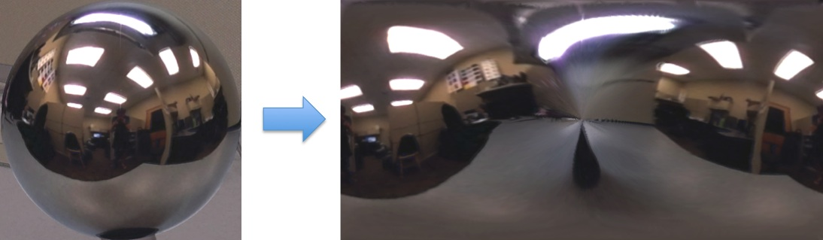
Mirror ball -> equirectangular

Slide 61
Mirror ball -> equirectangular
Spherical coordinates
  Convert the light directions incident to the ball into spherical coordinates (phi, theta)
  Map from mirror ball phi, theta to equirectangular phi, theta
for i=1:d
F = TriScatteredInterp(phi_ball, theta_ball, mirrorball(:,:,i));
latlon(:,:,i) = F(phi_latlon, theta_latlon);
end

Slide 62
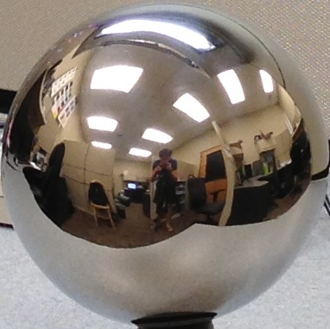


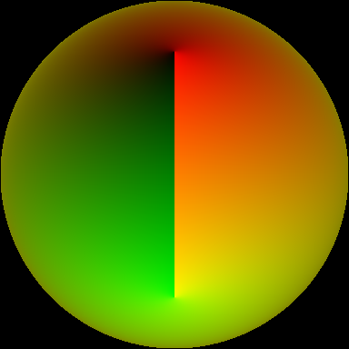
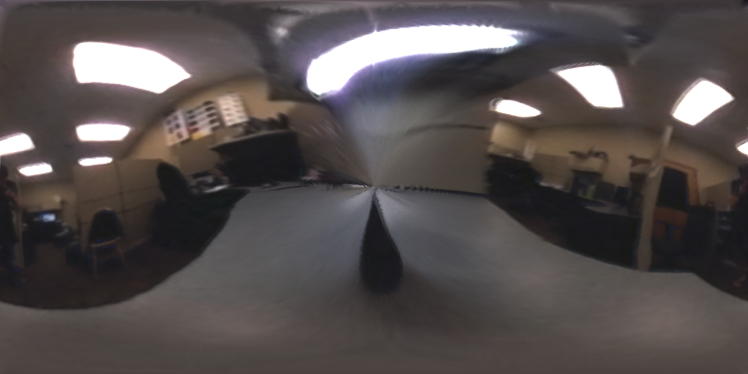

Mirror ball -> equirectangular
Mirror ball
Normals
Reflection
vectors
Phi/theta of reflection vecs
Equirectangular
Phi/theta equirectangular domain

Slide 63
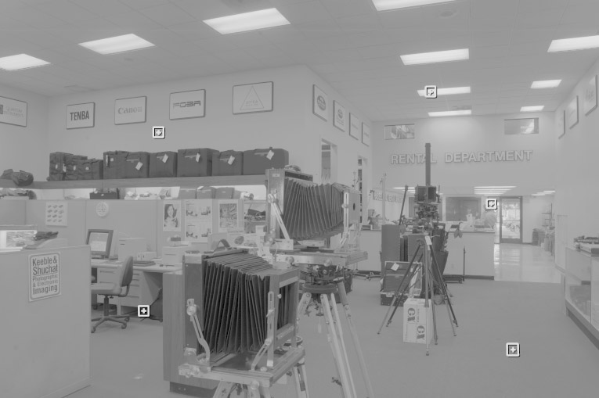
One small snag
How do we deal with light sources? Sun, lights, etc?
  They are much, much brighter than the rest of the environment
1907
.
46
.
.
15116
1
.
.
18

Slide 64
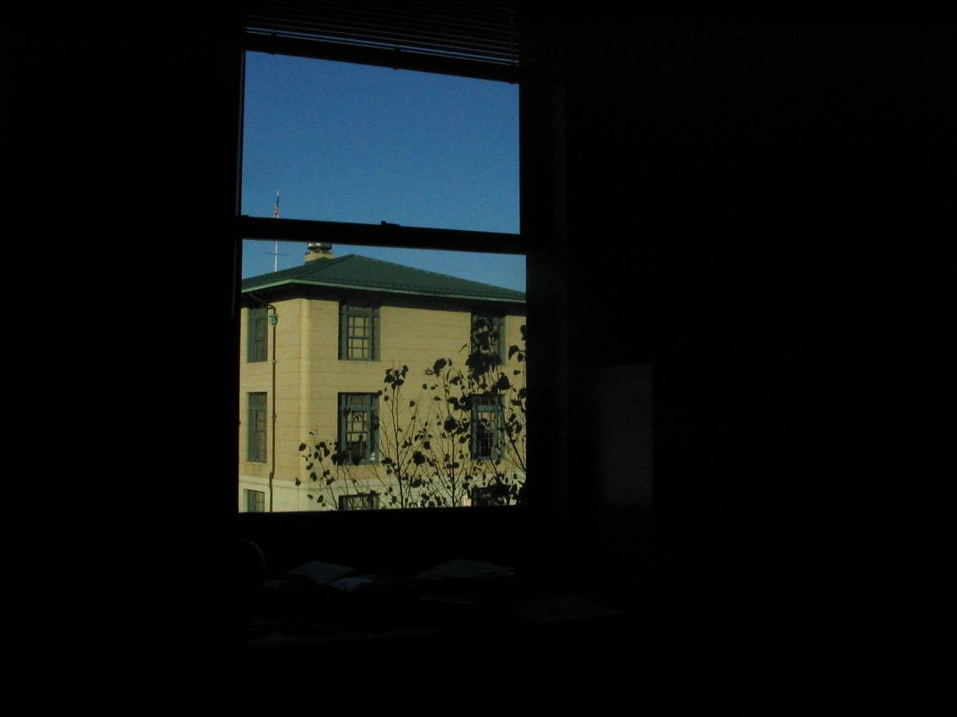
Problem: Dynamic Range

Slide 65
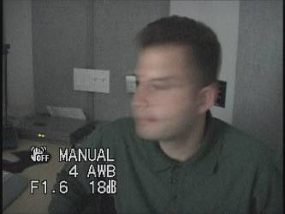
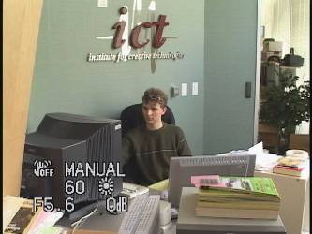



Problem: Dynamic Range
1
The real world is
high dynamic range.
1500
25,000
400,000
2,000,000,000

Slide 66
Long Exposure
10⁻⁶
High dynamic range
10⁶
Real world
10⁻⁶
10⁶
Picture
^{0 to 255}

Slide 67
Short Exposure
10⁻⁶
High dynamic range
10⁶
Real world
10⁻⁶
10⁶
Picture
^{0 to 255}

Slide 68
Camera Calibration
Geometric
  How pixel coordinates relate to directions in the world
Photometric
  How pixel values relate to radiance amounts in the world

Slide 69
The Image Acquisition Pipeline
Lens
Shutter
Film
scene
radiance
(W/sr/m )
sensor
irradiance
∫
sensor
exposure
latent
image
2
Δt
Electronic Camera
Development
CCD
ADC
Remapping
film
density
analog
voltages
digital
values
pixel
values
Notes:
3

Slide 70
Imaging system response function
255
Pixel
value
0
log Exposure = log (Radiance * Δt)
(CCD photon count)
Notes:
1

Slide 71

Varying Exposure

Slide 72
Camera is not a photometer!
Limited dynamic range
  Perhaps use multiple exposures?
Unknown, nonlinear response
  Not possible to convert pixel values to radiance
Solution:
  Recover response curve from multiple exposures, then reconstruct the radiance map
Notes:
4

Slide 73
Next class
How to capture HDR image using “bracketing”
How to relight an object from an environment map

