Slide 1
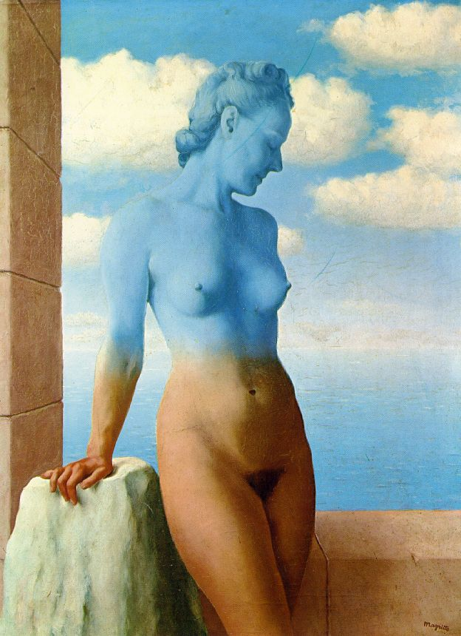
Blending and Compositing
09/26/17
Computational Photography
Derek Hoiem, University of Illinois

Slide 2
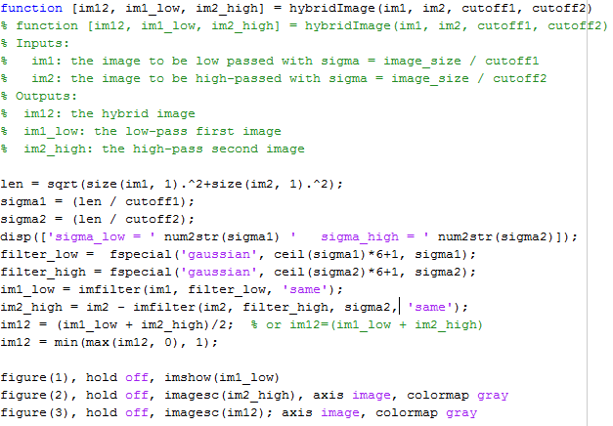
hybridImage.m

Slide 3
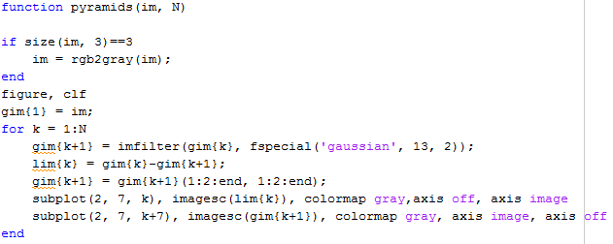
pyramids.m

Slide 4
Project 1: issues
Basic tips
  Display/save Laplacian images using mat2gray or imagesc (imshow is only for normal images)
  Downsampling: use sigma ~= 2 for factor of 2

Slide 5
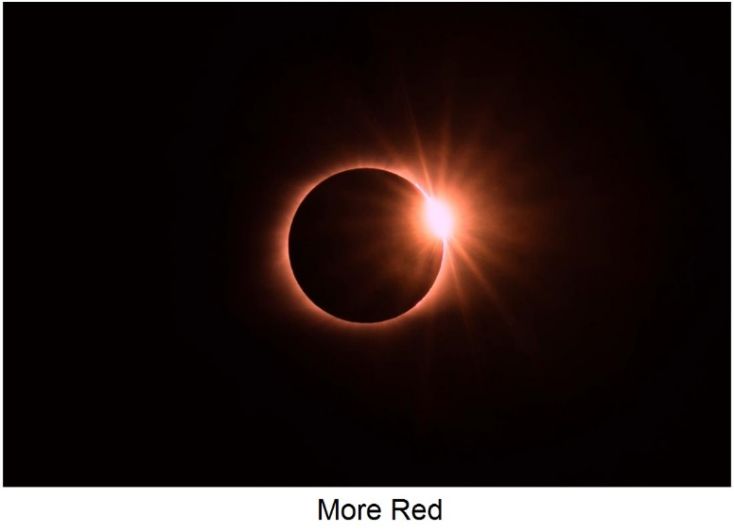
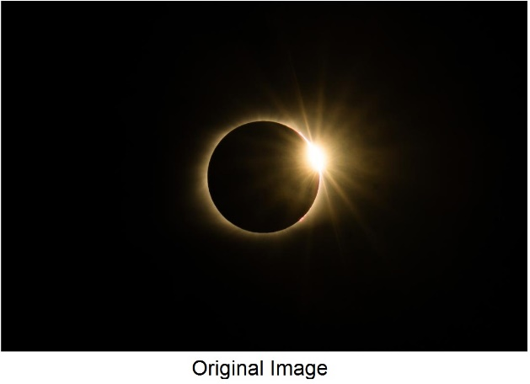
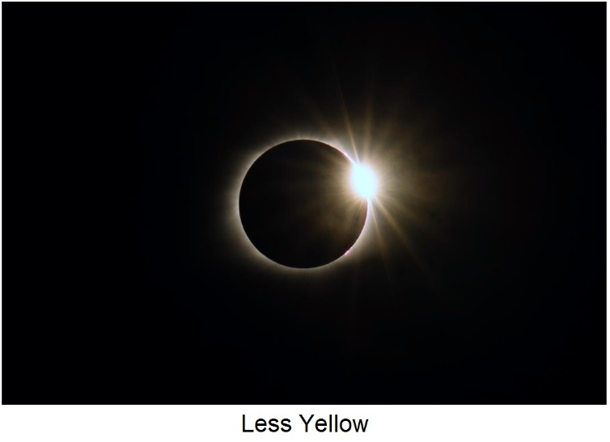
Color shift
Result from Sihao Chen
More red (increase positive a channel values)
L*a*b* space
Less yellow (decrease positive b channel values)

Slide 6
Project 1 Results
Incomplete list of great project pages
  http://xiaoyan5.web.engr.illinois.edu/cs445/proj1/ (Xiaoyan Wang: most likes)
  http://tgurtler.web.engr.illinois.edu/cs445/proj1/
  http://schen149.web.engr.illinois.edu/cs445/proj1/
  http://kurtovc2.web.engr.illinois.edu/cs445/proj1/
  http://jdrynld2.web.engr.illinois.edu/cs445/proj1/
  http://mscraft2.web.engr.illinois.edu/cs445/proj1/
  http://trrscld2.web.engr.illinois.edu/cs445/proj1/

Slide 7
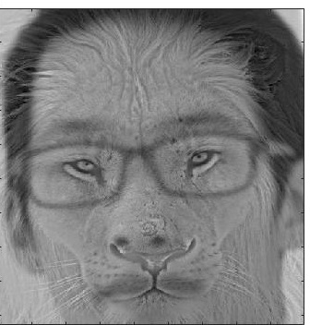


Hybrid results
Sihao Chen

Slide 8
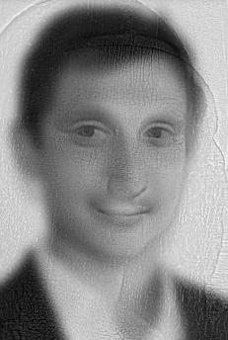
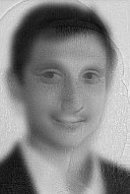
jdrynld2

Slide 9
Last class: finding boundaries
Intelligent scissors
  Good boundary has a low-cost path from seed to cursor
  Low cost = edge, high gradient, right orientation
GrabCut
  Good region is similar to foreground color model and dissimilar from background color
  Good boundaries have a high gradient
  Optimize over both

Slide 10
Take-home questions
1. What would be the result in “Intelligent Scissors” if all of the edge costs were set to 1?
2. How could you change boundary costs for graph cuts to work better for objects with many thin parts?

Slide 11
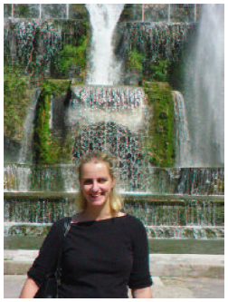
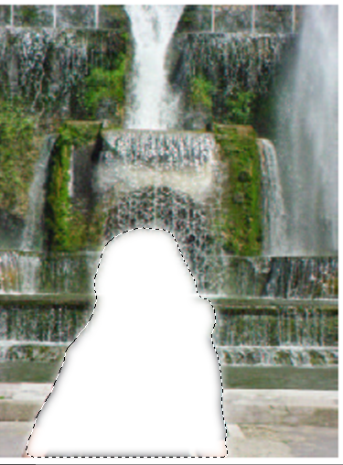
Last Class: cutting out objects

Slide 12
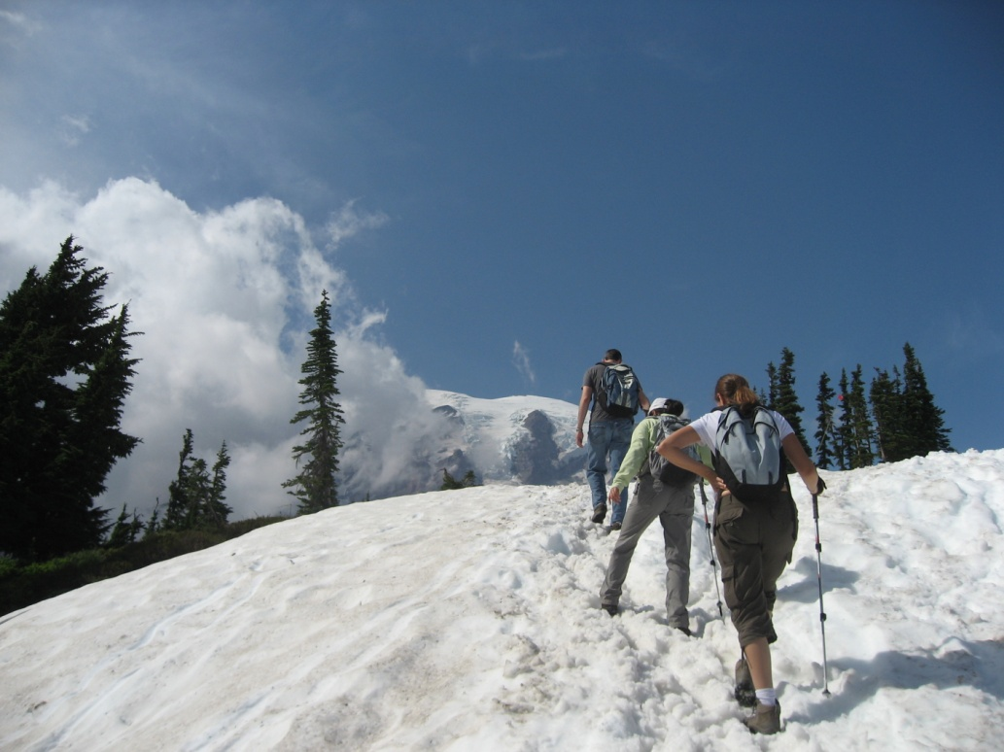
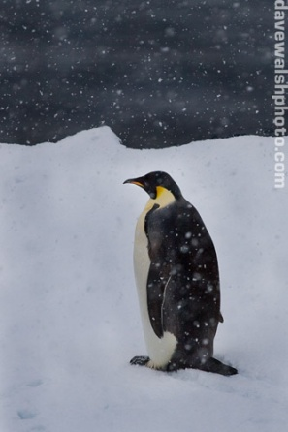
This Class
How do I put an object from one image into another?

Slide 13
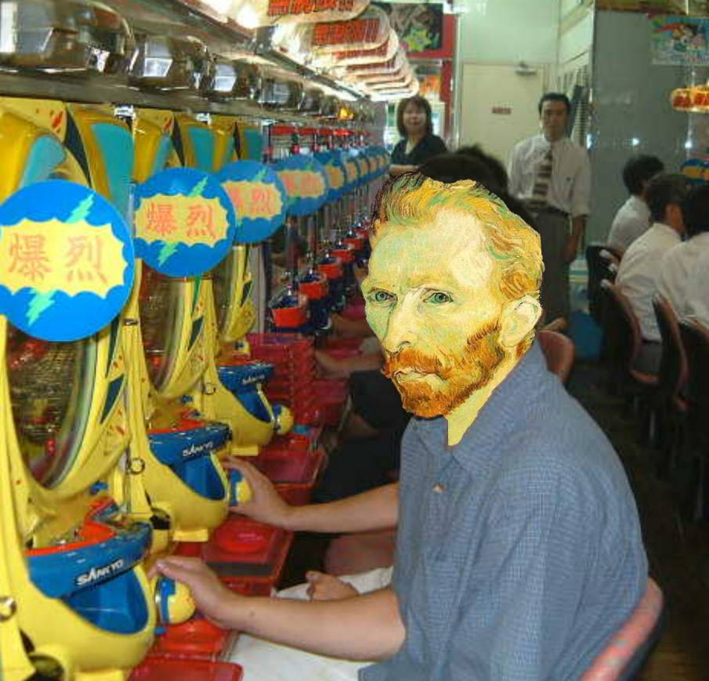
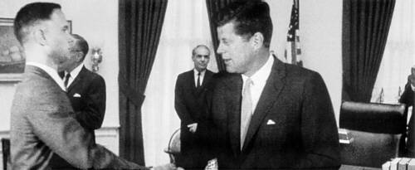
Image Compositing
Some slides from Efros/Seitz

Slide 14
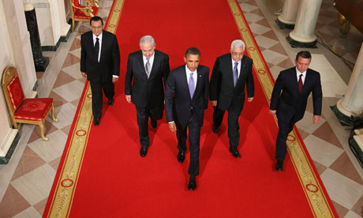
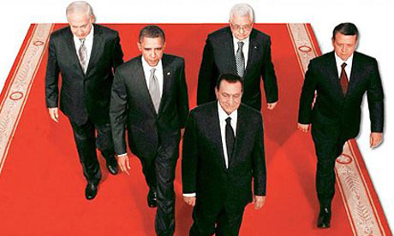
News Composites
http://www.guardian.co.uk/world/2010/sep/16/mubarak-doctored-red-carpet-picture
Original
“Enhanced” Version

Slide 15
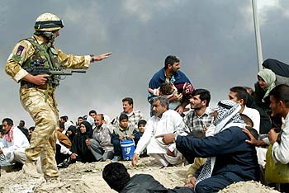
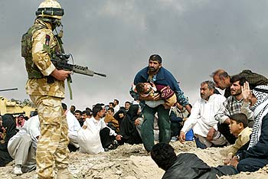
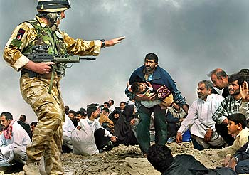
News Composites
Original
“Enhanced” Version
Walski, LA Times, 2003

Slide 16
Three methods
Cut and paste
Laplacian pyramid blending
Poisson blending

Slide 17
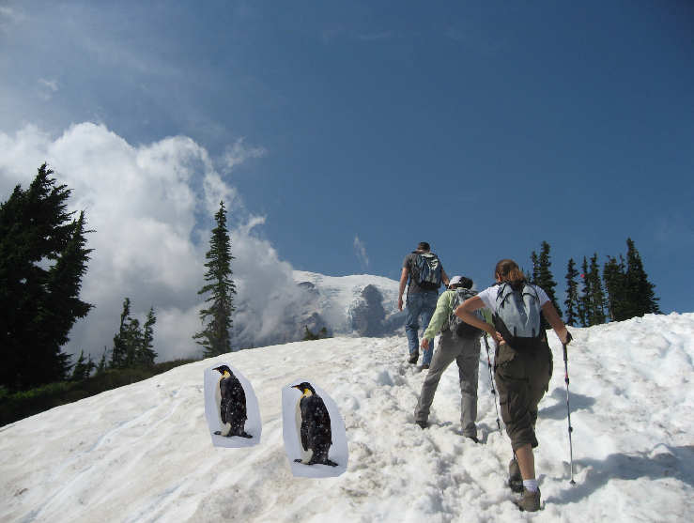
Method 1: Cut and Paste

Slide 18
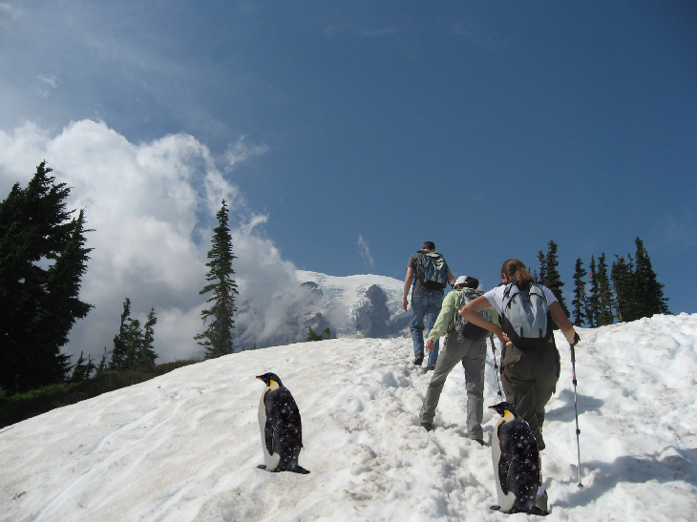
Method 1: Cut and Paste
Method:
Segment using intelligent scissors
Paste foreground pixels onto target region

Slide 19
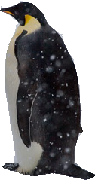
Method 1: Cut and Paste
Problems:
Small segmentation errors noticeable
Pixels are too blocky
Won’t work for semi-transparent materials

Slide 20
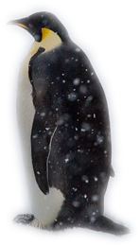
Feathering
Near object boundary pixel values come partly from foreground and partly from background

Slide 21
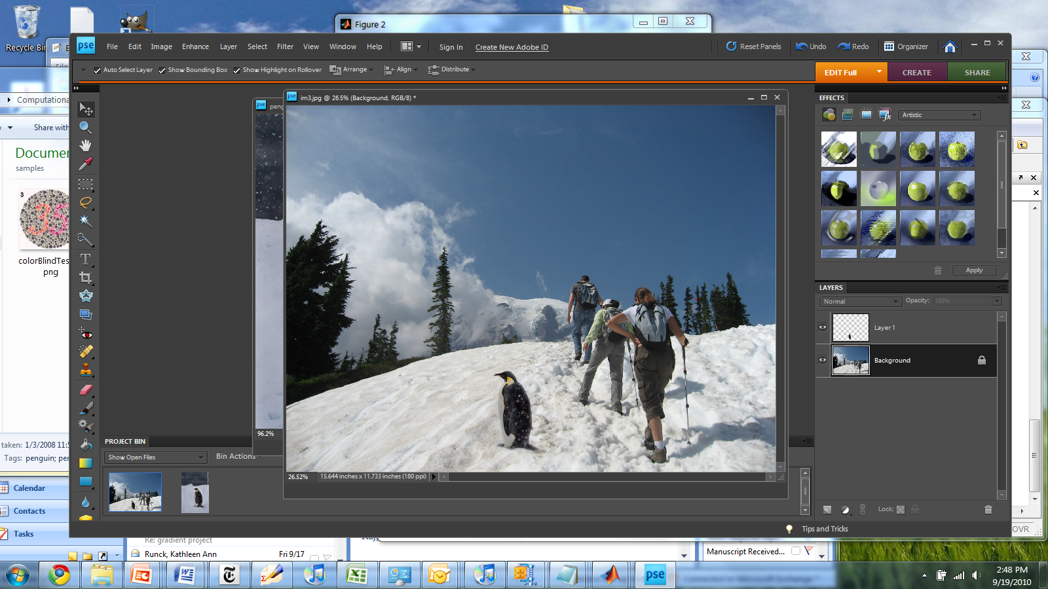
Method 1: Cut and Paste (with feathering)

Slide 22
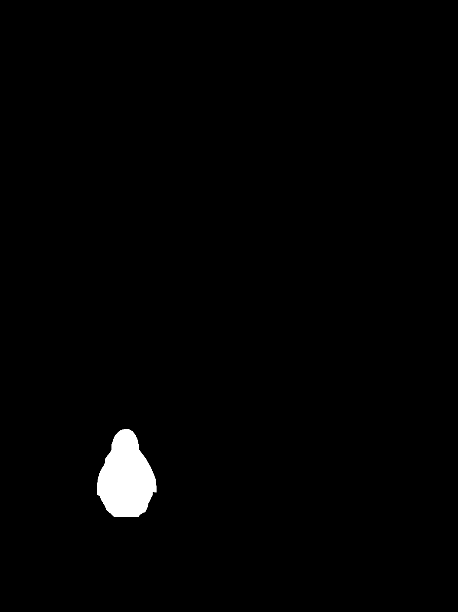
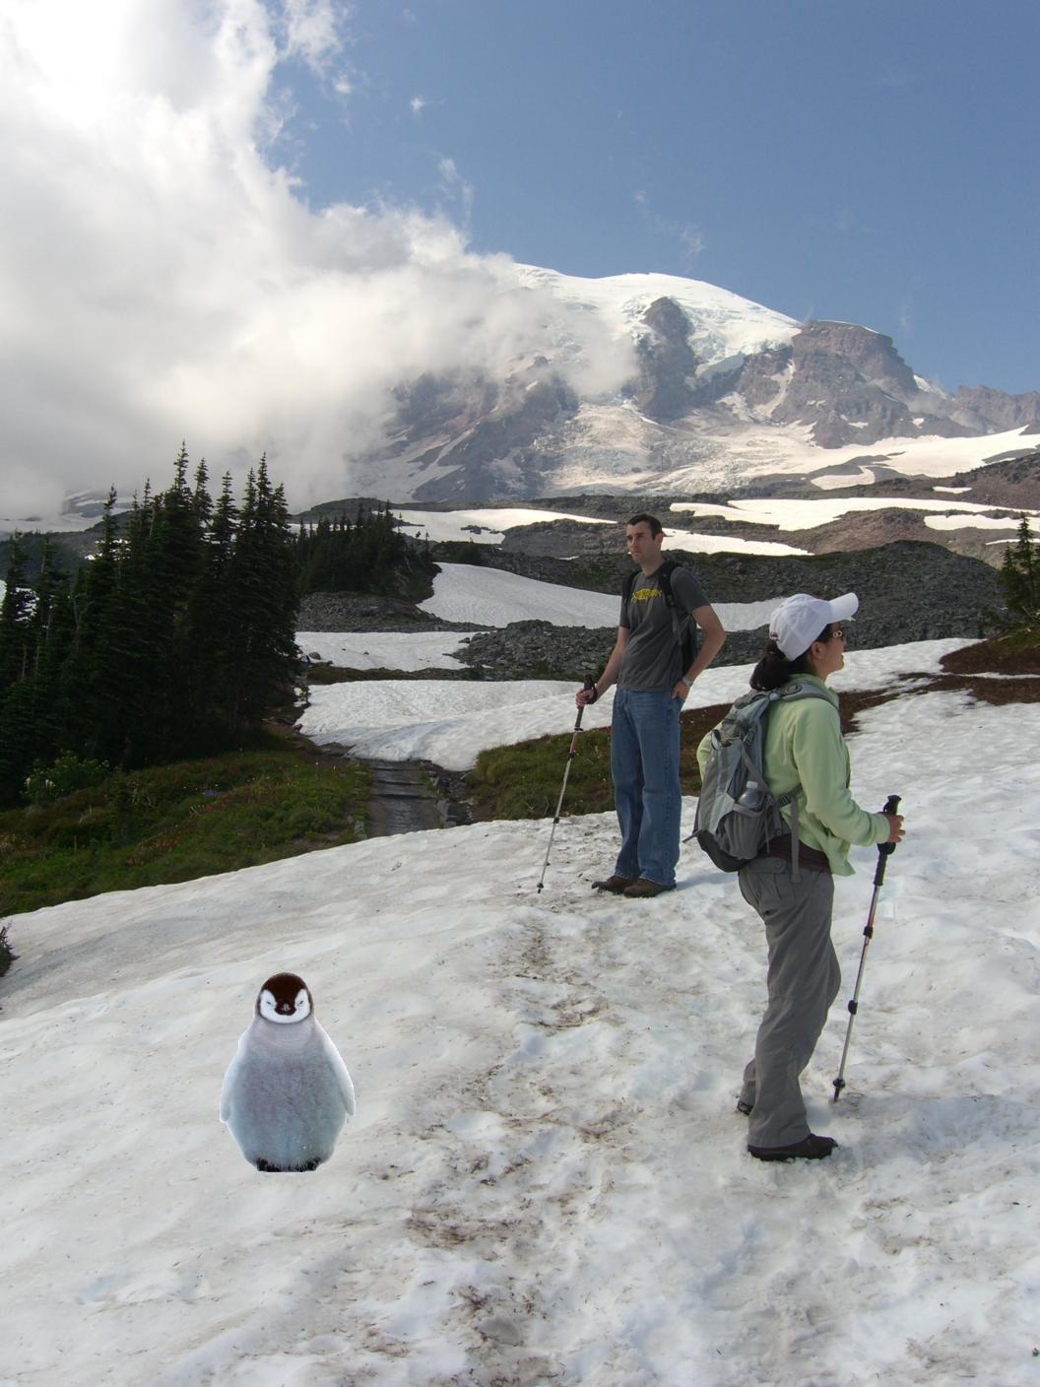
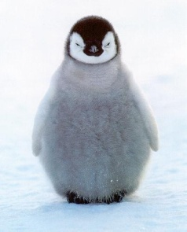
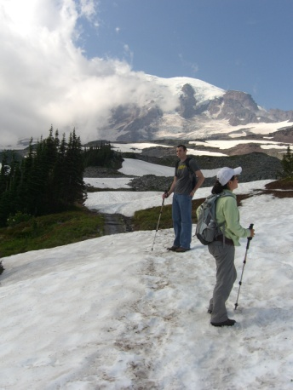
Alpha compositing
+
Output = foreground*mask + background*(1-mask)

Slide 23


Alpha compositing with feathering
Output = foreground*mask + background*(1-mask)

Slide 24
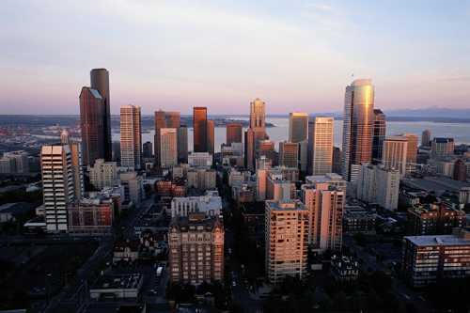

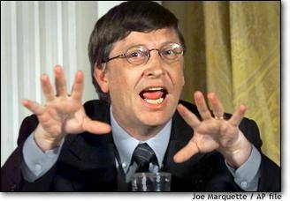

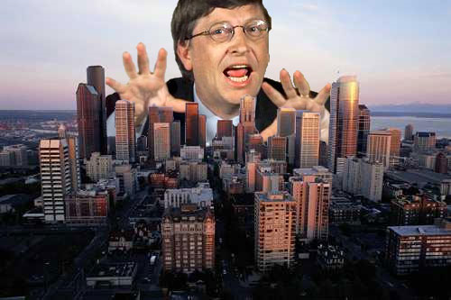
Another example (without feathering)
Mattes
Composite
Composite by
David Dewey

Slide 25
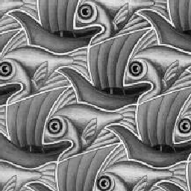
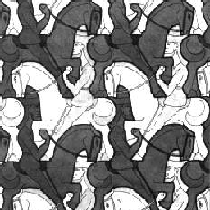
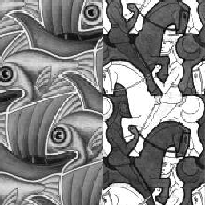
Proper blending is key

Slide 26
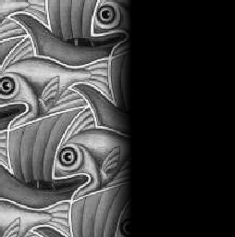
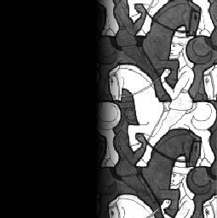

Alpha Blending / Feathering
+
1
1
0
0
I_{blend} = αI_{left} + (1-α)I_{right}
=

Slide 27
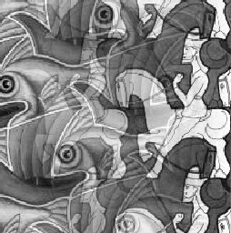
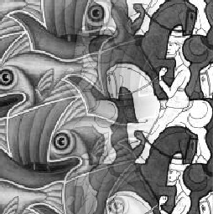
Effect of Window Size
1
left
1
right
0
0

Slide 28


Effect of Window Size
1
1
0
0

Slide 29

Good Window Size
1
0
“Optimal” Window: smooth but not ghosted

Slide 30
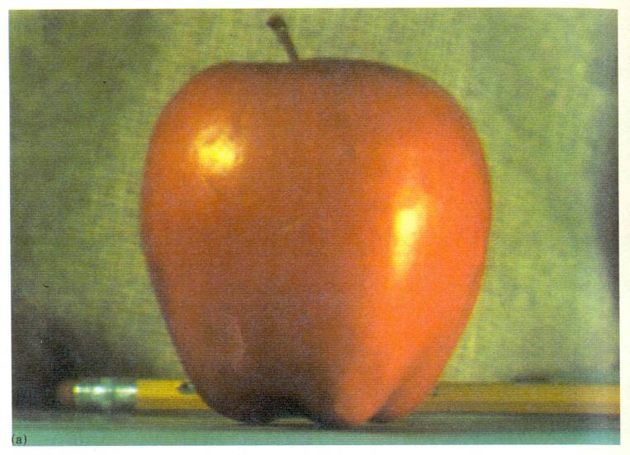
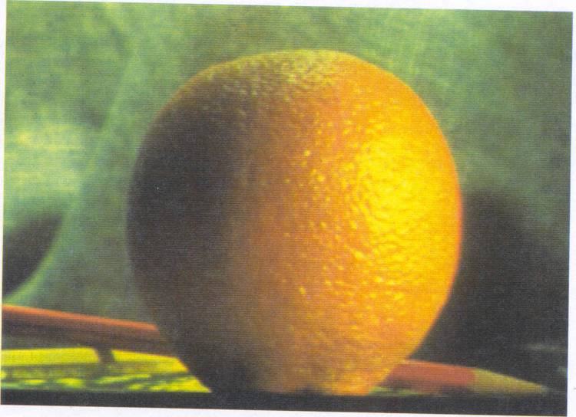
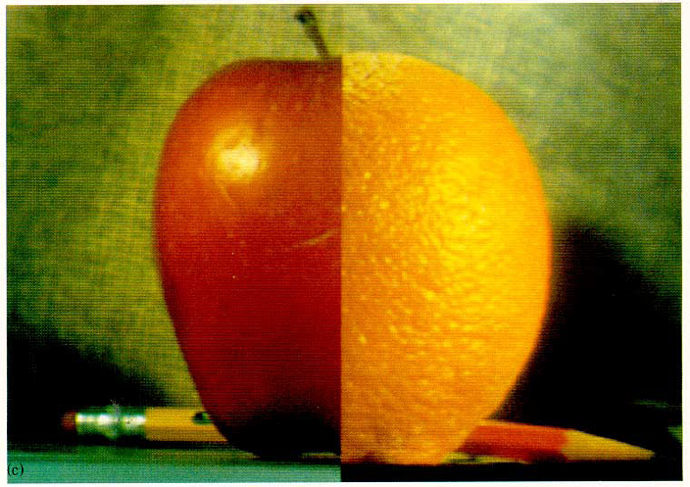
How much should we blend?

Slide 31
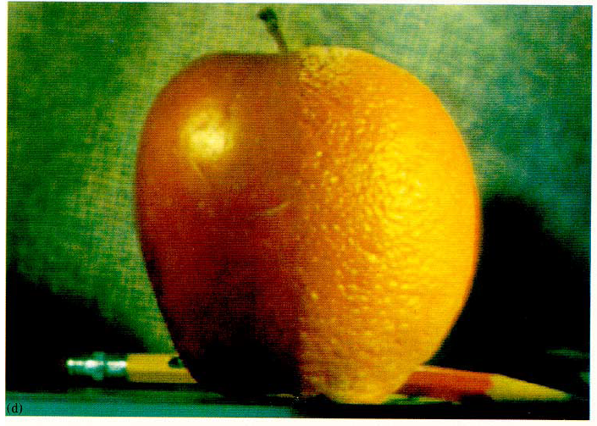
Method 2: Pyramid Blending

Slide 32
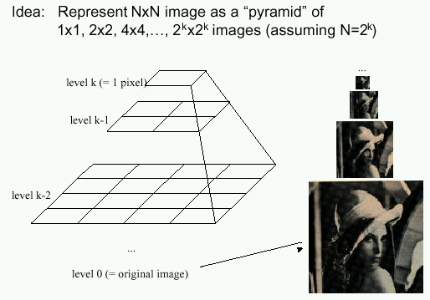
Method 2: Pyramid Blending
At low frequencies, blend slowly
At high frequencies, blend quickly
1
0
1
0
1
0
Left pyramid
blend
Right pyramid

Slide 33
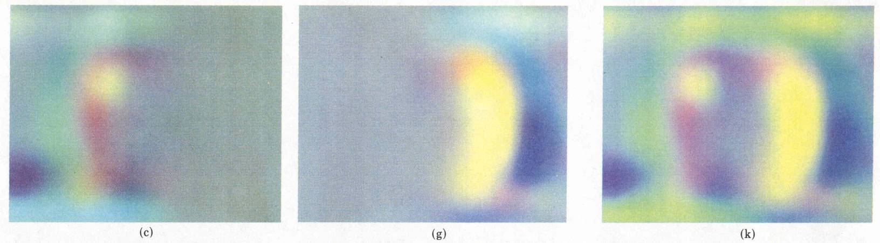
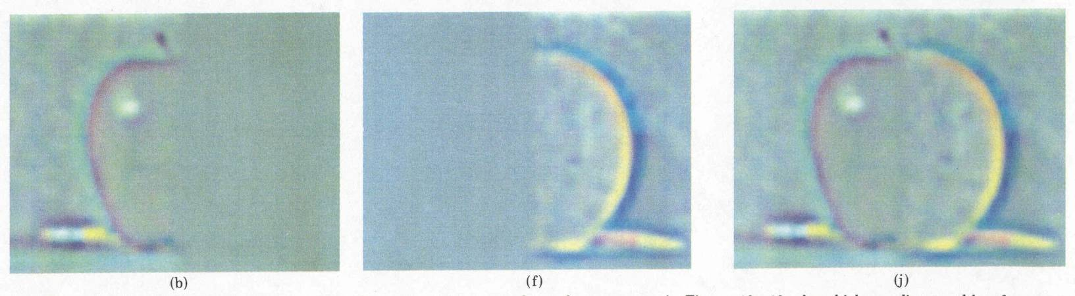
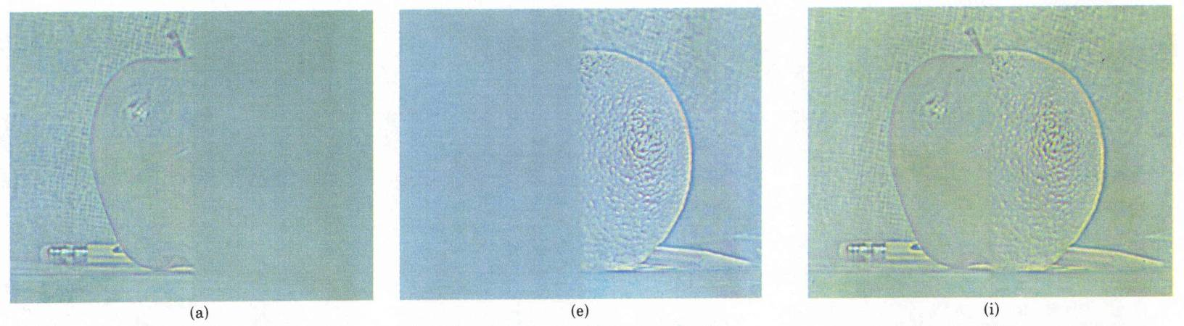
laplacian
level
4
laplacian
level
2
laplacian
level
0
left pyramid
right pyramid
blended pyramid

Slide 34
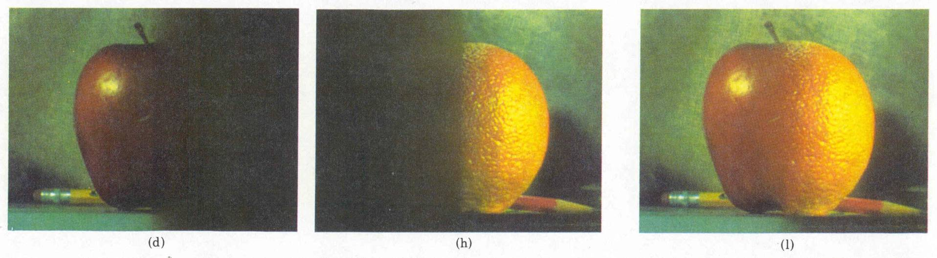
Method 2: Pyramid Blending
Burt and Adelson 1983

Slide 35
Laplacian Pyramid Blending
Implementation:
Build Laplacian pyramids for each image
Build a Gaussian pyramid of region mask
Blend each level of pyramid using region mask from the same level
Collapse the pyramid to get the final blended image
Image 1 at level i of Laplacian pyramid
Region mask at level i of Gaussian pyramid
Pointwise multiply
Burt and Adelson 1983

Slide 36
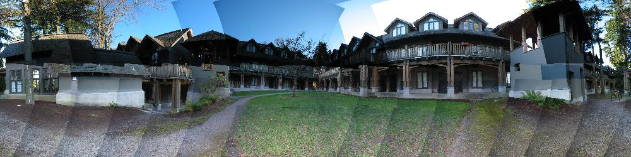
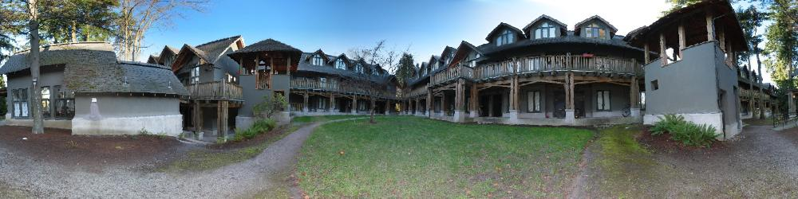
Simplification: Two-band Blending
Brown & Lowe, 2003
  Only use two bands: high freq. and low freq.
  Blends low freq. smoothly
  Blend high freq. with no smoothing: use binary alpha

Slide 37


2-band Blending
Low frequency
High frequency

Slide 38

Linear Blending

Slide 39

2-band Blending

Slide 40

Blending Regions

Slide 41

© Chris Cameron

Slide 42

Related idea: Poisson Blending
A good blend should preserve gradients of source region without changing the background
Perez et al. 2003

Slide 43
Related idea: Poisson Blending
A good blend should preserve gradients of source region without changing the background
Project 3!
Perez et al. 2003

Slide 44
Method 3: Poisson Blending
A good blend should preserve gradients of source region without changing the background
Treat pixels as variables to be solved
  Minimize squared difference between gradients of foreground region and gradients of target region
  Keep background pixels constant
Perez et al. 2003
Notes:
Draw on board

Slide 45


Example
Gradient Visualization
Source: Evan Wallace

Slide 46



+
Specify object region
Source: Evan Wallace

Slide 47

Gradient-domain editing
Creation of image = least squares problem in terms of: 1) pixel intensities; 2) differences of pixel intensities
Use Matlab least-squares solvers for numerically stable solution with sparse A
Least Squares Line Fit in 2 Dimensions

Slide 48
Examples
Line-fitting: y=mx+b

Slide 49
Examples
2. Gradient domain processing
source image
background image
target image
1
5
9
13
1
5
9
13
1
5
9
13
20 | 20 | 20 | 20
20 | 80 | 20 | 20
20 | 20 | 80 | 20
20 | 20 | 20 | 20
10 | 10 | 10 | 10
10 | 10 | 10 | 10
10 | 10 | 10 | 10
10 | 10 | 10 | 10
10 | 10 | 10 | 10
10 | v₁ | v₃ | 10
10 | v₂ | v₄ | 10
10 | 10 | 10 | 10
2
6
10
14
2
6
10
14
2
6
10
14
3
7
11
15
3
7
11
15
3
7
11
15
4
8
12
16
4
8
12
16
4
8
12
16

Slide 50


Other results
Perez et al. 2003

Slide 51
What do we lose?
Foreground color changes
Background pixels in target region are replaced
Perez et al. 2003
Notes:
Background pixels completely replaced, color of foreground changed

Slide 52

Blending with Mixed Gradients
Use foreground or background gradient with larger magnitude as the guiding gradient
Perez et al. 2003

Slide 53
Project 3: Gradient Domain Editing
General concept: Solve for pixels of new image that satisfy constraints on the gradient and the intensity
  Constraints can be from one image (for filtering) or more (for blending)

Slide 54

Project 3: Reconstruction from Gradients
Preserve x-y gradients
Preserve intensity of one pixel
Source pixels: s
Variable pixels: v
minimize (v(x+1,y)-v(x,y) - (s(x+1,y)-s(x,y))^2
minimize (v(x,y+1)-v(x,y) - (s(x,y+1)-s(x,y))^2
minimize (v(1,1)-s(1,1))^2

Slide 55


Project 3 (extra): Color2Gray
rgb2gray
Gradient-domain editing
?

Slide 56

Project 3 (extra): NPR
Preserve gradients on edges
  e.g., get canny edges with edge(im, ‘canny’)
Reduce gradients not on edges
Preserve original intensity
Perez et al. 2003

Slide 57




Colorization using optimization
Solve for uv channels such that similar intensities have similar colors
Minimize squared color difference, weighted by intensity similarity
Solve with sparse linear system of equations
http://www.cs.huji.ac.il/~yweiss/Colorization/

Slide 58
Things to remember
Three ways to blend/composite
  Alpha compositing
    Need nice cut (intelligent scissors)
    Should feather
  Laplacian pyramid blending
    Smooth blending at low frequencies, sharp at high frequencies
    Usually used for stitching
  Gradient domain editing
    Also called Poisson Editing
    Explicit control over what to preserve
    Changes foreground color (for better or worse)
    Applicable for many things besides blending

Slide 59

Take-home questions
1) I am trying to blend this bear into this pool. What problems will I have if I use:
  Alpha compositing with feathering
  Laplacian pyramid blending
  Poisson editing?

Slide 60
Take-home questions
2) How would you make a sharpening filter using gradient domain processing? What are the constraints on the gradients and the intensities?

Slide 61
Next class
Image warping: affine, projective, rotation, etc.

