Slide 1
Cutting Images: Graphs and Boundary Finding
09/21/17
Computational Photography
Derek Hoiem, University of Illinois
“The Double Secret”, Magritte

Slide 2
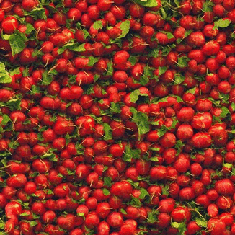
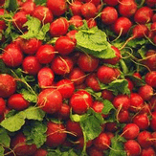
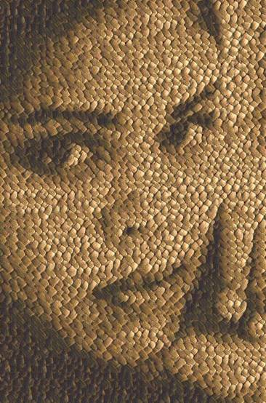
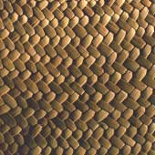
Last class: texture synthesis and transfer

Slide 3
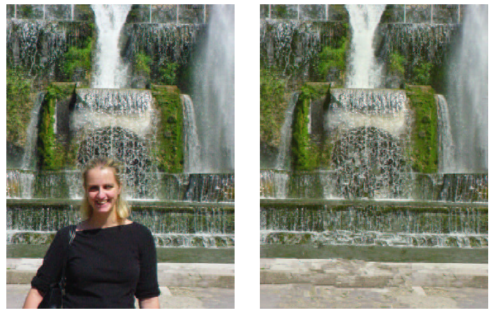
Last class: in-painting

Slide 4
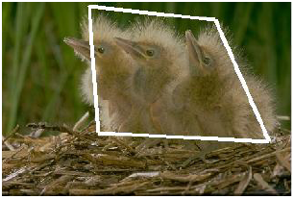
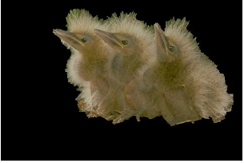
This Lecture: Finding Seams and Boundaries
Segmentation

Slide 5
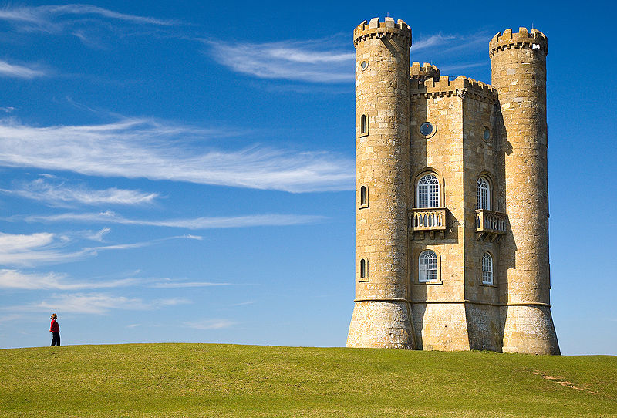
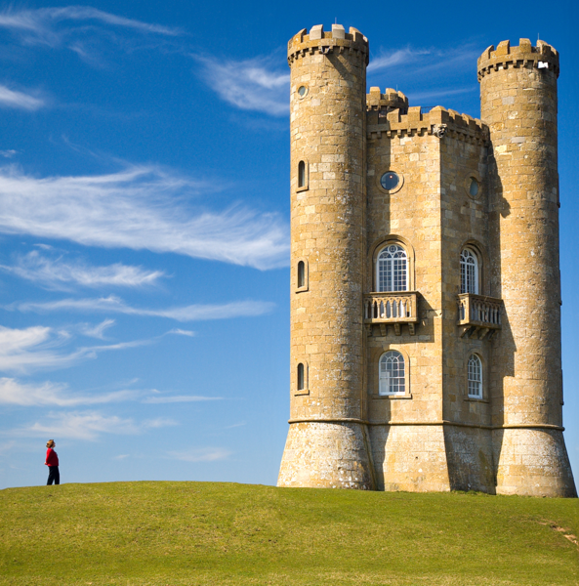
This Lecture: Finding Seams and Boundaries
Retargeting

Slide 6
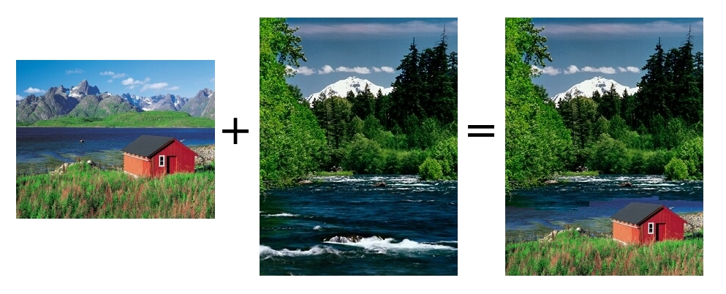
This Lecture: Finding Seams and Boundaries
Stitching

Slide 7
This Lecture: Finding seams and boundaries
Fundamental Concept: The Image as a Graph
Intelligent Scissors: Good boundary = short path
Graph cuts: Good region has low cutting cost

Slide 8
Semi-automated segmentation
User provides imprecise and incomplete specification of region – your algorithm has to read his/her mind.
Key problems
What groups of pixels form cohesive regions?
What pixels are likely to be on the boundary of regions?
Which region is the user trying to select?

Slide 9
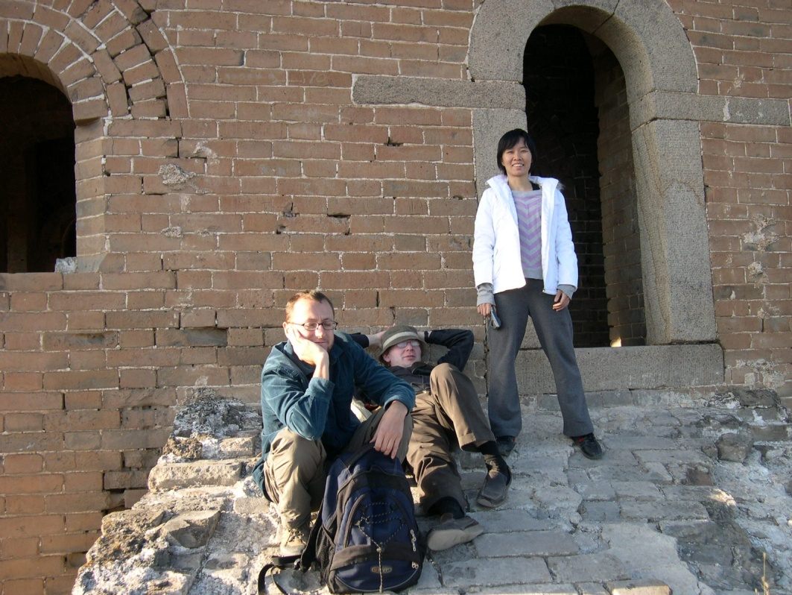
What makes a good region?
Contains small range of color/texture
Looks different than background
Compact
Notes:
Similar color/texture, compact

Slide 10
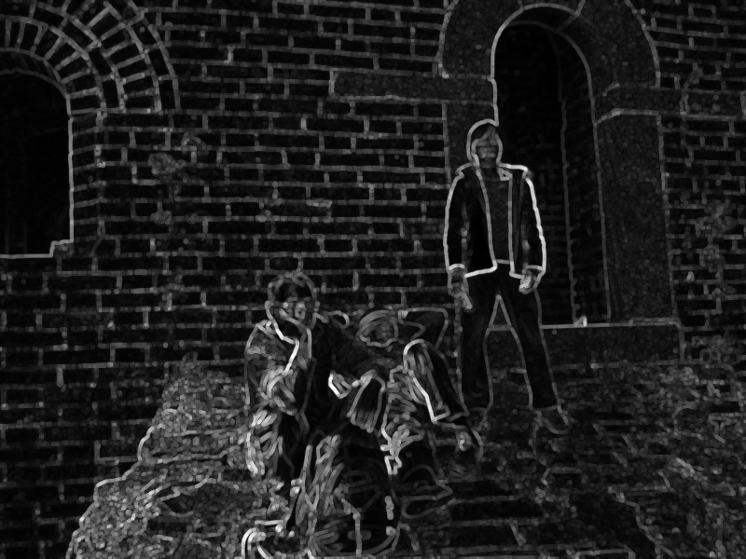
What makes a good boundary?
High gradient along boundary
Gradient in right direction
Smooth
Notes:
Smooth, high gradient along boundary

Slide 11
The Image as a Graph
Node: pixel
Edge: cost of path or cut between two pixels

Slide 12
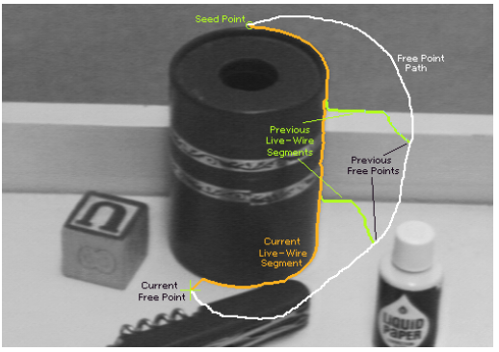
Intelligent Scissors
Mortenson and Barrett (SIGGRAPH 1995)

Slide 13
Intelligent Scissors
Mortenson and Barrett (SIGGRAPH 1995)
A good image boundary has a short path through the graph.
1
2
1
Start
2
1
1
9
5
4
4
3
3
3
6
1
1
End
1

Slide 14
Intelligent Scissors
Formulation: find good boundary between seed points
Challenges
Minimize interaction time
Define what makes a good boundary
Efficiently find it

Slide 15
Intelligent Scissors: method
Define boundary cost between neighboring pixels
User specifies a starting point (seed)
Compute lowest cost from seed to each other pixel
Get path from seed to cursor, choose new seed, repeat

Slide 16
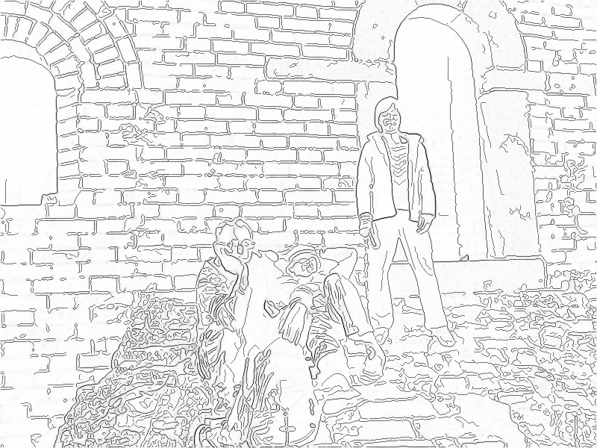
Intelligent Scissors: method
Define boundary cost between neighboring pixels
Lower if edge is present (e.g., with edge(im, ‘canny’))
Lower if gradient is strong
Lower if gradient is in direction of boundary

Slide 17
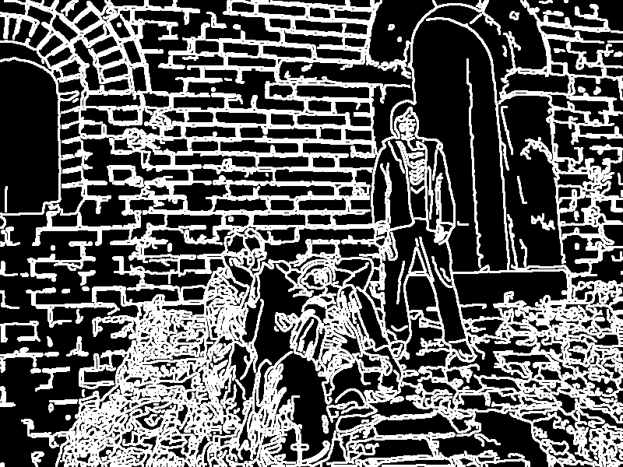
Gradients, Edges, and Path Cost
Gradient Magnitude
Path Cost
Edge Image

Slide 18
Intelligent Scissors: method
Define boundary cost between neighboring pixels
User specifies a starting point (seed)
Snapping

Slide 19
Intelligent Scissors: method
Define boundary cost between neighboring pixels
User specifies a starting point (seed)
Compute lowest cost from seed to each other pixel
Djikstra’s shortest path algorithm

Slide 20
Djikstra’s shortest path algorithm
Initialize, given seed s:
Compute cost₂(q, r) % cost for boundary from pixel q to neighboring pixel r
cost(s) = 0 % total cost from seed to this point
A = {s} % set to be expanded
E = { } % set of expanded pixels
P(q) % pointer to pixel that leads to q
Loop while A is not empty
q = pixel in A with lowest cost
Add q to E
for each pixel r in neighborhood of q that is not in E
cost_tmp = cost(q) + cost₂(q,r)
if (r is not in A) OR (cost_tmp < cost(r))
cost(r) = cost_tmp
P(r) = q
Add r to A

Slide 21
Example of Djikstra’s algorithm
1
2
1
2
1
1
9
5
4
Start
4
3
3
3
6
1
1
1

Slide 22
Intelligent Scissors: method
Define boundary cost between neighboring pixels
User specifies a starting point (seed)
Compute lowest cost from seed to each other pixel
Get new seed, get path between seeds, repeat

Slide 23
Intelligent Scissors: improving interaction
Snap when placing first seed
Automatically adjust to boundary as user drags
Freeze stable boundary points to make new seeds

Slide 24
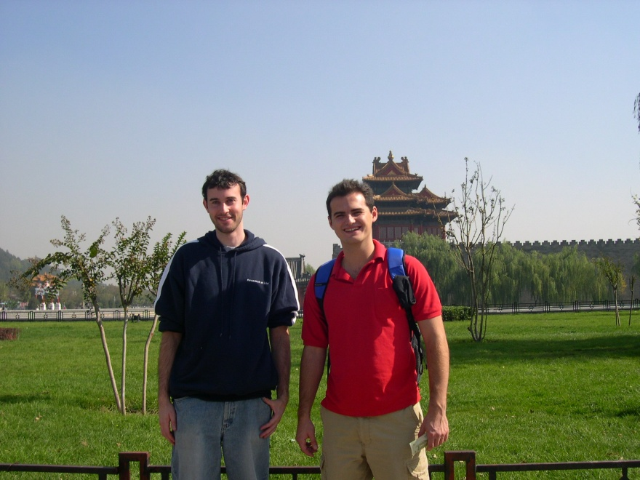
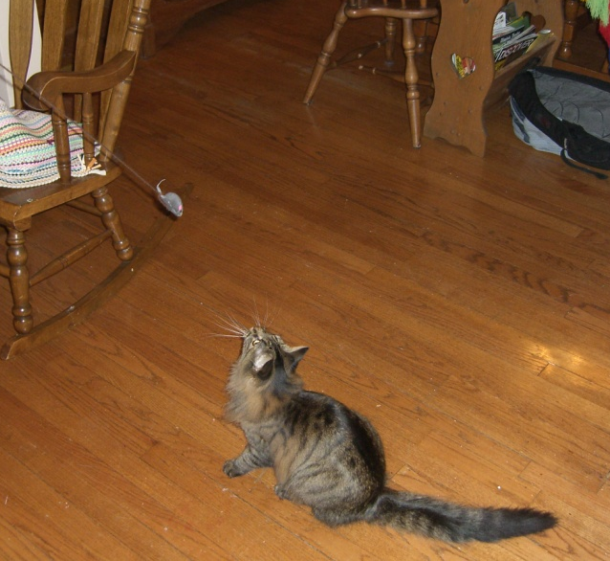
Where will intelligent scissors work well, or have problems?
Notes:
What information is intelligent scissors missing?

Slide 25
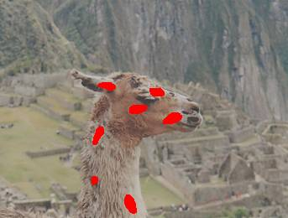
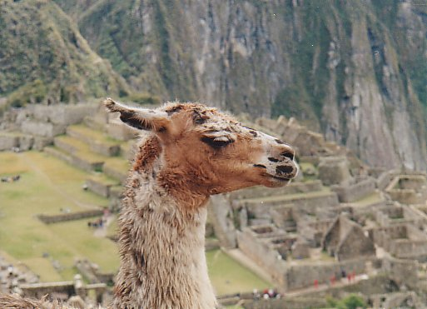
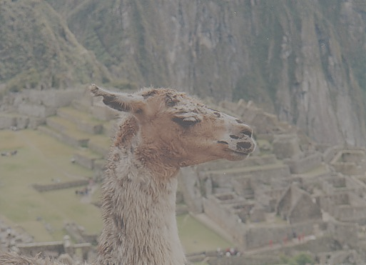
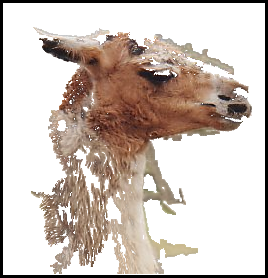
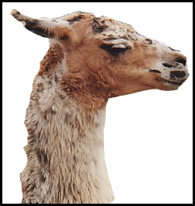
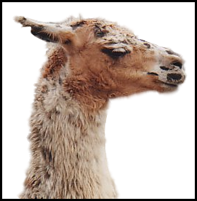
Grab cuts and graph cuts
Magic Wand (198?)
Intelligent Scissors Mortensen and Barrett (1995)
GrabCut
User Input
Result
Regions
Boundary
Regions & Boundary
Source: Rother
Notes:
Basic idea is to combine the information which was used in the 2 well known tools: MW and IS.
MS select a region of similar colour according to your input. Fat pen and the boundary snapps to high contrast edges.
Grabcut combines it. And this allows us to simplify the user interface considerably by …

Slide 26
Segmentation with graph cuts
Source (Label 0)
Cost to assign to 1
(attraction to 0)
Cost to split nodes
Cost to assign to 0
Sink (Label 1)

Slide 27
Segmentation with graph cuts
Source (Label 0)
Cost to assign to 1
Cost to split nodes
Cost to assign to 0
Sink (Label 1)

Slide 28
Graph cuts segmentation
Define graph
usually 4-connected or 8-connected
Set weights to foreground/background
Color histogram or mixture of Gaussians for background and foreground
Set weights for edges between pixels
Apply min-cut/max-flow algorithm
Return to 2, using current labels to compute foreground, background models

Slide 29
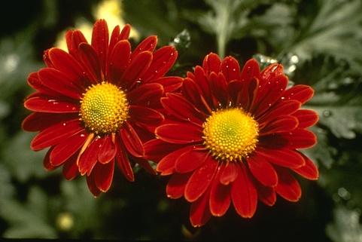
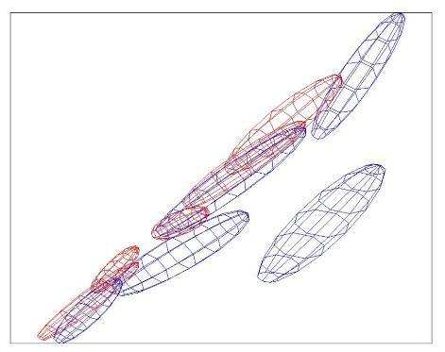
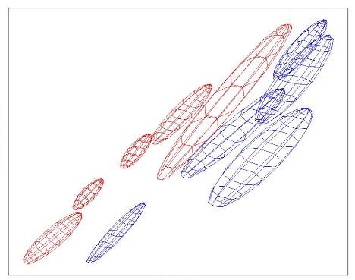
Colour Model
R
R
Foreground & Background
Iterated graph cut
Foreground
Background
G
Background
G
Gaussian Mixture Model (typically 5-8 components)
Source: Rother
Notes:
Color enbergy.
Iterations have the effect of pulling them away;
D is – log likelyhood of the GMM.

Slide 30
Graph cuts Boykov and Jolly (2001)
Foreground (source)
Image
Min Cut
Background (sink)
Cut: separating source and sink; Energy: collection of edges
Min Cut: Global minimal enegry in polynomial time
Source: Rother
Notes:
Optimization engine we use Graph Cuts. By now everybody should know what graph cut is. IN case you missed it here is a very brief introduction.
To image. 3D view. First task to construct a graph.
All pixels on a certain scanline. Just a few of them.
Next step introduce artificial nodes. fgd and background.
Edges – contrast. Boundary is quite likely between black and white.
Min Cut - Minimum edge strength.

Slide 31
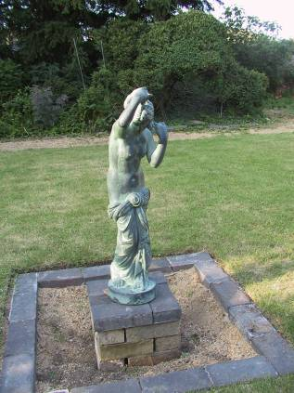
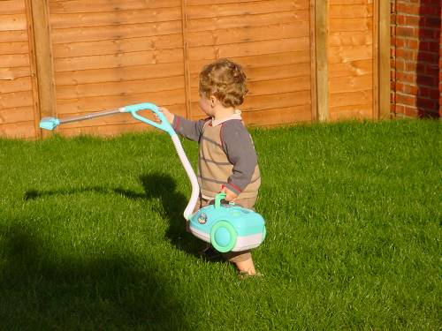
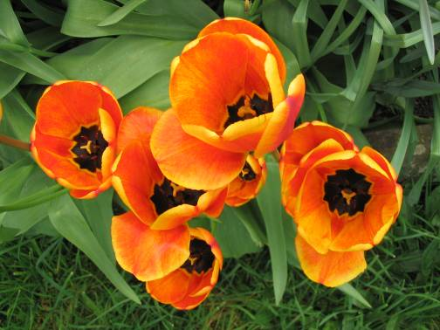
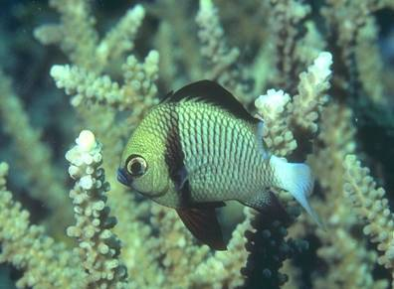
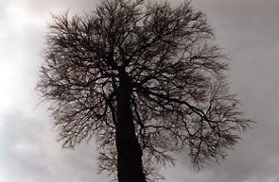
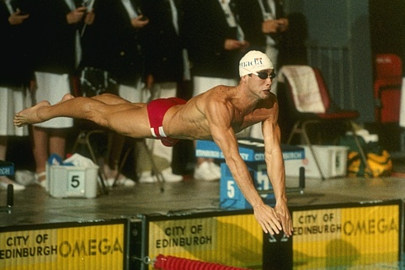
What is easy or hard about these cases for graphcut-based segmentation?

Slide 32
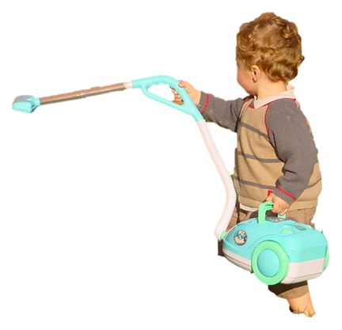
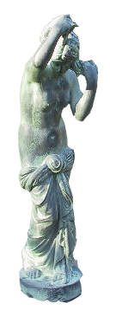
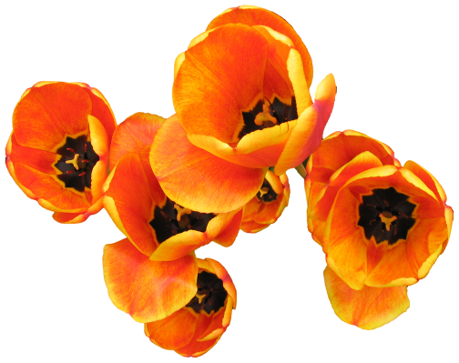
Easier examples
GrabCut – Interactive Foreground Extraction 10
Notes:
Moderately straightforward examples- after the user input automnatically

Slide 33
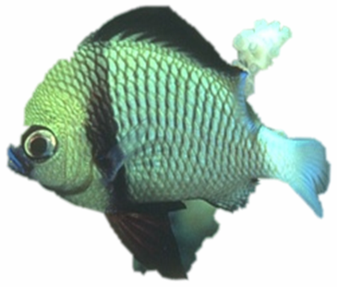
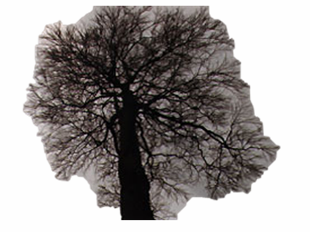
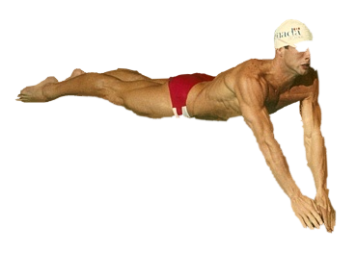
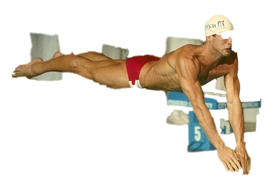
More difficult Examples
Camouflage &
Low Contrast
Fine structure
Harder Case
Initial Rectangle
Initial Result
GrabCut – Interactive Foreground Extraction 11
Notes:
You might wonder when does it fail. 4 cases. Low contrats – an edge not good visible

Slide 34
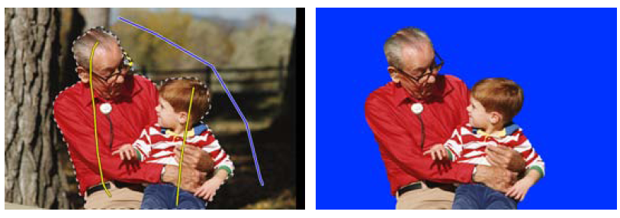
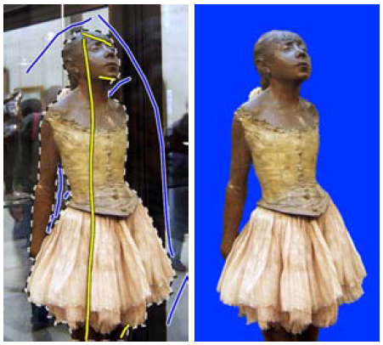
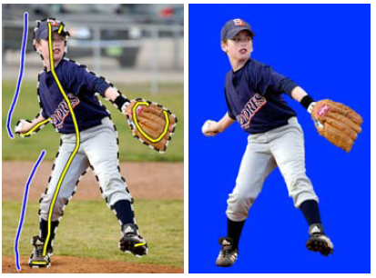
Lazy Snapping (Li et al. SG 2004)

Slide 35
Limitations of Graph Cuts
Requires associative graphs
Connected nodes should prefer to have the same label
Is optimal only for binary problems

Slide 36
Other applications: Seam Carving
Seam Carving – Avidan and Shamir (2007)
Demo: http://nparashuram.com/seamcarving/

Slide 37
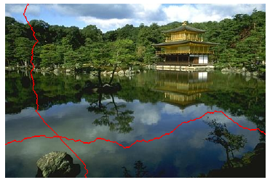
Other applications: Seam Carving
Find shortest path from top to bottom (or left to right), where cost = gradient magnitude
http://www.youtube.com/watch?v=6NcIJXTlugc
Seam Carving – Avidan and Shamir (2007)

Slide 38
Other applications: stitching
Graphcut Textures – Kwatra et al. SIGGRAPH 2003

Slide 39
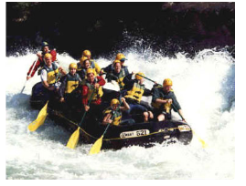
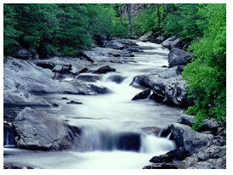
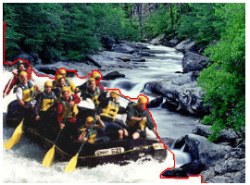
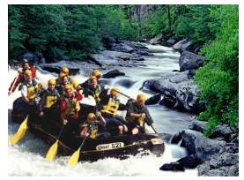
Other applications: stitching
Graphcut Textures – Kwatra et al. SIGGRAPH 2003
+
Ideal boundary:
Similar color in both images
High gradient in both images

Slide 40
Summary of big ideas
Treat image as a graph
Pixels are nodes
Between-pixel edge weights based on gradients
Sometimes per-pixel weights for affinity to foreground/background
Good boundaries are a short path through the graph (Intelligent Scissors, Seam Carving)
Good regions are produced by a low-cost cut (GrabCuts, Graph Cut Stitching)

Slide 41
Take-home questions
1. What would be the result in “Intelligent Scissors” if all of the edge costs were set to 1?
2. How could you change boundary costs for graph cuts to work better for objects with many thin parts?

Slide 42
Next class
Compositing and blending

