Slide 1
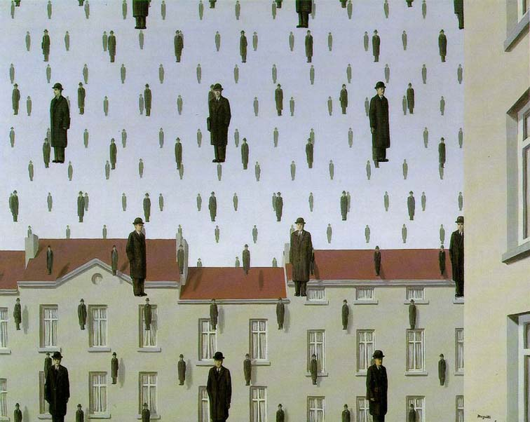
Templates and Image Pyramids
09/07/17
Computational Photography
Derek Hoiem, University of Illinois

Slide 2
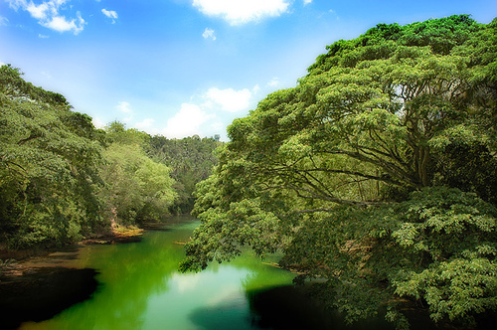
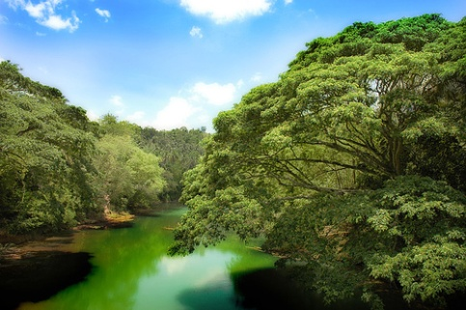
Why does a lower resolution image still make sense to us? What do we lose?
Image: http://www.flickr.com/photos/igorms/136916757/

Slide 3
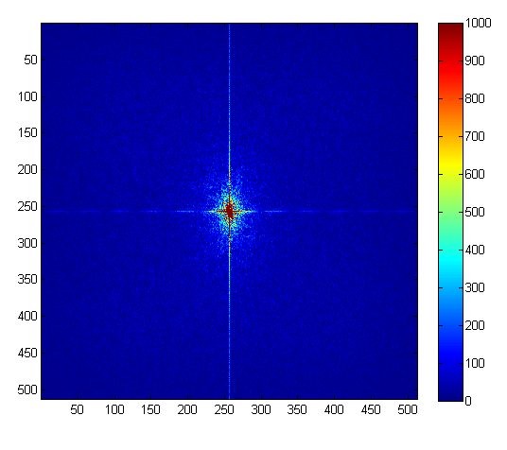
Why does a lower resolution image still make sense to us? What do we lose?
FFT linear scale
+
Image: http://www.flickr.com/photos/igorms/136916757/

Slide 4
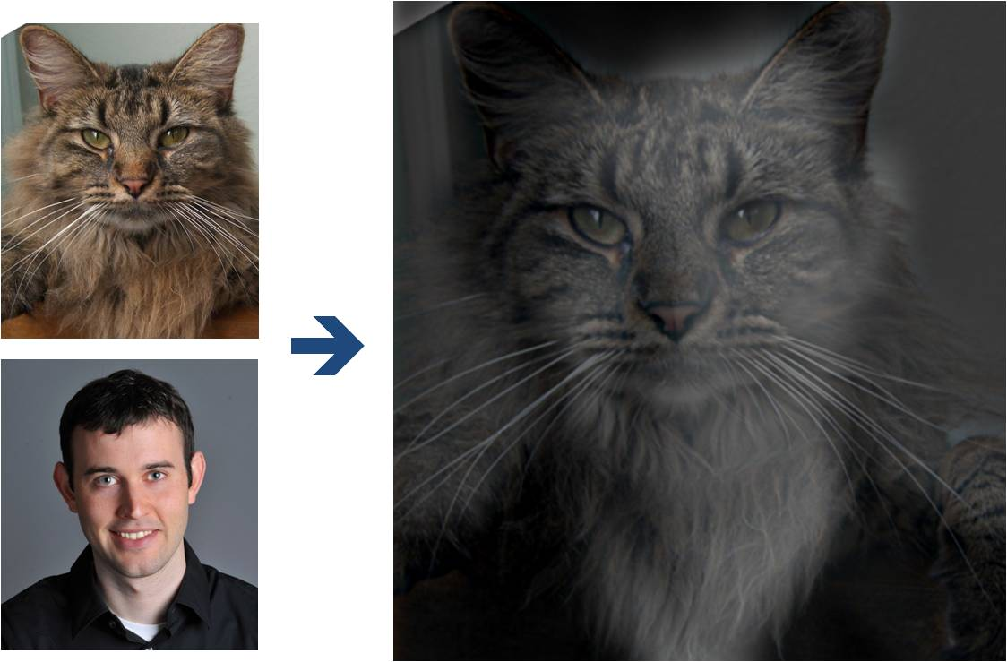
Why do we get different, distance-dependent interpretations of hybrid images?
?

Slide 5
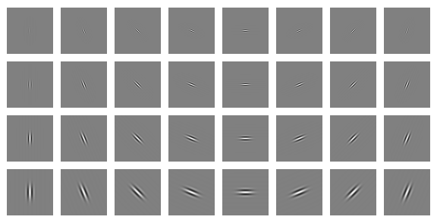
Clues from Human Perception
Early processing in humans filters for various orientations and scales of frequency
Perceptual cues in the mid frequencies dominate perception
When we see an image from far away, we are effectively subsampling it
Early Visual Processing: Multi-scale edge and blob filters

Slide 6
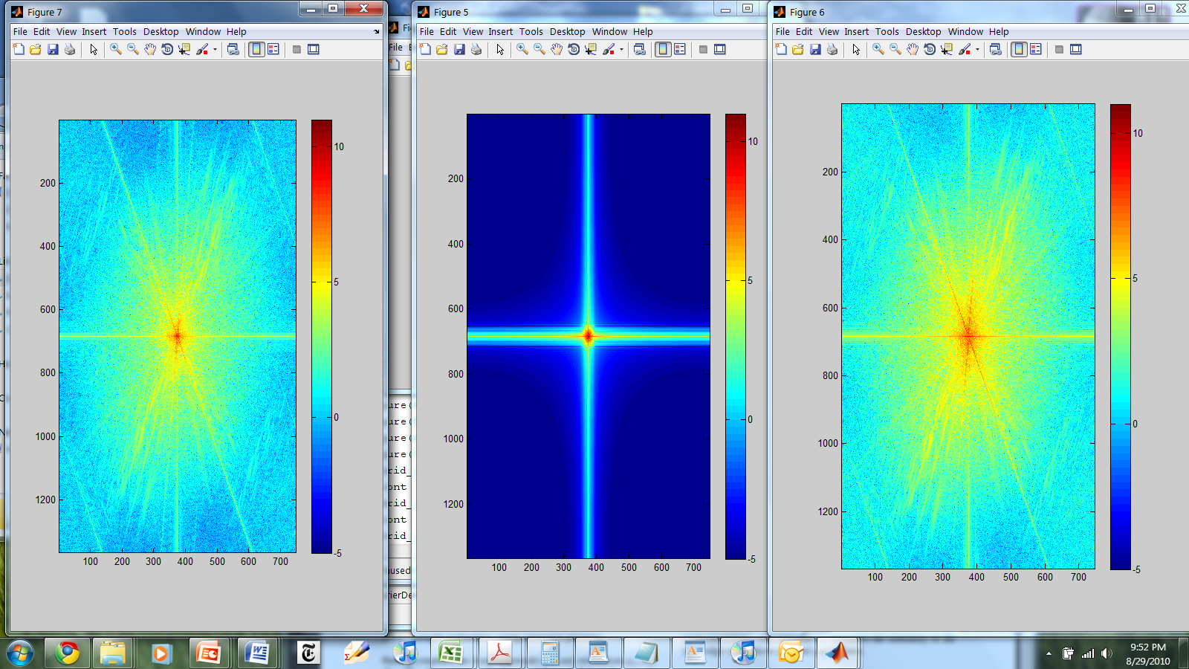
Hybrid Image in FFT
Hybrid Image
Low-passed Image
High-passed Image

Slide 7
Perception
Why do we get different, distance-dependent interpretations of hybrid images?
?

Slide 8
Reminder
Start working on project 1 (due Sept 18)
  Make sure you can get a project page up
  Can now complete first part (hybrid images)

Slide 9
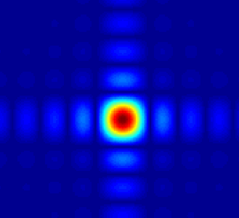
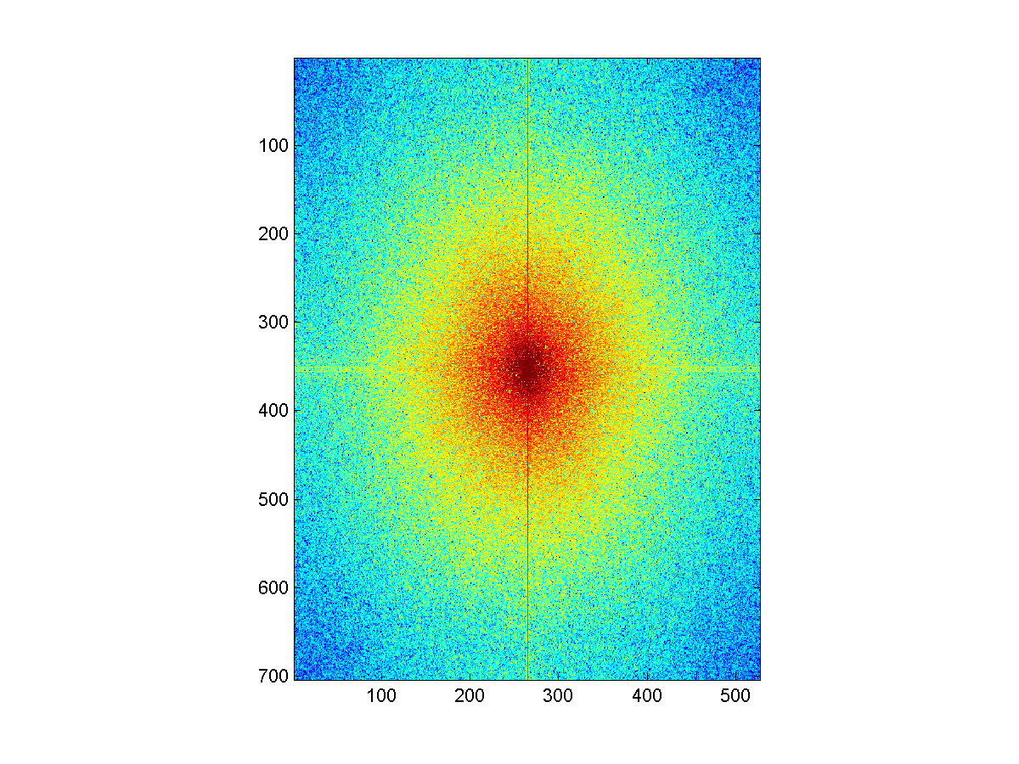
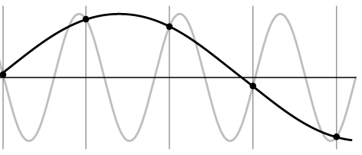
Things to Remember
Sometimes it makes sense to think of images and filtering in the frequency domain
  Fourier analysis
Can be faster to filter using FFT for large images (N logN vs. N² for auto-correlation)
Images are mostly smooth
  Basis for compression
Remember to low-pass before sampling

Slide 10
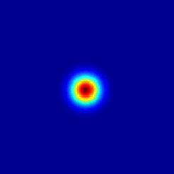
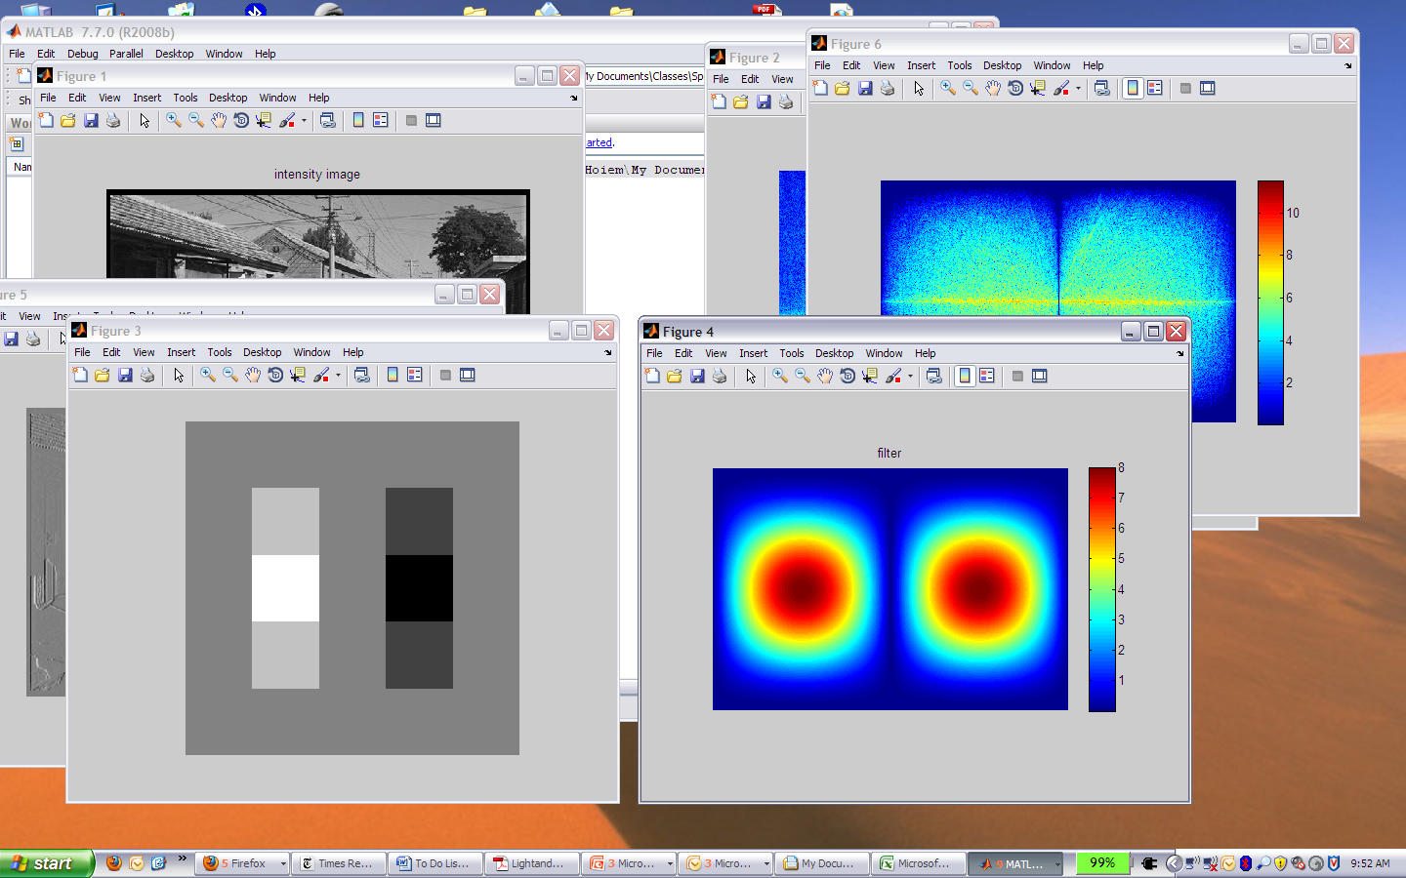
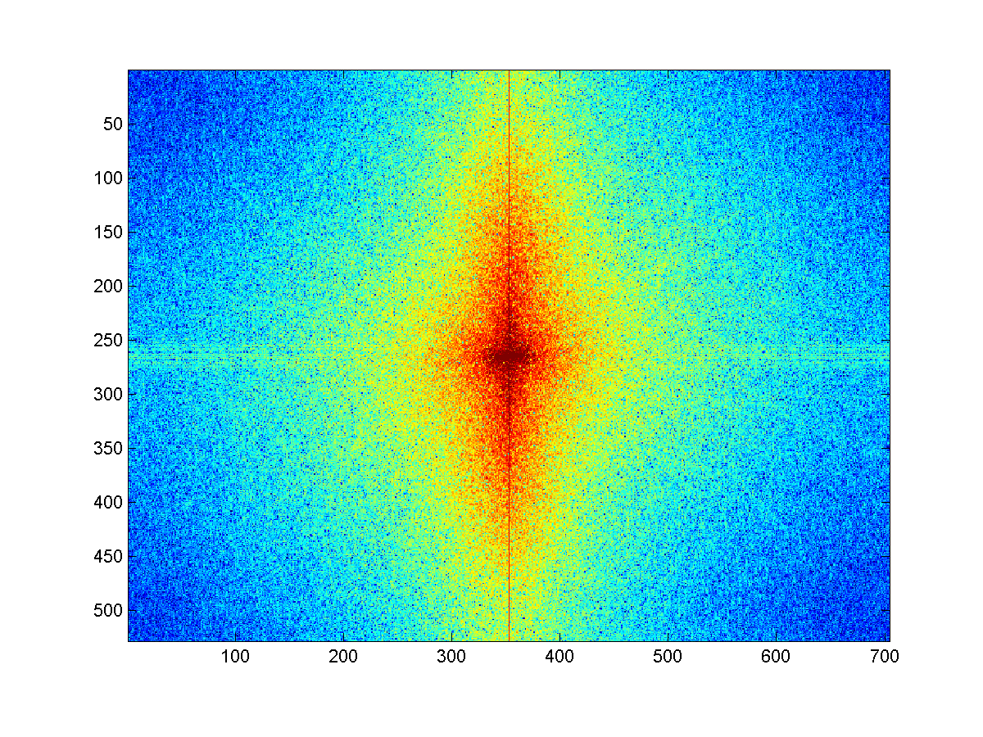
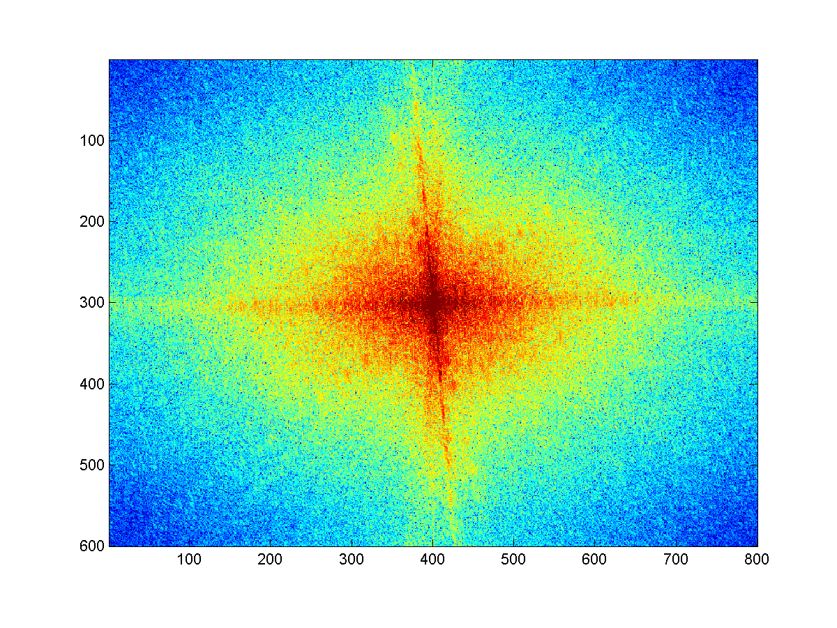
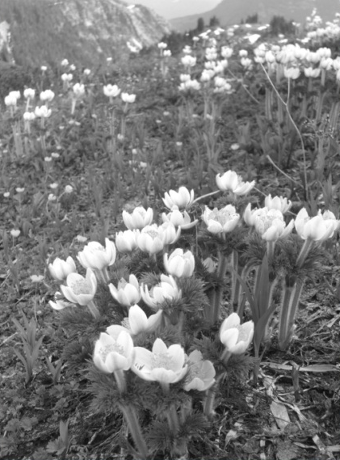
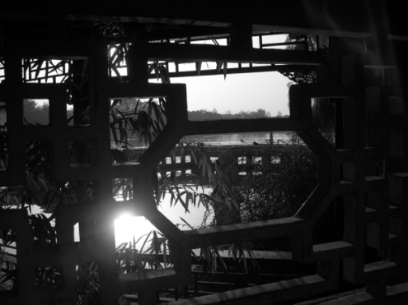
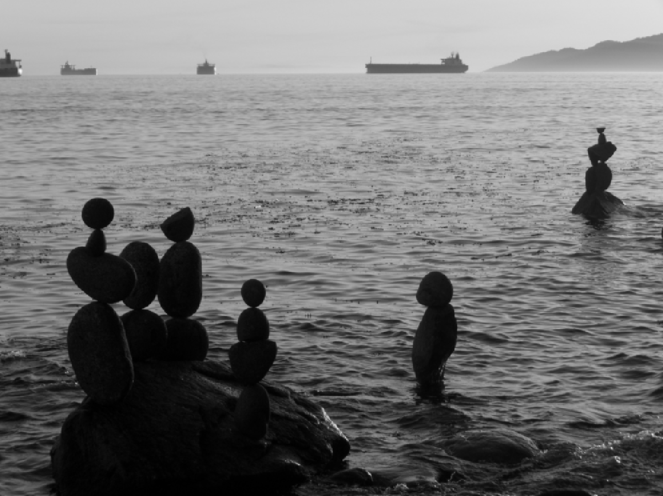


Review
Match the spatial domain image to the Fourier magnitude image
1
2
3
4
5
B
A
C
E
D

Slide 11
Today’s class: applications of filtering
Template matching
Coarse-to-fine alignment
Denoising, Compression

Slide 12
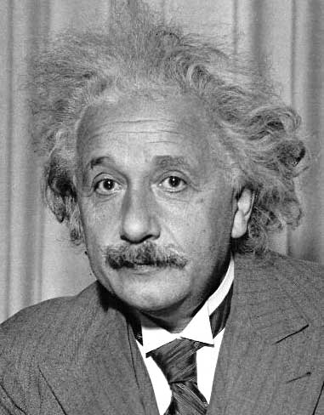
Template matching
Goal: find in image
Main challenge: What is a good similarity or distance measure between two patches?
  Correlation
  Zero-mean correlation
  Sum Square Difference
  Normalized Cross Correlation

Slide 13
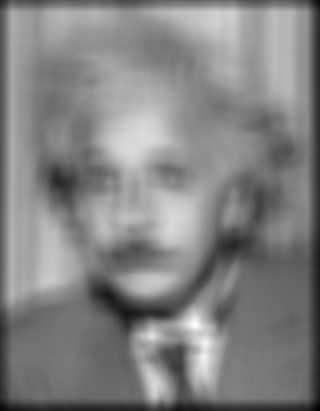
Matching with filters
Goal: find in image
Method 0: filter the image with eye patch
f = image
g = filter
What went wrong?
Input
Filtered Image
Notes:
Problem: response is stronger for higher intensity

Slide 14
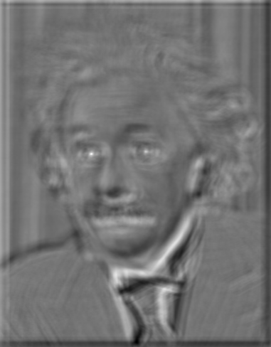
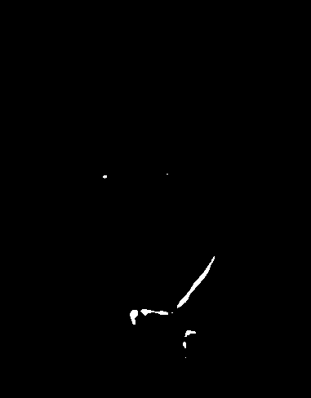
Matching with filters
Goal: find in image
Method 1: filter the image with zero-mean eye
mean of f
True detections
False detections
Input
Filtered Image (scaled)
Thresholded Image
Notes:
Likes bright pixels where filters are above average, dark pixels where filters are below average. Problems: response is sensitive to gain/contrast, pixels in filter that are near the mean have little effect, does not require pixel values in image to be near or proportional to values in filter.

Slide 15
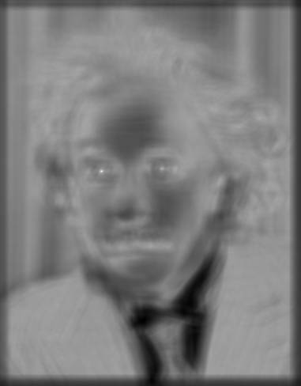
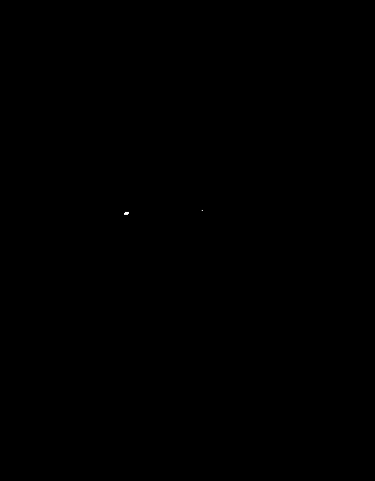
Matching with filters
Goal: find in image
Method 2: SSD
True detections
Input
1- sqrt(SSD)
Thresholded Image
Notes:
Problem: SSD sensitive to average intensity

Slide 16
Matching with filters
Can SSD be implemented with linear filters?

Slide 17
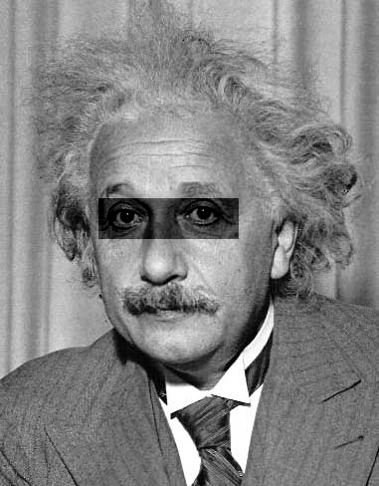
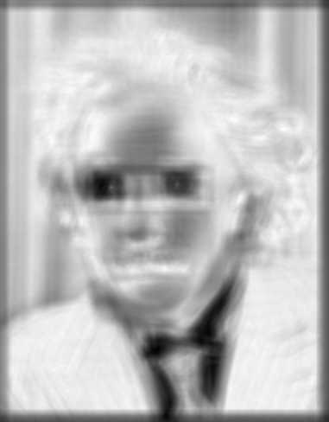
Matching with filters
Goal: find in image
Method 2: SSD
What’s the potential downside of SSD?
Input
1- sqrt(SSD)
Notes:
Problem: SSD sensitive to average intensity

Slide 18
Matching with filters
Goal: find in image
Method 3: Normalized cross-correlation
mean template
mean image patch
Matlab: normxcorr2(template, im)
Notes:
Invariant to mean and scale of intensity

Slide 19
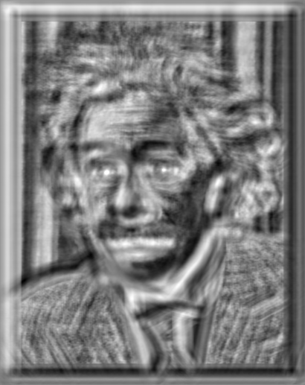

Matching with filters
Goal: find in image
Method 3: Normalized cross-correlation
True detections
Input
Normalized X-Correlation
Thresholded Image

Slide 20
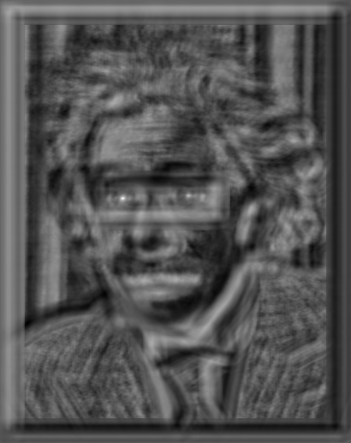
Matching with filters
Goal: find in image
Method 3: Normalized cross-correlation
True detections
Input
Normalized X-Correlation
Thresholded Image

Slide 21
Q: What is the best method to use?
A: Depends
Zero-mean filter: fastest but not a great matcher
SSD: next fastest, sensitive to overall intensity
Normalized cross-correlation: slowest, invariant to local average intensity and contrast

Slide 22
Q: What if we want to find larger or smaller eyes?
A: Image Pyramid

Slide 23
Review of Sampling
Gaussian
Filter
Image
Low-Pass Filtered Image
Sample
Low-Res Image

Slide 24
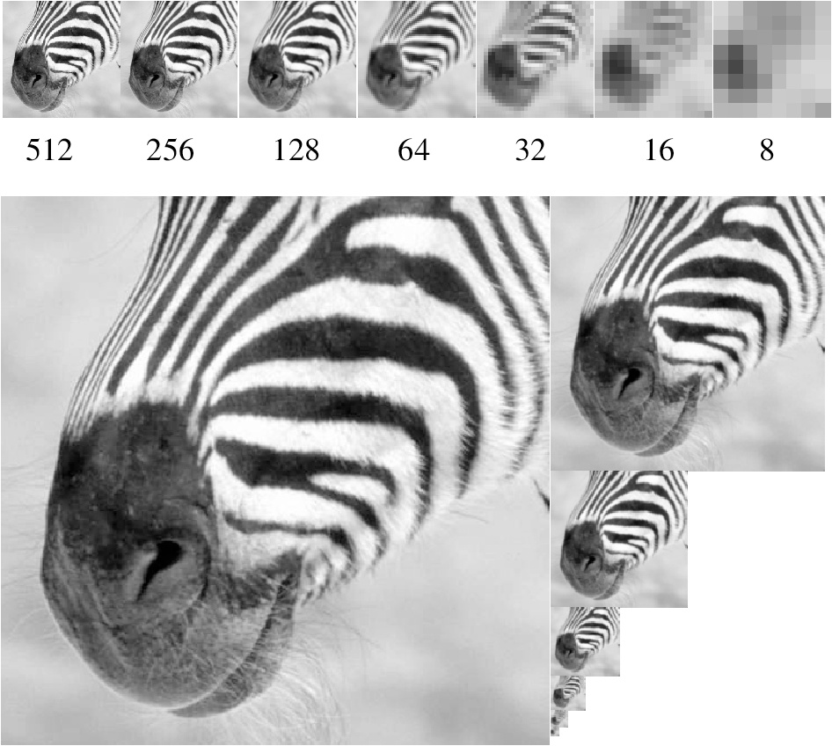
Gaussian pyramid
Source: Forsyth

Slide 25
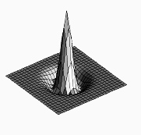

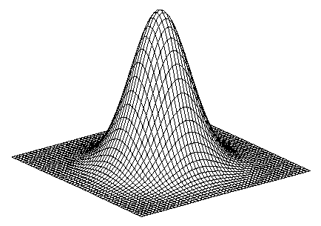
Laplacian filter
unit impulse
Gaussian
Laplacian of Gaussian
Source: Lazebnik

Slide 26
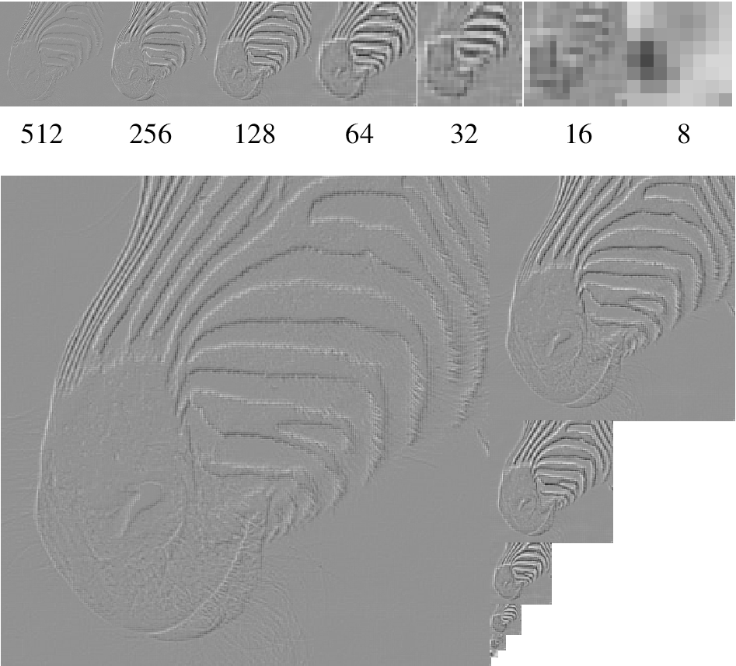
Laplacian pyramid
Source: Forsyth

Slide 27
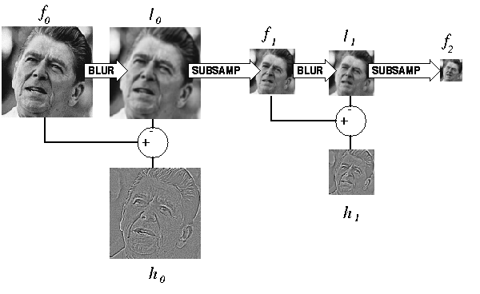
Computing Gaussian/Laplacian Pyramid
Can we reconstruct the original from the laplacian pyramid?
http://sepwww.stanford.edu/~morgan/texturematch/paper_html/node3.html

Slide 28
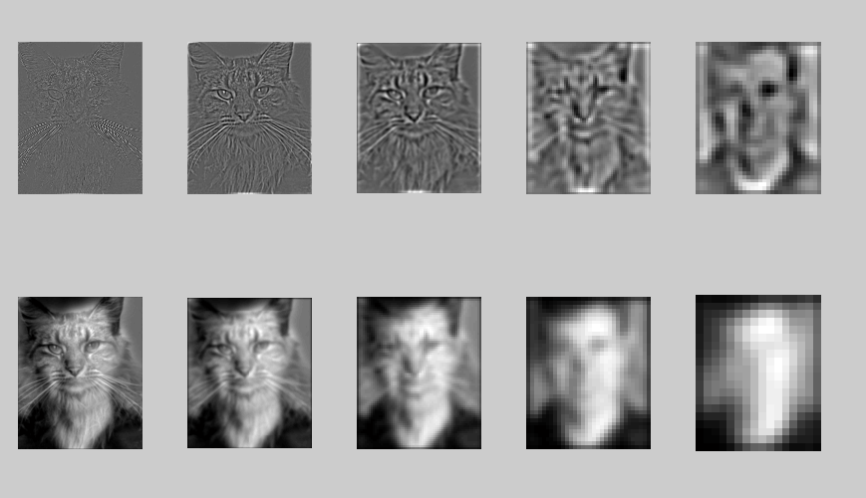
Hybrid Image in Laplacian Pyramid
Extra points for project 1
High frequency → Low frequency

Slide 29
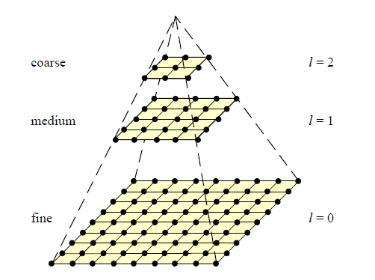
Coarse-to-fine Image Registration
Compute Gaussian pyramid
Align with coarse pyramid
  Find minimum SSD position
Successively align with finer pyramids
  Search small range (e.g., 5x5) centered around position determined at coarser scale
Why is this faster?
Are we guaranteed to get the same result?

Slide 30
Question
Can you align the images using the FFT?

Slide 31
Compression
How is it that a 4MP image can be compressed to a few hundred KB without a noticeable change?

Slide 32
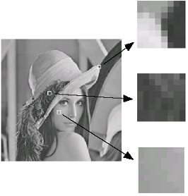
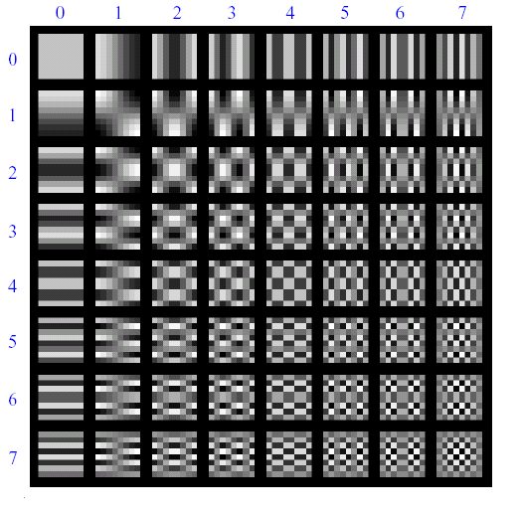
Lossy Image Compression (JPEG)
Block-based Discrete Cosine Transform (DCT)
Slides: Efros

Slide 33
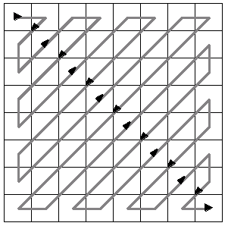
Using DCT in JPEG
The first coefficient B(0,0) is the DC component, the average intensity
The top-left coeffs represent low frequencies, the bottom right – high frequencies

Slide 34
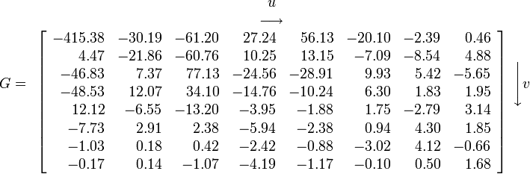
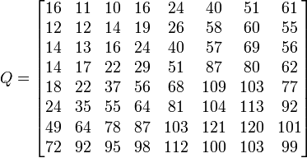
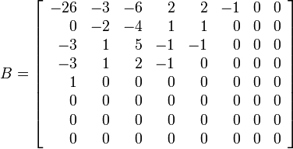
Image compression using DCT
Quantize
  More coarsely for high frequencies (which also tend to have smaller values)
  Many quantized high frequency values will be zero
Encode
  Can decode with inverse dct
Filter responses
Quantization table
Quantized values

Slide 35
JPEG Compression Summary
Convert image to YCrCb
Subsample color by factor of 2
  People have bad resolution for color
Split into blocks (8x8, typically), subtract 128
For each block
  Compute DCT coefficients
  Coarsely quantize
    Many high frequency components will become zero
  Encode (e.g., with Huffman coding)
http://en.wikipedia.org/wiki/YCbCr
http://en.wikipedia.org/wiki/JPEG

Slide 36
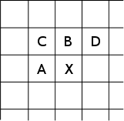
Lossless compression (PNG)
Predict that a pixel’s value based on its upper-left neighborhood
Store difference of predicted and actual value
Pkzip it (DEFLATE algorithm)

Slide 37

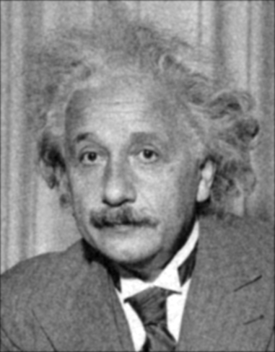
Denoising
Gaussian Filter
Additive Gaussian Noise

Slide 38
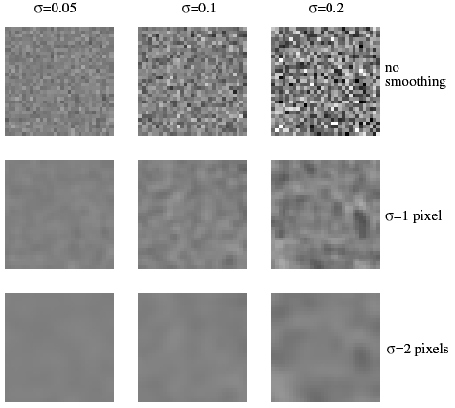
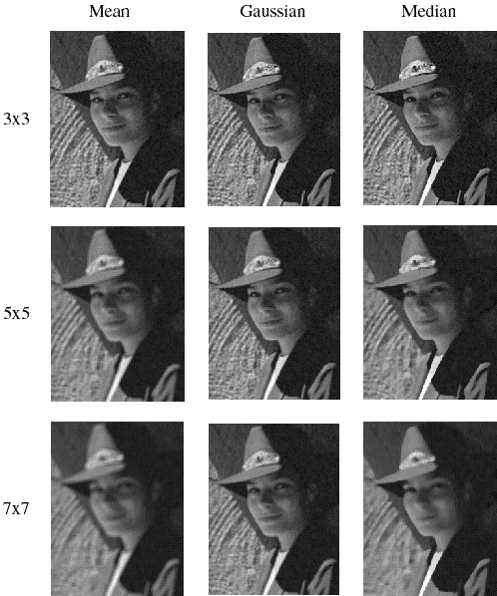
Reducing Gaussian noise
Smoothing with larger standard deviations suppresses noise, but also blurs the image
Source: S. Lazebnik

Slide 39
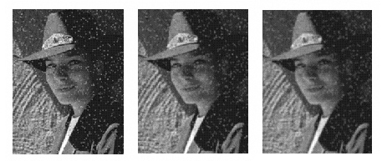
Reducing salt-and-pepper noise by Gaussian smoothing
3x3
5x5
7x7
Notes:
What’s wrong with these results?

Slide 40
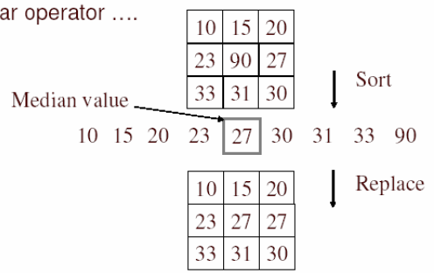
Alternative idea: Median filtering
A median filter operates over a window by selecting the median intensity in the window
Is median filtering linear?
Source: K. Grauman
Notes:
Better at salt’n’pepper noise
Not convolution: try a region with 1’s and a 2, and then 1’s and a 3

Slide 41
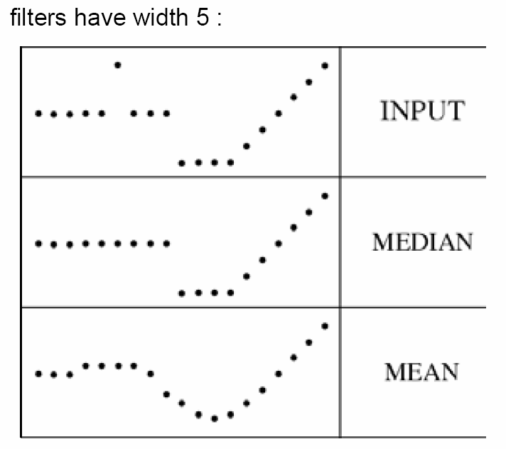
Median filter
What advantage does median filtering have over Gaussian filtering?
  Robustness to outliers
Source: K. Grauman

Slide 42
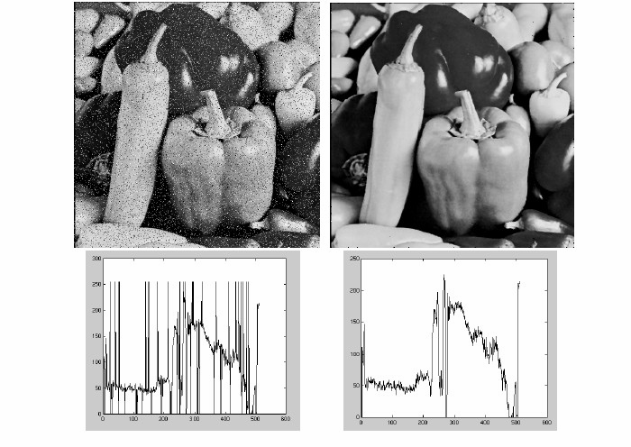
Median filter
Salt-and-pepper noise
Median filtered
MATLAB: medfilt2(image, [h w])
Source: M. Hebert

Slide 43
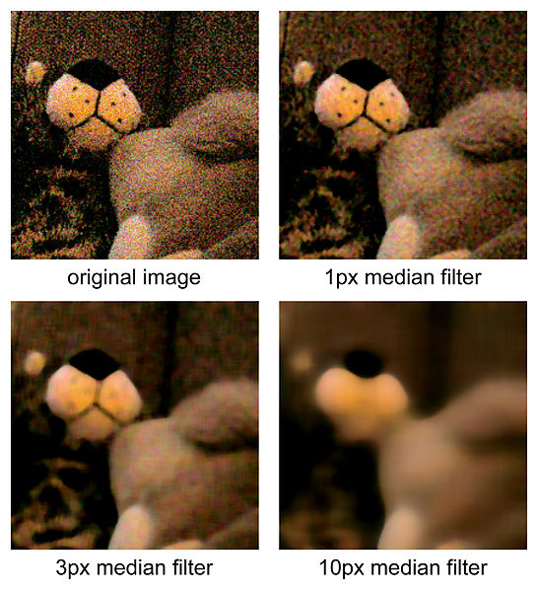
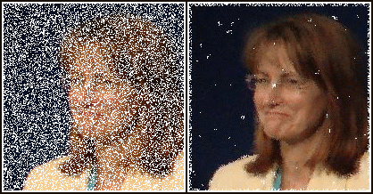
Median Filtered Examples
http://en.wikipedia.org/wiki/File:Medianfilterp.png
http://en.wikipedia.org/wiki/File:Median_filter_example.jpg

Slide 44

Median vs. Gaussian filtering
3x3
5x5
7x7
Gaussian
Median

Slide 45

Other filter choices
Weighted median (pixels further from center count less)
Clipped mean (average, ignoring few brightest and darkest pixels)
Bilateral filtering (weight by spatial distance and intensity difference)
Bilateral filtering
Image:
http://vision.ai.uiuc.edu/?p=1455

Slide 46
Review of Last 3 Days
Filtering in spatial domain
  Slide filter over image and take dot product at each position
  Remember linearity (for linear filters)
  Examples
    1D: [-1 0 1], [0 0 0 0 0.5 1 1 1 0.5 0 0 0]
    1D: [0.25 0.5 0.25], [0 0 0 0 0.5 1 1 1 0.5 0 0 0]
    2D: [1 0 0 ; 0 2 0 ; 0 0 1]/4

Slide 47


Review of Last 3 Days
Linear filters for basic processing
  Edge filter (high-pass)
  Gaussian filter (low-pass)
[-1 1]
Gaussian
FFT of Gradient Filter
FFT of Gaussian

Slide 48

Review of Last 3 Days
Derivative of Gaussian

Slide 49
Review of Last 3 Days
Filtering in frequency domain
  Can be faster than filtering in spatial domain (for large filters)
  Can help understand effect of filter
  Algorithm:
    Convert image and filter to fft (fft2 in matlab)
    Pointwise-multiply ffts
    Convert result to spatial domain with ifft2

Slide 50
Review of Last 3 Days
Applications of filters
  Template matching (SSD or Normxcorr2)
    SSD can be done with linear filters, is sensitive to overall intensity
  Gaussian pyramid
    Coarse-to-fine search, multi-scale detection
  Laplacian pyramid
    Can be used for blending (later)
    More compact image representation

Slide 51
Review of Last 3 Days
Applications of filters
  Downsampling
    Need to sufficiently low-pass before downsampling
  Compression
    In JPEG, coarsely quantize high frequencies
  Reducing noise (important for aesthetics and for later processing such as edge detection)
    Gaussian filter, median filter, bilateral filter

Slide 52

Next class
Light and color

