Slide 1
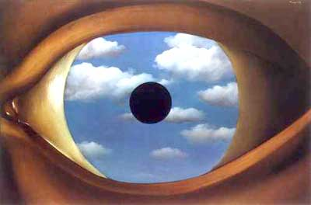
Computational Approaches to Cameras
11/12/15
Magritte , The False Mirror (1935)
Computational Photography
Derek Hoiem, University of Illinois

Slide 2
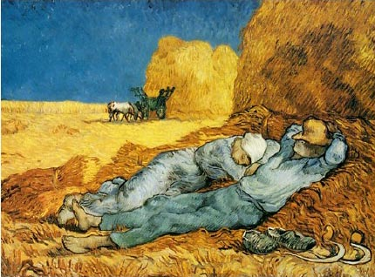
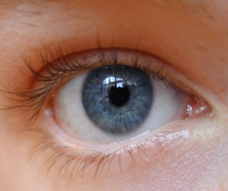
Conventional cameras
Conventional cameras are designed to capture light in a medium that is directly viewable
Scene
Eye
Sensor
Lens
Light
Display

Slide 3
Computational cameras
With a computational approach, we can capture light and then figure out what to do with it
Captured Light
Computation
Scene
Eyes
Light
Displays

Slide 4
Questions for today
How can we represent all of the information contained in light?
What are the fundamental limitations of cameras?
What sacrifices have we made in conventional cameras? For what benefits?
How else can we design cameras for better focus, deblurring, multiple views, depth, etc.?

Slide 5
How can we represent all of the information contained in light?

Slide 6
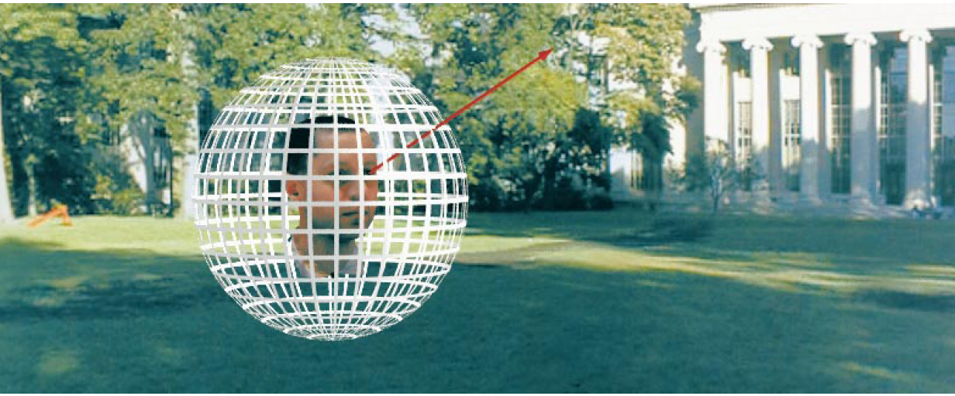
Representing Light: The Plenoptic Function
Figure by Leonard McMillan
Q: What is the set of all things that we can ever see?
A: The Plenoptic Function (Adelson & Bergen)
Let’s start with a stationary person and try to parameterize everything that he can see…
Slides from Efros

Slide 7
Grayscale snapshot
P(θ,φ)
is intensity of light
Seen from a single view point
At a single time
Averaged over the wavelengths of the visible spectrum
(can also do P(x,y), but spherical coordinate are nicer)

Slide 8
Color snapshot
P(θ,φ,λ)
is intensity of light
Seen from a single view point
At a single time
As a function of wavelength

Slide 9
A movie
P(θ,φ,λ,t)
is intensity of light
Seen from a single view point
Over time
As a function of wavelength

Slide 10
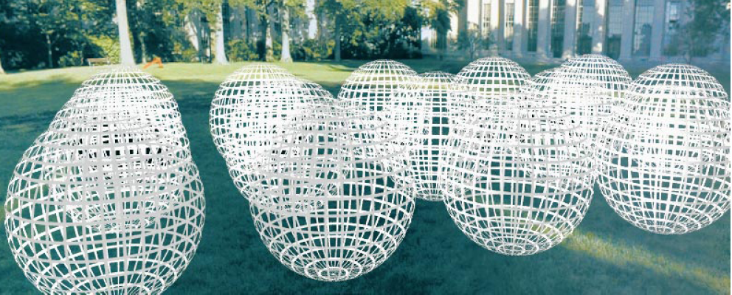
Holographic movie
P(θ,φ,λ,t,V_{X},V_{Y},V_{Z})
is intensity of light
Seen from ANY viewpoint
Over time
As a function of wavelength

Slide 11
The Plenoptic Function
P(θ,φ,λ,t,V_{X},V_{Y},V_{Z})
Can reconstruct every possible view, at every moment, from every position, at every wavelength
Contains every photograph, every movie, everything that anyone has ever seen!

Slide 12
Full Plenoptic Camera
Records position and orientation of each ray at each time and wavelength
P(V_{X}, V_{Y}, V_{Z}, θ, φ, t, λ)

Slide 13
What fundamentally limits cameras?

Slide 14
Representing light
The atomic element of light: a pixel a ray

Slide 15
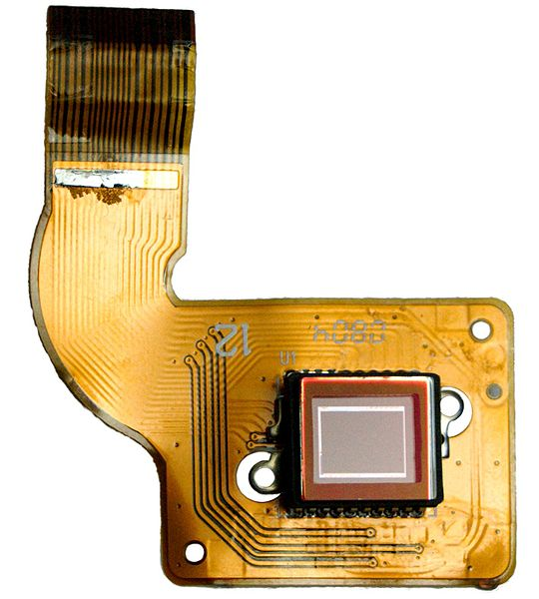
Fundamental limitations and trade-offs
Only so much light in a given area to capture
Basic sensor accumulates light at a set of positions from all orientations, over all time
We want intensity of light at a given time at one position for a set of orientations
Solutions:
funnel, constrain, redirect light
change the sensor
CCD inside camera

Slide 16
What sacrifices does the conventional camera make? For what gains?

Slide 17


Trade-offs of conventional camera
Add a pinhole
Pixels correspond to small range of orientations at the camera center, instead of all gathered light at one position
Much less light hits sensor
Add a lens
More light hits sensor
Limited depth of field
Chromatic aberration
Add a shutter
Capture average intensity at a particular range of times
Increase sensor resolution
Each pixel represents a smaller range of orientations
Less light per pixel
Controls: aperture size, focal length, shutter time

Slide 18
How else can we design cameras?
What do they sacrifice/gain?

Slide 19
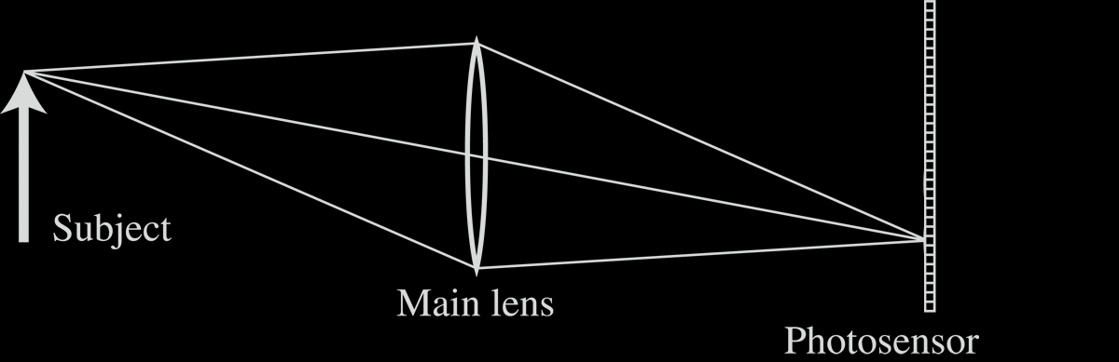
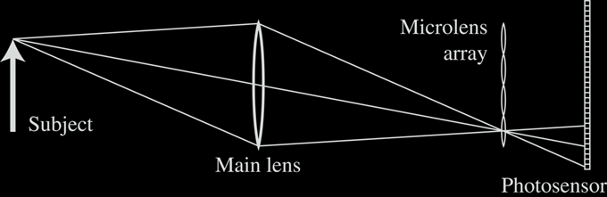
1. Light Field Photography with “Plenoptic Camera”
Conventional Camera
“Plenoptic Camera”
Adelson and Wang 1992
Ng et al. Stanford TR, 2005

Slide 20
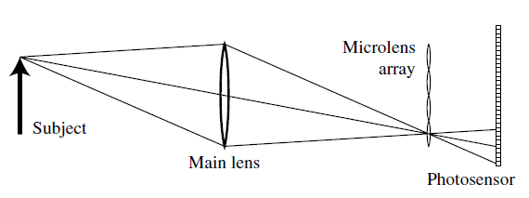
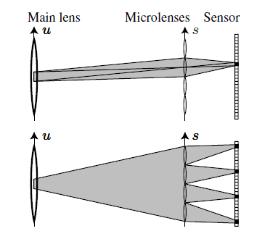
Light field photography
Like replacing the human retina with an insect compound eye
Records where light ray hits the lens

Slide 21
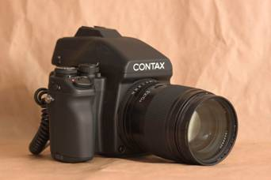
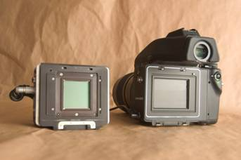
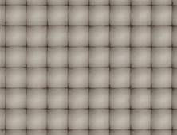
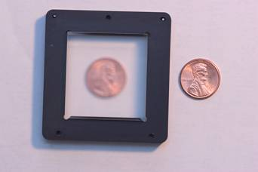
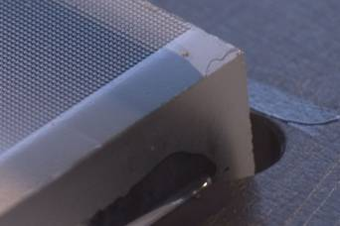
Stanford Plenoptic Camera [Ng et al 2005]
Contax medium format camera
Kodak 16-megapixel sensor
Adaptive Optics microlens array
125μ square-sided microlenses
4000 × 4000 pixels ÷ 292 × 292 lenses = 14 × 14 pixels per lens

Slide 22
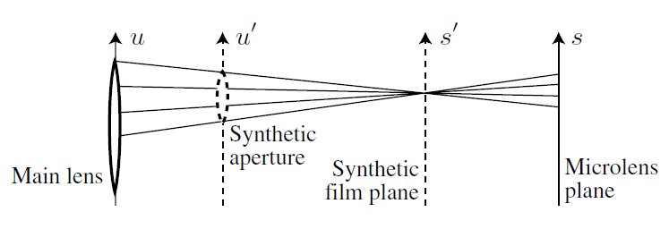
Light field photography: applications

Slide 23
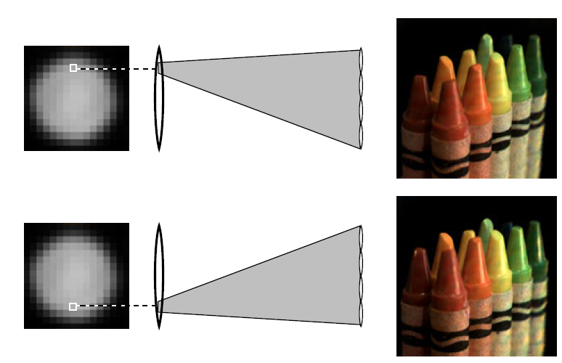
Light field photography: applications
Change in viewpoint

Slide 24
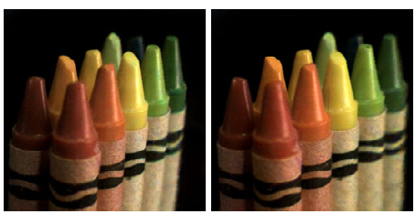
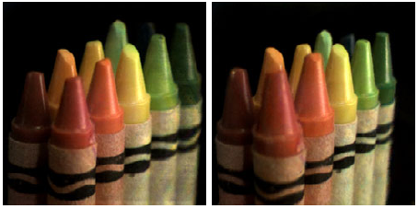
Light field photography: applications
Change in viewpoint
Lateral
Along Optical Axis

Slide 25
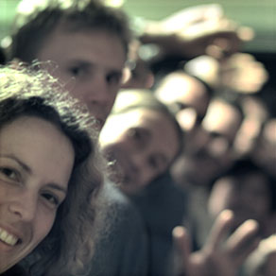
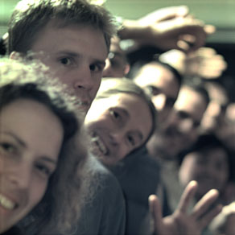
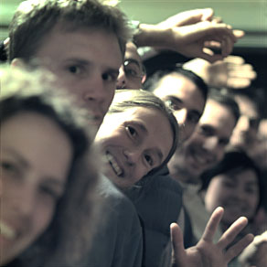
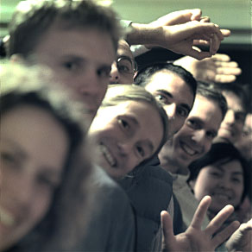
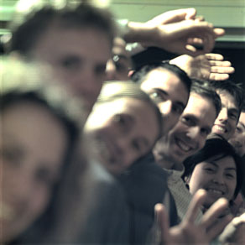
Digital Refocusing

Slide 26
Light field photography w/ microlenses
We gain
Ability to refocus or increase depth of field
Ability for small viewpoint shifts
What do we lose (vs. conventional camera)?

Slide 27
2. Coded apertures

Slide 28
Image and Depth from a Conventional Camera with a Coded Aperture
Anat Levin, Rob Fergus, Frédo Durand, William Freeman
MIT CSAIL
Slides from SIGGRAPH Presentation

Slide 29
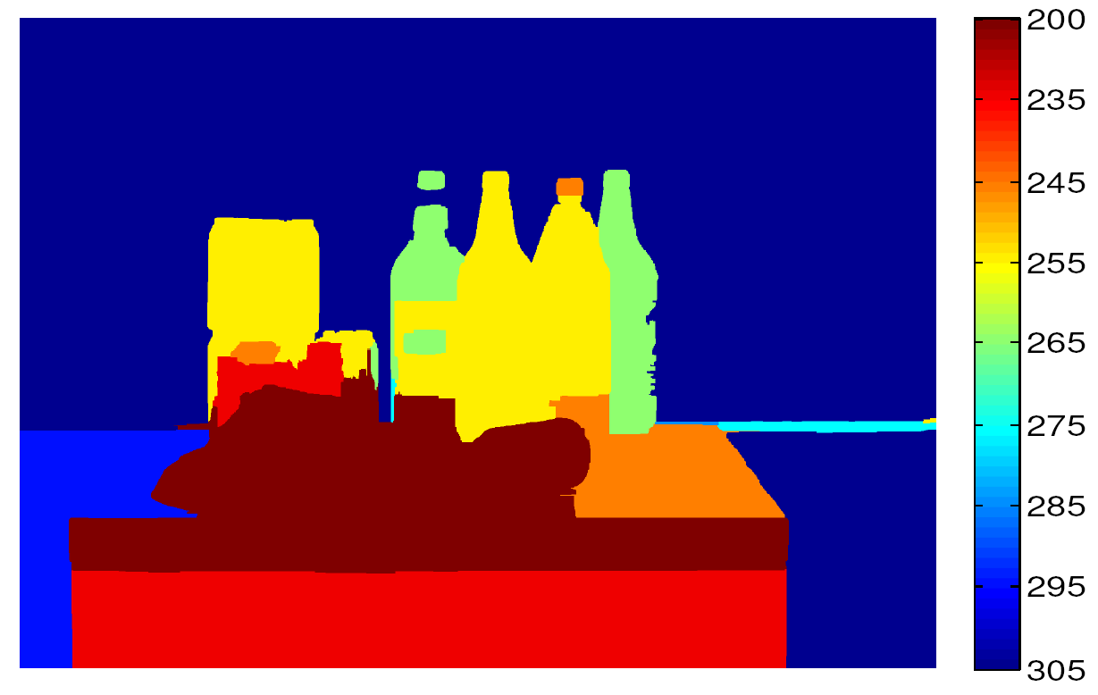
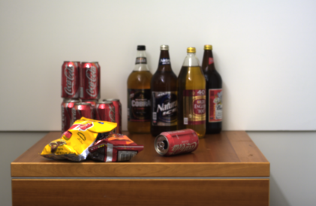
Output #1: Depth map
Single input image:

Slide 30
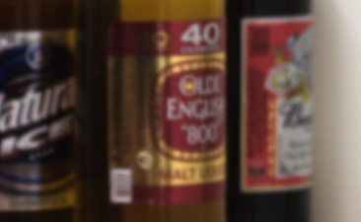

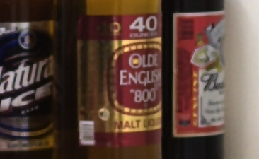
Output #1: Depth map
Single input image:
Output #2: All-focused image

Slide 31
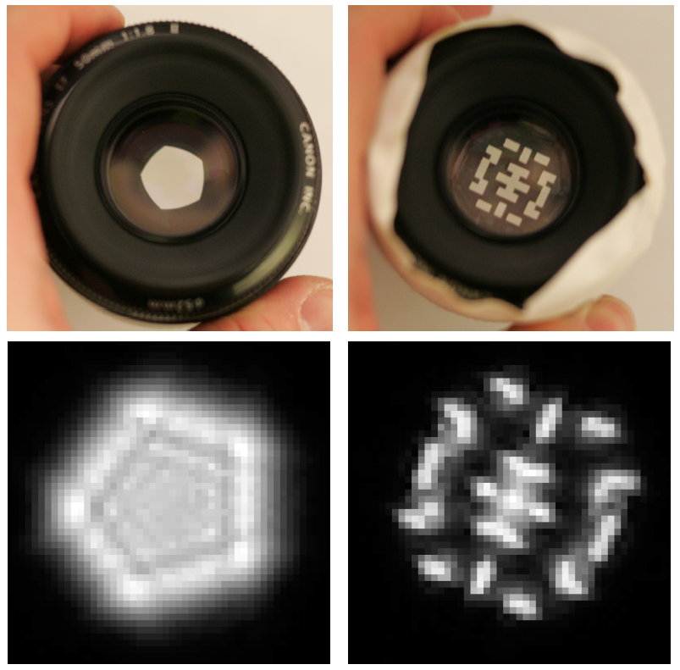
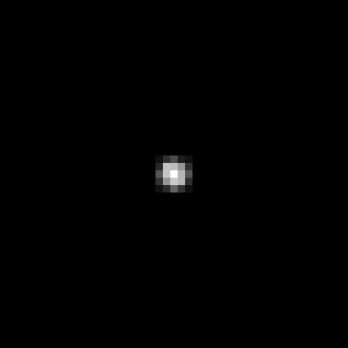
Lens and defocus
Lens’ aperture
Image of a point light source
Lens
Camera sensor
Point spread function
Focal plane

Slide 32
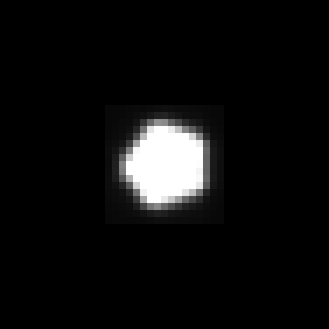
Lens and defocus
Lens’ aperture
Image of a defocused point light source
Object
Lens
Camera sensor
Point spread function
Focal plane

Slide 33
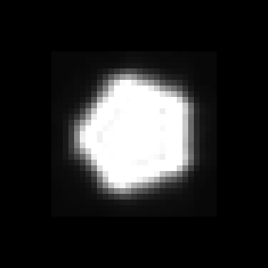
Lens and defocus
Lens’ aperture
Image of a defocused point light source
Object
Lens
Camera sensor
Point spread function
Focal plane

Slide 34
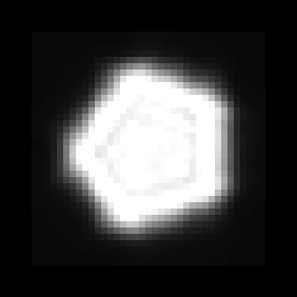
Lens and defocus
Lens’ aperture
Image of a defocused point light source
Object
Lens
Camera sensor
Point spread function
Focal plane

Slide 35
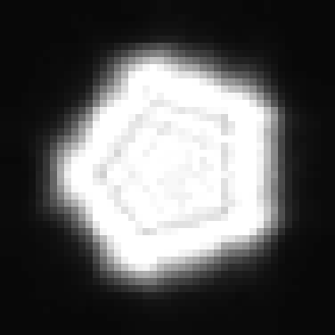
Lens and defocus
Lens’ aperture
Image of a defocused point light source
Object
Lens
Camera sensor
Point spread function
Focal plane

Slide 36
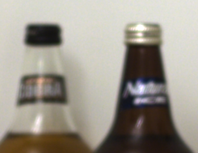
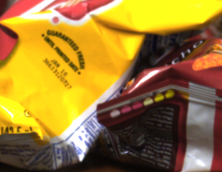
Depth and defocus
Out of focus
Depth from defocus:
Infer depth by analyzing local scale of defocus blur
ill posed
In focus
Notes:
Therefore, if we could measure the exact amount of defocus blur at every image location, we could infer the depth of the scene.
Unfortunately, despite many years of research there is no good way to measure defocus from a single input image. In fact, deconvolution is an inherently ill-posed problem, and we will see the reasons why in a bit.

Slide 37
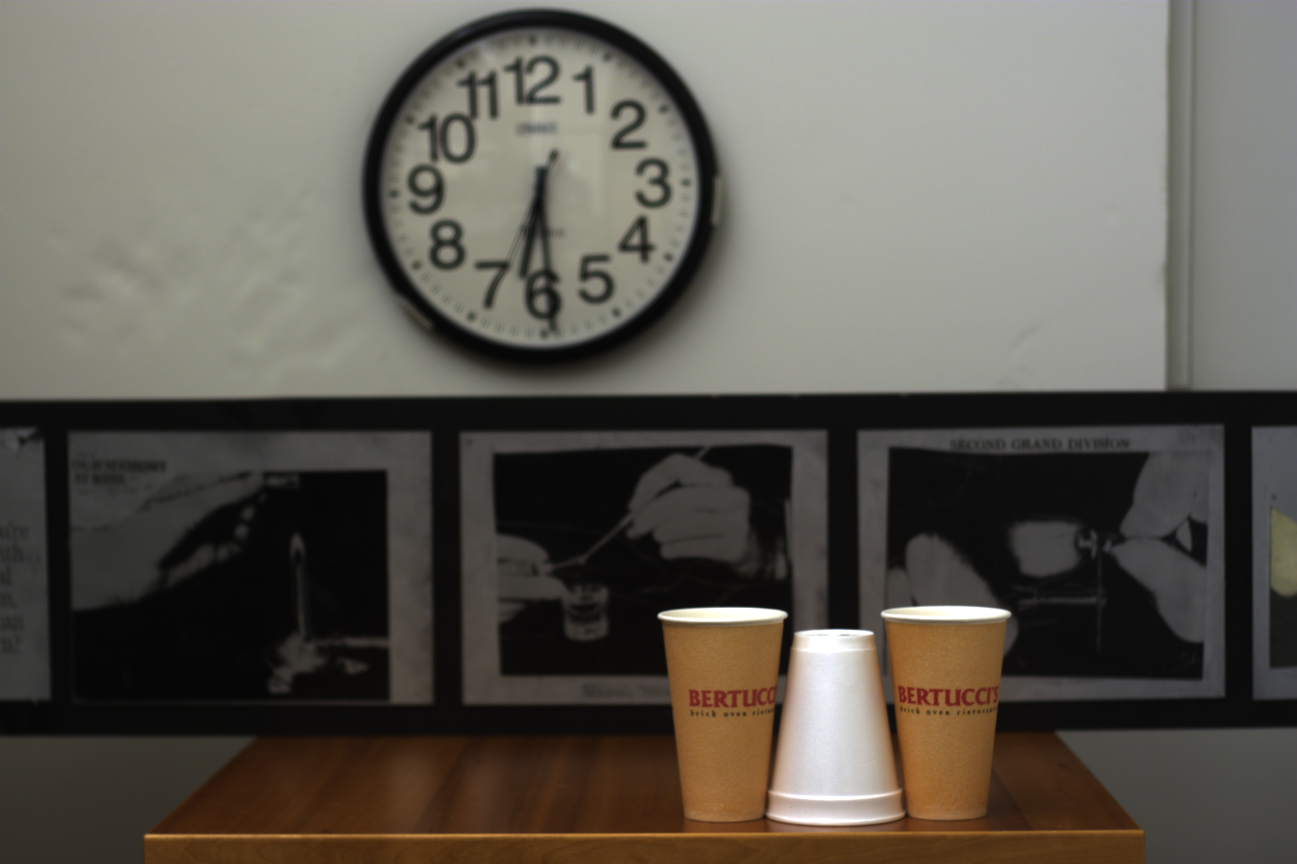
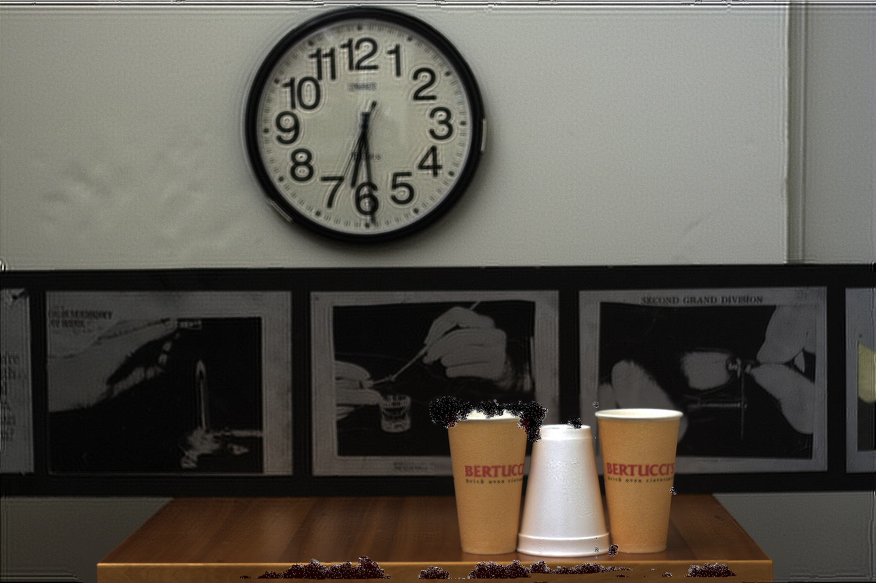
Challenges
Hard to discriminate a smooth scene from defocus blur
Hard to undo defocus blur
?
Out of focus
Input
Ringing with conventional deblurring algorithm
Notes:
Two of the challenges that make this problem hard are, firstly, that when observing a blurry image window it’s very hard to know: do we observe the blurry image of a sharp object, or the sharp image of a blurry scene. And the second challenge involved is that even if we could infer the depth, undoing the defocus blur is still not a straightforward task.

Slide 38
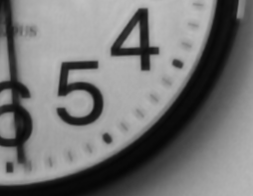
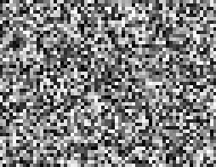
Key ideas
Exploit prior on natural images
- Improve deconvolution
- Improve depth discrimination
Coded aperture (mask inside lens)
- make defocus patterns different from natural images and easier to discriminate
Natural
Unnatural
Notes:
To address these challenges we use two main ideas. The first is the fact that typical images we observe around us are not just white noise, and we can impose strong image priors which will guide our search.
The second idea is to replace the conventional lens with a coded one, which allows us to change the defocus pattern and make it more discriminative to depth variations.

Slide 39
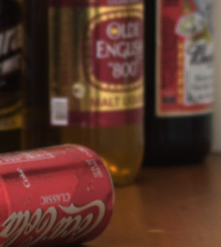
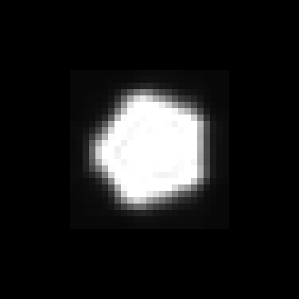
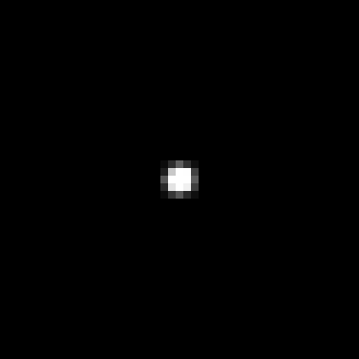
Defocus as local convolution
Calibrated blur kernels at different depths
Input defocused image
Notes:
Now let’s define the problem mathematically. Our input is a single defocused image. In addition, we can calibrate and pre-store the lens blur at different depths.

Slide 40





Defocus as local convolution
Input defocused image
Local sub-window
Calibrated blur kernels at depth
Sharp sub-window
Depth k=1:
Depth k=2:
Depth k=3:

Slide 41




Overview
Try deconvolving local input windows with different scaled filters:
?
Larger scale
?
Correct scale
?
Smaller scale
Somehow: select best scale.

Slide 42

Challenges
Hard to deconvolve even when kernel is known
Hard to deconvolve even when kernel is known
Input
Ringing with the traditional Richardson-Lucy deconvolution algorithm
Hard to identify correct scale:
?
Larger scale
?
Correct scale
?
Smaller scale

Slide 43
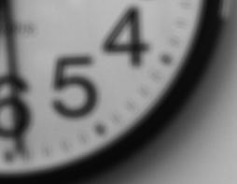
Deconvolution is ill posed
?
=

Slide 44
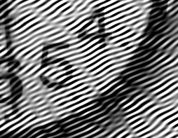

Deconvolution is ill posed
Solution 1:
=
?
Solution 2:
=
?

Slide 45
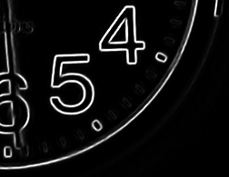
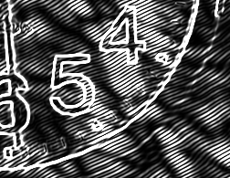
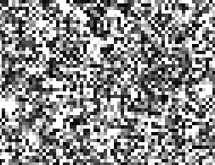
Idea 1: Natural images prior
What makes images special?
Natural
Unnatural
Image
gradient
Natural images have sparse gradients
put a penalty on gradients

Slide 46
Deconvolution with prior
Convolution error
Derivatives prior
2
_
+
?
Low
Equal convolution error
2
_
+
?
High

Slide 47
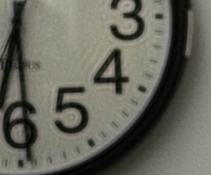

Comparing deconvolution algorithms
(Non blind) deconvolution code available online: http://groups.csail.mit.edu/graphics/CodedAperture/
Input
“spread” gradients
“localizes” gradients
Richardson-Lucy
Gaussian prior
Sparse prior

Slide 48
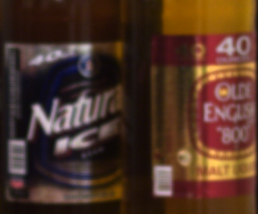



Comparing deconvolution algorithms
(Non blind) deconvolution code available online: http://groups.csail.mit.edu/graphics/CodedAperture/
Input
“spread” gradients
“localizes” gradients
Richardson-Lucy
Gaussian prior
Sparse prior

Slide 49
Recall: Overview
Try deconvolving local input windows with different scaled filters:
Larger scale
?
Correct scale
?
?
Smaller scale
Somehow: select best scale.
Challenge: smaller scale not so different than correct

Slide 50
Idea 2: Coded Aperture
Mask (code) in aperture plane
- make defocus patterns different from natural images and easier to discriminate
Conventional aperture
Our coded aperture

Slide 51
Idea 2: Coded Aperture
Mask (code) in aperture plane
- make defocus patterns different from natural images and easier to discriminate
Conventional aperture
Coded
aperture

Slide 52


Idea 2: Coded Aperture
Mask (code) in aperture plane
- make defocus patterns different from natural images and easier to discriminate
Coded
aperture

Slide 53
Solution: lens with occluder
Object
Lens
Camera sensor
Point spread function
Focal plane

Slide 54

Solution: lens with occluder
Aperture pattern
Image of a defocused point light source
Object
Lens with coded aperture
Camera sensor
Point spread function
Focal plane

Slide 55

Solution: lens with occluder
Aperture pattern
Image of a defocused point light source
Object
Lens with coded aperture
Camera sensor
Point spread function
Focal plane

Slide 56
Solution: lens with occluder
Aperture pattern
Image of a defocused point light source
Object
Lens with coded aperture
Camera sensor
Point spread function
Focal plane

Slide 57
Solution: lens with occluder
Aperture pattern
Image of a defocused point light source
Object
Lens with coded aperture
Camera sensor
Point spread function
Focal plane

Slide 58
Solution: lens with occluder
Aperture pattern
Image of a defocused point light source
Object
Lens with coded aperture
Camera sensor
Point spread function
Focal plane

Slide 59



Coded aperture reduces uncertainty in scale identification
Conventional
Coded
Larger scale
Correct scale
Smaller scale

Slide 60





Convolution- frequency domain representation
Sharp Image
spectrum
=
1st observed image
Frequency
spectrum
Filter, 1st scale
spectrum
Frequency
Frequency
Sharp Image
spectrum
=
2nd observed image
Frequency
spectrum
Filter, 2nd scale
spectrum
Frequency
Frequency
Output spectrum has zeros where filter spectrum has zeros
Spatial convolution frequency multiplication

Slide 61

Coded aperture: Scale estimation and division by zero
Estimated image
?
spectrum
Frequency
=
Observed image
Filter, correct scale
spectrum
spectrum
Frequency
Frequency
Large magnitude in image to compensate for tiny magnitude in filter
Estimated image
?
spectrum
Frequency
=
Filter, wrong scale
spectrum
spatial ringing
Frequency

Slide 62




Division by zero with a conventional aperture?
Estimated image
?
spectrum
Frequency
=
Observed image
Filter, correct scale
spectrum
spectrum
Frequency
Frequency
Estimated image
?
spectrum
no spatial ringing
Frequency
=
Filter, wrong scale
spectrum
Frequency

Slide 63




Filter Design
Analytically search for a pattern maximizing discrimination between images at different defocus scales (KL-divergence)
Account for image prior and physical constraints
Score
More discrimination between scales
Less discrimination between scales
Sampled aperture patterns
Conventional aperture

Slide 64
Depth results

Slide 65


Regularizing depth estimation
Try deblurring with 10 different aperture scales
Convolution error
Derivatives prior
2
_
+
Keep minimal error scale in each local window
+ regularization
Input
Local depth estimation
Regularized depth

Slide 66

Regularizing depth estimation
Local depth estimation
Input
Regularized depth

Slide 67
All focused results

Slide 68

Input

Slide 69

All-focused (deconvolved)
Notes:
Unlike conventional plenoptic cameras, our approach produces images at full resolution, which in this case exceeds that of the projector, so we need to zoom in to see better.

Slide 70
Close-up
Original image
All-focus image

Slide 71

Comparison- conventional aperture result
Ringing due to wrong scale estimation

Slide 72
Comparison- coded aperture result

Slide 73

Input

Slide 74

All-focused (deconvolved)

Slide 75


Close-up
Original image
All-focus image
Naïve sharpening
Notes:
Zooming in, we can see the original and deblurred output. For comparison, we also try a naive edge sharpening operation using simply a Laplacian filer, but it simply increases the artifacts in the image.

Slide 76

Application: Digital refocusing from a single image

Slide 77

Application: Digital refocusing from a single image

Slide 78

Application: Digital refocusing from a single image

Slide 79

Application: Digital refocusing from a single image

Slide 80

Application: Digital refocusing from a single image

Slide 81

Application: Digital refocusing from a single image

Slide 82

Application: Digital refocusing from a single image

Slide 83


Coded aperture: pros and cons
+
Image AND depth at a single shot
No loss of image resolution
Simple modification to lens
Depth is coarse
But depth is a pure bonus
Lose some light
But deconvolution increases depth of field
+
+
-
unable to get depth at untextured areas, might need manual corrections.
+
-
+

Slide 84


50mm f/1.8:
$79.95
Cardboard:
$1
Tape:
$1
Depth acquisition:
priceless

Slide 85
Some more quick examples

Slide 86

Quickly move camera in a parabola when taking a picture
A motion at any speed in the direction of the parabola will give the same blur kernel

Slide 87


Results
Static Camera
Parabolic Camera

Slide 88

Results
Static Camera
Parabolic Camera
Motion in wrong direction

Slide 89



Slide 90
Recap of questions
How can we represent all of the information contained in light?
What are the fundamental limitations of cameras?
What sacrifices have we made in conventional cameras? For what benefits?
How else can we design cameras for better focus, deblurring, multiple views, depth, etc.?
Notes:
Answers:
1) Plenoptic function
2) Amount of light
3) Limit light and get depth of field effects; sharp images that are easy to display
4) Lots of ways

Slide 91

Next class
Exam review

