Slide 1
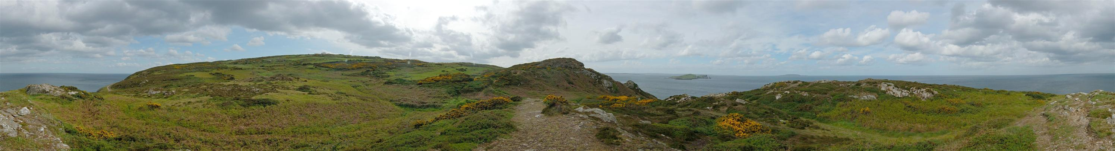
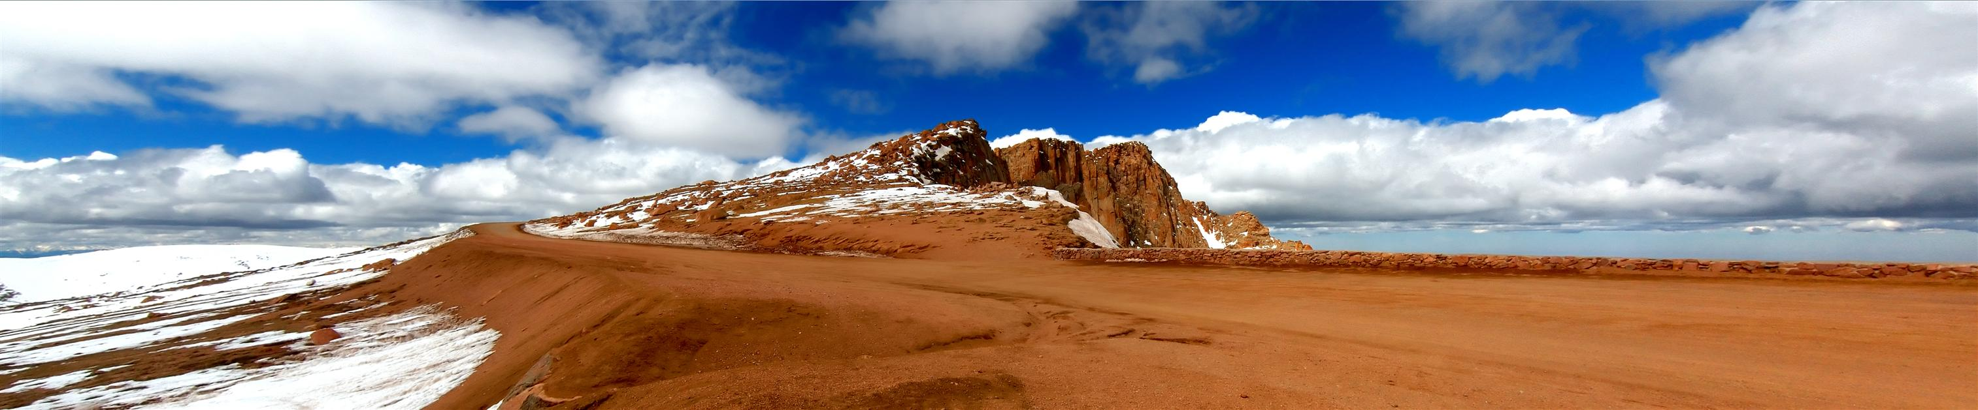
10/27/15
Image Stitching
Computational Photography
Derek Hoiem, University of Illinois
Photos by Russ Hewett

Slide 2
Project 3 Highlights
For good/interesting blending results: (really, most pages fit here)
https://web.engr.illinois.edu/~cchen156/cs445/proj3/
https://web.engr.illinois.edu/~ulzeean2/cs445/proj3/
https://web.engr.illinois.edu/~bechapm2/cs445/proj3/
https://web.engr.illinois.edu/~gubatan2/cs445/proj3/
https://web.engr.illinois.edu/~zli16/cs445/proj3/
https://web.engr.illinois.edu/~ramados2/cs445/proj3/
https://web.engr.illinois.edu/~hoskere2/cs445/proj3/
https://web.engr.illinois.edu/~mwakaba2/cs445/proj3/
For overall correctness of implementation (including the color2gray section):
https://web.engr.illinois.edu/~yhsu30/cs445/proj3/
For NPR:
https://web.engr.illinois.edu/~mnmeyer2/cs445/proj3/
https://web.engr.illinois.edu/~myeh2/cs445/proj3/ (+ other good results)

Slide 3
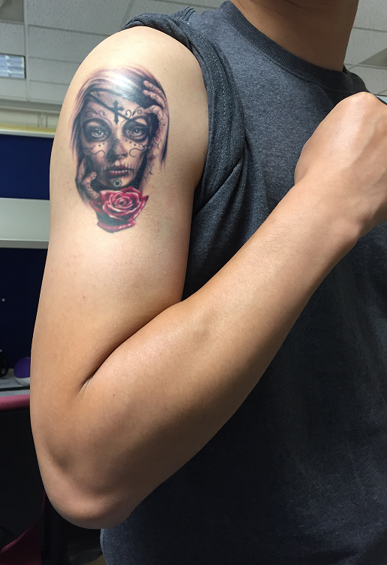
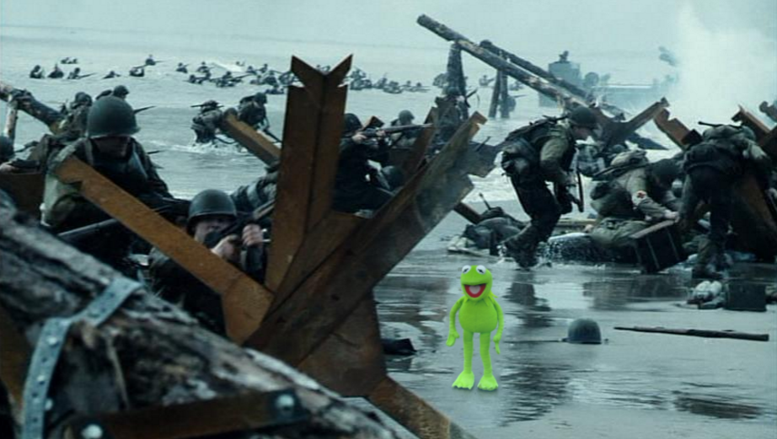
Project 3 Results
Ulzee An
Chen Chen

Slide 4

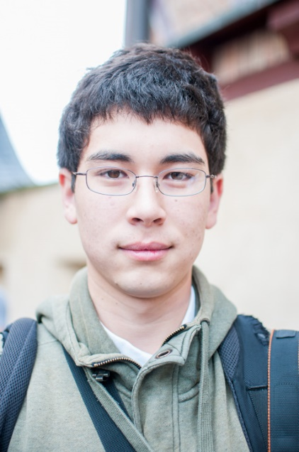
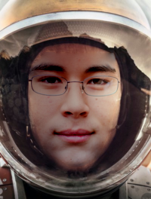
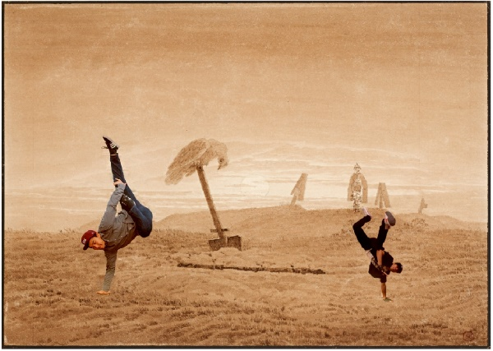
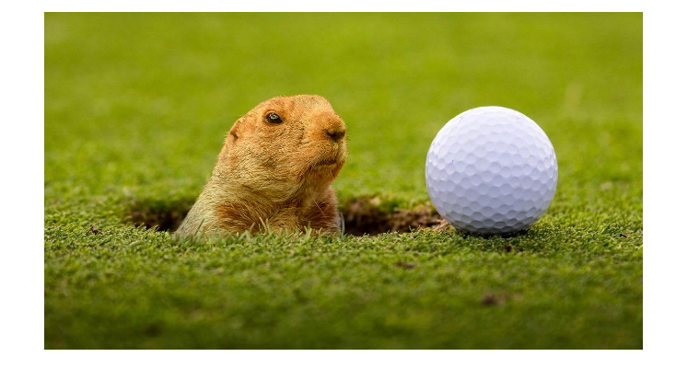
Project 3 Results
+
=
Blade Chapman
Mark Gubutan
Vivek Ramadoss

Slide 5

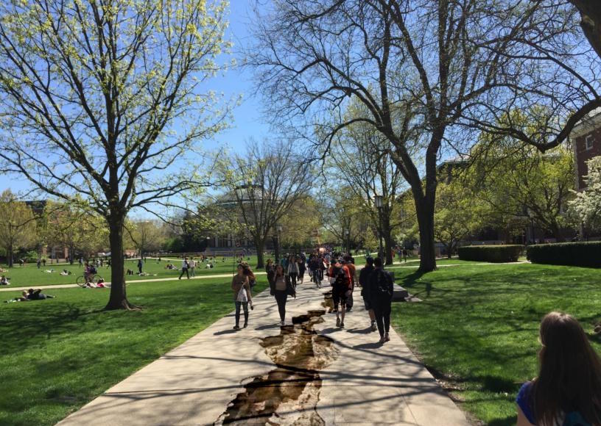
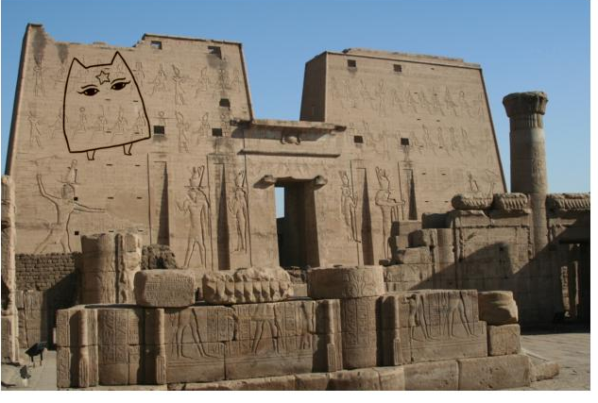
Mao-Chuang Yeh
Zhenbang Li
Yao-Tsung Hsu

Slide 6
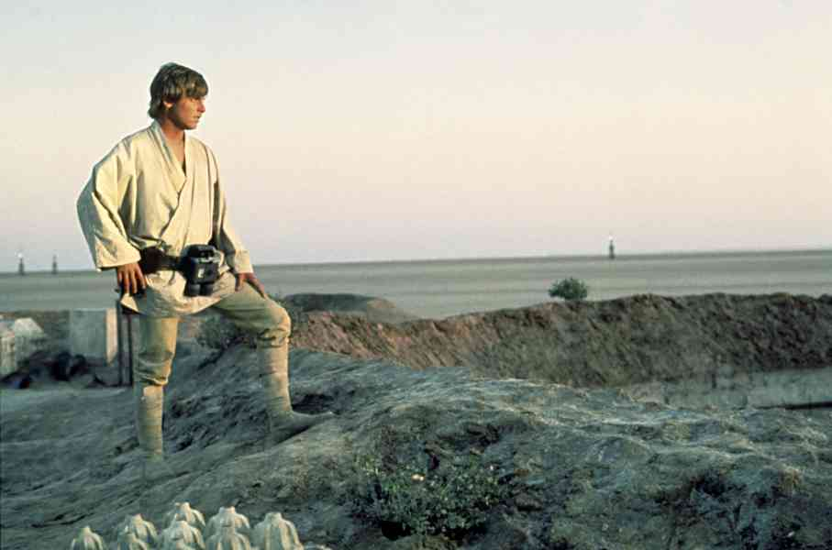
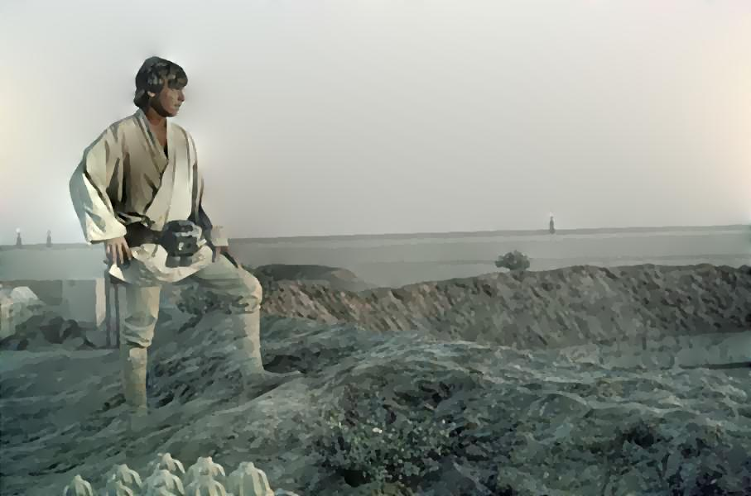
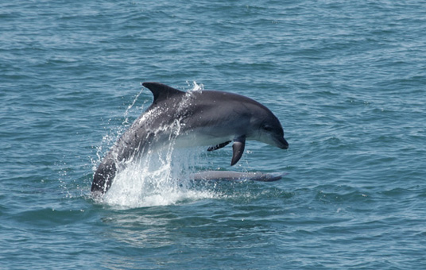
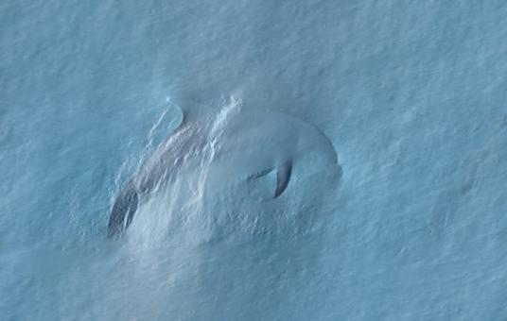
Michael Meyer (Texture Flattening)
Vedhus Hoskere (Gloss Effect)

Slide 7
Project 5
Input video:
https://www.youtube.com/watch?v=agI5za_gHHU
Aligned frames:
https://www.youtube.com/watch?v=Uahy6kPotaE
Background:
https://www.youtube.com/watch?v=Vt9vv1zCnLA
Foreground:
https://www.youtube.com/watch?v=OICkKNndEt4

Slide 8
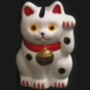



Last Class: Keypoint Matching
1. Find a set of
distinctive key-
points
A₁
B₃
2. Define a region
around each
keypoint
A₂
A₃
B₁
B₂
3. Extract and
normalize the
region content
4. Compute a local
descriptor from the
normalized region
5. Match local
descriptors

Slide 9
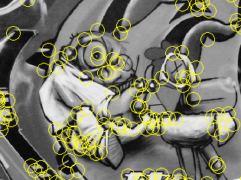
Last Class: Summary
Keypoint detection: repeatable and distinctive
  Corners, blobs
  Harris, DoG
Descriptors: robust and selective
  SIFT: spatial histograms of gradient orientation

Slide 10
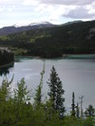
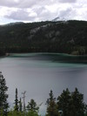
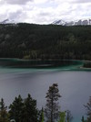
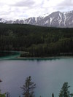
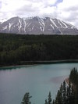
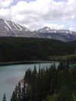
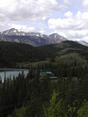
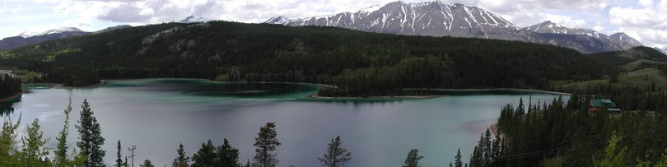
Today: Image Stitching
Combine two or more overlapping images to make one larger image
Add example
Slide credit: Vaibhav Vaish

Slide 11
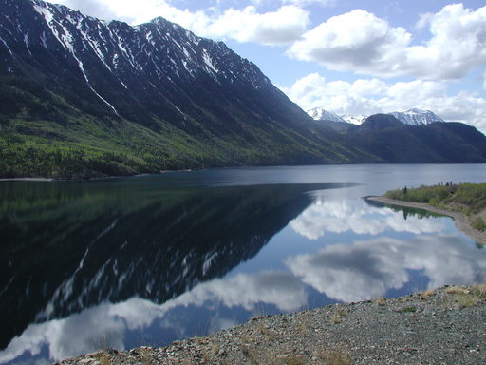
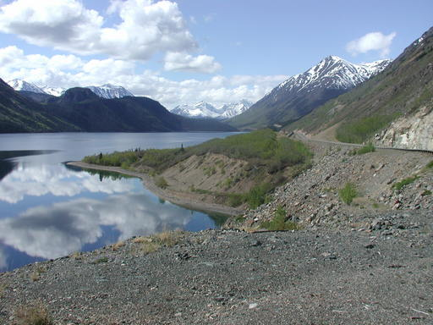
Views from rotating camera
Camera Center

Slide 12
Photo stitching
P
Q
Camera Center

Slide 13
Problem basics
Do on board

Slide 14
Basic problem
x = K [R t] X
x’ = K’ [R’ t’] X’
t=t’=0
x‘=Hx where H = K’ R’ R⁻¹ K⁻¹
Typically only R and f will change (4 parameters), but, in general, H has 8 parameters
.
X
x
x'
f
f'

Slide 15
Image Stitching Algorithm Overview
Detect keypoints
Match keypoints
Estimate homography with four matched keypoints (using RANSAC)
Project onto a surface and blend

Slide 16
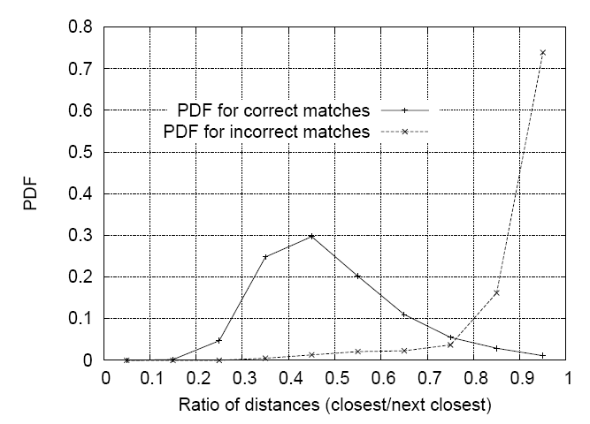
Image Stitching Algorithm Overview
Detect/extract keypoints (e.g., DoG/SIFT)
Match keypoints (most similar features, compared to 2nd most similar)

Slide 17
Computing homography
Assume we have four matched points: How do we compute homography H?
Direct Linear Transformation (DLT)

Slide 18
Computing homography
Direct Linear Transform
Apply SVD: UDV^{T} = A
h = V_{smallest} (column of V corr. to smallest singular value)
Matlab
[U, S, V] = svd(A);
h = V(:, end);
Notes:
SVD gives the homogeneous least squares solution constrained to have a norm of 1

Slide 19
Computing homography
Assume we have four matched points: How do we compute homography H?
Normalized DLT
Normalize coordinates for each image
  Translate for zero mean
  Scale so that u and v are ~=1 on average
  This makes problem better behaved numerically (see Hartley and Zisserman p. 107-108)
Compute using DLT in normalized coordinates
Unnormalize:

Slide 20
Computing homography
Assume we have matched points with outliers: How do we compute homography H?
Automatic Homography Estimation with RANSAC

Slide 21
RANSAC: RANdom SAmple Consensus
Scenario: We’ve got way more matched points than needed to fit the parameters, but we’re not sure which are correct
RANSAC Algorithm
Repeat N times
  Randomly select a sample
  Select just enough points to recover the parameters
  Fit the model with random sample
  See how many other points agree
Best estimate is one with most agreement
  can use agreeing points to refine estimate

Slide 22
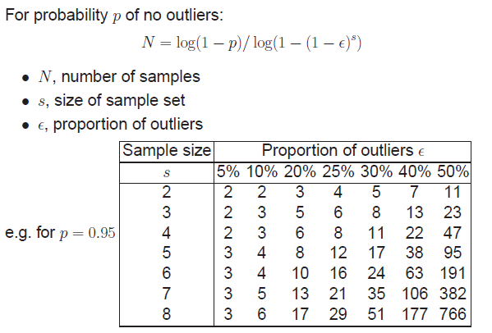
Computing homography
Assume we have matched points with outliers: How do we compute homography H?
Automatic Homography Estimation with RANSAC
Choose number of samples N
HZ Tutorial ‘99

Slide 23
Computing homography
Assume we have matched points with outliers: How do we compute homography H?
Automatic Homography Estimation with RANSAC
Choose number of samples N
Choose 4 random potential matches
Compute H using normalized DLT
Project points from x to x’ for each potentially matching pair:
Count points with projected distance < t
  E.g., t = 3 pixels
Repeat steps 2-5 N times
  Choose H with most inliers
HZ Tutorial ‘99

Slide 24
Automatic Image Stitching
Compute interest points on each image
Find candidate matches
Estimate homography H using matched points and RANSAC with normalized DLT
Project each image onto the same surface and blend

Slide 25
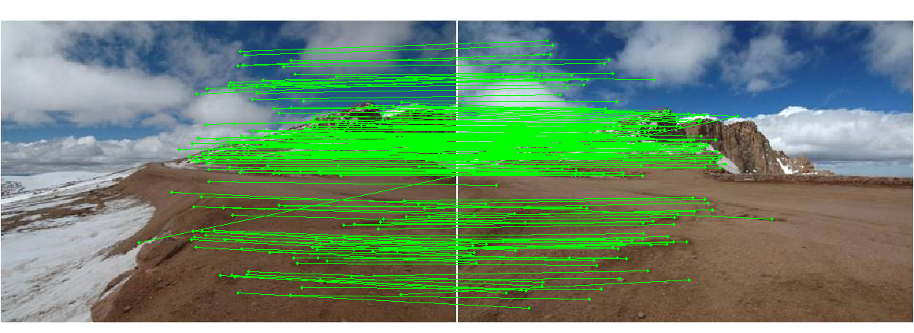
Choosing a Projection Surface
Many to choose: planar, cylindrical, spherical, cubic, etc.

Slide 26
Planar Mapping
x
x
f
f
For red image: pixels are already on the planar surface
For green image: map to first image plane

Slide 27
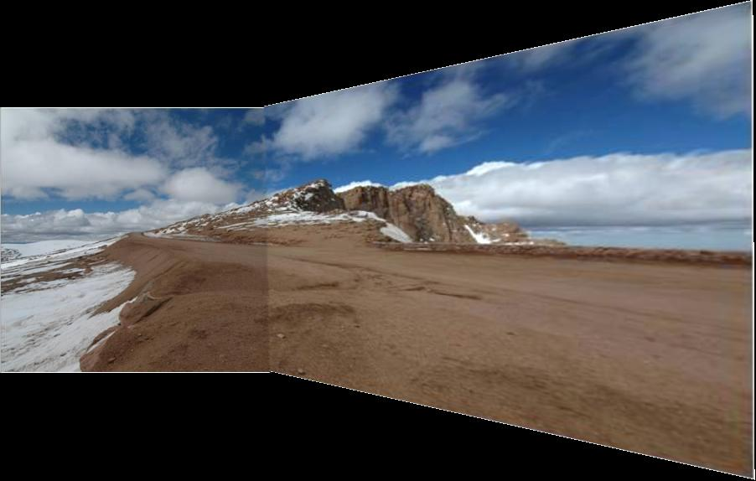
Planar vs. Cylindrical Projection
Planar
Photos by Russ Hewett

Slide 28
Planar vs. Cylindrical Projection
Planar

Slide 29
Cylindrical Mapping
x
x
f
f
For red image: compute h, theta on cylindrical surface from (u, v)
For green image: map to first image plane, than map to cylindrical surface

Slide 30
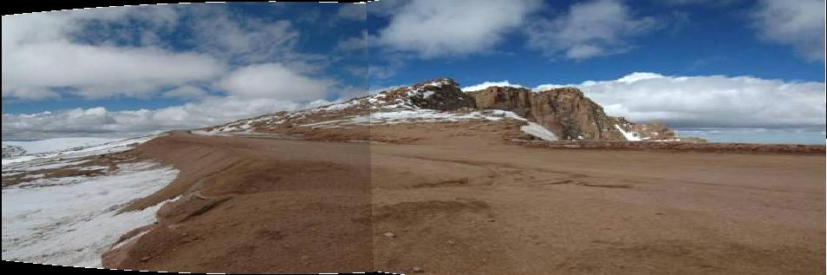
Planar vs. Cylindrical Projection
Cylindrical

Slide 31
Planar vs. Cylindrical Projection
Cylindrical

Slide 32
Planar
Cylindrical

Slide 33
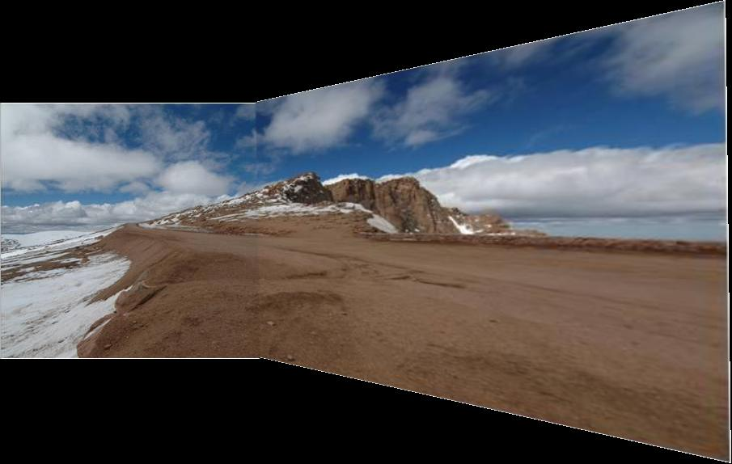
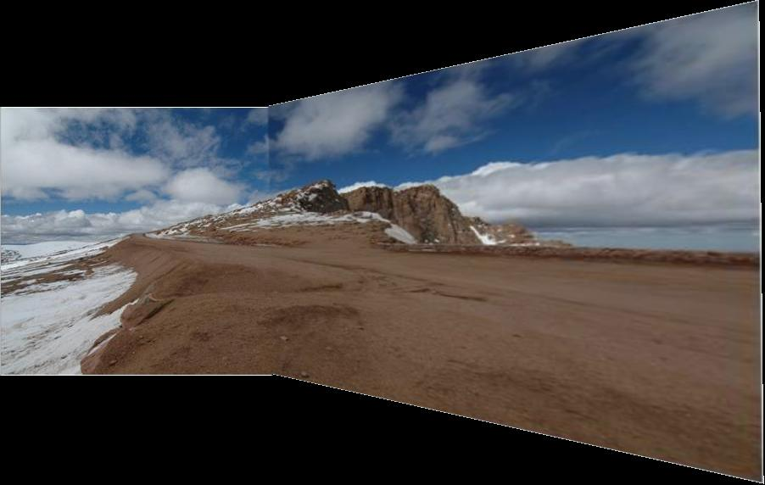
Simple gain adjustment

Slide 34
Automatically choosing images to stitch

Slide 35
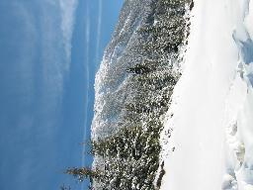
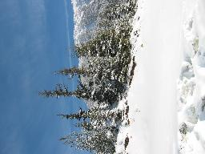
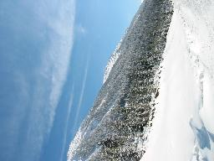
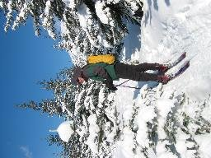
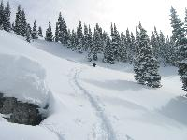
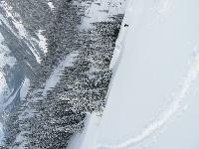
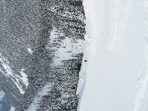
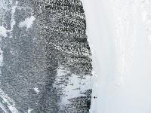
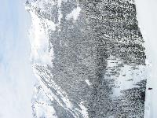
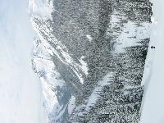
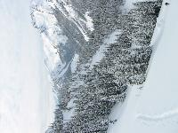
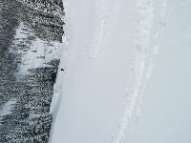
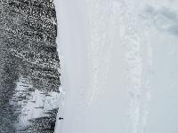
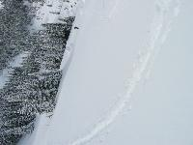
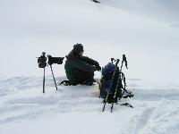
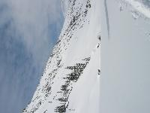
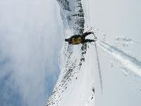











Recognizing Panoramas
Some of following material from Brown and Lowe 2003 talk
Brown and Lowe 2003, 2007

Slide 36
Recognizing Panoramas
Input: N images
Extract SIFT points, descriptors from all images
Find K-nearest neighbors for each point (K=4)
For each image
  Select M candidate matching images by counting matched keypoints (M=6)
  Solve homography H_{ij} for each matched image

Slide 37
Recognizing Panoramas
Input: N images
Extract SIFT points, descriptors from all images
Find K-nearest neighbors for each point (K=4)
For each image
  Select M candidate matching images by counting matched keypoints (M=6)
  Solve homography H_{ij} for each matched image
  Decide if match is valid (n_{i} > 8 + 0.3 n_{f} )
# inliers
# keypoints in overlapping area

Slide 38




RANSAC for Homography
Initial Matched Points

Slide 39


RANSAC for Homography
Final Matched Points

Slide 40


Verification

Slide 41

RANSAC for Homography

Slide 42
Recognizing Panoramas (cont.)
(now we have matched pairs of images)
Find connected components

Slide 43
Finding the panoramas

Slide 44
Finding the panoramas

Slide 45
Finding the panoramas

Slide 46
Recognizing Panoramas (cont.)
(now we have matched pairs of images)
Find connected components
For each connected component
  Perform bundle adjustment to solve for rotation (θ₁, θ₂, θ₃) and focal length f of all cameras
  Project to a surface (plane, cylinder, or sphere)
  Render with multiband blending

Slide 47


Bundle adjustment for stitching
Non-linear minimization of re-projection error
where H = K’ R’ R⁻¹ K⁻¹
Solve non-linear least squares (Levenberg-Marquardt algorithm)
  See paper for details

Slide 48





































Bundle Adjustment
New images initialized with rotation, focal length of the best matching image

Slide 49

Bundle Adjustment
New images initialized with rotation, focal length of the best matching image

Slide 50
Blending
Gain compensation: minimize intensity difference of overlapping pixels
Blending
  Pixels near center of image get more weight
  Multiband blending to prevent blurring

Slide 51


Multi-band Blending (Laplacian Pyramid)
Burt & Adelson 1983
  Blend frequency bands over range ∝ λ

Slide 52

Multiband blending

Slide 53

Blending comparison (IJCV 2007)

Slide 54

Blending Comparison

Slide 55


Straightening
Rectify images so that “up” is vertical

Slide 56
Further reading
Harley and Zisserman: Multi-view Geometry book
DLT algorithm: HZ p. 91 (alg 4.2), p. 585
Normalization: HZ p. 107-109 (alg 4.2)
RANSAC: HZ Sec 4.7, p. 123, alg 4.6
Tutorial: http://users.cecs.anu.edu.au/~hartley/Papers/CVPR99-tutorial/tut_4up.pdf
Recognising Panoramas: Brown and Lowe, IJCV 2007 (also bundle adjustment)

Slide 57
Tips and Photos from Russ Hewett

Slide 58
Capturing Panoramic Images
Tripod vs Handheld
  Help from modern cameras
  Leveling tripod
  Gigapan
  Or wing it
Image Sequence
  Requires a reasonable amount of overlap (at least 15-30%)
  Enough to overcome lens distortion
Exposure
  Consistent exposure between frames
  Gives smooth transitions
  Manual exposure
  Makes consistent exposure of dynamic scenes easier
  But scenes don’t have constant intensity everywhere
Caution
  Distortion in lens (Pin Cushion, Barrel, and Fisheye)
  Polarizing filters
  Sharpness in image edge / overlap region

Slide 59



Pike’s Peak Highway, CO
Photo: Russell J. Hewett
Nikon D70s, Tokina 12-24mm @ 16mm, f/22, 1/40s

Slide 60
Pike’s Peak Highway, CO
Photo: Russell J. Hewett
(See Photo On Web)

Slide 61














360 Degrees, Tripod Leveled
Photo: Russell J. Hewett
Nikon D70, Tokina 12-24mm @ 12mm, f/8, 1/125s

Slide 62
Howth, Ireland
Photo: Russell J. Hewett
(See Photo On Web)

Slide 63









Handheld Camera
Photo: Russell J. Hewett
Nikon D70s, Nikon 18-70mm @ 70mm, f/6.3, 1/200s

Slide 64

Handheld Camera
Photo: Russell J. Hewett

Slide 65

Les Diablerets, Switzerland
Photo: Russell J. Hewett
(See Photo On Web)

Slide 66




Macro
Photo: Russell J. Hewett & Bowen Lee
Nikon D70s, Tamron 90mm Micro @ 90mm, f/10, 15s

Slide 67

Side of Laptop
Photo: Russell J. Hewett & Bowen Lee

Slide 68
Considerations For Stitching
Variable intensity across the total scene
Variable intensity and contrast between frames
Lens distortion
  Pin Cushion, Barrel, and Fisheye
  Profile your lens at the chosen focal length (read from EXIF)
  Or get a profile from LensFun
Dynamics/Motion in the scene
  Causes ghosting
  Once images are aligned, simply choose from one or the other
Misalignment
  Also causes ghosting
  Pick better control points
Visually pleasing result
  Super wide panoramas are not always ‘pleasant’ to look at
  Crop to golden ratio, 10:3, or something else visually pleasing

Slide 69




Ghosting and Variable Intensity
Photo: Russell J. Hewett
Nikon D70s, Tokina 12-24mm @ 12mm, f/8, 1/400s

Slide 70


Photo: Russell J. Hewett

Slide 71


Ghosting From Motion
Photo: Bowen Lee
Nikon e4100 P&S

Slide 72


Motion Between Frames
Photo: Russell J. Hewett
Nikon D70, Nikon 70-210mm @ 135mm, f/11, 1/320s

Slide 73


Photo: Russell J. Hewett

Slide 74

Gibson City, IL
Photo: Russell J. Hewett
(See Photo On Web)

Slide 75







Mount Blanca, CO
Photo: Russell J. Hewett
Nikon D70s, Tokina 12-24mm @ 12mm, f/22, 1/50s

Slide 76

Mount Blanca, CO
Photo: Russell J. Hewett
(See Photo On Web)

Slide 77
Things to remember
Homography relates rotating cameras
  Homography is plane to plane mapping
Recover homography using RANSAC and normalized DLT
Can choose surface of projection: cylinder, plane, and sphere are most common
Lots of room for tweaking (blending, straightening, etc.)

Slide 78
Next class
Object recognition and retrieval

