Slide 1
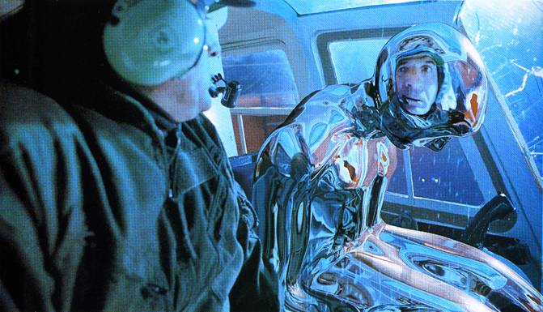
Image-based Lighting
10/13/15
T2
Computational Photography
Derek Hoiem, University of Illinois
Many slides from Debevec, some from Efros

Slide 2
Catching up from last class….

Slide 3
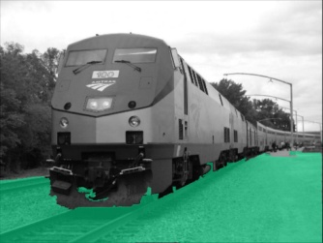
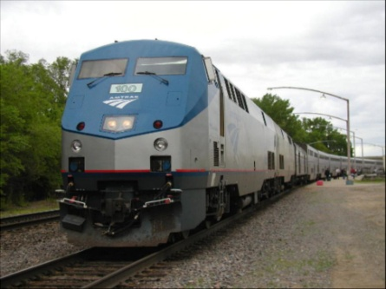
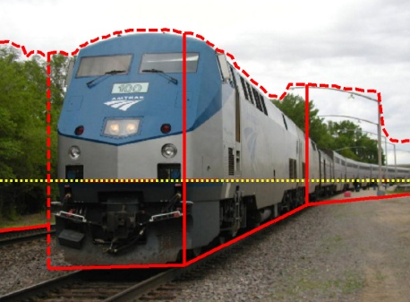
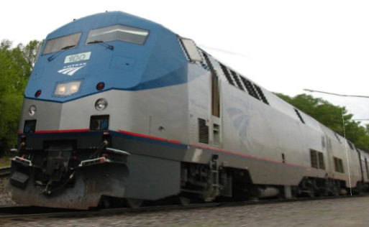
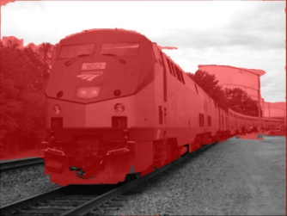












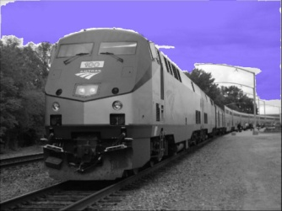
Automatic Photo Pop-up
Input
Geometric Labels
Cut’n’Fold
3D Model
Ground
Image
Vertical
Learned Models
Sky
Hoiem et al. 2005

Slide 4
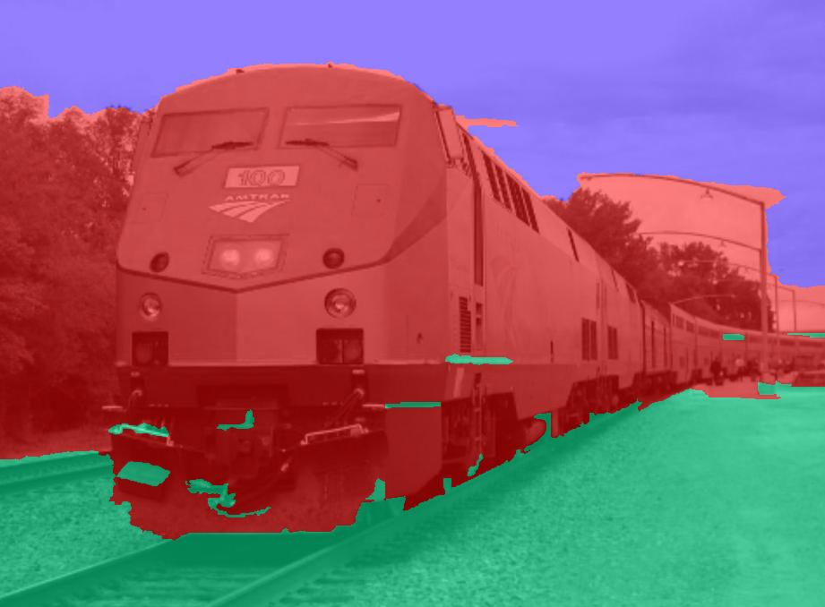
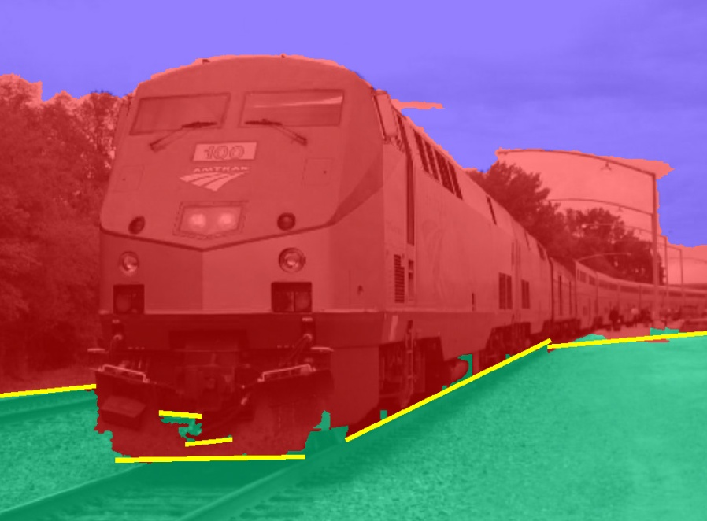
Cutting and Folding
Fit ground-vertical boundary
  Iterative Hough transform

Slide 5
Cutting and Folding
Form polylines from boundary segments
  Join segments that intersect at slight angles
  Remove small overlapping polylines
Estimate horizon position from perspective cues

Slide 6

Cutting and Folding
``Fold’’ along polylines and at corners
``Cut’’ at ends of polylines and along vertical-sky boundary

Slide 7
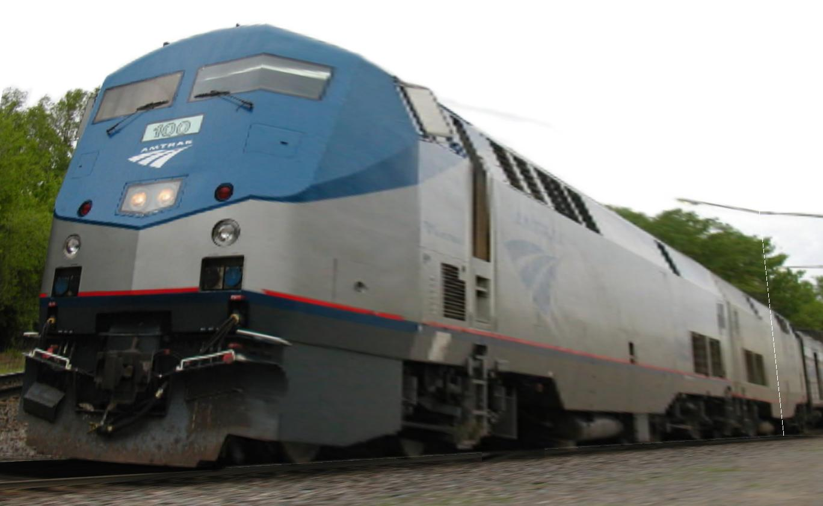
Cutting and Folding
Construct 3D model
Texture map

Slide 8
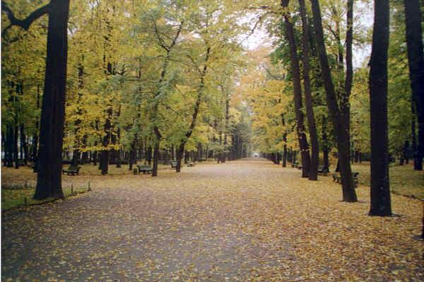
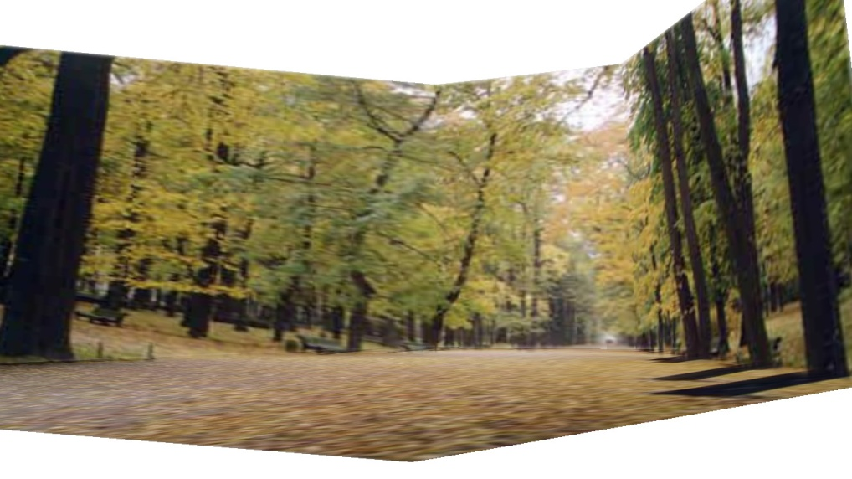
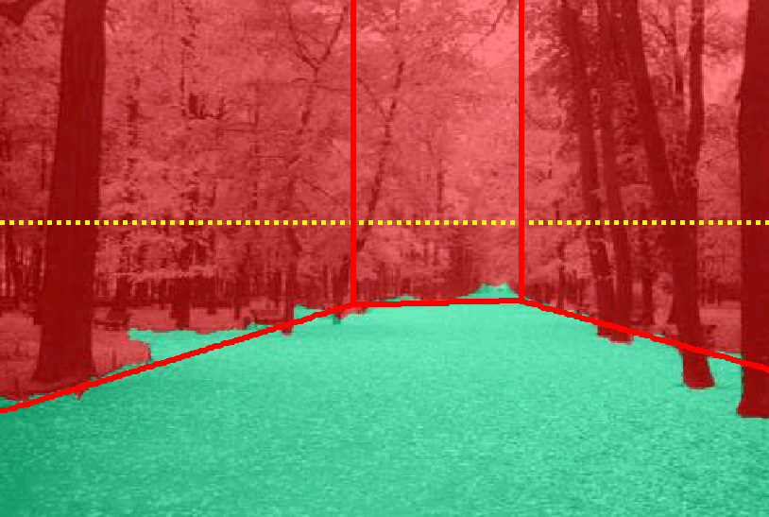
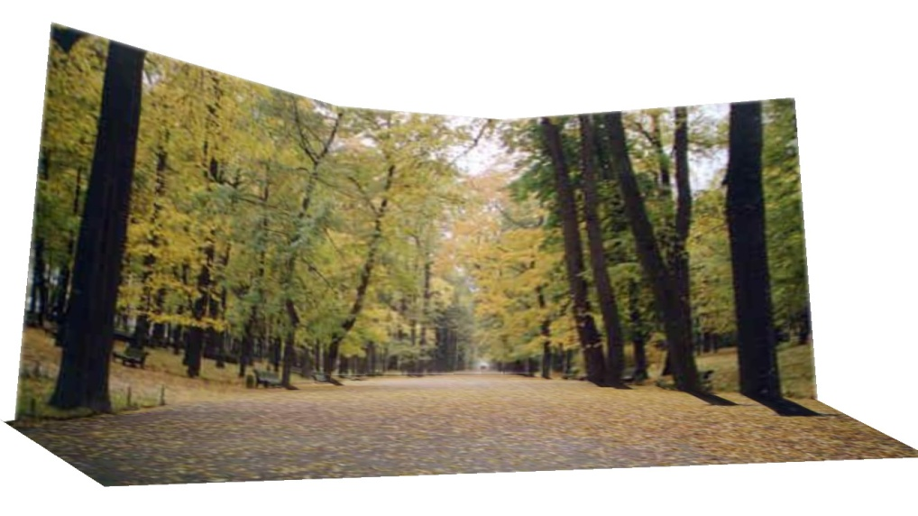
Results
http://www.cs.illinois.edu/homes/dhoiem/projects/popup/
Input Image
Cut and Fold
Automatic Photo Pop-up

Slide 9
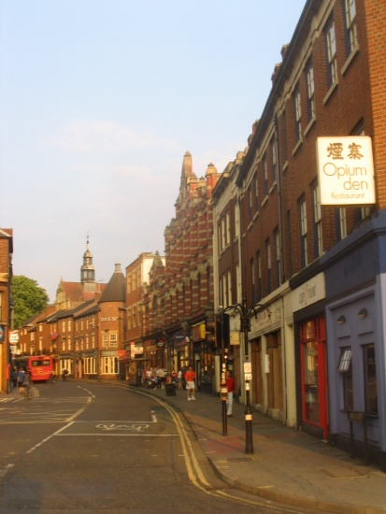
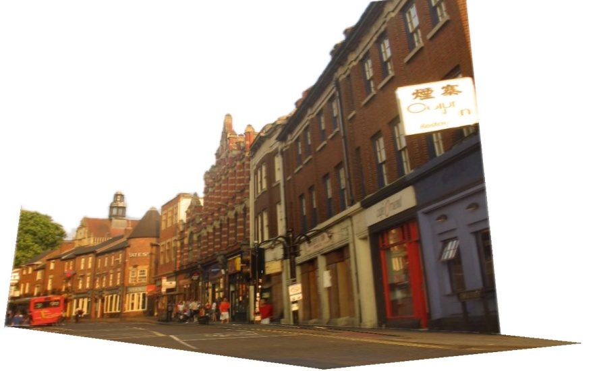
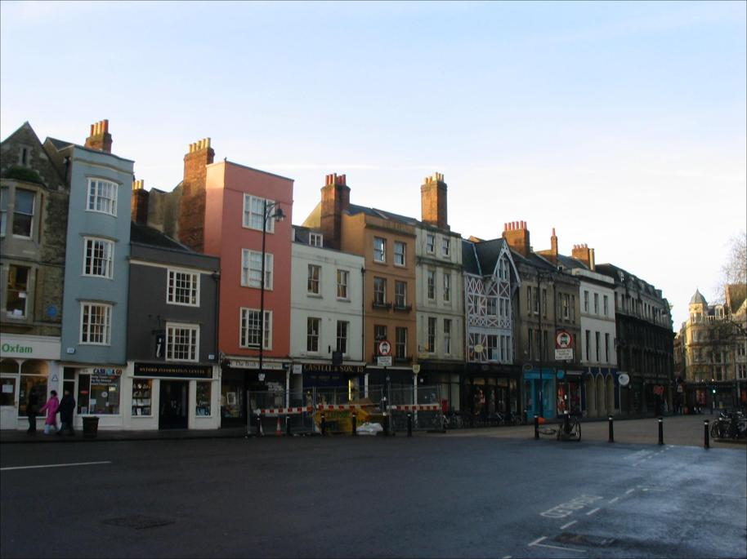
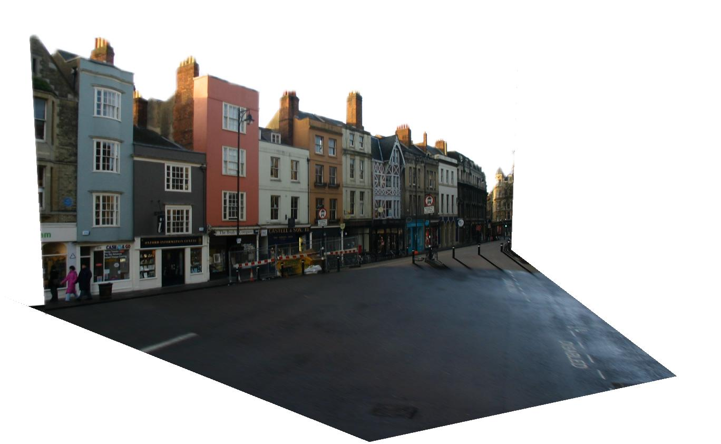
Results
Input Image
Automatic Photo Pop-up

Slide 10
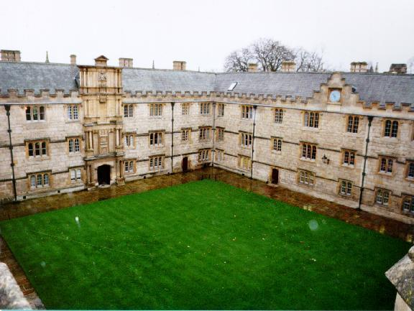
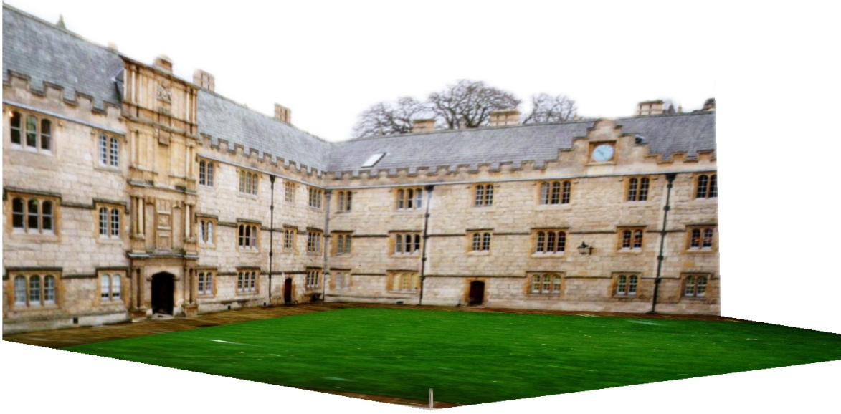
Comparison with Manual Method
[Liebowitz et al. 1999]
Input Image
Automatic Photo Pop-up (15 sec)!
Notes:
From the results of Liebowitz et al. As you can see, their model is slightly better in that the roof is slanted, but our method is fully automatic requiring none of the user’s time, while their method requires extensive manual labeling.

Slide 11
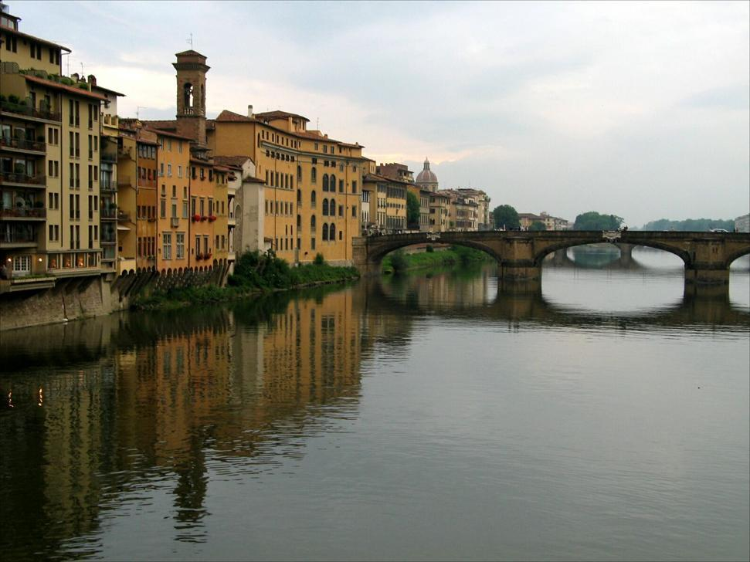
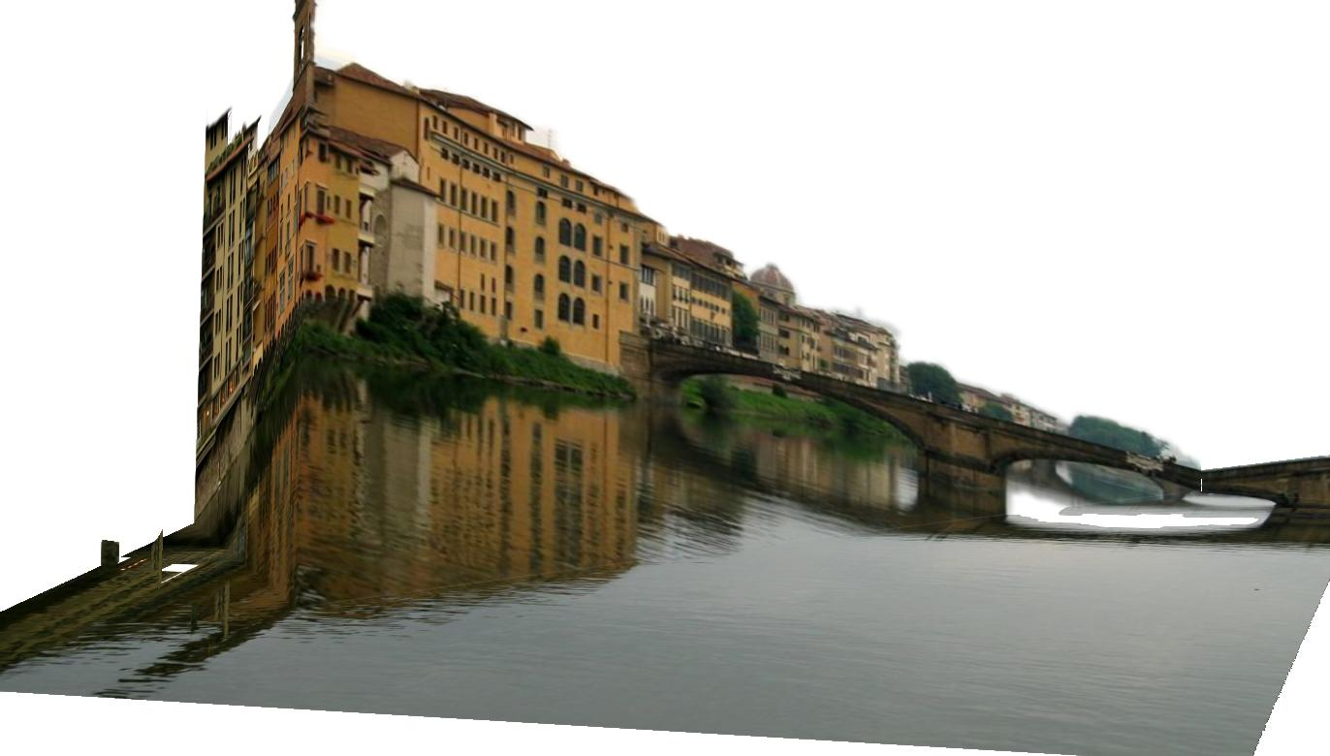
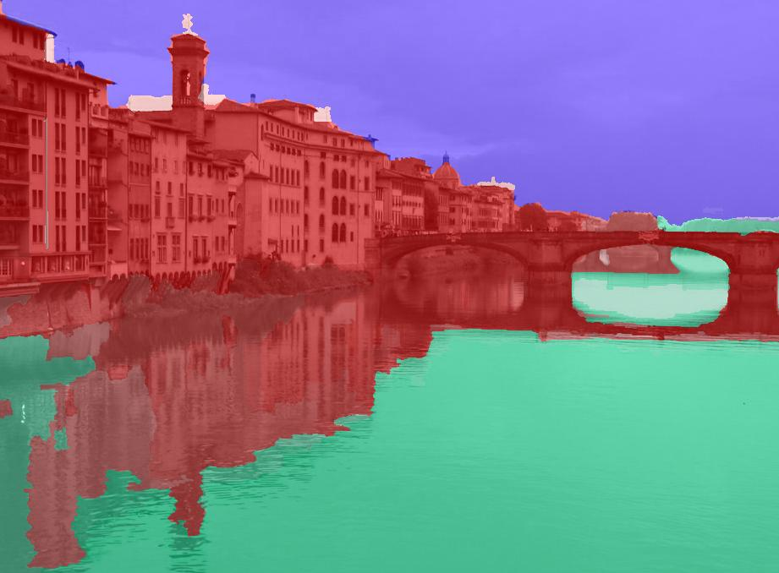
Failures
Labeling Errors

Slide 12
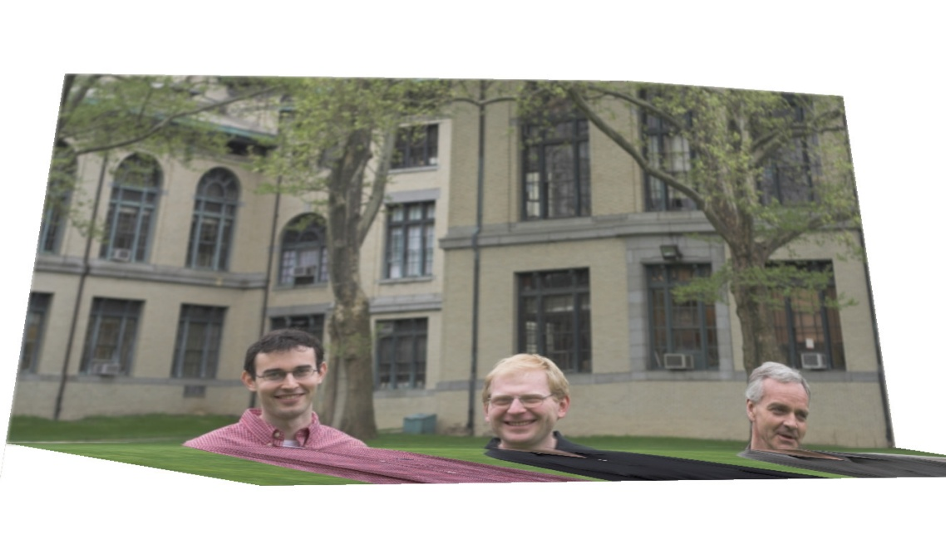
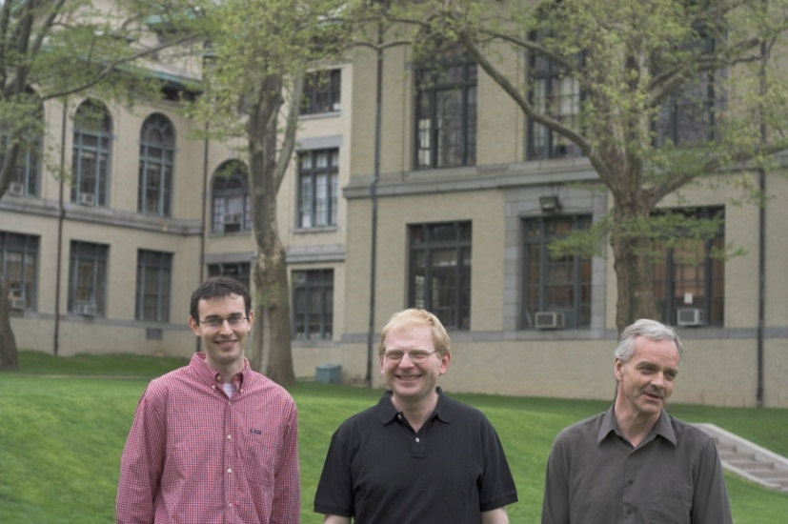
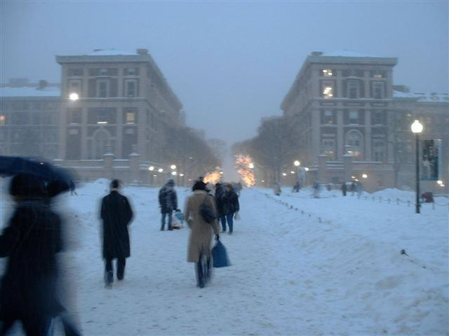
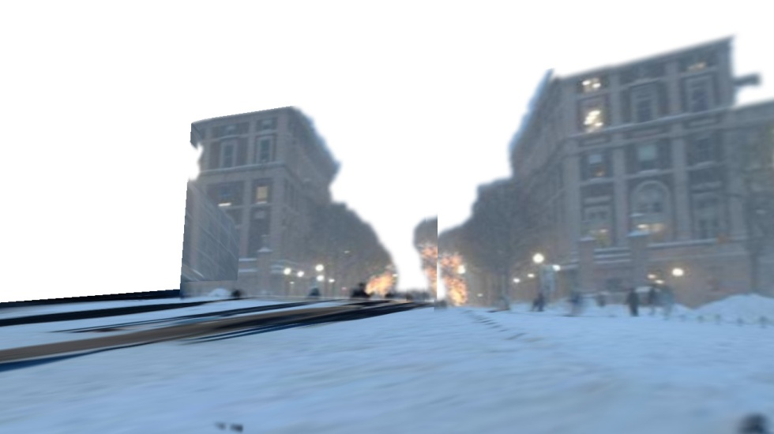
Failures
Foreground Objects

Slide 13
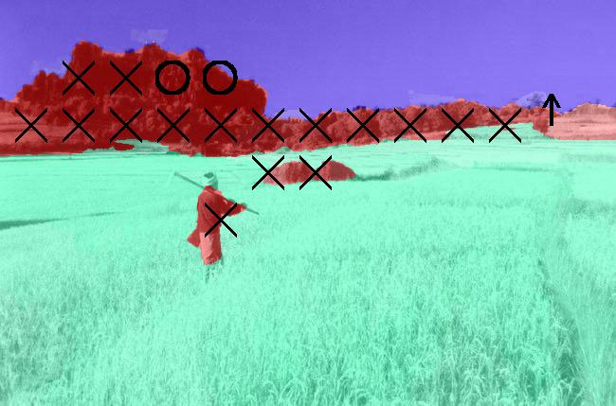
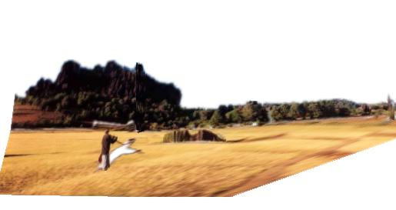
Adding Foreground Labels
Recovered Surface Labels +
Ground-Vertical Boundary Fit
Object Boundaries + Horizon

Slide 14
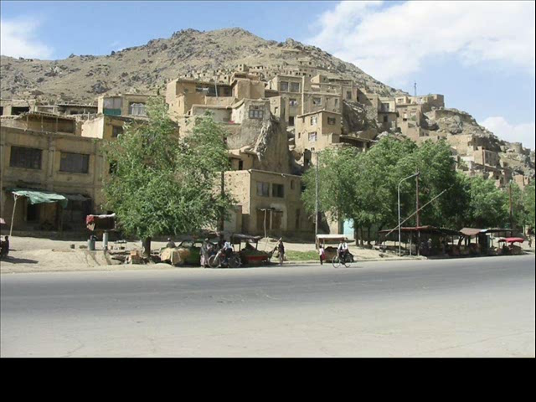
Notes:
Explain holes

Slide 15
Final project ideas
If a one-person project:
  Interactive program to make 3D model from an image (e.g., output in VRML, or draw path for animation)
If a two-person team, 2nd person:
  Add tools for cutting out foreground objects and automatic hole-filling

Slide 16
Next two classes
Today
Start on ray tracing, environment maps, and relighting 3D objects (project 4 topics)
Thursday
More HDR, light probes, etc.

Slide 17
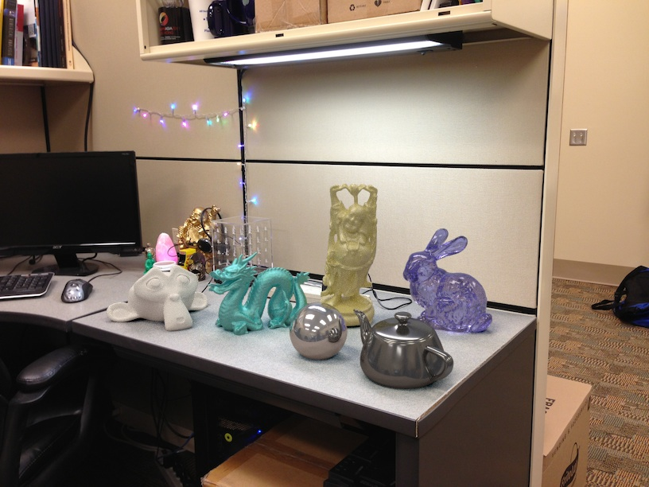
Project 4

Slide 18
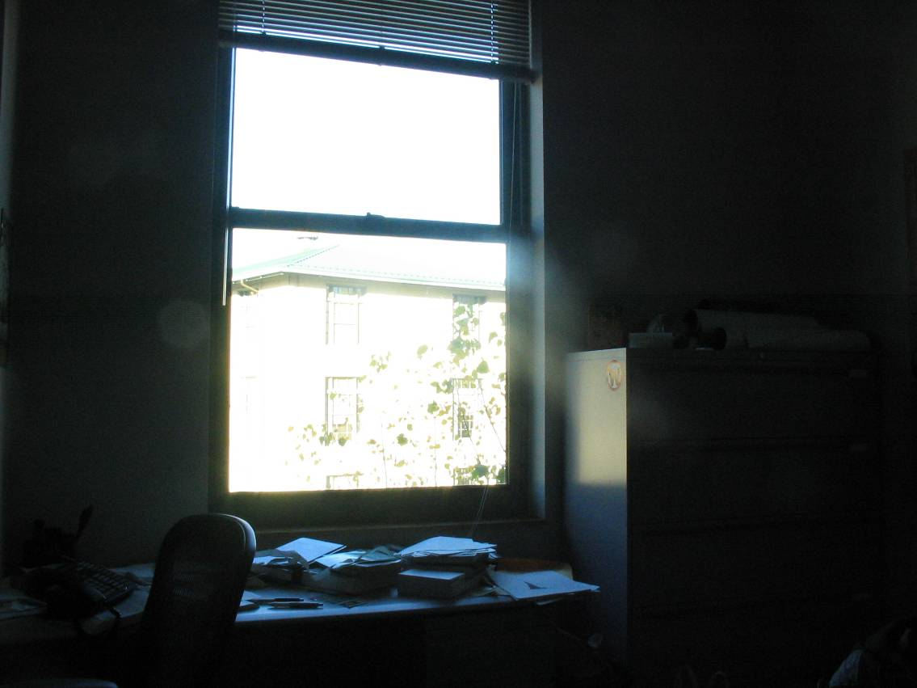
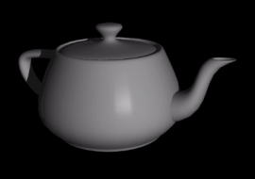
How to render an object inserted into an image?
What’s wrong with the teapot?
Notes:
Lighting, no shadows, blending, etc.

Slide 19
Relighting is important!
http://smashinghub.com/8-of-the-most-epic-government-photoshop-fails-ever.htm
http://petapixel.com/2013/10/13/another-north-korean-photoshop-fail/

Slide 20
How to render an object inserted into an image?
Traditional graphics way
Manually model BRDFs of all room surfaces
Manually model radiance of lights
Do ray tracing to relight object, shadows, etc.
Notes:
Lighting, no shadows, blending, etc.

Slide 21
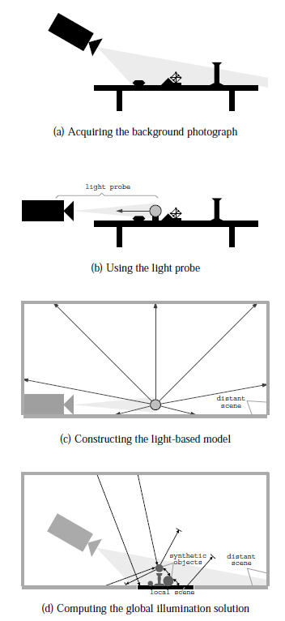
How to render an object inserted into an image?
Image-based lighting
Capture incoming light with a “light probe”
Model local scene
Ray trace, but replace distant scene with info from light probe
Debevec SIGGRAPH 1998

Slide 22


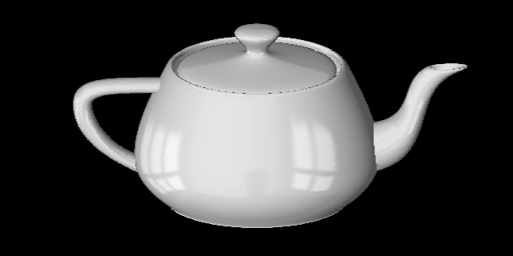
Key ideas for Image-based Lighting
Environment maps: tell what light is entering at each angle within some shell
+

Slide 23
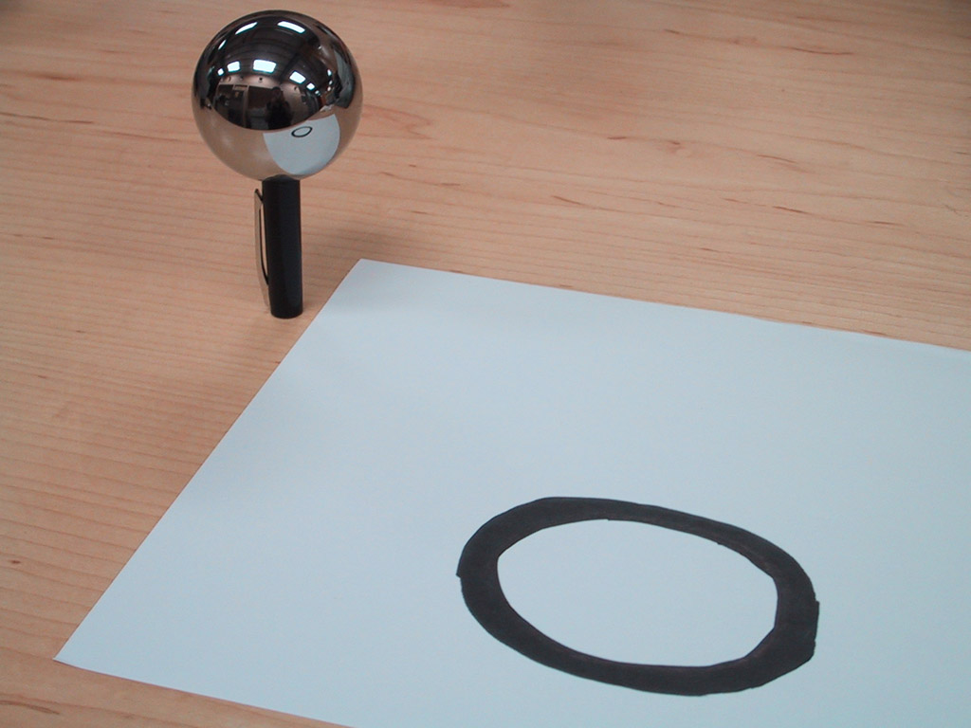
Key ideas for Image-based Lighting
Light probes: a way of capturing environment maps in real scenes

Slide 24
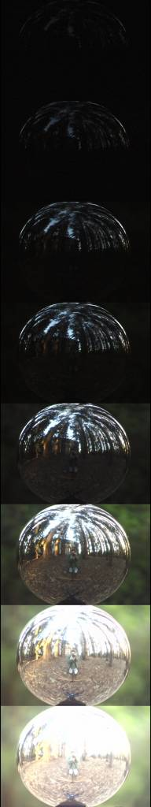
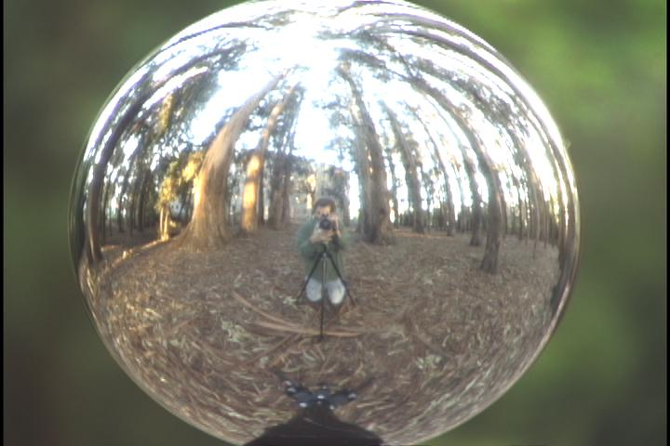
Key ideas for Image-based Lighting
Capturing HDR images: needed so that light probes capture full range of radiance

Slide 25
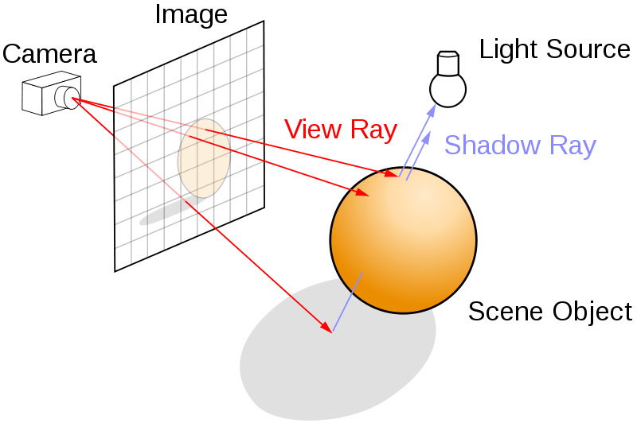
Key ideas for Image-based Lighting
Ray tracing: synthesize light paths between camera and light sources

Slide 26
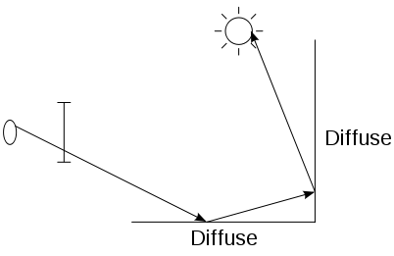
Key ideas for Image-based Lighting
Ray tracing: determining pixel intensity by shooting out rays from the camera

Slide 27
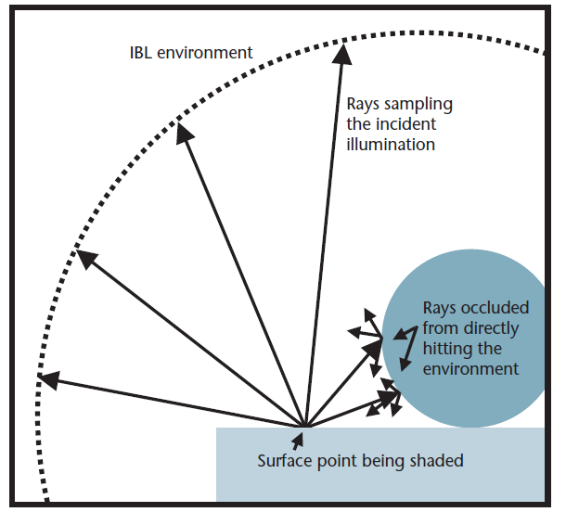
Key ideas for Image-based Lighting
Relighting: environment map acts as light source, substituting for distant scene

Slide 28
Today
Ray tracing
Capturing environment maps

Slide 29
A photon’s life choices
Absorption
Diffusion
Reflection
Transparency
Refraction
Fluorescence
Subsurface scattering
Phosphorescence
Interreflection
light source
λ
?

Slide 30
A photon’s life choices
Absorption
Diffusion
Reflection
Transparency
Refraction
Fluorescence
Subsurface scattering
Phosphorescence
Interreflection
light source
λ

Slide 31
A photon’s life choices
Absorption
Diffuse Reflection
Reflection
Transparency
Refraction
Fluorescence
Subsurface scattering
Phosphorescence
Interreflection
light source
λ

Slide 32
A photon’s life choices
Absorption
Diffusion
Specular Reflection
Transparency
Refraction
Fluorescence
Subsurface scattering
Phosphorescence
Interreflection
light source
λ

Slide 33
A photon’s life choices
Absorption
Diffusion
Reflection
Transparency
Refraction
Fluorescence
Subsurface scattering
Phosphorescence
Interreflection
light source
λ

Slide 34
A photon’s life choices
Absorption
Diffusion
Reflection
Transparency
Refraction
Fluorescence
Subsurface scattering
Phosphorescence
Interreflection
light source
λ

Slide 35
A photon’s life choices
Absorption
Diffusion
Reflection
Transparency
Refraction
Fluorescence
Subsurface scattering
Phosphorescence
Interreflection
light source
λ₁
λ₂

Slide 36
A photon’s life choices
Absorption
Diffusion
Reflection
Transparency
Refraction
Fluorescence
Subsurface scattering
Phosphorescence
Interreflection
light source
λ

Slide 37
A photon’s life choices
Absorption
Diffusion
Reflection
Transparency
Refraction
Fluorescence
Subsurface scattering
Phosphorescence
Interreflection
light source
t=1
t=n

Slide 38
A photon’s life choices
Absorption
Diffusion
Reflection
Transparency
Refraction
Fluorescence
Subsurface scattering
Phosphorescence
Interreflection
light source
λ
(Specular Interreflection)

Slide 39
A photon’s life choices
Absorption
Diffusion
Reflection
Transparency
Fluorescence
Interreflection
Subsurface scattering
Phosphoresence
image plane
light source
camera center
λ
?

Slide 40
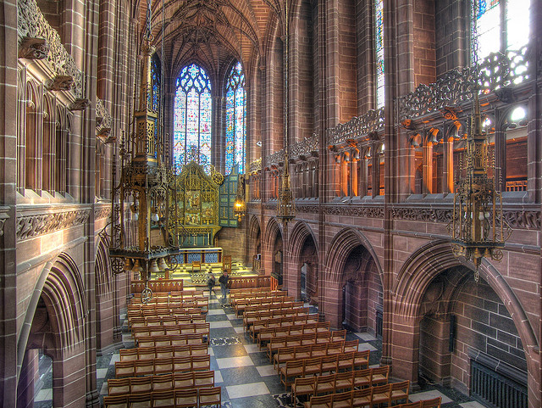
Where are the light sources are in this room?
http://www.flickr.com/photos/chrisdonbavand/493707413/sizes/z/in/photostream/

Slide 41
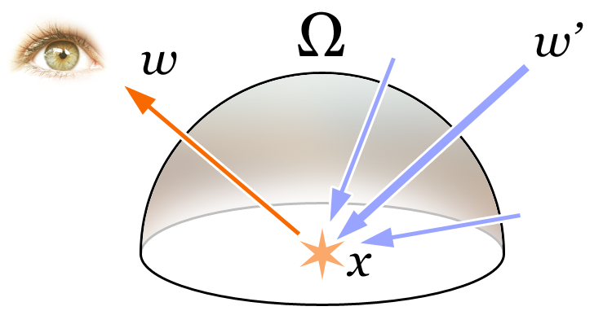
Rendering Equation
Total reflected light
Outgoing light
Generated light
BRDF
Incoming Light
Incident angle

Slide 42
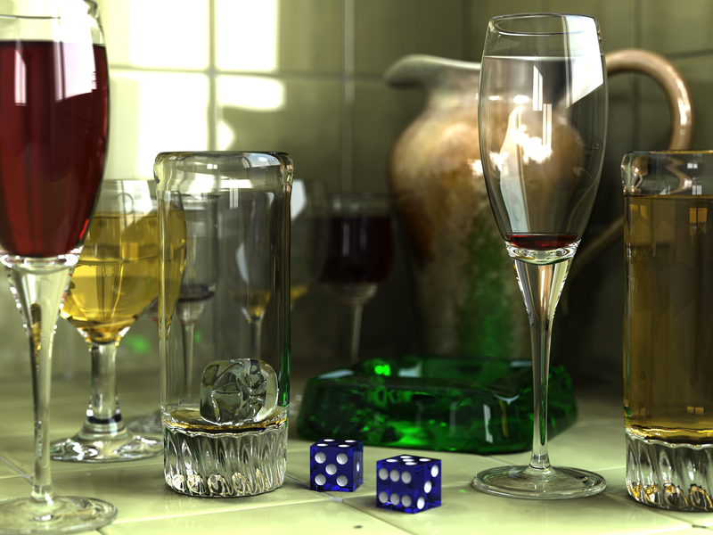
Rendering a scene with ray tracing
http://en.wikipedia.org/wiki/File:Glasses_800_edit.png

Slide 43
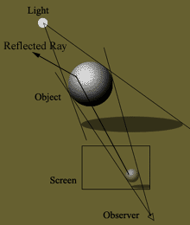
Ray tracing: basics
image plane
light source
camera center
λ

Slide 44
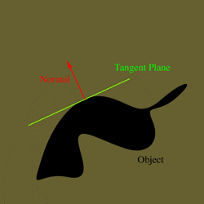
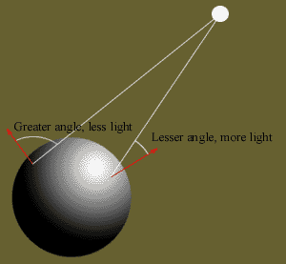
Diffuse shading
http://www.groovyvis.com/other/raytracing/basic.html

Slide 45
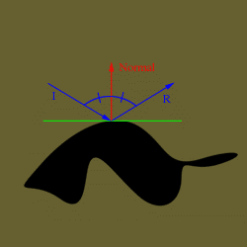
Reflections

Slide 46
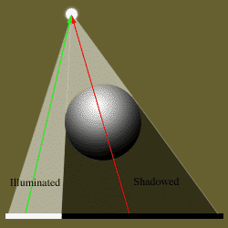
Shadows

Slide 47
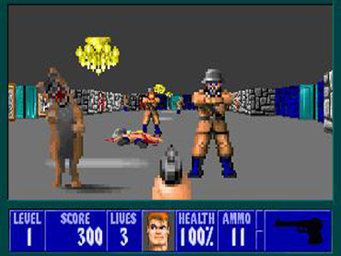
Ray casting
Store colors of surfaces, cast out rays, see what colors each ray hits
Wolfenstein 3D (1992)

Slide 48

Ray tracing: fast approximation
Upon hitting a surface
Cast reflection/refraction ray to determine reflected or refracted surface
Cast shadow ray: go towards light and see if an object is in the way
http://en.wikipedia.org/wiki/File:Ray_trace_diagram.svg

Slide 49

Ray tracing: interreflections
Reflect light N times before heading to light source
N=2
N=16
http://en.wikipedia.org/wiki/Ray_tracing_(graphics)#mediaviewer/File:Ray-traced_steel_balls.jpg

Slide 50

Ray tracing
Conceptually simple but hard to do fast
Full solution requires tracing millions of rays for many inter-reflections
Design choices
  Ray paths: Light to camera vs. camera to light?
  How many samples per pixel (avoid aliasing)?
  How to sample diffuse reflections?
  How many inter-reflections to allow?
  Deal with subsurface scattering, etc?

Slide 51
Environment Maps
The environment map may take various forms:
  Cubic mapping
  Spherical mapping
  other
Describes the shape of the surface on which the map “resides”
Determines how the map is generated and how it is indexed

Slide 52


Cubic Map Example

Slide 53
Cubic Mapping
The map resides on the surfaces of a cube around the object
  Typically, align the faces of the cube with the coordinate axes
To generate the map:
  For each face of the cube, render the world from the center of the object with the cube face as the image plane
    Rendering can be arbitrarily complex (it’s off-line)
To use the map:
  Index the R ray into the correct cube face
  Compute texture coordinates

Slide 54


Spherical Map Example

Slide 55
Sphere mapping
Map lives on a sphere
To generate the map:
  Render a spherical panorama from the designed center point
Rendering with environment map:
  Use the orientation of the R ray to index directly into the sphere

Slide 56
What approximations are made?
The map should contain a view of the world with the point of interest on the object as the Center of Projection
  We can’t store a separate map for each point, so one map is used with the COP at the center of the object
  Introduces distortions in the reflection, but we usually don’t notice
  Distortions are minimized for a small object in a large room
The object will not reflect itself!

Slide 57
Rendering with environment maps and local models
image plane
camera center

Slide 58

Storing spherical environment maps

Slide 59

Equirectangular (latitude-longitude) projection

Slide 60

Equirectangular (latitude-longitude) projection

Slide 61



What about real scenes?
From Flight of the Navigator

Slide 62
What about real scenes?
from Terminator 2

Slide 63
Real environment maps
We can use photographs to capture environment maps
  The first use of panoramic mosaics
  Fisheye lens
  Mirrored balls (light probes)

Slide 64


Mirrored Sphere

Slide 65


Slide 66



Slide 67

Mirror balls for image-based lighting

Slide 68

Mirror balls for image-based lighting

Slide 69
Mirror balls for image-based lighting

Slide 70

Sources of Mirrored Balls
2-inch chrome balls ~ $20 ea.
  McMaster-Carr Supply Company
  www.mcmaster.com
6-12 inch large gazing balls
  Baker’s Lawn Ornaments
  www.bakerslawnorn.com
Hollow Spheres, 2in – 4in
  Dube Juggling Equipment
  www.dube.com
FAQ on www.debevec.org/HDRShop/

Slide 71
0.34
=> 59% Reflective
Calibrating Mirrored Sphere Reflectivity
0.58

Slide 72
Spherical map domain transformations
Many rendering programs only accept one format (mirror ball, equirectangular, cube map, etc)
  E.g. Blender only accepts equirectangular maps
How to convert mirror ball to equirectangular?

Slide 73

Mirror ball -> equirectangular

Slide 74
Mirror ball -> equirectangular
Spherical coordinates
  Convert the light directions incident to the ball into spherical coordinates (phi, theta)
  Map from mirror ball phi, theta to equirectangular phi, theta
for i=1:d
F = TriScatteredInterp(phi_ball, theta_ball, mirrorball(:,:,i));
latlon(:,:,i) = F(phi_latlon, theta_latlon);
end

Slide 75






Mirror ball -> equirectangular
Mirror ball
Normals
Reflection
vectors
Phi/theta of reflection vecs
Equirectangular
Phi/theta equirectangular domain

Slide 76

One small snag
How do we deal with light sources? Sun, lights, etc?
  They are much, much brighter than the rest of the environment
1907
.
46
.
.
15116
1
.
.
18

Slide 77

Problem: Dynamic Range

Slide 78





Problem: Dynamic Range
1
The real world is
high dynamic range.
1500
25,000
400,000
2,000,000,000

Slide 79
Long Exposure
10⁻⁶
High dynamic range
10⁶
Real world
10⁻⁶
10⁶
Picture
^{0 to 255}

Slide 80
Short Exposure
10⁻⁶
High dynamic range
10⁶
Real world
10⁻⁶
10⁶
Picture
^{0 to 255}

Slide 81
Camera Calibration
Geometric
  How pixel coordinates relate to directions in the world
Photometric
  How pixel values relate to radiance amounts in the world

Slide 82
The Image Acquisition Pipeline
Lens
Shutter
Film
scene
radiance
(W/sr/m )
sensor
irradiance
∫
sensor
exposure
latent
image
2
Δt
Electronic Camera
Development
CCD
ADC
Remapping
film
density
analog
voltages
digital
values
pixel
values
Notes:
3

Slide 83
Imaging system response function
255
Pixel
value
0
log Exposure = log (Radiance * Δt)
(CCD photon count)
Notes:
1

Slide 84

Varying Exposure

Slide 85
Camera is not a photometer!
Limited dynamic range
  Perhaps use multiple exposures?
Unknown, nonlinear response
  Not possible to convert pixel values to radiance
Solution:
  Recover response curve from multiple exposures, then reconstruct the radiance map
Notes:
4

Slide 86
Next class
How to capture HDR image using “bracketing”
How to relight an object from an environment map

