Slide 1
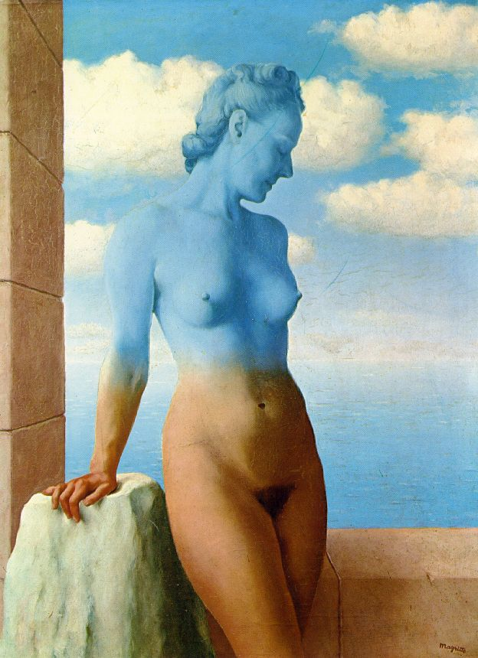
Blending and Compositing
09/22/15
Computational Photography
Derek Hoiem, University of Illinois

Slide 2
Project 1: issues
Basic tips
Display/save Laplacian images using mat2gray or imagesc (imshow is only for normal images)
Downsampling: use sigma ~= 2 for factor of 2

Slide 3
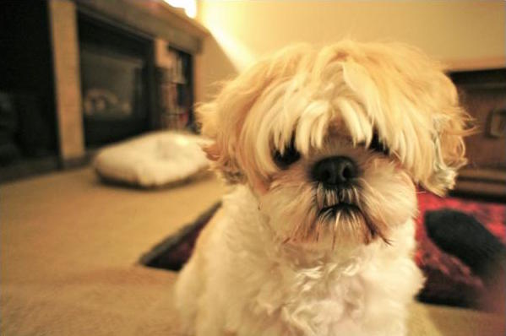
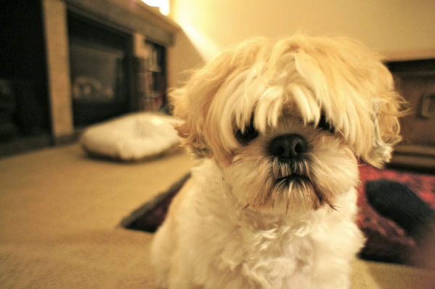
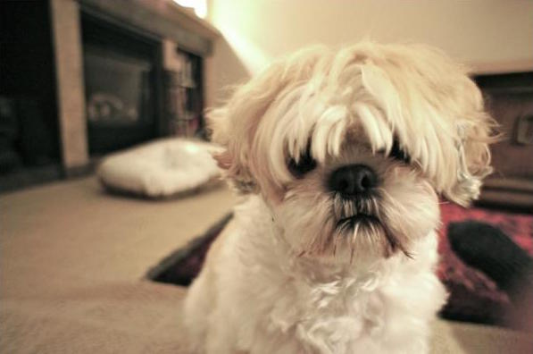
Color shift
Result from Ryan Kuck
More red (increase positive a channel values)
L*a*b* space
Less yellow (decrease positive b channel values)

Slide 4
Project 1 Results
Incomplete list of great project pages
Ulzee An: http://web.engr.illinois.edu/~ulzeean2/cs445/proj1/
great hybrid images and image pyramid results, good visualization
Mahika Dubey: http://web.engr.illinois.edu/~dubey3/cs445/proj1/
good explanation of histogram equalization, good hybrid image results, image pyramids implemented successfully
Yao-Tsung Hsu: http://web.engr.illinois.edu/~yhsu30/cs445/proj1/
good explanation of histogram equalization, good hybrid image results, image pyramids implemented successfully
Amir Ibrahim: http://web.engr.illinois.edu/~aaelsay2/cs445/proj1/
good hybrid images and explanation of image enhancement techniques
Harry Jian: http://web.engr.illinois.edu/~jian3/cs445/proj1/
interesting idea for hybrid images, good image pyramids
Mariko Wakabayashi: http://web.engr.illinois.edu/~mwakaba2/cs445/proj1/
great hybrid image result and overall presentation of results
Vivek Ramadoss: http://web.engr.illinois.edu/~ramados2/cs445/proj1/
another good hybrid image that works well + great zoom tool!

Slide 5
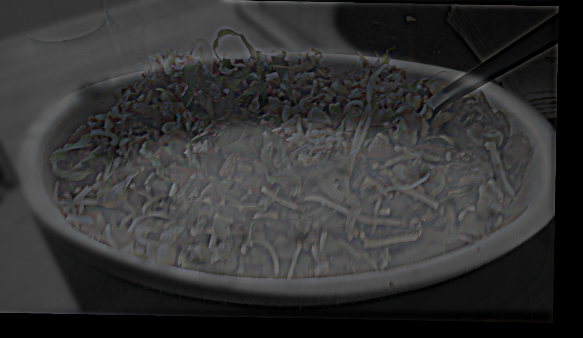
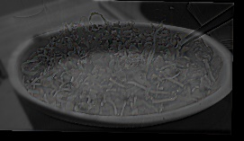

Hybrid results
Harry Jian

Slide 6
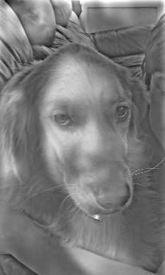

Mahika Dubey

Slide 7
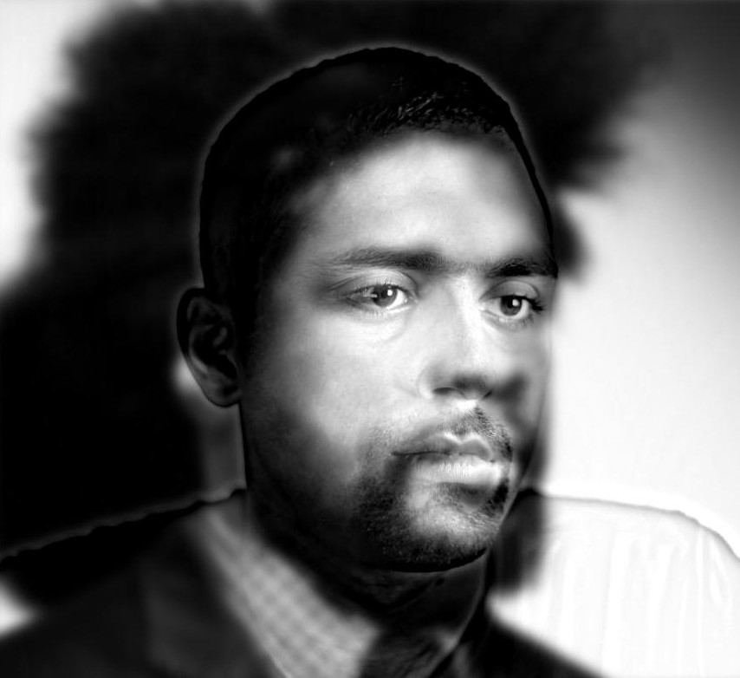
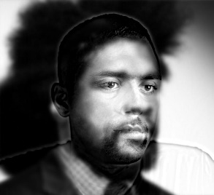

Vivek Ramadoss

Slide 8
Last class: finding boundaries
Intelligent scissors
Good boundary has a low-cost path from seed to cursor
Low cost = edge, high gradient, right orientation
GrabCut
Good region is similar to foreground color model and dissimilar from background color
Good boundaries have a high gradient
Optimize over both

Slide 9
Take-home questions
1. What would be the result in “Intelligent Scissors” if all of the edge costs were set to 1?
2. How could you change boundary costs for graph cuts to work better for objects with many thin parts?

Slide 10
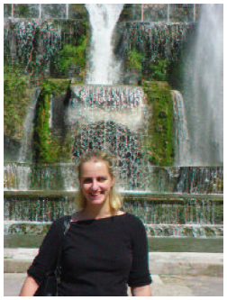
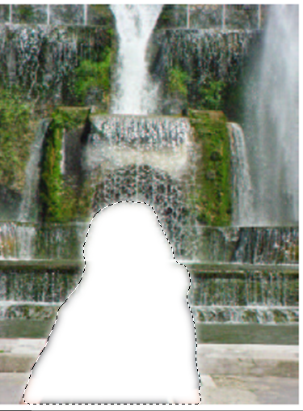
Last Class: cutting out objects

Slide 11
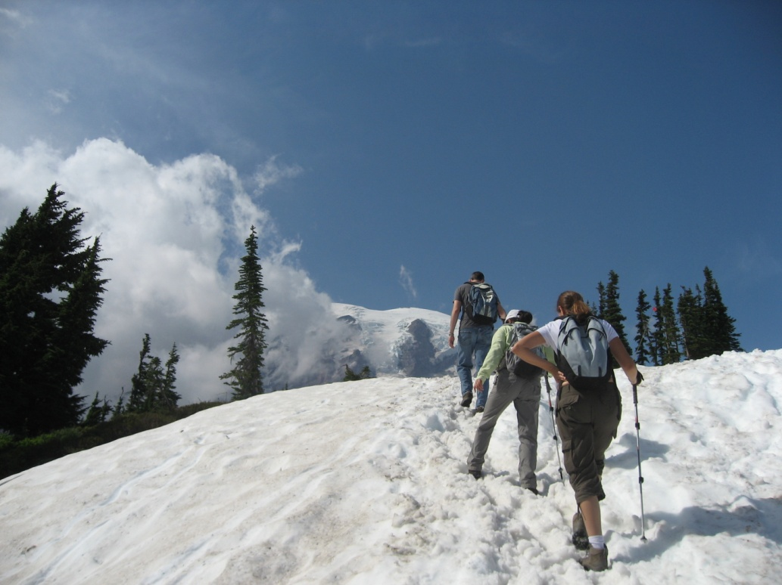
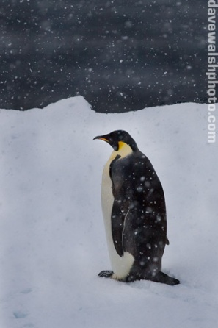
This Class
How do I put an object from one image into another?

Slide 12
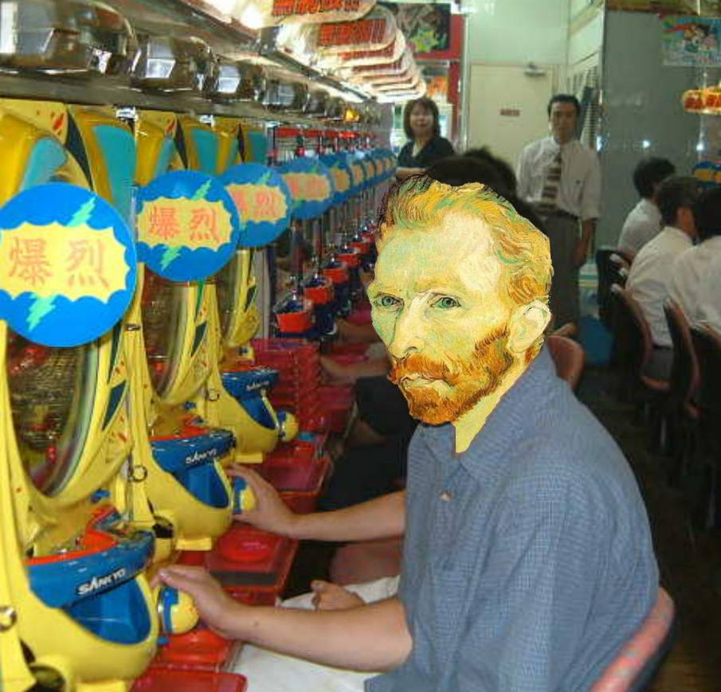
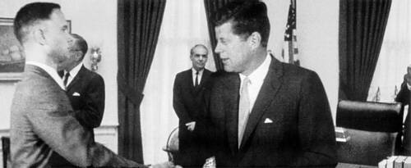
Image Compositing
Some slides from Efros/Seitz

Slide 13
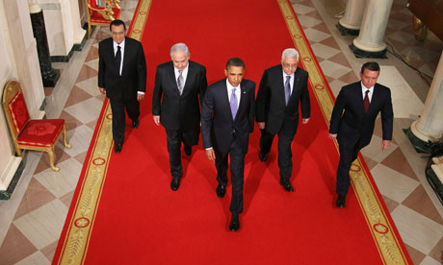
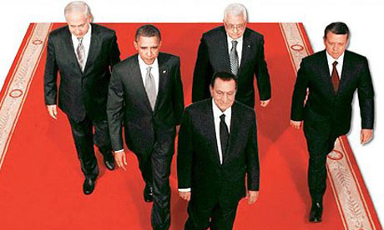
News Composites
http://www.guardian.co.uk/world/2010/sep/16/mubarak-doctored-red-carpet-picture
Original
“Enhanced” Version

Slide 14
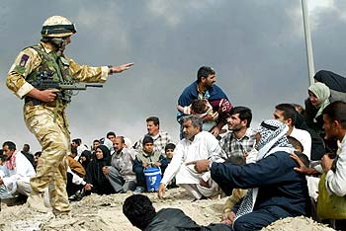
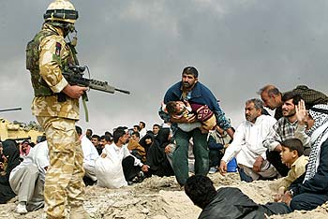
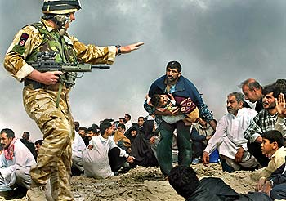
News Composites
Original
“Enhanced” Version
Walski, LA Times, 2003

Slide 15
Three methods
Cut and paste
Laplacian pyramid blending
Poisson blending

Slide 16
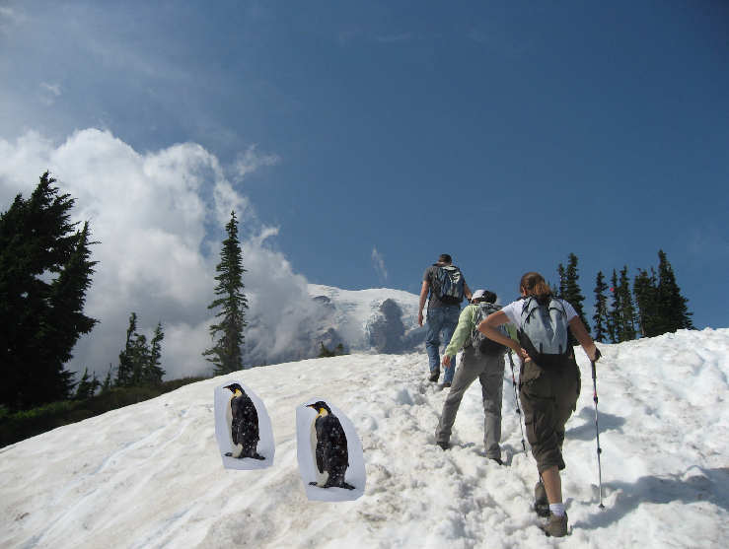
Method 1: Cut and Paste

Slide 17
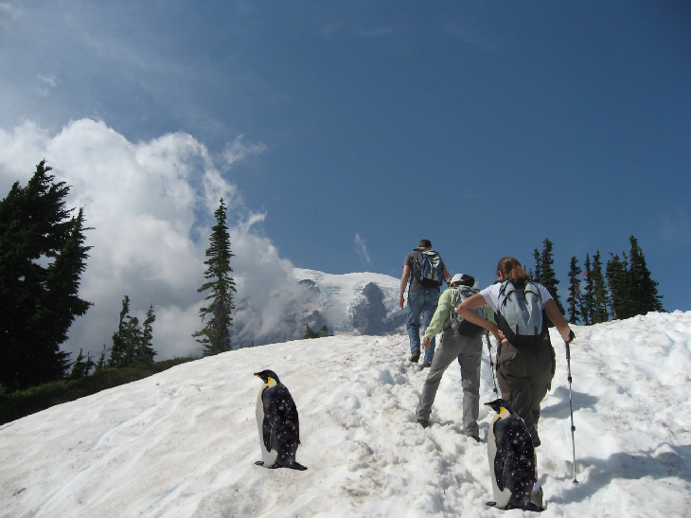
Method 1: Cut and Paste
Method:
Segment using intelligent scissors
Paste foreground pixels onto target region

Slide 18
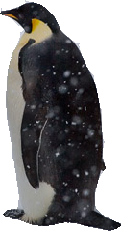
Method 1: Cut and Paste
Problems:
Small segmentation errors noticeable
Pixels are too blocky
Won’t work for semi-transparent materials

Slide 19
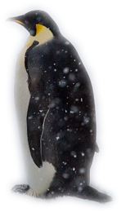
Feathering
Near object boundary pixel values come partly from foreground and partly from background

Slide 20
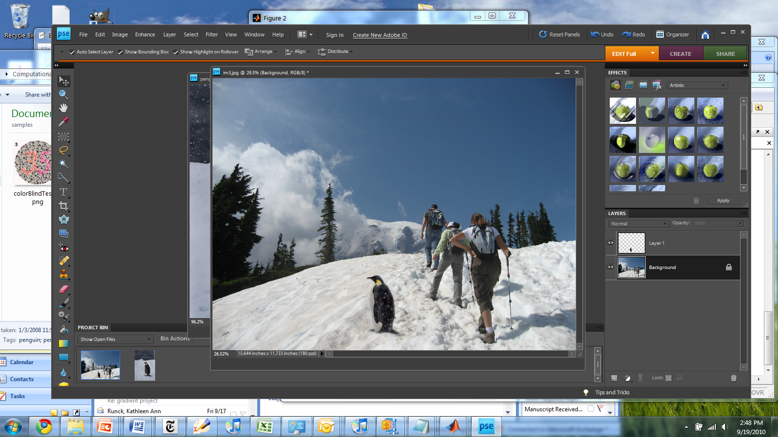
Method 1: Cut and Paste (with feathering)

Slide 21
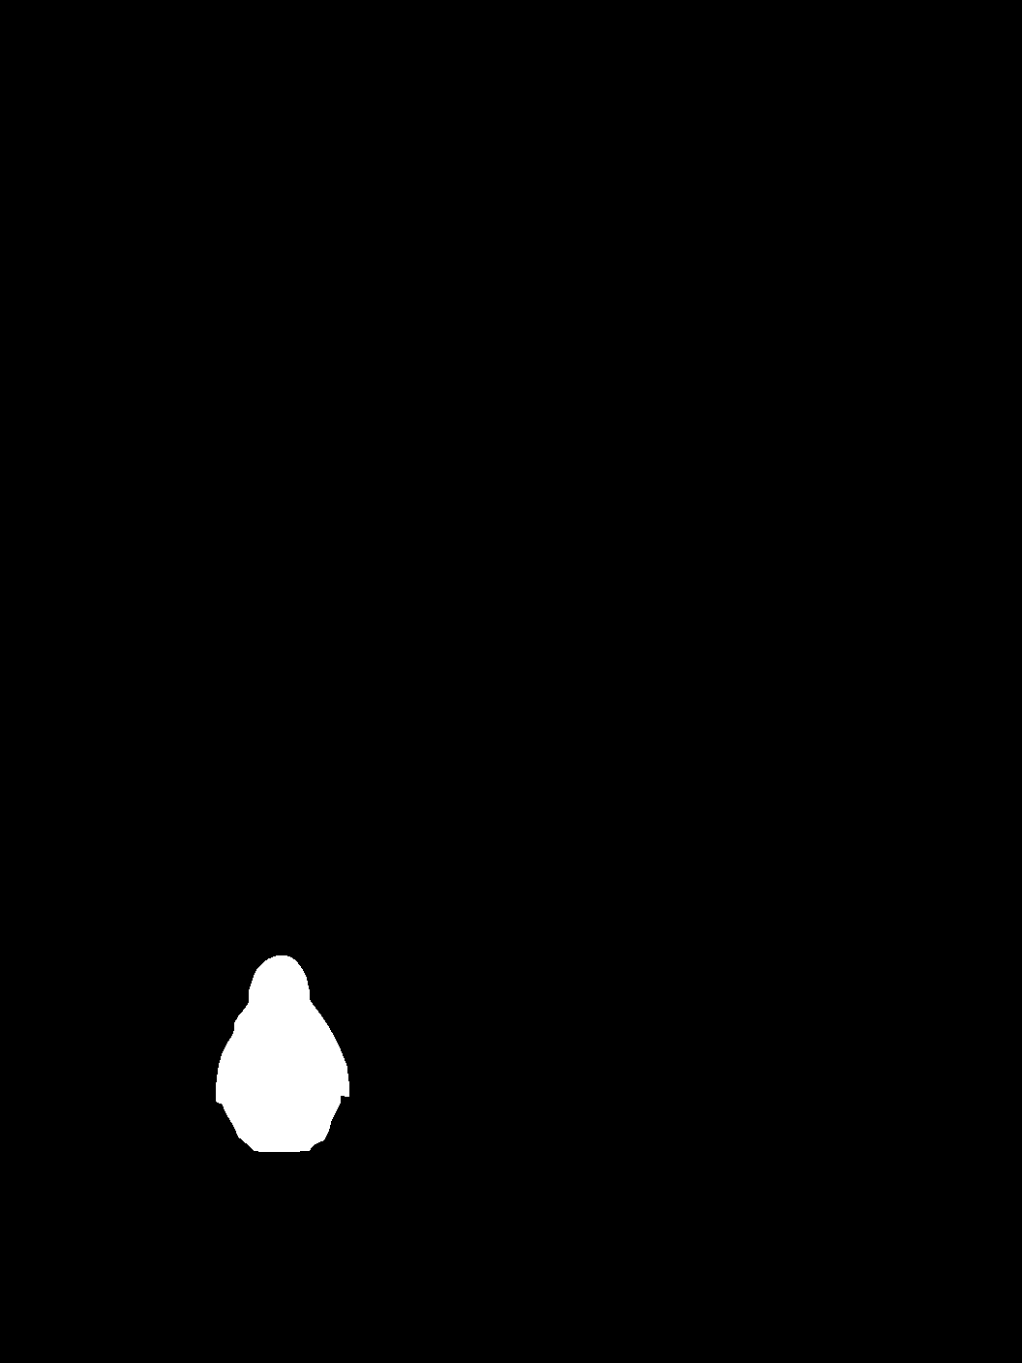
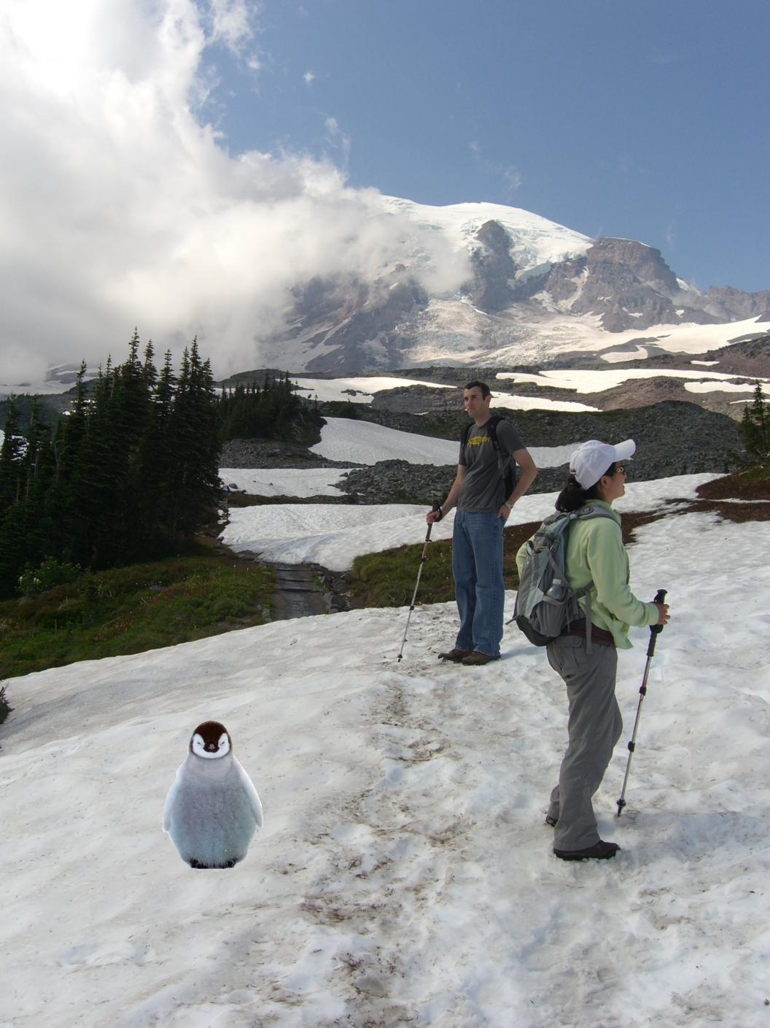
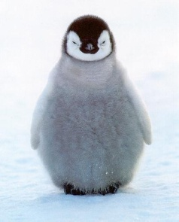
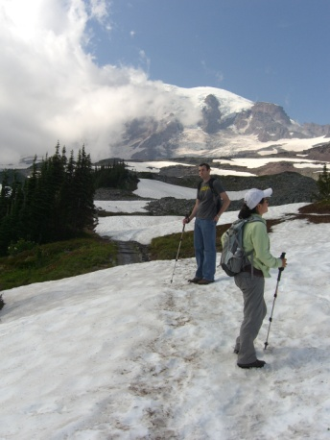
Alpha compositing
+
Output = foreground*mask + background*(1-mask)

Slide 22


Alpha compositing with feathering
Output = foreground*mask + background*(1-mask)

Slide 23
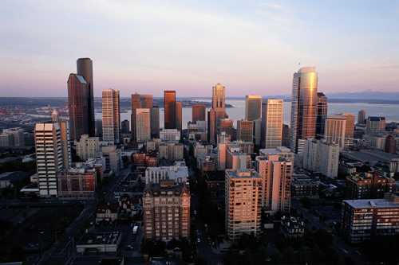

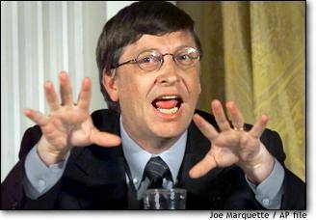

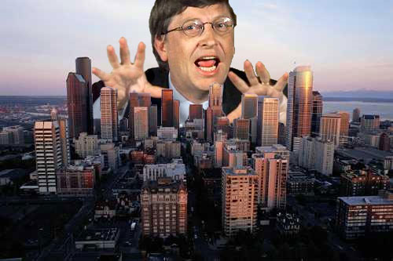
Another example (without feathering)
Mattes
Composite
Composite by
David Dewey

Slide 24
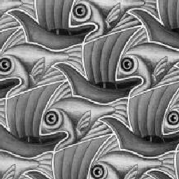
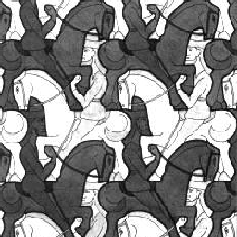
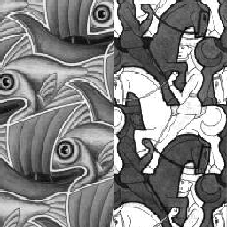
Proper blending is key

Slide 25
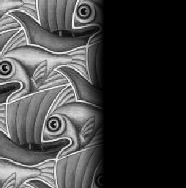
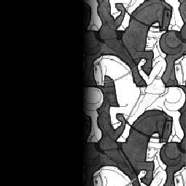

Alpha Blending / Feathering
+
1
1
0
0
I_{blend} = αI_{left} + (1-α)I_{right}
=

Slide 26
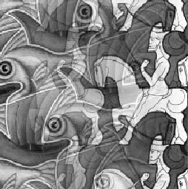
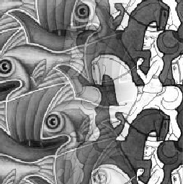
Effect of Window Size
1
left
1
right
0
0

Slide 27


Effect of Window Size
1
1
0
0

Slide 28

Good Window Size
1
0
“Optimal” Window: smooth but not ghosted

Slide 29
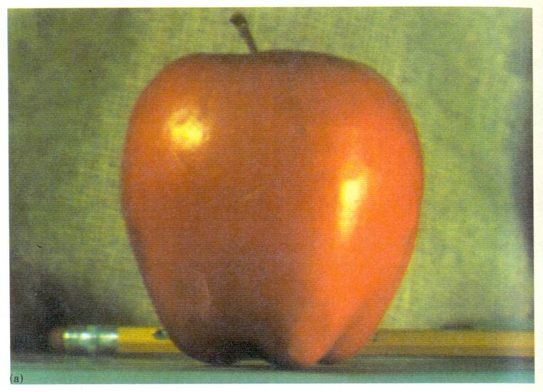
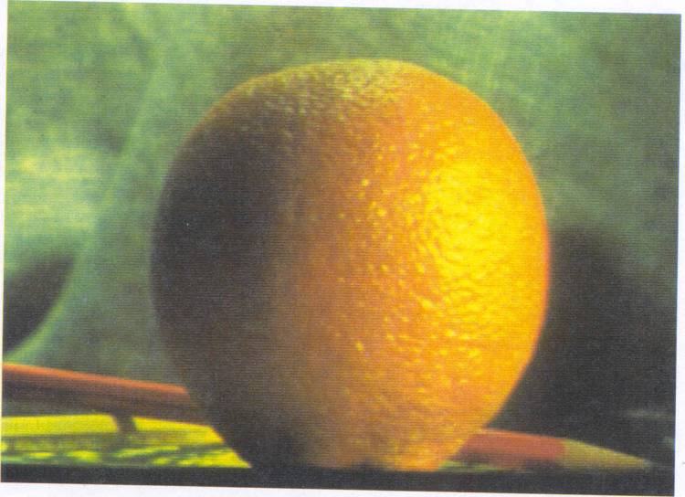
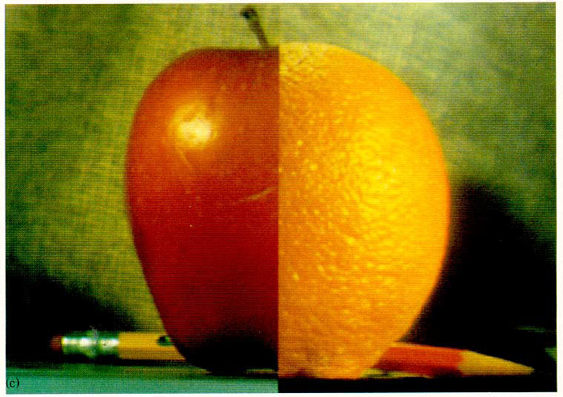
How much should we blend?

Slide 30
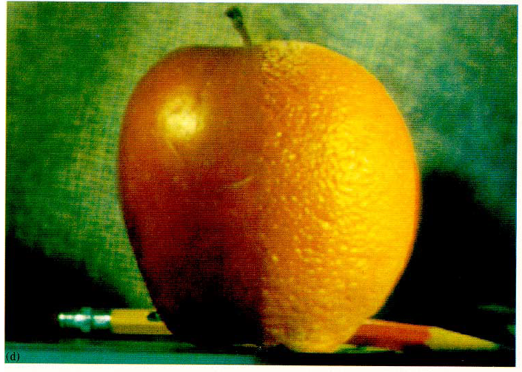
Method 2: Pyramid Blending

Slide 31
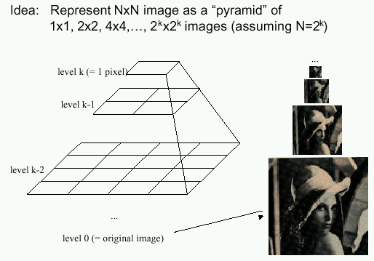
Method 2: Pyramid Blending
At low frequencies, blend slowly
At high frequencies, blend quickly
1
0
1
0
1
0
Left pyramid
blend
Right pyramid

Slide 32
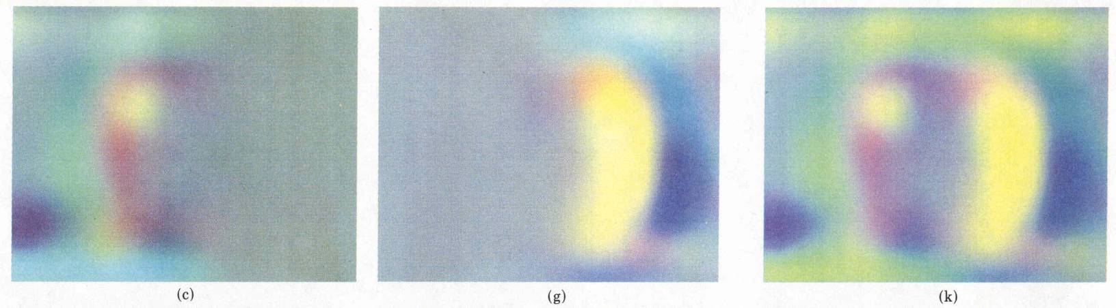
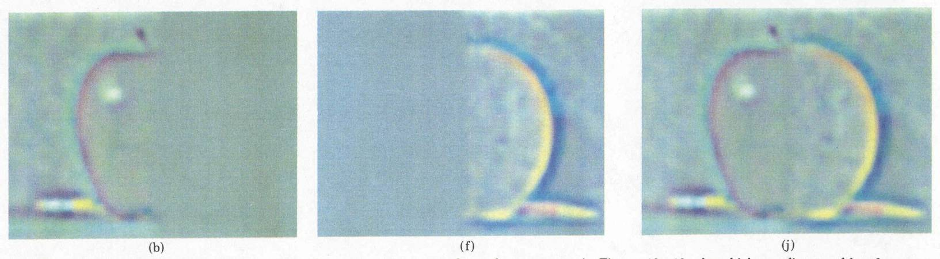
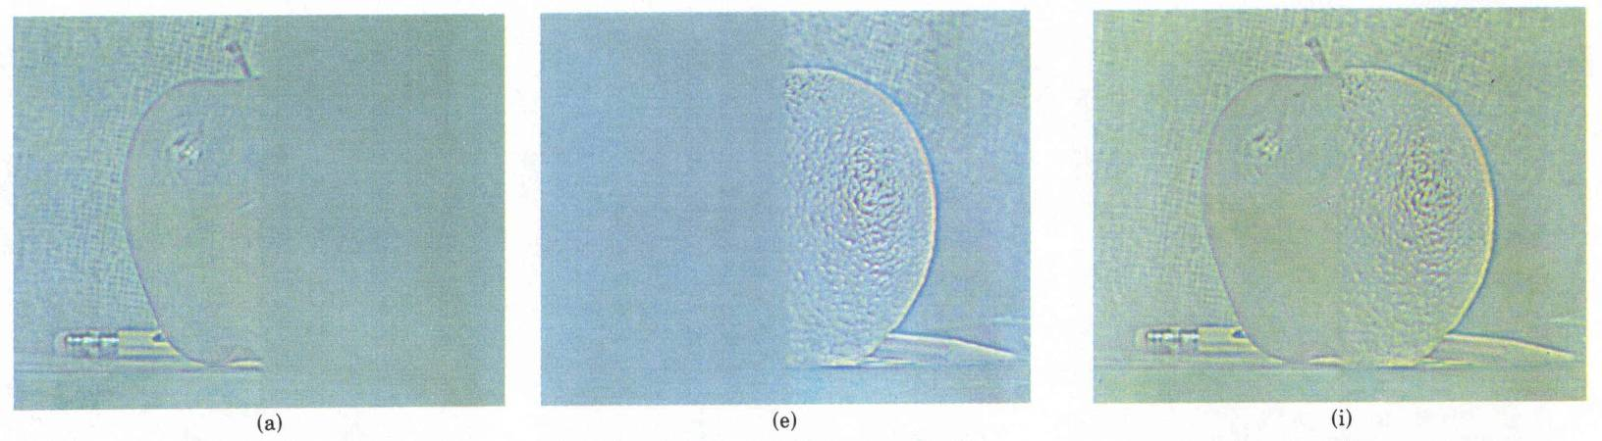
laplacian
level
4
laplacian
level
2
laplacian
level
0
left pyramid
right pyramid
blended pyramid

Slide 33
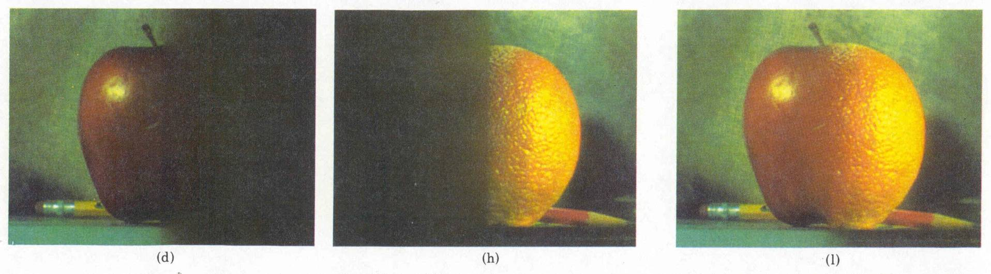
Method 2: Pyramid Blending
Burt and Adelson 1983

Slide 34
Laplacian Pyramid Blending
Implementation:
Build Laplacian pyramids for each image
Build a Gaussian pyramid of region mask
Blend each level of pyramid using region mask from the same level
Collapse the pyramid to get the final blended image
Image 1 at level i of Laplacian pyramid
Region mask at level i of Gaussian pyramid
Pointwise multiply
Burt and Adelson 1983

Slide 35
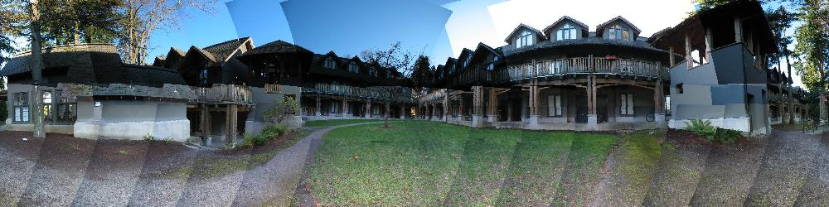
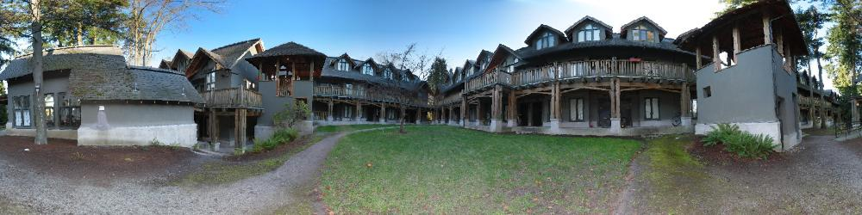
Simplification: Two-band Blending
Brown & Lowe, 2003
Only use two bands: high freq. and low freq.
Blends low freq. smoothly
Blend high freq. with no smoothing: use binary alpha

Slide 36


2-band Blending
Low frequency
High frequency

Slide 37

Linear Blending

Slide 38

2-band Blending

Slide 39

Blending Regions

Slide 40

© Chris Cameron

Slide 41

Related idea: Poisson Blending
A good blend should preserve gradients of source region without changing the background
Perez et al. 2003

Slide 42
Related idea: Poisson Blending
A good blend should preserve gradients of source region without changing the background
Project 3!
Perez et al. 2003

Slide 43
Method 3: Poisson Blending
A good blend should preserve gradients of source region without changing the background
Treat pixels as variables to be solved
Minimize squared difference between gradients of foreground region and gradients of target region
Keep background pixels constant
Perez et al. 2003
Notes:
Draw on board

Slide 44


Example
Gradient Visualization
Source: Evan Wallace

Slide 45



+
Specify object region
Source: Evan Wallace

Slide 46

Gradient-domain editing
Creation of image = least squares problem in terms of: 1) pixel intensities; 2) differences of pixel intensities
Use Matlab least-squares solvers for numerically stable solution with sparse A
Least Squares Line Fit in 2 Dimensions

Slide 47
Examples
Line-fitting: y=mx+b

Slide 48
Examples
2. Gradient domain processing
source image
background image
target image
1
5
9
13
1
5
9
13
1
5
9
13
20 | 20 | 20 | 20
20 | 80 | 20 | 20
20 | 20 | 80 | 20
20 | 20 | 20 | 20
10 | 10 | 10 | 10
10 | 10 | 10 | 10
10 | 10 | 10 | 10
10 | 10 | 10 | 10
10 | 10 | 10 | 10
10 | v₁ | v₃ | 10
10 | v₂ | v₄ | 10
10 | 10 | 10 | 10
2
6
10
14
2
6
10
14
2
6
10
14
3
7
11
15
3
7
11
15
3
7
11
15
4
8
12
16
4
8
12
16
4
8
12
16

Slide 49


Other results
Perez et al. 2003

Slide 50
What do we lose?
Foreground color changes
Background pixels in target region are replaced
Perez et al. 2003
Notes:
Background pixels completely replaced, color of foreground changed

Slide 51

Blending with Mixed Gradients
Use foreground or background gradient with larger magnitude as the guiding gradient
Perez et al. 2003

Slide 52
Project 3: Gradient Domain Editing
General concept: Solve for pixels of new image that satisfy constraints on the gradient and the intensity
Constraints can be from one image (for filtering) or more (for blending)

Slide 53

Project 3: Reconstruction from Gradients
Preserve x-y gradients
Preserve intensity of one pixel
Source pixels: s
Variable pixels: v
minimize (v(x+1,y)-v(x,y) - (s(x+1,y)-s(x,y))^2
minimize (v(x,y+1)-v(x,y) - (s(x,y+1)-s(x,y))^2
minimize (v(1,1)-s(1,1))^2

Slide 54


Project 3 (extra): Color2Gray
rgb2gray
Gradient-domain editing
?

Slide 55

Project 3 (extra): NPR
Preserve gradients on edges
e.g., get canny edges with edge(im, ‘canny’)
Reduce gradients not on edges
Preserve original intensity
Perez et al. 2003

Slide 56




Colorization using optimization
Solve for uv channels such that similar intensities have similar colors
Minimize squared color difference, weighted by intensity similarity
Solve with sparse linear system of equations
http://www.cs.huji.ac.il/~yweiss/Colorization/

Slide 57
Things to remember
Three ways to blend/composite
Alpha compositing
Need nice cut (intelligent scissors)
Should feather
Laplacian pyramid blending
Smooth blending at low frequencies, sharp at high frequencies
Usually used for stitching
Gradient domain editing
Also called Poisson Editing
Explicit control over what to preserve
Changes foreground color (for better or worse)
Applicable for many things besides blending

Slide 58

Take-home questions
1) I am trying to blend this bear into this pool. What problems will I have if I use:
Alpha compositing with feathering
Laplacian pyramid blending
Poisson editing?

Slide 59
Take-home questions
2) How would you make a sharpening filter using gradient domain processing? What are the constraints on the gradients and the intensities?

Slide 60
Next class
Image warping: affine, projective, rotation, etc.

