Slide 1

Texture Synthesis and Hole-Filling
09/15/15
Computational Photography
Derek Hoiem, University of Illinois

Slide 2
Project 1
Results page is up
Aim to have it graded in the next few days (but there are lots to grade)

Slide 3

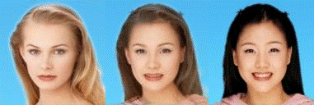
Next section: The digital canvas
Cutting and pasting objects, filling holes, and blending
Image warping and object morphing

Slide 4
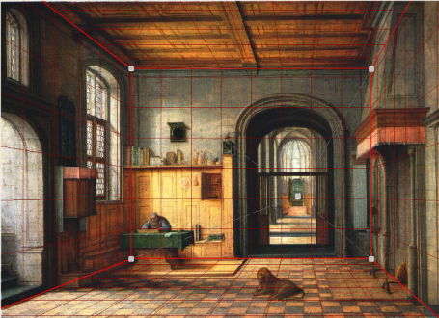
Next section: The digital canvas
Cutting and pasting objects, filling holes, and blending
Image warping and object morphing
Camera models, single-view geometry, and 3D reconstruction

Slide 5
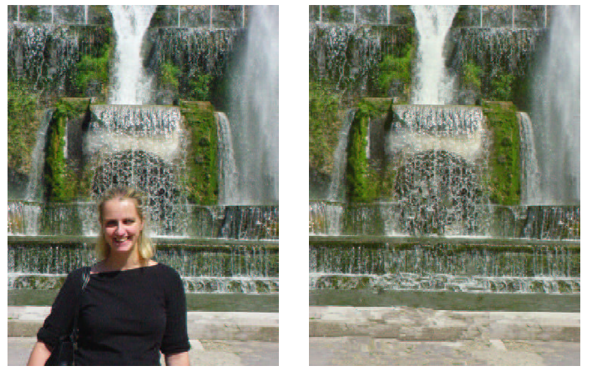
Today’s Class
Texture synthesis and hole-filling

Slide 6
Texture
Texture depicts spatially repeating patterns
Textures appear naturally and frequently
radishes
rocks
yogurt
Many slides from James Hays

Slide 7
Texture Synthesis
Goal of Texture Synthesis: create new samples of a given texture
Many applications: virtual environments, hole-filling, texturing surfaces

Slide 8
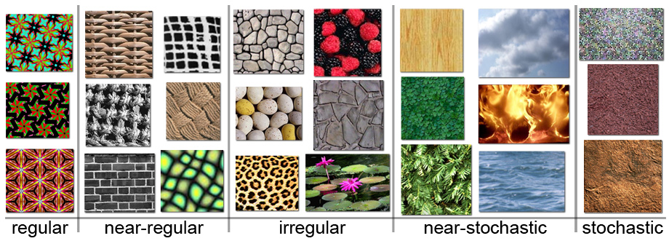
The Challenge
Need to model the whole spectrum: from repeated to stochastic texture

Slide 9
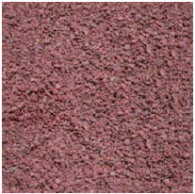
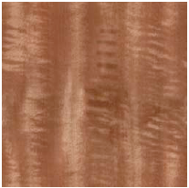
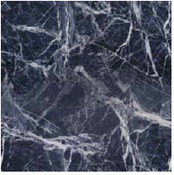
One idea: Build Probability Distributions
Basic idea
Compute statistics of input texture (e.g., histogram of edge filter responses)
Generate a new texture that keeps those same statistics
D. J. Heeger and J. R. Bergen. Pyramid-based texture analysis/synthesis. In SIGGRAPH ’95.
E. P. Simoncelli and J. Portilla. Texture characterization via joint statistics of wavelet coefficient magnitudes. In ICIP 1998.

Slide 10
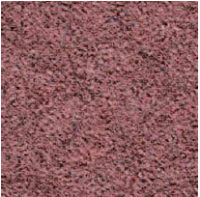
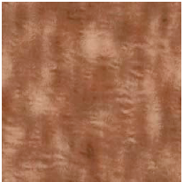
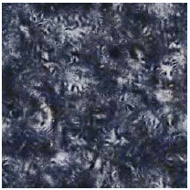
One idea: Build Probability Distributions
But it (usually) doesn’t work
Probability distributions are hard to model well
Input
Synthesized

Slide 11

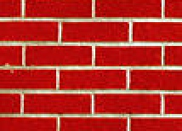
Another idea: Sample from the image
non-parametric
sampling
p
Input image
Synthesizing a pixel
Assuming Markov property, compute P(p|N(p))
Building explicit probability tables infeasible
Instead, we search the input image for all similar neighborhoods — that’s our pdf for p
To sample from this pdf, just pick one match at random
Efros and Leung 1999 SIGGRAPH

Slide 12
Idea from Shannon (Information Theory)
Generate English-sounding sentences by modeling the probability of each word given the previous words (n-grams)
Large “n” will give more structured sentences
“I spent an interesting evening recently with a grain of salt.”
(example from fake single.net user Mark V Shaney)

Slide 13
Details
How to match patches?
Gaussian-weighted SSD (more emphasis on nearby pixels)
What order to fill in new pixels?
“Onion skin” order: pixels with most neighbors are synthesized first
To synthesize from scratch, start with a randomly selected small patch from the source texture
How big should the patches be?

Slide 14



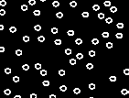

Size of Neighborhood Window
input

Slide 15

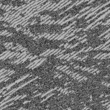
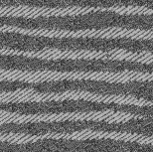
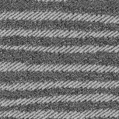
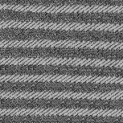

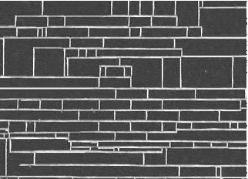
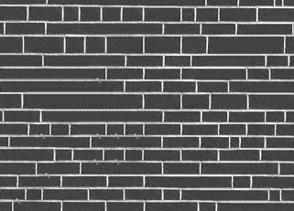
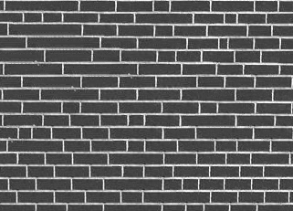
Varying Window Size
Increasing window size

Slide 16
Texture synthesis algorithm
While image not filled
Get unfilled pixels with filled neighbors, sorted by number of filled neighbors
For each pixel, get top N matches based on visible neighbors
- Patch Distance: Gaussian-weighted SSD
Randomly select one of the matches and copy pixel from it

Slide 17


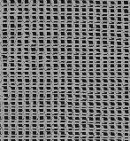
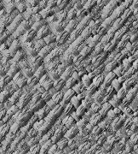
Synthesis Results
french canvas
rafia weave

Slide 18


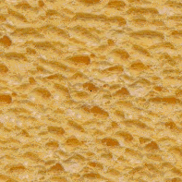
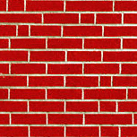
More Results
white bread
brick wall

Slide 19
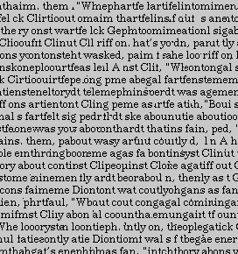
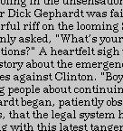
Homage to Shannon

Slide 20
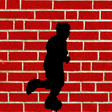
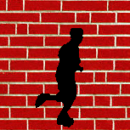
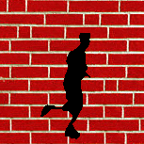
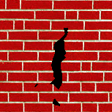
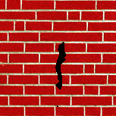
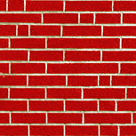
Hole Filling

Slide 21
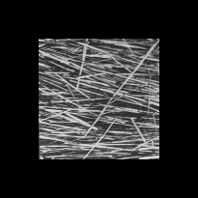
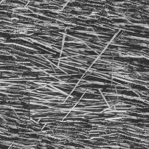
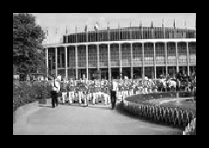
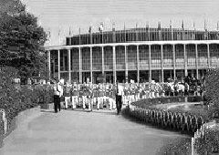
Extrapolation

Slide 22
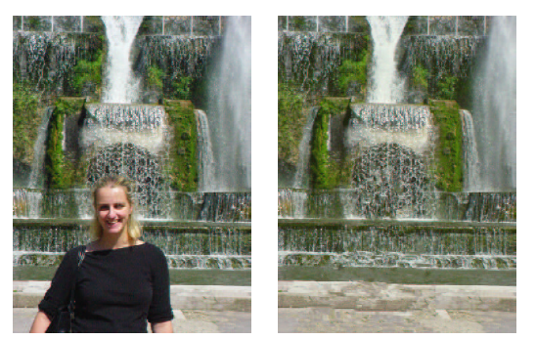
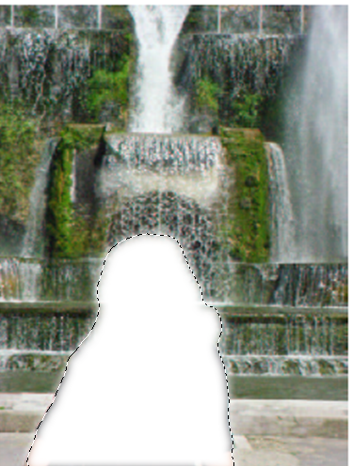
In-painting natural scenes
Criminisi, Perez, and Toyama. “Object Removal by Exemplar-based Inpainting,” Proc. CVPR, 2003.

Slide 23


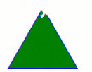

Key idea: Filling order matters
In-painting Result
Image with Hole
Raster-Scan Order
Onion-Peel (Concentric Layers)
Gradient-Sensitive Order
Criminisi, Perez, and Toyama. “Object Removal by Exemplar-based Inpainting,” Proc. CVPR, 2003.

Slide 24
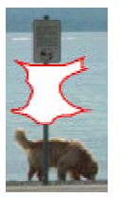
Filling order
Fill a pixel that:
Is surrounded by other known pixels
Is a continuation of a strong gradient or edge
Criminisi, Perez, and Toyama. “Object Removal by Exemplar-based Inpainting,” Proc. CVPR, 2003.

Slide 25
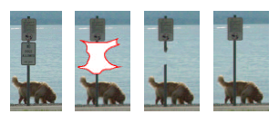
Comparison
Original With Hole Onion-Ring Fill Criminisi
Criminisi, Perez, and Toyama. “Object Removal by Exemplar-based Inpainting,” Proc. CVPR, 2003.

Slide 26
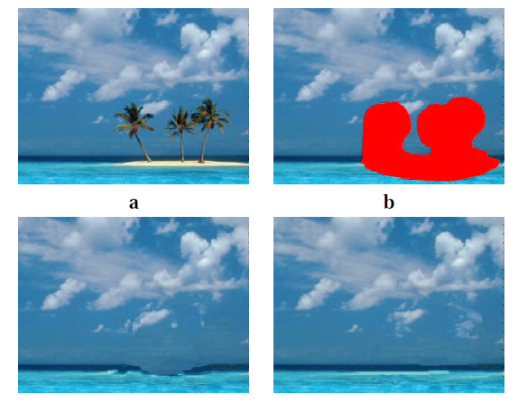
Comparison
Concentric Layers
Gradient Sensitive

Slide 27
Summary
The Efros & Leung texture synthesis algorithm
Very simple
Surprisingly good results
Synthesis is easier than analysis!
…but very slow

Slide 28
Image Quilting [Efros & Freeman 2001]
non-parametric
sampling
p
B
Input image
Synthesizing a block
Observation: neighbor pixels are highly correlated
Idea: unit of synthesis = block
Exactly the same but now we want P(B|N(B))
Much faster: synthesize all pixels in a block at once

Slide 29

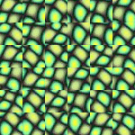
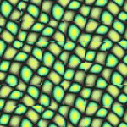
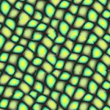
block
Input texture
B1
B2
B1
B2
B1
B2
Random placement
of blocks
Neighboring blocks
constrained by overlap
Minimal error
boundary cut

Slide 30
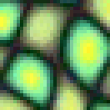
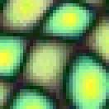
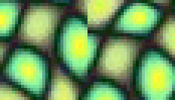


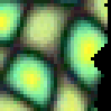
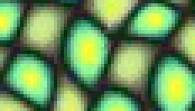
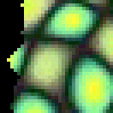
Minimal error boundary
overlapping blocks
vertical boundary
2
_
=
overlap error
min. error boundary

Slide 31
Solving for Minimum Cut Path
Cost of a cut through this pixel
1
3
4
1
2
1
2
3
4
2
1
4

Slide 32
Solving for Minimum Cut Path
prev = r1
cost = 4
cost = 6
cost = 5
1
3
4
1
r1
prev = r1
cost = 2
cost = 4
cost = 6
2
1
2
3
r2
prev = r2
cost = 4
cost = 3
cost = 7
4
2
1
4
r3

Slide 33
Solving for Minimum Cut Path
Best Path
cost = 5
1
3
4
3
1
cost = 6
2
1
2
1
3
cost = 7
4
2
1
4

Slide 34
Solving for Minimum Cut Path
1
3
4
3
3
Region 1
2
1
2
1
1
Region 2
4
2
1
2
Mask Based on Best Path

Slide 35





Slide 36





Slide 38





Slide 39



Slide 40






Slide 41





Portilla & Simoncelli
Xu, Guo & Shum
input image
Wei & Levoy
Quilting

Slide 42





Portilla & Simoncelli
Xu, Guo & Shum
input image
Wei & Levoy
Quilting

Slide 43

Political Texture Synthesis!

Slide 44




Texture Transfer
Try to explain one object with bits and pieces of another object:
+
=

Slide 45
Texture Transfer
Constraint
Texture sample

Slide 46

Texture Transfer
Take the texture from one image and “paint” it onto another object
Same as texture synthesis, except an additional constraint:
Consistency of texture
Patches from texture should correspond to patches from constraint in some way. Typical example: blur luminance, use SSD for distance

Slide 47


Slide 48




+
=

Slide 49




Slide 50



Making sacred toast
+
?
http://www.nbcnews.com/id/6511148/ns/us_news-weird_news/t/virgin-mary-grilled-cheese-sells/

Slide 51





Project 2: texture synthesis and transfer
https://courses.engr.illinois.edu/cs445/fa2015/projects/quilting/ComputationalPhotography_ProjectQuilting.html
Note: this is significantly more challenging than the first project

Slide 52

Texture Synthesis and Transfer Recap
Sample
Output
For each overlapping patch in the output image
Compute the cost to each patch in the sample
Texture synthesis: this cost is the SSD (sum of square difference) of pixel values in the overlapping portion of the existing output and sample
Texture transfer: cost is $α∗SSD_{overlap}+\left(1−α\right)∗SSD_{transfer}$ The latter term enforces that the source and target correspondence patches should match.
Select one sample patch that has a small cost
Find a cut through the left/top borders of the patch based on overlapping region with existing output
Use this cut to create a mask that specifies which pixels to copy from sample patch
Copy masked pixels from sample image to corresponding pixel locations in output image

Slide 53
PatchMatch
More efficient search:
Randomly initialize matches
See if neighbor’s offsets are better
Randomly search a local window for better matches
Repeat 3, 4 across image several times
Reconstructing top-left image with patches from bottom-left image
Applications to hole-filling, retargeting; constraints can guide search
Barnes et al. Siggraph 2009
http://gfx.cs.princeton.edu/pubs/Barnes_2009_PAR/index.php

Slide 54




Related idea: Image Analogies
: :
A
A’
: :
B
B’
Image Analogies, Hertzmann et al. SG 2001

Slide 56
Image analogies
: :
Define a similarity between A and B
For each patch in B:
Find a matching patch in A, whose corresponding A’ also fits in well with existing patches in B’
Copy the patch in A’ to B’
Algorithm is done iteratively, coarse-to-fine
A
A’
: :
B
B’

Slide 57

Blur Filter

Slide 58

Edge Filter

Slide 59




Artistic Filters
A
A’
B
B’

Slide 60

Colorization

Slide 61




Texture-by-numbers
A
A’
B
B’

Slide 62




Super-resolution
A
A’

Slide 63


Super-resolution (result!)
B
B’

Slide 64
Things to remember
Texture synthesis and hole-filling can be thought of as a form of probabilistic hallucination
Simple, similarity-based matching is a powerful tool
Synthesis
Hole-filling
Transfer
Artistic filtering
Super-resolution
Recognition, etc.
Key is how to define similarity and efficiently find neighbors

Slide 65
Next class
Cutting and seam finding

