Slide 1
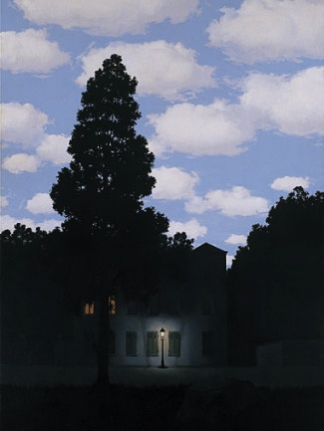
Histograms and Color Balancing
09/10/15
“Empire of Light”, Magritte
Computational Photography
Derek Hoiem, University of Illinois

Slide 2
Administrative stuff
Project 1: due Monday
Part I: Hybrid Image
Part II: Enhance Contrast/Color

Slide 3
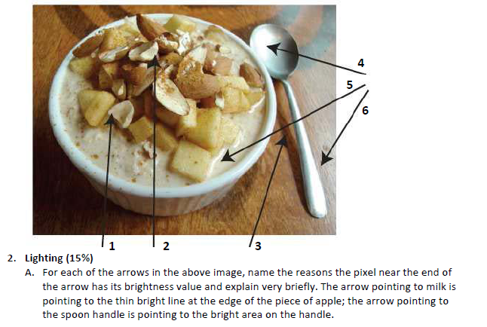
Review of last class
Possible factors: albedo, shadows, texture, specularities, curvature, lighting direction

Slide 4
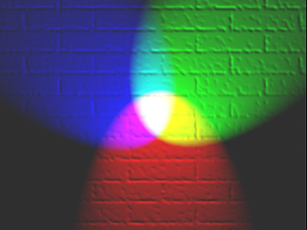
Today’s class
How can we represent color?
How do we adjust the intensity of an image to improve contrast, aesthetics?

Slide 5
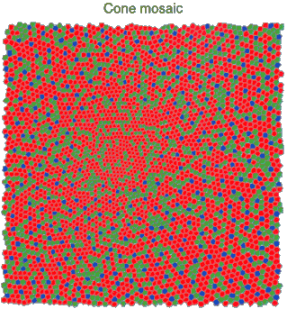
Physiology of Color Vision
Three kinds of cones:
Why are M and L cones so close?
Why are there 3?
© Stephen E. Palmer, 2002

Slide 6
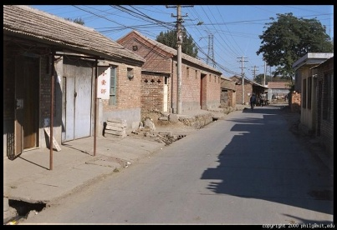
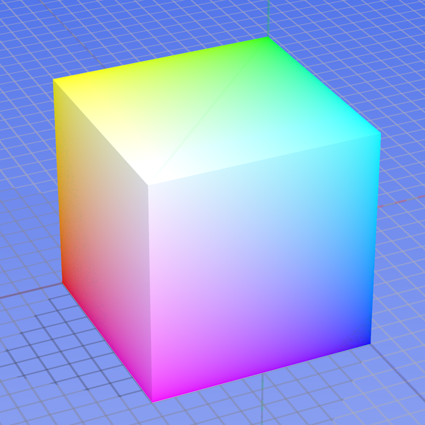
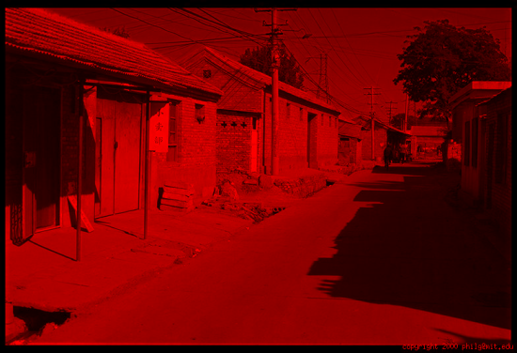
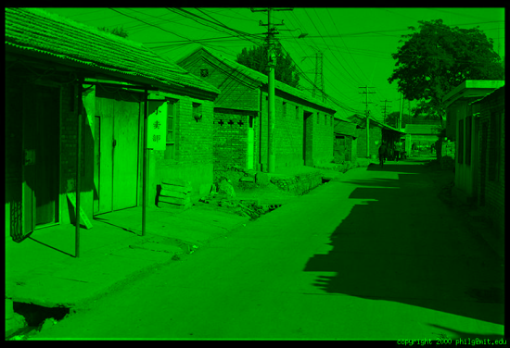
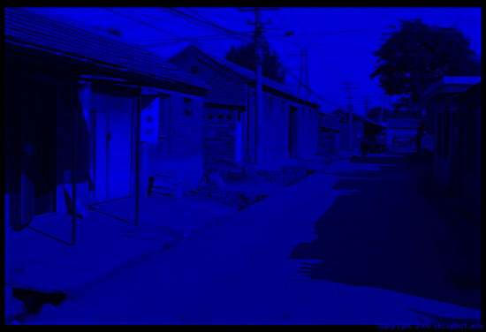
Color spaces: RGB
Default color space
0,1,0
R
(G=0,B=0)
1,0,0
G
(R=0,B=0)
0,0,1
B
(R=0,G=0)
Some drawbacks
Strongly correlated channels
Non-perceptual
Image from: http://en.wikipedia.org/wiki/File:RGB_color_solid_cube.png

Slide 7
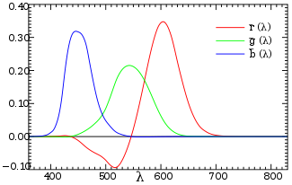
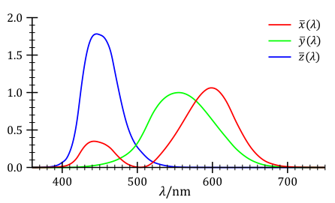
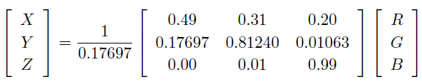
Trichromacy and CIE-XYZ
Perceptual equivalents with RGB
Perceptual equivalents with CIE-XYZ

Slide 8

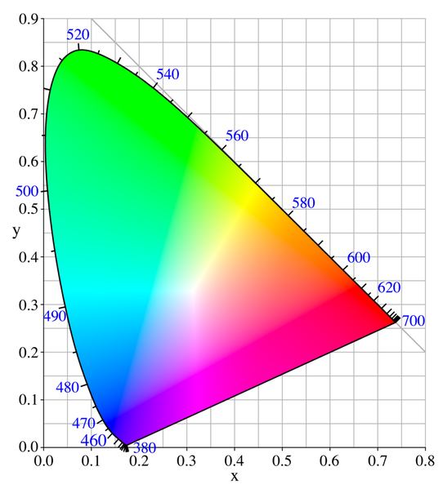

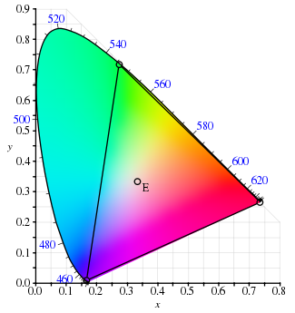
Color Space: CIE-XYZ
RGB portion is in triangle

Slide 9
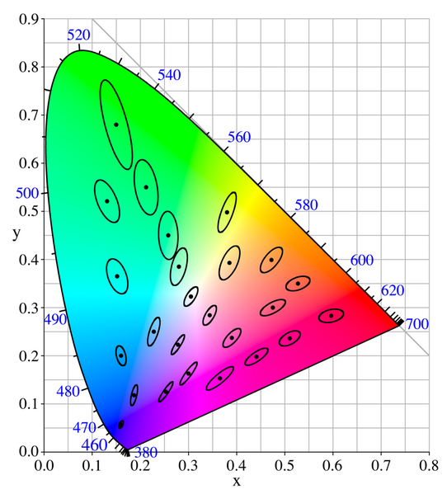
Perceptual uniformity

Slide 10
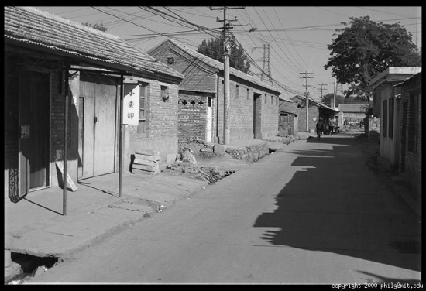
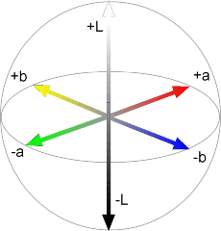
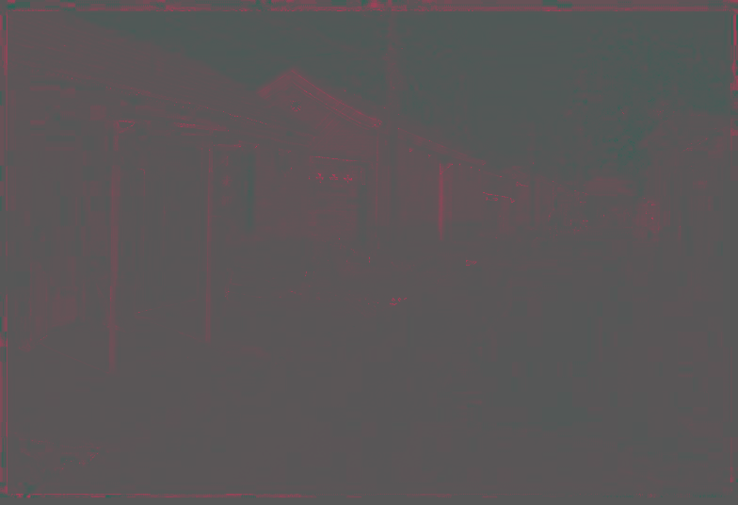
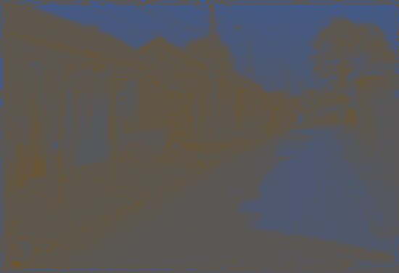
Color spaces: CIE L*a*b*
“Perceptually uniform” color space
L
(a=0,b=0)
a
(L=65,b=0)
b
(L=65,a=0)
Luminance = brightness
Chrominance = color

Slide 11
If you had to choose, would you rather go without luminance or chrominance?

Slide 12
If you had to choose, would you rather go without luminance or chrominance?

Slide 13
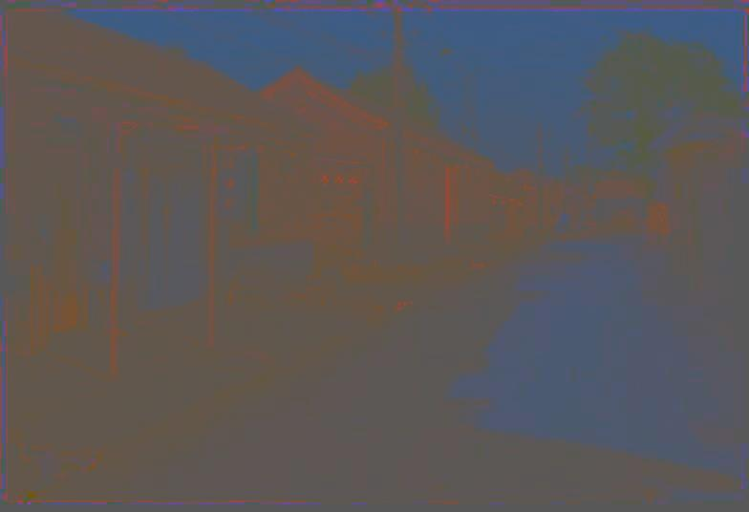
Most information in intensity
Only color shown – constant intensity

Slide 14

Most information in intensity
Only intensity shown – constant color

Slide 15

Most information in intensity
Original image

Slide 16
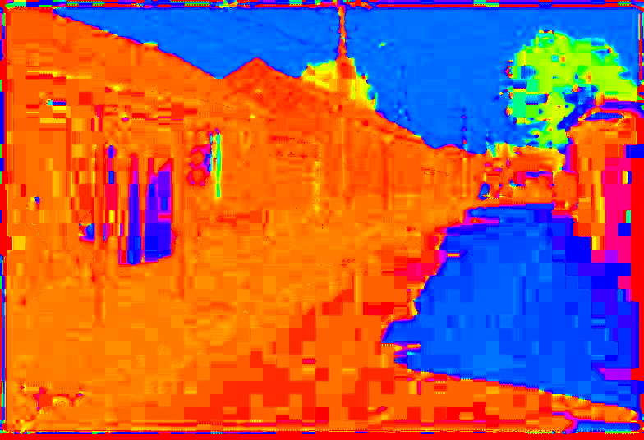
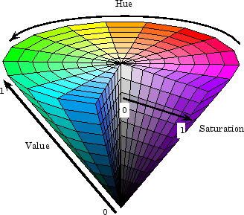
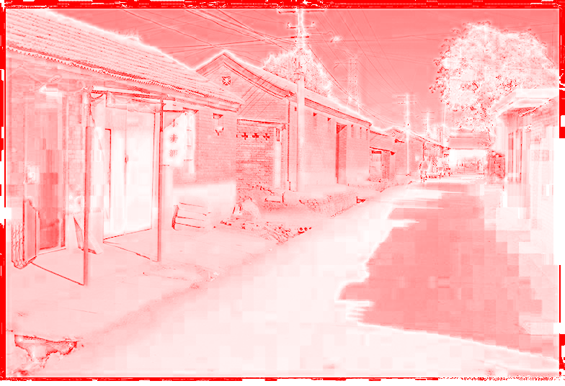
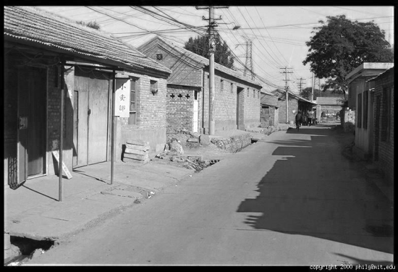
Color spaces: HSV
Intuitive color space
H
(S=1,V=1)
S
(H=1,V=1)
V
(H=1,S=0)

Slide 17
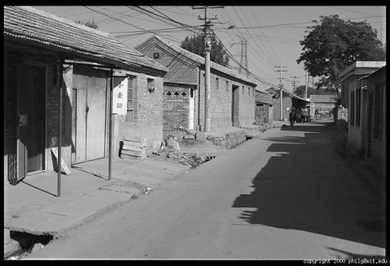
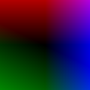




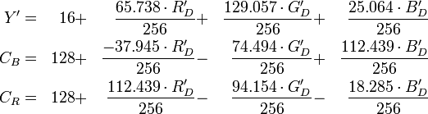
Color spaces: YCbCr
Fast to compute, good for compression, used by TV
Y=0
Y=0.5
Y
(Cb=0.5,Cr=0.5)
Cr
Cb
(Y=0.5,Cr=0.5)
Cb
Y=1
Cr
(Y=0.5,Cb=05)

Slide 18
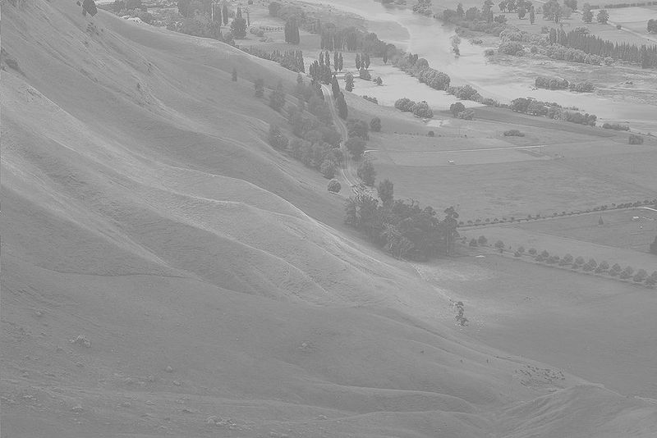
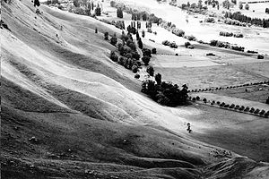
Contrast enhancement
http://en.wikipedia.org/wiki/Histogram_equalization

Slide 19
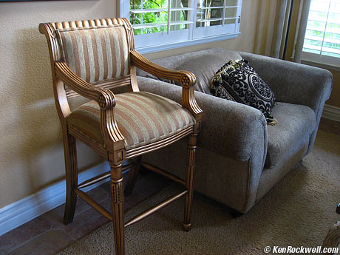
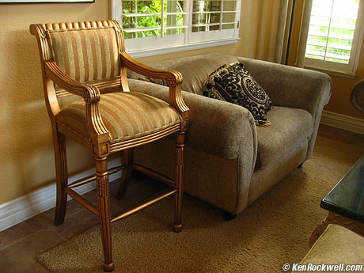
Color balancing
Photos: http://www.kenrockwell.com/tech/whitebalance.htm

Slide 20
Important ideas
Typical images are gray on average; this can be used to detect distortions
Larger differences are more visible, so using the full intensity range improves visibility
It’s often easier to work in a non-RGB color space

Slide 21
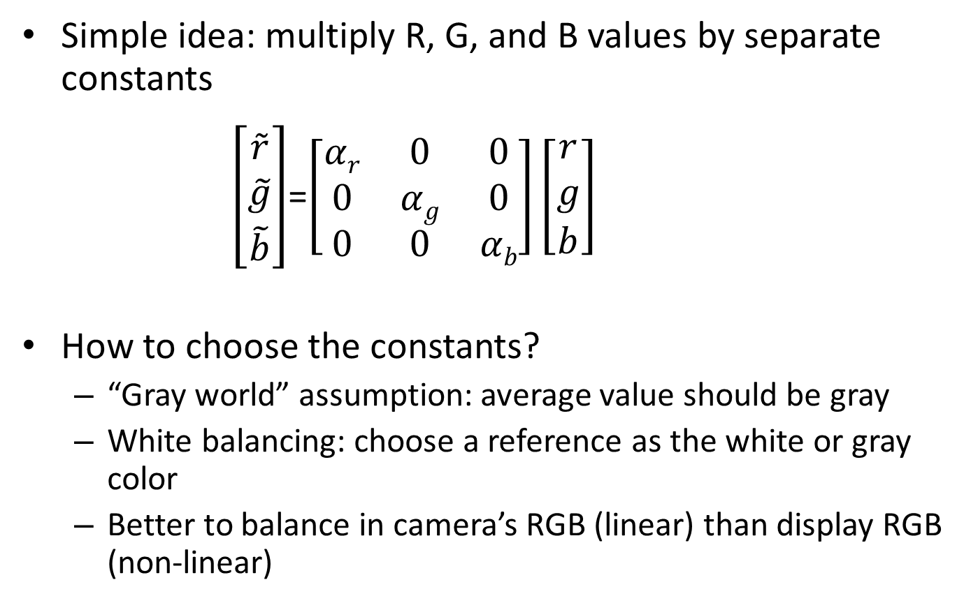
Color balancing via linear adjustment
Simple idea: multiply R, G, and B values by separate constants
$\left[\begin{matrix}\tilde{r} \\ \tilde{g} \\ \tilde{b}\end{matrix}\right]$=$\left[\begin{matrix}αr & 0 & 0 \\ 0 & αg & 0 \\ 0 & 0 & αb\end{matrix}\right]\left[\begin{matrix}r \\ g \\ b\end{matrix}\right]$
How to choose the constants?
“Gray world” assumption: average value should be gray
White balancing: choose a reference as the white or gray color
Better to balance in camera’s RGB (linear) than display RGB (non-linear)
Notes:
Demo

Slide 22
Tone Mapping
Typical problem: compress values from a high range to a smaller range
E.g., camera captures 12-bit linear intensity and needs to compress to 8 bits

Slide 23
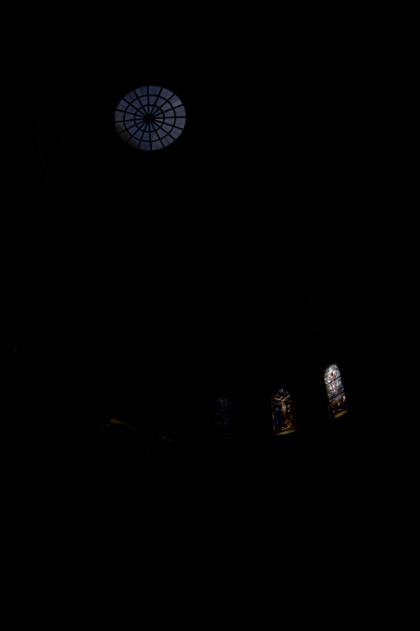
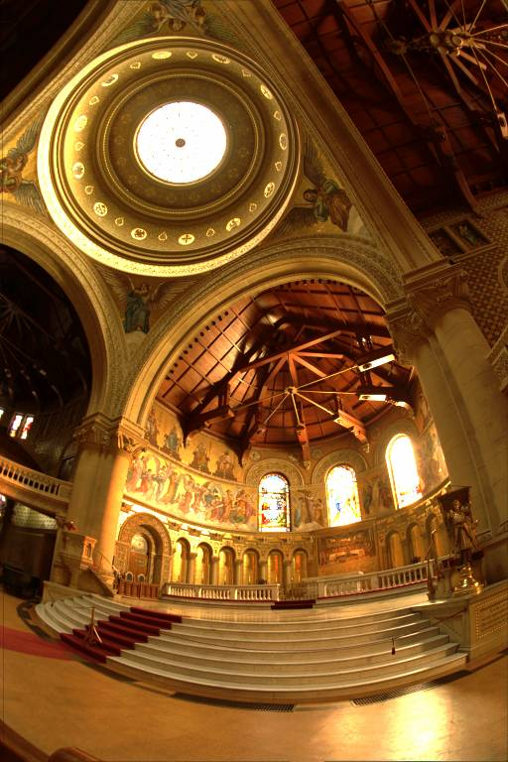
Example: Linear display of HDR
Scaled for brightest pixels
Scaled for darkest pixels

Slide 24
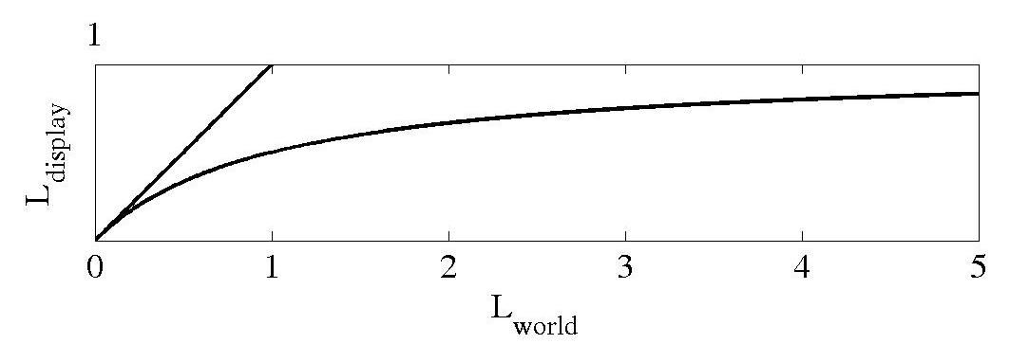
Global operator (Reinhart et al.)
Simple solution: map to a non-linear range of values

Slide 25
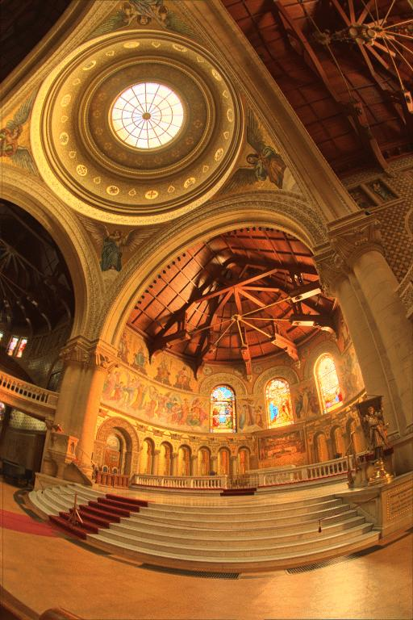
Reinhart Operator
Darkest 0.1% scaled
to display device

Slide 26
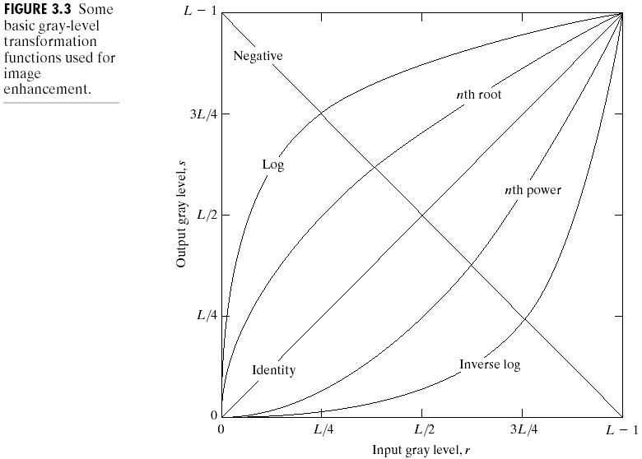
Simple Point Processing
Some figs from A. Efros’ slides

Slide 27
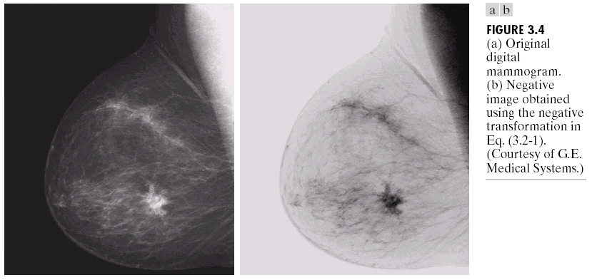
Negative

Slide 28
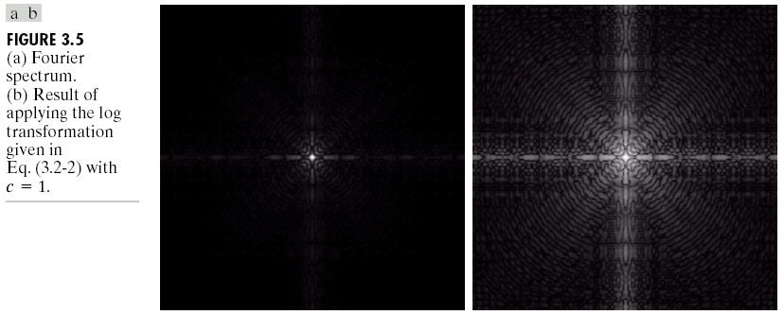
Log

Slide 29
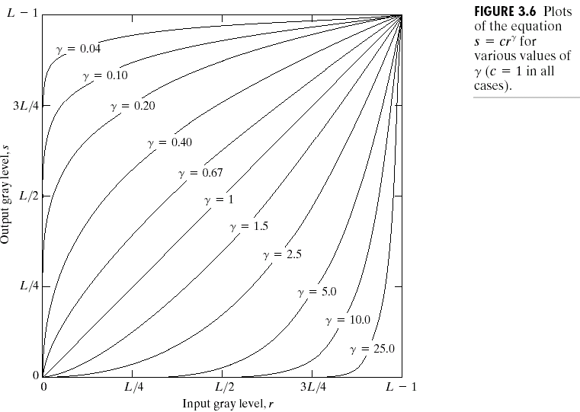
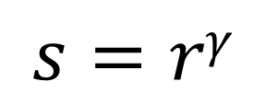
Power-law transformations
$$s=rγ$$

Slide 30
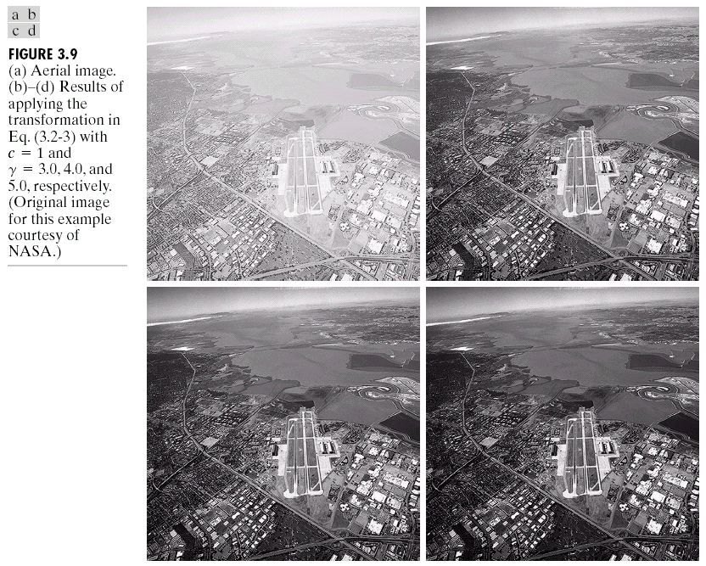
Image Enhancement

Slide 31
Matlab example

Slide 32
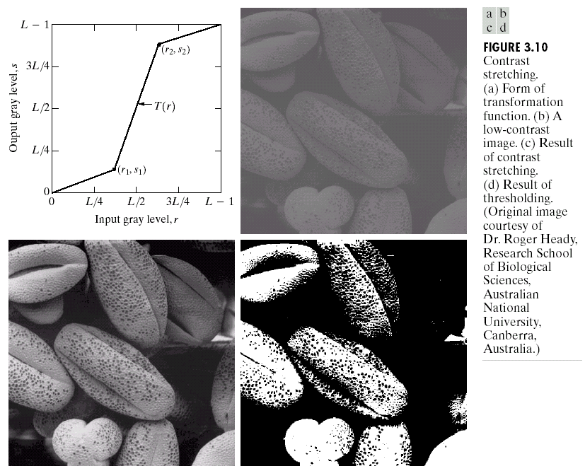
Contrast Stretching

Slide 33
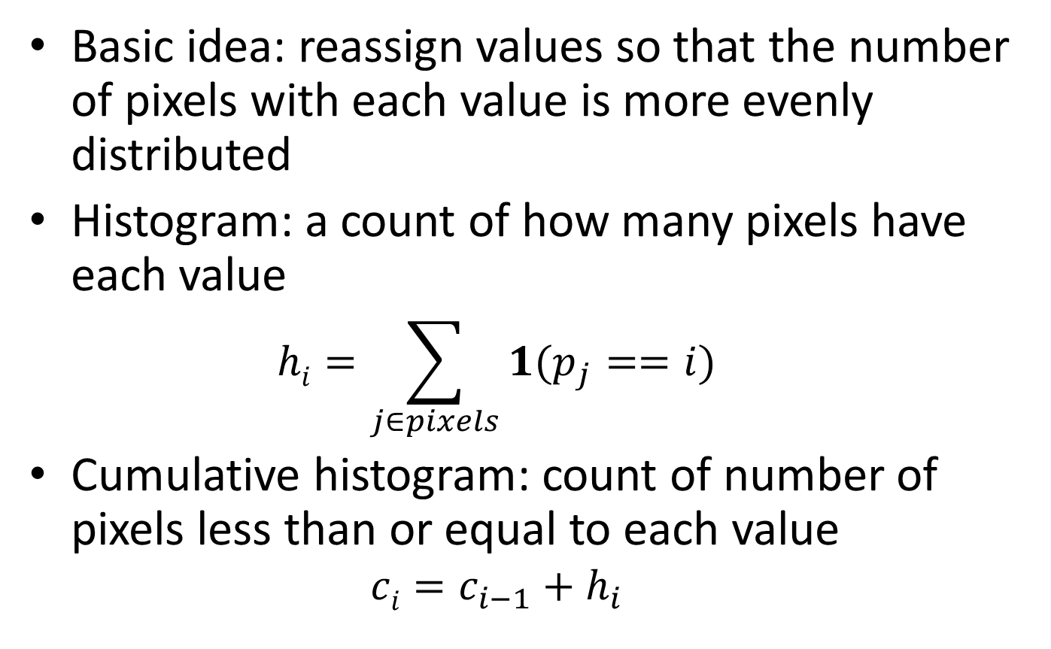
Histogram equalization
Basic idea: reassign values so that the number of pixels with each value is more evenly distributed
Histogram: a count of how many pixels have each value
$$hi=\sum_{j∈pixels}{1(p_{j}}==i)$$
Cumulative histogram: count of number of pixels less than or equal to each value
$$ci=c_{i−1}+h_{i}$$
Notes:
Do simple example of histogram on board: 3 1 2 1 2 3 4 1 5 4 3 2 1 = [(1, 4), …]

Slide 34
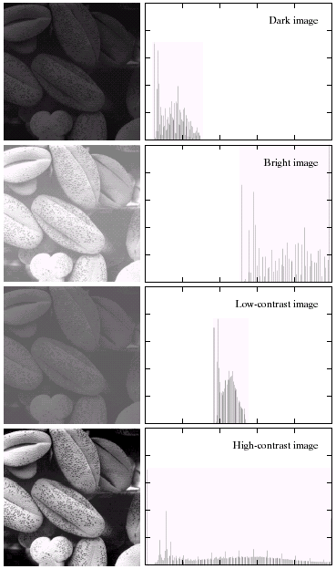
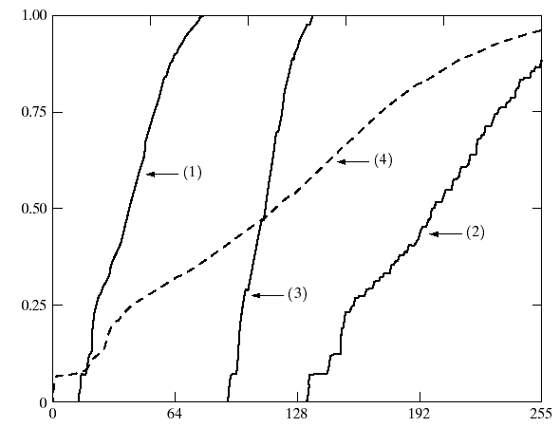

Image Histograms
Cumulative Histograms

Slide 35
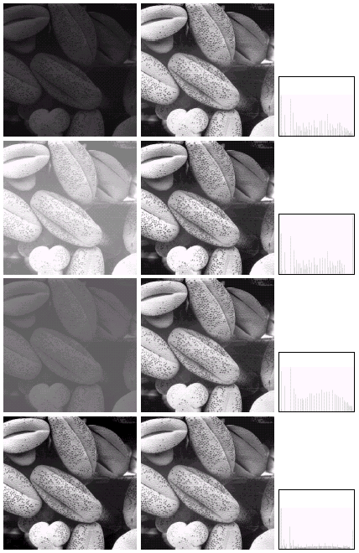

Histogram Equalization

Slide 36
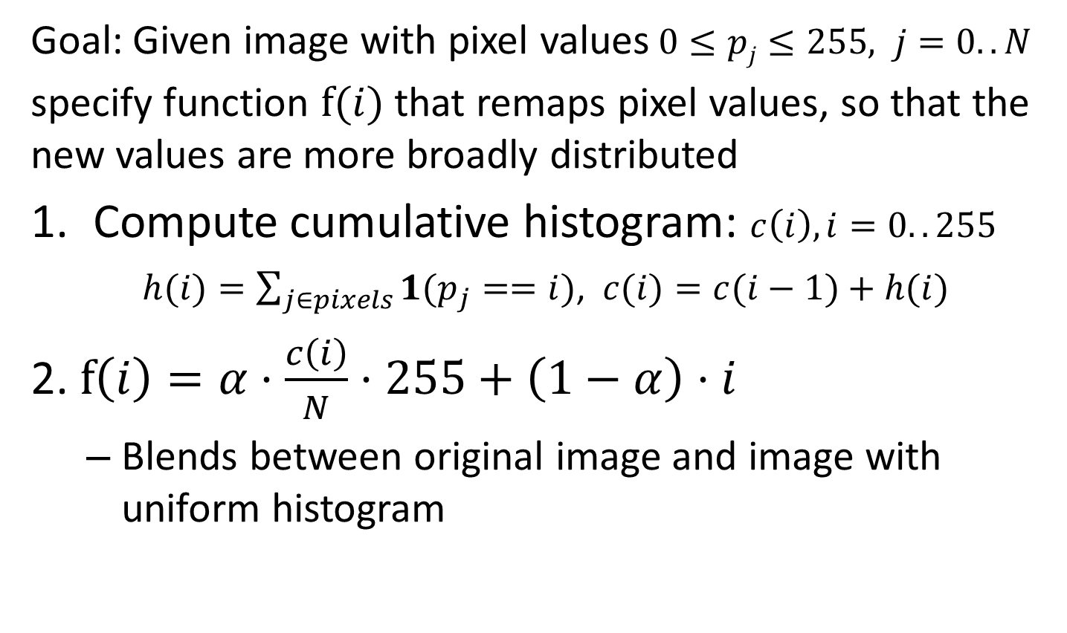
Algorithm for global histogram equalization
Goal: Given image with pixel values$0≤pj≤255, j=0..N$
specify function $f(i)$ that remaps pixel values, so that the new values are more broadly distributed
Compute cumulative histogram: $c\left(i\right), i=0..255$
$h(i)=\sum_{j∈pixels}{1(p_{j}}==i)$, $c(i)=c(i−1)+h(i)$
2. $f\left(i\right)=α⋅\frac{c\left(i\right)}{N}⋅255+\left(1−α\right)⋅i$
Blends between original image and image with uniform histogram
Notes:
Show this on board for an image with alpha = 0:0.05:1. Cumulative histogram maps pixel intensity to its percentile

Slide 37
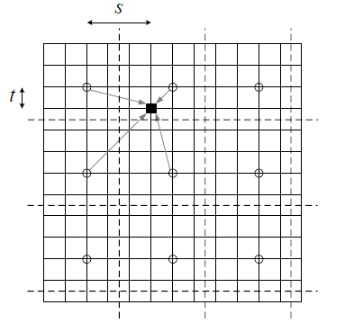
Locally weighted histograms
Compute cumulative histograms in non-overlapping MxM grid
For each pixel, interpolate between the histograms from the four nearest grid cells
Figure from Szeliski book (Fig. 3.9)
Pixel (black) is mapped based on interpolated value from its cell and nearest horizontal, vertical, diagonal neighbors
Notes:
adapthisteq in Matlab

Slide 38
Other issues
Dealing with color images
Often better to split into luminance and chrominance to avoid unwanted color shift
Manipulating particular regions
Can use mask to select particular areas for manipulation
Useful Matlab functions
rgb2hsv, hsv2rgb, hist, cumsum

Slide 39
Matlab Example 2

Slide 40

Things to remember
Familiarize yourself with the basic color spaces: RGB, HSV, Lab
Simple auto contrast/color adjustments: gray world assumption, histogram equalization
When improving contrast in a color image, often best to operate on luminance channel

Slide 41

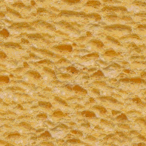
Next class: texture synthesis and transfer

