Slide 1
Reinforcement Learning
Applied Machine Learning
Joshua Levine

Slide 2
Today’s Lecture
Markov Decision Process
Overview of Reinforcement Learning
Q-Learning
Example Applications

Slide 3
Reinforcement Learning
Main idea: an agent learns to take actions by simulating episodes and collecting rewards.

Slide 4
Learning To Park

Slide 5
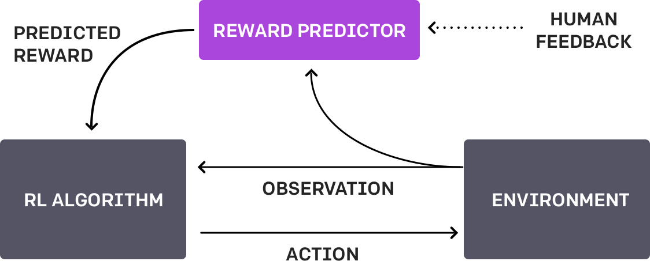
Reinforcement Learning from Human Feedback (RLHF)

Slide 6
Reinforcement Learning from Human Feedback (RLHF)

Slide 7
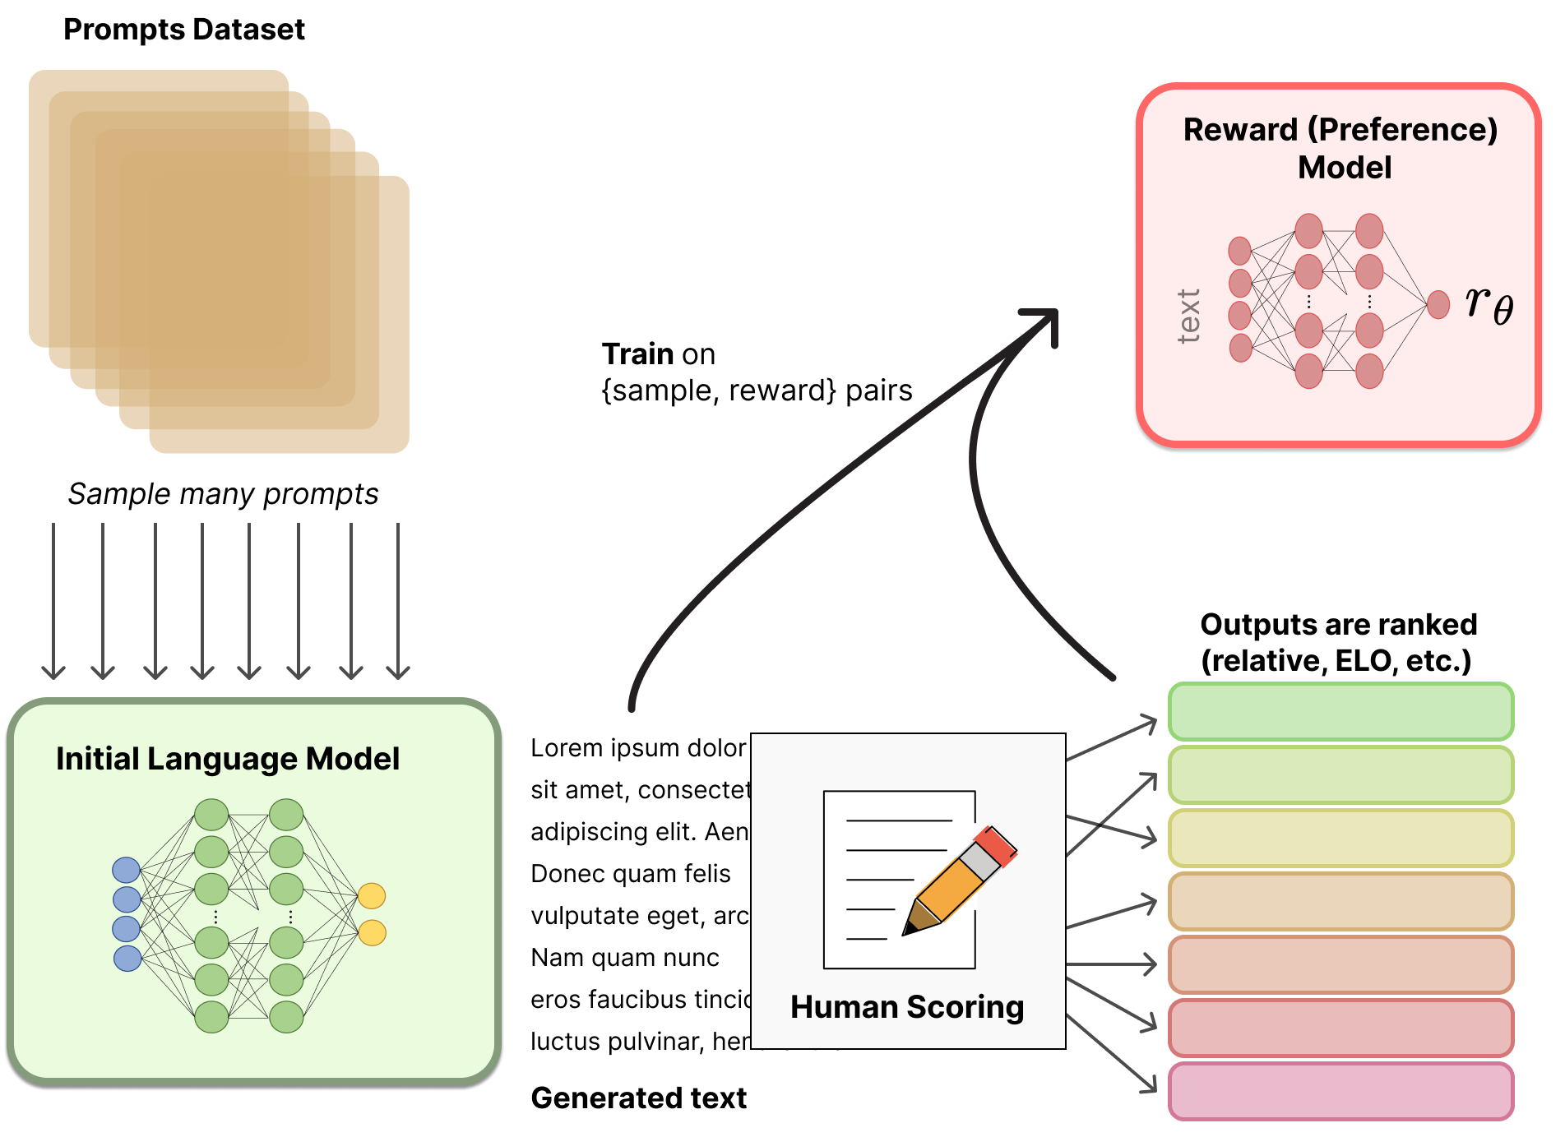
RLHF for Large Language Models
LLMs can learn from human feedback.

Slide 8
Markov Decision Process
MDP is defined by:
Set of states $s∈S$
Set of actions $a∈A$
Transition function $T(s, a, s^{′})$
Probability that $a$ in $s$ leads to $s′$: $P(s^{′}|s,a)$
Reward function $R(s, a, s^{′})$
A start state
Possibly one or more terminal states
Possibly a discount factor $γ$

Slide 9
Policies
The policy determines the actions that an agent will take
Policies can be deterministic or stochastic
The goal of an agent is to learn an optimal policy $π^{∗}$
In Deep RL we define the policy with learned parameters $θ$
$$a_{t}=π_{θ}(s_{t})$$

Slide 10
Discounted Rewards
Solving an MDP: maximize cumulative reward
Convergence: we use $γ$ to give less weight to samples that are further in the future. This causes the utility to converge
Discounted utility:
$$U\left(\left[s_{0}, a_{0},s_{1},a_{1},s_{2},…\right]\right)=R\left(s_{0}, a_{0},s_{1}\right)+γR\left(s_{1}, a_{1},s_{2}\right)+γ^{2}R\left(s_{2}, a_{2},s_{3}\right)+⋯$$

Slide 11
Compute Rewards
$$U\left(\left[s_{0}, a_{0},s_{1},a_{1},…\right]\right)=$$
$$R\left(s_{0}, a_{0},s_{1}\right)+γR\left(s_{1}, a_{1},s_{2}\right)+⋯$$
States: $S=\{a,b,c,d,e\}$
Actions: $A=\{Left,Right,Exit\}$, and $Exit$ is only valid in states $a$ and $e$
Discount factor: $γ=0.1$
10 |  |  |  | 1
a | b | c | d | e
Start State | Reward
a | 10
b | 1
c | 0.1
d | 0.1
e | 1
Policy:
Exit | ← | ← | → | Exit
a | b | c | d | e

Slide 12
What if we don’t know T and R?
Usually we don’t know the transition probabilities or the reward function
The agent needs to learn a policy from the unknown probabilities and reward function

Slide 13
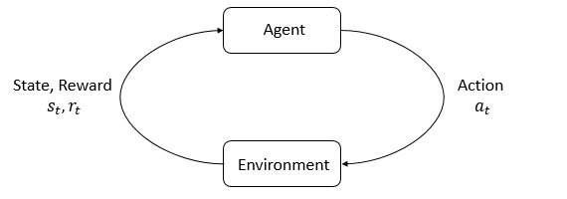
Reinforcement Learning
The environment is the world that the agent acts in
The agent receives a reward to represent how good or bad the current state is
RL: the agent learns to maximize cumulative reward

Slide 14
Value Functions
On-Policy Value Function, $V^{π}\left(s\right)$: expected return starting in state $s$ acting according to policy $π$
Q-state Value Function, $Q^{π}(s, a)$: expected return if we start in state $s$, take $a$, then act according to $π$
$V^{∗}(s)$ and $Q^{∗}(s,a)$ are the optimal functions, used with the optimal policy, $π^{∗}$

Slide 15
Bellman Equations
Main Idea: the value of the starting point is the reward for being there plus the value of the next state
$$V^{∗}\left(s\right)=\max_{a}\sum_{s′}{T\left(s, a, s^{′}\right)[R\left(s, a, s^{′}\right)+γV^{∗}\left(s^{′}\right)]}$$
$$Q^{∗}\left(s,a\right)=\sum_{s′}{T\left(s, a, s^{′}\right)[R\left(s, a, s^{′}\right)+γV^{∗}\left(s^{′}\right)]}$$
$$a_{t}^{∗}={\text{arg} \text{max}}_{a}Q^{∗}(s_{t},a)$$

Slide 16
Model-Free vs Model-Based RL
Model-Based: the agent either has access to or learns a model of the environment
Often used for games
Model-Free: the agent neither learns nor has access to a model of the environment
Policy Optimization
Q-Learning

Slide 17
Policy Optimization
Optimize $π_{θ}$ either directly or using gradient ascent on an objective function, which depends on the cumulative reward
The optimization is generally done on-policy
The policy can only be updated by data from the policy we want to update

Slide 18
Q-Learning
Learn an approximator $Q_{θ}(s, a)$, using the Bellman equation for an objective function
Optimization is performed off-policy, the Q-values can be updated using data from any time during training
Recall that once we learn the Q-values, our policy becomes:
$$π(s)={\text{arg} \text{max}}_{a}Q_{θ} (s,a)$$

Slide 19
Q-Learning
Collect samples to update $Q(s,a)$:
$$\text{sample}=R\left(s,a,s^{′}\right)+γ{\text{max}}_{a^{′}}Q\left(s^{′},a^{′}\right)$$
Incorporate samples into an exponential moving average with learning rate $α$:
$$Q\left(s,a\right)←\left(1−α\right)Q\left(s,a\right)+α∙\text{sample}$$

Slide 20
Q-Learning
Collect samples to update $Q(s,a)$:
$$\text{sample}=R\left(s,a,s^{′}\right)+γ{\text{max}}_{a^{′}}Q\left(s^{′},a^{′}\right)$$
Incorporate samples into an exponential moving average:
$$Q\left(s,a\right)←\left(1−α\right)Q\left(s,a\right)+α∙\text{sample}$$
State | Left | Right | Exit
a | 0 | 0 | 10
b | 1 | 0 | -
c | 0.1 | 0 | -
d | 0.01 | 0 | -
e | 0 | 0 | 0
10 |  |  |  | 1
a | b | c | d | e
$$γ=0.1$$
$$α=1$$

Slide 21
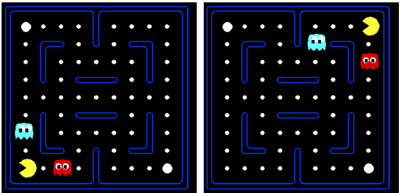
Approximate Q-Learning
A Q-value table would be too big
Represent states with feature vectors
Feature vector might include:
Distance to nearest ghost
Distance to nearest food pellet
Number of ghosts
Is pacman trapped?
Value of Q-states becomes a linear value function
We can do the same for state values
$$Q\left(s,a\right)=w_{1}f_{1}\left(s,a\right)+w_{2}f_{2}\left(s,a\right)+⋯+w_{n}f_{n}\left(s\right)=\vec{w}∙\vec{f}(s,a)$$
$\vec{f}(s,a)$ is the feature vector for Q-state $\left(s, a\right)$
$\vec{w}$ is a weight vector

Slide 22
Approximate Q-Learning
Collect samples to update $Q(s,a)$:
$$sample=R\left(s,a,s^{′}\right)+γ{\text{max}}_{a^{′}}Q\left(s^{′},a^{′}\right)$$
Define Difference:
$$\text{difference}=sample−Q(s,a)$$
Update with learning rate $α$:
$$w_{i}←w_{i}+α∙\text{difference}∙f_{i}(s,a)$$
* Note: Exact Q-learning can be expressed as $Q\left(s, a\right)←Q\left(s,a\right)+α∗\text{difference}$

Slide 23
Trade-offs
Policy optimization optimizes the thing you want
More stable and reliable; less efficient
Q-learning can reuse data better because it uses off-policy optimization
More efficient; less stable

Slide 24
RLHF for Large Language Models
LLMs can learn from human feedback.

Slide 25
Training
Exploration: explore new states to update approximators
Exploitation: rely on approximators for actions
Encourage exploration in the objective function or by randomly choosing some actions

Slide 26
Stretch Break
Think about:
How does reinforcement learning differ from other types of machine learning, such as supervised and unsupervised learning?
What are some advantages and disadvantages of reinforcement learning compared to these other types?
After the break: Applications of RL

Slide 27
Applications

Slide 28
Deep RL: Steps to train an agent
Choose or design an algorithm
If you are doing deep RL, construct $π_{θ}$ which is a deep neural network that can be optimized
Define a reward function
Start training and tune your reward function as necessary

Slide 29
Hide & Seek
Baker et al., 2020 Emergent Tool Use From Multi-Agent Autocurricula

Slide 30
Popular Algorithms
Taxonomy of RL Algorithms [Open AI]

Slide 31
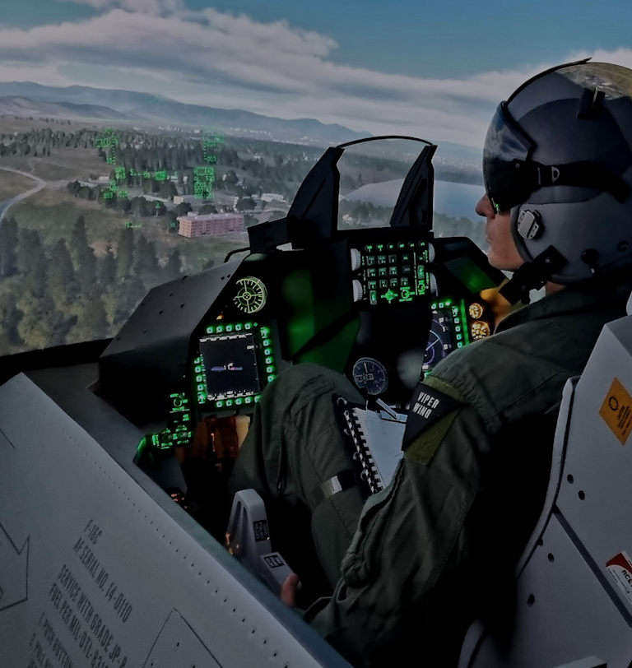
Aircraft Controller
Soft Actor-Critic
Hybrid between policy optimization and Q-learning
Actor learns policy while critic learns values
Entropy regularization
Balancing convergence time and sparse rewards
Creating a realistic environment
Developing cooperative controllers
Simulated Cockpit [Viper Wing]
Notes:
Aerial Imaging

Slide 32
Additional Challenges
Multi-Agent Reinforcement Learning: multiple agents in an environment learn policies and can either compete or cooperate
Sim-to-Real Gap: policies in simulation don’t usually transfer well to the real world
Tuning LMs: using PPO variants for LLM tuning
Imitation Learning: learning from examples
Source

Slide 33
Things to remember
Markov Decision Process:
States, actions, transition probabilities, reward
Discounted utility
Policy determines actions
Reinforcement Learning
Agents live in and get rewards from the environment
On-policy Value Function and Q-State Value Function
Bellman Equations
Model-Based vs. Model-free RL
Policy Optimization
Q-Learning
Approximate Q-Learning

Slide 34
References
Open AI Spinning Up Introduction to RL
UC Berkeley CS188
UIUC CS440
Notes:
Imitation rl
Model free/model based
Explain difference in q/approx. eqs.
Supervised vs. RL: in RL you don’t always get reward for each sample
RL: requires lots of episodes
Combination between rl and supervised
Actual hide and seek rewaeds
Talk more about my work
More steps
More on bellman

