Slide 1

Optimization and Stochastic Gradient Descent
Applied Machine Learning
Derek Hoiem
Dall-E

Slide 2
Machine learning optimization
 | Optimization | Solution Depends on Initialization or Randomized Optimization? | Optimization Strategy is Important to Effectiveness?
KNN | N/A | No | No
K-means | Coordinate Descent | Yes | No
Linear Regression | Iterative | No | No
Logistic Regression | Iterative | No | No
Linear SVM | Iterative | No | No
Kernelized SVM | Iterative | No | No
EM Algorithm | Coordinate Descent | Yes | No
Decision Tree | Greedy selection | No | No
For methods we learned so far, one optimizer may be faster or more memory efficient than other, but they will generally be able to achieve similar solutions.

Slide 3
Machine learning optimization
 | Optimization | Solution Depends on Initialization or Randomized Optimization? | Optimization Strategy is Important to Effectiveness?
KNN | N/A | No | No
K-means | Coordinate Descent | Yes | No
Linear Regression | Iterative | No | No
Logistic Regression | Iterative | No | No
Linear SVM | Iterative | No | No
Kernelized SVM | Iterative | No | No
EM Algorithm | Coordinate Descent | Yes | No
Decision Tree | Greedy selection | No | No
MLPs, Deep Networks | Iterative | Yes | Yes
For methods we learned so far, one optimizer may be faster or more memory efficient than other, but they will generally be able to achieve similar solutions.
For MLPs and deep networks, optimization is an important part of design.

Slide 4
This lecture
Batch gradient descent
PEGASOS: Stochastic Gradient Descent for SVM
Perceptrons

Slide 5
Gradient descent
gradient_descent(f’(x), x0, lr, niter)
x = x0
for t in range(niter):
x = x – lr*f’(x)
return x

Slide 6
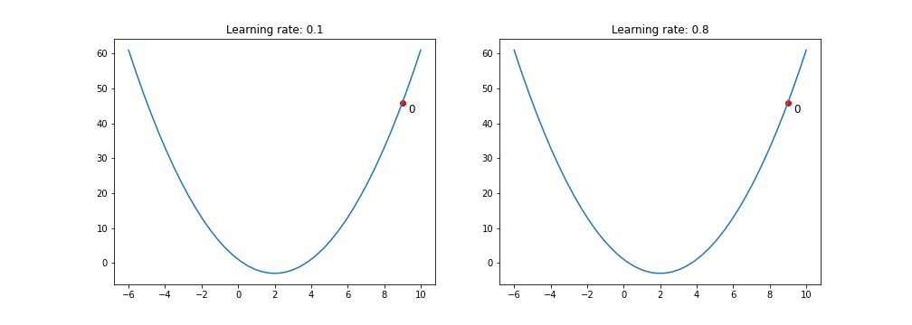

Gradient descent
gradient_descent(f’(x), x0, lr, niter)
x = x0
for t in range(niter):
x = x – lr*f’(x)
return x
Example:
$$f\left(x\right)= x^{2}−4x+1$$
$$f^{′}\left(x\right)=2x−4$$
Example: https://towardsdatascience.com/gradient-descent-algorithm-a-deep-dive-cf04e8115f21

Slide 7
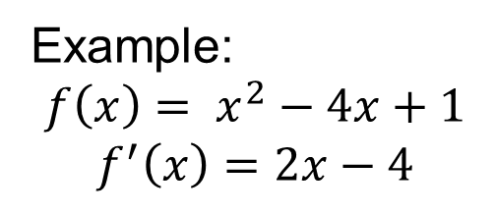
Gradient descent
gradient_descent(f’(x), x0, lr, niter)
x = x0
for t in range(niter):
x = x – lr*f’(x)
return x
Example:
$$f\left(x\right)= x^{2}−4x+1$$
$$f^{′}\left(x\right)=2x−4$$
Example: https://towardsdatascience.com/gradient-descent-algorithm-a-deep-dive-cf04e8115f21

Slide 8
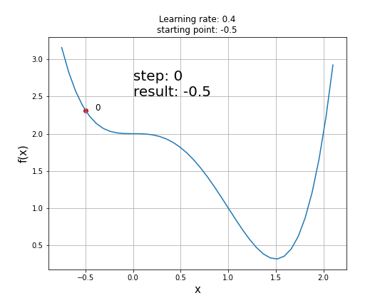
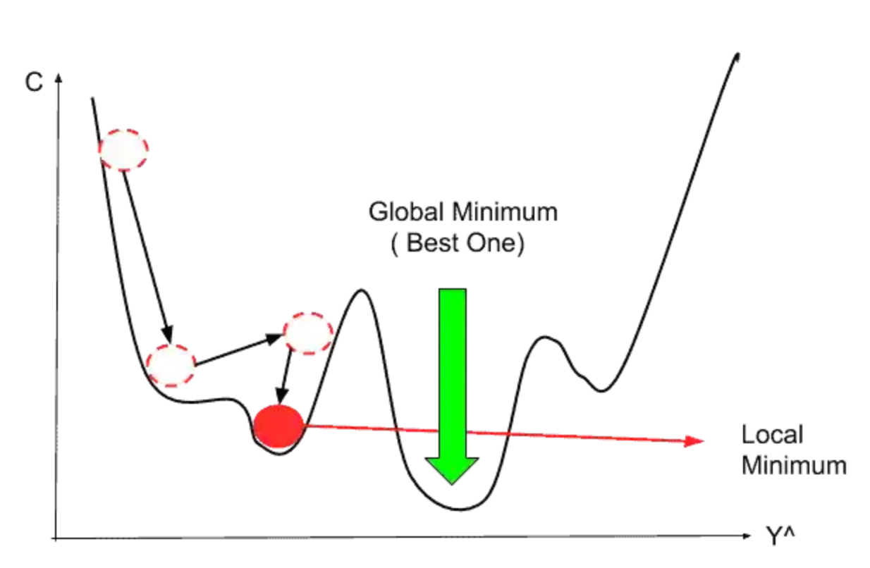
Gradient descent challenge cases
Saddle points (gradient = 0 in some parts of solution space)
Multiple local minima
Many models we’ve learned so far (e.g., SVM, logistic regression, linear regression) are convex, so they don’t have these challenges.
Example: https://towardsdatascience.com/gradient-descent-algorithm-a-deep-dive-cf04e8115f21
Fig: https://www.mltut.com/stochastic-gradient-descent-a-super-easy-complete-guide/

Slide 9
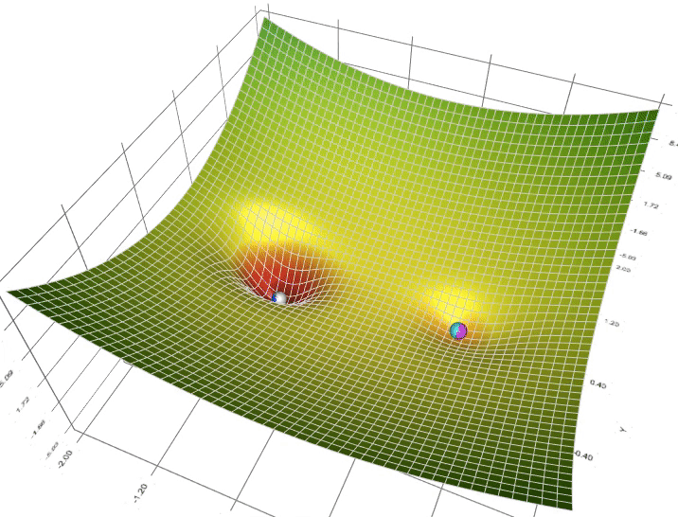
Gradient Descent Visualization with Local Minima
Figure source

Slide 10
Learning rates and learning schedules
Learning rate = step size that is multiplied by gradient direction/magnitude
  Large rate allows big movements toward optimum but might over-step
  Small rate is less likely to over-step but could take longer
Learning schedule: change learning rate over time
  Constant
  Exponential decay, e.g. lr = lr * 0.95
  Linear, e.g. lr = lr0 *(1 – iter / max_iter)

Slide 11
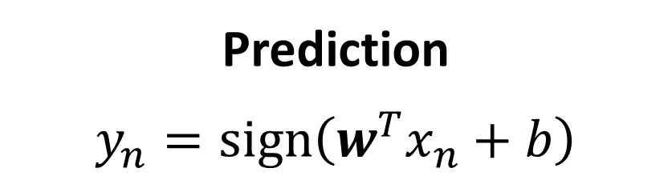
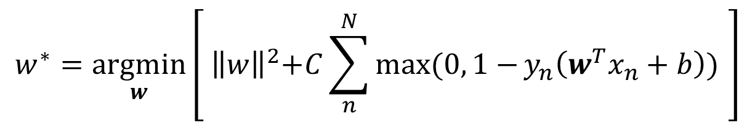
SVM Formulation
Prediction
$$y_{n}=sign\left(w^{T}x_{n}+b\right)$$
Optimization
Known as “hinge loss”
Penalty is paid if margin is less than 1
$$w^{∗}=\underset{w}{argmin}\left[{ \left\|w\right\|}^{2}+C\sum_{n}^{N}{\max{(0, 1−}}y_{n}\left(w^{T}x_{n}+b\right)) \right]$$
Here, $y∈\{−1,1\}$ which is a common convention that simplifies notation for binary classifiers

Slide 12
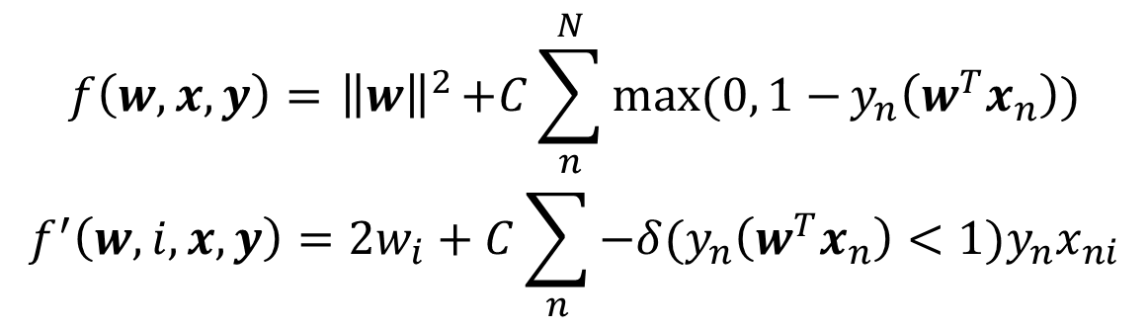
Gradient descent with SVM
gradient_descent(f’(w,i,x,y), lr, niter)
w = zeros(x.shape[1],)
for t in range(niter):
for i in range(len(w)):
w[i] = w[i] – lr*f’(w,i,x,y)
return x
$$f\left(w,x,y\right)={ \left\|w\right\|}^{2}+C\sum_{n}^{N}{\max{(0, 1−}}y_{n}\left(w^{T}x_{n}\right))$$
$$f^{′}\left(w,i, x,y\right)=2w_{i}+C\sum_{n}{−δ(y_{n}\left(w^{T}x_{n}\right)<1)y_{n}x_{ni}}$$
Only examples with score of correct answer less than 1 contribute to the gradient

Slide 13
Pegasos: Primal Estimated sub-GrAdient SOlver for SVM (2011)
SVM problem that we want to solve
(Minimize weights square + sum of hinge losses on all samples)
Problem in terms of one sample
Gradient in terms of one sample
- Direction to move to improve solution
https://home.ttic.edu/~nati/Publications/PegasosMPB.pdf

Slide 14
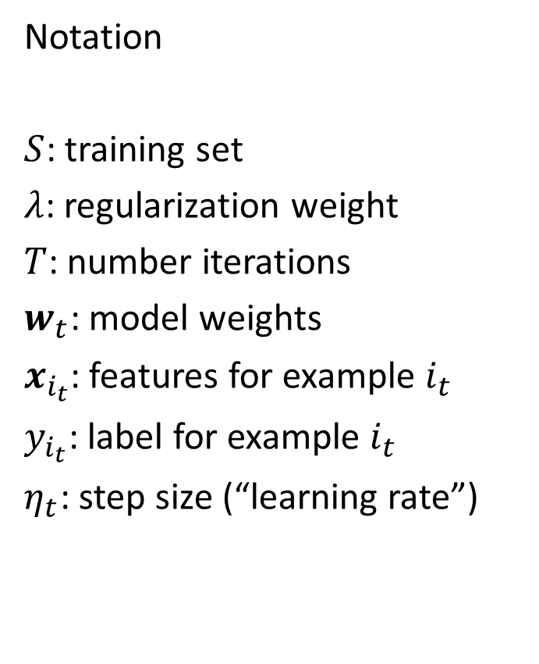
Pegasos algorithm: Stochastic Gradient Descent (SGD)
Notation
$S$: training set
$λ$: regularization weight
$T$: number iterations
$w_{t}$: model weights
$x_{i_{t}}$: features for example $i_{t}$
$y_{i_{t}}$: label for example $i_{t}$
$η_{t}$: step size (“learning rate”)

Slide 15

Pegasos with mini-batch
Calculating gradient based on multiple examples reduces variance of gradient estimate
$k$: batch size
$m$: number of training samples
$A_{t}$: batch of examples
$A_{t}^{+}$: examples within margin
$S$: training set
$λ$: regularization weight
$T$: number iterations
$w_{t}$: model weights
$x_{i}$: features for example $i$
$y_{i}$: label for example $i$
$η_{t}$: step size (“learning rate”)

Slide 16
SGD applies to many losses
z is the score for y=1
SVM (hinge loss)
Logistic regression / sigmoid loss
Hinge L1 regression
Margin loss between scores of most likely and correct label
Variant of a logistic loss

Slide 17
SGD is fast compared to other optimization approaches
SDCA = stochastic dual coordinate descent, another form of sub-gradient optimization that chooses learning rate dynamically

Slide 18
Experiments with Linear SVM
Training time and test error

Slide 19
Experiments using Gaussian kernel SVM (see paper for kernelized Pegasos algorithm)

Slide 20
Effect of mini-batch size

Slide 21
Effect of sampling procedure: randomly ordered epochs is best
Sampling with replacement
Use different random order for each “epoch”
Use same order for each epoch
Epoch: one run through the training set

Slide 22
Learning rate comparison
Zhang uses fixed learning rate
Plots show error over iterations for several rates

Slide 23
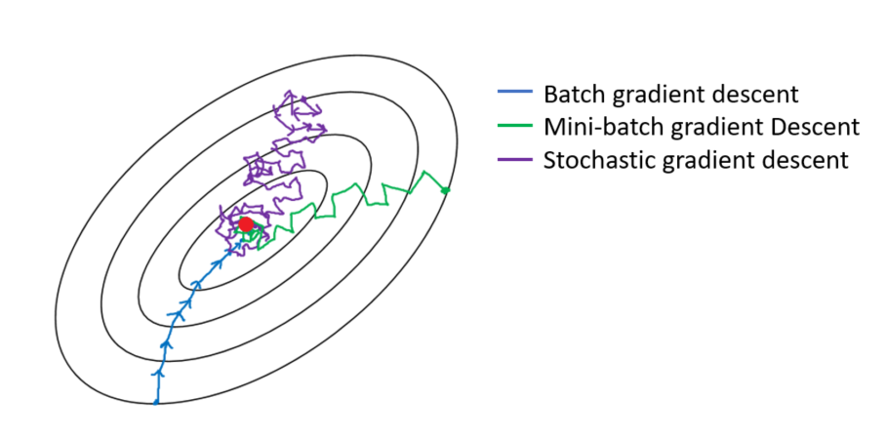
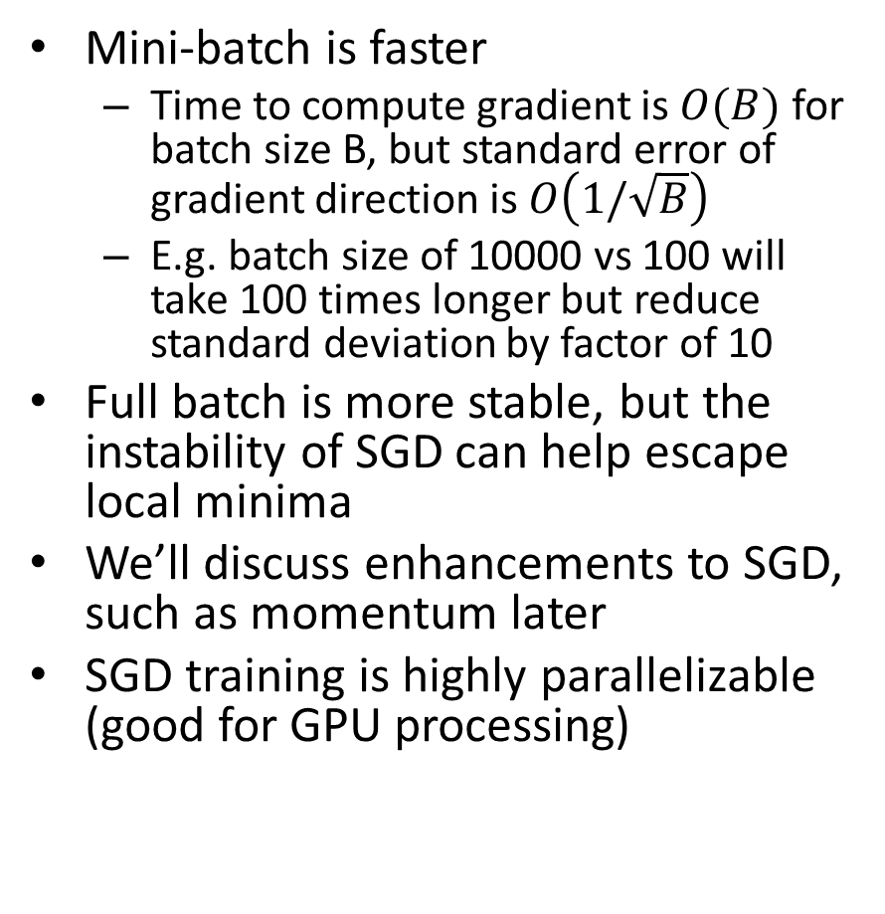
Mini-Batch SGD vs. Full Batch Gradient Descent
Mini-batch is faster
  Time to compute gradient is $O(B)$ for batch size B, but standard error of gradient direction is $O\left(1/\sqrt{B}\right)$
  E.g. batch size of 10000 vs 100 will take 100 times longer but reduce standard deviation by factor of 10
Full batch is more stable, but the instability of SGD can help escape local minima
We’ll discuss enhancements to SGD, such as momentum later
SGD training is highly parallelizable (good for GPU processing)
https://medium.com/analytics-vidhya/gradient-descent-vs-stochastic-gd-vs-mini-batch-sgd-fbd3a2cb4ba4

Slide 24
Pegasos: take-ways and surprising facts
SGD is very simple and effective optimization algorithm – step toward better solution based on a small sample of training data
Not very sensitive to mini-batch size (but larger batches can be much faster with GPU parallel processing)
The same learning schedule is effective across several problems
A larger training set makes it faster to obtain the same test performance

Slide 25
Review questions
http://tinyurl.com/cs441sgd
(participation in all remaining forms worth total of 20 points)
True or False:
Unlike SVM, linear logistic regression loss always adds a non-zero penalty over all training data points.
The PEGASUS algorithm computes the gradient for the optimization algorithm using only one sample out of the training data points – instead of using the whole dataset – thus increasing its computational efficiency.
PEGASUS has the disadvantage that the larger the training dataset, the slower it can be optimized to reach a particular test error.
Which of these algorithms’ objective functions have a single local optimum?
  Logistic regression, linear regression, linear SVM, kernelized SVM, EM algorithm, K-means

Slide 26
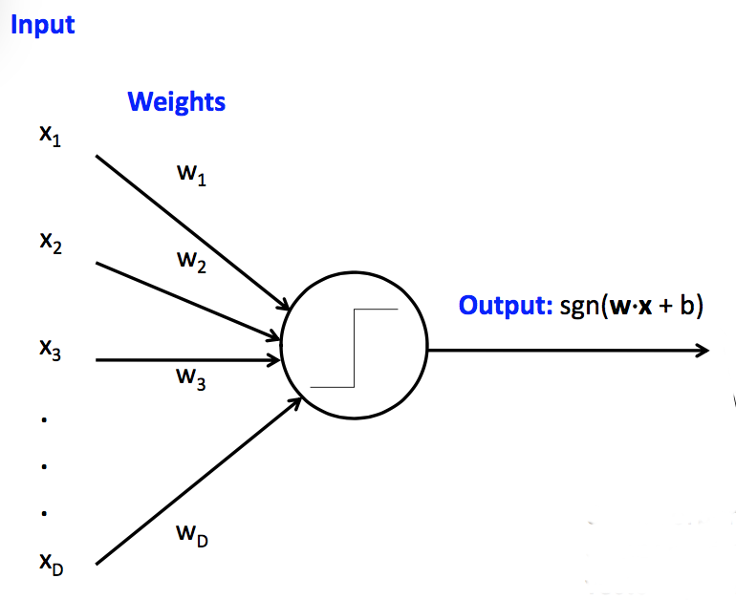
Perceptron
Perceptron = thresholded linear prediction model for classification
Very similar to linear logistic regression, though perceptron does not imply a particular error or training objective
sgn returns -1 for negative inputs and +1 for positive inputs
Fig source: CS 440

Slide 27

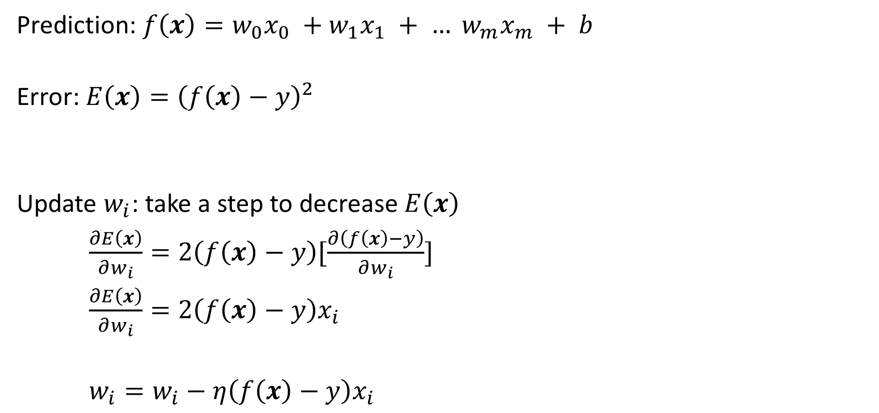
Perceptron Update Rule
Prediction: $f\left(x\right)=w_{0}x_{0} +w_{1}x_{1} + … w_{m}x_{m} + b$
Error: $E\left(x\right)={\left(f\left(x\right)−y\right)}^{2}$
Update $w_{i}$: take a step to decrease $E\left(x\right)$
$\frac{∂E\left(x\right)}{∂w_{i}}=2\left(f\left(x\right)−y\right)[\frac{∂\left(f\left(x\right)−y\right)}{∂w_{i}}]$
$\frac{∂E\left(x\right)}{∂w_{i}}=2\left(f\left(x\right)−y\right)x_{i}$
$w_{i}=w_{i}−η\left(f\left(x\right)−y\right)x_{i}$
prediction
target
Chain Rule:
$h\left(x\right)=f(g\left(x\right))$, then
$h^{′}\left(x\right)=f^{′}\left(g\left(x\right)\right)g′(x)$
(the 2 is folded into the learning rate)
Make error lower
Learning rate

Slide 28
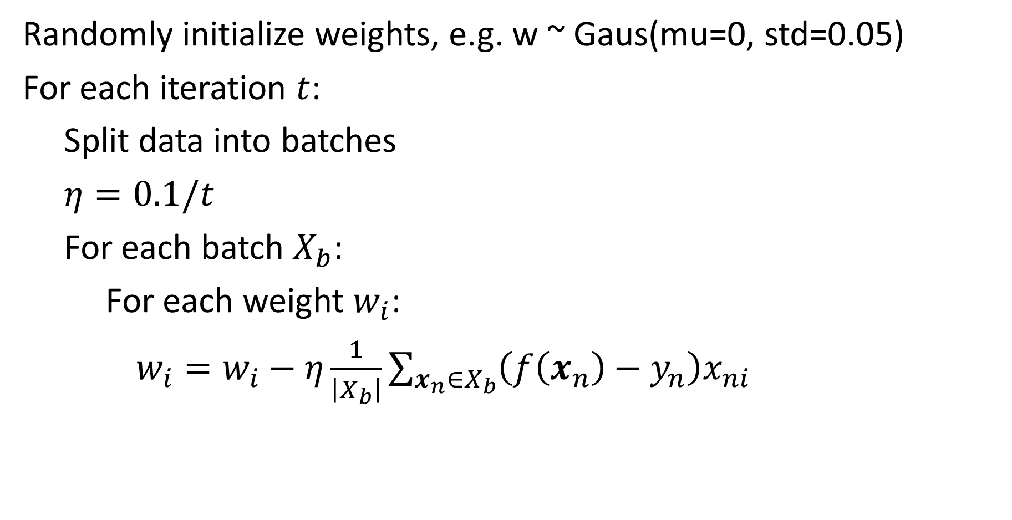
Perceptron Optimization by SGD
Randomly initialize weights, e.g. w ~ Gaus(mu=0, std=0.05)
For each iteration $t$:
Split data into batches
$η=0.1/t$
For each batch $X_{b}$:
For each weight $w_{i}$:
$w_{i}=w_{i}−η\frac{1}{\left|X_{b}\right|}\sum_{x_{n}∈X_{b}}{\left(f\left(x_{n}\right)−y_{n}\right)x_{ni}}$

Slide 29

With different loss, the update changes accordingly
Logistic loss:
$f\left(x\right)=w_{0}x_{0} +w_{1}x_{1} + … w_{m}x_{m} + b$
$P\left(y|x\right)=\frac{1}{1+\exp\left(−yf\left(x\right)\right)}, y∈\{−1,1\}$
$E\left(x\right)=−log{P\left(y|x\right)}$
$w_{i}=w_{i}+η\frac{1}{\left|X_{b}\right|}\sum_{x_{n}∈X_{b}}{y_{n}x_{ni}\left(1−P(y=y_{n}|x_{n})\right)}$
decrease –logP(y|x) → increase logP(y|x)

Slide 30
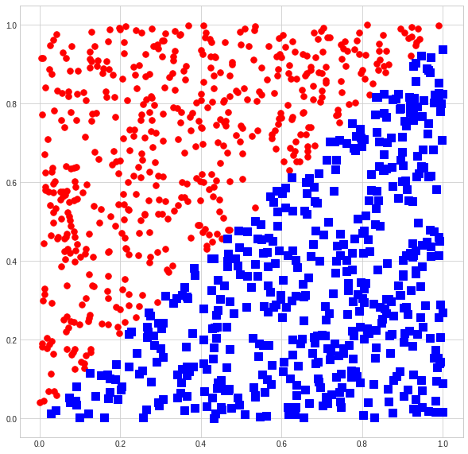
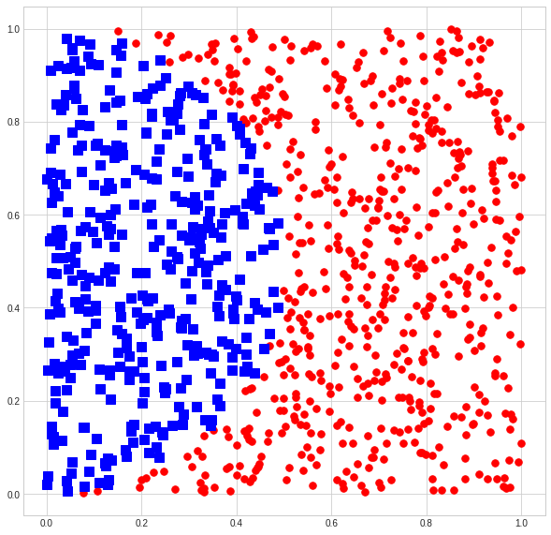
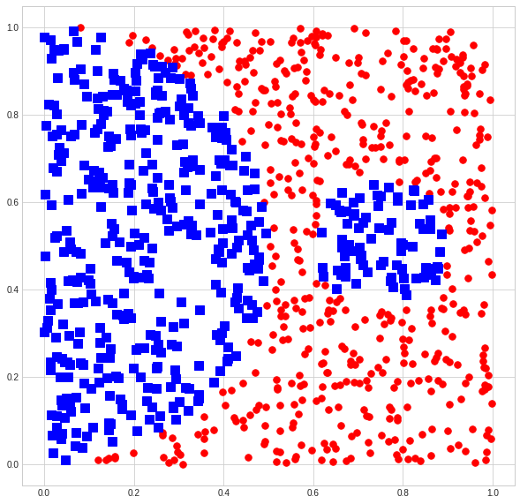
Is a perceptron enough?
Which of these can a perceptron solve (fit with zero training error)?

Slide 31
Demo
https://colab.research.google.com/drive/1nKNJyolqgzW53Rz59M2BZtyQM8bbrExb?usp=sharing

Slide 32
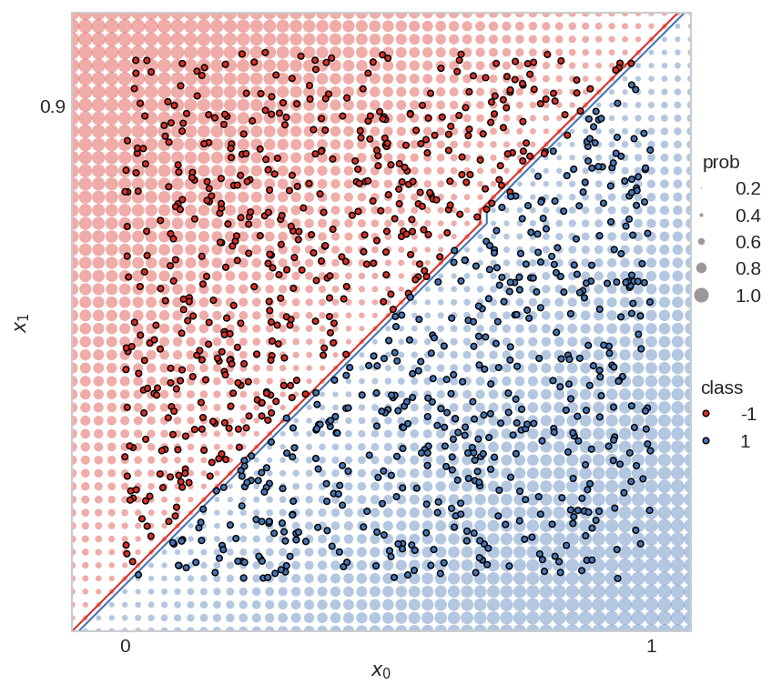
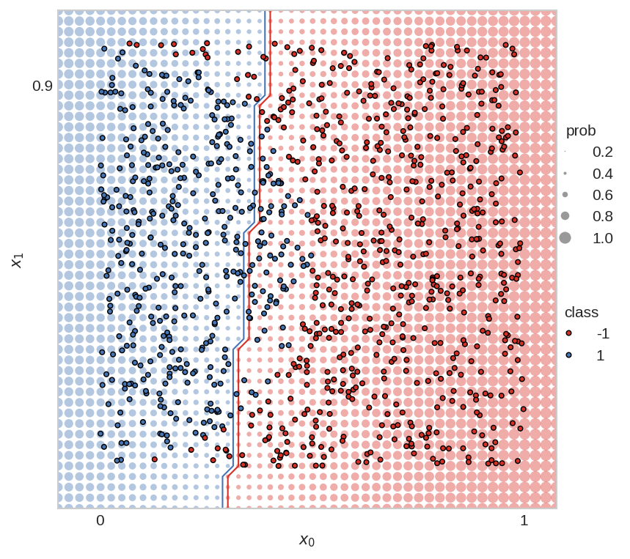
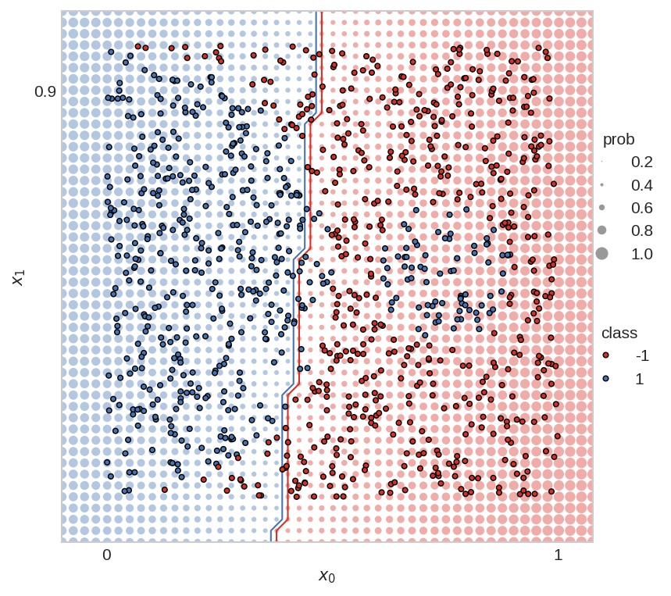
Perceptron is often not enough
Perceptron is linear, but we often need a non-linear prediction function
Which of these can a perceptron solve (fit with zero training error)?
Yes
No
Not even close

Slide 33
Review questions
http://tinyurl.com/cs441sgd
Which of these are true about gradient descent or SGD?
  Full-batch gradient descent (GD) guarantees an improvement in the objective at every step
  GD offers more stable progression toward the objective than mini-batch SGD
  SGD is able to reach better solutions for linear models than GD
  SGD optimization tends to be faster than GD
  SGD is better at escaping local minima than GD
  Understanding SGD is critical for deep learning, even if you don’t care about efficiency

Slide 34
Next week
Tuesday: Recap and review for midterm
Thursday: Exam – no lecture

