Slide 1
Dimensionality Reduction: PCA and low-D embeddings
Applied Machine Learning
Derek Hoiem
Go to tinyurl.com/cs441chat to ask questions during lecture (CampusWire in-lecture chat room)
McInnes et al. (UMAP, 2000): Visualization of 30,000,000 integers as represented by binary vectors of prime divisibility, colored by integer value of the point

Slide 2
Last Class - KNN
K-nearest neighbor classification and regression
Measuring and understanding error

Slide 3

Which of these tend to be decreased as the number of training examples increases?
  Training error
  Test error
  Generalization error

Slide 4
This class – dimensionality reduction
Goal: We want to represent high dimensional data with fewer dimensions, e.g. for:
  Compression: reduced storage, faster retrieval
  Visualization: plot in two dimensions
A good dimensionality reduction can be defined in different ways
  Be able to reproduce the original data
  Preserve discriminative features
  Preserve the neighborhood structure
One main strategy is linear projection, e.g. a street map projects everything onto the 2D ground dimensions and ignores height
Another strategy is embedding or manifold fitting, where we try to preserve relationships in the data

Slide 5
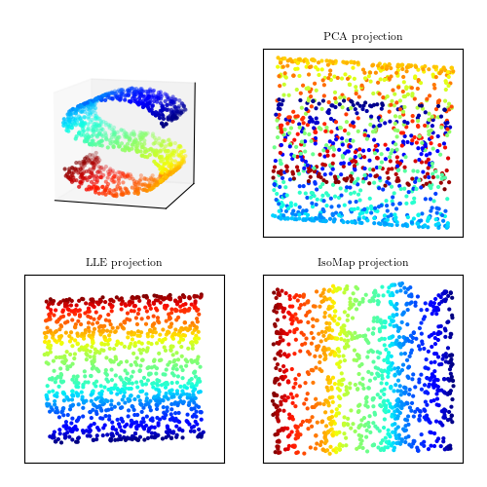
This class – PCA and manifolds
3D Data
Linear projection
  PCA: Principal Components Analysis
  Reduce dimension while preserving variance of data
Embedding/manifold learning
  MDS (multidimensional scaling), IsoMap and t-SNE
  Preserve point distances and/or local structure

Slide 6
Key terms
Vectors and matrices
Translation
Projection
Scaling
Rotation
Rank
Eigenvectors/eigenvalues
SVD

Slide 7
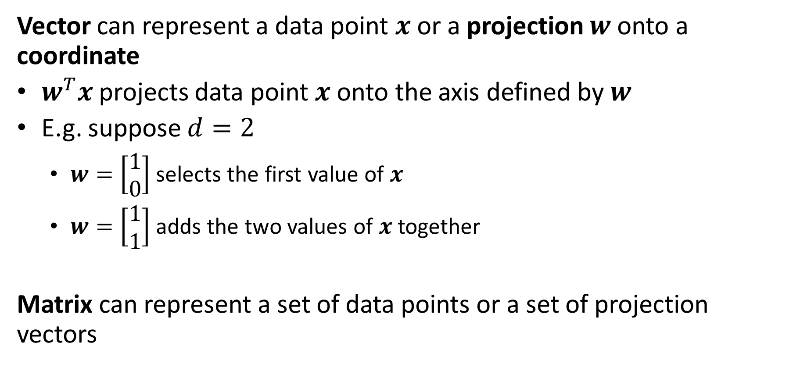
Key terms
Vector can represent a data point $x$or a projection $w$onto a coordinate
$w^{T}x$ projects data point $x$ onto the axis defined by $w$
E.g. suppose $d=2$
  $w=\left[\begin{matrix}1 \\ 0\end{matrix}\right]$ selects the first value of $x$
  $w=\left[\begin{matrix}1 \\ 1\end{matrix}\right]$ adds the two values of $x$ together
Matrix can represent a set of data points or a set of projection vectors

Slide 8
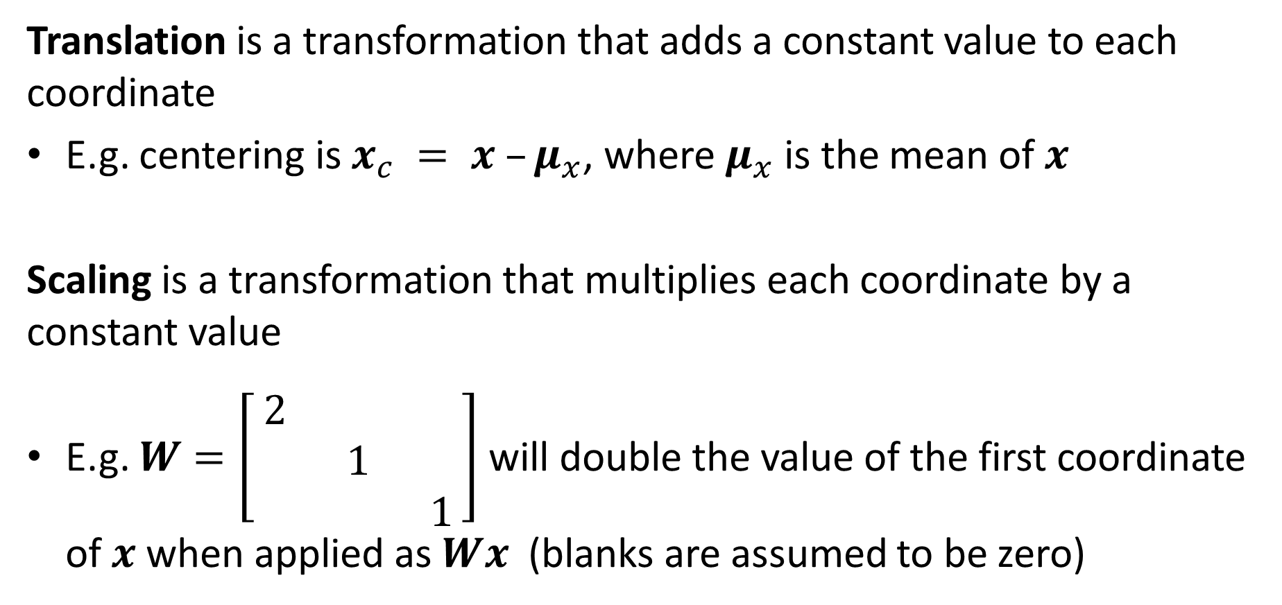
Key terms
Translation is a transformation that adds a constant value to each coordinate
E.g. centering is $x_{c} = x –μ_{x}$, where $μ_{x}$ is the mean of $x$
Scaling is a transformation that multiplies each coordinate by a constant value
E.g. $W=\left[\begin{matrix}2 & & \\ & 1 & \\ & & 1\end{matrix}\right]$ will double the value of the first coordinate of $x$ when applied as $Wx$ (blanks are assumed to be zero)

Slide 9
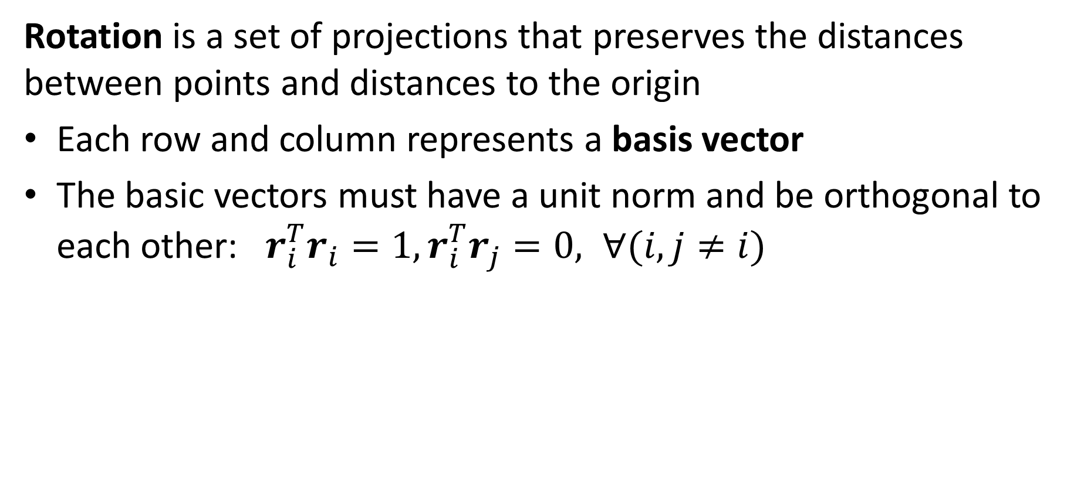
Key terms
Rotation is a set of projections that preserves the distances between points and distances to the origin
Each row and column represents a basis vector
The basic vectors must have a unit norm and be orthogonal to each other: $r_{i}^{T}r_{i}=1, r_{i}^{T}r_{j}=0, ∀(i,j≠i)$

Slide 10
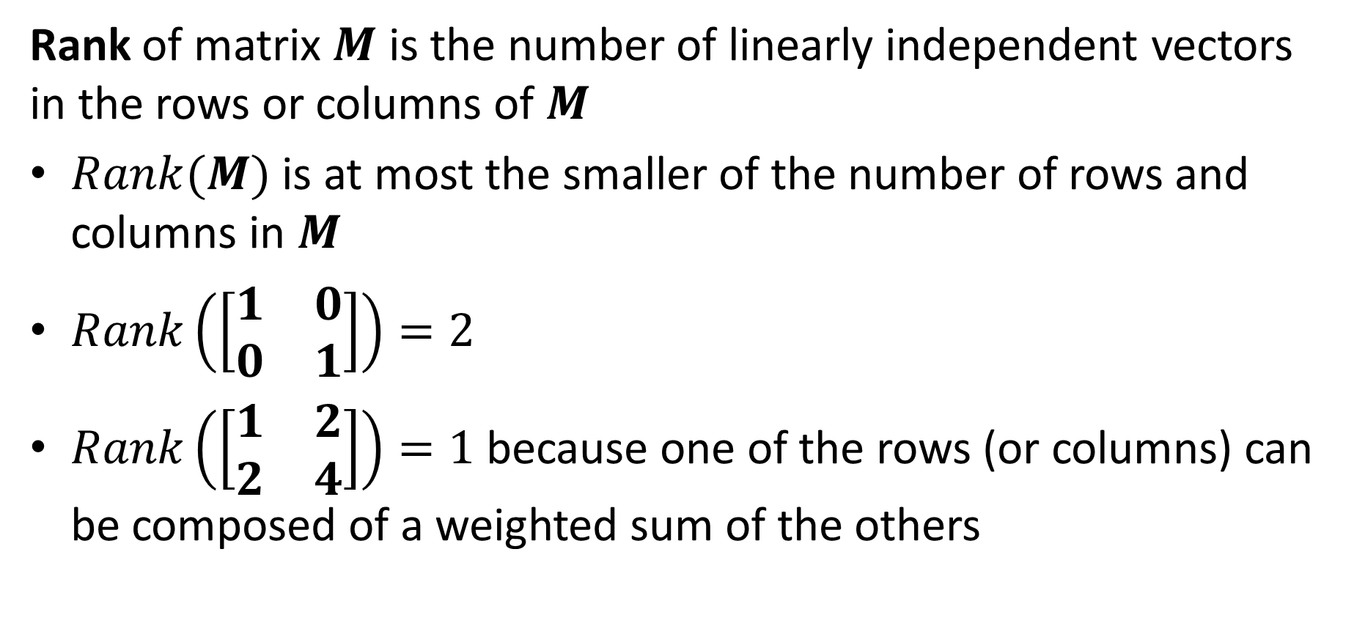
Key terms
Rank of matrix $M$ is the number of linearly independent vectors in the rows or columns of $M$
$Rank(M)$ is at most the smaller of the number of rows and columns in $M$
$Rank\left(\left[\begin{matrix}1 & 0 \\ 0 & 1\end{matrix}\right]\right)=2$
$Rank\left(\left[\begin{matrix}1 & 2 \\ 2 & 4\end{matrix}\right]\right)=1$ because one of the rows (or columns) can be composed of a weighted sum of the others

Slide 11
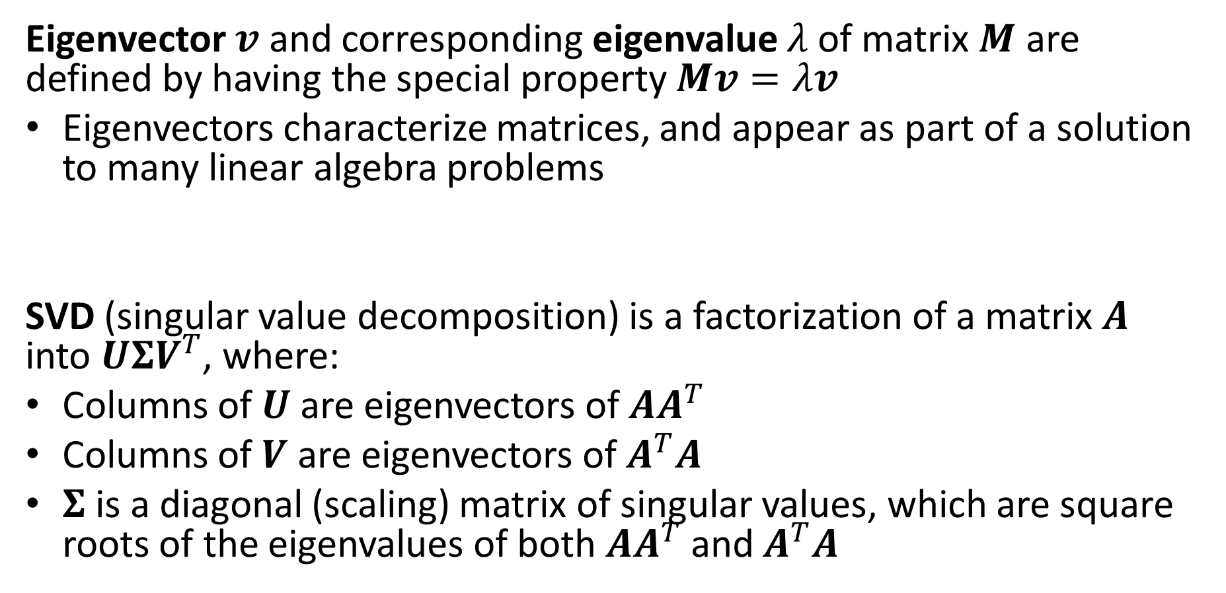
Key terms
Eigenvector $v$ and corresponding eigenvalue $λ$of matrix $M$ are defined by having the special property $Mv=λv$
Eigenvectors characterize matrices, and appear as part of a solution to many linear algebra problems
SVD (singular value decomposition) is a factorization of a matrix $A$ into $UΣV^{T}$, where:
Columns of $U$ are eigenvectors of $AA^{T}$
Columns of $V$ are eigenvectors of $A^{T}A$
$Σ$ is a diagonal (scaling) matrix of singular values, which are square roots of the eigenvalues of both $AA^{T}$ and $A^{T}A$

Slide 12
PCA
General dimensionality reduction technique
  Finds major orthogonal directions of variation
Preserves most of variance with a much more compact representation
  Lower storage requirements
  Faster matching/retrieval
  Easier to work in low dimensions, e.g. for probability estimation

Slide 13

Center and rotate the axes
Original 2D Representation
New 2D Representation
(4.2,0.04)
(3,4)
(0.5,-2)
(-2.1,0.1)
(-4.1,-0.03)
(-1,-3)

Slide 14

Now data is well-approximated by dropping the coordinates with the least variance
New 2D Representation
New 1D Representation
(4.2,0.04)
(4.2,0)
$$≈$$
(-2.1,0.1)
(-2.1,0)
(-4.1,-0.03)
(-4.1,0)

Slide 15
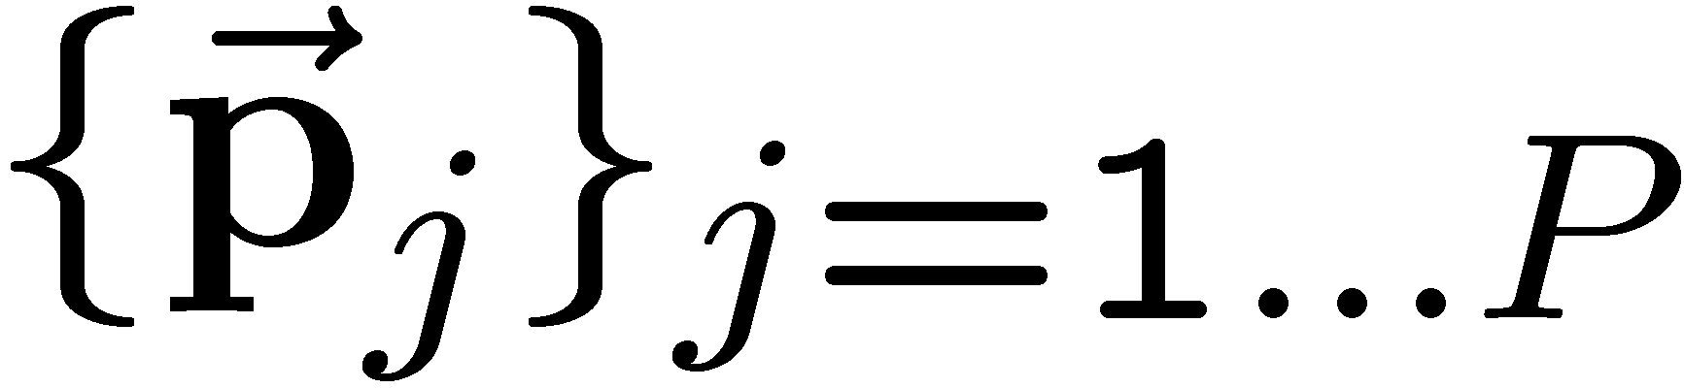
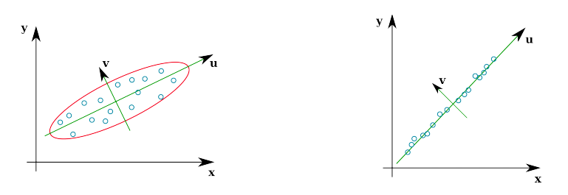
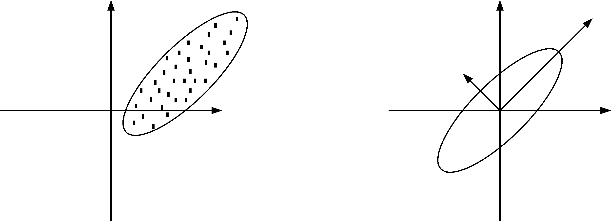
Principal Component Analysis
Given a point set , in an M-dim space, PCA finds a basis such that
  The most variation is in the first basis vector
  The second most, in the second vector that is orthogonal to the first vector
  The third…
2nd principal component
x₁
1st principal component
x₁
1st principal component
2nd principal component
x₀
x₀
Notes:
The goal of PCA is to find orthogonal vectors that the first r vectors have the highest variance of all.
----- Meeting Notes (10/4/11 17:12) -----
Write it more mathematically
say what PCA is solving

Slide 16
Principal Component Analysis (PCA)
Given: N data points x₁, … ,x_{N} in R^{d}
We want to find a new set of features that are linear combinations of original ones:
u(x_{i}) = u^{T}(x_{i} – µ)
(µ: mean of data points)
Choose unit vector u in R^{d} that captures the most data variance

Slide 17
Principal Component Analysis
Direction that maximizes the variance of the projected data:
N
Maximize
subject to ||u||=1
Projection of data point
N
1/N
Covariance matrix of data
The direction that maximizes the variance is the eigenvector associated with the largest eigenvalue of Σ (can be derived using Raleigh’s quotient or Lagrange multiplier)

Slide 18
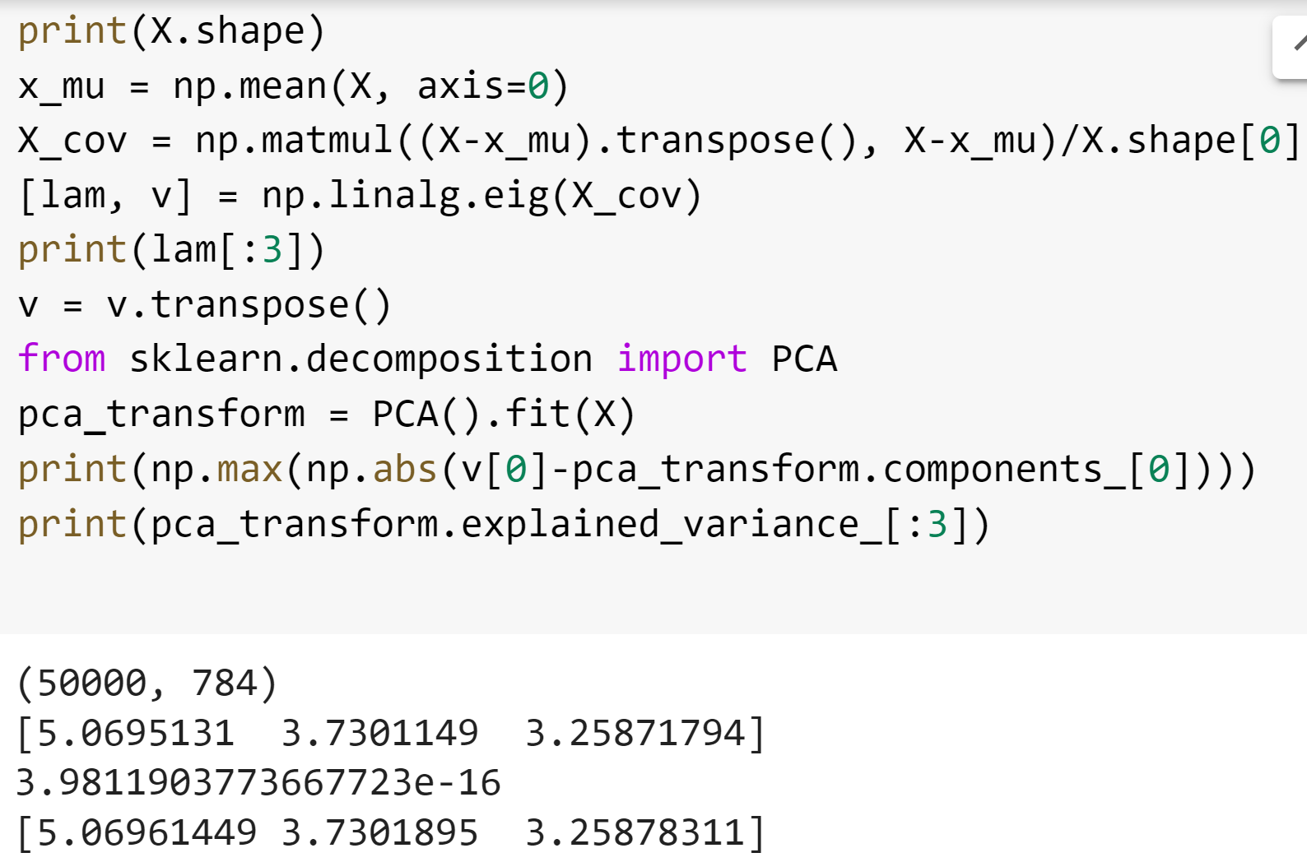
PCA in Python
Compute PCA components as eigenvectors of covariance matrix
Compute PCA using the PCA function
Printout shows that eigenvalues are the same as the explained variance, and the first component is identical (up to numerical precision)

Slide 19
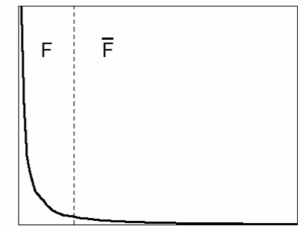
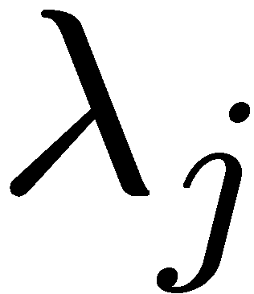
Principal Component Analysis
  First r < M principal component vectors provide an approximate basis that minimizes the mean-squared-error (MSE) of reconstructing the original points
Choosing subspace dimension r:
  look at decay of the eigenvalues as a function of r
  Larger r means lower expected error in the subspace data approximation
eigenvalues
1
r
M

Slide 20
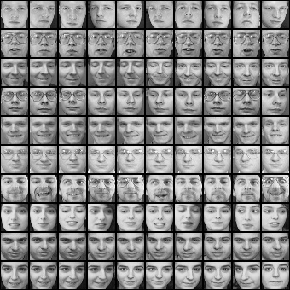
Example on aligned faces
x₁,…,x_{N} are pixel values of each face

Slide 21
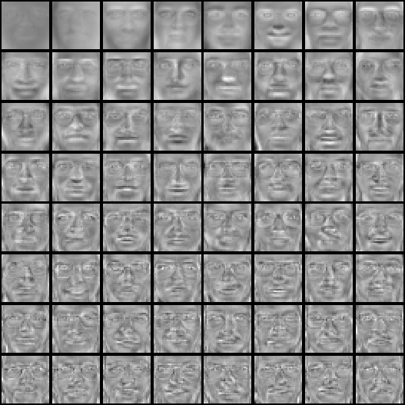
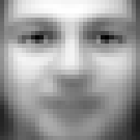
PCA of aligned face images (called “eigenfaces”)
Top eigenvectors: u₁,…u_{k}
Mean: μ

Slide 22

Visualization of eigenfaces (appearance variation)
Principal component (eigenvector) u_{k}
μ + 3σ_{k}u_{k}
μ – 3σ_{k}u_{k}

Slide 23

Representation and reconstruction
Face x in “face space” coordinates:
=

Slide 24

Representation and reconstruction
Face x in “face space” coordinates:
Reconstruction:
=
=
+
^
x
=
µ + w₁u₁+w₂u₂+w₃u₃+w₄u₄+ …

Slide 25
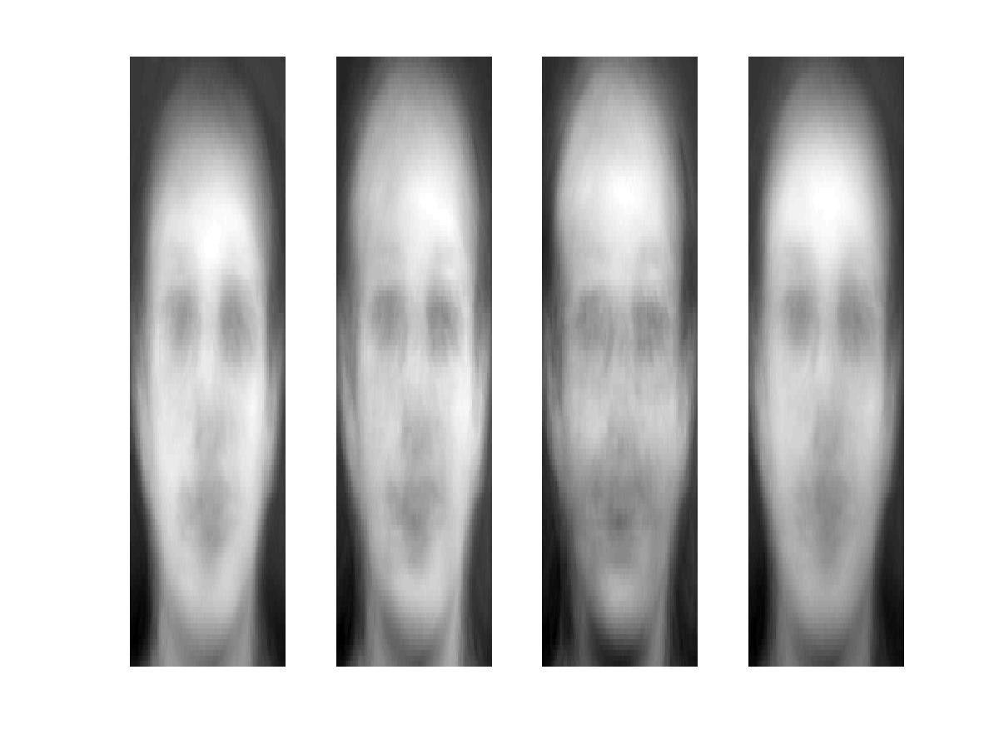
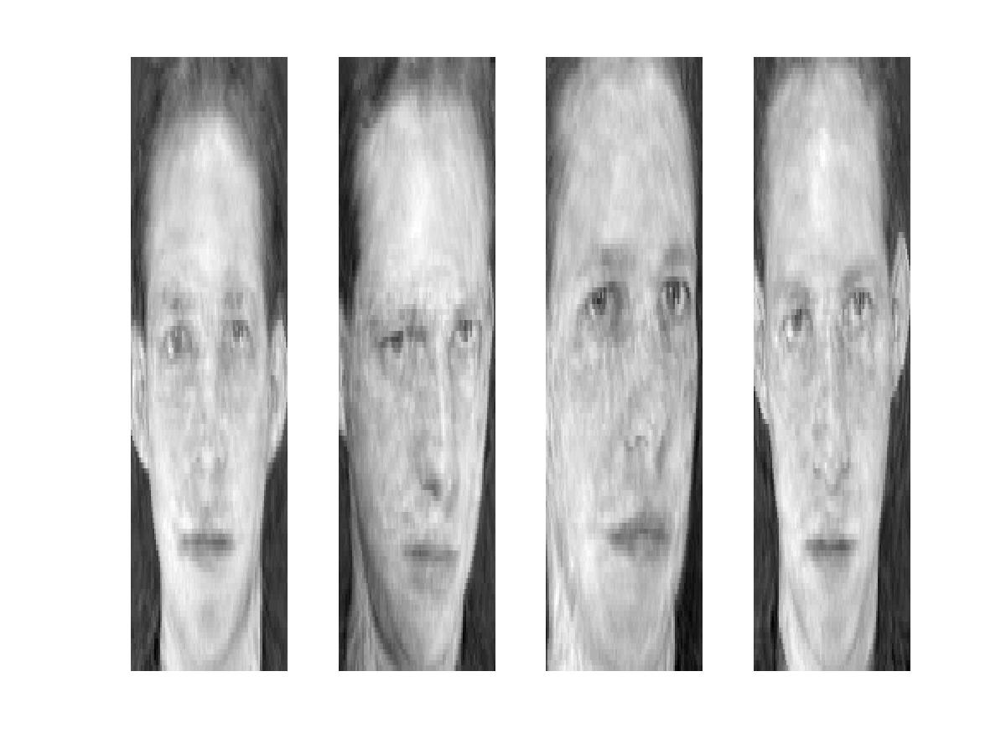
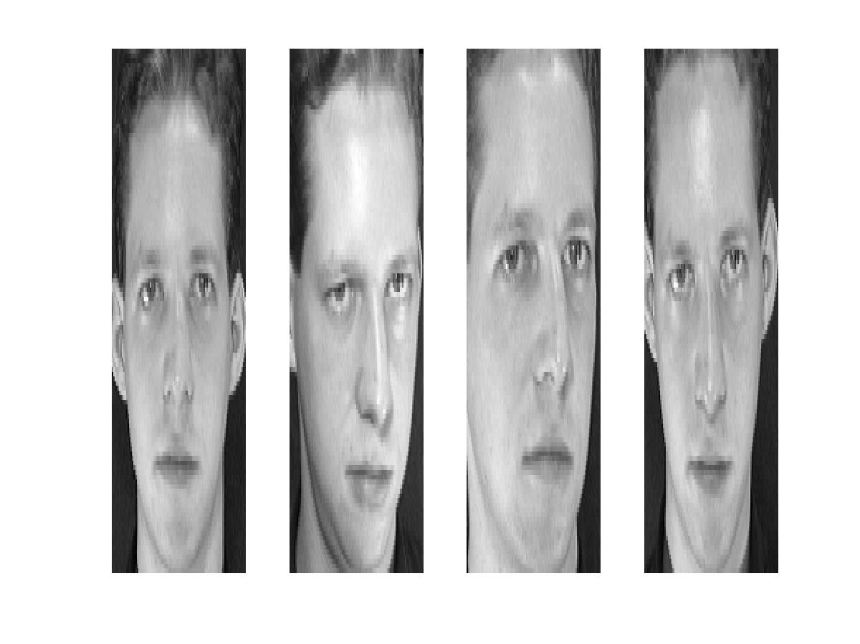
Reconstruction
P = 4
P = 200
P = 400
After computing eigenfaces using 400 face images from ORL face database

Slide 26
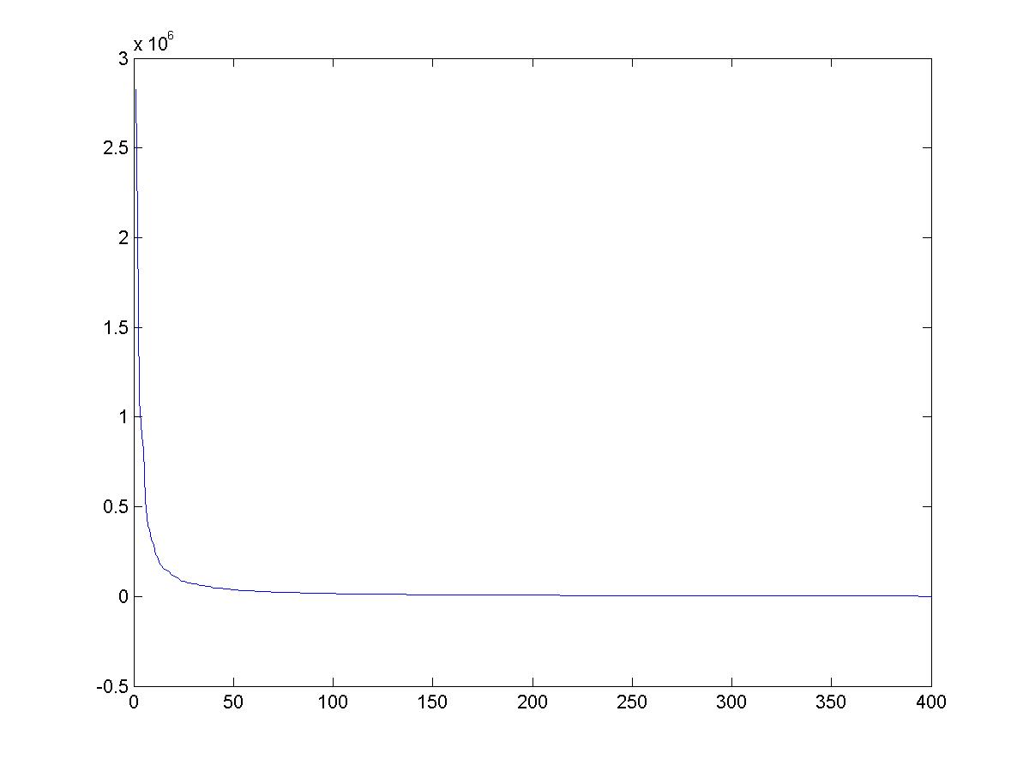
Note
Preserving variance (minimizing MSE) does not necessarily lead to perceptually good reconstruction.
P = 200
Plot of eigenvalues for each eigenvector of the covariance matrix, equivalent to the variance contained along each principal component

Slide 27
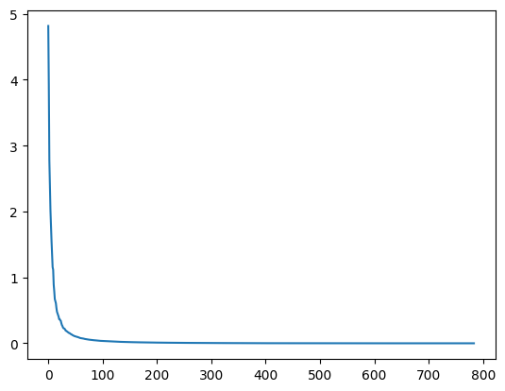
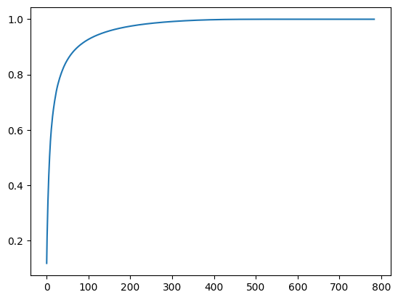
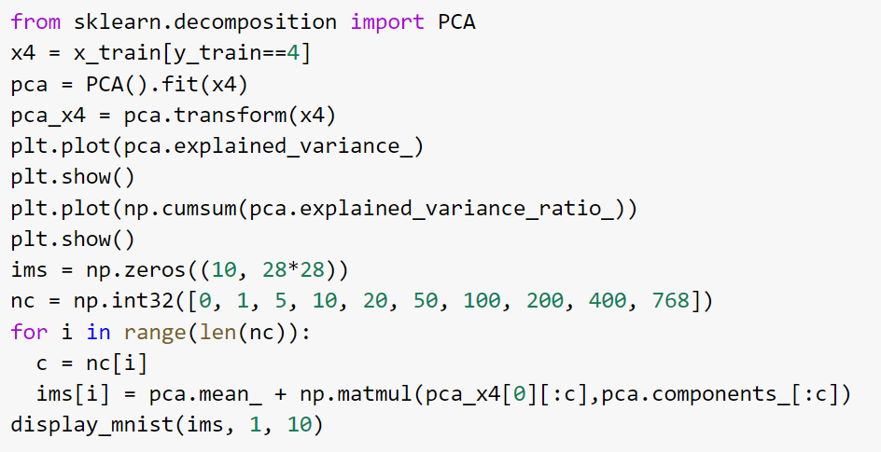
Another example, representing MNIST 4’s
Reconstructions with varying # PCs
Variance per component
0
1
5
10
20
Cumulative % variance explained
50
100
200
400
768

Slide 28
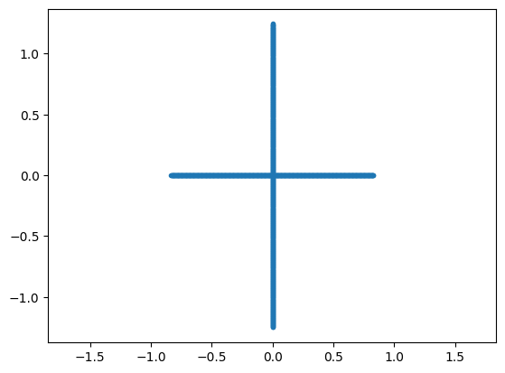
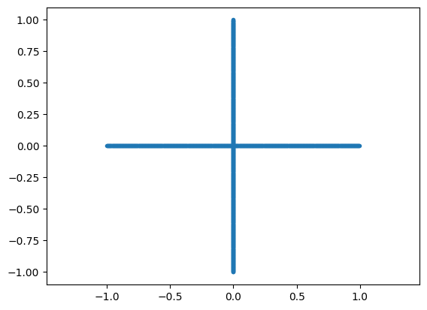
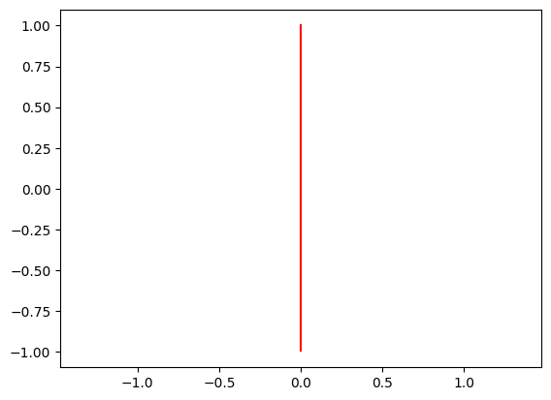
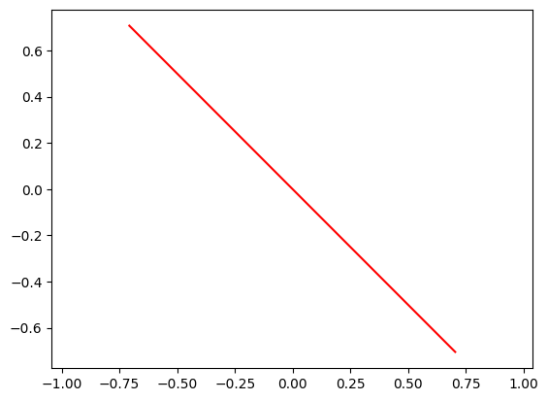
Two minute break (3 questions)
For each plot of data, what is the direction of the first principal component?
If X consists of N data points of d dimensions, what is the maximum number of PCA components that would be needed to perfectly reconstruct the data?
Rank(X) <= min(N, d)

Slide 29
What will be the first principal component of this data?

Slide 30
What will be the first principal component of this data?

Slide 31
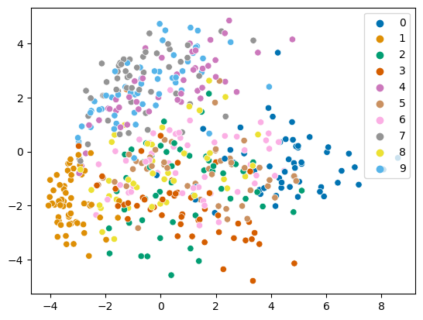
PCA: MNIST at 2 dimensions
Note: I’m only plotting a subset

Slide 32
Non-Linear Scaling and Manifold Estimation
We may care less about being able to reconstruct each data point than representing the relationships between data points
MDS: Preserve Euclidean pairwise distances
Non-metric MDS: Preserve distance orderings
ISOMAP: Define distances in terms of “geodesic” (graph-based) similarity

Slide 33

MultiDimensional Scaling (MDS)
For all data points, solve for new coordinate positions that preserve some input set of pairwise distances
Classic case (equations on right) uses Euclidean distance and has closed form solution
More generally, distance can be defined arbitrarily (e.g. from user surveys)
Major drawback is that the solution is most influenced by points that are far from each other
Solve for y that minimizes
where
$x$ are old coordinates, $y$ are new coordinates
See Forsyth AML 6.2 for details

Slide 34
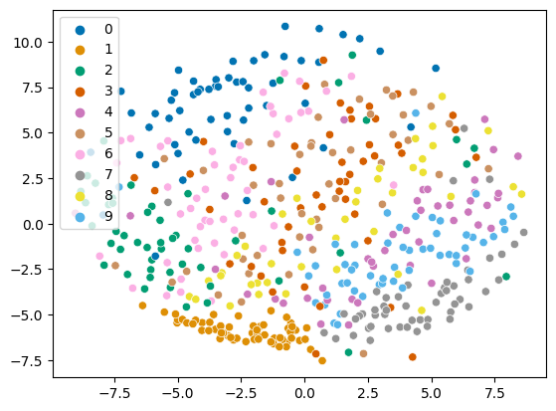
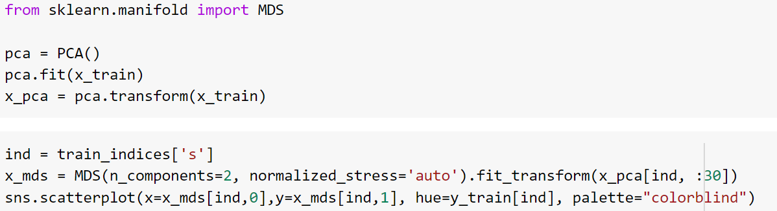
MDS on MNIST
30 PCA components
MDS to 2 dimensions
Note: For MDS and others, manifolds are fit on 500 pts for speed

Slide 35
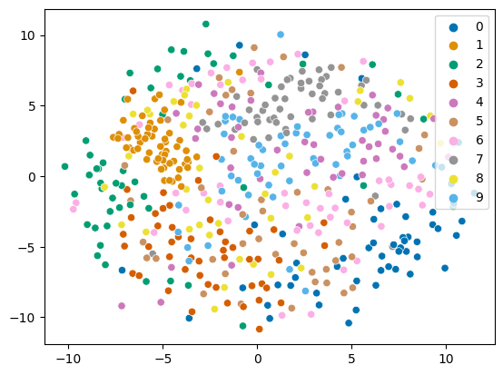
MDS on MNIST
Pre-process with PCA to 30 dim
No PCA

Slide 36
Non-metric MDS
Optimize position of data points so that Euclidean distance preserves the ordering of input pairwise distances
Requires only an order of dissimilarities
Slow because this is a complicated optimization

Slide 37
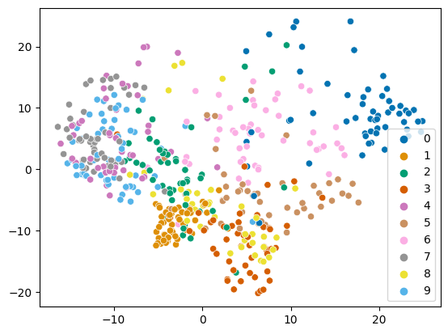
ISOMAP
MNIST ISOMAP (PCA: 30)
Same as MDS but define distance in a graph
  Compute adjacency graph (e.g. 5 nearest neighbors)
  Distance is shortest path in graph between two points
MNIST MDS (PCA: 30)

Slide 38
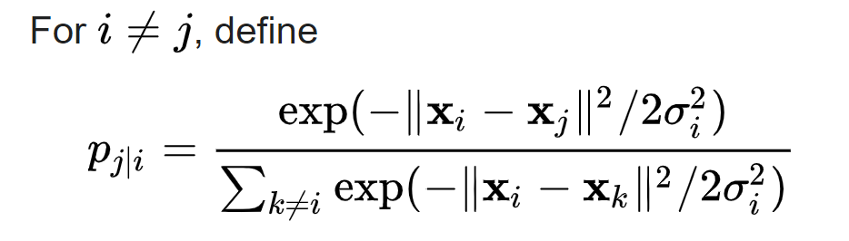
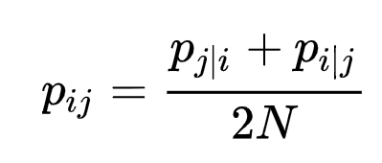
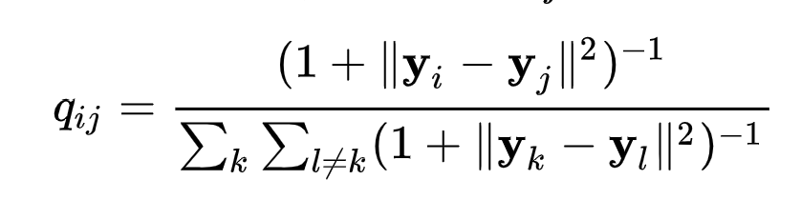
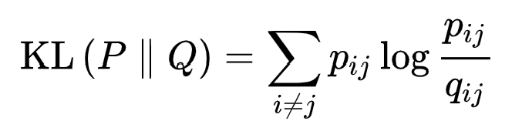
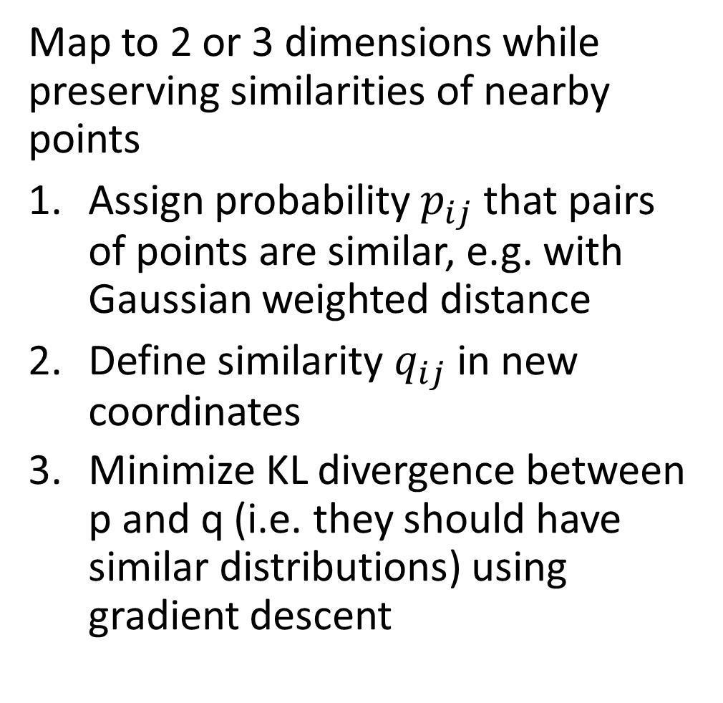
t-SNE
Map to 2 or 3 dimensions while preserving similarities of nearby points
Assign probability $p_{ij}$ that pairs of points are similar, e.g. with Gaussian weighted distance
Define similarity $q_{ij}$in new coordinates
Minimize KL divergence between p and q (i.e. they should have similar distributions) using gradient descent

Slide 39
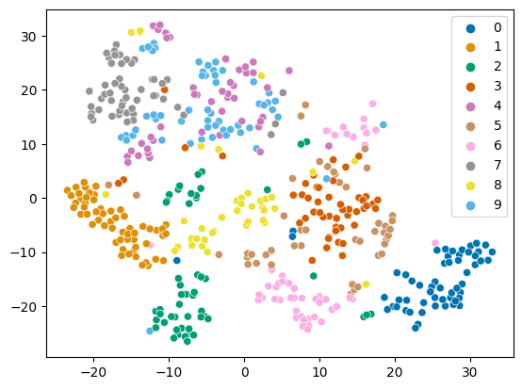
t-SNE
In high dimensions, each point tends to be similarly distant to many points, so we often use PCA before applying t-SNE
t-SNE on 30 PCA dimensions of MNIST

Slide 40
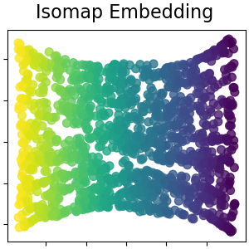
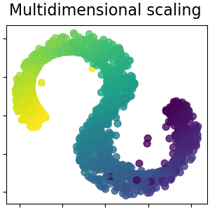
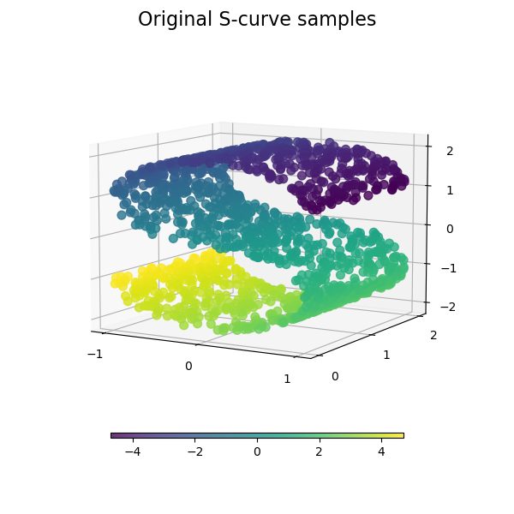
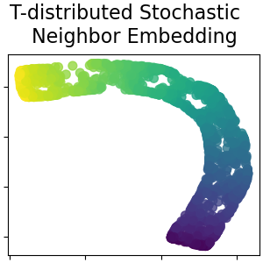
Comparison
https://scikit-learn.org/stable/auto_examples/manifold/plot_compare_methods.html

Slide 41
Comparison on MNIST
PCA
MDS
IsoMap
tSNE

Slide 42
UMAP (McInnes, 2020)
Assumes data is uniformly distributed on an underlying manifold that is locally connected. Goal is to preserve that local structure.
Algorithm: relatively complicated, incorporates many ideas from other methods, has strong mathematical foundations
Hyperparameters:
  number of neighbors to consider
  dimension of target embedding
  desired separation between close points
  number of training epochs
https://arxiv.org/abs/1802.03426

Slide 44
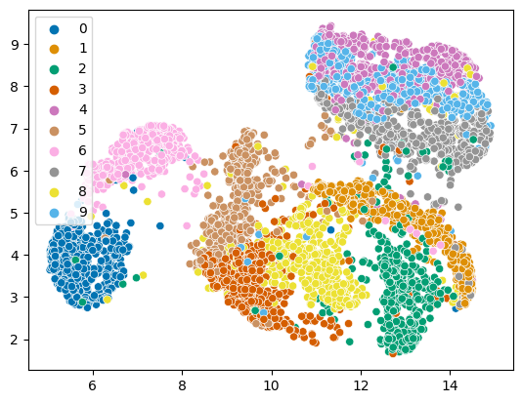
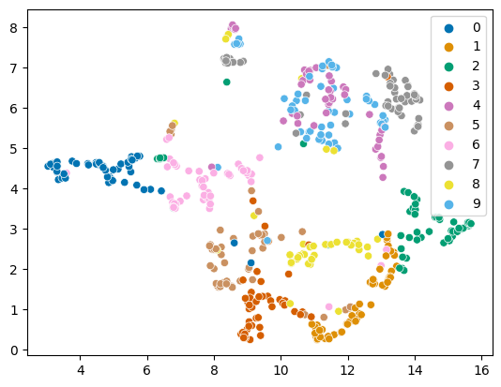
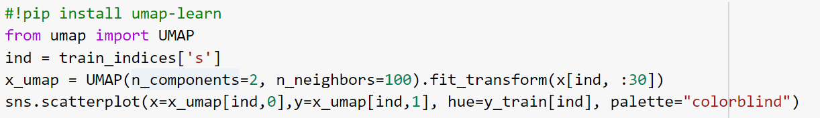
UMAP on MNIST
5000 points, 100 neighbors, 34s
500 pts, 10 neighbors

Slide 45
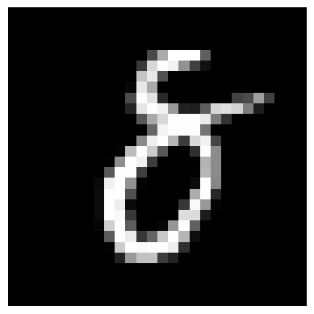

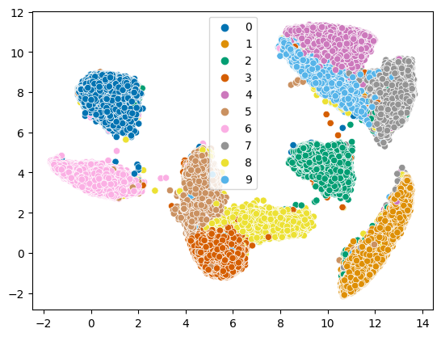
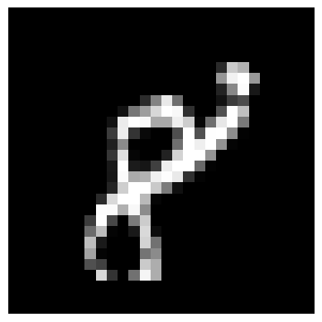
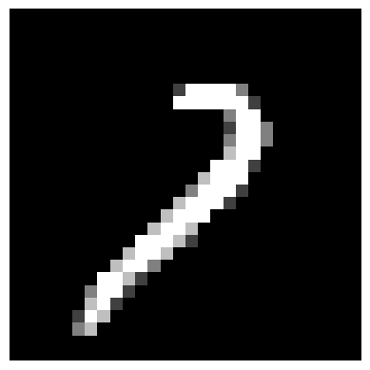
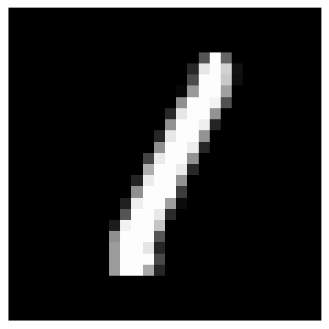
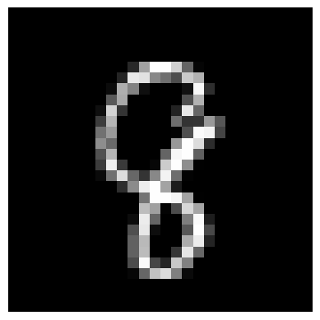
UMAP on MNIST
50,000 points, 100 neighbors, 200s

Slide 46
Things to remember
PCA reduces dimensions by linear projection
  Preserves variance to reproduce data as well as possible, according to mean squared error
  May not preserve local connectivity structure or discriminative information
Other methods try to preserve relationships between points
  MDS: preserve pairwise distances
  IsoMap: MDS but using a graph-based distance
  t-SNE: preserve a probabilistic distribution of neighbors for each point (also focusing on closest points)
  UMAP: incorporates k-nn structure, spectral embedding, and more to achieve good embeddings relatively quickly

Slide 47
Next class: Linear Regression and Regularization

