Slide 1
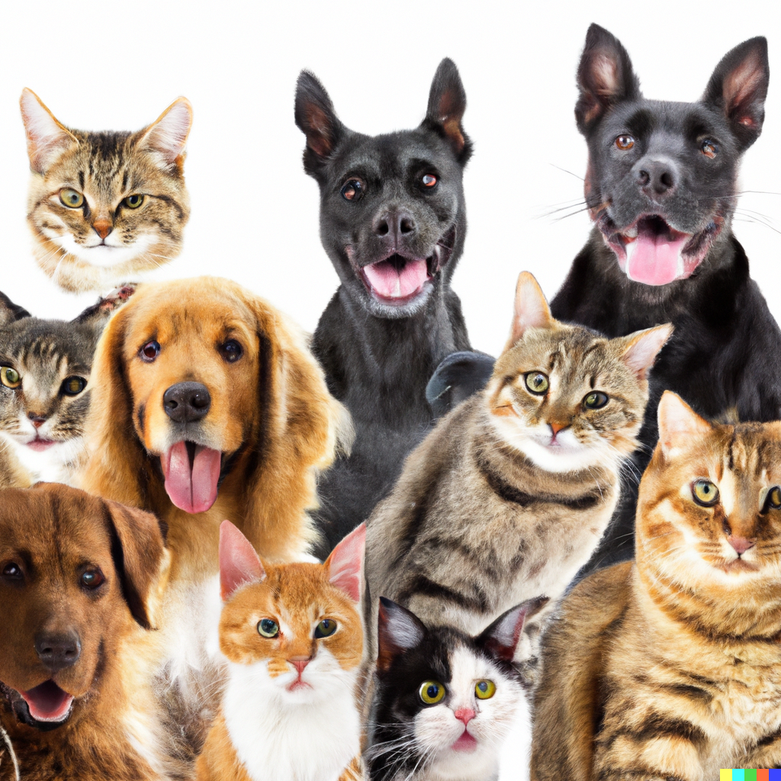
Similarity, Clustering, and Retrieval
Applied Machine Learning Derek Hoiem
Dall-E

Slide 2
Last class: How to represent data
Images, text, categories, numerical → vector of numbers
Dataset: a collection of data points or samples from some distribution
We can measure entropy, information gain, and other distributional properties

Slide 3
Today’s lecture
Similarity
Retrieval
“Brute force”
Faiss library
Approximate: LSH
Clustering
Kmeans
Hierarchical Kmeans
Agglomerative Clustering

Slide 4
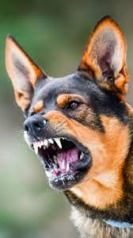
Key principle of machine learning
Given feature/target pairs $\left(X_{1},y_{1}\right),…,\left(X_{n},y_{n}\right):$
if $X_{i}$ is similar to $X_{j}$, then $y_{i}$ is probably similar to $y_{j}$
Fundamentally, learning depends on:
Representation of samples
Similarity function
Aggressive
Friendly
Aggressive?
Probably Aggressive

Slide 5
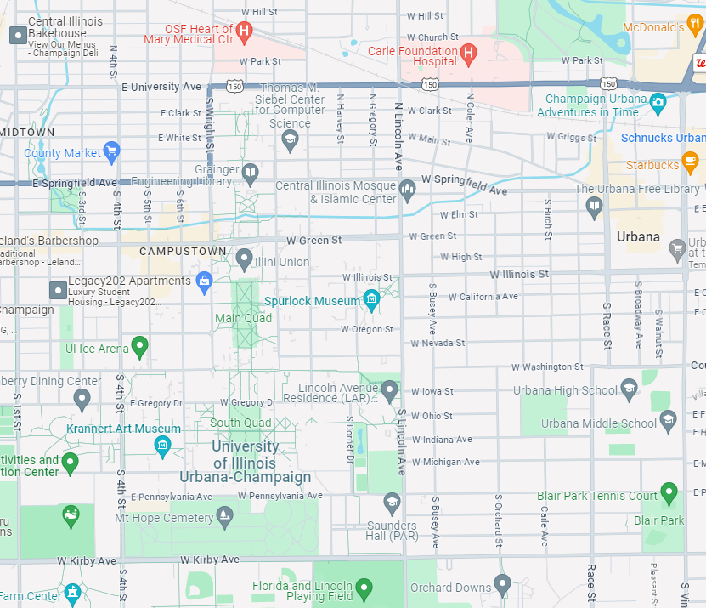
Common Distance/Similarity Measures
L2: Euclidean
$$d_{2}\left(x,y\right)={\left\|x−y\right\|}_{2}=\sqrt{\sum_{i}{{\left(x_{i}−y_{i}\right)}^{2}}}$$

Slide 6
Common Distance/Similarity Measures
L1: City-Block
$$d_{1}\left(x,y\right)={\left\|x−y\right\|}_{1}=\sum_{i}{|x_{i}−y_{i}|}$$

Slide 7
Common Distance/Similarity Measures
Dot product, Cosine
Dot product (or inner product)
$$s_{dot}\left(x,y\right)=x^{T}y=\sum_{i}{x_{i}y_{i}}$$
Cosine similarity
$$s_{cos}\left(x,y\right)=\frac{x^{T}y}{{\left\|x\right\|}_{2}{\left\|y\right\|}_{2}}$$
Cosine similarity
Dot product: how far does one vector go in the direction of the other vector
Cosine similarity: how similar are the two directions

Slide 8
Which is closest to the red circle under L1, L2, and cosine distance?
Notes:
Answer: orange is closest under L2, green is closest under L1, and purple is closest under cosine

Slide 9
Comparing distance/similarity functions
L2 depends much more heavily than L1 on the coordinates with the biggest differences
$d_{2}\left(\left[0 100\right], \left[5 1\right]\right)=99.1$
$$d_{1}\left(\left[0 100\right], \left[5 1\right]\right)=104$$
Cosine and L2 are equivalent if the vectors are unit length
$${\left\|x−y\right\|}_{2}^{2}=x^{T}x−2x^{T}y+y^{T}y=2(1−s_{cos}\left(x,y\right))$$
1
1

Slide 10
Retrieval
Given a new sample, find the closest sample in a dataset
Applications
Finding information (web search)
Prediction (e.g. nearest neighbor algorithm)
Clustering (kmeans)

Slide 11
“Brute force” search
Compute distance between query and each dataset point and return closest point

Slide 12
Brute force search pseudo-code
getNearest(x_q, X)
dist_min = Inf
idx_min = -1
For each nth sample in X:
dist = sum((X[n]-x_q)**2) # sum square diff
if dist < dist_min:
dist_min = dist
idx_min = n
return idx_min

Slide 13
FAISS library makes even brute force search very fast
Multi-threading, BLAS libraries, SIMD vectorization, GPU implementations
KNN for MNIST takes seconds
https://engineering.fb.com/2017/03/29/data-infrastructure/faiss-a-library-for-efficient-similarity-search/

Slide 14
Locality Sensitive Hashing (LSH)
A fast approximate search method to return similar data points to query

Slide 15
Basic LSH process
Convert each data point into an array of bits or integers, using the same conversion process/parameters for each
Map the arrays into buckets (e.g. with 10 bits, you have 2^10 buckets)
Can use subsets of arrays to create multiple sets of buckets
On query, return points in the same bucket(s)
Can check additional buckets by flipping bits to find points within hash distances greater than 0

Slide 16
Random Projection LSH
Data Preparation
Given data {X} with dimension d:
Center data on origin (subtract mean)
Create b random vectors h_{b} of length d
Convert each X_{n} to b bits: X_{n}h^{T} > 0
Query
Convert X_{q} to bits using h
Check buckets based on bit vector and similar bit vectors to return most similar data points
h= np.random.rand(nbits, d) - .5

Slide 17
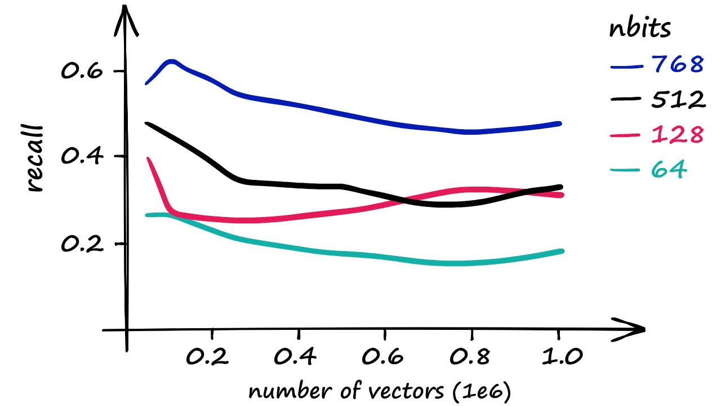
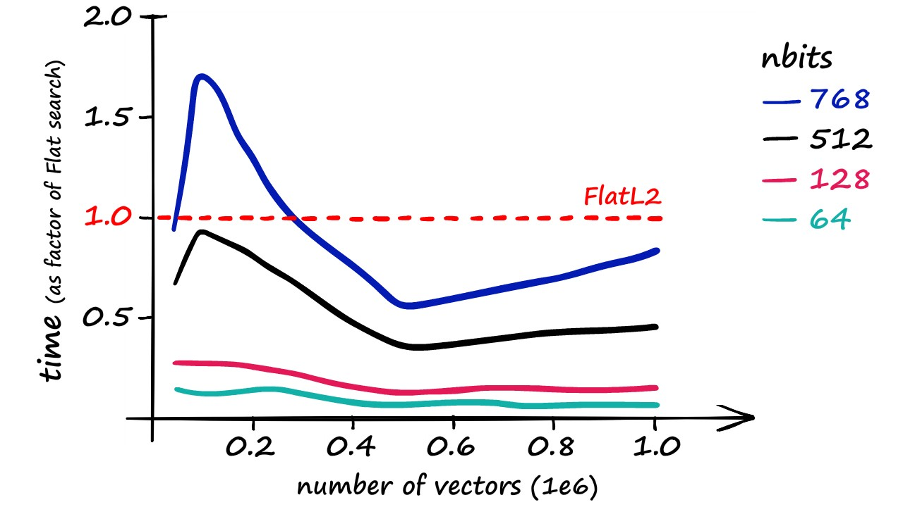
Key parameter: nbits
Rule of thumb: nbits = dim is a decent choice (1 bit per feature dimension)
Optionally, can retrieve K closest data points and then use brute force search on those
Recall vs. exact nearest neighbor
Time compared to brute force search

Slide 18
Nice video about LSH in faiss: https://youtu.be/ZLfdQq_u7Eo which is part of this very detailed and helpful post: https://www.pinecone.io/learn/locality-sensitive-hashing-random-projection/

Slide 19
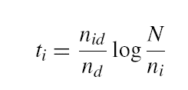
Inverse document file for retrieval of count-based docs
Applies to text (word counts), images (clustered keypoint counts), and other tokenized representations
Like a book index: keep a list of all the words (tokens) and all the pages (documents) that contain them.
Rank database documents based on summed tf-idf measure for each word/token in the query document
tf-idf: Term Frequency – Inverse Document Frequency
# documents
# times word appears in document
# documents that contain the word
# words in document

Slide 20
Clustering
Assign a label to each data point based on the similarities between points
Why cluster
Represent data point with a single integer instead of a floating point vector
Saves space
Simple to count and estimate probability
Discover trends in the data
Make predictions based on groupings

Slide 21
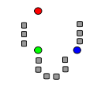
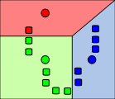
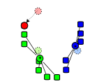
K-means algorithm
1. Randomly select K centers
2. Assign each point to nearest center (L2 dist)
3. Compute new center (mean) for each cluster
Illustration: http://en.wikipedia.org/wiki/K-means_clustering

Slide 22
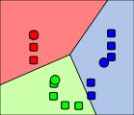
K-means algorithm
1. Randomly select K centers
2. Assign each point to nearest center (L2 dist)
Back to 2
3. Compute new center (mean) for each cluster
Illustration: http://en.wikipedia.org/wiki/K-means_clustering

Slide 23
Pseudo-code
kmeans(X, K, maxiter)
# Create cluster centers
center = X[:K]
Until maxiter iterations or convergence:
For each nth sample in X:
# get index of nearest center
idx[n] = get_nearest(X[n], centers)
For each kth center:
# get mean of data points assigned to cluster k
center[k] = X[idx==k].mean(axis=0)
Convergence is if no idx changed in this iteration
return center, idx

Slide 24
What is the cost minimized by K means?
$$id∗, centers∗=argmin_{id, centers}\sum_{n}{{\left|\left|centers_{id_{n}}−X_{n}\right|\right|}^{2}}$$
Choose ids that minimizes square cost given centers
Choose centers that minimize square cost given ids

Slide 25
K-means Demo
https://www.naftaliharris.com/blog/visualizing-k-means-clustering/

Slide 26
What are some disadvantages of K-means in terms of clustering quality?
2 minute break

Slide 27
What are some disadvantages of K-means in terms of clustering quality?
All feature dimensions equally important
Tends to break data into clusters of similar numbers of points (can be good or bad)
Does not take into account any local structure
Typically, not an easy way to choose K
Can be slow if the number of data points and clusters is large

Slide 28
Implementation issues
How to choose K?
Typically chosen by hand
Often based on the number of clusters you want considering time/space requirements
How do you initialize
Randomly choose points
Iterative furthest point

Slide 29
Evaluating clustering with RMSE
RMSE = root mean squared error
Measures a kind of compression loss, i.e. how well is each data point represented by the closest cluster center
$$RMSE(X, C)=\sqrt{\frac{1}{N}\sum_{n∈\{0..N−1\}}{{\min_{k}{{\left\|C_{k}−X_{n}\right\|}_{2}}}^{2}}}$$

Slide 30
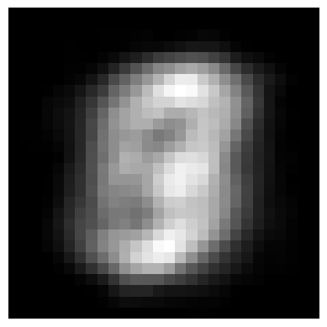
Example: K-means on MNIST
K=3, RMSE = 49.3
K=1, RMSE = 55.0
K=5, RMSE = 45.6
K=10, RMSE = 41.9
K=20, RMSE = 37.82
K=40, RMSE = 34.44

Slide 31
Evaluating clusters with purity
We often cluster when there is no definitively correct answer, but a purity measure can be used to check the consistency with labels
$$purity=\sum_{k}{\left(\max_{y}{\sum_{n:id_{n}=k}{δ(label_{n}=y)}}\right)}{/N}$$
Purity is the count of data points with the most common label in each cluster, divided by the total number of data points (N)
E.g., labels = {0, 0, 0, 0, 1, 1, 1, 1}, cluster ids = {0, 0, 0, 0, 0, 1, 1, 1}, purity = ?
purity = 7/8
Purity can be used to select the number of clusters, or to compare approaches with a given number of clusters
A relatively small number of labels can be used to estimate purity, even if there are many data points

Slide 32
Hierarchical K-means
Iteratively cluster points into K groups, then cluster each group into K groups

Slide 33
Notes:
We then run k-means on the descriptor space. In this setting, k defines what we call the branch-factor of the tree, which indicates how fast the tree branches.
In this illustration, k is three. We then run k-means again, recursively on each of the resulting quantization cells.
This defines the vocabulary tree, which is essentially a hierarchical set of cluster centers and their corresponding Voronoi regions.
We typically use a branch-factor of 10 and six levels, resulting in a million leaf nodes. We lovingly call this the Mega-Voc.

Slide 43
Notes:
We now have the vocabulary tree, and the online phase can begin.
In order to add an image to the database, we perform feature extraction. Each descriptor vector is now dropped down from the root of the tree and quantized very efficiently into a path down the tree, encoded by a single integer.
Each node in the vocabulary tree has an associated inverted file index.
Indicies back to the new image are then added to the relevant inverted files.
This is a very efficient operation that is carried out whenever we want to add an image.

Slide 44
Advantages of Hierarchical K-Means
Fast cluster training
With a branching factor of 10, can cluster into 1M clusters by clustering into 10 clusters ~111,111 times, each time using e.g. 10K data points
Vs. e.g. clustering 1B data points into 1M clusters
Kmeans is O(K*N*D) per iteration so this is a 900,000x speedup!
Fast lookup
Find cluster number in O(log(K)*D) vs. O(K*D)
16,667x speedup in the example above

Slide 45
Are there any disadvantages of hierarchical Kmeans?
Yes, the assignment might not be quite as good, but often usually isn’t a huge deal since K means is used to approximate data points with centroid anyway
Notes:
Yes, the assignment might not be quite as good, but this usually isn’t a huge deal since K means is used to approximate data points with centroid anyway

Slide 46
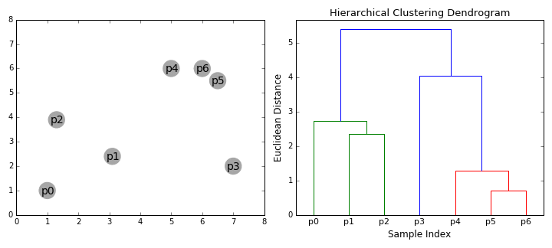
Agglomerative clustering
Iteratively merge the two most similar points or clusters
Can use various distance measures
Can use different “linkages”, e.g. distance of nearest points in two clusters or the cluster averages
Ideally the minimum distance between clusters should increase after each merge (e.g. if using the distance between cluster centers)
Number of clusters can be set based on when the cost to merge increases suddenly
https://dashee87.github.io/data%20science/general/Clustering-with-Scikit-with-GIFs/

Slide 47
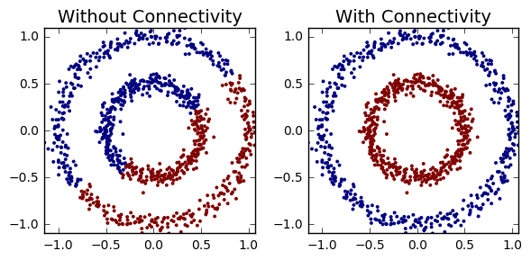
Agglomerative clustering
With good choices of linkage, agglomerative clustering can reflect the data connectivity structure (“manifold”)
Clustering based on distance of 5 nearest neighbors between clusters
https://dashee87.github.io/data%20science/general/Clustering-with-Scikit-with-GIFs/

Slide 48
Applications of clustering
K-means
Quantization (codebooks for image generation)
Search
Data visualization (show the average image of clusters of images)
Hierarchical K-means
Fast search (document / image search)
Agglomerative clustering
Finding structures in the data (image segmentation, grouping camera locations together)

Slide 49
Things to remember
Similarity is foundational to machine learning
Use highly optimized libraries like FAISS for search/retrieval
Approximate search methods like LSH can be used to find similar points quickly
TF-IDF is used for similarity of tokenized documents and used with index for fast search
Clustering groups similar data points
K-means is the must-know method, but there are many others

