Slide 1
Conclusion
Applied Machine Learning
CS 441
Derek Hoiem

Slide 2
This class: Conclusion
Birds-eye view of machine learning
Where to learn more
Trends and future of machine learning
Feedback and closing remarks

Slide 3
We’ve learned a lot
Target Labels
Loss / Feedback
Loss / Feedback
Raw Data
Encoder
Decoder
Prediction
Text
Images
Audio
Discrete/continuous values
Structured/unstructured
Few/many examples
Few/many features
Clean/noisy labels
Manual feature design
Deep networks
Trees
Clustering
Feature selection
Kernels
Density estimation
Linear regressor
SVM
Logistic regressor
Nearest Neighbor
Probabilistic model
Clusters
Low dimensional embedding
Category
Pixel labels
Generated text, image, audio
Positions
Yes/No

Slide 4
We’ve covered what you need to get started for most ML applications
Solid foundation in core ML concepts
Classification, clustering, dimensionality reduction, objectives, losses, regularization, generalization, experimental setups
Intuition, some math, and application of classic methods
Logistic regression, Linear Regression, SVM, KNN, Neural Nets, Naïve Bayes, Boosting, Trees, Ensembles, PCA, K-means, Kernel Density Estimation, EM algorithm, PCA
Exposure to state of the art recent methods
Deep convolutional networks, transformers, CLIP, GPT, UMAP
Data representation and application domains
Images, text, audio, general data, 1D time series
Practical considerations for deployment of ML applications
Societal impact, bias and mitigation, process for creating ML applications

Slide 5
Predictors: Three basic kinds
Linear (Regression, Logistic Regression, SVM)
General purpose for classification/regression
Benefits from feature learning
Instance-based (KNN)
Zero training time, flexible
Benefits from feature learning
Probabilistic: P(features | class)
General, but more complicated and often less accurate than linear with feature learning

Slide 6
Feature learning: Two basic kinds
Tree
Learn how to partition input space to group examples together in a discriminative way
Followed by instance/linear/probabilistic prediction
Easily combine unnormalized continuous and discrete features
Especially powerful with ensembles, as in Random Forests or Boosted Trees
Neural network
Jointly train feature representation with linear predictor
Major advantages for structured data with convolutional or transformer architectures, or use for retrieval/similarity
Representations can be learned on one problem and tuned or applied for another problem in the same domain

Slide 7
Go-to approaches for classification
K-NN
Super easy and sometimes surprisingly effective, good sanity check
Linear SVM or linear logistic regression
Easy to optimize, often works well
Random forest or boosted trees
Highly effective with minimal fuss, very flexible
Linear probe or fine-tune deep network
Best for common structured data like images, text, audio

Slide 8
Go-to approaches for regression
Linear regression
Interpretable and often works well
Sometimes important to transform features or targets so they are better captured by a linear model
Random forest
Highly effective with minimal fuss
K-NN
Especially helpful when predicting multiple correlated values, e.g. which patch can be used to fill a hole in the image

Slide 9
In supervised learning, always remember
Clean experiments
training set to learn model parameters
validation set to select method and hyperparameters
test set for final performance evaluation
Bias/variance trade-off
Avoidable error is due to challenge in fitting parameters (variance) and inability to perfectly fit the data (bias)
Model designs and hyperparameters often trade off between these, e.g. increasing model complexity can increase variance but reduce bias
Ensembles work around this trade-off, and modern deep networks often act like ensembles
People and algorithms use mental shortcuts that lead to a kind of bias that can be harmful to society – transparency and fairness require conscientious sourcing, development, and evaluation

Slide 10
Data organization
PCA is used to compress a vector into fewer values in a way that can be decompressed with minimal mean squared difference
Clustering reveals common modes of data
K-means is an essential algorithm
Search for similar data items is an important application and is the computational foundation for clustering
FAISS is a very useful library for efficient search
Approximate search, e.g. trees and LSH, are needed when speed is a priority
Representation learning (e.g. with deep networks or latent semantic analysis) is needed to make similarity meaningful

Slide 11
It’s all about the data
Model architectures and computational techniques get all the attention, but there are often many reasonable choices that perform similarly
To get best performance, data requires more thought and effort than algorithms
Need creative ways to get freely supervised data, as well as careful curation of evaluation sets

Slide 12
Machine learning is easier and more effective than ever
Great libraries like sklearn and pytorch
Great models like CLIP, GPT, BERT
Leverage existing models whenever possible to minimize development cost

Slide 13
Two minute break
Then, how to learn more and trends/future of ML

Slide 14
Where to learn more: courses
Many related 400-level courses, e.g.
CS 412: Data Mining
CS 442: Trustworthy ML
CS 443: Reinforcement Learning (SP)
CS 444: Deep Learning for Vision (SP)
CS 445: Computational Photography
CS 446: Machine Learning
CS 447: NLP (SP)
CS 448: Audio Computing Lab (SP)
CS 449: Robot Perception
Also many 500-level courses, often requiring background in ML and some domain, e.g.
CS 543 (Computer Vision)
CS 545 (ML for Signals)
CS 598 (Adv Robotics)
CS 562 (Topics in Security and Privacy)

Slide 15
Where to learn more: try things
Many datasets, github repos, and libraries available
Easy to check out state-of-art in many problems or to try out different related algorithms

Slide 16
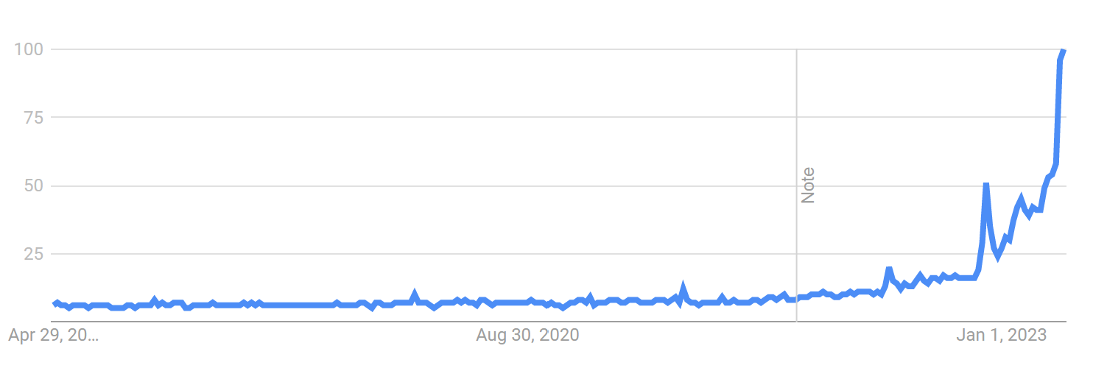
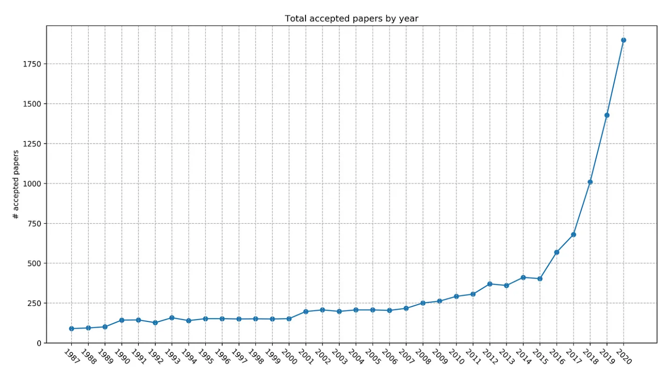
ML is changing
Google Trends: AI over past 5 years
Papers published in NeurIPS
2672 in 2022
10x growth in 12 years

Slide 17
ML is changing
Machine learning has been used for decades, e.g. reading addresses for the post office, but it’s now everywhere
Major increases in conference attendance, press coverage, investment by companies, number of authors per paper
Much better infrastructure for ML in terms of libraries and models, as well as tutorials and other online resources
Short-term value in AI is more clear, causing many companies to focus their investments

Slide 18
AI/ML will change the world in unpredictable ways
We have seen transformations of agriculture and manufacturing – AI will transform services
In a three sector breakdown, the first two sectors of raw materials (including agriculture) and production have already been transformed by technology
In consequence, the majority of the workforce has move into services in advanced countries, as well as people working less on average
AI may dramatically transform services, but it’s not clear where the workforce can move
Previous products were predictable; AI, not so
Objects and computer software are under direct control of their users and operate in predictable ways
ML-based products depend on data in non-transparent ways

Slide 19
How to prepare yourself for a fast-changing tech world?
Master the fundamentals
Tools and algorithms change, but the ideas behind them are relatively constant
Fundamentals are math, ability to frame problems computationally, ability to draw insights and predict from data, communication, and empathy
These abilities enable you to learn the latest, design solutions, and apply effectively

Slide 20
Current state of AI/ML
Fundamental ideas of classification and regression are well established and haven’t changed in many years
Recent advances enable integrating lots of data to create powerful predictors/generators
AI capability is still far inferior to humans
Requires clearly defined tasks
Cannot perform complex tasks
Requires many examples
Difficult to adapt to new tasks

Slide 21
Future directions for machine learning
Using ML to perform complex tasks
Perform software tasks, such as image editing, drafting slides based on an outline, or summarizing and reporting information from diverse sources
Learn from watching how people perform tasks and through natural training interfaces
Integrating ML into physical devices
IoT, sensors
Robots
Multimodal and broadly knowledgeable AI
Models increasingly defined in terms of input/output modalities rather than narrow tasks
Use vision, language, situation-specific, and broader knowledge to summarize and recommend
Complementary learning systems
Integrate predictive/generative models and retrieval of individual memories and associations
Integrate with planning, task decomposition, and prioritization

Slide 22
One example: Visual Programming
Use LLM to generate code that calls pretrained vision models and functions
Gupta and Khembavi 2023

Slide 23
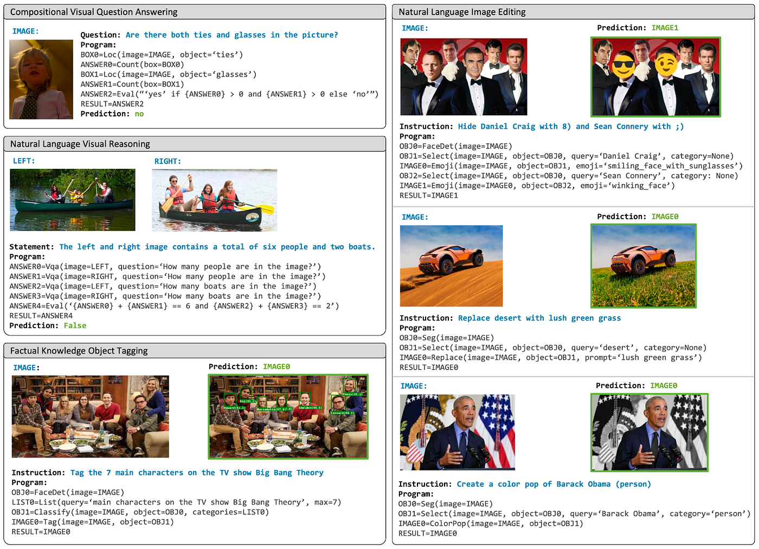

Slide 24
Finishing up the semester
Wed May 3: Final project due at 11:59pm
May 9: Final exam covers entire semester
Covers all material for semester
You may start between 9:30am on May 9 to 9:30am on May 10
See CampusWire pinned posts for details
Only one more office hour after May 3: Derek’s at 11am on May 8
We will still monitor and respond to CampusWire until the exam period
We will not answer questions during the exam period, unless it pertains to access or technical difficulty with PrairieLearn

Slide 25
ICES Feedback
We put much time and energy into this course
Please take some time to provide ratings and feedback
go.illinois.edu/ices-online
Good things to know about ICES in general
Considered mainly as a reflection of the instructor and considered for promotions and course improvements
Reflect aspects of the course that are controllable by instructor, e.g. content, structure, and behavior. Can comment on facilities, time, and your external workload, but it’s best not to factor them into overall ratings
Unconscious bias that negatively affects women, people of color, and other nationalities is well documented; try to consciously counter-act it

Slide 26
Thank you to the course staff for all of their hard work to create materials, grade, and answer questions. Thank you for your hard work and engagement!
Notes:
Have a great summer!

