Slide 1

Topic Models
Applied Machine Learning
Derek Hoiem
Dall-E

Slide 2
Last Class: Dimensionality Reduction
PCA finds the linear basis projection that maximizes variance
UMAP solves for an embedding that preserves local and, to some extent, global structure of samples
When might PCA be a better choice than UMAP?
When might UMAP be a better choice than PCA?

Slide 3
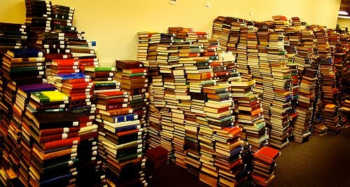
Today’s Class: Topic Modeling
Suppose you’re given a massive corpora and asked to carry out the following tasks
Organize the documents into thematic categories
Describe the evolution of those categories over time
Enable a domain expert to analyze and understand the content
Find relationships between the categories
Understand how authorship inﬂuences the content
Slide: Gormley, CMU 10-701, Lec 20, 2016

Slide 4
Today’s Class: Topic Modeling
Represent documents as a collection of words, where only the count of words matters (“bag of words” model)
Latent Semantic Analysis: Based on word-document co-occurrence, solve for a continuous vector to represent each word and document
Latent Dirichlet Allocation: Model topics as a distribution of words, and documents as a distribution of topics
BertTopic: Use deep learning to encode words or sentences and then apply topic modeling

Slide 5
Latent Semantic Analysis
Goal: Given a collection of documents that each contains a set of terms, learn representations for documents and terms that can be used to classify, retrieve, or find relationships
Ordering of terms is not considered

Slide 6
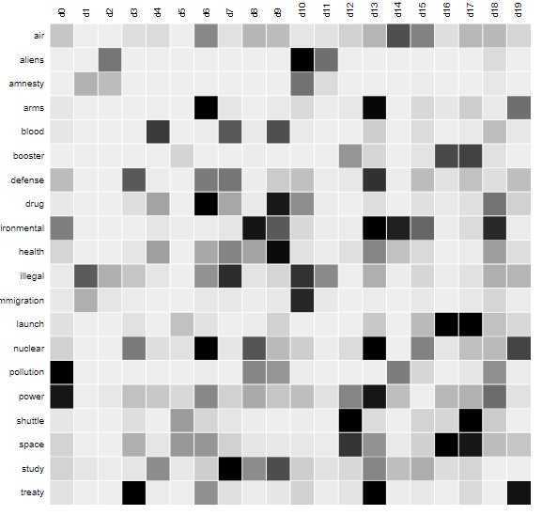
Latent Semantic Analysis
Form a term-document matrix M of tf-idf score of each term in each document
https://topicmodels.west.uni-koblenz.de/ckling/tmt/svd_ap.html

Slide 7
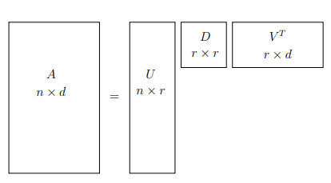




Latent Semantic Analysis
Form a term-document matrix M of tf-idf score of each term in each document
Decompose and compress the matrix using SVD and keeping only k singular values
$$k×k$$
$$k×d$$
$A=UDV^{T}≈U\left[:, :k\right]D[:k,:k]V^{T}$[:k,:]
$$n×k$$
This gives the same approximation to A that you would get from PCA. If X is centered, the right columns of V are the principal components.

Slide 8


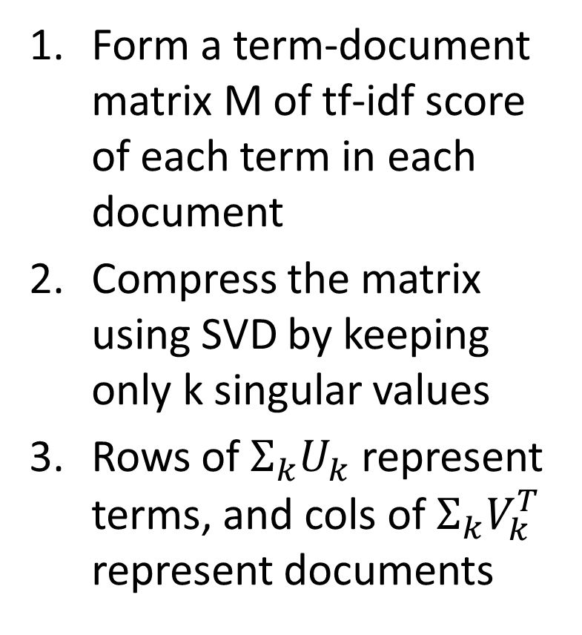




Latent Semantic Analysis
Form a term-document matrix M of tf-idf score of each term in each document
Compress the matrix using SVD by keeping only k singular values
Rows of ${Σ_{k}U}_{k}$ represent terms, and cols of ${Σ_{k}V}_{k}^{T}$ represent documents
$$k×k$$
$$k×d$$
$$n×k$$
$$k×k$$
$$k×d$$
$$n×k$$

Slide 9
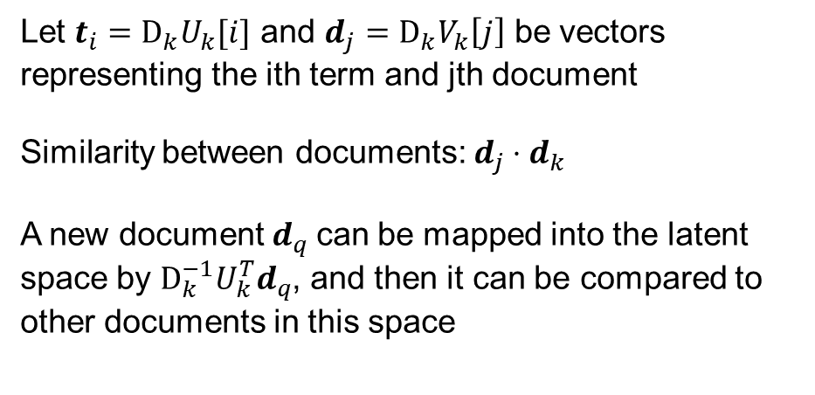
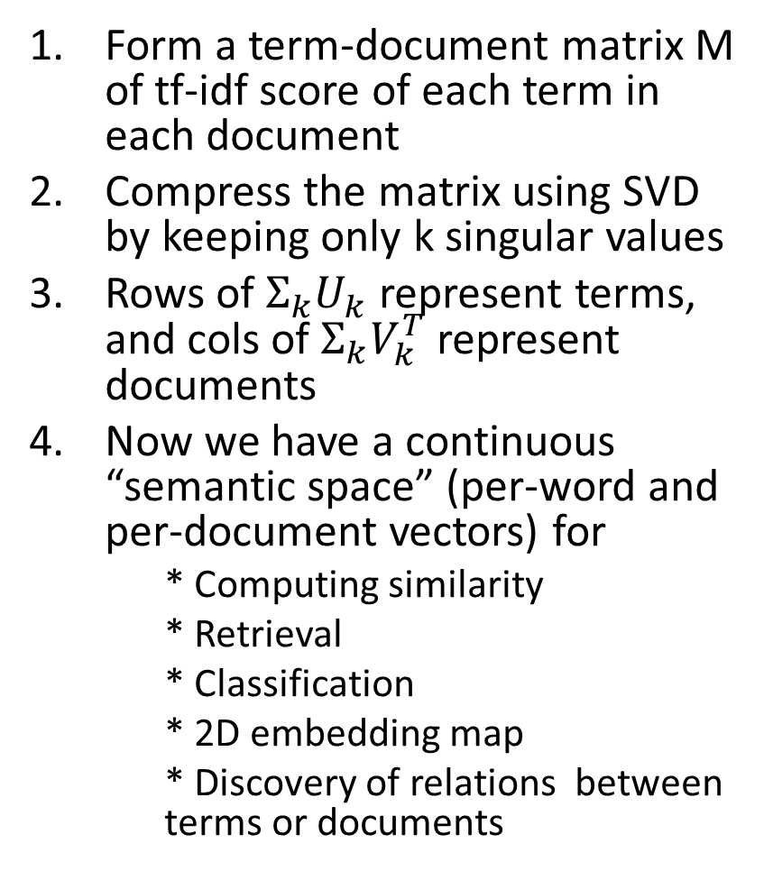
Latent Semantic Analysis
Form a term-document matrix M of tf-idf score of each term in each document
Compress the matrix using SVD by keeping only k singular values
Rows of ${Σ_{k}U}_{k}$ represent terms, and cols of ${Σ_{k}V}_{k}^{T}$ represent documents
Now we have a continuous “semantic space” (per-word and per-document vectors) for
  * Computing similarity
  * Retrieval
  * Classification
  * 2D embedding map
  * Discovery of relations between terms or documents
$$k×k$$
$$k×d$$
$$n×k$$
Let $t_{i}={D_{k}U}_{k}[i]$ and $d_{j}={D_{k}V}_{k}\left[j\right]$ be vectors representing the ith term and jth document
Similarity between documents: $d_{j}⋅d_{k}$
A new document $d_{q}$can be mapped into the latent space by ${D_{k}^{−1}U}_{k}^{T}d_{q}$, and then it can be compared to other documents in this space

Slide 10
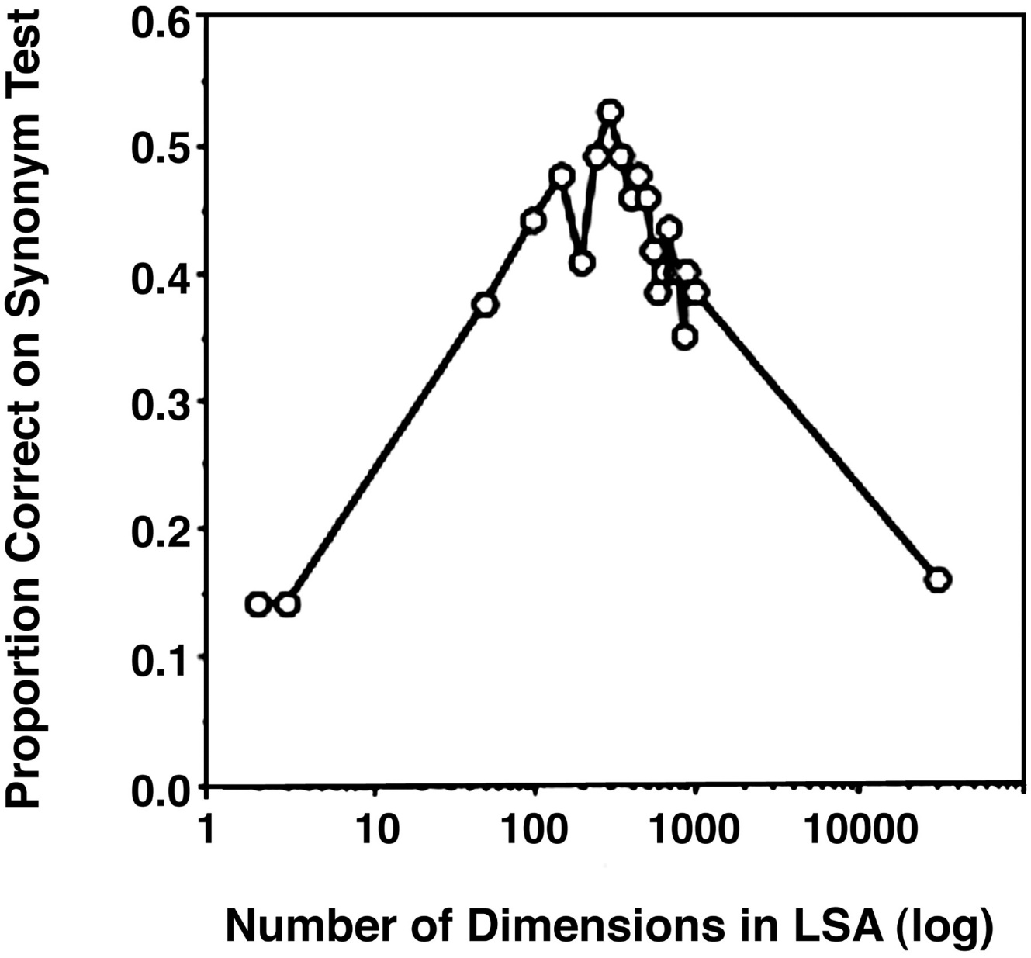
Use of LSA to identify synonyms (similar terms)
https://www.pnas.org/doi/10.1073/pnas.0400341101

Slide 11
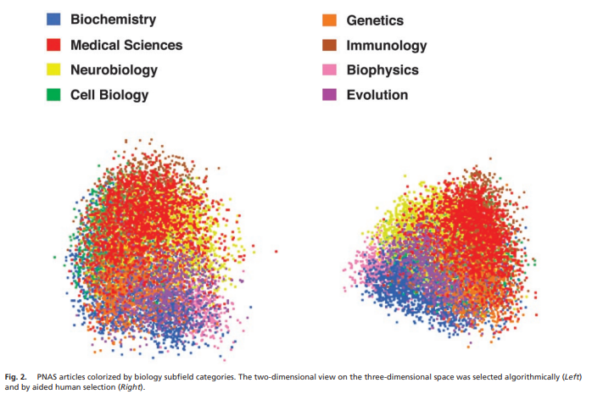
Use of LSA to organize science articles

Slide 12
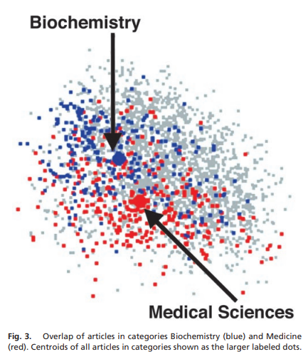
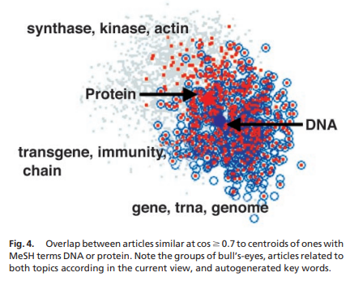
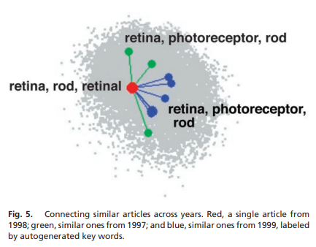
Discovering article relationships with LSA

Slide 13
LDA: Latent Dirichlet Allocation
Models document as composed of a set of topics, each of which has a distribution of words
Word order is not considered

Slide 14
Recall previously the “Bad Annotator” problem
Good annotators provide consistent scores for a given image; bad annotators assign random scores
We can view this as a generative process:
  Generate a good or bad annotator with some probability
  That annotator then generates a score for each image, where good annotator’s score is according to that image’s good score distribution, and bad annotator’s score is uniform
We solved for the parameters (P(good), P(score|good, image), P(score|bad)) using the EM Algorithm

Slide 15
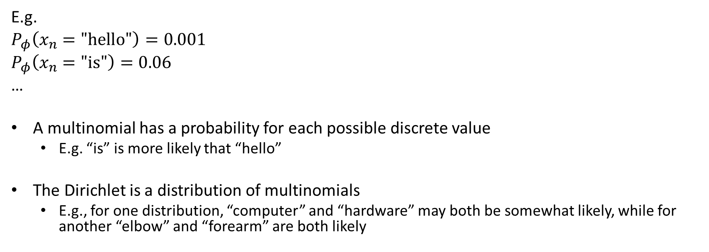
Dirichlet-Multinomial Model
E.g.
$P_{φ}\left(x_{n}=\text{"}\text{hello}\text{"}\right)=0.001$
$P_{φ}\left(x_{n}=\text{"}\text{is}\text{"}\right)=0.06$
…
A multinomial has a probability for each possible discrete value
  E.g. “is” is more likely that “hello”
The Dirichlet is a distribution of multinomials
  E.g., for one distribution, “computer” and “hardware” may both be somewhat likely, while for another “elbow” and “forearm” are both likely
Fig: Gormley, CMU 10-701, Lec 20, 2016

Slide 16
Dirichlet-Multinomial Mixture Model (aka pLSA)
Each document has a topic, according to a topic distribution
Then, words are generated, according to a topic-specific word distribution
  These word distributions can have a Dirichlet prior, which indicates how diverse the distributions are likely to be
Fig: Gormley, CMU 10-701, Lec 20, 2016

Slide 17
Latent Dirichlet Allocation (LDA) – an “admixture”
Each document has a distribution of topics
Each word is sampled by generating a topic, and then generating a word from the topic-specific word distribution

Slide 18
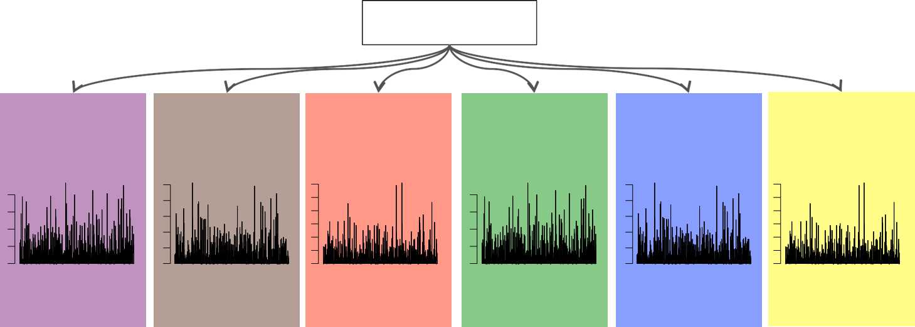
LDA for Topic Modeling
(Blei, Ng, & Jordan, 2003)
Dirichlet(β)
•
The generative story begins with only a Dirichlet prior over the topics, which can establish how concentrated the topics are likely to be.
Each topic is deﬁned as a Multinomial distribution
over the vocabulary, parameterized by ϕ_{k}
•
Slide: Gormley, CMU 10-701, Lec 20, 2016

Slide 19
LDA for Topic Modeling
(Blei, Ng, & Jordan, 2003)
Dirichlet(β)
ϕ₁
ϕ₂
ϕ₃
ϕ₄
ϕ₅
ϕ₆
•
The generative story begins with only a Dirichlet prior over the topics.
Each topic is deﬁned as a Multinomial distribution
over the vocabulary, parameterized by ϕ_{k}
•
Slide: Gormley, CMU 10-701, Lec 20, 2016

Slide 20
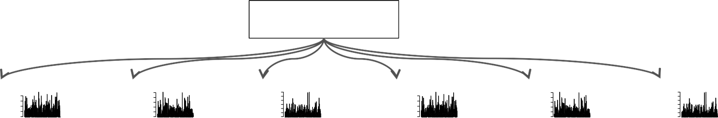
LDA for Topic Modeling
(Blei, Ng, & Jordan, 2003)
Dirichlet(β)
ϕ₁
ϕ₂
ϕ₃
ϕ₄
ϕ₅
ϕ₆
team, season, hockey, player, penguins, ice, canadiens, puck, montreal, stanley, cup
A topic is visualized as its high probability words.
Slide: Gormley, CMU 10-701, Lec 20, 2016

Slide 21
LDA for Topic Modeling
(Blei, Ng, & Jordan, 2003)
Dirichlet(β)
ϕ₁
ϕ₂
ϕ₃
ϕ₄
ϕ₅
ϕ₆
{hockey}
team, season, hockey, player, penguins, ice, canadiens, puck, montreal, stanley, cup
A topic is visualized as its high probability words.
A pedagogical label is used to identify the topic.
Slide: Gormley, CMU 10-701, Lec 20, 2016

Slide 22
LDA for Topic Modeling
(Blei, Ng, & Jordan, 2003)
Dirichlet(β)
ϕ₁
ϕ₂
ϕ₃
ϕ₄
ϕ₅
ϕ₆
{Canadian gov.}
{government}
{hockey}
{U.S. gov.}
{baseball}
{Japan}
A topic is visualized as its high probability words.
A pedagogical label is used to identify the topic.
Slide: Gormley, CMU 10-701, Lec 20, 2016

Slide 23
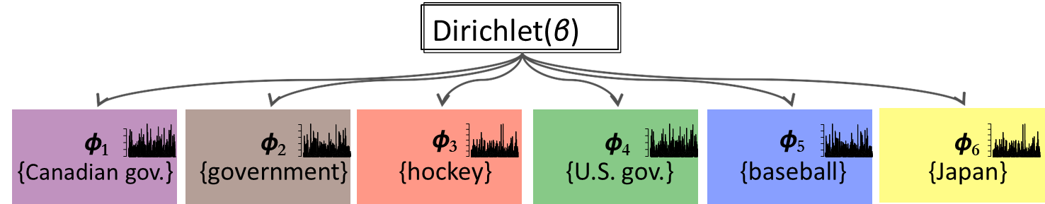


LDA for Topic Modeling
(Blei, Ng, & Jordan, 2003)
Dirichlet(α)
θ₁=
Slide: Gormley, CMU 10-701, Lec 20, 2016

Slide 24
LDA for Topic Modeling
(Blei, Ng, & Jordan, 2003)
Dirichlet(α)
θ₁=
The 54/40'
boundary
dispute is
sIll unresolved, and
Canadian
and US
Slide: Gormley, CMU 10-701, Lec 20, 2016

Slide 25
LDA for Topic Modeling
(Blei, Ng, & Jordan, 2003)
Dirichlet(α)
θ₁=
The 54/40'
boundary
dispute is
sIll unresolved, and
Canadian
and US
Slide: Gormley, CMU 10-701, Lec 20, 2016

Slide 26
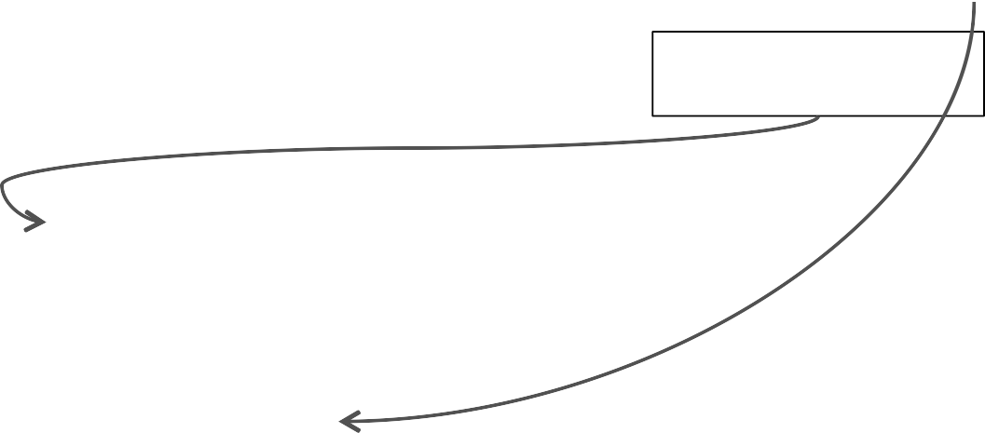
LDA for Topic Modeling
(Blei, Ng, & Jordan, 2003)
Dirichlet(α)
θ₁=
The 54/40' boundary dispute is sIll unresolved, and Canadian and US Coast Guard
Slide: Gormley, CMU 10-701, Lec 20, 2016

Slide 27
LDA for Topic Modeling
(Blei, Ng, & Jordan, 2003)
Dirichlet(α)
θ₁=
The 54/40'
boundary
dispute is
sIll unresolved, and
Canadian
and US Coast Guard vessels
regularly if infrequently
detain
each other's ﬁsh boats in the disputed waters oﬀ Dixon…
Slide: Gormley, CMU 10-701, Lec 20, 2016

Slide 28
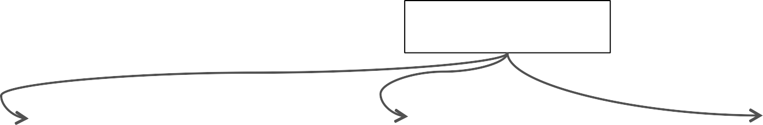




LDA for Topic Modeling
(Blei, Ng, & Jordan, 2003)
Dirichlet(α)
θ₁=
θ₂=
θ₃=
The 54/40'
boundary
dispute is
In the year before
The Orioles' pitching staﬀ again is having a ﬁne
still unresolved, and
Canadian
Lemieux came, Pittsburgh
and US Coast Guard vessels
ﬁnished with 38 points.
exhibiIon season. Four
regularly if infrequently
detain
Following his arrival, the
shutouts, low team ERA,
each other's ﬁsh boats in the
Pens
ﬁnished…
(Well, I haven't gotten any
disputed waters oﬀ Dixon…
baseball…

Slide 29
LDA for Topic Modeling
(Blei, Ng, & Jordan, 2003)
Distribution over words per topic
Distribution over topics per doc
Dirichlet(α)
θ₁=
θ₂=
θ₃=
The 54/40'
boundary
dispute is
In the year before
The Orioles' pitching staﬀ again is having a ﬁne
stll unresolved, and
Canadian
Lemieux came, Pittsburgh
and US Coast Guard vessels
ﬁnished with 38 points.
exhibiIon season. Four
regularly if infrequently
detain
Following his arrival, the
shutouts, low team ERA,
each other's ﬁsh boats in the
Pens
ﬁnished…
(Well, I haven't gotten any
disputed waters oﬀ Dixon…
baseball…

Slide 30
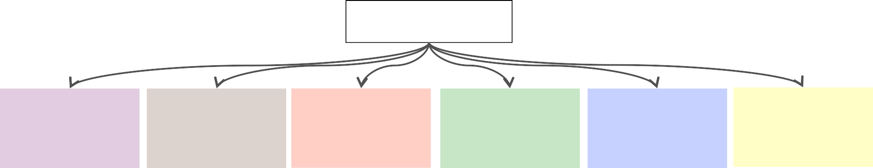
LDA for Topic Modeling
(Blei, Ng, & Jordan, 2003)
Inference and learning start with only the data
Dirichlet( )
ϕ₁ =
ϕ₂ =
ϕ₃ =
ϕ₄ =
ϕ₅ =
ϕ₆ =
Dirichlet( )
θ₁=
θ₂=
θ₃=
The 54/40' boundary dispute is stil unresolved, and Canadian
In the year before Lemieux came, Pittsburgh
The Orioles' itching staﬀ again is having a ﬁne
and US Coast Guard vessels regularly if infrequently detain each other's ﬁsh boats in the disputed waters oﬀ Dixon…
ﬁnished with 38 points. Following his arrival, the Pens ﬁnished…
exhibiIon season. Four shutouts, low team ERA, (Well, I haven't gotten any baseball…
Slide: Gormley, CMU 10-701, Lec 20, 2016

Slide 31
Latent Dirichlet Allocation
Questions:
Is this a believable story for the generation of a corpus of documents?
Why might it work well anyway?
Slide: Gormley, CMU 10-701, Lec 20, 2016

Slide 32

Latent Dirichlet Allocation
Why does LDA “work”?
LDA trades off two goals.
  For each document, allocate its words to as few topics as possible.
  For each topic, assign high probability to as few terms as possible.
These goals are at odds.
Putting a document in a single topic makes #2 hard: All of its words must have probability under that topic.
Putting very few words in each topic makes #1 hard:
To cover a document’s words, it must assign many topics to it.
Trading off these goals finds groups of tightly co-occurring words.
Slide from David Blei, MLSS 2012

Slide 33
Solving for the parameters of LDA Model
Need to solve for
  Parameters of multinomials (topic/word distributions)
  Latent variables of which topics are generated by each document
This can be solved by a variational EM
  E-step: For each document, infer the topic distribution using variational inference (involving sampling from distributions)
  M-step: Optimize the model parameters

Slide 34
Fig: Blei et al. 2003

Slide 35
Comparison of how well the models explain the word distributions
Fig: Blei et al. 2003

Slide 36
Classification using topic distributions as features for documents
Fig: Blei et al. 2003

Slide 37
Applications of LDA
Detect the presence of structured genetic variation in a group of individuals
  alternative gene forms “allele” are drawn from a source population, and the specific gene form is drawn from the allele
Identify common themes of self-images experienced by young people in social situations (Kin et al. 2022)
Topic extraction in construction safety and health posts in Instagram (Zeng et al. 2023)
Discover tonal structures in music corpora (Lieck et al. 2020)

Slide 38
Play: Guess the Topics
https://colab.research.google.com/drive/1RbYMJCXY07e3TaHfp7BaHUN5z99WUdXK?usp=sharing

Slide 39
BERTopic (Grootendorst 2022)
A library for using deep learning modules as part of topic modeling
  Convert documents to embedding; they use Sentence-BERT so that each sentence is one vector
  Cluster embeddings
    Reduce dimensionality; they use UMAP
    Cluster in the lower dimension to create “terms”; they use HDBSCAN (a hierarchical density-based clustering algorithm)
  Compute c-tf-idf, which identifies the most salient terms for each cluster
  Apply topic modeling methods, like LDA or LSA
Explanation/usage: https://www.pinecone.io/learn/bertopic/
Paper: https://arxiv.org/pdf/2203.05794.pdf
Code/docs: https://maartengr.github.io/BERTopic/index.html

Slide 40
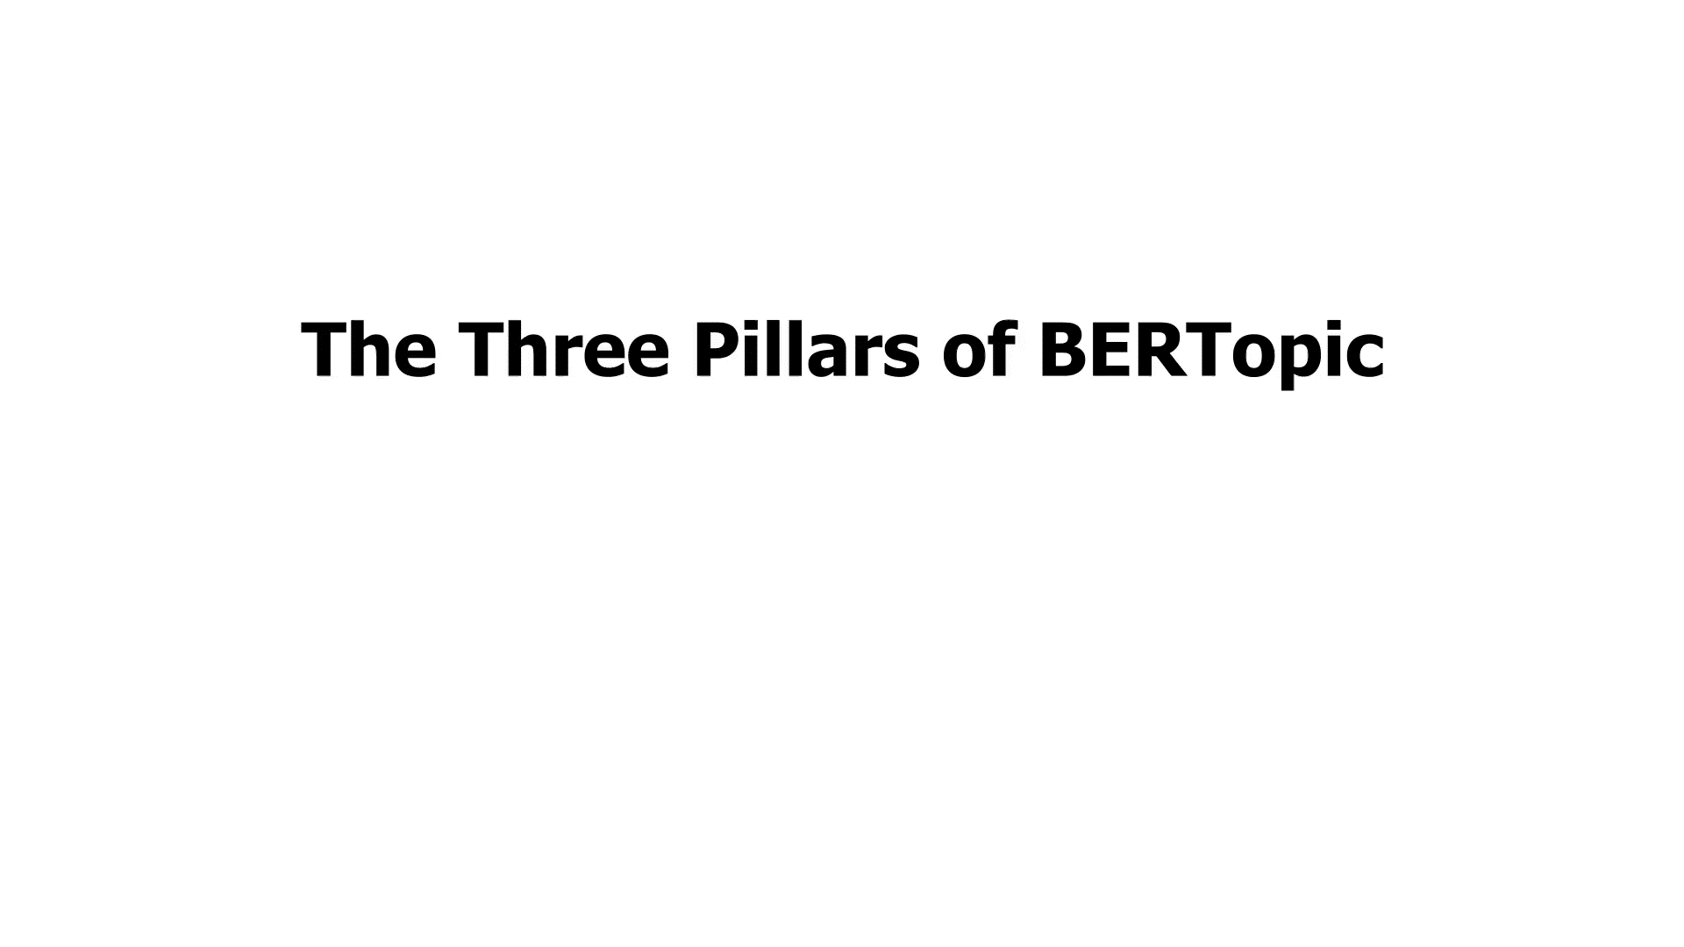

Slide 41
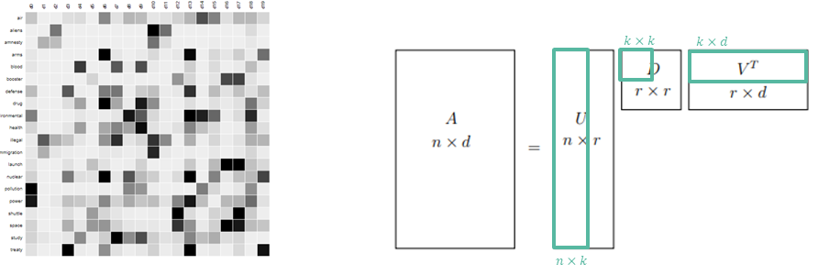
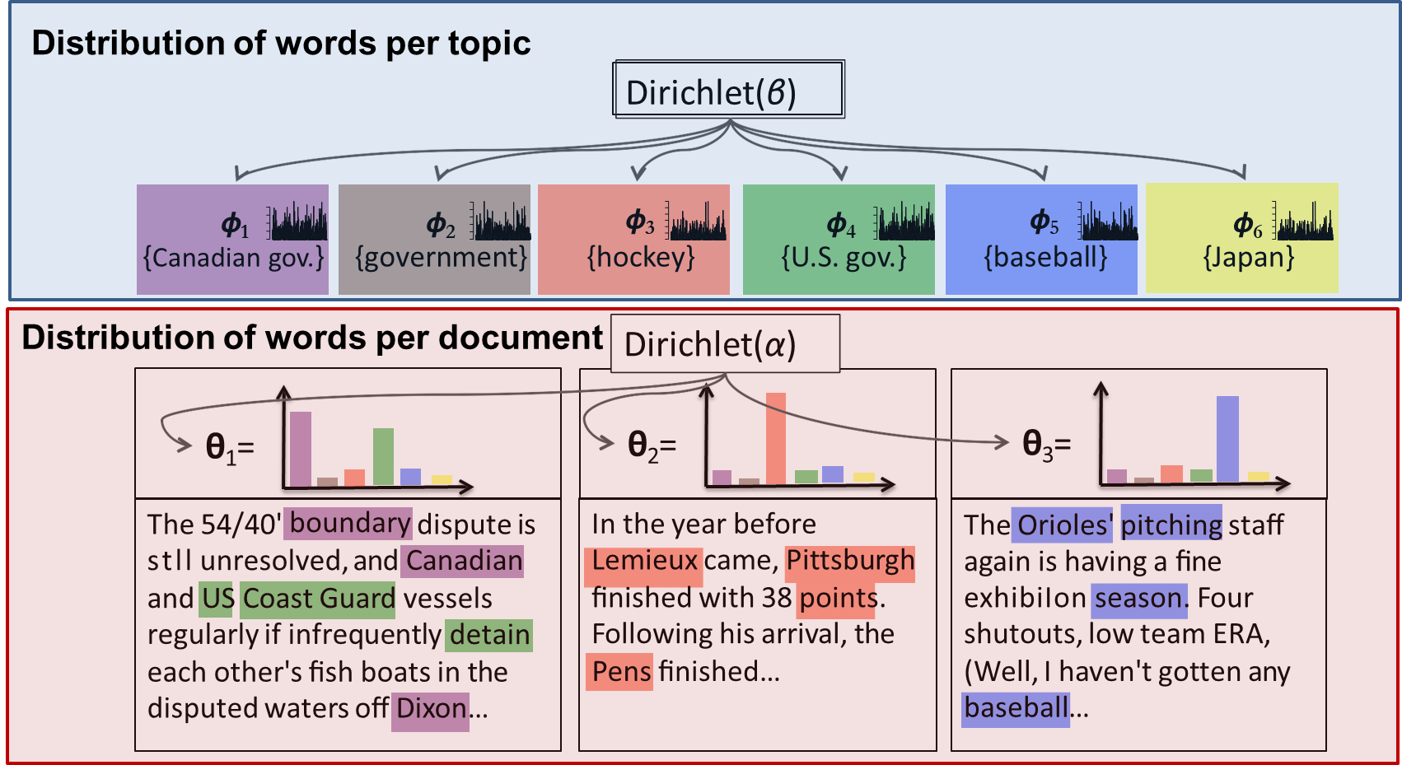
Things to remember
Topic modeling considers a document to be a collection of topics that compose words
LSA: documents are a linear combination of vectors that are linear combinations of words
LDA: documents generate topics that generate words
BERTopic uses deep learning models to represent words/sentences and then applies classic methods

Slide 42
Next week
Robust estimates and outliers
Reinforcement learning – by Josh Levine (your TA)

