Slide 1

Building an ML Application and Transfer Learning
Applied Machine Learning
Derek Hoiem
Dall-E

Slide 2
Today’s lecture
Review a few exam questions
Example of building an ML application
Transfer learning

Slide 3
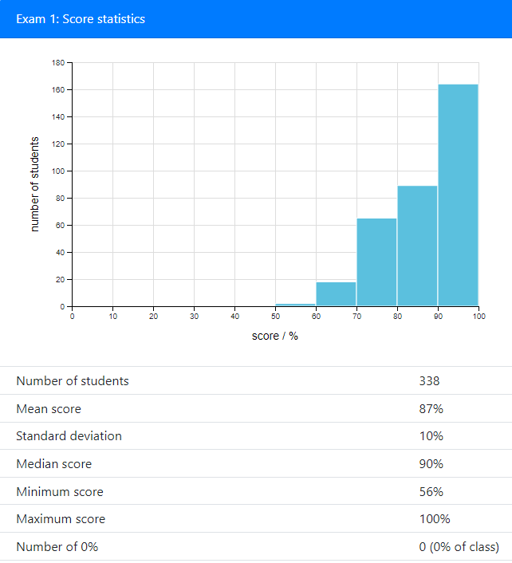
Exam
Well done!

Slide 4
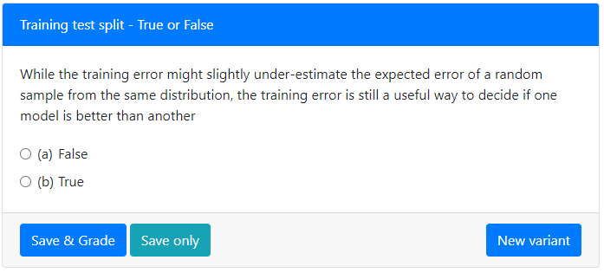
False: It’s possible (and common) for a method to achieve low/zero training error, but still perform badly in testing, especially if the training examples are few compared to the model size

Slide 5
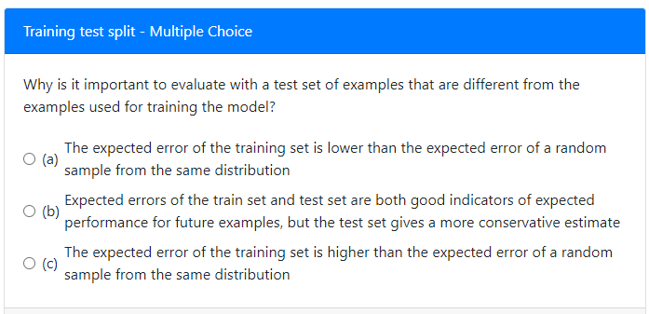
(a): The parameters optimize the objective for the training data, so evaluation on the training data is a strongly biased optimistic estimate of performance, and is not a good indicator of expected performance for future examples

Slide 6
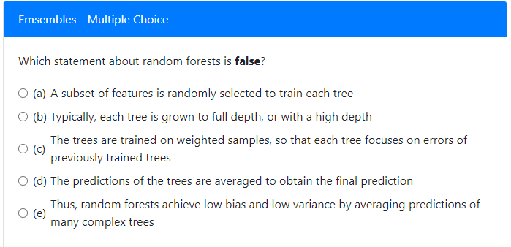
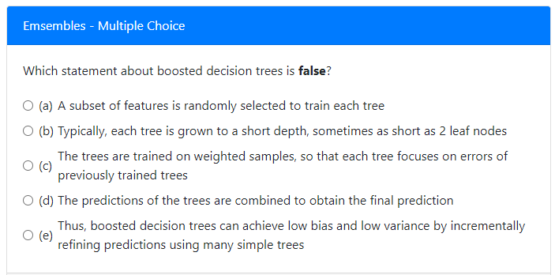
(c) The trees are independently trained
(a) All features are used to train each tree

Slide 7
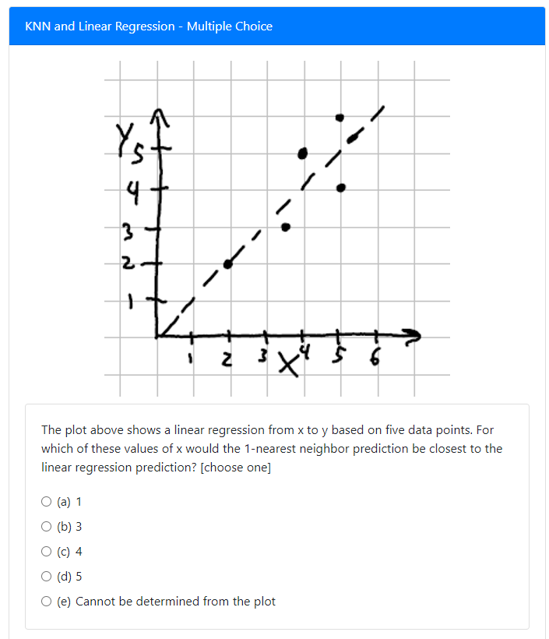
(b) x=3→y~=3 for regression and nearest neighbor

Slide 8
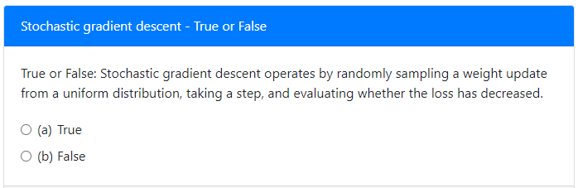
False: The weight update is not sampled randomly from a uniform distribution, but computed from a random sample of data. Also, SGD does not proceed by checking whether an update decreases the loss -- it just takes a step according to the loss gradient for that mini-batch.

Slide 9
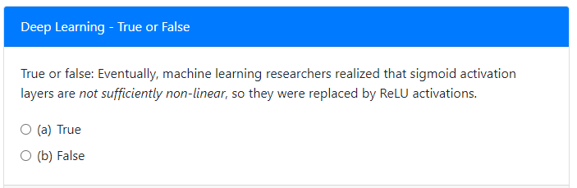
False: Sigmoid activations are very non-linear. The problem is that the gradient is always less than 1 and often very small, so with many layers, the gradient becomes negligible.

Slide 10



We’ve covered a lot of ground in deep networks
ReLU activations, residual connections, and improved optimization techniques enabled training arbitrarily large and deep models
Transformers provide a general and scalable way to process many kinds of data
Training on large annotated datasets or even larger unannotated datasets yields impressive models that are useful for many applications

Slide 11
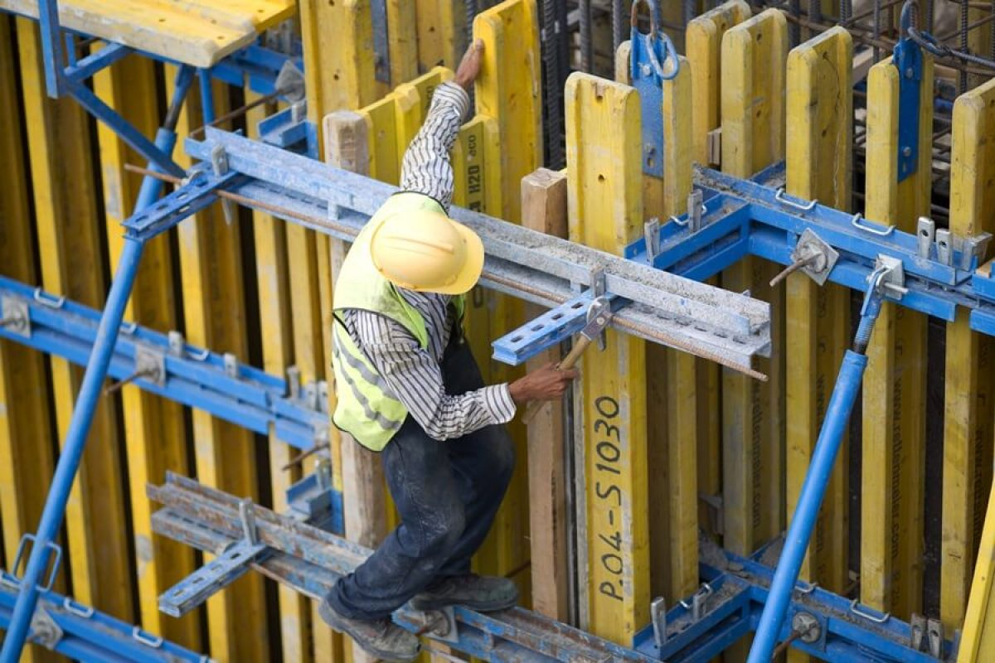
How do you make your own ML application?
Example: Safety inspector wants to know what fraction of workers are wearing helmets, gloves, and boots on each job site
PPE use is low (e.g., 60% use in a study in Egypt; frequent lack of use in US and other countries too)
1,008 fatal and 174,100 non-fatal injuries in US construction in 2020
Consistently using PPE would significantly reduce injury and sometimes death
Image src

Slide 12
Step 1: Propose a solution in more technical terms
Proposed solution: Process images from the job site to detect the workers and count what fraction of detected workers are wearing each item
Left Glove: No
Right Glove: No
Hard hat: Yes
Vest: Yes
Boots: Yes

Slide 13
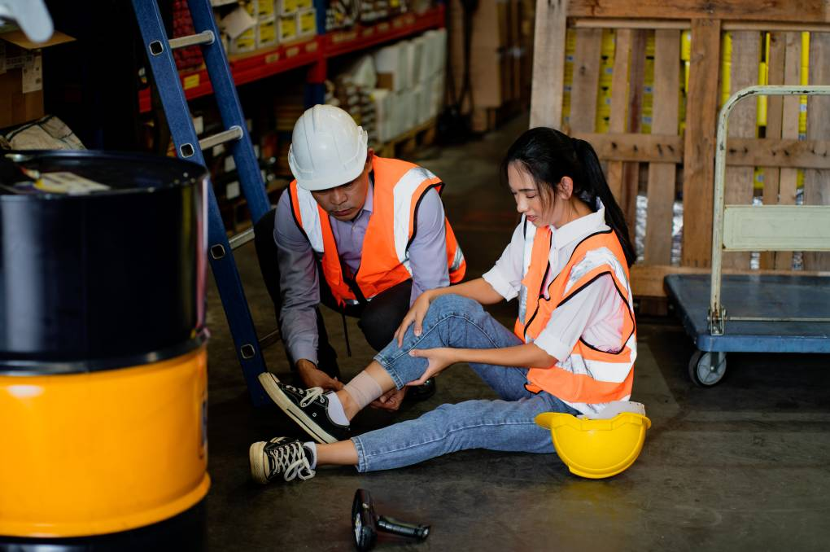
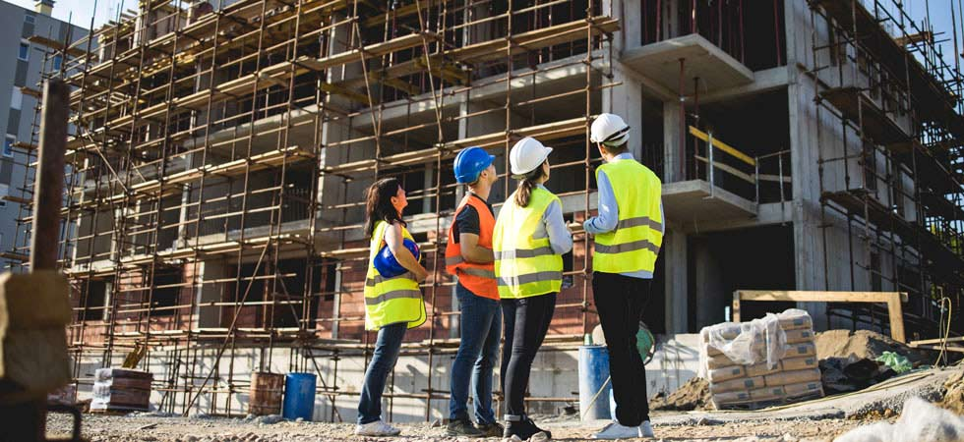
Step 1: Propose a solution in more technical terms
Main ML problem: Given an image, detect each worker and whether each detected worker is wearing: (a) glove on left hand; (b) glove on right hand; (c) boots; (d) hard hat; (e) vest
Note: There are lots of other aspects to the problem that we won’t consider in this example
How to get images onto a server where we can process them
How to avoid duplicate counts when the same person is in more than one image on the same day
How to summarize results and report them to the safety inspector
src
src

Slide 14
Step 2: Decide how to measure success
What matters?
  We want the overall estimate of fraction of workers wearing each item to be accurate
  We want to report specific instances of workers not wearing an item, so that they can be checked as problematic or not

Slide 15
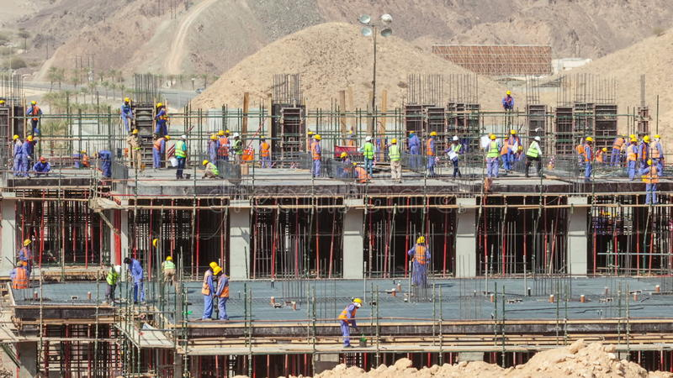
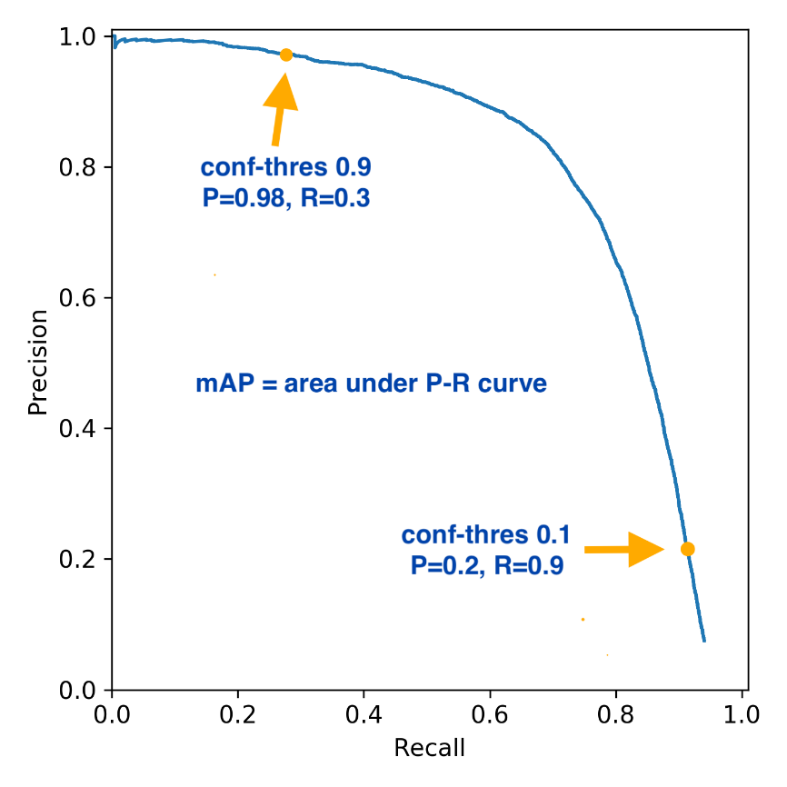
Step 2: Decide how to measure success
Key aspects of performance
  Human detection performance
    Do we care about “small” or heavily occluded workers?
    What counts as correct? (maybe high overlap in bounding boxes)
    Measure precision (fraction of detections that are correct) and recall (fraction of workers that are detected)
    Can measure Precision and Recall for each level of confidence and generate a P-R curve
    Common overall performance measure is average precision
    We may care about recall at a high precision value because we don’t care about counting the number of workers, just knowing how likely a worker is to wear PPE
src
src

Slide 16
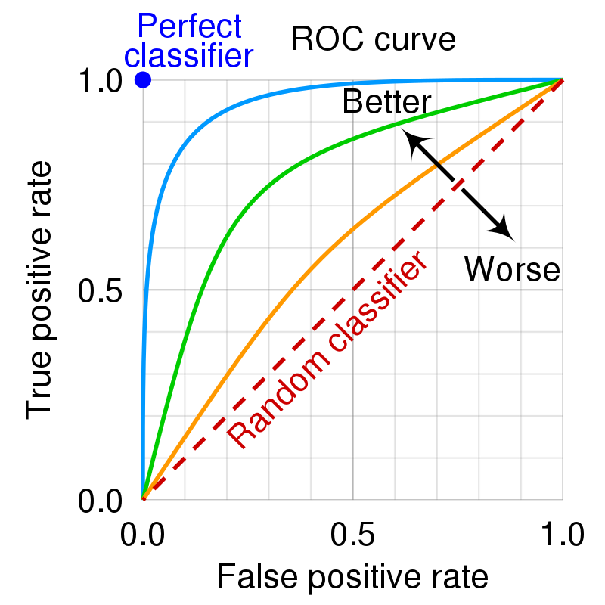
Step 2: Decide how to measure success
Key aspects of performance
  Human detection performance
  Apparel classification performance, for correctly detected humans and each item:
    TP rate: fraction of actual items that are detected
    FP rate: fraction of item detections that are false
    Summarize with equal error rate, accuracy when confidence is set so that FP rate = (1- detection rate)
EER

Slide 17
Step 2: Decide how to measure success
Key aspects of performance
  Human detection performance
  Apparel detection performance, for correctly detected humans and each item
  Overall: Deviance between the estimated fraction of workers wearing equipment from the true fraction over a set of images
    Difference in fractions
    Bias: tends to overcount or undercount
    Variance: how much could the difference be expected to vary, given a particular number of images

Slide 18
Step 3: collect and annotate validation/test images
Collect images
  Should be the same kind of images that will be processed in deployment
  Collect from a variety of sites and different dates. Try to get representative diversity
Annotate
  Draw boxes around each worker, even very small and hard to detect ones
  For each PPE item, label “present”, “absent”, or “not visible”
  How to get annotations
    In house:
      Use open source tool, such as VGG image annotator, or commercial tool like LabelBox
      Develop custom tool (e.g. to process 360 images or fully integrate into existing application)
    Outsource:
      Amazon Mechanical Turk or other crowdsourcing tool
      Commercial service
    In this case, creating a small initial development validation set in-house and larger set by outsourcing could make sense
Split into a validation set and test set

Slide 19
Step 4: Determine technical details of approach
For this example, we’ll base the approach on Mask-RCNN
Detects objects and person keypoints
Includes additional branch to detect person keypoints
Modifications
Remove bounding box detections and masks for non-person objects
Add classification layer to keypoint branch to classify
  Wearing left glove
  Wearing right glove
  Wearing hard hat
  Wearing boots
  Wearing safety vest

Slide 20
Step 5: Collect training data
Consider combination of existing data (with applicable licenses) and new data
Existing
  Papers with code
  Google for existing papers/datasets, e.g.
Collect own data
  similar to collecting test/validation, but not quite as much concern about being representative or reflecting actual use cases
  E.g., could ask job sites to send photos of workers wearing and not wearing PPE (on purpose, briefly) while in natural poses

Slide 21
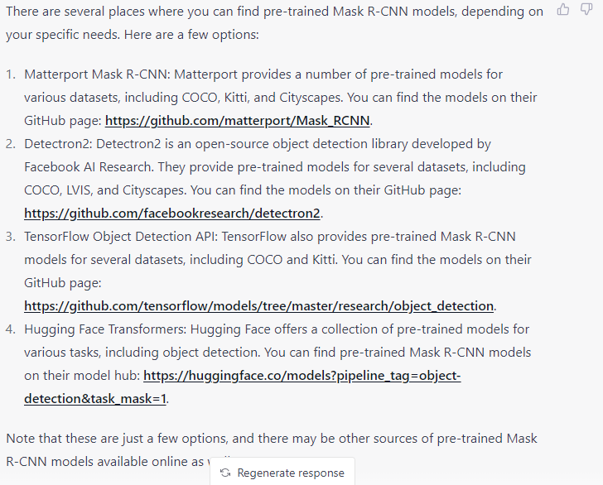
Step 6: Develop model
(from Chat GPT)
Whenever possible, start with a pretrained model
Alternatively, you could use unsupervised pretraining to initialize your model (e.g. Masked Autoencoder)
https://huggingface.co/models

Slide 22
Step 6a: Develop model: establish baselines
Run the model as-is on your validation data and measure human detection performance
Train a linear probe for classifying PPE item presence and measure all performance metrics
Manually validate your evaluation code by displaying images and detections and checking against metrics

Slide 23
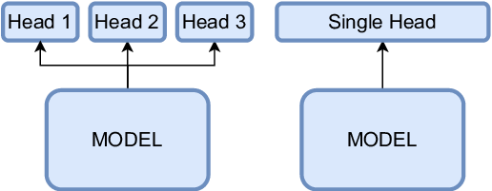
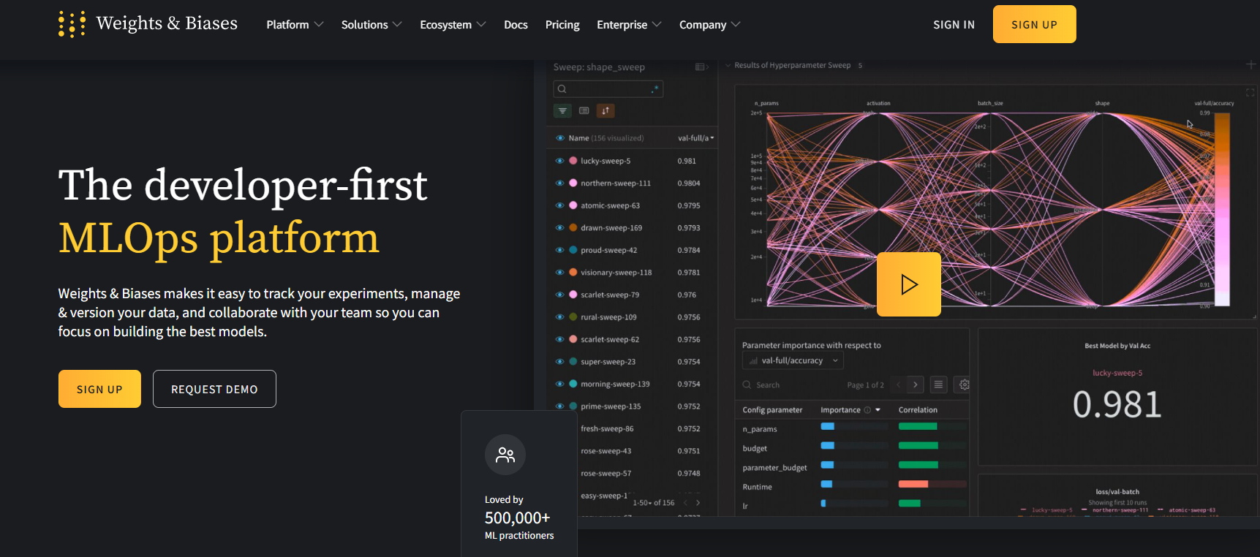
Step 6b: Develop model: refine model
Fine-tune the model on your data
Train using mix of existing and application-specific data
  Apply only the losses that are applicable (e.g. detection or pose only for some datasets)
Use tools like TensorBoard or Weights and Biases to monitor training and compare results
  Always plot validation and training loss, and measure validation performance at training milestones
src
https://huggingface.co/autotrain

Slide 24
Step 7: Evaluate on test set
Measure performance metrics and characterize when it works and doesn’t
  As function of occlusion, person size, camera viewpoint, etc

Slide 25
Step 8: Integrate into application
Beta test in complete workflows
Write guides for when it works and doesn’t
Improve efficiency, refine approach

Slide 26
Summary of how to build a new ML application
Identify problem and general approach to solution
  This also involves thinking ahead to metrics, available models, data, and more, to ensure viability
Specify success metrics
  Check with product managers and/or users to ensure these metrics reflect important performance characteristics
  Often, the metrics can’t be optimized directly
Create evaluation sets
  Achieving targets for success metrics on these sets should indicate high likelihood of application success
Select model, objectives, and other design details
  Usually this involves finding an analogous approach that has been successful
Collect data for training
  Custom data and labeling is expensive and time-consuming, so exploit available data sources where available, and as allowed by license terms
Develop model, starting with baselines and simple approaches
  Starting simple is critical so that it is easier to debug and validate changes
Evaluate on your test set
  It’s not just about the performance number, but about predictability and effectiveness within the application
Integrate into the application
  This requires a lot of work and testing

Slide 27
2 minute break

Slide 28
Thank you to Yuxiong Wang for following slides on domain adaptation and transfer learning!

Slide 29

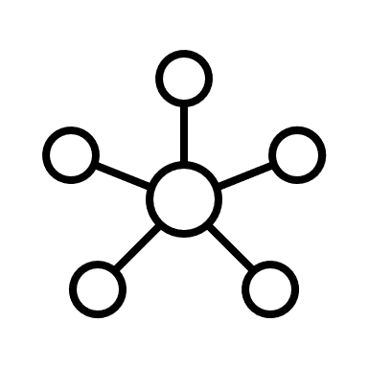


Challenge for Machine Learning Models
Development and real-world application may face different scenarios
Limiting model performance and reliability
Curated Dataset for Development
Trained
ML Model
Real-world Setting
Questionable Performance
Slide credit: Yuxiong Wang

Slide 30
Types of Shifts
Mainly two types of shifts from one scenario to another:
Task shift Domain shift
Slide credit: Yuxiong Wang

Slide 31
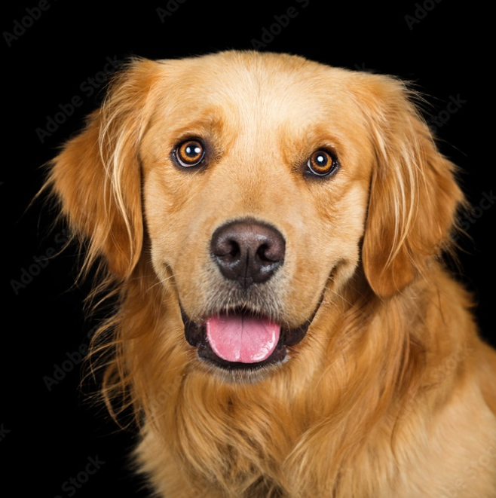
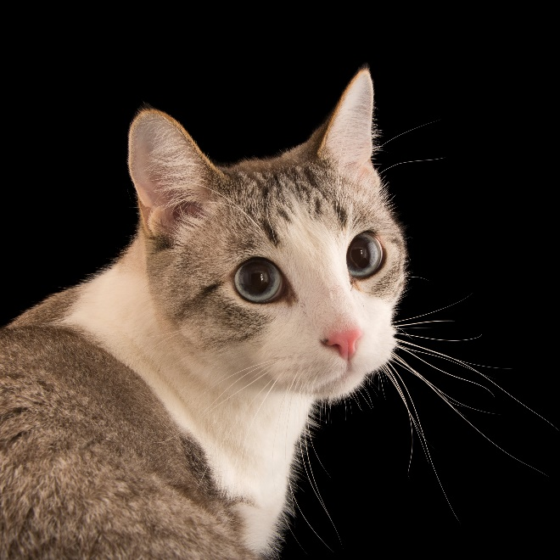
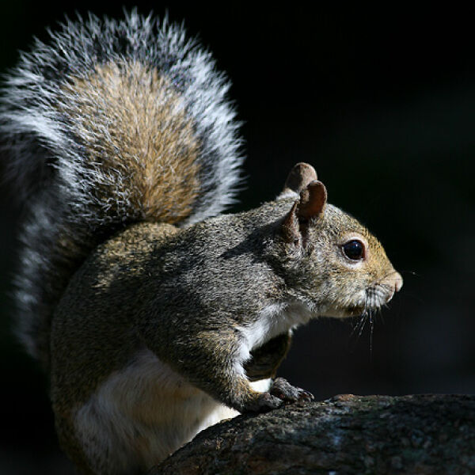
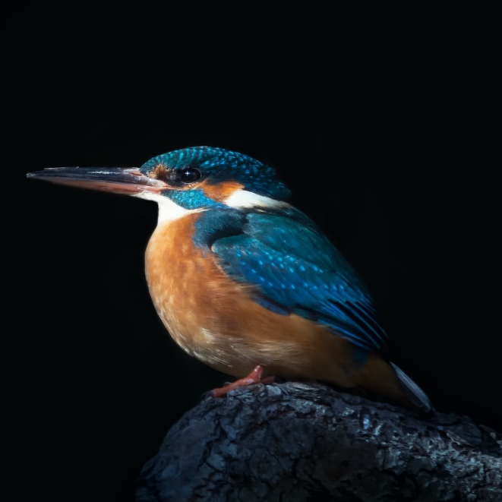
Task Shift: Changed Model Objectives
Classifying dogs and cats
Source (Old) Task
Classifying squirrels and birds
Target (New) Task
Slide credit: Yuxiong Wang

Slide 32
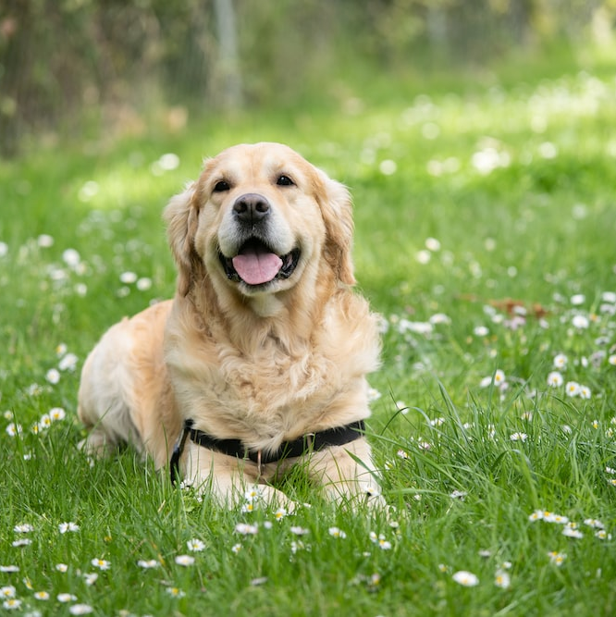
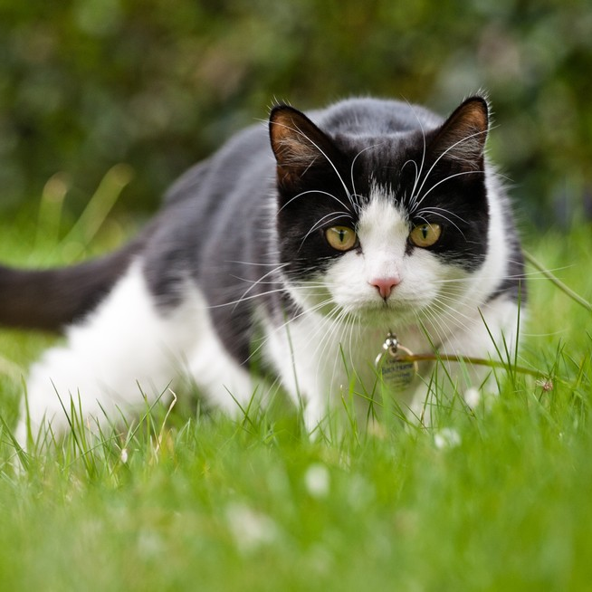
Domain Shift: Changed Input Data Distributions
Classifying dogs and cats in studio
Source (Old) Domain
Classifying dogs and cats on grass
Target (New) Domain
Slide credit: Yuxiong Wang

Slide 33
Types of Shifts: Task or Domain?
Task shift
  Objective of model is changed
  But data distributions are usually assumed similar or related
Domain shift
  Input data come from changed distributions
  But model task usually remains the same
Slide credit: Yuxiong Wang

Slide 34


Overcoming Task/Domain Shift
Curated Dataset for Development
Trained
ML Model
Real-world Setting
Questionable Performance
Adapted
ML Model
Real-world Setting
Improved Performance
Slide credit: Yuxiong Wang

Slide 35
Overcoming Task/Domain Shift
Task adaptation
  Transfer learning
  Meta-learning
Domain adaptation
  Instance translation
  Domain adversarial training
Task shift
  Changed task objective
Domain shift
  Changed data distribution
Some adaptation ideas may be applicable for both (e.g., Meta-learning)
Slide credit: Yuxiong Wang

Slide 36
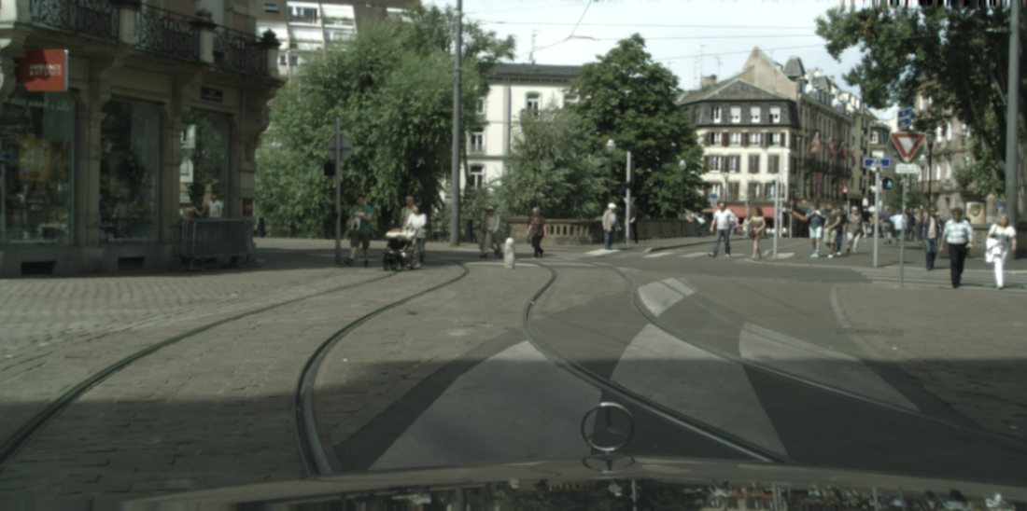
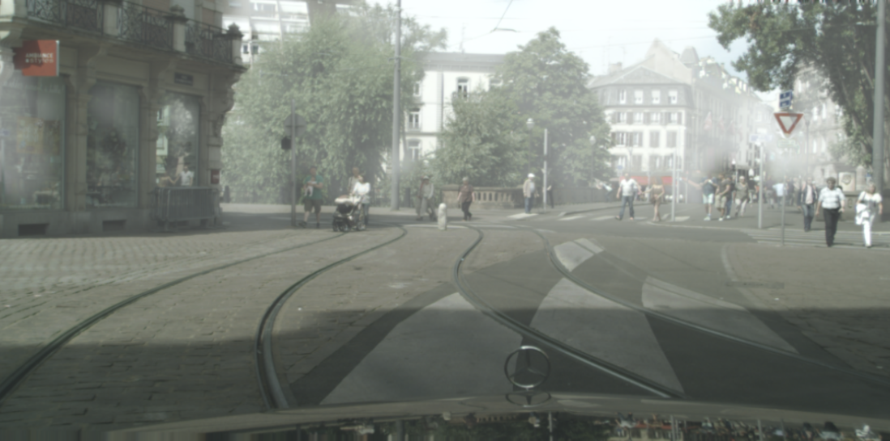
Application: Autonomous Driving
Adapt to different weather conditions, lighting conditions, or driving environments
Normal Weather Condition
Foggy Weather Condition
Images from Sakaridis et al. IJCV '18
Slide credit: Yuxiong Wang

Slide 37
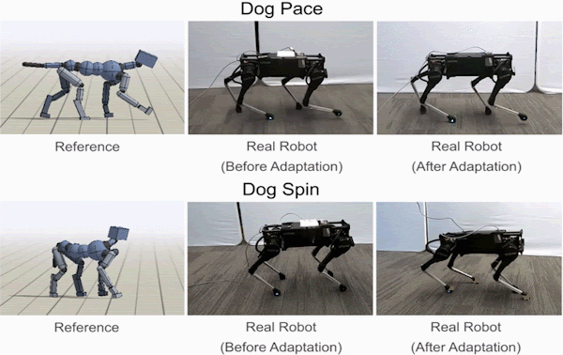
Application: Robotics
Adapt from simulated environment to real-world robotic systems, or adapt from one learned task to another
Images from Google Research, 2020
Slide credit: Yuxiong Wang

Slide 38
Application: Speech recognition
Adapt to different accents, speaking styles, or environmental conditions
Example: Model trained with American English could be adapted to British English by fine-tuning on new domain
Slide credit: Yuxiong Wang

Slide 39
Methods for Task Adaptation
Transfer learning: Pre-training and fine-tuning
Meta-learning: Model-Agnostic Meta-Learning (MAML) and variants
Slide credit: Yuxiong Wang

Slide 40
Transfer Learning
Goal: To reuse knowledge learned from one task (which usually has abundant supervisory information), to another related task
Implementation is simple
  "Pre-train" model on source task
  Copy learned weights from learned model
  "Fine-tune" new model on target task
Slide credit: Yuxiong Wang

Slide 41
Transfer Learning
Model 1
Task 1 Data
Backbone
Head
Task 1 Outputs
Initialize weights
Model 2
Task 2 Data
Backbone
New Head
Task 2 Outputs
Slide credit: Yuxiong Wang

Slide 42
Transfer Learning
Step 1: Pre-train Model 1 on Task 1
Model 1
Task 1 Data
Backbone
Head
Task 1 Outputs
Initialize weights
Model 2
Task 2 Data
Backbone
New Head
Task 2 Outputs
Slide credit: Yuxiong Wang

Slide 43
Transfer Learning
Step 2: Initialize weights using learned Model 1
Model 1
Task 1 Data
Backbone
Head
Task 1 Outputs
Initialize weights
Model 2
Task 2 Data
Backbone
New Head
Task 2 Outputs
Slide credit: Yuxiong Wang

Slide 44
Transfer Learning
Step 3: Fine-tune Model 2 on Task 2
  Backbone may use a smaller learning rate or even be "frozen"
Model 1
Task 1 Data
Backbone
Head
Task 1 Outputs
Initialize weights
Model 2
Task 2 Data
Backbone
New Head
Task 2 Outputs
Slide credit: Yuxiong Wang

Slide 45
Model-Agnostic Meta-Learning (MAML)
Proposed by Finn et al. ICML '17
Goal: To learn a good parameter initialization that can be quickly adapted to new tasks
Model-agnostic: Can be applied to any differentiable model
  Flexible, can be used in a wide range of applications
  Including computer vision, natural language processing, and robotics
Slide credit: Yuxiong Wang

Slide 46
Model-Agnostic Meta-Learning (MAML)
Assumption and setting
  Have a pool of various tasks
  Each task contains a set of training/validation samples
An example of task pool
  Classify Dogs into Shepherd, Labrador, Golden, Husky ...
  Classify Cat into Siamese, Maine, Persian, Shorthair ...
  Classify Bird into Canary, Parrot, Dove, Sparrow ...
Slide credit: Yuxiong Wang

Slide 47
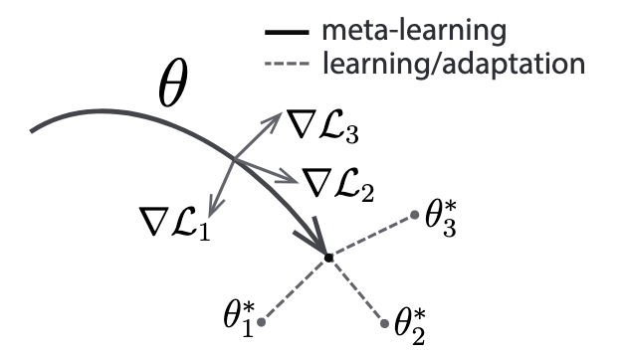
Model-Agnostic Meta-Learning (MAML)
Meta-learning phase
  Use pool of tasks to obtain a good parameter initialization
  Learn from the "experience of learning"
Adaptation phase
  Use few samples and optimization steps to adapt to new task
  New task can be outside the task pool used in meta-learning
Slide credit: Yuxiong Wang

Slide 48
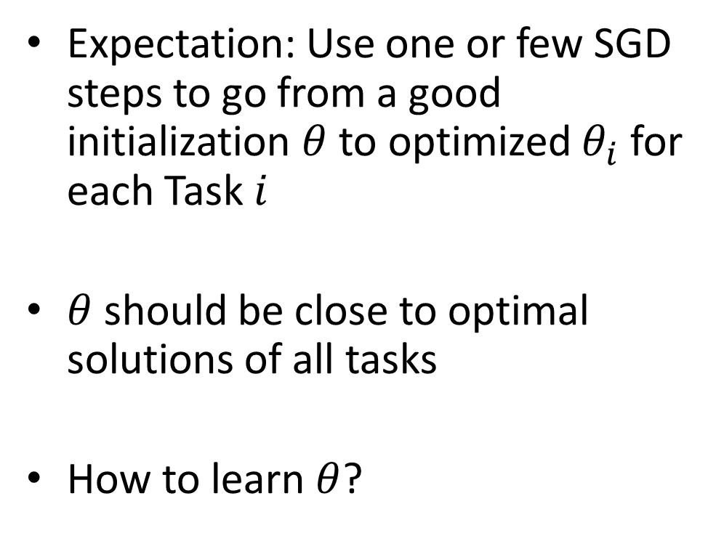
Adaptation Phase
Expectation: Use one or few SGD steps to go from a good initialization $θ$ to optimized $θ_{i}$ for each Task $i$
$θ$ should be close to optimal solutions of all tasks
How to learn $θ$?
Slide credit: Yuxiong Wang

Slide 49
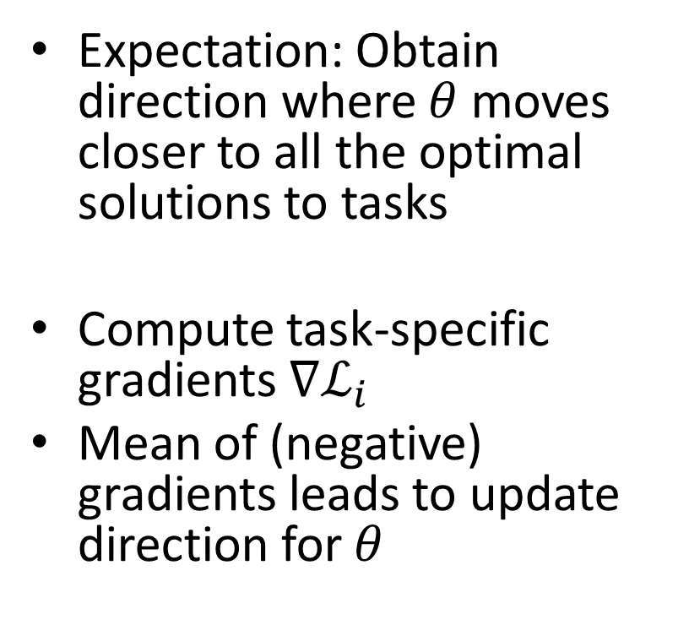
Meta-learning Phase
Expectation: Obtain direction where $θ$ moves closer to all the optimal solutions to tasks
Compute task-specific gradients $∇ℒ_{i}$
Mean of (negative) gradients leads to update direction for $θ$
Slide credit: Yuxiong Wang

Slide 50
Find gradient step(s) to improve parameters for each few-shot task
Update parameters so that those update steps reduce the loss as much as possible for all tasks

Slide 51
MAML is “learning to learn” – it learns parameters that are close to good parameters for many classification tasks, so that new tasks can be learned from a few examples and optimization steps

Slide 52
Transfer learning vs. Meta-learning
Aspect | Transfer learning | Meta-learning
Key idea | Leverage pre-trained knowledge from a related task | Learn to quickly adapt to new tasks using only a few examples
Training data | Requires labeled data from the source task and the target task | Requires meta-training data from a set of tasks
Generalization | Assumes source and target tasks are related | May generalize to a wide range of tasks
Potential drawback | Can introduce bias or overfitting if source data is not representative | Can be prone to overfitting with insufficient meta-training data
Depending on specific task or application, relative advantages and disadvantages of
transfer learning and meta-learning may vary
Slide credit: Yuxiong Wang

Slide 53
Overcoming Task/Domain Shift
Task adaptation
  Transfer learning
  Meta-learning
Domain adaptation
  Instance translation
  Domain adversarial training
Task shift
  Changed task objective
Domain shift
  Changed data distribution
Distinction between task and domain shift could be vague. Some adaptation ideas may be applicable for both (e.g., Meta-learning)

Slide 54
Methods for Domain Adaptation
Instance translation
  Transform target-domain data into source-domain
Domain adversarial training
  Align source-domain and target-domain feature spaces
Slide credit: Yuxiong Wang

Slide 55
Instance Translation
Use generative models (e.g., CycleGAN by Zhu et al. ICCV '17) to create instances
Look like source domain but preserve same target domain content
Then feed source-like instances into source-domain model ✅
Slide credit: Yuxiong Wang

Slide 56
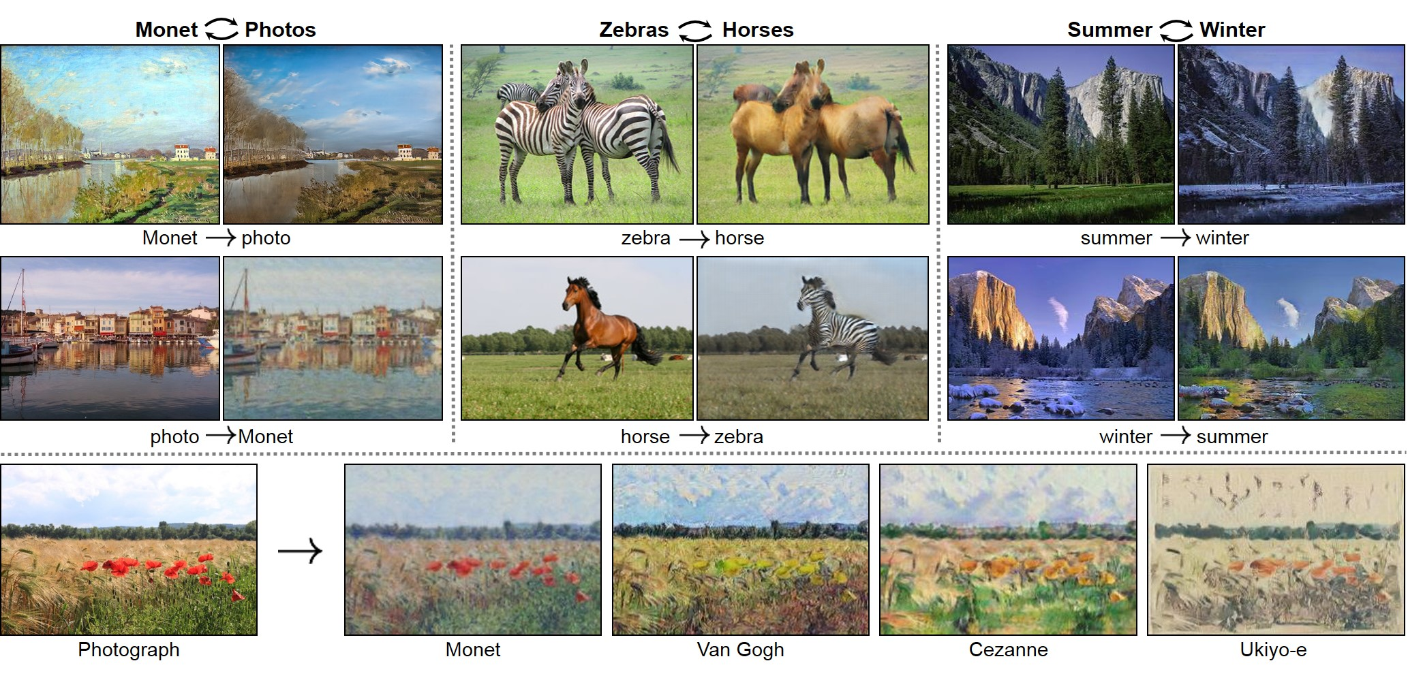
Instance Translation
CycleGAN by Zhu et al. ICCV '17
Slide credit: Yuxiong Wang

Slide 57
Domain Adversarial Training
Proposed by Ganin et al. JMLR '17
Goal: Learn a domain-invariant model
  Model produces features that do not change with domain shift
  Only reflect contents about labels, but not domain characteristics
Slide credit: Yuxiong Wang

Slide 58
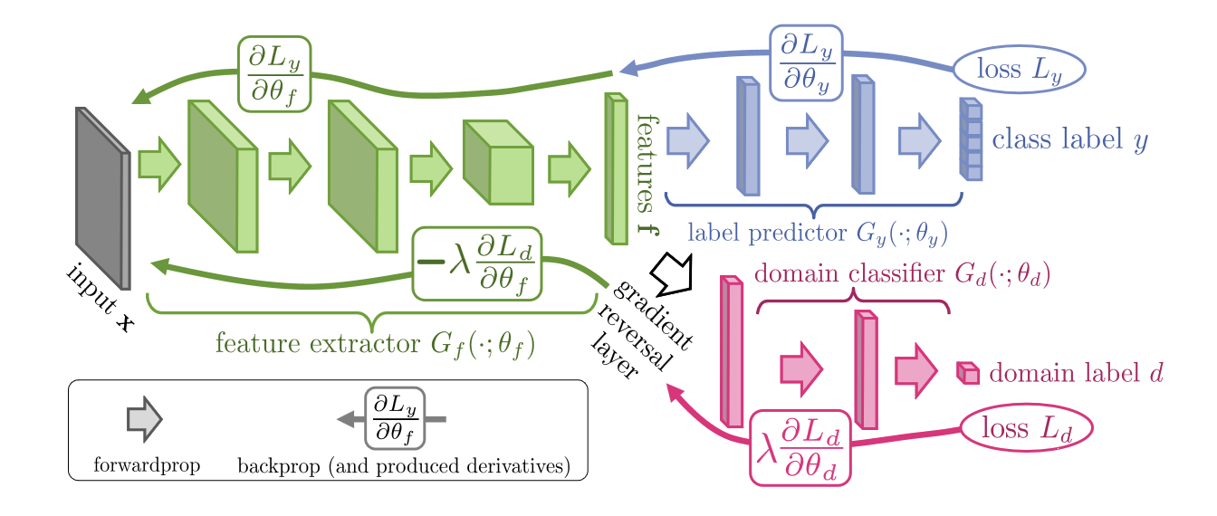
Domain Adversarial Training
Attach a domain classifier network and apply adversarial training
Aim of domain classifier: To distinguish source vs. target domains
Slide credit: Yuxiong Wang

Slide 59
Domain Adversarial Training
Aim of main network: 1) Correctly predict label of source-domain data;
Slide credit: Yuxiong Wang

Slide 60
Domain Adversarial Training
Aim of main network: 1) Correctly predict label of source-domain data; 2) Using features that cannot distinguish between source and target domains
Slide credit: Yuxiong Wang

Slide 61
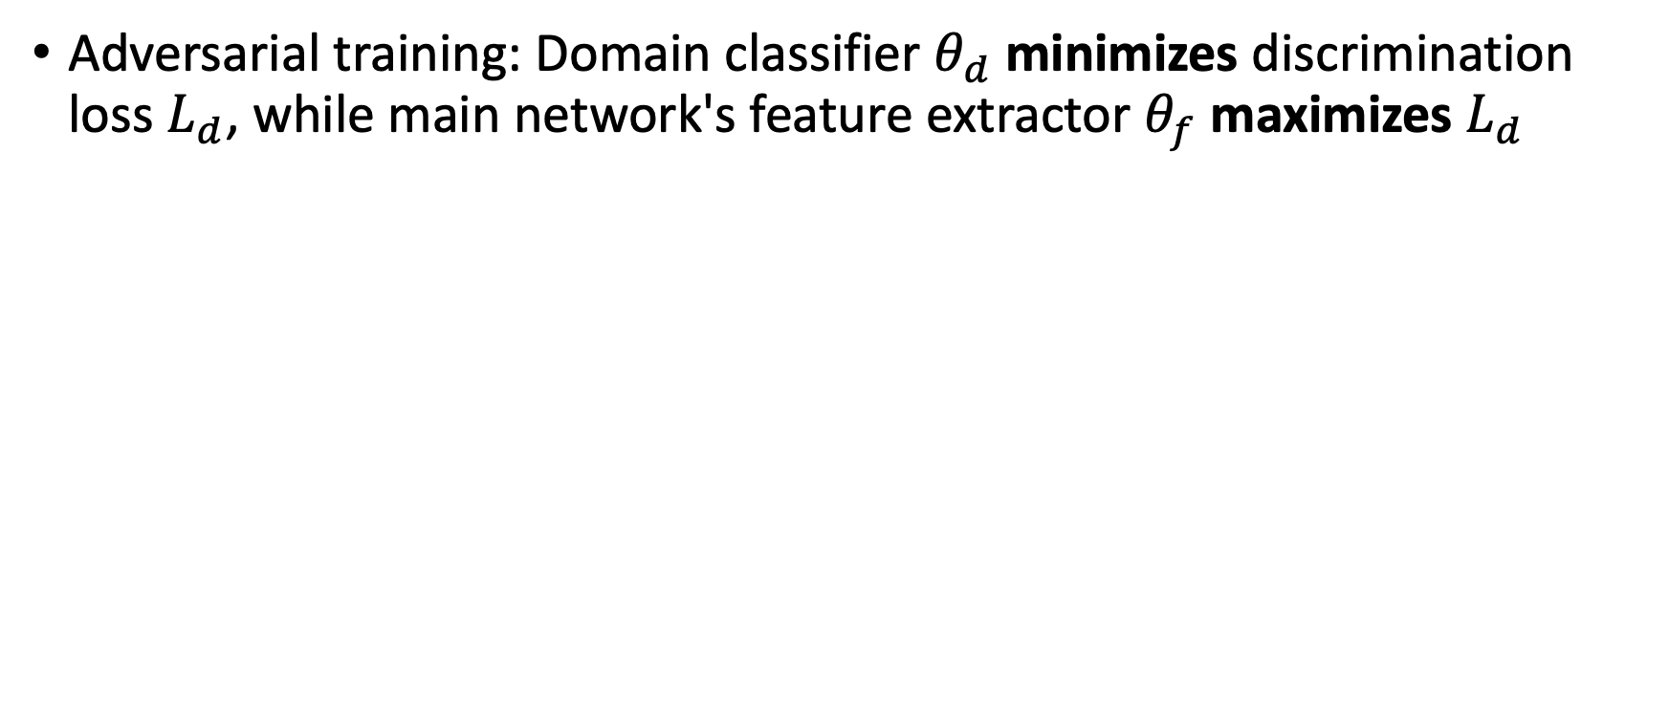
Domain Adversarial Training
Adversarial training: Domain classifier $θ_{d}$ minimizes discrimination loss $L_{d}$, while main network's feature extractor $θ_{f}$ maximizes $L_{d}$
Adversarial training is implemented by reversing gradients here
Slide credit: Yuxiong Wang

Slide 62
Domain Adversarial Training
One mainstream of domain adaptation
  Various follow-up methods study how to better learn domain-invariant models or feature representations
Other ideas (may be combined with domain adversarial training)
  Instance translation
  Pseudo-labeling and self-training
  Domain randomization
Slide credit: Yuxiong Wang

Slide 63
CyCADA: Cycle-Consistent Adversarial Domain Adaptation
Given data and labels in the source domain (e.g. synthetic images), you want to be able to predict labels in the target domain (e.g. real images) for which you have data but no labels
Given pools of source domain (e.g. synthetic
[Hoffman et al. 2018]

Slide 64
Recent Trend in NLP
Large language models (LLM)
  Are trained on massive amounts of text data in an unsupervised
  Can generate high-quality representations of natural language
  Examples: OpenAI's GPT (Generative Pre-trained Transformer), Google's BERT and Facebook's RoBERTa
Slide credit: Yuxiong Wang

Slide 65
How are LLMs applied in various tasks/domains?
Previously
  By adding task-specific layers on top of LLMs and fine-tuning them on labeled data of such tasks
  Examples: Text classification, language translation, question-answering
Slide credit: Yuxiong Wang

Slide 66
How are LLMs applied in various tasks/domains?
Previously
  By adding task-specific layers on top of LLMs and fine-tuning them on labeled data of such tasks
  Examples: Text classification, language translation, question-answering
More recently
  By prompt engineering/tuning, without changing LLM params
  Design a prompt that elicits the desired output from the LLM
  Example (English->French translation):
Translate the following English sentence [sentence input] to French: [model output]
Slide credit: Yuxiong Wang

Slide 67
Overcoming Task/Domain Shift
Task adaptation
  Transfer learning
  Meta-learning
Domain adaptation
  Instance translation
  Domain adversarial training
Task shift
  Changed task objective
Domain shift
  Changed data distribution
More recently for LLMs: Prompt Engineering
Slide credit: Yuxiong Wang

Slide 68
Challenges in Adaptation
Data availability
  Task and domain adaptation often require a large amount of labeled data, which may be costly or even unavailable
Overfitting
  When target task/domain is significantly different from source, or training data are limited, model may overfit to source and cannot generalize well

Slide 69
Challenges in Adaptation
Model complexity
  Recent deep networks have too many parameters and complex architecture, making it difficult to adapt them effectively for a new task or domain
Task complexity
  Many tasks have much more complex objectives than classification, making adaptation techniques not directly applicable

Slide 70
Future Directions
Unsupervised adaptation
  No longer require labels for target task/domain
  Use self-supervision to learn from target data
Source-free adaptation
  No longer require source task/domain data when adapting model
  Generate source-like data or features

Slide 71
Future Directions
Adaptation for dense prediction tasks
  In computer vision: object detection, instance segmentation, etc.
  Involve more prediction modules (e.g., object classification, bounding box regression) into adaptation
Continual adaptation
  Adapt model over time as new data or tasks become available
  Data distribution changes over time in online learning, and model needs to be continuously updated to account for new knowledge

Slide 72
Summary
Task adaptation for changed task objective
  Transfer learning
  Meta-learning
Domain adaptation for changed data distribution
  Instance translation
  Domain adversarial training
Slide credit: Yuxiong Wang

Slide 73
Coming up
Thursday: Ethics and Impact of AI

