Slide 1
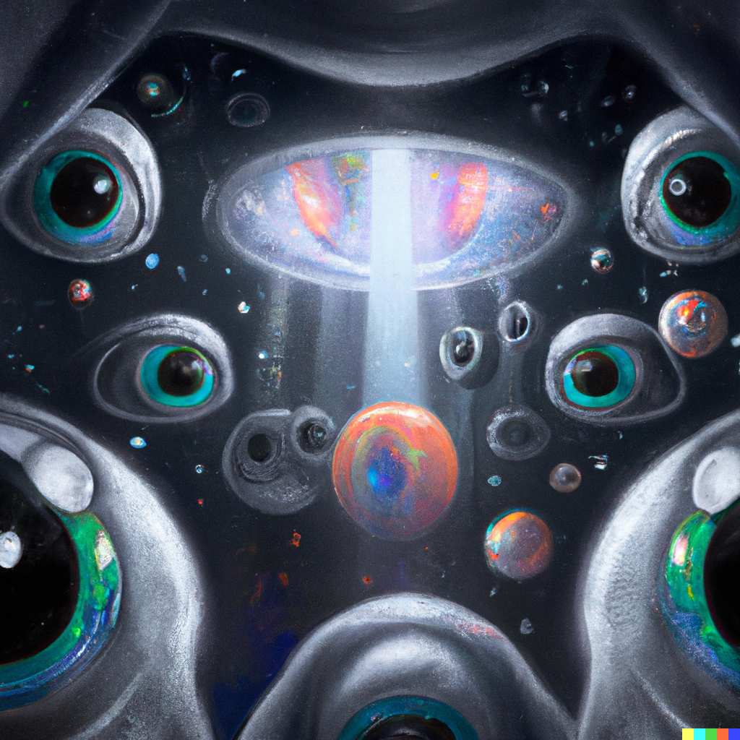
CNNs and Computer Vision
Applied Machine Learning
Derek Hoiem
Dall-E

Slide 2
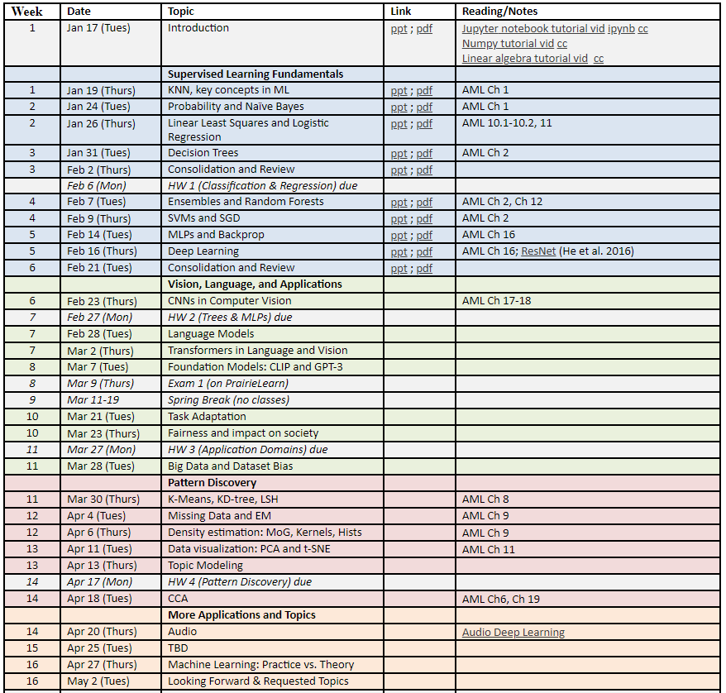
You are here!

Slide 3
Today’s Lecture
ImageNet Challenge Overview
ResNet model in more detail
Adapting a pre-trained network to new tasks
Mask-RCNN line of detection/segmentation
U-Net Architecture

Slide 9
Slide source

Slide 10
2012 ImageNet 1K (Fall 2012)
AlexNet
Slide: Jia-bin Huang

Slide 11
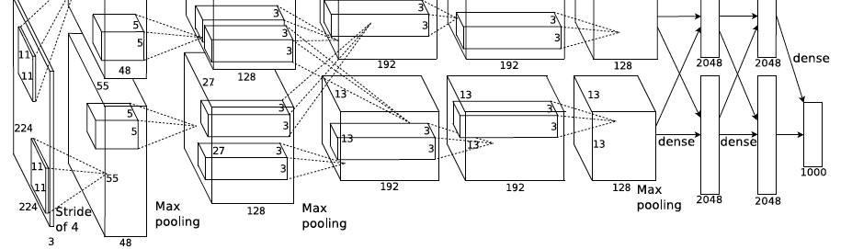
AlexNet: ILSVRC 2012 winner
Similar framework to LeNet but:
  Max pooling, ReLU nonlinearity
  More data and bigger model (7 hidden layers, 650K units, 60M params)
  GPU implementation (50x speedup over CPU)
    Trained on two GPUs for a week
  Dropout regularization
A. Krizhevsky, I. Sutskever, and G. Hinton, ImageNet Classification with Deep Convolutional Neural Networks, NIPS 2012
Notes:
Two-GPU architecture

Slide 12
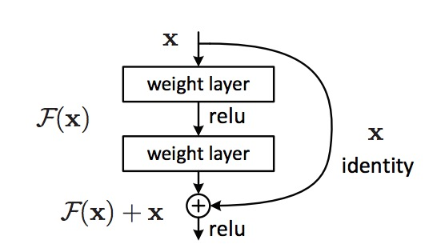
ResNet: the residual module
Use skip or shortcut connections around 2-3 layer MLPs
Gradients can flow quickly back through skip connections
Each module needs only add information to the previous layers
Kaiming He, Xiangyu Zhang, Shaoqing Ren, and Jian Sun, Deep Residual Learning for Image Recognition, CVPR 2016 (Best Paper), 150K+ citations

Slide 13
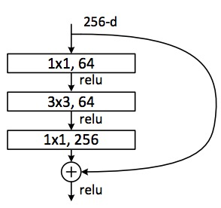
ResNet: Residual Bottleneck Module
Used in 50+ layer networks
  Directly performing 3x3 convolutions with 256 feature maps at input and output:
  256 x 256 x 3 x 3 ~ 600K operations
  Using 1x1 convolutions to reduce 256 to 64 feature maps, followed by 3x3 convolutions, followed by 1x1 convolutions to expand back to 256 maps:
  256 x 64 x 1 x 1 ~ 16K
  64 x 64 x 3 x 3 ~ 36K
  64 x 256 x 1 x 1 ~ 16K
  Total: ~70K
Kaiming He, Xiangyu Zhang, Shaoqing Ren, and Jian Sun, Deep Residual Learning for Image Recognition, CVPR 2016 (Best Paper)
Slide: Lazebnik

Slide 14
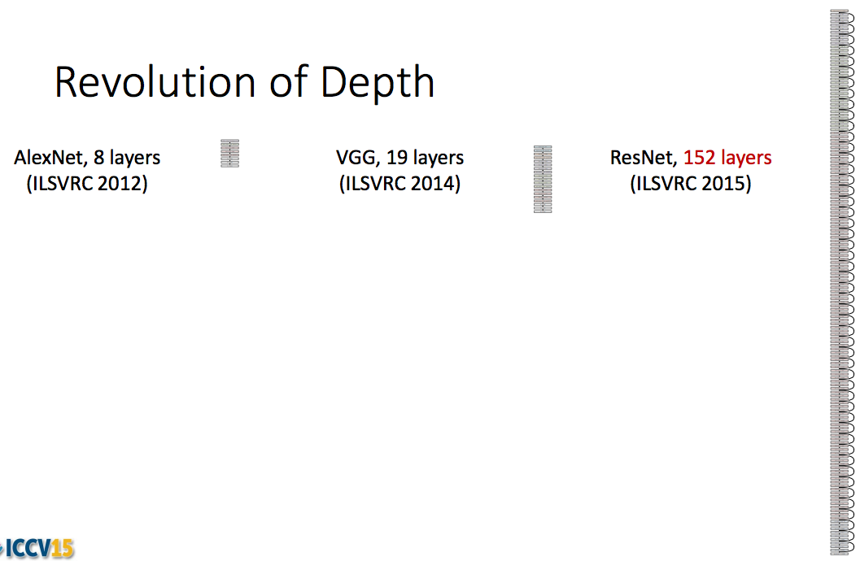
ResNet: going real deep
Despite depth, the residual connections enable error gradients to “skip” all the way back to the beginning
Kaiming He, Xiangyu Zhang, Shaoqing Ren, and Jian Sun, Deep Residual Learning for Image Recognition, CVPR 2016

Slide 15
ResNet CNN Components
Conv2d: learned 2D convolutional filters (same linear weights applied to a patch surrounding each pixel)
BatchNorm2D: Convolutional batch normalization (see next slide)
ReLU: non-linearity with gradient={0,1}
Linear layer: feature projection / final linear classifier

Slide 16
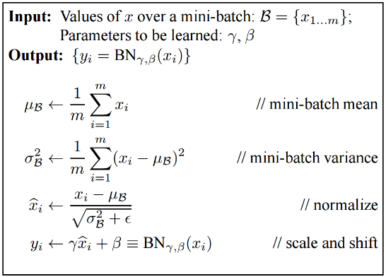
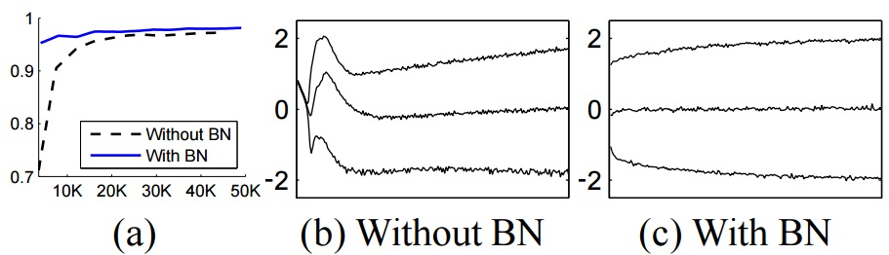
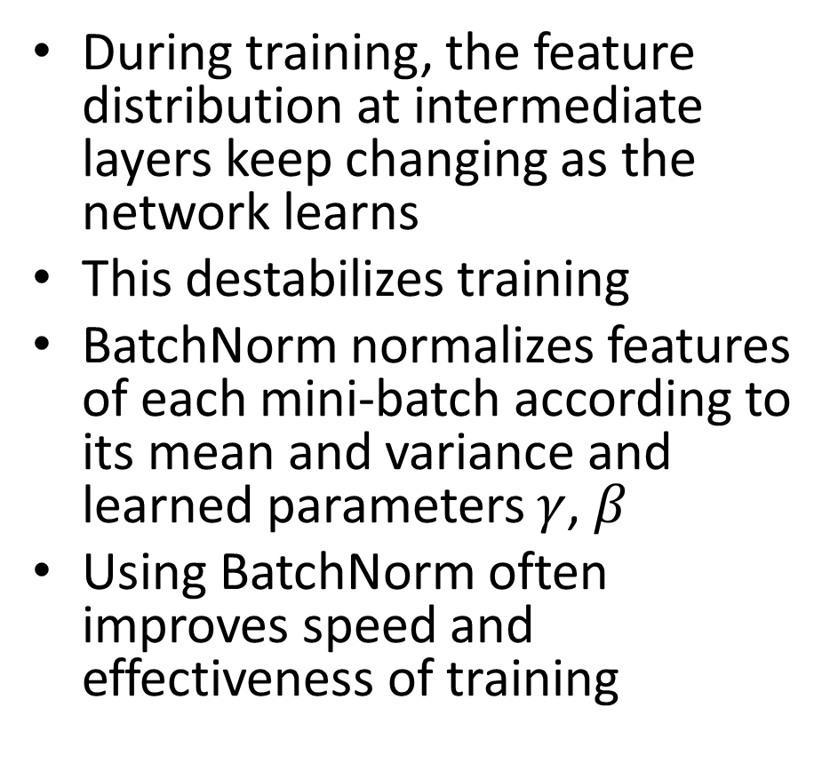
Batch Normalization
During training, the feature distribution at intermediate layers keep changing as the network learns
This destabilizes training
BatchNorm normalizes features of each mini-batch according to its mean and variance and learned parameters $γ$, $β$
Using BatchNorm often improves speed and effectiveness of training
Batch Normalization: Accelerating Deep Network Training by
Reducing Internal Covariate Shift [Ioffe and Szegedy 2015]

Slide 17
Example code: ResBlock
“channels” = # feature maps
kernel_size = filter size, e.g. 3x3
stride = # pixels to skip when evaluating convolution
padding: to calculate filter values near edge of image/map
class ResBlock(nn.Module):
def __init__(self, in_channels, out_channels, downsample):
super().__init__()
if downsample:
self.conv1 = nn.Conv2d(in_channels, out_channels, kernel_size=3, stride=2, padding=1)
self.shortcut = nn.Sequential(
nn.Conv2d(in_channels, out_channels, kernel_size=1, stride=2),
nn.BatchNorm2d(out_channels)
)
else:
self.conv1 = nn.Conv2d(in_channels, out_channels, kernel_size=3, stride=1, padding=1)
self.shortcut = nn.Sequential()
self.conv2 = nn.Conv2d(out_channels, out_channels, kernel_size=3, stride=1, padding=1)
self.bn1 = nn.BatchNorm2d(out_channels)
self.bn2 = nn.BatchNorm2d(out_channels)
def forward(self, input):
shortcut = self.shortcut(input)
input = nn.ReLU()(self.bn1(self.conv1(input)))
input = nn.ReLU()(self.bn2(self.conv2(input)))
input = input + shortcut
return nn.ReLU()(input)
If downsampling, do it here too so dimensions match
This ‘+’ is the skip connection!

Slide 18
Example code: ResNet-18 architecture for ImageNet
class Network(nn.Module):
def __init__(self, num_classes=1000):
super().__init__()
resblock = ResBlock
self.layer0 = nn.Sequential(
nn.Conv2d(3, 64, kernel_size=7, stride=2, padding=3),
nn.MaxPool2d(kernel_size=3, stride=2, padding=1),
nn.BatchNorm2d(64),
nn.ReLU()
)
self.layer1 = nn.Sequential(
resblock(64, 64, downsample=False),
resblock(64, 64, downsample=False)
)
self.layer2 = nn.Sequential(
resblock(64, 128, downsample=True),
resblock(128, 128, downsample=False)
)
self.layer3 = nn.Sequential(
resblock(128, 256, downsample=True),
resblock(256, 256, downsample=False)
)
self.layer4 = nn.Sequential(
resblock(256, 512, downsample=True),
resblock(512, 512, downsample=False)
)
self.gap = torch.nn.AdaptiveAvgPool2d(1)
self.fc = torch.nn.Linear(512, num_classes)
def forward(self, input):
input = self.layer0(input)
input = self.layer1(input)
input = self.layer2(input)
input = self.layer3(input)
input = self.layer4(input)
input = self.gap(input)
input = torch.flatten(input, 1)
input = self.fc(input)
return input
Pretrained Torch models

Slide 19
ResNet Architectures and Results
(vs. 15% top-5 err for AlexNet)

Slide 20
Another common trick: “data augmentation”
Randomly translate, crop, rotate, mirror, shift colors, or overlay images to create more variations
  Apply random transformation to each sample in each batch as it is processed in training
  Simulates a larger training set, and makes it so that the network will learn from variations of the original example in each epoch
Can improve performance, even with fairly large datasets

Slide 21
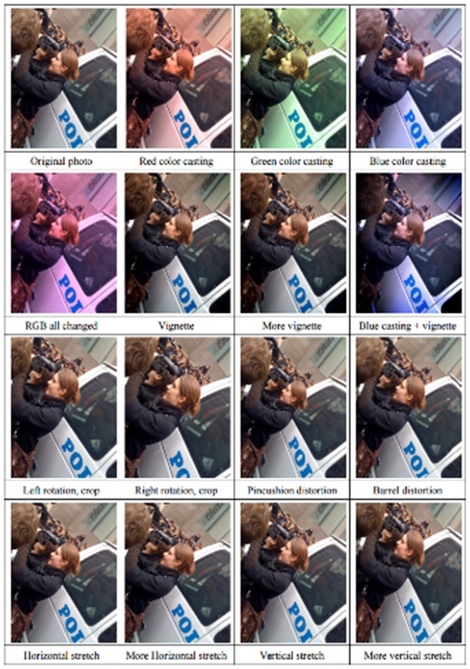
Data Augmentation (Jittering)
Slide: Jiabin Huang
Create virtual training samples
  Horizontal flip
  Random crop
  Color casting
  Geometric distortion
Idea goes back to Pomerleau 1995 at least (neural net for car driving)
Deep Image [Wu et al. 2015]

Slide 22
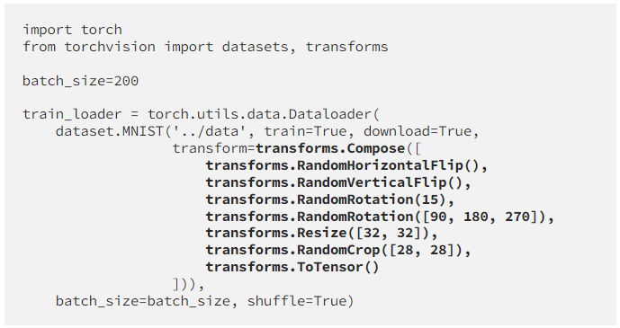
Applying Data Augmentation
Define transformation sequence
Input transform specification to data loader
References:
https://medium.com/dejunhuang/learning-day-23-data-augmentation-in-pytorch-e375e19100c3
https://pytorch.org/vision/main/transforms.html

Slide 23
What if we want to do some new task?
Suppose we’ve trained ImageNet model
But we want to do something else, e.g. classify flowers or dog breeds
We don’t have a huge dataset for that task
ImageNet Trained Model
Encoder
Decoder
Input
Image
Output 1000 Class
Logits
E.g. weights of convolutional layers, trained on ImageNet
E.g. final 1000 class linear layer weights

Slide 24
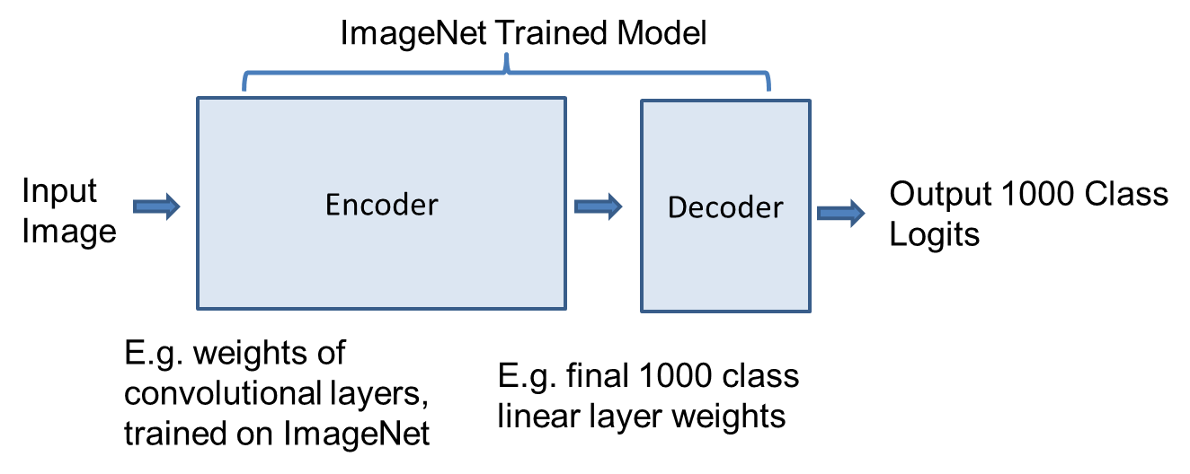
New Task Solution 1: “Linear probe” / “Feature extraction”
Pre-trained Model
Keep original encoder weights. Replace decoder linear layer and train its weights on new task without changing encoder.
Equivalently, extract features from encoder and train linear model on those features
ImageNet Trained Encoder
New Task Decoder
Encoder
(Frozen)
Decoder
(Tuned)
Target Model
Input
Image
Output N_{c} Class
Logits

Slide 25
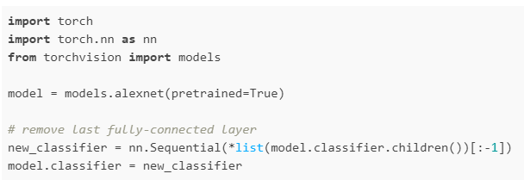
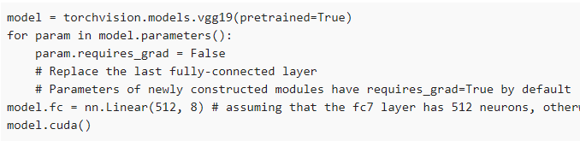
How to apply linear probe
Pre-compute features method
Load pretrained model (many available)
  https://pytorch.org/vision/stable/models.html
Remove prediction final layer
Apply model to each image to get features; save them
Train new linear model (e.g. logistic regression or SVM) on the features
Freeze encoder method
Load pretrained model (many available)
  https://pytorch.org/vision/stable/models.html
Set network to not update weights
Replace last layer
Retrain network with new dataset
- Slower than method on left but does not require storing features, and can apply data augmentation
Source

Slide 26
New Task Solution 2: “Fine-tuning”
Pre-trained Model
Initialize with original encoder weights.
Replace decoder linear layer.
Use 10x smaller learning rate than normal and train
New Task Encoder
New Task Decoder
Encoder
(Fine-tuned)
Decoder
(Tuned)
Target Model
Input
Image
Output N_{c} Class
Logits

Slide 27

How to apply fine-tuning
Load pre-trained model
Replace last layer
Set a low learning rate (e.g. lr=e-4)
  Learning rate is often at least 10x lower than for “scratch” training
  Can “warm start” by freezing earlier layers initially and then unfreezing after a few epochs when the linear layer is mostly trained (avoids messing up encoder while classifier is adjusting)
  Can set lower learning rate for earlier layers
Assumes last layer has 512 features and is called “fc”
Other examples of layer customization (from Weijie)

Slide 28
Task transfer vs. # target task examples
Green: Train from scratch
Blue: Linear Probe from ImageNet
Purple: Fine-tune from ImageNet
ResNet18, Err vs # examples / class (in paren)
“Learning Curves” (2021) pdf

Slide 29
2 Minute Break
Comparing linear probe, fine-tuning, and training from scratch, when does each have an advantage and why?

Slide 30

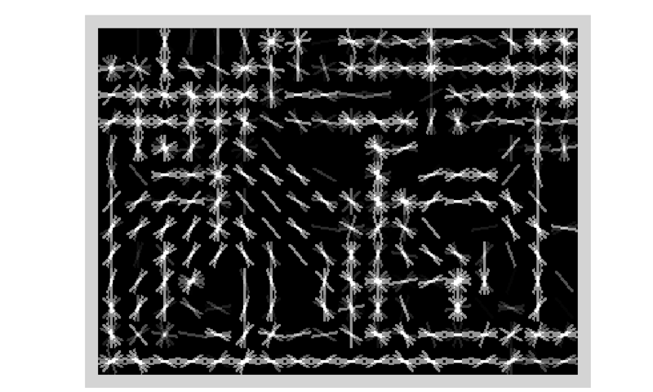
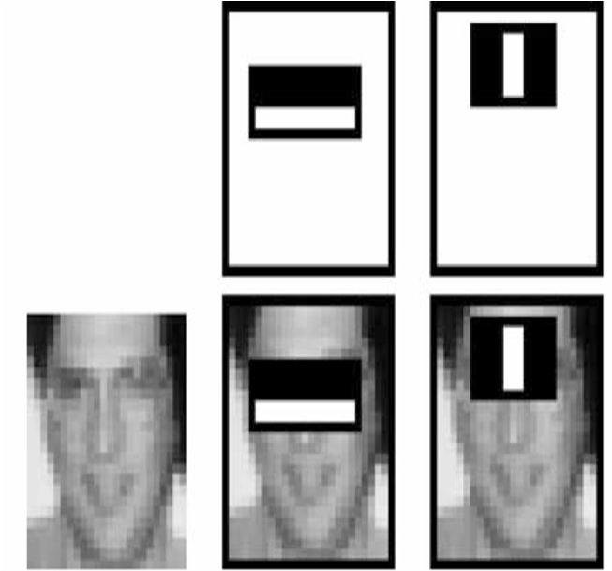
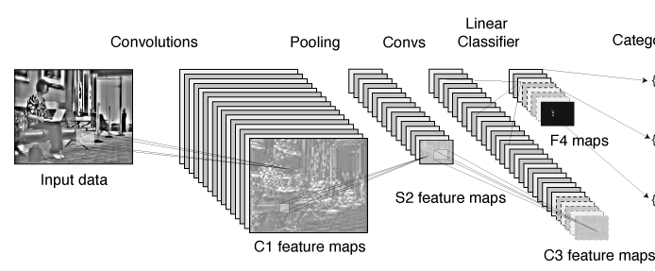
Statistical template approach to object detection
Propose Window
Extract Features
Classify
Post-process
SVM
Boosted stubs
Neural network
Non-max suppression
Segment or refine localization
HOG
Sliding window: scan image pyramid
Fast randomized features
Region proposals: edge/region-based, resize to fixed window
CNN features

Slide 31
R-CNN (Girshick et al. CVPR 2014)
Extract regions using Selective Search method (Uijilings et al. IJCV 2013)
Extract rectangles around regions and resize to 227x227
Extract features with fine-tuned CNN (that was initialized with network trained on ImageNet before training)
Classify last layer of network features with SVM
http://arxiv.org/pdf/1311.2524.pdf

Slide 32
CNN (Deep Learning) for Classification
Operations
  Convolution with learned filters, ReLU
    Note: after first layer, filters operate on high dimensional feature maps, not intensities
  Spatial pooling and downsample 2x
  “Bottlenecks” to limit parameters
  “Skip connections” to simplify optimization, enable ensemble behavior
  Classification (with multilabel or softmax loss)
Tricks to train
  Pretrain
  Batchnorm
  ADAM / momentum / Ranger
  Data augmentation
  Set parameters appropriately (weight initialization, learning rate schedule, momentum, weight decay)
Each filter: 3x3x512
Final feature map: 7x7x512
Fig: Deep Residual Learning for Image Recognition
He et al. CVPR 2006
Notes:
Go through this slowly. Make sure to emphasize that convolutional layers operate on high dimensional feature maps, and that the feature maps eventually get very low res, so they are kind of like a spatial pyramids model

Slide 33
Fine-tuning: ImageNet->VOC
Train full network on ImageNet 1000-class classification
Replace classification layer with output layer for VOC (e.g. confidences for 20 classes)
Train on VOC pos/neg examples with low initial learning rate (1/10th what is used for new network)
Notes
This usually works well if the “big data” task and target task are similar (object classification vs detection)
  0.45 AP without fine-tuning → 0.54 AP with fine tuning; training only on VOC does much worse
May not be necessary if target task is also very big

Slide 34
Fast R-CNN – Girshick 2015
Compute CNN features for image once
ROI Pooling: Pool into 7x7 spatial bins for each region proposal, output class scores and regressed bboxes
Other refinements: compress classification layer, use network for final classification, end-to-end training
100x speed up of R-CNN (0.02 – 0.1 FPS → 0.5-20 FPS) with similar accuracy

Slide 35
Faster R-CNN – Ren et al. 2016
Convolutional features used for generating proposals and scoring
  Generate proposals with “objectness” scores and refined bboxes for each of k “anchors”
  Score proposals in same way as Fast R-CNN
Similar accuracy to Fast R-CNN with 10x speedup

Slide 36
Faster R-CNN slightly better accuracy than Fast R-CNN
More data improves results considerably

Slide 37
Mask R-CNN – He Gxioxari Dollar Girshick (2017)
Same network as Faster R-CNN, except
  Bilinearly interpolate when extracting 7x7 cells of ROI features for better alignment of features to image
  Instance segmentation: produce a 28x28 mask for each object category
  Keypoint prediction: produce a 56x56 mask for each keypoint (aim is to label single pixel as correct keypoint)
Example ROI and predicted mask
Example ROI and predicted mask and keypoints

Slide 38
Top performing object detector, keypoint segmenter, instance segmenter (at time of release and for a bit after)

Slide 39
Example detections and instance segmentations

Slide 40
Example detections and instance segmentations

Slide 41
Example keypoint detections

Slide 42
What does the CNN learn?

Slide 43
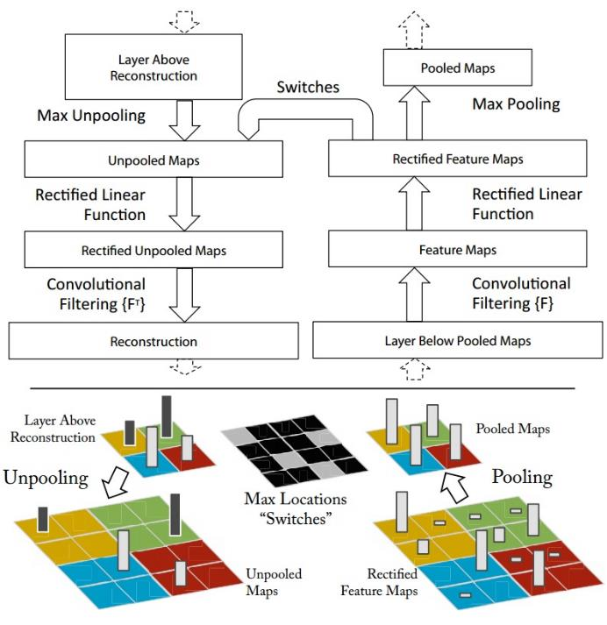
Map activation back to the input pixel space
What input pattern originally caused a given activation in the feature maps?
Visualizing and Understanding Convolutional Networks [Zeiler and Fergus, ECCV 2014]

Slide 44
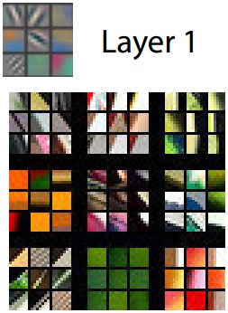
Layer 1 (visualization of randomly sampled features)
Activations (which pixels caused the feature to have a high magnitude)
Image patches that had high activations
Visualizing and Understanding Convolutional Networks [Zeiler and Fergus, ECCV 2014]

Slide 45
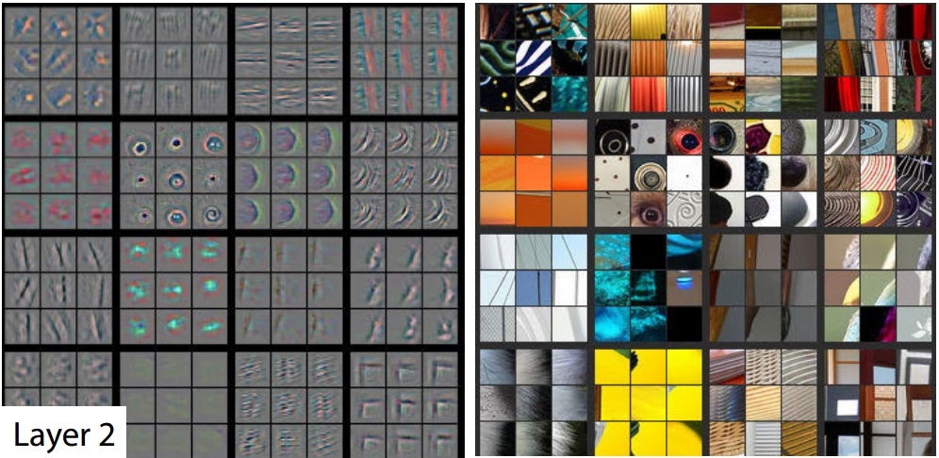
Layer 2
Visualizing and Understanding Convolutional Networks [Zeiler and Fergus, ECCV 2014]

Slide 46
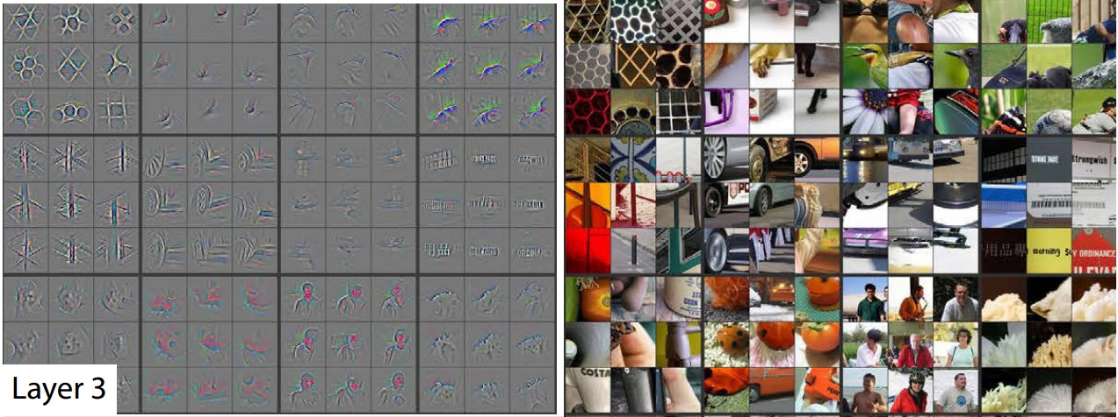
Layer 3
Visualizing and Understanding Convolutional Networks [Zeiler and Fergus, ECCV 2014]

Slide 47
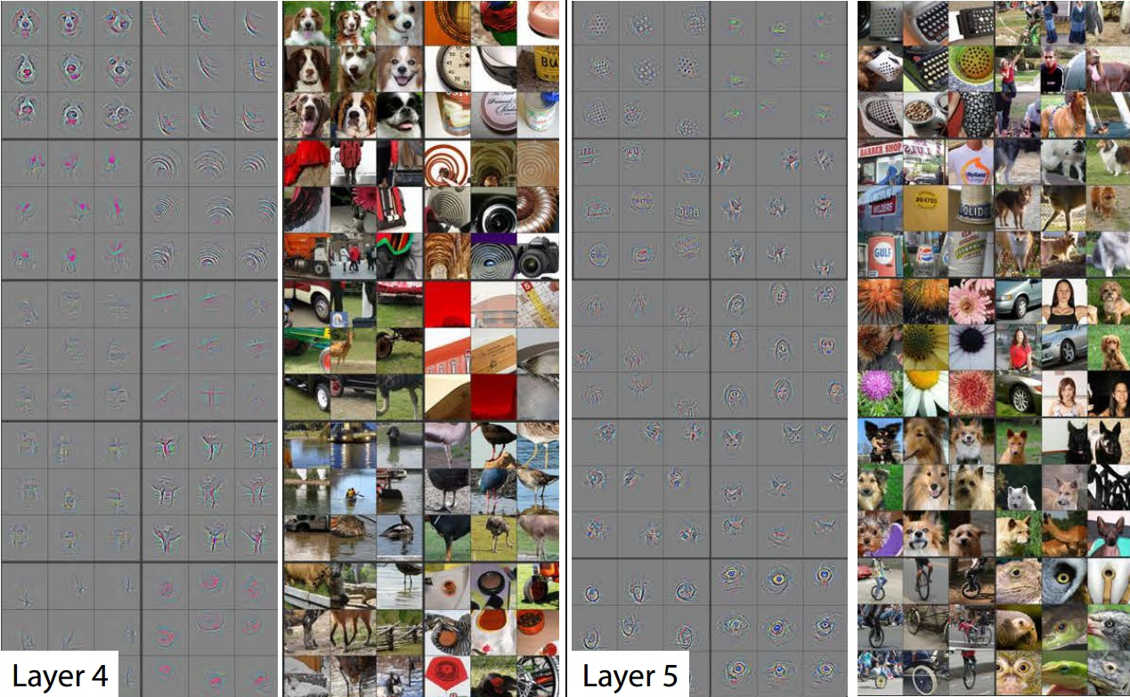
Layer 4 and 5
Visualizing and Understanding Convolutional Networks [Zeiler and Fergus, ECCV 2014]

Slide 48
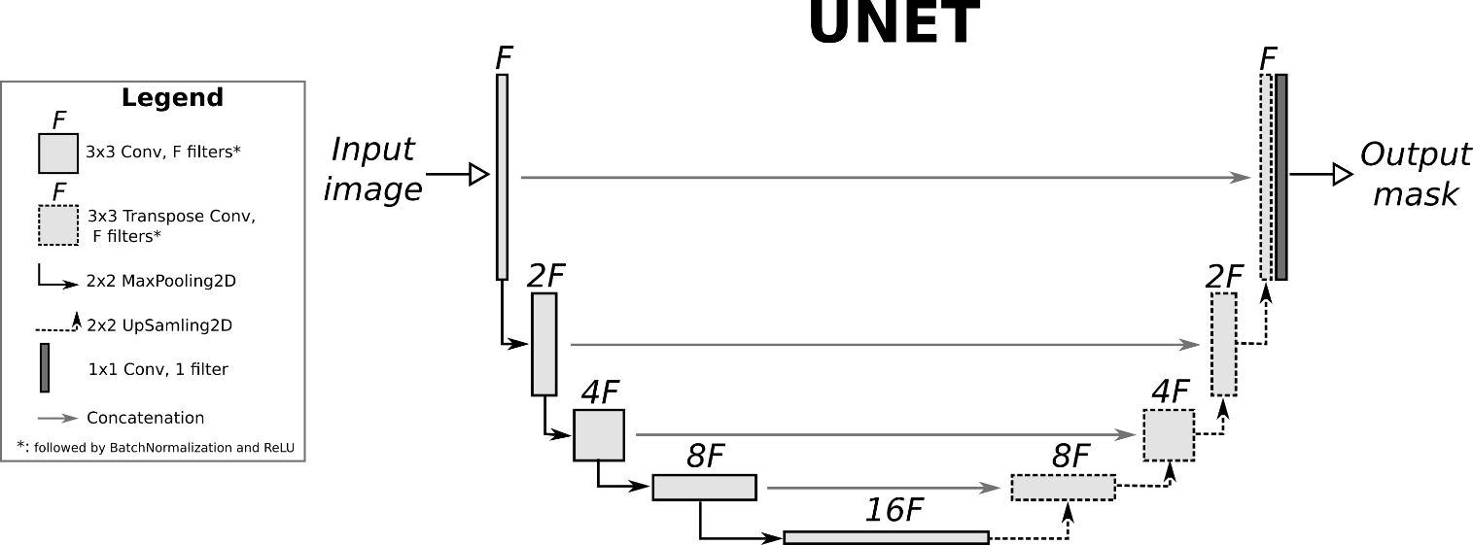
U-Net Architecture
O. Ronneberger, P. Fischer, and T. Brox. U-net: Convolutional
networks for biomedical image segmentation. In MICCAI, 2015.
The “U-Net” is an encoder-decoder with skip connections between mirrored layers in the encoder and decoder stacks.
U-Net style architectures are used to generate pixel maps (e.g., RGB images or per-pixel labels)
Fig from Isola et al. 2017
Fig src

Slide 49
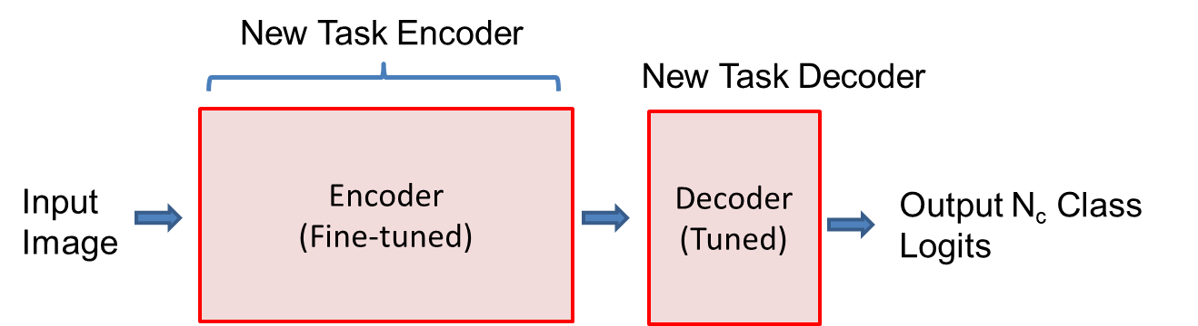
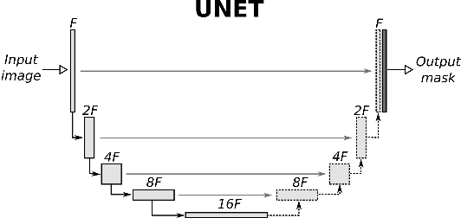
Things to remember
Massive ImageNet dataset was an ingredient to deep learning breakthrough
Skip connections, data augmentation, and batch normalization are commonly used techniques
Models trained on ImageNet are used as pretrained “backbones” for other vision tasks
Mask-RCNN samples patches in feature maps and predicts boxes, object region, and keypoints
Many image generation and segmentation methods are based on U-Net downsamples while deepening features, then upsamples with skip connections

