Slide 1
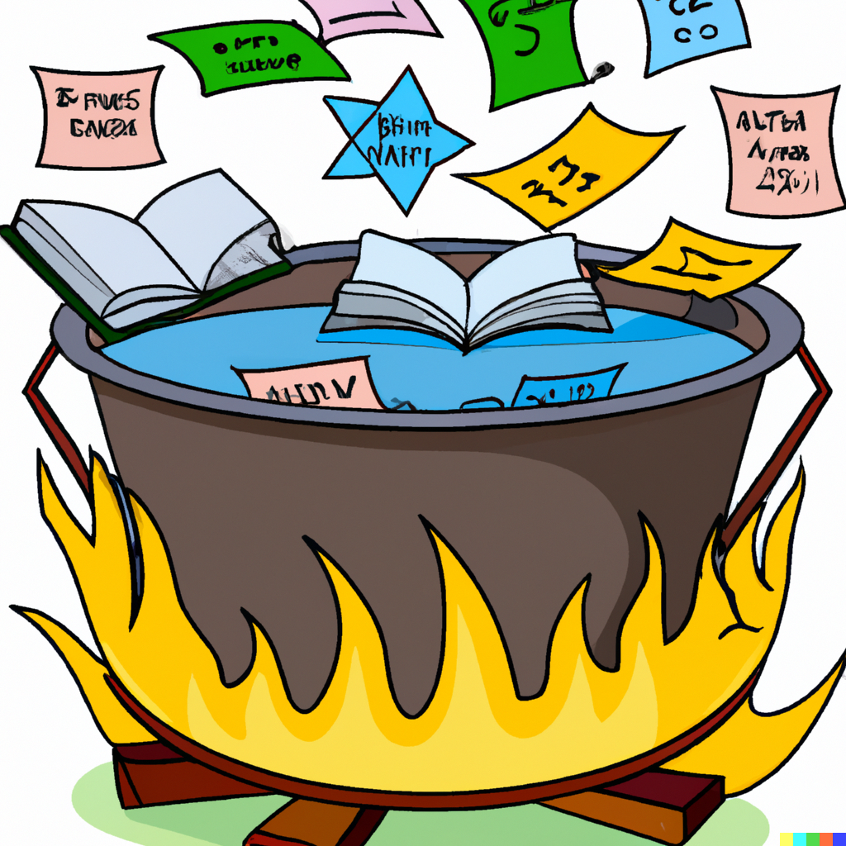
Consolidation and Review
Applied Machine Learning
Derek Hoiem
Dall-E: A cauldron full of books and math equations and plots in a fire, cartoon style

Slide 2
Training (Parameter Learning)
Target Labels
Model
Raw Features
Encoder
Decoder
Prediction
Discrete/continuous values
Images
Text
Images
Audio
Structured/unstructured
Few/many features
Clean/noisy labels
Trees
Feature selection
Manual feature design
Deep networks
Clustering
Kernels
Density estimation
Linear regressor
Logistic regressor
Nearest Neighbor
Probabilistic model
SVM
Category
Continuous value
Clusters
Low dimensional embedding
Pixel labels
Generated text, image, audio
Positions

Slide 3
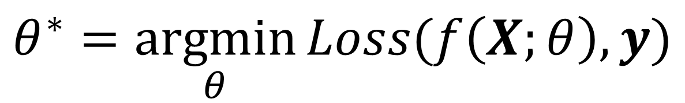
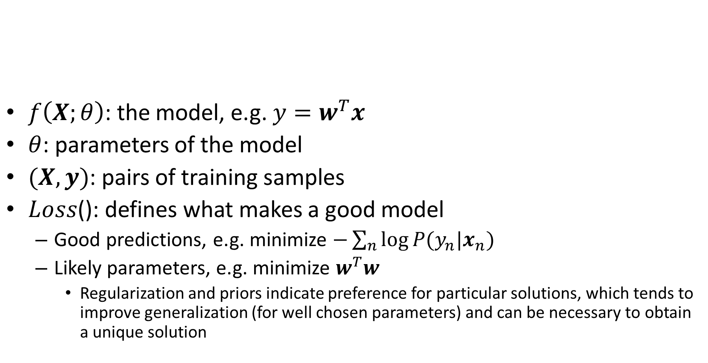
Learning a model
$f\left(X;θ\right)$: the model, e.g. ${y=w}^{T}x$
$θ$: parameters of the model
$(X, y)$: pairs of training samples
$Loss$(): defines what makes a good model
  Good predictions, e.g. minimize $−\sum_{n}{log⁡P(y_{n}|x_{n})}$
  Likely parameters, e.g. minimize $w^{T}w$
    Regularization and priors indicate preference for particular solutions, which tends to improve generalization (for well chosen parameters) and can be necessary to obtain a unique solution
$$θ^{∗}=\underset{θ}{argmin}{Loss(f\left(X;θ\right),y)}$$

Slide 4
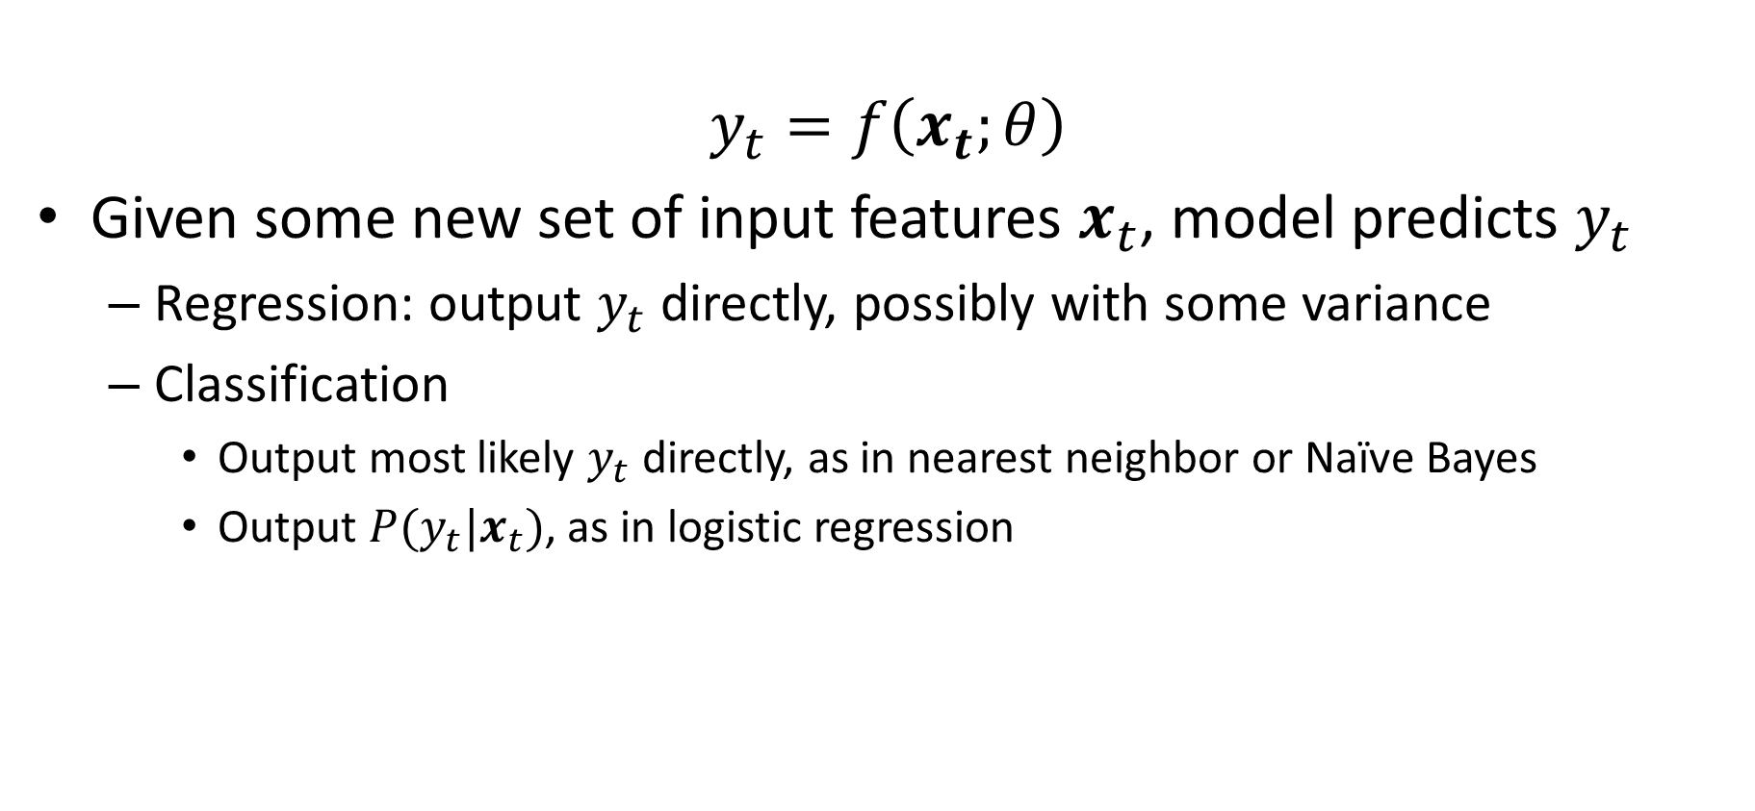
Prediction using a model
$$y_{t}=f\left(x_{t};θ\right)$$
Given some new set of input features $x_{t}$, model predicts $y_{t}$
  Regression: output $y_{t}$ directly, possibly with some variance
  Classification
    Output most likely $y_{t}$ directly, as in nearest neighbor or Naïve Bayes
    Output $P(y_{t}|x_{t})$, as in logistic regression

Slide 5
Model evaluation process
Collect/define training, validation, and test sets
Decide on some candidate models and parameters
For each candidate:
  Learn parameters with training set
  Evaluate trained model on the validation set
Select best model
Evaluate best model’s performance on the test set
  Cross-validation can be used as an alternative
  Common measures include error or accuracy, root mean squared error, precision-recall

Slide 6
How to think about ML algorithms
What is the model?
  What kinds of functions can it represent?
  What functions does it prefer? (regularization/prior)
What is the objective function?
  What “values” are implied?
  Note that the objective function often does not match the final evaluation metric
  Objectives are designed to be optimizable and improve generalization
How do I optimize the model?
  How long does it take to train, and how does it depend on the amount of training data or number of features?
  Can I reach a global optimum?
How does the prediction work?
  How fast can I make a prediction for a new sample?
  Can I find the most likely prediction according to my model?
  Does my algorithm provide a confidence on its prediction?

Slide 7
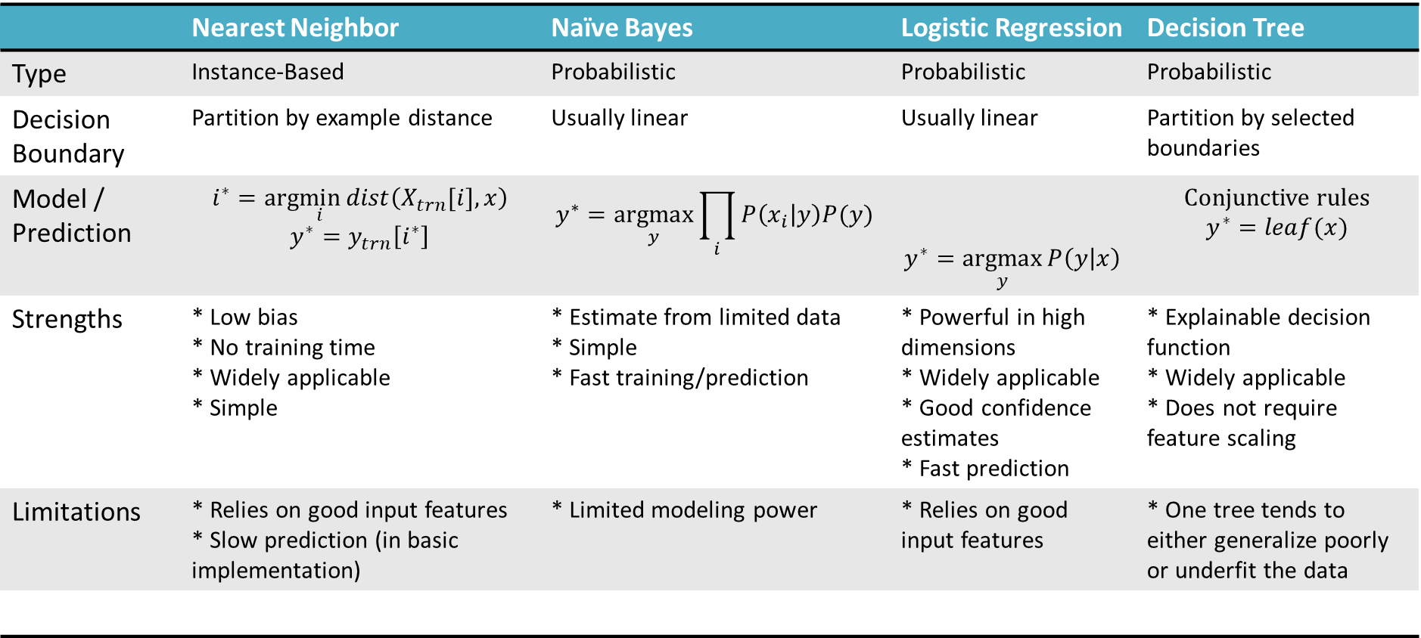
Classification methods
 | Nearest Neighbor | Naïve Bayes | Logistic Regression | Decision Tree
Type | Instance-Based | Probabilistic | Probabilistic | Probabilistic
Decision Boundary | Partition by example distance | Usually linear | Usually linear | Partition by selected boundaries
Model / Prediction | $$i^{∗}=arg\min_{i}{dist\left(X_{trn}[i],x\right)}$$ $$y^{∗}=y_{trn}\left[i^{∗}\right]$$ | $$y^{∗}=\underset{y}{argmax}{\prod_{i}{P\left(x_{i} | y\right)P(y)}}$$ | $$y^{∗}=\underset{y}{argmax}{P\left(y | x\right)}$$ | Conjunctive rules $$y^{∗}=leaf(x)$$
Strengths | * Low bias * No training time * Widely applicable * Simple | * Estimate from limited data * Simple * Fast training/prediction | * Powerful in high dimensions * Widely applicable * Good confidence estimates * Fast prediction | * Explainable decision function * Widely applicable * Does not require feature scaling
Limitations | * Relies on good input features * Slow prediction (in basic implementation) | * Limited modeling power | * Relies on good input features | * One tree tends to either generalize poorly or underfit the data

Slide 8
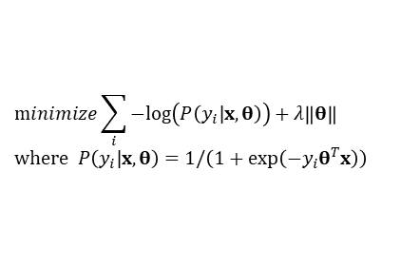
Classification methods (extended)
assuming x in {0 1}
Learning Objective
Training
Inference
Naïve Bayes
Logistic Regression
$$\operatorname{minimize}{\sum_{i}{−log\left(P\left(y_{i}|x,θ\right)\right)}}+λ\left\|θ\right\| \\ \text{where} P\left(y_{i}|x,θ\right)=1/\left(1+\exp\left(−y_{i}θ^{T}x\right)\right)$$
Gradient descent
Linear SVM
Quadratic programming or subgradient opt.
Kernelized SVM
complicated to write
Quadratic programming
Nearest Neighbor
most similar features → same label
Record data
* Notation may differ from previous slide

Slide 9
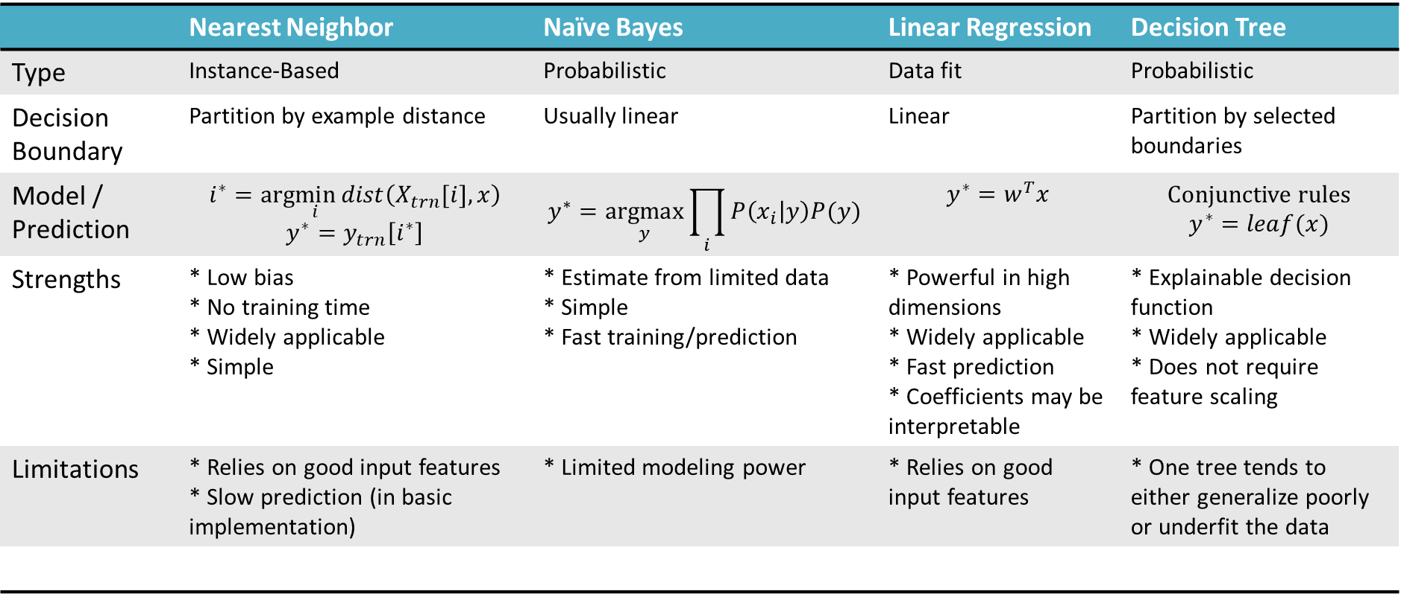
Regression methods
 | Nearest Neighbor | Naïve Bayes | Linear Regression | Decision Tree
Type | Instance-Based | Probabilistic | Data fit | Probabilistic
Decision Boundary | Partition by example distance | Usually linear | Linear | Partition by selected boundaries
Model / Prediction | $$i^{∗}=arg\min_{i}{dist\left(X_{trn}[i],x\right)}$$ $$y^{∗}=y_{trn}\left[i^{∗}\right]$$ | $$y^{∗}=\underset{y}{argmax}{\prod_{i}{P\left(x_{i} | y\right)P(y)}}$$ | $$y^{∗}=w^{T}x$$ | Conjunctive rules $$y^{∗}=leaf(x)$$
Strengths | * Low bias * No training time * Widely applicable * Simple | * Estimate from limited data * Simple * Fast training/prediction | * Powerful in high dimensions * Widely applicable * Fast prediction * Coefficients may be interpretable | * Explainable decision function * Widely applicable * Does not require feature scaling
Limitations | * Relies on good input features * Slow prediction (in basic implementation) | * Limited modeling power | * Relies on good input features | * One tree tends to either generalize poorly or underfit the data

Slide 10
Performance vs training size
As we get more training data:
  The same model has more difficulty fitting the data
  But the test error becomes closer to training error (reduced generalization error)
  Overall test performance improves
Fixed model
Due to limited training data (model variance) and distribution shift
Testing
Error
Test error with infinite training examples
Due to difference in P(y|x) in training and test (function shift)
Train error with infinite training examples
Training
Number of Training Examples
Due to limited power of model (model bias) and unavoidable intrinsic error (Bayes optimal error)

Slide 11
Example: Breast Cancer Classification
Motivation
  Breast cancer diagnosis from fine needle aspirates (FNA) is reported to be 94%, but results are suspected to be biased
  Need computer-based tests that are less subjective so that FNA is a more effective diagnostic tool for breast cancer
Collected data from 569 patients, plus 54 for held-out testing
A user interface was created to outline borders of suspect cells, and automated measurement of ten characteristics (e.g. radius, area, compactness, …) was performed and mean of all cells, mean of 3 largest, and std were recorded for each patient
[paper (Wolberg et al. 1995)]

Slide 12
Let’s explore in Python
https://colab.research.google.com/drive/1viVU62gk77THZBFuztWjxgL93xMMpiU0?usp=sharing

Slide 13
Method/Results from Breast Cancer Analysis Paper
A MSM-Tree was used for classification
  Fits a linear classifier based on a few features for each split
  Aimed to minimize the number of splitting planes and number of features used (for simplicity and to improve generalization)
  Final approach was splitting plane based on mean texture, worst area, and worst smoothness
10-fold cross validatdion
  Achieved 3% error (+- 1.5% for 95% confidence interval)
Perfect accuracy in held out test set

Slide 14
Next week
Ensembles: model averaging and forests
SVM and stochastic gradient descent

