Slide 1
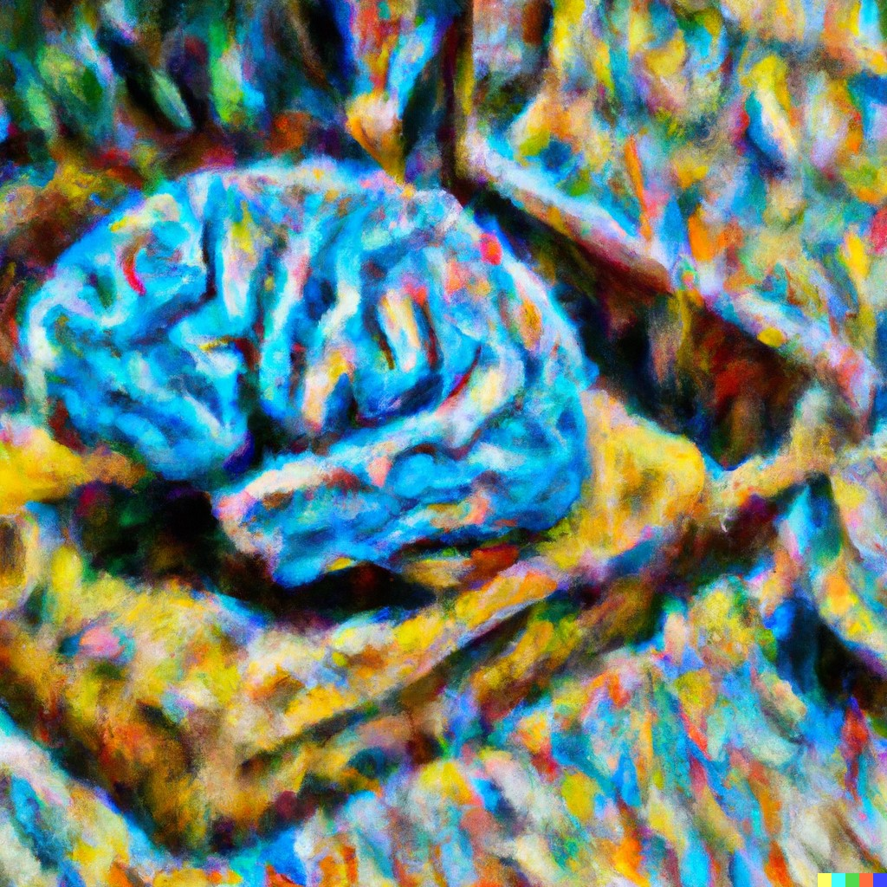
CS441 Applied Machine Learning
Instructor: Derek Hoiem
Art by Dall-E: “Computer brain gathering knowledge, impressionist”

Slide 2
Today’s Class
A little about me
Intro to Applied Machine Learning
Course outline and logistics

Slide 3
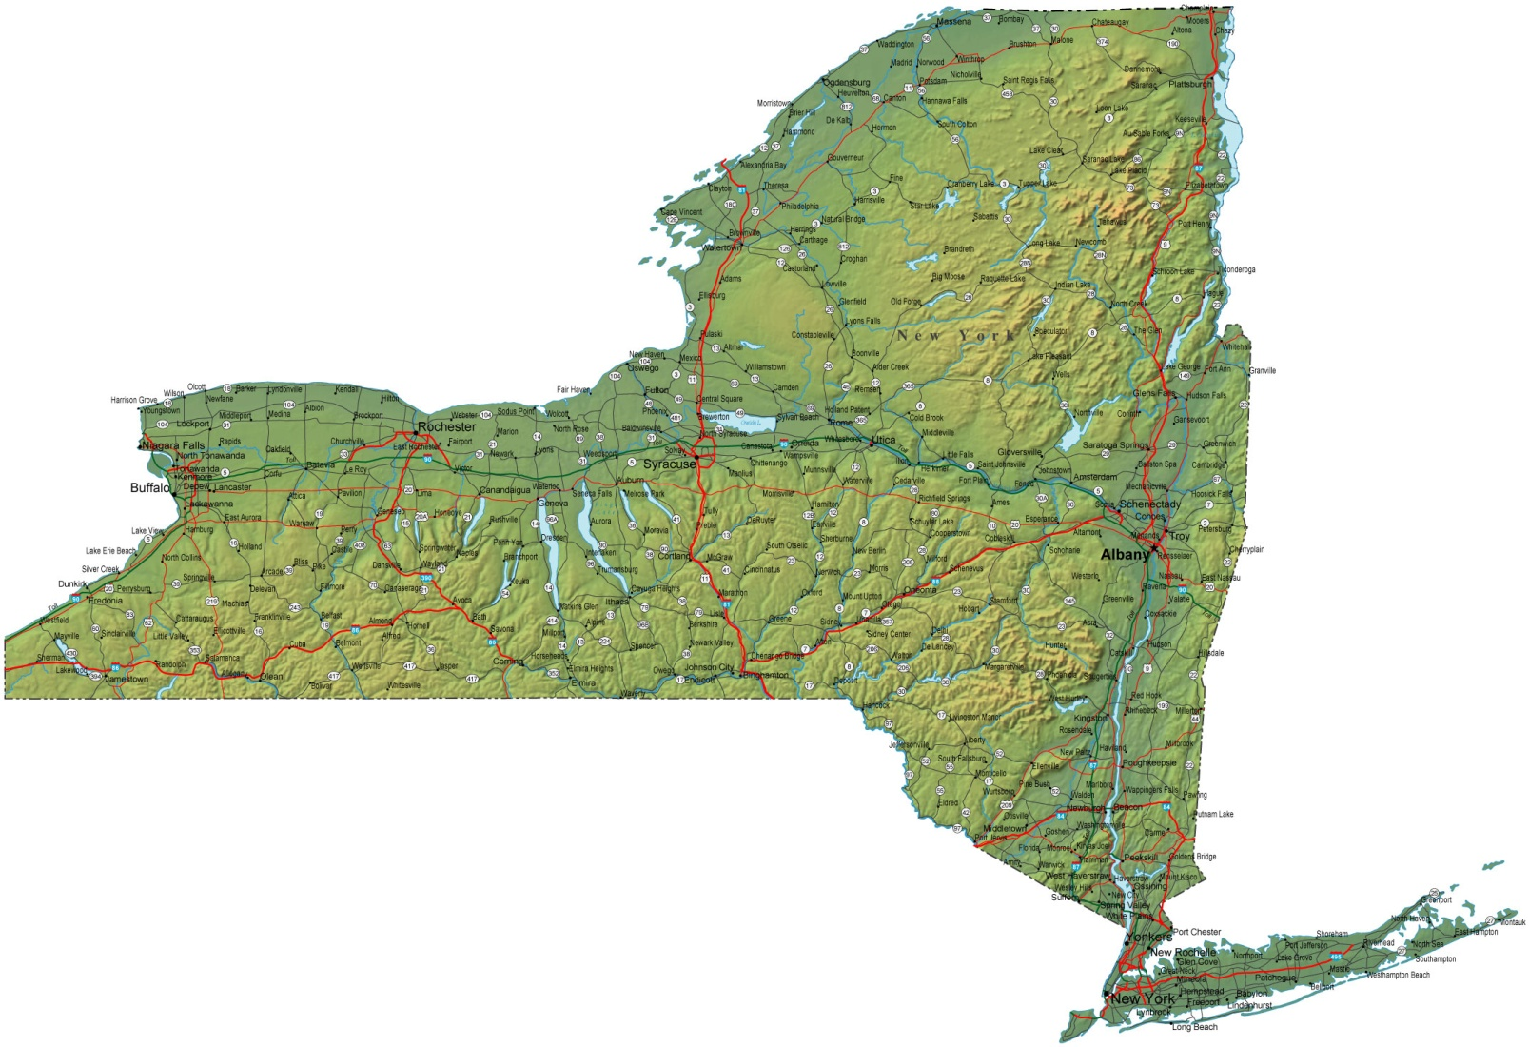
About me
Raised in “upstate” NY

Slide 4
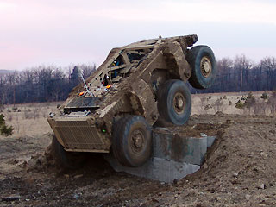
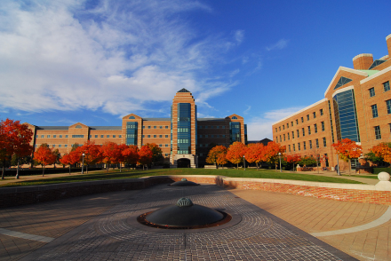
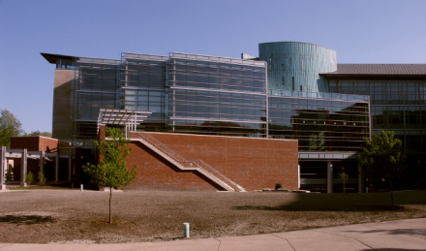
About me
1998-2002
Undergrad at SUNY Buffalo
B.S., EE and CSE
2002-2007
Grad at Carnegie Mellon
Ph.D. in Robotics
2007-2008
Postdoc at Beckman Institute
2009-
Prof in CS at UIUC

Slide 5
My research
Hoiem et al. 2005

Slide 6
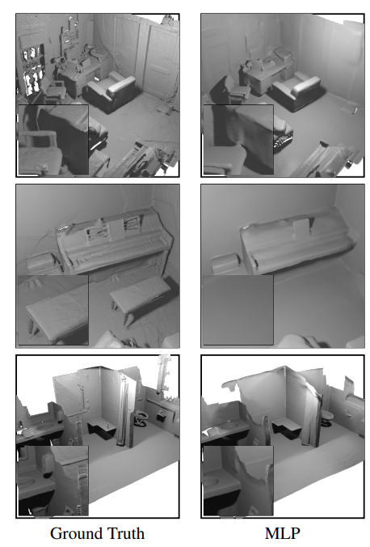
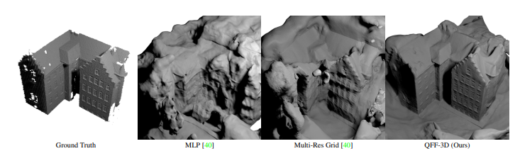
Neural Radiance Fields: use deep networks to model 3D scenes
Lee et al. 2022

Slide 7
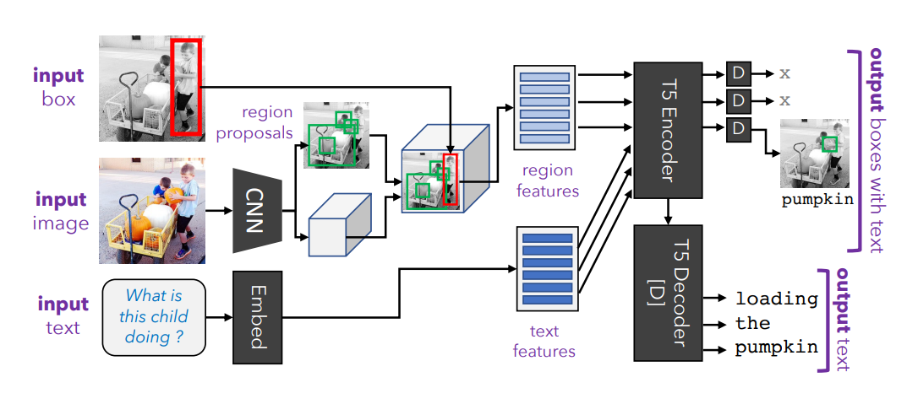
General Purpose Learners
Kamath et al. 2022

Slide 8
Other examples of my research that use machine learning
Vision
Object detection
Image classification
Photo album organization
Image retrieval
Describing objects
3D scene modeling
3D object modeling
Robot navigation
Shadow detection and removal
Generating animations
Vision and Language
Visual question answering
Phrase grounding
Video analysis
General purpose vision-language
Audio
Sound detection
Music identification

Slide 9
Reconstruct: vision for construction
Crunchbase top 50 global startups
https://vimeo.com/242479887
https://www.reconstructinc.com/

Slide 10
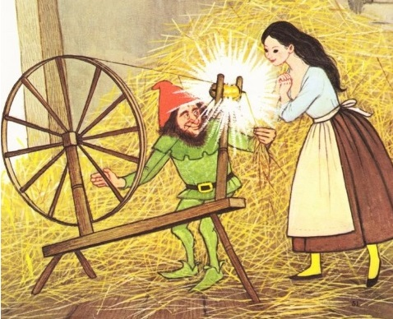
What is machine learning?
Create predictive models or useful insights from raw data
Alexa speech recognition
Amazon product recommendations
Tesla autopilot
GPT-3 text generation
Image generation
Data visualization
Data
Algorithm
ML spins raw data into gold!

Slide 11
The whole machine learning problem
Data preparation
Collect and curate data
Annotate the data (for supervised problems)
Split your data into train, validation, and test sets
Algorithm and model development
Design methods to extract features from the data
Design a machine learning model and identify key parameters and loss
Train, select parameters, and evaluate your designs using the validation set
Final evaluation using the test set
Integrate into your application
Example: voice recognition in Alexa
Our focus, but it’s important to understand all of it

Slide 12
Algorithm and model development
Target Labels
Loss / Feedback
Loss / Feedback
Raw Data
Encoder
Decoder
Prediction
Text
Images
Audio
Discrete/continuous values
Structured/unstructured
Few/many examples
Few/many features
Clean/noisy labels
Manual feature design
Deep networks
Trees
Clustering
Feature selection
Kernels
Density estimation
Linear regressor
SVN
Logistic regressor
Nearest Neighbor
Probabilistic model
Clusters
Low dimensional embedding
Category
Pixel labels
Generated text, image, audio
Positions
Yes/No

Slide 13
Course objectives
Learn how to solve problems with ML
Key concepts and methodologies for learning from data
Algorithms and their strengths and limitations
Domain-specific representations
Ability to select the right tools for the job
The global machine learning market is expected to grow from $21.17 billion in 2022 to $209.91 billion by 2029, at a CAGR of 38.8%. With the field growing at such an exponential rate the number of jobs is growing too and machine learning is one of the most trending career paths of today. - Emeritus

Slide 14
2. Better understanding of real-life application and social implications of machine learning
Recommending systems
Surveillance
Robots
Smart assistants
Text generation
Autonomous cars
Social media bots
Tesla accident

Slide 15
3. Appreciation for your own constantly learning mind

Slide 16
Course outline
Prof: Derek Hoiem dhoiem@illinois.edu
TAs
Vatsal Chheda (vchheda2)
Joshua Levine (joshua45)
Weijie Lyu (wlyu3)
Kshitij Phulare (phulare2)
Yuqun Wu (yuqunwu2)
Mington Zhang (mz62)
Wentao Zhang (wentao4)

Slide 17
Topics
Supervised learning fundamentals
KNN, Naïve Bayes, Linear regression, logistic regression, trees, random forests, SVMs, neural networks, deep networks
Application domains
Vision and CNNs, language models, transformers for vision and language, foundation models, task and domain adaptation, audio, ethics and impact, data issues
Pattern discovery
Clustering and retrieval, missing data and EM, density estimation, topic models, outliers, data visualization, CCA

Slide 18
Grades
Homeworks and final project (80%)
4 homeworks: 100+ points each
1 final project: 100 points (details TBD)
3 credit: graded out of 450 points
4 credit: graded out of 550 points
Up to 15 points extra credit
Exams (20%)
Midterm 10%: covers first half
Final 10%: covers entire semester
Late policy
Up to ten free days total – use them wisely!
5 point penalty per day after that
Project must be submitted within two weeks of due date to receive any points

Slide 19
Covid, masks, sickness
If you’re well, please come to lectures and office hours. Masks are optional, per university policy. You’re encouraged to follow CDC guidelines for masking.
If you’re sick, please stay home. No need to show proof of illness or get permission to miss.
Lectures will be recorded, and exams can be taken from home

Slide 20
Homework details
Implement and apply machine learning methods in Python notebooks
Submit Report PDF and Jupyter notebook

Slide 21
Learning resources
Website: https://courses.engr.illinois.edu/cs441/sp2023/
Syllabus
Recordings
CampusWire Discussion
Canvas Submission
Assignments
Schedule
Lecture slides and readings
Lectures
In-person, recorded
Office hours
Will be updated on pinned CampusWire post
Readings/textbook: Forsyth Applied Machine Learning

Slide 22
Academic Integrity
These are OK
Discuss homeworks with classmates (don’t show each other code)
Use Stack Overflow to learn how to use a Python module
Get ideas from online (make sure to attribute the source)
Not OK
Copying or looking at homework-specific code (i.e. so that you claim credit for part of an assignment based on code that you didn’t write)
Using external resources (code, ideas, data) without acknowledging them
Remember
Ask if you’re not sure if it’s ok
You are safe as long as you acknowledge all of your sources of inspiration, code, etc. in your write-up

Slide 23
Other comments
Prerequisites
Probability/stages, linear algebra, calculus
Experience with Python will help but is not necessary, understanding that it may take more time to complete assignments
Watch tutorials (see schedule: intro reading) for linear algebra, python/numpy, and jupyter notebooks.

Slide 24
How is this course different from…
CS 446 ML
This course provides a foundation for ML practice, while 446 provides a foundation for ML research
This course has less theory, derivations, and optimization, and more on application representations and examples
Online version of CS 441 AML
This course has fewer, larger homeworks, a final project, and exams (vs. many small homeworks and quizzes)
This course focuses more on concepts and modern usage of ML
CS 444 Deep Learning for CV
This course is much broader

Slide 25
Should you take this course?
Take this course if …
You want to learn how to apply machine learning
You like coding-based homeworks and are OK with math too
You are willing to spend 10-12 hours per week (maybe even more) on lectures, reading, review, and assignments
Do not take this course if …
You want more of a theoretical background (take 446 instead)
You want to focus on one application domain (take vision, NLP, or a special topics course instead)
You want an “easy A” (it’s not going to be easy)

Slide 26
Feedback is welcome
I will occasionally solicit feedback through surveys – please respond
You can always talk to me after class or send me a message on CampusWire
My goal is to be a force multiplier on how much you can learn with a given amount of effort

Slide 27
What to do next
Bookmark the website
Sign up for campuswire
Read the syllabus and schedule
Unless you consider yourself highly proficient in Python/numpy and linear algebra, watch/do the tutorials linked in the web page

