Slide 1
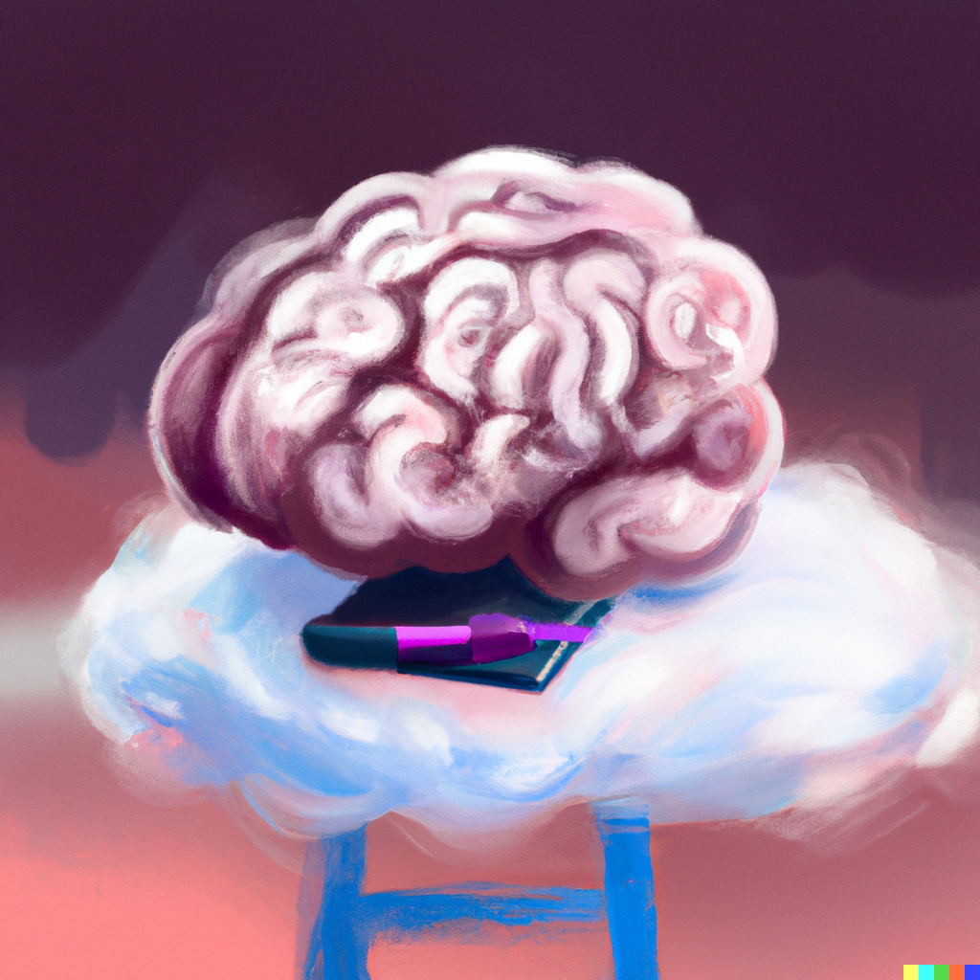
Foundation Models: CLIP and GPT
Applied Machine Learning
Derek Hoiem
Dall-E

Slide 2
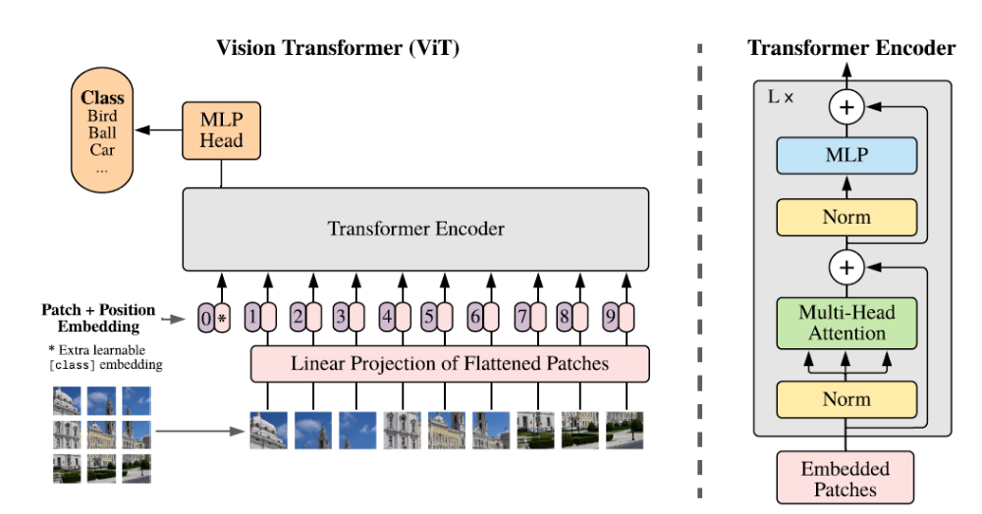
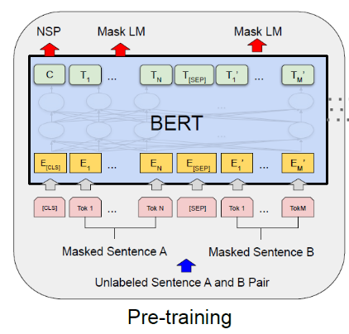
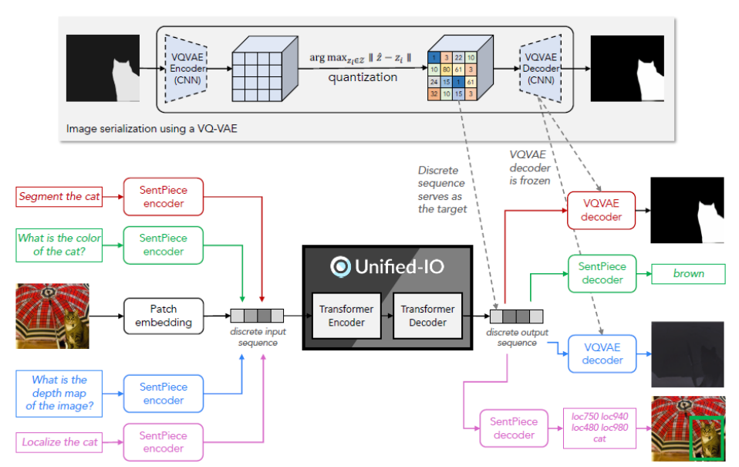
Last class: Transformer Models
Transformers are efficient, multi-modal data processors

Slide 3
This lecture
Foundation models: Models that are trained on exorbitant data and compute on a broad task, either for general purpose use or adaption to other tasks
Key questions for foundation models are
  How to train them (what architecture, what data, what objective)
  How to apply them, e.g.
    Zero-shot: apply to new tasks without any training examples for those specific tasks
    Linear probe: train a linear model on the features
    Fine-tune: adjust the entire network to perform better in the target task
We previously saw two examples of foundation models suitable for fine-tuning
  ImageNet pretrained models for vision
  BERT for language
We will now learn about two more famous models that can do zero shot
  CLIP: Contrastive Language-Image Pretraining for Vision
  GPT: Generative Pretraining Models for Language

Slide 4
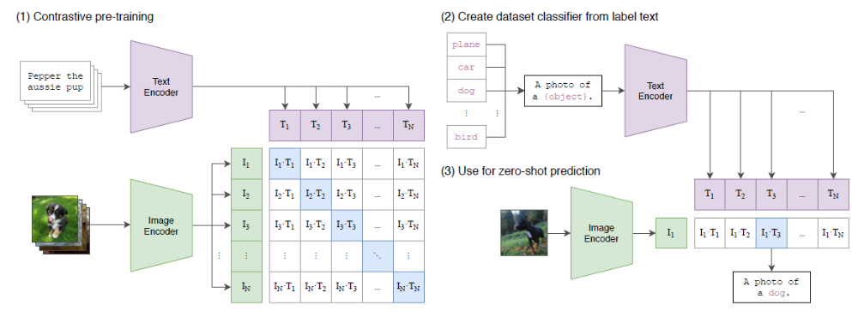
CLIP: Learning Transferrable Models from Natural Language Supervision (Radford et al. 2021)
First key idea: use a text encoder as a classifier
pdf

Slide 5
First key idea: use a text encoder as a classifier
This is an old idea – words and pictures work goes back to ~2000, but at a smaller scale
Main challenge: How to scale?
  Learn from natural language supervision (not tags or class labels)
  Scrape 400 million image/text pairs
  Contrastive objective, instead of predicting exact language
  Use transformer architecture

Slide 6
Second key idea: learn to contrastively match text to image
Use small transformer language model (63M parameters for base)
Matching task with large batch (size = 32,768)
  Each image and text from batch is encoded
  Similarity score obtained for 32K x 32K image-text pairings
  Loss is cross-entropy on matching each image to its text, and each text to its image
Contrastive task formulations is a good general way to learn when exact target is unpredictable

Slide 7
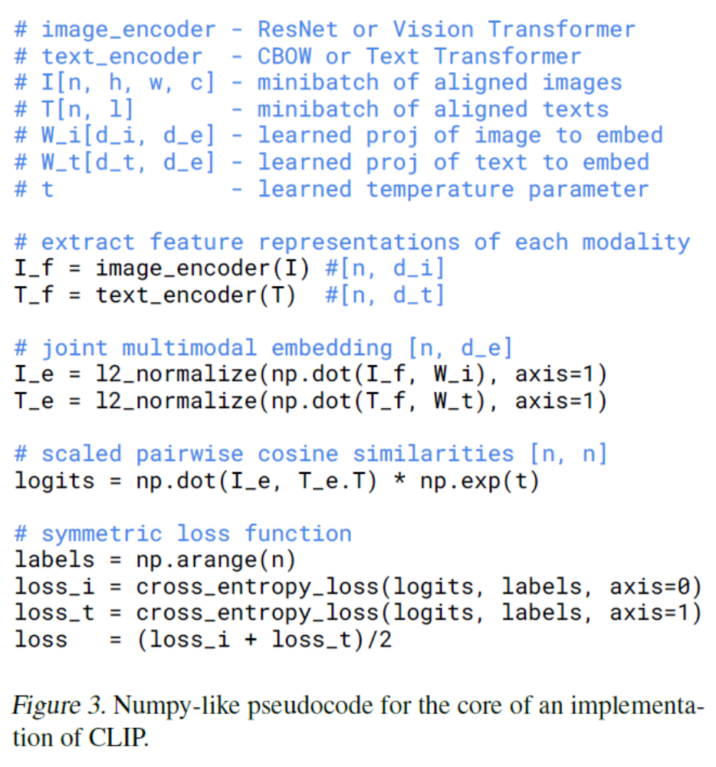

Slide 8
Training cost
“The largest ResNet model RN50x64, took 18 days to train on 592 V100 GPUs, while the largest Vision Transformer took 12 days on 256 V100 GPUs”
  ~$91K for Transformer model; $300K for ResNet model

Slide 9
Key idea 3: zero-shot classification
Every batch of training is like a novel classification task, matching 32K classes to 32K images
To create a new classification task:
Convert class labels into captions and encode the text
Encode the image
Assign the image to the label whose caption matches best

Slide 10
Four ways to adapt CLIP to a new task
Zero-shot: convert labels to text and use text-image similarity
Linear probe: freeze the image encoder and train a linear layer on its features
Nearest neighbor (not in paper): record features of training examples and use K-NN classifier
Fine-tune CLIP encoder for the new task (but then it loses its generality)

Slide 11
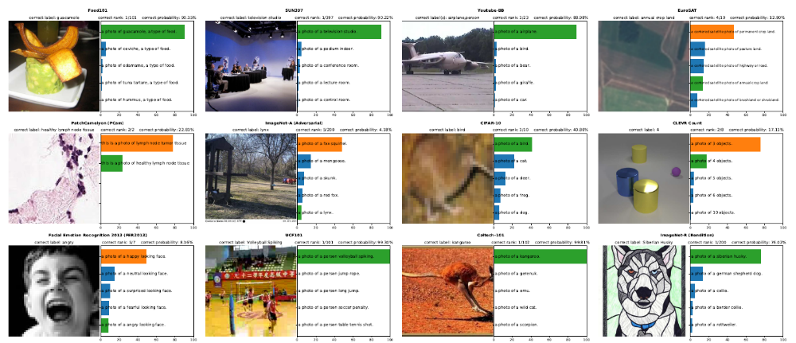
Zero shot prediction examples (randomly selected)

Slide 12
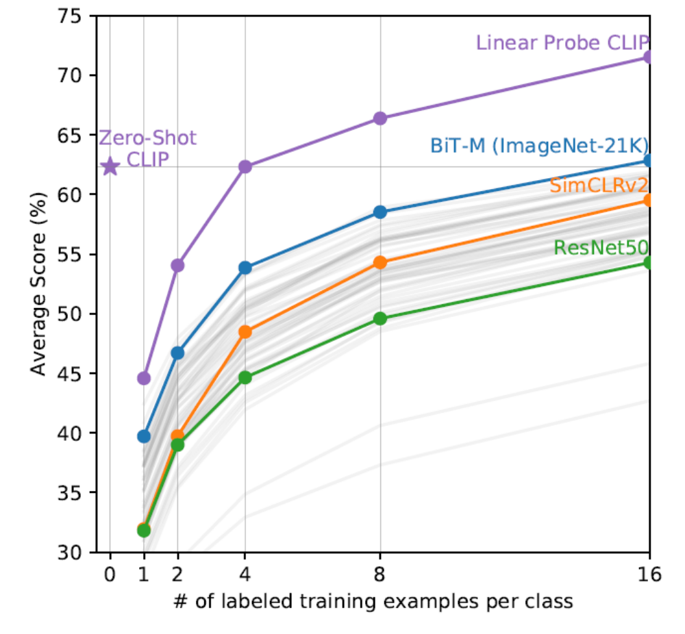
Zero-shot clip performs as well as a strong baseline trained on 16 examples per class
Linear probe needs 4 examples to reach zero-shot performance (on average)

Slide 13
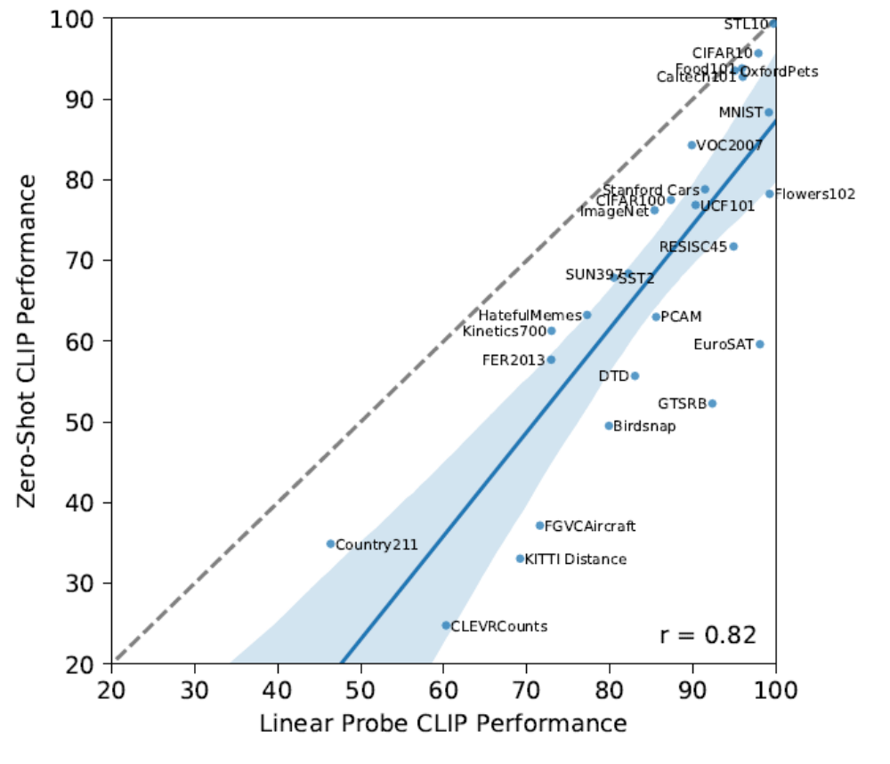
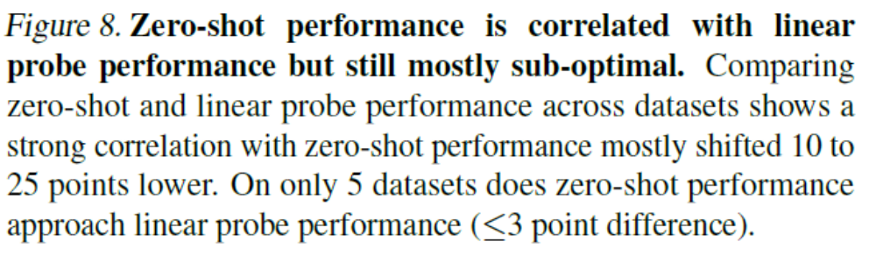

Slide 14
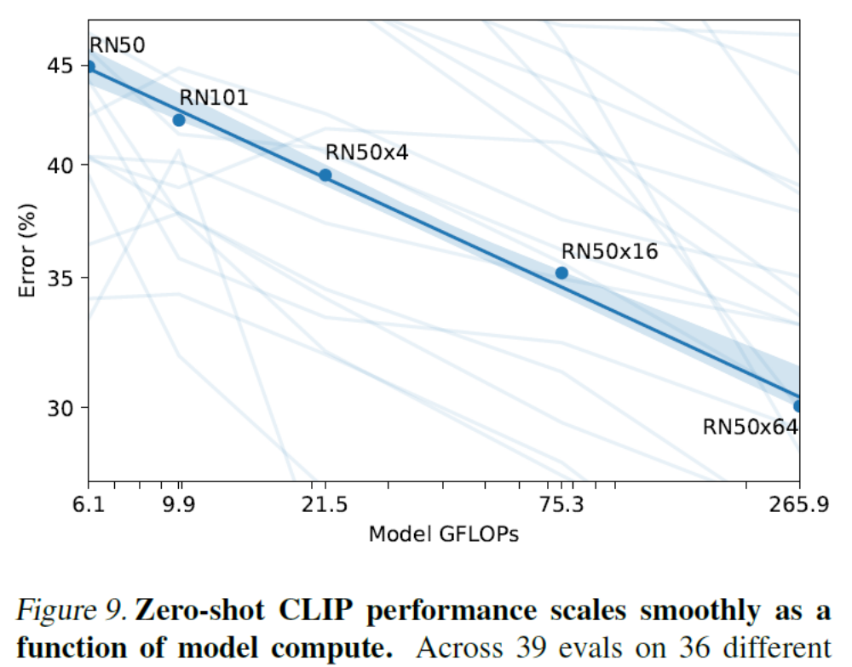

Slide 15
The CLIP model is used as the image or text encoder for many vision-language models and image generators, e.g. DALL-E2, Stable Diffusion, BLIP-2, Molmo

Slide 16

Q1-2
https://tinyurl.com/AML441-L20

Slide 17
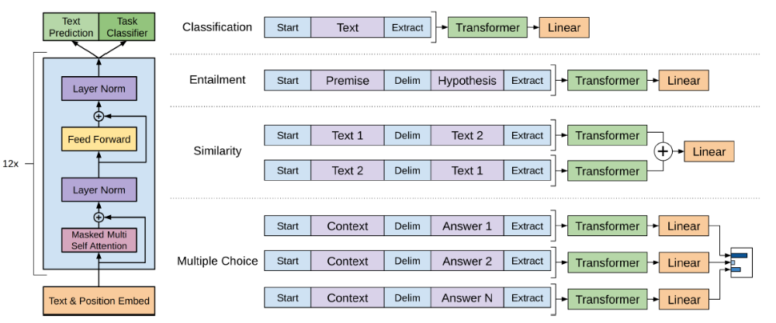
GPT1 - Improving Language Understanding by Generative Pre-Training (Radford et al. 2018)

Slide 18
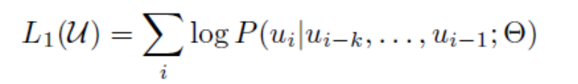
GPT1 (2018)
Pre-cursor to BERT (2019) that we discussed last class
Similar architecture and training procedures
  117M parameters in GPT1 vs. 340M for BERT Large
Pre-training: Maximize data likelihood as a product of conditional probabilities, trained on Books Corpus
  Predict each token based on the k tokens (the “context”) that came before
Fine-tuned for each task while also retaining the generative objective. Some tasks need to be processed in a special way
Achieved state-of-art in 9 out of 12 tasks

Slide 19
GPT-2 (Radford et al. 2019) - Language Models are Unsupervised Multitask Learners
Aims to create a general purpose language learner
“Current systems are better characterized as narrow experts rather than competent generalists. We would like to move towards more general systems which can perform many tasks – eventually without the need to manually create and label a training dataset for each one.
The dominant approach to creating ML systems is to collect a dataset of training examples demonstrating correct
behavior for a desired task, train a system to imitate these behaviors, and then test its performance on independent
and identically distributed (IID) held-out examples. This has served well to make progress on narrow experts. But
the often erratic behavior of captioning models (Lake et al., 2017), reading comprehension systems (Jia & Liang, 2017),
and image classifiers (Alcorn et al., 2018) on the diversity and variety of possible inputs highlights some of the shortcomings of this approach.
Our suspicion is that the prevalence of single task training on single domain datasets is a major contributor to the lack
of generalization observed in current systems. Progress towards robust systems with current architectures is likely
to require training and measuring performance on a wide range of domains and tasks.”
PDF
Notes:
~30 min up to this point

Slide 20
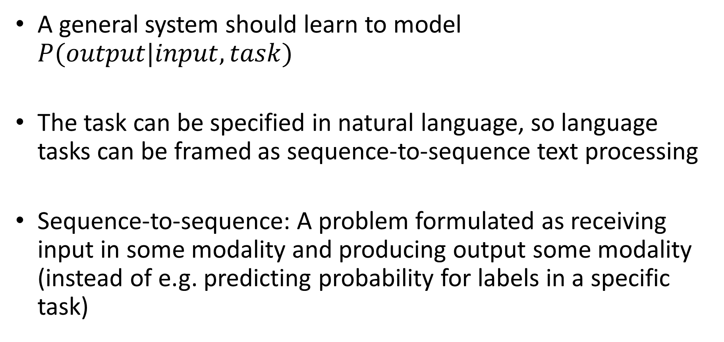
GPT-2
A general system should learn to model $P(output|input, task)$
The task can be specified in natural language, so language tasks can be framed as sequence-to-sequence text processing
Sequence-to-sequence: A problem formulated as receiving input in some modality and producing output some modality (instead of e.g. predicting probability for labels in a specific task)

Slide 21
GPT-2: Data and Training
WebText Dataset: Created a new web scrape of pages linked from Reddit with at least 3 karma, as these should be of reasonable quality
  Does not require additional manual annotation
  Yields 8 million documents (40GB text) from before 2018 after de-duplication and cleaning
  Removed Wikipedia, since it is commonly used in test sets
GPT-2 is generatively trained on WebText data and not fine-tuned on anything else

Slide 22
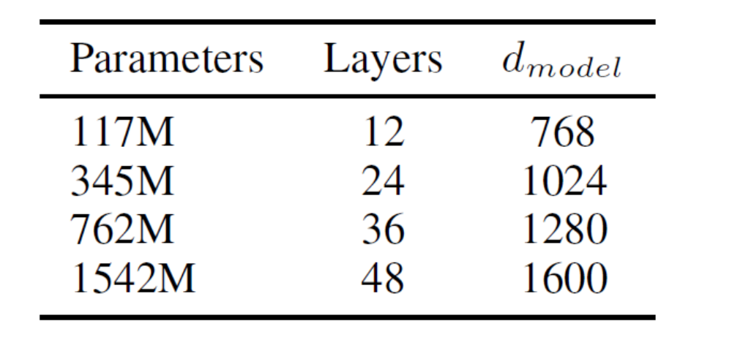
GPT-2 Architecture and Model Sizes
Architecture is basically the same as GPT-1 and BERT
GPT-1 Size
BERT Size

Slide 23
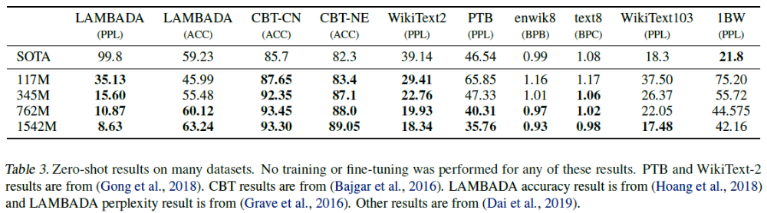
GPT-2: Zero shot results
Achieves state-of-art in many tasks without tuning for them
Performs much worse than state-of-art in summarization and translation (though can effectively translate word for word)
Perplexity (PPL) is 2^entropy; lower is better

Slide 24
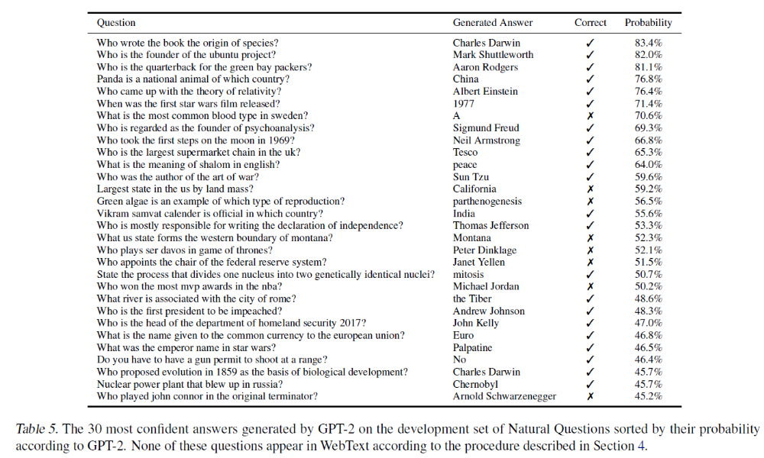

Slide 25
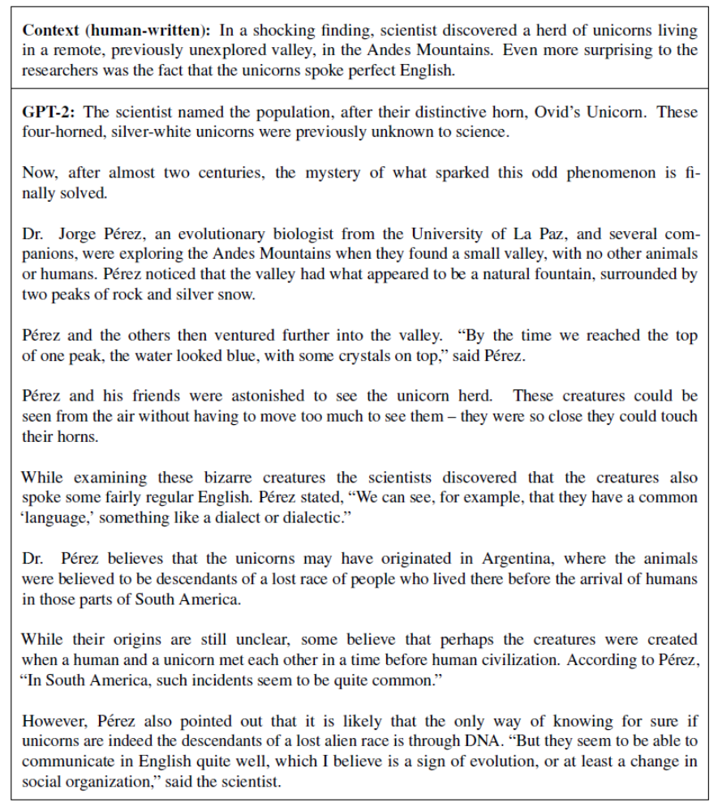
See many more examples in the paper

Slide 26
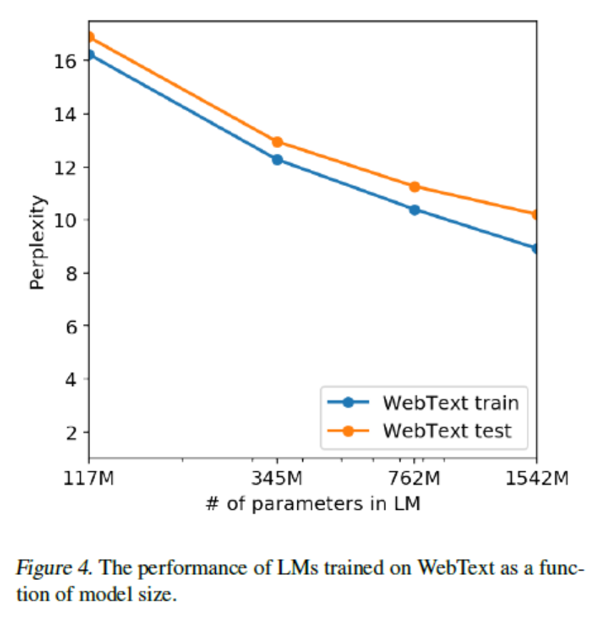
Continued log-linear improvement with model size
Conclusion: “The diversity of tasks the model is able to perform in a zero-shot setting suggests that high-capacity models trained to maximize the likelihood of a sufficiently varied text corpus begin to learn how to perform a surprising amount of tasks without the need for explicit supervision.”

Slide 27
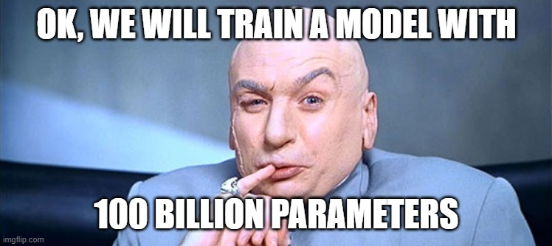
In the Open AI board room…

Slide 28
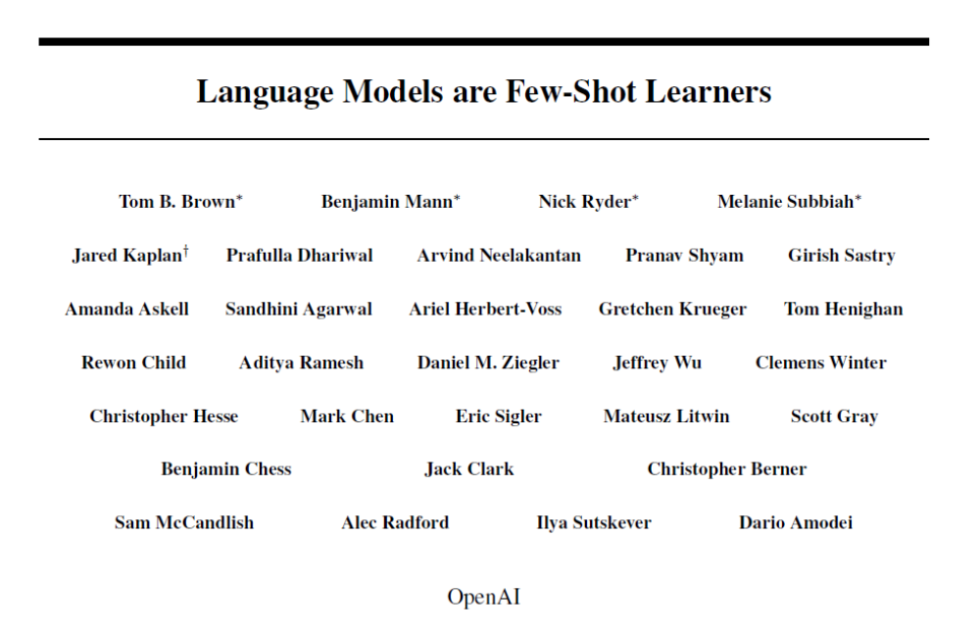
GPT-3 (Brown et al. 2020)

Slide 29
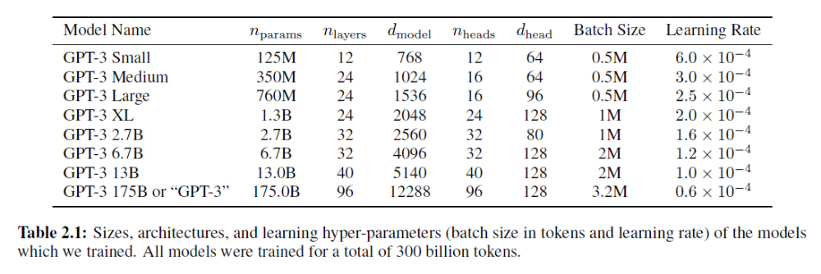
Models and Architectures

Slide 30
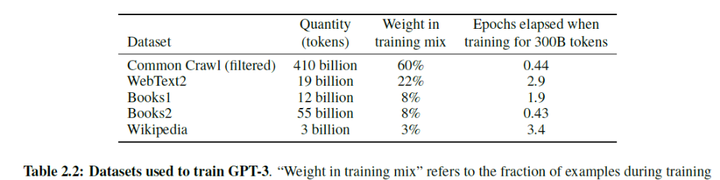
Training data

Slide 31
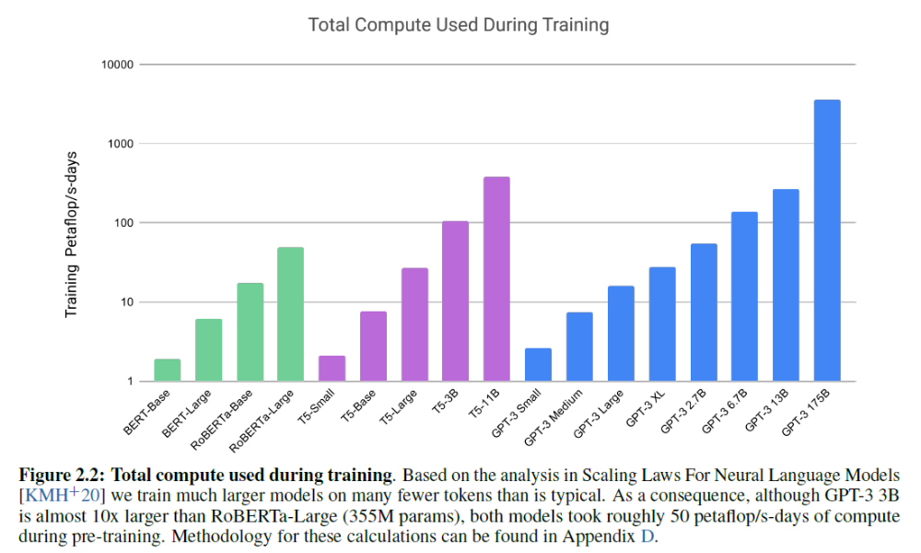
Training compute
List price of compute to train GPT-3 175B: ~$4.5M

Slide 32
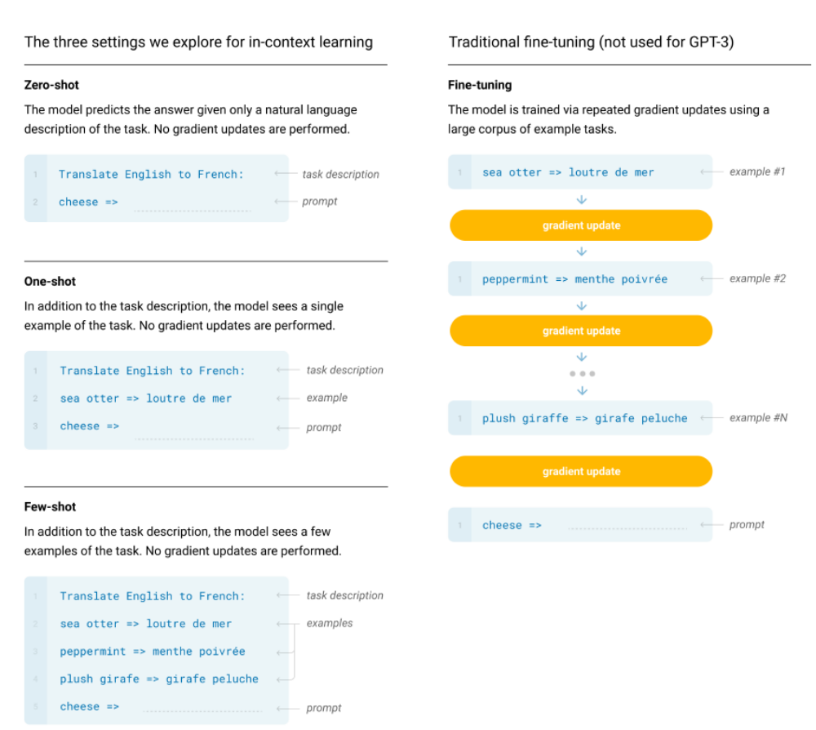
Few-shot “In Context Learning”

Slide 33
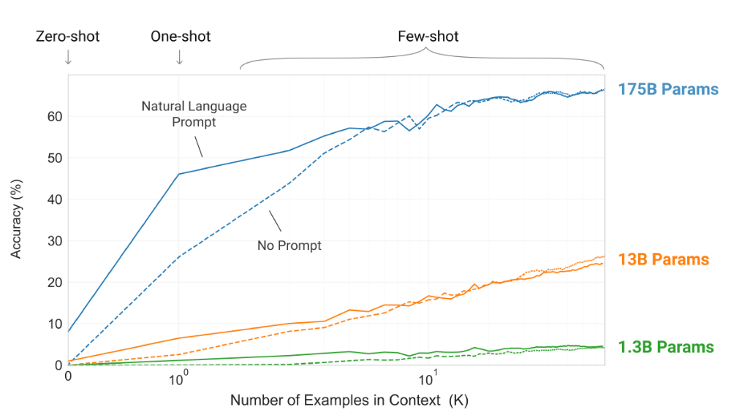
GPT-3
GPT-2 scale
Accuracy on a simple task to remove random symbols from a word

Slide 34
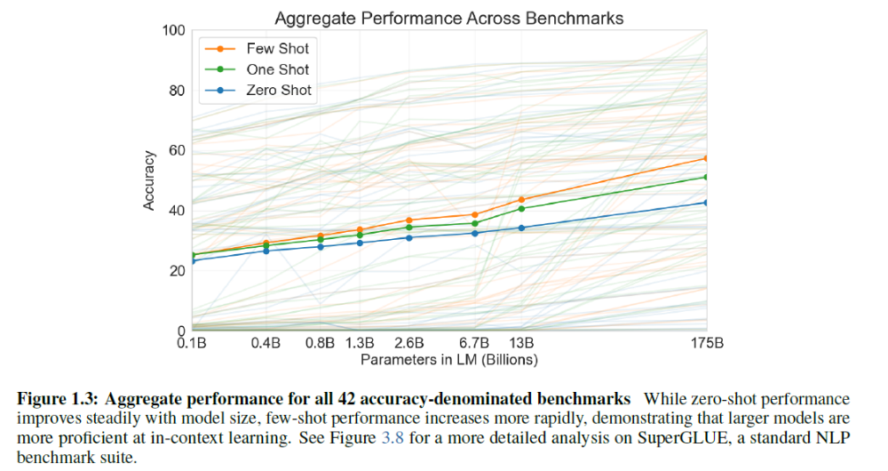
GPT-3: zero-shot performance increases with scale, but few-shot increases even faster

Slide 35
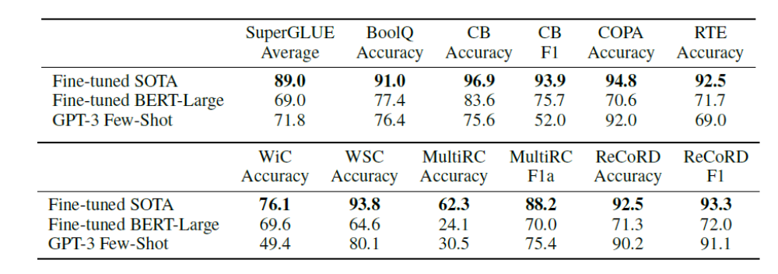
Performance of GPT-3
Average performance of few-shot is about the same as fine-tuned BERT-Large, but varies by task
Per-task specialized SOTA models are still best
But don’t underestimate the importance of flexibility!

Slide 36
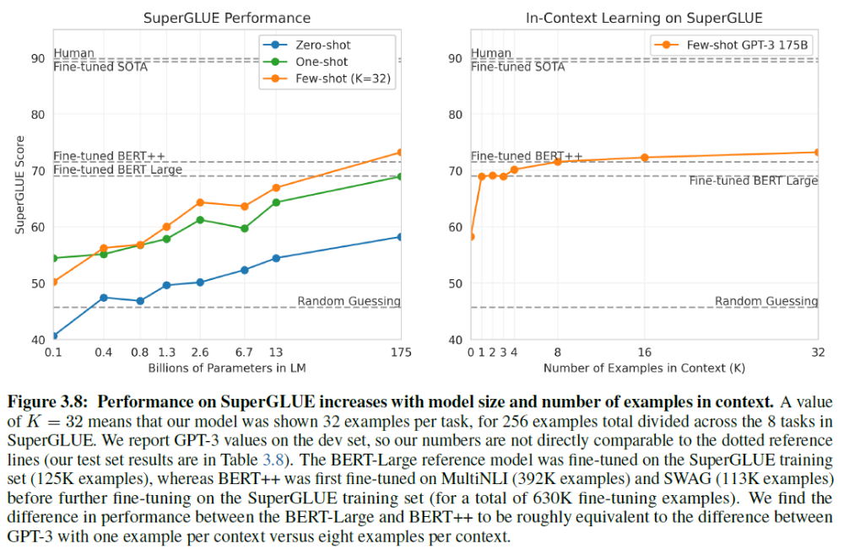

Slide 37
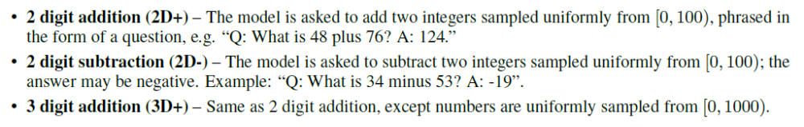
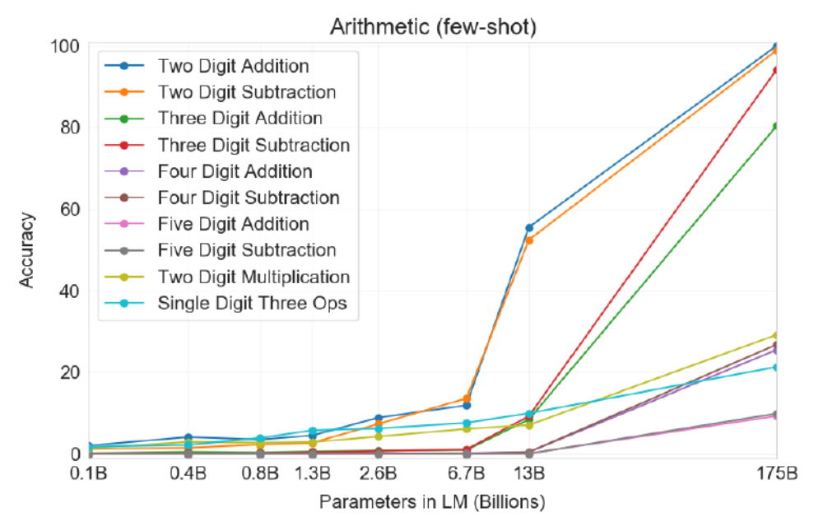
GPT-3 Arithmetic

Slide 38
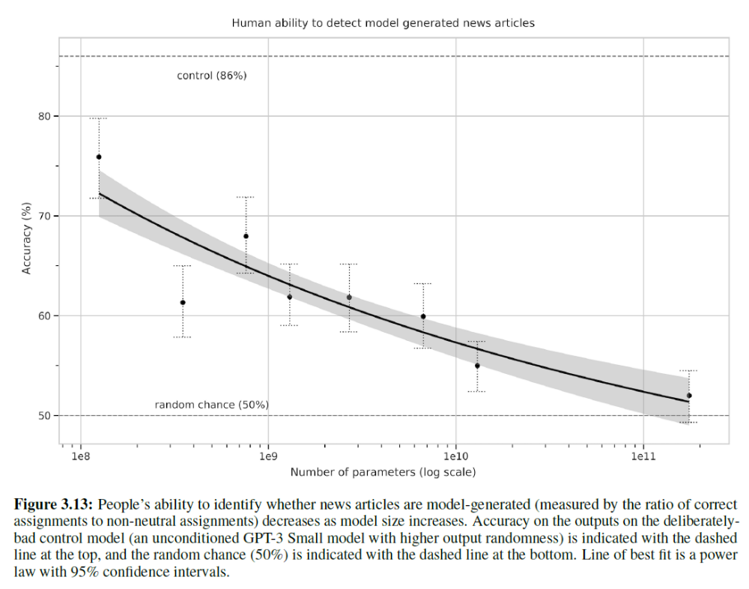

Slide 39
What to learn from the GPT Papers
GPT: generative-pretraining (GPT) is effective for large language models
  Learns to predict the next word given preceding words
GPT-2: GPT models can perform reasonable zero-shot task performance with larger models trained on more data
GPT-3: Even larger GPT models trained on even more data are good at many tasks, especially text generation, and can be “trained” at inference time with in-context examples

Slide 40
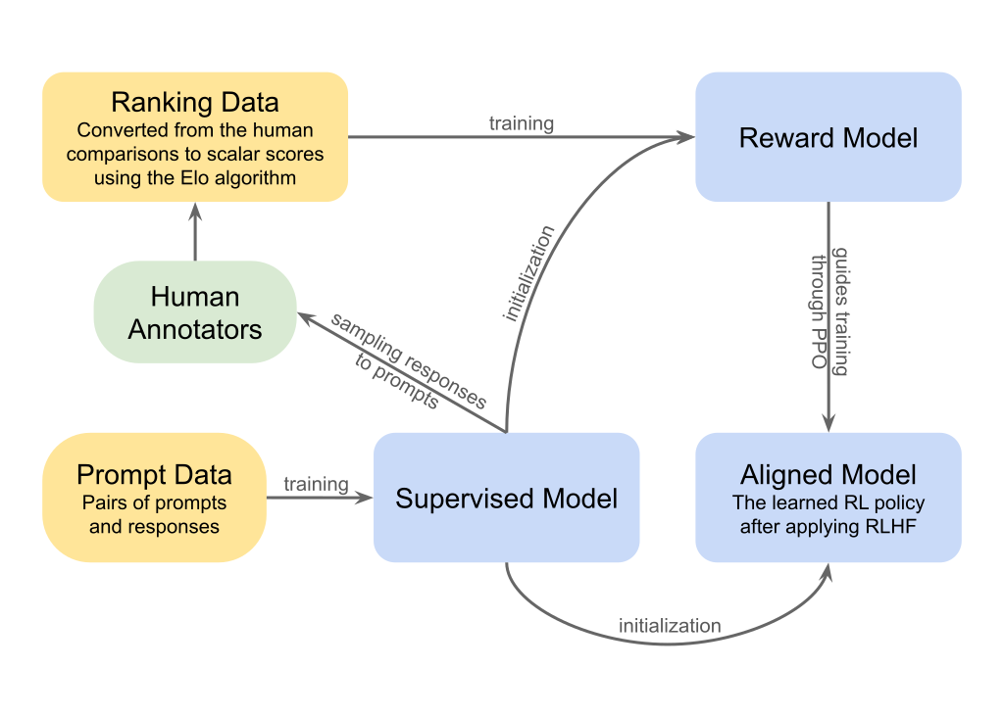
GPT3 -> ChatGPT: SFT on demonstrations, then Reinforcement Learning from Human Feedback (RLHF)
Human feedback on multiple outputs used to create a “quality” scorer and tune the model to give higher quality responses
https://commons.wikimedia.org/wiki/File:RLHF_diagram.svg

Slide 41
How much of our thoughts and conversation are just next word prediction?

Slide 42
Q3-4
https://tinyurl.com/AML441-L20

Slide 43
Scaling Laws and Limits: GPT 4 and beyond
Based on slides by Zhen Zhu (2025 TA)

Slide 44
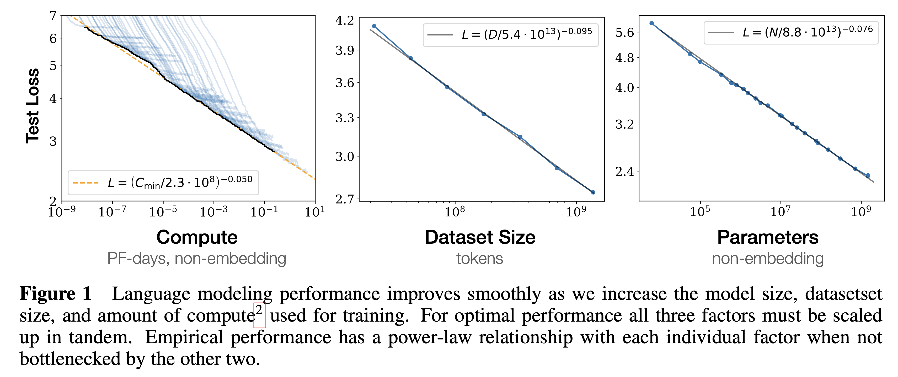

How to predict performance using small compute?
Scaling law:
  Test loss follows simple power laws in parameters N, data tokens D, and minimum training compute C_min
[Kaplan et al. Scaling Laws for Neural Language Models. 2020]

Slide 45
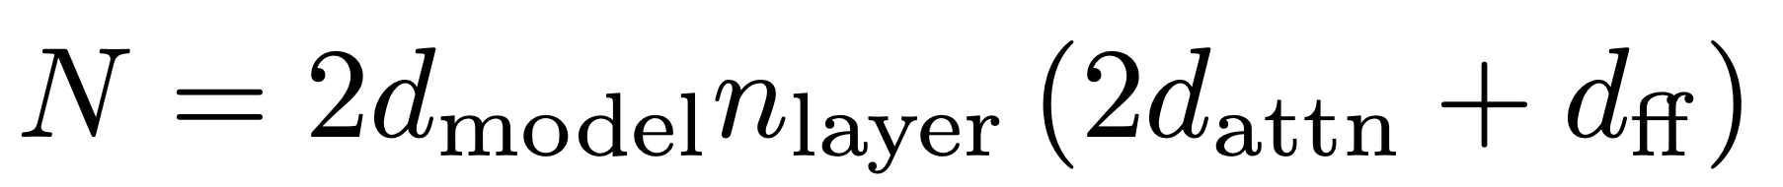
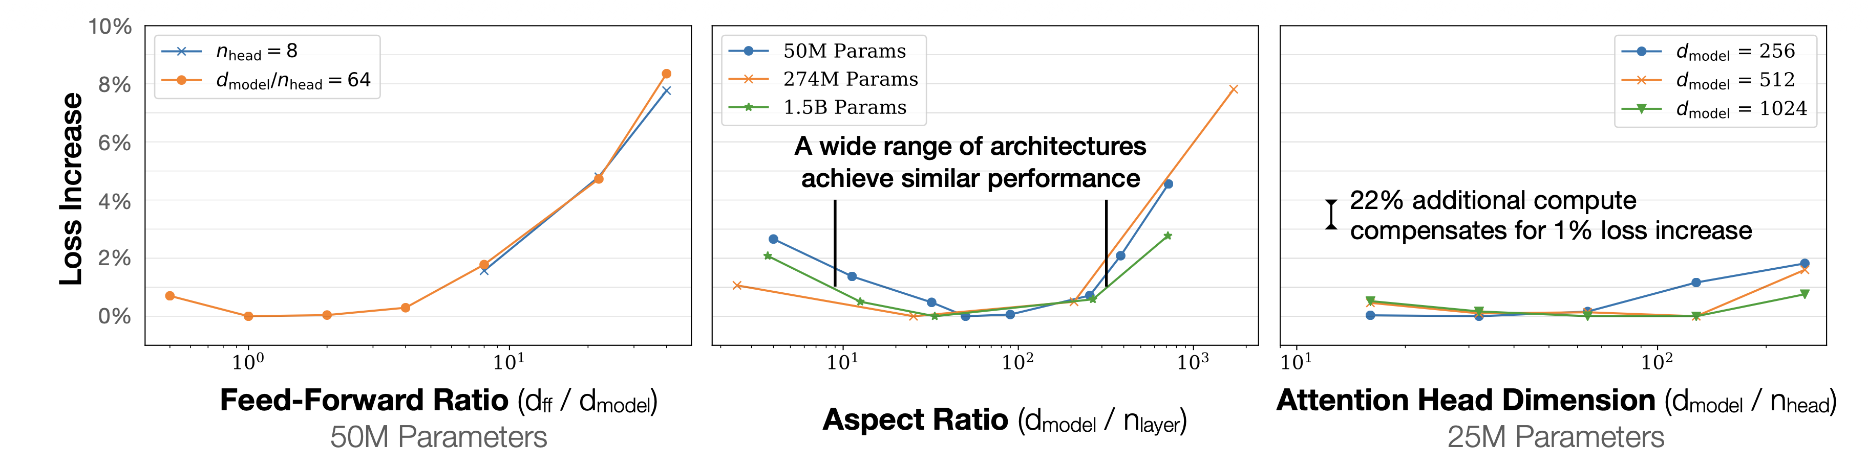
Loss has weak dependence on architectures
n_layer: number of total layers in Transformer
n_head: number of heads per layer
d_ff: feed-forward layer dimension
d_attn: attention projection layer dimension
d_model: residual stream dimension
Total number of parameters N kept fixed
[Kaplan et al. Scaling Laws for Neural Language Models. 2020]

Slide 46
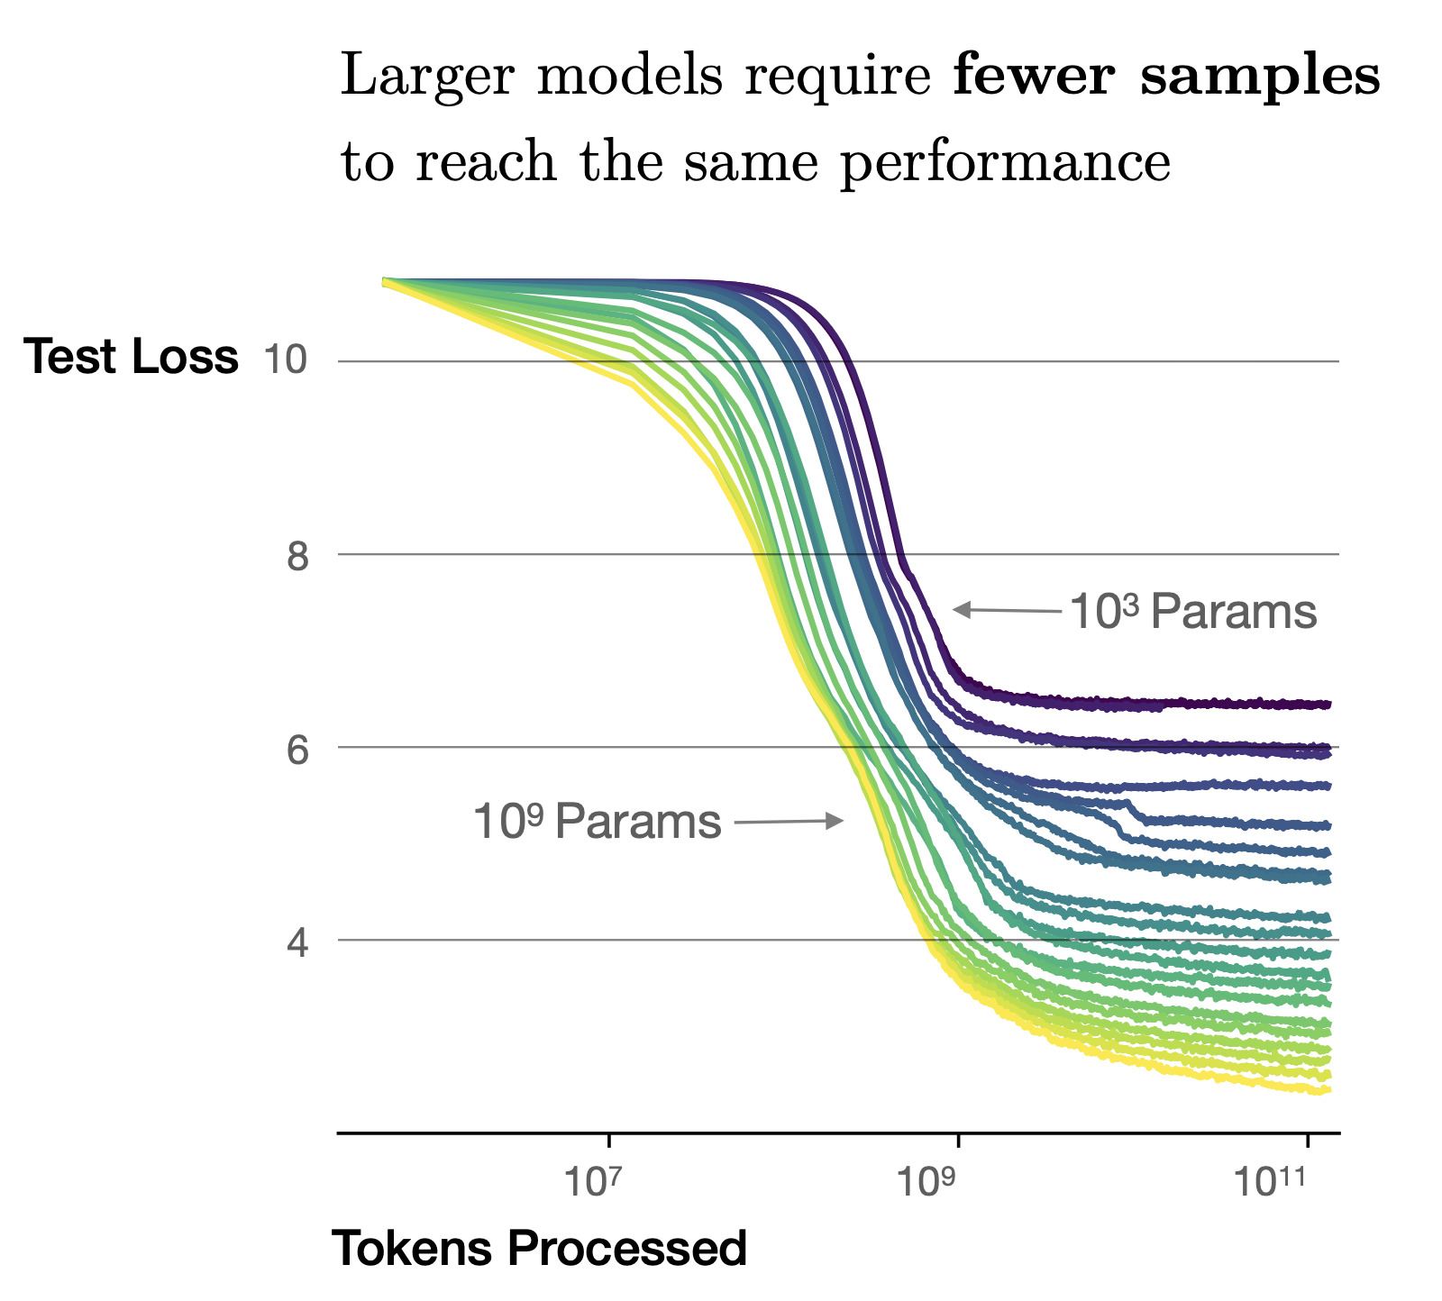
Large models are more sample efficient
[Kaplan et al. Scaling Laws for Neural Language Models. 2020]

Slide 47
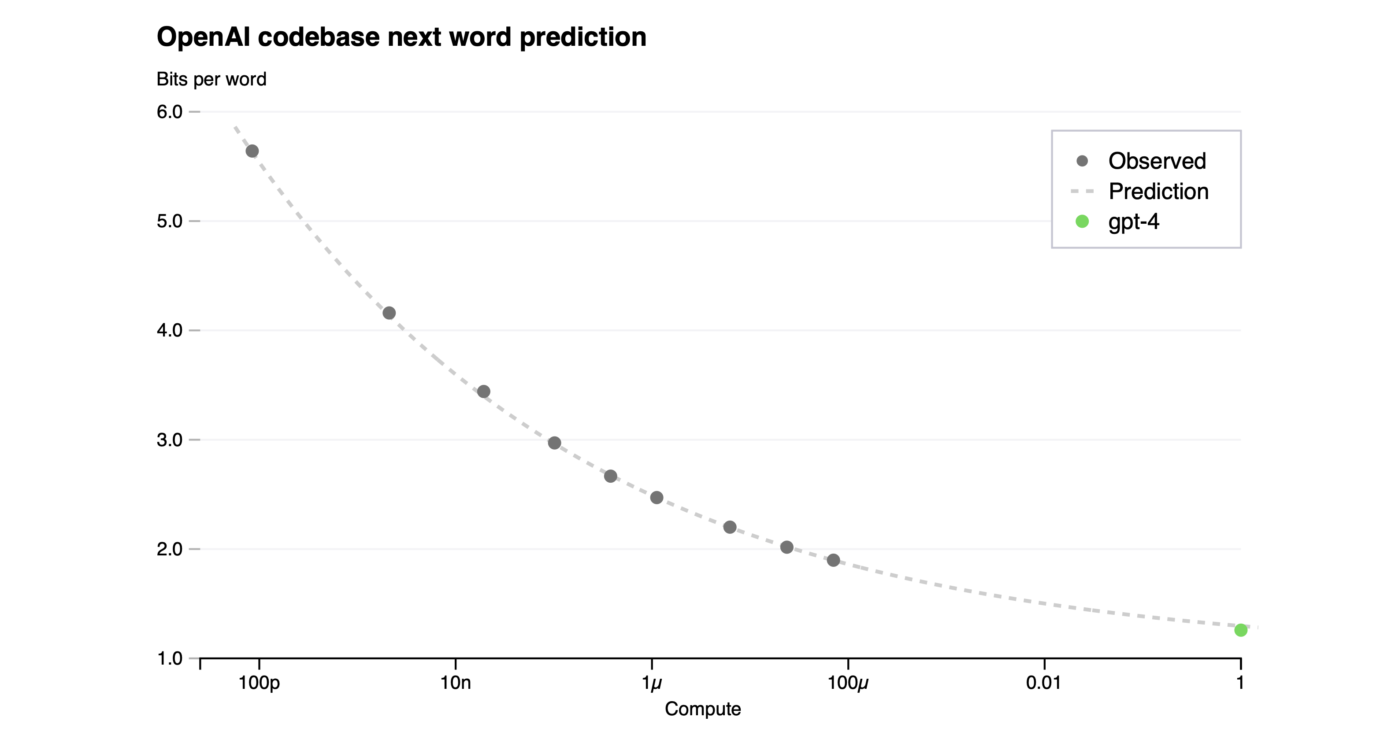
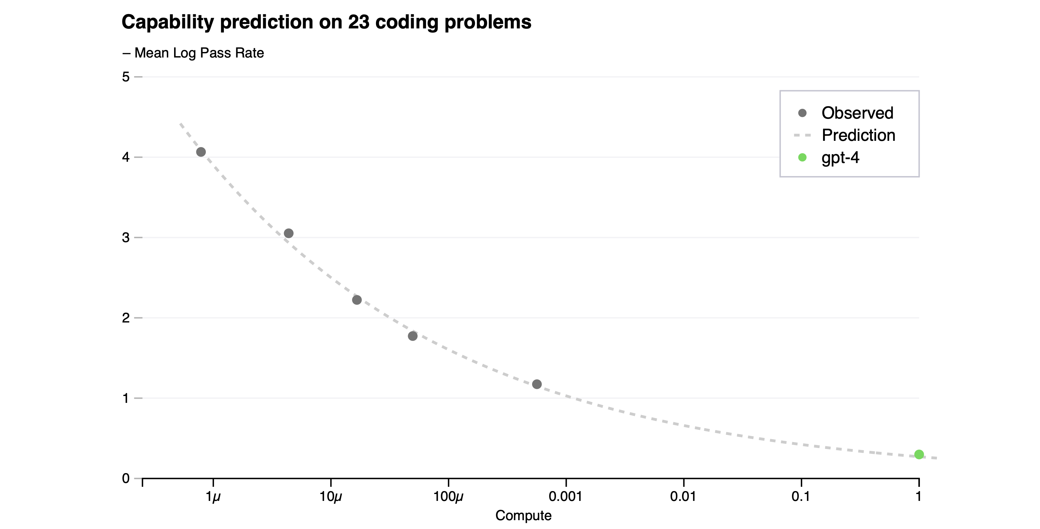
GPT-4 works as predicted from scaling law
[OpenAI. GPT-4 Technical Report. 2023]

Slide 48
Question: are bigger models able to solve all problems?

Slide 49
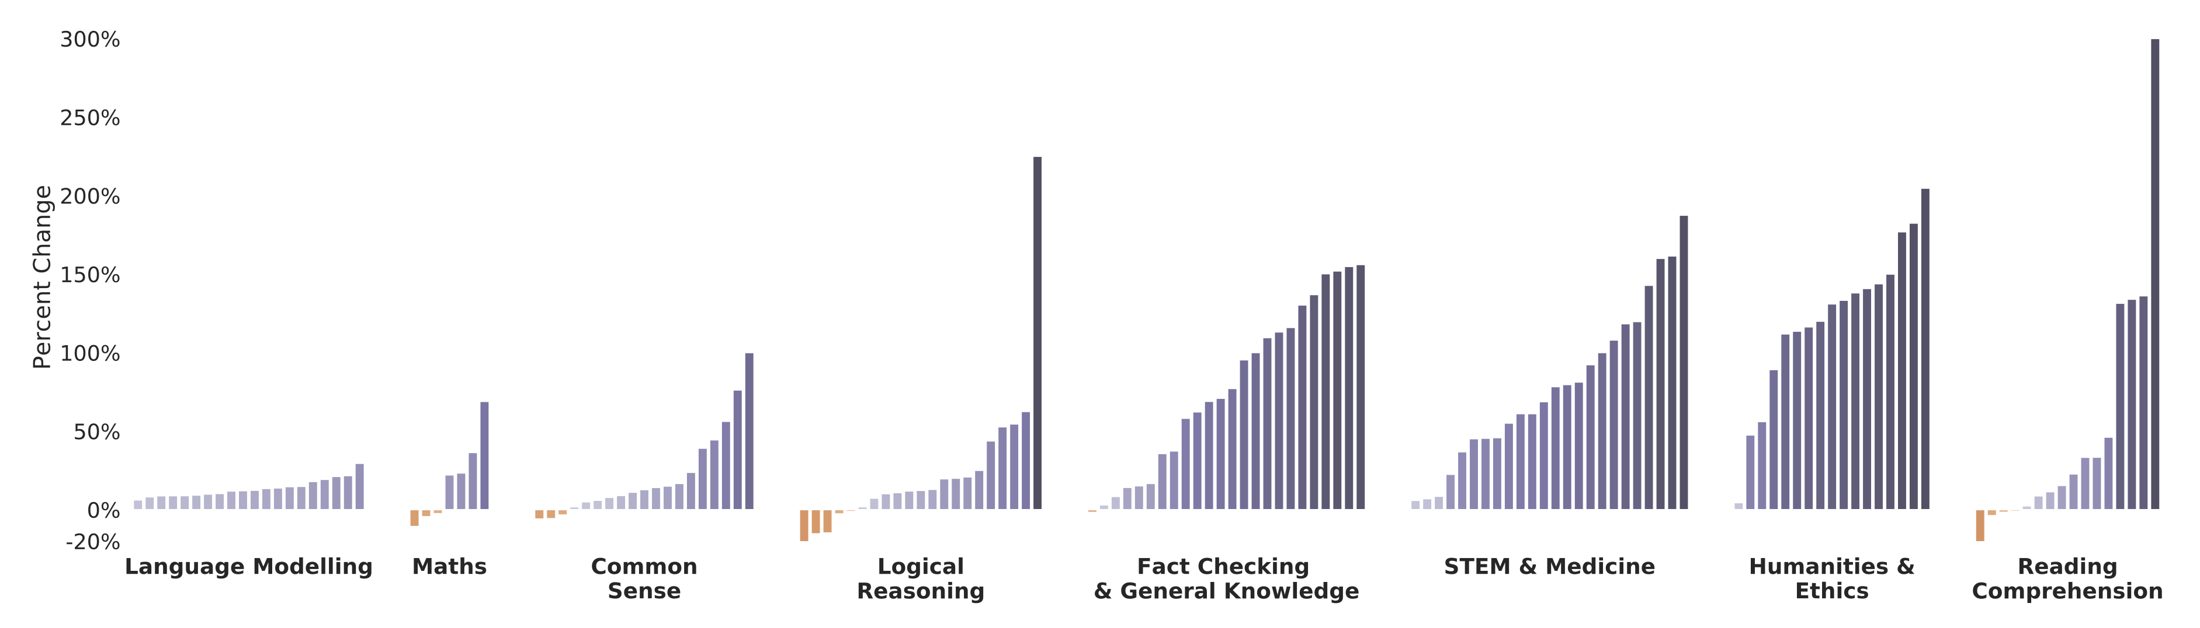
Tasks requiring reasoning are hard for scaling LLMs
Scaling up model size alone has not proved sufficient for tasks containing flavors of mathematical or logical reasoning
Relative performance improvement of Gopher 280B vs 7.1B over 152 tasks
[Rae et al. Scaling Language Models: Methods, Analysis & Insights from Training Gopher. 2022]

Slide 50
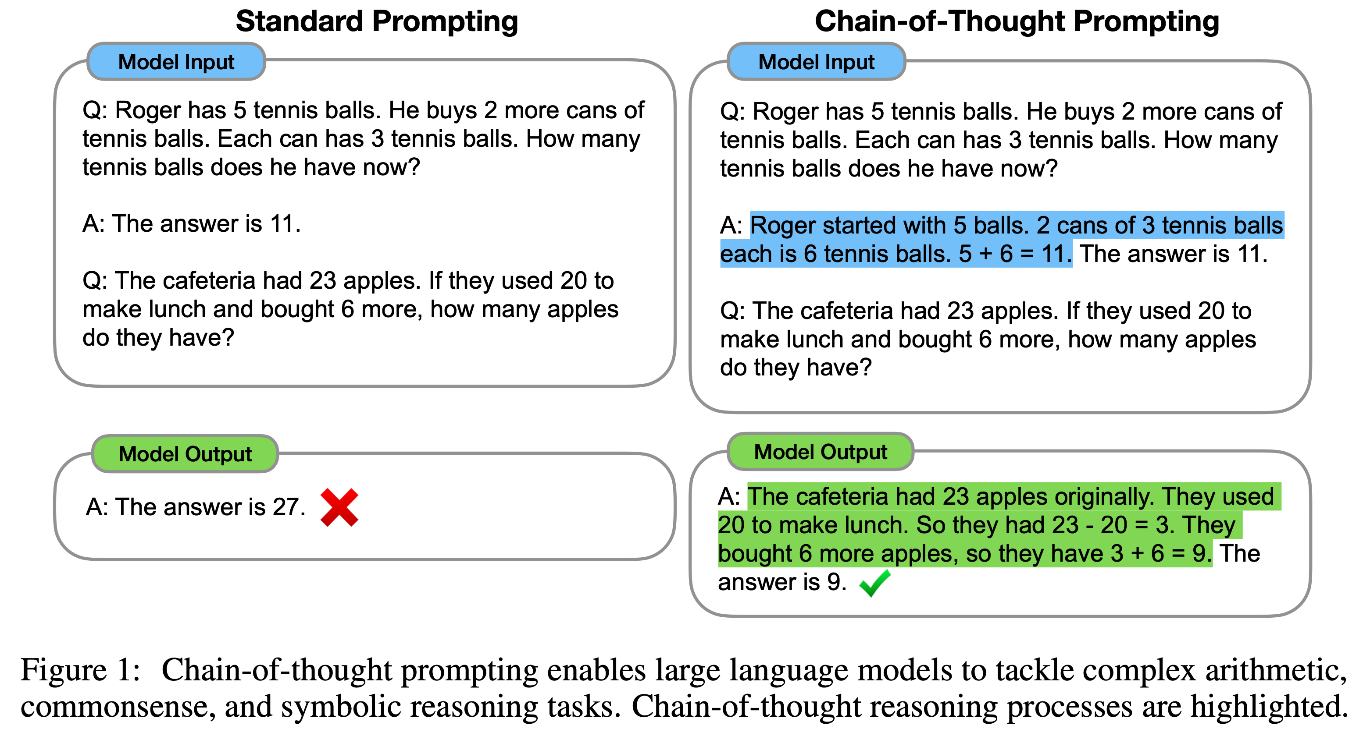
Chain-of-Thought to the rescue
Idea: give a reasoning example in the prompt
[Wei et al. Chain-of-Thought Prompting Elicits Reasoning in Large Language Models. 2022]

Slide 51
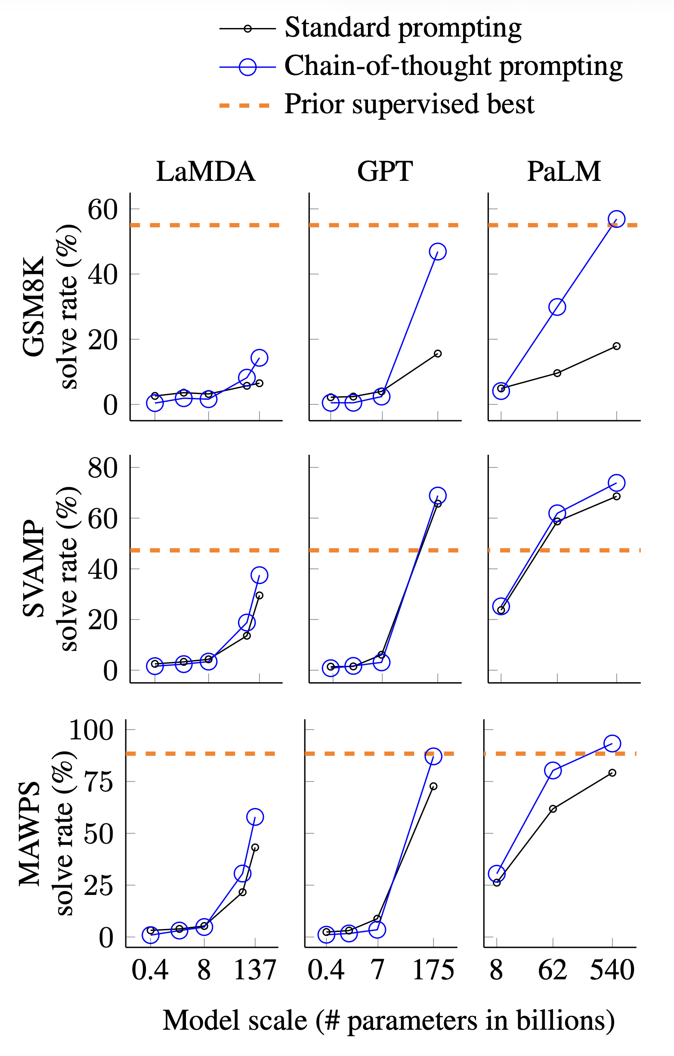
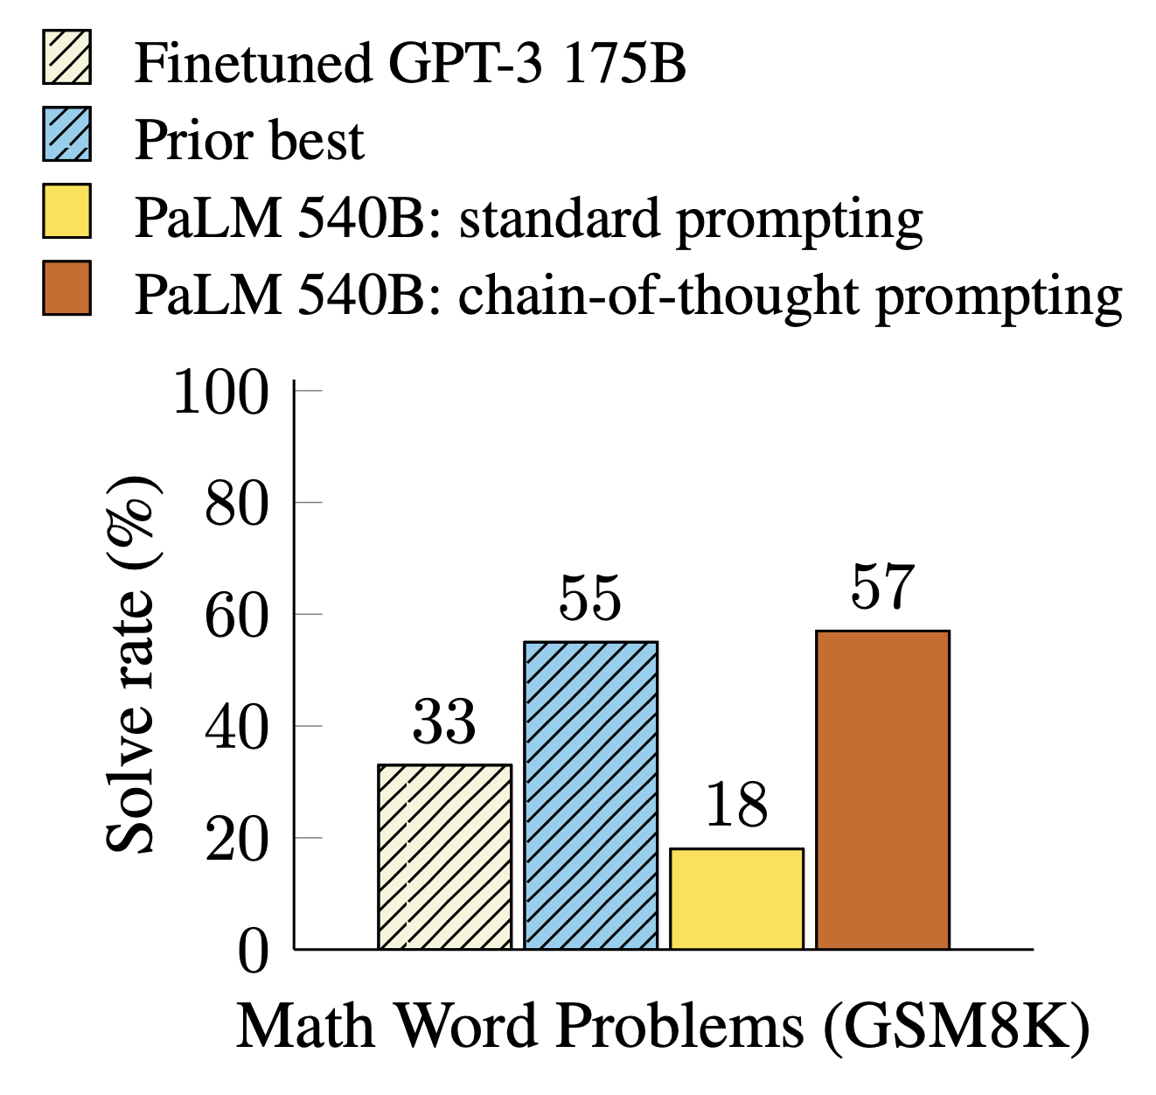
Chain-of-Thought to the rescue
CoT prompting is helpful
CoT prompting is an emergent ability of model scale
[Wei et al. Chain-of-Thought Prompting Elicits Reasoning in Large Language Models. 2022]

Slide 52
Include Chain-of-Thoughts in training
O1-preview
oyfjdnisdr rtqwainr acxz mynzbhhx -> Think step by step
Use the example above to decode:
oyekaijzdf aaptcg suaokybhai ouow aqht mynznvaatzacdfoulxxz
…
Wait a minute.
I think maybe there is an anagram or substitution cipher here.
Alternatively, I think that we can notice that each group of ciphertext corresponds to a plaintext word.
Check the number of letters.
First ciphertext word: oyfjdnisdr (10 letters)
First plaintext word: Think (5 letters)
Hmm.
Second ciphertext word: rtqwainr (8 letters)
Second plaintext word: step (4 letters)
Third ciphertext word: acxz (4 letters)
Third plaintext word: by (2 letters)
Fourth ciphertext word: mynzbhhx (8 letters)
Fourth plaintext word: step (4 letters)
Interesting.
It seems that the ciphertext words are exactly twice as long as the plaintext words.
(10 vs 5, 8 vs 4, 4 vs 2, 8 vs 4)
Idea: Maybe we need to take every other letter or rebuild the plaintext from the ciphertext accordingly.
Let's test this theory.
…
GPT-4o
Let’s break this down step by step based on the example:
1. Example given:
• Input: oyfjdnisdr rtqwainr acxz mynzbhhx
• Output: Think step by step
By examining the words:
• The pattern involves selecting specific letters or transforming them.
2. Now, let’s decode the new phrase:
• Input: oyekaijzdf aaptcg suaokybhai ouow aqht mynznvaatzacdfoulxxz
Step-by-step decoding process:
Identify possible word divisions.
The first phrase might follow the same structure as the example. It seems like the input text could be broken into groups based on natural separations or patterns.
A possible division could be:
oyekaijzdf
aaptcg
suaokybhai
ouow
aqht
mynznvaatzacdfoulxxz
However, to make a meaningful decoding, I would need more context about the transformations or letter shifting that might be involved.
Could you provide any additional decoding rules or transformations used in this cipher?
Cipher example from [OpenAI. Learning to reason with LLMs. September, 2024]

Slide 53
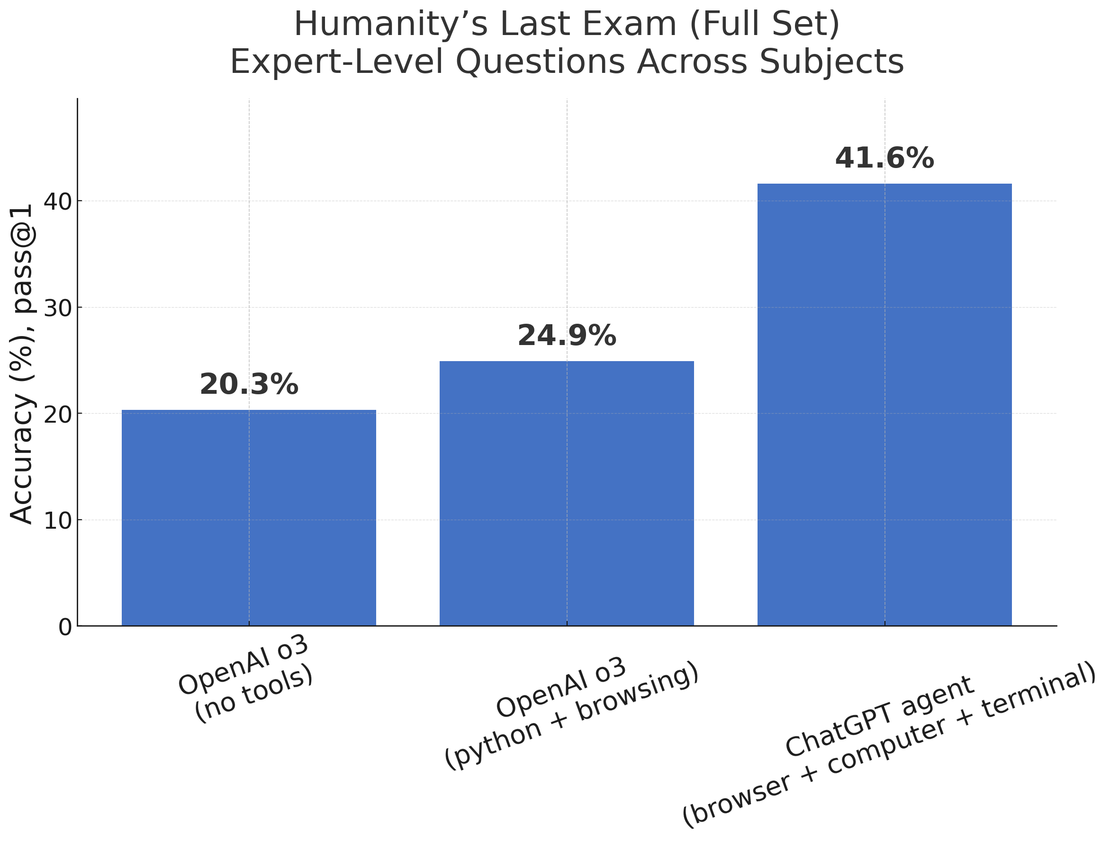
Use of tools (agents)
Recreated figure from [OpenAI. Introducing ChatGPT agent: bridging research and action. July, 2025]

Slide 54
Learning to reason with RL (DeepSeek-R1, 2025)
An open recipe for o1-style reasoning, starting from the DeepSeek-V3 base model (671B mixture-of-experts, 37B active)
R1-Zero: pure RL, without supervised reasoning data Sample many answers per problem; reward only whether the final answer is correct and the format is followed (GRPO, no learned reward model)
  Answers well, but generates unreadable traces
  learns to think longer on its own; re-checking and reflection ("wait...") emerge
R1 = small SFT warm-up → reasoning RL → SFT on its own filtered outputs → RLHF
  Good answering and traces; performance comparable to OpenAI o1
Reasoning distills into small open models (1.5B to 70B) via SFT on R1 outputs
[DeepSeek-AI. DeepSeek-R1: Incentivizing Reasoning Capability in LLMs via Reinforcement Learning. 2025]

Slide 55
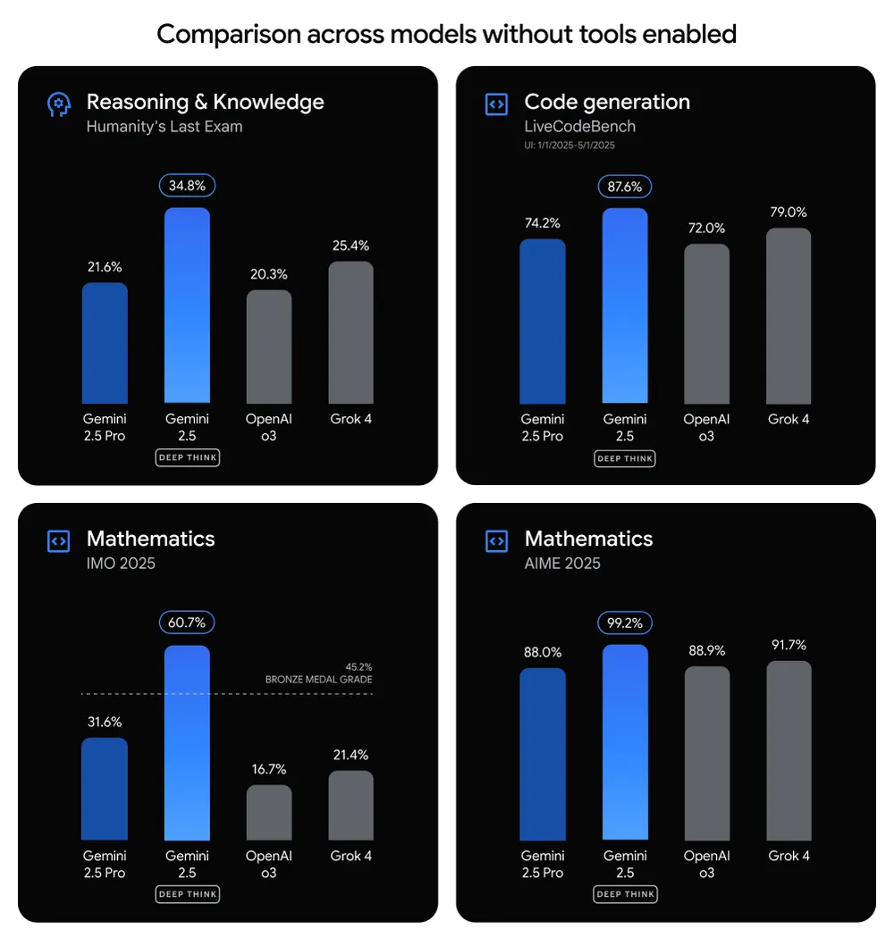
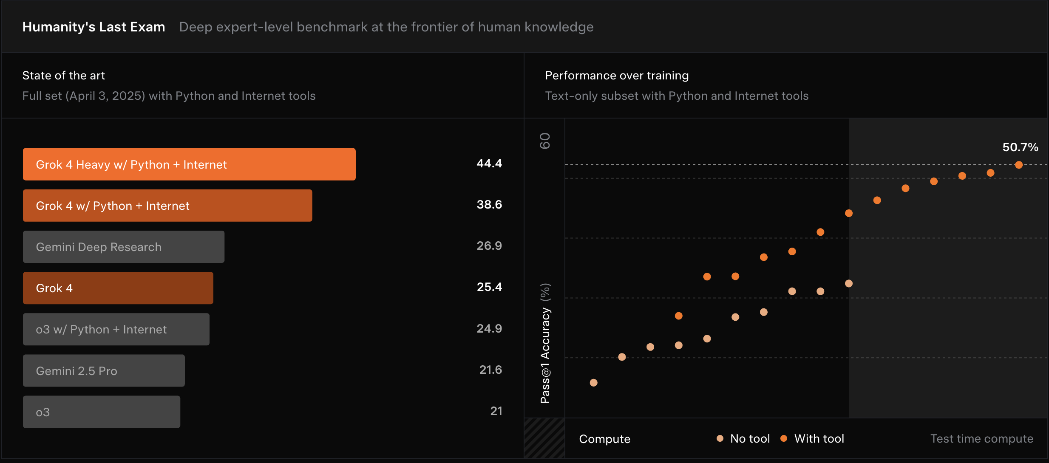
Examples of Best-of-N (run model multiple times in parallel and choose best answer)
GPT-5 Pro
Gemini DeepThink
Grok 4 heavy
Grok 4 heavy
Gemini DeepThink

Slide 56
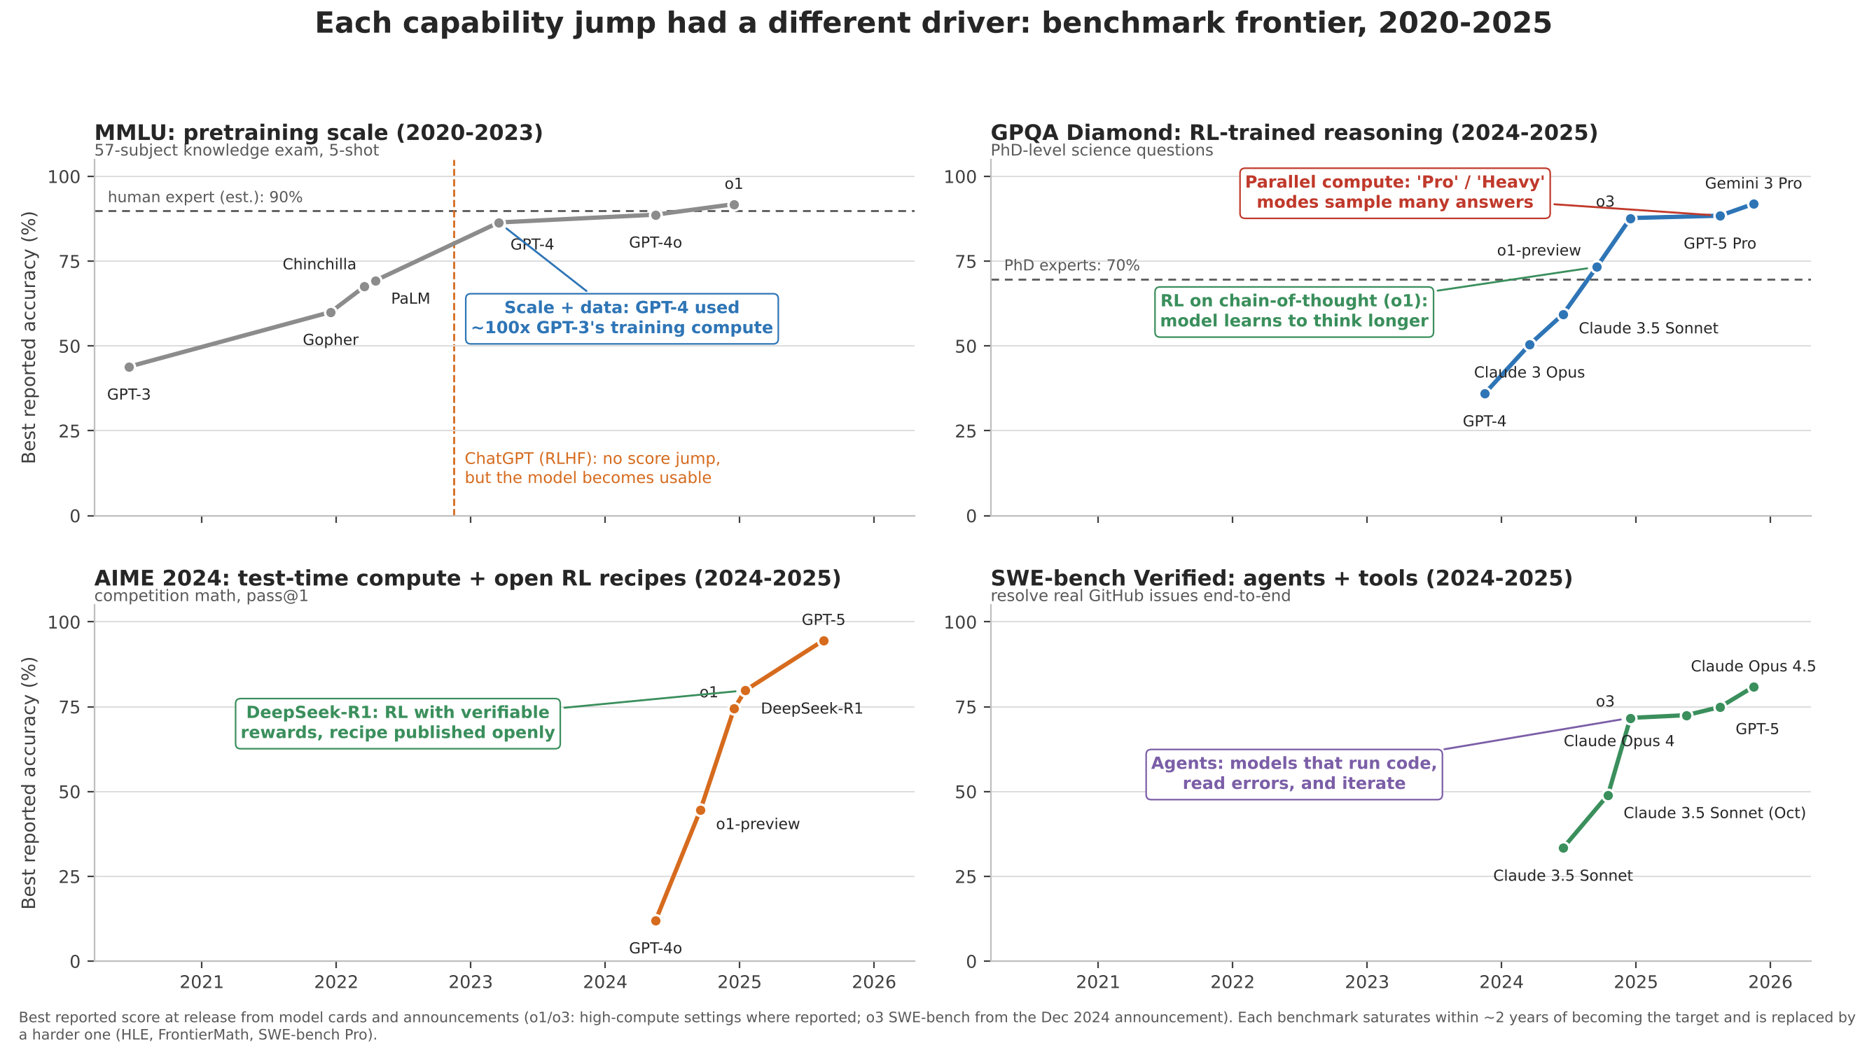

Slide 57
Each capability jump had a different driver
RL on chain-of-thought (o1):
the model learns to think longer
Scale + data: GPT-4 trained with
~100x GPT-3's compute
ChatGPT (RLHF): no score jump,
but now usable
DeepSeek-R1: RL with verifiable
rewards, recipe published openly
Agents: models that run code,
read errors, and iterate
Notes:
Panel 1, MMLU: pretraining scale. From GPT-3 to GPT-4, the gains came mostly from scaling the Kaplan/Chinchilla way: more parameters, more tokens, more compute. GPT-4 used on the order of 100 times GPT-3’s training compute, and MMLU went from 44% to 86%. Notice that ChatGPT, in late 2022, produces no jump on this curve at all. RLHF didn’t make the model know more; it made the same base model usable, which is why it changed the world while the benchmark didn’t move. By 2024 MMLU is at human level and stops being informative.
Panel 2, GPQA: RL-trained reasoning. These are PhD-level science questions, and until mid-2024 the best models were well below the 70% expert baseline. The jump comes with o1 in September 2024. The new ingredient was reinforcement learning on chain-of-thought: instead of being prompted to think step by step, the model is trained, with a reward for getting the answer right, to produce long reasoning before answering. The capability now scales with how much the model thinks at inference time, not only with how big it is. That was the first genuinely new axis of scaling since GPT-3.
Panel 3, AIME: test-time compute and open recipes. Competition math makes the same point even more sharply, from 12% to 95% in fifteen months. Two things to call out. DeepSeek-R1, in January 2025, showed that this recipe is simple and reproducible: RL with only a rule-based correctness reward, starting from a base model with no human-written reasoning examples, and they published everything. And the “Pro” and “Heavy” modes that appeared in 2025 added parallel test-time compute, sampling many attempts and selecting among them, on top of the sequential thinking.
Panel 4, SWE-bench Verified: agents and tools. Resolving real GitHub issues requires more than answering a question. The model has to read a codebase, write code, run the tests, read the errors, and iterate, and it is judged only on whether the tests pass. The gains here came from training models to use tools in long multi-step loops, and from the surrounding scaffolding. Within two years this went from a third of issues to 95%, and the benchmark was retired in favor of harder ones.
The takeaway. Scale made models capable, post-training made them usable, RL on reasoning made them good at hard problems, and agents let them act. Each of these was a separate idea, and each was reached when the previous one started to flatten. The last thing to notice is the pattern of the benchmarks themselves: each one saturates within about two years of becoming the target and gets replaced, so a saturated benchmark tells you more about what the field was optimizing than about where the ceiling is.

Slide 58
Are we hitting a wall?

Slide 59
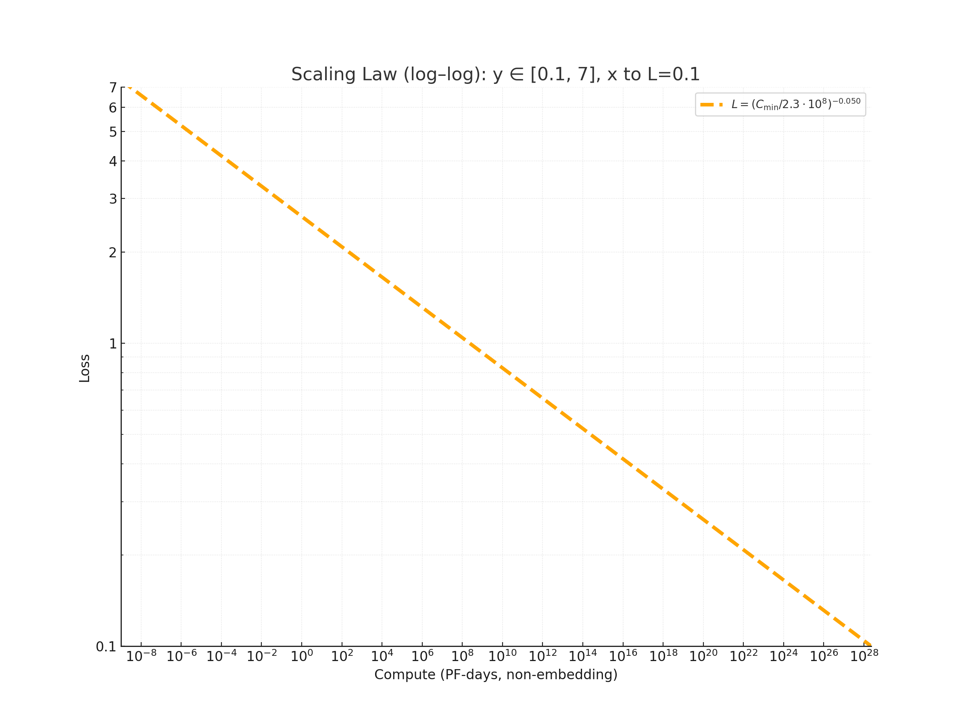
The power use of GPT-5 to handle 2.5 billion daily queries equals to the daily electricity demand of about 1.5 million US homes. (by one estimate)
Beneath the smooth curve: lower loss comes at exponential computational cost.
--The Guardian

Slide 60
What to remember
Deep learning models are rarely trained from scratch. Instead,
  Train on a large supervised dataset and fine-tune on target tasks, e.g. ImageNet-based models
  Train on a large unsupervised dataset and fine-tune on target tasks, e.g. BERT
  Train on a large unsupervised dataset and apply to target tasks without fine-tuning, e.g. CLIP and GPT
With large-scale training and the right formulations, models can perform a range of tasks including those not explicitly trained
CLIP shows that learning to match images to text produces a good zero-shot classifier and an excellent image encoder
GPT demonstrates that learning to predict the next word produces a flexible zero-shot and few-shot general language task performer

Slide 61
Coming up
Exam: Thurs to Sunday
Applications
  Ethics and Impact of AI
  Bias and Fairness
  Audio and 1D signals
  Real-world Applications in ML, with guest speaker Chenxi Yu

