Slide 1

Transformers in Language and Vision
Applied Machine Learning
Derek Hoiem
Dall-E

Slide 2
Self-attention, in simple words
Project the input token values into query, key, and value vectors using (linear) weight matrices
Using keys and queries, compare each input token to all the tokens (including itself) to get a similarity score
Replace the input values with a similarity-weighted sum of all values

Slide 3
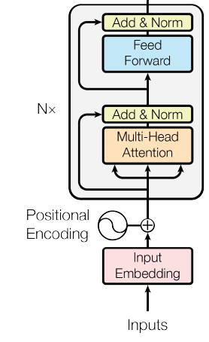
Transformers: general data processors
Input tokens can represent anything: image patches, text tokens, audio, controls, etc.
Invariant to order of tokens: add positional embedding to distinguish pos/type of input
Transformer block:
  Apply multi-head attention
  Apply 2-layer MLP with ReLU to each token separately
  Residual and layer norm (over all tokens) after each
Can stack any number of transformer blocks
Attention is all you need

Slide 4
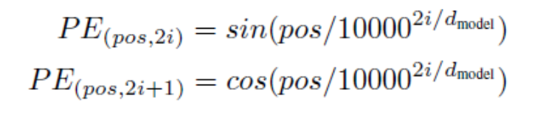
Positional encodings
Transformer processing does not depend on position of token
  This is kind of similar to convolution, as each “patch” or token vector is processed independently, but no overlap between patches
  But to compare between tokens, relative position may be important
Sinusoidal encoding (on right) is such that a dot product between encodings corresponds to positional similarity
Learned or even fixed random encodings also work similarly in practice

Slide 5
Remember from last class
Learned vector embeddings of these integers model the relationships between words
Stacked transformer blocks are a powerful network architecture that alternates attention and MLPs
Sub-word tokenization based on byte-pair encoding is an effective way to turn natural text into a sequence of integers
Attention is a general processing mechanism that regresses or clusters values
Chair is broken →
ch##, ##air, is, brok##, ##en
Paris – France + Italy = Rome
Input (k,q,v) | iter 1 | iter 2 | iter 3 | iter 4
1.000 | 1.497 | 1.818 | 1.988 | 2.147
9.000 | 8.503 | 8.182 | 8.012 | 7.853
8.000 | 8.128 | 8.141 | 8.010 | 7.853
2.000 | 1.872 | 1.859 | 1.990 | 2.147
Further reading: http://nlp.seas.harvard.edu/annotated-transformer/

Slide 6

Q1
https://tinyurl.com/AML441-L19

Slide 7
Today’s Lecture
Language Transformer architecture
BERT: Large Language Model
ViT (Vision Transformer): Image classification
CNN vs Transformer comparison
Unified-IO: Sequence-to-sequence vision-language

Slide 8
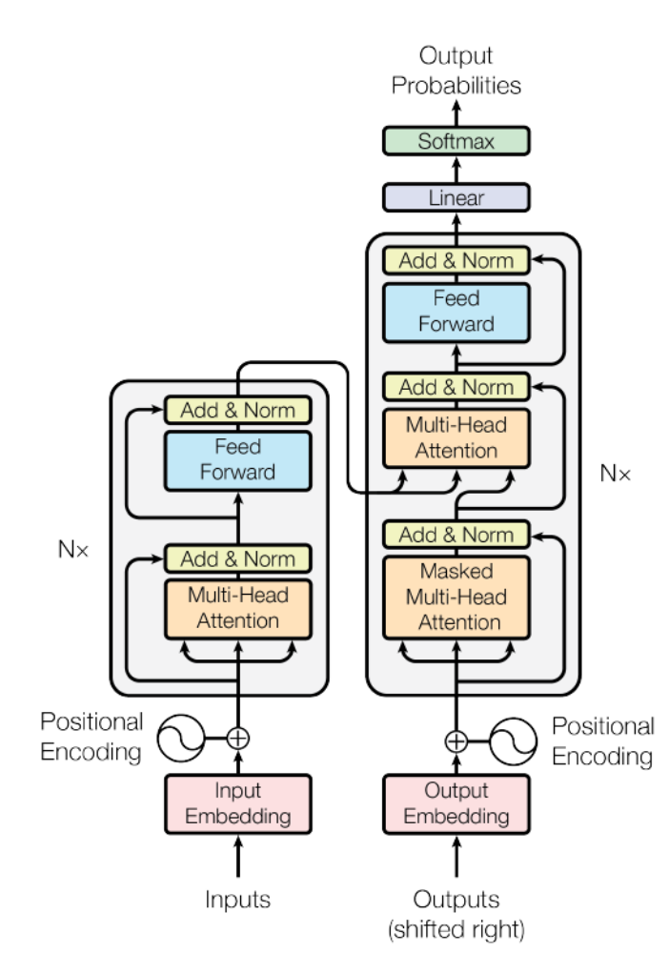
Language Transformer: Complete Architecture
WordPiece tokens (integers) are mapped to learned 512-d vectors
Positional encoding added to each vector
N=6 transformer blocks applied to input
Until <EOS> is output:
  Process input + output so far
  Output most likely word (after more attention blocks and linear model)
Encoder/decoder architecture for sequence to sequence tasks
Decoder
Encoder
Cross-Attention
Self-Attention
Self-Attention
Attention is all you need

Slide 9
Output Probabilities
Next-token probabilities (top 5)
Softmax
over the vocabulary
Linear
Add & Norm
Feed
Forward
Example: translating the French le chat noir into English.
Click to step through how the output is generated one token at a time.
Add & Norm
Add & Norm
Feed
Forward
Multi-Head
Attention
N×
N×
Add & Norm
Add & Norm
Multi-Head
Attention
Masked
Multi-Head Attention
Generated output
Positional
Encoding
Positional
Encoding
fed back as the
next decoder input
Input
Embedding
Output
Embedding
block currently computing
encoder output (reused)
Inputs (source)
Outputs (shifted right)
generated token

Slide 10
Output Probabilities
Next-token probabilities (top 5)
Softmax
over the vocabulary
Linear
encoder output (keys & values):
computed once, reused every step
Add & Norm
Feed
Forward
Encoder (runs once). The encoder reads the whole source sentence in one pass. Its output is computed once and reused by cross-attention at every decoding step.
Add & Norm
Add & Norm
Feed
Forward
Multi-Head
Attention
N×
N×
Add & Norm
Add & Norm
Multi-Head
Attention
Masked
Multi-Head Attention
Generated output
Positional
Encoding
Positional
Encoding
fed back as the
next decoder input
Input
Embedding
Output
Embedding
block currently computing
le
chat
noir
encoder output (reused)
Inputs (source)
Outputs (shifted right)
generated token

Slide 11
Output Probabilities
Next-token probabilities (top 5)
Softmax
over the vocabulary
the
0.62
a
0.15
Linear
black
0.09
Add & Norm
cat
0.05
encoder output (keys & values):
computed once, reused every step
Feed
Forward
le
0.03
Step 1 of 4 — run the decoder. Decoder input: <s>. The decoder outputs a probability for every word in the vocabulary.
Add & Norm
Add & Norm
Feed
Forward
Multi-Head
Attention
N×
N×
Add & Norm
Add & Norm
Multi-Head
Attention
Masked
Multi-Head Attention
Generated output
Positional
Encoding
Positional
Encoding
fed back as the
next decoder input
Input
Embedding
Output
Embedding
block currently computing
le
chat
noir
<s>
encoder output (reused)
Inputs (source)
Outputs (shifted right)
generated token

Slide 12
Output Probabilities
Next-token probabilities (top 5)
Softmax
over the vocabulary
the
0.62
a
0.15
Linear
black
0.09
Add & Norm
cat
0.05
encoder output (keys & values):
computed once, reused every step
Feed
Forward
le
0.03
Step 1 of 4 — pick & feed back. The most likely word, the, is appended to the output and fed back in (shifted right) as the next decoder input.
Add & Norm
Add & Norm
Feed
Forward
Multi-Head
Attention
N×
N×
Add & Norm
Add & Norm
Multi-Head
Attention
Masked
Multi-Head Attention
Generated output
the
Positional
Encoding
Positional
Encoding
fed back as the
next decoder input
Input
Embedding
Output
Embedding
block currently computing
le
chat
noir
<s>
the
encoder output (reused)
Inputs (source)
Outputs (shifted right)
generated token

Slide 13
Output Probabilities
Next-token probabilities (top 5)
Softmax
over the vocabulary
black
0.71
cat
0.12
Linear
dark
0.07
Add & Norm
the
0.03
encoder output (keys & values):
computed once, reused every step
Feed
Forward
</s>
0.02
Step 2 of 4 — run the decoder. Decoder input: <s> the. The decoder outputs a probability for every word in the vocabulary. Masked self-attention lets each position look only at earlier tokens.
Add & Norm
Add & Norm
Feed
Forward
Multi-Head
Attention
N×
N×
Add & Norm
Add & Norm
Multi-Head
Attention
Masked
Multi-Head Attention
Generated output
the
Positional
Encoding
Positional
Encoding
fed back as the
next decoder input
Input
Embedding
Output
Embedding
block currently computing
le
chat
noir
<s>
the
encoder output (reused)
Inputs (source)
Outputs (shifted right)
generated token

Slide 14
Output Probabilities
Next-token probabilities (top 5)
Softmax
over the vocabulary
black
0.71
cat
0.12
Linear
dark
0.07
Add & Norm
the
0.03
encoder output (keys & values):
computed once, reused every step
Feed
Forward
</s>
0.02
Step 2 of 4 — pick & feed back. The most likely word, black, is appended to the output and fed back in (shifted right) as the next decoder input.
Add & Norm
Add & Norm
Feed
Forward
Multi-Head
Attention
N×
N×
Add & Norm
Add & Norm
Multi-Head
Attention
Masked
Multi-Head Attention
Generated output
the
black
Positional
Encoding
Positional
Encoding
fed back as the
next decoder input
Input
Embedding
Output
Embedding
block currently computing
le
chat
noir
<s>
the
black
encoder output (reused)
Inputs (source)
Outputs (shifted right)
generated token

Slide 15
Output Probabilities
Next-token probabilities (top 5)
Softmax
over the vocabulary
cat
0.83
dog
0.05
Linear
kitten
0.04
Add & Norm
black
0.02
encoder output (keys & values):
computed once, reused every step
Feed
Forward
</s>
0.02
Step 3 of 4 — run the decoder. Decoder input: <s> the black. The decoder outputs a probability for every word in the vocabulary. The next-token prediction is read from the last position.
Add & Norm
Add & Norm
Feed
Forward
Multi-Head
Attention
N×
N×
Add & Norm
Add & Norm
Multi-Head
Attention
Masked
Multi-Head Attention
Generated output
the
black
Positional
Encoding
Positional
Encoding
fed back as the
next decoder input
Input
Embedding
Output
Embedding
block currently computing
le
chat
noir
<s>
the
black
encoder output (reused)
Inputs (source)
Outputs (shifted right)
generated token

Slide 16
Output Probabilities
Next-token probabilities (top 5)
Softmax
over the vocabulary
cat
0.83
dog
0.05
Linear
kitten
0.04
Add & Norm
black
0.02
encoder output (keys & values):
computed once, reused every step
Feed
Forward
</s>
0.02
Step 3 of 4 — pick & feed back. The most likely word, cat, is appended to the output and fed back in (shifted right) as the next decoder input.
Add & Norm
Add & Norm
Feed
Forward
Multi-Head
Attention
N×
N×
Add & Norm
Add & Norm
Multi-Head
Attention
Masked
Multi-Head Attention
Generated output
the
black
cat
Positional
Encoding
Positional
Encoding
fed back as the
next decoder input
Input
Embedding
Output
Embedding
block currently computing
le
chat
noir
<s>
the
black
cat
encoder output (reused)
Inputs (source)
Outputs (shifted right)
generated token

Slide 17
Output Probabilities
Next-token probabilities (top 5)
Softmax
over the vocabulary
</s>
0.88
.
0.06
Linear
is
0.02
Add & Norm
sat
0.01
encoder output (keys & values):
computed once, reused every step
Feed
Forward
cat
0.01
Step 4 of 4 — run the decoder. Decoder input: <s> the black cat. The decoder outputs a probability for every word in the vocabulary.
Add & Norm
Add & Norm
Feed
Forward
Multi-Head
Attention
N×
N×
Add & Norm
Add & Norm
Multi-Head
Attention
Masked
Multi-Head Attention
Generated output
the
black
cat
Positional
Encoding
Positional
Encoding
fed back as the
next decoder input
Input
Embedding
Output
Embedding
block currently computing
le
chat
noir
<s>
the
black
cat
encoder output (reused)
Inputs (source)
Outputs (shifted right)
generated token

Slide 18
Output Probabilities
Next-token probabilities (top 5)
Softmax
over the vocabulary
</s>
0.88
.
0.06
Linear
is
0.02
Add & Norm
sat
0.01
encoder output (keys & values):
computed once, reused every step
Feed
Forward
cat
0.01
Step 4 of 4 — stop. The end-of-sequence token </s> is chosen, so generation stops. Final output: the black cat.
Encoder: 1 pass. Decoder: 1 pass per generated token.
Add & Norm
Add & Norm
Feed
Forward
Multi-Head
Attention
N×
N×
Add & Norm
Add & Norm
Multi-Head
Attention
Masked
Multi-Head Attention
Generated output
the
black
cat
</s>
Positional
Encoding
Positional
Encoding
fed back as the
next decoder input
Input
Embedding
Output
Embedding
block currently computing
le
chat
noir
<s>
the
black
cat
encoder output (reused)
Inputs (source)
Outputs (shifted right)
generated token

Slide 19
Output Probabilities
Next-token probabilities (top 5)
over the vocabulary
the
black
cat
</s>
0.62
0.71
0.83
Softmax
0.88
a
cat
dog
.
0.05
0.06
0.12
0.15
Linear
black
dark
kitten
is
0.02
0.04
0.07
0.09
cat
the
black
sat
0.01
0.02
0.03
Add & Norm
0.05
encoder output (keys & values):
computed once, reused every step
le
</s>
</s>
cat
0.01
0.02
0.02
Feed
Forward
0.03
Example: translating the French le chat noir into English.
Click to step through how the output is generated one token at a time.
Encoder (runs once). The encoder reads the whole source sentence in one pass. Its output is computed once and reused by cross-attention at every decoding step.
Step 1 of 4 — run the decoder. Decoder input: <s>. The decoder outputs a probability for every word in the vocabulary.
Step 1 of 4 — pick & feed back. The most likely word, the, is appended to the output and fed back in (shifted right) as the next decoder input.
Step 2 of 4 — run the decoder. Decoder input: <s> the. The decoder outputs a probability for every word in the vocabulary. Masked self-attention lets each position look only at earlier tokens.
Step 2 of 4 — pick & feed back. The most likely word, black, is appended to the output and fed back in (shifted right) as the next decoder input.
Step 3 of 4 — run the decoder. Decoder input: <s> the black. The decoder outputs a probability for every word in the vocabulary. The next-token prediction is read from the last position.
Step 3 of 4 — pick & feed back. The most likely word, cat, is appended to the output and fed back in (shifted right) as the next decoder input.
Step 4 of 4 — run the decoder. Decoder input: <s> the black cat. The decoder outputs a probability for every word in the vocabulary.
Step 4 of 4 — stop. The end-of-sequence token </s> is chosen, so generation stops. Final output: the black cat.
Encoder: 1 pass. Decoder: 1 pass per generated token.
Add & Norm
Add & Norm
Feed
Forward
Multi-Head
Attention
N×
N×
Add & Norm
Add & Norm
Multi-Head
Attention
Masked
Multi-Head Attention
Generated output
the
the
black
black
cat
cat
</s>
Positional
Encoding
Positional
Encoding
fed back as the
next decoder input
Input
Embedding
Output
Embedding
block currently computing
le
chat
noir
<s>
encoder output (reused)
Inputs (source)
Outputs (shifted right)
generated token
Notes:
Click 1: the encoder processes the whole source sentence once; its output (purple) feeds every cross-attention layer in the decoder. Then each token takes two clicks: (a) the decoder runs on all tokens generated so far (red highlight) and produces a probability distribution for the next token; (b) the most likely token is appended to the output and copied back to the decoder input, shifted one position right. Generation stops when </s> is produced. Probabilities are illustrative. Note: in practice a KV cache avoids recomputing earlier positions, but conceptually the decoder sees the whole prefix.

Slide 20
Application to Translation
English-German
  4.5M sentence pairs
  37K tokens
English-French
  36M sentences
  32K tokens
Base models trained on 8 P100s for 12 hours
Big models (2x token dim, 3x training steps) trained for 3.5 days
Adam optimizer: learning rate ramps up for 4K iterations, then down
Regularization: drop-out, L2 weight, label smoothing
Cross-Attention
Self-Attention
Self-Attention
Attention is all you need

Slide 21
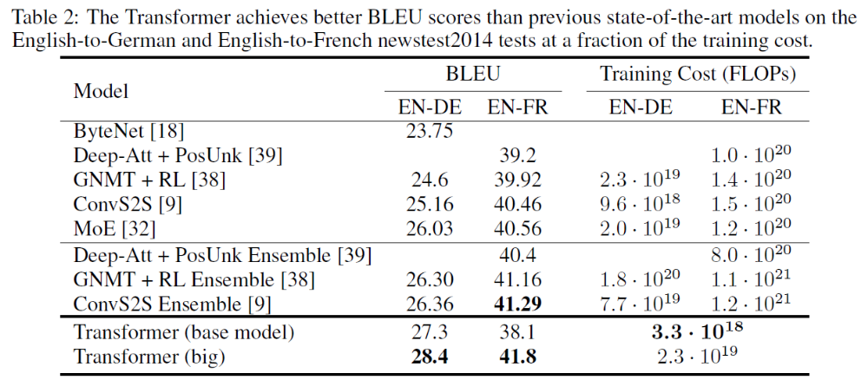
Results

Slide 22
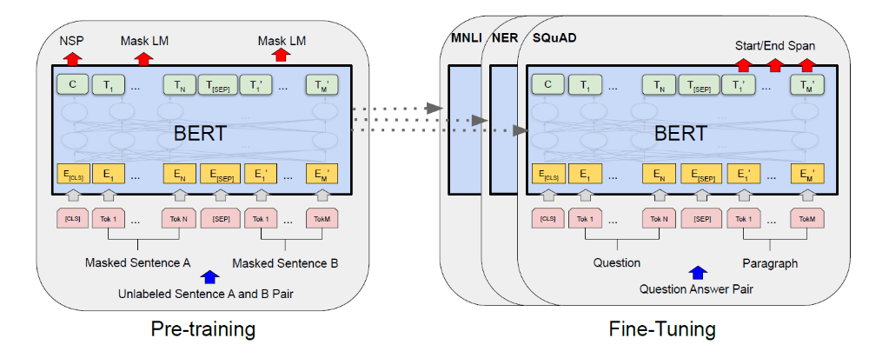
BERT (Devlin et al. 2019)
https://arxiv.org/abs/1810.04805

Slide 23
Why is BERT worth knowing?
(150K+ citations)
BERT is a significant breakthrough in NLP
  One of the first LLMs
  Transformer-based architecture
  Pre-training on large amounts of text data via masking objective
  Fine-tuned to achieve SotA for many tasks
  Still widely used

Slide 24
Overview of BERT
Uses standard transformer blocks, encoder only
  Base: 12 layers, 768-dim, 12 heads; 110M parameters
  Large: 24 layers, 1024-dim, 16 heads; 340M parameters
WordPiece: 30K tokens
  Special [CLS] and [SEP] tokens
  Positional and sentence embeddings
Pre-trained with masked language modeling (MLM) and next sentence prediction
Fine-tuned for other tasks

Slide 25
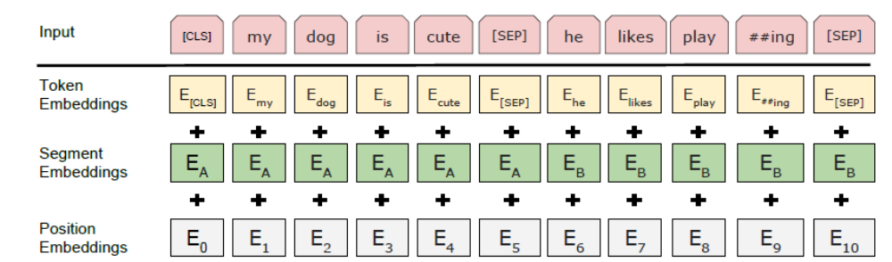
BERT: Input representation
WordPiece: 30K tokens
  Special tokens
    [CLS] at start to encode sentence summary
    [SEP] to separate sentences or question and answer
  Positional and sentence embeddings

Slide 26
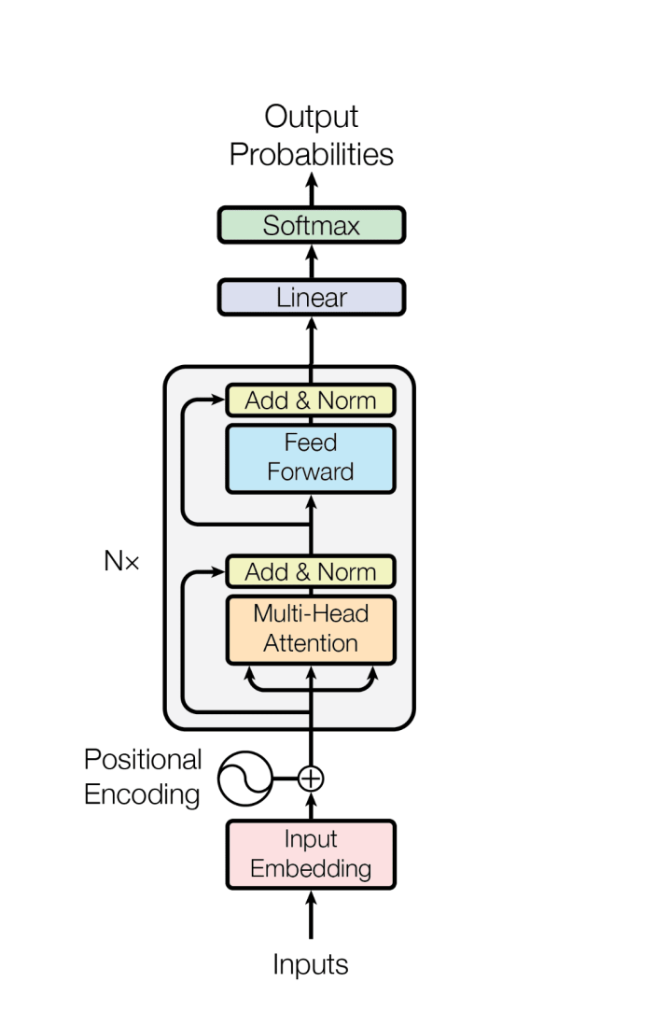
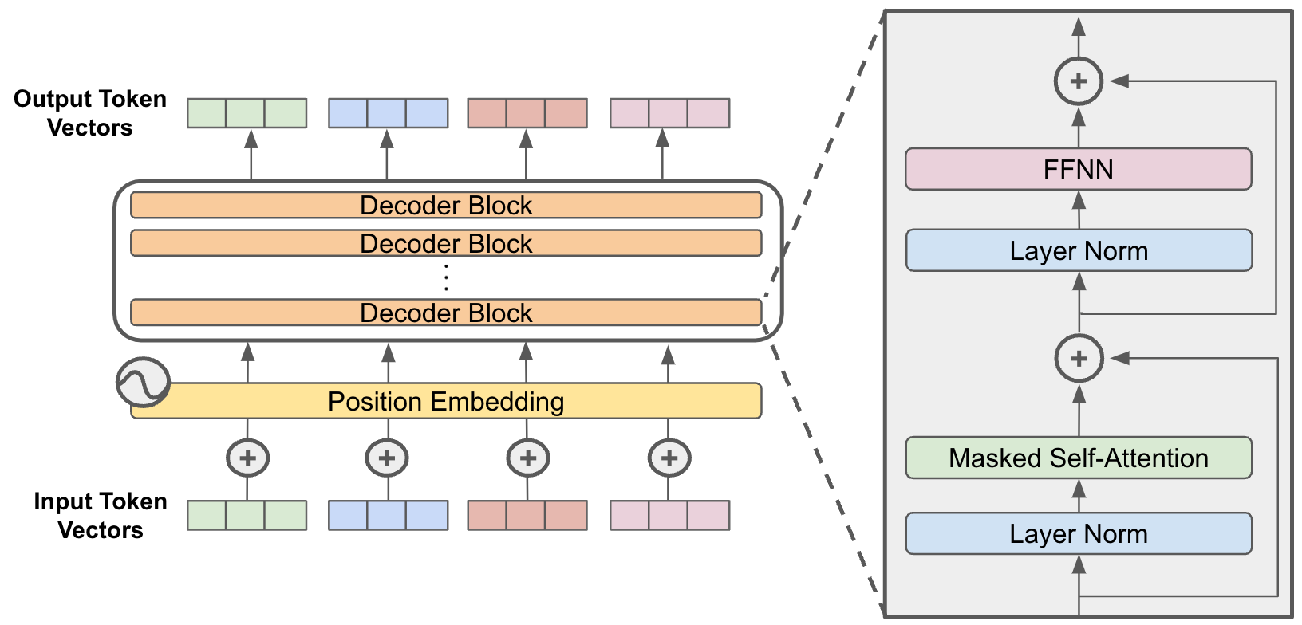
“Encoder-only” and “Decoder-only” architectures
Encoder-only (e.g. BERT): Each token attends to all input tokens (bidirectional). May output a single vector (CLS) or one per token.
Decoder-only (e.g. GPT): Each token attends to only the preceding tokens (causal) and outputs a prediction of the next token.
Figure: https://cameronrwolfe.substack.com/p/decoder-only-transformers-the-workhorse
Figure: https://towardsdatascience.com/a-complete-guide-to-bert-with-code-9f87602e4a11/

Slide 27
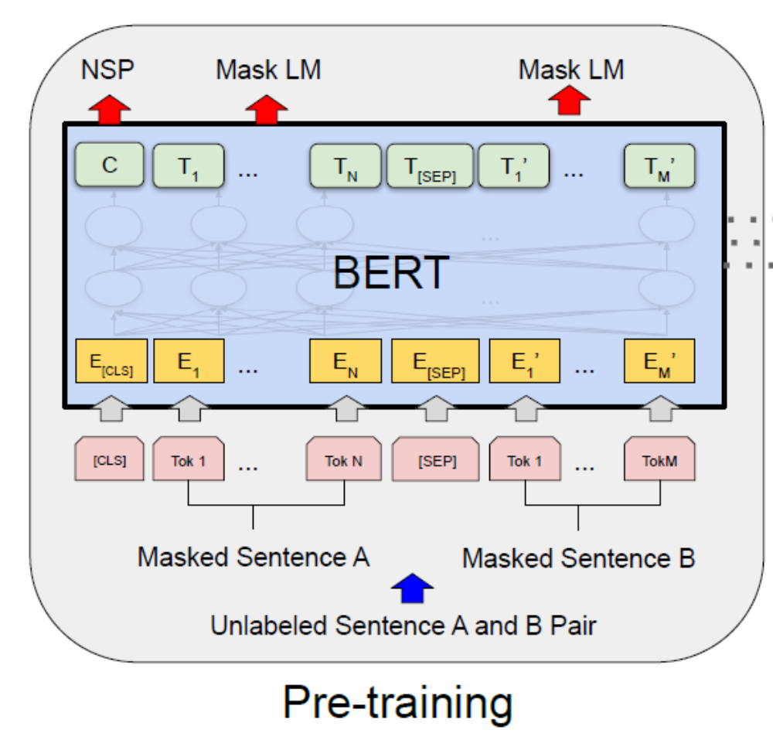
Pre-training with masked language modeling (MLM)
Randomly select 15% of text tokens to be “masked” and predicted by based on surrounding tokens
Masked tokens are replaced by
  [MASK] token (80% of the time)
  Random token (10%)
  Unchanged token (10%)
Only masked tokens are evaluated
Masking example:
[cls] My dog is cute [sep] He likes play ##ing [sep]
[cls] [MASK] dog is grave [sep] He likes play ##ing [sep]

Slide 28
Pre-training with next sentence prediction
Input is two sentences A and B
Replace B with a random sentence 50% of the time
Predict whether B is the original sentence or not (via [CLS] token)

Slide 29
Pre-training and fine-tuning
Pre-train on MLM and NSP tasks
  BooksCorpus: 800M words
  English Wikipedia: 2.5B words
  Important to use full documents, not just shuffled sentences
  BERT_{BASE} trained on 16 TPU chips; BERT_{LARGE} on 64 chips; 4 days each
Fine-tune on each task, takes a few hours on a GPU
  Paraphrasing
  Entailment
  Question answering
  …

Slide 30
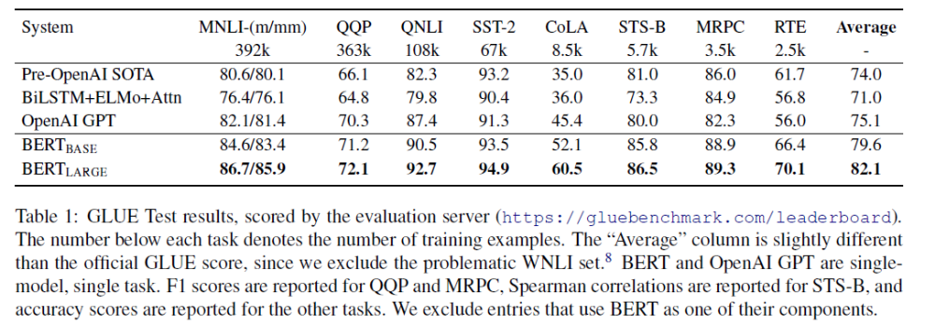
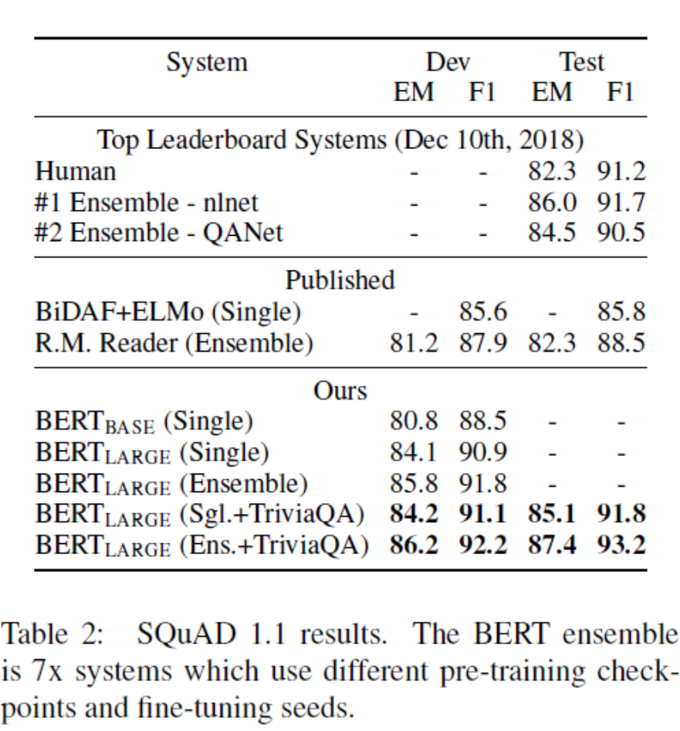
BERT results
SQuAD: question answering dataset
GLUE: General Language Understanding Evaluation – many tasks
MNLI: whether a sentence entails, contradicts, or is unrelated to another
QQP: whether two sentences are semantically equivalent
QNLI: question answering
SST-2: positive or negative sentiment
CoLA: whether sentence is grammatically correct
STS-B: sentence similarity score
MRPC: whether one sentence paraphrases another
RTE: whether a sentence entails a hypothesis

Slide 31
Key Take-aways from BERT
Bi-directional masked language modeling is highly effective pre-training
  Does not require supervision
  Learns general representations
Same idea has been adopted for vision, but with much higher masking ratio (~80% of patches masked)

Slide 32
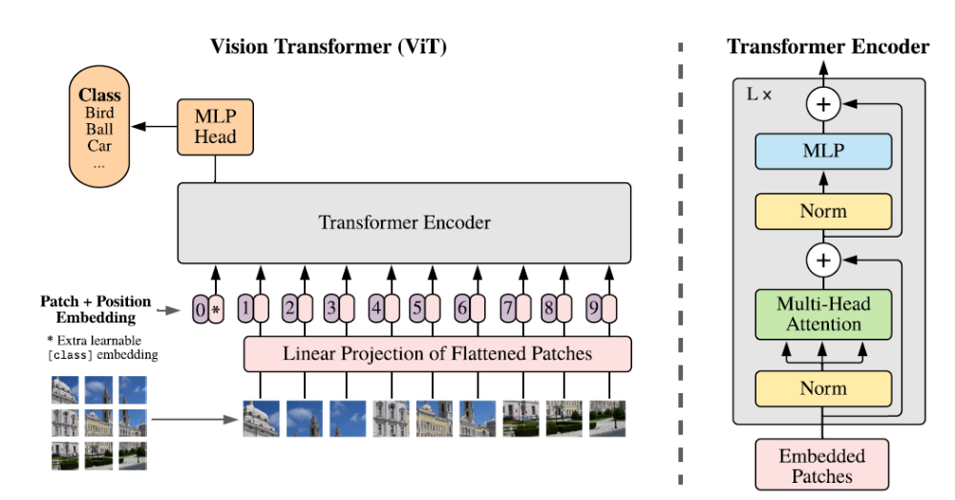
ViT: Vision Transformers (Dosovitskiy et al. 2021)
https://arxiv.org/abs/2010.11929

Slide 33
Why is ViT worth knowing about?
(100K+ citations)
Shows that the same exact Transformer blocks can be used for vision, paving the way for multimodal processing
Transformers work as well as CNNs but are more computationally efficient
Vision and language are easier to combine using transformers

Slide 34
ViT Overview
Image is divided into patches (e.g., 16x16)
Each patch projects into a fixed length vector
Positional encoding added to each patch
Extra [CLS] token to encode image summary
Multiple layers of standard transformer (same as for language)
For classification, final prediction is linear layer applied to [class] token

Slide 35
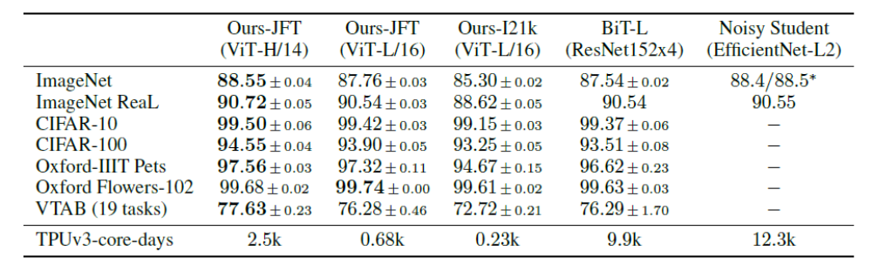
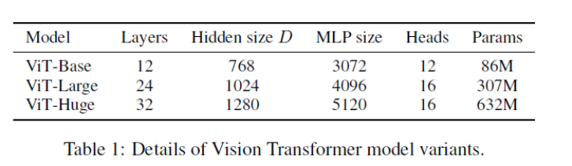
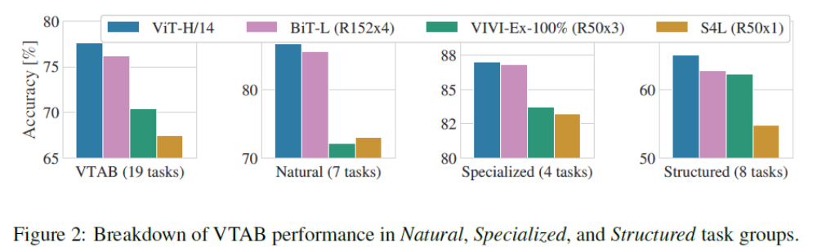
Different size models, same pretraining
Same model, different pretraining dataset
Big convolutional networks
$30K
$120K

Slide 36
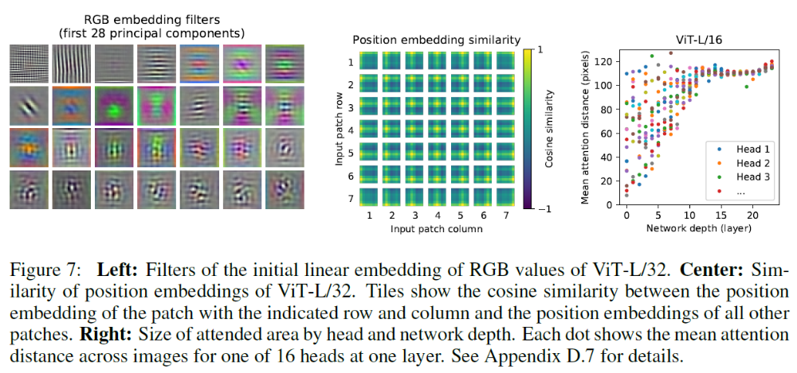
Information is integrated among distant patches

Slide 37
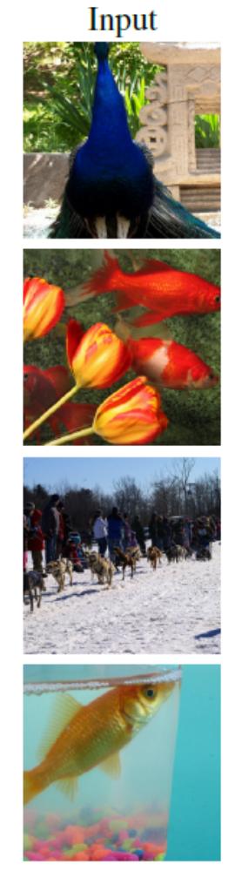
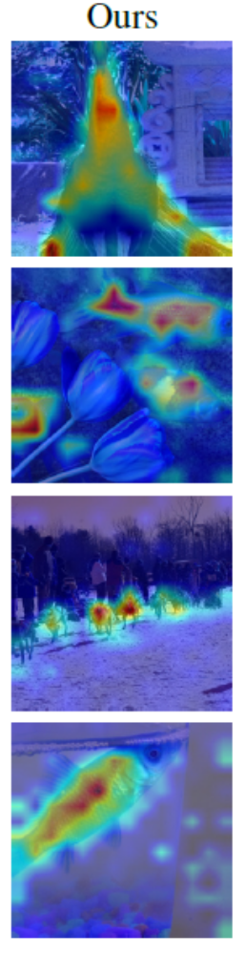
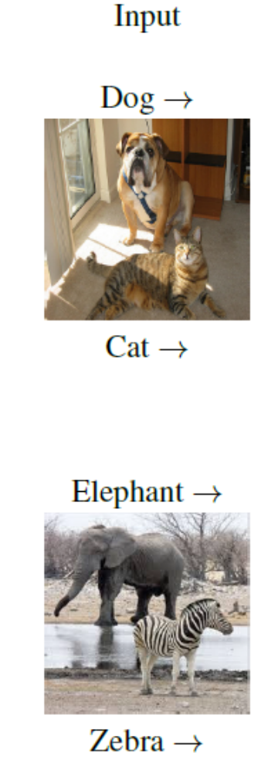
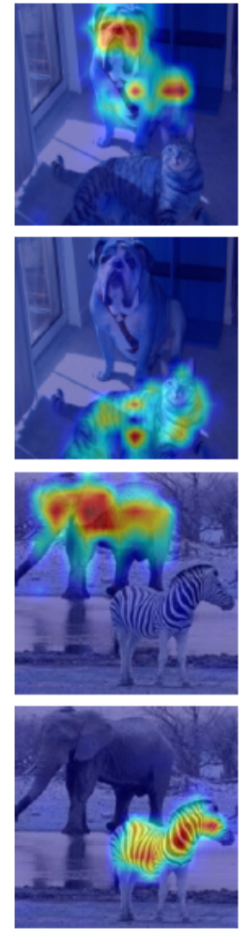
Visualizing transformer (Chefer et al. 2021)
Visualizations for overall and class-specific feature importance

Slide 38
CNNs vs. Transformers
CNNs encode position as an index in the feature map. Transformers do not care about index order but encode positional embeddings
  Even when positional embeddings are not used, transformer models still surprisingly work well (at least for vision)
CNNs encode a bias that nearby pixels are most related. Transformers enable combining information from distant patches, with positional embedding making it easy to learn that nearby patches are related
  CNNs can only use information in neighboring pixels/cells, but the receptive field (pixel area considered) grows larger as network gets deeper
In practice, CNNs and Transformers perform similarly for pure vision tasks given enough data; CNNs do better with less data, while Transformers scale more efficiently with large data and compute
  Hybrids are possible, e.g. apply shallow CNN before first patch embedding
Transformers operate on “tokens”, which is very general and can be applied to any modality

Slide 39
Q2-4
https://tinyurl.com/AML441-L19

Slide 40
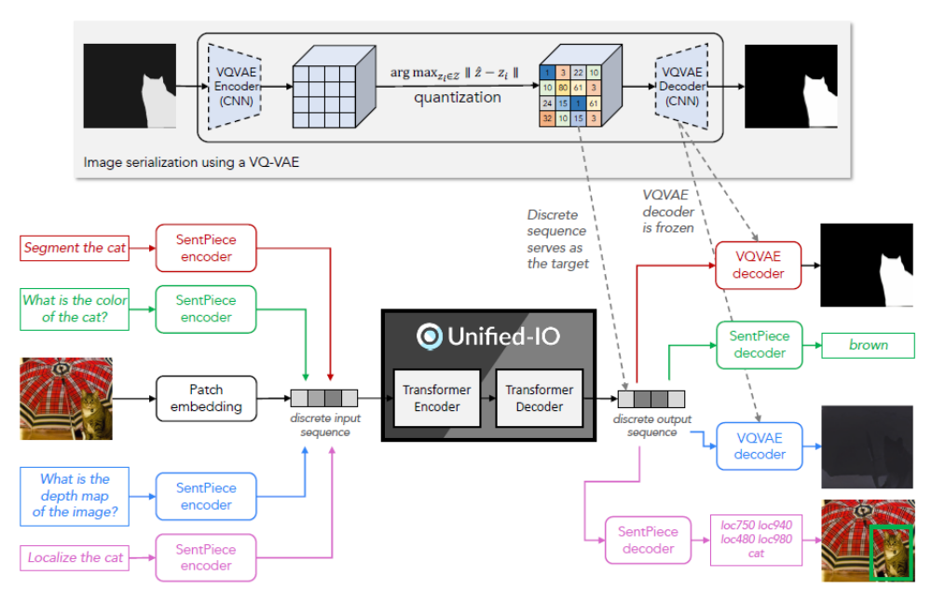
Unified-IO: <text, image> to <text, image> (Lu et al. 2022)
3B parameters
Pre-train on masked text and image completion for text, images, and image/caption pairs
Multitask training on 80 datasets
Unified-IO (June 2022)
https://unified-io.allenai.org/

Slide 41
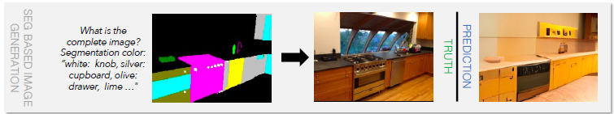
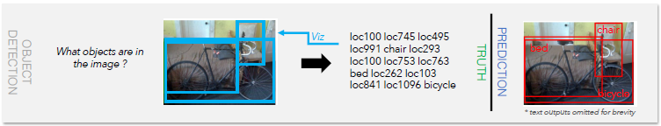
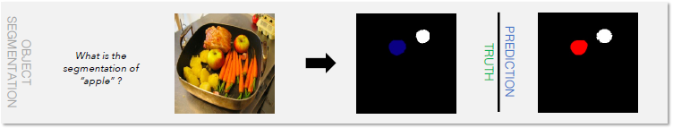
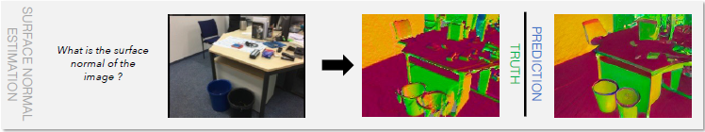
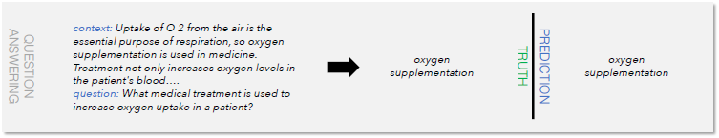
Vision tasks
Image synthesis from text / inpainting / segmentation
Image/object classification
Object detection, segmentation, keypoint estimation
Depth/normal estimation
Vision-language tasks
VQA, image/region captioning, referring expressions comprehension, relationship detection
NLP tasks
Question answering
Text classification

Slide 42
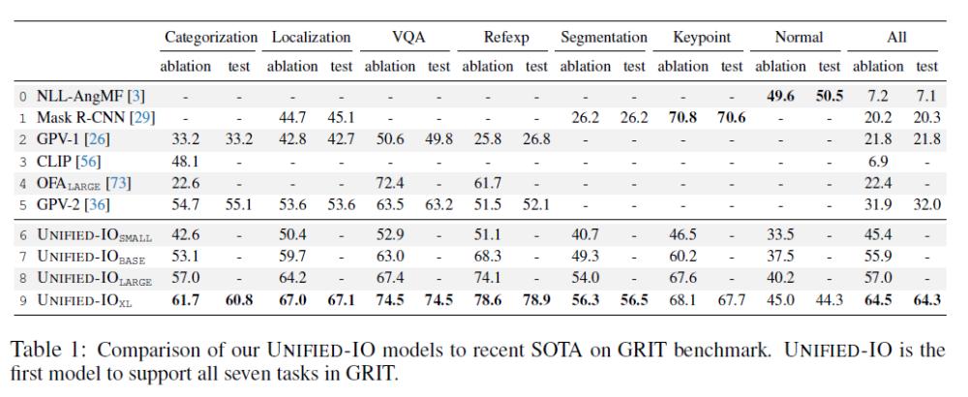
State-of-Art on GRIT

Slide 43
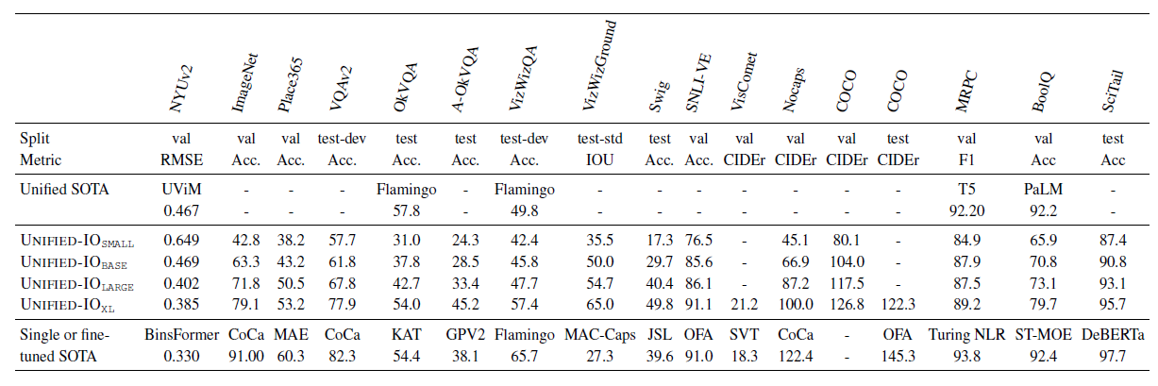
Often performs similarly or better than SotA single-task models

Slide 44
Explore demo of Unified IO 2 which extends to audio and multiple image inputs
https://unified-io-2.allenai.org/

Slide 45
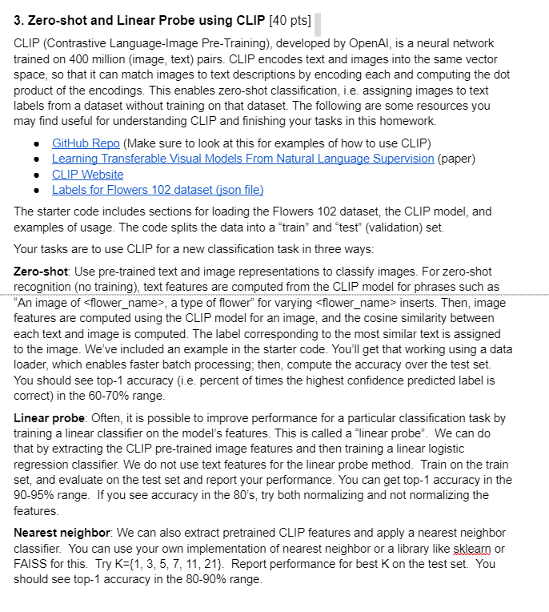
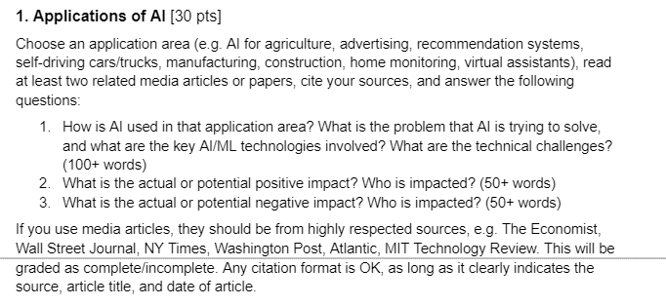
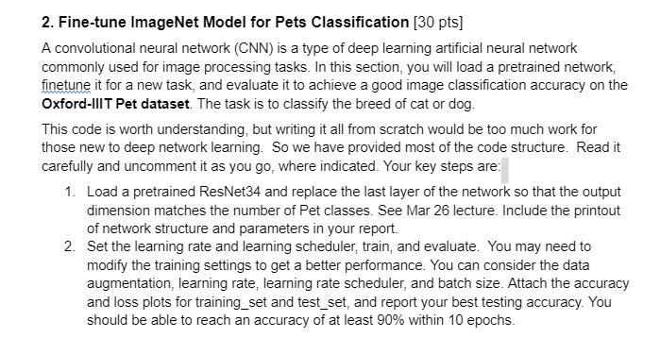
HW 5
(Coming soon)

Slide 46
Things to remember
Transformers are general data processors, applicable to text, vision, audio, control, and other domains
Pre-training to generate missing tokens in unsupervised text data learns a general model that can be fine-tuned
  Same idea is also applicable to other domains
Transformer architectures are state-of-art for vision and language individually
Arguably, the biggest benefit of transformers is ability to combine information from multiple domains

Slide 47
Next class: Foundation Models
CLIP
GPT line of work

