Slide 1

Word Representations and Transformers
Applied Machine Learning
Derek Hoiem
Dall-E

Slide 2
Reminders:
HW 4 due Nov 2
Exam 2 next Thurs-Sun (Nov 5-8)
Group project proposal due Nov 9 (very similar to practice form, will be up soon)

Slide 3
Today’s Lecture
Representing natural language text as integers
  Byte pair encoding
  WordPiece
Representing text tokens with continuous vectors
  Word2Vec
Attention and Transformers
  “Attention is all you need” transformers

Slide 4

Each pixel means little, but images can be interpreted by grouping and recognizing patterns in groups of groups of groups of pixels
https://www.istockphoto.com/photos/funny-animal

Slide 5
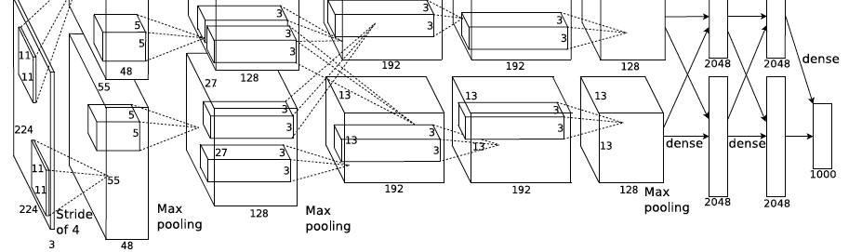
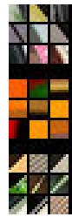
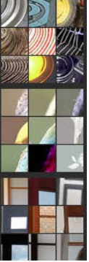
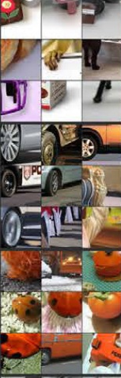
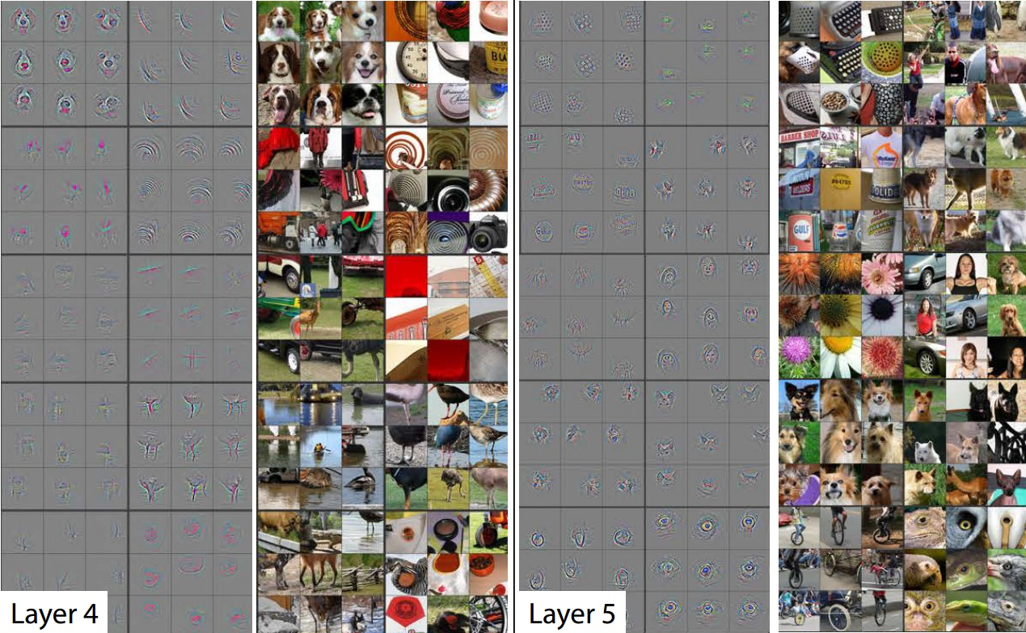
CNNs iteratively process pixels->edges/colors->textures->sub-parts->parts->objects/scenes
Examples of strongly activating regions

Slide 6
But in text, the meaning is already in the words… right?

Slide 7
What does this mean?
Usiadłem na kaktusie
Notes:
I sat on a cactus (Polish)

Slide 8
Which of these is more similar?
The chair says the department is broke.
He sat on the chair, and it broke.
After his sitting, the seat is broken.

Slide 9
Which of these is more similar?
The chair says the department is broke.
He sat on the chair, and it broke.
After his sitting, the seat is broken.

Slide 10
He sat on the chair, and it broke.
Same word (character sequence) may mean different things
Different words may mean similar things
Word meaning depends on associations and surrounding words
The chair says the department is broke.
After sitting, the seat is broken.

Slide 11
To analyze text, need to convert text to tokens
“Token”: an integer or vector that represents a data element, a unit of processing
With integer tokens, the values are not continuous (e.g. 5 is no closer to 10 than 5000)
With vector tokens, similarity/distance (typically L2, dot product or cosine) is meaningful

Slide 12
Word → Integer
Each unique space-delimited character string is assigned to a different integer
  To limit vocabulary size, assign only the most frequent words to integers
  Others are <unk> (unknown)
Pros and cons
  Simple
  Possible to compare/retrieve documents based on count of tokens
  Many words map to unknown (e.g. 1298, Bart’s, Area-52, anachronism, …)
  Large vocabulary needed
  Does not model similarity of related words like broke/broken
He sat on the chair, and it broke.
The chair says the department is broke.
After sitting, the seat is broken.

Slide 13
Character → Integer
Each character is assigned to a unique integer
Pros and cons
  Simple
  Every document within alphabet can be fully modeled
  Small vocabulary (< 100 integers needed for English)
  Sometimes, similar words will have similar sequences (broke/n)
  Count of tokens is not meaningful
  Character sequences are long

Slide 14
Subword → Integer
Common sequences of characters are assigned to unique integers
Pros and cons
  Every document within alphabet can be fully modeled
  Vocabulary size is flexible (e.g. 30K for BERT, 50K for GPT-3)
  Sometimes, similar words will have similar sequences (broke/n)
  Need to solve for good subword tokenization

Slide 15
Character
Subword
Word
“Chair is broken”
c, h, a, i, r, …
ch##, ##air, is, brok##, ##en
chair, is, broken
Vocabulary Size
256
4K-50K
> 30K
Completeness
Perfect
Perfect
Incomplete
Independent Meaningfulness
Bad
OK
Good
Medium
(e.g., 1.4 tokens per word)
Sequence Length
Long
A little shorter

Slide 16
Subword Tokenizers: Byte Pair Encoding
Start with each character assigned to a unique token
Iteratively assign a new token to the most common pair of consecutive tokens, until max_tokens is reached
Initial array of 4 characters
aaabdaaabac
Replace aa by Z
ZabdZabac
Z=aa
ZYdZYac
Y=ab
Z=aa
XZd →
ZYZd → aaabaad
Replace ab by Y
XdXac
X=ZY
Y=ab
Z=aa
Replace ZY by X
Example from Wikipedia

Slide 17
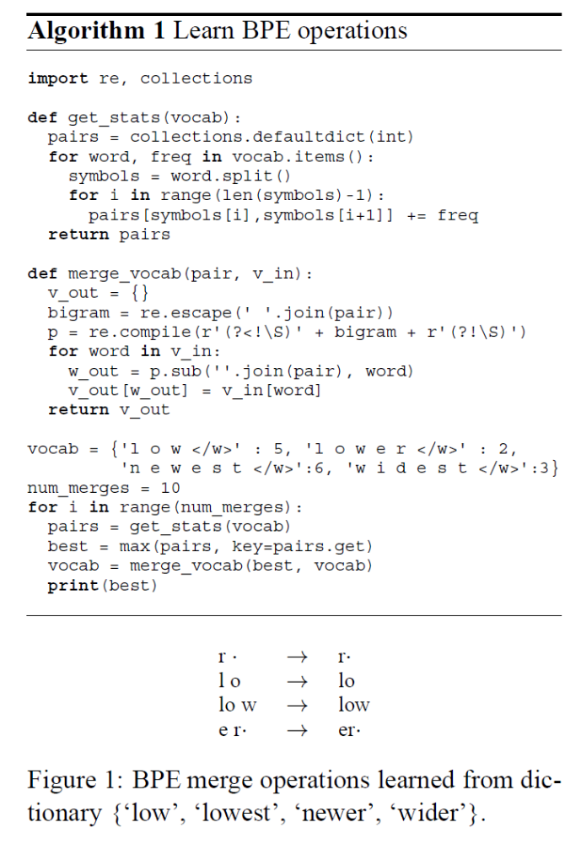
WordPiece Tokenizer (Sennrich et al., Wu et al. 2016)
Word: Jet makers feud over seat width with big orders at stake
wordpieces: _J et _makers _fe ud _over _seat _width _with _big _orders _at _stake
For each merge:
Count token pair frequencies in dataset
Select most frequent pair
Merge that “best” pair
  Assign best pair to new token
  Replace all instances of best pair in dataset with that token
https://arxiv.org/abs/1508.07909
https://arxiv.org/pdf/1609.08144.pdf

Slide 18
Try it
For each merge:
Count token pair frequencies in dataset
Select most frequent pair
Merge that “best” pair
  Assign best pair to new token
  Replace all instances of best pair in dataset with that token
Do first two merges of:
Your cat cannot do the can-can, can he?
_Your _cat _cannot _do _the _can-can, _can he?
_Your _Xt _Xnnot _do _the _Xn-Xn, _Xn _he?
_Your _Xt _Znot _do _the _Z-Z, _Z, _he?

Slide 19
How can we better encode word similarity?
Different words are related to each other
Encode “meaning” in a continuous vector
Learn these vectors based on surrounding words

Slide 20
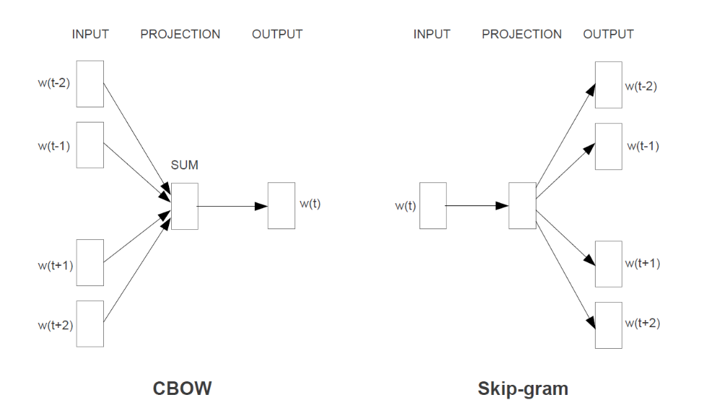
Word2Vec (Mikolov et al. 2013)
For each word, solve for a continuous vector representation:
CBOW: predict center word as average of surrounding words (after projecting each word to a vector)
Skip-Gram: each word (after projecting to a vector) predicts each surrounding word with a linear model
Train by gradient descent
At the end, each word integer can be replaced by a fixed-length continuous vector
https://arxiv.org/pdf/1301.3781.pdf

Slide 21
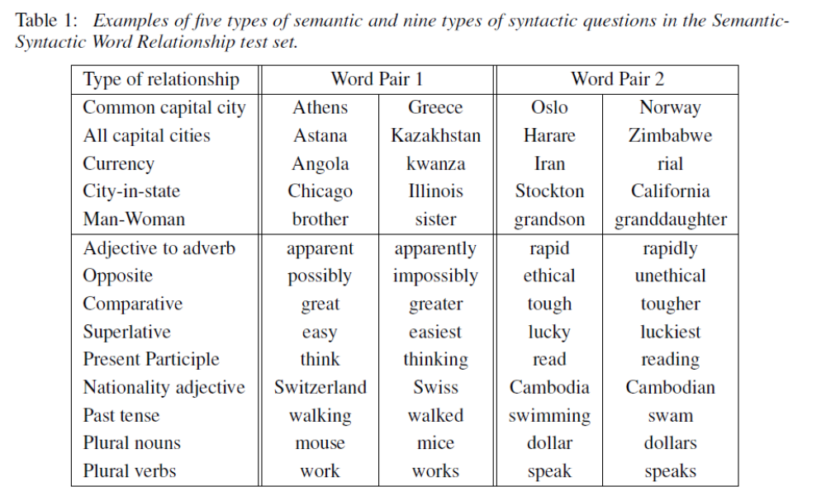
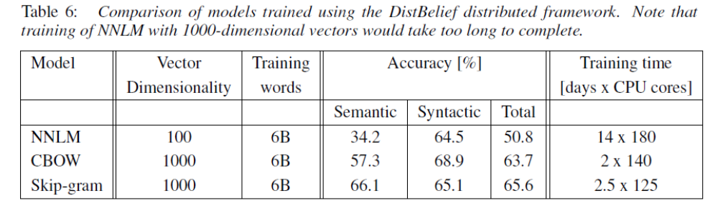
Word vectors predict word relationships

Slide 22
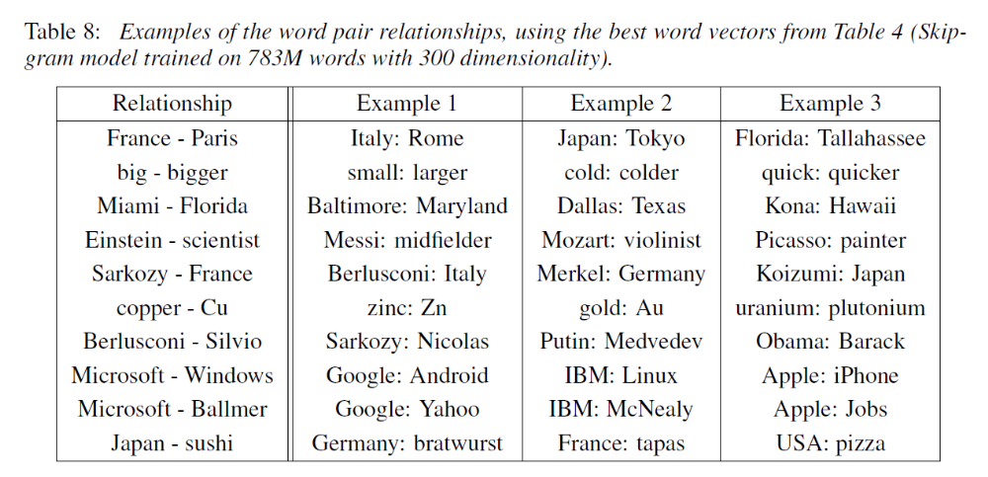
Word2Vec predicted relationship examples
E.g., Paris – France + Italy = Rome

Slide 23
Word2Vec demos
https://turbomaze.github.io/word2vecjson (fastest)
https://www.cs.cmu.edu/~dst/WordEmbeddingDemo/ (best)
https://remykarem.github.io/word2vec-demo/ (training)

Slide 24

Q1-Q3
https://tinyurl.com/441AML-L18

Slide 25
A new type of data processing
Linear: output is sum of weights times features
Convolution: output at each position is sum of weights times features within a sliding window
Attention: average of values, weighted by key-query similarity

Slide 26
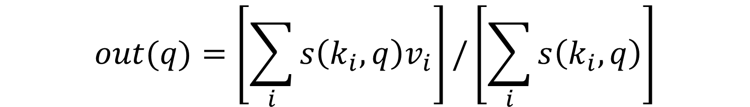
Attention
<key k, value v>: a data pair, in which key is used for matching and value is used to output
<query q>: used to match keys and accumulate values
$$out(q)=\left[\sum_{i}{s\left(k_{i}, q\right)v_{i}}\right]/\left[\sum_{i}{s\left(k_{i}, q\right)}\right]$$
Similarity of ith key and query
ith value
Make similarities sum to 1
The new value of a token is a weighted average of all token values, weighted by the similarity of their keys to its query

Slide 27
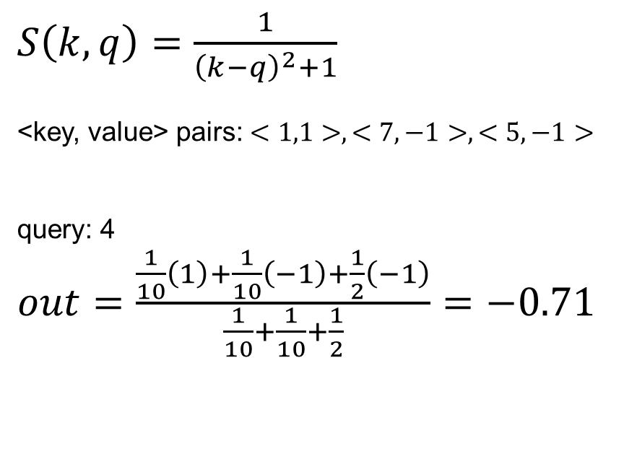
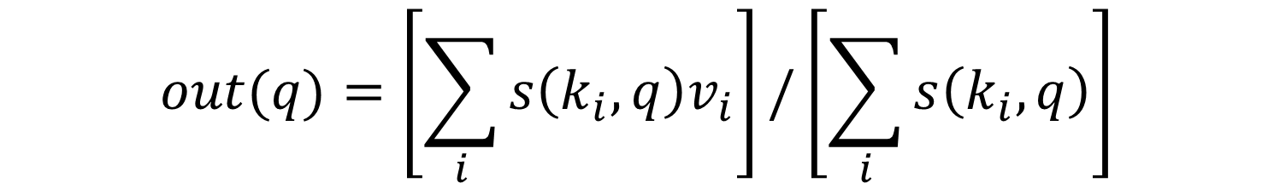
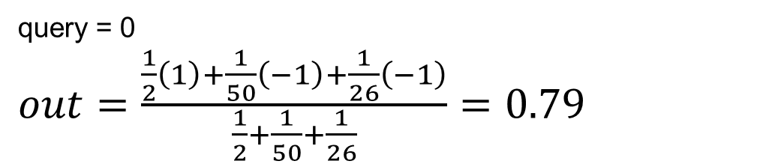
Attention simple example
$$out(q)=\left[\sum_{i}{s\left(k_{i}, q\right)v_{i}}\right]/\left[\sum_{i}{s\left(k_{i}, q\right)}\right]$$
$S\left(k,q\right)=\frac{1}{{\left(k−q\right)}^{2}+1}$
<key, value> pairs: $<1,1>, <7, −1>, <5,−1>$
query: 4
$out=\frac{\frac{1}{10}\left(1\right)+\frac{1}{10}\left(−1\right)+\frac{1}{2}\left(−1\right)}{\frac{1}{10}+\frac{1}{10}+\frac{1}{2}}=−0.71$
query = 0
$out=\frac{\frac{1}{2}\left(1\right)+\frac{1}{50}\left(−1\right)+\frac{1}{26}\left(−1\right)}{\frac{1}{2}+\frac{1}{50}+\frac{1}{26}}=0.79$

Slide 28

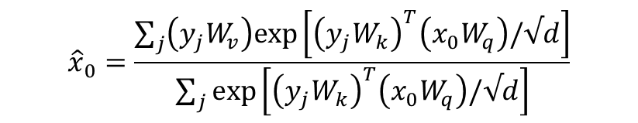












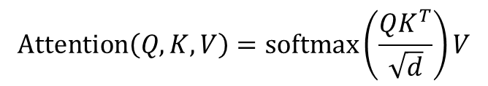
Cross-Attention: each input token acquires the values of the cross-attended tokens, weighted by key-query similarity
$${\hat{x}}_{0}$$
$${\hat{x}}_{1}$$
$${\hat{x}}_{2}$$
$$\text{Attention}\left(Q,K,V\right)=\text{softmax}\left(\frac{QK^{T}}{\sqrt{d}}\right)V$$
$$y_{0}$$
$y_{0}W_{k}$, $y_{0}W_{v}$
Compute key, value per token (multiply by K, V)
$${\hat{x}}_{0}=\frac{\sum_{j}{\left(y_{j}W_{v}\right)exp\left[{\left(y_{j}W_{k}\right)}^{T}\left(x_{0}W_{q}\right)/√d\right]}}{\sum_{j}{exp\left[{\left(y_{j}W_{k}\right)}^{T}\left(x_{0}W_{q}\right)/√d\right]}}$$
$$y_{1}$$
$y_{1}W_{k}$, $y_{1}W_{v}$
$$x_{0}W_{q}$$
$$x_{1}W_{q}$$
$$x_{2}W_{q}$$
Compute query per token (multiply by Q)
$$x_{0}$$
$$x_{1}$$
$$x_{2}$$

Slide 29





Cross-Attention: each input token acquires the values of the cross-attended tokens, weighted by key-query similarity
$${\hat{x}}_{0}$$
$${\hat{x}}_{1}$$
$${\hat{x}}_{2}$$
$$1×d$$
$$\text{Attention}\left(Q,K,V\right)=\text{softmax}\left(\frac{QK^{T}}{\sqrt{d}}\right)V$$
$$d×d$$
$$y_{0}$$
$y_{0}W_{k}$, $y_{0}W_{v}$
Compute key, value per token (multiply by K, V)
$${\hat{x}}_{0}=\frac{\sum_{j}{\left(y_{j}W_{v}\right)exp\left[{\left(y_{j}W_{k}\right)}^{T}\left(x_{0}W_{q}\right)/√d\right]}}{\sum_{j}{exp\left[{\left(y_{j}W_{k}\right)}^{T}\left(x_{0}W_{q}\right)/√d\right]}}$$
$$y_{1}$$
$y_{1}W_{k}$, $y_{1}W_{v}$
$$d×d$$
$$x_{0}W_{q}$$
$$x_{1}W_{q}$$
$$x_{2}W_{q}$$
Compute query per token (multiply by Q)
Linear projection by $W_{q}$
$$x_{0}$$
$$x_{1}$$
$$x_{2}$$
$$1×d$$

Slide 30

Cross-Attention: each input token acquires the values of the cross-attended tokens, weighted by key-query similarity
$${\hat{x}}_{0}$$
$${\hat{x}}_{1}$$
$${\hat{x}}_{2}$$
$$1×d$$
$$\text{Attention}\left(Q,K,V\right)=\text{softmax}\left(\frac{QK^{T}}{\sqrt{d}}\right)V$$
$$d×d$$
$$y_{0}$$
$y_{0}W_{k}$, $y_{0}W_{v}$
Compute key, value per token (multiply by K, V)
$${\hat{x}}_{0}=\frac{\sum_{j}{\left(y_{j}W_{v}\right)exp\left[{\left(y_{j}W_{k}\right)}^{T}\left(x_{0}W_{q}\right)/√d\right]}}{\sum_{j}{exp\left[{\left(y_{j}W_{k}\right)}^{T}\left(x_{0}W_{q}\right)/√d\right]}}$$
$$y_{1}$$
$y_{1}W_{k}$, $y_{1}W_{v}$
$$x_{0}W_{q}$$
$$x_{1}W_{q}$$
$$x_{2}W_{q}$$
Compute query per token (multiply by Q)
Linear projection by $W_{k}, W_{v}$
$$x_{0}$$
$$x_{1}$$
$$x_{2}$$

Slide 31
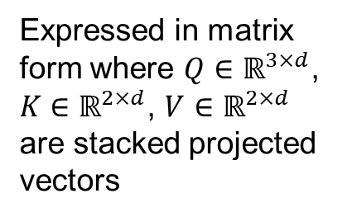
Cross-Attention: each input token acquires the values of the cross-attended tokens, weighted by key-query similarity
$${\hat{x}}_{0}$$
$${\hat{x}}_{1}$$
$${\hat{x}}_{2}$$
Expressed in matrix form where $Q∈ℝ^{3×d}$, $K$ $∈ℝ^{2×d}$, $V$ $∈ℝ^{2×d}$ are stacked projected vectors
$$\text{Attention}\left(Q,K,V\right)=\text{softmax}\left(\frac{QK^{T}}{\sqrt{d}}\right)V$$
$$y_{0}$$
$y_{0}W_{k}$, $y_{0}W_{v}$
Compute key, value per token (multiply by K, V)
$${\hat{x}}_{0}=\frac{\sum_{j}{\left(y_{j}W_{v}\right)exp\left[{\left(y_{j}W_{k}\right)}^{T}\left(x_{0}W_{q}\right)/√d\right]}}{\sum_{j}{exp\left[{\left(y_{j}W_{k}\right)}^{T}\left(x_{0}W_{q}\right)/√d\right]}}$$
$$y_{1}$$
$y_{1}W_{k}$, $y_{1}W_{v}$
$$x_{0}W_{q}$$
$$x_{1}W_{q}$$
$$x_{2}W_{q}$$
Compute query per token (multiply by Q)
$$x_{0}$$
$$x_{1}$$
$$x_{2}$$

Slide 32
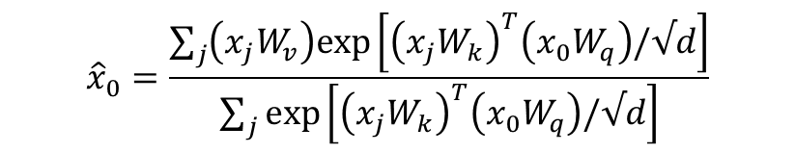

Self-Attention: each input token acquires the values of the input tokens, weighted by key-query similarity
$${\hat{x}}_{0}$$
$${\hat{x}}_{1}$$
$${\hat{x}}_{2}$$
$$\text{Attention}\left(Q,K,V\right)=\text{softmax}\left(\frac{QK^{T}}{\sqrt{d}}\right)V$$
Only difference is that each input token attends to all the input tokens, instead of a separate pool of cross-attention tokens
$${\hat{x}}_{0}=\frac{\sum_{j}{\left(x_{j}W_{v}\right)exp\left[{\left(x_{j}W_{k}\right)}^{T}\left(x_{0}W_{q}\right)/√d\right]}}{\sum_{j}{exp\left[{\left(x_{j}W_{k}\right)}^{T}\left(x_{0}W_{q}\right)/√d\right]}}$$
$$x_{0}W_{q},x_{0}W_{k},x_{0}W_{v}$$
Compute query/key/value per token (multiply by Q, K, V)
$$x_{0}$$
$$x_{1}$$
$$x_{2}$$

Slide 33
Attention
Cross-Attention: query tokens are separate from <key, value> tokens
  Performs instance-based regression
Self-Attention: query tokens are the same as the key and value tokens
  Performs soft clustering/aggregation
  Adding multi-dimensional vectors can overlay multiple types of information, not just blend or replace
Attention is extremely powerful and general when combined with learned similarity and MLPs

Slide 34
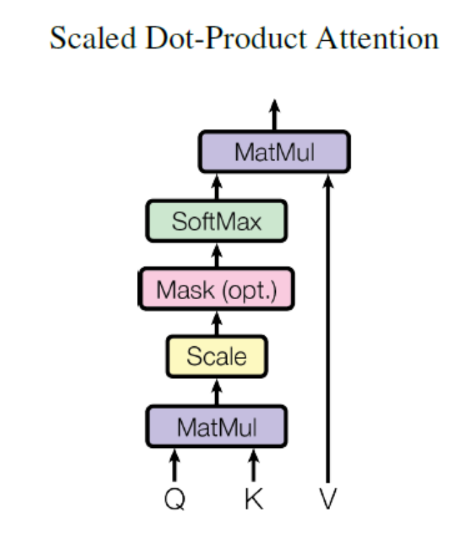
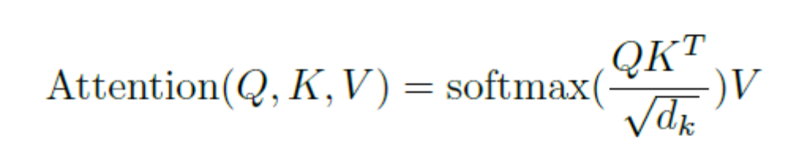
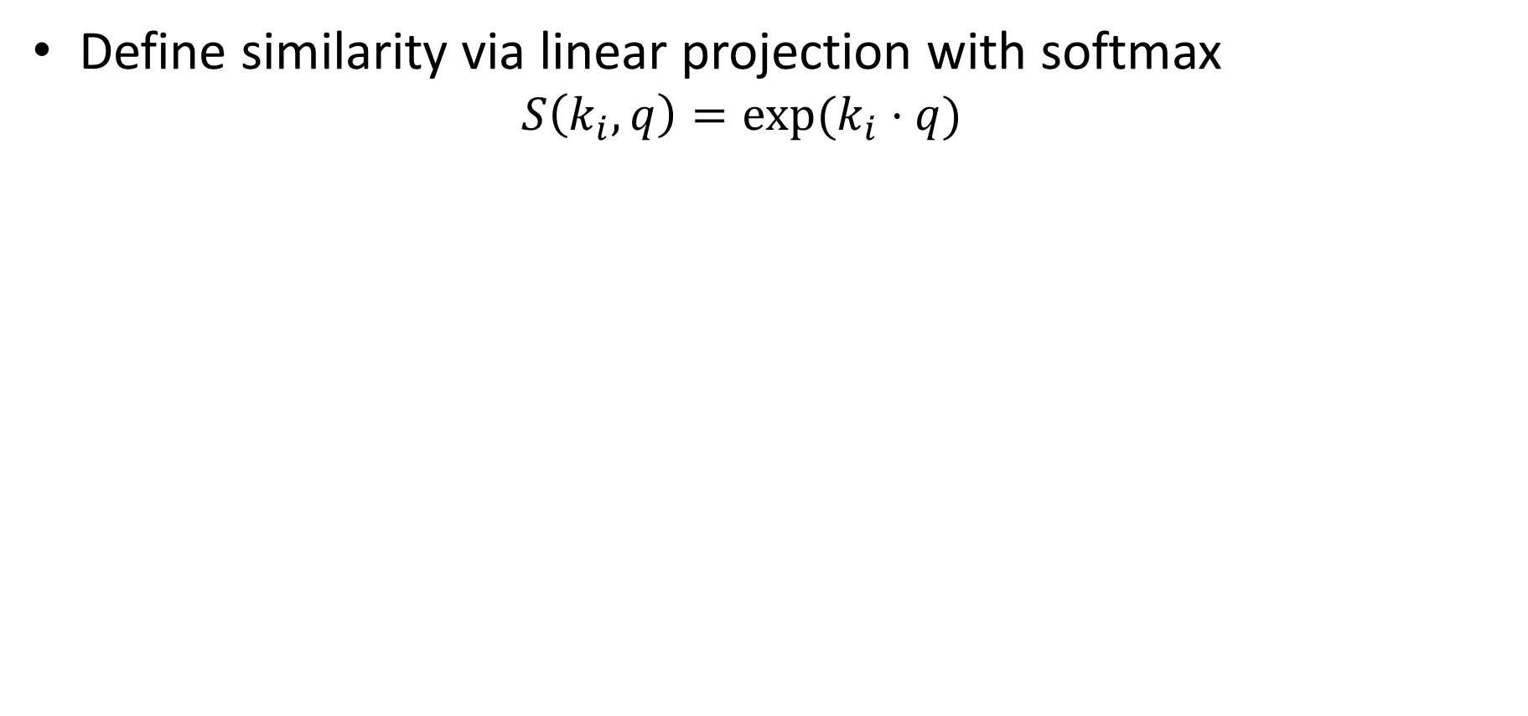
Transformer (Vaswani et al. 2017)
Define similarity via linear projection with softmax
  $$S\left(k_{i},q\right)=exp(k_{i}⋅q)$$
Normalize by sqrt of dimensionality of keys
Attention is all you need

Slide 35
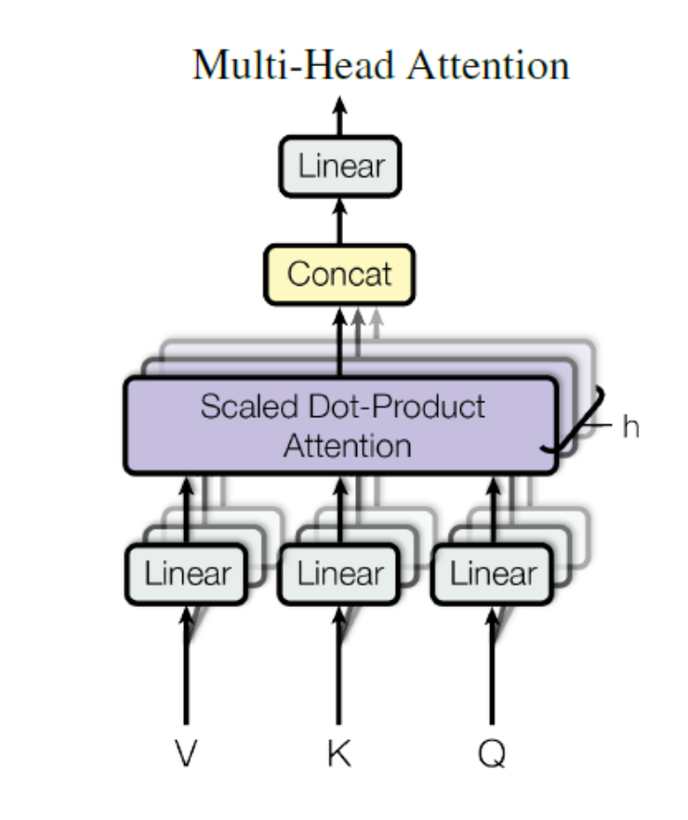
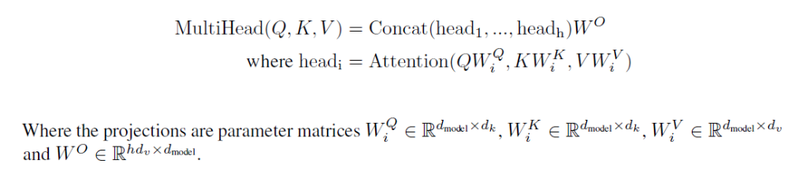
Transformer (Vaswani et al. 2017)
One or more similarity functions can be learned with linear layers
  If there are h similarities and D dimensions to input, each parallel linear layer outputs D/h values
Attention is all you need

Slide 36
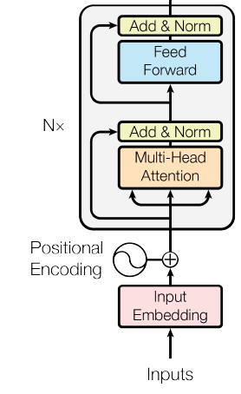
Transformers: general data processors
Input tokens can represent anything: image patches, text tokens, audio, controls, etc.
Invariant to order of tokens: add positional embedding to distinguish pos/type of input
Transformer block:
  Apply multi-head attention
  Apply 2-layer MLP with ReLU to each token separately
  Residual and layer norm (over all tokens) after each
Can stack any number of transformer blocks
Attention is all you need

Slide 37
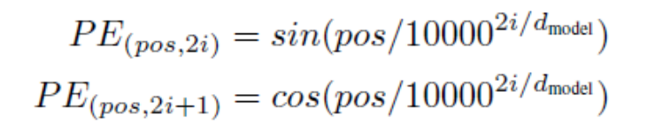
Positional encodings
Transformer processing does not depend on position of token
  But to compare between tokens, relative position may be important
Sinusoidal encoding (on right) is such that a dot product between encodings corresponds to positional similarity
Learned or even fixed random encodings also work similarly in practice

Slide 38
Transformer: alternates data processing (self-attention) and memory injection (MLP)
⊕
MLP-down
MLP: concepts, external memory lookup (up) and output distribution (down) [1]
Concept activation
MLP-up
Layer norm
⊕
O projection
Attention: skills, algorithms on inputs [2]
Multi-head Attention
Q, K, V projection
…
Input tokens
[1] Geva, Mor, et al. "Transformer Feed-Forward Layers Are Key-Value Memories." Proceedings of the 2021 Conference on Empirical Methods in Natural Language Processing. 2021.
[2] Olsson, Catherine, et al. "In-context learning and induction heads." arXiv:2209.11895 (2022).

Slide 39
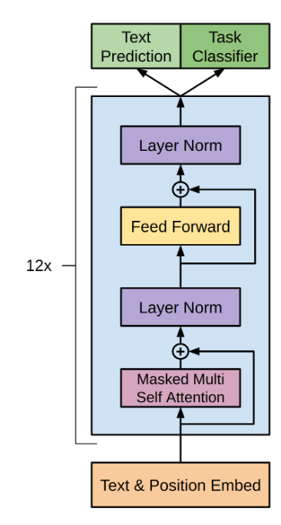
Transformer-based Model
Preparing inputs
Text is converted into subword tokens (integer ids)
Subword integers are mapped to learned vectors (embedding)
Positional embedding is added to the vectors, providing ordering information
Inference
Inputs go through 12 transformer blocks
  Self-attention (organize inputs)
  MLP (retrieve and output memory)
  Interleaved layer norms and skip connections
Output
Predict the next word (classes are subword ids)
Perform a classification task
GPT-1 Model
Radford et al. 2018

Slide 40
Q4
https://tinyurl.com/441AML-L18

Slide 41
Things to remember
Learned vector embeddings of these integers model the relationships between words
Stacked transformer blocks are a powerful network architecture that alternates attention and MLPs
Sub-word tokenization based on byte-pair encoding is an effective way to turn natural text into a sequence of integers
Attention is a general processing mechanism that regresses or aggregates values
Chair is broken →
ch##, ##air, is, brok##, ##en
Paris – France + Italy = Rome
Further reading: http://nlp.seas.harvard.edu/annotated-transformer/

Slide 42
Next class: Transformers in Language and Vision
BERT
ViT
Unified-IO

Slide 44
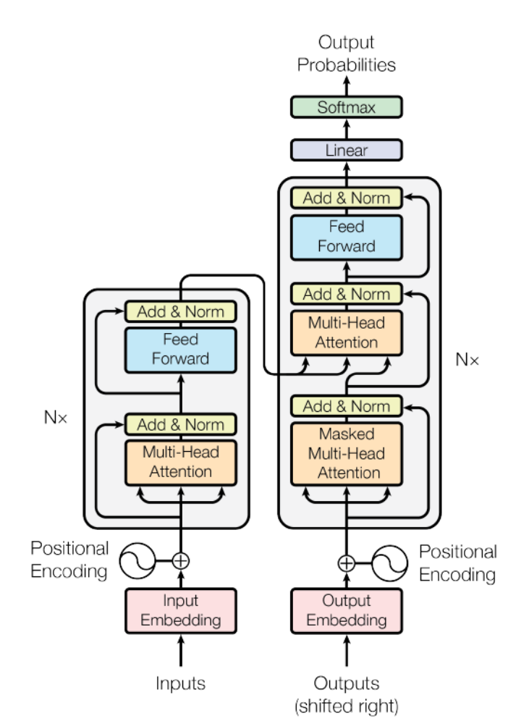
Language Transformer: Complete Architecture
WordPiece tokens (integers) are mapped to learned 512-d vectors
Positional encoding added to each vector
N=6 transformer blocks applied to input
Until <EOS> is output:
  Process input + output so far
  Output most likely word (after more attention blocks and linear model)
Cross-Attention
Self-Attention
(each token attends to earlier output tokens)
Self-Attention
Attention is all you need

Slide 45
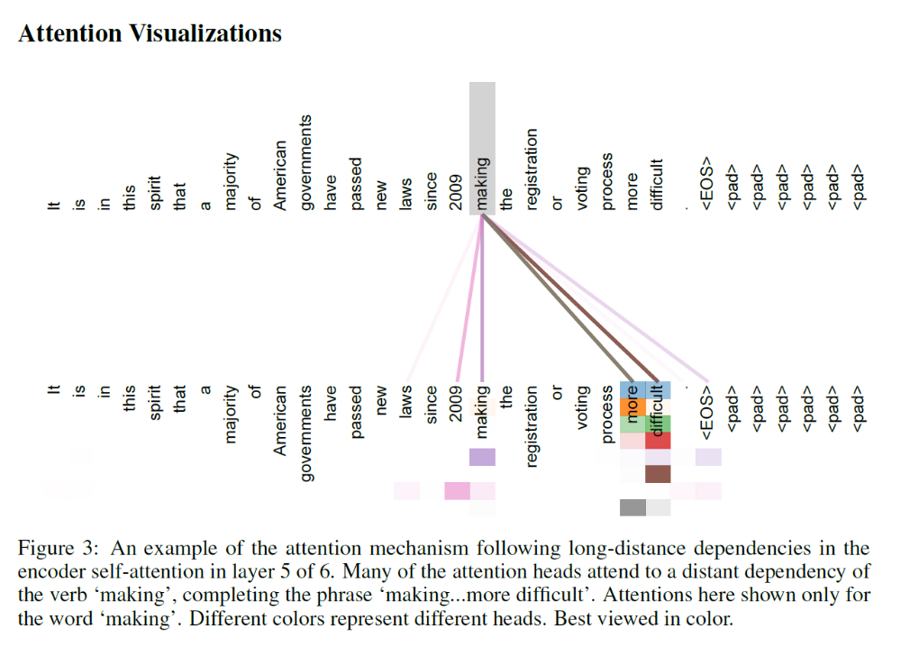

Slide 46
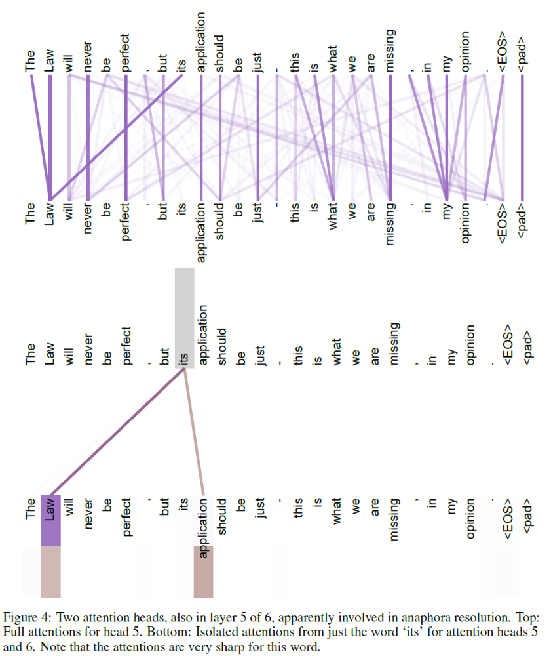
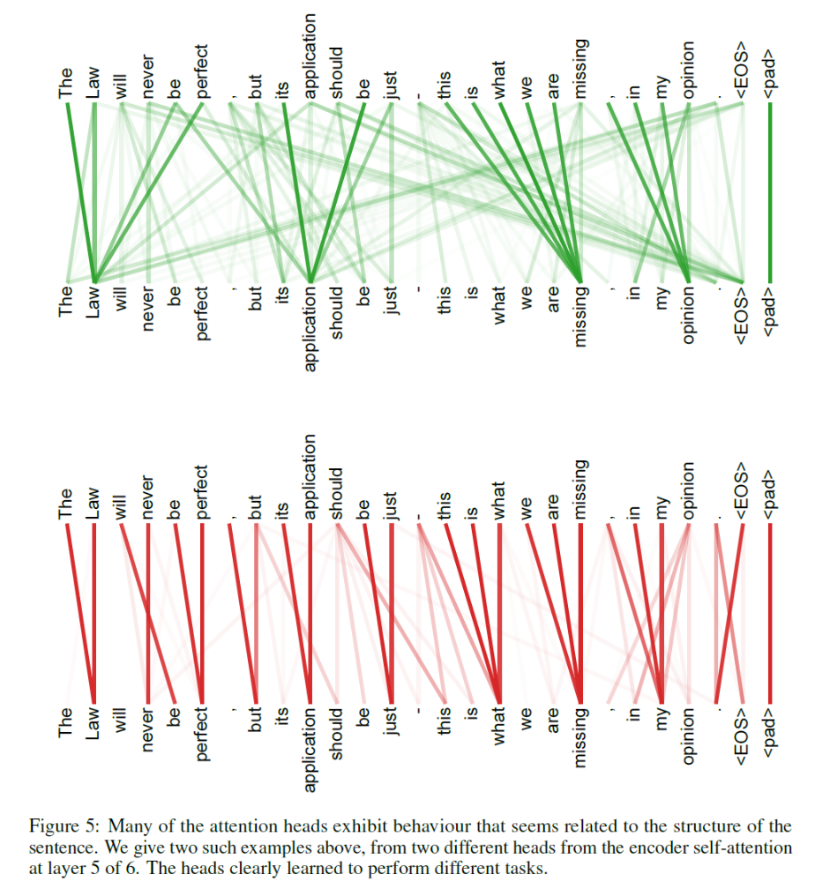

Slide 47
Application to Translation
English-German
  4.5M sentence pairs
  37K tokens
English-French
  36M sentences
  32K tokens
Base models trained on 8 P100s for 12 hours
Big models (2x token dim, 3x training steps) trained for 3.5 days
Adam optimizer: learning rate ramps up for 4K iterations, then down
Regularization: drop-out, L2 weight, label smoothing
Cross-Attention
Self-Attention
Self-Attention
Attention is all you need

Slide 48
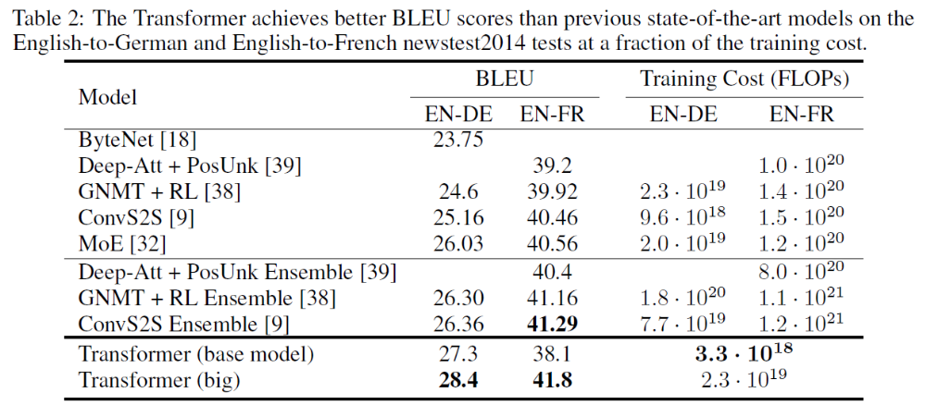
Results

