Slide 1
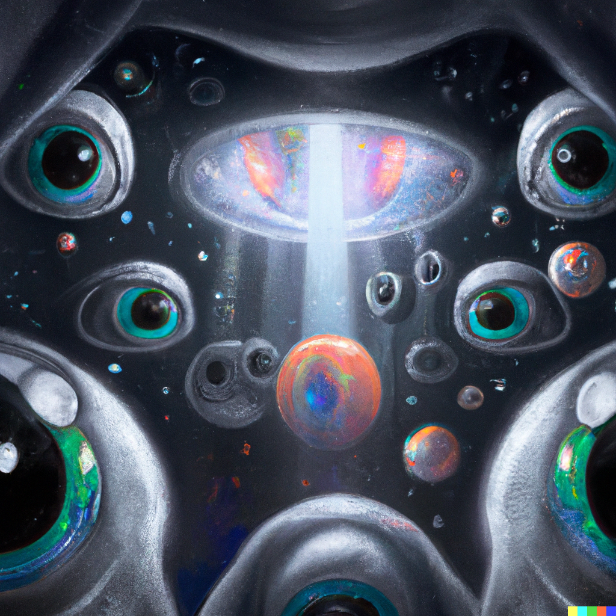
Deep Learning Optimization and Computer Vision
Applied Machine Learning
Derek Hoiem
Dall-E

Slide 2
Today’s Lecture
Defining and training a deep network w/ PyTorch
Adopting the network to new tasks
  Fine-tuning
  Linear probe
Mask RCNN recognition system

Slide 3
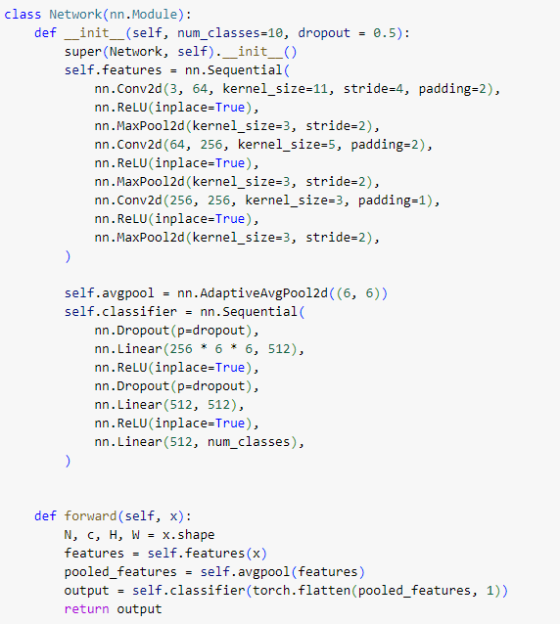
Training a deep network
Convolutional network for Digits Classification
Define the network model

Slide 4
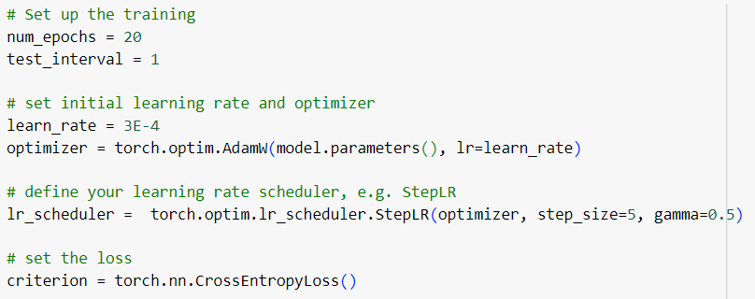
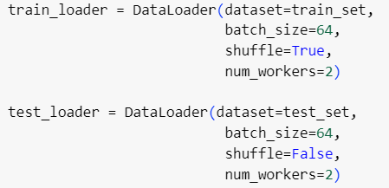
Training a deep network
Define the network model
Set the key training parameters: # epochs, initial learning rate and schedule, optimizer, loss function, data loaders

Slide 5
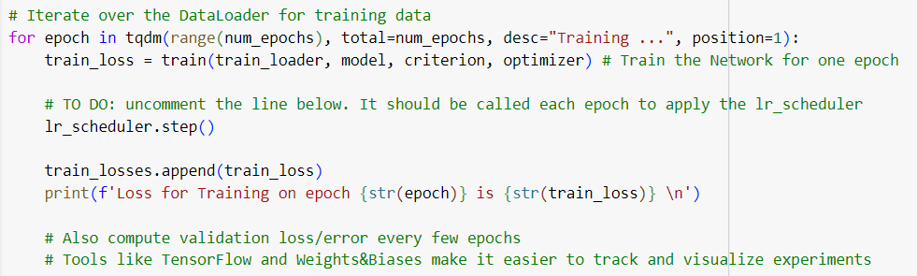
Training a deep network
Define the network model
Set the key training parameters
Train and track performance
Top-level of training

Slide 6
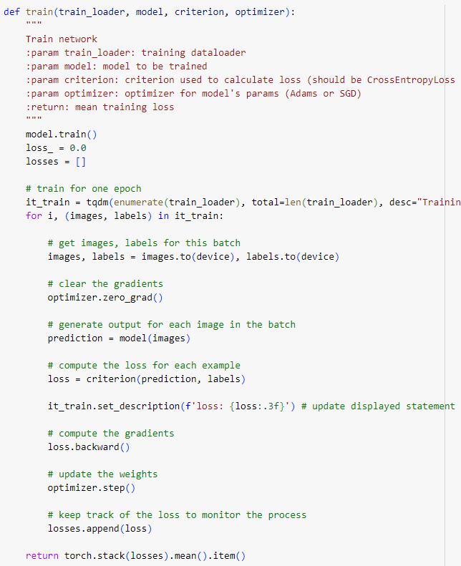
Training a deep network
Define the network model
Set the key training parameters
Train and track performance

Slide 7
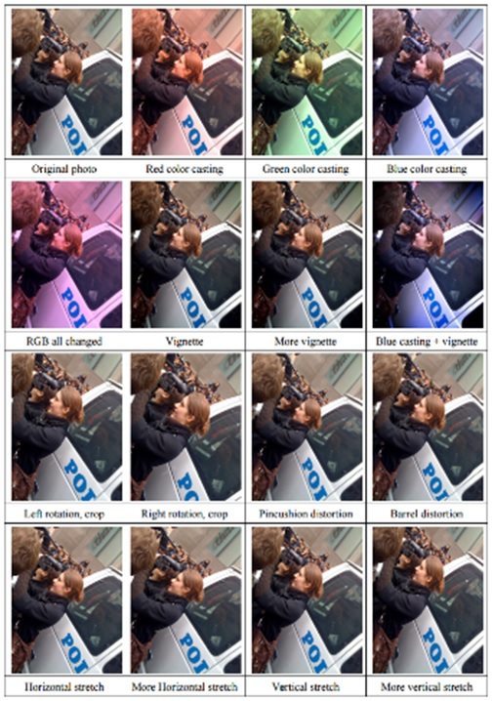
Training Trick: Data Augmentation
Slide: Jiabin Huang
Create virtual training samples
  Horizontal flip
  Random crop
  Color casting
  Geometric distortion
Simulates a larger training set, often improves improve performance
Idea goes back to Pomerleau 1995 at least (neural net for car driving)
Deep Image [Wu et al. 2015]

Slide 8
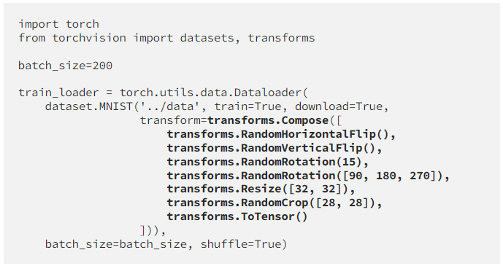
Applying Data Augmentation
Define transformation sequence
Input transform specification to data loader
References:
https://medium.com/dejunhuang/learning-day-23-data-augmentation-in-pytorch-e375e19100c3
https://pytorch.org/vision/main/transforms.html

Slide 9
Training deep networks is a craft
https://karpathy.github.io/2019/04/25/recipe/
  Read this in entirety to get a better understanding of training deep learning models and what you need to learn more about
https://myrtle.ai/learn/how-to-train-your-resnet/
  Interesting deep dive into hyperparameter selection

Slide 10
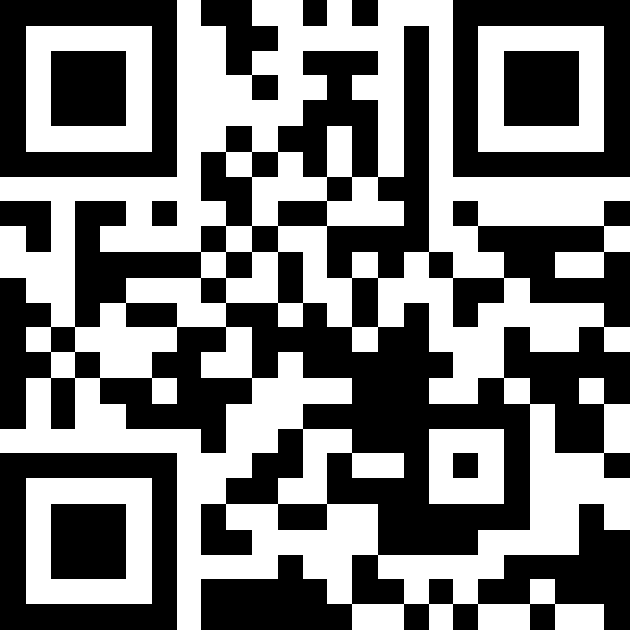
Q1-3
https://tinyurl.com/441AML-L17

Slide 11
Adapting Networks to New Tasks
Training a deep network from scratch requires a lot of data and a lot of compute
What if you don’t have a lot of data or compute?
Critical concept: We can start with a “pre-trained” network and adapt it to a new task
  Linear probe
  Fine-tuning

Slide 12
Adapting Networks to New Tasks
Suppose we’ve trained ImageNet model
But we want to do something else, e.g. classify flowers or dog breeds
We don’t have a huge dataset for that task
ImageNet Trained Model
Encoder
Decoder
Input
Image
Output 1000 Class
Logits
E.g. weights of convolutional layers, trained on ImageNet
E.g. final 1000 class linear layer weights

Slide 13
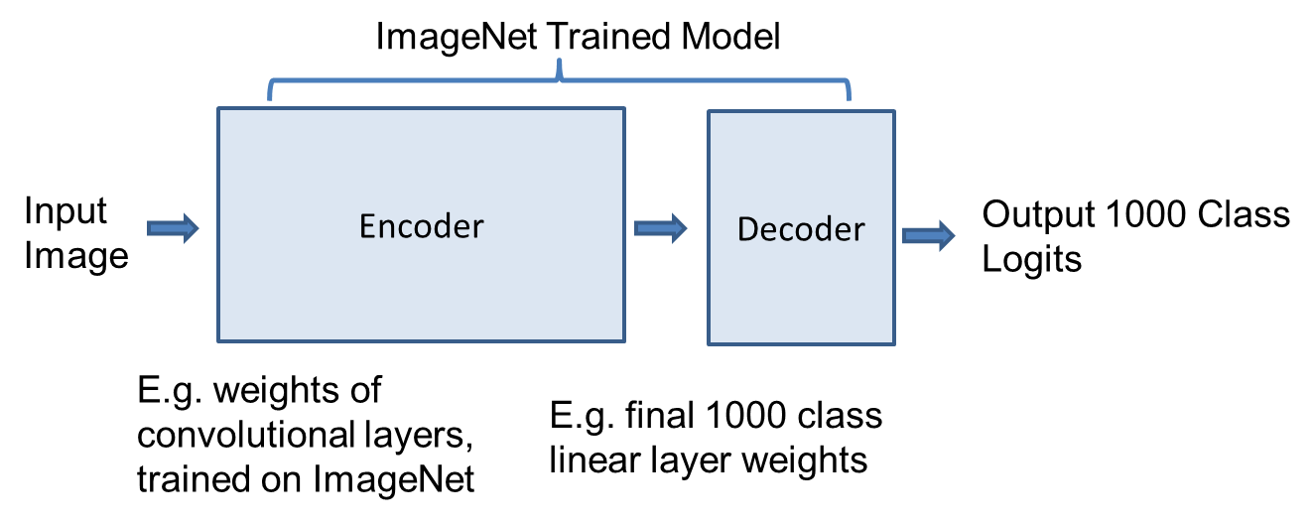
Linear probe, a.k.a. Feature extraction
Pre-trained Model
Keep original encoder weights. Replace decoder linear layer and train its weights on new task without changing encoder.
Equivalently, extract features from encoder and train linear model on those features
ImageNet Trained Encoder
New Task Decoder
Encoder
(Frozen)
Decoder
(Tuned)
Target Model
Input
Image
Output N_{c} Class
Logits

Slide 14
How to apply linear probe
import torch, torch.nn as nn
from torchvision import models
from sklearn.linear_model import LogisticRegression
# 1. load pretrained model
model = models.alexnet(weights="DEFAULT")
# 2. remove last fully-connected layer
model.classifier = nn.Sequential(*list(model.classifier.children())[:-1])
model.eval()
# 3. compute features for each image
feats, labels = [], []
with torch.no_grad():
for x, y in loader: # x: preprocessed images, y: labels
feats.append(model(x)); labels.append(y)
X = torch.cat(feats).numpy(); Y = torch.cat(labels).numpy()
# 4. train linear classifier on features
clf = LogisticRegression(max_iter=1000).fit(X, Y)
Pre-compute features method
Load pretrained model (many available)
  https://pytorch.org/vision/stable/models.html
Remove prediction final layer
Apply model to each image to get features; save them with labels
Train new linear model (e.g. logistic regression or SVM) on the features

Slide 15
How to apply linear probe
Freeze encoder method
Load pretrained model (many available)
  https://pytorch.org/vision/stable/models.html
Set network to not update weights
Replace last layer
Retrain network with new dataset
- Slower than pre-compute features method but does not require storing features, and can apply data augmentation
import torch, torch.nn as nn
from torchvision import models
# 1. load pretrained model
model = models.vgg19(weights="DEFAULT")
# 2. freeze all weights
for param in model.parameters():
param.requires_grad = False
# 3. replace last layer (new layer has requires_grad=True by default)
model.classifier[6] = nn.Linear(4096, num_classes)
model.cuda()
# 4. train on new dataset; only the new layer is updated
optimizer = torch.optim.SGD(model.classifier[6].parameters(), lr=0.01)
for epoch in range(num_epochs):
for x, y in loader:
loss = nn.functional.cross_entropy(model(x.cuda()), y.cuda())
optimizer.zero_grad(); loss.backward(); optimizer.step()

Slide 16
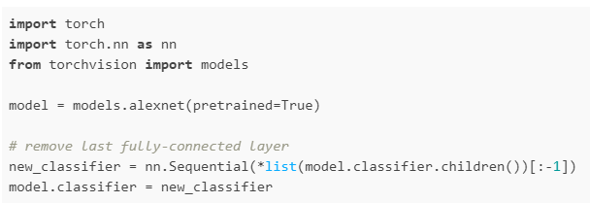
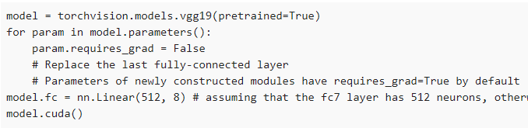
How to apply linear probe
Pre-compute features method
Load pretrained model (many available)
  https://pytorch.org/vision/stable/models.html
Remove prediction final layer
Apply model to each image to get features; save them with labels
Train new linear model (e.g. logistic regression or SVM) on the features
Freeze encoder method
Load pretrained model (many available)
  https://pytorch.org/vision/stable/models.html
Set network to not update weights
Replace last layer
Retrain network with new dataset
- Slower than method on left but does not require storing features, and can apply data augmentation
Source

Slide 17
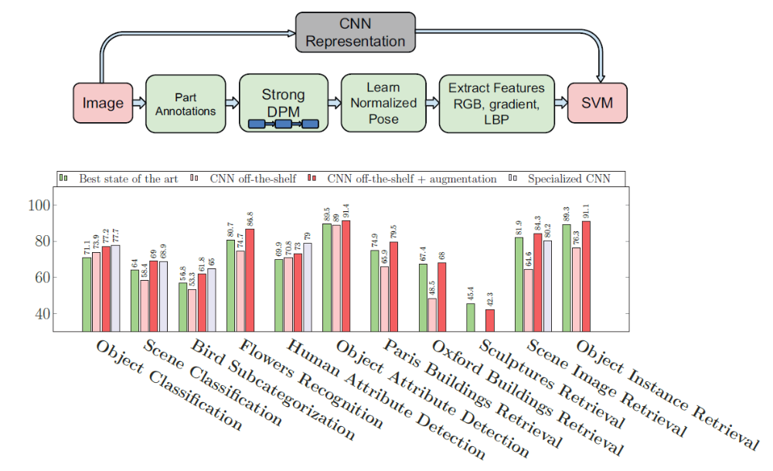
Pre-trained networks can provide very good features, as shown in “CNN Features off-the-shelf: an Astounding Baseline for Recognition”
Razavian et al. CVPR 2014

Slide 18
Fine-tuning
Pre-trained Model
Initialize with original encoder weights.
Replace decoder linear layer.
Use 10-100x smaller learning rate than normal for the pretrained weights
Fully tune
New Task Encoder
New Task Decoder
Encoder
(Fine-tuned)
Decoder
(Tuned)
Target Model
Input
Image
Output N_{c} Class
Logits

Slide 19

How to apply fine-tuning
Load pre-trained model
Replace last layer
Set a low learning rate (e.g. lr=1e-4)
  Very sensitive to learning rate because you want to improve but not drift too far from the initial model -- learning rate is the most critical parameter for fine-tuning!
  Learning rate is often at least 10x lower than from “scratch” training
  Can “warm start” by freezing earlier layers initially and then unfreezing after a few epochs when the linear layer is mostly trained (avoids messing up encoder while classifier is adjusting), or start learning rate near zero and increase slowly over several epochs
  Can set lower learning rate for earlier layers
In this example, last layer has 512 input features and is called “fc”
Other examples of layer customization (from ‘23 TA Weijie)

Slide 20
Q4-6
https://tinyurl.com/441AML-L17

Slide 21
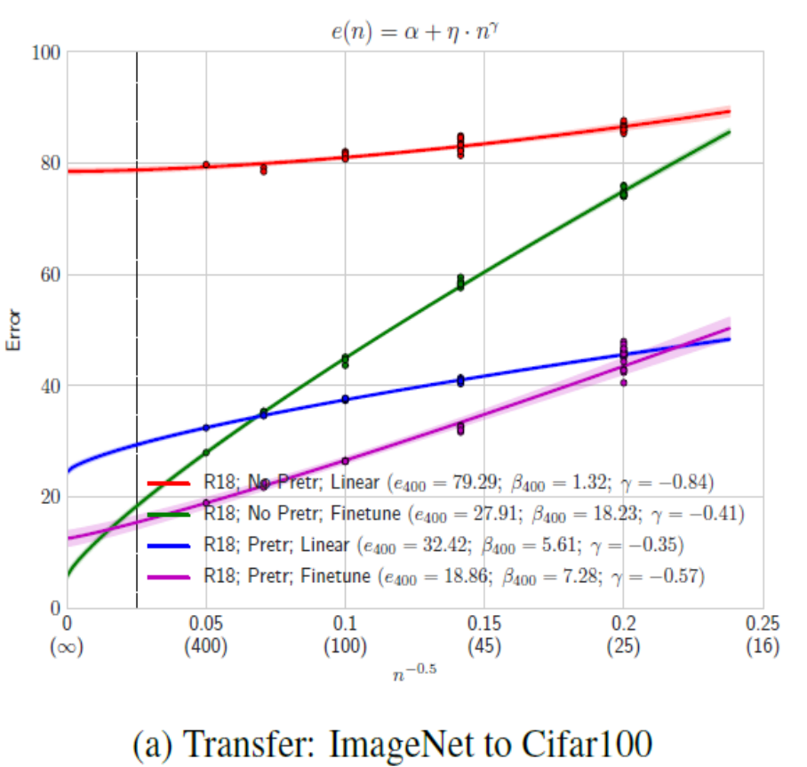
Comparing linear probe, fine-tuning, and training from scratch, when does each have an advantage and why?
ResNet18, Err vs # examples / class (in paren)
Green: Train from scratch
Blue: Linear Probe from ImageNet
Purple: Fine-tune from ImageNet
Very little data
Use linear probe on pre-trained model
Moderate data
Fine-tune pre-trained model
Very large dataset
Either fine-tune or train from scratch
400+ examples per class
16 examples per class
“Learning Curves” (2021) pdf

Slide 22
R-CNN first demonstrated major detection improvement by pre-training on ImageNet and fine-tuning on PASCAL VOC
R-CNN
Deep learning detection
Regionlets
Deformable Parts Model (v1-v5)
HOG Template
HOG: Dalal-Triggs 2005 DPM: Felzenszwalb et al. 2008-2012 Regionlets: Wang et al. 2013 R-CNN: Girshick et al. 2014

Slide 23
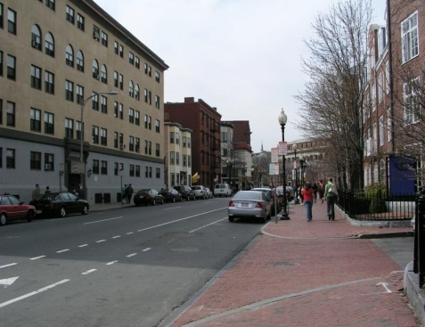
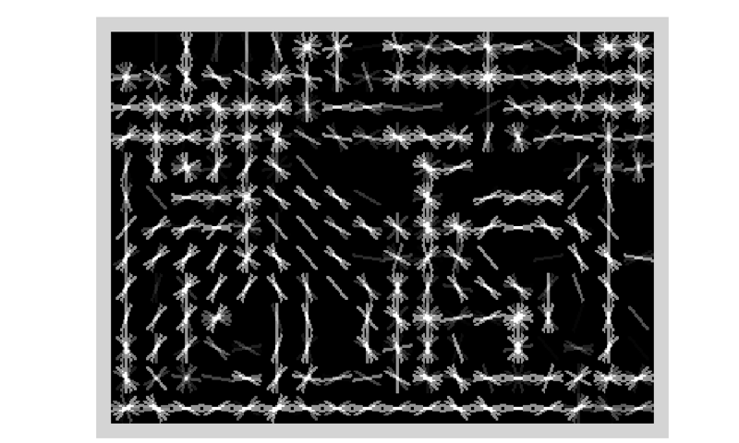
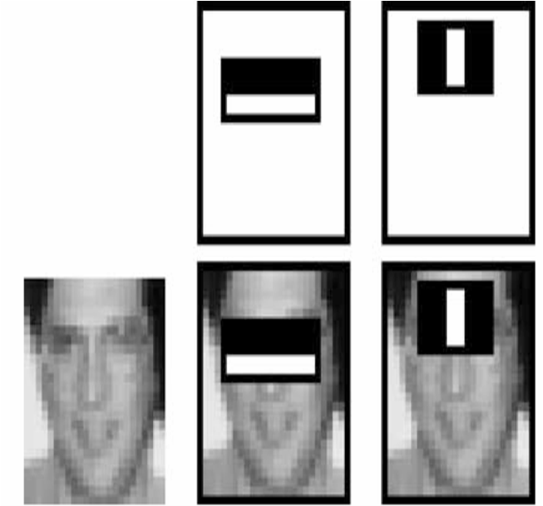
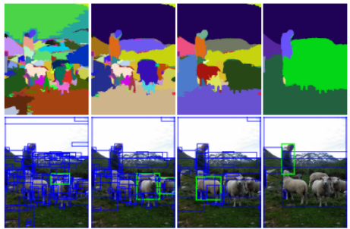
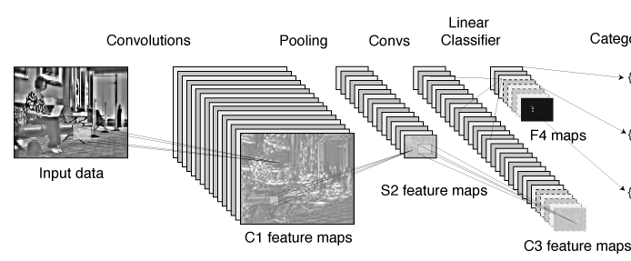
Statistical template approach to object detection
Propose Window
Extract Features
Classify
Post-process
SVM
Boosted stubs
Neural network
Non-max suppression
Segment or refine localization
HOG
Sliding window: scan image pyramid
Fast randomized features
Region proposals: edge/region-based, resize to fixed window
CNN features

Slide 24
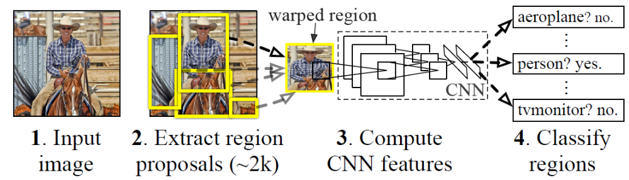
R-CNN (Girshick et al. CVPR 2014)
Extract regions using Selective Search method (Uijilings et al. IJCV 2013)
Extract rectangles around regions and resize to 227x227
Extract features with fine-tuned CNN (that was initialized with network trained on ImageNet before training)
Classify last layer of network features with SVM
http://arxiv.org/pdf/1311.2524.pdf

Slide 25
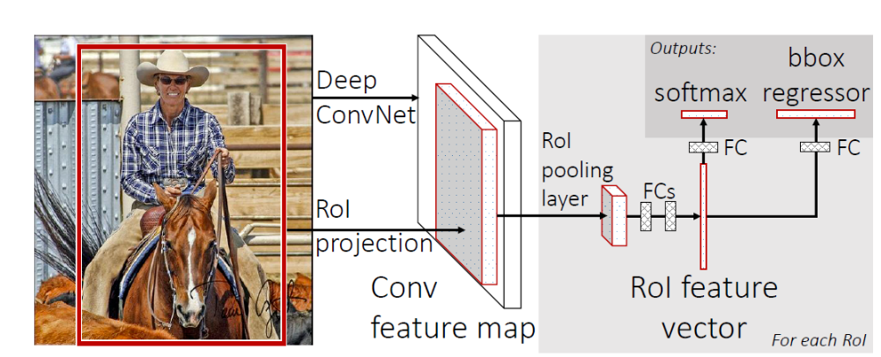
Fast R-CNN – Girshick 2015
Compute CNN features for image once
ROI Pooling: Pool into 7x7 spatial bins for each region proposal, output class scores and regressed bboxes
Other refinements: compress classification layer, use network for final classification, end-to-end training
100x speed up of R-CNN (0.02 – 0.1 FPS → 0.5-20 FPS) with similar accuracy

Slide 26
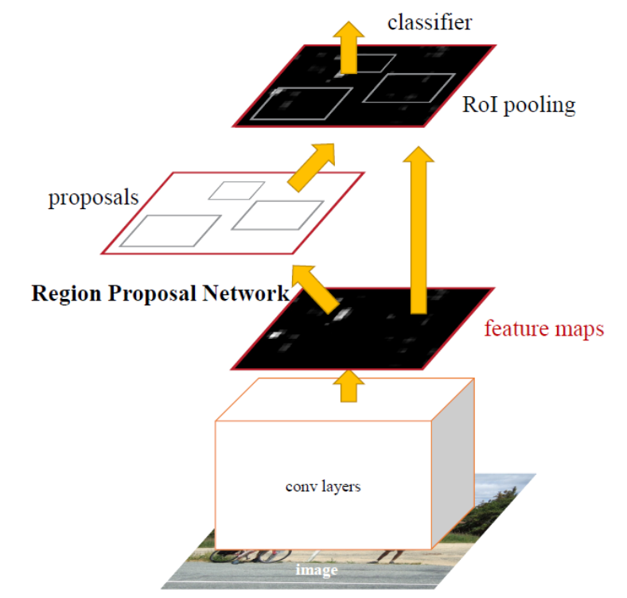
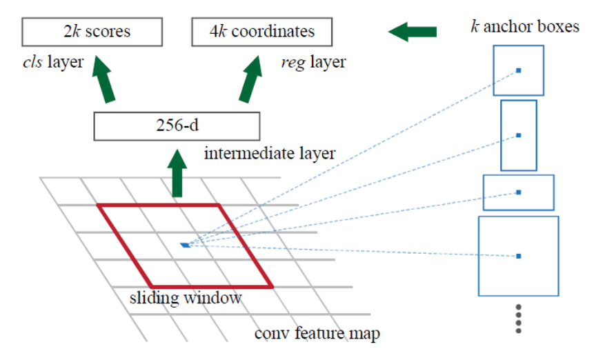
Faster R-CNN – Ren et al. 2016
Convolutional features used for generating proposals and scoring
  Generate proposals with “objectness” scores and refined bboxes for each of k “anchors”
  Score proposals in same way as Fast R-CNN
Similar accuracy to Fast R-CNN with 10x speedup

Slide 27
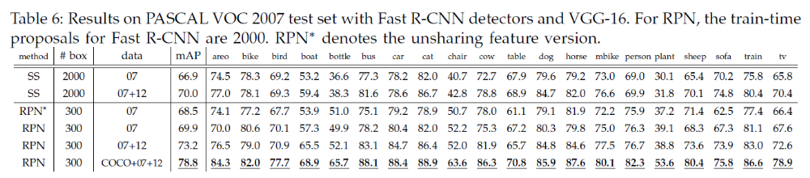
Faster R-CNN slightly better accuracy than Fast R-CNN
More data improves results considerably

Slide 28
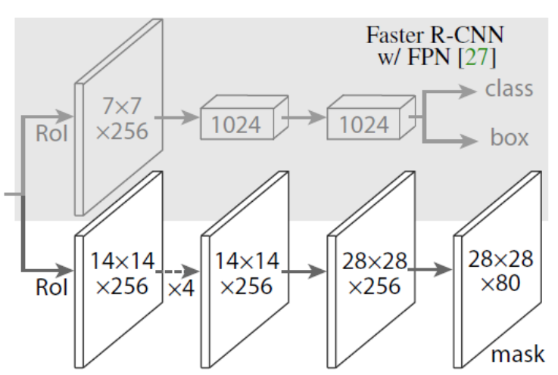
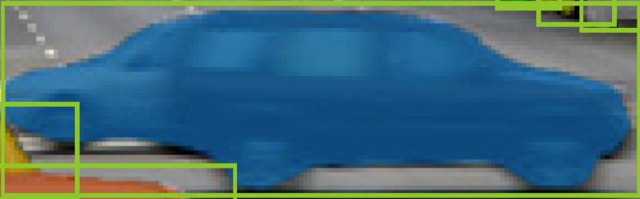
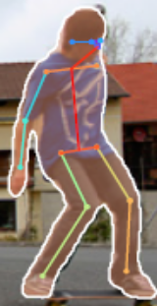
Mask R-CNN – He Gxioxari Dollar Girshick (2017)
Same network as Faster R-CNN, except
  Bilinearly interpolate when extracting 7x7 cells of ROI features for better alignment of features to image
  Instance segmentation: produce a 28x28 mask for each object category
  Keypoint prediction: produce a 56x56 mask for each keypoint (aim is to label single pixel as correct keypoint)
Example ROI and predicted mask
Example ROI and predicted mask and keypoints

Slide 29
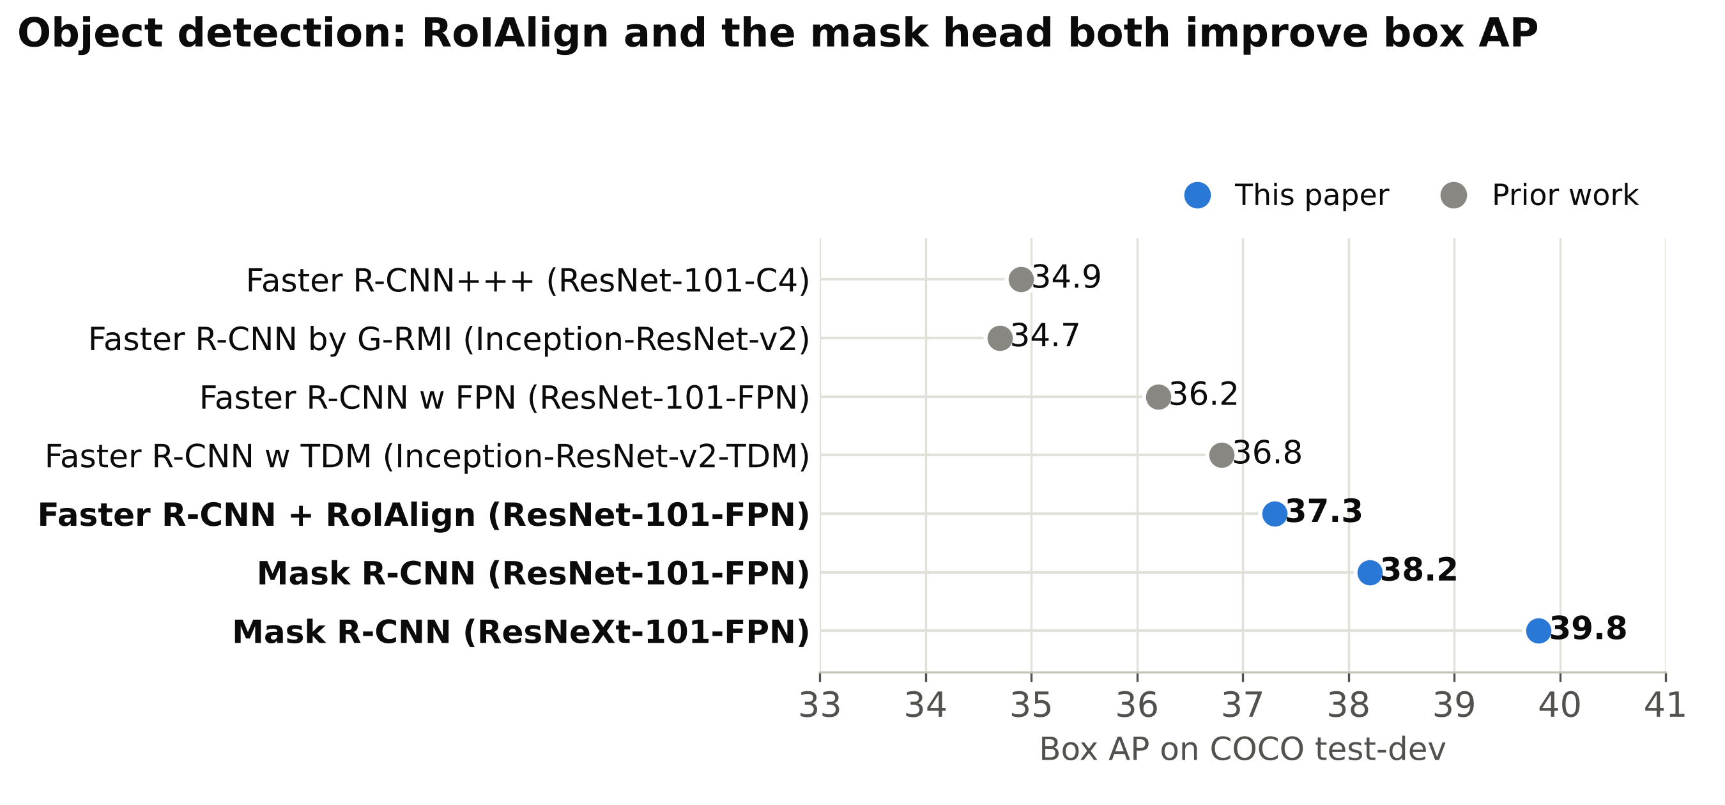
Mask RCNN was top performing object detector, instance segmenter, keypoint detector (at time of release and for a bit after)

Slide 30
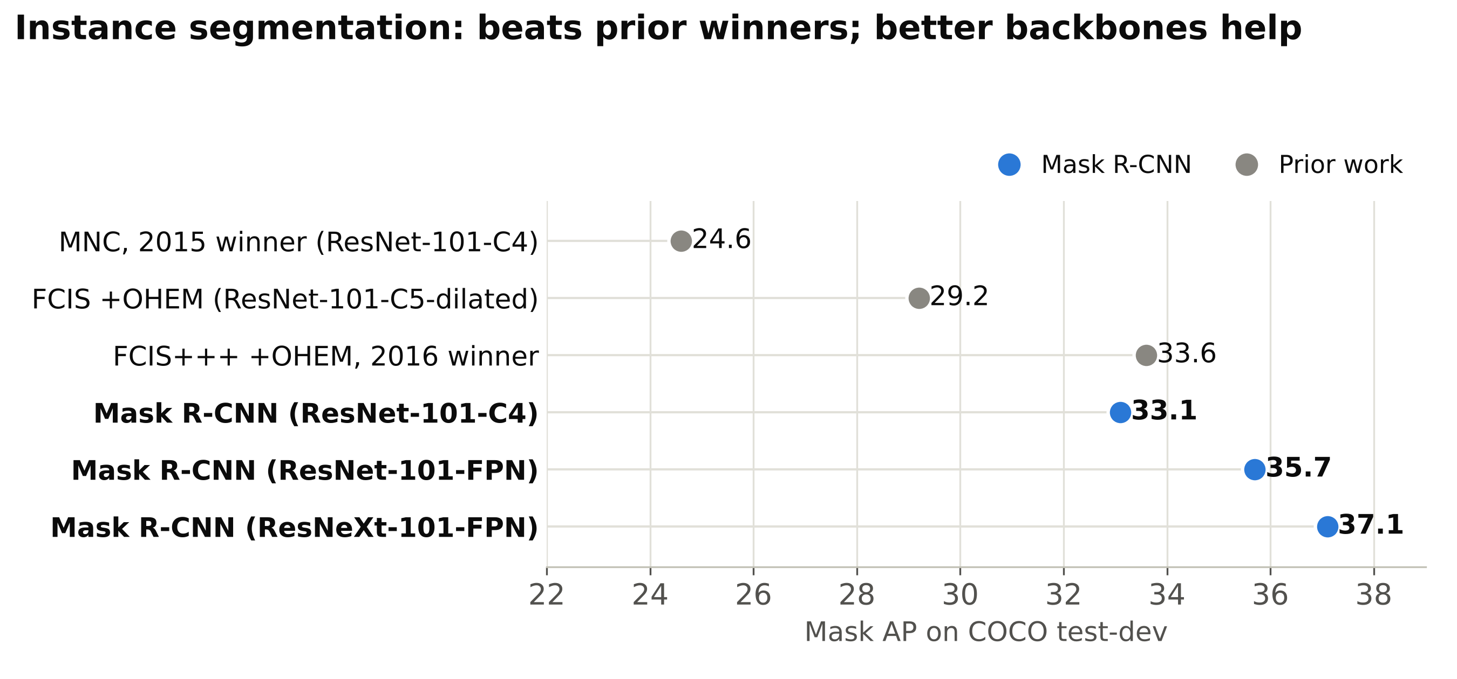

Slide 31
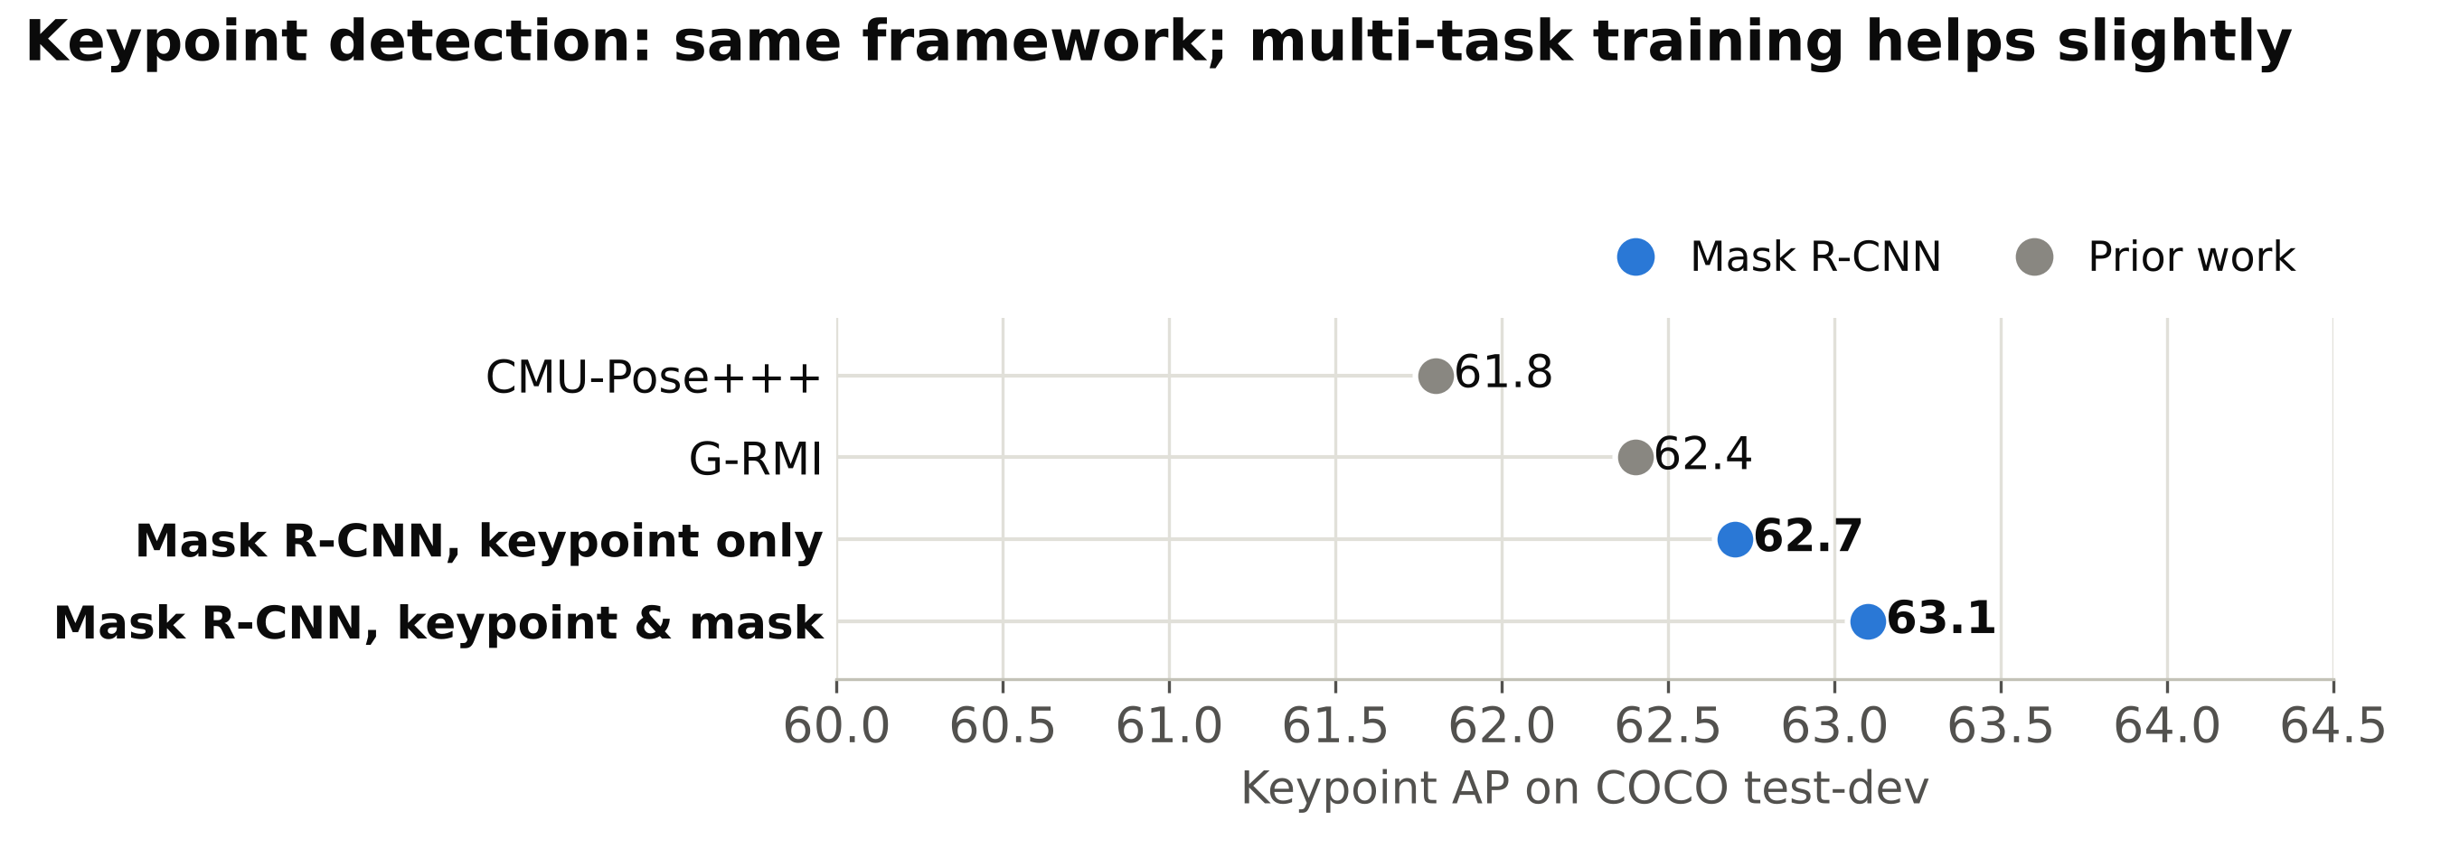

Slide 32
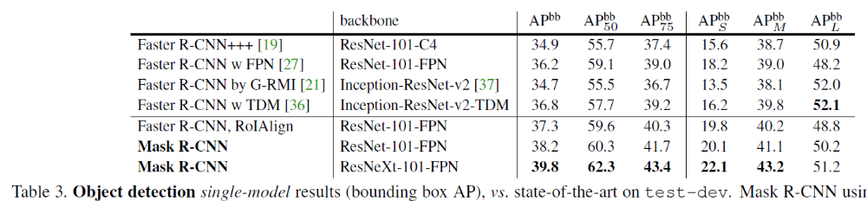
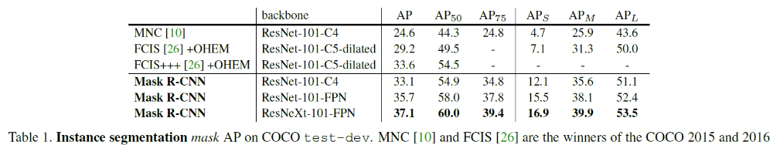
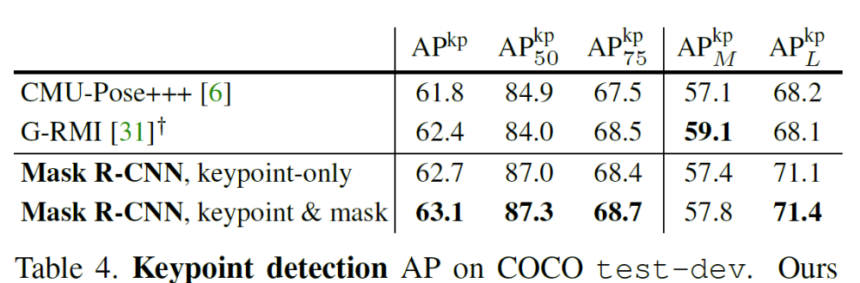
Top performing object detector, keypoint segmenter, instance segmenter (at time of release and for a bit after)

Slide 33
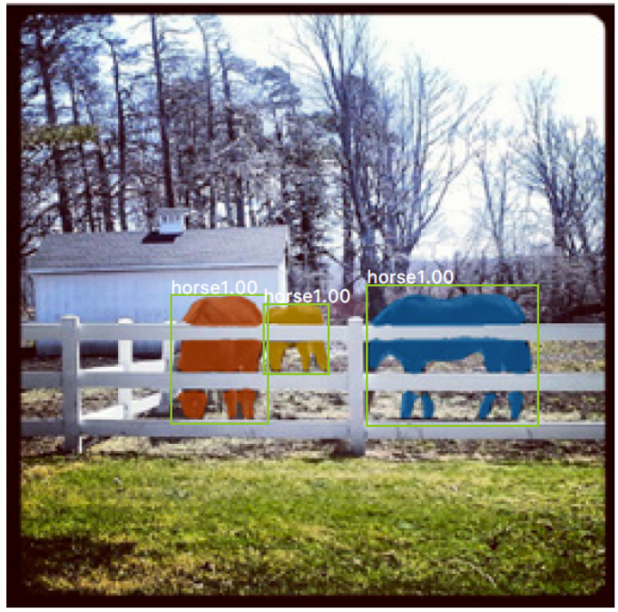
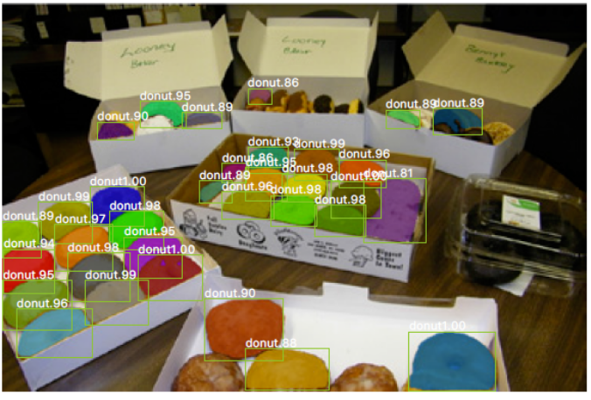
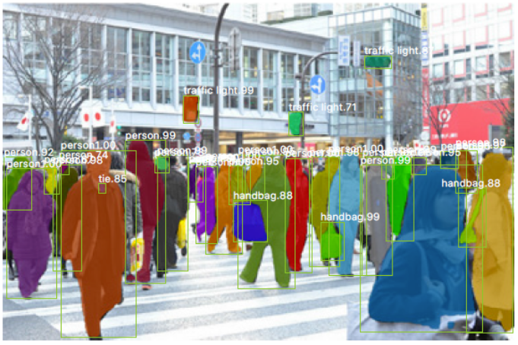
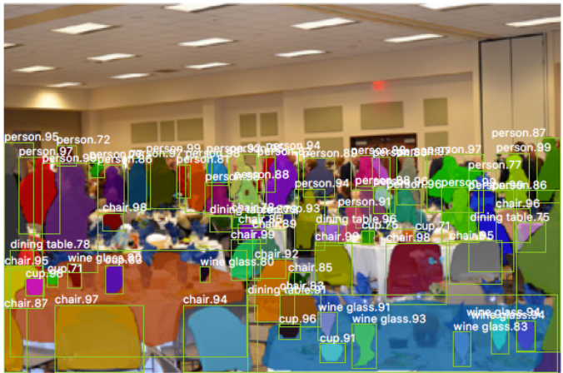
Example detections and instance segmentations

Slide 34
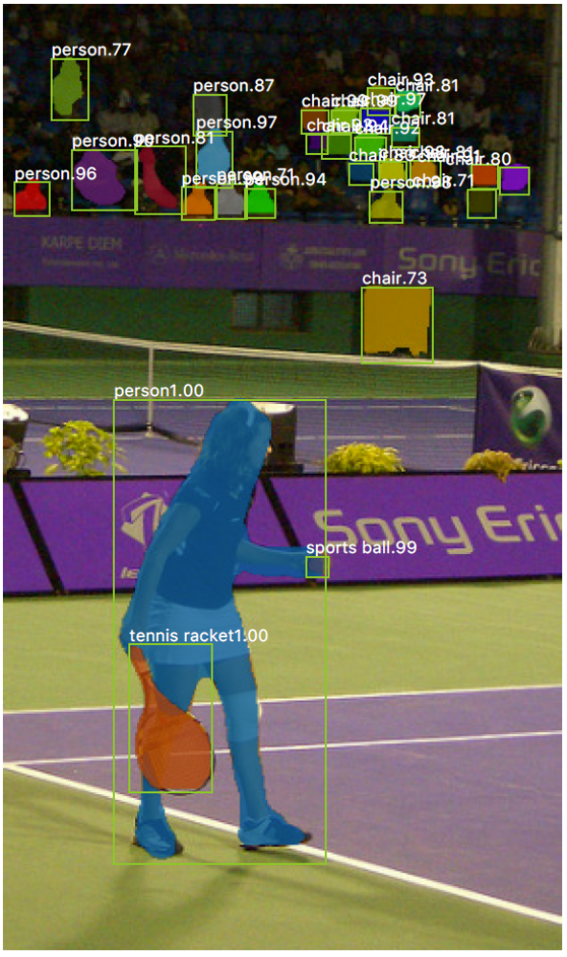
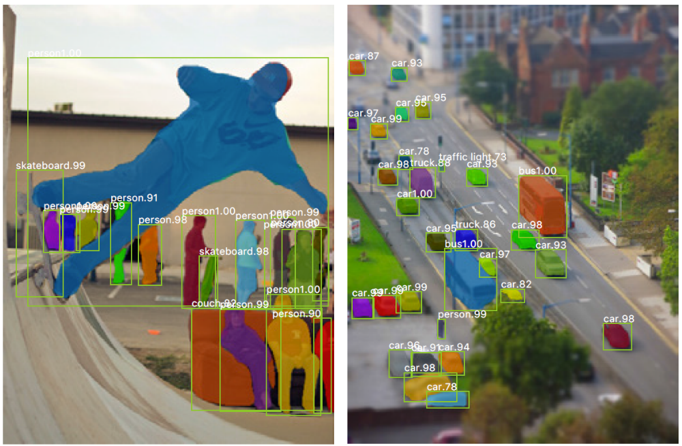
Example detections and instance segmentations

Slide 35
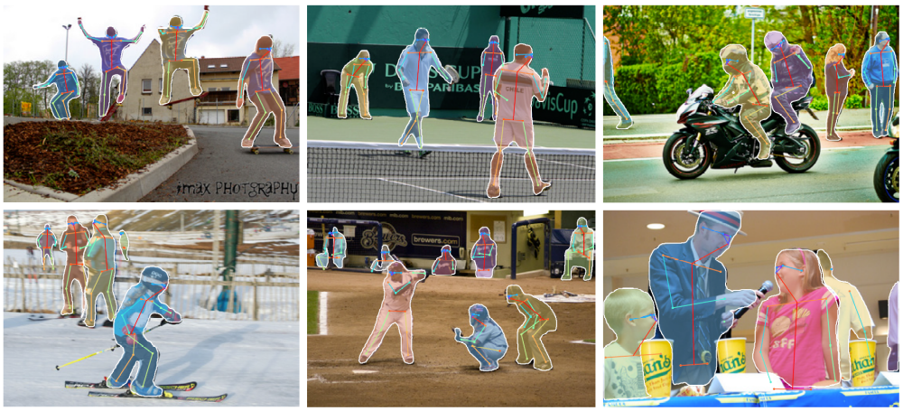
Example keypoint detections

Slide 36
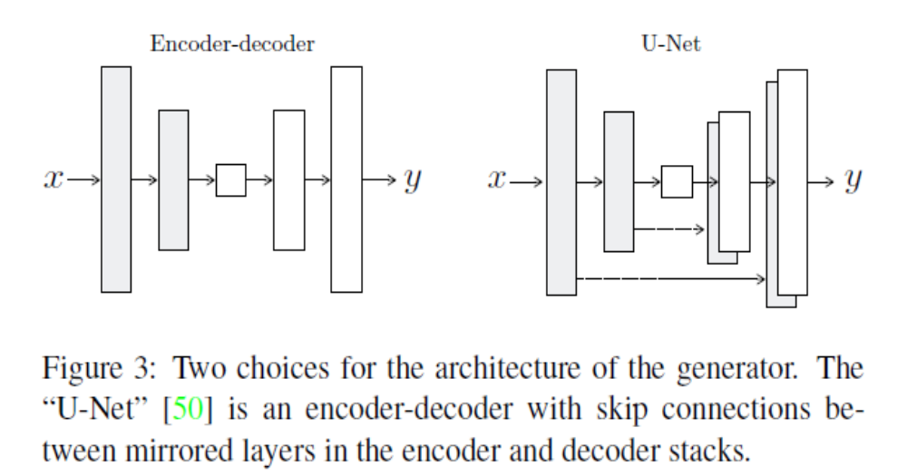
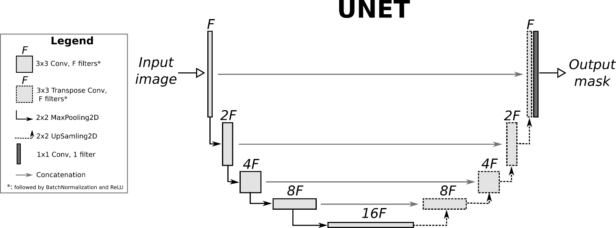
U-Net Architecture
O. Ronneberger, P. Fischer, and T. Brox. U-net: Convolutional
networks for biomedical image segmentation. In MICCAI, 2015.
The “U-Net” is an encoder-decoder with skip connections between mirrored layers in the encoder and decoder stacks.
U-Net style architectures are used to generate pixel maps (e.g., RGB images or per-pixel labels)
Fig from Isola et al. 2017
Fig src

Slide 37
What does the CNN learn?

Slide 38
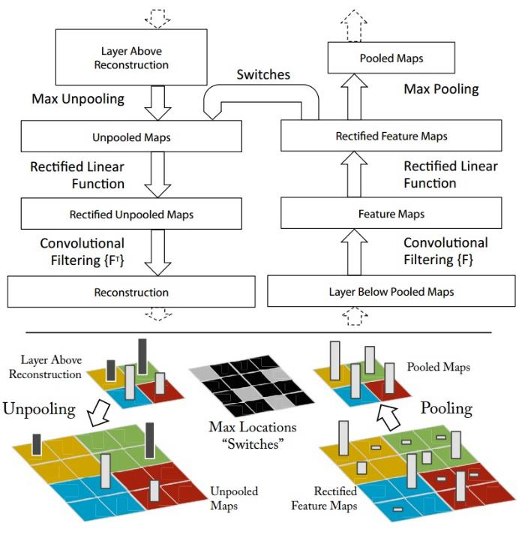
Map activation back to the input pixel space
What input pattern originally caused a given activation in the feature maps?
Visualizing and Understanding Convolutional Networks [Zeiler and Fergus, ECCV 2014]

Slide 39
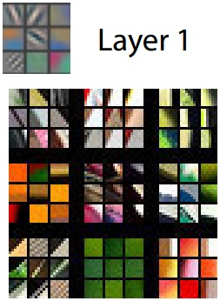
Layer 1 (visualization of randomly sampled features)
Activations (which pixels caused the feature to have a high magnitude)
Image patches that had high activations
Visualizing and Understanding Convolutional Networks [Zeiler and Fergus, ECCV 2014]

Slide 40
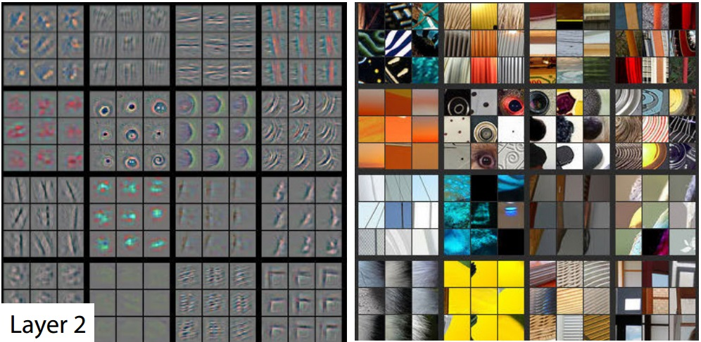
Layer 2
Visualizing and Understanding Convolutional Networks [Zeiler and Fergus, ECCV 2014]

Slide 41
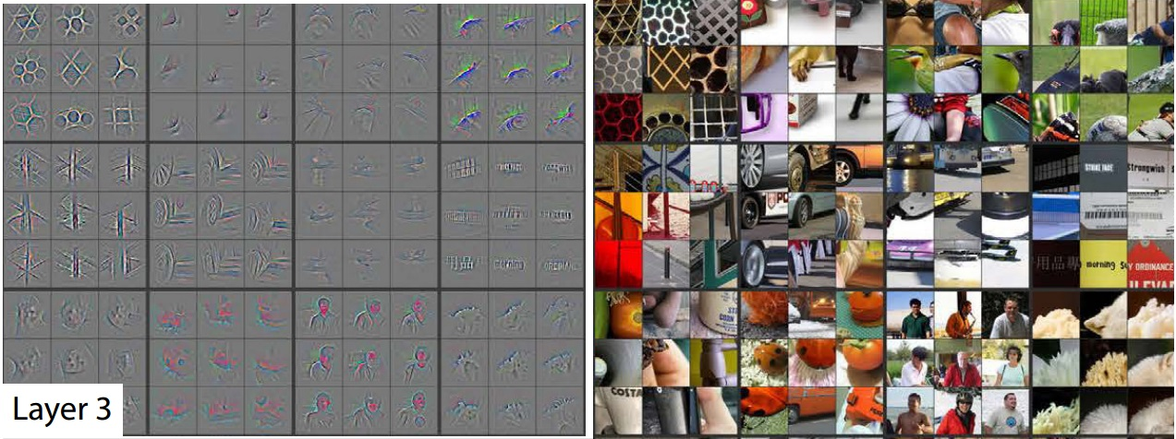
Layer 3
Visualizing and Understanding Convolutional Networks [Zeiler and Fergus, ECCV 2014]

Slide 42
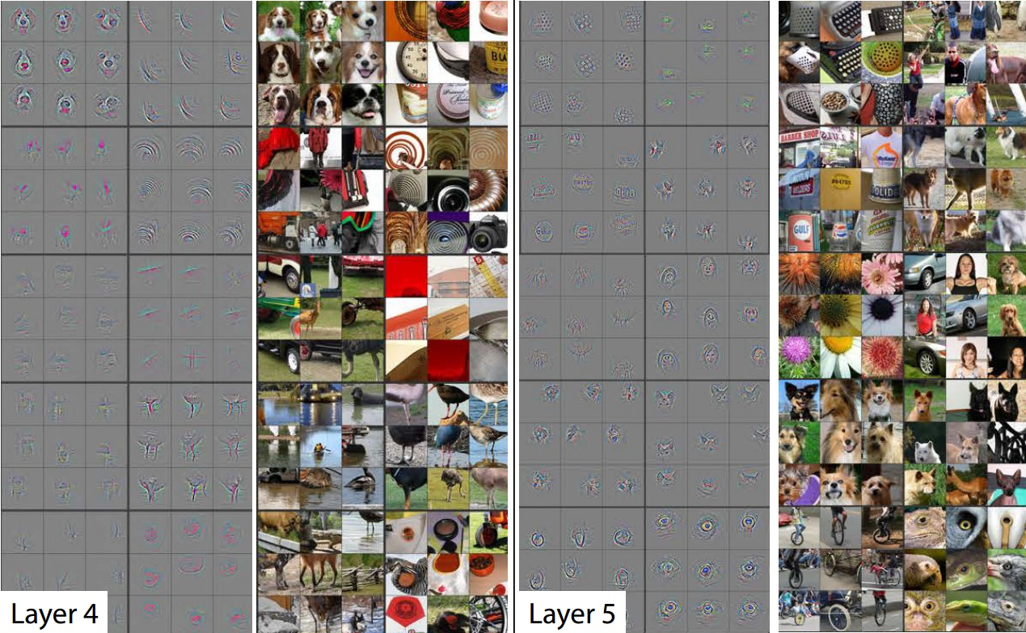
Layer 4 and 5
Visualizing and Understanding Convolutional Networks [Zeiler and Fergus, ECCV 2014]

Slide 43
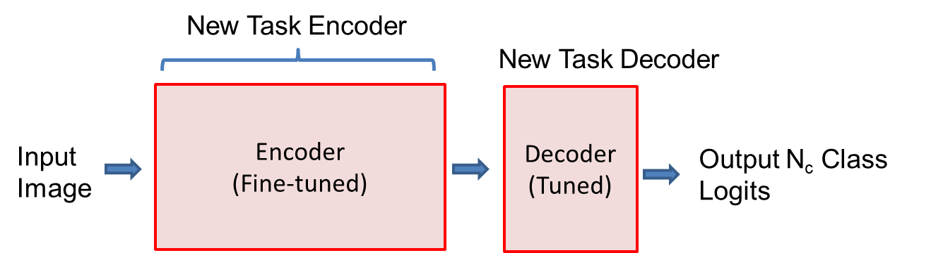
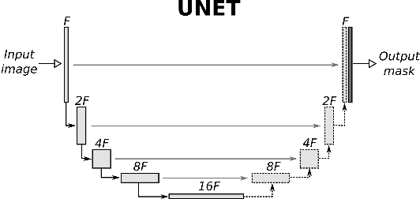
Things to remember
Models trained on ImageNet are used as pretrained “backbones” for other vision tasks
Mask-RCNN samples patches in feature maps and predicts boxes, object region, and keypoints
Many image generation and segmentation methods are based on U-Net: downsamples while deepening features, then upsamples with skip connections

