Slide 1
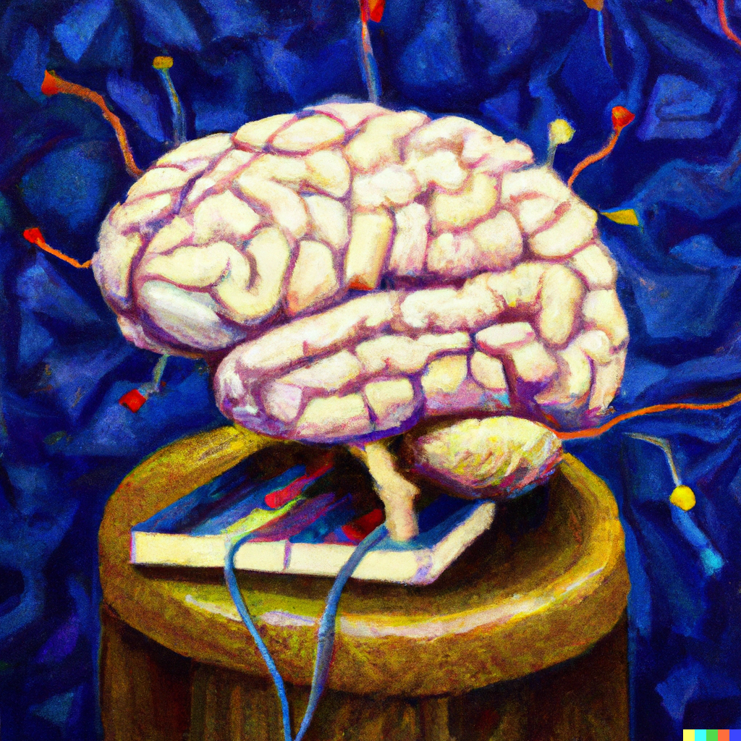
CNNs and Key Ingredients of Deep Learning
Applied Machine Learning
Derek Hoiem
Dall-E

Slide 2
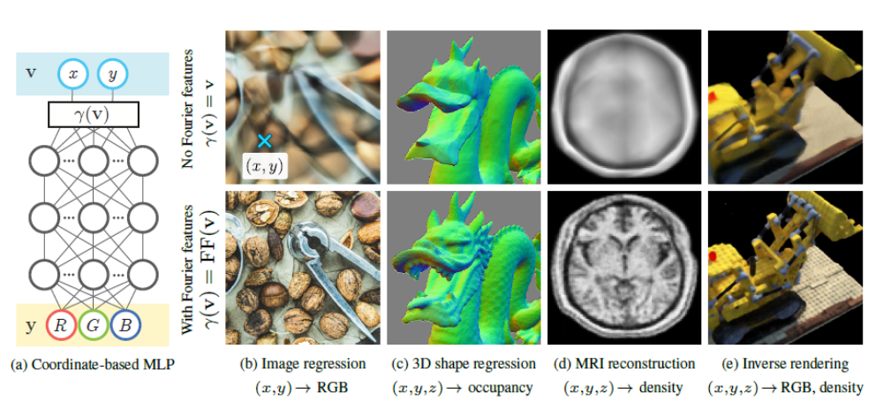
MLPs are powerful, but input representation matters. Example: mapping position/ray to color
L2 loss
ReLU MLP with 4 layers and 256 channels (nodes per layer)
Sigmoid activation on output
256 frequency positional encoding
Fourier Features (Tancik et al. 2020)
NeRF (Mildenhall et al. 2020)

Slide 3
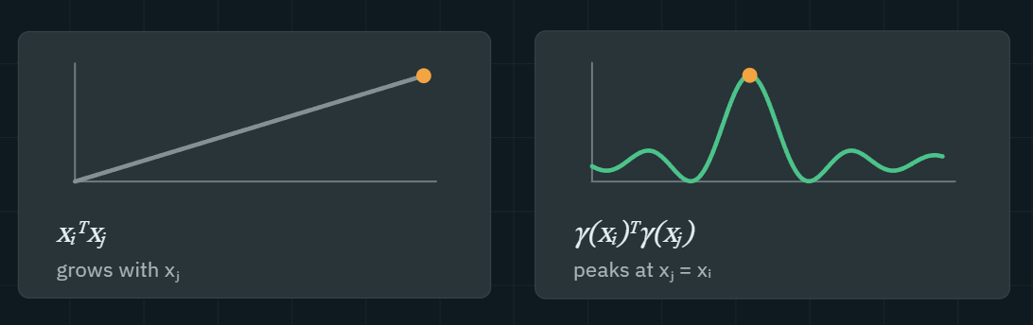
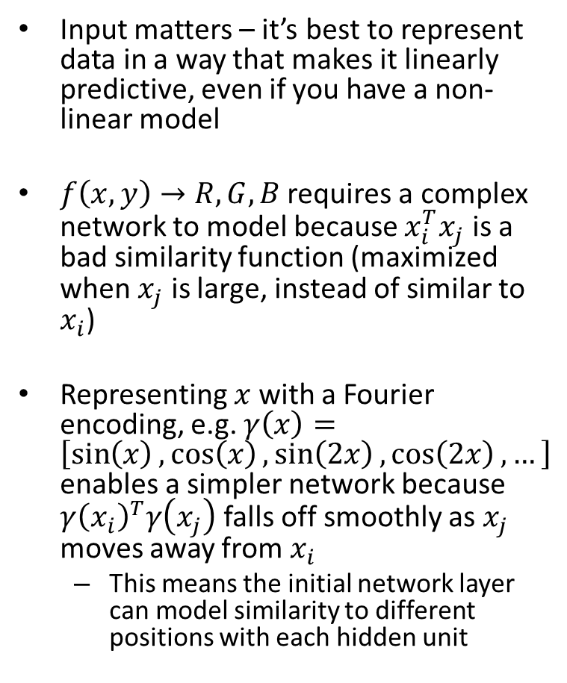
Generalized insight from “Fourier Features”
Input matters – it’s best to represent data in a way that makes it linearly predictive, even if you have a non-linear model
$f\left(x, y\right)→R,G,B$ requires a complex network to model because $x_{i}^{T}x_{j}$ is a bad similarity function (maximized when $x_{j}$ is large, instead of similar to $x_{i}$)
Representing $x$ with a Fourier encoding, e.g. $γ\left(x\right)=\left[\sin\left(x\right),\cos\left(x\right),\sin\left(2x\right),\cos\left(2x\right), …\right]$ enables a simpler network because $γ{\left(x_{i}\right)}^{T}γ\left(x_{j}\right)$ falls off smoothly as $x_{j}$ moves away from $x_{i}$
  This means the initial network layer can model similarity to different positions with each hidden unit

Slide 4
Today’s Lecture
A bit of deep learning history
Early advances in deep networks
  Convolutional networks
  Residual connections
  BatchNorm
Enhancements to SGD

Slide 5
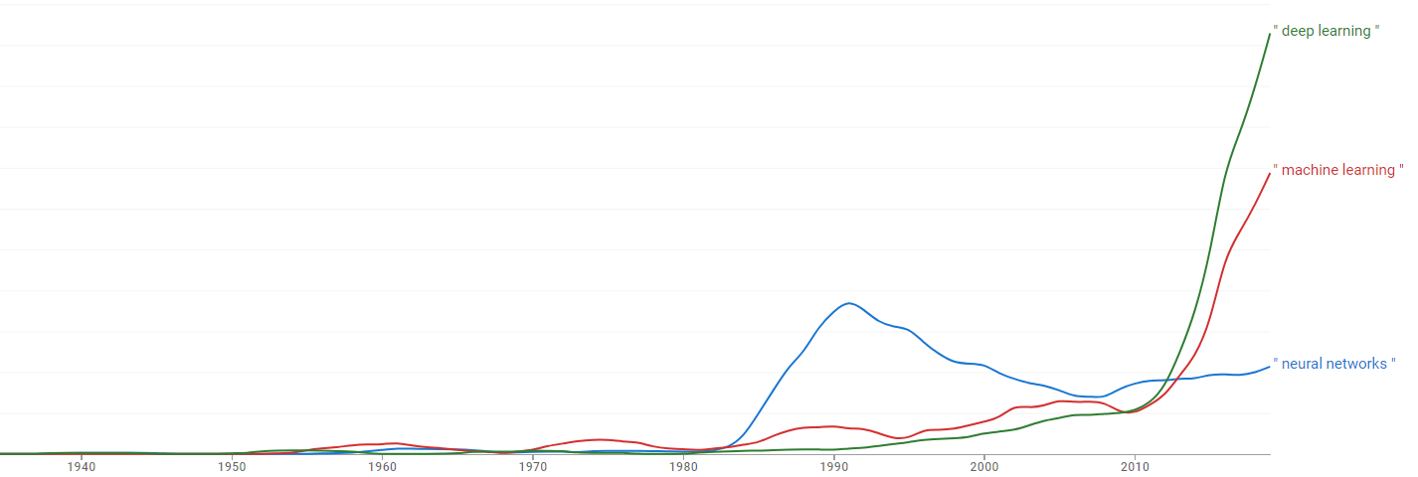
Brief history of deep learning
1958: neural nets (perceptron and MLP) invented by Rosenblatt
1967: First use of SGD in deep-learning network (Amari)
1980’s/1990’s: Neural nets are popularized and then abandoned as being interesting idea but too difficult to optimize or “unprincipled”, supplanted by SVM
1990’s: LeCun and colleagues achieve state-of-art performance on character recognition with convolutional network
2000’s: Hinton, Bottou, Bengio, LeCun, Ng, and others keep trying stuff with deep networks but without much traction/acclaim in most areas
2010-2011: Substantial progress in some areas, but vision community still unconvinced
2012: shock at ECCV 2012 with ImageNet challenge
Google Book Ngram Plot

Slide 6
The Perceptron, the first neural network
Slide: Lazebnik
Input
Weights
x₁
w₁
x₂
w₂
Output: sgn(w⋅x + b)
x₃
w₃
.
.
.
w_{D}
x_{D}
Rosenblatt, Frank (1958), The Perceptron: A Probabilistic Model for Information Storage and Organization in the Brain, Cornell Aeronautical Laboratory, Psychological Review, v65, No. 6, pp. 386–408.

Slide 7
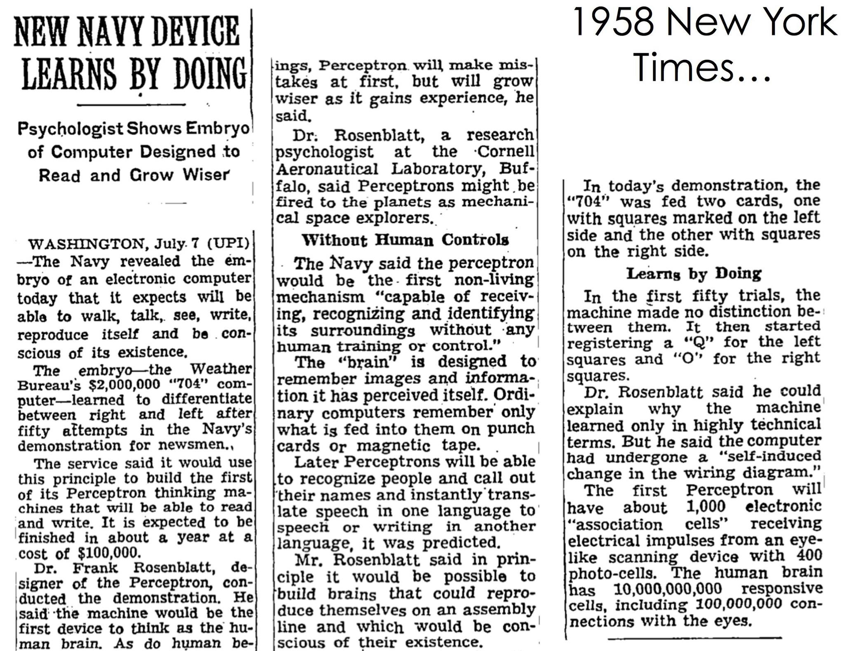
Slide: Lazebnik

Slide 8
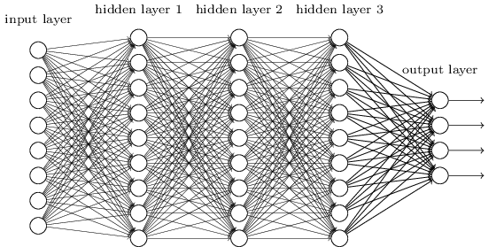
A key problem: how to model the compositional nature of text and images?
You could treat the image like a vector of values and add fully connected layers
(which we do in HW4)
But this doesn’t take advantage of the 2D structure of images
Slide: Lazebnik

Slide 9
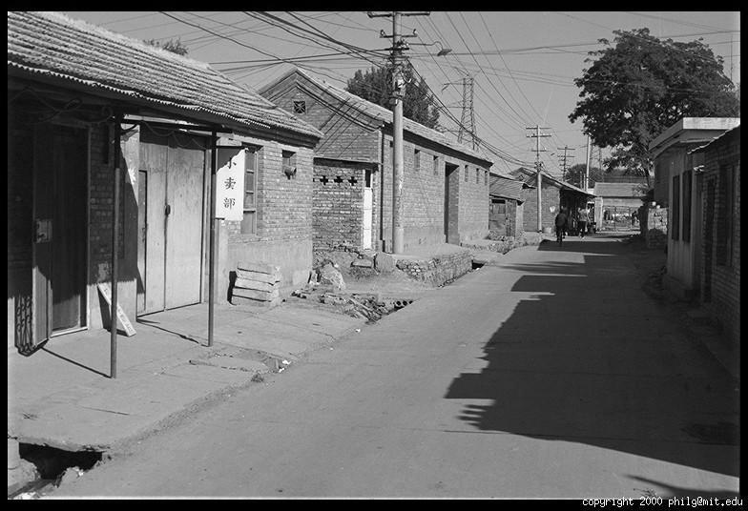
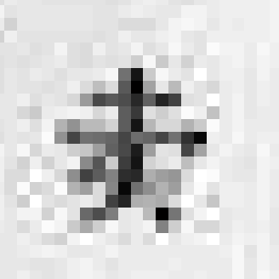
Images have local patterns that can appear at different positions
0.92 | 0.93 | 0.94 | 0.97 | 0.62 | 0.37 | 0.85 | 0.97 | 0.93 | 0.92 | 0.99
0.95 | 0.89 | 0.82 | 0.89 | 0.56 | 0.31 | 0.75 | 0.92 | 0.81 | 0.95 | 0.91
0.89 | 0.72 | 0.51 | 0.55 | 0.51 | 0.42 | 0.57 | 0.41 | 0.49 | 0.91 | 0.92
0.96 | 0.95 | 0.88 | 0.94 | 0.56 | 0.46 | 0.91 | 0.87 | 0.90 | 0.97 | 0.95
0.71 | 0.81 | 0.81 | 0.87 | 0.57 | 0.37 | 0.80 | 0.88 | 0.89 | 0.79 | 0.85
0.49 | 0.62 | 0.60 | 0.58 | 0.50 | 0.60 | 0.58 | 0.50 | 0.61 | 0.45 | 0.33
0.86 | 0.84 | 0.74 | 0.58 | 0.51 | 0.39 | 0.73 | 0.92 | 0.91 | 0.49 | 0.74
0.96 | 0.67 | 0.54 | 0.85 | 0.48 | 0.37 | 0.88 | 0.90 | 0.94 | 0.82 | 0.93
0.69 | 0.49 | 0.56 | 0.66 | 0.43 | 0.42 | 0.77 | 0.73 | 0.71 | 0.90 | 0.99
0.79 | 0.73 | 0.90 | 0.67 | 0.33 | 0.61 | 0.69 | 0.79 | 0.73 | 0.93 | 0.97
0.91 | 0.94 | 0.89 | 0.49 | 0.41 | 0.78 | 0.78 | 0.77 | 0.89 | 0.99 | 0.93

Slide 10
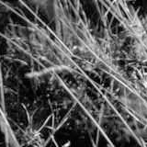
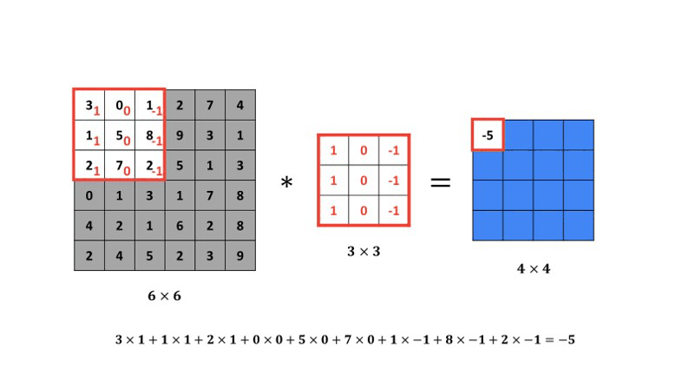
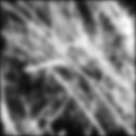
Linear filtering is a foundation of image processing
Smoothing Filter
Linear image filtering: at each pixel, output a weighted sum of pixels in surrounding patch
  E.g. Gaussian-weighted smoothing filter (right), edge detection (below), local pattern detection
Animation: https://datahacker.rs/004-how-to-smooth-and-sharpen-an-image-in-opencv/

Slide 11
A CNN (convolutional network) learns filter weights to create grids of features (“feature map”)
feature map
learned weights
image
Convolutional layer
Slide: Lazebnik

Slide 12
Repeatedly filter and pool to detect patterns of patterns of patterns of …
Label
Feature maps
Dense
Dense
MLP
Spatial pooling
Dense
Convolution/pool
Non-linearity
Convolution/pool
Convolution (Learned)
Convolution/pool
Convolutional Blocks
Convolution/pool
Input Image
Convolution/pool
Image

Slide 13
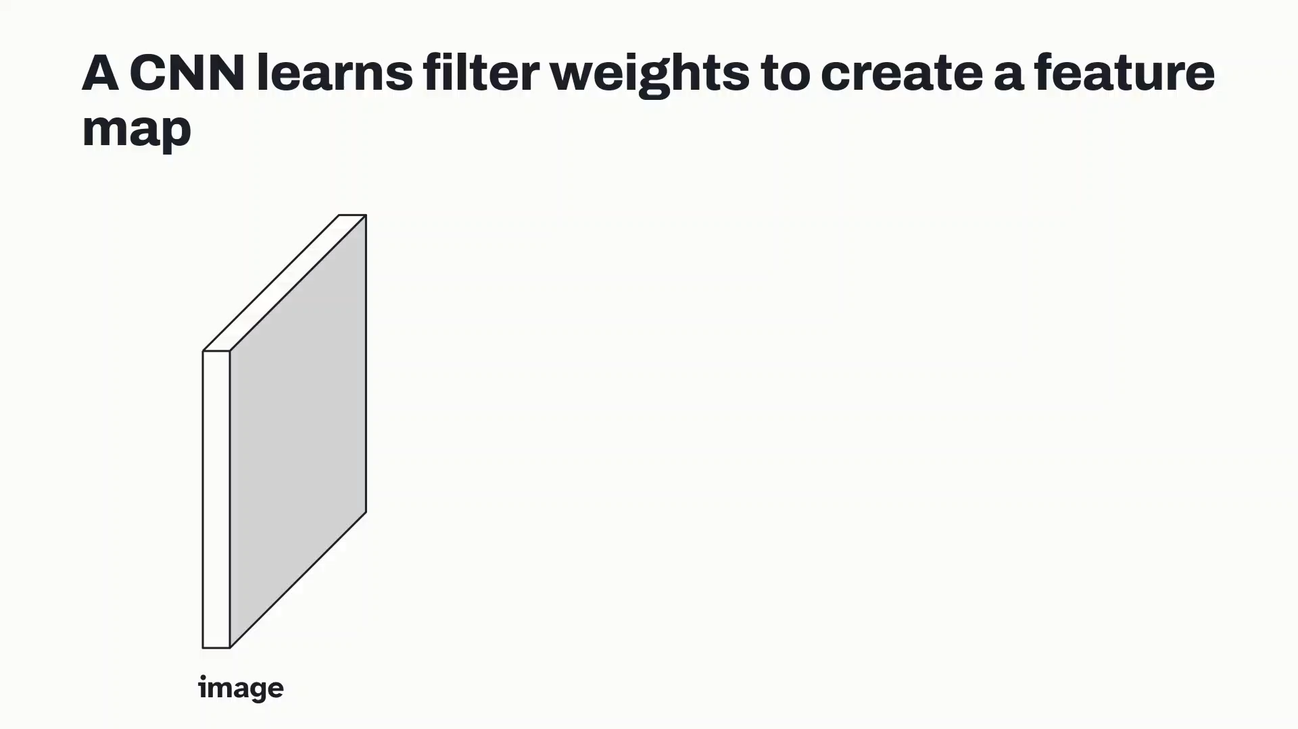

Slide 14
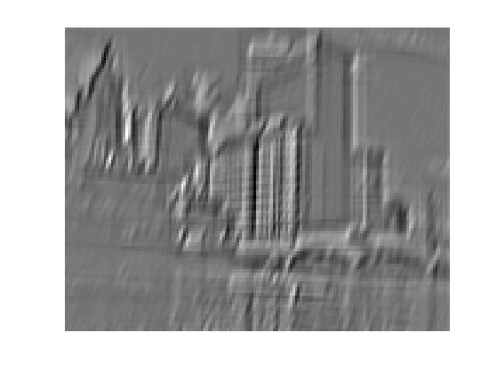
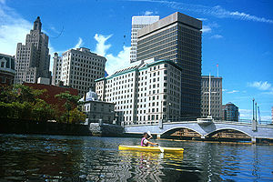
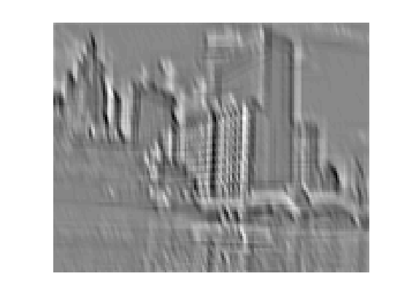
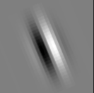
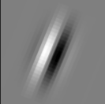
Convolution as feature extraction
...
Input
Feature Map
Slide: Lazebnik

Slide 15
Multiple filters are learned, producing a map of feature vectors
feature map
learned weights
image
Convolutional layer
Slide: Lazebnik

Slide 16
Following layers operate on the feature map from the previous layer
next layer
image
Convolutional layer
Slide: Lazebnik

Slide 17
Key operations in a CNN
Feature maps
Spatial pooling
Non-linearity
Convolution (Learned)
...
Input Image
Input
Feature Map
Source: R. Fergus, Y. LeCun
Slide: Lazebnik

Slide 18
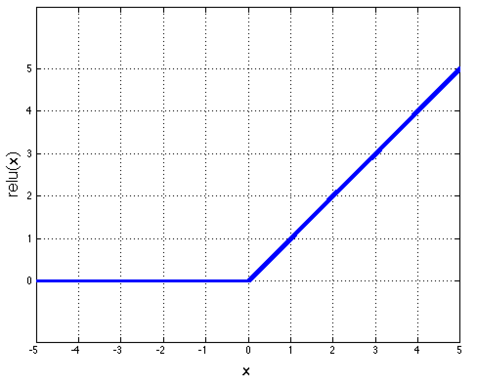
Key operations
Feature maps
Spatial pooling
Rectified Linear Unit (ReLU)
Non-linearity
Convolution (Learned)
Input Image
Source: R. Fergus, Y. LeCun
Slide: Lazebnik

Slide 19
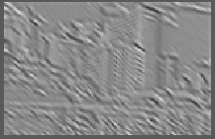
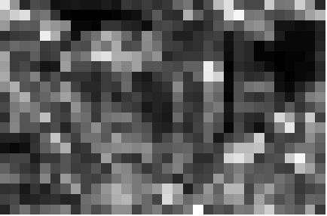
Key operations
Feature maps
Spatial pooling
  Max
Non-linearity
Convolution (Learned)
Input Image
Source: R. Fergus, Y. LeCun
Slide: Lazebnik

Slide 20
Key idea: learn features and classifier that work well together (“end-to-end training”)
Label
Dense
Dense
Dense
Convolution/pool
Convolution/pool
Convolution/pool
Convolution/pool
Convolution/pool
Image

Slide 21
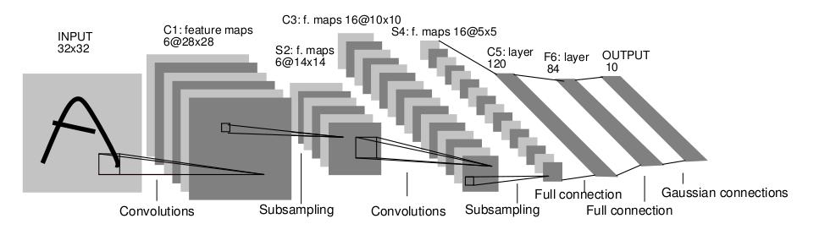
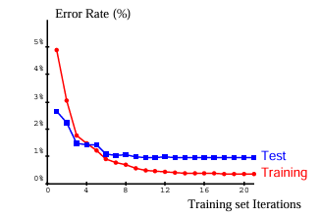
LeNet-5 for character/digit recognition
MNIST results (~1% test error)
Average pooling
Sigmoid or tanh nonlinearity
Fully connected layers at the end
Trained on MNIST digit dataset with 60K training examples
Y. LeCun, L. Bottou, Y. Bengio, and P. Haffner, Gradient-based learning applied to document recognition, Proc. IEEE 86(11): 2278–2324, 1998.

Slide 22
CNN: Convolutional Neural Network
Architecture explicitly designed to model compositional patterns with translational invariance
Combines convolutional layers with MLPs
Can have 1D CNNs for text or signals, or 3D CNNs for volumetric data

Slide 23

Q1
https://tinyurl.com/441AML-L16

Slide 24
For the next 10+ years, neural networks did not gain traction, and they were dismissed as an interesting idea that just didn’t work
2009 – Raina et al. train CNN with GPU
2011 – Glorot et al. found that using ReLUs improved training
2012…

Slide 25
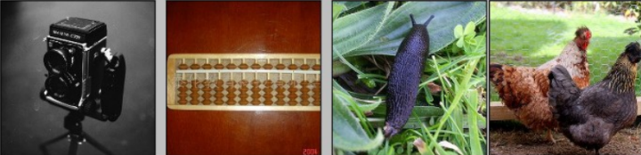
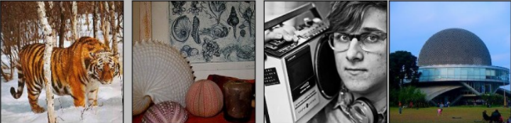
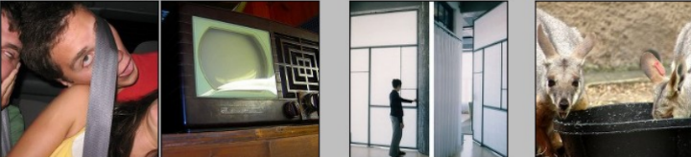
Fast forward to the arrival of big visual data…
Created in 2006
~14 million labeled images, 20k classes
Images gathered from Internet
Human labels via Amazon MTurk
ImageNet Large-Scale Visual Recognition Challenge (ILSVRC):
1.2 million training images, 1000 classes
www.image-net.org/challenges/LSVRC/
Slide: Lazebnik

Slide 26
Surprise in the 2012 ImageNet competition at ECCV
Slide: Jia-bin Huang

Slide 27

Surprise in the 2012 ImageNet competition at ECCV
Slide: Jia-bin Huang

Slide 28
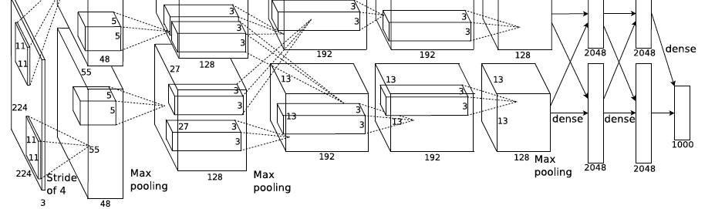
AlexNet: ILSVRC 2012 winner
Similar framework to LeNet but:
  Max pooling, ReLU nonlinearity
  More data and bigger model (7 hidden layers, 650K units, 60M params)
  GPU implementation (50x speedup over CPU)
    Trained on two GPUs for a week
  Dropout regularization
A. Krizhevsky, I. Sutskever, and G. Hinton, ImageNet Classification with Deep Convolutional Neural Networks, NIPS 2012
Notes:
Two-GPU architecture

Slide 29

What enabled the breakthrough?
ReLU activation enabled large models to be optimized
ImageNet provided diverse and massive annotation to take advantage of the models
GPU processing made the optimization practicable

Slide 30
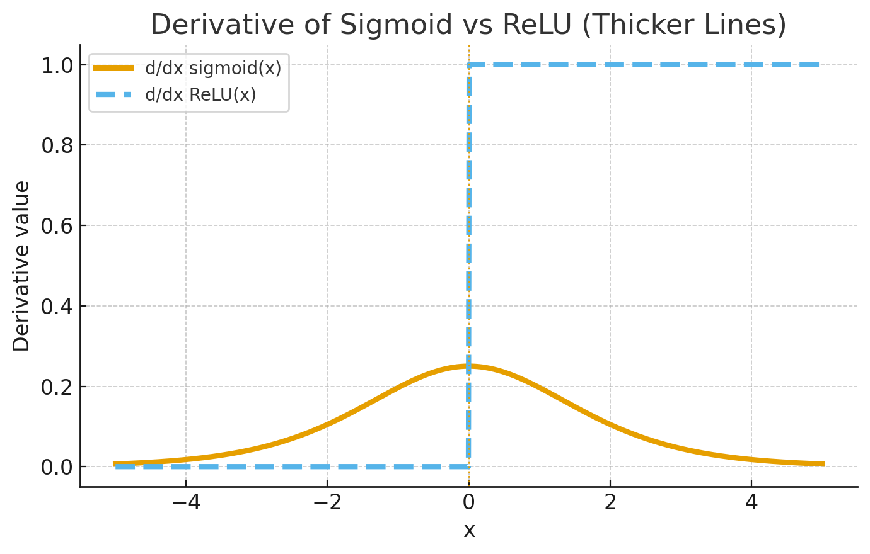
Sigmoid vs ReLU
Sigmoid has derivative less than 1 everywhere
Long products of gradients will have vanishingly small values
ReLU have gradient of 1 for positive values, so a long product can potentially have a gradient of 1
Derivative of Sigmoid and ReLU

Slide 31
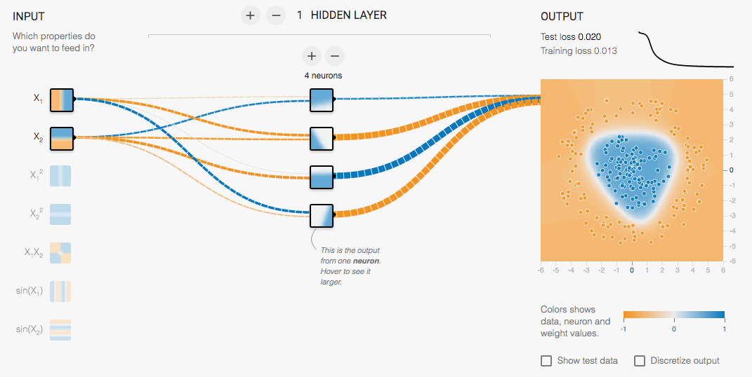
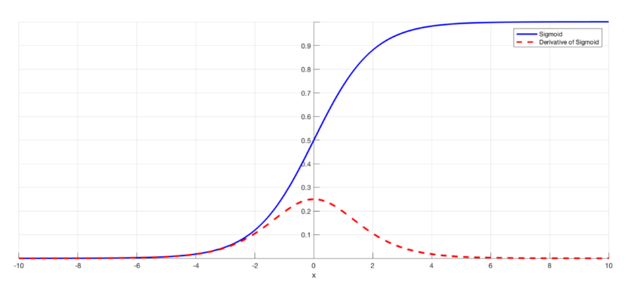
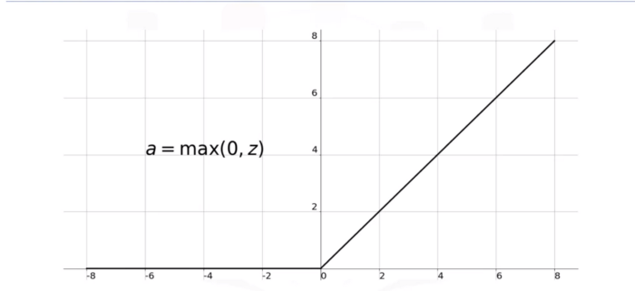
Sigmoid vs. ReLU
Sigmoid
ReLU
http://playground.tensorflow.org/
Try many layers with sigmoid vs relu
Slide: Lazebnik

Slide 32
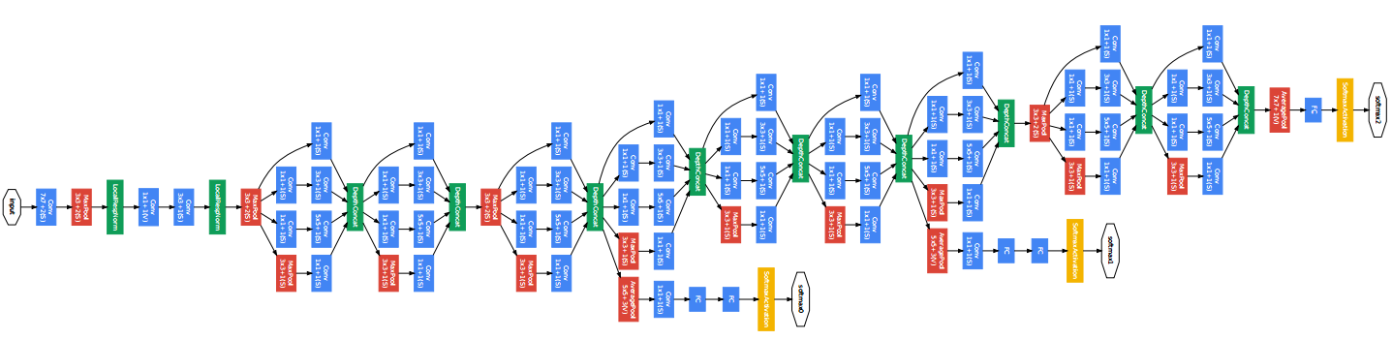
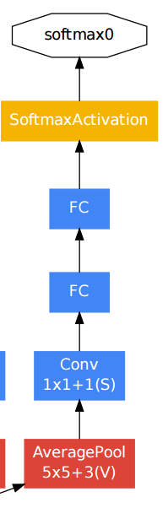
Even with ReLU, it was hard to get very deep networks to work well
GoogLeNet: add bottlenecks and multiple stages of supervision
Auxiliary classifier
C. Szegedy et al., Going deeper with convolutions, CVPR 2015

Slide 33
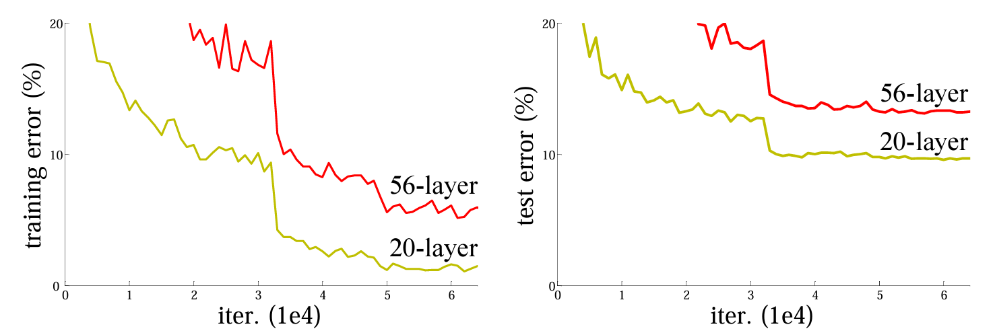
What was the problem?
Were deeper networks overfitting the training data?
Or was the problem just that we couldn’t optimize them?
How could we answer this question?

Slide 34
Look at the training error!
With deeper networks, the training error goes up!?!
Fig: He et al. 2016

Slide 35
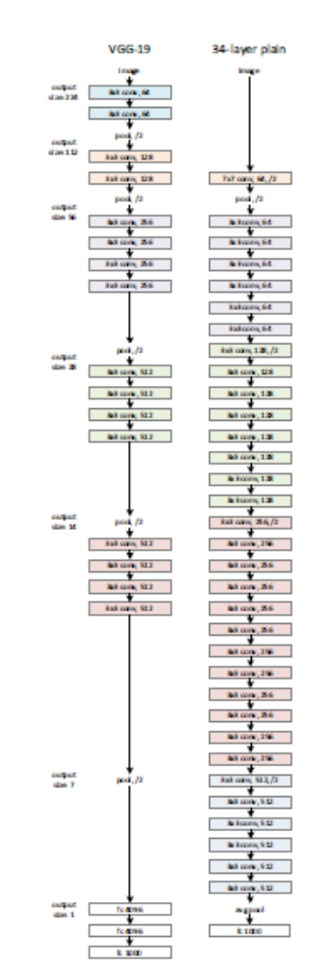
Very deep networks, vanishing gradients, and information propagation
Vanishing gradients
Early weights have a long path to reach output
Any zeros along that path kill the gradient
Early layers cannot be optimized
Multiple stages of supervision can help, but it’s complicated and time-consuming
Information propagation
Networks need to continually maintain and add to information represented in previous layers

Slide 36
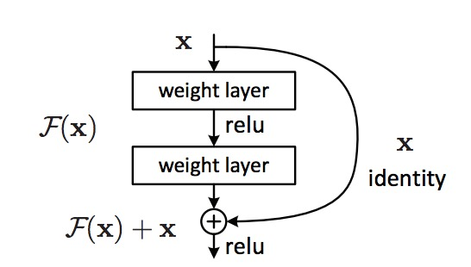
ResNet: the residual module
Use skip or shortcut connections around 2-3 layer MLPs or CNNs
Gradients can flow quickly back through skip connections
Each module needs only add information to the previous layers
Kaiming He, Xiangyu Zhang, Shaoqing Ren, and Jian Sun, Deep Residual Learning for Image Recognition, CVPR 2016 (Best Paper), 346K citations
Most cited paper of the 21st century!

Slide 37
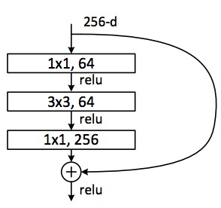
ResNet: Residual Bottleneck Module
Used in 50+ layer networks
  Directly performing 3x3 convolutions with 256 feature maps at input and output:
  256 x 256 x 3 x 3 ~ 600K operations
  Using 1x1 convolutions to reduce 256 to 64 feature maps, followed by 3x3 convolutions, followed by 1x1 convolutions to expand back to 256 maps:
  256 x 64 x 1 x 1 ~ 16K
  64 x 64 x 3 x 3 ~ 36K
  64 x 256 x 1 x 1 ~ 16K
  Total: ~70K
Kaiming He, Xiangyu Zhang, Shaoqing Ren, and Jian Sun, Deep Residual Learning for Image Recognition, CVPR 2016
Slide: Lazebnik

Slide 38
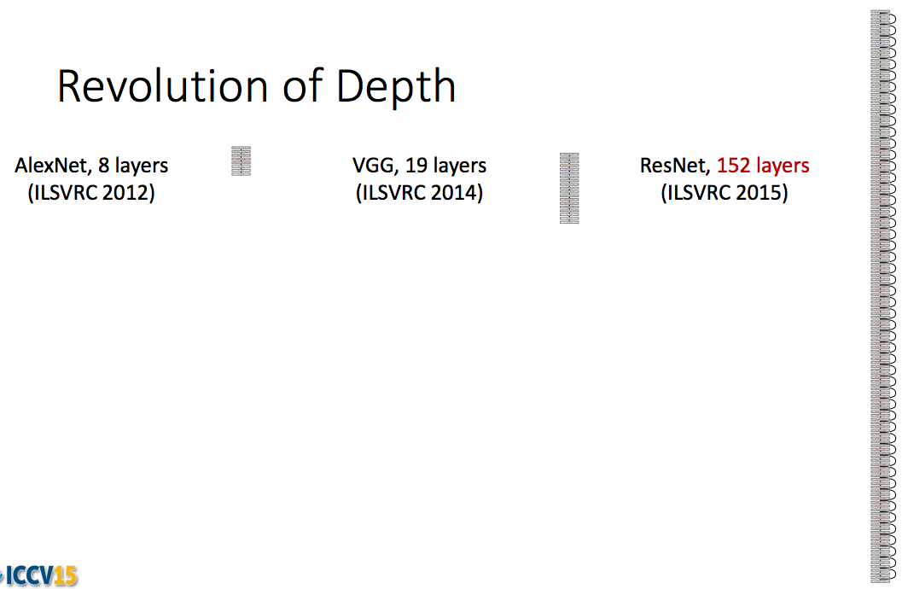
ResNet: going real deep
Despite depth, the residual connections enable error gradients to “skip” all the way back to the beginning
Kaiming He, Xiangyu Zhang, Shaoqing Ren, and Jian Sun, Deep Residual Learning for Image Recognition, CVPR 2016

Slide 39
Example code: ResBlock
“channels” = # feature maps
kernel_size = filter size, e.g. 3x3
stride = # pixels to skip when evaluating convolution
padding: to calculate filter values near edge of image/map
class ResBlock(nn.Module):
def __init__(self, in_channels, out_channels, downsample):
super().__init__()
if downsample:
self.conv1 = nn.Conv2d(in_channels, out_channels, kernel_size=3, stride=2, padding=1)
self.shortcut = nn.Sequential(
nn.Conv2d(in_channels, out_channels, kernel_size=1, stride=2),
nn.BatchNorm2d(out_channels)
)
else:
self.conv1 = nn.Conv2d(in_channels, out_channels, kernel_size=3, stride=1, padding=1)
self.shortcut = nn.Sequential()
self.conv2 = nn.Conv2d(out_channels, out_channels, kernel_size=3, stride=1, padding=1)
self.bn1 = nn.BatchNorm2d(out_channels)
self.bn2 = nn.BatchNorm2d(out_channels)
def forward(self, input):
output = nn.ReLU()(self.bn1(self.conv1(input)))
output = nn.ReLU()(self.bn2(self.conv2(output)))
shortcut = self.shortcut(input)
output = output + shortcut
return nn.ReLU()(output)
If downsampling, do it here too so dimensions match
This “+ shortcut” is the skip connection

Slide 40
Example code: ResNet-18 architecture for ImageNet
class Network(nn.Module):
def __init__(self, num_classes=1000):
super().__init__()
resblock = ResBlock
self.layer0 = nn.Sequential(
nn.Conv2d(3, 64, kernel_size=7, stride=2, padding=3),
nn.MaxPool2d(kernel_size=3, stride=2, padding=1),
nn.BatchNorm2d(64),
nn.ReLU()
)
self.layer1 = nn.Sequential(
resblock(64, 64, downsample=False),
resblock(64, 64, downsample=False)
)
self.layer2 = nn.Sequential(
resblock(64, 128, downsample=True),
resblock(128, 128, downsample=False)
)
self.layer3 = nn.Sequential(
resblock(128, 256, downsample=True),
resblock(256, 256, downsample=False)
)
self.layer4 = nn.Sequential(
resblock(256, 512, downsample=True),
resblock(512, 512, downsample=False)
)
self.gap = torch.nn.AdaptiveAvgPool2d(1)
self.fc = torch.nn.Linear(512, num_classes)
def forward(self, input):
input = self.layer0(input)
input = self.layer1(input)
input = self.layer2(input)
input = self.layer3(input)
input = self.layer4(input)
input = self.gap(input)
input = torch.flatten(input, 1)
input = self.fc(input)
return input
Forward applies prediction, going through each layer
Backward applies backpropagation to compute the loss gradient with respect to parameters in each layer
Pretrained Torch models

Slide 41
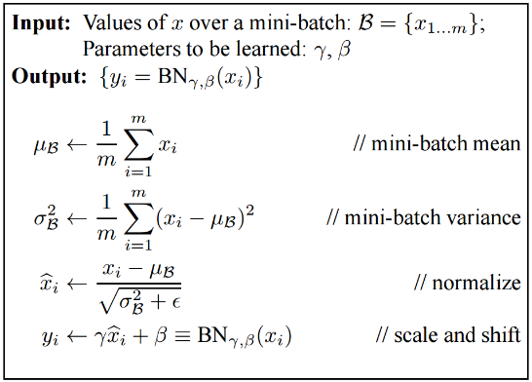
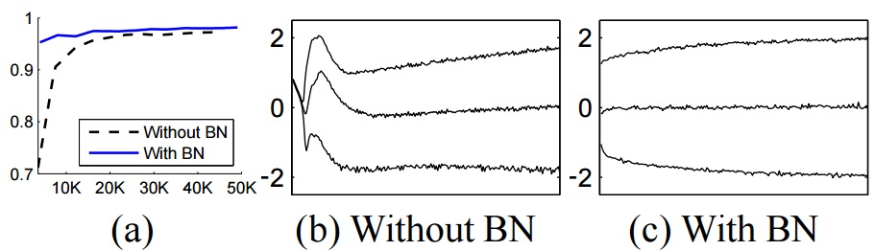
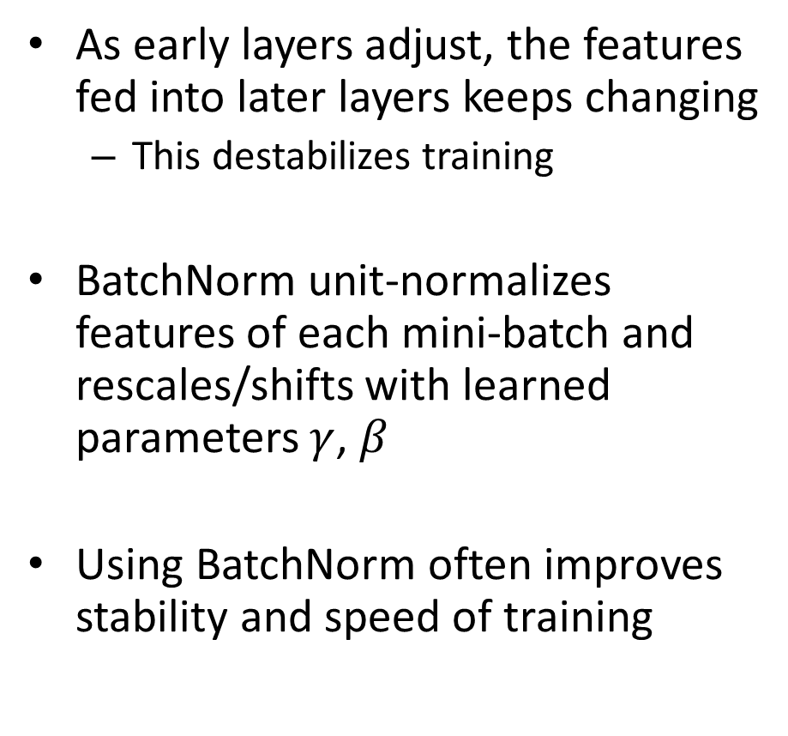
Batch Normalization
As early layers adjust, the features fed into later layers keeps changing
  This destabilizes training
BatchNorm unit-normalizes features of each mini-batch and rescales/shifts with learned parameters $γ$, $β$
Using BatchNorm often improves stability and speed of training
With BN reaches higher accuracy faster
With BN, the mean (center line) and variance (15th/85th pctl lines shown) of activations are more stable
Batch Normalization: Accelerating Deep Network Training by
Reducing Internal Covariate Shift [Ioffe and Szegedy 2015]

Slide 42
Example code: ResBlock
class ResBlock(nn.Module):
def __init__(self, in_channels, out_channels, downsample):
super().__init__()
if downsample:
self.conv1 = nn.Conv2d(in_channels, out_channels, kernel_size=3, stride=2, padding=1)
self.shortcut = nn.Sequential(
nn.Conv2d(in_channels, out_channels, kernel_size=1, stride=2),
nn.BatchNorm2d(out_channels)
)
else:
self.conv1 = nn.Conv2d(in_channels, out_channels, kernel_size=3, stride=1, padding=1)
self.shortcut = nn.Sequential()
self.conv2 = nn.Conv2d(out_channels, out_channels, kernel_size=3, stride=1, padding=1)
self.bn1 = nn.BatchNorm2d(out_channels)
self.bn2 = nn.BatchNorm2d(out_channels)
def forward(self, input):
shortcut = self.shortcut(input)
input = nn.ReLU()(self.bn1(self.conv1(input)))
input = nn.ReLU()(self.bn2(self.conv2(input)))
input = input + shortcut
return nn.ReLU()(input)

Slide 43
Example code: ResNet-18 architecture for ImageNet
class Network(nn.Module):
def __init__(self, num_classes=37):
super().__init__()
resblock = ResBlock
self.layer0 = nn.Sequential(
nn.Conv2d(3, 64, kernel_size=7, stride=2, padding=3),
nn.MaxPool2d(kernel_size=3, stride=2, padding=1),
nn.BatchNorm2d(64),
nn.ReLU()
)
self.layer1 = nn.Sequential(
resblock(64, 64, downsample=False),
resblock(64, 64, downsample=False)
)
self.layer2 = nn.Sequential(
resblock(64, 128, downsample=True),
resblock(128, 128, downsample=False)
)
self.layer3 = nn.Sequential(
resblock(128, 256, downsample=True),
resblock(256, 256, downsample=False)
)
self.layer4 = nn.Sequential(
resblock(256, 512, downsample=True),
resblock(512, 512, downsample=False)
)
self.gap = torch.nn.AdaptiveAvgPool2d(1)
self.fc = torch.nn.Linear(512, num_classes)
def forward(self, input):
input = self.layer0(input)
input = self.layer1(input)
input = self.layer2(input)
input = self.layer3(input)
input = self.layer4(input)
input = self.gap(input)
input = torch.flatten(input, 1)
input = self.fc(input)
return input

Slide 44
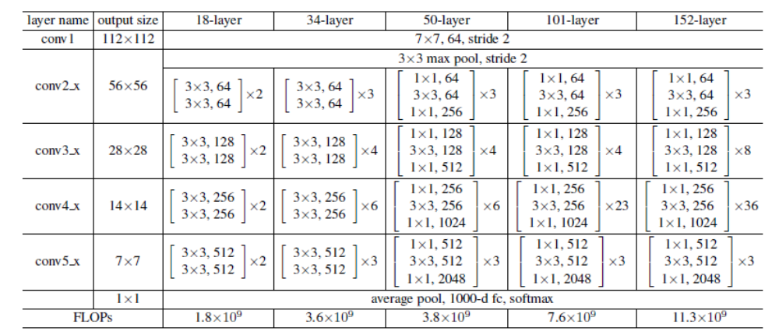
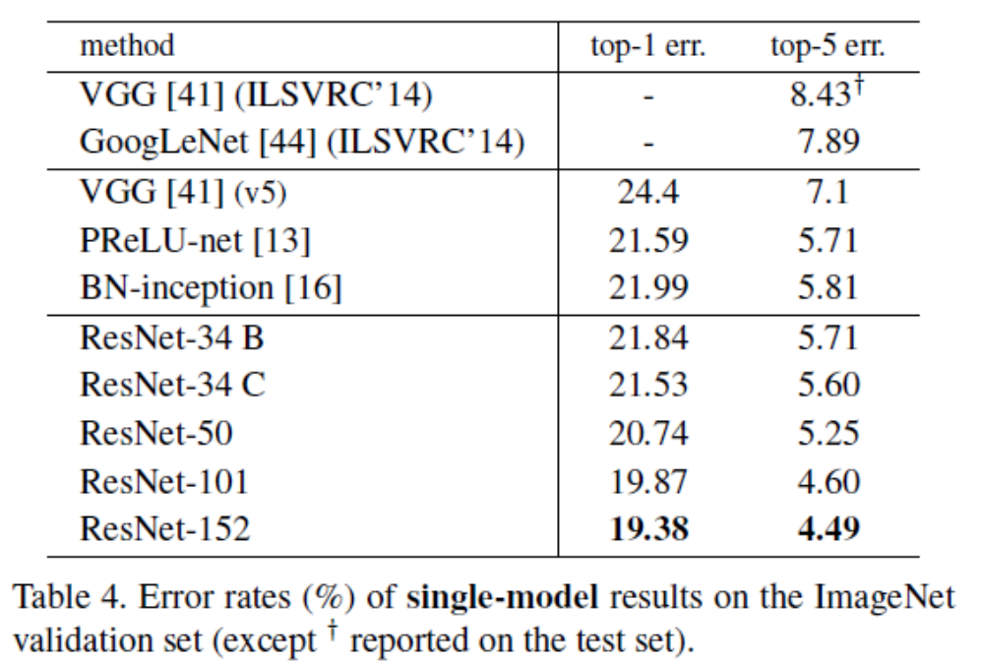
ResNet Architectures and Results
Network design is starting to become formulaic
First case where bigger keeps getting better

Slide 45
Q2-3
https://tinyurl.com/441AML-L16

Slide 46
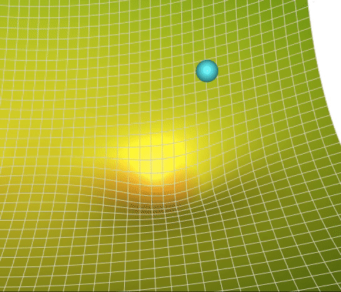
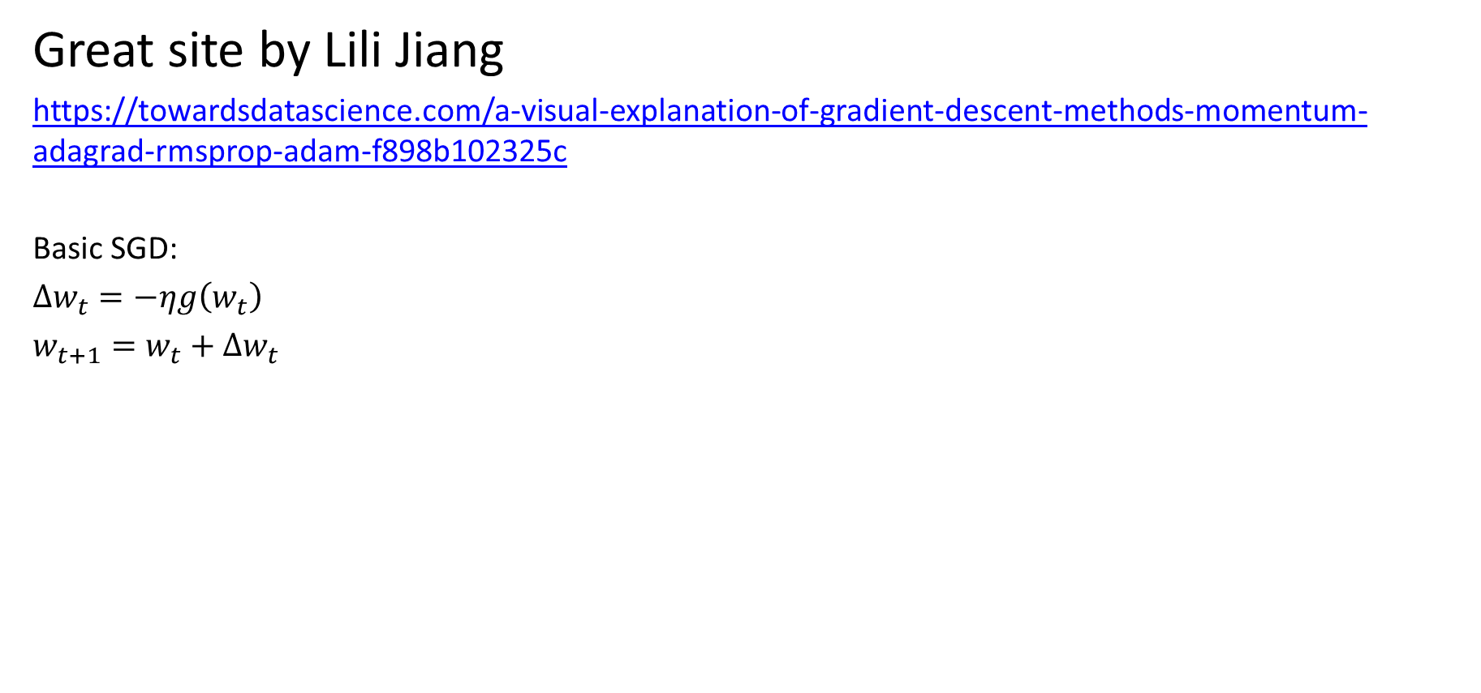
Improvements to SGD
Great site by Lili Jiang
https://towardsdatascience.com/a-visual-explanation-of-gradient-descent-methods-momentum-adagrad-rmsprop-adam-f898b102325c
Basic SGD:
$Δw_{t}=−ηg\left(w_{t}\right)$
$w_{t+1}=w_{t}+Δw_{t}$
Gradient of loss wrt weights

Slide 47
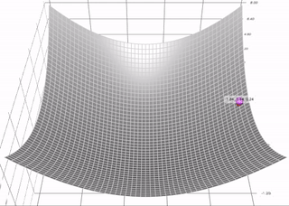
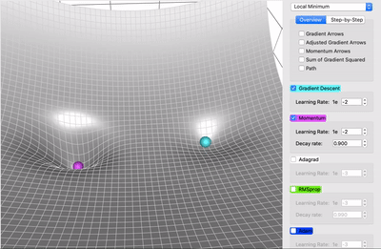
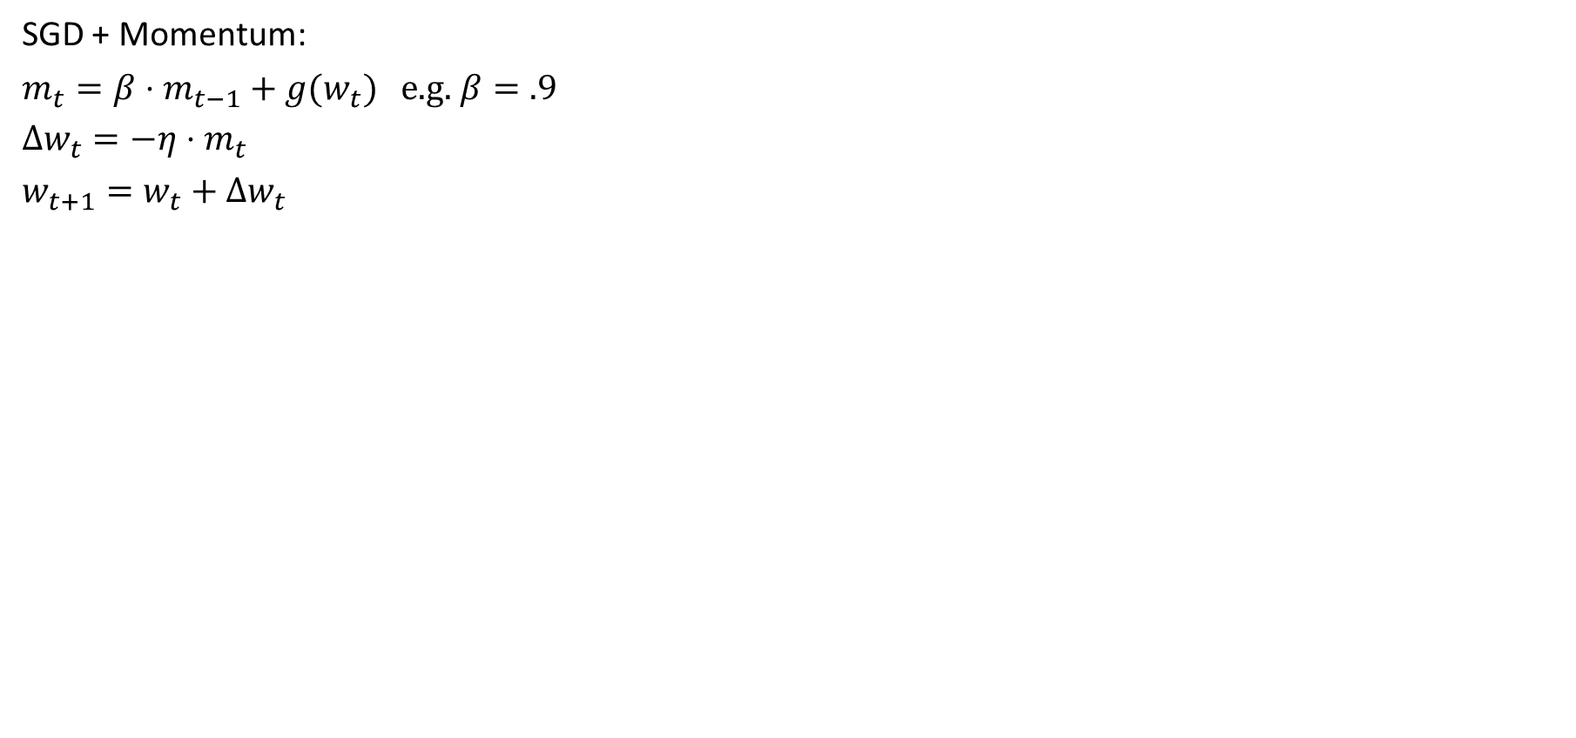
SGD + Momentum
SGD + Momentum:
$m_{t}=β⋅m_{t−1}+g(w_{t})$ e.g. $β=.9$
$Δw_{t}=−η⋅m_{t}$
$w_{t+1}=w_{t}+Δw_{t}$
Momentum (magenta) converges faster and carries the ball through a local minimum
Figure source

Slide 48
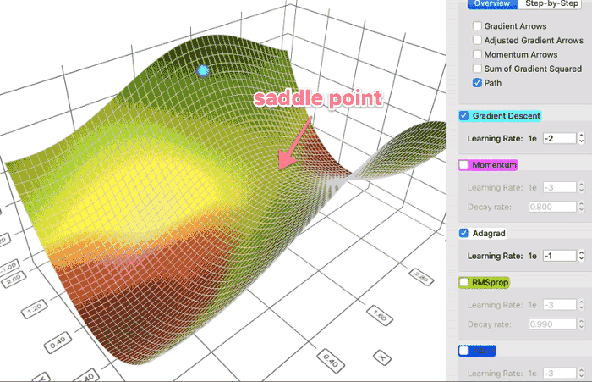
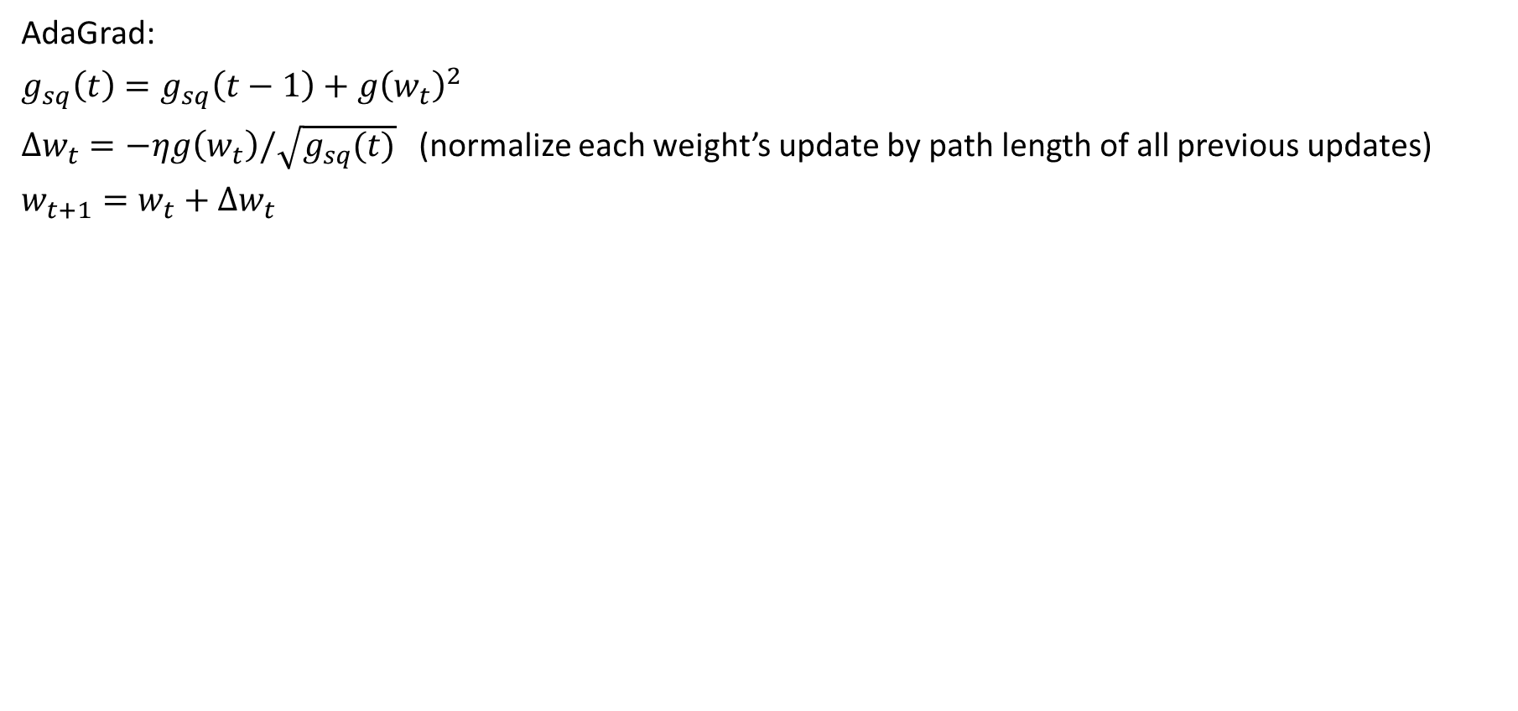
AdaGrad: Adaptive Gradient
AdaGrad:
$g_{sq}\left(t\right)=g_{sq}\left(t−1\right)+g{\left(w_{t}\right)}^{2}$
$Δw_{t}=−ηg\left(w_{t}\right)/\sqrt{g_{sq}(t)}$ (normalize each weight’s update by path length of all previous updates)
$w_{t+1}=w_{t}+Δw_{t}$
AdaGrad (white) avoids moving in only one weight direction, and can lead to smoother convergence
Can be seen as setting a per-weight learning rate
Figure source

Slide 49


RMSProp: Root Mean Squared Propagation
RMSProp:
$g_{sq}\left(t\right)={ε⋅g}_{sq}\left(t−1\right)+\left(1−ε\right)⋅g{\left(w_{t}\right)}^{2}$ (introducing decay rate turns this into moving avg)
$Δw_{t}=−ηg\left(w_{t}\right)/\sqrt{g_{sq}(t)}$ (normalize by moving average length of previous updates)
$w_{t+1}=w_{t}+Δw_{t}$
RMSProp (green) moves faster than AdaGrad (white)
Figure source

Slide 50

Adam: Adaptive Moment Estimation
Adam:
$m_{t}=β⋅m_{t−1}+\left(1−β\right)⋅g(w_{t})$ [momentum, $β=0.9$]
$g_{sq}\left(t\right)={ε⋅g}_{sq}\left(t−1\right)+\left(1−ε\right)⋅g{\left(w_{t}\right)}^{2}$ [RMSProp, $ε=0.999$]
$Δw_{t}=−η⋅m_{t}/\sqrt{g_{sq}\left(w_{t}\right)}$
$w_{t+1}=w_{t}+Δw_{t}$
“AdamW” is a fix on Adam to correctly update weight decay
use AdamW in code with weight decay, but I’ll refer to both as Adam
Videos
Adam is widely used and easier to tune than SGD + momentum
Figure source

Slide 51
What to use?
Adam is less sensitive to hyperparameters (easier to get a decent solution working)
Some computer vision practitioners say SGD+momentum can achieve the best performance, if you’re able to optimize over hyperparameters
Adam is the most used optimizer in research papers; newer optimizers such as Muon are gaining adoption in large-scale LLM pretraining

Slide 52
Q4
https://tinyurl.com/441AML-L16

Slide 53


What to remember
ImageNet
Deep networks provide huge gains in performance
  Large capacity, optimizable models
  Learn from new large datasets
ReLU and skip connections simplify optimization
SGD+momentum and AdamW are the most commonly used optimizers

Slide 54
Next lecture
Defining and training a deep network w/ PyTorch
Adopting the network to new tasks
  Linear probe
  Fine-tuning
Mask RCNN recognition system

