Slide 1

Decision and Regression Trees
Applied Machine Learning
Derek Hoiem
Dall-E: A dirt road splits around a large gnarly tree, fractal art

Slide 2
Recap of classification and regression
Nearest neighbor is widely used
  Super-powers: can instantly learn new classes and predict from one or many examples
Naïve Bayes represents a common assumption as part of density estimation, more typical as part of an approach rather than the final predictor
  Super-powers: Fast estimation from lots of data; not terrible estimation from limited data
Logistic Regression is widely used
  Super-powers: Effective prediction from high-dimensional features; good confidence estimates
Linear Regression is widely used
  Super-powers: Can extrapolate, explain relationships, and predict continuous values from many variables
Almost all algorithms involve nearest neighbor, logistic regression, or linear regression
  The main learning challenge is typically feature learning

Slide 3
So far, we’ve seen two main choices for how to use features
  Nearest neighbor uses all the features jointly to find similar examples
  Linear models make predictions out of weighted sums of the features
If you wanted to give someone a rule to split the ‘o’ from the ‘x’, what other idea might you try?
x
x
x
x
o
o
o
x
o
o
o
o
x
x2
x
x
x
x1
If x2 < 0.6 and x2 > 0.2 and x1 < 0.7, ‘o’
Else ‘x’
Can we learn these kinds of rules automatically?

Slide 4
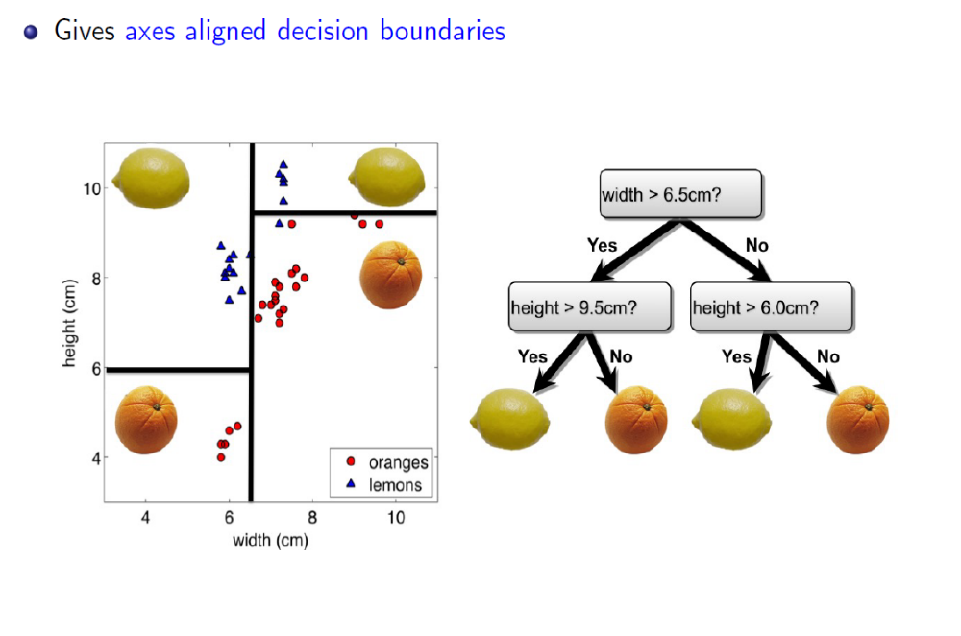
Decision trees
Training: Iteratively choose the attribute and split value that best separates the classes for the data in the current node
Combines feature selection/modeling with prediction
Fig Credit: Zemel, Urtasun, Fidler

Slide 5
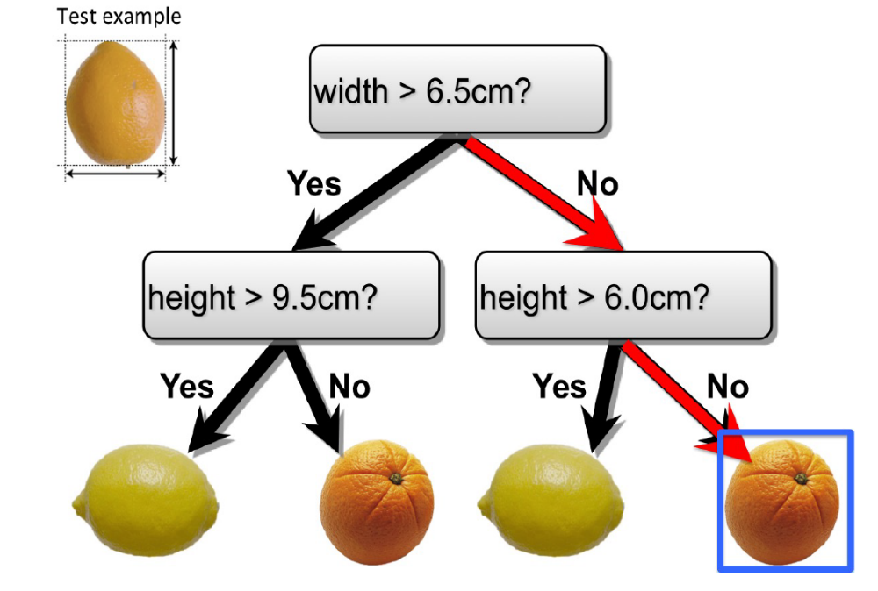
Decision Tree Classification
Slide Credit: Zemel, Urtasun, Fidler

Slide 6
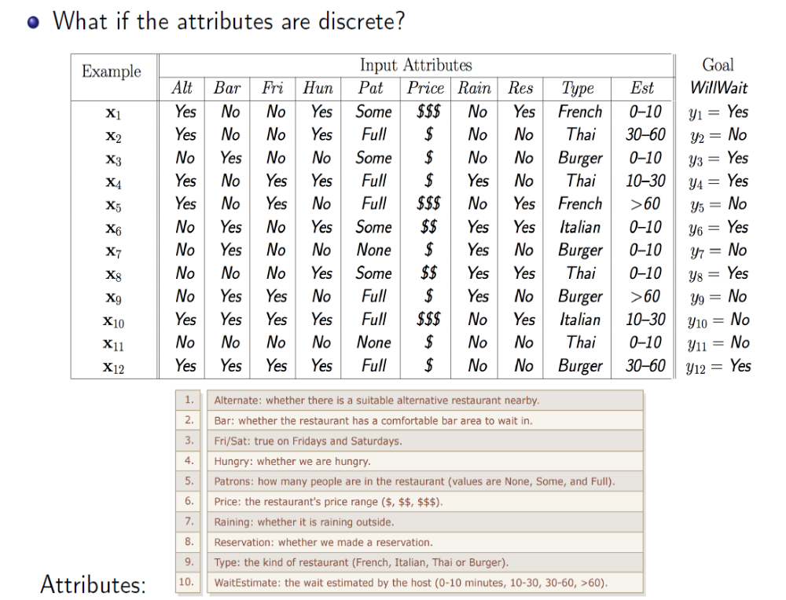
Example with discrete inputs
Slide Credit: Zemel, Urtasun, Fidler

Slide 7
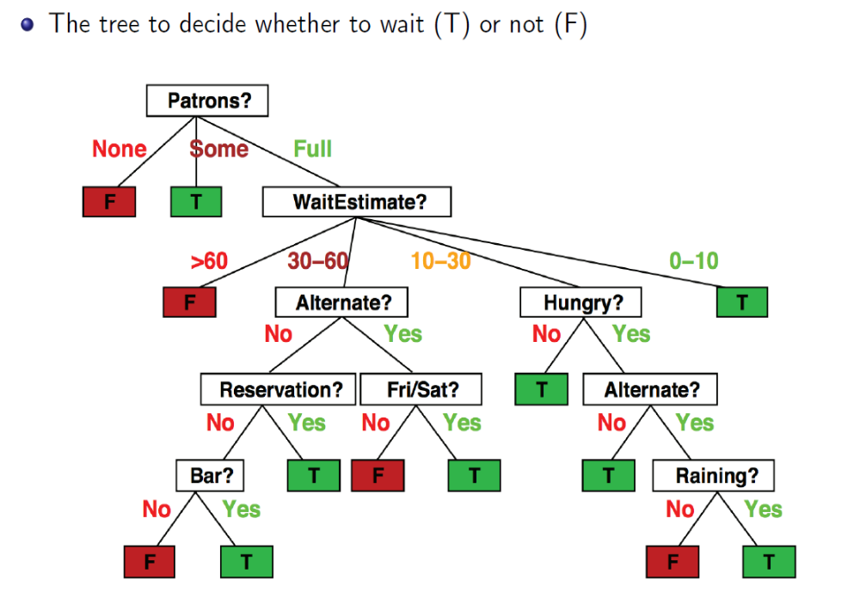
Example with discrete inputs
Figure Source: Zemel, Urtasun, Fidler

Slide 8
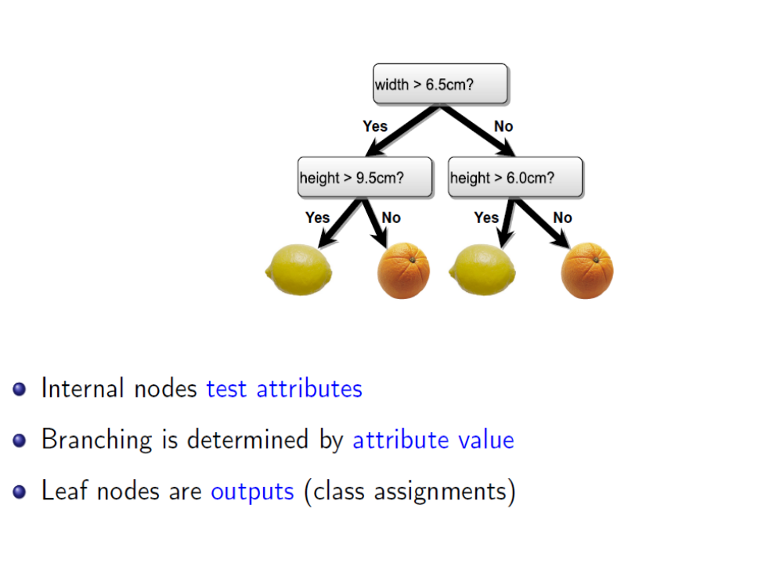
Decision Trees
Figure Source: Zemel, Urtasun, Fidler

Slide 9
Decision tree algorithm
Training
Recursively, for each node in tree:
  If labels in the node are mixed:
    Choose attribute and split values based on data that reaches each node
    Branch and create 2 (or more) nodes
  Return
x
x
x
o
x
x
x
o
x
o
x
o
o
o
o
x2
x1

Slide 10
Decision tree algorithm
x2 < 0.6
y
n
Training
Recursively, for each node in tree:
  If labels in the node are mixed:
    Choose attribute and split values based on data that reaches each node
    Branch and create 2 (or more) nodes
  Return
1
x
x
x
o
x
x
x
o
x
o
x
o
o
o
o
x2
(0,0)
x1
1

Slide 11
Decision tree algorithm
x2 < 0.6
y
n
x1 < 0.7
Training
Recursively, for each node in tree:
  If labels in the node are mixed:
    Choose attribute and split values based on data that reaches each node
    Branch and create 2 (or more) nodes
  Return
o
x
1
x
x
x
o
x
x
x
o
x
o
x
o
o
o
o
x2
(0,0)
x1
1

Slide 12
Decision tree algorithm
x2 < 0.6
y
n
x1 < 0.7
x2 < 0.8
Training
Recursively, for each node in tree:
  If labels in the node are mixed:
    Choose attribute and split values based on data that reaches each node
    Branch and create 2 (or more) nodes
  Return
o
x
x
1
x
x
x
o
x
x
x
o
x
o
x
o
o
o
o
x2
(0,0)
x1
1

Slide 13
Decision tree algorithm
x2 < 0.6
y
n
x1 < 0.7
x2 < 0.8
Training
Recursively, for each node in tree:
  If labels in the node are mixed:
    Choose attribute and split values based on data that reaches each node
    Branch and create 2 (or more) nodes
  Return
o
x
x
x1 < 0.4
x
x1 < 0.5
o
x
1
x
x
x
o
x
x
x
o
x
o
x
o
o
o
o
x2
(0,0)
x1
1

Slide 14
Decision tree algorithm
x2 < 0.6
y
n
Prediction
Check conditions to descend tree
Return label of leaf node
x1 < 0.7
x2 < 0.8
o
x
x
x1 < 0.4
x
x1 < 0.5
o
x
x
x
x
o
x
x
*
x
*
o
x
o
x
o
o
o
o
x2
(0,0)
x1
1

Slide 15
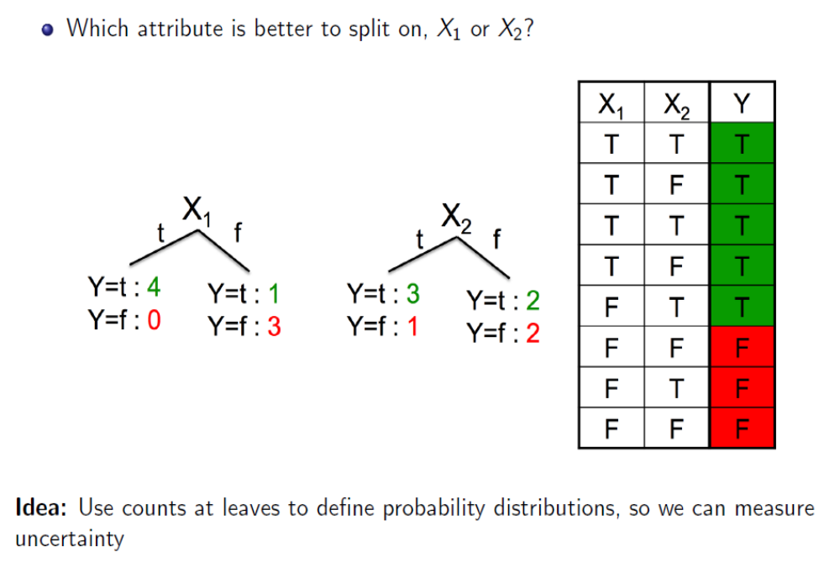
How do you choose what/where to split?
Slide Source: Zemel, Urtasun, Fidler

Slide 16
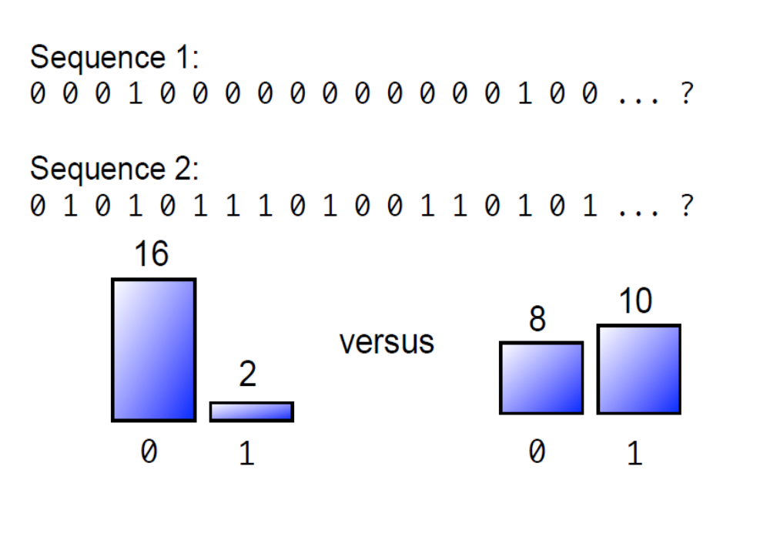
Quantifying Uncertainty: Coin Flip Example
Slide Source: Zemel, Urtasun, Fidler

Slide 17
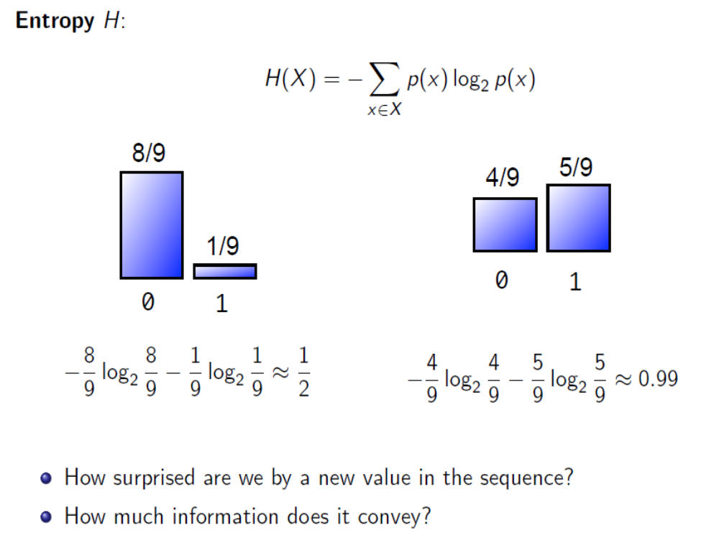
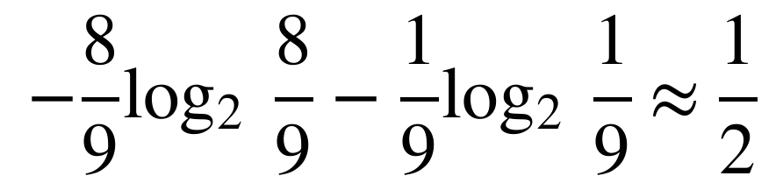
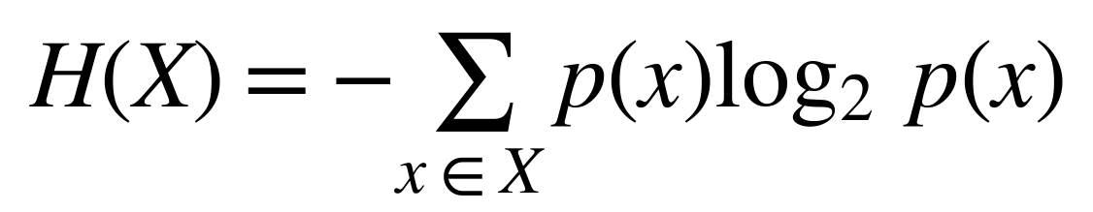
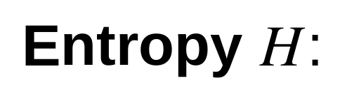
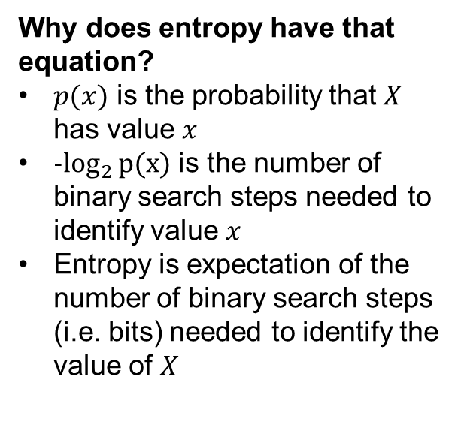
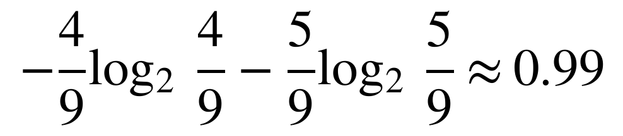
Quantifying Uncertainty: Coin Flip Example
Entropy $H$:
$$H\left(X\right)=−\sum_{x∈X}{p\left(x\right)\log_{2}{p\left(x\right)}}$$
Why does entropy have that equation?
$p(x)$ is the probability that $X$ has value $x$
$−\log_{2}{p(x)}$ is the number of binary search steps needed to identify value $x$
Entropy is expectation of the number of binary search steps (i.e. bits) needed to identify the value of $X$
$$−\frac{8}{9}\log_{2}{\frac{8}{9}}−\frac{1}{9}\log_{2}{\frac{1}{9}}≈\frac{1}{2}$$
$$−\frac{4}{9}\log_{2}{\frac{4}{9}}−\frac{5}{9}\log_{2}{\frac{5}{9}}≈0.99$$
How surprised are we by a new value in the sequence?
How much information does it convey?
Slide Source: Zemel, Urtasun, Fidler

Slide 18
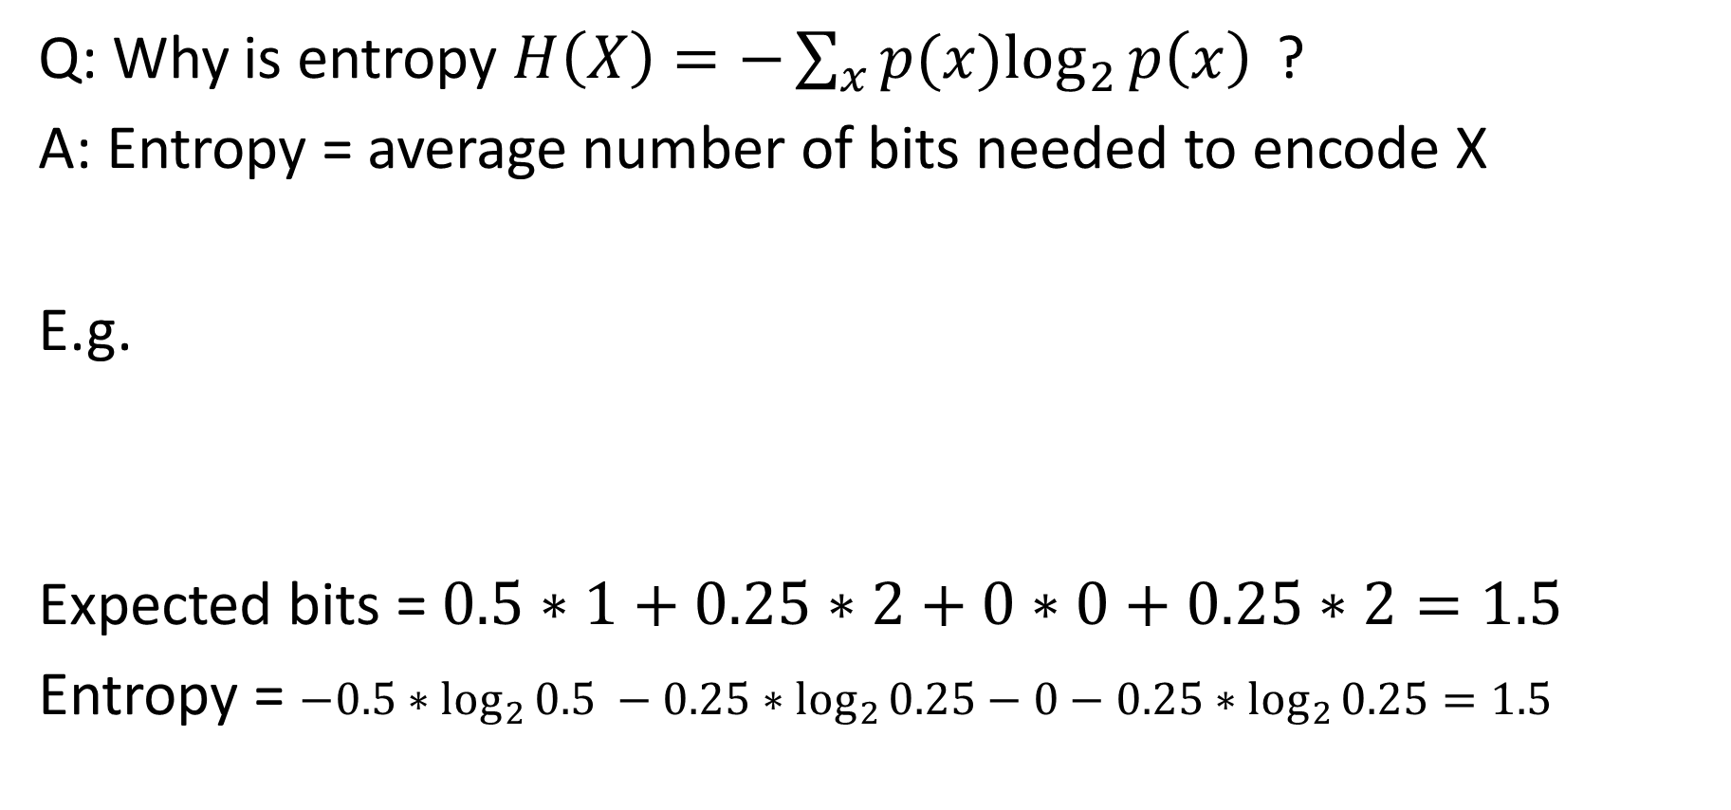
Entropy Explanation
Q: Why is entropy $H\left(X\right)=−\sum_{x}{p(x)\log_{2}{p\left(x\right)} }$?
A: Entropy = average number of bits needed to encode X
E.g.
Expected bits = $0.5∗1+0.25∗2+0∗0+0.25∗2=1.5$
Entropy = $−0.5∗\log_{2}{0.5} −0.25∗\log_{2}{0.25}−0−0.25∗\log_{2}{0.25}=1.5$
X= | 1 | 2 | 3 | 4
P(X) | 50% | 25% | 0% | 25%
Encoding | 0 | 1-0 |  | 1-1
Bits Used | 1 | 2 | 0 | 2

Slide 19
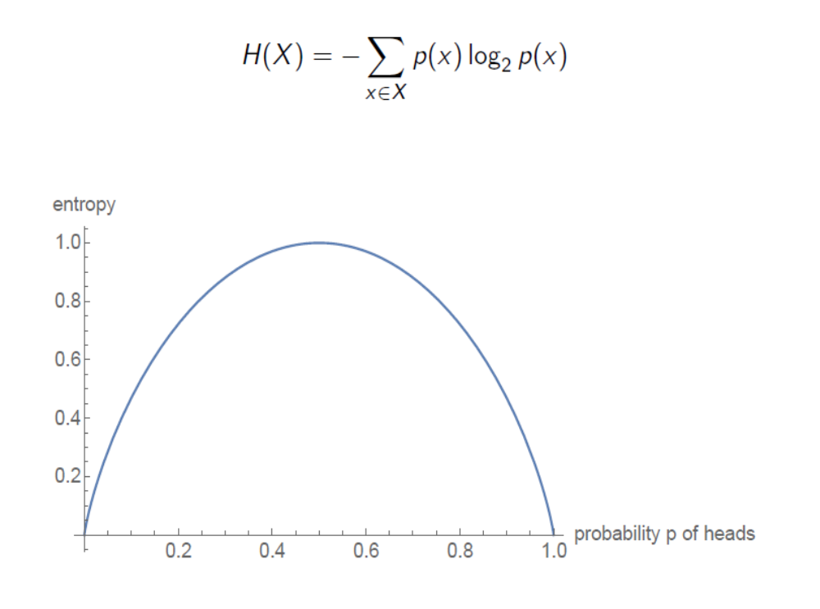
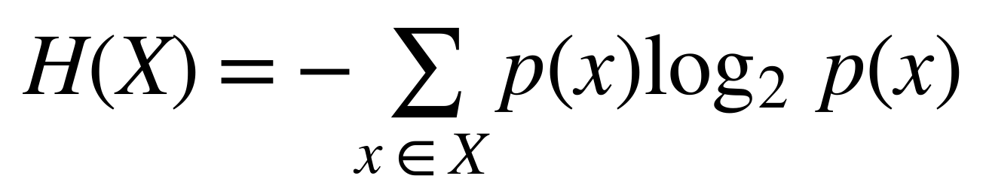
Quantifying Uncertainty: Coin Flip Example
$$H\left(X\right)=−\sum_{x∈X}{p\left(x\right)\log_{2}{p\left(x\right)}}$$
Entropy:
Slide Source: Zemel, Urtasun, Fidler

Slide 20
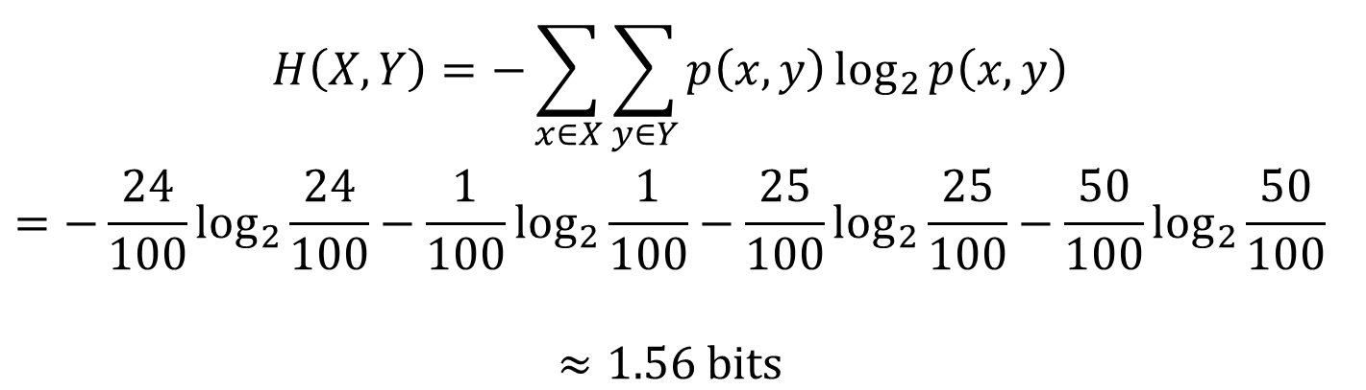
Entropy of a Joint Distribution
Example: $X=\{\text{Raining, Not raining}\}$, $Y=\{\text{Cloudy, Not cloudy}\}$
 | Cloudy | Not Cloudy
Raining | 24/100 | 1/100
Not Raining | 25/100 | 50/100
$$\begin{aligned}H\left(X,Y\right)=−\sum_{x∈X}{\sum_{y∈Y}{p\left(x,y\right)\log_{2}{p\left(x,y\right)}}} \\ =−\frac{24}{100}\log_{2}{\frac{24}{100}}−\frac{1}{100}\log_{2}{\frac{1}{100}}−\frac{25}{100}\log_{2}{\frac{25}{100}}−\frac{50}{100}\log_{2}{\frac{50}{100}} \\ \\ ≈1.56\text{ bits}\end{aligned}$$
Slide Source: Zemel, Urtasun, Fidler

Slide 21

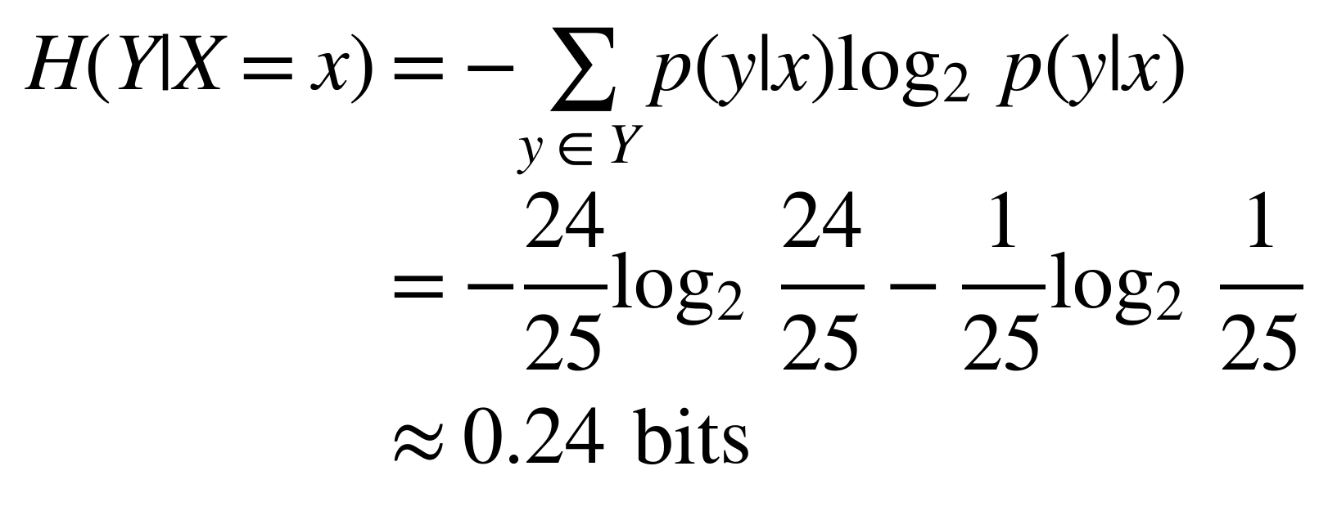
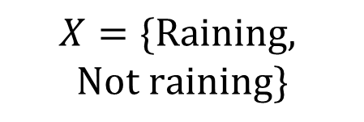
Specific Conditional Entropy
$$Y=\{\text{Cloudy, Not cloudy}\}$$
 | Cloudy | Not Cloudy
Raining | 24/100 | 1/100
Not Raining | 25/100 | 50/100
$$X=\{\text{Raining, }$$
$$\text{Not raining}\}$$
What is the entropy of cloudiness $Y$, given that it is raining?
$$\begin{aligned}H\left(Y|X=x\right)=−\sum_{y∈Y}{p\left(y|x\right)\log_{2}{p\left(y|x\right)}} \\ =−\frac{24}{25}\log_{2}{\frac{24}{25}}−\frac{1}{25}\log_{2}{\frac{1}{25}} \\ ≈0.24\text{ bits}\end{aligned}$$
We used: $p\left(y|x\right)=\frac{p\left(x,y\right)}{p\left(x\right)}$, and $p\left(x\right)=\sum_{y}{p\left(x,y\right)}$ (sum in a row)
Slide Source: Zemel, Urtasun, Fidler

Slide 22
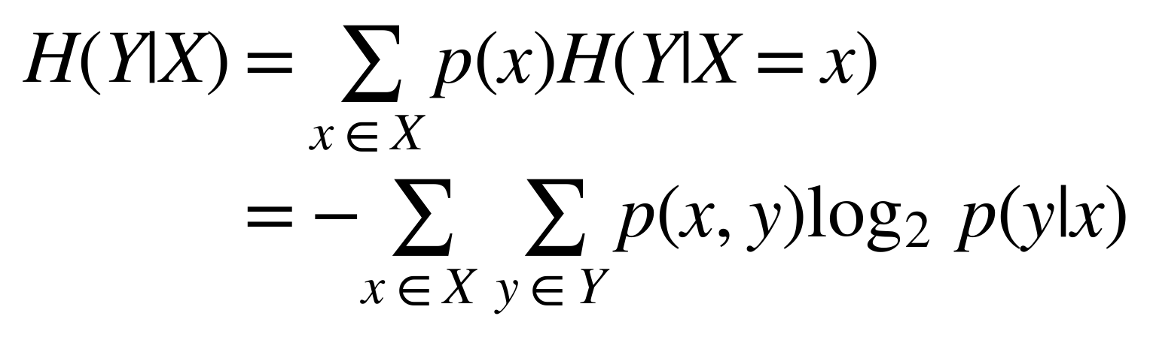
Conditional Entropy
 | Cloudy | Not Cloudy
Raining | 24/100 | 1/100
Not Raining | 25/100 | 50/100
The expected conditional entropy:
$$\begin{aligned}H\left(Y|X\right)=\sum_{x∈X}{p\left(x\right)H\left(Y|X=x\right)} \\ =−\sum_{x∈X}{\sum_{y∈Y}{p\left(x,y\right)\log_{2}{p\left(y|x\right)}}}\end{aligned}$$
Slide Source: Zemel, Urtasun, Fidler

Slide 23
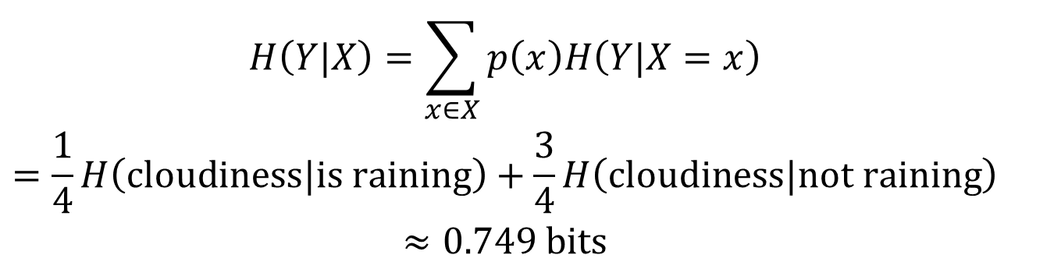
Conditional Entropy
$$Y=\{\text{Cloudy, Not cloudy}\}$$
 | Cloudy | Not Cloudy
Raining | 24/100 | 1/100
Not Raining | 25/100 | 50/100
$$X=\{\text{Raining, }$$
$$\text{Not raining}\}$$
What is the entropy of cloudiness, given the knowledge of whether
or not it is raining?
$$\begin{aligned}H\left(Y|X\right)=\sum_{x∈X}{p\left(x\right)H\left(Y|X=x\right)} \\ =\frac{1}{4}H\left(\text{cloud}iness|\text{is raining}\right)+\frac{3}{4}H\left(\text{cloud}iness|\text{not raining}\right) \\ ≈0.749\text{ bits}\end{aligned}$$
0.242
0.918
Slide Source: Zemel, Urtasun, Fidler

Slide 24
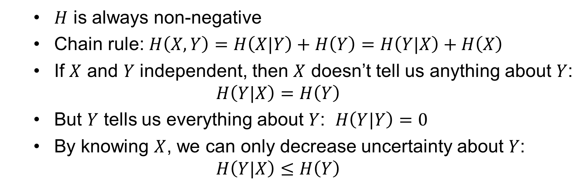
Come useful properties of conditional entropy
$H$ is always non-negative
Chain rule: $H\left(X,Y\right)=H\left(X|Y\right)+H\left(Y\right)=H\left(Y|X\right)+H\left(X\right)$
If $X$ and $Y$ independent, then $X$ doesn’t tell us anything about $Y$:
$H\left(Y|X\right)=H\left(Y\right)$
But $Y$ tells us everything about $Y$: $H\left(Y|Y\right)=0$
By knowing $X$, we can only decrease uncertainty about $Y$:
$H\left(Y|X\right)≤H\left(Y\right)$

Slide 25
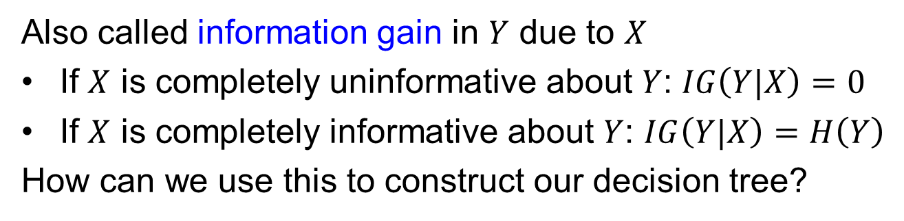

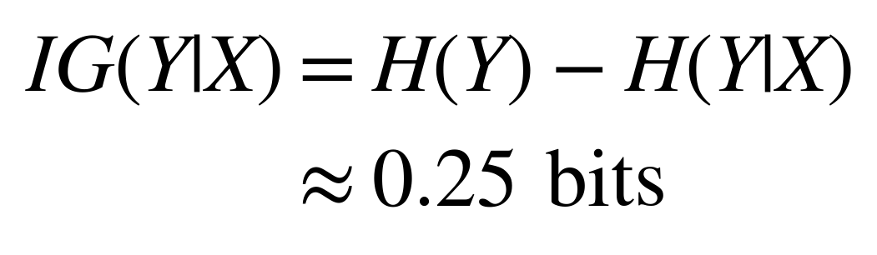



Information Gain
$$Y$$
 | Cloudy | Not Cloudy
Raining | 24/100 | 1/100
Not Raining | 25/100 | 50/100
$$X$$
How much information about cloudiness do we get by discovering
whether it is raining?
$$≈1.0$$
$$≈0.75$$
$$\begin{aligned}IG\left(Y|X\right)=H\left(Y\right)−H\left(Y|X\right) \\ ≈0.25\text{ bits}\end{aligned}$$
Also called information gain in $Y$ due to $X$
If $X$ is completely uninformative about $Y$: $IG\left(Y|X\right)=0$
If $X$ is completely informative about $Y$: $IG\left(Y|X\right)=H\left(Y\right)$
How can we use this to construct our decision tree?
Slide Source: Zemel, Urtasun, Fidler

Slide 26
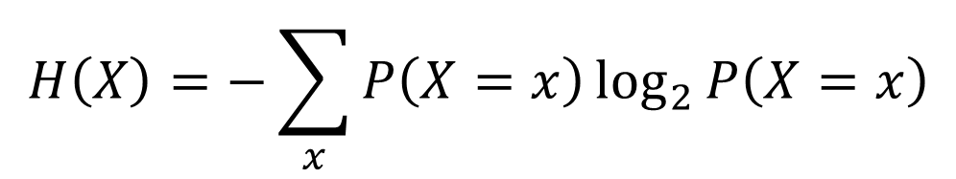
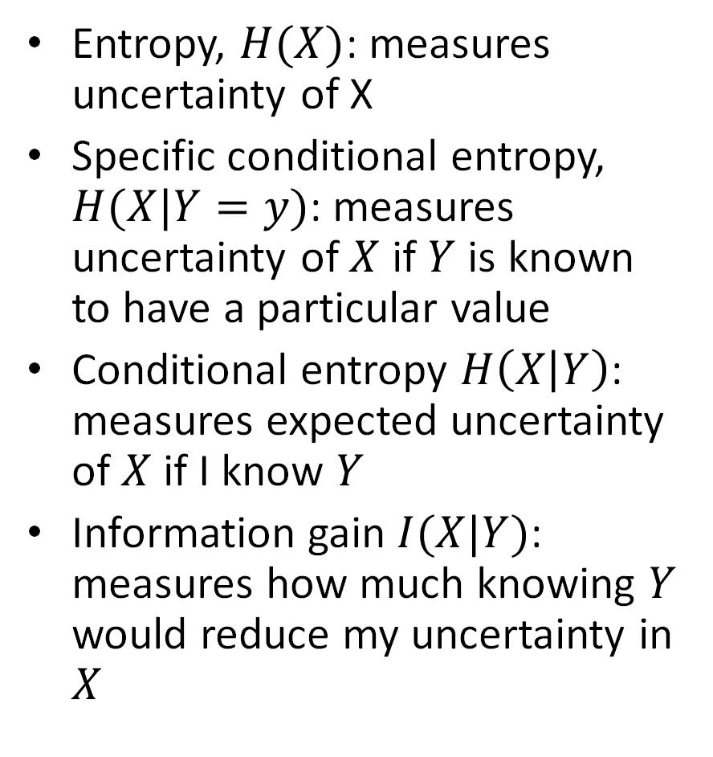

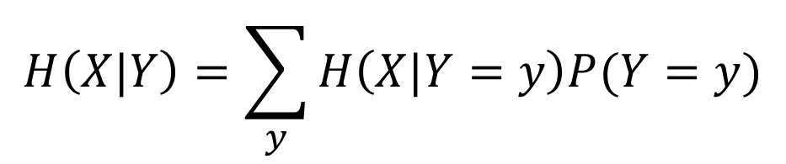
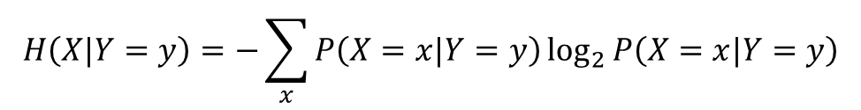
Terminology Recap
$$H\left(X\right)=−\sum_{x}{P\left(X=x\right)\log_{2}{P\left(X=x\right)}}$$
Entropy, $H(X)$: measures uncertainty of X
Specific conditional entropy, $H(X|Y=y)$: measures uncertainty of $X$ if $Y$ is known to have a particular value
Conditional entropy $H\left(X | Y\right)$: measures expected uncertainty of $X$ if I know $Y$
Information gain $I(X|Y)$: measures how much knowing $Y$ would reduce my uncertainty in $X$
$$H\left(X|Y=y\right)=−\sum_{x}{P\left(X=x|Y=y\right)\log_{2}{P\left(X=x|Y=y\right)}}$$
$$H\left(X|Y\right)=\sum_{y}{H\left(X|Y=y\right)P(Y=y)}$$
$$I\left(X|Y\right)=H\left(X\right)−H(X|Y)$$

Slide 27
Constructing decision tree
Training
Recursively, for each node in tree:
  If labels in the node are mixed:
    Choose attribute and split values based on data that reaches each node
    Branch and create 2 (or more) nodes
  Return
Measure information gain
  For each discrete attribute: compute information gain of split
  For each continuous attribute: select most informative threshold and compute its information gain. Can be done efficiently based on sorted values.
Select attribute / threshold with highest information gain

Slide 28

Q1-Q3
https://tinyurl.com/441AML-L12

Slide 29
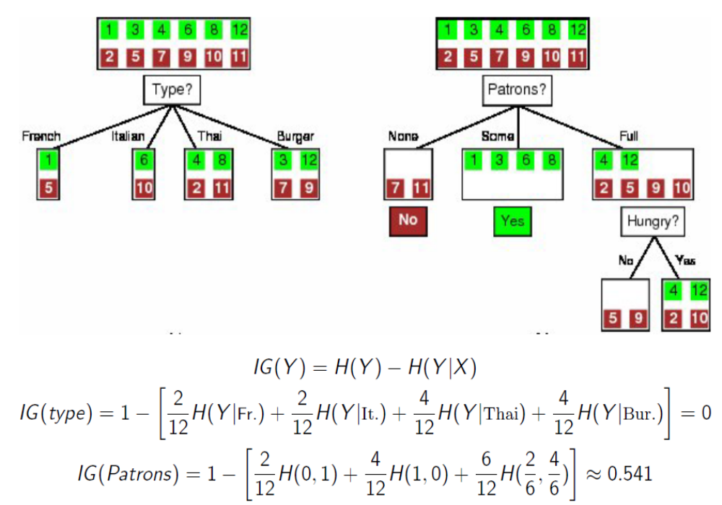
Q3 answer explained
Slide Source: Zemel, Urtasun, Fidler

Slide 30
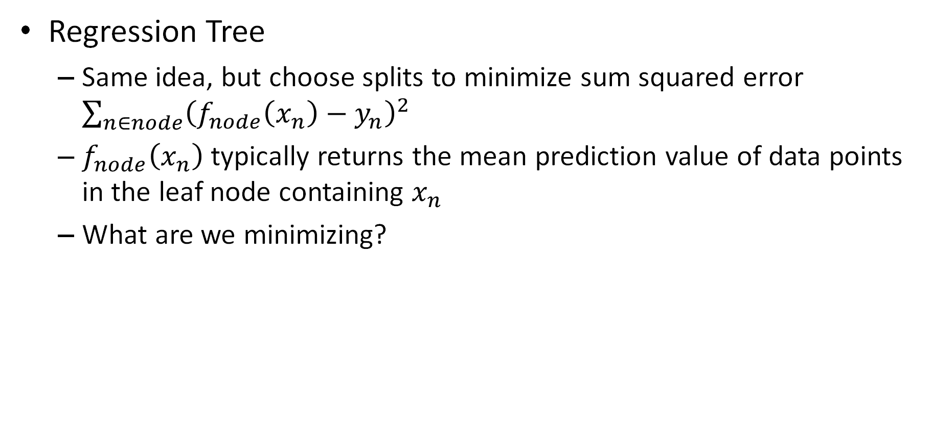
What if you need to predict a continuous value?
Regression Tree
  Same idea, but choose splits to minimize sum squared error $\sum_{n∈node}{{\left(f_{node}\left(x_{n}\right)−y_{n}\right)}^{2}}$
  $f_{node}\left(x_{n}\right)$ typically returns the mean prediction value of data points in the leaf node containing $x_{n}$
  What are we minimizing?
Q4
https://tinyurl.com/441AML-L12
Notes:
We are finding the tree structure that greedily minimizes the expected variance of y given x

Slide 31
What does a regression tree minimize?
Conditional variance $\text{V}\text{ar}(y|x)$ according to clustering given by tree:
$$\sum_{n}{{\left(f\left(x_{n}\right)−y_{n}\right)}^{2}}\text{ where }f\left(x_{n}\right)\text{ is mean of }y_{i}\text{’s with corresponding }x_{i}\text{ in the same node as }x_{n}$$

Slide 32
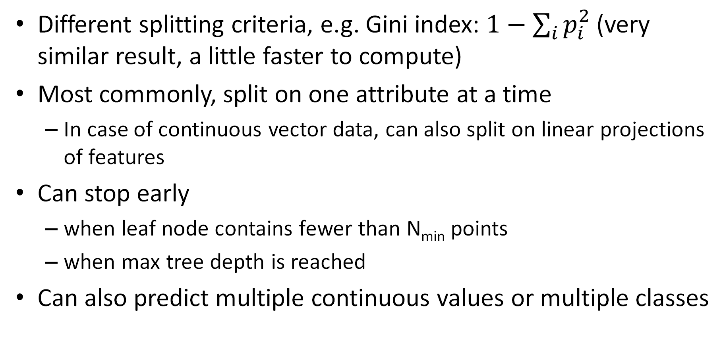
Variants
Different splitting criteria, e.g. Gini index: $1−\sum_{i}{p_{i}^{2}}$ (very similar result, a little faster to compute)
Most commonly, split on one attribute at a time
  In case of continuous vector data, can also split on linear projections of features
Can stop early
  when leaf node contains fewer than N_{min} points
  when max tree depth is reached
Can also predict multiple continuous values or multiple classes

Slide 33
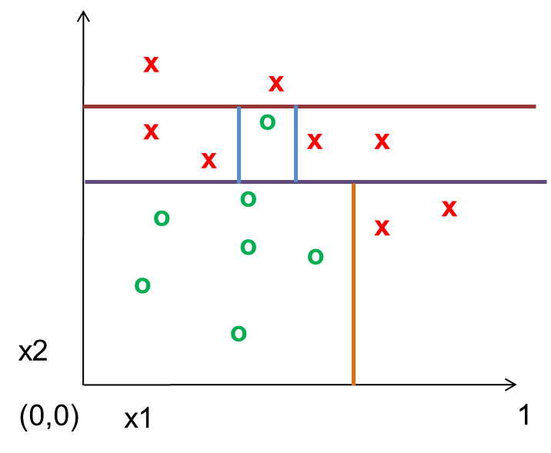
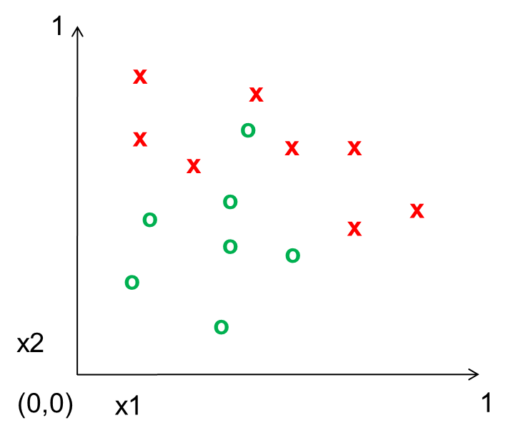
Decision Tree vs. 1-NN
DT Boundaries
Both have piecewise-linear decisions
Decision tree is typically “axis-aligned”
Decision tree has ability for early stopping to improve generalization
True power of decision trees arrives with ensembles (lots of small or randomized trees)
1-NN Boundaries

Slide 34
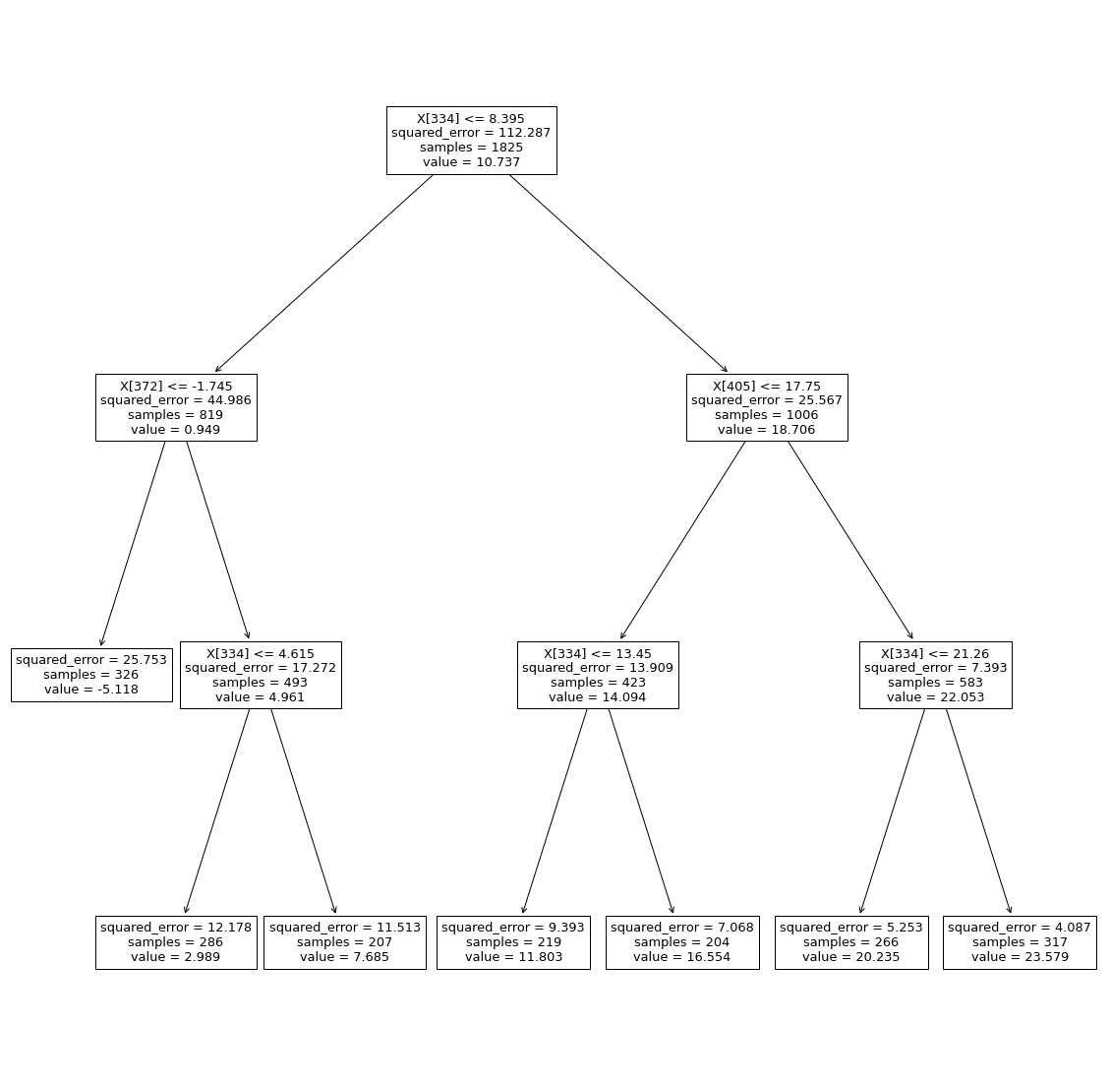
Regression Tree for Temperature Prediction
Min leaf size: 200
RMSE= 3.42
R²=0.88
Chicago, yesterday
Milwaukee, yesterday
Grand Rapids, yesterday
Chicago, yesterday
Chicago, yesterday
from sklearn import tree
from sklearn.tree import DecisionTreeRegressor
model = DecisionTreeRegressor(random_state=0, min_samples_leaf=200)
model.fit(x_train, y_train)
y_pred = model.predict(x_val)
tree_rmse = np.sqrt(np.mean((y_pred-y_val)**2))
tree_mae = np.sqrt(np.median(np.abs(y_pred-y_val)))
print('LR: RMSE={}, MAE={}'.format(tree_rmse, tree_mae))
print('R^2: {}'.format(1-tree_rmse**2/np.mean((y_pred-y_pred.mean())**2)))
plt.figure(figsize=(20,20))
tree.plot_tree(model)
plt.show()
for f in [334, 372, 405]:
print('{}: {}, {}'.format(f, feature_to_city[f], feature_to_day[f]))

Slide 35
from sklearn import tree
from sklearn.tree import DecisionTreeRegressor
model = DecisionTreeRegressor(random_state=0, min_samples_leaf=200)
model.fit(x_train, y_train)
y_pred = model.predict(x_val)
tree_rmse = np.sqrt(np.mean((y_pred-y_val)**2))
tree_mae = np.sqrt(np.median(np.abs(y_pred-y_val)))
print('LR: RMSE={}, MAE={}'.format(tree_rmse, tree_mae))
print('R^2: {}'.format(1-tree_rmse**2/np.mean((y_pred-y_pred.mean())**2)))
plt.figure(figsize=(20,20))
tree.plot_tree(model)
plt.show()
for f in [334, 372, 405]:
print('{}: {}, {}'.format(f, feature_to_city[f], feature_to_day[f]))

Slide 36
Classification/Regression Trees Summary
Key Assumptions
  Samples with similar features have similar predictions
Model Parameters
  Tree structure with split criteria at each internal node and prediction at each leaf node
Designs
  Limits on tree growth
  What kinds of splits are considered
  Criterion for choosing attribute/split (e.g. gini impurity score is another common choice)
When to Use
  Want an explainable decision function (e.g. for medical diagnosis)
  As part of an ensemble (as we’ll see Thursday)
When Not to Use
  One tree is not a great performer, but a forest is

Slide 37
Q5-Q8
https://tinyurl.com/441AML-L12

Slide 38
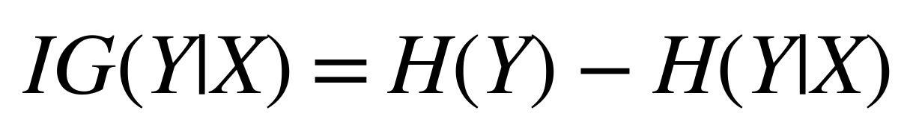
Things to remember
Decision/regression trees learn to split up the feature space into partitions with similar values
Entropy is a measure of uncertainty
Information gain measures how much particular knowledge reduces prediction uncertainty
$$H\left(X\right)=−\sum_{x∈X}{p\left(x\right)\log_{2}{p\left(x\right)}}$$
$$IG\left(Y|X\right)=H\left(Y\right)−H\left(Y|X\right)$$

Slide 39
Thursday
Ensembles: model averaging and forests

