Slide 1
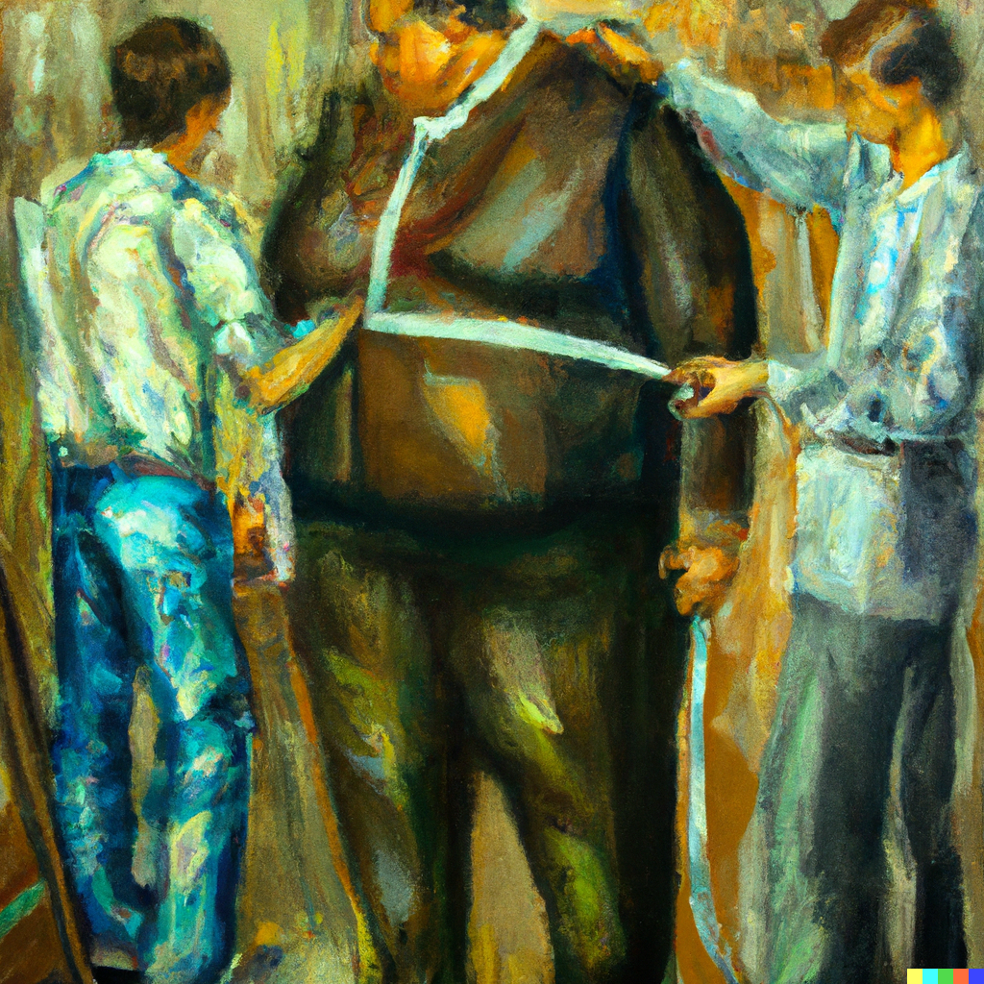
Outliers and Robust Estimation
Applied Machine Learning
Derek Hoiem
Dall-E

Slide 2
This class: Robust Estimation
Robust statistics and quantiles
Detecting outliers
Robust fitting
  Reweighted least squares
  RANSAC

Slide 3
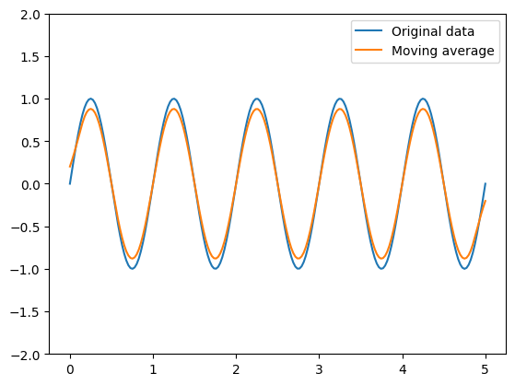
Moving average
Compute the mean value of data within a window
Example: moving average with 3-size window
1 | 2 | 3 | 3 | 2 | 1 | 1 | 2 | 3
 | 2 | 8/3 | 8/3 | 2 | 4/3 | ? | 2
(1+1+2)/3=4/3
Sinusoidal signal (200 points)
11-element window for moving average

Slide 4
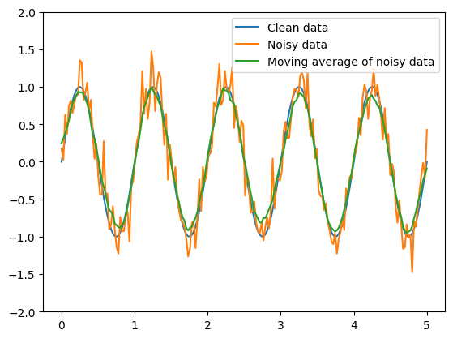
Moving average
Moving average is robust to random additive noise
Noisy signal = clean signal + noise
If noise has zero mean, then it gets averaged out
Sinusoidal signal + 0.2 stdev noise (200 points)
11-element window for moving average

Slide 5
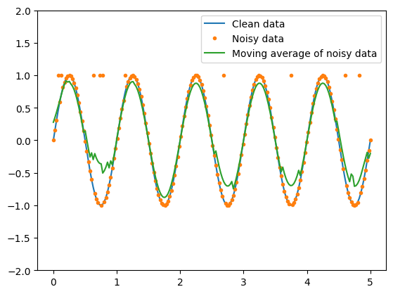
Moving average
Moving average is not robust to outliers because these can pull the average far in one direction
Sinusoidal signal w/ 5% outliers (replaced with 1)
11-element window for moving average

Slide 6
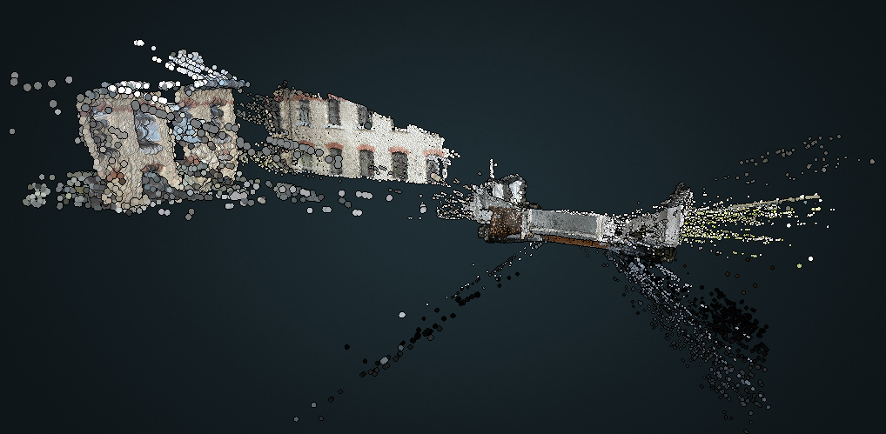
Why are outliers common?
Simple noise can sometimes lead to majorly wrong values
  E.g. in estimating point clouds, slight errors in estimating corresponding pixels can lead to large errors in 3D point estimates
Data may have missing values that are filled with constants
  E.g. unknown salaries may be filled with “0”
Data may have incorrectly entered values
  E.g. some salaries are entered in thousands or some entries had typos
Naturally occurring processes are not fully modeled
  E.g. stocks could split or merge, or a company could go bankrupt, leading to misleading or exceptional price changes
  Sensors may be occasionally blocked by another object, or briefly output erroneous values
Values could be correct but non-representative
  E.g. average net worth of Harvard drop-outs is very high, partly due to Bill Gates ($115B), Mark Zuckerburg ($258B)

Slide 7
Median is more robust
Moving median: return median within each window
Mean(1, 2, 6)=3
Median(1, 2, 6) =2
Mean(1, 2, 96) = 33
Median(1, 2, 96) = 2
data | 1 | 2 | 3 | 3 | 2 | 1 | 1 | 2 | 3
mean |  | 2 | 8/3 | 8/3 | 2 | 4/3 | 4/3 | 2
median |  | 2 | 3 | 3 | 2 | 1 | 1 | 2
data | 1 | 2 | -50 | 3 | 2 | 1 | 200 | 2 | 3
mean |  | -47/3 | -15 | -15 | 2 | 203/3 | 203/3 | 205/3
median |  | 1 | 2 | 2 | 2 | ? | ? | ?
2 2 3

Slide 8
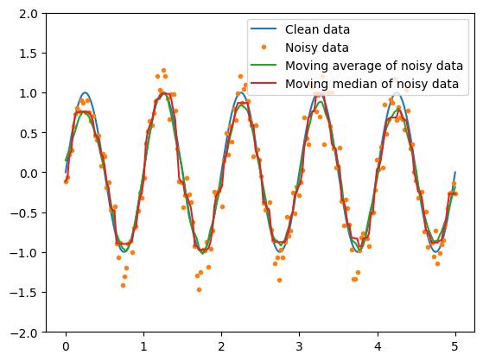
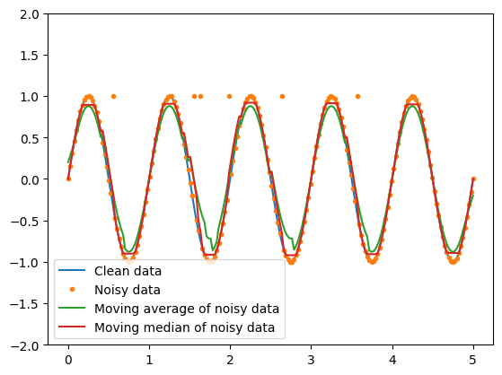
Moving median vs. moving mean
Gaussian noise
5% Outlier noise

Slide 9
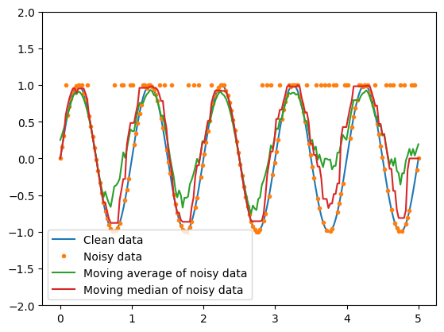
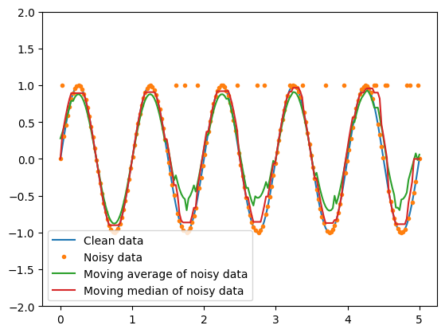
Moving median vs. moving mean
10% outlier noise
25% outlier noise

Slide 10
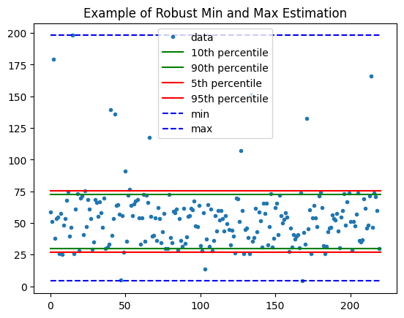
Robust Min and Max Estimation
200 “clean” points in U(25, 75) + 20 outliers in U(0, 200)
Min of range
  True: 25
  Min data: 4
  5th pct: 27
  10th pct: 30
Max of range
  True: 75
  Max data: 198
  95th pct: 76
  90th pct: 72

Slide 11
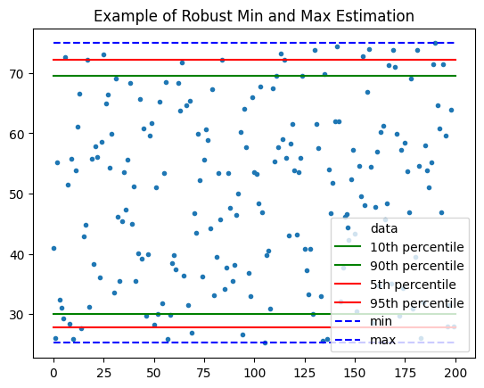
Robust Min and Max in clean data
(min, 5th, 10th) = (25, 28, 30)
(max, 95th, 90th) = (75, 72, 70)

Slide 12
Percentiles give consistent under-estimate of range when data is clean. Can we correct for this?

Slide 13
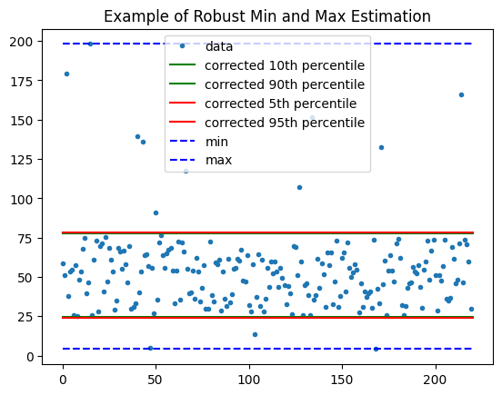
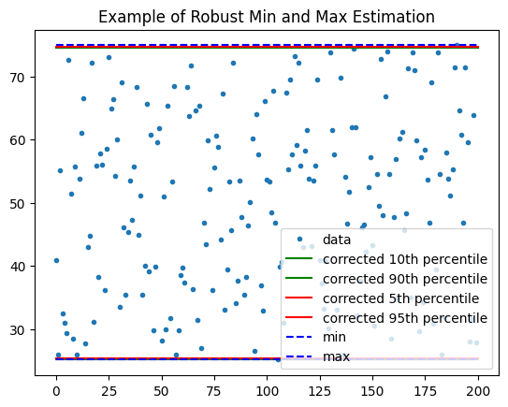
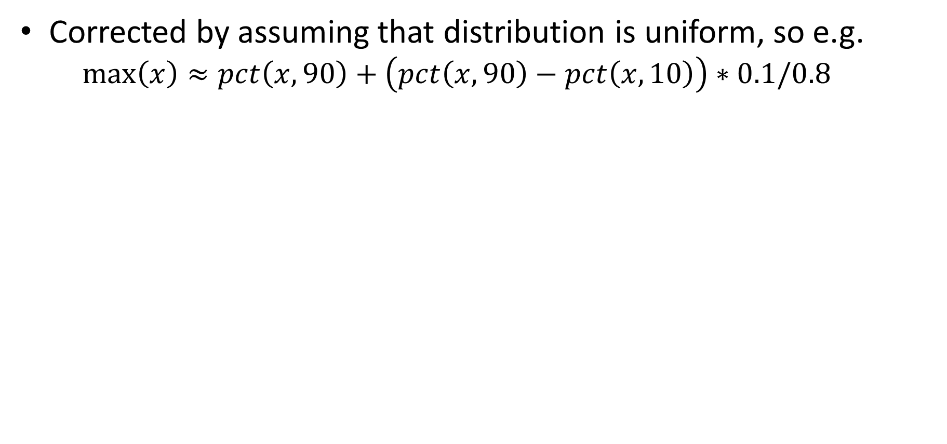
Robust Min and Max, Corrected
Corrected by assuming that distribution is uniform, so e.g.
  $$\max\left(x\right)≈pct\left(x,90\right)+\left(pct\left(x,90\right)−pct\left(x,10\right)\right)∗0.1/0.8$$

Slide 14
Detecting outliers
Outlier detection involves identifying which data points are distractors, not just robustly estimating statistics
If we can detect and remove outliers, we can use any method for further analysis
How might we detect outliers with PCA and/or Gaussian Mixture Model?

Slide 15
Detecting outliers: low probability data points
Estimate 40 component diagonal GMM
Find 20 lowest probability examples (only considering features, not labels)

Slide 16
Detect outliers: PCA Reconstruction Error
Compress to 100 PCA coefficients
Reconstruct, and measure reconstruction error
Show examples with highest reconstruction error

Slide 17
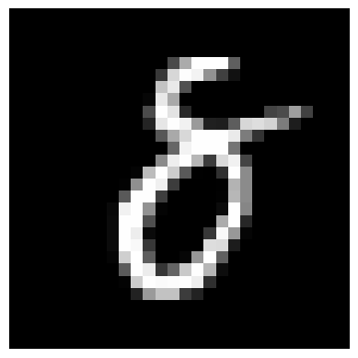

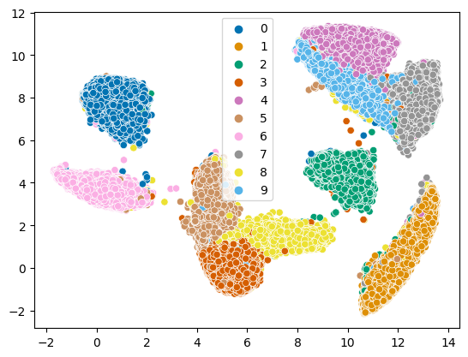
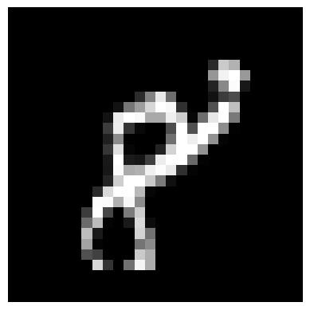
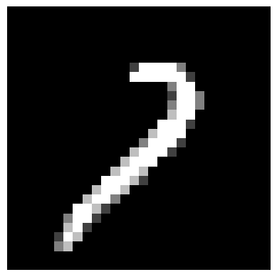
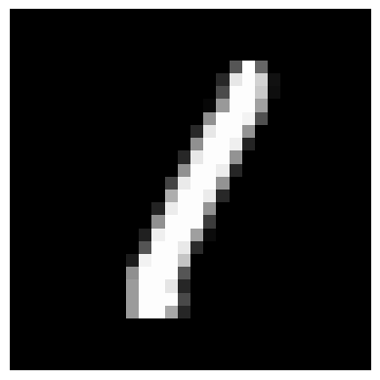
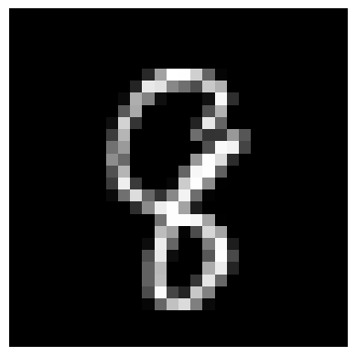
Detect outliers: UMAP Embedding
‘all’ (50,000 points), 100 neighbors, 200s

Slide 18
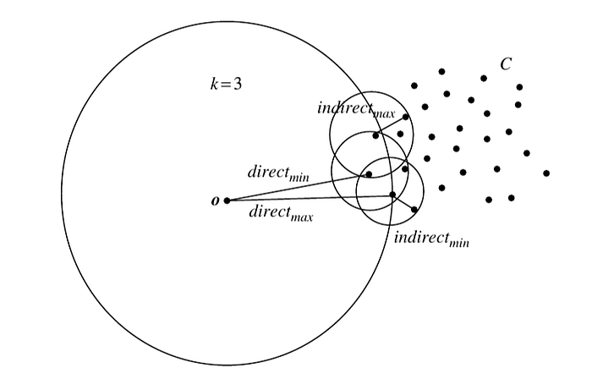
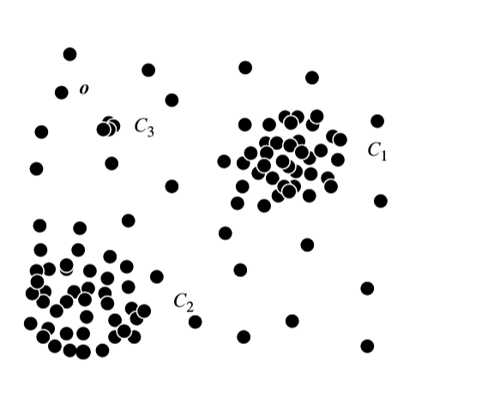
Identifying outliers based on density
Based on neighborhood density:
Compute average density based on some samples, e.g. inverse density is average distance to K neighbors
If point has much lower density than its neighbors, it is an outlier
Based on a radius:
Compute average number of points within some radius of another point
Any points that have much lower density than average are outliers
Figs: https://towardsdatascience.com/density-based-algorithm-for-outlier-detection-8f278d2f7983

Slide 19

Q1-Q2
https://tinyurl.com/AML441-L11

Slide 20




2 minute break

Slide 21
Robust estimation
Fitting data with robustness to outliers

Slide 22
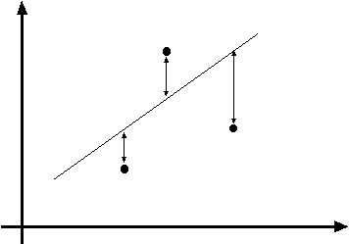
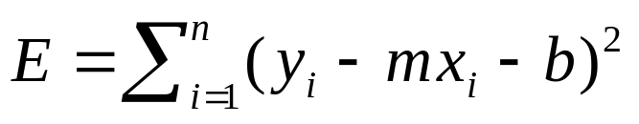
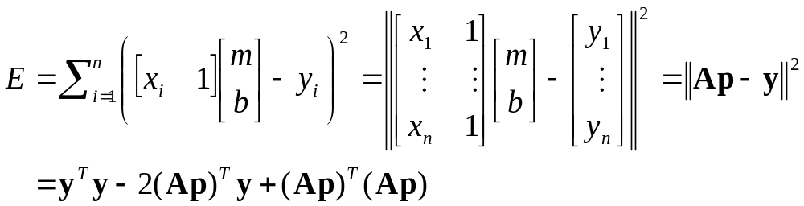
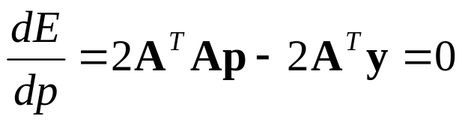
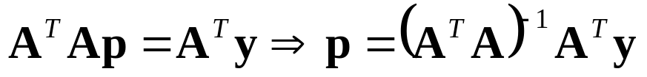
Least squares line fitting
Data: (x₁, y₁), …, (x_{n}, y_{n})
Line equation: y_{i} = m x_{i} + b
Find (m, b) to minimize
y=mx+b
(x_{i}, y_{i})
Modified from S. Lazebnik

Slide 24
Least squares line fit based on clean points

Slide 25
Outlier
Least squares line fit based on all points, heavily influenced by outlier
Least squares line fit based on clean points

Slide 26
Outlier
LSQ w/ outlier
Minimize L1 error, robust to outliers
LSQ w/o outlier

Slide 27
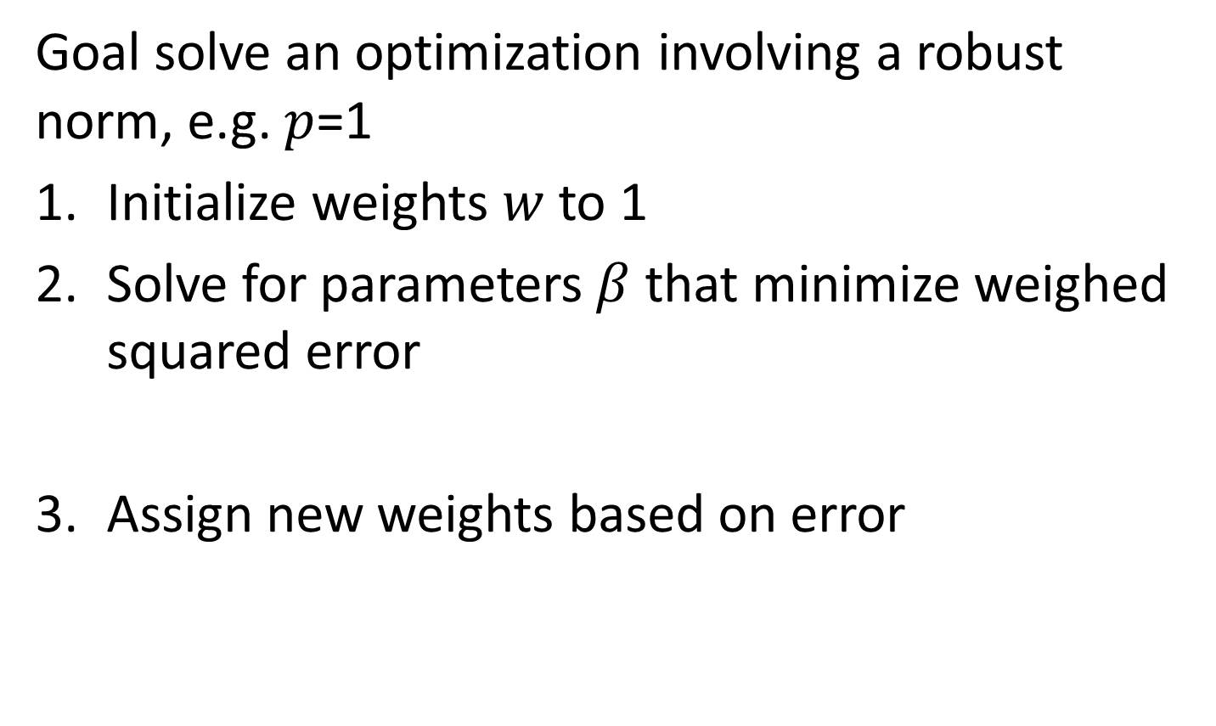

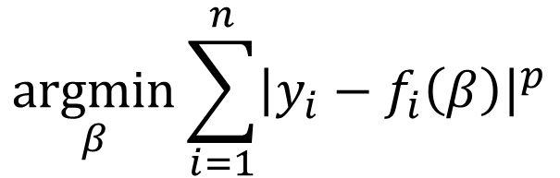
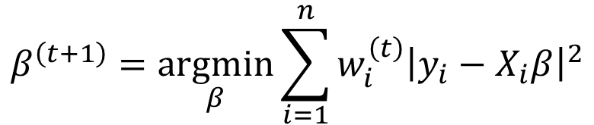
Iteratively Reweighted Least Squares (IRLS) – outlier handling
Goal solve an optimization involving a robust norm, e.g. $p$=1
Initialize weights $w$ to 1
Solve for parameters $β$ that minimize weighed squared error
Assign new weights based on error
$$\underset{β}{\text{arg}min}\sum_{i=1}^{n}{{\left|y_{i}−f_{i}\left(β\right)\right|}^{p}}$$
$$β^{\left(t+1\right)}=\underset{β}{\text{arg}min}\sum_{i=1}^{n}{w_{i}^{\left(t\right)}{\left|y_{i}−X_{i}β\right|}^{2}}$$
$$w_{i}^{\left(t\right)}={\left|y_{i}−X_{i}β^{\left(t\right)}\right|}^{p−2}$$

Slide 28
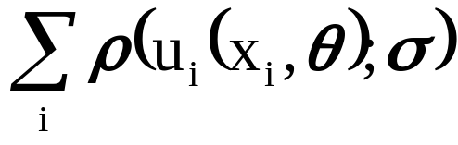
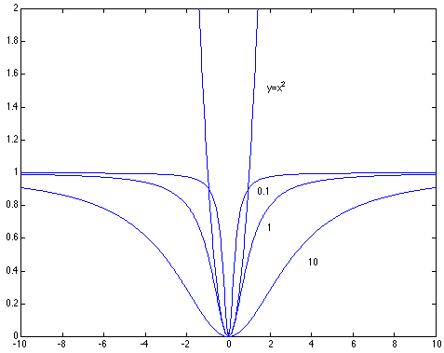
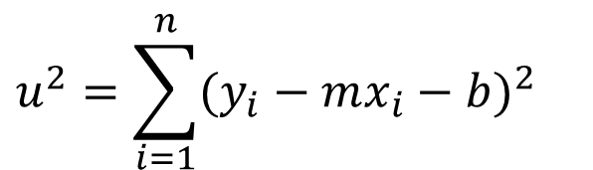
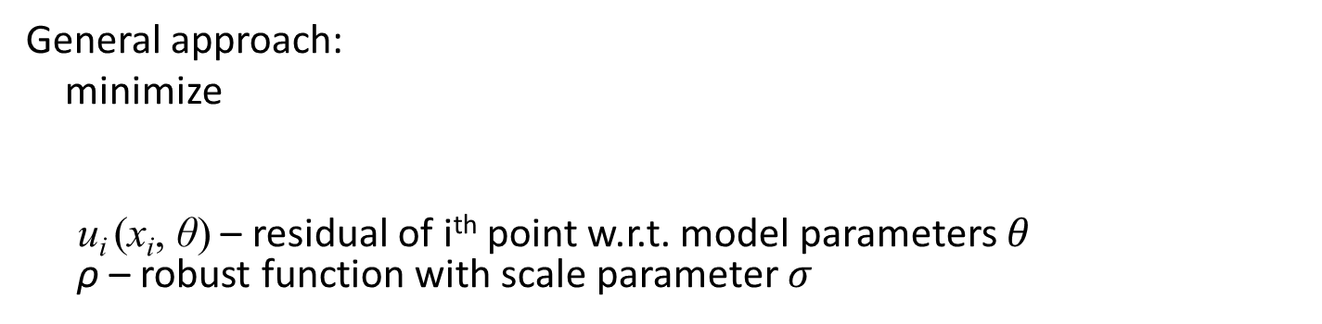
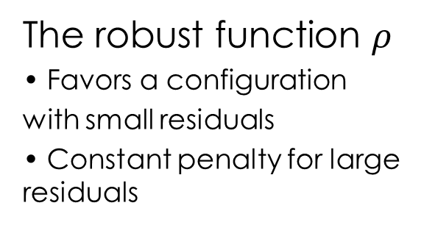
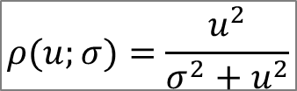
Robust least squares, aka M-estimation (another way to deal with outliers)
General approach:
minimize
u_{i} (x_{i}, θ) – residual of i^{th} point w.r.t. model parameters $θ$
ρ – robust function with scale parameter $σ$
$$u^{2}=\sum_{i=1}^{n}{(y_{i}−mx_{i}−b)^{2}}$$
$$ρ(u;σ)=\frac{u^{2}}{σ^{2}+u^{2}}$$
The robust function $ρ$
Favors a configuration
with small residuals
Constant penalty for large residuals
Slide from S. Savarese

Slide 29
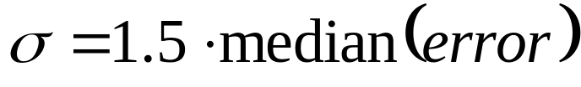
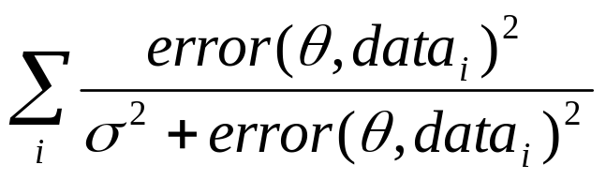
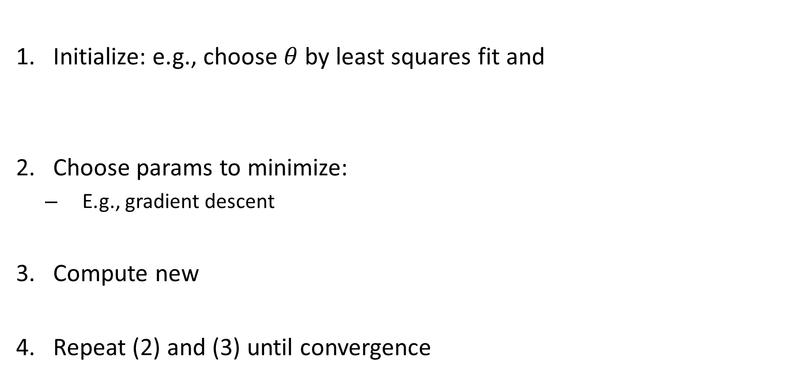
Robust Estimator
Initialize: e.g., choose $θ$ by least squares fit and
Choose params to minimize:
  E.g., gradient descent
Compute new
Repeat (2) and (3) until convergence

Slide 30
RANSAC
_{(RANdom SAmple Consensus) :}
Fischler & Bolles in ‘81.
Algorithm:
Sample (randomly) the number of points required to fit the model
Solve for model parameters using samples
Score by the fraction of inliers within a preset threshold of the model
Repeat 1-3 until the best model is found with high confidence
Notes:
Let me give you an intuition of what is going on. Suppose we have the standard line fitting problem in presence of outliers.
We can formulate this problem as follows: want to find the best partition of points in inlier set and outlier set such that…
The objective consists of adjusting the parameters of a model function so as to best fit a data set.
"best" is defined by a function f that needs to be minimized.
Such that the best parameter of fitting the line give rise to a residual error lower that delta
as when the sum, S, of squared residuals

Slide 31
RANSAC
Line fitting example
Algorithm:
Sample (randomly) the number of points required to fit the model (#=2)
Solve for model parameters using samples
Score by the fraction of inliers within a preset threshold of the model
Repeat 1-3 until the best model is found with high confidence
Illustration by Savarese
Notes:
Let me give you an intuition of what is going on. Suppose we have the standard line fitting problem in presence of outliers.
We can formulate this problem as follows: want to find the best partition of points in inlier set and outlier set such that…
The objective consists of adjusting the parameters of a model function so as to best fit a data set.
"best" is defined by a function f that needs to be minimized.
Such that the best parameter of fitting the line give rise to a residual error lower that delta
as when the sum, S, of squared residuals

Slide 32
RANSAC
Line fitting example
Algorithm:
Sample (randomly) the number of points required to fit the model (#=2)
Solve for model parameters using samples
Score by the fraction of inliers within a preset threshold of the model
Repeat 1-3 until the best model is found with high confidence
Notes:
Let me give you an intuition of what is going on. Suppose we have the standard line fitting problem in presence of outliers.
We can formulate this problem as follows: want to find the best partition of points in inlier set and outlier set such that…
The objective consists of adjusting the parameters of a model function so as to best fit a data set.
"best" is defined by a function f that needs to be minimized.
Such that the best parameter of fitting the line give rise to a residual error lower that delta
as when the sum, S, of squared residuals

Slide 33

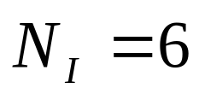
RANSAC
Line fitting example
Algorithm:
Sample (randomly) the number of points required to fit the model (#=2)
Solve for model parameters using samples
Score by the fraction of inliers within a preset threshold of the model
Repeat 1-3 until the best model is found with high confidence
Notes:
Let me give you an intuition of what is going on. Suppose we have the standard line fitting problem in presence of outliers.
We can formulate this problem as follows: want to find the best partition of points in inlier set and outlier set such that…
The objective consists of adjusting the parameters of a model function so as to best fit a data set.
"best" is defined by a function f that needs to be minimized.
Such that the best parameter of fitting the line give rise to a residual error lower that delta
as when the sum, S, of squared residuals

Slide 34
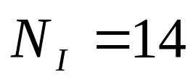
RANSAC
Algorithm:
Sample (randomly) the number of points required to fit the model (#=2)
Solve for model parameters using samples
Score by the fraction of inliers within a preset threshold of the model
Repeat 1-3 until the best model is found with high confidence
Notes:
Let me give you an intuition of what is going on. Suppose we have the standard line fitting problem in presence of outliers.
We can formulate this problem as follows: want to find the best partition of points in inlier set and outlier set such that…
The objective consists of adjusting the parameters of a model function so as to best fit a data set.
"best" is defined by a function f that needs to be minimized.
Such that the best parameter of fitting the line give rise to a residual error lower that delta
as when the sum, S, of squared residuals

Slide 35

How to choose parameters?
Number of samples N
  Choose N so that, with probability p, at least one random sample is free from outliers (e.g. p=0.99) (outlier ratio: e )
Number of sampled points s
  Minimum number needed to fit the model
Distance threshold δ
  Choose δ so that a good point with noise is likely (e.g., prob=0.95) within threshold
  Zero-mean Gaussian noise with std. dev. σ: t²=3.84σ²
 | proportion of outliers e
s | 5% | 10% | 20% | 25% | 30% | 40% | 50%
2 | 2 | 3 | 5 | 6 | 7 | 11 | 17
3 | 3 | 4 | 7 | 9 | 11 | 19 | 35
4 | 3 | 5 | 9 | 13 | 17 | 34 | 72
5 | 4 | 6 | 12 | 17 | 26 | 57 | 146
6 | 4 | 7 | 16 | 24 | 37 | 97 | 293
7 | 4 | 8 | 20 | 33 | 54 | 163 | 588
8 | 5 | 9 | 26 | 44 | 78 | 272 | 1177
Advanced algorithms automatically find N and δ
modified from M. Pollefeys

Slide 36
RANSAC conclusions
Good
Robust to outliers
Advanced forms can automatically estimate thresholds and number of iterations
Bad
Computational time grows quickly with fraction of outliers and number of parameters

Slide 37
Colab demo
https://colab.research.google.com/drive/1bPRkR1Kzq7NKlsv4Avki6yVoA1mVC7uH?usp=sharing

Slide 38
Q3-Q6
https://tinyurl.com/AML441-L11

Slide 39
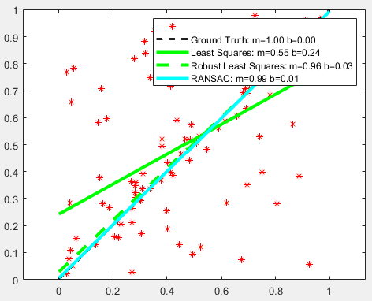
Things to remember
Median and quantiles are robust to outliers, while mean/min/max aren’t
Outliers can be detected as low probability points, low density points, poorly compressible points, or through 2D visualizations
Least squares is not robust to outliers. Use RANSAC or IRLS or robust loss function instead.

Slide 40
Next:
Thurs: optional review for exam
Exam 1: Thurs – Sun via CBTF
Next week: Decision trees and ensemble models
  I will be out on Thursday, will use recording

