Slide 1

Recap and Review – Exam 1
Applied Machine Learning
Derek Hoiem

Slide 2
Bias-Variance Trade-off
Variance: due to limited data
Different training samples will give different models that vary in predictions for the same test sample
“Noise”: irreducible error due to data/problem
Bias: error when optimal model is learned from infinite data
Above is for regression.
But same error = variance + noise + bias² holds for classification error and logistic regression.
See this for derivation
Fig Sources

Slide 3
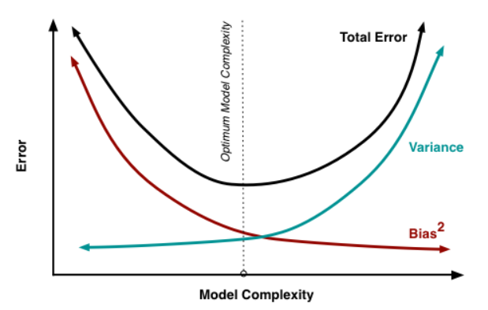
Underfitting
Overfitting
How to detect high variance:
Test error is much higher than training error
How to detect high bias or noise:
The training error is high
As you increase model complexity:
Training error will decrease
Test error may decrease (if you are currently “underfitting”) or increase (if you are “overfitting”)

Slide 4
Bias-Variance / Generalization
Decreases variance
Increase regularization weight
Decrease model complexity
Increase number of training examples
Decreases bias
Decrease regularization weight
Increase model complexity, or select model that can better fit data

Slide 5
Performance vs training size
As we get more training data:
  The same model has more difficulty fitting the training data
  But the test error becomes closer to training error (reduced generalization error)
  Overall test performance improves
Fixed model
Due to limited training data (model variance) and distribution shift
Testing
Error
Test error with infinite training examples
Due to difference in P(y|x) in training and test (function shift)
Train error with infinite training examples
Training
Number of Training Examples
Due to limited power of model (model bias) and unavoidable intrinsic error (Bayes optimal error)

Slide 6
How to think about a ML model
What are your inputs and outputs?
  Are your features tabular or continuous or mixed?
  Are you trying to predict a categorical label (classification) or a continuous value (regression)?
Do you expect a simple distance in features to be predictive, or that the features are linearly correlated with the target?
  NN relies on example distance (can normalize or use representation learning ahead of time if needed)
  Linear models learn feature weights, but rely on a direct (linear) relationship between features and target
How much training data do you have?
  With more data, it’s possible to use more complex models
How important is training time? Prediction time?
  NN is fast in training, relatively slow in prediction compared to linear models

Slide 7
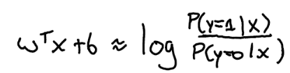
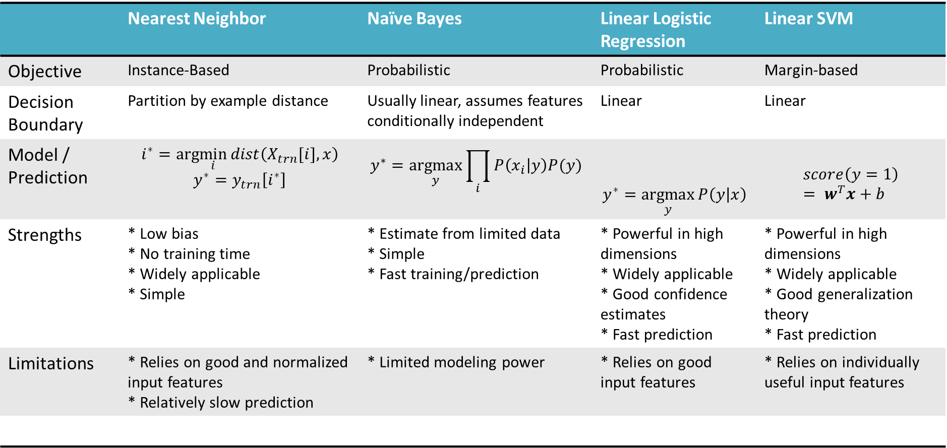
Classification methods
 | Nearest Neighbor | Naïve Bayes | Linear Logistic Regression | Linear SVM
Objective | Instance-Based | Probabilistic | Probabilistic | Margin-based
Decision Boundary | Partition by example distance | Usually linear, assumes features conditionally independent | Linear | Linear
Model / Prediction | $$i^{∗}=arg\min_{i}{dist\left(X_{trn}[i],x\right)}$$ $$y^{∗}=y_{trn}\left[i^{∗}\right]$$ | $$y^{∗}=\underset{y}{argmax}{\prod_{i}{P\left(x_{i} | y\right)P(y)}}$$ | $$y^{∗}=\underset{y}{argmax}{P\left(y | x\right)}$$ | $$score\left(y=1\right)= w^{T}x+b$$
Strengths | * Low bias * No training time * Widely applicable * Simple | * Estimate from limited data * Simple * Fast training/prediction | * Powerful in high dimensions * Widely applicable * Good confidence estimates * Fast prediction | * Powerful in high dimensions * Widely applicable * Good generalization theory * Fast prediction
Limitations | * Relies on good and normalized input features * Relatively slow prediction | * Limited modeling power | * Relies on good input features | * Relies on individually useful input features

Slide 8
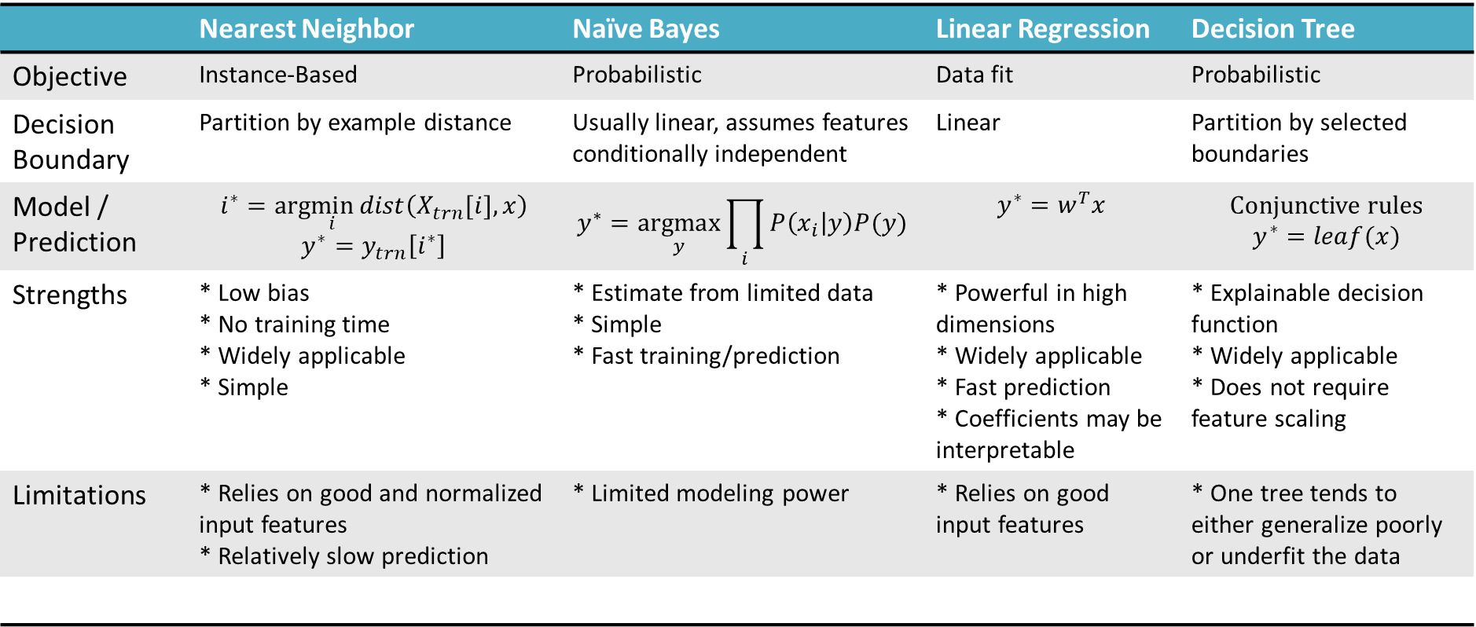
Regression methods
 | Nearest Neighbor | Naïve Bayes | Linear Regression | Decision Tree
Objective | Instance-Based | Probabilistic | Data fit | Probabilistic
Decision Boundary | Partition by example distance | Usually linear, assumes features conditionally independent | Linear | Partition by selected boundaries
Model / Prediction | $$i^{∗}=arg\min_{i}{dist\left(X_{trn}[i],x\right)}$$ $$y^{∗}=y_{trn}\left[i^{∗}\right]$$ | $$y^{∗}=\underset{y}{argmax}{\prod_{i}{P\left(x_{i} | y\right)P(y)}}$$ | $$y^{∗}=w^{T}x$$ | Conjunctive rules $$y^{∗}=leaf(x)$$
Strengths | * Low bias * No training time * Widely applicable * Simple | * Estimate from limited data * Simple * Fast training/prediction | * Powerful in high dimensions * Widely applicable * Fast prediction * Coefficients may be interpretable | * Explainable decision function * Widely applicable * Does not require feature scaling
Limitations | * Relies on good and normalized input features * Relatively slow prediction | * Limited modeling power | * Relies on good input features | * One tree tends to either generalize poorly or underfit the data

Slide 9
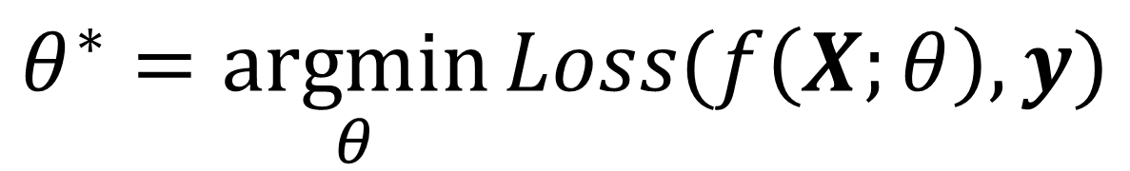
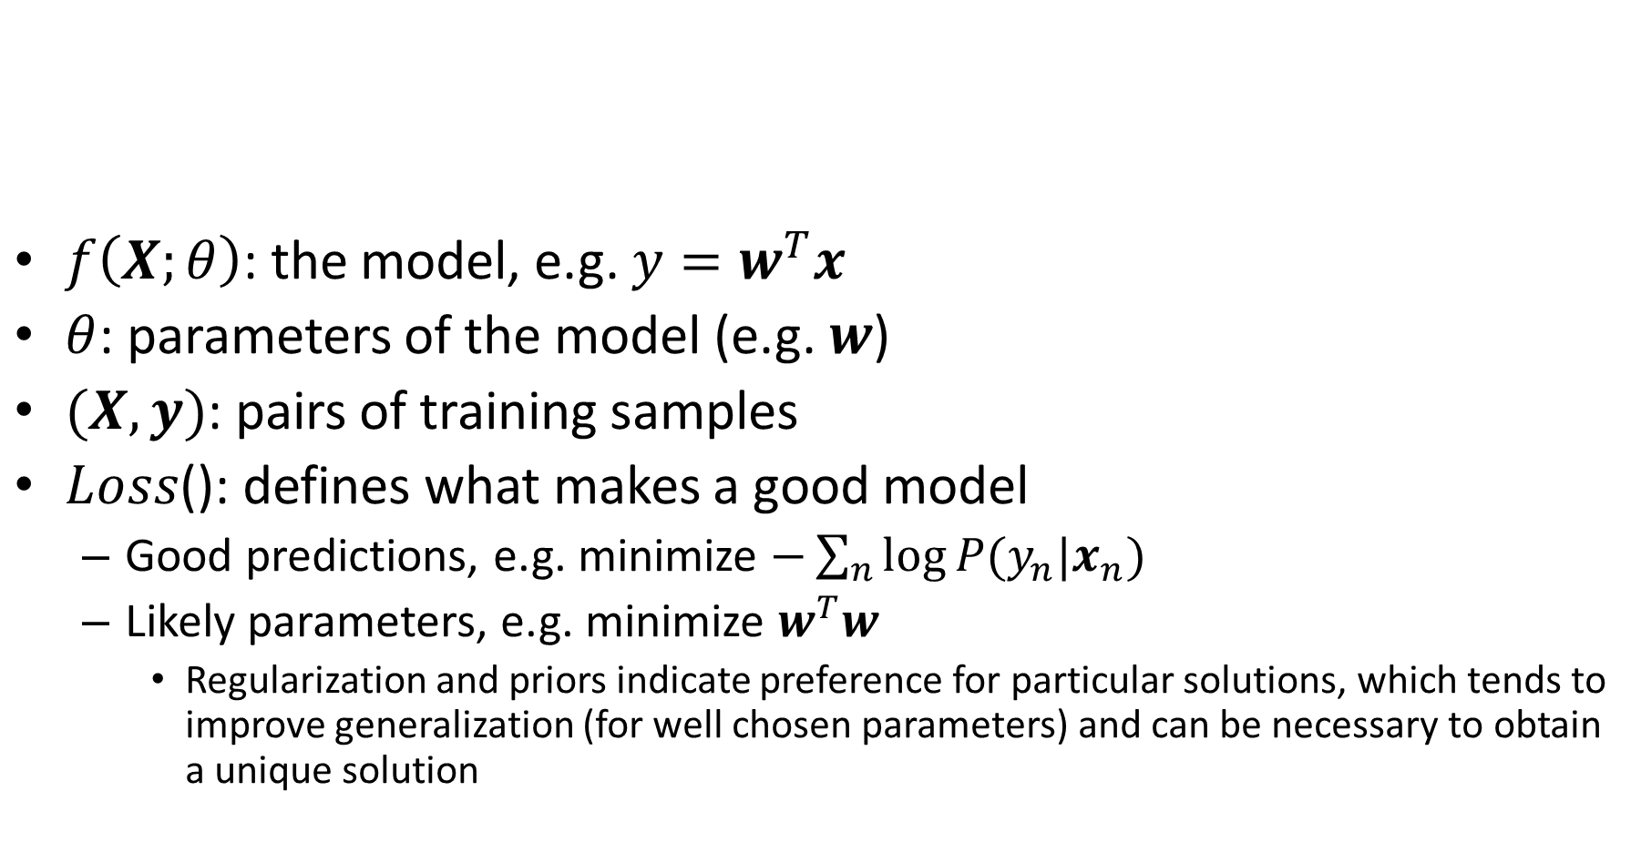
Training a model
$f\left(X;θ\right)$: the model, e.g. ${y=w}^{T}x$
$θ$: parameters of the model (e.g. $w$)
$(X, y)$: pairs of training samples
$Loss$(): defines what makes a good model
  Good predictions, e.g. minimize $−\sum_{n}{log⁡P(y_{n}|x_{n})}$
  Likely parameters, e.g. minimize $w^{T}w$
    Regularization and priors indicate preference for particular solutions, which tends to improve generalization (for well chosen parameters) and can be necessary to obtain a unique solution
$$θ^{∗}=\underset{θ}{argmin}{Loss(f\left(X;θ\right),y)}$$

Slide 10
Model evaluation process
Collect/define training, validation, and test sets
Decide on some candidate models and hyperparameters
For each candidate:
  Learn parameters with training set
  Evaluate trained model on the validation set
Select best model
Evaluate best model’s performance on the test set
  Cross-validation can be used as an alternative
  Common measures include error or accuracy, root mean squared error, precision-recall

Slide 11
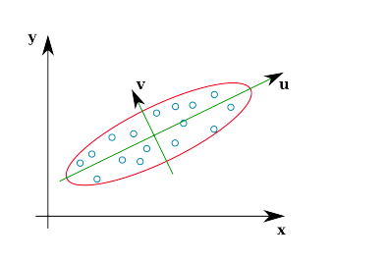
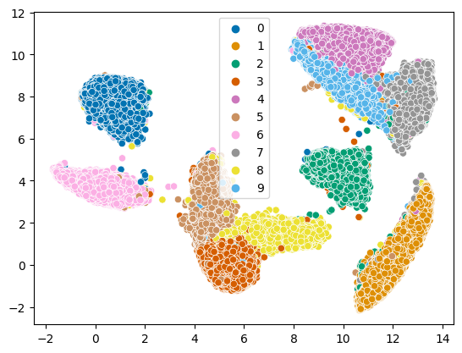
PCA/Embedding (L5)
PCA reduces dimensions by linear projection
  Preserves variance to reproduce data as well as possible, according to mean squared error
  May not preserve local connectivity structure or discriminative information
Other methods try to preserve relationships between points
  MDS: preserve pairwise distances
  IsoMap: MDS but using a graph-based distance
  t-SNE: preserve a probabilistic distribution of neighbors for each point (also focusing on closest points)
  UMAP: incorporates k-nn structure, spectral embedding, and more to achieve good embeddings relatively quickly

Slide 12
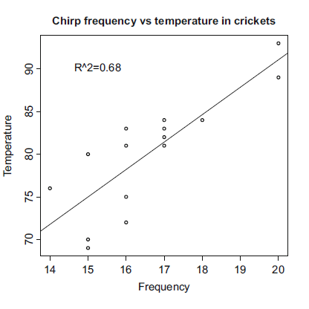
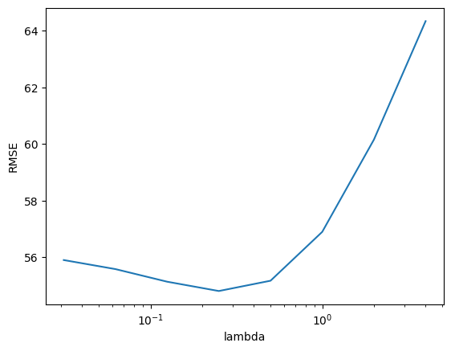
Linear Regression (L6)
Linear regression fits a linear model to a set of feature points to predict a continuous value
  Explain relationships
  Predict values
  Extrapolate observations
Regularization prevents overfitting by restricting the magnitude of feature weights
  L1: prefers to assign a lot of weight to the most useful features
  L2: prefers to assign smaller weight to everything

Slide 13

Practice questions
https://tinyurl.com/AML441-Exam1Review

Slide 14

All in-class practice questions
https://tinyurl.com/AML441-AllQs

