Slide 1

Conclusion
Applied Machine Learning
CS 441
Derek Hoiem

Slide 2
This class: Conclusion
Birds-eye view of machine learning, recap
Where to learn more
Trends and future of machine learning
Feedback and closing remarks

Slide 3

Any questions or things you want me to talk about?
Put into the form (at top) at any time, and I will answer some of them later
https://tinyurl.com/AML441-L26

Slide 4
We’ve learned a lot
Target Labels
Loss / Feedback
Loss / Feedback
Raw Data
Encoder
Decoder
Prediction
Text
Images
Audio
Discrete/continuous values
Structured/unstructured
Few/many examples
Few/many features
Clean/noisy labels
Manual feature design
Deep networks
Trees
Clustering
Feature selection
Kernels
Density estimation
Linear regressor
SVM
Logistic regressor
Nearest Neighbor
Probabilistic model
Clusters
Low dimensional embedding
Category
Pixel labels
Generated text, image, audio
Positions
Yes/No

Slide 5
We’ve covered what you need to get started for most ML applications
Solid foundation in core ML concepts
Classification, clustering, dimensionality reduction, objectives, losses, regularization, generalization, experimental setups
Intuition, some math, and application of classic methods
Logistic regression, Linear Regression, SVM, KNN, Neural Nets, Naïve Bayes, Boosting, Trees, Ensembles, PCA, K-means, Kernel Density Estimation, EM algorithm, PCA
Exposure to state of the art recent methods
Deep convolutional networks, transformers, CLIP, GPT, UMAP
Data representation and application domains
Images, text, audio, general data
Practical considerations for deployment of ML applications
Societal impact, bias and mitigation, example of business application

Slide 6
Predictors: Three basic kinds
Linear (Regression, Logistic Regression, SVM)
General purpose for classification/regression
Benefits from feature learning
Instance-based (KNN)
Zero training time, flexible
Benefits from feature learning
Probabilistic:
Works well if a parametric form is known, or with tree ensembles

Slide 7
Feature learning: Two basic kinds
Tree
Learn how to partition input space to group examples together in a discriminative way
Followed by instance/linear/probabilistic prediction
Easily combine unnormalized continuous and discrete features
Especially powerful with ensembles, as in Random Forests or Boosted Trees
Neural network
Jointly train feature representation with linear predictor
Major advantages for structured data with convolutional or transformer architectures, or use for retrieval/similarity
Representations can be learned on one problem and tuned or applied for another problem in the same domain

Slide 8
Go-to approaches for classification
K-NN
Super easy and sometimes surprisingly effective, good sanity check
Linear SVM or linear logistic regression
Easy to optimize, often works well
Random forest or boosted trees
Highly effective with minimal fuss, very flexible
Linear probe or fine-tune deep network
Best for common structured data like images, text, audio

Slide 9
Go-to approaches for regression
Linear regression
Interpretable and often works well
Sometimes important to transform features or targets so they are better captured by a linear model
Random forest
Highly effective with minimal fuss
K-NN
Especially helpful when predicting multiple correlated values, e.g. which patch can be used to fill a hole in the image

Slide 10
In supervised learning, always remember
Clean experiments
training set to learn model parameters
validation set to select method and hyperparameters
test set for final performance evaluation
Bias/variance trade-off
Avoidable error is due to challenge in fitting parameters (variance) and inability to perfectly fit the data (bias)
Model designs and hyperparameters often trade off between these, e.g. increasing model complexity can increase variance but reduce bias
Ensembles work around this trade-off, and modern deep networks often act like ensembles
People and algorithms use mental shortcuts that lead to a kind of bias that can be harmful to society – transparency and fairness require conscientious sourcing, development, and evaluation

Slide 11
Data organization
PCA is used to compress a vector into fewer values in a way that can be decompressed with minimal mean squared difference
Clustering reveals common modes of data
K-means is an essential algorithm
Search for similar data items is an important application and is the computational foundation for clustering
FAISS is a very useful library for efficient search
Approximate search, e.g. trees and LSH, are needed when speed is a priority
Representation learning (e.g. with deep networks) is needed to make similarity meaningful

Slide 12
It’s all about the data
Model architectures and computational techniques get all the attention, but there are often many reasonable choices that perform similarly
To get best performance, data requires more thought and effort than algorithms
Need creative ways to get freely supervised data, as well as careful curation of evaluation sets

Slide 13
UMAP
TSNE
PCA
Unsupervised
Visualize
Kmeans
EM
Agglomerative
Explore
Cluster
Brute Force
LSH
HNSW
Search
Supervised
Pretrained network + linear, in-context, nearest-neighbor
What are you trying to do?
Structured (image, text, audio)
Little Data
Classify / Regress
More Data
Pretrained network + fine-tune, RAG
Tabular
Little Data, more interpretable
Linear model (regressor, SVM, logistic regressor)
Self-Supervised
Deep Generative Model (GAN, Diffusion, LLM)
More Data, higher accuracy
Random forest, boosting, MLP
Generate

Slide 14
Choosing the right tool for the job
https://tinyurl.com/AML441-L26

Slide 15
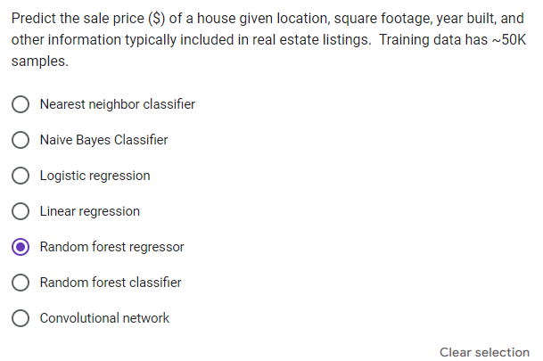
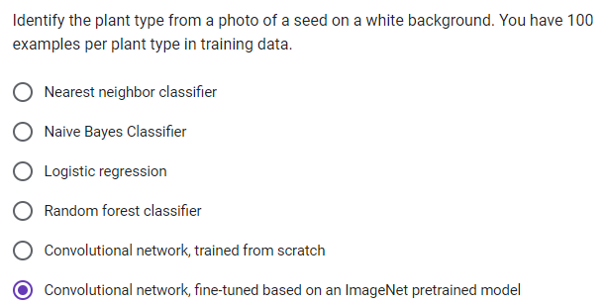
Choosing the right tool for the job: answers
Random forest regressor
Regression problem
Mixed continuous and categorical features
Lots of training data available
Fine-tuned ConvNet
Image classification (use deep network to take advantage of structured image data)
Limited data, so fine-tuning from pre-trained is much better than training from scratch

Slide 16
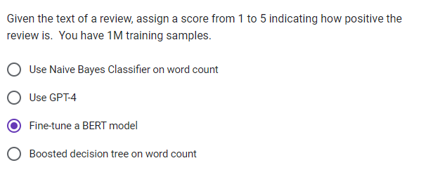
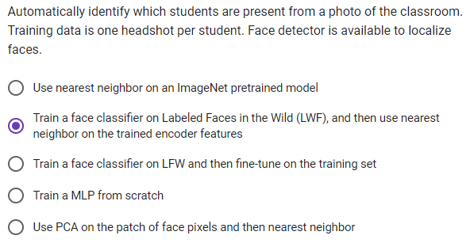
Choosing the right tool for the job: answers
Fine-tune BERT
Using a deep network language model gives more effective features than word count
Plenty of data for fine-tuning
GPT-4 is slow/expensive and not easy to tune
NN w/ LWF-pretrained model
Training a deep network face classifier on a large dataset can provide good features
Only one example per face available, so use nearest neighbor (fine-tuning will overfit)

Slide 17
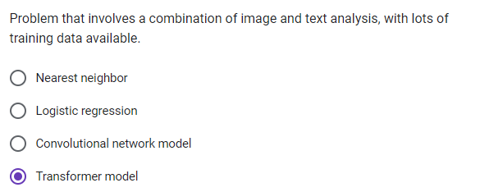
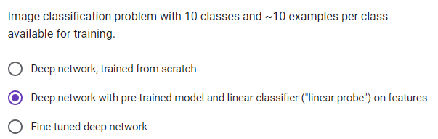
Choosing the right tool for the job: answers
Transformer
Both images and text can be represented as tokens that can be processed together with the transformer
Plenty of data for training
Pre-trained model w/ linear classifier
Use good features from pre-trained model
Probably not enough examples to effectively fine-tune and validate

Slide 18
What questions do you have?

Slide 19
Other related courses
AI Core
Machine Learning
CS 440 Artificial Intelligence
CS 441 Applied Machine learning
CS 442 Trustworthy Machine Learning
CS 443 Reinforcement Learning
CS 446 Machine Learning
CS 498 Introduction to Generative AI
CS 498 Agentic AI
CS 540 Deep Learning Theory
CS 542 Statistical Reinforcement Learning
CS 547 Deep Learning
CS 598 Learning to Learn
CS 598 Deep Generative Models
CS 598 Topic in LLM Agents
Computer Vision
CS 444 Deep Learning for Computer Vision
CS 445 Computational Photography
CS 543 Computer Vision
CS 544 Optimization in Computer Vision
CS 598 Computer Vision for Healthcare
CS 598 3D Vision
Language
CS 410 Text Information Systems
CS 447 Natural Language Processing
CS 546 Advanced Topics in NLP
Audio and Signals
CS 448 Audio Computing Laboratory
CS 545 Machine Learning for Signal Processing
Robotics
CS 452 Topics in Robotics
CS 588 Autonomous Vehicle System Engineering
AI Breadth and Other Electives
Data Workflows
CS 412 Introduction to Data Mining (DAIS)
CS 470 Social & Information Networks (DAIS)
CS 510 Advanced Information Retrieval (DAIS)
CS 512 Data Mining Principles (DAIS)
CS 513 Theory & Practice of Data Cleaning (DAIS)
CS 514 Advanced Social & Information Networks (DAIS)
People & AI
CS 464 Spec Top in Societal Impacts / Cyber Dystopia (IC)
CS 565 Ethics in AI (IC)
CS 568 User-Centered Machine Learning (IC)
CS 442 Trustworthy Machine Learning (SP)
CS 562 Advanced Topics in Security, Privacy and ML (SP)
CS 598 Language, Interfaces, and Communication (IC)
CS 598 CSS: Computational Social Science (IC)
ML Systems
CS 498 Machine Learning Systems (SN)
CS 598 Systems for GenAI (SN)
CS 521 ML and Compilers (PLFMSE)
CS 521 Trustworthy AI Systems (PLFMSE)
CS 598 ML for Code (PLFMSE)
CS 598 Software Quality Assurance with Generative AI (PLFMSE)
CS 598 AI Efficiency: Systems and Algorithms (SN)
CS 598 APE - Advanced Perform Engineering (ACP)
Other AI Electives
CS 417 Introduction to Virtual Reality (IC)
CS 466 Introduction to Bioinformatics (BCB)
CS 469 Computational Advertising Infrastructure (IC)
CS 463 Computer Security II (SP)
CS 473 Algorithms (Th)
CS 563 Advanced Computer Security (SP)
CS 582 Machine Learning for Bioinformatics (BCB)
CS 598 Deep Learning for Healthcare (BCB)
AI MCS (preview)
3 AI Core, including 1 ML
1 each of Data Workflows, People & AI, ML Systems
1 more of anything

Slide 20

Where is AI going?

Slide 21
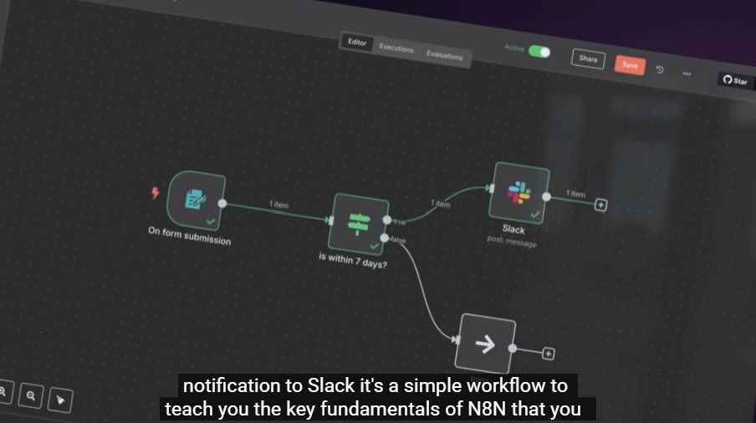
Agentic AI Workflows – multi-decision processes involving humans and models working together
Think about which of your daily tasks involve multiple software steps, e.g.
Checking multiple news feeds
Paying bills
Scheduling appointments
In business, e.g. sales, customer help, billing, reporting, there are many more of these
These can be automated using AI agents, and more complex processes can be built by stacking multiple workflows and human steps
https://www.youtube.com/watch?v=4cQWJViybAQ
Notes:
E.g. sales --- someone fills out a form requesting information. It sends sales person a text with key info to call the person. After the call, it’s summarized and categorized and automatically stored in the sales software, and the next step in the sales process is triggered.

Slide 22
Automating work with computers
Model watches you perform your daily tasks to learn how you use software
You can ask it to do something for you, e.g. draft your emails which requires looking up information in various systems
You can work with the agent, talking through what you’re trying to do so that it solves problems for you in parallel

Slide 23
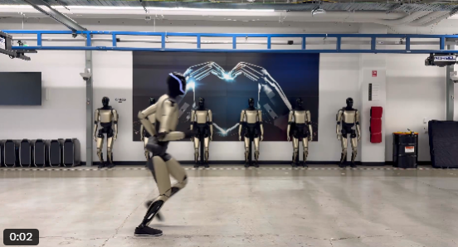
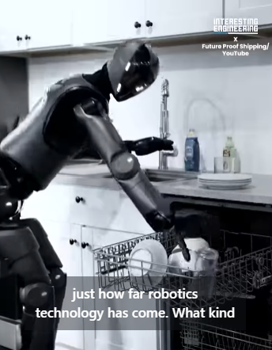
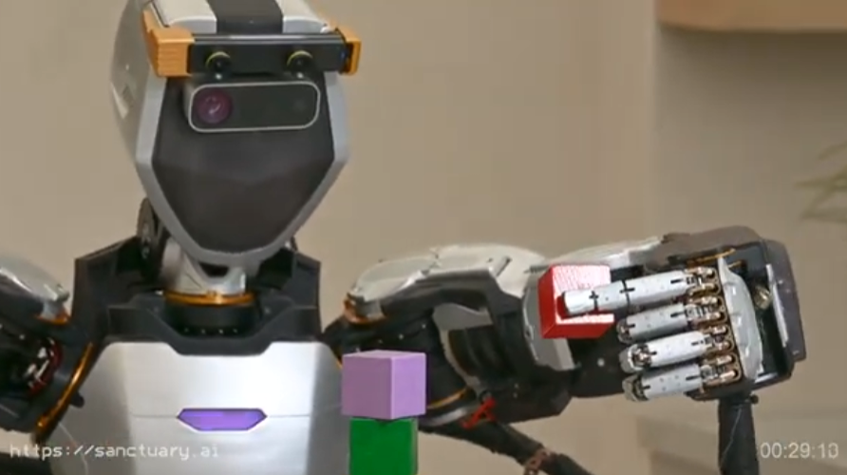
Robots
A lot of jobs require physical presence and action
Robots can run, do dishes, stack blocks, and more
What’s missing?

Slide 24
Barriers to more complete AI solutions
Memory
AI has no episodic memory – it doesn’t remember where or when it learned something, and acquired memory is only accessible through simplistic retrieval mechanisms
Weights are trained and frozen, limiting adaptability
Real-time interaction
We don’t know to make AI work fluidly with people (everything is framed as input → processing → output
Physicality
Robots are physically brittle, with little agility, and limited sensors (e.g. humans have 4M touch sensors, but most robots have 0)
Very limited generalization – new objects, new environments, new variations on tasks tend to completely break a robot’s ability. Most demos are narrowly scripted.

Slide 25
Finishing up the semester
Dec 14: Final project due at 11:59pm
Dec 4-9: Final exam
Covers all material for semester
See CampusWire pinned post for details
Dec 9 – I will be here in lecture period for help with final project (not exam prep), or possibly general questions beyond class
Last office hour is Dec 12
We will still monitor and respond to CampusWire until Dec 14

Slide 26
FLEX Feedback
We put much time and energy into this course
Please take some time to provide ratings and feedback
go.illinois.edu/flex
We’ll use it to keep making the course better

Slide 27
Thank you to the course staff for all their hard work to answer questions and grade. Thank you for your hard work and engagement!
Notes:
Have a great summer!

Slide 28
Generative AI: Text
Write a one paragraph fairytale synopsis about a girl that finds a magical flower that saves her ailing father.
Once upon a time, in a quaint village nestled at the edge of an enchanted forest, lived a young girl named Elara. Her father, the village blacksmith, fell gravely ill, and no remedy seemed to help. Desperate, Elara ventured into the mystical woods, guided by tales of a legendary flower with unparalleled healing powers. After braving countless trials and befriending magical creatures, she discovered the radiant Moonblossom, blooming under the light of the full moon. With unwavering hope, she brought the flower back and brewed a potion from its petals, curing her father and restoring joy to their home. The village celebrated Elara's bravery and the magical bond between a daughter's love and nature's wonders.
ChatGPT

Slide 29



Generative AI: Images
Generate a series of three images that illustrates this story.
Elara standing at the edge of an enchanted forest, determined to find the magical flower.
Elara in the middle of the enchanted forest, reaching out to the glowing Moonblossom surrounded by magical creatures.
Elara back in her village, standing beside her now healthy father, with villagers celebrating her success and bravery.
ChatGPT, Dall-E3

Slide 30

Generative AI: Audio
Write a short catchy song about this story with three versus and no chorus.
Folk music: gentle acoustic guitar, fiddle, and tambourine, female vocal, irish lilt, fast pace
Verse 1: In a village by the forest deep, Lived a girl named Elara, dreams she’d keep, Her father sick, hope fading fast, She ventured forth, her heart steadfast.
Verse 2: Through enchanted woods, with creatures fair, Moonlight guiding, magic in the air, Found a flower, glowing bright, Moonblossom’s petals, cure in sight.
Verse 3: Back to the village, Elara ran, Her father's smile, health began, Villagers cheered, tales to tell, Bravery and love cast a healing spell.
ChatGPT, Suno

Slide 31
Current state of AI/ML
AI capability is still far inferior to humans
Usually requires clearly defined tasks
Cannot perform complex tasks
Requires many examples
Difficult to adapt to new tasks

Slide 32
Research directions in machine learning
Using ML to perform complex tasks
Perform software tasks, such as image editing, drafting slides based on an outline, or summarizing and reporting information from diverse sources
Learn from watching how people perform tasks and through natural training interfaces
Integrating ML into physical devices
IoT, sensors
Robots
Multimodal and broadly knowledgeable AI
Models increasingly defined in terms of input/output modalities rather than narrow tasks
Use vision, language, situation-specific, and broader knowledge to summarize and recommend
Complementary learning systems
Integrate predictive/generative models and retrieval of individual memories and associations
Integrate with planning, task decomposition, and prioritization
World models
Learn to predict how observations will change given action

Slide 33
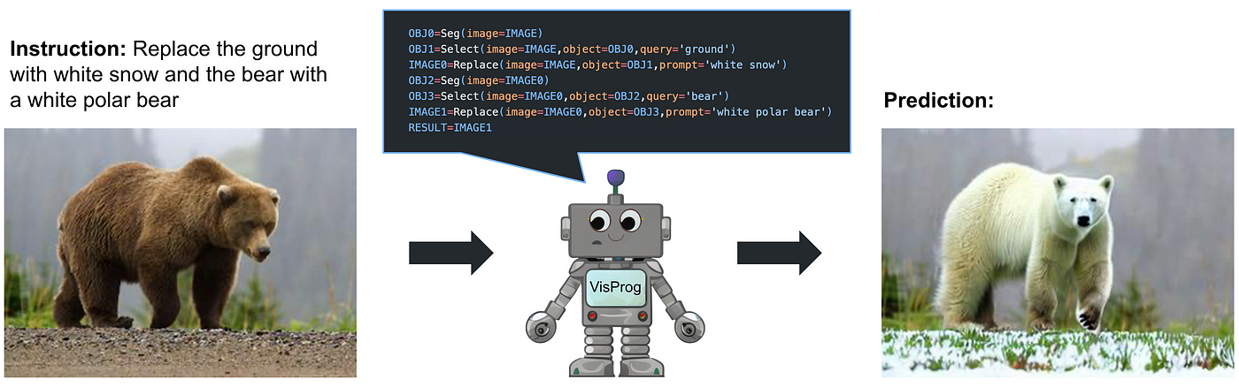
One example: Visual Programming
Use LLM to generate code that calls pretrained vision models and functions
Gupta and Khembavi 2023

Slide 34
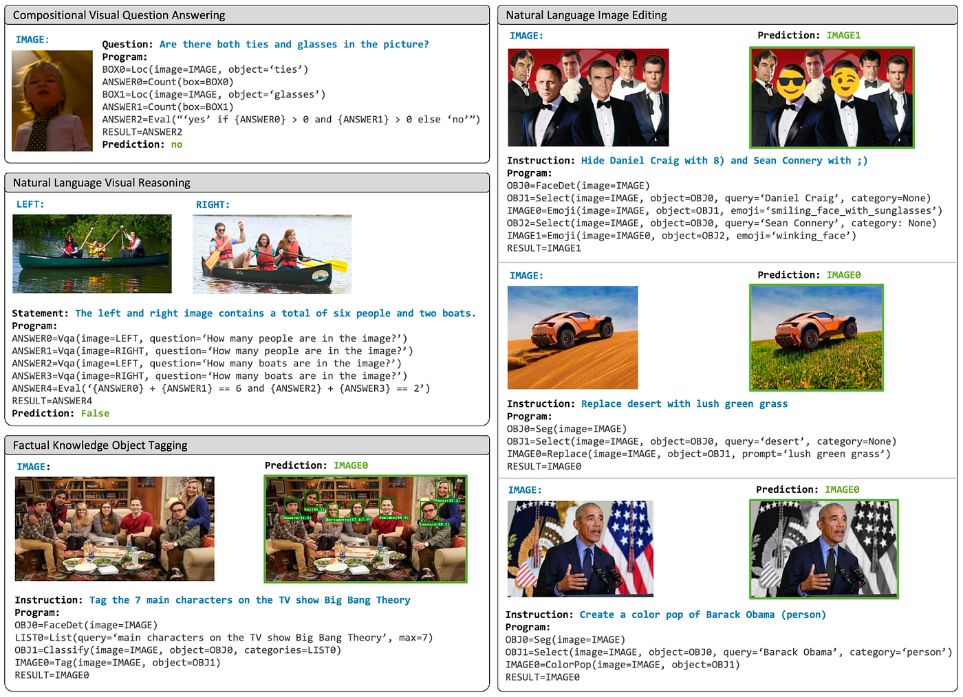

Slide 35
High-impact applications and what is needed to make them really work
Personalized tutors, e.g. Khanmigo
Episodic memory, to have a history with the student
Personalization, to learn preferences by cues and previous responses
Improved ability to illustrate concepts
Tool usage through language --- anything that is currently done through keyboard/mouse (shopping, finding information, creating illustrations, using spreadsheets) can be done with LLMs
Robots (embodied agents)
Continual learning: gaining and using information about the environment, people, and concepts in real time
General purpose skill learning, maybe with world models as a foundation
Lighter, cheaper, easily repaired hardware

Slide 36
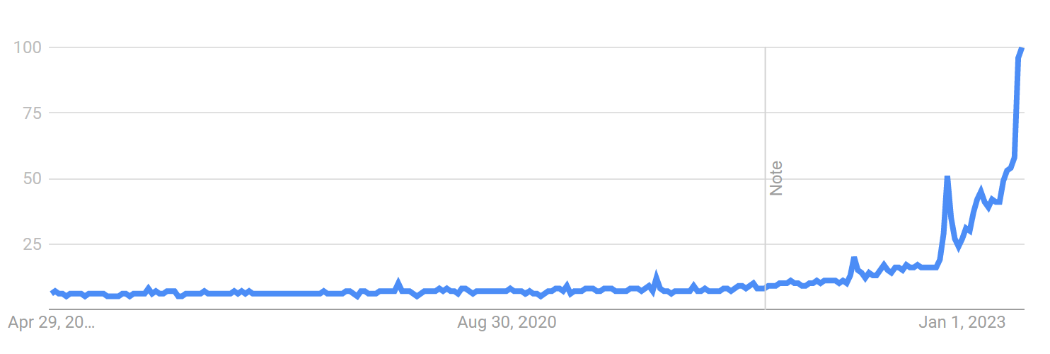
ML is changing
Google Trends: AI (2018-2023)

Slide 37
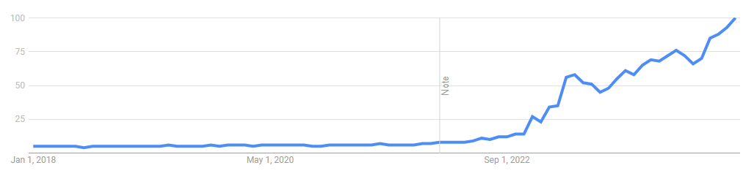
ML is changing
Google Trends: 2018-2024

Slide 38
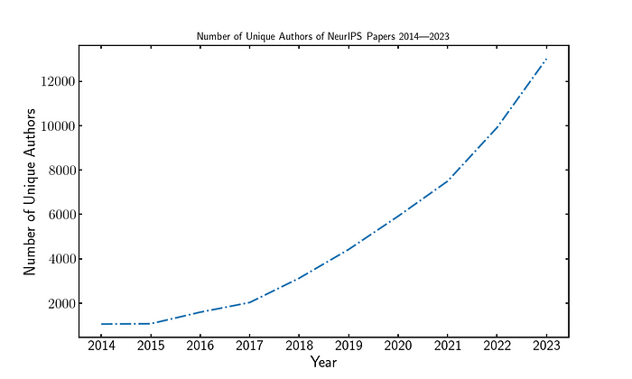
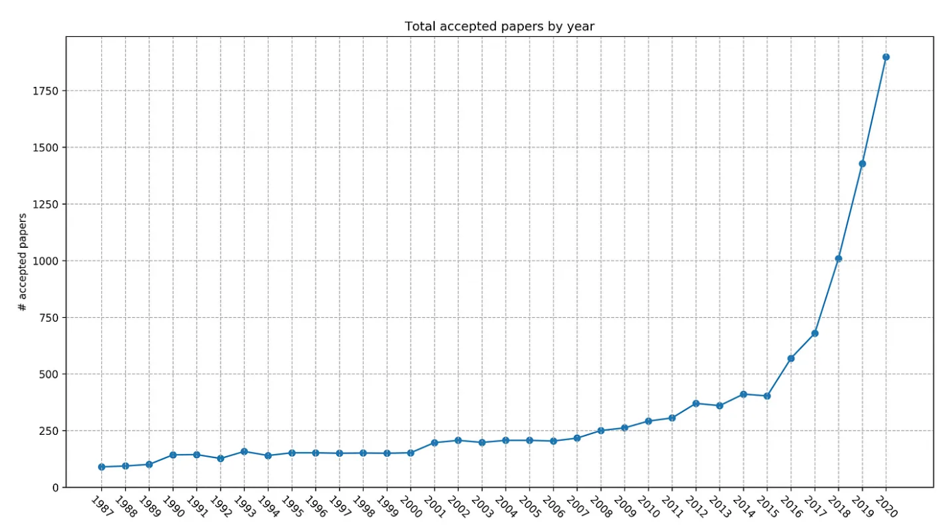
ML is changing
Papers published in NeurIPS
2,672 in 2022
3,584 in 2023
4,033 in 2024
10x growth in 10 years
Unique Authors in NeurIPS
Increased from 1,064 in 2014 to 13,012 in 2023
13x growth in in 9 years
https://medium.com/voxel51/neurips-2023-and-the-state-of-ai-research-2cd2d678e264

Slide 39
ML is changing
Machine learning has been used for decades, e.g. reading addresses for the post office, but it’s now everywhere
Major increases in conference attendance, press coverage, investment by companies, number of authors per paper
Much better infrastructure for ML in terms of libraries and models, as well as tutorials and other online resources
Short-term value in AI is more clear, causing many companies to focus their investments

Slide 40
AI/ML will change the world in unpredictable ways
We have seen transformations of agriculture and manufacturing – AI will transform services
In a three sector breakdown, the first two sectors of raw materials (including agriculture) and production have already been transformed by technology
In consequence, the majority of the workforce has move into services in advanced countries, as well as people working less on average
AI may dramatically transform services, but it’s not clear where the workforce can move
Previous products were predictable; AI, not so
Objects and computer software are under direct control of their users and operate in predictable ways
ML-based products depend on data in non-transparent ways

Slide 41
How to prepare yourself for a fast-changing tech world?
Master the fundamentals
Tools and algorithms change, but the ideas behind them are relatively constant
Fundamentals are math, ability to frame problems computationally, ability to draw insights and predict from data, communication, and empathy
These abilities enable you to learn the latest, design solutions, and apply effectively

Slide 42
Current state of AI/ML
Fundamental ideas of classification and regression are well established and haven’t changed in many years
Recent advances enable integrating lots of data to create powerful predictors/generators

