Slide 1
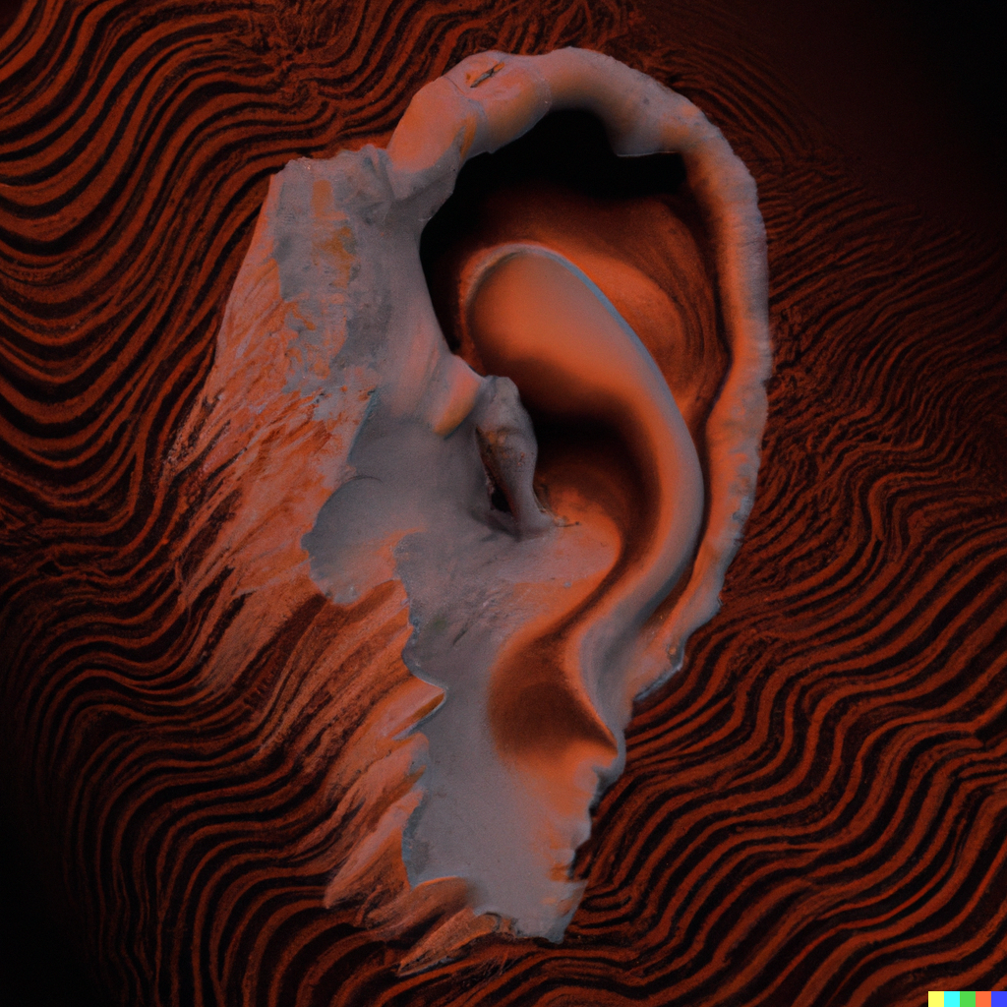
1D Signals and Audio
Applied Machine Learning
Derek Hoiem

Slide 2
This class: Audio and 1D signals
Representing sound with frequencies
Deep networks for audio
Other 1D time series

Slide 3
1D time series problems are common
Stock prices, vibrations, popularity trends, temperature, …
Audio
  Speech recognition, sound classification, source separation

Slide 4
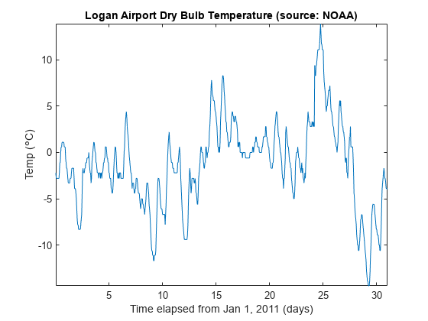
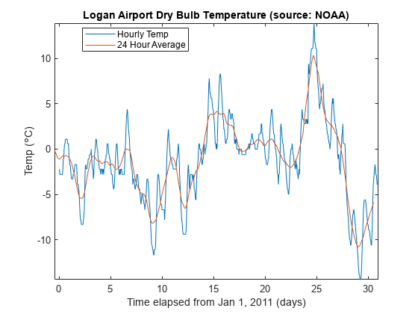
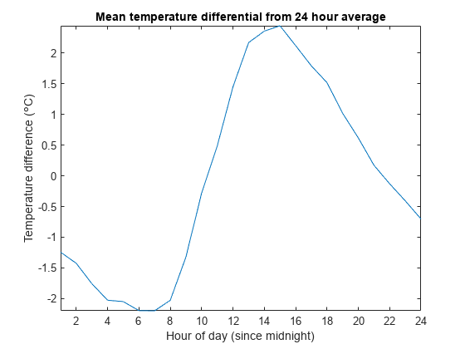
Example: Temperature at Logan Airport
Trends can occur at multiple time scales
Smoothing and differencing are important forms of analysis
https://www.mathworks.com/help/signal/ug/signal-smoothing.html

Slide 5
How are 1D signals different from other problems?
Signals are often periodic, and can be analyzed in terms of slow and fast moving changes
Signals can have arbitrary length, and can be analyzed in terms of recent data points (windows) or some cumulative representation

Slide 6
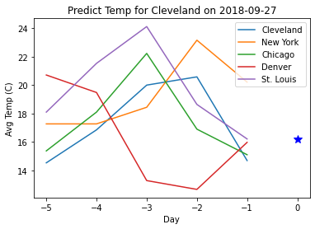
Example: city temperature prediction
Recall HW 1: predict temperature in Cleveland based on temperatures from US cities in previous days
What did we do to handle this time series?

Slide 7
Example: city temperature prediction
Recall HW 1: predict temperature in Cleveland based on temperatures from US cities in previous days
What did we do to handle this time series?
  Windowed prediction: Consider temperature given five preceding days
  Various prediction methods
    Linear regression
    Nearest neighbor
    Random forest

Slide 8
Example: city temperature prediction
Recall HW 1: predict temperature in Cleveland based on temperatures from US cities in previous days
What could we do to improve prediction?

Slide 9
1D Time Series more generally
Recall HW 1: predict temperature in Cleveland based on temperatures from US cities in previous days
What could we do to improve prediction?
Take into account other features: time of year, other atmospheric effects
Learn better representations, e.g. use multitask learning to regress difference of temperature for each city from previous day in a deep neural net
Reframe in terms of differences from recent days and same day in recent years

Slide 10
1D Series Prediction
Common to apply 1-D filter operations to smooth (e.g. 1D Gaussian) or highlight differences (e.g. difference filter [-1 1 0])
Signal is often converted into fixed length by windowing and/or padding
Predictions by dynamic models can also be used as features, e.g. accounting for position, velocity, and acceleration
Continuity of features can be achieved using convolutional networks, LSTMs, or other recurrent networks

Slide 11
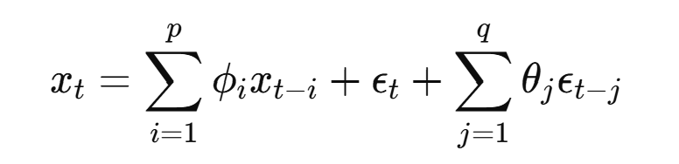
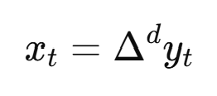
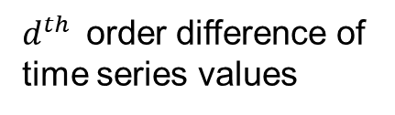
ARIMA: autoregressive integrated moving average
ARIMA is statistical time series model that predicts the difference from the last value based on the recent history of consecutive differences
$d^{th }$ order difference of time series values
Linear predictor from recent differences
Linear predictor from recent forecasting errors
Parameterized with $d$ (order of difference), $p$ (series history length), $q$ (error history length)

Slide 12
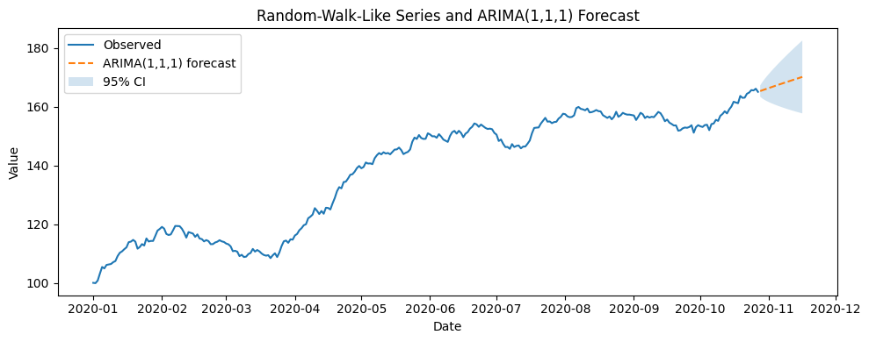
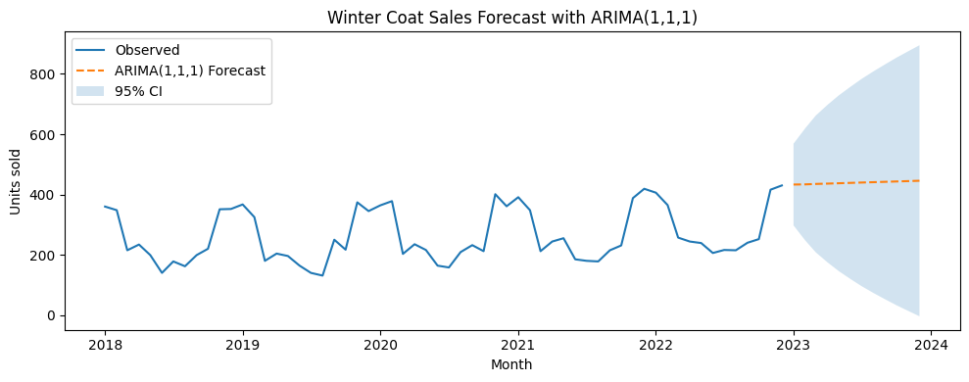
ARIMA Predictions

Slide 13
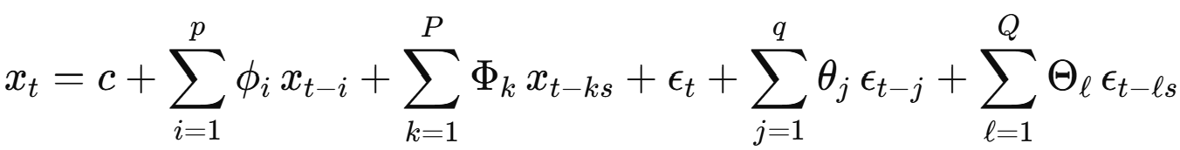
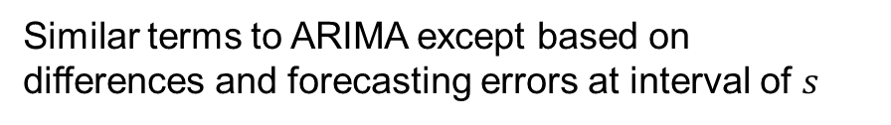
SARIMA: seaonal autoregressive integrated moving average
SARIMA extends ARIMA by adding a seasonal term, e.g. also considering differences from a previous cycle, e.g.
  Coat sales in December 2025 based on recent months and December sales in previous years
Similar terms to ARIMA except based on differences and forecasting errors at interval of $s$

Slide 14
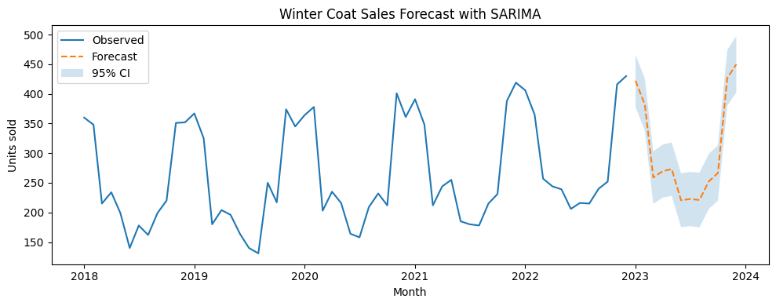
SARIMA Prediction

Slide 15
Deep networks for time series forecasting
The success of deep networks in vision, language, and audio is due to ability to train pre-trained models on large corpora and transfer representations to target tasks
But time series problems seem quite different, e.g. predicting the price of commodities, the temperature, or the favorability polling of a political candidate
Can we pre-train a model that adapts well to target time series forecasting tasks?

Slide 16
Yes, we can train deep models to forecast, but tree-based and statistical models are usually more practical
Methods like Temporal Fusion Transformer (TFT), Informer, and N-BEATs are:
  Interesting and innovate
  Perform well in academic benchmarks and used widely in research
Tree-based models (e.g. XGBoost, random forests) and ARIMA/SARIMA and other statistical models are:
  More interpretable (easier to debug and explain)
  Lower computation
  Much more widely used
In practice, raw prediction accuracy is only one factor – also important are
  Interpretability
  Stability
  Controllability
  Ease of incorporating expert knowledge
  Ease of monitoring & debugging
  Low maintenance cost

Slide 17
Zero-shot time-series forecasting, N-BEATS
Train a network on diverse time series forecasting tasks
  100K+ time series sequences
  Predict next value given preceding values
Apply it zero shot to new time series forecasting tasks
https://arxiv.org/abs/2002.02887
https://arxiv.org/abs/1905.10437

Slide 18
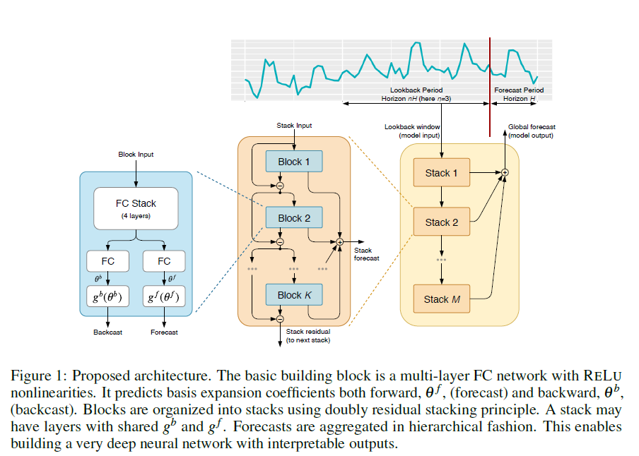
Zero-shot time-series forecasting, N-BEATS
Input is preceding window of time series data
Each block updates the forecast based on unexplained data
  Receives delta of input and “backcast”
  Applies MLP
  Outputs “backcast”, the estimate of input signal
  Outputs delta to forecast
Residual connections between blocks and for each stack allow training gradients to flow throughout the network
Output is total forecast
https://arxiv.org/abs/2002.02887
https://arxiv.org/abs/1905.10437

Slide 19
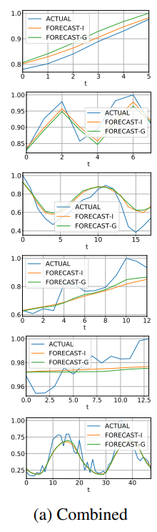
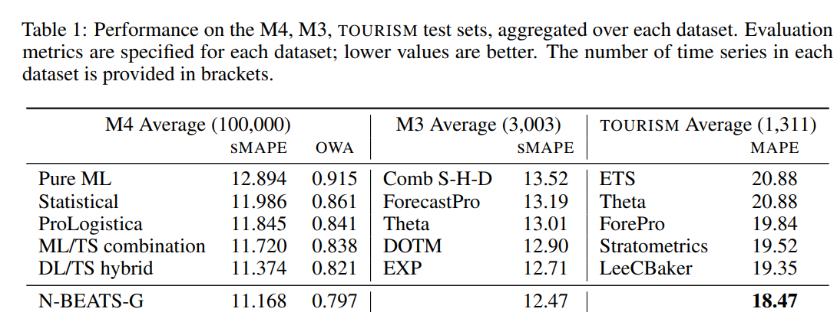
More accurate than other ML and statistical models, some of which take into account seasonality and other time-series behaviors

Slide 20

Q1-3
https://tinyurl.com/AML441-L23

Slide 21
To understand audio, we need better ways to represent frequency

Slide 22
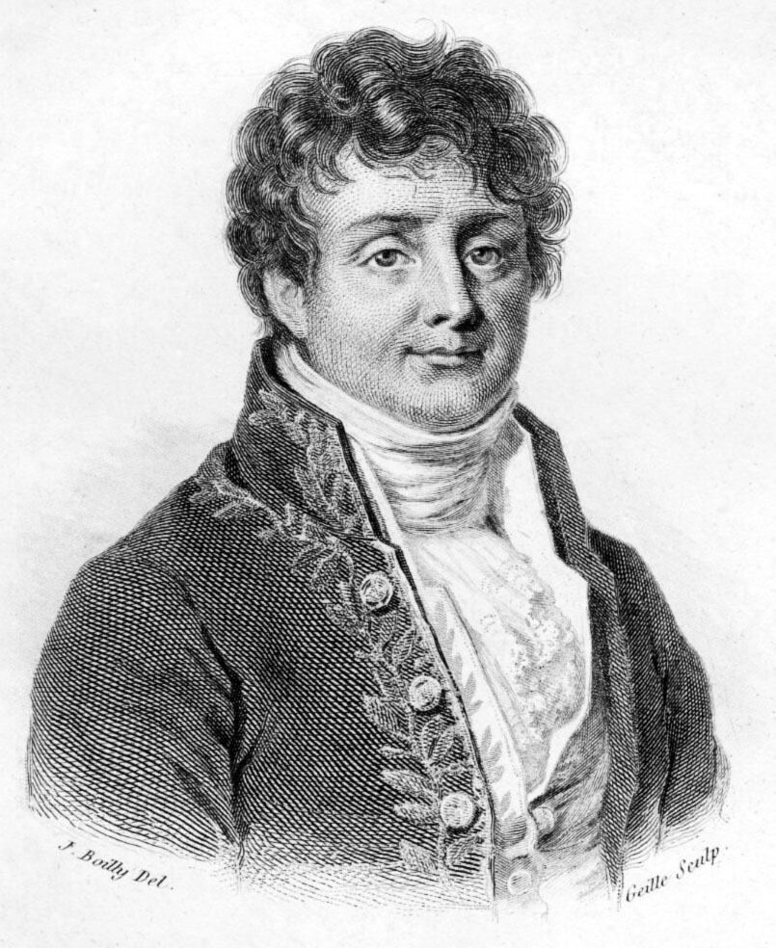
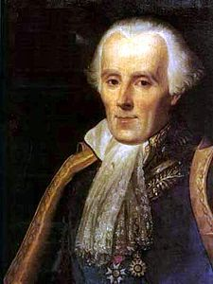
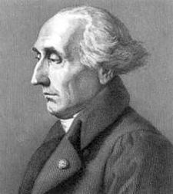

Jean Baptiste Joseph Fourier had a crazy idea in 1807
...the manner in which the author arrives at these equations is not exempt of difficulties and...his analysis to integrate them still leaves something to be desired on the score of generality and even rigour.
Any univariate function can be rewritten as a weighted sum of sines and cosines of different frequencies.
Don’t believe it?
  Neither did Lagrange, Laplace, Poisson and other big wigs
  Not translated into English until 1878!
But it’s (mostly) true
  called Fourier Series
  there are some subtle restrictions
Laplace
Legendre
Lagrange
Slide: Efros

Slide 23
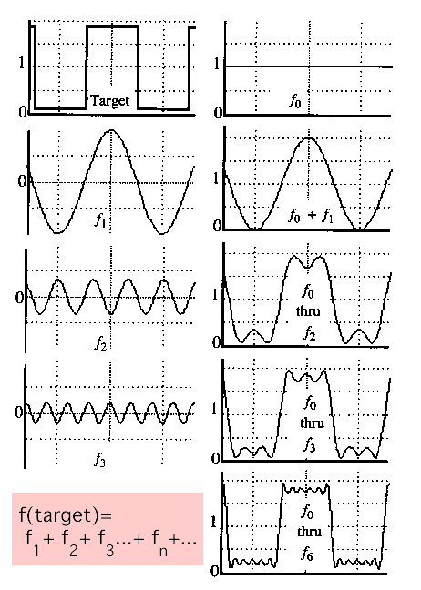
A sum of sines
Our building block:
Add enough of them to get any signal f(x) you want!

Slide 24
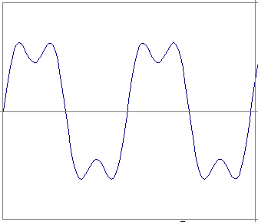
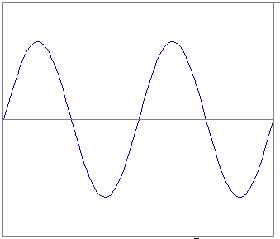
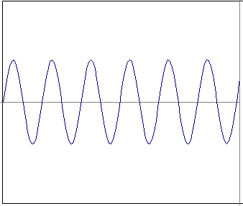
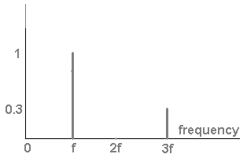
Frequency Spectra
example : g(t) = sin(2πf t) + (1/3)sin(2π(3f) t)
=
+
Slides: Efros

Slide 25
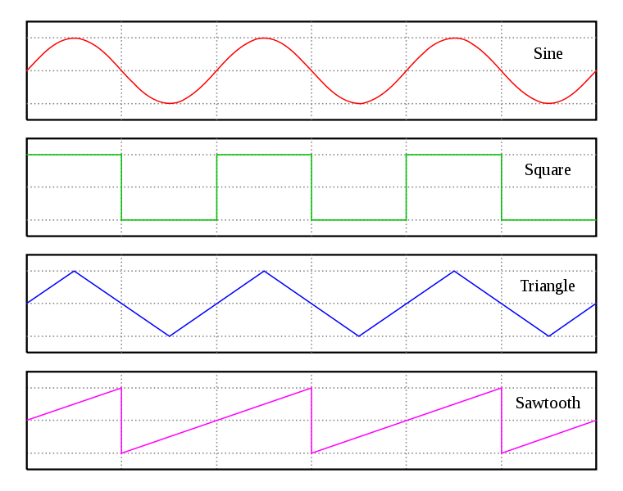
Frequency Spectra

Slide 26
Frequency Spectra
=
+
=

Slide 27
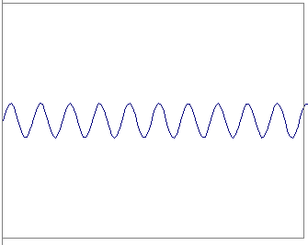
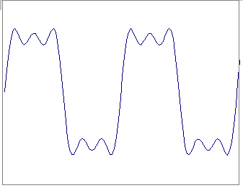
Frequency Spectra
=
+
=

Slide 28
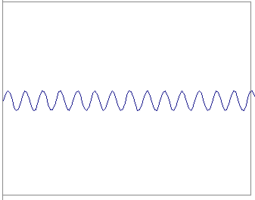
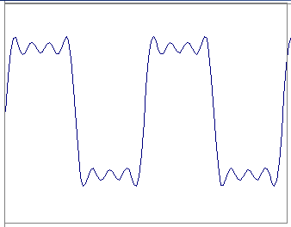
Frequency Spectra
=
+
=

Slide 29
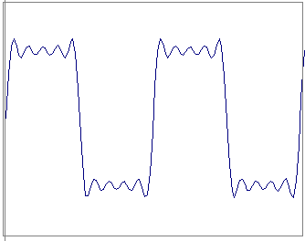
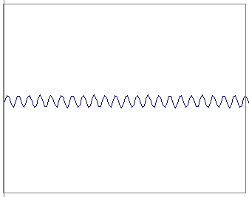
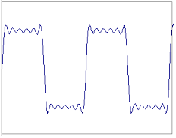
Frequency Spectra
=
+
=

Slide 30
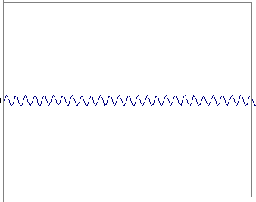
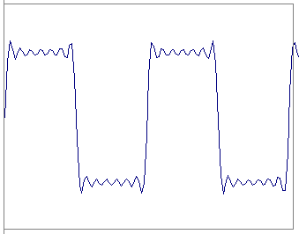
Frequency Spectra
=
+
=

Slide 31
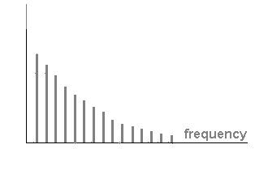
Frequency Spectra
=

Slide 32
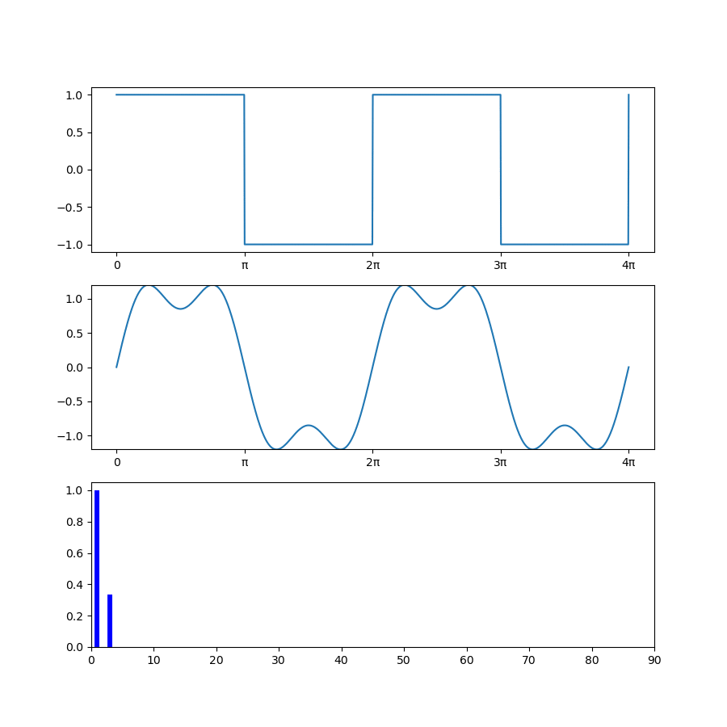
Frequency Spectra

Slide 33
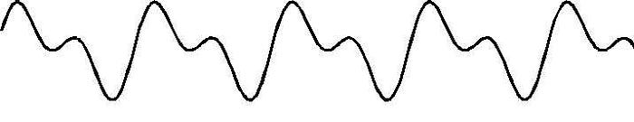
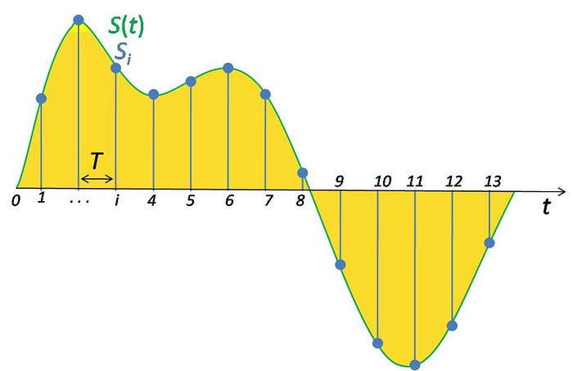
Sound
Sound is composed of overlaid sinusoidal functions with varying frequency and amplitude
Digital sound is recorded by sampling the sound signal with high sampling frequency
Fig src
Fig src
Slide content source: TDS

Slide 34
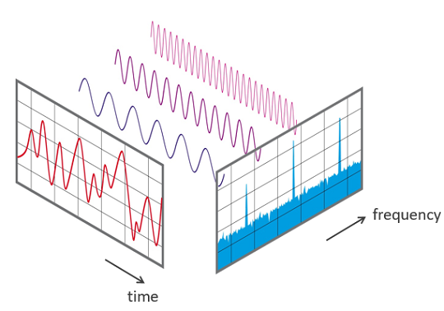
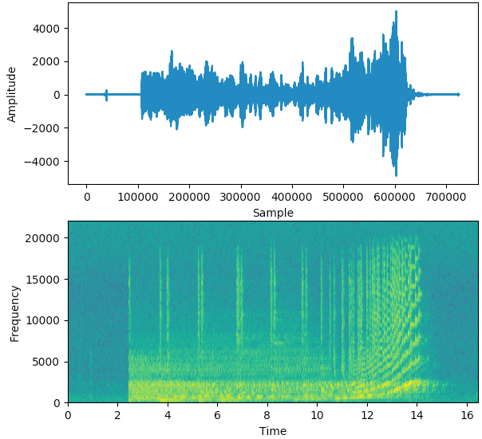
Spectrogram
Sound is a series of sinusoids with varying amplitudes, frequencies, and phases
Total amplitude tells us how loud the sound is at some point, but that’s not very informative
The spectrogram tells us the power in each frequency over some time window
Fig src
Slide content source: TDS

Slide 35
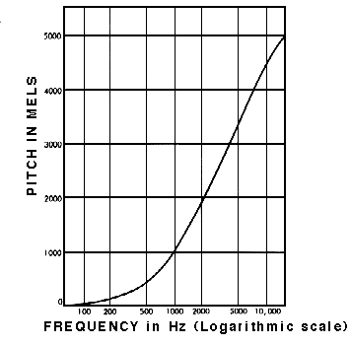
Mel Spectrograms
Humans perceive frequency on a logarithmic scale, e.g. each octave in music doubles the frequency
Mel scale maps frequency to human perception of pitch
Mel scale records amplitude in decibels (logarithmic base 10)
Slide content source: TDS

Slide 36
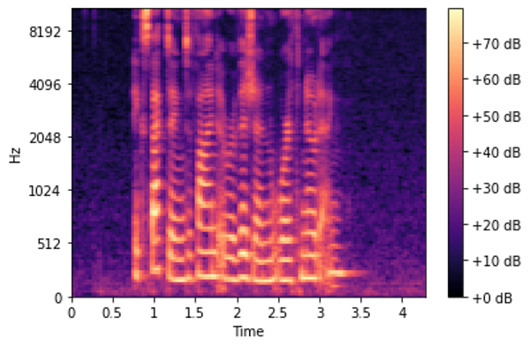
Mel Spectrogram
Slide content source: TDS See this link for code to generate Mel Spectrogram

Slide 37
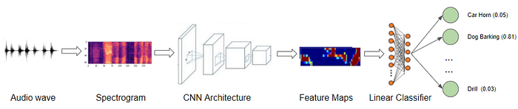
Audio Classification
Pre-process into Mel Spectogram Image
Apply vision-based architectures to classify
  Data augmentation can include time shift on audio wave and time/frequency masking on spectrogram
Details and code here: https://towardsdatascience.com/audio-deep-learning-made-simple-sound-classification-step-by-step-cebc936bbe5

Slide 38
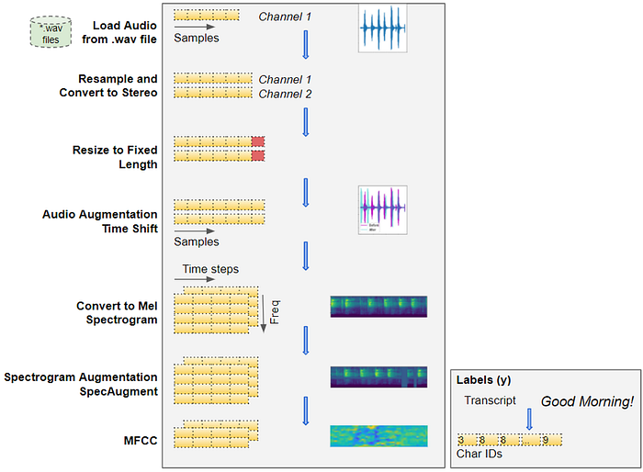
Audio to Speech (ASR)
Process data, similar to audio classification
MFCC processes Mel Spectrogram with DCT to get a compressed representation that focuses on speech-related frequencies
Content src

Slide 39
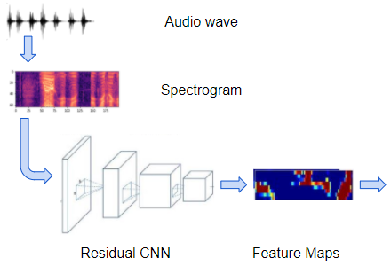
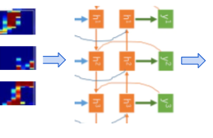
ASR
Deep network with vision architecture extracts features
Recurrent network (e.g. LSTM) models each output at time t as dependent on the features at time t and latent representations at time (t-1) and/or (t+1)
Feature Map Windows
LSTM
Based on Baidu’s Deep Speech model, as described here

Slide 40
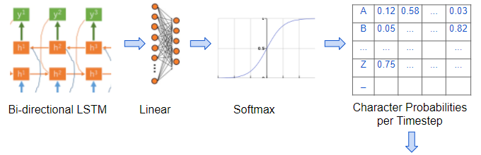
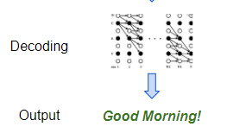
ASR
Each time step predicts a probability for each character
Character probabilities are decoded into text output
Based on Baidu’s Deep Speech model, as described here

Slide 41
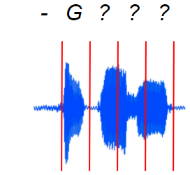
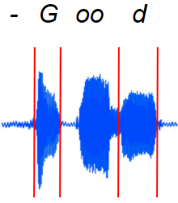


ASR
A challenge of ASR is temporal spacing between characters
Audio is sliced uniformly and fed into RNN
RNN predicts character probabilities, merges repeated characters, and removes blanks
Based on Baidu’s Deep Speech model, as described here

Slide 42

Other details
Loss based on likelihood of true character sequence
Error is often reported as Word Error Rate or Character Error Rate
A language model and/or beam search can be used to improve output
As described here

Slide 43
Popular libraries for audio processing
Librosa: https://librosa.org/doc/latest/index.html
Torch Audio: https://pytorch.org/audio/stable/index.html
Others: https://wiki.python.org/moin/Audio/
HuggingFace Models: https://huggingface.co/docs/transformers/tasks/audio_classification

Slide 44
Audio Foundation Models
Domain | Model (with URL) | Typical Tasks
Speech | Metis https://metis-demo.github.io/ | ASR, TTS, voice conversion, speech enhancement
Speech | WhisperX https://github.com/m-bain/whisperX | Speech transcription, translation
Music | LLark https://github.com/spotify-research/llark | Music understanding, captioning, metadata extraction
Music | MusicGen https://audiocraft.metademolab.com/musicgen.html | Music generation
Universal / General Audio | UniAudio https://github.com/yangdongchao/UniAudio | Speech + audio + music generation
Universal / General Audio | Qwen-Audio https://huggingface.co/Qwen/Qwen-Audio | Audio reasoning, classification, ASR
Universal / General Audio | Kimi-Audio https://github.com/MoonshotAI/Kimi-Audio | Audio understanding, generation, conversation
Domain-Specific (Bioacoustics) | BirdAVES https://github.com/earthspecies/aves | Birdsong modeling, species identification
Domain-Specific (Bioacoustics) | NatureLM-Audio https://earthspecies.github.io/naturelm-audio-demo/ | Wildlife and ambient acoustic modeling

Slide 45
Q4
https://tinyurl.com/AML441-L23

Slide 46
And now, this…
Smarter Better Faster (my parody lyrics)
https://suno.com/song/eb2a33d3-aa01-466f-8d4b-a8ebcb49ced4
It’s my loss (my lyrics)
https://suno.com/song/2cdf6a66-7a1a-4b2f-afff-507d8554b610

Slide 47
Things to remember
1D Time classification or forecasting methods often take a windowed approach, making a prediction based on data from a fixed length of time
Statistical models like (S)ARIMA are often preferred for time series forecasting due to their interpretability and controllability
Audio is best represented in terms of amplitudes of frequency ranges over time
Audio models use vision-based architectures on Mel Spectrograms

Slide 48
Coming up
Submit your final project form before Thursday
Guest Lecture -- Chenxi Yu from State Farm on Thursday
Fall Break next week (no office hours 11/22 to 11/30)

