Slide 1
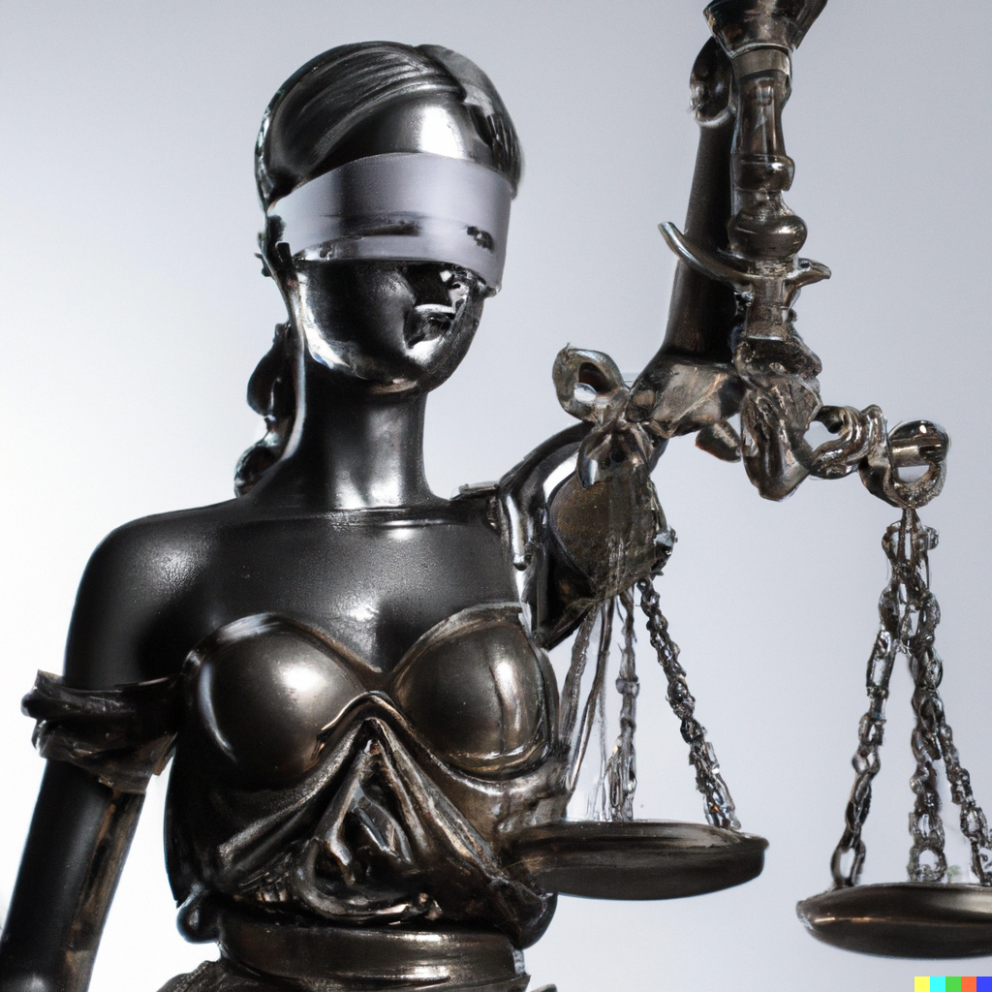
Data Bias and Fair ML
Applied Machine Learning
Derek Hoiem
Dall-E

Slide 2
Today’s lecture
Human, Data, and Algorithm Bias; and what to do about it
  Adopted from a 2019 guest lecture by Margaret Mitchell, with permission
Fairness and Justice
  Adopted from Pietro Perona IVCSS 2024 talk, with permission

Slide 3
What is bias?
Bias in ML (“bias-variance trade-off”): the model is too limited to fully encode the true distribution, e.g. linear regression is used for a problem that requires non-linear regression
Bias in Statistics: even with infinite samples, your estimate of the statistic will not converge to the true value
Bias in Data: the distribution of the training data is more limited or different than in deployment
Cognitive Bias: wrong thinking, e.g. confirmation bias, recency bias, optimism bias
Algorithmic Bias: the use of algorithms to apply unjust, unfair, or prejudicial treatment of people related to protected attributes (e.g., race, income, sexual orientation, religion, gender)

Slide 4

What’s the big deal?
True story
Face recognition trained on predominantly white people
Identifies black person as matching a suspect in armed robbery & carjacking
Black person was 8 months pregnant, with no connection to circumstances of the crime
Police arrested and charged her, due to the high confidence “objective” ID
Turns out to be a false arrest

Slide 5
How does this happen?
Humans are biased
Algorithms consume human data and make biased judgements, or performance varies for different groups
Humans trust computers to be correct and unbiased

Slide 6
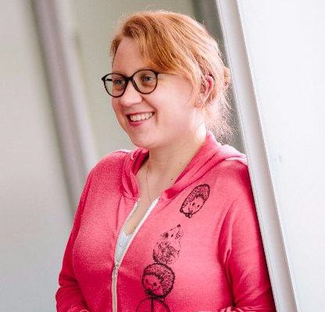

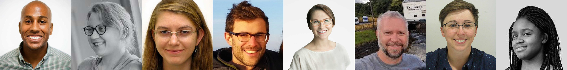
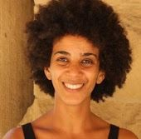
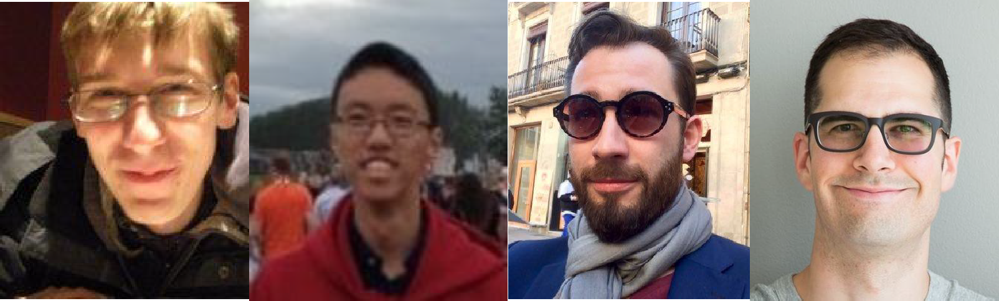
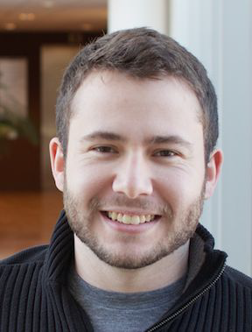

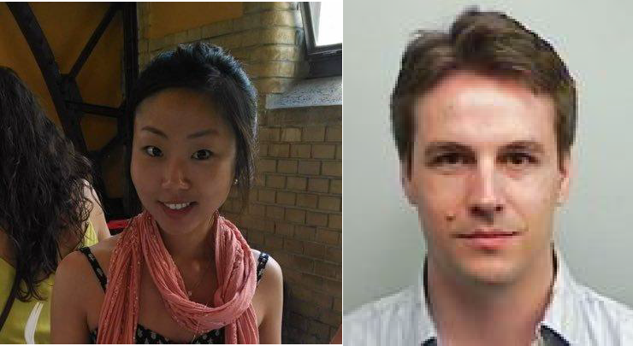

Bias in the Vision and Language of
Artificial Intelligence
Margaret Mitchell
Senior Research Scientist Google AI
Conversation AI
Andrew | Me | Simone | Parker | Lucy | Ben | Elena | Deb | Timnit Gebru
Zaldivar |  | Wu | Barnes | Vasserman | Hutchinson | Spitzer | Raji
Adrian Benton
Brian Zhang
Dirk Hovy
Josh Lovejoy
Alex Beutel
Blake Lemoine
Hee Jung Ryu
Hartwig Adam
Blaise Agüera y Arcas
CC BY / Margaret Mitchell / m-mitchell.com

Slide 7
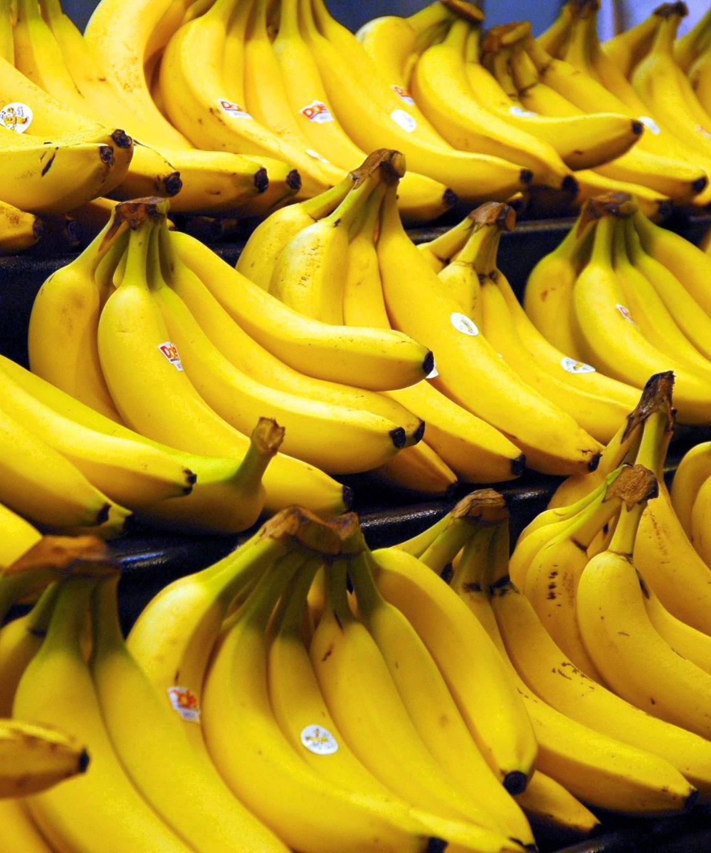
What do you see?
CC BY / Margaret Mitchell / m-mitchell.com

Slide 8
What do you see?
Bananas
CC BY / Margaret Mitchell / m-mitchell.com

Slide 9
What do you see?
Bananas
Stickers
CC BY / Margaret Mitchell / m-mitchell.com

Slide 10
What do you see?
Bananas
Stickers
Dole Bananas
CC BY / Margaret Mitchell / m-mitchell.com

Slide 11
What do you see?
Bananas
Stickers
Dole Bananas
Bananas at a store
CC BY / Margaret Mitchell / m-mitchell.com

Slide 12
What do you see?
Bananas
Stickers
Dole Bananas
Bananas at a store
Bananas on shelves
CC BY / Margaret Mitchell / m-mitchell.com

Slide 13
What do you see?
Bananas
Stickers
Dole Bananas
Bananas at a store
Bananas on shelves
Bunches of bananas
CC BY / Margaret Mitchell / m-mitchell.com

Slide 14
What do you see?
Bananas
Stickers
Dole Bananas
Bananas at a store
Bananas on shelves
Bunches of bananas
Bananas with stickers on them
CC BY / Margaret Mitchell / m-mitchell.com

Slide 15
What do you see?
Bananas
Stickers
Dole Bananas
Bananas at a store
Bananas on shelves
Bunches of bananas
Bananas with stickers on them
Bunches of bananas with stickers on them on shelves in a store
CC BY / Margaret Mitchell / m-mitchell.com

Slide 16
What do you see?
Bananas
Stickers
Dole Bananas
Bananas at a store
Bananas on shelves
Bunches of bananas
Bananas with stickers on them
Bunches of bananas with stickers on them on shelves in a store
...We don’t tend to say
Yellow Bananas
CC BY / Margaret Mitchell / m-mitchell.com

Slide 17
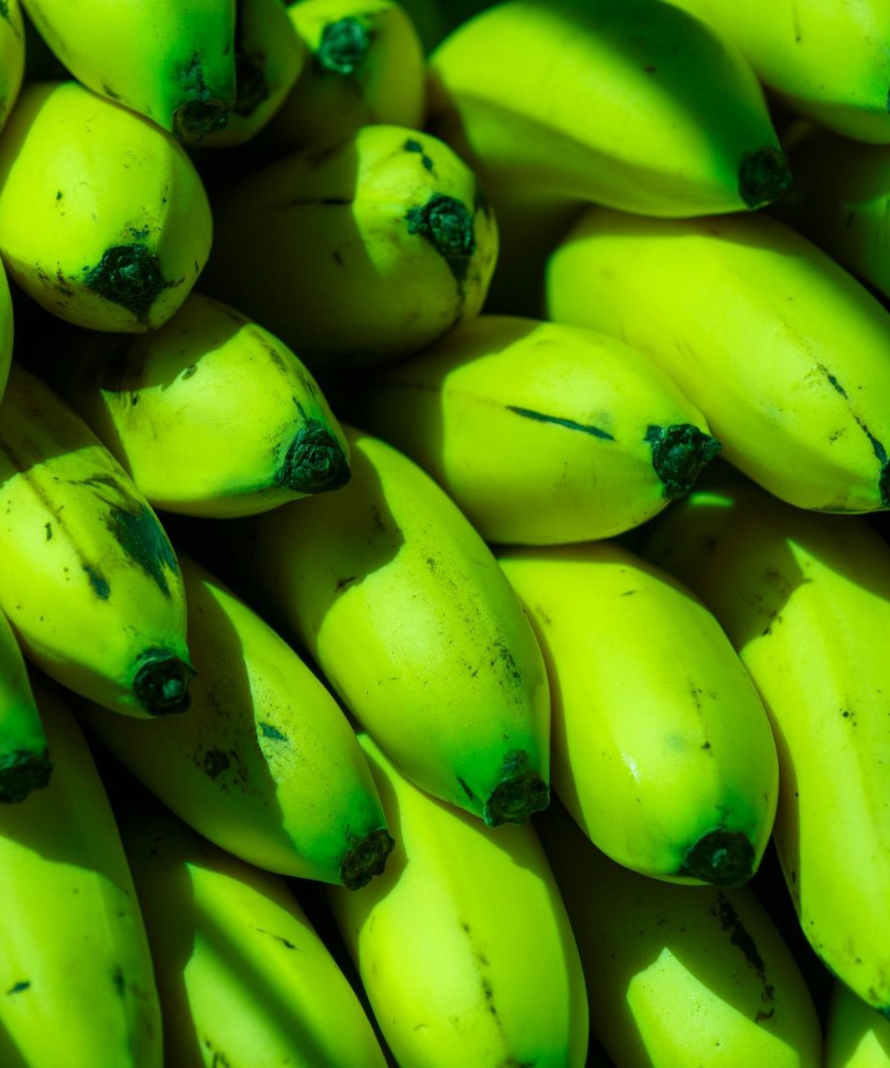
What do you see?
Green Bananas
Unripe Bananas
CC BY / Margaret Mitchell / m-mitchell.com

Slide 18
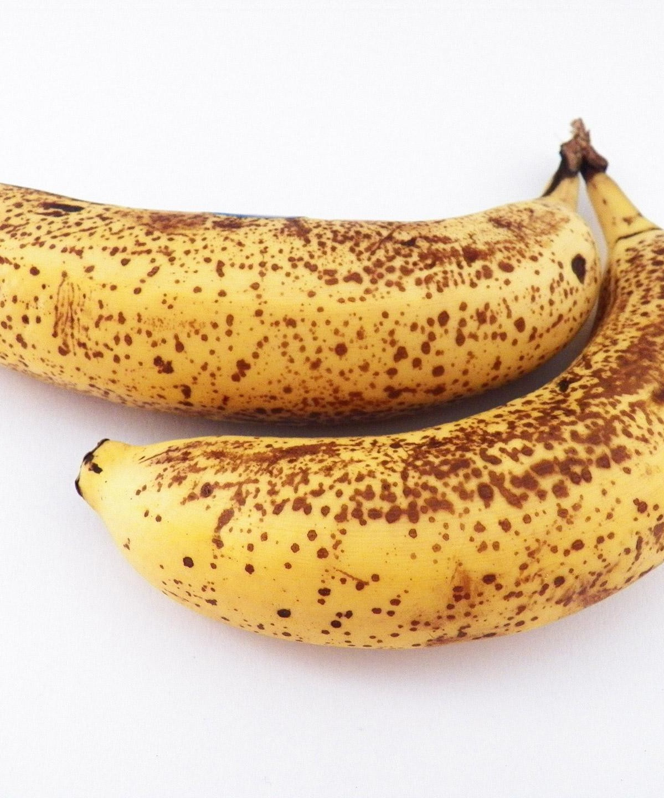
What do you see?
Ripe Bananas
Bananas with spots
CC BY / Margaret Mitchell / m-mitchell.com

Slide 19
What do you see?
Ripe Bananas
Bananas with spots
Bananas good for banana bread
CC BY / Margaret Mitchell / m-mitchell.com

Slide 20
What do you see?
Yellow Bananas
Yellow is prototypical for bananas
CC BY / Margaret Mitchell / m-mitchell.com

Slide 21
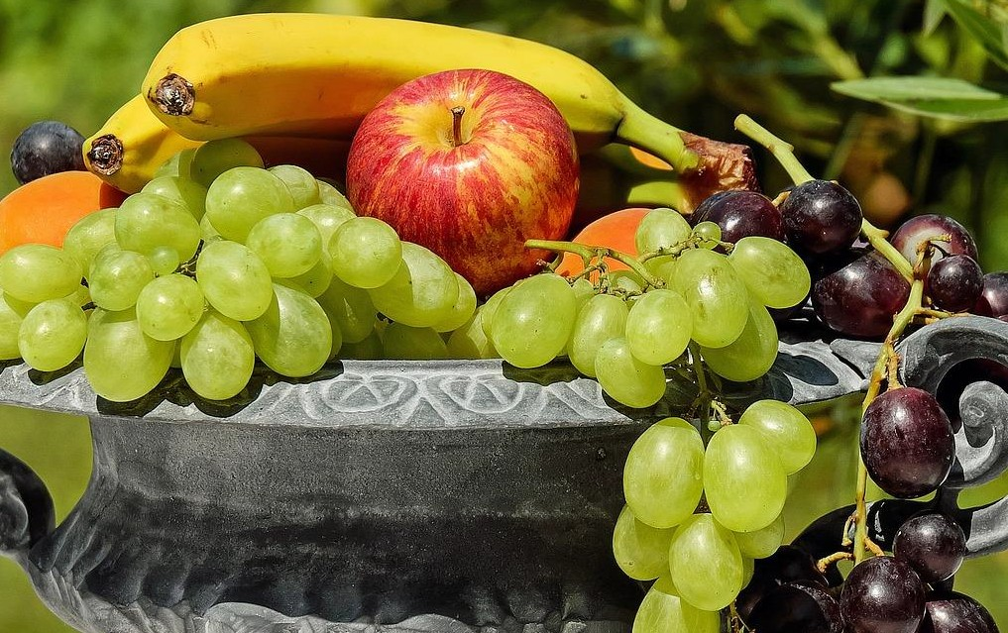
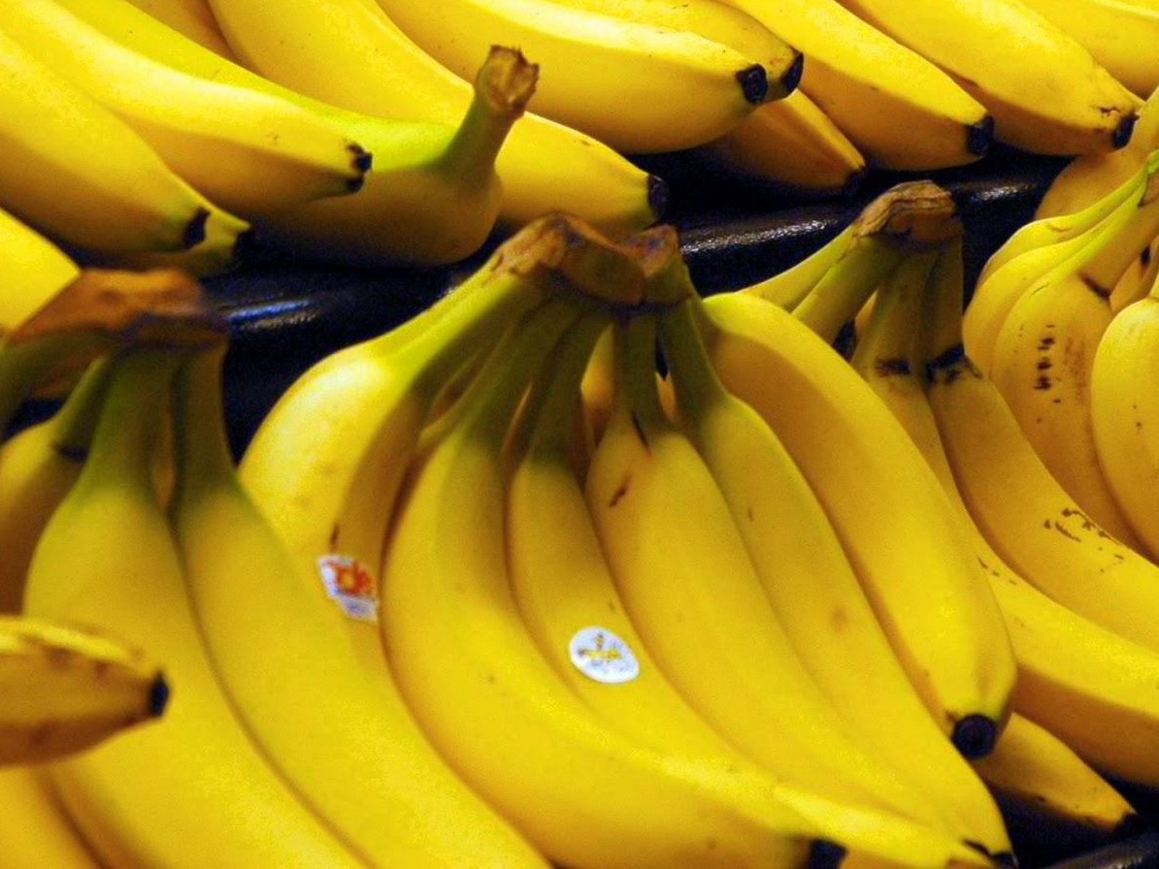
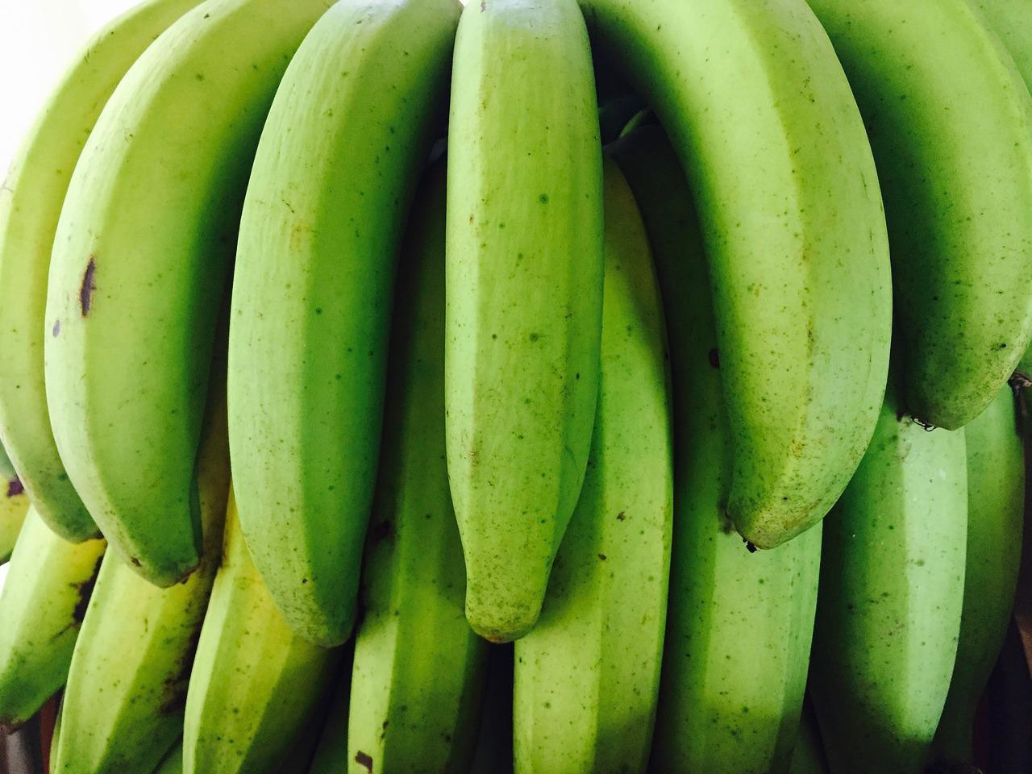
Prototype Theory
One purpose of categorization is to reduce the infinite differences among stimuli to behaviourally and cognitively usable proportions
There may be some central, prototypical notions of items that arise from stored typical properties for an object category (Rosch, 1975)
May also store exemplars (Wu & Barsalou, 2009)
Banana
Fruit
Bananas
“Basic Level”
Unripe Bananas, Cavendish Bananas

Slide 22
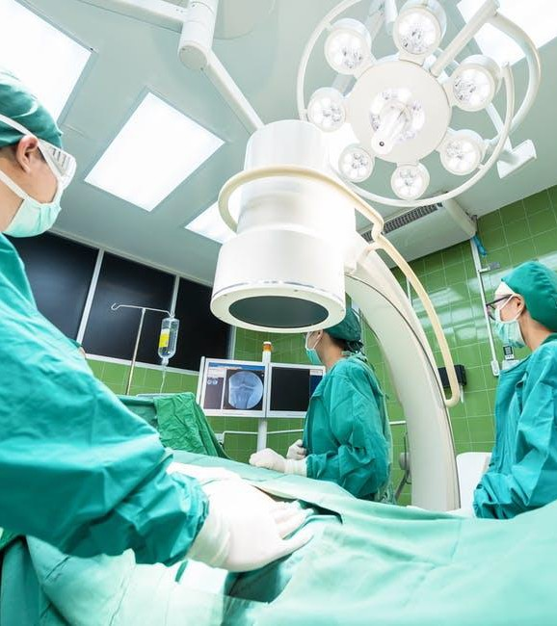
A man and his son are in a terrible accident and are rushed to the hospital in critical care.
The doctor looks at the boy and exclaims "I can't operate on this boy, he's my son!"
How could this be?
CC BY / Margaret Mitchell / m-mitchell.com

Slide 23

A man and his son are in a terrible accident and are rushed to the hospital in critical care.
The doctor looks at the boy and exclaims "I can't operate on this boy, he's my son!"
How could this be?

Slide 24
A man and his son are in a terrible accident and are rushed to the hospital in critical care.
The doctor looks at the boy and exclaims "I can't operate on this boy, he's my son!"
How could this be?
CC BY / Margaret Mitchell / m-mitchell.com

Slide 25


Slide 26
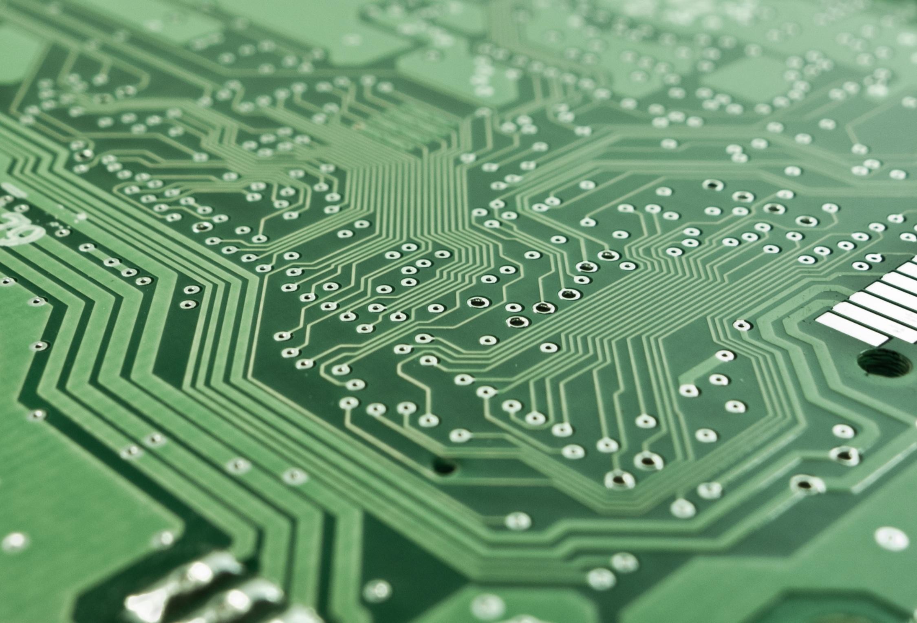
The majority of test subjects overlooked the possibility that the doctor is a she - including men, women, and self-described feminists.
Wapman & Belle, Boston University
CC BY / Margaret Mitchell / m-mitchell.com

Slide 27
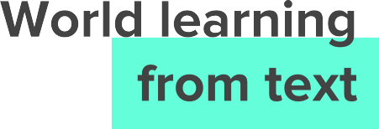
Word | Frequency in Google Web corpus
“spoke” | 11,577,917
“laughed” | 3,904,519
“murdered” | 2,834,529
“inhaled” | 984,613
“breathed” | 725,034
“hugged” | 610,040
“blinked” | 390,692
“exhale” | 168,985
Gordon and Van Durme, 2013
CC BY / Margaret Mitchell / m-mitchell.com

Slide 28
Human Reporting Bias
The frequency with which people write about actions, outcomes, or properties is not a reflection of real-world frequencies or the degree to which a property is characteristic of a class of individuals
CC BY / Margaret Mitchell / m-mitchell.com

Slide 29
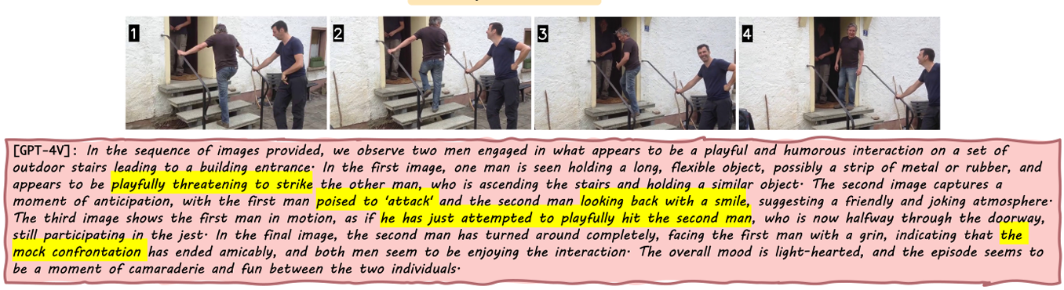
Human reporting bias affects ML models
https://arxiv.org/pdf/2401.10529.pdf

Slide 30


CC BY / Margaret Mitchell / m-mitchell.com

Slide 31



CC BY / Margaret Mitchell / m-mitchell.com

Slide 32





CC BY / Margaret Mitchell / m-mitchell.com

Slide 33



CC BY / Margaret Mitchell / m-mitchell.com

Slide 34

CC BY / Margaret Mitchell / m-mitchell.com

Slide 35

CC BY / Margaret Mitchell / m-mitchell.com

Slide 36
Reporting bias: What people share is not a reflection of real-world frequencies
Data
Selection Bias: Selection does not reflect a random sample
Out-group homogeneity bias: People tend to see outgroup members as more alike than ingroup members when comparing attitudes, values, personality traits, and other characteristics
Confirmation bias: The tendency to search for, interpret, favor, and recall information in a way that confirms one's preexisting beliefs or hypotheses
Overgeneralization: Coming to conclusion based on information that is too general and/or not specific enough
Correlation fallacy: Confusing correlation with causation
Automation bias: Propensity for humans to favor suggestions from automated decision-making systems over contradictory information without automation
More at: https://developers.google.com/machine-learning/glossary/
Interpretation
CC BY / Margaret Mitchell / m-mitchell.com

Slide 37
Biases in Data

Slide 38
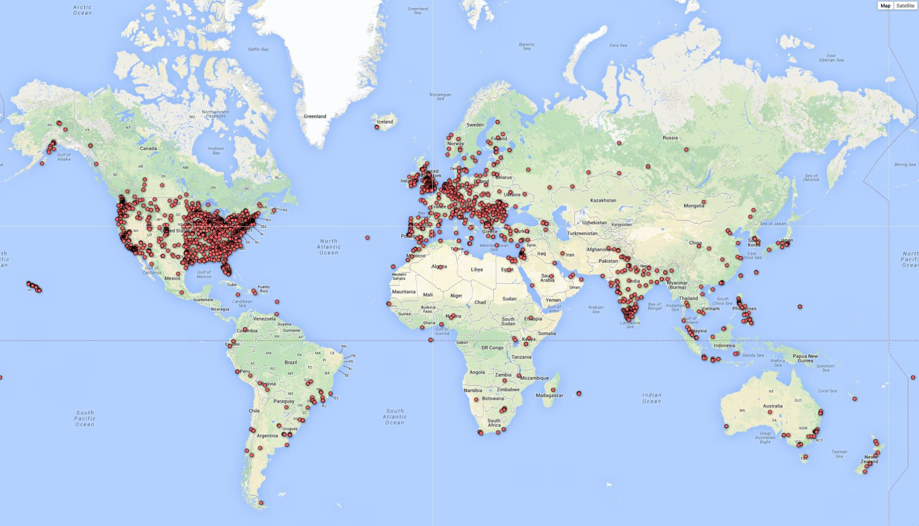
Biases in Data
Selection Bias: Selection does not reflect a random sample
CREDIT
© 2013–2016 Michael Yoshitaka Erlewine and Hadas Kotek
CC BY / Margaret Mitchell / m-mitchell.com

Slide 39
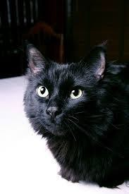
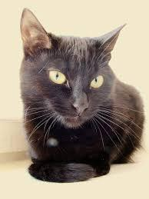

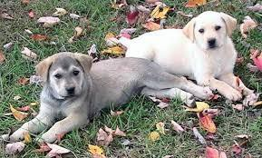



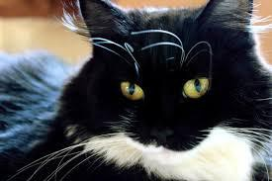
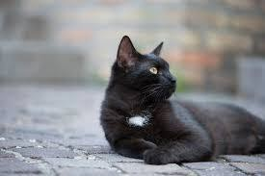
Biases in Data
Out-group homogeneity bias: Tendency to see outgroup members as more alike than ingroup members
CC BY / Margaret Mitchell / m-mitchell.com

Slide 40
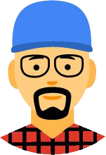
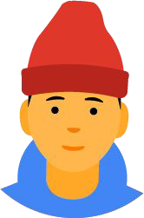
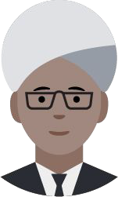

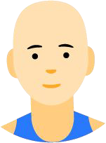
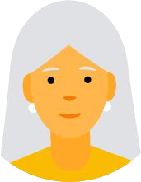
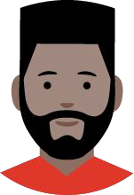
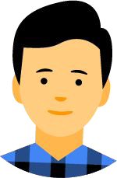

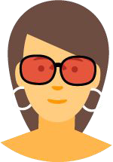
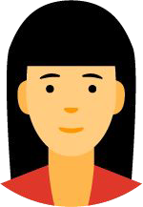
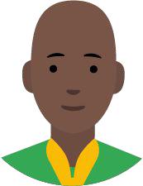
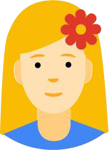
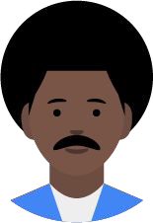

Biases in Data → Biased Data Representation
It's possible that you have an appropriate amount of data for every group you can think of but that some groups are represented less positively than others.
CC BY / Margaret Mitchell / m-mitchell.com

Slide 41
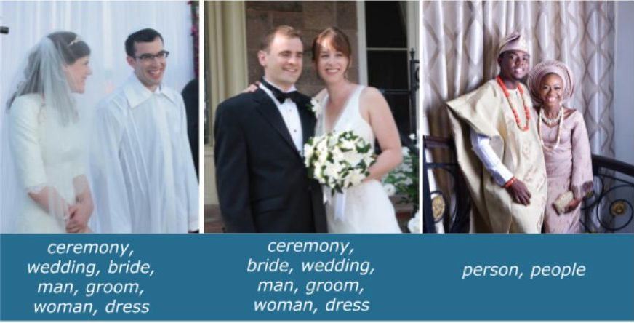
Biases in Data → Biased Labels
Annotations in your dataset will reflect the worldviews of your annotators.
https://ai.googleblog.com/2018/09/introducing-inclusive-images-competition.html

Slide 42
Biases in Interpretation

Slide 43
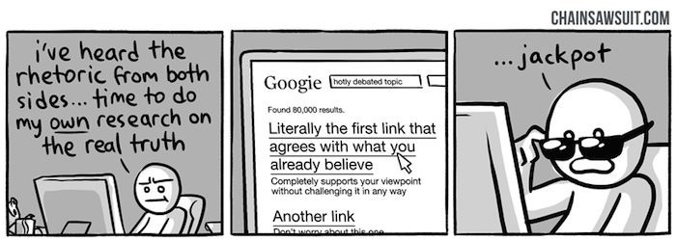
Biases in Interpretation
Confirmation bias: The tendency to search for, interpret, favor, recall information in a way that confirms preexisting beliefs
CREDIT
© kris straub - Chainsawsuit.com
CC BY / Margaret Mitchell / m-mitchell.com

Slide 44
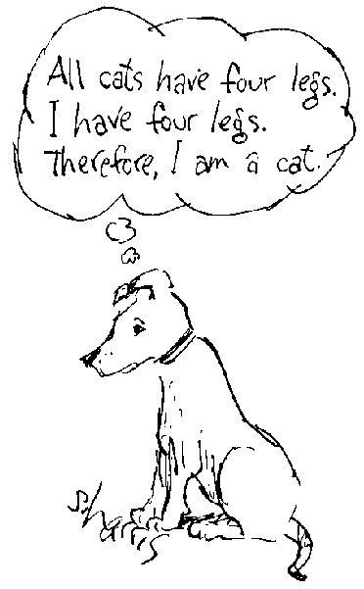
Biases in Interpretation
Overgeneralization: Coming to conclusion based on information that is too general and/or not specific enough (related: overfitting)
CREDIT
Sidney Harris
CC BY / Margaret Mitchell / m-mitchell.com

Slide 45
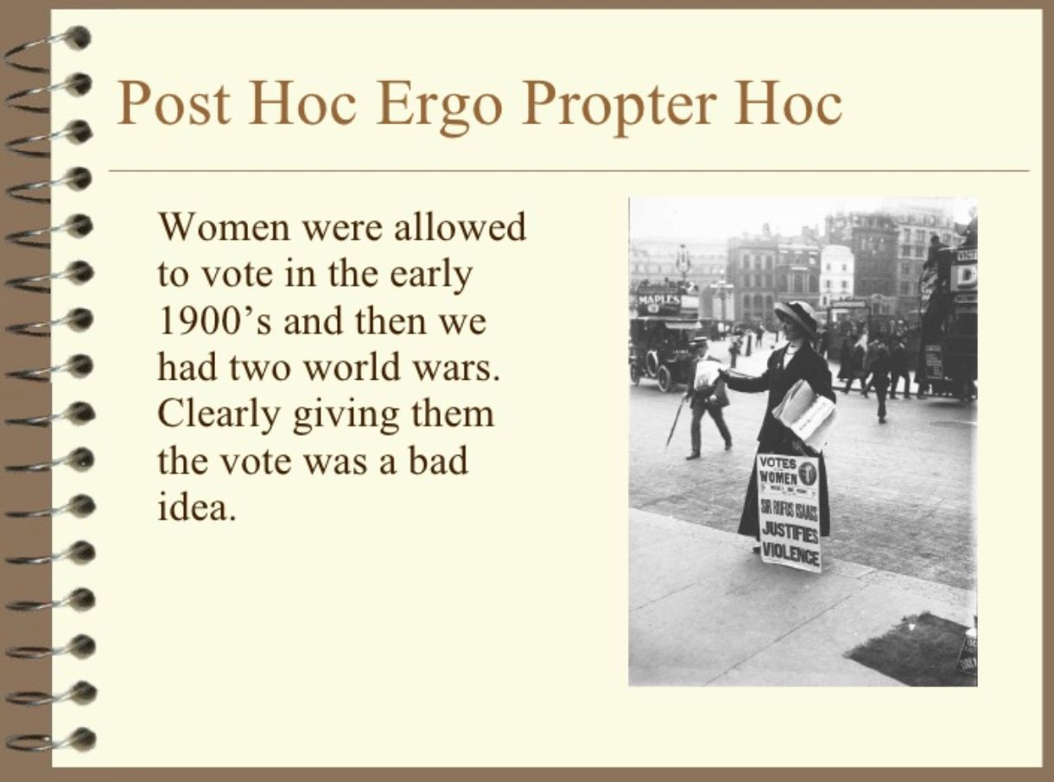
Biases in Interpretation
Correlation fallacy: Confusing correlation with causation
CREDIT
© mollysdad - Slideshare - Introduction to Logical Fallacies
CC BY / Margaret Mitchell / m-mitchell.com

Slide 46
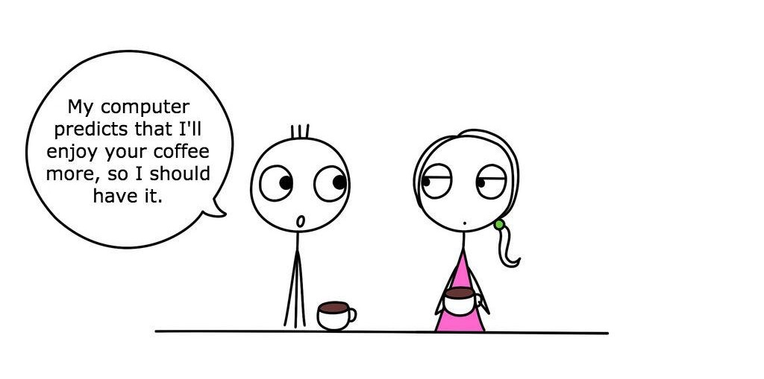
Biases in Interpretation
Automation bias: Propensity for humans to favor suggestions from automated decision-making systems over contradictory information without automation
CREDIT
thedailyenglishshow.com | CC BY 2.0
CC BY / Margaret Mitchell / m-mitchell.com

Slide 47
CC BY / Margaret Mitchell / m-mitchell.com

Slide 48











CC BY / Margaret Mitchell / m-mitchell.com

Slide 49
CC BY / Margaret Mitchell / m-mitchell.com

Slide 50





Slide 51


Slide 52
Human data perpetuates human biases.
As ML learns from human data, the result is a bias network effect.

Slide 53

Q1
https://tinyurl.com/AML441-L22

Slide 54
Predicting Future Criminal Behavior

Slide 55
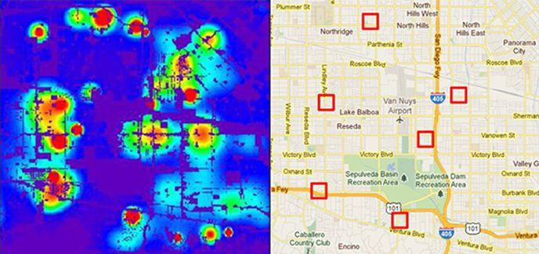
Predicting Policing
Algorithms identify potential crime hot-spots
Based on where crime is previously reported, not where it is known to have occurred
Predicts future events from past
CREDIT
Smithsonian. Artificial Intelligence Is Now Used to Predict Crime. But Is It Biased? 2018
CC BY / Margaret Mitchell / m-mitchell.com

Slide 56
Predicting Sentencing
Prater (who is white) rated low risk after shoplifting, despite two armed robberies; one attempted armed robbery.
Borden (who is black) rated high risk after she and a friend took (but returned before police arrived) a bike and scooter sitting outside.
Two years later, Borden has not been charged with any new crimes. Prater serving 8-year prison term for grand theft.
CREDIT
ProPublica. Northpointe: Risk in Criminal Sentencing. 2016.
CC BY / Margaret Mitchell / m-mitchell.com

Slide 57
It’s up to us to influence how AI evolves.
Here are some things we can do.
CC BY / Margaret Mitchell / m-mitchell.com

Slide 58
Data
CC BY / Margaret Mitchell / m-mitchell.com

Slide 59

Data Really, Really Matters
Understand your Data: skews, correlations
Abandon single training-set / testing-set from similar distribution
Combine inputs from multiple sources
Use held-out test set for hard use cases
Talk to experts about additional signals
CC BY / Margaret Mitchell / m-mitchell.com

Slide 60
Tools for data exploration
https://pair.withgoogle.com/
Facets: feature visualization libraries
https://pair-code.github.io/facets/
Know your data: dataset visualization
https://knowyourdata.withgoogle.com/

Slide 61
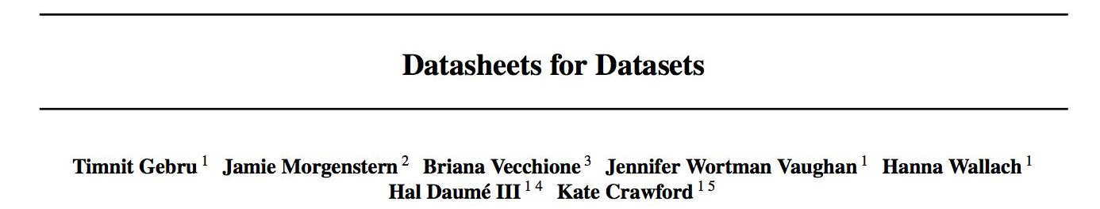
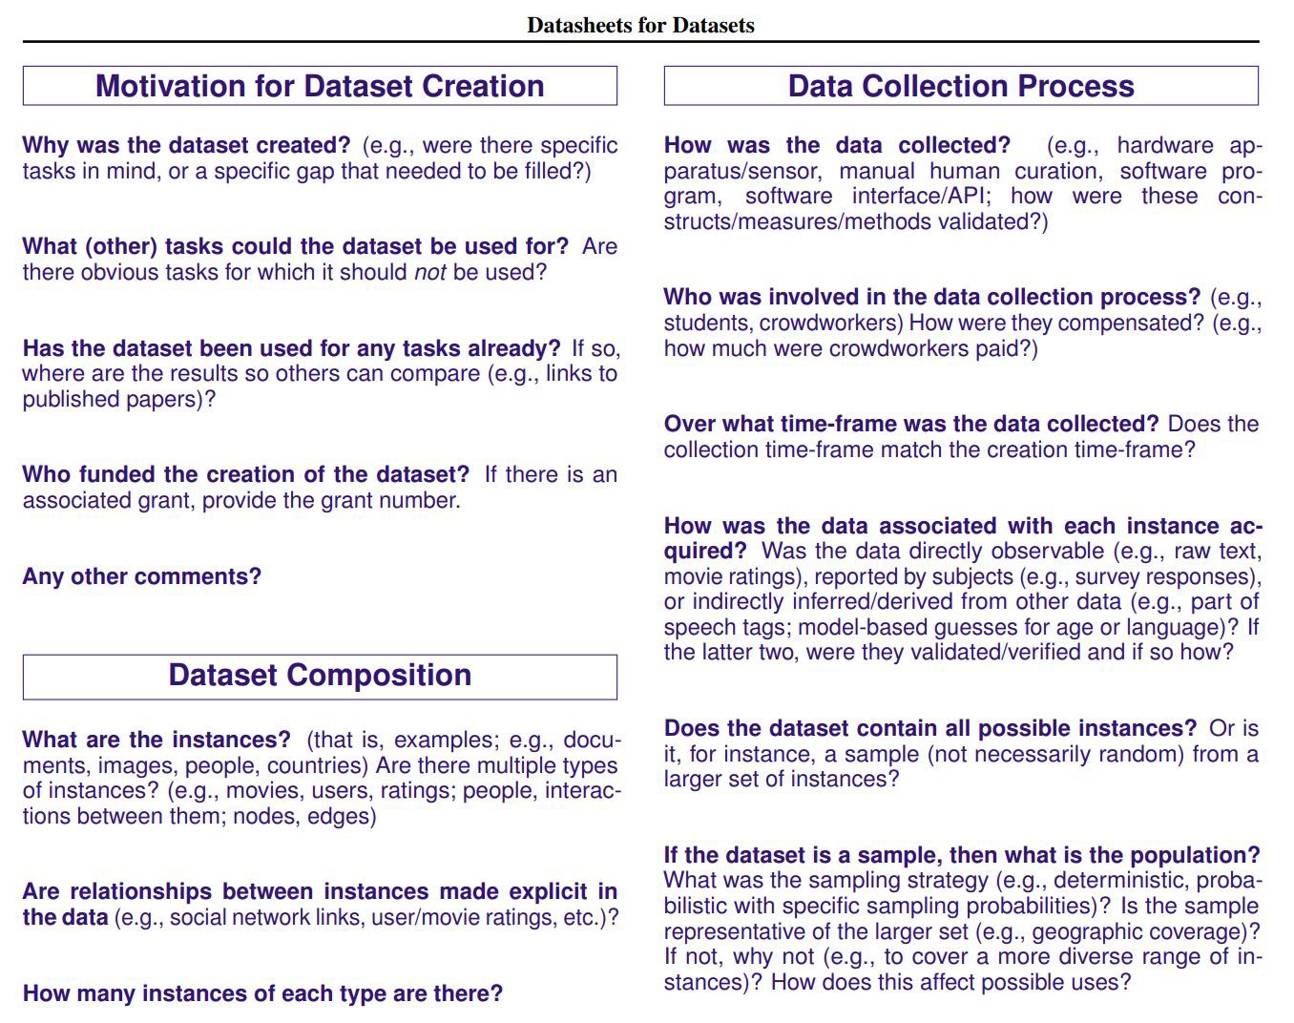
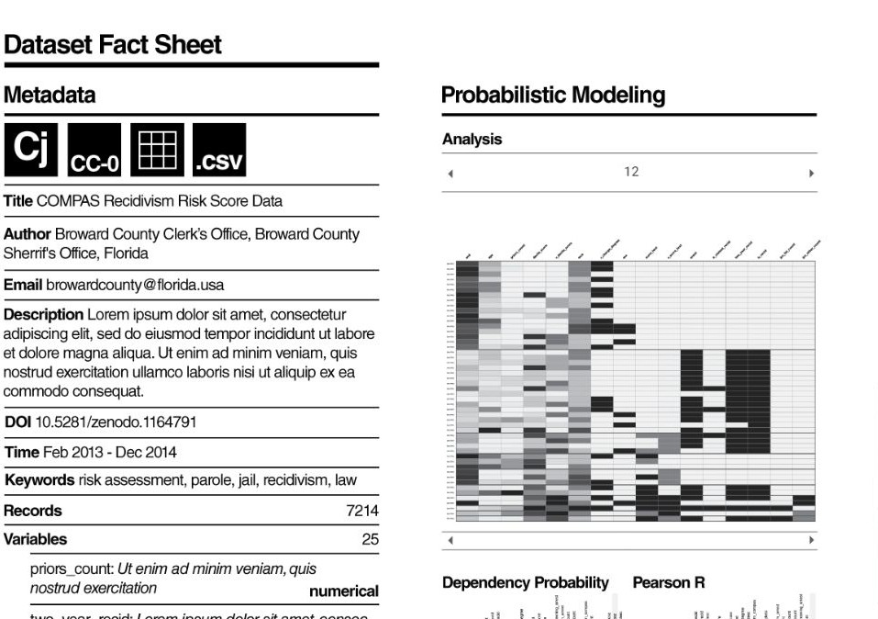
CC BY / Margaret Mitchell / m-mitchell.com

Slide 62
Machine Learning

Slide 63
Use ML Techniques for Bias Mitigation and Inclusion
Adversarial Multi-task Learning to Mitigate Bias
Removing the signal for problematic output
  Stereotyping
  Sexism, Racism, *-ism
  “Debiasing”
CC BY / Margaret Mitchell / m-mitchell.com

Slide 64
Adversarial Multi-task Learning to Mitigate Bias

Slide 65
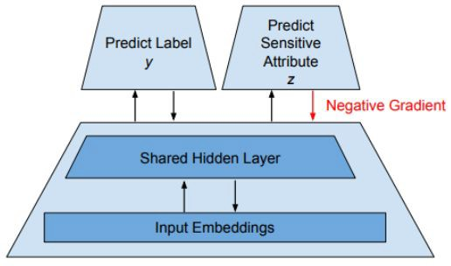
Multitask Adversarial Learning
Z⊥D | Y
Get promoted Gender
Basic idea: Jointly predict:
  Output decision D
  Attribute you’d like to remove from decision Z
  Negate the effect of the undesired attribute
Beutel, Chen, Zhao, Chi. Data Decisions and Theoretical Implications when Adversarially Learning Fair Representations. FAT/ML, 2017.
Zhang, Lemoine, Mitchell. Mitigating Unwanted Biases with Adversarial Learning. AIES, 2018.
CC BY / Margaret Mitchell / m-mitchell.com

Slide 66
Release Responsibly

Slide 67
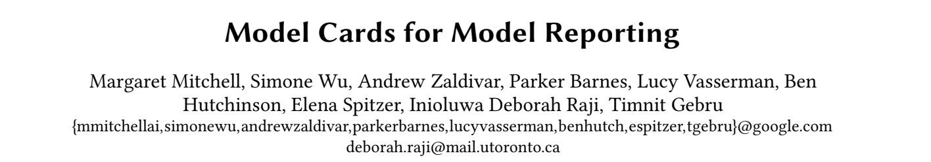
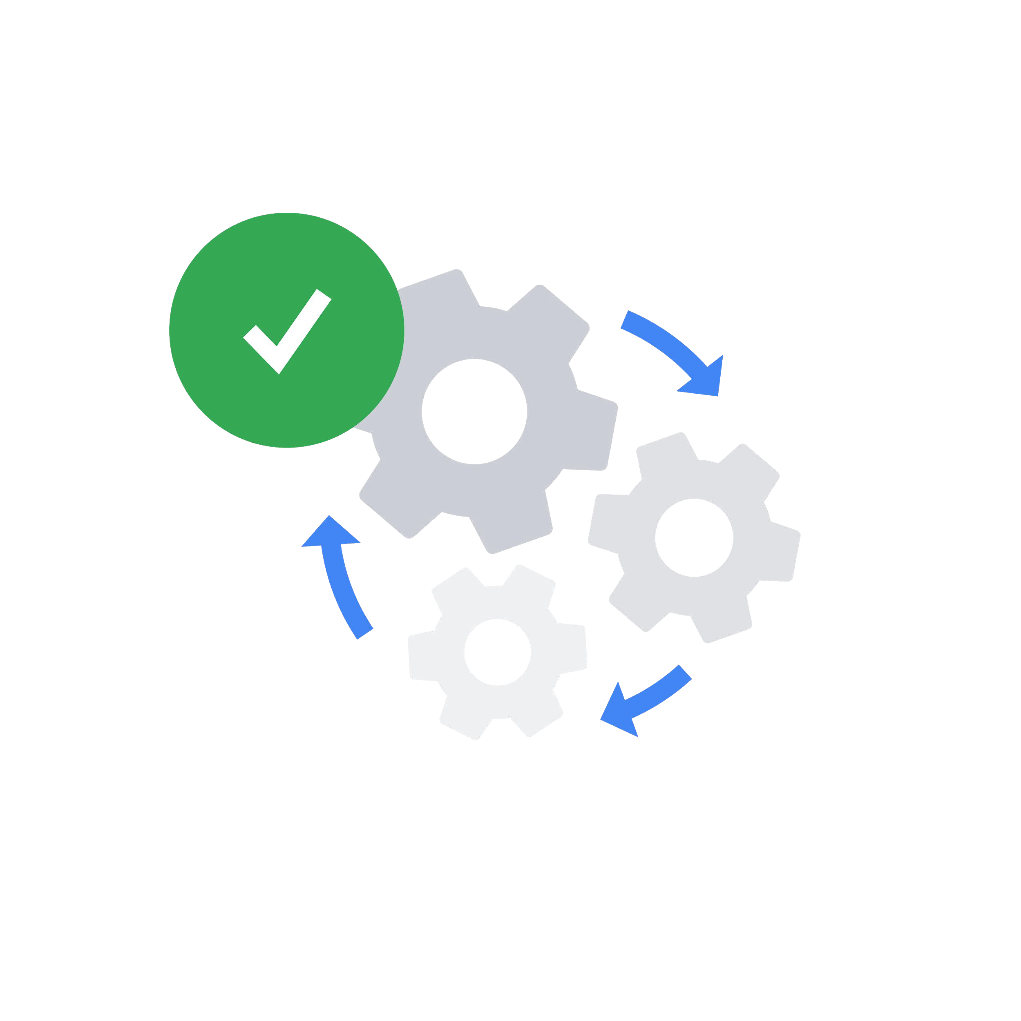
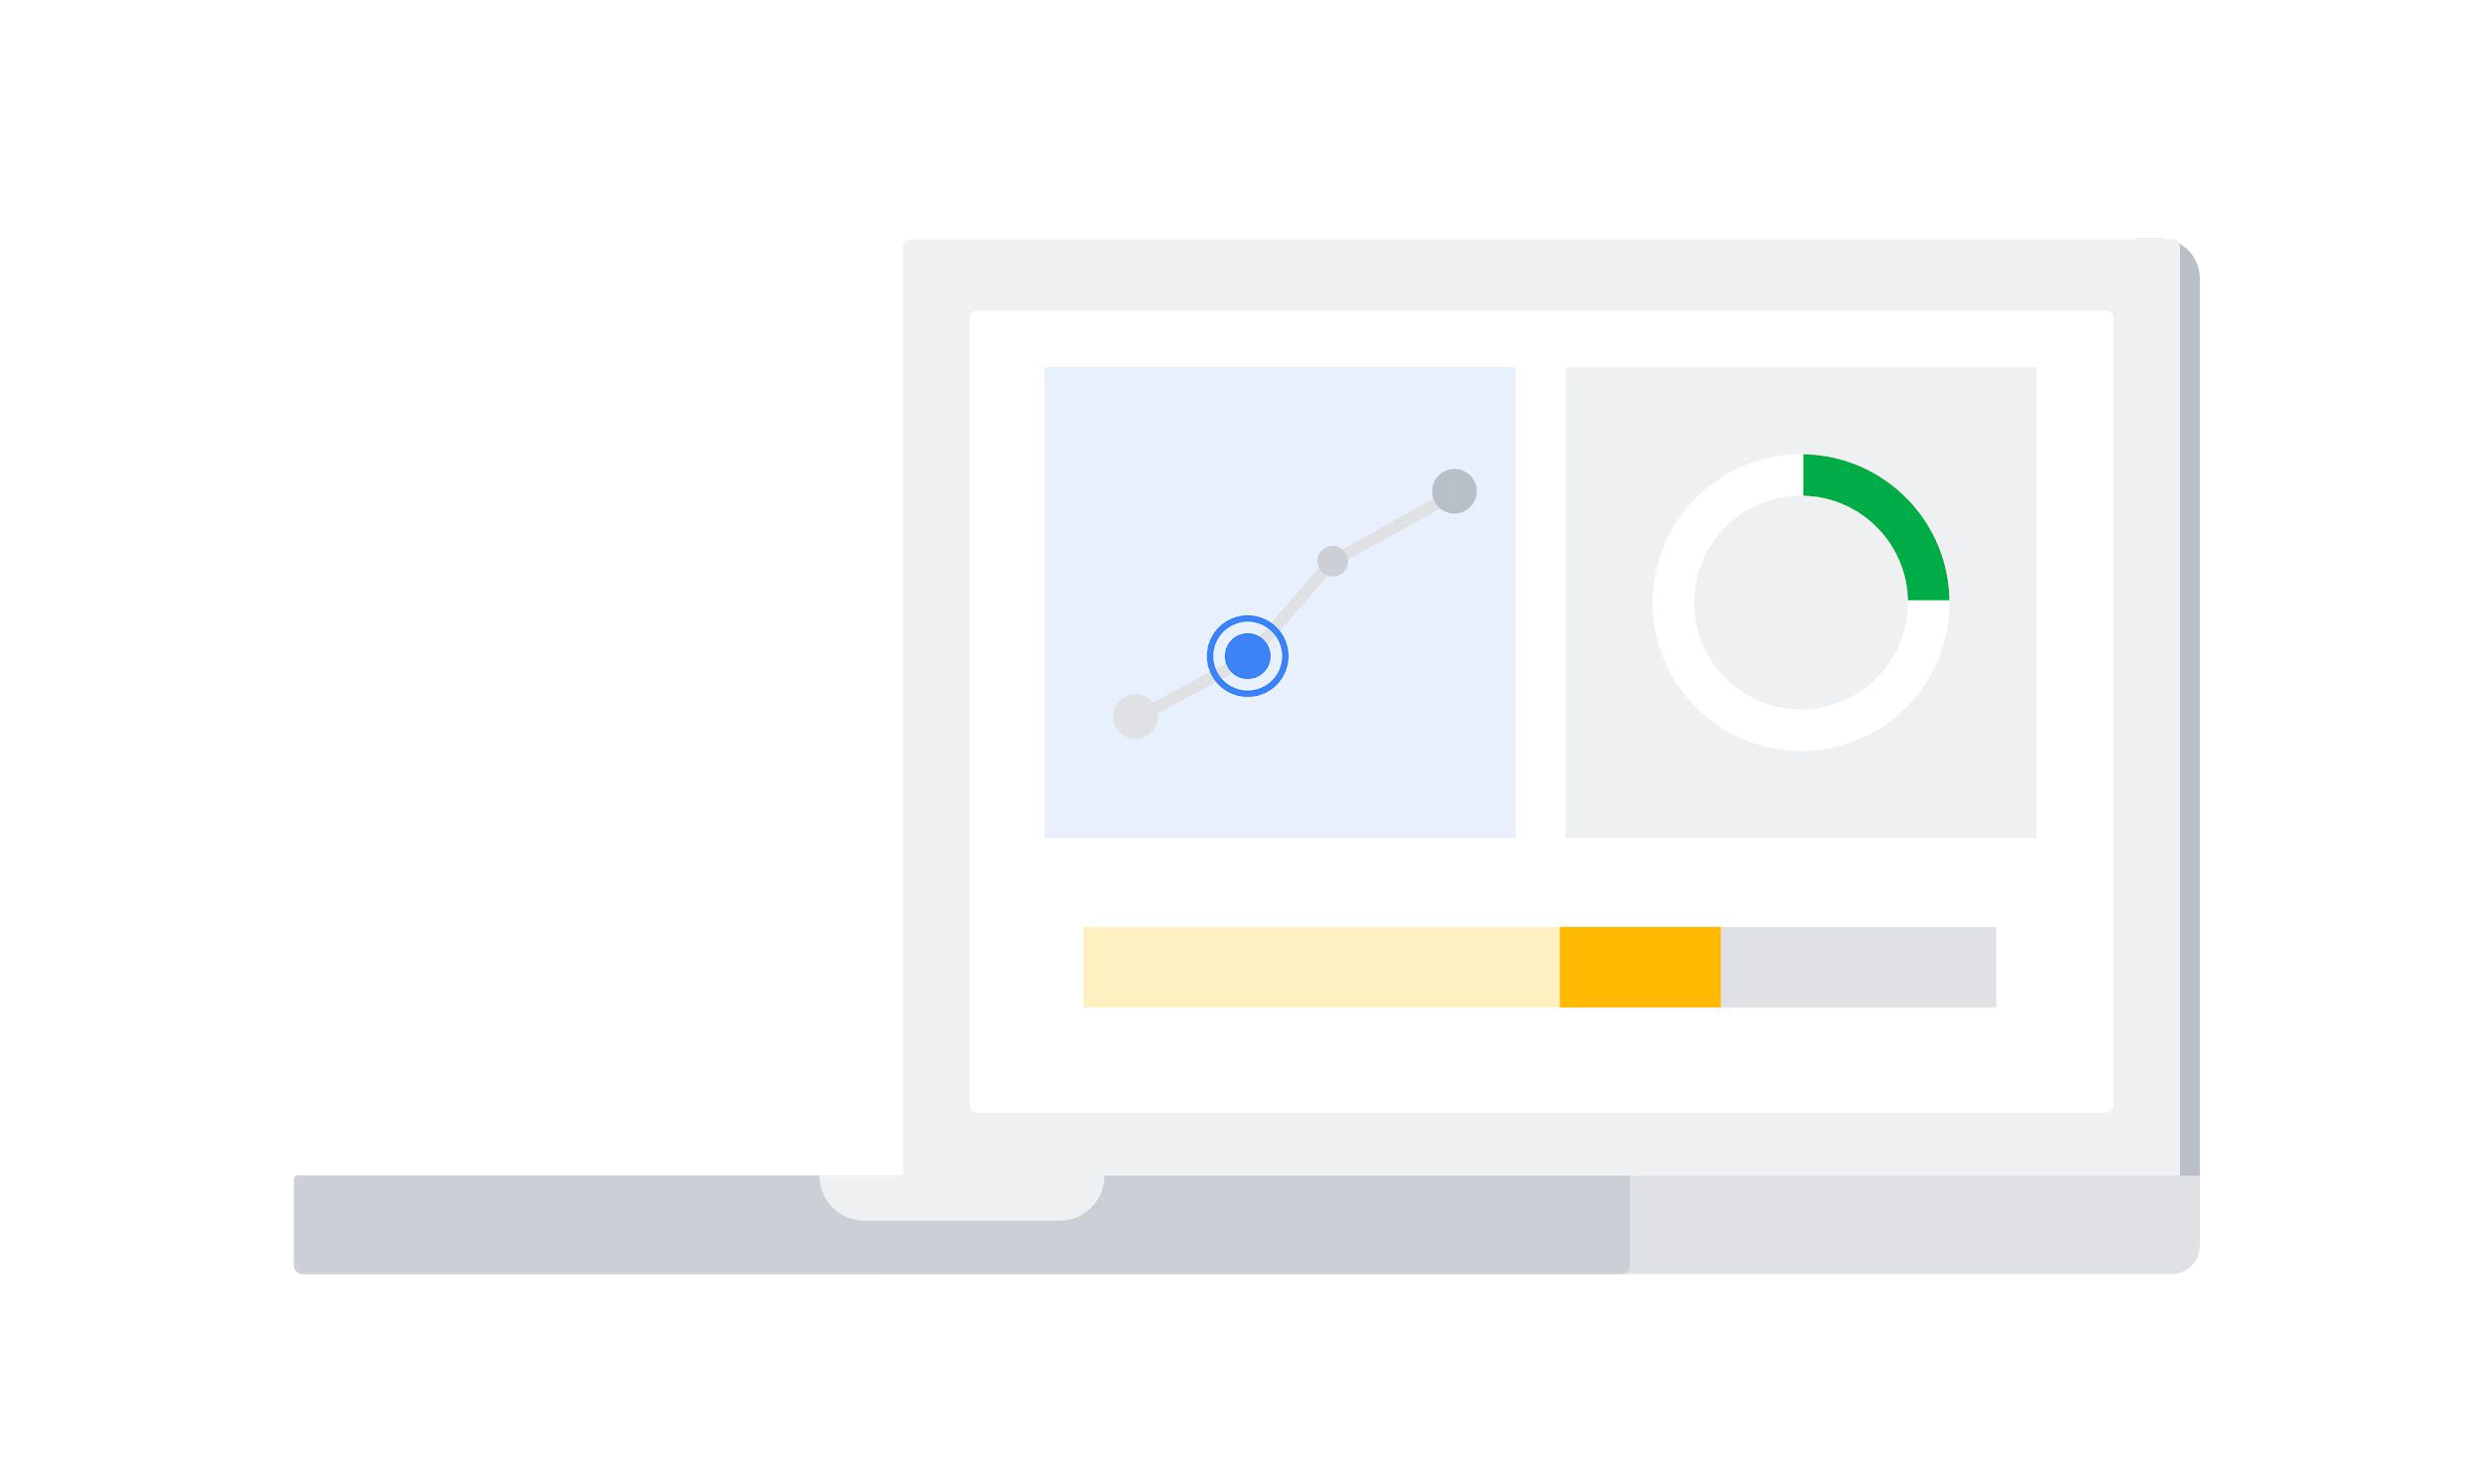
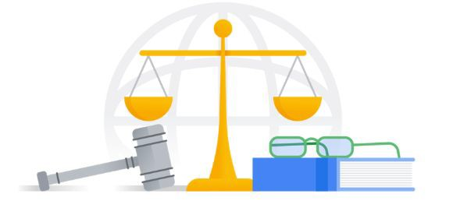
Model Cards for Model Reporting
What It Does
How It Works
Why It Matters
A report that focuses on transparency in model performance to encourage responsible AI adoption and application.
It is an easily discoverable and usable artifact presented at important steps of a user journey for a diverse set of users and public stakeholders.
It keeps model developer accountable to release high quality and fair models.
Mitchell et al. Model Cards for Model Reporting. FAT*, 2019.

Slide 68
Intended Use, Factors and Subgroups
Example Model Card - Toxicity in Text
Model Details | Developed by Jigsaw in 2017 as a convolutional neural network trained to predict the likelihood that a comment will be perceived as toxic.
Intended Use | Supporting human moderation, providing feedback to comment authors, and allowing comment viewers to control their experience.
Factors | Identity terms referencing frequently attacked groups focusing on the categories of sexual orientation, gender identity and race.
Mitchell et al. Model Cards for Model Reporting. FAT*, 2019.

Slide 69
Metrics and Data
Metrics | Pinned AUC, which measures threshold-agnostic separability of toxic and non-toxic comments for each group, within the context of a background distribution of other groups.
Evaluation Data | A synthetic test set generated using a template-based approach, where identity terms are swapped into a variety of template sentences.
Training Data | Includes comments from a variety of online forums with crowdsourced labels of whether the comment is “toxic”. “Toxic” is defined as, “a rude, disrespectful, or unreasonable comment that is likely to make you leave a discussion”.
Mitchell et al. Model Cards for Model Reporting. FAT*, 2019.

Slide 70
Considerations, Recommendations
Ethical Considerations | A set of values around community, transparency, inclusivity, privacy and topic-neutrality to guide their work.
Caveats & Recommendations | Synthetic test data covers only a small set of very specific comments. While these are designed to be representative of common use cases and concerns, it is not comprehensive.
Mitchell et al. Model Cards for Model Reporting. FAT*, 2019.

Slide 71
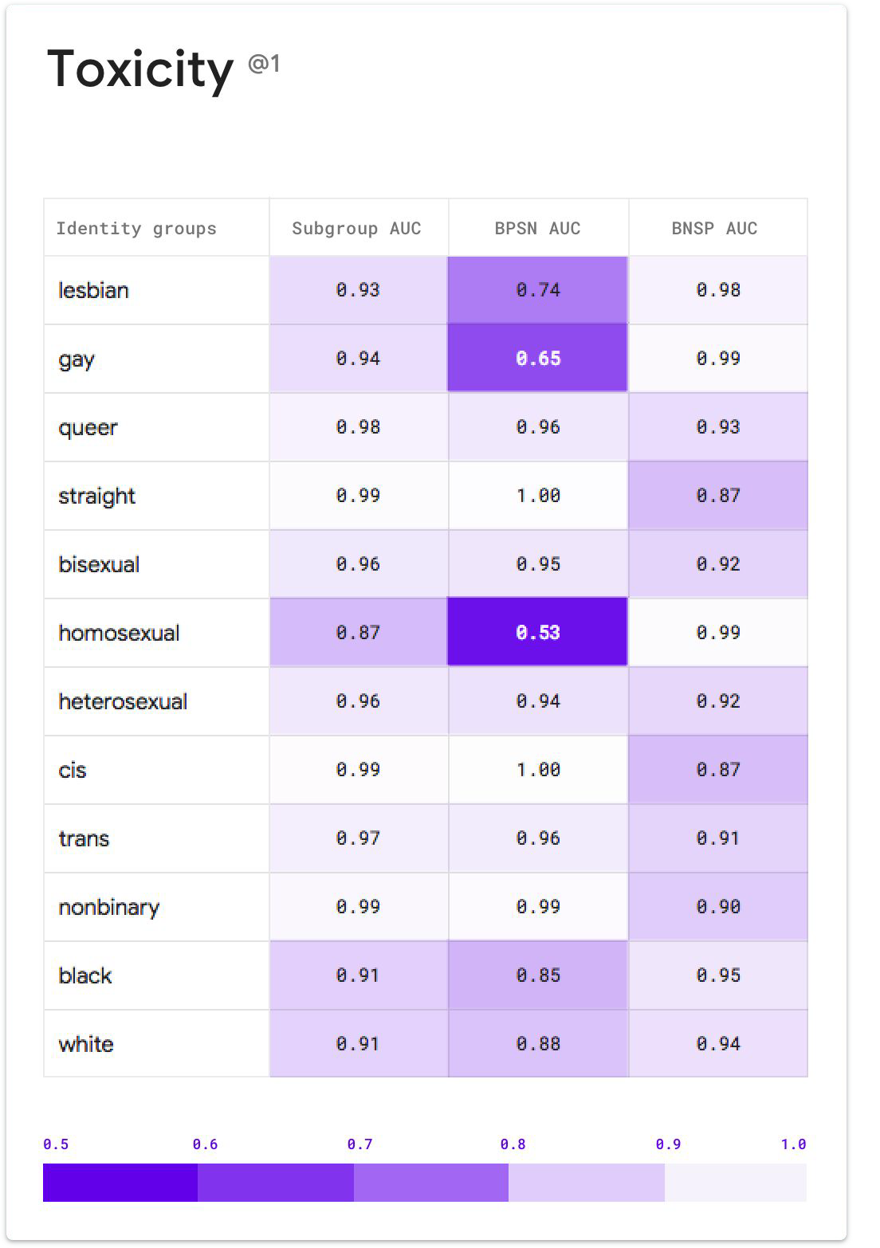



Disaggregated Intersectional Evaluation
CC BY / Margaret Mitchell / m-mitchell.com

Slide 72
Q2
https://tinyurl.com/AML441-L22

Slide 73

Three goals: unbiased, fair, and just
Slide source: Perona 2024

Slide 74

Slide source: Perona 2024

Slide 75

Fairness always needs to be defined wrt some “protected attributes”
Slide source: Perona 2024

Slide 76

Equal outcome or equal opportunity?
Slide source: Perona 2024

Slide 77

Equal outcome or equal opportunity?
Slide source: Perona 2024

Slide 78
An algorithm can’t be unbiased, fair, and just at the same time
It’s not possible to satisfy all “fairness” goals at the same time
Equal opportunity: given the same opportunity, but unequal inputs will have unequal outcomes
Equal outcome: may give more support to some than others

Slide 79

Hardworking ant prepares for winter
Lazy grasshopper doesn’t
Should the grasshopper get some of the ant’s food?

Slide 80

Hardworking ant prepares for winter, but its stores gets destroyed in a storm
Grasshopper doesn’t prepare but ends up finding a large abandoned food store
Should the ant get some of the grasshopper’s food?

Slide 81
Q3-Q6
https://tinyurl.com/AML441-L22

Slide 82

Things to remember
Unless actively countered, bias in algorithms is an expected (harmful) outcome, due to bias in the data and people involved in creation and use of the algorithms
Be wary of using algorithms to make decisions about people, e.g. criminality, admissions, hiring
Adversarial learning can be used to learn representations that are not predictive of sensitive attributes
Model cards, dataset cards, and intersectional evaluation are used to disclose potential biases and limitations
Unbiased, fair, and just are different, often conflicting. Wisdom is needed to choose among them.
Who do we trust to make decisions – humans, whose bias may vary, or machines whose bias is easier to measure?

Slide 83
Next week
Mon: HW5 due
Tues: Audio and 1D Signals
Thurs: Guest lecture by Chenxi Wu on “Building and Deploying ML”

