Slide 1
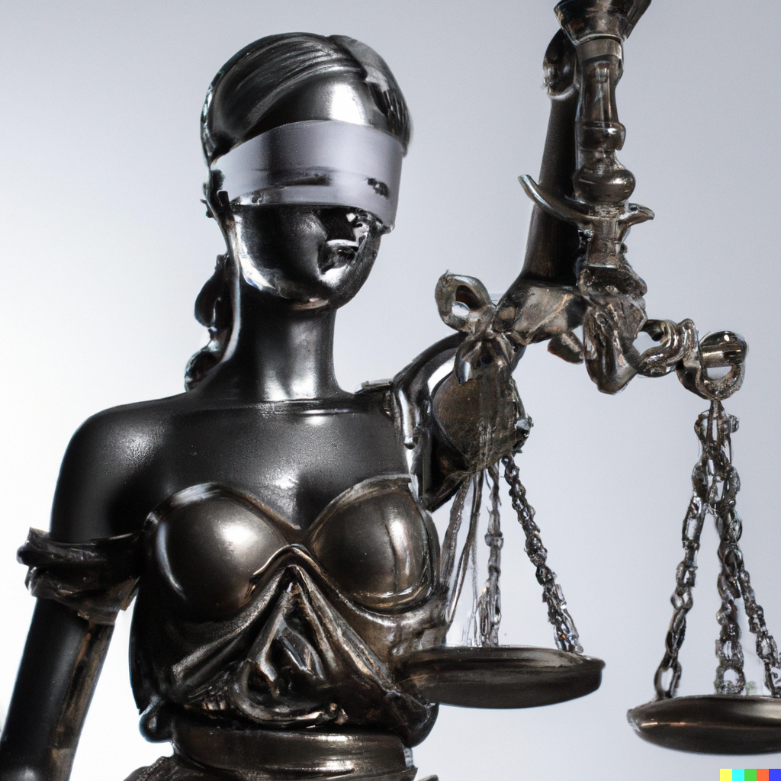
Ethics and Impact of AI
Applied Machine Learning
Derek Hoiem
Dall-E

Slide 2
This lecture
Discuss some of the impacts and ethical questions around AI
  How to think about impact?
  How will AI impact the environment?
  How will AI impact the economy and workforce?
  What should be regulated?
  Who is responsible for harm?
  Who owns the data?
Learn about model cards and other tools

Slide 3
AI has many impacts
Manufacturing: robotics
Healthcare: drug discovery
Education: learning assistants
Media: article generation
Customer service: automated help center
Transportation: autonomous vehicles
Improving productivity / automating jobs, such as programming, marketing, help support, …

Slide 4
What/who is impacted by AI?
“Who will have access to the technology and be able to reap its benefits? Who will be able to empower themselves by using AI? Who will be excluded from these rewards?”
AI Ethics, Coeckelbergh (p 76)

Slide 5
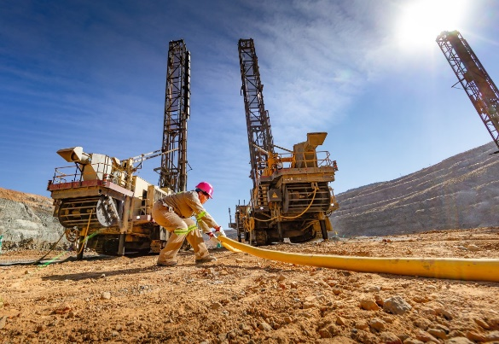
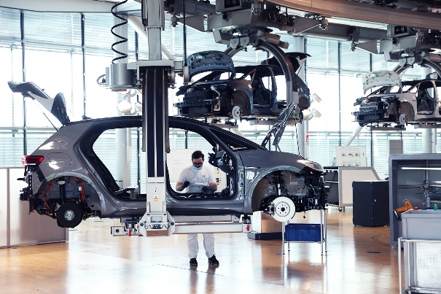
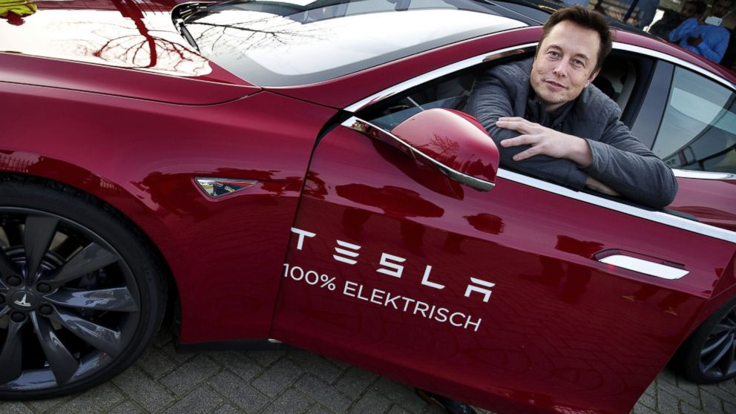

How do we think about impact?
Consider Electric Cars
Mining for Raw Materials
Manufacturing
Automakers
Usage
Geo-political
China supplies more than 70% of capacity for battery raw materials and manufacturing
US depends on importing critical raw materials for batteries
Workers
* China’s battery material mines may include forced labor
Manufacturing
EV have fewer moving parts, more battery-based, so different process
New factories employ fewer workers and have different safety concerns
Owners/investors
Massive wealth to Tesla
Massive investment required by others
Lower barrier to entry, since manufacturing EV from components is simpler
Drivers
Quiet and fun to drive
May be expensive
Status symbol
Others
Lower pollution

Slide 6

Think / discuss
Q1-2. Who will be impacted by AI and how?
https://tinyurl.com/AML441-L21

Slide 7
Impact on environment
2019
GPT-3 estimate: ~1.1M lbs
Crypto-assets: 0.3% of global annual greenhouse gas emissions
All data centers: 2% of global emissions (may be underestimate)
https://arxiv.org/pdf/1906.02243.pdf

Slide 8
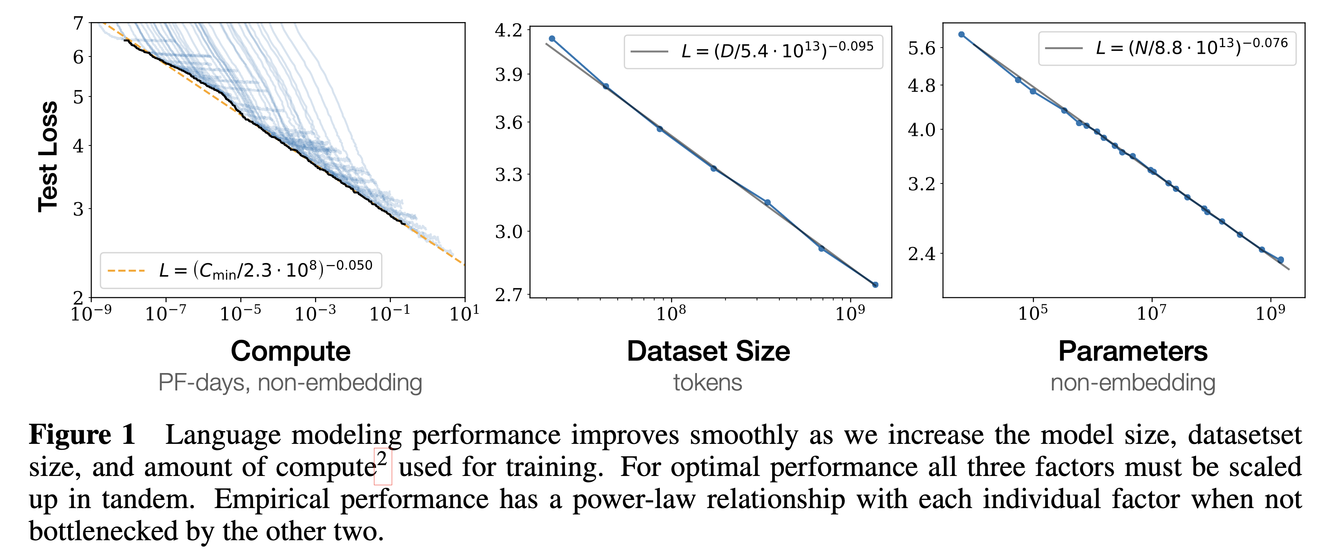
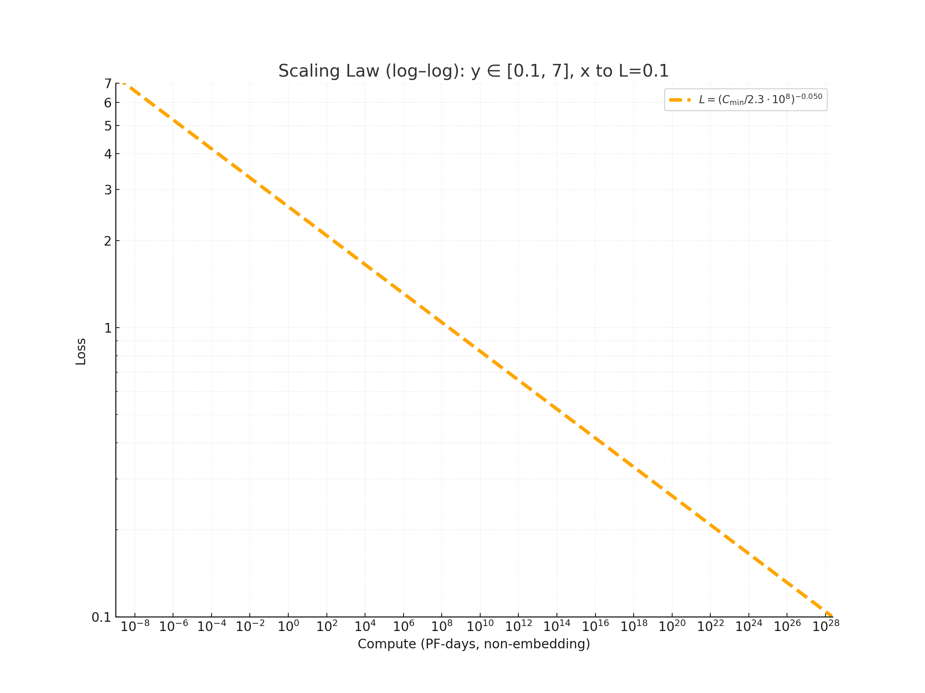
The power use of GPT-5 to handle 2.5 billion daily queries equals to the daily electricity demand of about 1.5 million US homes.
Beneath the smooth curve: lower loss comes at exponential computational cost.
--The Guardian
Total Energy Production in US
Slide credit: Zhen Zhu

Slide 9
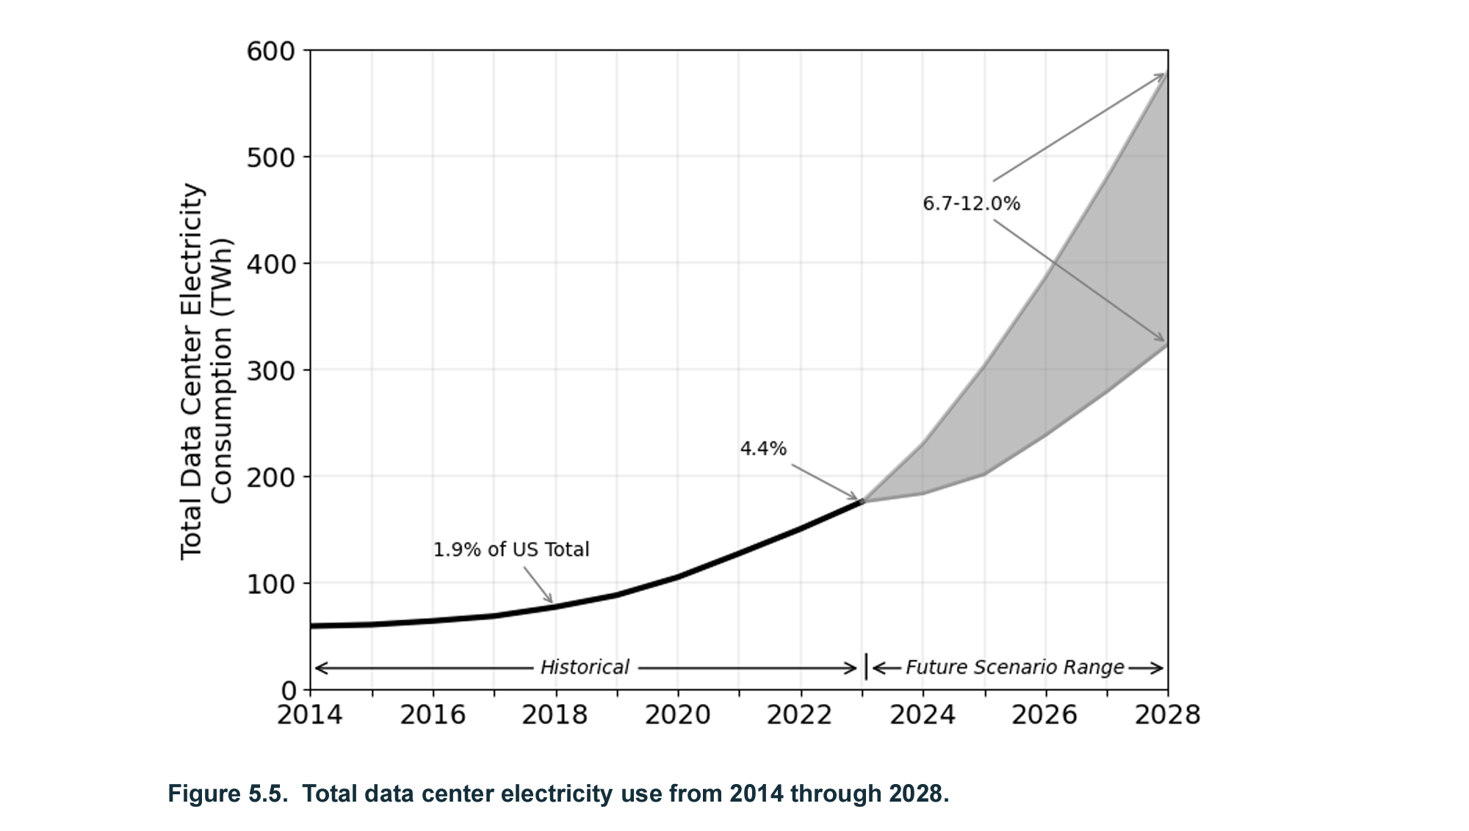
In some areas near data centers, electricity costs have risen 267% in the last five years.
- Bloomberg.com
5.2%
Source

Slide 10
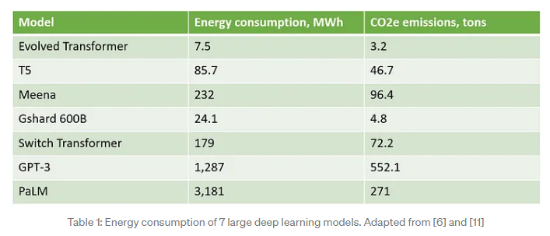
There are techniques to estimate and reduce the carbon footprint of your models
https://towardsdatascience.com/how-to-estimate-and-reduce-the-carbon-footprint-of-machine-learning-models-49f24510880

Slide 11
Think / discuss
Q3. Is it ethical to build new LLMs, given the power cost?
https://tinyurl.com/AML441-L21

Slide 12
Economic Impact
Research by Accenture suggests that AI could double global economic growth rates by 2035, across 12 developed economies. This growth will be driven by a 40% increase in labor productivity, the creation of a virtual workforce capable of problem-solving and self-learning, and the diffusion of innovation that will create new revenue streams.
Pricewaterhouse Coopers (PwC) estimates that the development and take-up of AI could increase global GDP by up to 14% (equivalent to US$15.7 trillion) by 2030.
  Productivity gains in the near term, based on automation of routine tasks
  Complementing/assisting of the existing workforce with AI technologies to perform tasks better
https://www.europarl.europa.eu/RegData/etudes/BRIE/2019/637967/EPRS_BRI(2019)637967_EN.pdf

Slide 13
Impact of AI on Work
Most fields, especially knowledge work, are expected to dramatically change over the next 10 years
AI performs some routine work
New ways to produce/store/access information
AI-based workflows
https://www.whitehouse.gov/wp-content/uploads/2022/12/TTC-EC-CEA-AI-Report-12052022-1.pdf

Slide 14
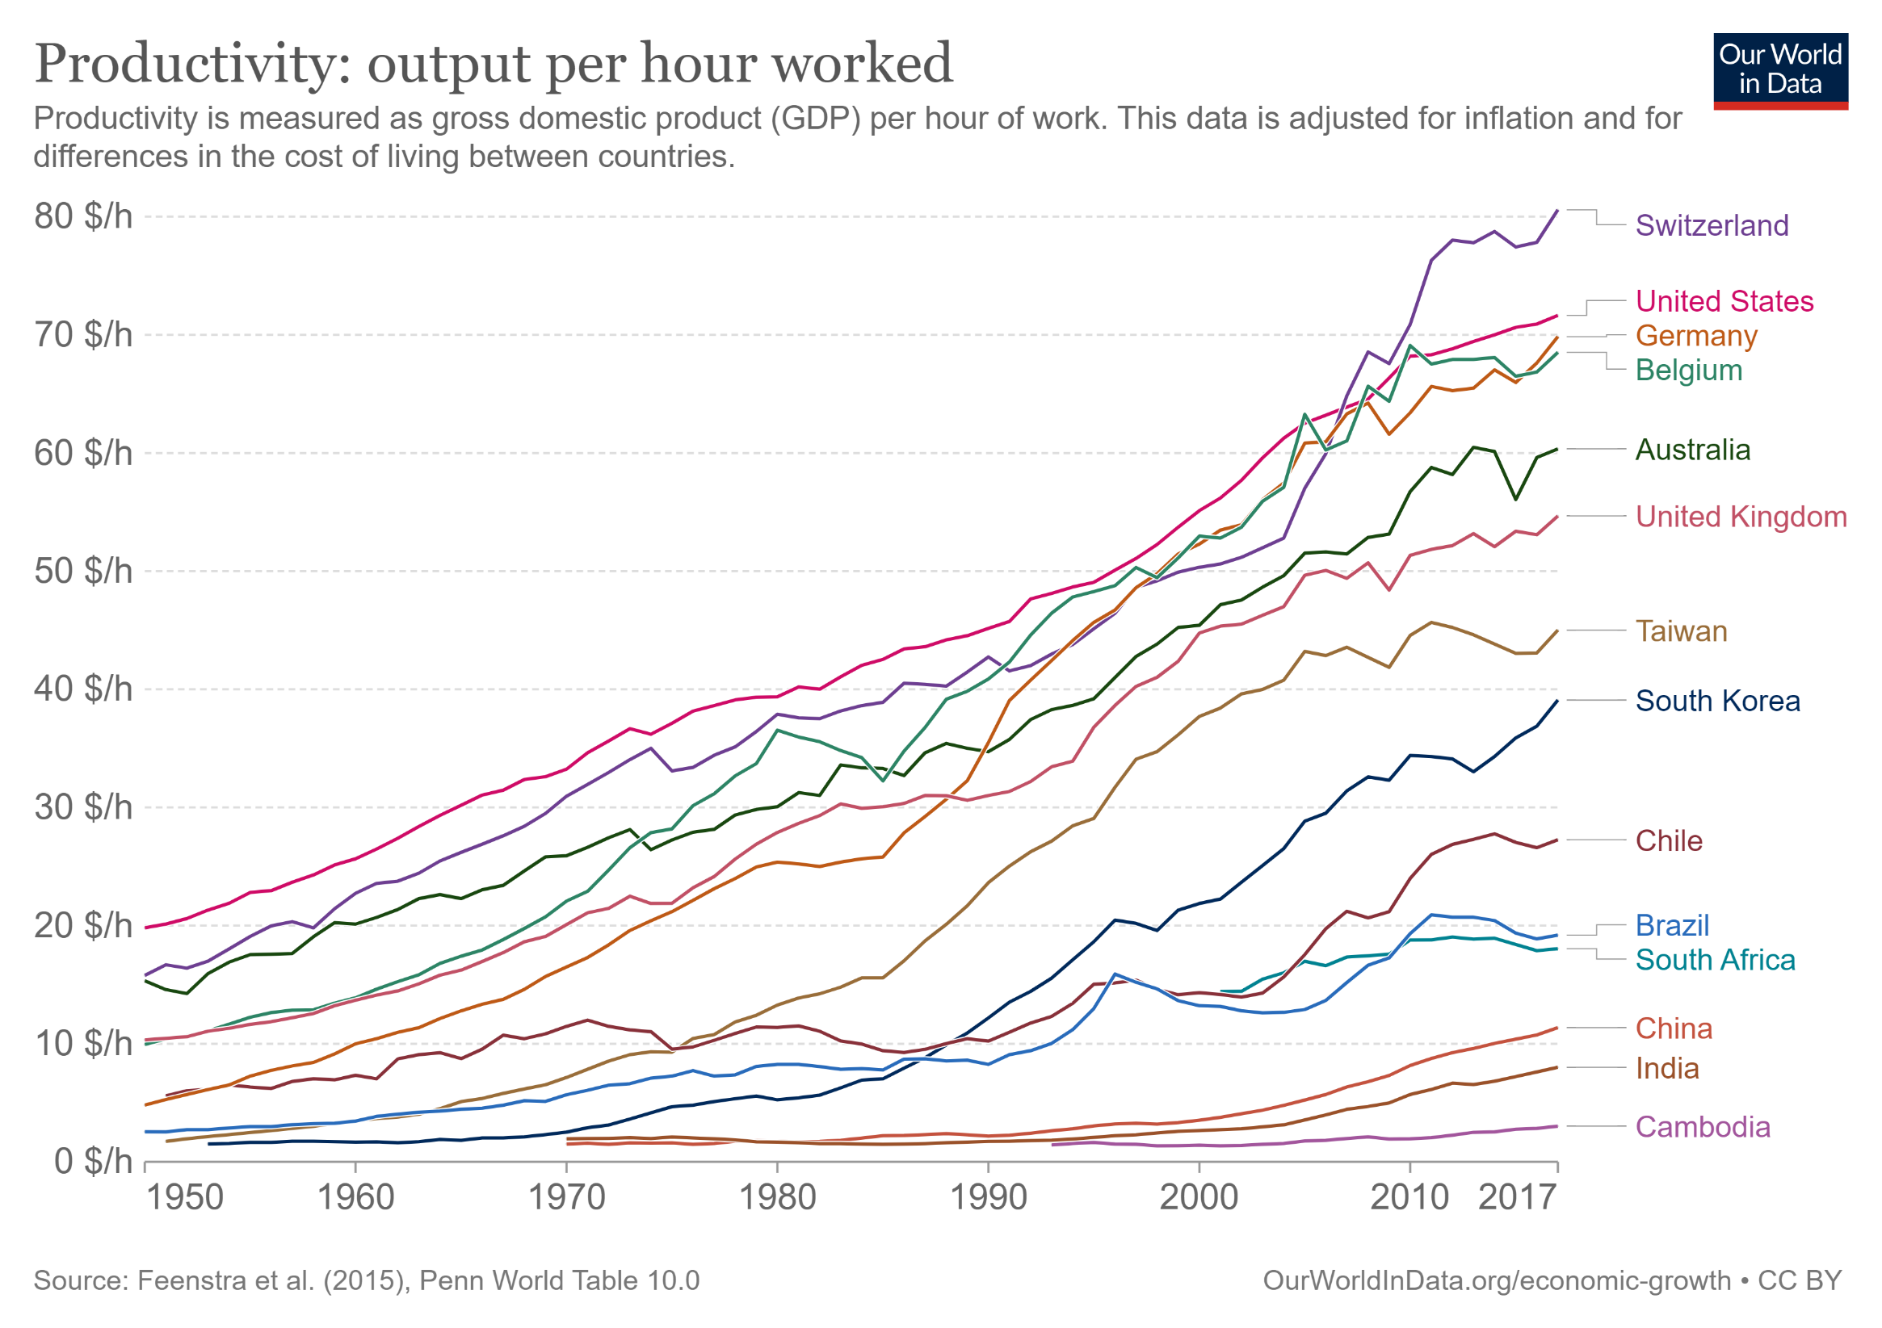

Slide 15
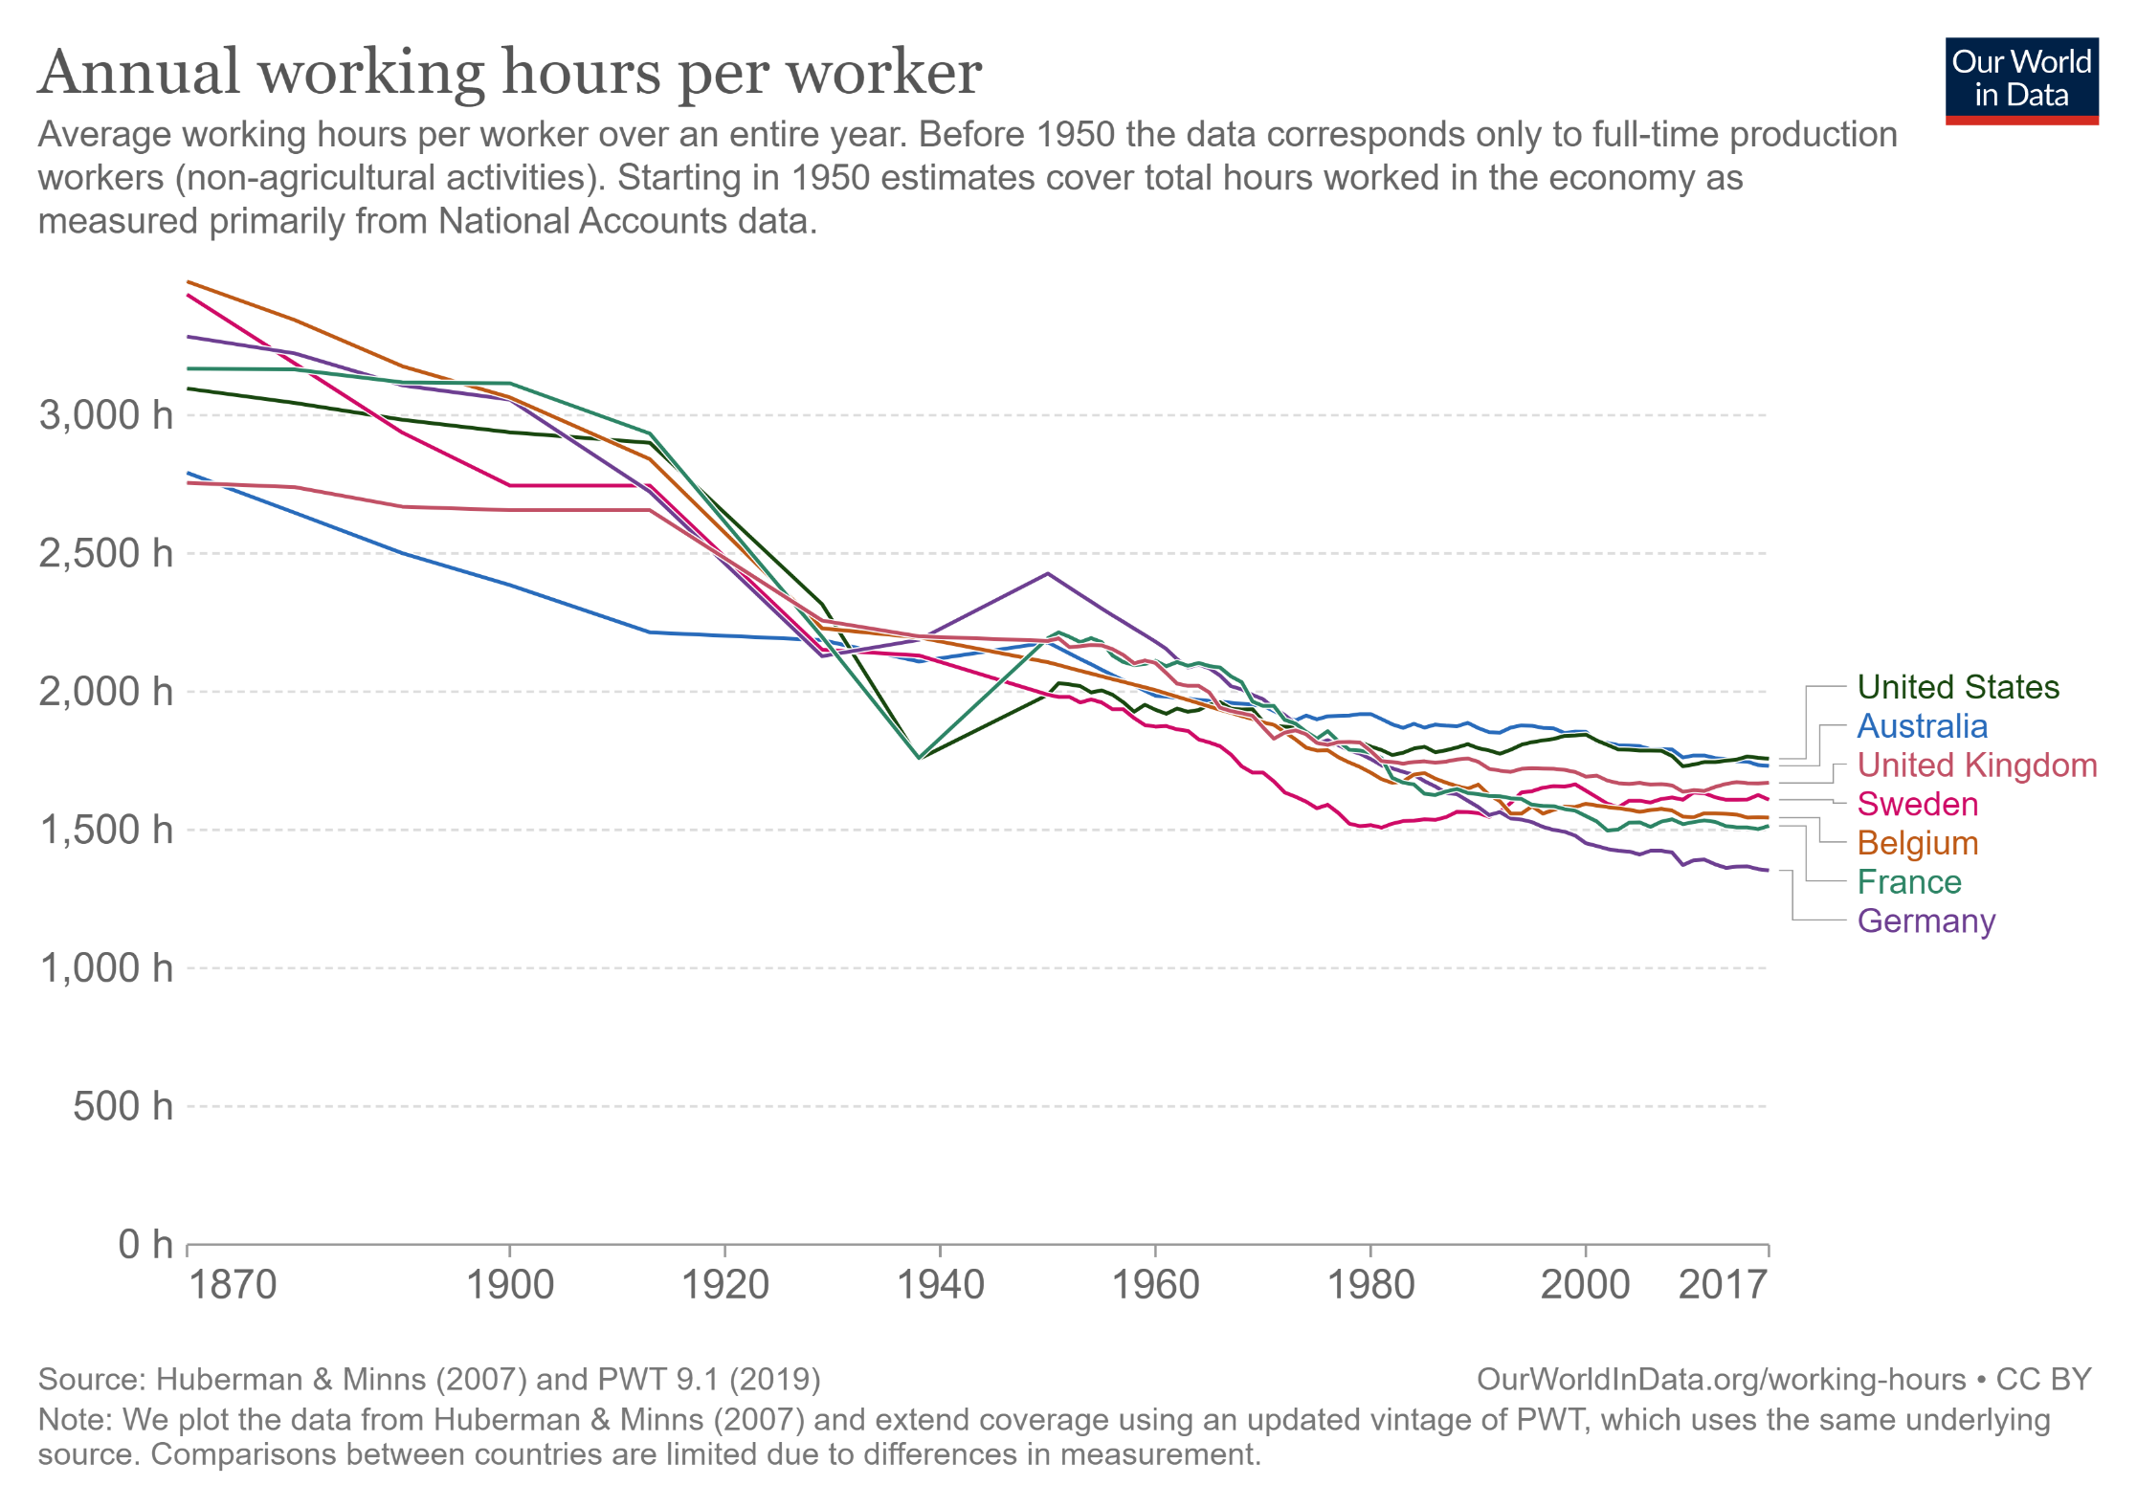
More productivity → more leisure
https://ourworldindata.org/working-hours

Slide 16
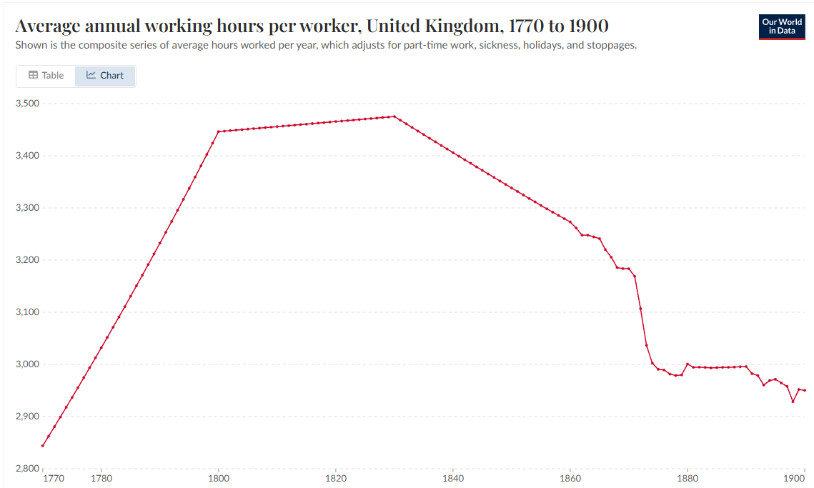
But benefits can take time, and policy:
Check out industrial revolution
More work hours
Limited hours for children
Regulation reducing factory hours
Regulate hours for apprentice children in cotton mills
No children under 9 working in cotton mills
Right to vote (for men)

Slide 17
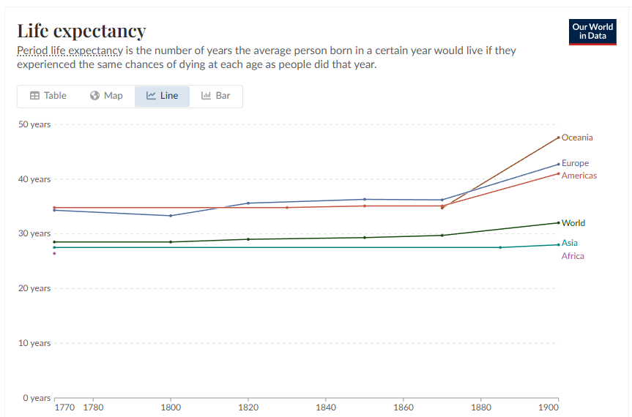
100 years to increase life expectancy
https://ourworldindata.org/

Slide 18
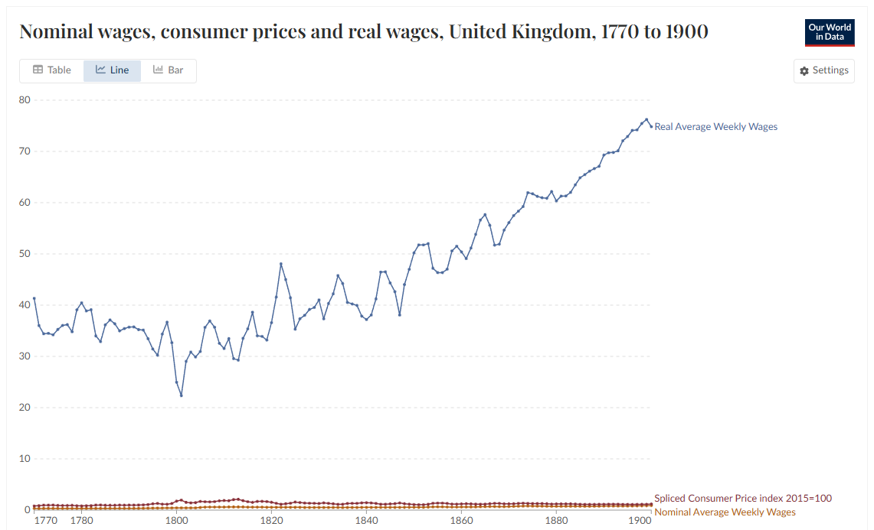
70 years for wages to recover and rise
The “Engels’ Pause”: Output up, wages flat
Between about 1770 and 1840, GDP per capita rose, but real wages stagnated or even fell slightly, especially for manual workers.
Named after Friedrich Engels, who observed Manchester’s misery in The Condition of the Working Class in England (1845), this period marks the lag between industrial productivity and workers’ share of that productivity.
Data snapshot (Britain):
Real wages roughly flat from 1770–1830
GDP per capita rose by about 40–60% over the same period
Real wages began sustained growth only after ~1850
https://ourworldindata.org/

Slide 19
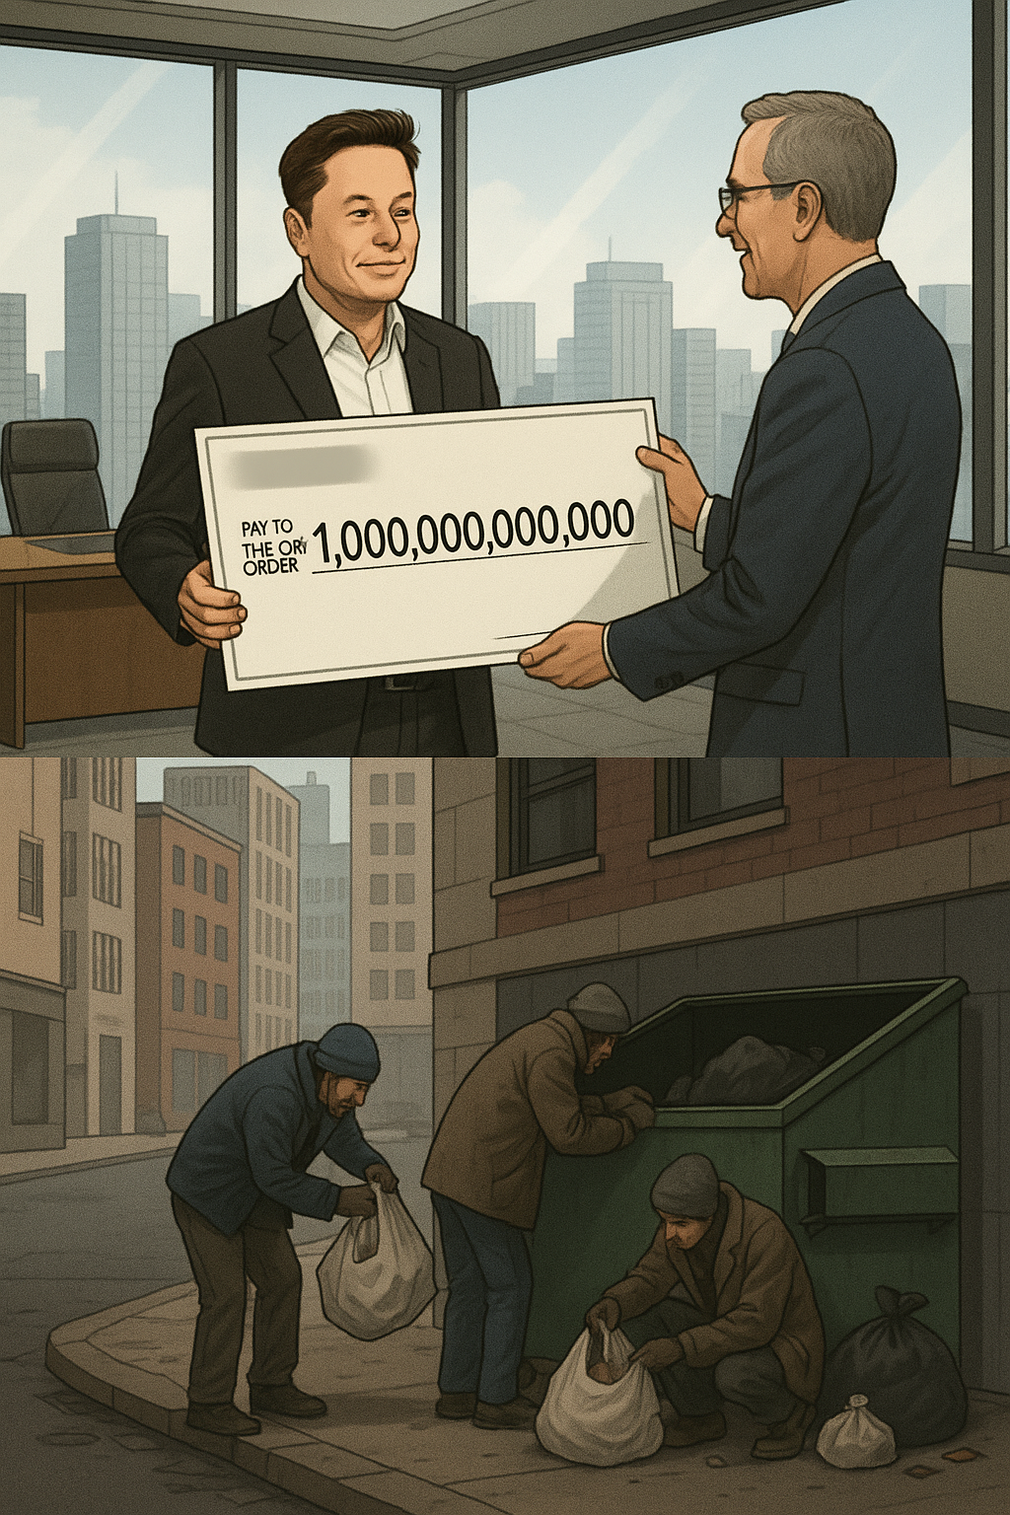
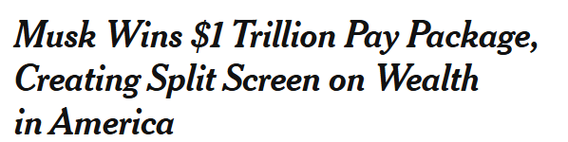
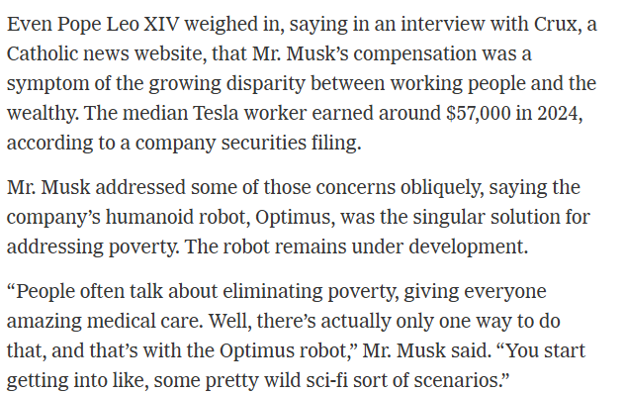
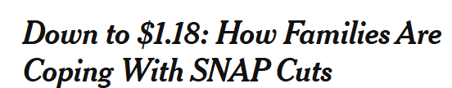
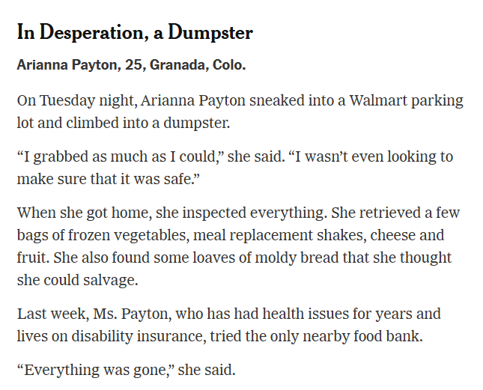
NYT News on Nov 6 & 7 2025

Slide 20
Technology is exciting, but fast technological change can be painful
We will see disruption, lost jobs, hardship
Policies to regulate work, distribution of gains, and promote education and mobility are critical

Slide 21
Impact of AI
We just don’t know because it’s happening so fast
“I would advocate not moving fast and breaking things.”
- Demis Hassibis (Deep Mind CEO)

Slide 22

Q2. Which of the regulation proposals do you support?
AI has potential for many harms
  Disinformation, e.g. through social media
  Information spamming – automatically generated internet content
  Cheating or avoiding learning by having AI complete assignments
  AI agents stealing and reproducing synthetic content such as music, stories, art
AI producers do not have a strong incentive to restrict their products
https://tinyurl.com/441-L21-fa24

Slide 23
Popular support for Regulation
Regulating Deepfakes
Prohibit the use of deepfakes in political campaign advertisements, such as to depict an opponent saying something they did not, or to depict an event that did not occur, as proposed by the Federal Election Commission. (National 84%, Republicans 83%, Democrats 86%)
Prohibit the public distribution of any pornographic deepfake that was made without the consent of the person being depicted, as proposed in the Preventing Deepfakes of Intimate Images Act and DEFIANCE Act. (National 86%, Republicans 85%, Democrats 87%)
Require that all deepfakes which are shared publicly be clearly labeled as such, as proposed in the AI Labeling Act, AI Disclosure Act, and DEEPFAKES Accountability Act. (National 83%, Republicans 83%, Democrats 85%)
Nine Major Proposals for Government Regulating Artificial Intelligence Favored by Very Large Bipartisan Majorities of Voters | Program for Public Consultation

Slide 24
Regulating AI programs that make decisions which can significantly impact people’s lives
Require these AI programs pass a test before they can be put into use, which would evaluate whether they may violate regulations, make biased decisions, or have security vulnerabilities. (National 81%, Republicans 76%, Democrats 88%)
Allow the government to audit programs that are in use, and require the AI company to fix any problems that are found. (National 77%, Republicans 74%, Democrats 82%)
Require AI companies to disclose information to the government about how the decision-making AI was trained, if requested, to aid with pre-testing and audits. (National 72%, Republicans 67%, Democrats 81%)

Slide 25
Others
Creating a new federal agency for AI to enforce regulations, oversee AI development and provide guidance on AI policy is supported by 74% (Republicans 68%, Democrats 81%).
Creating a treaty to prohibit the development of weapons that can use AI to fire on targets without human control – called lethal autonomous weapons – as has been called for by the International Committee of the Red Cross, and the Campaign to Stop Killer Robots.
A large bipartisan majority (77%) favors the creation of such an international agency that would develop international standards for large-scale AI and have the authority to monitor and inspect whether their standards are being met

Slide 26
Who is responsible?
Developers decide what algorithm, what priors/constraints, what data to use
Company management releases products and features
Users may apply the AI to their own ends
The AI itself is not entirely predictable and lacks understanding of relevance, experience, sensitivity, and wisdom
AI Ethics, Coeckelbergh (p 90-1)

Slide 27
Responsibility requires
Control
Knowledge
Children and animals are not typically held responsible, due to lack of control and knowledge.
AI does not “know” what it is doing. But do its developers?

Slide 28
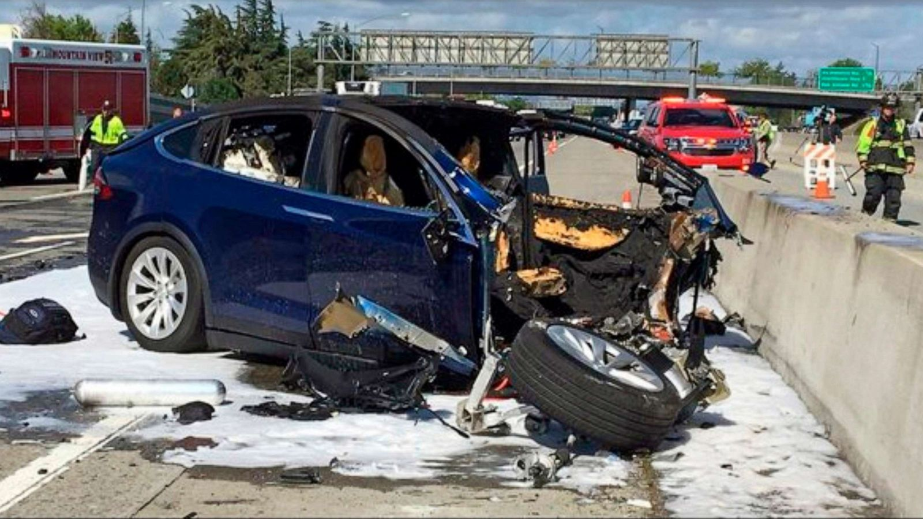
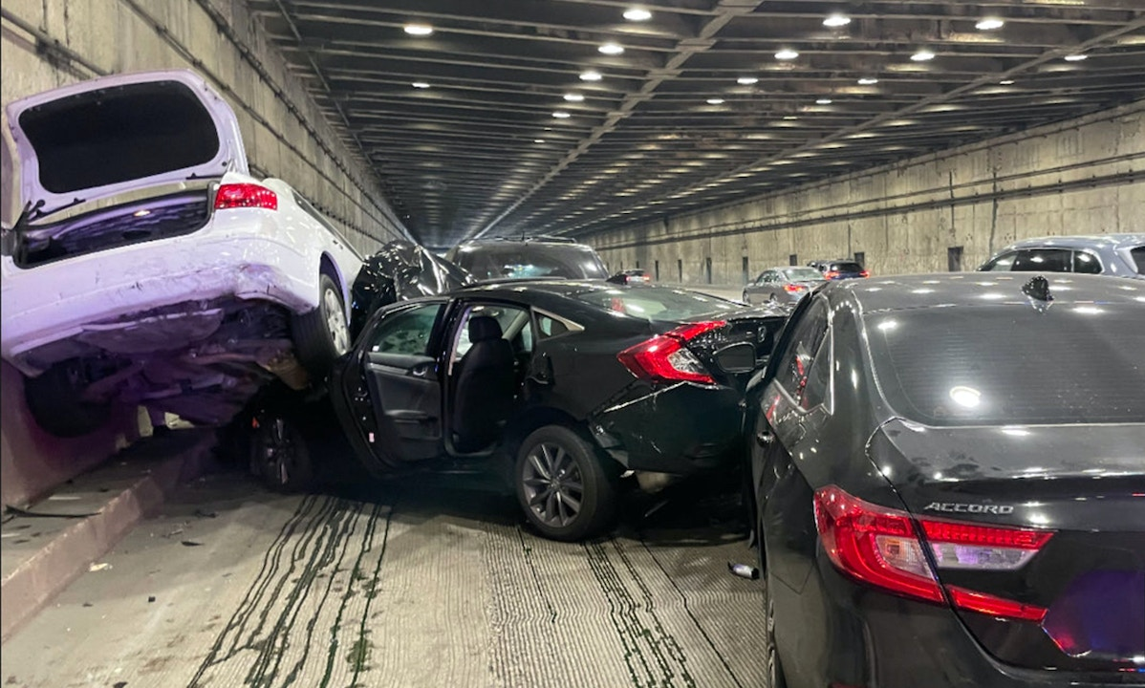
Who is responsible for self-driving vehicle crashes?
Tesla crash on Bay Bridge
https://abcnews.go.com/Business/tesla-autopilot-steered-driver-barrier-fatal-crash-ntsb/story?id=68936725
Tesla on autopilot had steered driver towards same barrier before fatal crash, NTSB says
https://theintercept.com/2023/01/10/tesla-crash-footage-autopilot/
“Autopilot, Enhanced Autopilot and Full Self-Driving Capability are intended for use with a fully attentive driver, who has their hands on the wheel and is prepared to take over at any moment. While these features are designed to become more capable over time, the currently enabled features do not make the vehicle autonomous.”

Slide 29
Q4. Discuss: who is responsible if an autonomous vehicle crashes due to failure of autonomous system?
https://tinyurl.com/AML441-L21

Slide 30
Who is responsible if GPT is used for disinformation?
https://www.nytimes.com/2023/02/08/technology/ai-chatbots-disinformation.html
“This tool is going to be the most powerful tool for spreading misinformation that has ever been on the internet,” said Gordon Crovitz, a co-chief executive of NewsGuard, a company that tracks online misinformation and conducted the experiment last month. “Crafting a new false narrative can now be done at dramatic scale, and much more frequently — it’s like having A.I. agents contributing to disinformation.”
OpenAI: We’ve trained a classifier to distinguish between text written by a human and text written by AIs from a variety of providers. … Our classifier is not fully reliable. In our evaluations on a “challenge set” of English texts, our classifier correctly identifies 26% of AI-written text (true positives) as “likely AI-written,” while incorrectly labeling human-written text as AI-written 9% of the time (false positives).
https://openai.com/blog/new-ai-classifier-for-indicating-ai-written-text

Slide 31
Q5-Q7. Who is responsible if AI generates misinformation?
https://tinyurl.com/AML441-L21

Slide 32
Who owns the data?
The value of an AI model is often the ability to synthesize large amounts of data
Large tech companies make fortunes by harvesting data from users
Often this data is collected without consent or knowledge

Slide 33
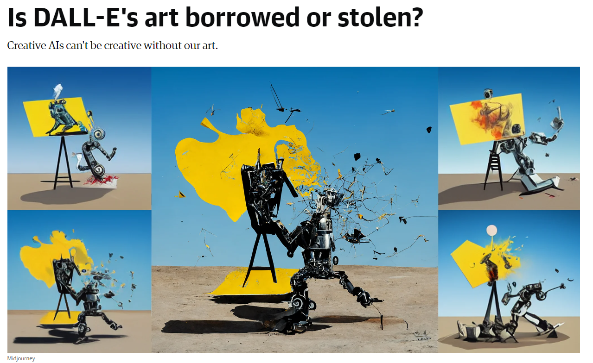
https://www.engadget.com/dall-e-generative-ai-tracking-data-privacy-160034656.html

Slide 34
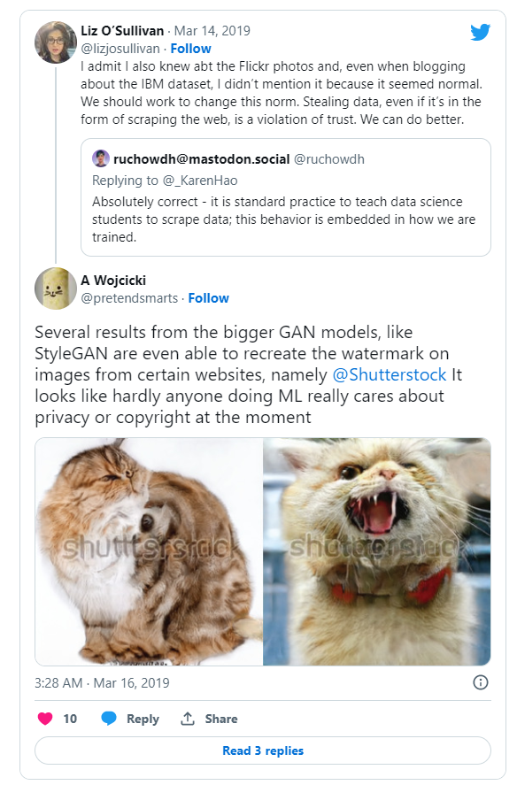
[Endgadget Article]

Slide 35
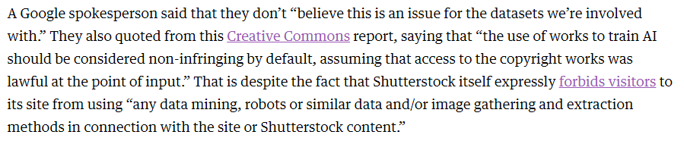
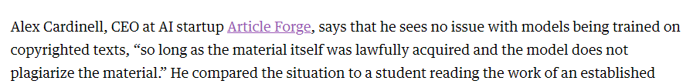
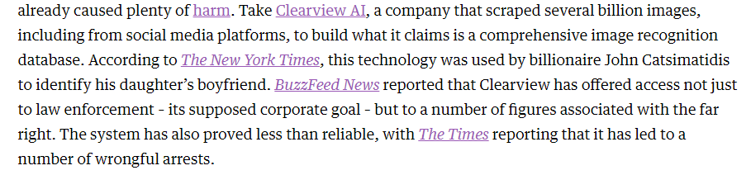

[Endgadget Article]

Slide 36
Q8-9. What should be the limits of AI model’s scraping?
https://tinyurl.com/AML441-L21

Slide 37
Model Cards for Model Reporting
Mitchell et al. 2019
https://arxiv.org/pdf/1810.03993.pdf

Slide 40
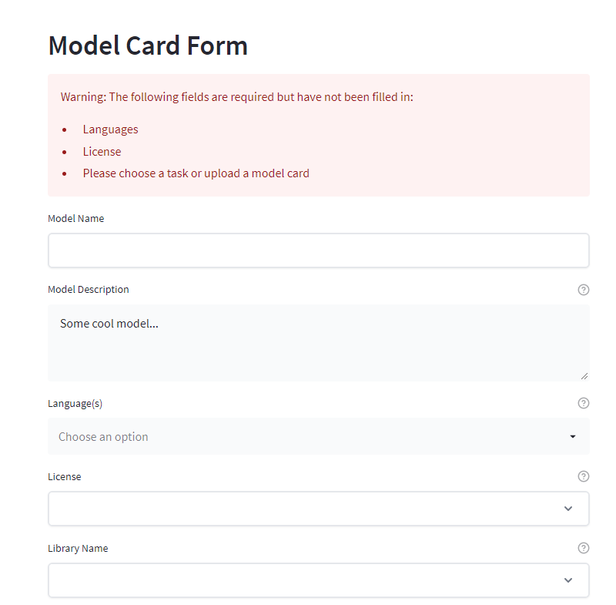
Model cards hugging face

Slide 41
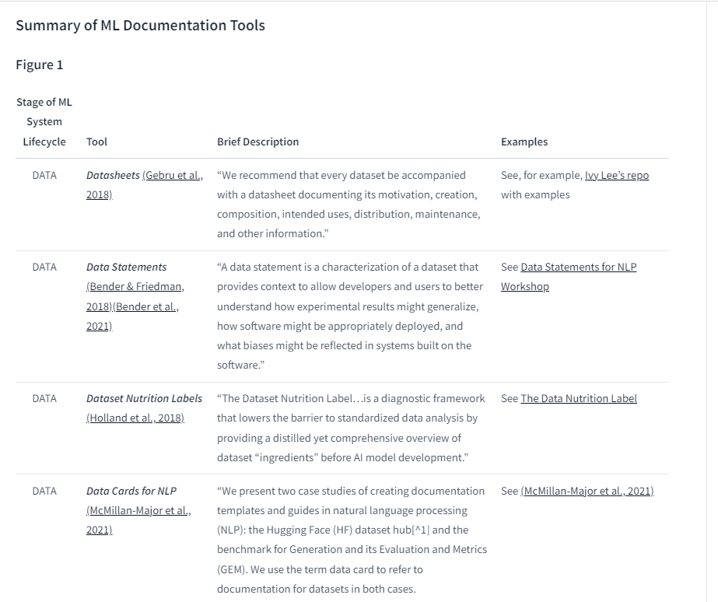
https://huggingface.co/docs/hub/model-card-landscape-analysis

Slide 42
Things to remember
Our work as ML engineers can have major personal and societal impact
  Who benefits? Who is harmed?
  What is the impact on society?
  Who is responsible when it goes wrong?
  Who “owns” the data, models?
We can do much good, but there is also potential for much harm
Tools for practicing ethical AI, e.g. model cards, emissions calculators, and datasheets are being developed -- use them

Slide 43
On Thursday…
Bias and fairness in AI

