Slide 1

Ensembles and Forests
Applied Machine Learning
Derek Hoiem
Dall-E

Slide 2
Previously…
We’ve learned how to build and apply single models
  Nearest neighbor
  Logistic regression
  Linear regression
  Trees
Today
  Application of classifiers to Breast Cancer detection
  Ensembles + Application to Pose Estimation

Slide 3
Example: Breast Cancer Classification
Motivation
  Visual breast cancer diagnosis from fine needle aspirates (FNA) is reported to be 94% accurate, but publication bias is suspected
  Need computer-based tests that are less subjective so that FNA is a more effective diagnostic tool for breast cancer
Collected data from 569 patients, plus 54 for held-out testing
A user interface was created to outline borders of suspect cells, and automated measurement of ten characteristics (e.g. radius, area, compactness, …) was performed and mean of all cells, mean of 3 largest, and std were recorded for each patient
[paper (Wolberg et al. 1995)]

Slide 4
Let’s explore in Python
https://colab.research.google.com/drive/1viVU62gk77THZBFuztWjxgL93xMMpiU0?usp=sharing

Slide 5
Method/Results from Breast Cancer Analysis Paper
A MSM-Tree was used for classification
  Fits a linear classifier based on a few features for each split
  Aimed to minimize the number of splitting planes and number of features used (for simplicity and to improve generalization)
  Final approach was splitting plane based on mean texture, worst area, and worst smoothness
10-fold cross validation
  Achieved 3% error (+- 1.5% for 95% confidence interval)
Perfect accuracy in held out test set

Slide 6
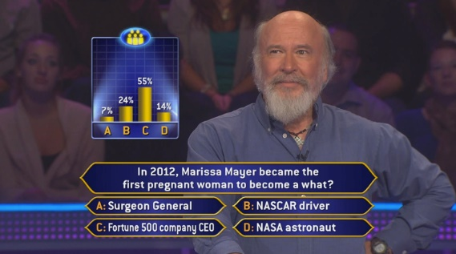
Ensemble Models
An ensemble averages or sums predictions from multiple models
Remember “Who Wants to be a Millionaire”?
  “Poll the audience” vs “Call a friend”
Averaging multiple “weak” predictions is often more accurate than any single predictor
  e.g. audience success rate is 92% vs 66% for the friend
Models can be constructed independently by sampling, or by incrementally training model to fix previous model’s mistakes
  Averaging independent predictions reduces variance
  Incrementally fixing mistakes reduces bias

Slide 7
Bias-Variance Trade-off
Variance: due to limited data
Different same-sized training sets will give different models that vary in predictions for the same test sample
“Noise”: irreducible error due to data/problem
Bias: (loosely) expected error when optimal model is learned from infinite data
Above is for regression.
But same “expected error = variance + noise + bias²“ holds for classification error and logistic regression.
See this for derivation
Fig Sources

Slide 8
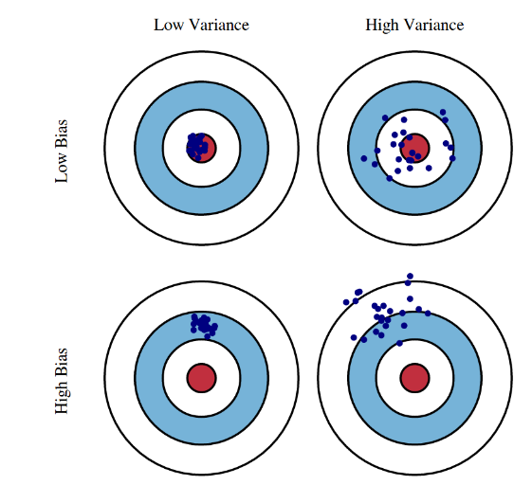
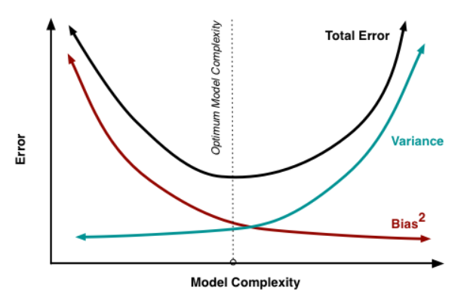
Bias-Variance Trade-off
See this for derivation
Fig Sources

Slide 9
Let’s see how ensembles battle bias and variance
Bootstrapping
Bagging
Boosting (Schapire 1989)
Adaboost (Schapire 1995)

Slide 10
Bootstrap Estimation
Repeatedly draw n samples from data D with replacement
For each set of samples, estimate a statistic
The bootstrap estimate is the mean of the individual estimates
Used to estimate a statistic (parameter) and its variance

Slide 11
Bagging - Aggregate Bootstrapping
For i = 1 .. M
  Draw n*<n samples from D with replacement
  Train classifier C_{i} using those samples
Final classifier is a vote of C₁ .. C_{M}
Increases classifier stability / reduces variance

Slide 12
Random Forests
Train a collection of trees (e.g. 100 trees).
For each:
  Randomly sample some fraction of data (e.g. 90%)
  Randomly sample some number of features
    For regression: suggest (# features) /3
    For classification: suggest sqrt(# features) or log_2(# features)
  Train a deep tree using only those samples/features
  (Optional: can get validation error on held out data)
Predict: Average the predictions of all trees
Breiman 2001 [pdf]

Slide 13
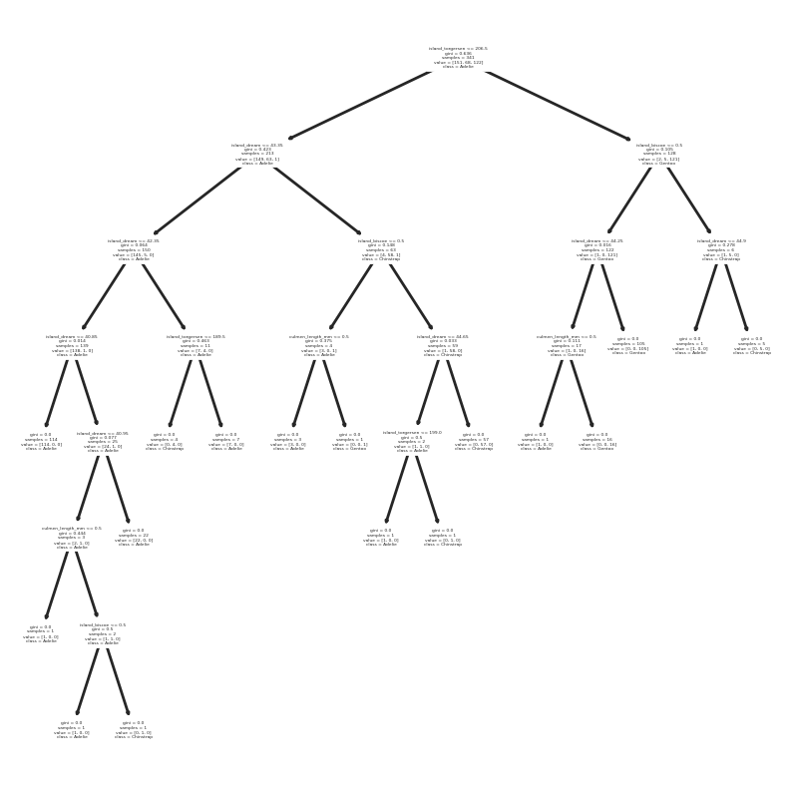
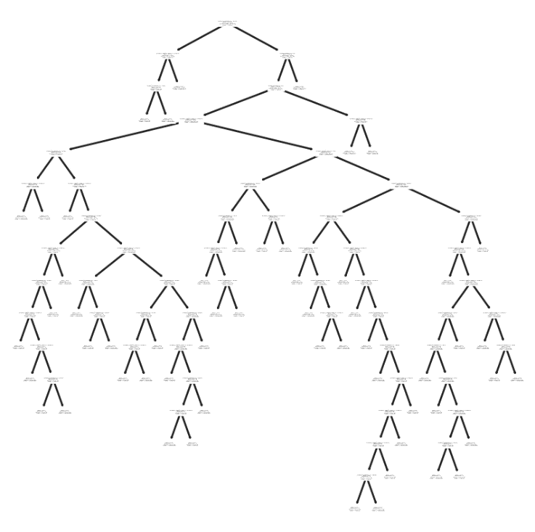
Random forest: intuition
Each tree uses different sets of features to fully explain the training set
Each tree’s prediction will be based on a complicated rule (low bias) but might be overfitting the training data
Averaging predictions from many complex rules enables prediction based on complicated combinations of features without relying on any particular prediction (reduces variance)
Trees for different subsets of features in penguin species prediction

Slide 14
Adaboost Terms
Learner = Hypothesis = Classifier
Weak Learner: classifier that can achieve < 50% training error over any training distribution
Strong Learner: makes prediction by combining weak learner predictions

Slide 15
Boosting (Schapire 1989)
Boosting Terminology
Learner = Hypothesis = Classifier
Weak Learner: classifier that can achieve < 50% training error over any training distribution
Strong Learner: makes prediction by combining weak learner predictions
Randomly select n₁ < n samples from D without replacement to obtain D₁
  Train weak learner C₁
Select n₂ < n samples from D with half of the samples misclassified by C₁ to obtain D₂
  Train weak learner C₂
Select all samples from D that C₁ and C₂ disagree on
  Train weak learner C₃
Final strong learner is vote of weak learners

Slide 16
Adaboost - Adaptive Boosting
Instead of sampling, re-weight
  Previous weak learner has only 50% accuracy over new distribution
Learn “weak classifiers” on the re-weighted samples
Final classification based on weighted vote of weak classifiers
https://cseweb.ucsd.edu/~yfreund/papers/IntroToBoosting.pdf (Freund Schapire ‘99)

Slide 17
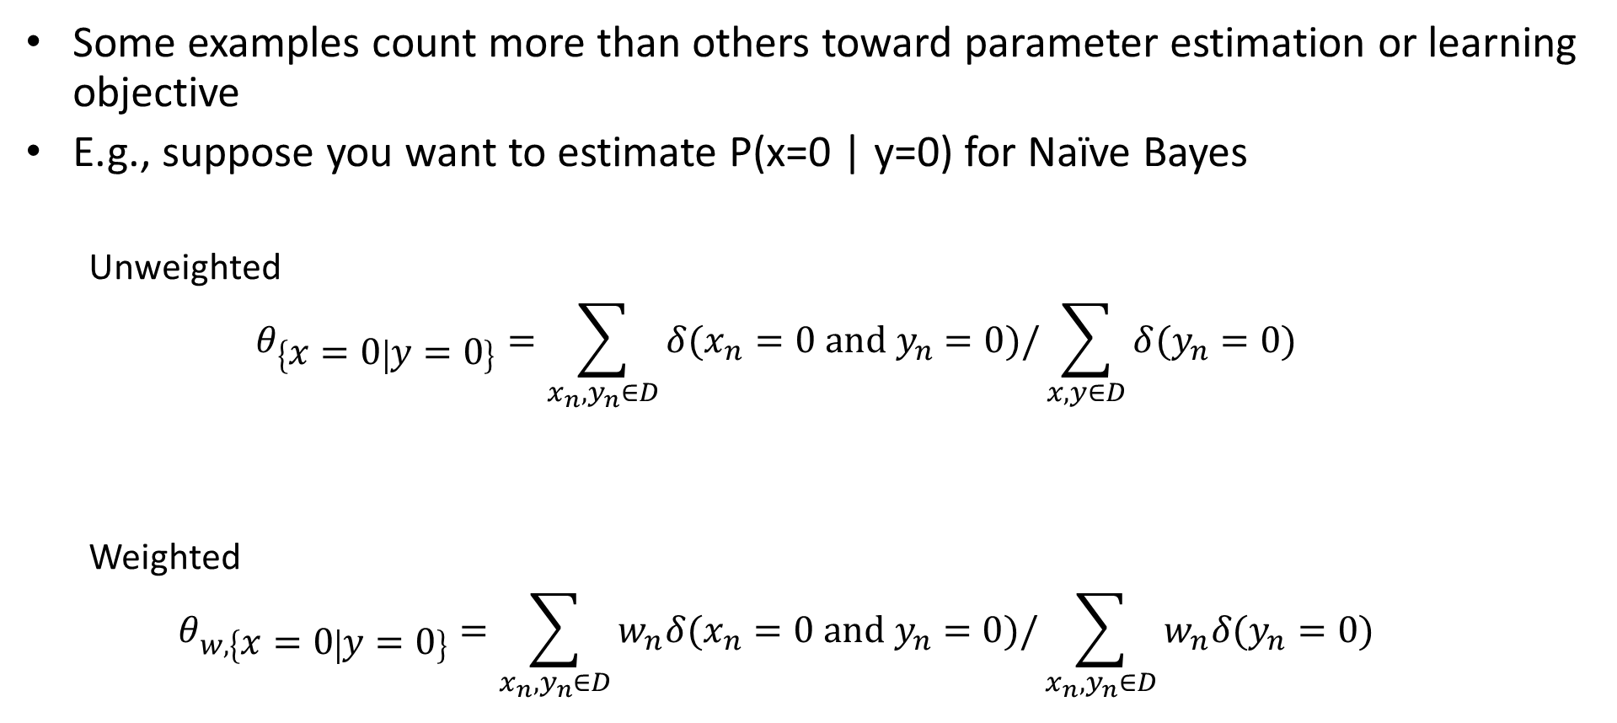
What does it mean to “weight” your training samples?
Some examples count more than others toward parameter estimation or learning objective
E.g., suppose you want to estimate P(x=0 | y=0) for Naïve Bayes
  Unweighted
  $$θ_{\left\{x=0 | y=0\right\}}=\sum_{x_{n},y_{n}∈D}{δ(x_{n}=0 and y_{n}=0)/\sum_{x,y∈D}{δ(y_{n}=0)}}$$
  Weighted
  $$θ_{w,\left\{x=0 | y=0\right\}}=\sum_{x_{n},y_{n}∈D}{w_{n}δ(x_{n}=0 and y_{n}=0)/\sum_{x_{n},y_{n}∈D}{w_{n}δ(y_{n}=0)}}$$

Slide 18
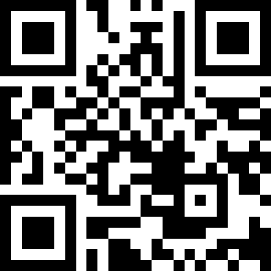
Q1-2
Estimate P(x=0 | y=0) using unweighted and weighted samples
https://tinyurl.com/441AML-L13
w | x | y
0.1 | 0 | 0
0.1 | 0 | 0
0.2 | 1 | 0
0.1 | 0 | 0
0.2 | 1 | 0
0.2 | 0 | 1
0.1 | 1 | 1

Slide 19
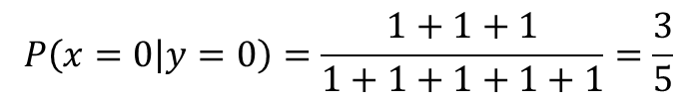
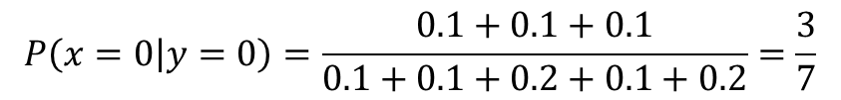
What does it mean to “weight” your training samples?
Estimate P(x=0 | y=0):
w | x | y
0.1 | 0 | 0
0.1 | 0 | 0
0.2 | 1 | 0
0.1 | 0 | 0
0.2 | 1 | 0
0.2 | 0 | 1
0.1 | 1 | 1
$$P\left(x=0 | y=0\right)=\frac{1+1+1}{1+1+1+1+1}=\frac{3}{5}$$
Unweighted:
Weighted:
$$P\left(x=0 | y=0\right)=\frac{0.1+0.1+0.1}{0.1+0.1+0.2+0.1+0.2}=\frac{3}{7}$$

Slide 20

Adaboost with Confidence Weighted Predictions (RealAB)
$$y_{i}∈\{−1,1\}$$
Friedman et al. Additive Logistic Regression: A Statistical View of Boosting (2000) [pdf]

Slide 21
Boosted decision trees
Train
Initialize sample weights to uniform
For each tree (e.g. 10-100), based on weighted samples:
  Train small tree (e.g. depth = 2-4 typically)
  Estimate logit prediction at each leaf node
  Reweight samples
Predict: sum logit predictions from all trees

Slide 22
ML Method Comparison by Caruana (2006)
BST-DT: Boosted Decision Tree
RF: Random Forest
ANN: Neural net
KNN
SVM
NB: Naïve Bayes
LR: Logistic Regression
Bold: best
*: not significantly worse than best
Calibration methods:
PLT: Platt Calibration
ISO: Isotonic Regression
- None used
[pdf]

Slide 23
Caruana et al. 2008: comparison on high dimensional data
Boosted Decision Trees FTW again!
RF second again!
But note that Adaboost underperforms in the very high dimensional datasets, where RF excels
[pdf]

Slide 24
Boosted Trees and Random Forests work for different reasons
Boosted trees
  Use small trees (high bias, low variance) to iteratively refine the prediction
  Combining prediction from many trees reduces bias
  Overfitting is a danger (i.e. too many / too large trees eliminates train error but increases test error)
Random forest
  Use large trees (low bias, high variance)
  Average of many tree predictions reduces variance
  Hard to break – just train a whole bunch of trees

Slide 25
Other ensembles
Can average predictions of any classifiers / regressors
  But they should not be duplicates, so e.g. averaging multiple linear regressors trained on all features/data has no point
  Averaging multiple deep networks (even when trained on all data) reduces error and improves confidence estimates
Cascades: early classifiers make decisions on easy examples; later ones deal only with hard examples
Wang et al. ICML 2022 [pdf]

Slide 26
Q3-5
https://tinyurl.com/441AML-L13

Slide 27
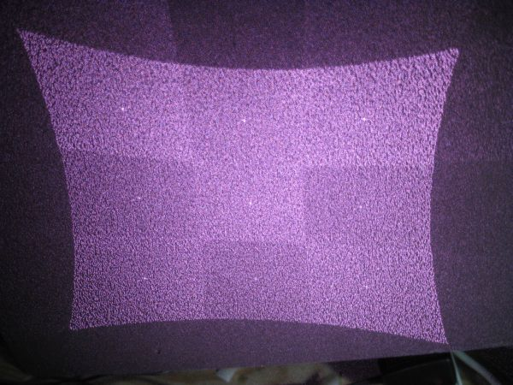
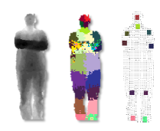
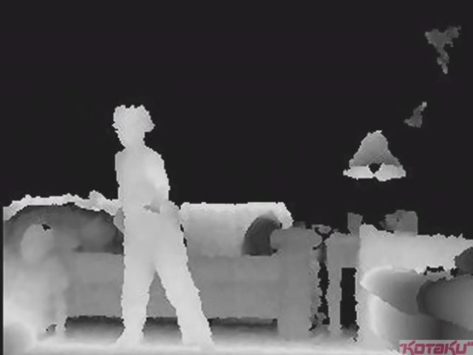
Example in detail: Depth from Kinect with RFs
IR Projector
IR Sensor
Projected Light Pattern
Stereo Algorithm
Segmentation,
Part Prediction
Depth Image
Body Pose

Slide 28
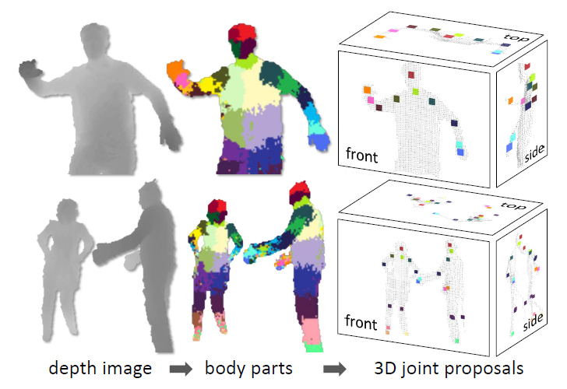
Goal: estimate pose from depth image
Real-Time Human Pose Recognition in Parts from a Single Depth Image
Jamie Shotton, Andrew Fitzgibbon, Mat Cook, Toby Sharp, Mark Finocchio, Richard Moore, Alex Kipman, and Andrew Blake
CVPR 2011

Slide 29
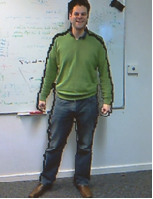
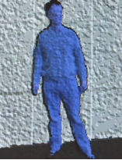
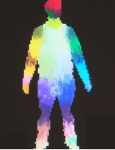
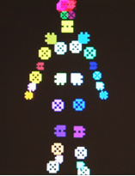
Goal: estimate pose from depth image
RGB
Depth
Part Label Map
Joint Positions
http://research.microsoft.com/apps/video/default.aspx?id=144455

Slide 30
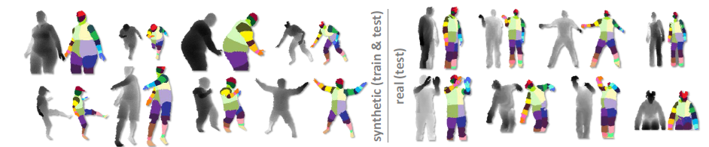
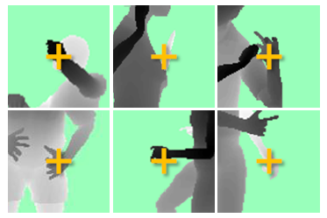
Challenges
Lots of variation in bodies, orientation, poses
Needs to be very fast (their algorithm runs at 200 FPS on the Xbox 360 GPU)
Pose Examples
Examples of one part

Slide 31
Extract body pixels by thresholding depth

Slide 32
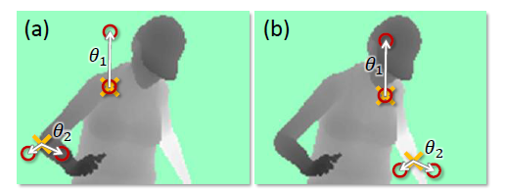
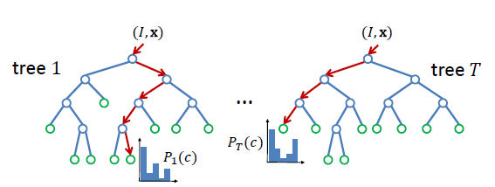
Basic learning approach
Very simple features
Lots of data
Flexible classifier

Slide 33
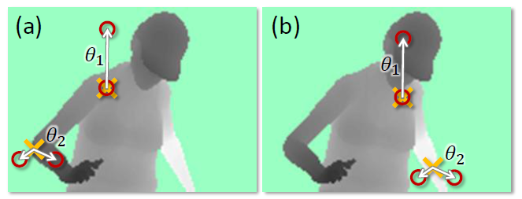
Features
Difference of depth at two offsets
  Offset is scaled by depth at center

Slide 34
Get lots of training data
Capture and sample 500K mocap frames of people kicking, driving, dancing, etc.
Get 3D models for 15 bodies with a variety of weight, height, etc.
Synthesize mocap data for all 15 body types

Slide 35
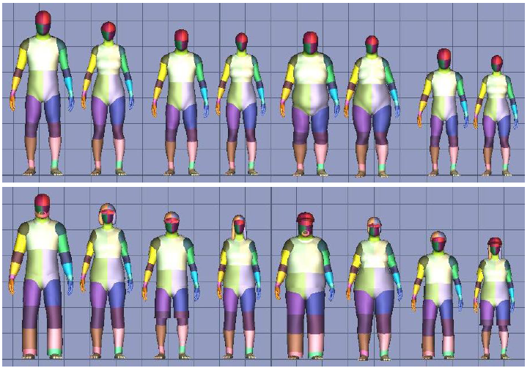
Body models

Slide 36
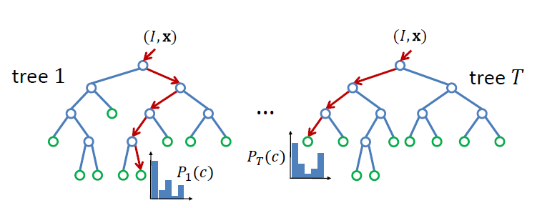
Part prediction with random forests
Randomized decision forests: collection of independently trained trees
Each tree is a classifier that predicts the likelihood of a pixel belonging to each part
  Node corresponds to a thresholded feature
  The leaf node that an example falls into corresponds to a conjunction of several features
  In training, at each node, a subset of features is chosen randomly, and the most discriminative is selected

Slide 37
Joint estimation
Joints are estimated using mean-shift (a fast mode-finding algorithm)
Observed part center is offset by pre-estimated value

Slide 38
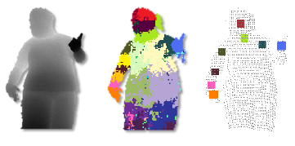
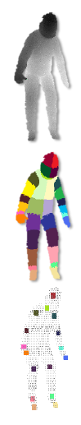
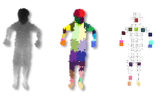
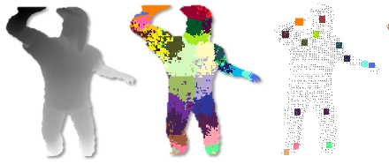
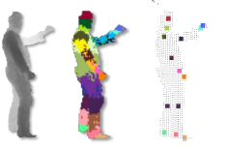
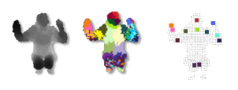
Results
Ground Truth

Slide 39
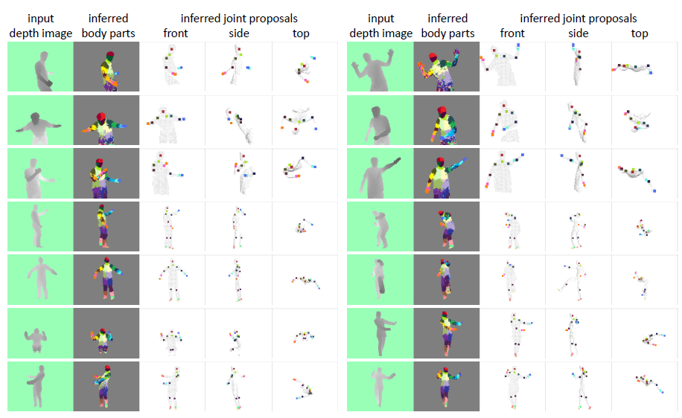
More results

Slide 40
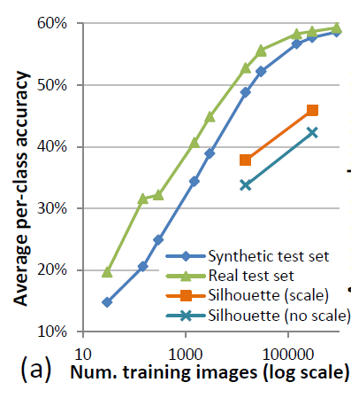
Accuracy vs. Number of Training Examples

Slide 41
Things to Remember
Ensembles improve accuracy and confidence estimates by reducing bias and/or variance
Boosted trees minimize bias by fixing previous mistakes
Random forests minimize variance by averaging over multiple different trees
Random forests and boosted trees are powerful classifiers and useful for a wide variety of problems

Slide 42
Next week
Mon: HW3 due
Tues: Stochastic Gradient Descent
Thurs: MLPs

