Slide 1

Linear Regression and Regularization
Applied Machine Learning
Derek Hoiem
Dall-E

Slide 2
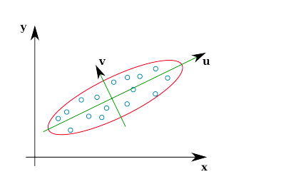
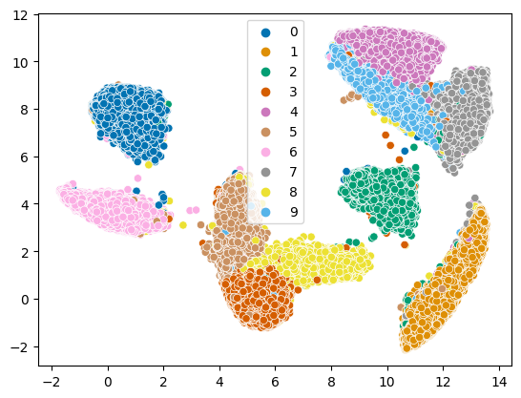
Last class
PCA reduces dimensions by linear projection
  Preserves variance to reproduce data as well as possible, according to mean squared error
  May not preserve local connectivity structure or discriminative information
Other methods try to preserve relationships between points
  MDS: preserve pairwise distances
  IsoMap: MDS but using a graph-based distance
  t-SNE: preserve a probabilistic distribution of neighbors for each point (also focusing on closest points)
  UMAP: incorporates k-nn structure, spectral embedding, and more to achieve good embeddings relatively quickly

Slide 3
Today’s Lecture
Linear regression
Regularization
  What is it
  How it affects models
  How to select regularization parameters

Slide 4


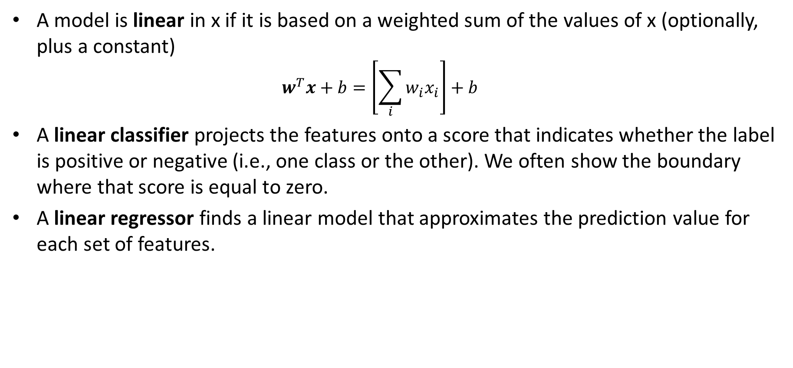

Linear Models
A model is linear in x if it is based on a weighted sum of the values of x (optionally, plus a constant)
  $$w^{T}x+b=\left[\sum_{i}{w_{i}x_{i}}\right]+b$$
A linear classifier projects the features onto a score that indicates whether the label is positive or negative (i.e., one class or the other). We often show the boundary where that score is equal to zero.
A linear regressor finds a linear model that approximates the prediction value for each set of features.
.
.
.
Target ($y$)
.
$$y=w^{T}x+b$$
$$score\left(y=1\right)=w^{T}x+b$$
Feature ($x$)
$w^{T}x+b$=0

Slide 5
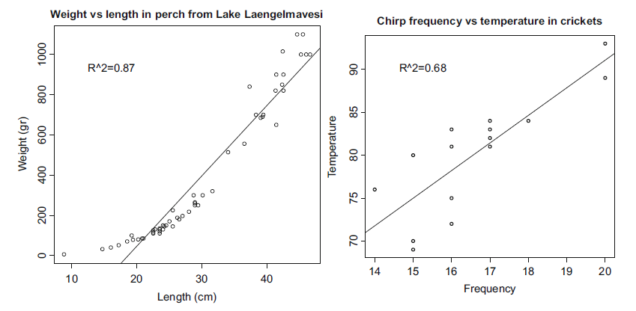
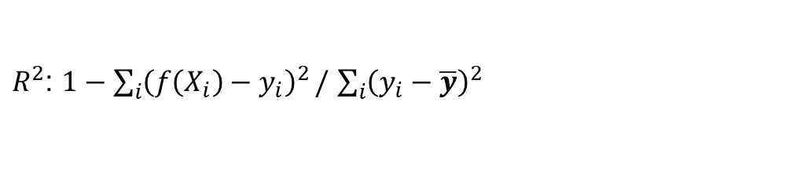
Linear regression
Examples from Forsyth AML
Fit linear coefficients to features to predict a continuous variable
R² close to zero indicates very weak relationship
R² close to 1 indicates y very linearly predictable from x
$R^{2}$: $1−\sum_{i}{{\left(f\left(X_{i}\right)−y_{i}\right)}^{2}}/$ $\sum_{i}{{\left(y_{i}−\overline{y}\right)}^{2}}$

Slide 6
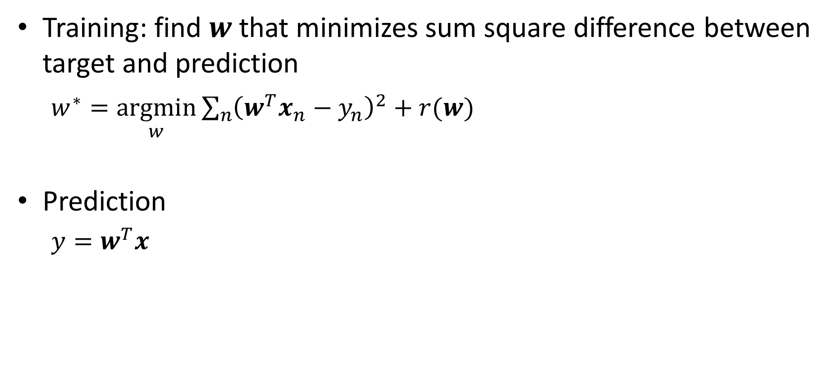
Linear Regression algorithm
Training: find $w$that minimizes sum square difference between target and prediction
  $w^{∗}=\underset{w}{argmin}{\sum_{n}{{\left(w^{T}x_{n}−y_{n}\right)}^{2}+r(w)}}$
Prediction
  $y=w^{T}x$
Loss due to missing the target
Loss due to parameter complexity

Slide 7

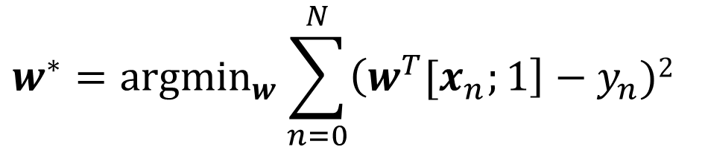
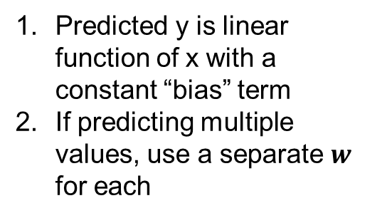


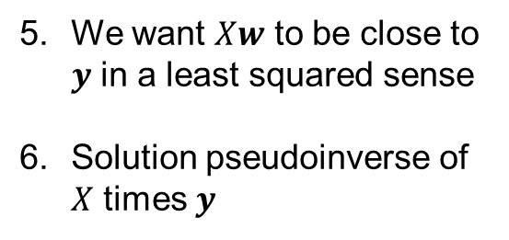



Linear regression
Model/Prediction
$$w^{T}{[x}_{n};1]=y_{n}^{w}$$
Predicted y is linear function of x with a constant “bias” term
If predicting multiple values, use a separate $w$ for each
$$w^{∗}={argmin}_{w}\sum_{n=0}^{N}{\left(w^{T}{[x}_{n};1\right]−y_{n})2 }$$
Training (least squares)
Minimize the squared error between predicted and true value
Stack features/targets into matrix/vector
$$w^{∗}={argmin}_{w}{\left(Xw−y\right)}^{T}\left(Xw−y\right)$$
$$N×m$$
$$m×1$$
$$N×1$$
We want $Xw$ to be close to $y$ in a least squared sense
Solution pseudoinverse of $X$ times $y$
$$Xw≈y$$
$$w=X⟊y={\left(X^{T}X\right)}^{−1}X^{T}y$$

Slide 8

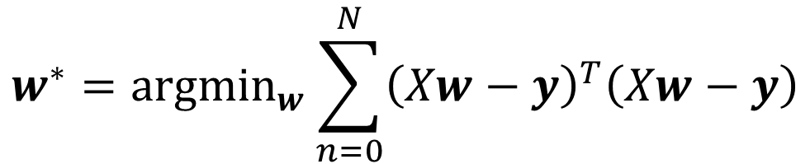
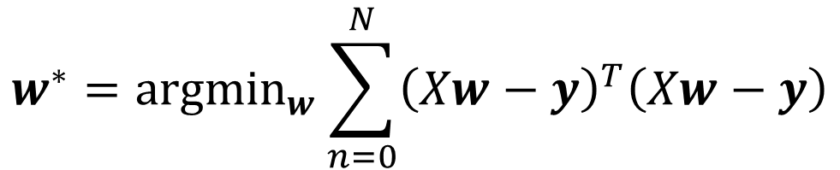
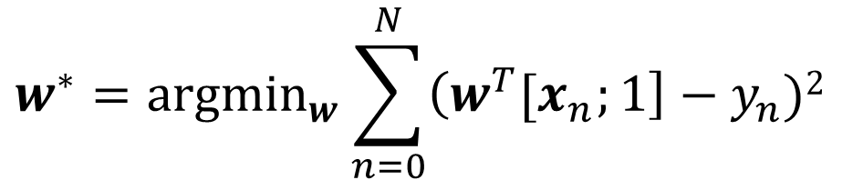
Linear regression
Model/Prediction
$$w^{T}{[x}_{n};1]=y_{n}$$
Training (least squares)
$$w^{∗}={argmin}_{w}\sum_{n=0}^{N}{\left(w^{T}{[x}_{n};1\right]−y_{n})2 }$$
$$w^{∗}={argmin}_{w}\sum_{n=0}^{N}{{\left(Xw−y\right)}^{T}\left(Xw−y\right)}$$
$$w^{∗}={argmin}_{w}\sum_{n=0}^{N}{{\left(Xw−y\right)}^{T}\left(Xw−y\right)}$$

Slide 9

Q1
https://tinyurl.com/AML441-L6

Slide 10
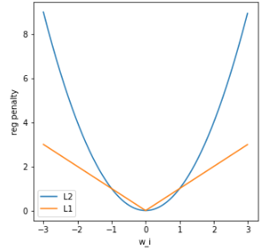
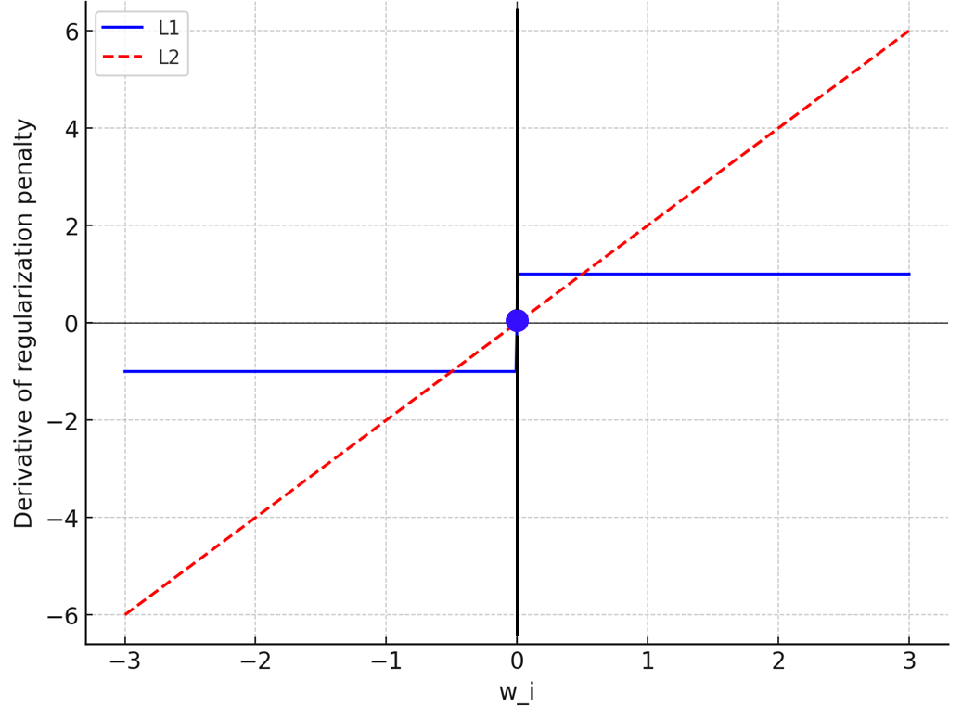

Training Linear Regression
  $w^{∗}=\underset{w}{argmin}{\sum_{n}{{\left(w^{T}x_{n}−y_{n}\right)}^{2}+r(w)}}$
L2 regularization: $r\left(w\right)=λ{\left\|w\right\|}_{2}^{2}=λ\sum_{i}{w_{i}^{2}}$
L1 regularization: $r\left(w\right)=λ{\left\|w\right\|}_{1}=λ\sum_{i}{|w_{i}|}$
L2 strongly penalizes big weights
L1 penalizes increasing the magnitude of big and small weights the same (derivative is 1 for negative weights, -1 for positive weights, 0 for 0)
L1 regularization can be used to select features
L2 linear regression is least squares and not hard to implement, but you can use a library.

Slide 11
Why regularize?
Biases each weight toward 0: helps prevent noisy features from having too much influence
  Bias: each weight toward 0
  Reduced variance: less difference with different samples
For L1, only most independently useful features have weight

Slide 12
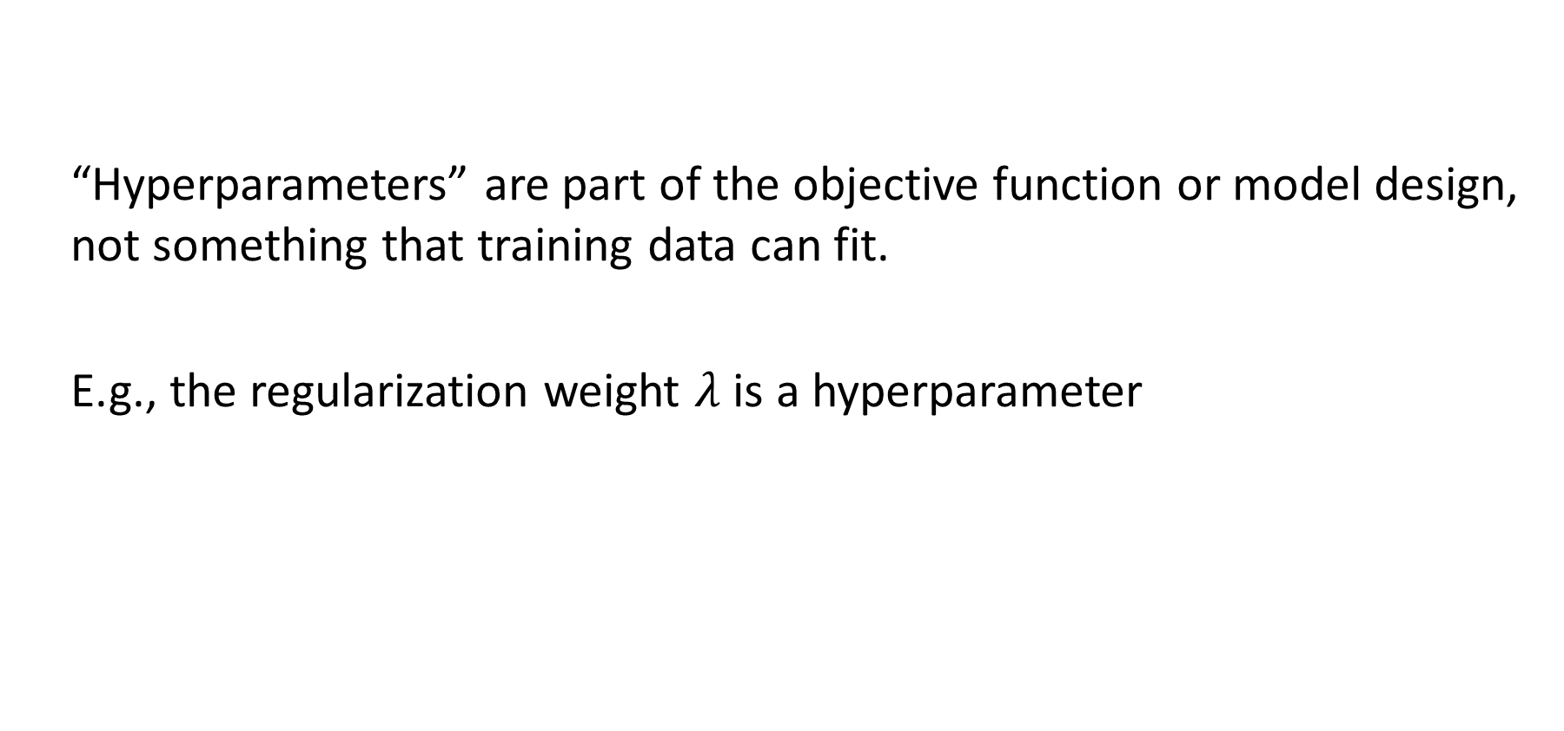
How to select hyperparameters
  “Hyperparameters” are part of the objective function or model design, not something that training data can fit.
  E.g., the regularization weight $λ$ is a hyperparameter

Slide 13
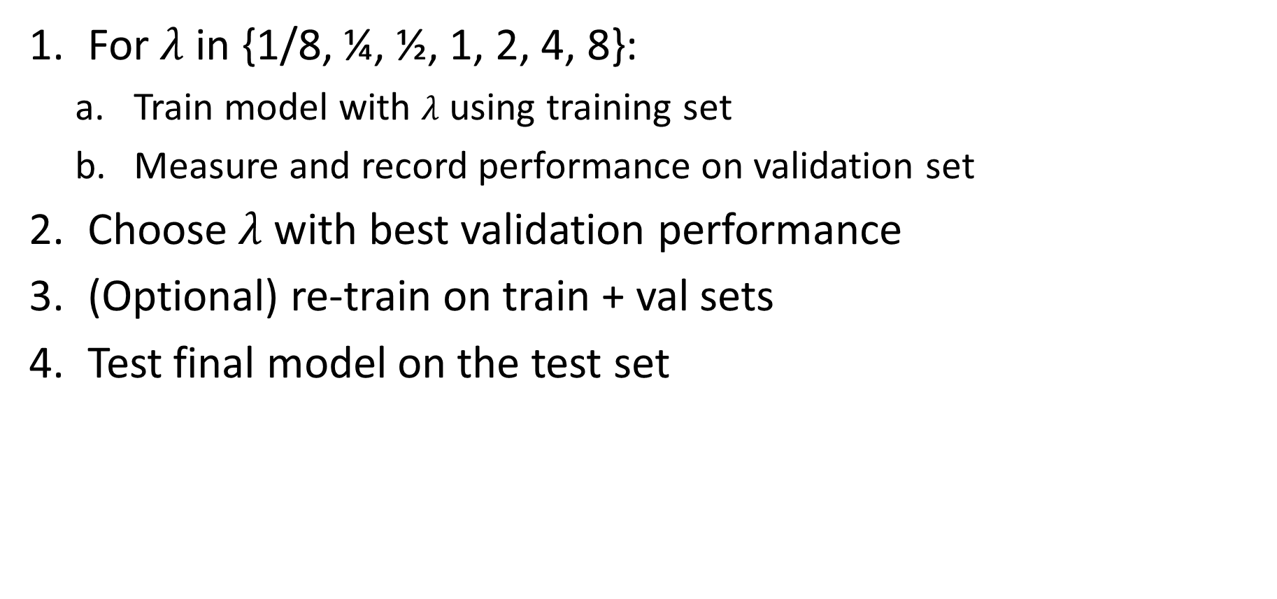
How to select hyperparameters
For $λ$ in {1/8, ¼, ½, 1, 2, 4, 8}:
  Train model with $λ$ using training set
  Measure and record performance on validation set
Choose $λ$ with best validation performance
(Optional) re-train on train + val sets
Test final model on the test set
Tips
In many cases, you want to vary parameters by factors, e.g. times 2 or times 5 for each candidate
You can start search broad and then narrow, e.g. if ¼ and ½ are the best two, then try 3/8

Slide 14
Linear Regression Walkthrough
Diabetes Dataset from sklearn
Number of Instances: 442
Target: measure of disease progression one year after baseline
Number of Attributes: 10
Attribute Information:
      age: age in years
      sex
      bmi :body mass index
      bp: average blood pressure
      s1: tc, total serum cholesterol
      s2: ldl, low-density lipoproteins
      s3: hdl, high-density lipoproteins
      s4: tch, total cholesterol / HDL
      s5: ltg, possibly log of serum triglycerides level
      s6: glu, blood sugar level
Normalization: subtract mean, divide by std, divide by sqrt(n_samples)
Goals: regress target value, explain causes of progression
Regression paper (Efron et al. 2003)

Slide 15
Q2 – Q4
https://tinyurl.com/AML441-L6

Slide 16
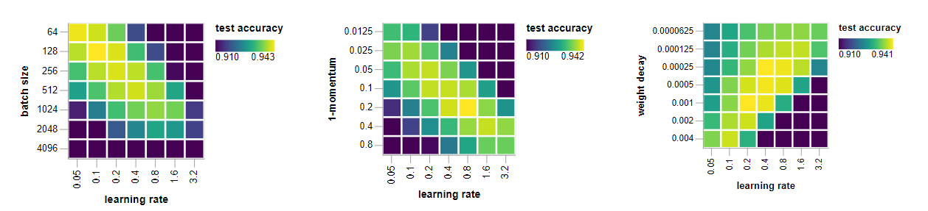
Hyper-parameter selection with multiple variables
Basic methods
  Grid search: try all possible combinations
    Becomes infeasible for more than two parameters
  Line search: optimize each parameter by itself sequentially
    Does not account for dependencies between parameters
  Randomized search: randomly generate parameters within a range
    Often best strategy for 3+ parameters
Article by Prof. Arindam Banerjee
Fig: https://myrtle.ai/learn/how-to-train-your-resnet-5-hyperparameters/

Slide 17
Other forms of hyper-parameter selection
Cross-validation
  Split training set into 5 parts (for 5-fold cross-validation)
  Train on 4/5 and train on remaining fifth
  Repeat five times, using a different fifth for validation each time
  Choose hyperparameters based on average validation performance
  Useful when you have limited training data
Leave-one-out cross-validation (LOOCV) is an extreme where for N data points, you have N splits (one held out for validation each time)

Slide 18
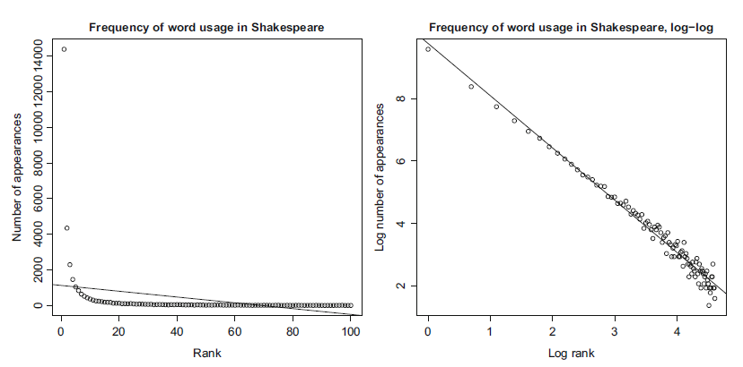
Transforming variables
Sometimes you need to transform variables before fitting a linear model
  Helpful to plot histograms or distributions of individual features to figure out what transformations might apply
Example from Forsyth AML

Slide 19
Linear regression can be sensitive to outliers
There are robust forms that estimate a weight on each sample, e.g. m-estimation
Minimizing the sum of absolute error does not have this problem, but is a harder optimization
Example from Forsyth AML

Slide 20
Linear regression vs KNN
KNN can fit non-linear functions
Only linear regression can extrapolate
Linear regression is more useful to explain a relationship
LR
3-NN

Slide 21
Linear Regression Summary
Linear regression is used to explain data or predict continuous variables in a wide range of applications
Key Assumptions
  y can be predicted by a linear combination of features
Model Parameters
  One coefficient per feature (plus one for y-intercept)
Designs
  L1 or L2 or elastic (both L1 and L2) regularization weight
  Different objective functions (e.g. squared error, absolute error, m-estimation)
When to Use
  Want to extrapolate
  Want to visualize or quantify correlations/relationships
  Have many features
When Not to Use
  Relationships are very non-linear (requires transformation or feature learning first)

Slide 22
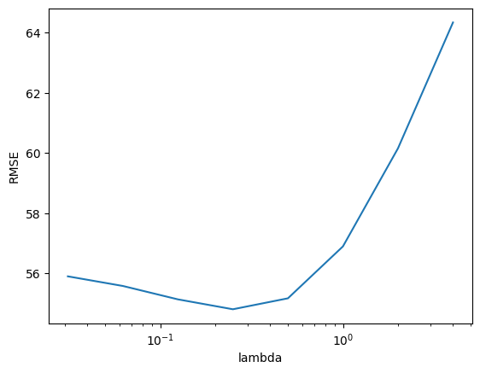
Things to remember
Linear regression fits a linear model to a set of feature points to predict a continuous value
  Explain relationships
  Predict values
  Extrapolate observations
Regularization prevents overfitting by restricting the magnitude of feature weights
  L1: prefers to assign a lot of weight to the most useful features
  L2: prefers to assign smaller weight to everything

Slide 23
Next week
HW 1 due on Monday
Linear classifiers
Naïve Bayes Classifier

