Slide 1
Dimensionality Reduction: PCA and low-D embeddings
Applied Machine Learning
Derek Hoiem
McInnes et al. (UMAP, 2000): Visualization of 30,000,000 integers as represented by binary vectors of prime divisibility, colored by integer value of the point

Slide 2
So far… KNN and retrieval
K-nearest neighbor classification and regression
Measuring and understanding error
Fast retrieval and clustering
  A few carry over slides coming up…

Slide 3
Advantages of Hierarchical K-Means
Fast cluster training
  With a branching factor of 10, can cluster into 1M clusters by clustering into 10 clusters ~111,111 times, each time using e.g. 10K data points
  Vs. e.g. clustering 1B data points into 1M clusters
  Kmeans is O(K*N*D) per iteration so this is a 900,000x speedup!
Fast lookup
  Find cluster number in O(log(K)*D) vs. O(K*D)
  16,667x speedup in the example above

Slide 4
Are there any disadvantages of hierarchical Kmeans?
Yes, the assignment might not be quite as good, but often usually isn’t a huge deal since K means is used to approximate data points with centroid anyway
Notes:
Yes, the assignment might not be quite as good, but this usually isn’t a huge deal since K means is used to approximate data points with centroid anyway

Slide 5
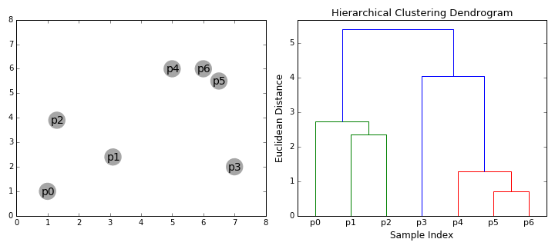
Agglomerative clustering
Iteratively merge the two most similar points or clusters
  Can use various distance measures
  Can use different “linkages”, e.g. distance of nearest points in two clusters or the cluster averages
  Ideally the minimum distance between clusters should increase after each merge (e.g. if using the distance between cluster centers)
  Number of clusters can be set based on when the cost to merge increases suddenly
https://dashee87.github.io/data%20science/general/Clustering-with-Scikit-with-GIFs/

Slide 6
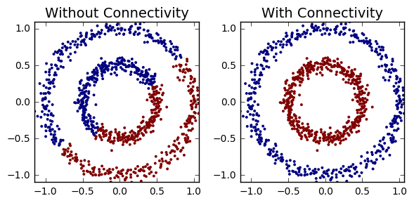
Agglomerative clustering
With good choices of linkage, agglomerative clustering can reflect the data connectivity structure (“manifold”)
Clustering based on distance of 5 nearest neighbors between clusters
https://dashee87.github.io/data%20science/general/Clustering-with-Scikit-with-GIFs/

Slide 7
Applications of clustering
K-means
  Quantization (codebooks for image generation)
  Search
  Data visualization (show the average image of clusters of images)
Hierarchical K-means
  Fast search (document / image search)
Agglomerative clustering
  Finding structures in the data (image segmentation, grouping camera locations together)

Slide 8

Q3-Q4
https://tinyurl.com/AML441-L4

Slide 9
This class – dimensionality reduction
Goal: We want to represent high dimensional data with fewer dimensions, e.g. for:
  Compression: reduced storage, faster retrieval
  Visualization: plot in two dimensions
A good dimensionality reduction can be defined in different ways
  Be able to reproduce the original data
  Preserve discriminative features
  Preserve the neighborhood structure

Slide 10
This class – dimensionality reduction
Goal: We want to represent high dimensional data with fewer dimensions, e.g. for:
  Compression: reduced storage, faster retrieval
  Visualization: plot in two dimensions
A good dimensionality reduction can be defined in different ways
  Be able to reproduce the original data
  Preserve discriminative features
  Preserve the neighborhood structure
One main strategy is linear projection, e.g. a street map projects everything onto the 2D ground dimensions and ignores height
Another strategy is embedding or manifold fitting, where we try to preserve relationships in the data

Slide 11
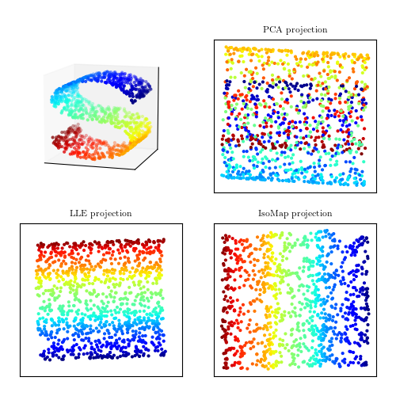
This class – PCA and manifolds
3D Data
Linear projection
  PCA: Principal Components Analysis
  Reduce dimension while preserving variance of data
Embedding/manifold learning
  MDS (multidimensional scaling), IsoMap, t-SNE, UMAP
  Preserve point distances and/or local structure

Slide 12
Key terms
Vectors and matrices
Translation
Projection
Scaling
Rotation
Rank
Eigenvectors/eigenvalues
SVD

Slide 13
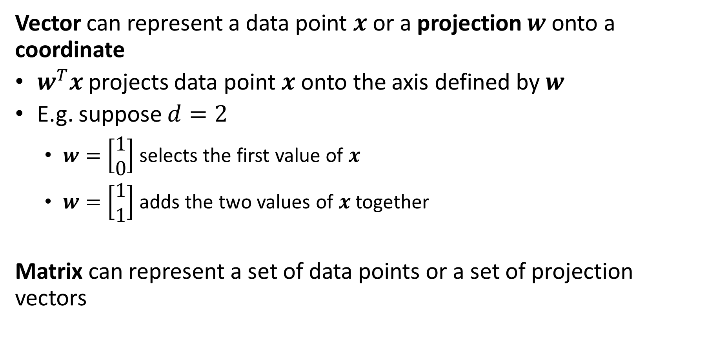
Key terms
Vector can represent a data point $x$or a projection $w$onto a coordinate
$w^{T}x$ projects data point $x$ onto the axis defined by $w$
E.g. suppose $d=2$
  $w=\left[\begin{matrix}1 \\ 0\end{matrix}\right]$ selects the first value of $x$
  $w=\left[\begin{matrix}1 \\ 1\end{matrix}\right]$ adds the two values of $x$ together
Matrix can represent a set of data points or a set of projection vectors

Slide 14
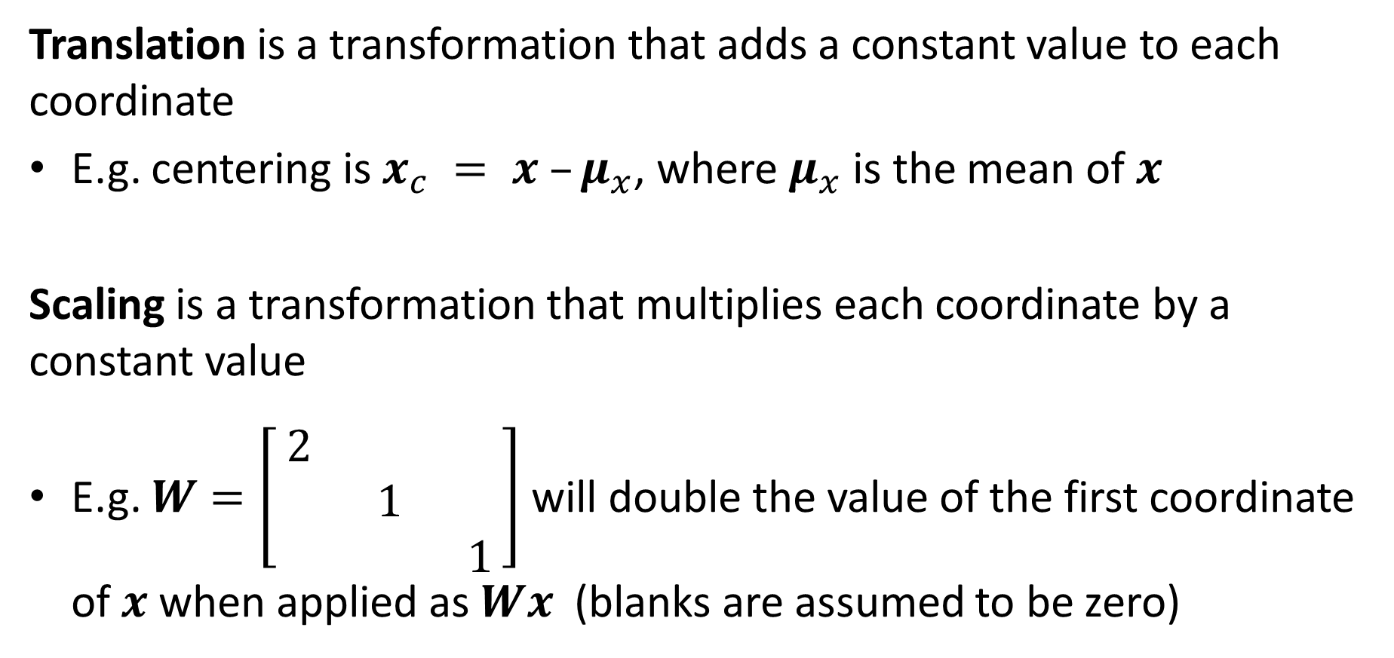
Key terms
Translation is a transformation that adds a constant value to each coordinate
E.g. centering is $x_{c} = x –μ_{x}$, where $μ_{x}$ is the mean of $x$
Scaling is a transformation that multiplies each coordinate by a constant value
E.g. $W=\left[\begin{matrix}2 & & \\ & 1 & \\ & & 1\end{matrix}\right]$ will double the value of the first coordinate of $x$ when applied as $Wx$ (blanks are assumed to be zero)

Slide 15
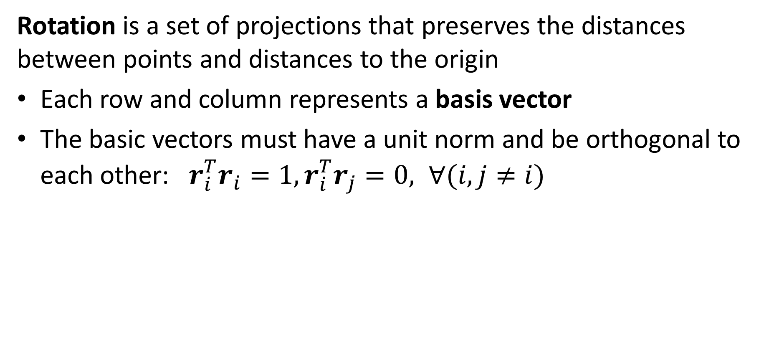
Key terms
Rotation is a set of projections that preserves the distances between points and distances to the origin
Each row and column represents a basis vector
The basic vectors must have a unit norm and be orthogonal to each other: $r_{i}^{T}r_{i}=1, r_{i}^{T}r_{j}=0, ∀(i,j≠i)$

Slide 16
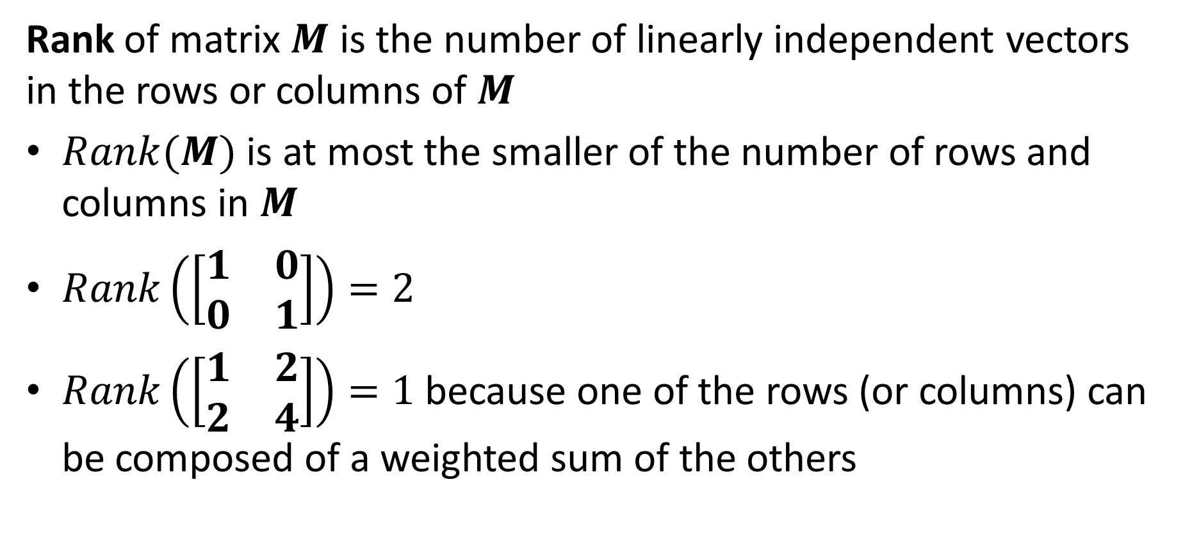
Key terms
Rank of matrix $M$ is the number of linearly independent vectors in the rows or columns of $M$
$Rank(M)$ is at most the smaller of the number of rows and columns in $M$
$Rank\left(\left[\begin{matrix}1 & 0 \\ 0 & 1\end{matrix}\right]\right)=2$
$Rank\left(\left[\begin{matrix}1 & 2 \\ 2 & 4\end{matrix}\right]\right)=1$ because one of the rows (or columns) can be composed of a weighted sum of the others

Slide 17
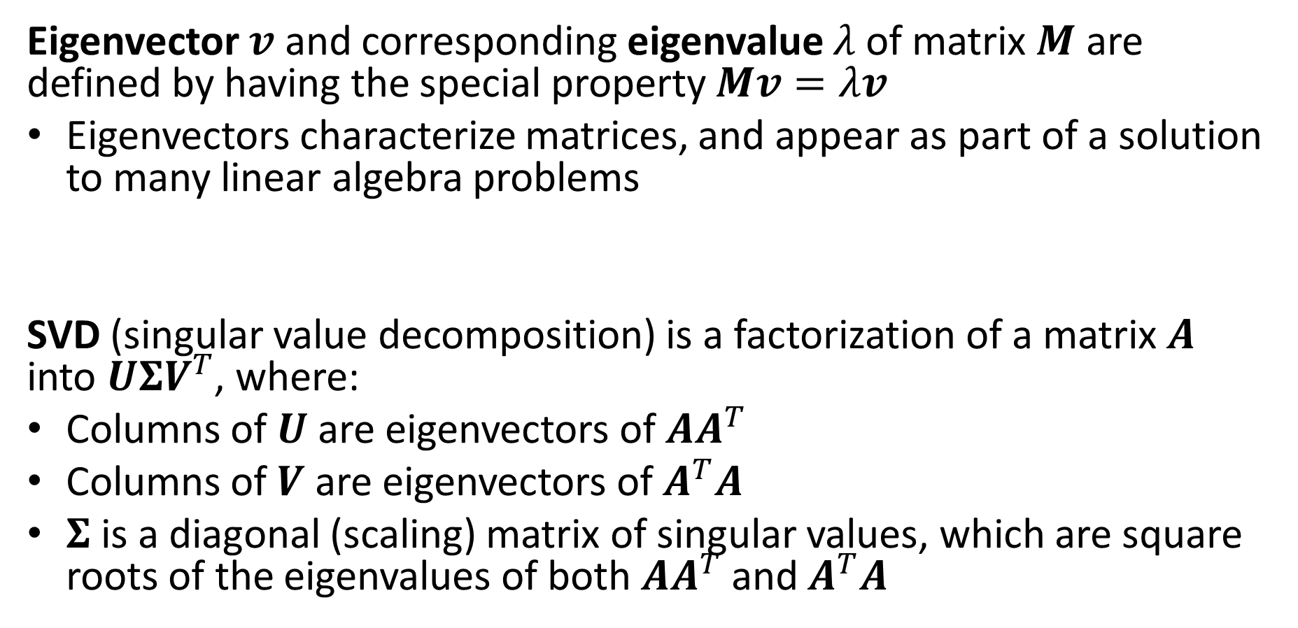
Key terms
Eigenvector $v$ and corresponding eigenvalue $λ$of matrix $M$ are defined by having the special property $Mv=λv$
Eigenvectors characterize matrices, and appear as part of a solution to many linear algebra problems
SVD (singular value decomposition) is a factorization of a matrix $A$ into $UΣV^{T}$, where:
Columns of $U$ are eigenvectors of $AA^{T}$
Columns of $V$ are eigenvectors of $A^{T}A$
$Σ$ is a diagonal (scaling) matrix of singular values, which are square roots of the eigenvalues of both $AA^{T}$ and $A^{T}A$

Slide 18
PCA
General dimensionality reduction technique
  Finds major orthogonal directions of variation
Preserves most of variance with a much more compact representation
  Lower storage requirements
  Faster matching/retrieval
  Easier to work in low dimensions, e.g. for probability estimation

Slide 19

Center and rotate the axes
Original 2D Representation
New 2D Representation
(4.2,0.04)
(3,4)
(0.5,-2)
(-2.1,0.1)
(-4.1,-0.03)
(-1,-3)

Slide 20

Now data is well-approximated by dropping the coordinates with the least variance
New 2D Representation
New 1D Representation
(4.2,0.04)
(4.2,0)
$$≈$$
(-2.1,0.1)
(-2.1,0)
(-4.1,-0.03)
(-4.1,0)

Slide 21
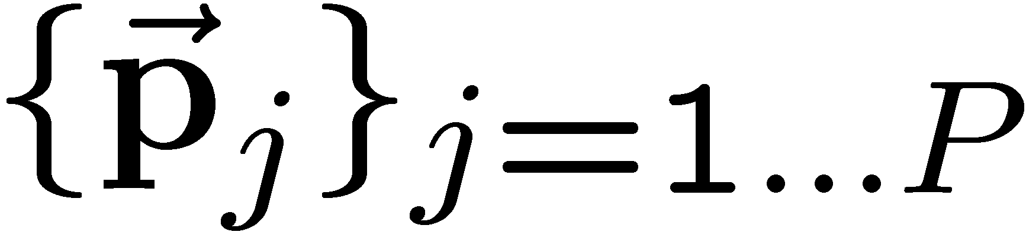
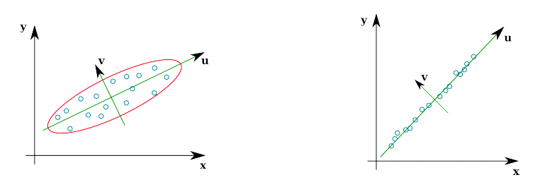
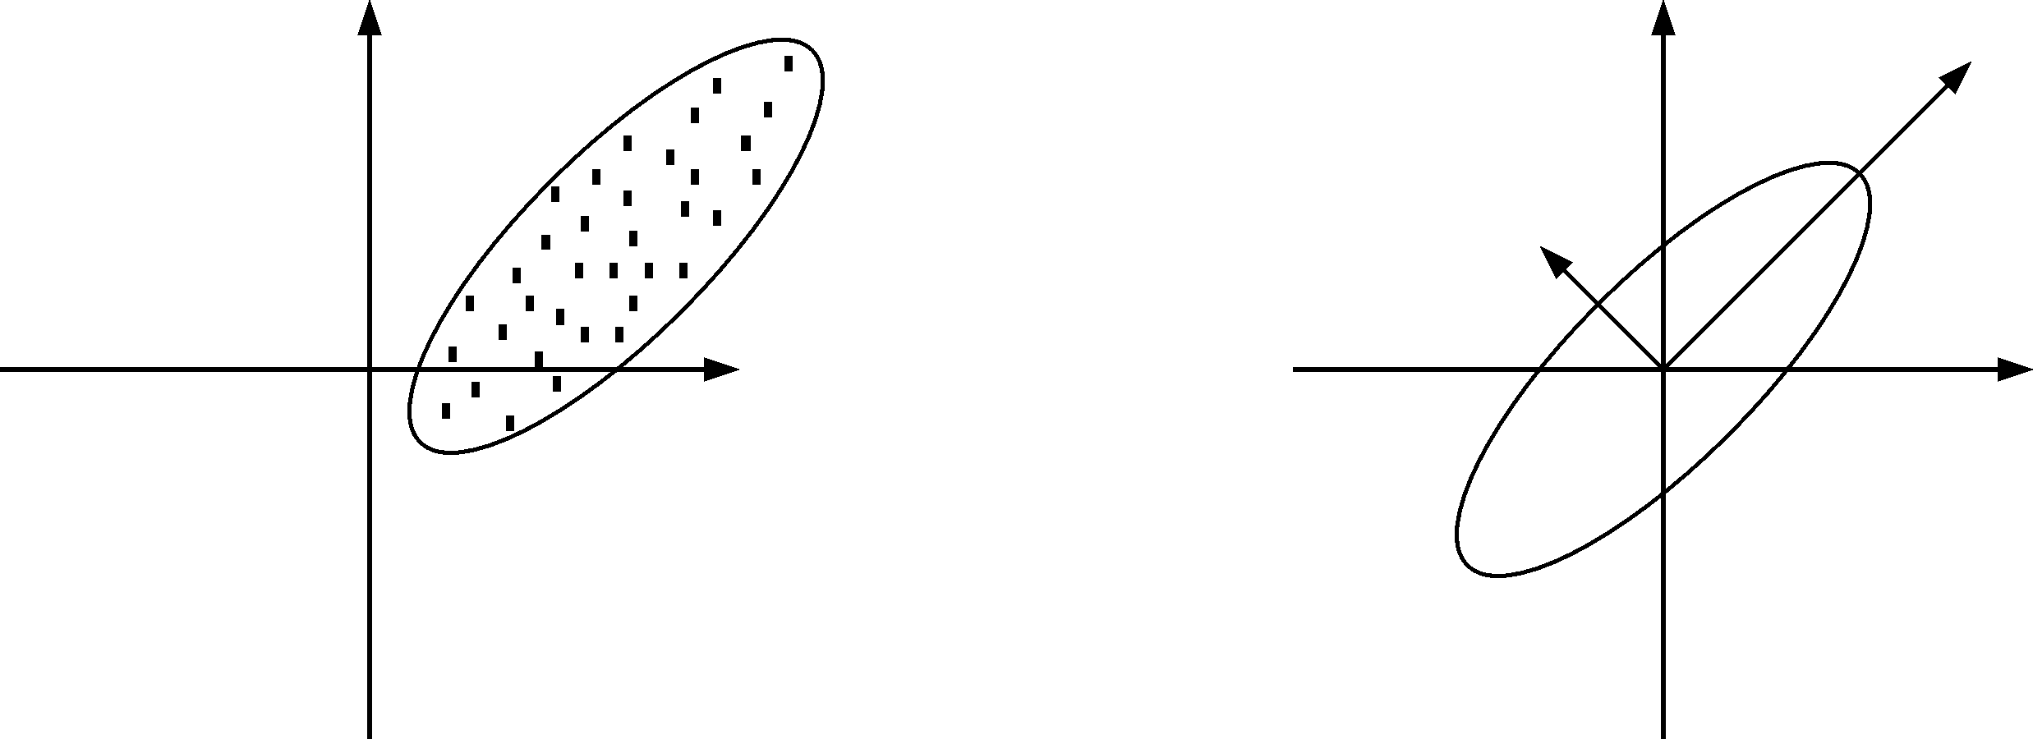
Principal Component Analysis
Given a point set , in an M-dim space, PCA finds a basis such that
  The most variation is in the first basis vector
  The second most, in the second vector that is orthogonal to the first vector
  The third…
2nd principal component
x₁
1st principal component
x₁
1st principal component
2nd principal component
x₀
x₀
Notes:
The goal of PCA is to find orthogonal vectors that the first r vectors have the highest variance of all.
----- Meeting Notes (10/4/11 17:12) -----
Write it more mathematically
say what PCA is solving

Slide 22
Principal Component Analysis (PCA)
Given: N data points x₁, … ,x_{N} in R^{d}
We want to find a new set of features that are linear combinations of original ones:
u(x_{i}) = u^{T}(x_{i} – µ)
(µ: mean of data points)
Choose unit vector u in R^{d} that captures the most data variance

Slide 23
Principal Component Analysis
Direction that maximizes the variance of the projected data:
N
Maximize
subject to ||u||=1
Projection of data point
N
1/N
Covariance matrix of data
The direction that maximizes the variance is the eigenvector associated with the largest eigenvalue of Σ (can be derived using Raleigh’s quotient or Lagrange multiplier)

Slide 24
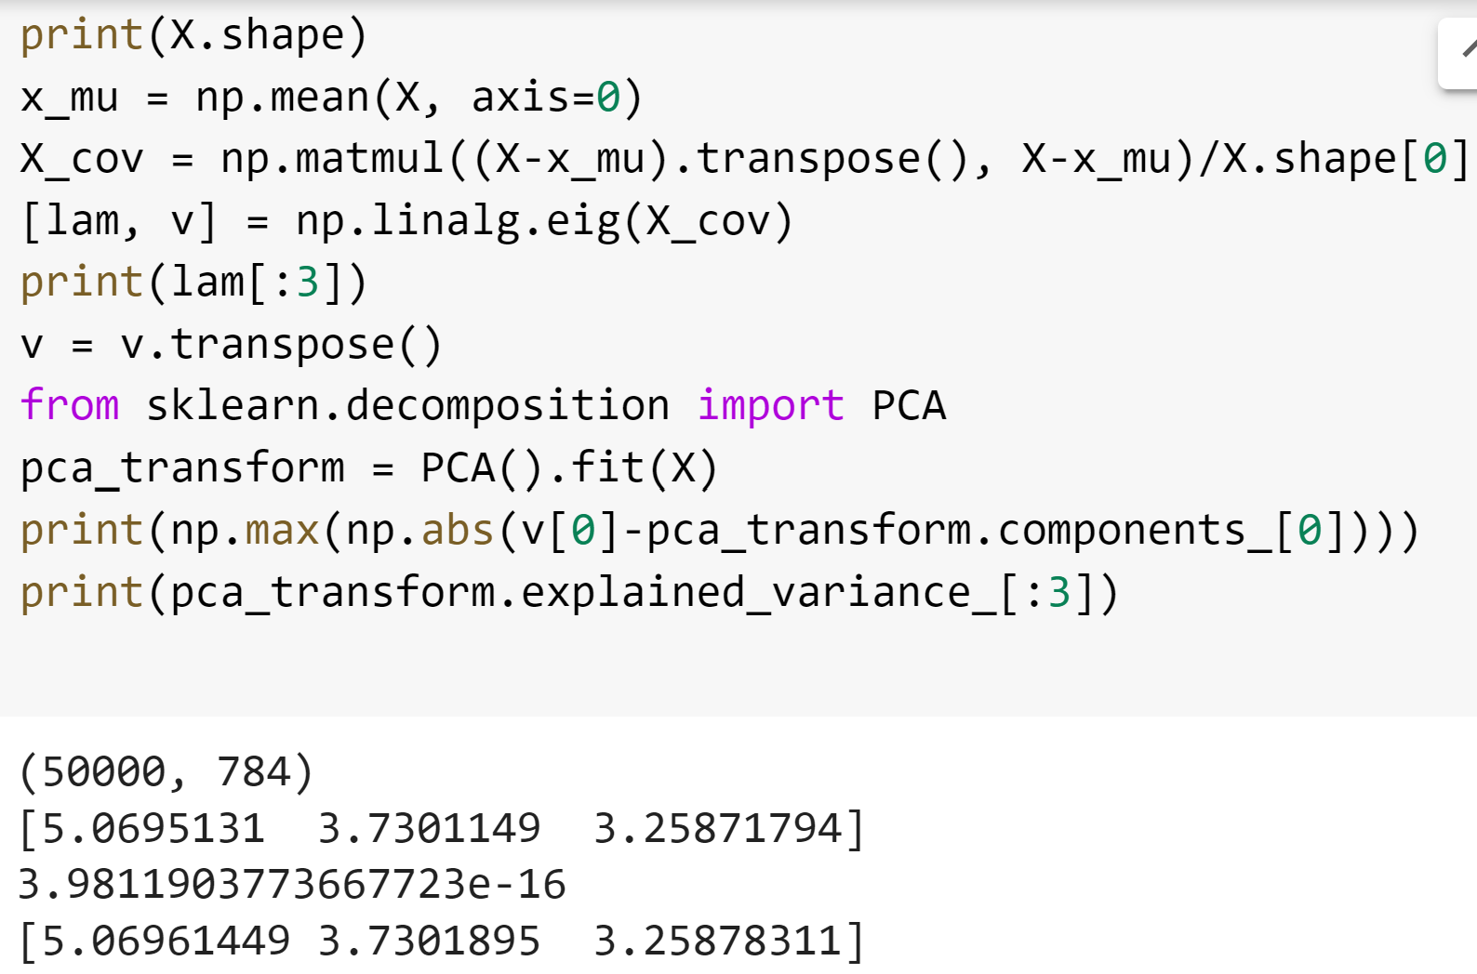
PCA in Python
Compute PCA components as eigenvectors of covariance matrix
Compute PCA using the PCA function
Printout shows that eigenvalues are the same as the explained variance, and the first component is identical (up to numerical precision)

Slide 25
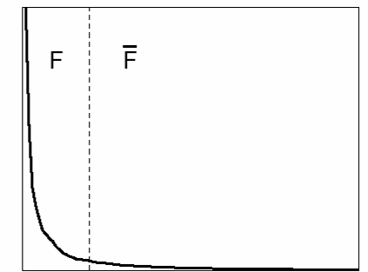
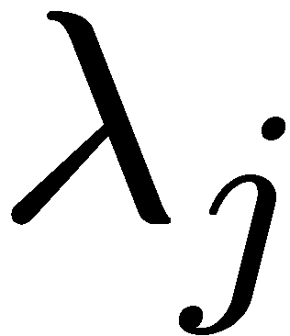
Principal Component Analysis
  First r < M principal component vectors provide an approximate basis that minimizes the mean-squared-error (MSE) of reconstructing the original points
Choosing subspace dimension r:
  look at decay of the eigenvalues as a function of r
  Larger r means lower expected error in the subspace data approximation
eigenvalues
1
r
M

Slide 26
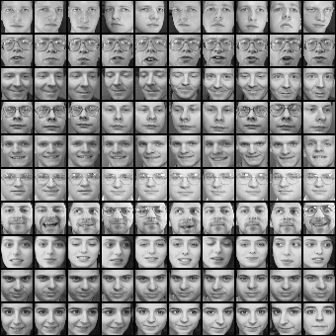
Example on aligned faces
x₁,…,x_{N} are pixel values of each face

Slide 27
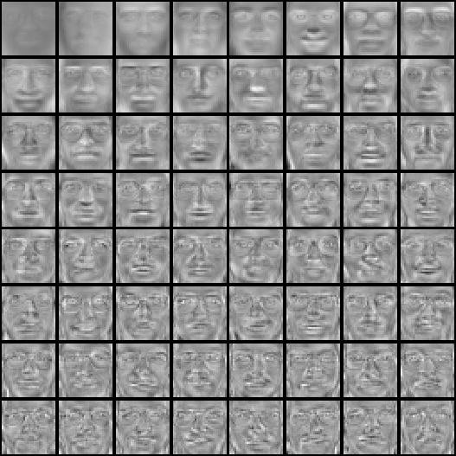
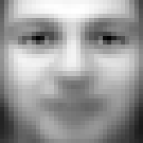
PCA of aligned face images (called “eigenfaces”)
Top eigenvectors: u₁,…u_{k}
Mean: μ

Slide 28
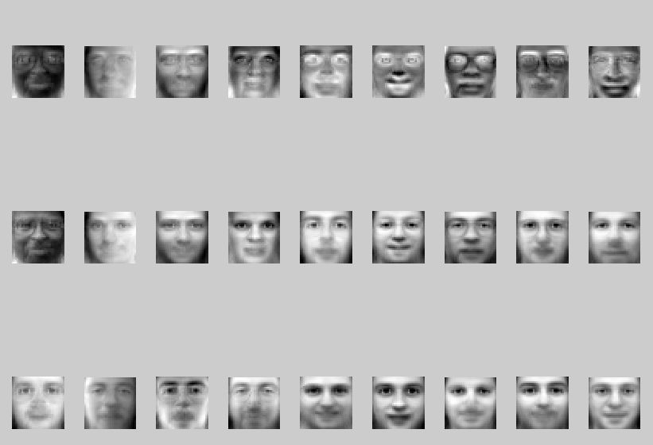
Visualization of eigenfaces (appearance variation)
Principal component (eigenvector) u_{k}
μ + 3σ_{k}u_{k}
μ – 3σ_{k}u_{k}

Slide 29

Representation and reconstruction
Face x in “face space” coordinates:
=

Slide 30

Representation and reconstruction
Face x in “face space” coordinates:
Reconstruction:
=
=
+
^
x
=
µ + w₁u₁+w₂u₂+w₃u₃+w₄u₄+ …

Slide 31
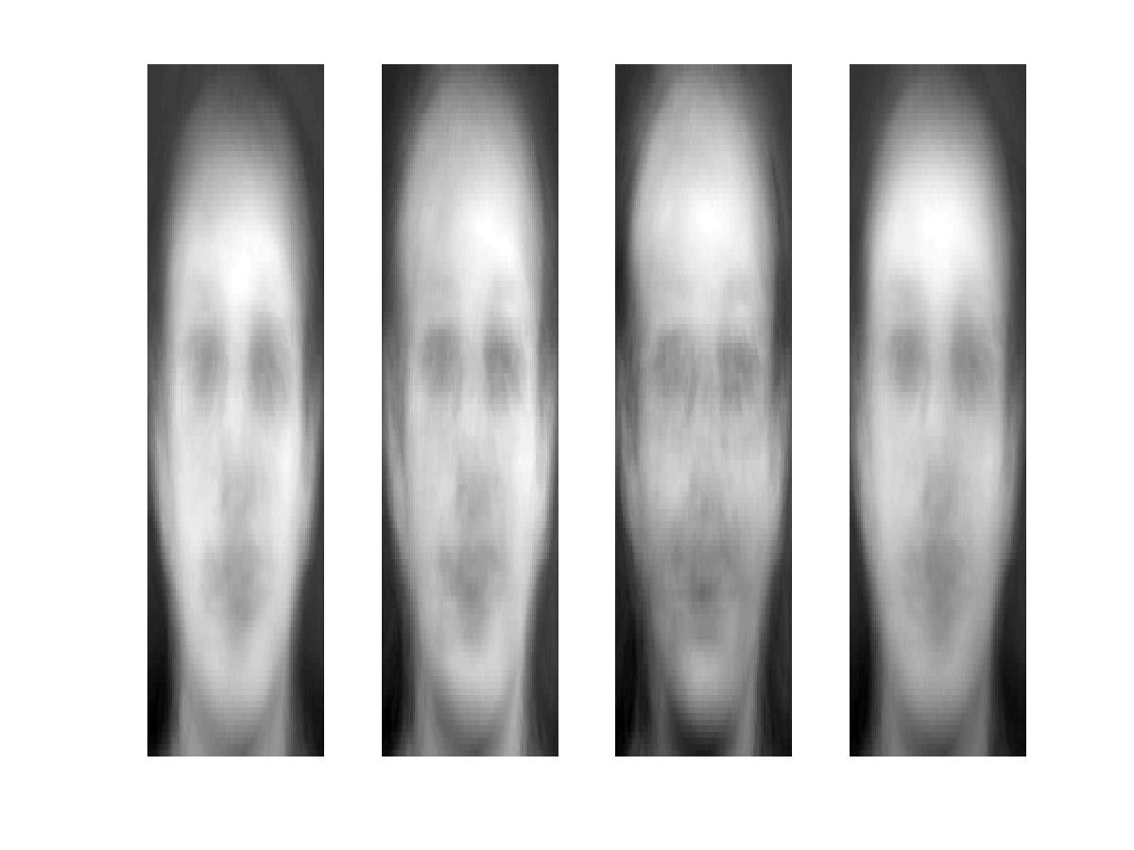
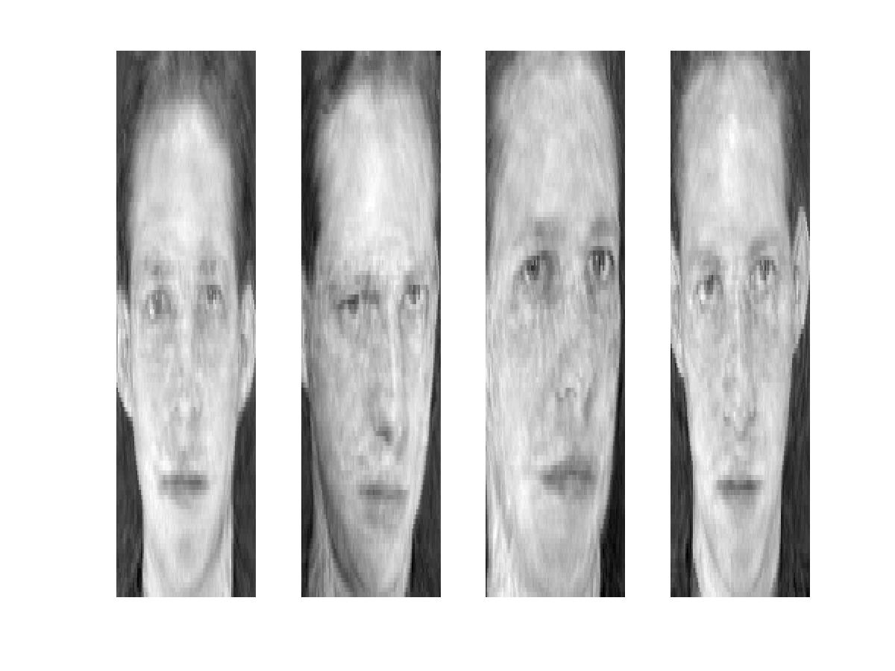
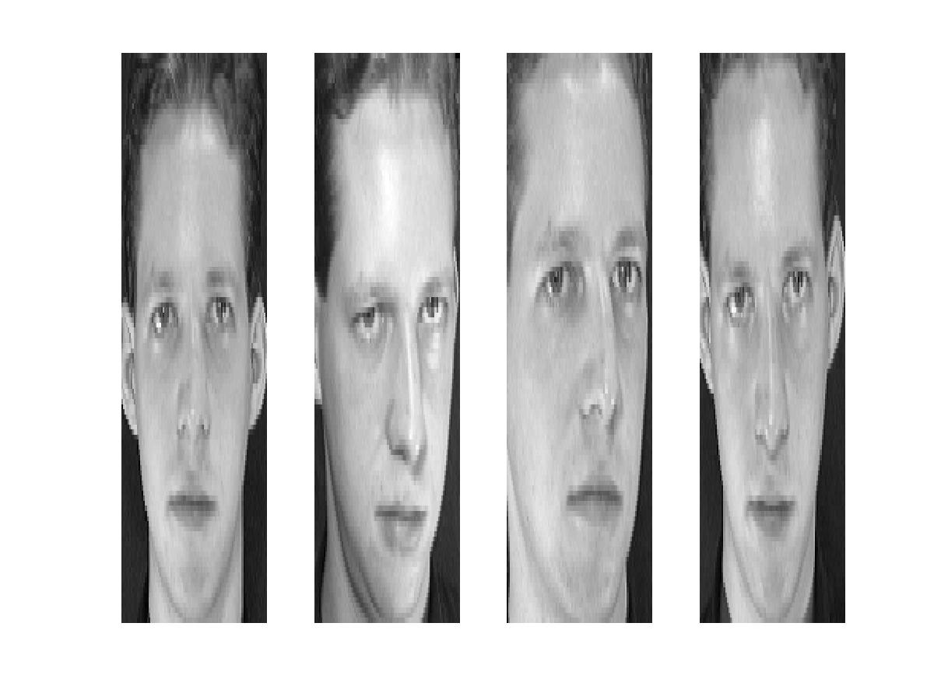
Reconstruction
P = 4
P = 200
P = 400
After computing eigenfaces using 400 face images from ORL face database

Slide 32
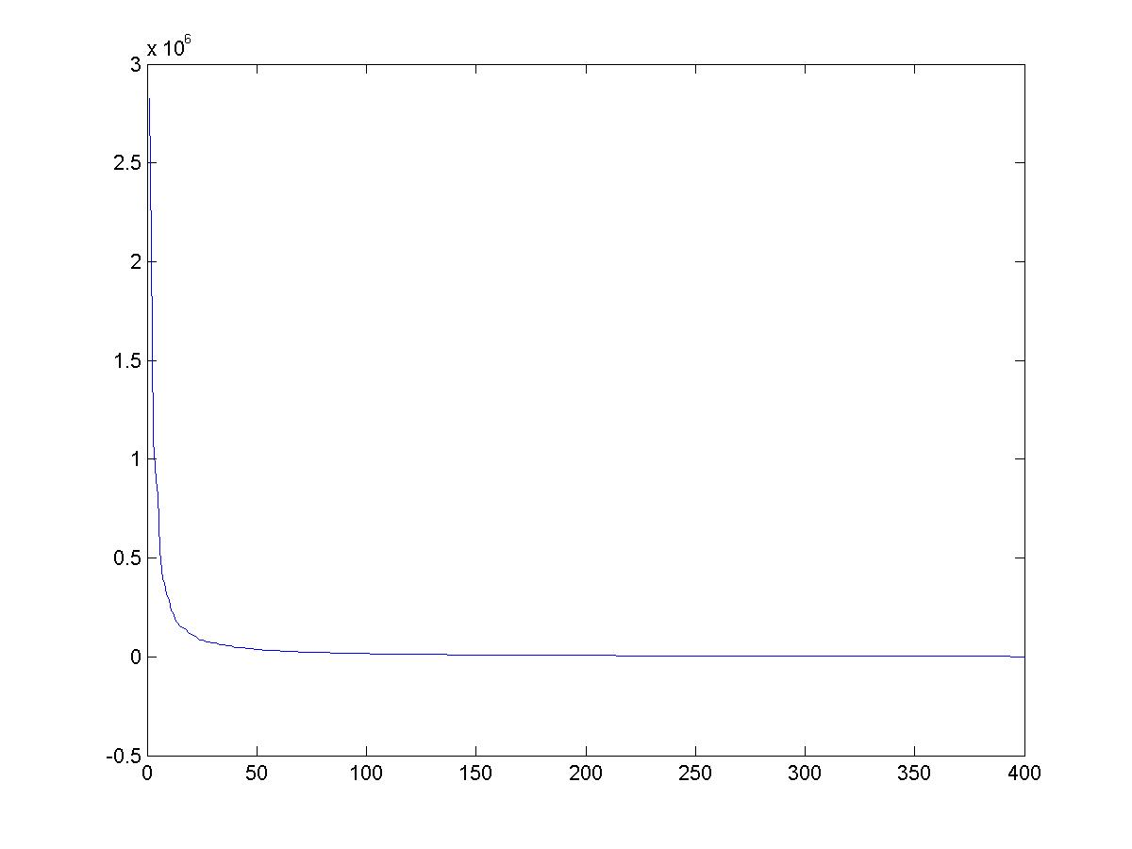
Note
Preserving variance (minimizing MSE) does not necessarily lead to perceptually good reconstruction.
P = 200
Plot of eigenvalues for each eigenvector of the covariance matrix, equivalent to the variance contained along each principal component

Slide 33
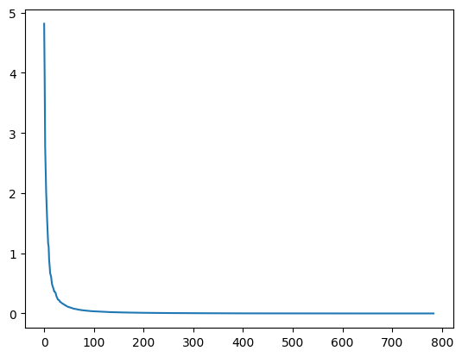
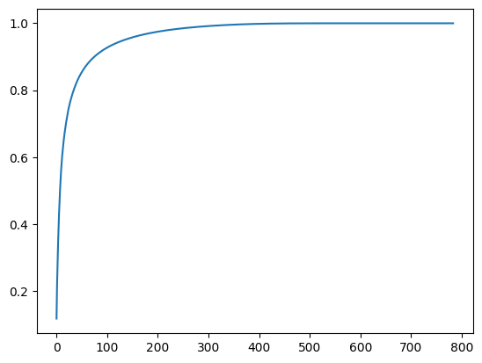
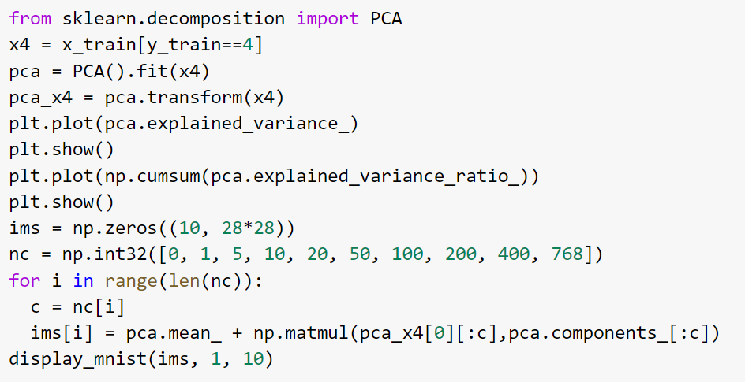
Another example, representing MNIST 4’s
Reconstructions with varying # PCs
Variance per component
0
1
5
10
20
Cumulative % variance explained
50
100
200
400
768

Slide 34

Q1-Q3
https://tinyurl.com/AML441-L5

Slide 36
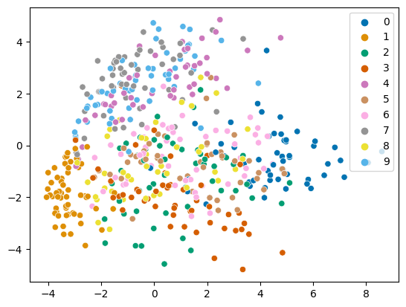
PCA: MNIST at 2 dimensions
Note: I’m only plotting a subset

Slide 37
Non-Linear Scaling and Manifold Estimation
We may care less about being able to reconstruct each data point than representing the relationships between data points
MDS: Preserve Euclidean pairwise distances
Non-metric MDS: Preserve distance orderings
ISOMAP: Define distances in terms of “geodesic” (graph-based) similarity

Slide 38

MultiDimensional Scaling (MDS)
For all data points, solve for new coordinate positions that preserve some input set of pairwise distances
Classic case (equations on right) uses Euclidean distance and has closed form solution
More generally, distance can be defined arbitrarily (e.g. from user surveys)
Major drawback is that the solution is most influenced by points that are far from each other
Solve for y that minimizes
where
$x$ are old coordinates, $y$ are new coordinates
See Forsyth AML 6.2 for details

Slide 39
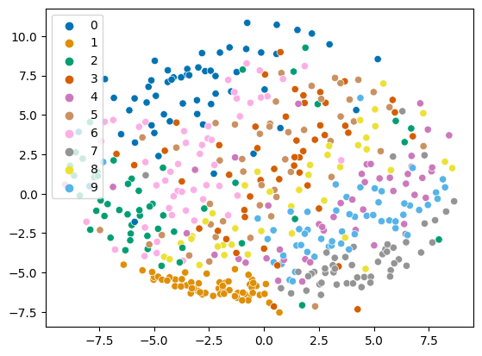
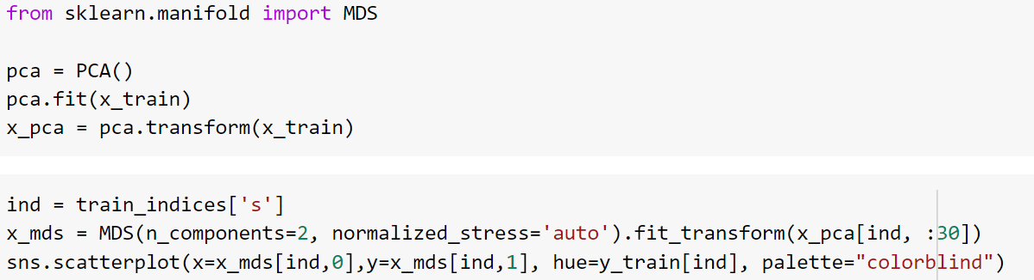
MDS on MNIST
30 PCA components
MDS to 2 dimensions
Note: For MDS and others, manifolds are fit on 500 pts for speed

Slide 40
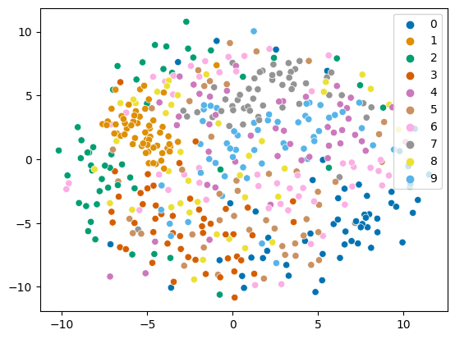
MDS on MNIST
Pre-process with PCA to 30 dim
No PCA

Slide 41
Non-metric MDS
Optimize position of data points so that Euclidean distance preserves the ordering of input pairwise distances
Requires only an order of dissimilarities
Slow because this is a complicated optimization

Slide 42
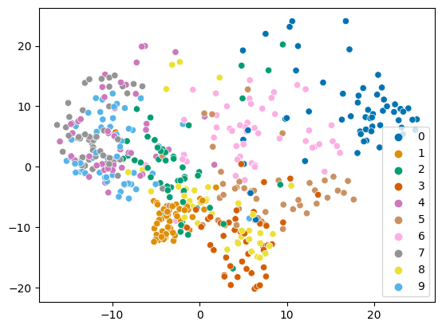
ISOMAP
MNIST ISOMAP (PCA: 30)
Same as MDS but define distance in a graph
  Compute adjacency graph (e.g. 5 nearest neighbors)
  Distance is shortest path in graph between two points
MNIST MDS (PCA: 30)

Slide 43
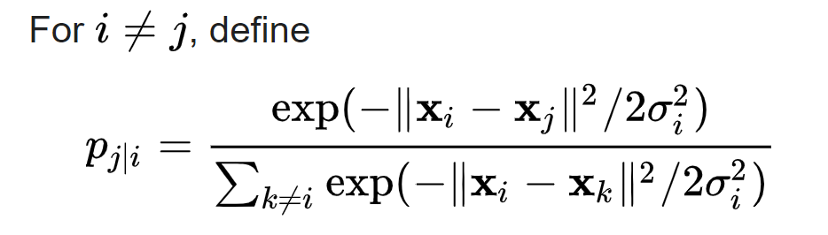
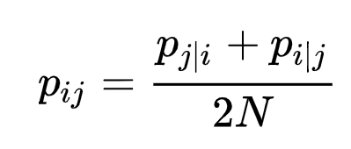
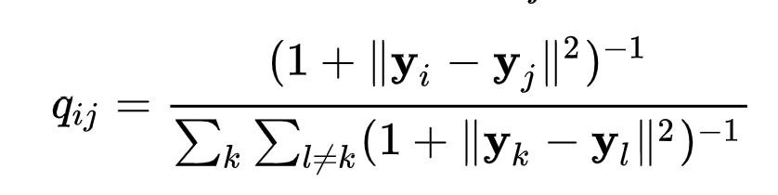
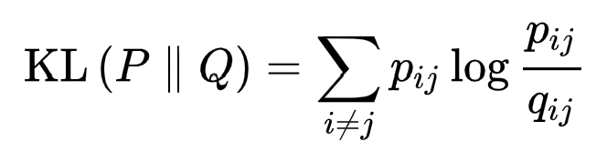
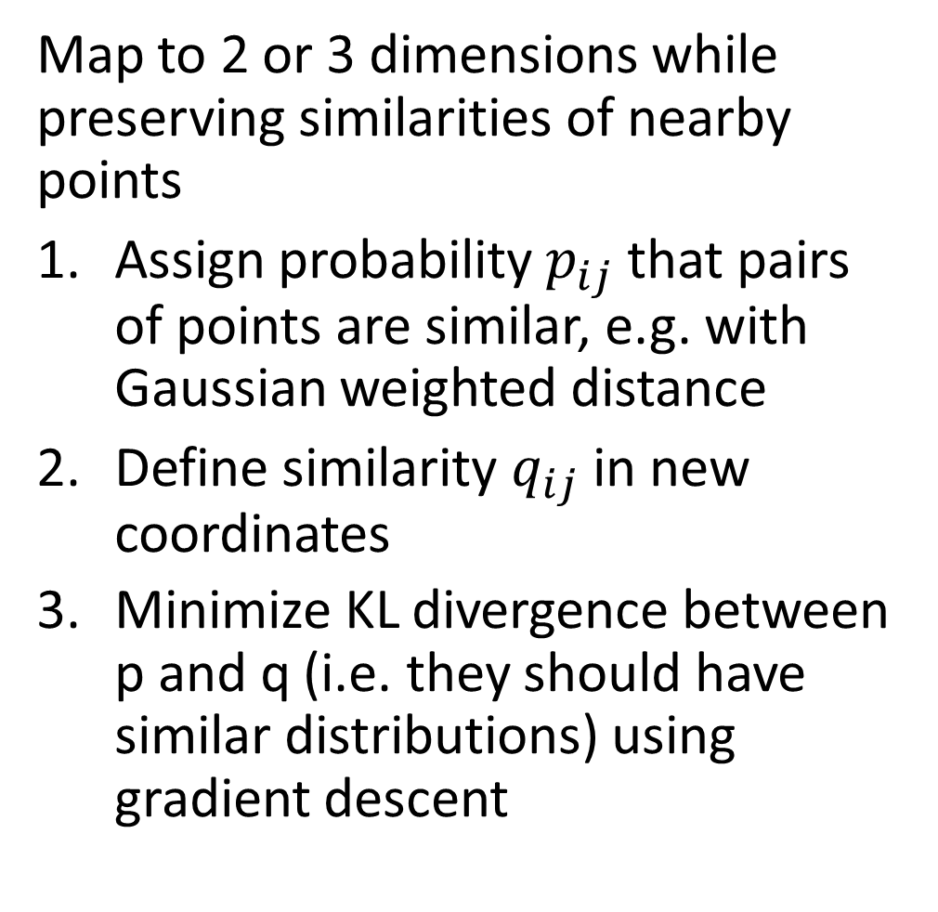
t-SNE
Map to 2 or 3 dimensions while preserving similarities of nearby points
Assign probability $p_{ij}$ that pairs of points are similar, e.g. with Gaussian weighted distance
Define similarity $q_{ij}$in new coordinates
Minimize KL divergence between p and q (i.e. they should have similar distributions) using gradient descent

Slide 44
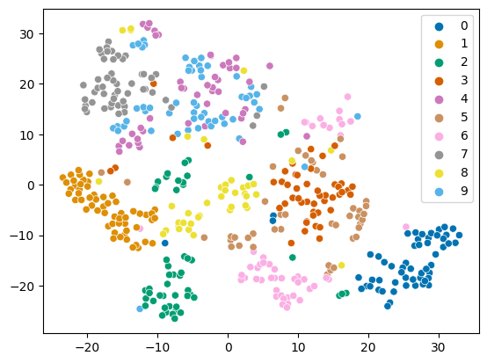
t-SNE
In high dimensions, each point tends to be similarly distant to many points, so we often use PCA before applying t-SNE
t-SNE on 30 PCA dimensions of MNIST

Slide 45
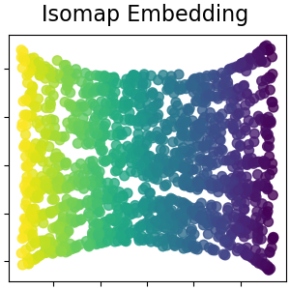
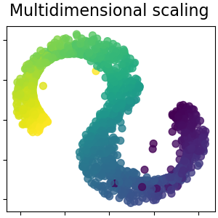
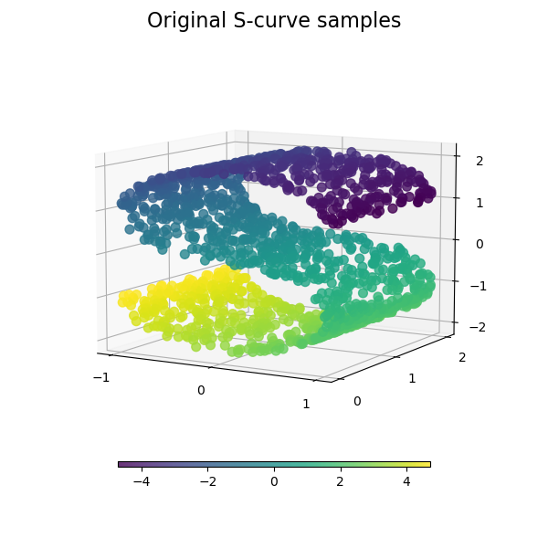
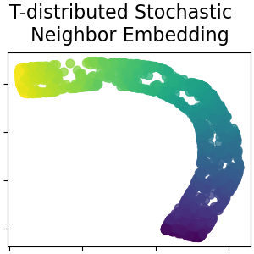
Comparison
https://scikit-learn.org/stable/auto_examples/manifold/plot_compare_methods.html

Slide 46
Comparison on MNIST
PCA
MDS
IsoMap
tSNE

Slide 47
UMAP (McInnes, 2020)
Assumes data is uniformly distributed on an underlying manifold that is locally connected. Goal is to preserve that local structure.
Algorithm: relatively complicated, incorporates many ideas from other methods, has strong mathematical foundations
Hyperparameters:
  number of neighbors to consider
  dimension of target embedding
  desired separation between close points
  number of training epochs
https://arxiv.org/abs/1802.03426

Slide 49
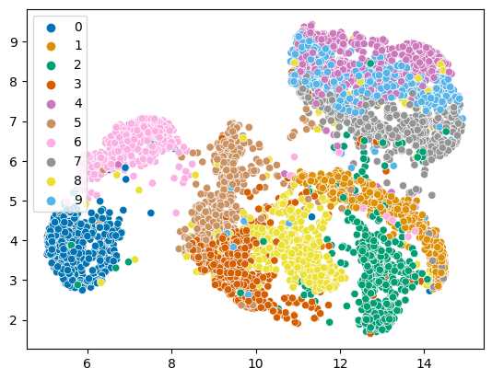
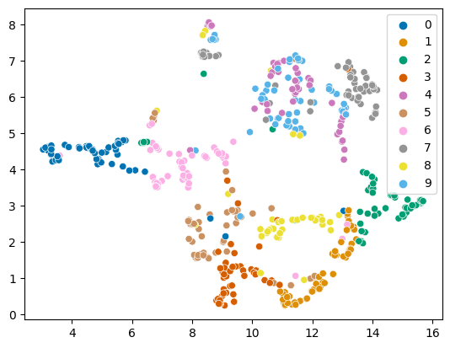
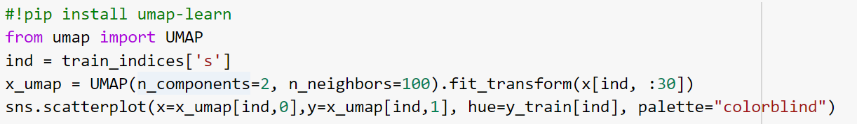
UMAP on MNIST
5000 points, 100 neighbors, 34s
500 pts, 10 neighbors

Slide 50
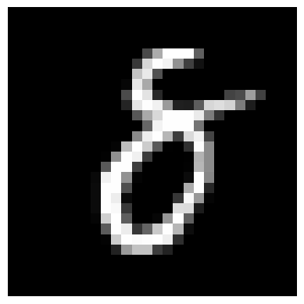

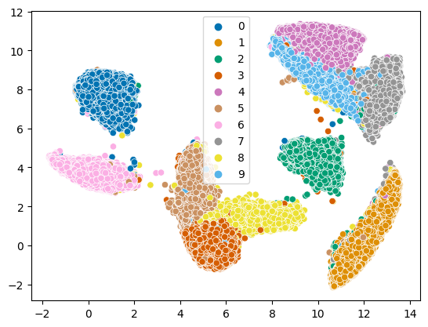
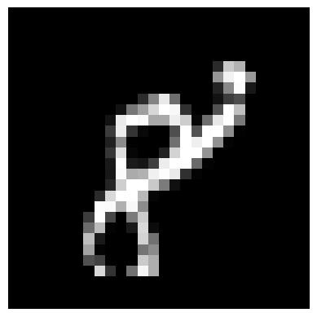

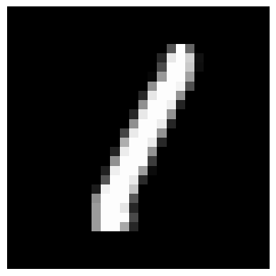
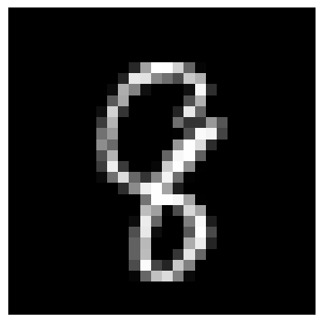
UMAP on MNIST
50,000 points, 100 neighbors, 200s

Slide 51
Q4
https://tinyurl.com/AML441-L5

Slide 52
Things to remember
PCA reduces dimensions by linear projection
  Preserves variance to reproduce data as well as possible, according to mean squared error
  May not preserve local connectivity structure or discriminative information
Other methods try to preserve relationships between points
  MDS: preserve pairwise distances
  IsoMap: MDS but using a graph-based distance
  t-SNE: preserve a probabilistic distribution of neighbors for each point (also focusing on closest points)
  UMAP: incorporates k-nn structure, spectral embedding, and more to achieve good embeddings relatively quickly

Slide 53
Next class: Linear Regression and Regularization

