Slide 1
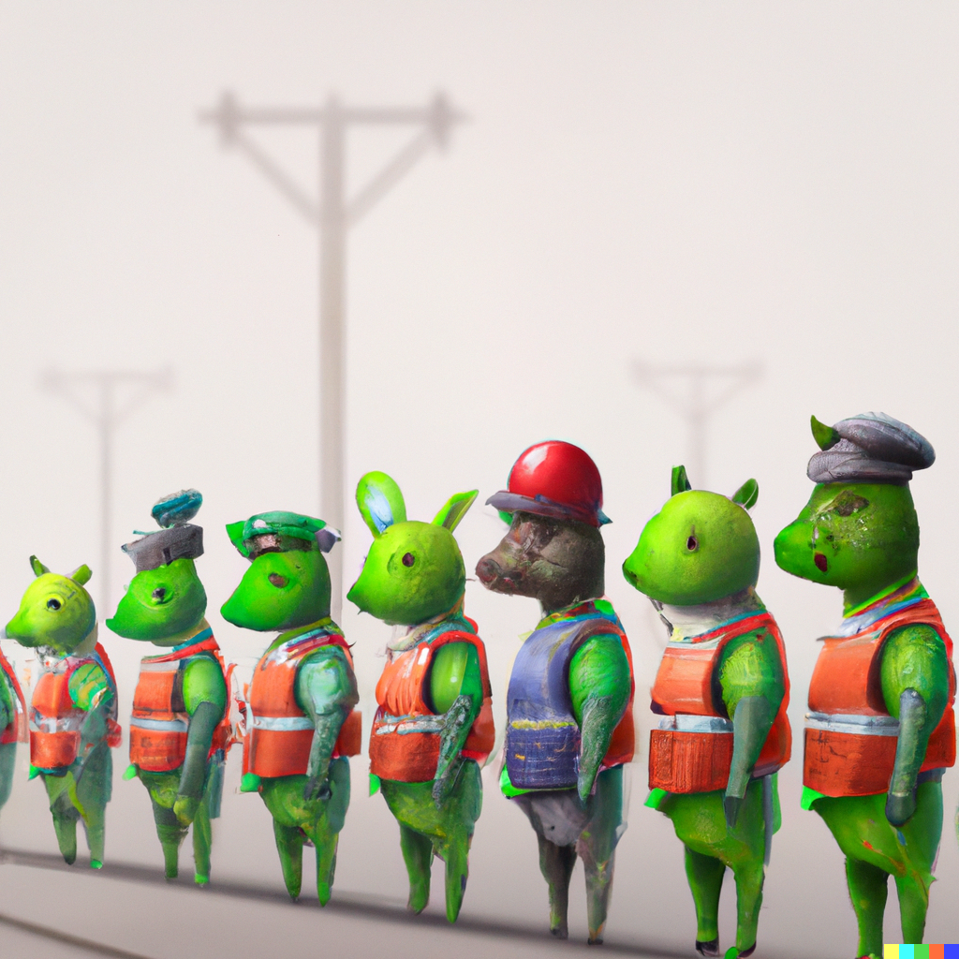
K-Nearest Neighbor
Applied Machine Learning Derek Hoiem
Dall-E

Slide 2
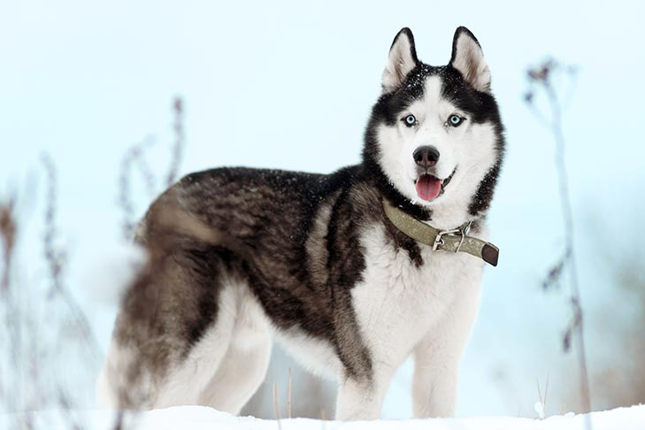
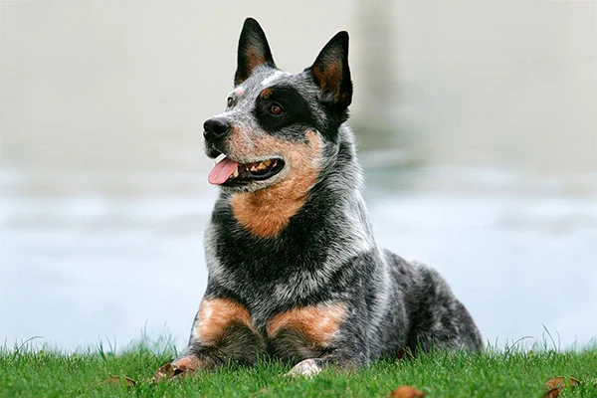
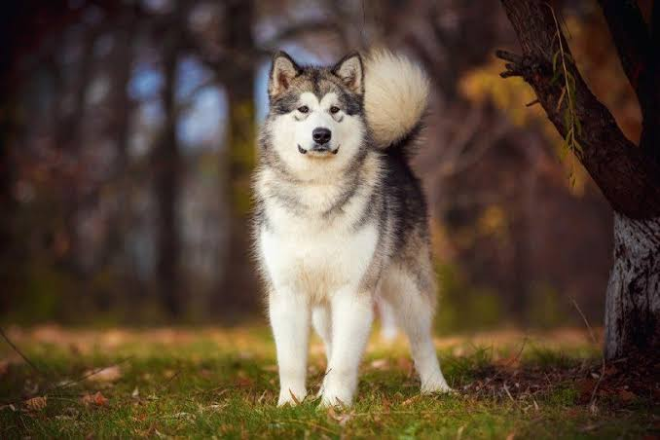
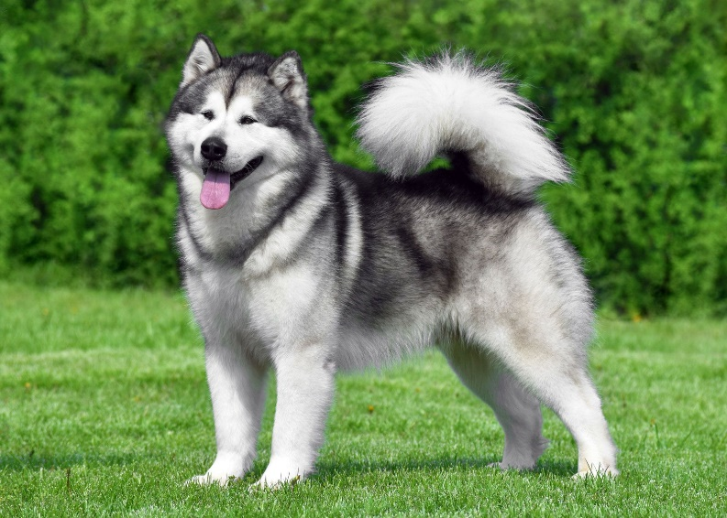
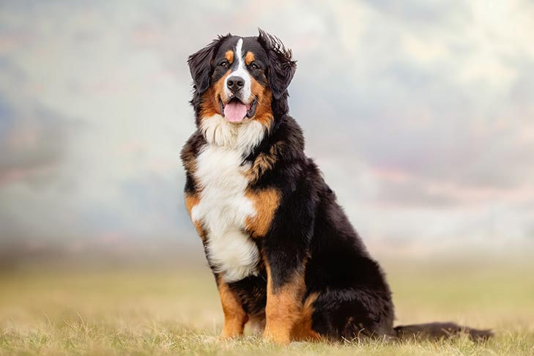
What breed is this?
(a) Siberian Husky
(b) Australian Cattle Dog
(c) Alaskan Malamut
(d) Bernese Mountain Dog
Notes:
Alaskan Malamut

Slide 3
How did you do it?
(a) Siberian Husky
(b) Australian Cattle Dog
(c) Alaskan Malamut
(d) Bernese Mountain Dog
Notes:
Alaskan Malamut

Slide 4
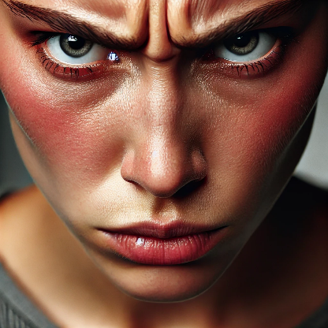
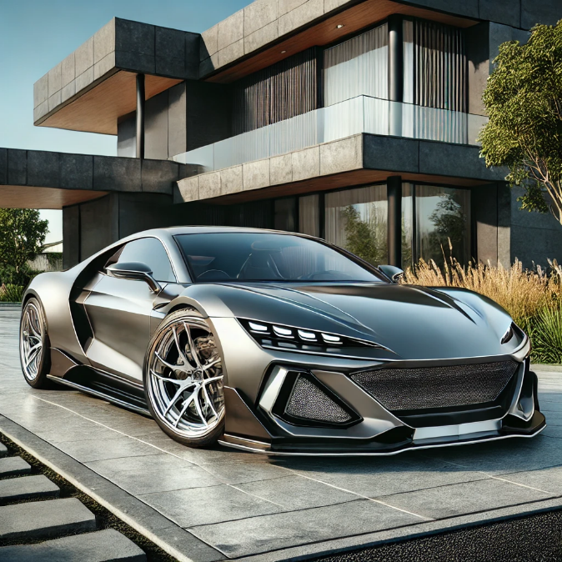
Foundation of Learning: Association
Similar inputs tend to produce similar outputs
Have a nice … ?
Happy or angry?
Affordable or expensive?

Slide 5

Key principle of machine learning
Given feature/target pairs $\left(x_{1},y_{1}\right),…,\left(x_{n},y_{n}\right):$
if $x_{i}$ is similar to $x_{j}$, then $y_{i}$ is probably similar to $y_{j}$

Slide 6
But how do we determine whether two things are similar?
Need to convert an image, audio, signal, text, etc. into a number or vector
Need to select a distance measure and/or decide the importance of different aspects of similarity

Slide 7
In ML, every object/concept/document is a number or series of numbers.
The main challenge is creating those numbers in a way that similarity makes sense.

Slide 8
Data and Information
Data are stored numbers
Information is the predictive power of data
Processing data never adds information, but it can make the information easier to access

Slide 9
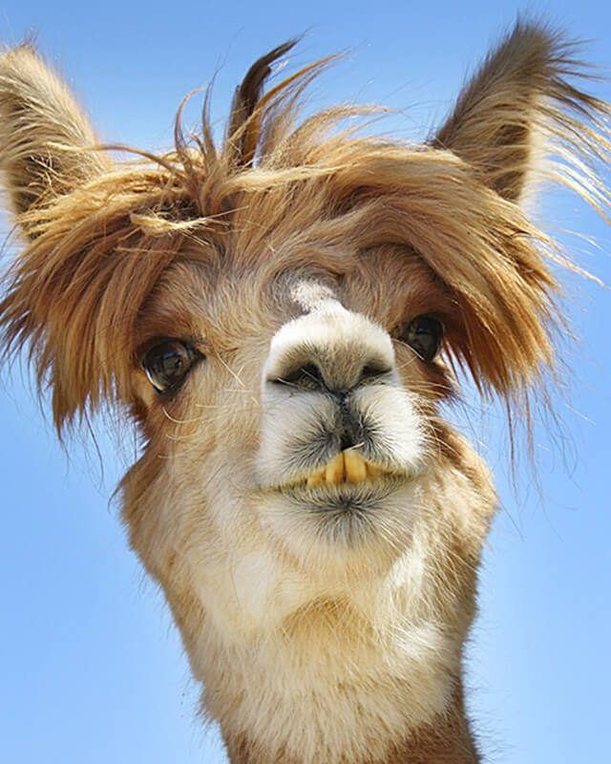
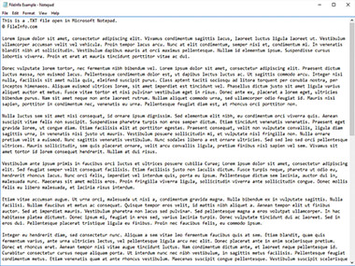
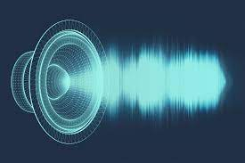
How do we represent data?
As humans: media we can see, read, and hear
Words, imagery, sounds, tables, plots
https://www.canto.com/blog/audio-file-types/
https://www.rd.com/list/funny-photos/
https://fileinfo.com/extension/txt

Slide 10
Sometimes, we can transform the data while preserving much or all of the information
Resize an image
Rephrase a paragraph
1.5x an audio book

Slide 11
Sometimes, we can even transform the data so that it is more informative (to humans)
Perform denoising on an image
Identify key points and insights in a document
Remove background noise from audio
None of these operations add information to the data, but they re-organize and/or remove distracting information

Slide 12
In computers, data are numbers
The numbers do not “mean” anything by themselves
The meaning comes from the way the numbers were produced and how they relate to each other
The meaning can be contained in each number by itself, or commonly by patterns in groups of numbers

Slide 13
We can transform the data while preserving much or all of the information
Add or multiply by a constant value
Represent as a 16-bit or 32-bit float or integer
Compress a document, or store in a different file format

Slide 14
Sometimes, we can even transform the data so that it is more informative (i.e. simple comparisons are more effective)
Center and rescale images of digits so they are easier to compare to each other
Normalize (subtract means and divide by standard deviations) cancer cell measurements to make simple similarity measures better reflect malignancy
Select features or create new ones out of combinations of inputs

Slide 15
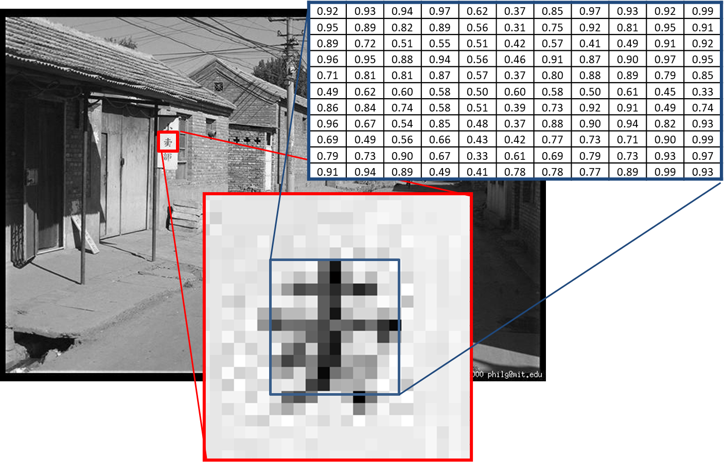
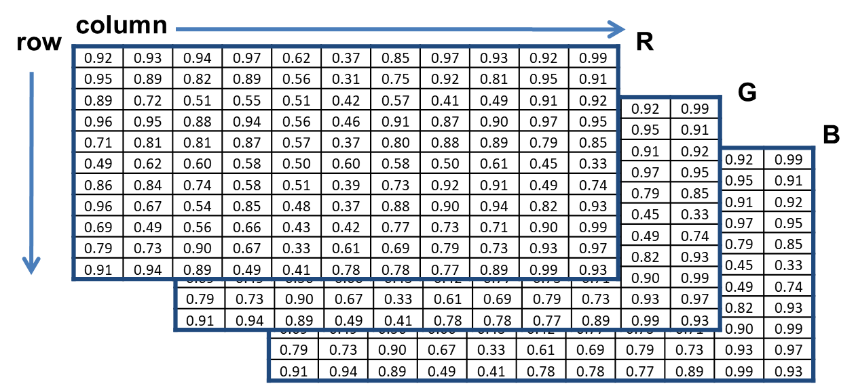
Images can be represented as 3D matrices (row, col, color)

Slide 16
We can change the structure of data to make it easier to process
Image as matrix
Image as vector
0.92 | 0.93 | 0.94 | 0.97 | 0.62 | 0.37 | 0.85 | 0.97 | 0.93 | 0.92 | 0.99
0.95 | 0.89 | 0.82 | 0.89 | 0.56 | 0.31 | 0.75 | 0.92 | 0.81 | 0.95 | 0.91
0.89 | 0.72 | 0.51 | 0.55 | 0.51 | 0.42 | 0.57 | 0.41 | 0.49 | 0.91 | 0.92
0.96 | 0.95 | 0.88 | 0.94 | 0.56 | 0.46 | 0.91 | 0.87 | 0.90 | 0.97 | 0.95
0.71 | 0.81 | 0.81 | 0.87 | 0.57 | 0.37 | 0.80 | 0.88 | 0.89 | 0.79 | 0.85
0.49 | 0.62 | 0.60 | 0.58 | 0.50 | 0.60 | 0.58 | 0.50 | 0.61 | 0.45 | 0.33
0.86 | 0.84 | 0.74 | 0.58 | 0.51 | 0.39 | 0.73 | 0.92 | 0.91 | 0.49 | 0.74
0.96 | 0.67 | 0.54 | 0.85 | 0.48 | 0.37 | 0.88 | 0.90 | 0.94 | 0.82 | 0.93
0.69 | 0.49 | 0.56 | 0.66 | 0.43 | 0.42 | 0.77 | 0.73 | 0.71 | 0.90 | 0.99
0.79 | 0.73 | 0.90 | 0.67 | 0.33 | 0.61 | 0.69 | 0.79 | 0.73 | 0.93 | 0.97
0.91 | 0.94 | 0.89 | 0.49 | 0.41 | 0.78 | 0.78 | 0.77 | 0.89 | 0.99 | 0.93
0.92
0.95
0.89
0.96
0.71
0.49
0.86
0.96
0.69
0.79
0.91
0.93
0.89
0.72
0.95
0.81
0.62
0.84
0.67
0.49
0.73
0.94
…
0.93
Convenient for local pattern analysis
This does not change the information in the data.
Convenient for linear projection or computing similarity

Slide 17
Text can be represented as a sequence of integers
Each character can map to a byte value, and then we have a sequence of bytes
“Dog ate” → [4 15 7 27 1 20 5]
Each complete word can map to an integer value, and we have a sequence of integers
“Dog ate” → [437 1256]
Common groups of letters can be mapped to subwords and then to integers
“Bedroom 1521” → [bed-room- -1-5-2-1]→[125 631 27 28 32 29 27]

Slide 18
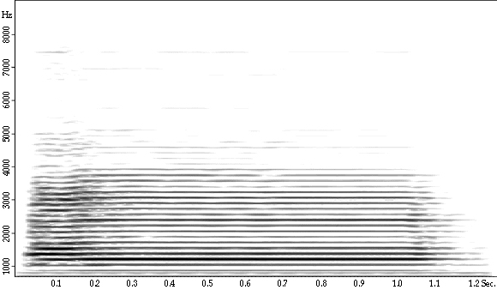
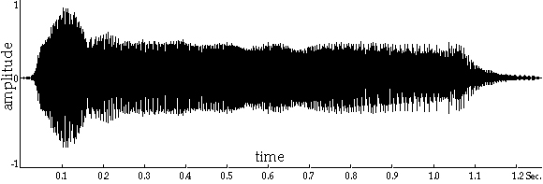
Audio can be represented as a waveform or spectrum
Amplitude vs Time
Frequency-Amplitude vs Time
Fig source

Slide 19
Other kinds of data
Measurements and continuous values typically represented as floating point numbers
Temperature, length, area, dollars
Categorical values represented as integers or one-hot vectors
Integer: Happy/Indifferent/Sad → 0/1/2
One-hot: Happy → [1 0 0]
Another example: Red/Green/Blue/Orange/Other → 0/1/2/3/4
Different kinds of values (text, images, measurements) can be reshaped and concatenated into a long feature vector

Slide 20
The same information content can be represented in many ways.
If the original numbers can be recovered, then a change in representation does not change the information content.
All types of data can be stored as 1D vectors/arrays.

Slide 21
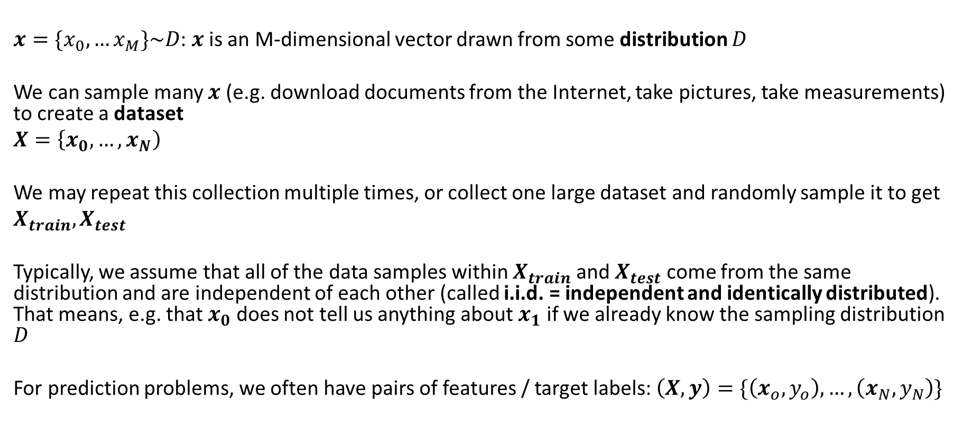
From data point to data set
$x=\{x_{0},…x_{M}\}\sim D$: $x$ is an M-dimensional vector drawn from some distribution $D$
We can sample many $x$ (e.g. download documents from the Internet, take pictures, take measurements) to create a dataset
$X=\left\{x_{0}, …, x_{N}\right)$
We may repeat this collection multiple times, or collect one large dataset and randomly sample it to get
$X_{train}, X_{test}$
Typically, we assume that all of the data samples within $X_{train}$ and $X_{test}$ come from the same distribution and are independent of each other (called i.i.d. = independent and identically distributed). That means, e.g. that $x_{0}$ does not tell us anything about $x_{1}$ if we already know the sampling distribution $D$
For prediction problems, we often have pairs of features / target labels: $\left(X, y\right)=\{\left(x_{o},y_{o}\right), …,\left(x_{N},y_{N}\right)\}$

Slide 22
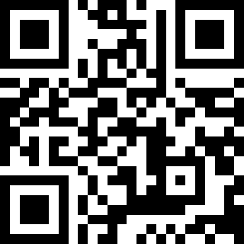
Answer Q1,Q2
https://tinyurl.com/AML441-L2

Slide 23
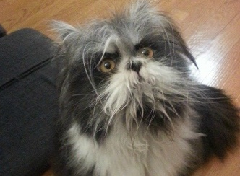
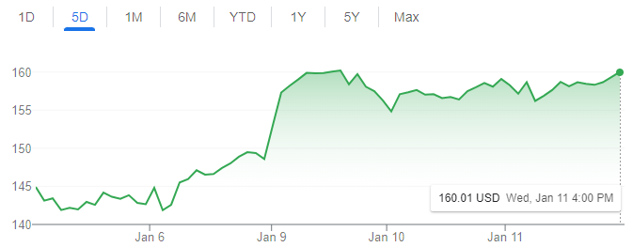
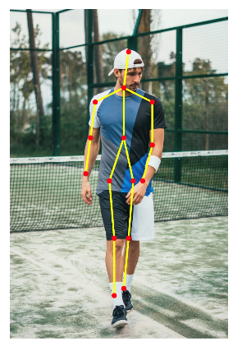
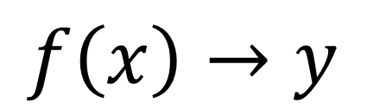
Machine learning model maps from features to prediction
$$f\left(x\right)→y$$
Features
Prediction
Examples
Classification: predict label
Is this a dog or a cat?
Is this email spam or not?
Regression: predict value
What will the stock price be tomorrow?
What will be the high temperature tomorrow?
Structured prediction
What is the pose of this person?

Slide 24
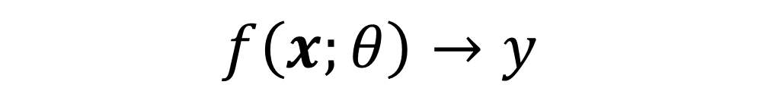


Classification problem
$$f\left(x;θ\right)→y$$
Input features
Model parameters
Predicted label
Digit classification example
$$x$$
$$y$$
3 8 7 9 9 0 1 1 5 2
Developing a classifier involves working with training, validation, and test data
Training data: used to fit parameters of the model
Validation data: used to select the best model and any parameters that need to be manually set (“hyperparameters”)
Test data: used to evaluate the final version of the model

Slide 25
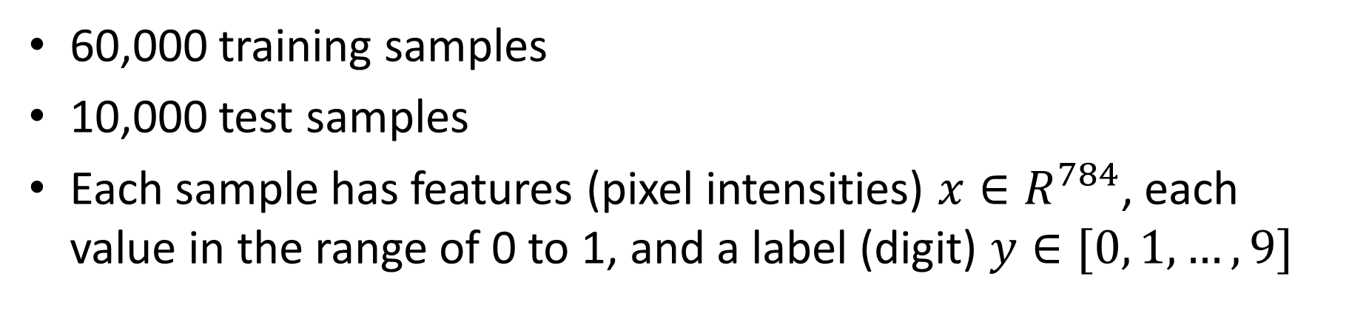


Introduction to MNIST, a classification benchmark
$$x$$
$$y$$
3 8 7 9 9 0 1 1 5 2
60,000 training samples
10,000 test samples
Each sample has features (pixel intensities) $x∈R^{784}$, each value in the range of 0 to 1, and a label (digit) $y∈[0, 1, …, 9]$

Slide 26
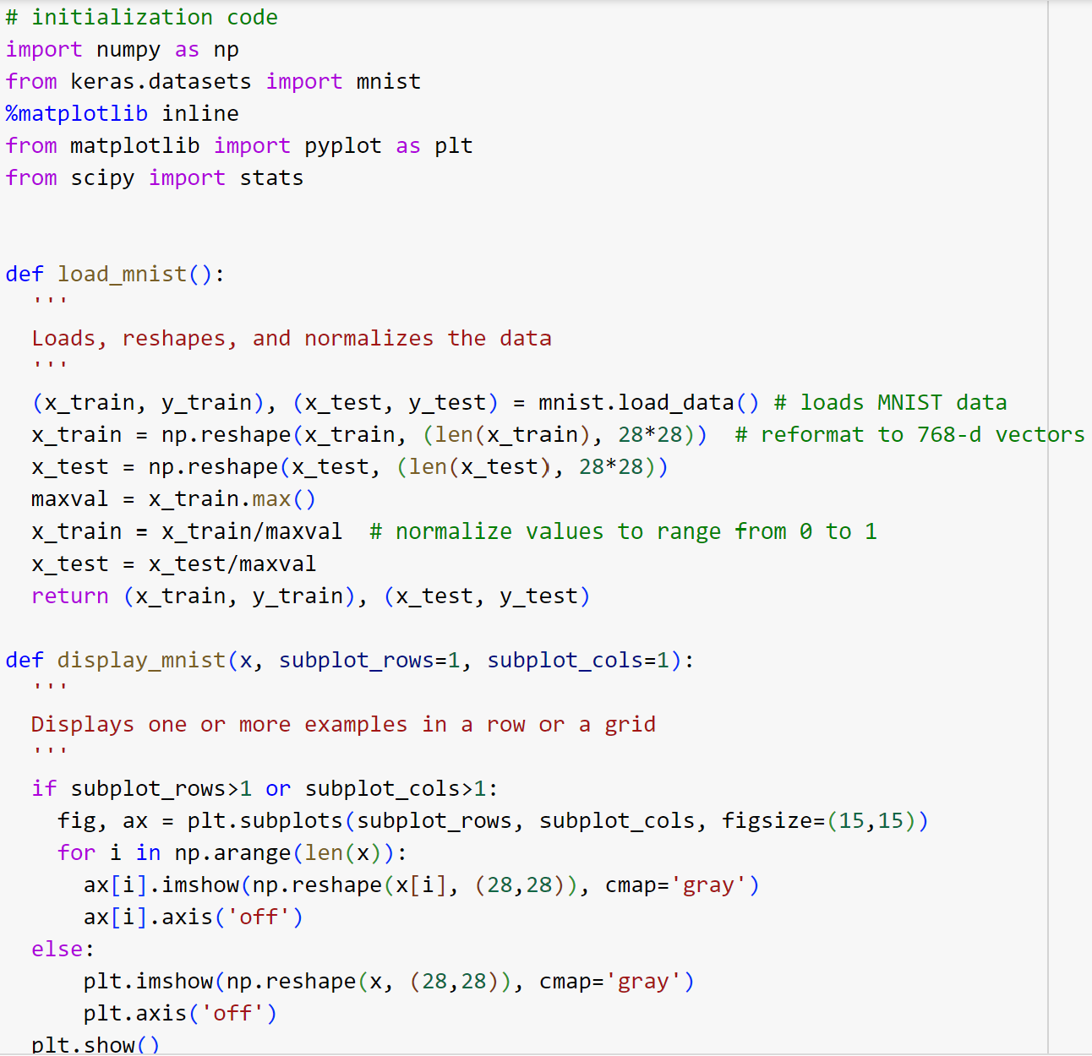
MNIST Processing
x_train[0] is the features of the first training sample
y_train[0] is the label of the first training sample
x_train[:1000] is the features of the first 1000 training samples
784-d

Slide 27
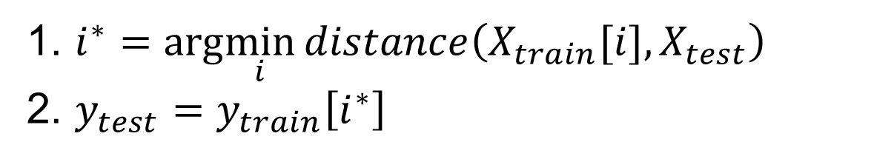
Nearest neighbor algorithm
For given test features, assign the label / target value of the most similar training features
1. $i^{∗}=arg\min_{i}{distance\left(X_{train}[i],X_{test}\right)}$
2. $y_{test}=y_{train}\left[i^{∗}\right]$
Distance is typically sum of squared distance or cosine distance.
There is no training! The accuracy depends on the features, and how much data you have.

Slide 28
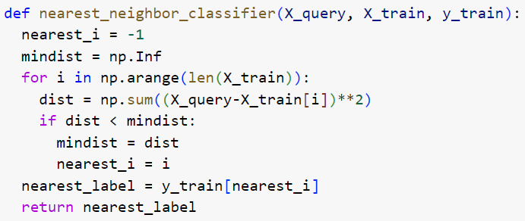
Nearest neighbor algorithm

Slide 29
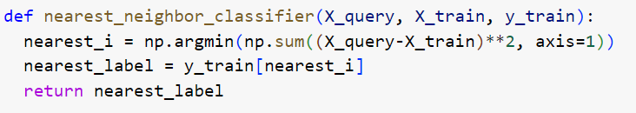
Nearest neighbor algorithm (concise)

Slide 30
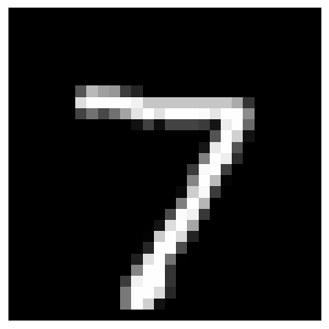










Example Predictions
Nearest Training Image and Label with Varying Number of Training Samples ($N$)
Test image
$$N=100$$
$$N=1000$$
$$N=10000$$
9
7
7
6
6
2

Slide 31
1-nearest neighbor (KNN, K=1)
x
x
x
o
x
x
x
+
o
o
x
x
o
o
+
o
o
x2
x1

Slide 32
3-nearest neighbor (KNN, K=3)
x
x
x
o
x
x
x
+
o
o
x
x
o
o
+
o
o
x2
x1

Slide 33
KNN: Increasing K gives a smoother decision boundary (less sensitive to unusual data points)
K=1
K=3
x
x
x
x
x
o
x
o
x
x
x
x
x
x
o
x
o
x
o
x
o
x
o
o
o
o
o
o
o
o
x2
x2
x1
x1

Slide 34
5-nearest neighbor (KNN, K=5)
x
x
x
o
x
x
x
+
o
o
x
x
o
o
+
o
o
x2
x1

Slide 35
Answer Q3
https://tinyurl.com/AML441-L2

Slide 36
Comments on K-NN
Simple: an excellent baseline and sometimes hard to beat
Naturally scales with data: it may be the only choice when you have one example per class, and is still often achieves good performance when you have many
Higher K gives smoother functions
Can work with only one example per class
Naïve implementations are slow, but fast retrieval methods are available (as we’ll see in Lecture 4)
No training time (other than storing/indexing examples)
With infinite examples, 1-NN provably has error that is at most twice Bayes optimal error (but we never have infinite examples)

Slide 37
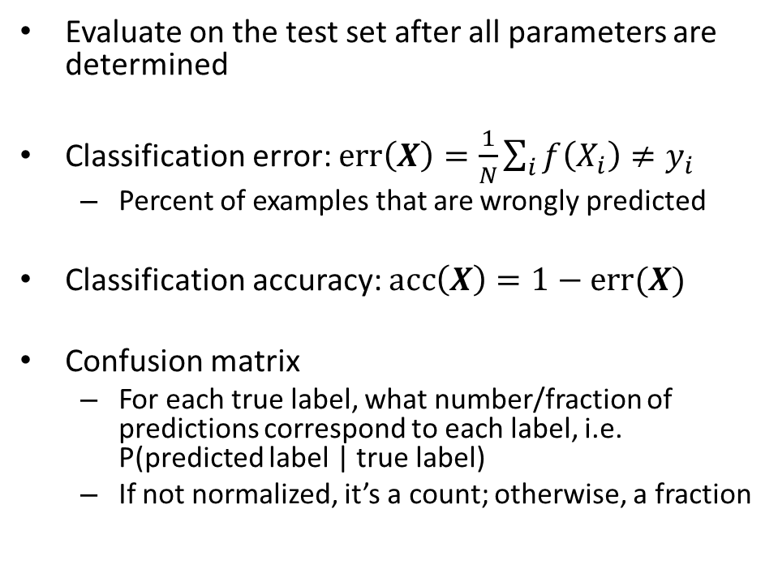
How do we measure and analyze classification performance?
Evaluate on the test set after all parameters are determined
Classification error: $err\left(X\right)=\frac{1}{N}\sum_{i}{f\left(X_{i}\right)≠y_{i}}$
Percent of examples that are wrongly predicted
Classification accuracy: $acc\left(X\right)=1−err(X)$
Confusion matrix
For each true label, what number/fraction of predictions correspond to each label, i.e. P(predicted label | true label)
If not normalized, it’s a count; otherwise, a fraction

Slide 38
Example
Answer Q4-Q6
Classifier predicts whether a team will lose, tie, or win
https://tinyurl.com/AML441-L2
True | Predicted
Win | Win
Loss | Tie
Tie | Tie
Win | Win
Tie | Loss

Slide 39
Performance measures are an estimate
E.g., suppose we have 1,000 training samples and measure an error rate of 8% on 100 test samples.
With a different set of test samples, we expect to see the same error rate, but it could vary
With a different set of the same number of training samples, we also expect to see the same error rate, but with variance
If we increase the number of test samples, the expected test error doesn’t change, but the variance in the estimate decreases
If we increase the number of training samples, the expected test error will be lower

Slide 40
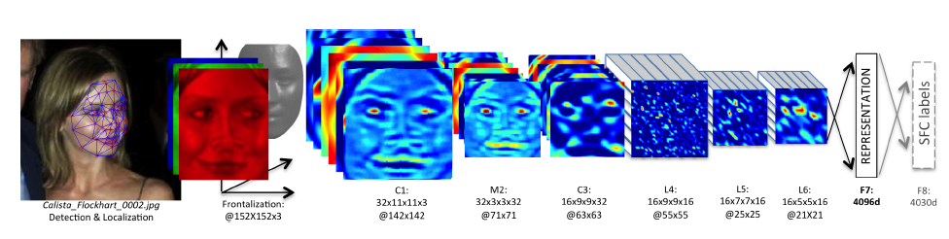
KNN Usage Example: Deep Face
CVPR 2014
Detect facial features
Align faces to be frontal
Extract features using deep network while training classifier to label image into person (dataset based on employee faces)
In testing, extract features from deep network and use nearest neighbor classifier to assign identity
Performs similarly to humans in the LFW dataset (labeled faces in the wild)
Can be used to organize photo albums, identifying celebrities, or alert user when someone posts an image of them
If this is used in a commercial deployment, what might be some unintended consequences?
This algorithm is/was used by Facebook (though with expanded training data)

Slide 41
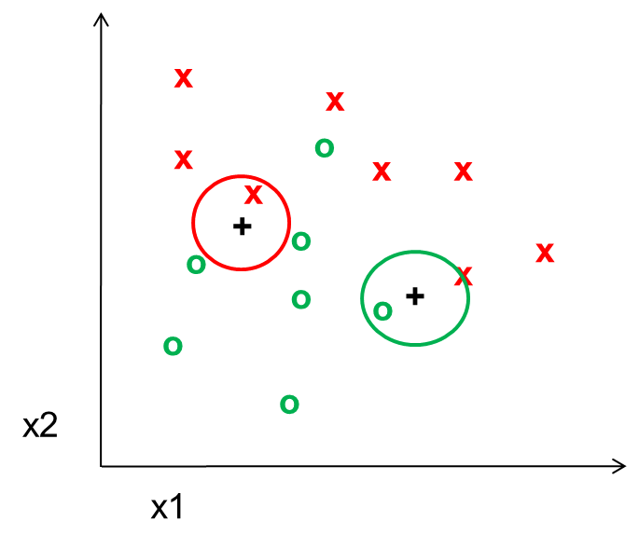
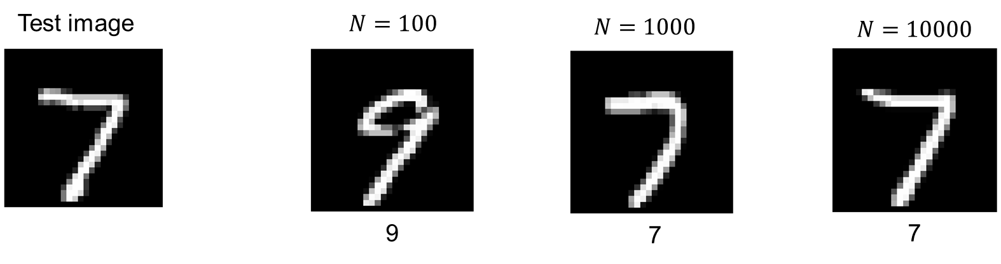
Things to remember
Foundation of ML: similar features predict similar labels
Hard part: How to represent inputs with vectors that reflect the similarity
KNN is a simple but effective classifier that predicts the label of the most similar training example(s)
Accuracy depends on quality of features and number of training samples
Larger K gives a smoother prediction function
Measure classification performance with error and confusion matrices

Slide 42
Coming up
Mon: Holiday!
Tues: Regression with KNN, Generalization
Thurs: Search and Clustering

Slide 44
Example
Classifier predicts whether a team will lose, tie, or win
Error = 40%
True | Predicted
Win | Win
Loss | Tie
Tie | Tie
Win | Win
Tie | Loss
Normalized Confusion Matrix
 |  | Predicted | N
 |  | L | T | W
True | L | 0 | 1 | 0
 | T | 0.5 | 0.5 | 0
 | W | 0 | 0 | 1

Slide 45
KNN Summary
Key Assumptions
Samples with similar input features will have similar output predictions
Depending on distance measure, may assume all dimensions are equally important
Model Parameters
Features and predictions of the training set
Designs
K (number of nearest neighbors to use for prediction)
How to combine multiple predictions if K > 1
Feature design (selection, transformations)
Distance function (e.g. L2, L1, Mahalanobis)
When to Use
Few examples per class, many classes
Features are all roughly equally important
Training data available for prediction changes frequently
Can be applied to classification or regression, with discrete or continuous features
Most powerful when combined with feature learning
When Not to Use
Many examples are available per class (feature learning with linear classifier may be better)
Limited storage (cannot store many training examples)
Limited computation (linear model may be faster to evaluate)

