Slide 1
Review of Probability
Applied Machine Learning
Derek Hoiem
Notes:
This took much too long and wasn’t very coherent. Next time, re-organize:
Estimate P(x,y) where x is one discrete variable
Estimate P(x,y) where x is two discrete variables
Estimate P(x,y) where x is 768 discrete variables? Can’t do it… need an assumption, Naïve Bayes
Introduce Naïve Bayes assumption
Apply naïve bayes to MNIST in code
Use prior probability
What if x and/or y is continuous?
If x is continuous… Gaussian or discretize
If y is continuous… Gaussian, solve for most likely y using calculus: first if there is one x, then if there are multiple xs

Slide 2
What is probability
Example: probability that a person attends a particular movie
Probability of one variable
Joint probability
Conditional probability
Getting marginal probability from joint probability
Getting conditional probability from joint probability
Probability density functions
What is a probability density
Gaussian and exponential distributions
Why we minimize sum_i log P(y_i | x_i)
Logistic function log [P(y_i = c | x) / P(y_i /= c | x)]
Prediction using probability
P(x) (generative)
P(y | x) (discriminative): linear functions
Entropy: expected negative log likelihood of the data

Slide 3
Outline
Probability, joint, conditional, marginal, independent
Probability density functions
Expectations, variance, and entropy
Maximum likelihood estimation

Slide 4
What is a probability
A belief, a confidence, a likelihood
“There’s a 60% chance it will rain tomorrow.”
Based on the information I have, if we were to simulate the future 100 times, I’d expect it to rain 60 of them.
I think it’s a little more likely to rain than not
You have a 1/18 chance of rolling a 3 with two dice.
If you roll an infinite number of pairs of dice, 1 out of 18 of them will sum to 3.
Probabilities are expectations, according to some information and assumptions.
E.g., it will either rain tomorrow or not

Slide 5
Why do we care about probability in machine learning?
ML problems are often formulated as maximizing a conditional probability $P(y|X)$, e.g. the probability of the true label given features, or maximizing the data likelihood $P(X)$
Algorithms involving probabilistic objectives include logistic regression, naïve Bayes, decision trees, boosting, random forests, deep networks, EM algorithm, and more

Slide 6
Example
Movie | Attendees
Bumblebee | 40
Apocalypse | 60
There are two movies showing: “Bumblebee”, with 40 attendees, and “Apocalypse” with 60 attendees.
What is the probability that a random person is watching Apocalypse? P(X=A)
Out of all events, what fraction satisfy the criterion
100 total people
Of those 60 are watching Apocalypse
So $P(M=A)=60 / 100 = 0.6$

Slide 7
Joint Probability
Movie | Adult | Child
Bumblebee | 20 | 20
Apocalypse | 50 | 10
Suppose we also know whether each movie-goer is a child or adult
What is the probability that a movie-goer watches Bumblebee and is an adult?
Out of all events, what fraction satisfy all criteria
$$P(M=B, Age=Adult) = 20 / (20+20+50+10) = 0.2$$

Slide 8
Conditional Probability
Movie | Adult | Child
Bumblebee | 20 | 20
Apocalypse | 50 | 10
Given that a movie-goer is a child, what is the probability that he or she is watching Bumblebee?
Out of all events that satisfy the condition, what fraction satisfy the criterion
$$P(M=B | Age=Child) = 20 / (20+10) = 0.667$$

Slide 9
Conditional Probability
Movie | Adult | Child
Bumblebee | 20 | 20
Apocalypse | 50 | 10
If I know a movie-goer watching Bumblebee, what is the probability he or she is a child?
Out of all events that satisfy the condition, what fraction satisfy the criterion
$$P(M=B | Age=Child) = 20 / (20 + 20) = 0.5$$

Slide 10
Relationships between joint and conditional/marginal probabilities
Joint probability is the product of the conditional probability and the probability that the condition is true.
$$P\left(X,Y\right)=P\left(X | Y\right)P\left(Y\right)=P\left(Y | X\right)P(X)$$
This extends to many variables with a chain rule.
$$P\left(X,Y,Z\right)=P\left(X | Y,Z\right)P\left(Y | Z\right)P(Z)$$
Marginalize out a variable by summing over its possible values
$$P\left(X\right)=\sum_{i}{P\left(X,Y=y_{i}\right)}=\sum_{i}{P\left(X|Y=y_{i}\right)P(y=y_{i})}$$

Slide 11
$$P(Movie, Age)$$
 | Adult | Child
Bumblebee | 0.2 | 0.2
Apocalypse | 0.5 | 0.1
From the joint probability table, you can always compute probabilities of subsets of variables or conditional probabilities with those variables.
$$P\left(Adult\right)=0.2+0.5$$
$$P\left(Bumblebee\right)=0.2+0.2$$
$$P\left(Adult | Bumblebee\right)=0.2/(0.2+0.2)$$

Slide 12
A is independent of B if (and only if)
$$P\left(A,B\right)=P\left(A\right)P\left(B\right)$$
$P\left(A | B\right)=P(A)$, $P\left(B | A\right)=P(B)$

Slide 13
A and B are conditionally independent of C if (and only if)
$$P\left(A,B|C\right)=P\left(A|C\right)P\left(B|C\right)$$

Slide 14
Estimate a discrete probability function by counting
Movie | Age
B | C
B | A
A | A
A | A
B | A
A | A
…
$$P\left(M=B\right)=\frac{1}{|N|}\sum_{n}{δ\left(M_{n}=B\right)}$$
$$P\left(M=B,A=C\right)=\frac{1}{|N|}\sum_{n}{δ\left(M_{n}=B,A_{n}=C\right)}$$

Slide 15
Probability density functions of continuous variables
What if the variable is continuous?
Precise values may never occur and be infinitesimally unlikely, e.g.
$$P(Age=11.05) = 0$$
We replace the probability function with the probability density function, which can be integrated over a range to give a probability.
$$P\left(10≤Age<11\right)=\int_{10}^{11}{p\left(Age=a\right)da}$$
Movie | Age
B | 10
B | 38
A | 22
A | 19
B | 25
A | 50
…

Slide 16
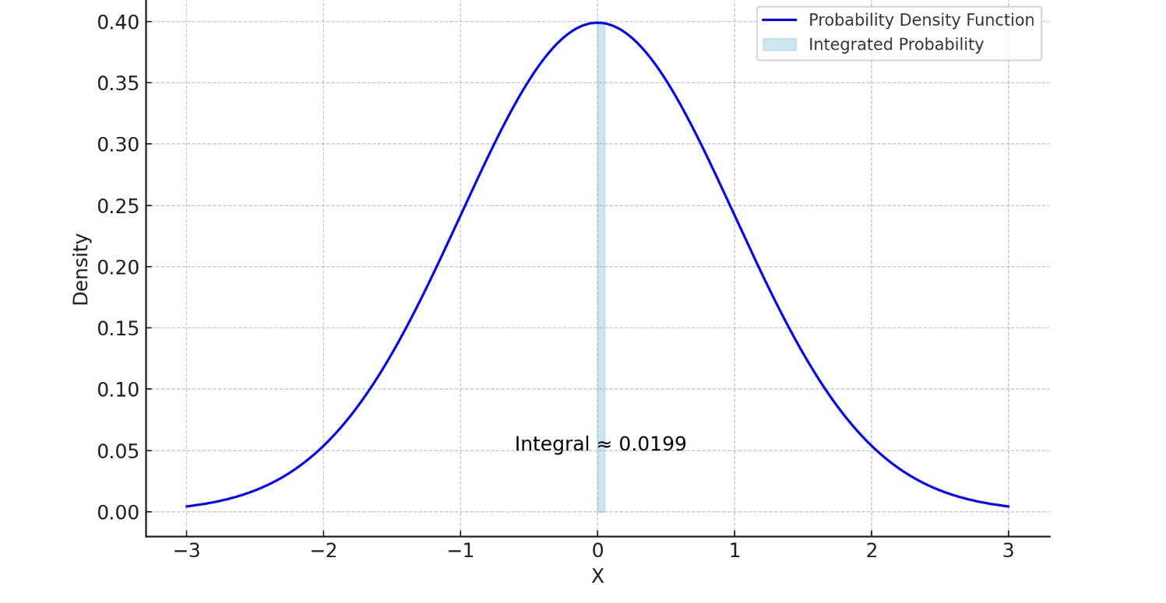
Probability density function (PDF) → Probability
$$P(0.95 < X < 1) ≈0.012$$
$$P\left(0 < X < 0.05\right)≈0.02$$
$$P(−0.05< X < 0.05) ≈0.04$$

Slide 17
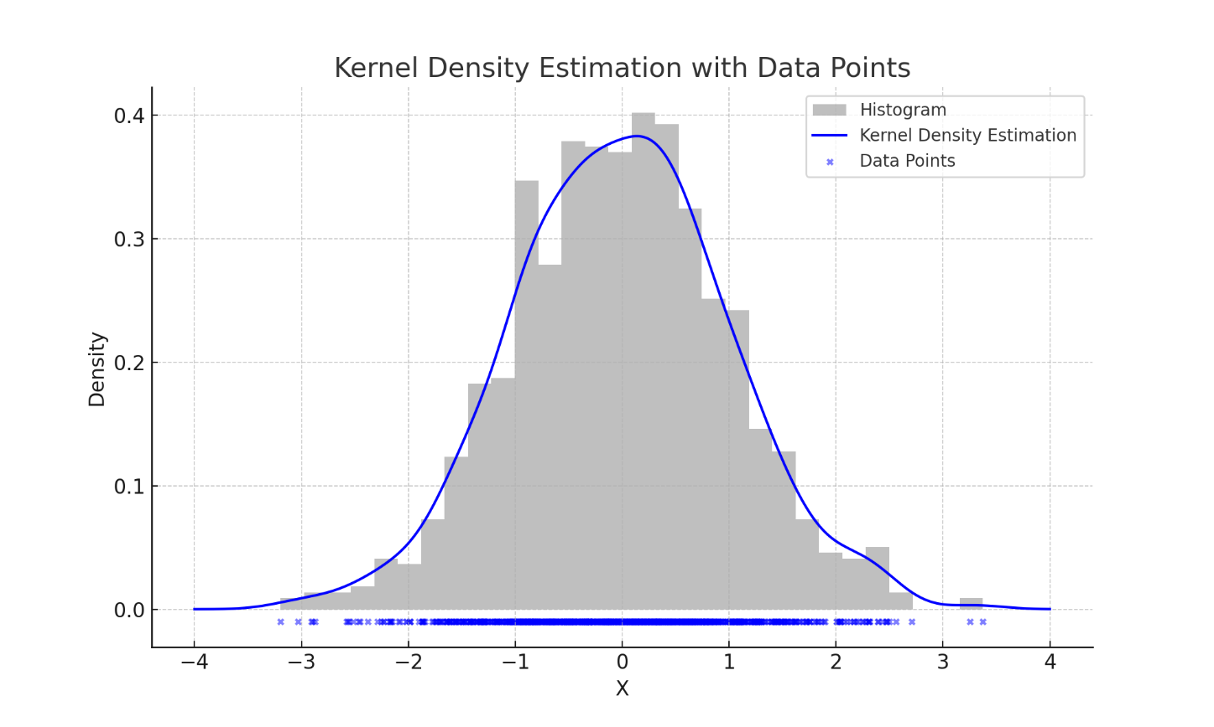
How to estimate probability density functions from samples
Discretize and count (histogram)
Kernel density estimation
Fit parameters of a model
Gaussian: $μ=−0.015 σ=1.004$

Slide 18
What must be true about probability functions?
Probabilities cannot be negative
The sum (for discrete) or integral (for continuous) must be 1
For discrete, this means that each value must be between 0 and 1
But values can be greater than 1 in a probability density function

Slide 19
Expectation and Variance
The expected value or mean of a random variable $X∈\{v_{1, }…, v_{N}\}$ is the average value we’d get if we took an infinitely large sample:
$$E\left(X\right)=\lim_{M→∞}{\frac{1}{M}\sum_{x_{i}\sim P(X)}{x_{i}}}=\sum_{i=1..N}{P\left(X=v_{i}\right)v_{i}}$$
We can take the expectation of a function $f(X)$:
$$E\left(f\left(X\right)\right)=\sum_{i=1..N}{P\left(X=v_{i}\right)f\left(v_{i}\right)}$$
The variance of $X$ measures the expected square difference of the values from the mean
$$Var\left(X\right)=E\left(\left(E\left(X\right)−X\right)2\right)=\sum_{i=1..N}{P\left(X=v_{i}\right){(E\left(x\right)−v}_{i})2 }$$
We can also take the mean or variance of a sample $S={[s}_{0},…{,s}_{K}]$, called the empirical mean or variance
$$E\left(S\right)=\frac{1}{K}\sum_{i=1..K}{s_{i}} Var\left(S\right)= \frac{1}{K}\sum_{i=1..K}{{(E\left(S\right)−s}_{i})2}$$

Slide 20
How do we measure the amount of data required to store a value of a variable?
First, let’s consider the likelihood of a set of values $x$ ~$P\left(X\right):$ $P\left(x\right)=\prod_{i}{P(x_{i})}$, assuming the values are independent. However, this will become inconveniently small, so we can equivalently consider $\log{P\left(x\right)}=\sum_{i}{\log{P\left(x_{i}\right)}}$. The expected value of this log likelihood gives us a measure of predictability.
Entropy $H(X)$ is the expected negative log likelihood of variable $X∈\{v_{1},…,v_{N}\}$
$$H\left(X\right)=\sum_{i=1..N}{−P\left(X=v_{i}\right)\log_{2}{P\left(X=v_{i}\right)}}$$
Greater entropy means that the value of X is less predictable
If $H(X)=0$, then $P\left(X=x_{i}\right)=1$ for some $x_{i}$ (and 0 for others)
If $H\left(X\right)=\log_{2}{P\left(N\right)}$, then $P\left(X=x_{i}\right)=\frac{1}{N}$ for all N values
If the values are less predictable, more bits are needed. Shannon’s source coding theorem shows that the minimum expected number of bits required to encode a string of $K$ i.i.d. values sampled from $P(X)$ is $KH(X)$
Complicated to prove, but think of each bit as dividing the possible values into two equally likely sets
E.g. let P(X=1)=1/4, P(X=2)=1/4, P(X=3)=0, P(X=4)=1/2. One bit can split ([1,2], 4) and, if needed, a second bit can split between 1 and 2. To encode, 1→00, 2→01, 4→1. This requires 1.5 bits on average. $H\left(X\right)=0.25∗2+0.25∗2+0.5∗1=1.5$. 1-1-1-01-00-10-1 = 4,4,4,2,1,4,2
$x \sim P(X)$ means that $x$ is drawn (randomly sampled) from the distribution $P(X)$

Slide 21
Typical machine learning problem: predict $Y$ from $X$
Given some features $X$, we want to predict target variable $y$, e.g.
$X$ = email text and header; $y$= spam or not spam
$X$ = meteorological data; $y$ = next day’s high temperature
$X$ = image of a handwritten number; $y$ = 0, 1, …, or 9
We often frame this probabilistically
To predict, select $y∗={argmax}_{y} P\left(y | X\right)$, i.e. choose the $y$ that is most likely given $X$
To train, optimize parameters that maximize the likelihood of the labels of the training data given the features of the training data

Slide 22
Basics of vector/matrix multiplication
$w^{T}x=w⋅x=\sum_{i}{w_{i}x_{i}}$
Element $(i, j)$ of $AB$ is the dot product of the $i$th row of $A$ with the $j$th column of $B$
$AB≠BA$
If $A$ is $N×M$size matrix and $B$ is $M×K$, then $AB$ is $N×K$
If $A$ is $N×M$size matrix and $B$ is $L×K$ with $L≠M$ then $A$ cannot be multiplied by $B$

Slide 23
Partial derivatives
$$\frac{∂}{∂w_{i}}w^{T}x=\frac{∂}{∂w_{i}}\sum_{i}{w_{i}x_{i}}=x_{i}$$

Slide 24
Classification by maximizing label likelihood
Suppose we want to predict a label $y_{i}∈\{−1, 1\}$ from an image $X_{i}$. Given a set of $N$ training examples, solve for model parameters $w$ to maximize $P({y_{1}…y_{n}|X}_{1}..X_{N})$. I.e., find the model parameters that make the training labels most likely, given the training features.
Assume each training sample is a sample from an identical and independent distribution (iid assumption): $P\left({y_{1}…y_{n}|X}_{1}..X_{N}\right)=$ $\prod_{i=1..N}{P\left(y_{i} | X_{i}\right)}$
Maximizing a product is hard because the derivative is complicated. Instead, we can maximize a sum of logs
$$log \prod_{i=1..N}{P\left(y_{i} | X_{i}\right)=\sum_{i=1..N}{log P\left(y_{i} | X_{i}\right)}}$$
We need a function (a.k.a. a model) to output the probability given the label. Let’s use linear logistic regression
$$f\left(X_{i},w\right)={wTX}_{i}=\log{P(y_{i}=1|X_{i})}−\log{P\left(y_i =−1|X_{i}\right)}=\log{\frac{P(y_{i}=1|X_{i})}{P\left(y_{i}=−1 | X_{i}\right)}}$$
This is called a logistic score or logit. We can convert the logit to a probability:
$$\frac{1}{1+\exp\left(−\log{\frac{P\left(y_{i}=1 | X_{i}\right)}{P\left(y_{i}=−1 | X_{i}\right)}}\right)}=\frac{1}{1+\frac{P\left(y_{i}=−1 | X_{i}\right)}{P\left(y_{i}=1 | X_{i}\right)}}=\frac{P\left(y_{i}=1 | X_{i}\right)}{P\left(y_{i}=1 | X_{i}\right)+P\left(y_{i}=−1 | X_{i}\right)}=P\left(y_{i}=1 | X_{i}\right)$$
This function $σ\left(x\right)=1/(1+\exp\left(−x\right))$ is called a sigmoid. So $σ({wTX}_{i})=P(y_{i}=1\left|X\right)$. Also, $σ(−{wTX}_{i})=P(y_{i}=−1\left|X\right)$.
Now we can write our objective in terms of parameters, image features, and labels:
$$w_{opt}={argmax}_{w}\sum_{i}{\log{{(y}_{i}σ({wTX}_{i}})})={argmin}_{w}\sum_{i}{−log{{(y}_{i}σ({wTX}_{i}})})$$
The argmin expression is the “loss”. We can optimize by taking the derivative of this expression wrt $w$ and performing gradient descent.

Slide 25
Problems
https://us.prairielearn.com/pl/course_instance/157430/assessment/2432153

Slide 26
Problems
Suppose $\ln{\frac{P(y_{i}=1|X_{i})}{P\left(y_{i}=−1 | X_{i}\right)}}=1.5$. What is $P(y_{i}=1|X_{i})$?
1/(1+exp(-1.5))
Suppose:
P(height | sex=M) ~ Gaussian(mu=70”, sigma=3”)
P(height | sex=F) ~ Gaussian(mu=63.5”, sigma=2.5”)
P(sex=M) = P(sex=F) = 0.5
What is P(sex=M | height = 68”)?
In the following table:
What is P(X=0)? 0.3
What is P(Y=1|X=0)? 0.4
Are X and Y independent? Y
Which of these are possible, where $f\left(x\right)$ is a probability density function (of continuous $x$) and $P(y)$ is a probability function (of discrete $y$)?
$max\left(f\left(x\right)\right)>1$
$\min\left(f\left(x\right)\right)<0$
$max\left(P\left(y\right)\right)>1$
P(y, z) > P(y) for some y and z
P(y | z) < P(y) for some y and z
5. Suppose that x and y are Gaussian variables, and the variance of y is greater than the variance of x. Which of these is true?
y has higher entropy than x
x has higher entropy than y
Neither is necessarily true
6. Suppose there are 7 girls and 13 boys in a class. If one of their names is randomly drawn from a hat, what is the probability that it will be a boy’s name?
0.65
P(X,Y) | Y=0 | Y=1
X=0 | 0.18 | 0.12
X=1 | 0.42 | 0.28

