Slide 1
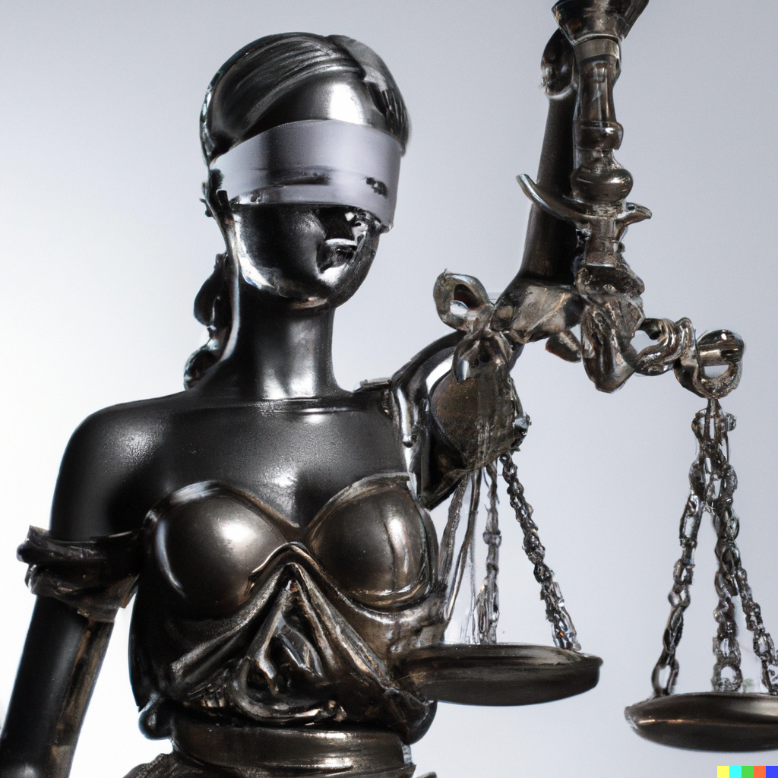
Ethics and Impact of AI
Applied Machine Learning
Derek Hoiem
Dall-E

Slide 2
This lecture
Discuss some of the impacts and ethical questions around AI
Learn about model cards and other tools

Slide 3
AI has many impacts
Manufacturing: robotics
Healthcare: drug discovery
Education: learning assistants
Media: article generation
Customer service: automated help center
Transportation: autonomous vehicles
Improving productivity / automating jobs, such as programming, marketing, help support, …

Slide 4
What/who is impacted by AI?
“Who will have access to the technology and be able to reap its benefits? Who will be able to empower themselves by using AI? Who will be excluded from these rewards?”
AI Ethics, Coeckelbergh (p 76)

Slide 5
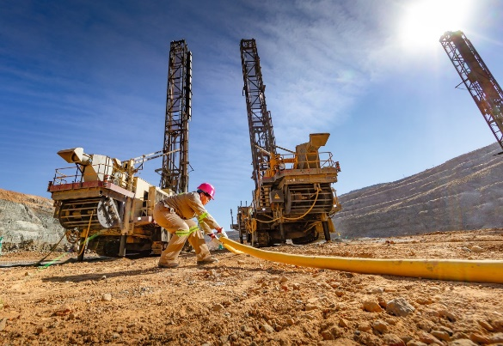
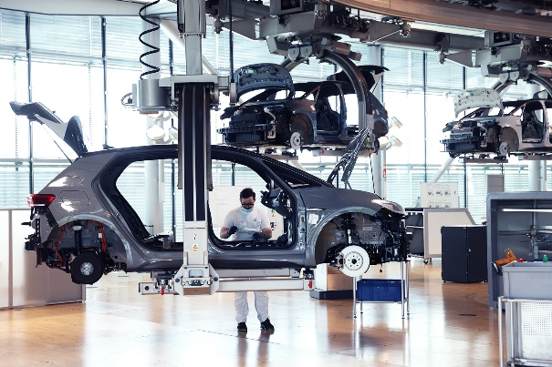
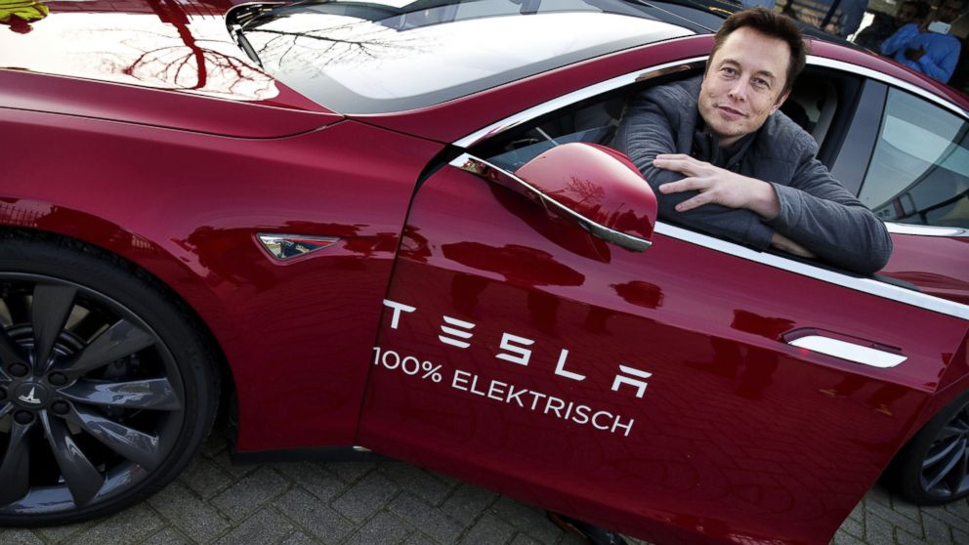
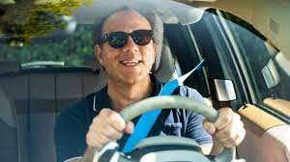
How do we think about impact?
Consider Electric Cars
Mining for Raw Materials
Manufacturing
Automakers
Usage
Geo-political
China supplies more than 70% of capacity for battery raw materials and manufacturing
US depends on importing critical raw materials for batteries
Workers
* China’s battery material mines may include forced labor
Manufacturing
EV have fewer moving parts, more battery-based, so different process
New factories employ fewer workers and have different safety concerns
Owners/investors
Massive wealth to Tesla
Massive investment required by others
Lower barrier to entry, since manufacturing EV from components is simpler
Drivers
Quiet and fun to drive
May be expensive
Status symbol
Others
Lower pollution

Slide 6
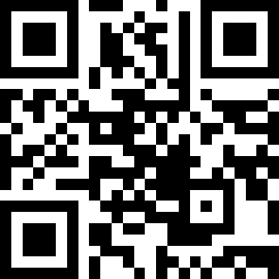
Discuss with your neighbor
Q1. What is one big impact of AI – who is impacted and how?
https://tinyurl.com/441-L21-fa24

Slide 7
Impact on environment
2019
GPT-3 estimate: ~1.1M lbs
Crypto-assets: 0.3% of global annual greenhouse gas emissions
All data centers: 2% of global emissions
https://arxiv.org/pdf/1906.02243.pdf

Slide 8
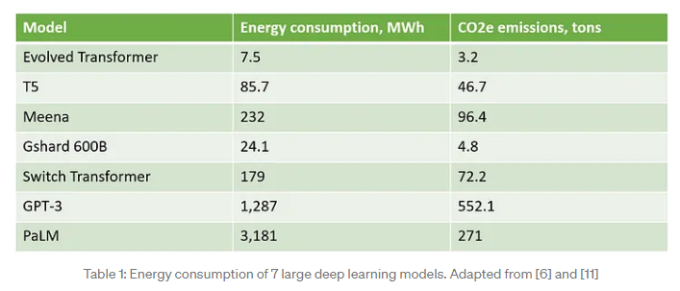
There are techniques to estimate and reduce the carbon footprint of your models
https://towardsdatascience.com/how-to-estimate-and-reduce-the-carbon-footprint-of-machine-learning-models-49f24510880

Slide 9
Economic Impact
Research by Accenture suggests that AI could double global economic growth rates by 2035, across 12 developed economies. This growth will be driven by a 40% increase in labor productivity, the creation of a virtual workforce capable of problem-solving and self-learning, and the diffusion of innovation that will create new revenue streams.
Pricewaterhouse Coopers (PwC) estimates that the development and take-up of AI could increase global GDP by up to 14% (equivalent to US$15.7 trillion) by 2030. PwC sees two main channels through which AI will impact the global economy: productivity gains in the near term, based on automation of routine tasks, and the complementing and assisting of the existing workforce with AI technologies to perform tasks better and more efficiently.
https://www.europarl.europa.eu/RegData/etudes/BRIE/2019/637967/EPRS_BRI(2019)637967_EN.pdf

Slide 10
Impact of AI on Work
At-risk (according to Webb 2020): tasks that involve detecting patterns, making judgments and optimizing
  Lab technicians
  Chemical engineers
  Optometrists
  Power plant operators
  Inspection and quality control
At-risk (according to Chat GPT)
  Data Entry Clerks
  Telemarketers
  Financial Analysts
  Factory Workers
  Delivery Drivers
  But could add jobs in software development, data analysis, and AI engineering
I will add
  Routine white collar jobs: legal services, content generators (e.g. marketing), retail clerks
This list does not make sense to me, mostly
https://www.whitehouse.gov/wp-content/uploads/2022/12/TTC-EC-CEA-AI-Report-12052022-1.pdf

Slide 11
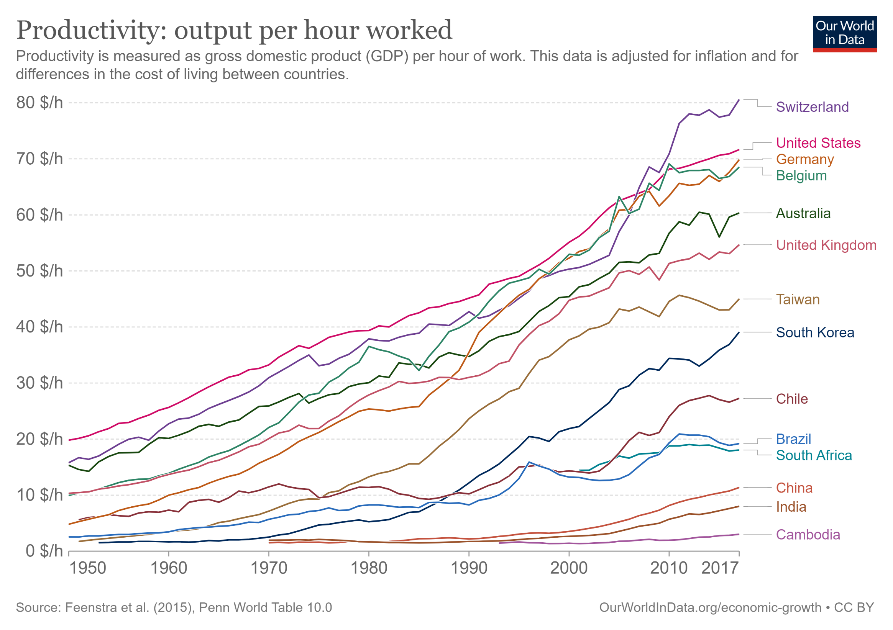

Slide 12
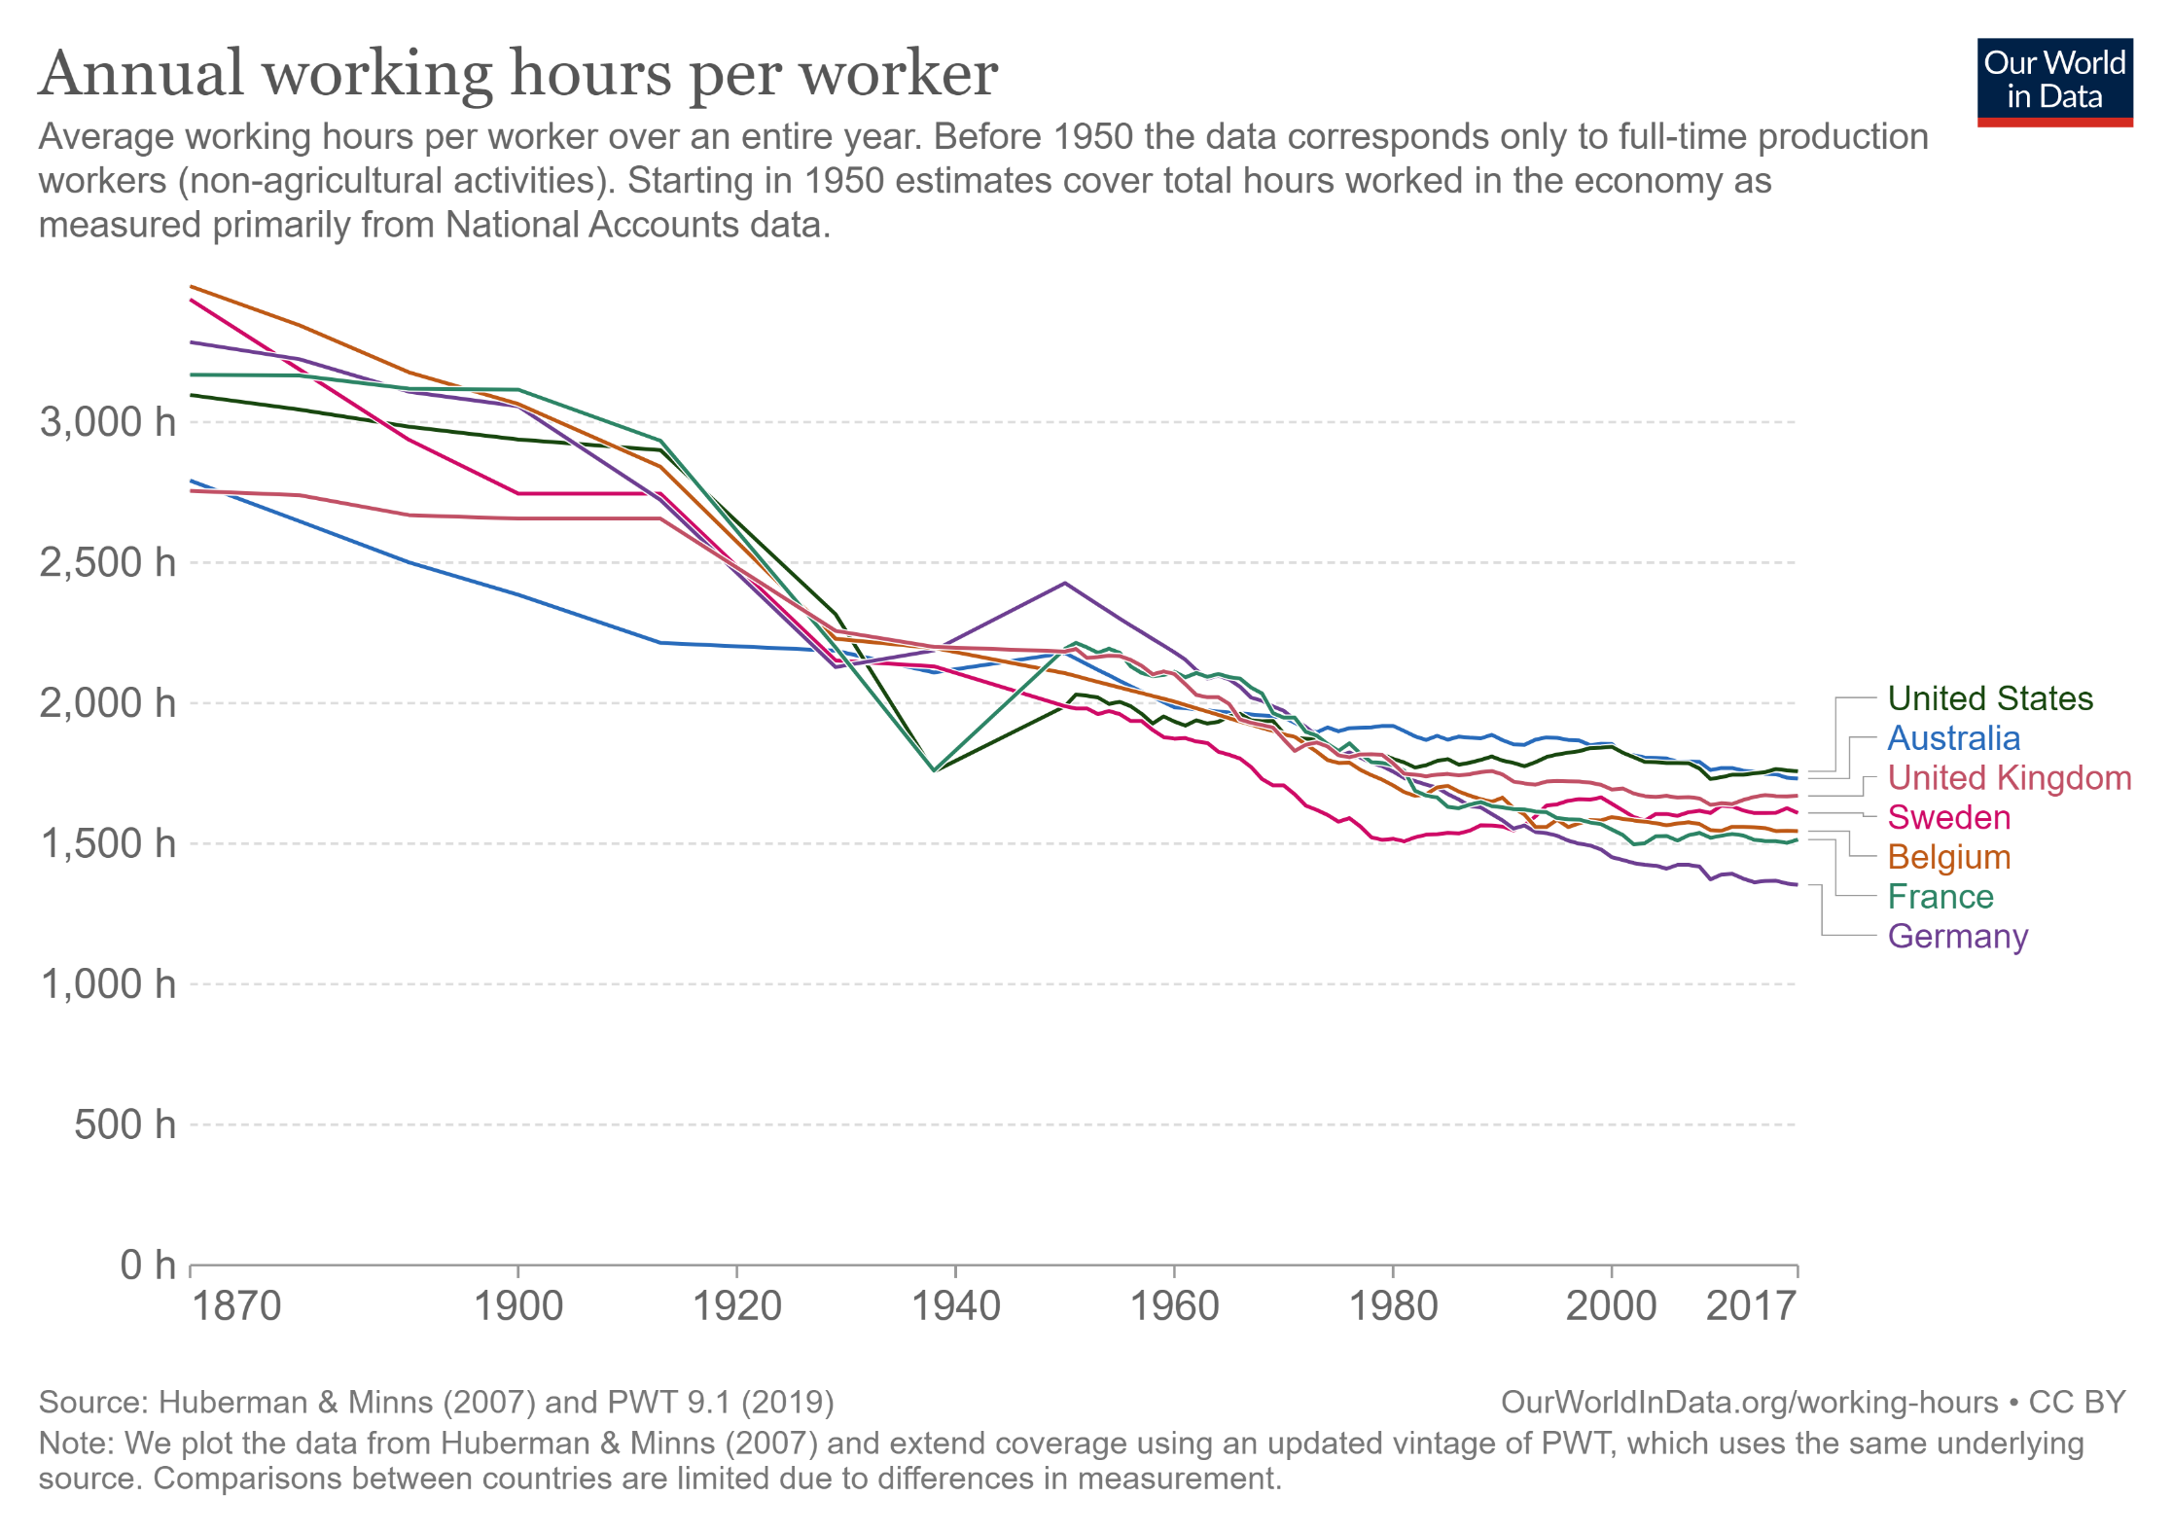
https://ourworldindata.org/working-hours

Slide 13
Impact of AI
We just don’t know because it’s happening so fast
“I would advocate not moving fast and breaking things.”
- Demis Hassibis (Deep Mind CEO)

Slide 14
Q2. Which of the regulation proposals do you support?
AI has potential for many harms
  Disinformation, e.g. through social media
  Information spamming – automatically generated internet content
  Cheating or avoiding learning by having AI complete assignments
  AI agents stealing and reproducing synthetic content such as music, stories, art
AI producers do not have a strong incentive to restrict their products
https://tinyurl.com/441-L21-fa24

Slide 15
Popular support for Regulation
Regulating Deepfakes
Prohibit the use of deepfakes in political campaign advertisements, such as to depict an opponent saying something they did not, or to depict an event that did not occur, as proposed by the Federal Election Commission. (National 84%, Republicans 83%, Democrats 86%)
Prohibit the public distribution of any pornographic deepfake that was made without the consent of the person being depicted, as proposed in the Preventing Deepfakes of Intimate Images Act and DEFIANCE Act. (National 86%, Republicans 85%, Democrats 87%)
Require that all deepfakes which are shared publicly be clearly labeled as such, as proposed in the AI Labeling Act, AI Disclosure Act, and DEEPFAKES Accountability Act. (National 83%, Republicans 83%, Democrats 85%)
Nine Major Proposals for Government Regulating Artificial Intelligence Favored by Very Large Bipartisan Majorities of Voters | Program for Public Consultation

Slide 16
Regulating AI programs that make decisions which can significantly impact people’s lives
Require these AI programs pass a test before they can be put into use, which would evaluate whether they may violate regulations, make biased decisions, or have security vulnerabilities. (National 81%, Republicans 76%, Democrats 88%)
Allow the government to audit programs that are in use, and require the AI company to fix any problems that are found. (National 77%, Republicans 74%, Democrats 82%)
Require AI companies to disclose information to the government about how the decision-making AI was trained, if requested, to aid with pre-testing and audits. (National 72%, Republicans 67%, Democrats 81%)

Slide 17
Others
Creating a new federal agency for AI to enforce regulations, oversee AI development and provide guidance on AI policy is supported by 74% (Republicans 68%, Democrats 81%).
Creating a treaty to prohibit the development of weapons that can use AI to fire on targets without human control – called lethal autonomous weapons – as has been called for by the International Committee of the Red Cross, and the Campaign to Stop Killer Robots.
A large bipartisan majority (77%) favors the creation of such an international agency that would develop international standards for large-scale AI and have the authority to monitor and inspect whether their standards are being met

Slide 18
Who is responsible?
Developers decide what algorithm, what priors/constraints, what data to use
Company management releases products and features
Users may apply the AI to their own ends
The AI itself is not entirely predictable and lacks understanding of relevance, experience, sensitivity, and wisdom
AI Ethics, Coeckelbergh (p 90-1)

Slide 19
Responsibility requires
Control
Knowledge
Children and animals are not typically held responsible, due to lack of control and knowledge.
AI does not “know” what it is doing. But do its developers?

Slide 20
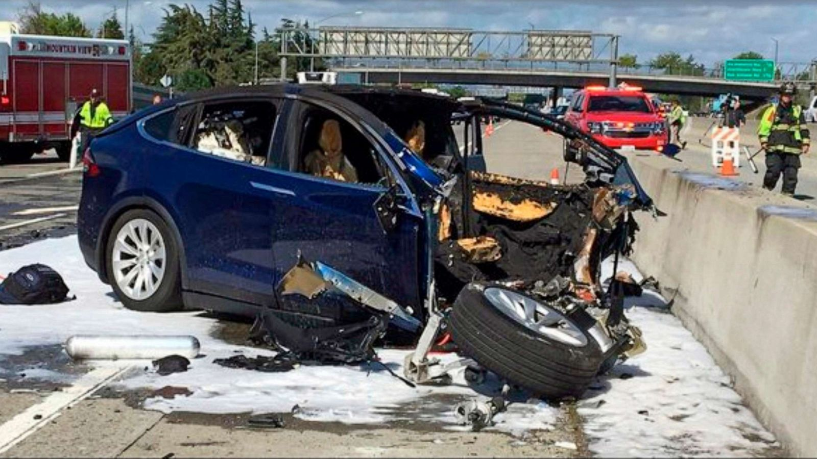
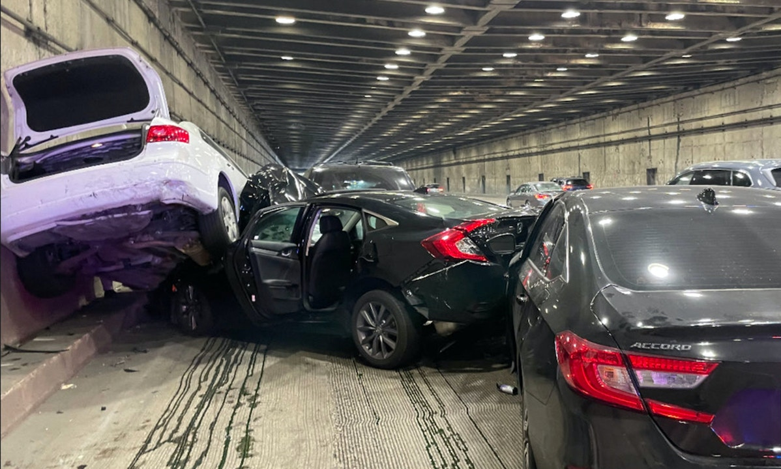
Who is responsible for self-driving vehicle crashes?
Tesla crash on Bay Bridge
https://abcnews.go.com/Business/tesla-autopilot-steered-driver-barrier-fatal-crash-ntsb/story?id=68936725
Tesla on autopilot had steered driver towards same barrier before fatal crash, NTSB says
https://theintercept.com/2023/01/10/tesla-crash-footage-autopilot/
“Autopilot, Enhanced Autopilot and Full Self-Driving Capability are intended for use with a fully attentive driver, who has their hands on the wheel and is prepared to take over at any moment. While these features are designed to become more capable over time, the currently enabled features do not make the vehicle autonomous.”

Slide 21
Q3. Discuss: who is responsible if an autonomous vehicle crashes due to failure of autonomous system?
https://tinyurl.com/441-L21-fa24

Slide 22
Who is responsible if GPT is used for disinformation?
https://www.nytimes.com/2023/02/08/technology/ai-chatbots-disinformation.html
“This tool is going to be the most powerful tool for spreading misinformation that has ever been on the internet,” said Gordon Crovitz, a co-chief executive of NewsGuard, a company that tracks online misinformation and conducted the experiment last month. “Crafting a new false narrative can now be done at dramatic scale, and much more frequently — it’s like having A.I. agents contributing to disinformation.”
OpenAI: We’ve trained a classifier to distinguish between text written by a human and text written by AIs from a variety of providers. … Our classifier is not fully reliable. In our evaluations on a “challenge set” of English texts, our classifier correctly identifies 26% of AI-written text (true positives) as “likely AI-written,” while incorrectly labeling human-written text as AI-written 9% of the time (false positives).
https://openai.com/blog/new-ai-classifier-for-indicating-ai-written-text

Slide 23
Q4. Discuss: who is responsible if GPT is used for dissinformation?
https://tinyurl.com/441-L21-fa24

Slide 24
Who owns the data?
The value of an AI model is often the ability to synthesize large amounts of data
Large tech companies make fortunes by harvesting data from users
Often this data is collected without consent or knowledge

Slide 25
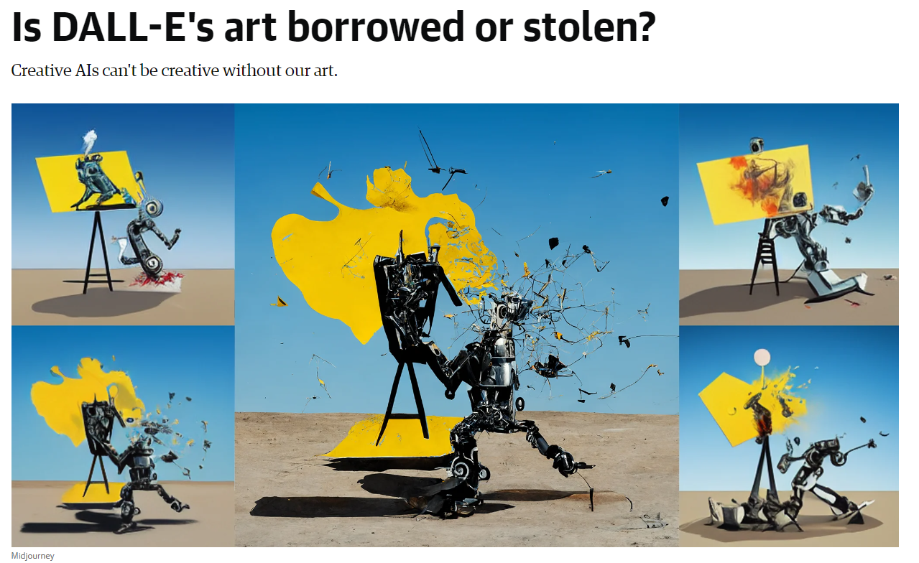
https://www.engadget.com/dall-e-generative-ai-tracking-data-privacy-160034656.html

Slide 26
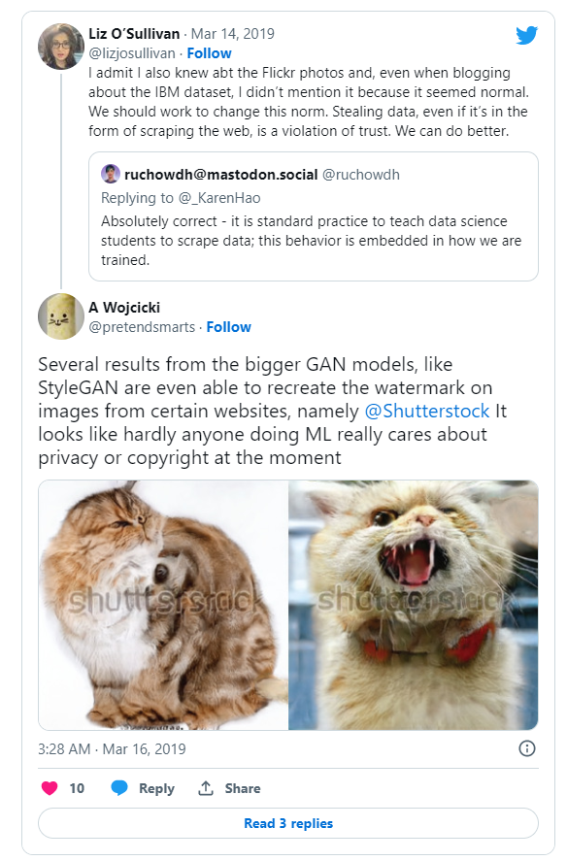
[Endgadget Article]

Slide 27
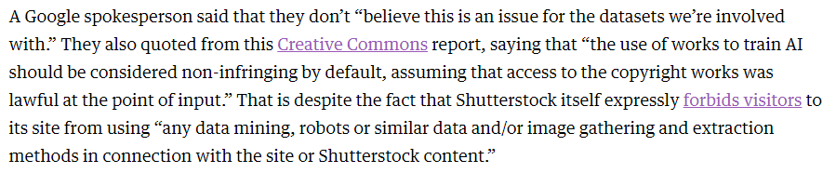
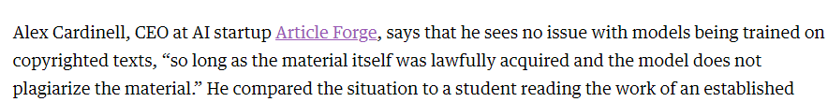
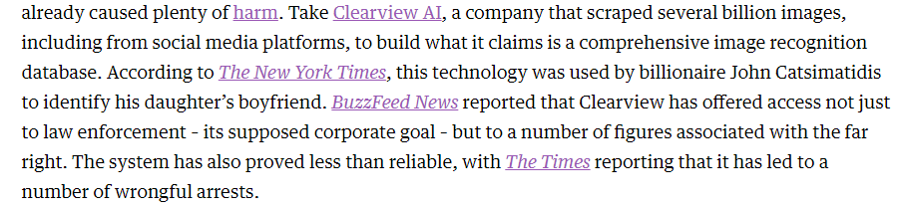

[Endgadget Article]

Slide 28
Q5. Discuss: Should companies be required to gain explicit permission to train on publicly accessible data? Or should content providers have an easy way to opt out?
https://tinyurl.com/441-L21-fa24

Slide 29
Model Cards for Model Reporting
Mitchell et al. 2019
https://arxiv.org/pdf/1810.03993.pdf

Slide 32
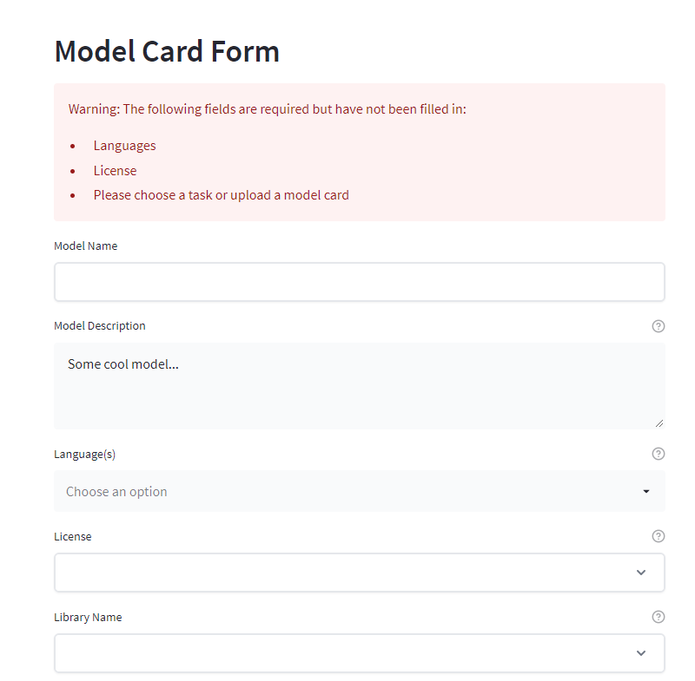
Model cards hugging face

Slide 33
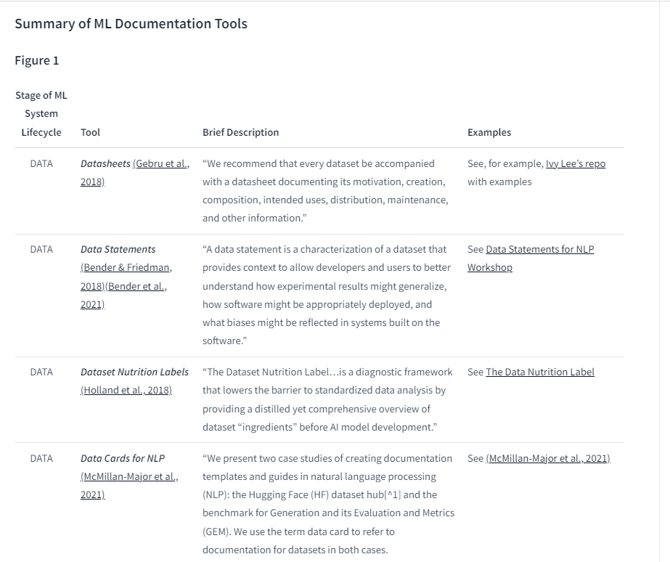
https://huggingface.co/docs/hub/model-card-landscape-analysis

Slide 34
Things to remember
Our work as ML engineers can have major personal and societal impact
  Who benefits? Who is harmed?
  What is the impact on society?
  Who is responsible when it goes wrong?
  Who “owns” the data, models?
We can do much good, but there is also potential for much harm
Tools for practicing ethical AI, e.g. model cards, emissions calculators, and datasheets are being developed -- use them

Slide 35
On Thursday…
Bias and fairness in AI

