Slide 1

Ensembles and Forests
Applied Machine Learning
Derek Hoiem
Dall-E

Slide 2
Previously…
We’ve learned how to build and apply single models
  Nearest neighbor
  Logistic regression
  Linear regression
  Trees
Today
  Review questions about classifiers
  Application to Breast Cancer detection
  Ensembles + Application to Pose Estimation

Slide 3

Q1-Q4 (Classifier Review Questions)
https://tinyurl.com/441-fa24-L13

Slide 4
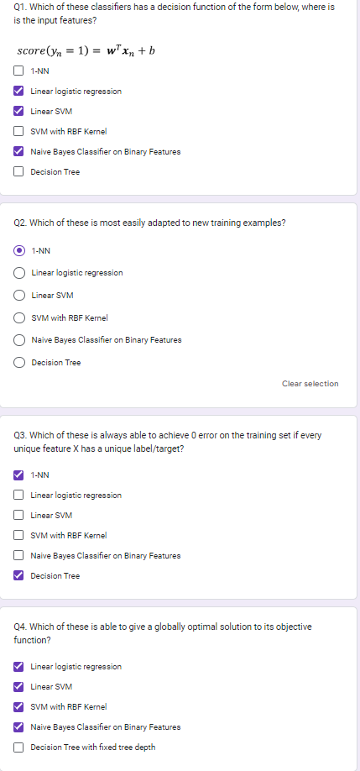

Slide 5
Example: Breast Cancer Classification
Motivation
  Breast cancer diagnosis from fine needle aspirates (FNA) is reported to be 94%, but results are suspected to be biased
  Need computer-based tests that are less subjective so that FNA is a more effective diagnostic tool for breast cancer
Collected data from 569 patients, plus 54 for held-out testing
A user interface was created to outline borders of suspect cells, and automated measurement of ten characteristics (e.g. radius, area, compactness, …) was performed and mean of all cells, mean of 3 largest, and std were recorded for each patient
[paper (Wolberg et al. 1995)]

Slide 6
Let’s explore in Python
https://colab.research.google.com/drive/1viVU62gk77THZBFuztWjxgL93xMMpiU0?usp=sharing

Slide 7
Method/Results from Breast Cancer Analysis Paper
A MSM-Tree was used for classification
  Fits a linear classifier based on a few features for each split
  Aimed to minimize the number of splitting planes and number of features used (for simplicity and to improve generalization)
  Final approach was splitting plane based on mean texture, worst area, and worst smoothness
10-fold cross validation
  Achieved 3% error (+- 1.5% for 95% confidence interval)
Perfect accuracy in held out test set

Slide 8
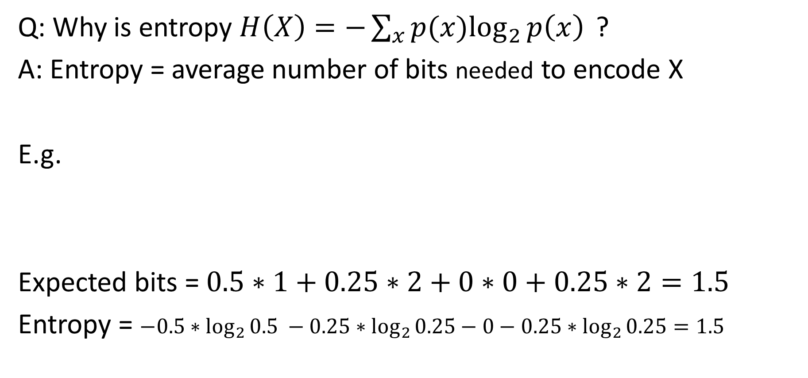
Entropy Explanation
Q: Why is entropy $H\left(X\right)=−\sum_{x}{p(x)\log_{2}{p\left(x\right)} }$?
A: Entropy = average number of bits needed to encode X
E.g.
Expected bits = $0.5∗1+0.25∗2+0∗0+0.25∗2=1.5$
Entropy = $−0.5∗\log_{2}{0.5} −0.25∗\log_{2}{0.25}−0−0.25∗\log_{2}{0.25}=1.5$
X= | 1 | 2 | 3 | 4
P(X) | 50% | 25% | 0% | 25%
Encoding | 0 | 1-0 |  | 1-1
Bits Used | 1 | 2 | 0 | 2

Slide 9
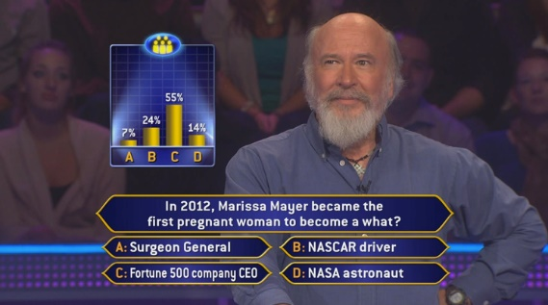
Ensemble Models
An ensemble averages or sums predictions from multiple models
Remember “Who Wants to be a Millionaire”?
  “Poll the audience” vs “Call a friend”
Averaging multiple “weak” predictions is often more accurate than any single predictor
  e.g. audience success rate is 92% vs 66% for the friend
Models can be constructed independently by sampling, or by incrementally training model to fix previous model’s mistakes
  Averaging independent predictions reduces variance
  Incrementally fixing mistakes reduces bias

Slide 10
Bias-Variance Trade-off
Variance: due to limited data
Different same-sized training sets will give different models that vary in predictions for the same test sample
“Noise”: irreducible error due to data/problem
Bias: (loosely) expected error when optimal model is learned from infinite data
Above is for regression.
But same “expected error = variance + noise + bias²“ holds for classification error and logistic regression.
See this for derivation
Fig Sources

Slide 11
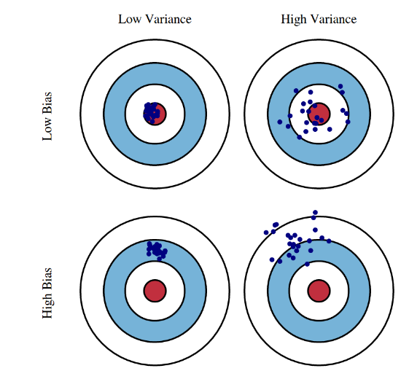
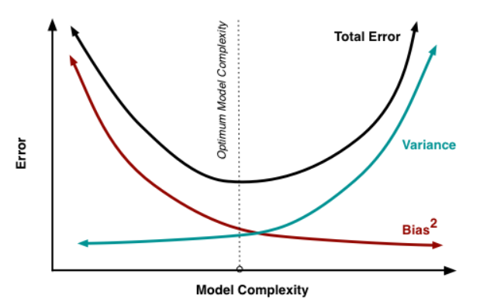
Bias-Variance Trade-off
See this for derivation
Fig Sources

Slide 12
Let’s see how ensembles battle bias and variance
Bootstrapping
Bagging
Boosting (Schapire 1989)
Adaboost (Schapire 1995)

Slide 13
Bootstrap Estimation
Repeatedly draw n samples from data D with replacement
For each set of samples, estimate a statistic
The bootstrap estimate is the mean of the individual estimates
Used to estimate a statistic (parameter) and its variance

Slide 14
Bagging - Aggregate Bootstrapping
For i = 1 .. M
  Draw n*<n samples from D with replacement
  Train classifier C_{i} using those samples
Final classifier is a vote of C₁ .. C_{M}
Increases classifier stability / reduces variance

Slide 15
Random Forests
Train a collection of trees (e.g. 100 trees).
For each:
  Randomly sample some fraction of data (e.g. 90%)
  Randomly sample some number of features
    For regression: suggest (# features) /3
    For classification: suggest sqrt(# features) or log_2(# features)
  Train a deep tree using only those samples/features
  (Optional: can get validation error on held out data)
Predict: Average the predictions of all trees
Breiman 2001 [pdf]

Slide 16
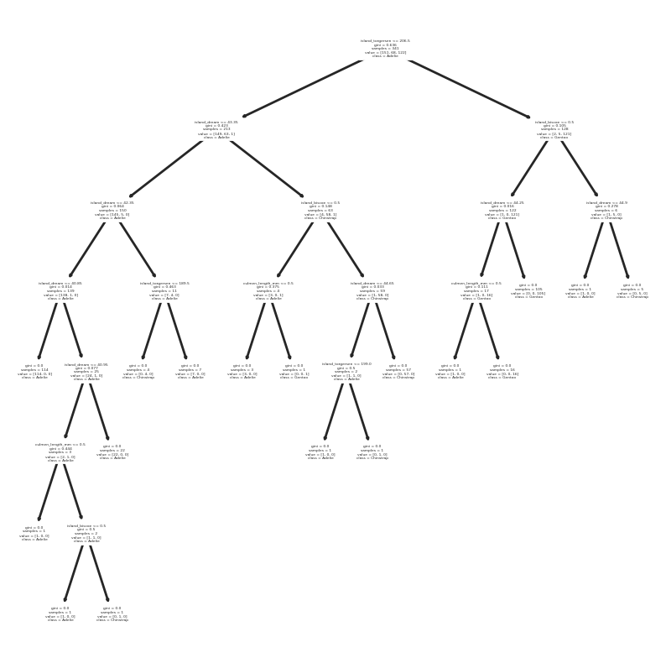
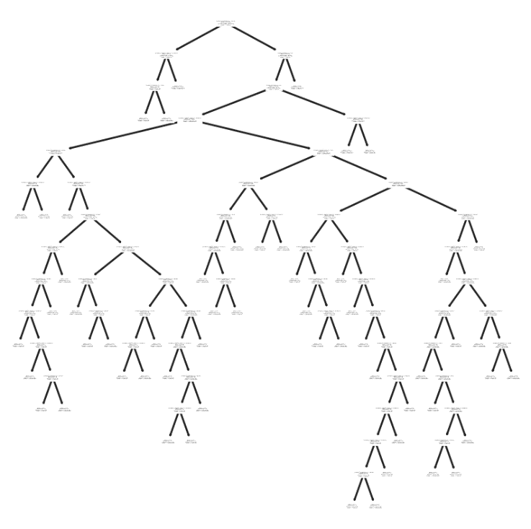
Random forest: intuition
Each tree uses different sets of features to fully explain the training set
Each tree’s prediction will be based on a complicated rule that will probably have exceptions for test samples
Averaging predictions from many complex rules enables prediction based on complicated combinations of features without relying on any particular prediction
Trees for different subsets of features in penguin species prediction

Slide 17
Adaboost Terms
Learner = Hypothesis = Classifier
Weak Learner: classifier that can achieve < 50% training error over any training distribution
Strong Learner: makes prediction by combining weak learner predictions

Slide 18
Boosting (Schapire 1989)
Boosting Terminology
Learner = Hypothesis = Classifier
Weak Learner: classifier that can achieve < 50% training error over any training distribution
Strong Learner: makes prediction by combining weak learner predictions
Randomly select n₁ < n samples from D without replacement to obtain D₁
  Train weak learner C₁
Select n₂ < n samples from D with half of the samples misclassified by C₁ to obtain D₂
  Train weak learner C₂
Select all samples from D that C₁ and C₂ disagree on
  Train weak learner C₃
Final strong learner is vote of weak learners

Slide 19
Adaboost - Adaptive Boosting
Instead of sampling, re-weight
  Previous weak learner has only 50% accuracy over new distribution
Learn “weak classifiers” on the re-weighted samples
Final classification based on weighted vote of weak classifiers
https://cseweb.ucsd.edu/~yfreund/papers/IntroToBoosting.pdf (Freund Schapire ‘99)

Slide 20
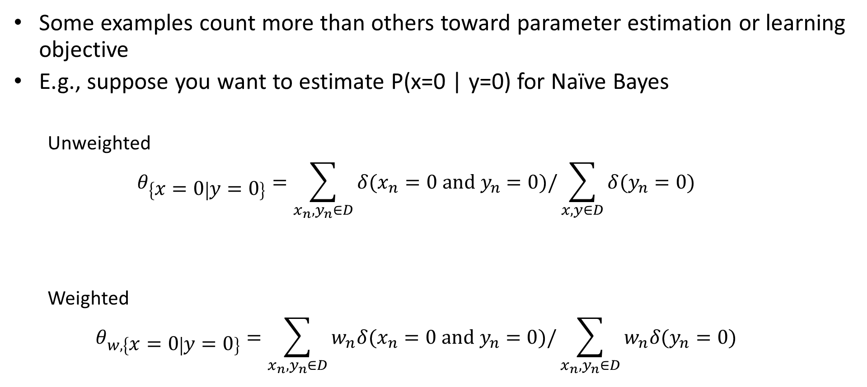
What does it mean to “weight” your training samples?
Some examples count more than others toward parameter estimation or learning objective
E.g., suppose you want to estimate P(x=0 | y=0) for Naïve Bayes
  Unweighted
  $$θ_{\left\{x=0 | y=0\right\}}=\sum_{x_{n},y_{n}∈D}{δ(x_{n}=0 and y_{n}=0)/\sum_{x,y∈D}{δ(y_{n}=0)}}$$
  Weighted
  $$θ_{w,\left\{x=0 | y=0\right\}}=\sum_{x_{n},y_{n}∈D}{w_{n}δ(x_{n}=0 and y_{n}=0)/\sum_{x_{n},y_{n}∈D}{w_{n}δ(y_{n}=0)}}$$

Slide 21
Q5-6
Estimate P(x=0 | y=0) using unweighted and weighted samples
https://tinyurl.com/441-fa24-L13
w | x | y
0.1 | 0 | 0
0.1 | 0 | 0
0.2 | 1 | 0
0.1 | 0 | 0
0.2 | 1 | 0
0.2 | 0 | 1
0.1 | 1 | 1

Slide 22
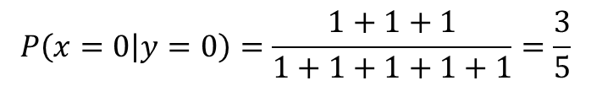
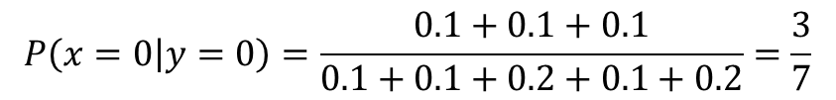
What does it mean to “weight” your training samples?
Estimate P(x=0 | y=0):
w | x | y
0.1 | 0 | 0
0.1 | 0 | 0
0.2 | 1 | 0
0.1 | 0 | 0
0.2 | 1 | 0
0.2 | 0 | 1
0.1 | 1 | 1
$$P\left(x=0 | y=0\right)=\frac{1+1+1}{1+1+1+1+1}=\frac{3}{5}$$
Unweighted:
Weighted:
$$P\left(x=0 | y=0\right)=\frac{0.1+0.1+0.1}{0.1+0.1+0.2+0.1+0.2}=\frac{3}{7}$$

Slide 23

Adaboost with Confidence Weighted Predictions (RealAB)
$$y_{i}∈\{−1,1\}$$
Friedman et al. Additive Logistic Regression: A Statistical View of Boosting (2000) [pdf]

Slide 24
Boosted decision trees
Train
Initialize sample weights to uniform
For each tree (e.g. 10-100), based on weighted samples:
  Train small tree (e.g. depth = 2-4 typically)
  Estimate logit prediction at each leaf node
  Reweight samples
Predict: sum logit predictions from all trees

Slide 25
ML Method Comparison by Caruana (2006)
BST-DT: Boosted Decision Tree
RF: Random Forest
ANN: Neural net
KNN
SVM
NB: Naïve Bayes
LR: Logistic Regression
Bold: best
*: not significantly worse than best
Calibration methods:
PLT: Platt Calibration
ISO: Isotonic Regression
- None used
[pdf]

Slide 26
Caruana et al. 2008: comparison on high dimensional data
Boosted Decision Trees FTW again!
RF second again!
But note that Adaboost underperforms in the very high dimensional datasets, where RF excels
[pdf]

Slide 27
Boosted Trees and Random Forests work for different reasons
Boosted trees
  Use small trees (high bias, low variance) to iteratively refine the prediction
  Combining prediction from many trees reduces bias
  Overfitting is a danger (i.e. too many / too large trees eliminates train error but increases test error)
Random forest
  Use large trees (low bias, high variance)
  Average of many tree predictions reduces variance
  Hard to break – just train a whole bunch of trees

Slide 28
Other ensembles
Can average predictions of any classifiers / regressors
  But they should not be duplicates, so e.g. averaging multiple linear regressors trained on all features/data has no point
  Averaging multiple deep networks (even when trained on all data) reduces error and improves confidence estimates
Cascades: early classifiers make decisions on easy examples; later ones deal only with hard examples
Wang et al. ICML 2022 [pdf]

Slide 29
Q7-9
https://tinyurl.com/441-fa24-L13

Slide 30
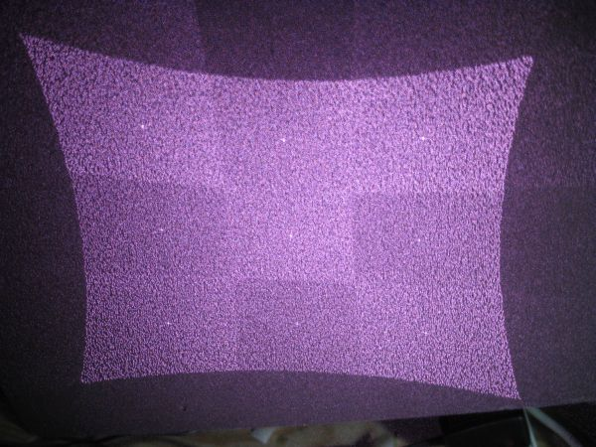
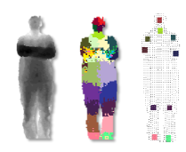
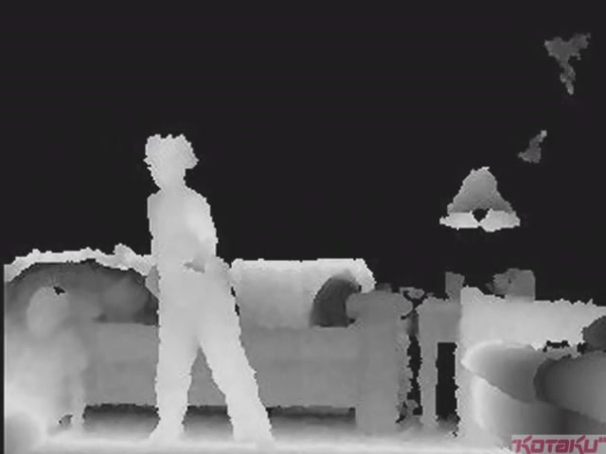
Example in detail: Depth from Kinect with RFs
IR Projector
IR Sensor
Projected Light Pattern
Stereo Algorithm
Segmentation,
Part Prediction
Depth Image
Body Pose

Slide 31
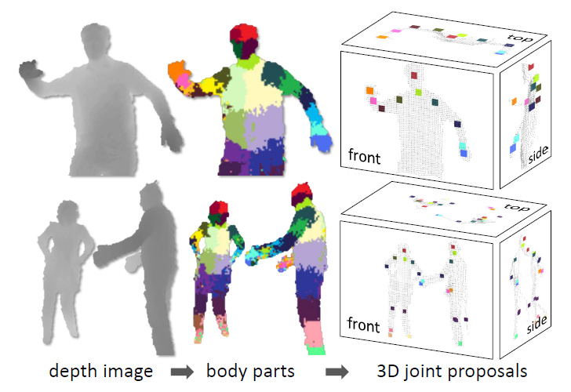
Goal: estimate pose from depth image
Real-Time Human Pose Recognition in Parts from a Single Depth Image
Jamie Shotton, Andrew Fitzgibbon, Mat Cook, Toby Sharp, Mark Finocchio, Richard Moore, Alex Kipman, and Andrew Blake
CVPR 2011

Slide 32
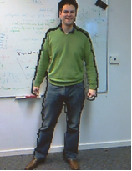
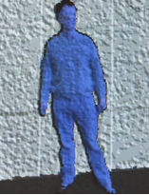
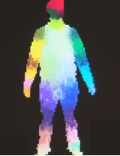
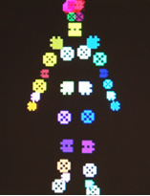
Goal: estimate pose from depth image
RGB
Depth
Part Label Map
Joint Positions
http://research.microsoft.com/apps/video/default.aspx?id=144455

Slide 33
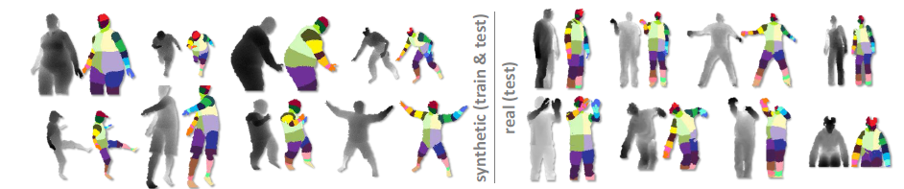
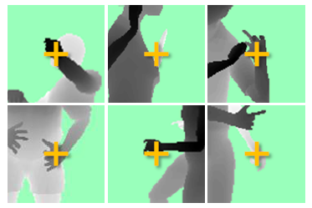
Challenges
Lots of variation in bodies, orientation, poses
Needs to be very fast (their algorithm runs at 200 FPS on the Xbox 360 GPU)
Pose Examples
Examples of one part

Slide 34
Extract body pixels by thresholding depth

Slide 35
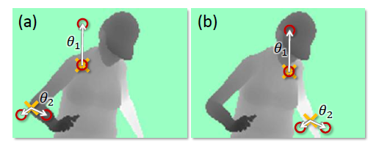
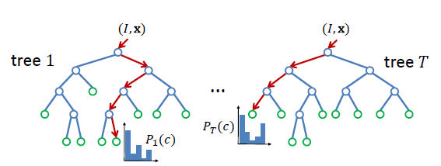
Basic learning approach
Very simple features
Lots of data
Flexible classifier

Slide 36
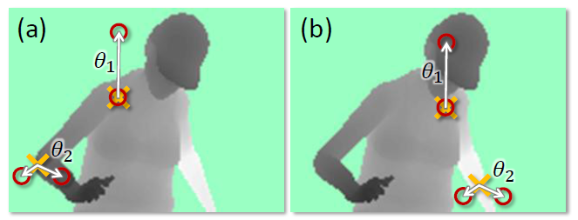
Features
Difference of depth at two offsets
  Offset is scaled by depth at center

Slide 37
Get lots of training data
Capture and sample 500K mocap frames of people kicking, driving, dancing, etc.
Get 3D models for 15 bodies with a variety of weight, height, etc.
Synthesize mocap data for all 15 body types

Slide 38
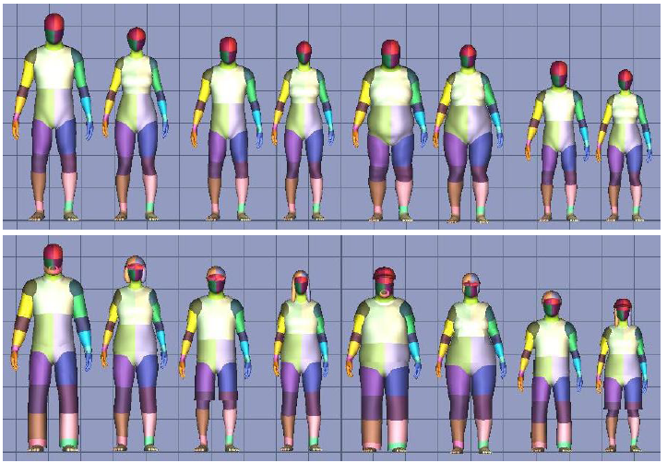
Body models

Slide 39
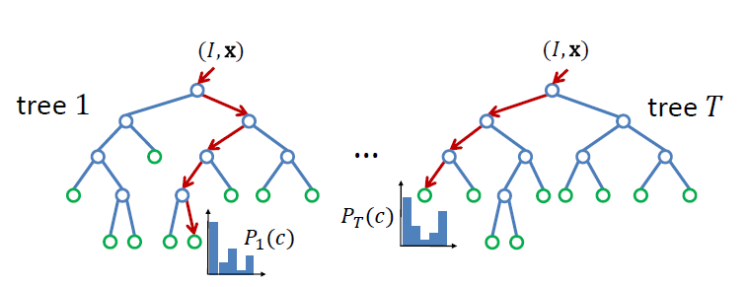
Part prediction with random forests
Randomized decision forests: collection of independently trained trees
Each tree is a classifier that predicts the likelihood of a pixel belonging to each part
  Node corresponds to a thresholded feature
  The leaf node that an example falls into corresponds to a conjunction of several features
  In training, at each node, a subset of features is chosen randomly, and the most discriminative is selected

Slide 40
Joint estimation
Joints are estimated using mean-shift (a fast mode-finding algorithm)
Observed part center is offset by pre-estimated value

Slide 41
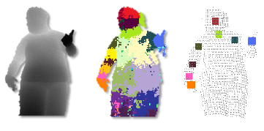
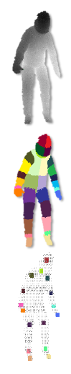
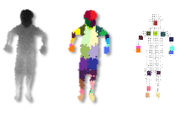
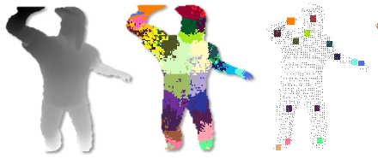
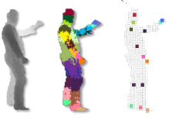
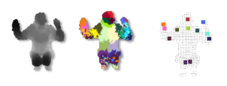
Results
Ground Truth

Slide 42
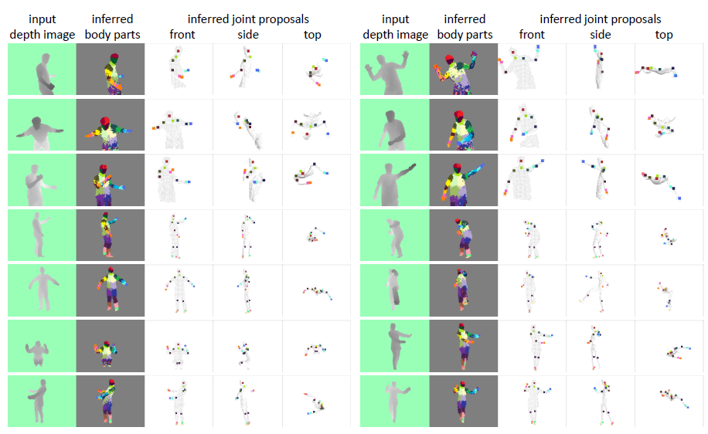
More results

Slide 43
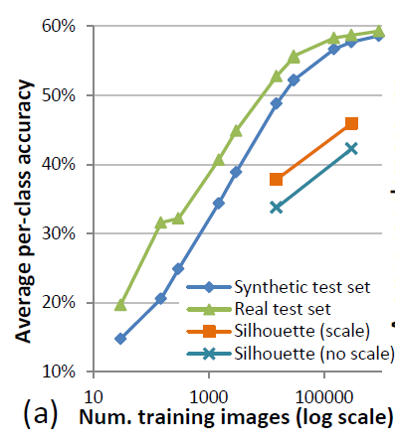
Accuracy vs. Number of Training Examples

Slide 44
Things to Remember
Ensembles improve accuracy and confidence estimates by reducing bias and/or variance
Boosted trees minimize bias by fixing previous mistakes
Random forests minimize variance by averaging over multiple different trees
Random forests and boosted trees are powerful classifiers and useful for a wide variety of problems

Slide 45
Next week
Mon: HW3 due
Tues: Stochastic Gradient Descent
Thurs: MLPs

