Slide 1
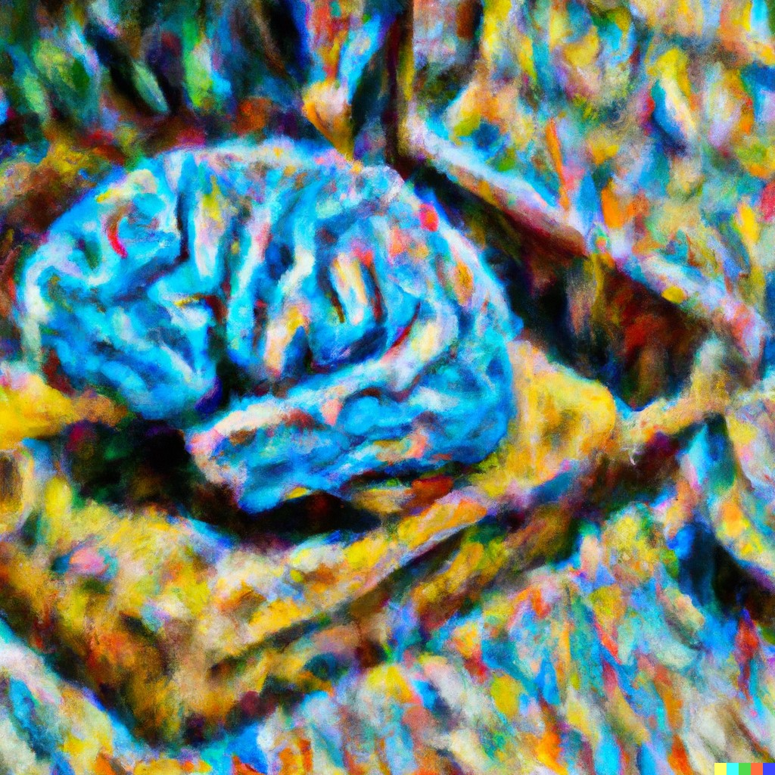
CS441 Applied Machine Learning
Instructor: Derek Hoiem
Art by Dall-E: “Computer brain gathering knowledge, impressionist”

Slide 2
Today’s Class
A little about me
Intro to Applied Machine Learning
Course outline and logistics

Slide 3
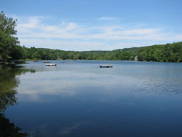
About me
Raised in “upstate” NY

Slide 4
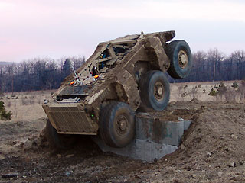
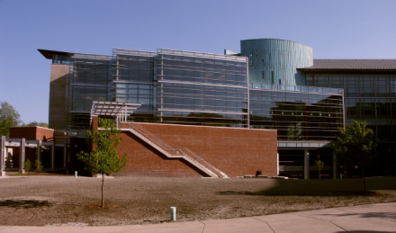
A little about me
Undergrad at SUNY Buffalo (EE, CE)
PhD in Robotics at Carnegie Mellon
Professor in Computer Science at University of Illinois

Slide 5
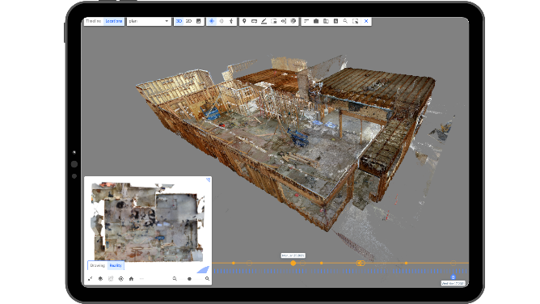
Reconstruct: vision for construction
Co-founder and Chief Science Officer of Reconstruct
https://vimeo.com/242479887
https://www.reconstructinc.com/

Slide 6
I ML

Slide 7
Machine learning and the quest for intelligent machines

Slide 8
Rabbi Loew’s Golem (16th century)
By Mikoláš Aleš https://commons.wikimedia.org/w/index.php?curid=2210897
Notes:
People have always been fascinated by life and how to re-create it

Slide 9
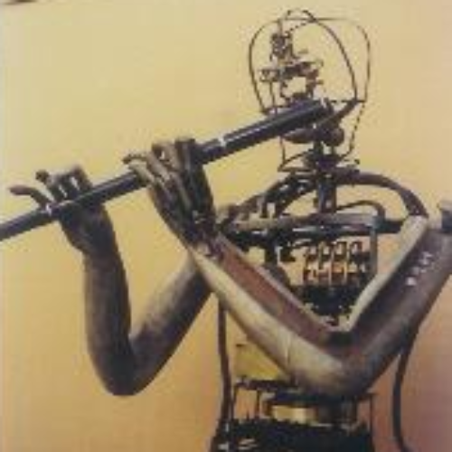
Vaucanson’s Automata (1738)
Flute player
Defecating Duck
Tambourine Player
http://www.francoisjunod.com/automates/eightennth/vaucanson_uk.htm
https://time.graphics/event/1736967
Notes:
In the late 18th century, people were particularly interested in the mechanics of the body.

Slide 10
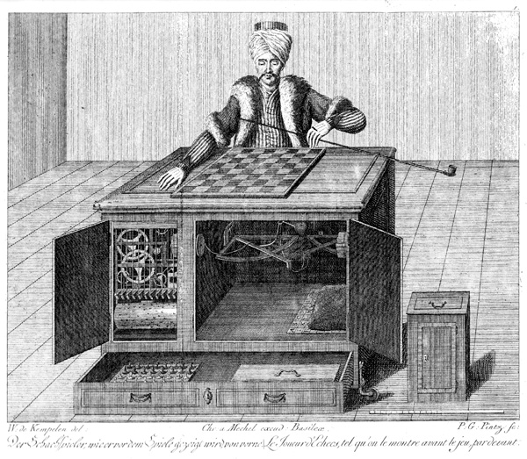
Mechanical Turk (1770)
Secretly operated by a chess master, the mechanical turk was exhibited as an automatic chess playing machine.
Opponents included Benjamin Franklin and Napoleon Bonaparte.
Engraving of Mechanical Turk (src)
Notes:
There was also interest in mechanizing intelligence

Slide 11
Babbage’s analytical engine (1837)
Not ever completely built
Ada Lovelace described a way to calculate Bernoulli numbers using the machine in 1843 (first computer program)
Analytical Engine Mill, built 1910 (src)

Slide 12
Some AI milestones
Alan Turing proposes the Imitation Game (1950)
The Logic Theorist theorem prover (1955) – Newell and Simon
The Perceptron - Rosenblatt (1957) (expected to lead to AGI)
Eliza Chat Bot (1966) – Weizenbaum
Deep Blue defeats Kasparov in Chess (1997)
AlphaGo defeats Lee Sedol in Go (2016)
ChatGPT released to public (2022)

Slide 13
We are what we learn – intelligence, the ability to learn, is a defining characteristic of our humanity
How our learning works is one of the great mysteries, and solving it will help us understand ourselves

Slide 14
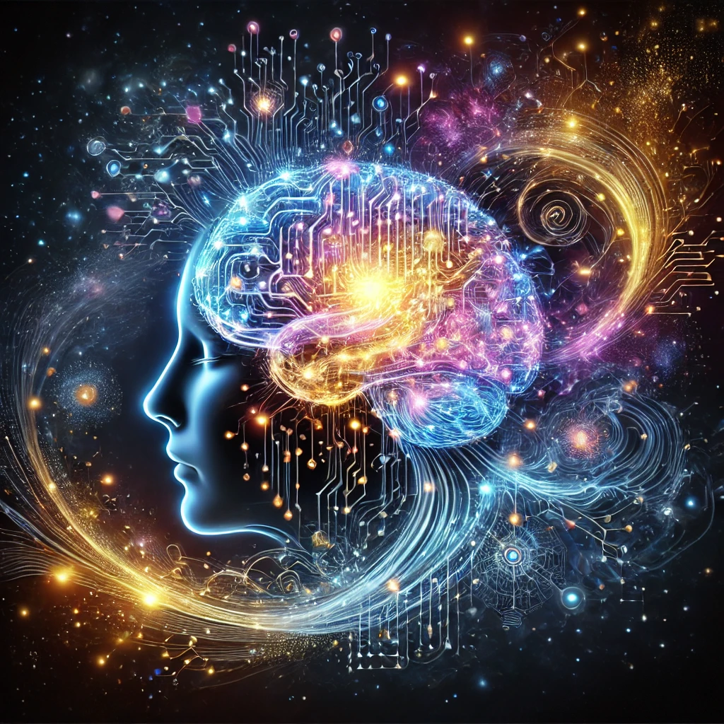
Course goal: Know thyself
Our identities are largely characterized by what we learn.
Making machines that learn can help understand our own learning.
Notes:
https://en.wikipedia.org/wiki/Know_thyself

Slide 15
Machine learning is also useful
Unimate (1961) – first industrial robot
Expert Systems (80’s) - first commercially successful AI for things like medical diagnosis
USPS fully automated optical reader (1982)
Tesla autonomous driving, Alexa, Siri, Copilot, …

Slide 16
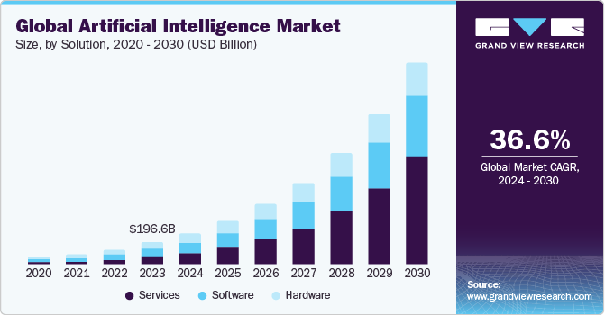
Course goal: Learn how to solve problems with ML
Key concepts and methodologies for learning from data
Algorithms and their strengths and limitations
Domain-specific representations
Ability to select the right tools for the job

Slide 17
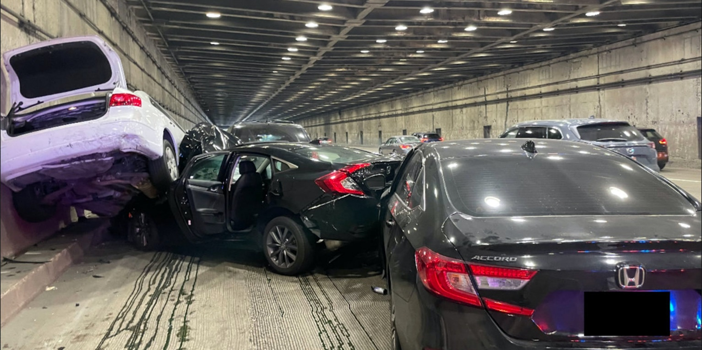
Course goal: Understand real-life application and social implications of machine learning
Recommending systems
Surveillance
Robots
Smart assistants
Text generation
Autonomous cars
Social media bots
Tesla accident

Slide 18
History of machine intelligence
Automatons
Promise of computers realized early
Early AI was largely rule and logic based
First in-roads of machine learning in the 80s
Hand-engineered features with classifiers and regressors
End-to-end learning
Multimodal learning
Dynamic learning and general AI
Notes:
1. The Dartmouth Conference (1956)
Often considered the "birthplace" of AI as a formal discipline, this conference was organized by John McCarthy, Marvin Minsky, Nathaniel Rochester, and Claude Shannon. The term "artificial intelligence" was coined here, and the event marked the beginning of serious research into AI.
2. The Logic Theorist (1955-1956)
Developed by Allen Newell and Herbert A. Simon, the Logic Theorist is considered one of the first AI programs. It was able to prove mathematical theorems by mimicking the reasoning process used by humans.
3. ELIZA (1966)
Created by Joseph Weizenbaum at MIT, ELIZA was an early natural language processing program that could mimic conversation. Its most famous mode, the "DOCTOR" script, simulated a Rogerian psychotherapist and engaged users in simple conversations.
4. The Perceptron (1958)
Invented by Frank Rosenblatt, the Perceptron was one of the earliest models of a neural network. Although initially limited, it laid the groundwork for later advances in machine learning.
5. The AI Winter (1970s-1980s)
This period saw reduced funding and interest in AI due to unmet expectations and the limitations of existing AI technologies. Research slowed significantly, but the period also led to valuable reassessments of the goals and methods in AI.
6. Expert Systems (1980s)
Expert systems, like MYCIN and DENDRAL, became one of the first commercially successful applications of AI. These systems used rule-based reasoning to solve complex problems in specific domains, such as medical diagnosis.
7. Deep Blue Defeats Garry Kasparov (1997)
IBM's Deep Blue, a chess-playing computer, defeated the world champion Garry Kasparov. This event was a significant milestone, demonstrating the power of AI in complex decision-making tasks.
8. The Advent of Machine Learning and Big Data (2000s)
The 2000s saw a shift towards machine learning, especially with the increasing availability of large datasets and the rise of big data. Algorithms like support vector machines and random forests became popular during this time.
9. Deep Learning Revolution (2010s)
The development of deep learning, particularly neural networks with many layers (deep neural networks), marked a major breakthrough. Notable achievements include AlexNet winning the ImageNet competition in 2012, which demonstrated the power of convolutional neural networks (CNNs) for image recognition.
10. AlphaGo Defeats Lee Sedol (2016)
Developed by DeepMind, AlphaGo defeated Lee Sedol, one of the world’s top Go players. This victory was particularly significant because Go is an extremely complex game with more possible moves than there are atoms in the universe, making it a challenging problem for AI.
11. GPT-3 (2020)
OpenAI’s GPT-3, a language model with 175 billion parameters, demonstrated unprecedented capabilities in natural language processing, including generating human-like text, answering questions, and performing tasks such as translation and summarization.
12. AI in Everyday Life (2020s)
AI has become integrated into everyday life through applications such as voice assistants (e.g., Siri, Alexa), recommendation systems (e.g., Netflix, YouTube), and autonomous vehicles. The ongoing development of AI ethics and regulation is also becoming increasingly important as AI systems become more pervasive.

Slide 19
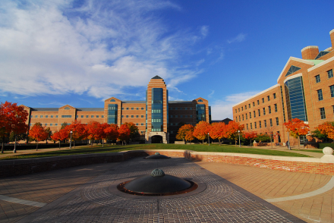
About me
1998-2002
Undergrad at SUNY Buffalo
B.S., EE and CSE
2002-2007
Grad at Carnegie Mellon
Ph.D. in Robotics
2007-2008
Postdoc at Beckman Institute
2009-
Prof in CS at UIUC

Slide 20
My early research: Learning to interpret geometry
Hoiem et al. 2005

Slide 21
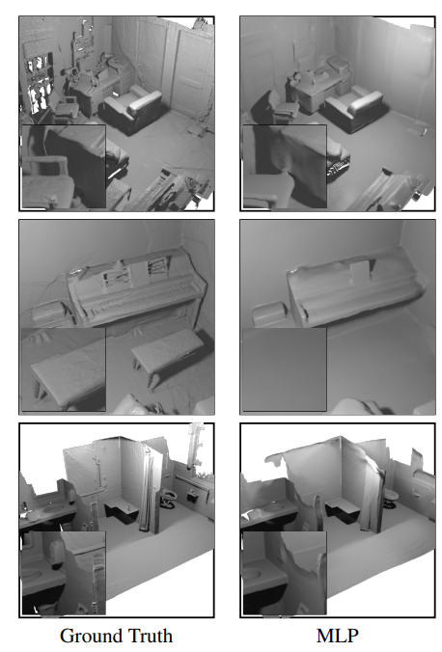
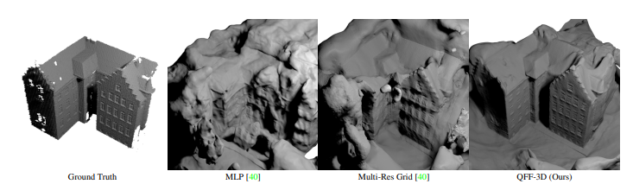
Neural Radiance Fields: use deep networks to model 3D scenes
Lee et al. 2022

Slide 22
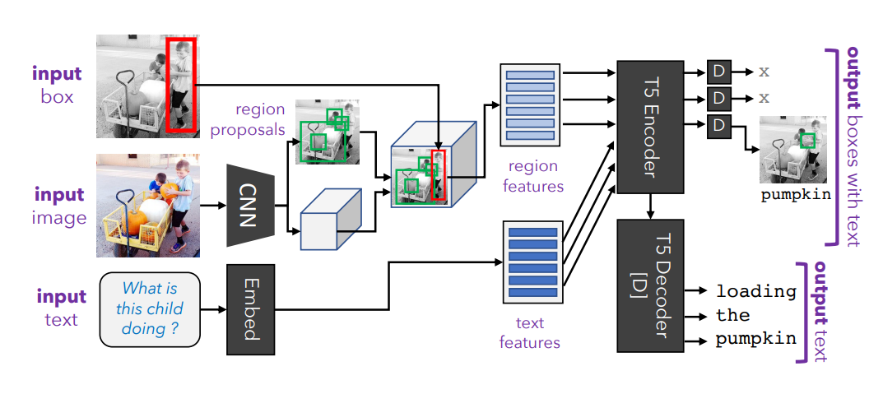
General Purpose Learners
Kamath et al. 2022

Slide 23
Other examples of my research that use machine learning
Vision
Object detection
Image classification
Photo album organization
Image retrieval
Describing objects
3D scene modeling
3D object modeling
Robot navigation
Shadow detection and removal
Generating animations
Vision and Language
Visual question answering
Phrase grounding
Video analysis
General purpose vision-language
Audio
Sound detection
Music identification

Slide 24
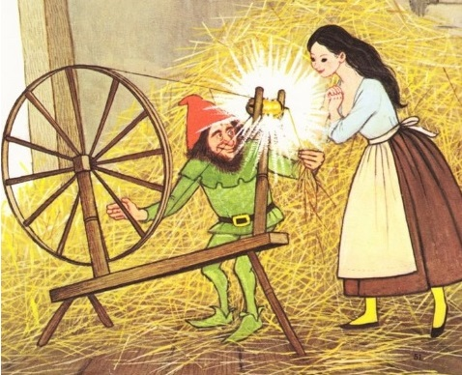
What is machine learning?
Create predictive models or useful insights from raw data
Alexa speech recognition
Amazon product recommendations
Tesla autopilot
GPT-3 text generation
Image generation
Data visualization
How? Select a model and solve for the parameters that optimize some objective in training data
Data
Algorithm
ML spins raw data into gold!

Slide 25
The whole machine learning problem
Data preparation
Collect and curate data
Annotate the data (for supervised problems)
Split your data into train, validation, and test sets
Algorithm and model development
Design methods to extract features from the data
Design a machine learning model and identify key parameters and loss
Train, select parameters, and evaluate your designs using the validation set
Final evaluation using the test set
Integrate into your application
Example: voice recognition in Alexa
Our focus, but it’s important to understand all of it

Slide 26
Algorithm and model development
Target Labels
Loss / Feedback
Loss / Feedback
Raw Data
Encoder
Decoder
Prediction
Text
Images
Audio
Discrete/continuous values
Structured/unstructured
Few/many examples
Few/many features
Clean/noisy labels
Manual feature design
Deep networks
Trees
Clustering
Feature selection
Kernels
Density estimation
Linear regressor
SVN
Logistic regressor
Nearest Neighbor
Probabilistic model
Clusters
Low dimensional embedding
Category
Pixel labels
Generated text, image, audio
Positions
Yes/No

Slide 27
Course outline
Prof: Derek Hoiem dhoiem@illinois.edu
TAs
Aakriti (aa117)
Deema Alnuhait (deemaa2)
Saharsh Barve (ssbarve2)
Ashutosh Sharma (sharma96)
Website: https://courses.engr.illinois.edu/cs441/fa2024/
Bookmark this page!!

Slide 28
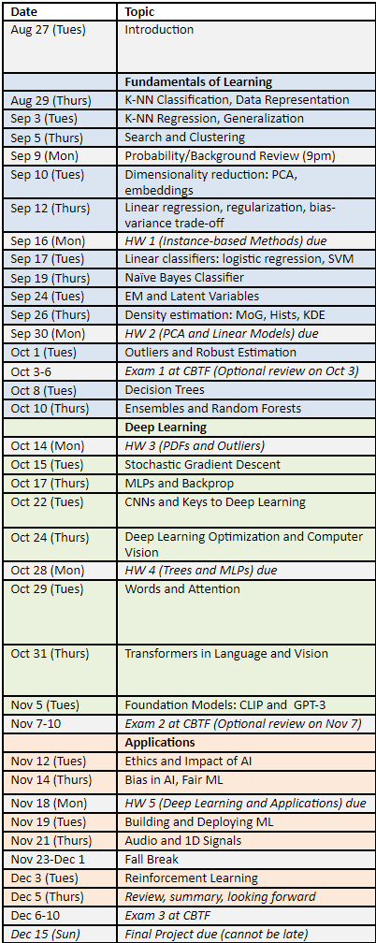
Topics
Fundamentals of learning
How to build classifiers and regressors based on provided features
Working with data, instance-based methods, linear models, probabilistic methods, trees
Deep representation learning
How to learn effective representations
Optimization, MLPs, CNNs, transformers, vision, language, foundational models
Applications
Ethics and impact, bias/fairness, building applications, RL, audio and time series

Slide 29
How will you learn?
Getting up to speed
A solid understanding of linear algebra, probability, calculus, and data structures is assumed, as well as ability to learn Python
Learn about Jupyter, Numpy, and linear algebra using the provided tutorials
I will do a recorded session on probability on Sep 9

Slide 30
How will you learn?
Lectures and Reading
Lecture attendance is expected
Reading materials and notes are optional
Lectures will be recorded, and slides and recordings will be available
If a technical problem prevents recording, only slides will be available

Slide 31
How will you learn?
Assignments
Conduct experiments in Jupyter notebook, report results, answer questions to test your understanding
HW 1: Instance-based methods (Sep 16)
Retrieval, clustering, KNN classification and regression
HW 2: Linear Models (Sep 30)
PCA and embeddings, linear regression, logistics regression, SVM
HW 3: Probabilistic Methods (Oct 14)
Naïve Bayes, EM, robust estimation
HW 4: Trees and MLPs (Oct 28)
Decision trees, random forests, boosting, multi-layer perceptrons
HW 5: Deep learning and applications (Nov 18)
Linear probe, fine-tuning, investigating a real-world application area
Final Project (Dec 5): Apply ML, compare algorithms, select parameters on a problem of your choosing

Slide 32
How will you learn?
Getting Help Outside of Class
For questions that have short answers, see if it’s been answered on CampusWire; if not, post
We try to answer within 24 hours (our schedule to check will be posted)
For more in-depth help, or to better understand the material, come to office hours
Schedule will be posted on CampusWire

Slide 33
How will you learn?
Exams
Three 50-minute exams to test conceptual knowledge
Exams will be held in CBTF (closed book/notes)
Cumulative

Slide 34
Grading
Experience Points: 500+ points
5 homeworks: 100+ points each
1 final project: 100+ points
Participation: 2 points per opportunity (up to ~30 opportunities)
3 credit: target is 500 points
4 credit: target is 625 points
Exams: 200 pts
Three 50 minute exams, at CBTF
Lowest exam score is dropped
Final grade calculation
Course_Grade = (EP + highest_exam + 2nd_highest_exam) / (max(EP, EP_target) + 200)
Late policy
Up to ten free days total – use them wisely!
5 point penalty per day after that
Project must be submitted within two weeks of due date to receive any points

Slide 35
Earn 2 points now – tell me a little about you
https://tinyurl.com/441-fa24-L1

Slide 36
Covid, masks, sickness
If you’re well, please come to lectures and office hours. Masks are optional.
If you’re sick, please stay home. No need to show proof of illness or get permission to miss.

Slide 37
Homework details
Overall
Mostly implementing and applying machine learning methods in Python notebooks
Some conceptual questions
Complete/submit Report PDF and Jupyter notebook
Assignments
HW 1: Instance-based methods
Retrieval, clustering, KNN classification and regression
HW 2: Linear Models
PCA and embeddings, linear regression, logistics regression, SVM
HW 3: Probabilistic Methods
Estimating PDFs, robust estimation
HW 4: Trees and MLPs
Decision trees, random forests, boosting, multi-layer perceptrons
HW 5: Deep learning and applications
Linear probe, fine-tuning, investigating a real-world application area
Final Project: Disaster tweet classification, house price regression, or custom project

Slide 38
Learning resources
Website: https://courses.engr.illinois.edu/cs441/sp2024/
Syllabus
Recordings
CampusWire Discussion
Canvas Submission
Assignments
Schedule
Lecture slides and readings
Lectures
In-person, recorded
Office hours
Will be updated on pinned CampusWire post
Readings/textbook: Forsyth Applied Machine Learning

Slide 39
Academic Integrity
These are OK
Discuss homeworks with classmates (don’t show each other code)
Use Stack Overflow to learn how to use a Python module
Use GPT/Co-Pilot/Gemini etc to learn how to use a Python module, or streamline coding
Get ideas from online (make sure to attribute the source)
Not OK
Copying or looking at homework-specific code (i.e. so that you claim credit for part of an assignment based on code that you didn’t write)
Using external resources (code, ideas, data) without acknowledging them
Remember
Ask if you’re not sure if it’s ok
You are safe as long as you acknowledge all of your sources of inspiration, code, etc. in your write-up
If you use an AI tool, acknowledge it

Slide 40
How is this course different from…
CS 446 ML
This course provides a foundation for ML practice, while 446 provides a foundation for ML research
This course has less theory, derivations, and optimization, and more on application, representations, and examples
Online version of CS 441 AML
CS 441 online is being updated to be more like this one
This course focuses more on concepts and modern usage of ML, homeworks require more independence
CS 444 Deep Learning for CV, other domain-oriented courses
This course is much broader

Slide 41
What is expected of you?
You have sufficient background in math and CS, and/or will work hard to catch up in the first couple weeks
You will attend all lectures (preferred), or watch the recordings
If you get stuck, you’ll try your best to figure it out, but then seek help if you can’t
You are willing to spend ~10-12 hours per week on lectures, reading, review and assignments

Slide 42
Feedback is welcome
I will occasionally solicit feedback through surveys – please respond
You can always talk to me after class or send me a message on CampusWire
My goal is to be a force multiplier on how much you can learn with a given amount of effort

Slide 43
What to do next
Bookmark the website
Sign up for campuswire (if not already signed up)
Read the syllabus and schedule
Unless you consider yourself highly proficient in Python/numpy and linear algebra, watch/do the tutorials linked in the web page
If you are planning to drop the class, please do it right away so that others can register

