Slide 1

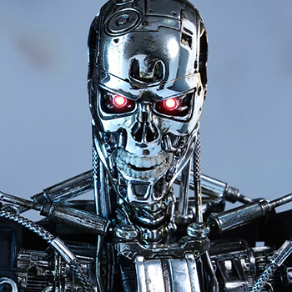
CS440/ECE448: Artificial Intelligence
Lecture 2: History and Themes
Slides by Svetlana Lazebnik, 9/2016
Modified by Mark Hasegawa-Johnson, 1/2019

Slide 2
Last time: What is AI?
Thinking Humanly?
  Examples: embodied cognition, trying to reconstruct a brain cell-by-cell
Acting Humanly?
  Examples: Turing test, Winograd schema
Thinking Rationally?
  Example: Aristotle, especially the Analytics
  Example: the logicist approach to AI, symbolic reasoning, fuzzy logic
Acting Rationally?
  Example: John Stuart Mill, Utilitarianism
  Example: rational agent theory, Economics

Slide 3
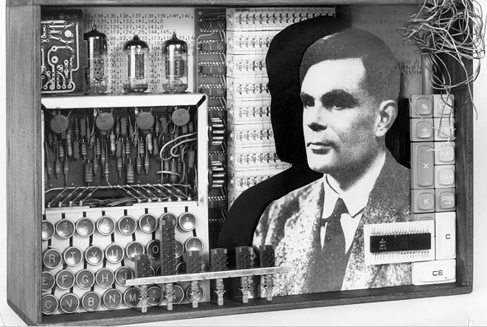
AI: History and themes
https://www.youtube.com/watch?v=BFWt5Bxfcjo
Image source

Slide 4
What are some successes of AI today?
…
…
…
…
…

Slide 5
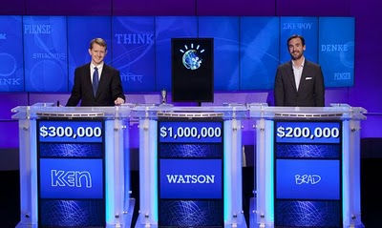
IBM Watson and “cognitive computing”
2010 NY Times article, trivia demo
February 2011: IBM Watson wins on Jeopardy
Since then: Watson Analytics, social services, personal shopping, health care
Notes:
From IBM website: “Cognitive computing systems learn and interact naturally with people to extend what either humans or machine could do on their own. They help human experts make better decisions by penetrating the complexity of Big Data.”

Slide 6
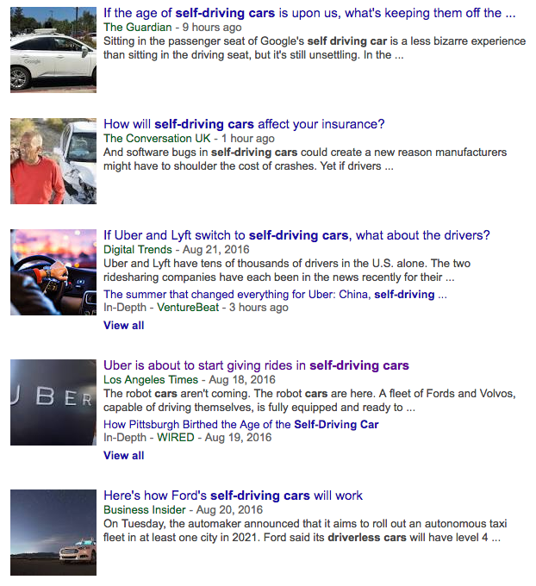
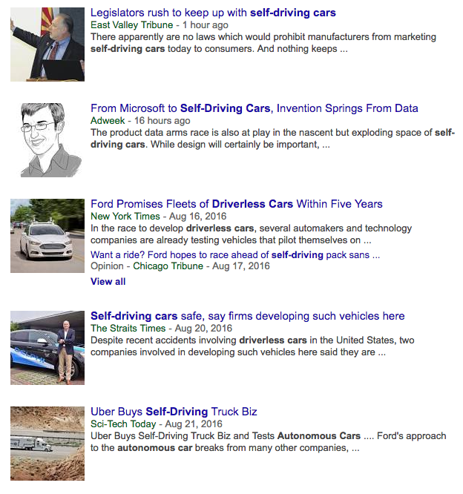
Self-driving cars
Google News snapshot as of August 22, 2016

Slide 7

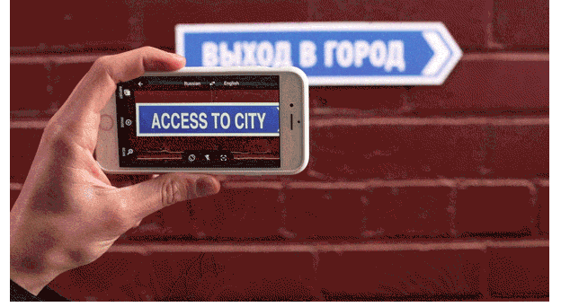

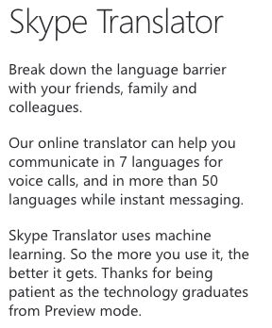

Speech and natural language
Instant translation with Word Lens
Have a conversation with Google Translate
https://www.skype.com/en/features/skype-translator/
http://googleblog.blogspot.com/2015/01/hallo-hola-ola-more-powerful-translate.html

Slide 8
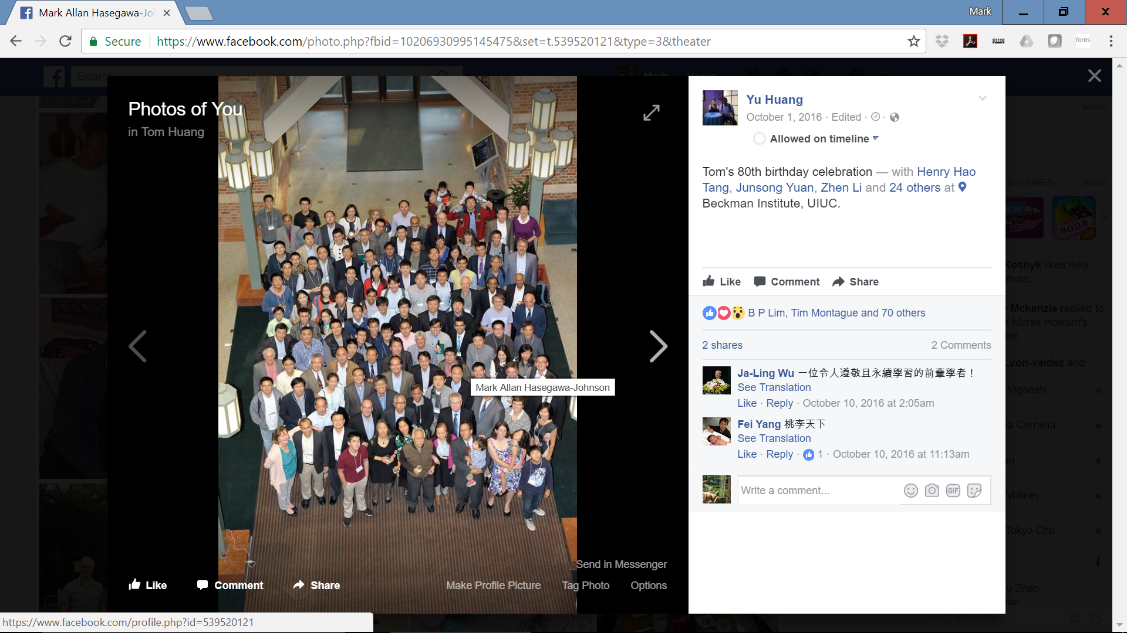
Computer Vision

Slide 9
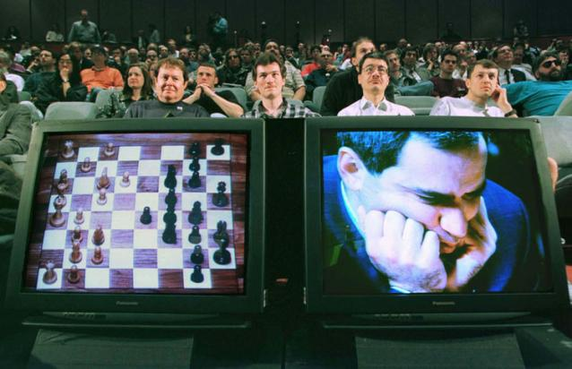
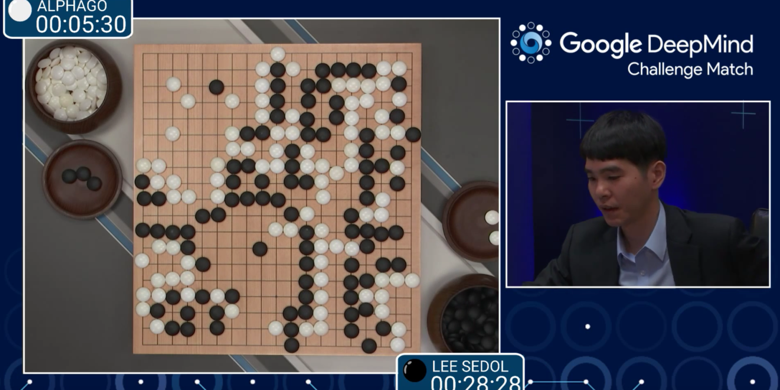
Games
1997: IBM’s Deep Blue defeats the reigning world chess champion Garry Kasparov
  1996: Kasparov Beats Deep Blue
  “I could feel – I could smell – a new kind
  of intelligence across the table.”
  1997: Deep Blue Beats Kasparov
  “Deep Blue hasn't proven anything.”
2007: Checkers is solved
  Though checkers programs had been beating the best human players for at least a decade before then
2014: Heads-up limit Texas Hold-em poker is solved
  First game of imperfect information
2016: AlphaGo computer beats
Go grandmaster Lee Sedol 4-1
Notes:
From the checkers article:
Perfection implies solving a game—determining the final result (game-theoretic value) when neither player makes a mistake. There are three levels of solving a game. For the lowest level, ultraweakly solved, the perfect-play result, but not a strategy for achieving that value, is known [e.g., in Hex the first player wins, but for large board sizes the winning strategy is not known]. For weakly solved games, both the result and a strategy for achieving it from the start of the game are known [e.g., in Go Moku the first player wins and a program can demonstrate the win]. Strongly solved games have the result computed for all possible positions that can arise in the game [e.g., Awari ].
With this paper, we announce that checkers has been weakly solved. From the starting position, we have a computational proof that checkers is a draw. The proof consists of an explicit strategy that never loses—the program can achieve at least a draw against any opponent, playing either the black or white pieces.
Abstract of the poker article: Poker is a family of games that exhibit imperfect information, where players do not have full knowledge of past events. Whereas many perfect-information games have been solved (e.g., Connect Four and checkers), no nontrivial imperfect-information game played competitively by humans has previously been solved. Here, we announce that heads-up limit Texas hold’em is now essentially weakly solved. Furthermore, this computation formally proves the common wisdom that the dealer in the game holds a substantial advantage. This result was enabled by a new algorithm, CFR⁺, which is capable of solving extensive-form games orders of magnitude larger than previously possible.

Slide 10

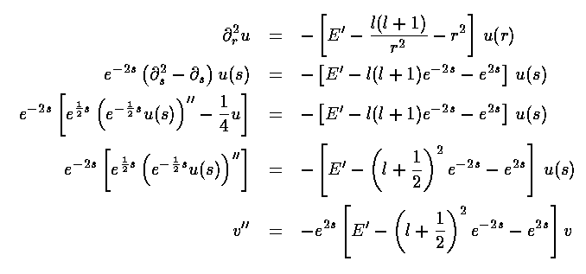
Mathematics
In 1996, a computer program written by researchers at Argonne National Laboratory proved a mathematical conjecture unsolved for decades
  NY Times story: “[The proof] would have been called creative if a human had thought of it”
Mathematical software:

Slide 11
Logistics, scheduling, planning
During the 1991 Gulf War, US forces deployed an AI logistics planning and scheduling program that involved up to 50,000 vehicles, cargo, and people
NASA’s Remote Agent software operated the Deep Space 1 spacecraft during two experiments in May 1999
In 2004, NASA introduced the MAPGEN system to plan the daily operations for the Mars Exploration Rovers

Slide 12
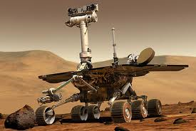
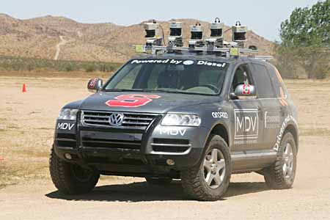

Robotics
Mars rovers
Autonomous vehicles
  DARPA Grand Challenge
  Self-driving cars
Autonomous helicopters
Robot soccer
  RoboCup
Personal robotics
  Humanoid robots
  Robotic pets
  Personal assistants?

Slide 13
Origins of AI: Early excitement
1940s First model of a neuron (W. S. McCulloch & W. Pitts)
Hebbian learning rule
Cybernetics
1950s Turing Test
Perceptrons (F. Rosenblatt)
Computer chess and checkers (C. Shannon, A. Samuel)
Machine translation (Georgetown-IBM experiment)
Theorem provers (A. Newell and H. Simon,
H. Gelernter and N. Rochester)
1956 Dartmouth meeting: “Artificial Intelligence” adopted

Slide 14
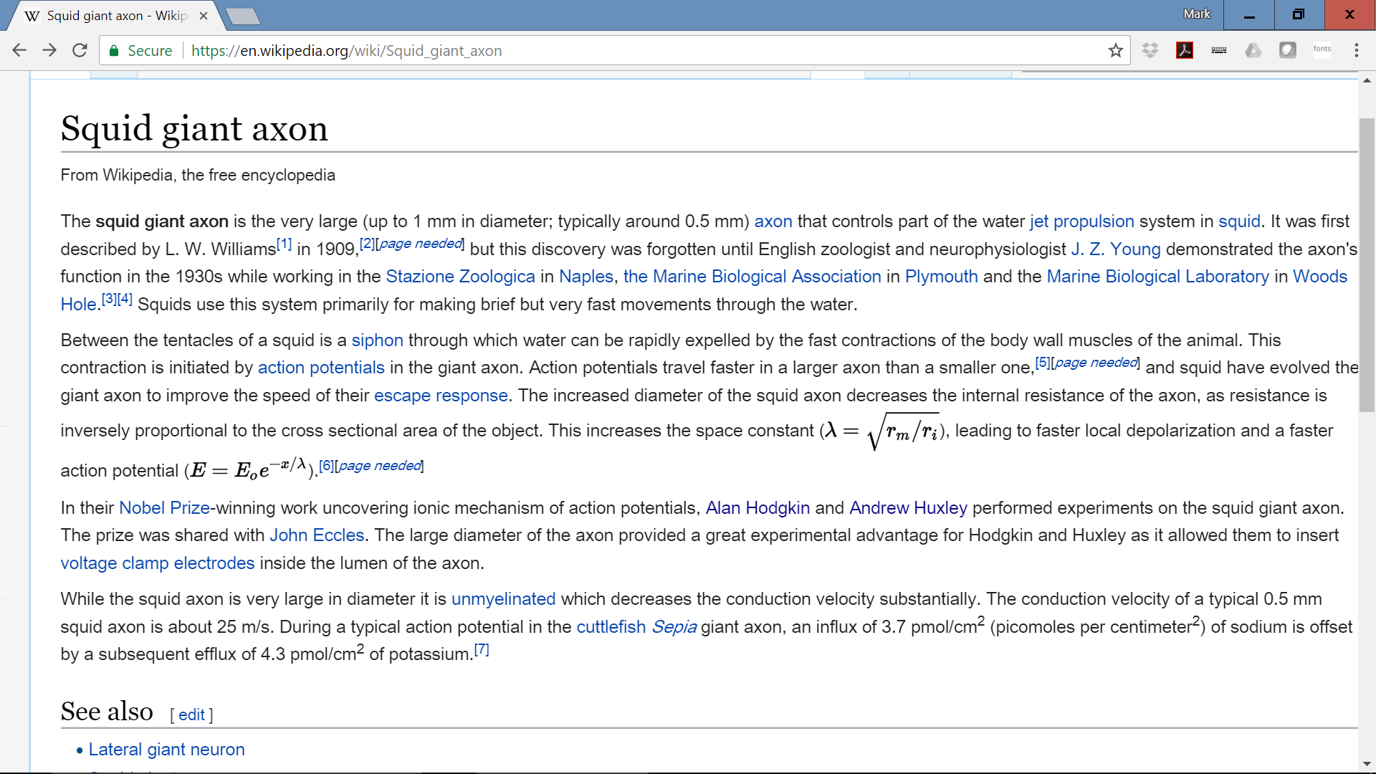
1939: Hodgkin & Huxley Measure the…

Slide 15
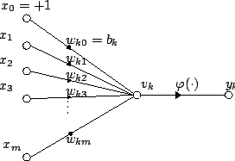
1943: McCulloch-Pitts Neuron Model
Attribution: Plarroy, https://commons.wikimedia.org/wiki/File:Artificial_neuron.png

Slide 16
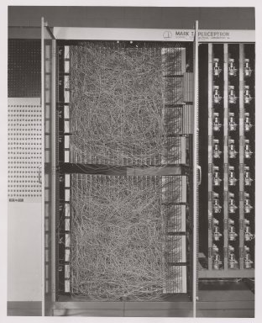
An Electronic Model of Neural Learning: the Perceptron, 1957, Rosenblatt
Attribution: Cornell University Library

Slide 17
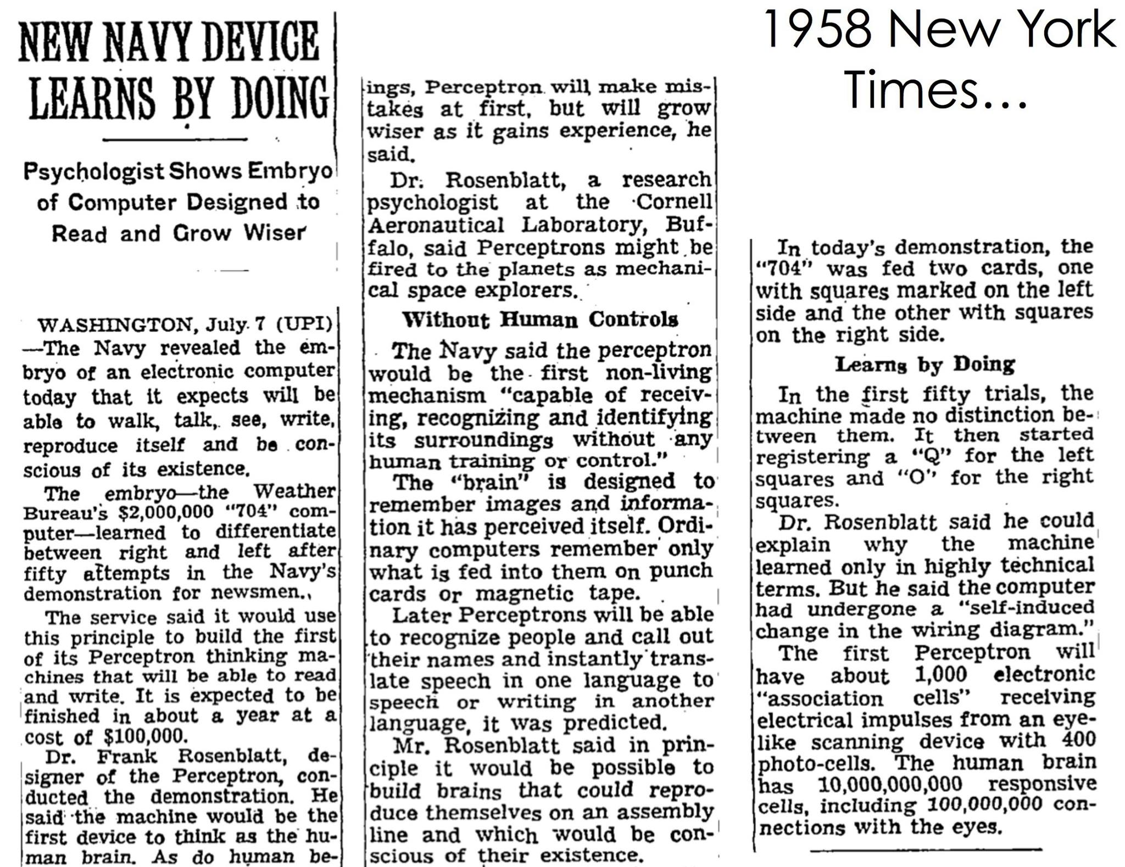

Slide 18
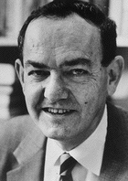
Herbert Simon, 1957
“It is not my aim to surprise or shock you –
but … there are now in the world
machines that think, that learn and that
create. Moreover, their ability to do these
things is going to increase rapidly until –
in a visible future – the range of problems
they can handle will be coextensive with
the range to which human mind has been applied. More precisely: within 10 years a computer would be chess champion, and an important new mathematical theorem would be proved by a computer.”
Prediction came true – but 40 years later instead of 10

Slide 19
Harder than originally thought
1966: Eliza chatbot (Weizenbaum)
  “ … mother …” → “Tell me more about your family”
  “I wanted to adopt a puppy, but it’s too young to be separated from its mother.”
1954: Georgetown-IBM experiment
  Completely automatic translation of more than sixty Russian sentences into English
  Only six grammar rules, 250 vocabulary words, restricted to organic chemistry
  Promised that machine translation would be solved in three to five years (press release)
  Automatic Language Processing Advisory Committee (ALPAC) report (1966): machine translation has failed
    “The spirit is willing but the flesh is weak.” →
    “The vodka is strong but the meat is rotten.”

Slide 20
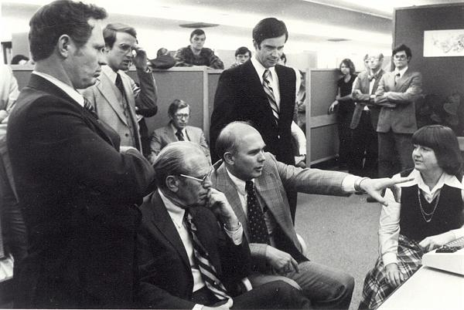
The ALPAC Report of 1966
“They concluded, in a famous 1966 report, that machine translation was more expensive, less accurate and slower than human translation.”
Photo: Eldon Lyttle,
https://commons.wikimedia.org/wiki/File:Computer-translation_Briefing_for_Gerald_Ford.jpg

Slide 21
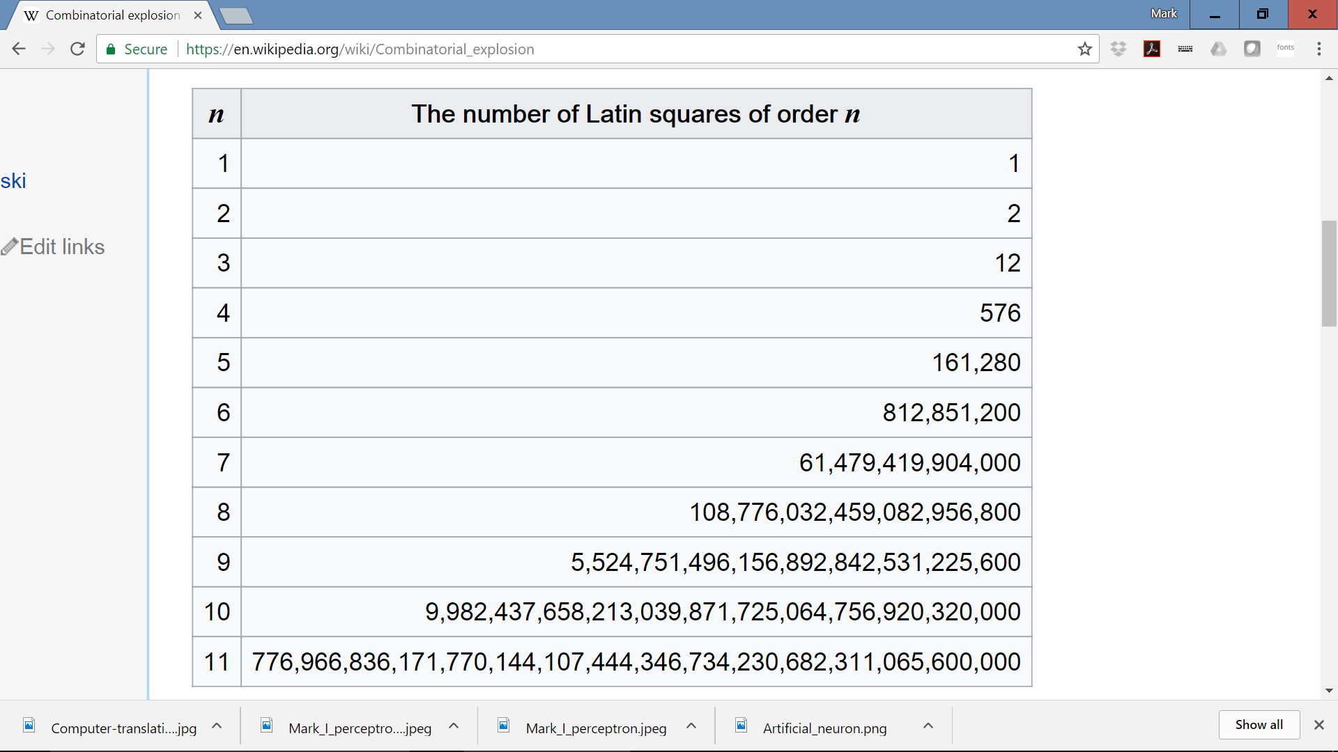
The Lighthill Report, 1973: combinatorial explosion is the key problem

Slide 22
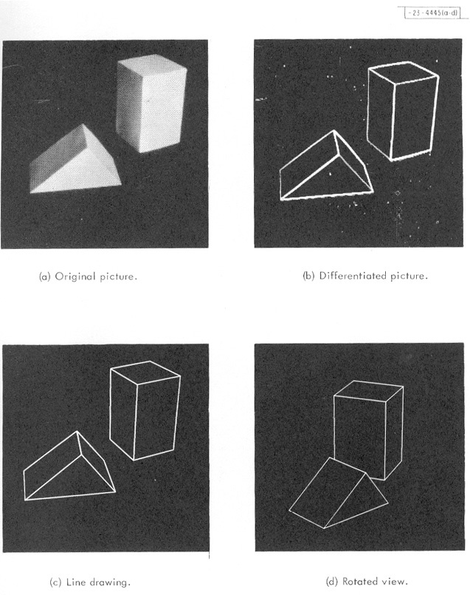
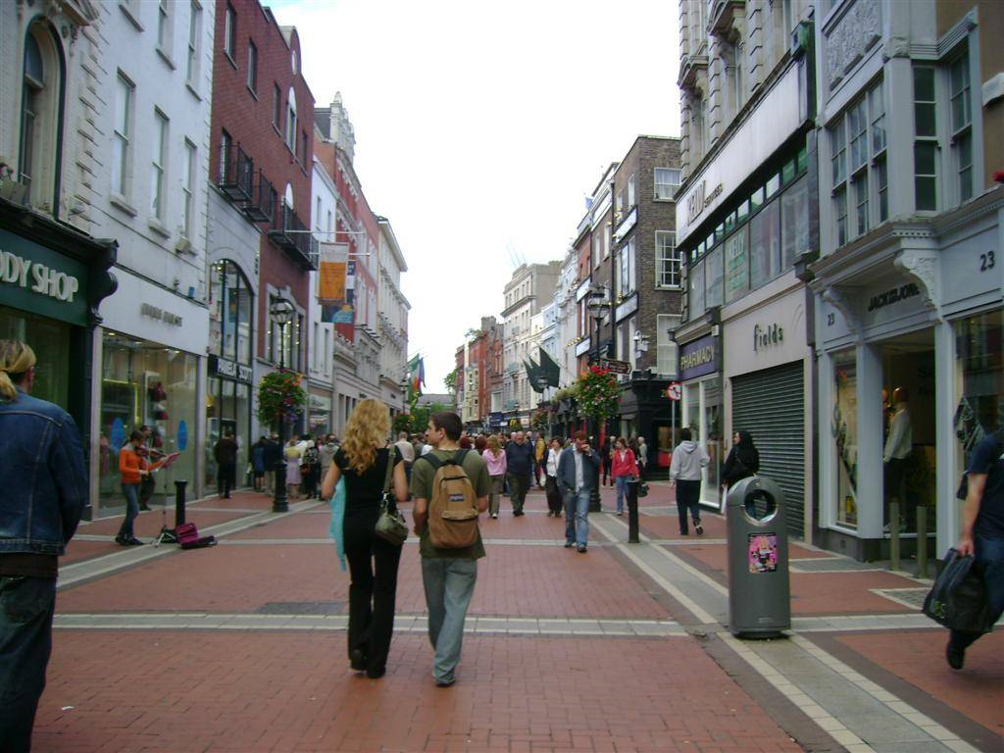
Blocks world (1960s – 1970s)
???
Larry Roberts, MIT, 1963

Slide 23
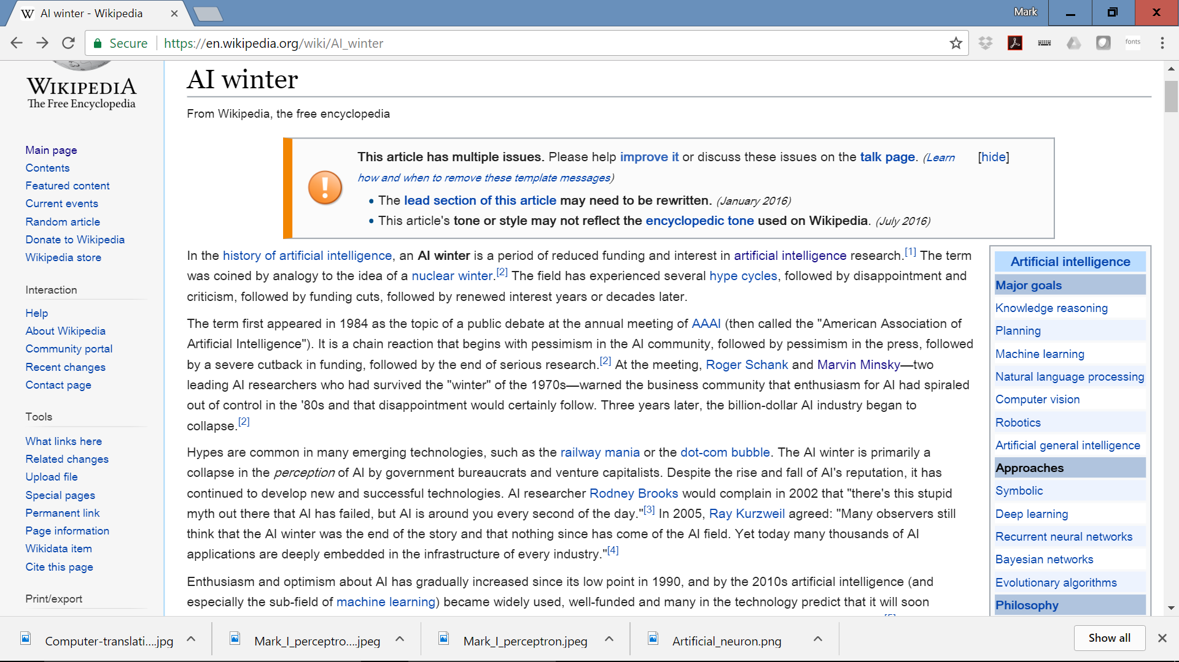

Slide 24
History of AI to the present day
1975-1985: Expert systems boom
1985-1995: Expert system bust; the second “AI winter”
Expert system, brief comic explanation:
https://www.youtube.com/watch?v=sg6hLmuyQ54
1995-2009: The probabilistic reasoning/ Bayesian logic boom
2009-present: Deep learning
Neural nets solve the expert system problems:
https://www.youtube.com/watch?v=n-YbJi4EPxc
History of AI on Wikipedia
Building Smarter Machines: NY Times Timeline

Slide 25
What accounts for recent successes in AI?
Faster computers
  The IBM 704 vacuum tube machine that played chess in 1958 could do about 50,000 calculations per second
  Deep Blue could do 50 billion calculations per second
  – a million times faster!
Dominance of statistical approaches, machine learning
Big data
Crowdsourcing

Slide 26
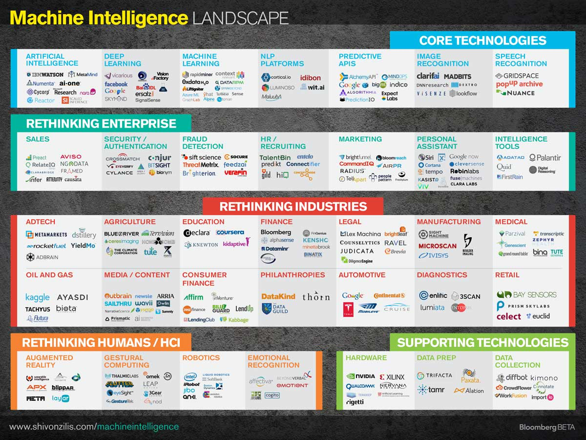

Slide 27
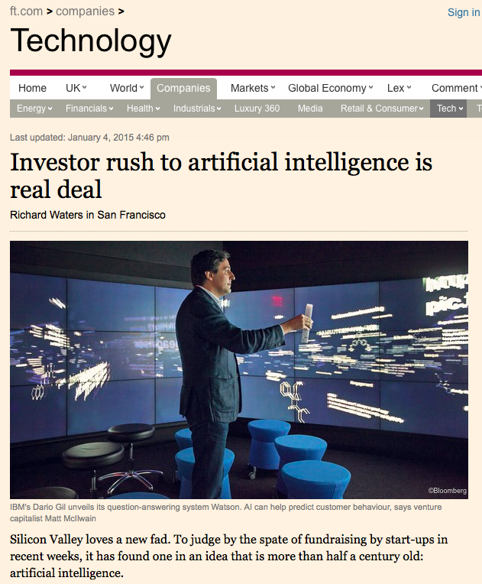

Slide 28
Historical themes
Boom and bust cycles
  Periods of (unjustified) optimism followed by periods of disillusionment and reduced funding
Silver bulletism (Levesque, 2013):
  “The tendency to believe in a silver bullet for AI, coupled with the belief that previous beliefs about silver bullets were hopelessly naïve”
Image problems
  “AI effect”/Moravec’s paradox: As soon as a machine gets good at performing some task, the task is no longer considered to require much intelligence
  AI as a threat to safety?
  AI as a threat to jobs?

Slide 29
AI Effect/Moravec’s paradox
Moravec’s paradox
  “It is comparatively easy to make computers exhibit adult level performance on intelligence tests or playing checkers, and difficult or impossible to give them the skills of a one-year-old when it comes to perception and mobility”
  [Hans Moravec, 1988]
Why is this?
  Early AI researchers concentrated on the tasks that they themselves found the most challenging, abilities of animals and two-year-olds were overlooked
  We are least conscious of what our brain does best
  Sensorimotor skills took millions of years to evolve, whereas abstract thinking is a relatively recent development

Slide 30
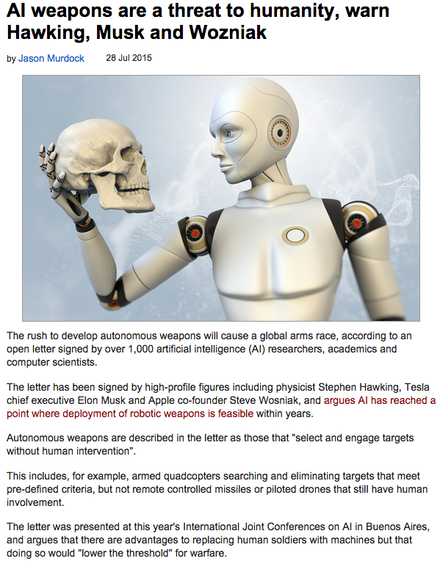
http://www.v3.co.uk/v3-uk/news/2419567/ai-weapons-are-a-threat-to-humanity-warn-hawking-musk-and-wozniak

Slide 31


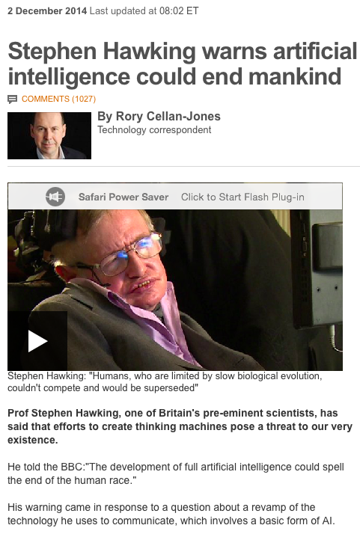
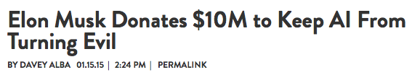
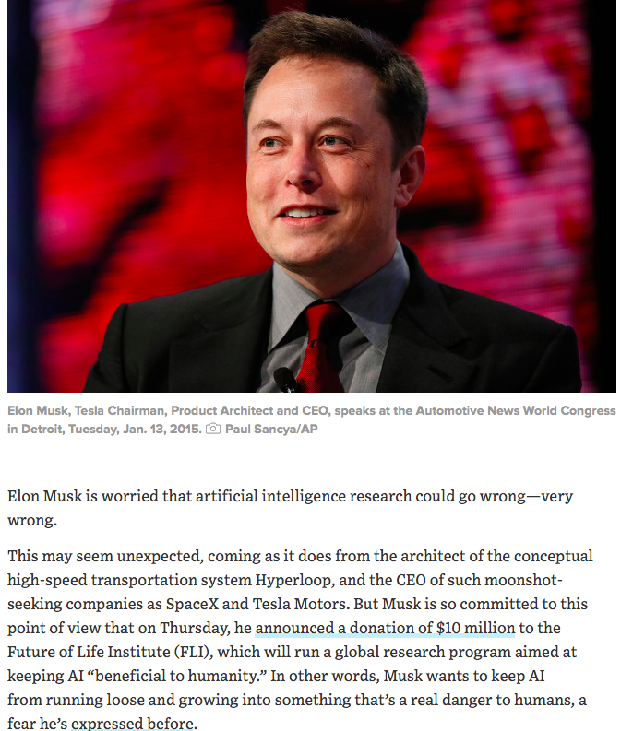
http://www.bbc.com/news/technology-30290540
http://www.wired.com/2015/01/elon-musk-ai-safety/

Slide 32
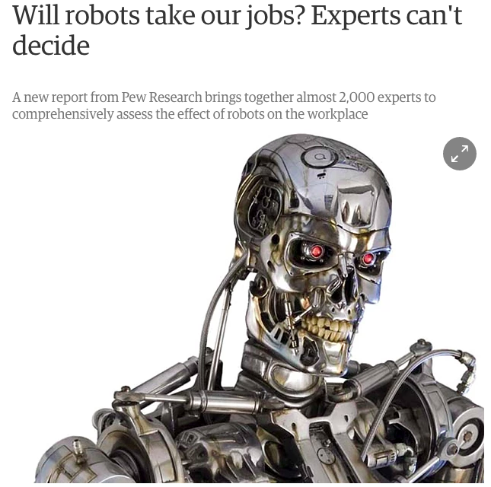


http://www.theguardian.com/technology/2014/aug/06/robots-jobs-artificial-intelligence-pew

Slide 33
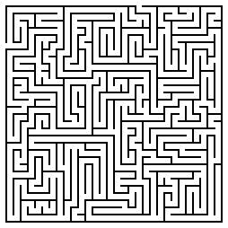
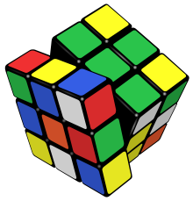
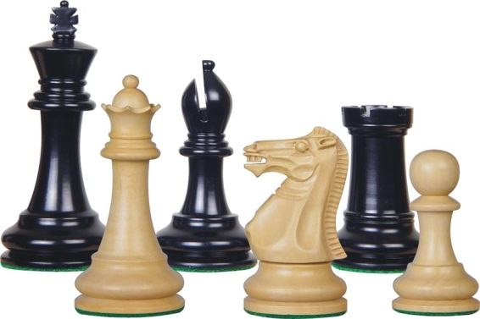
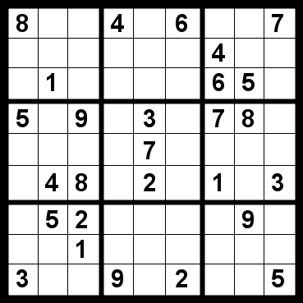
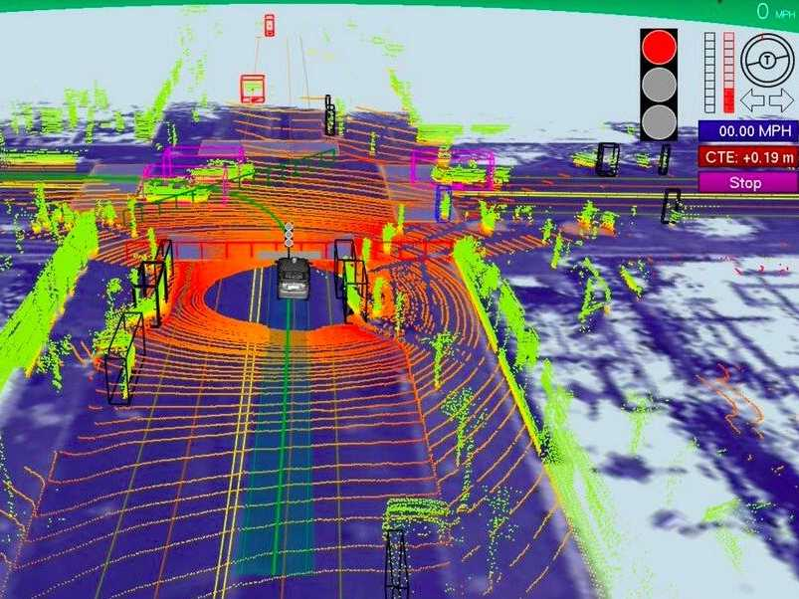
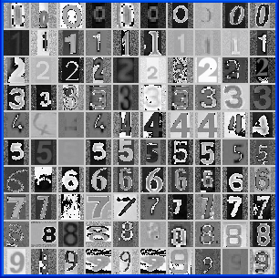
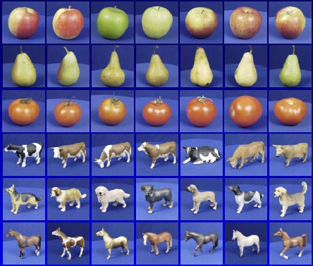

In this class
Part 1: sequential reasoning (MP1, MP2)
Part 2: pattern recognition and learning (MP3, MP4)

Slide 34
Philosophy of this class
Goal: use machines to solve hard problems that are traditionally thought to require human intelligence
We will try to follow a sound scientific/engineering methodology
  Consider relatively limited application domains
  Use well-defined input/output specifications
  Define operational criteria amenable to objective validation
  Zero in on essential problem features
  Focus on principles and basic building blocks

