Slide 1

CS440/ECE 448 Lecture 3:
Agents and Rationality
Slides by Svetlana Lazebnik, 9/2016
Modified by Mark Hasegawa-Johnson, 1/2019

Slide 2
Contents
Agent = Performance, Environment, Actions, Sensors (PEAS)
What makes an agent Rational?
What makes an agent Autonomous?
Types of Agents: Reflex, Internal-State, Goal-Directed, Utility-Directed (RIGU)
Properties of Environments: Observable, Deterministic, Episodic, Static, Continuous (ODESC)

Slide 3
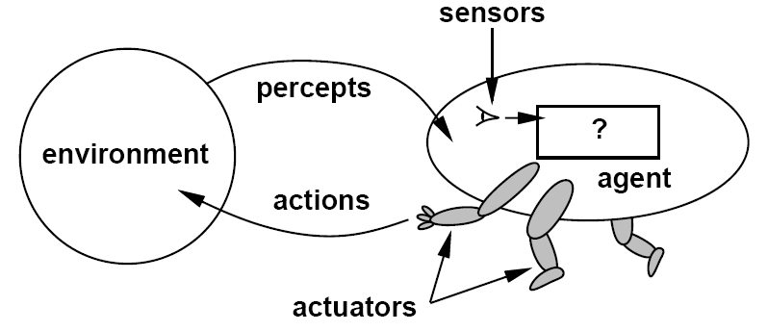
Agents
An agent is anything that can be viewed as perceiving its environment through sensors and acting upon that environment through actuators
sensations

Slide 4
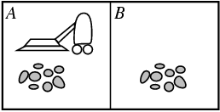
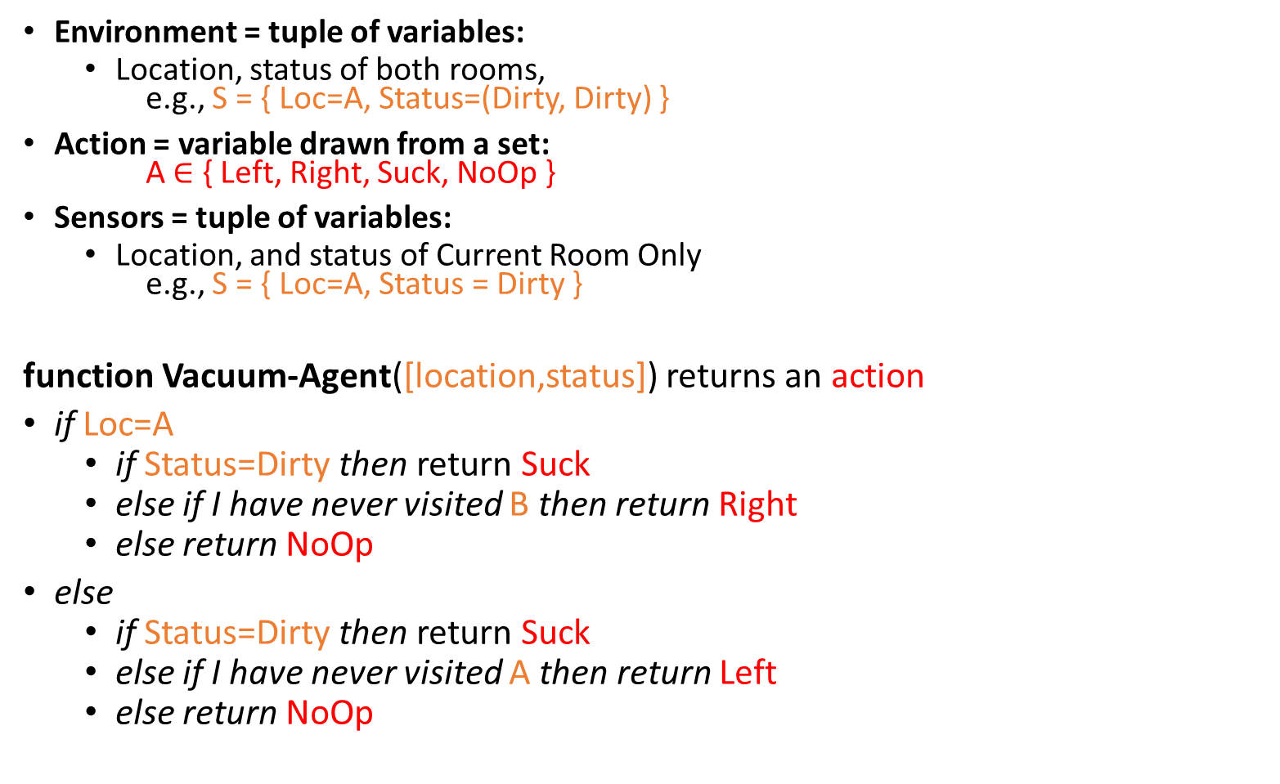
Example: Vacuum-Agent
Environment = tuple of variables:
  Location, status of both rooms,
  e.g., S = { Loc=A, Status=(Dirty, Dirty) }
Action = variable drawn from a set:
A$∈$ { Left, Right, Suck, NoOp }
Sensors = tuple of variables:
  Location, and status of Current Room Only
  e.g., S = { Loc=A, Status = Dirty }
function Vacuum-Agent([location,status]) returns an action
if Loc=A
  if Status=Dirty then return Suck
  else if I have never visited B then return Right
  else return NoOp
else
  if Status=Dirty then return Suck
  else if I have never visited A then return Left
  else return NoOp

Slide 5
Specifying the task environment
PEAS: Performance, Environment, Actions, Sensors
P: a function the agent is maximizing (or minimizing)
  Assumed given
E: a formal representation for world states
  For concreteness, a tuple (var₁=val₁, var₂=val₂, … ,var_{n}=val_{n})
A: actions that change the state according to a transition model
  Given a state and action, what is the successor state
  (or distribution over successor states)?
S: observations that allow the agent to infer the world state
  Often come in very different form than the state itself
  E.g., in tracking, observations may be pixels and state variables 3D coordinates

Slide 6
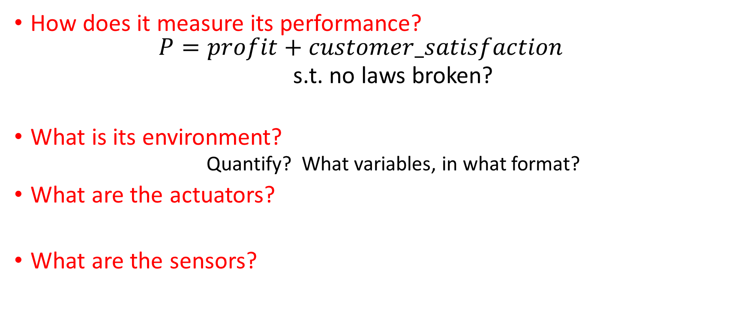
PEAS Example: Autonomous taxi
How does it measure its performance?
  $$P=profit+customer_satisfaction$$
  s.t. no laws broken?
What is its environment?
  Quantify? What variables, in what format?
What are the actuators?
What are the sensors?

Slide 7
Another PEAS example: Spam filter
Performance measure
Is a false accept as expensive as a false reject?
Performance per e-mail, or in aggregate?
Environment
  User’s e-mail account? Server hosting thousands of users?
Actuators?
Sensors?

Slide 8
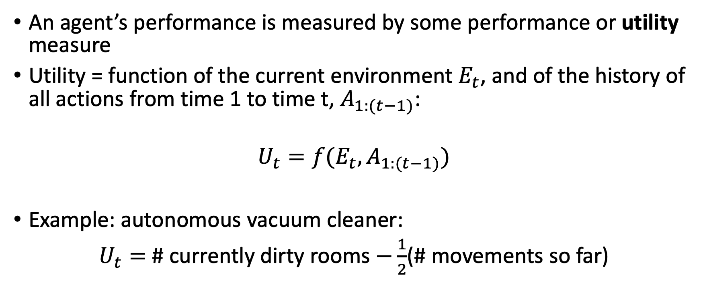
Performance Measure
An agent’s performance is measured by some performance or utility measure
Utility = function of the current environment $E_{t}$, and of the history of all actions from time 1 to time t, $A_{1:(t−1)}$:
$$U_{t}=f(E_{t},A_{1:(t−1)})$$
Example: autonomous vacuum cleaner:
$U_{t}=$ # currently dirty rooms $−\frac{1}{2}$(# movements so far)

Slide 9
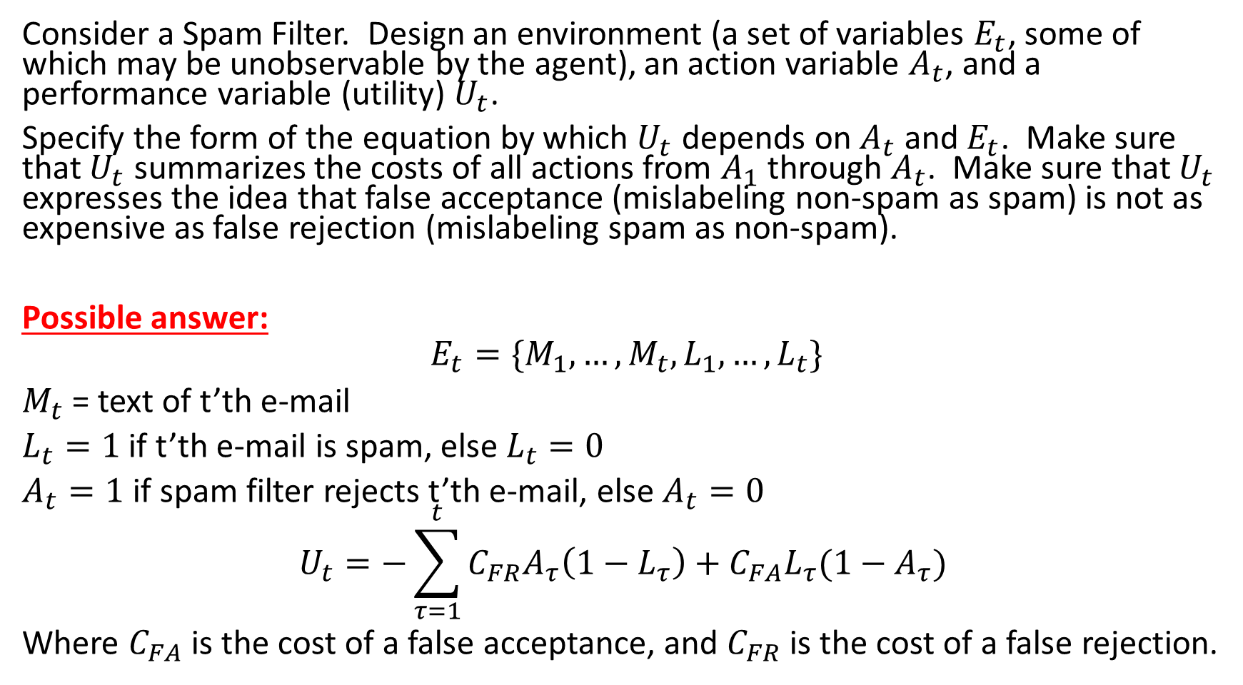
Example Problem: Spam Filter
Consider a Spam Filter. Design an environment (a set of variables $E_{t}$, some of which may be unobservable by the agent), an action variable $A_{t}$, and a performance variable (utility) $U_{t}$.
Specify the form of the equation by which $U_{t}$ depends on $A_{t}$ and $E_{t}$. Make sure that $U_{t}$ summarizes the costs of all actions from $A_{1}$ through $A_{t}$. Make sure that $U_{t}$ expresses the idea that false acceptance (mislabeling non-spam as spam) is not as expensive as false rejection (mislabeling spam as non-spam).
Possible answer:
$$E_{t}=\{M_{1},…,M_{t},L_{1},…,L_{t}\}$$
$M_{t}$ = text of t’th e-mail
$L_{t}=1$ if t’th e-mail is spam, else $L_{t}=0$
$A_{t}=1$ if spam filter rejects t’th e-mail, else $A_{t}=0$
$$U_{t}=−\sum_{τ=1}^{t}{C_{FR}A_{τ}\left(1−L_{τ}\right)+C_{FA}L_{τ}({1−A}_{τ}) }$$
Where $C_{FA}$ is the cost of a false acceptance, and $C_{FR}$ is the cost of a false rejection.

Slide 10
What makes an agent Rational?
RATIONAL AGENT is one with RATIONAL BEHAVIOR: For each possible percept sequence, a rational agent should select an action that is expected to maximize its performance measure, given the evidence provided by the percept sequence and the agent’s built-in knowledge
RATIONAL THOUGHT: all of the above, + agent calculates and maximizes the performance measures in its own brain.
Performance measure (utility function):
An objective criterion for success of an agent's behavior
Example Exam Problems:
  Can a rational agent make mistakes?
  Does rational behavior require rational thought?
Notes:
ExpectedUtility(action) = sum_outcomes Utility(outcome) * P(outcome|action)

Slide 11
Back to the Vacuum-Agent
function Vacuum-Agent([location,status]) returns an action
if Loc=A
  if Status=Dirty then return Suck
  else if I have never visited B then return Right
  else return NoOp
else
  if Status=Dirty then return Suck
  else if never visited A then Left
  else return NoOp
Example Exam Problem: Is this agent Rational?

Slide 12
What makes an agent Autonomous?
Russell & Norvig: “A system is autonomous to the extent that its behavior is determined by its own experience.”
A Rational Agent might not be Autonomous, if its designer was capable of foreseeing the maximum-utility action for every environment.
Example: Vacuum-Agent
Notes:
ExpectedUtility(action) = sum_outcomes Utility(outcome) * P(outcome|action)

Slide 13
Types of Agents
Reflex agent: no concept of past, future, or value
  Might still be Rational, if the environment is known to the designer with sufficient detail
Internal-State agent: knows about the past
Goal-Directed agent: knows about the past and future
Utility-Directed agent: knows about past, future, and value

Slide 14
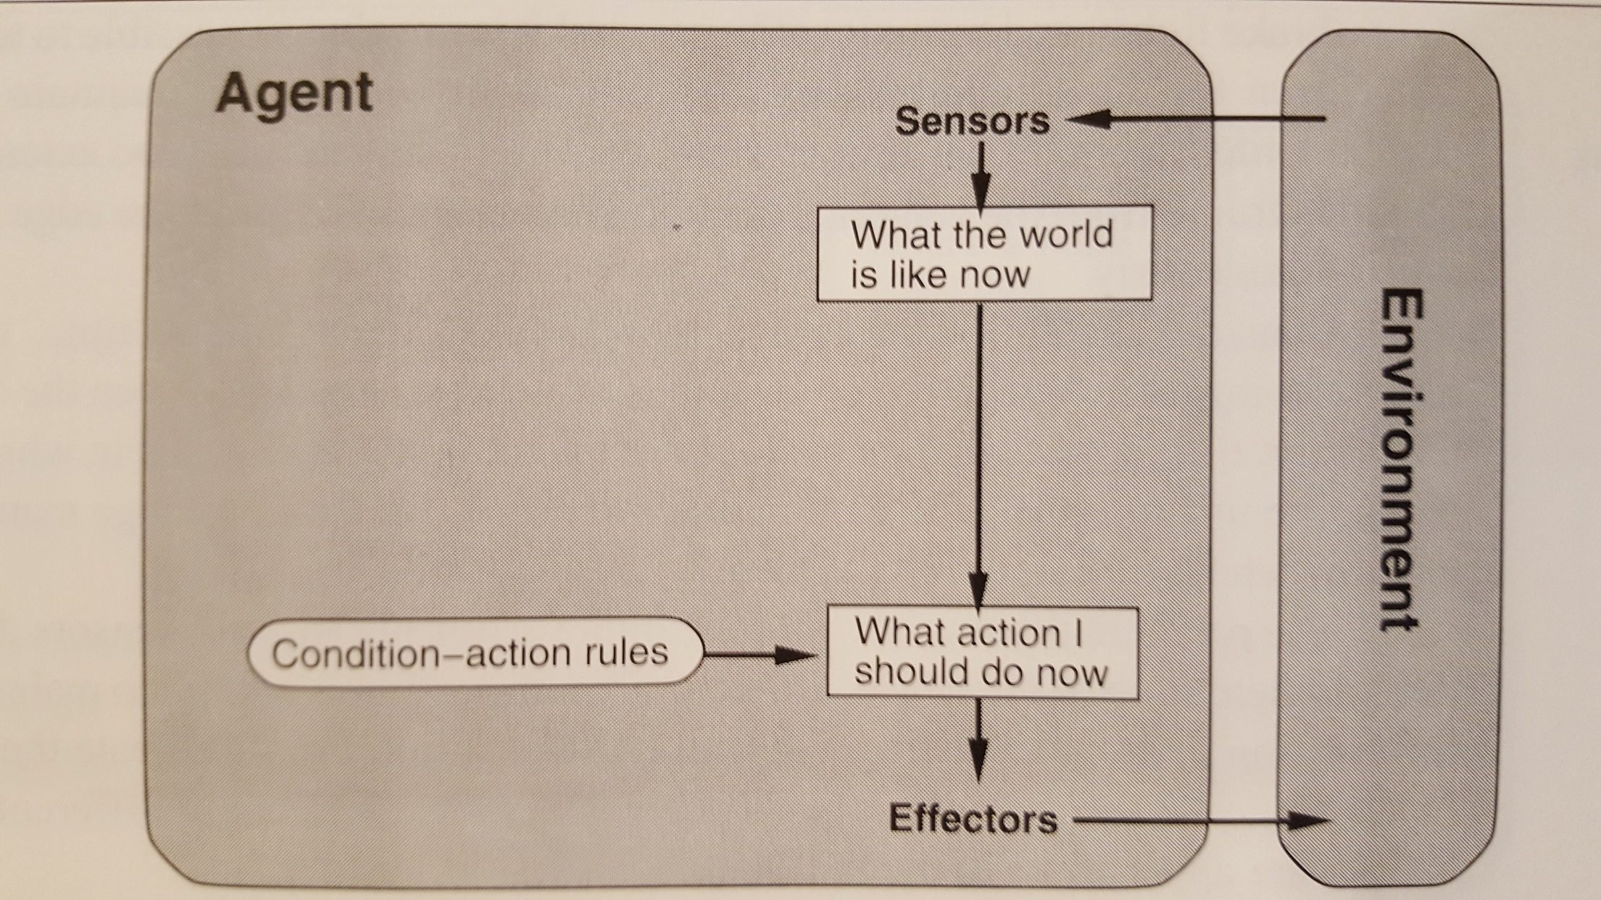
Reflex Agent

Slide 15
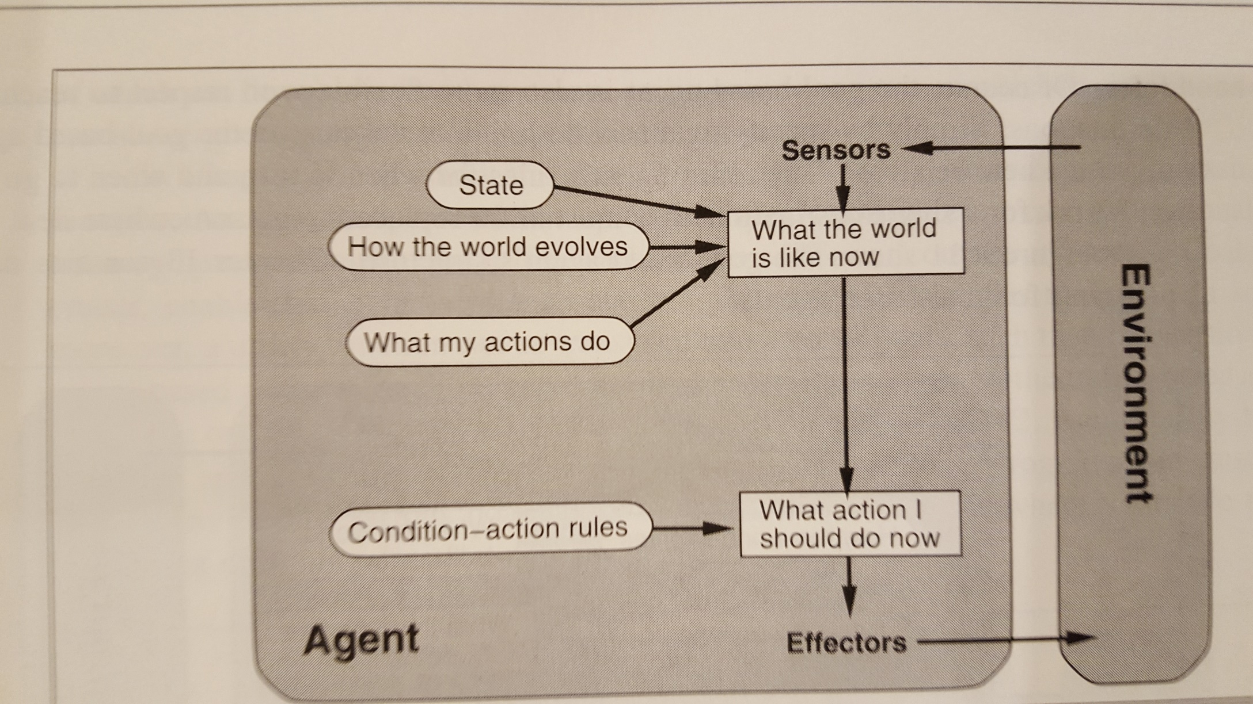
Internal-State Agent

Slide 16
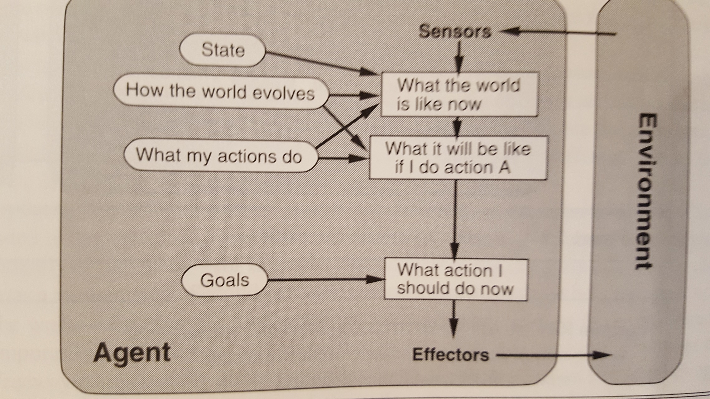
Goal-Directed Agent

Slide 17
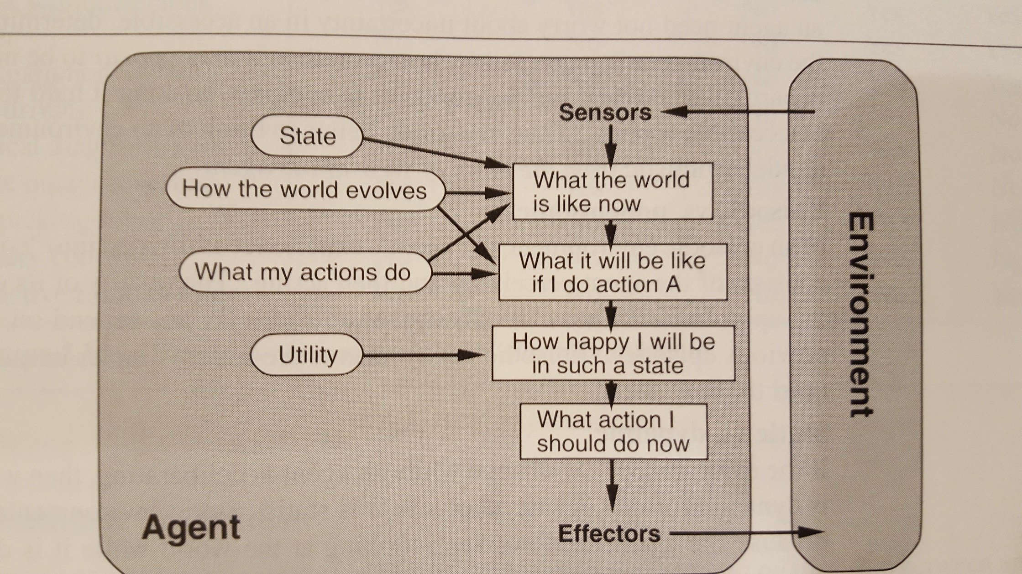
Utility-Directed Agent

Slide 18
PEAS
Performance measure: Determined by the system designer, attempts to measure some intuitive description of behavior goodness.
Actions: Determined by the system designer, usually trades off cost versus utility
Sensors: Determined by the system designer, usually trades off cost versus utility
Environment: Completely out of the control of the system designer.

Slide 19
Properties of Environments
Fully observable vs. partially observable
Deterministic vs. stochastic
Episodic vs. sequential
Static vs. dynamic
Discrete vs. continuous
Single agent vs. multi-agent
Known vs. unknown

Slide 20
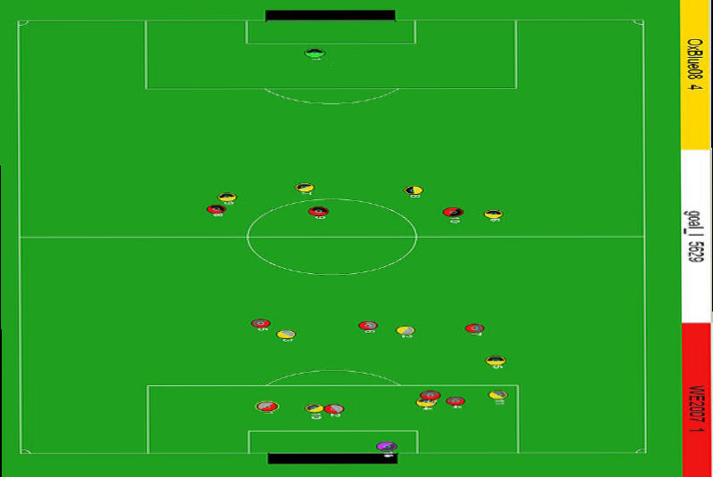
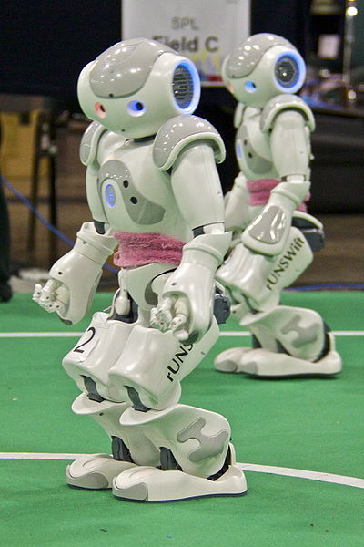
Fully observable vs. partially observable
Do the agent's sensors give it access to the complete state of the environment?
  For any given world state, are the values of all the variables known to the agent?
vs.
Source: L. Zettlemoyer

Slide 21
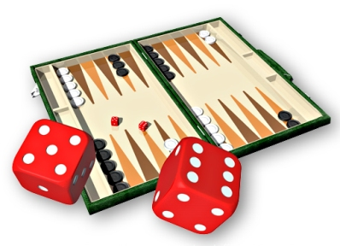
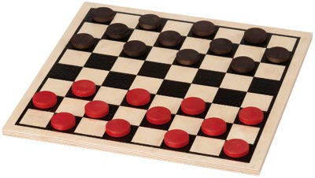
Deterministic vs. stochastic
Is the next state of the environment completely determined by the current state and the agent’s action?
  Is the transition model deterministic (unique successor state given current state and action) or stochastic (distribution over successor states given current state and action)?
  strategic: the environment is deterministic except for the actions of other agents
vs.

Slide 22
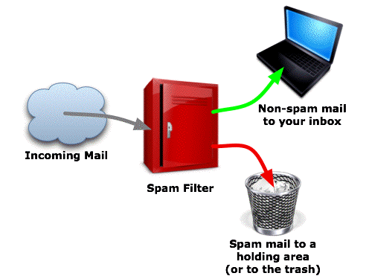
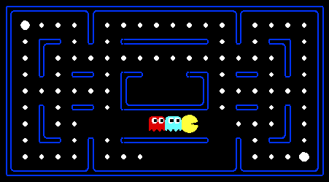
Episodic vs. sequential
Is the agent’s experience divided into unconnected episodes, or is it a coherent sequence of observations and actions?
  Does each problem instance involve just one action or a series of actions that change the world state according to the transition model?
vs.
Notes:
Episodic: The agent's experience is divided into atomic “episodes,” and the choice of action in each episode depends only on the episode itself

Slide 23
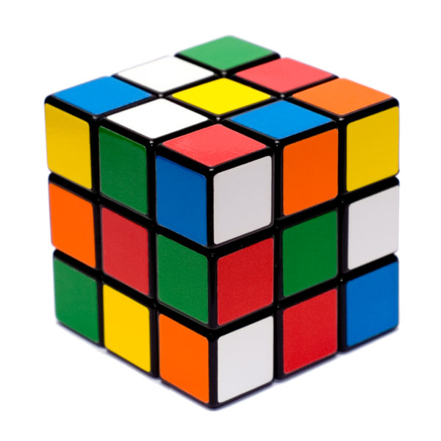
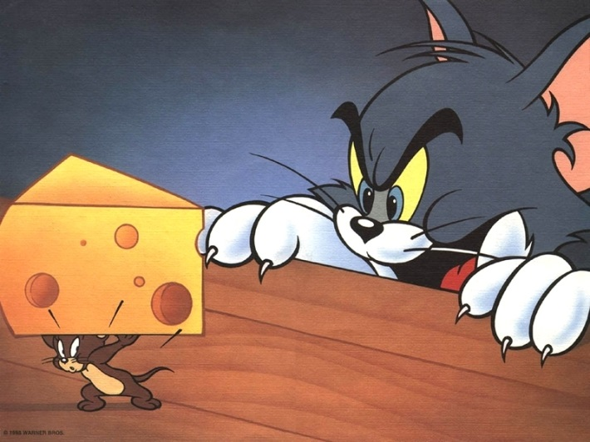
Static vs. dynamic
Is the world changing while the agent is thinking?
    Semidynamic: the environment does not change with the passage of time, but the agent's performance score does
vs.

Slide 24
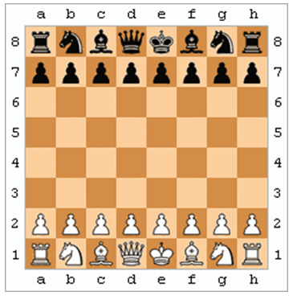
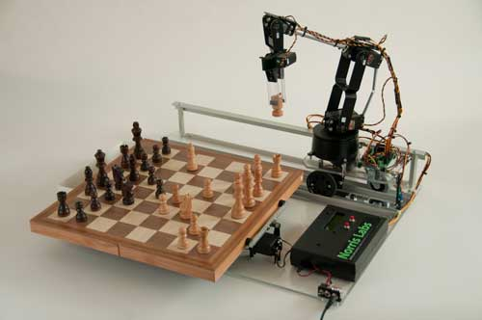
Discrete vs. continuous
Does the environment provide a countable (discrete) or uncountably infinite (continuous) number of distinct percepts, actions, and environment states?
  Are the values of the state variables discrete or continuous?
  Time can also evolve in a discrete or continuous fashion
  “Distinct” = different values of utility
vs.

Slide 25
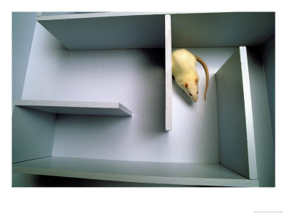
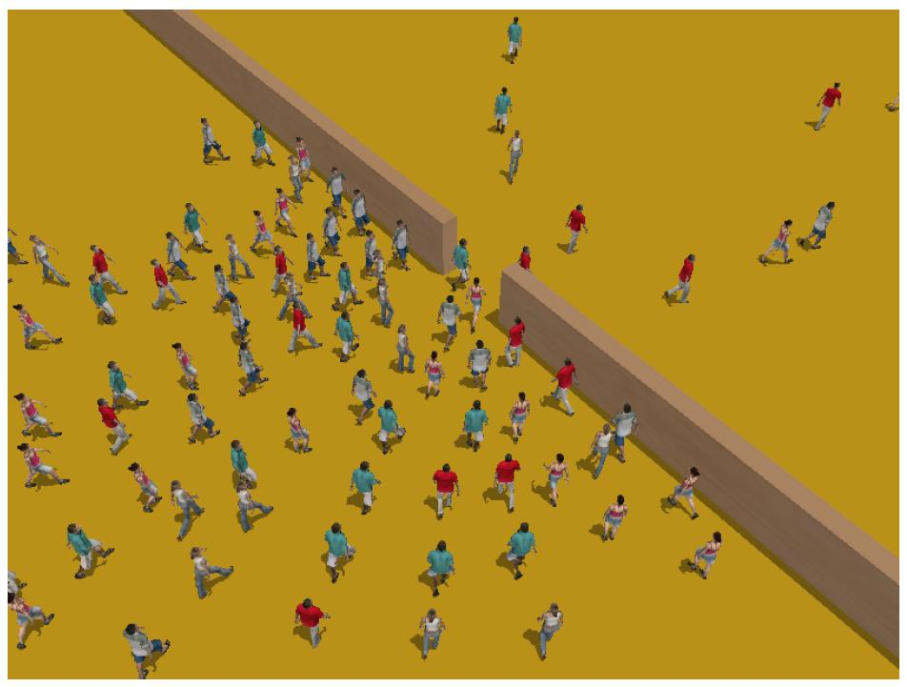
Single-agent vs. multiagent
Is an agent operating by itself in the environment?
vs.

Slide 26
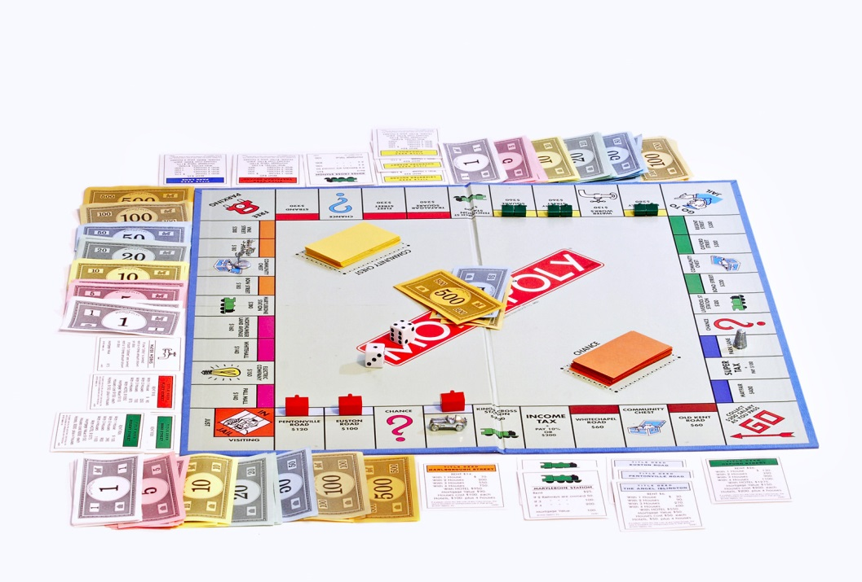
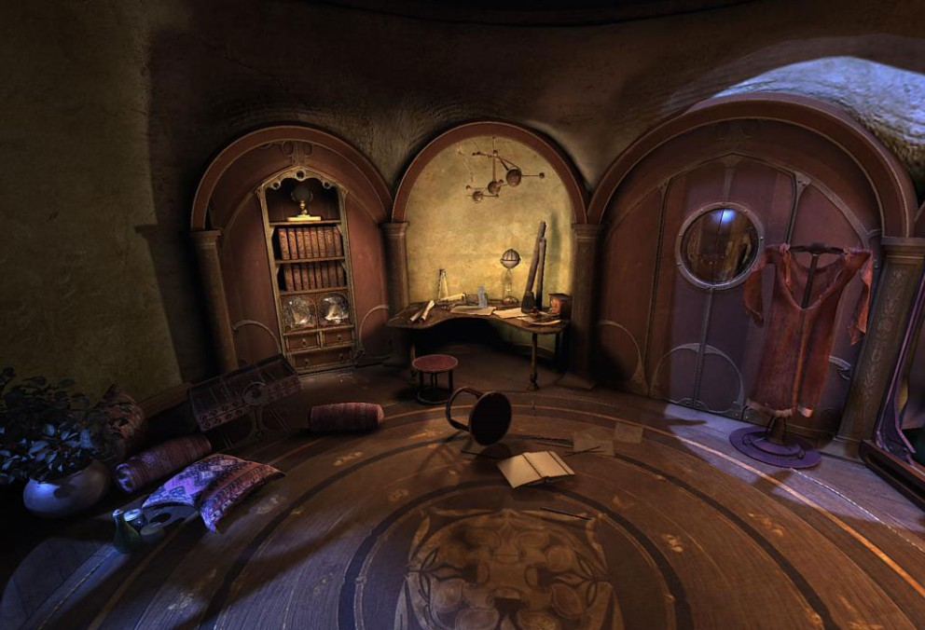
Known vs. unknown
Are the rules of the environment (transition model and rewards associated with states) known to the agent?
  Strictly speaking, not a property of the environment, but of the agent’s state of knowledge
vs.

Slide 27
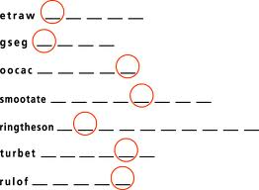
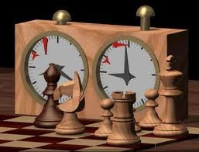
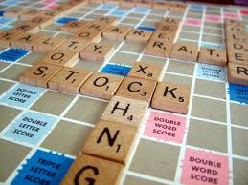
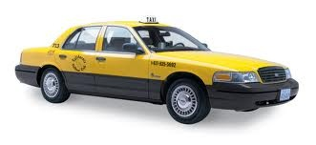
Examples of different environments
Word jumble
solver
Chess with
a clock
Scrabble
Autonomous driving
Fully
Fully
Partially
Partially
Observable
Deterministic
Episodic
Static
Discrete
Single agent
Deterministic
Strategic
Stochastic
Stochastic
Episodic
Sequential
Sequential
Sequential
Static
Semidynamic
Static
Dynamic
Discrete
Discrete
Discrete
Continuous
Single
Multi
Multi
Multi

Slide 28
Preview of the course
Deterministic environments: search, constraint satisfaction, logic
  Can be sequential or episodic
Strategic environments: minimax search, games
  Might be either deterministic (e.g., chess) or stochastic (e.g., poker)
  Might be fully observable (e.g., chess) or partially observable (e.g., battleship)
Stochastic environments
  Episodic: Bayesian networks, pattern classifiers
  Sequential, known: Markov decision processes
  Sequential, unknown: reinforcement learning

