Slide 1
CS440/ECE448 Lecture 26: Speech
Mark Hasegawa-Johnson, 4/17/2019, CC-By 3.0

Slide 2
Outline
Human speech processing
Modeling the ear: Fourier transforms and filterbanks
Speech-to-text-to-speech (S2T2S)
Hybrid DNN-HMM systems (*)
Recurrent neural nets (RNNs): Connectionist Temporal Classification, Trajectory nets
Sequence-to-sequence RNNs with attention
Languages other than English
Training and testing on 300 languages
Transfer learning: from languages with data, to languages without
Dialog systems for unwritten languages
Distorted speech
Motor disability
Second-language learners
(*): Underline shows which topic you need to understand for the exam.
Everything else in today’s lecture is considered optional background knowledge.

Slide 3








Speech communication
Speech communication: a message, stored in Alice’s brain, is converted to language, then converted to speech. Bob hears the speech, and decodes it to get the message.

Slide 4
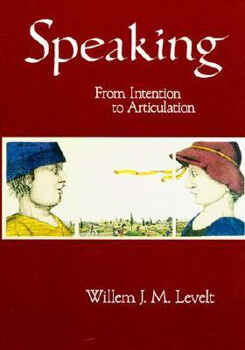
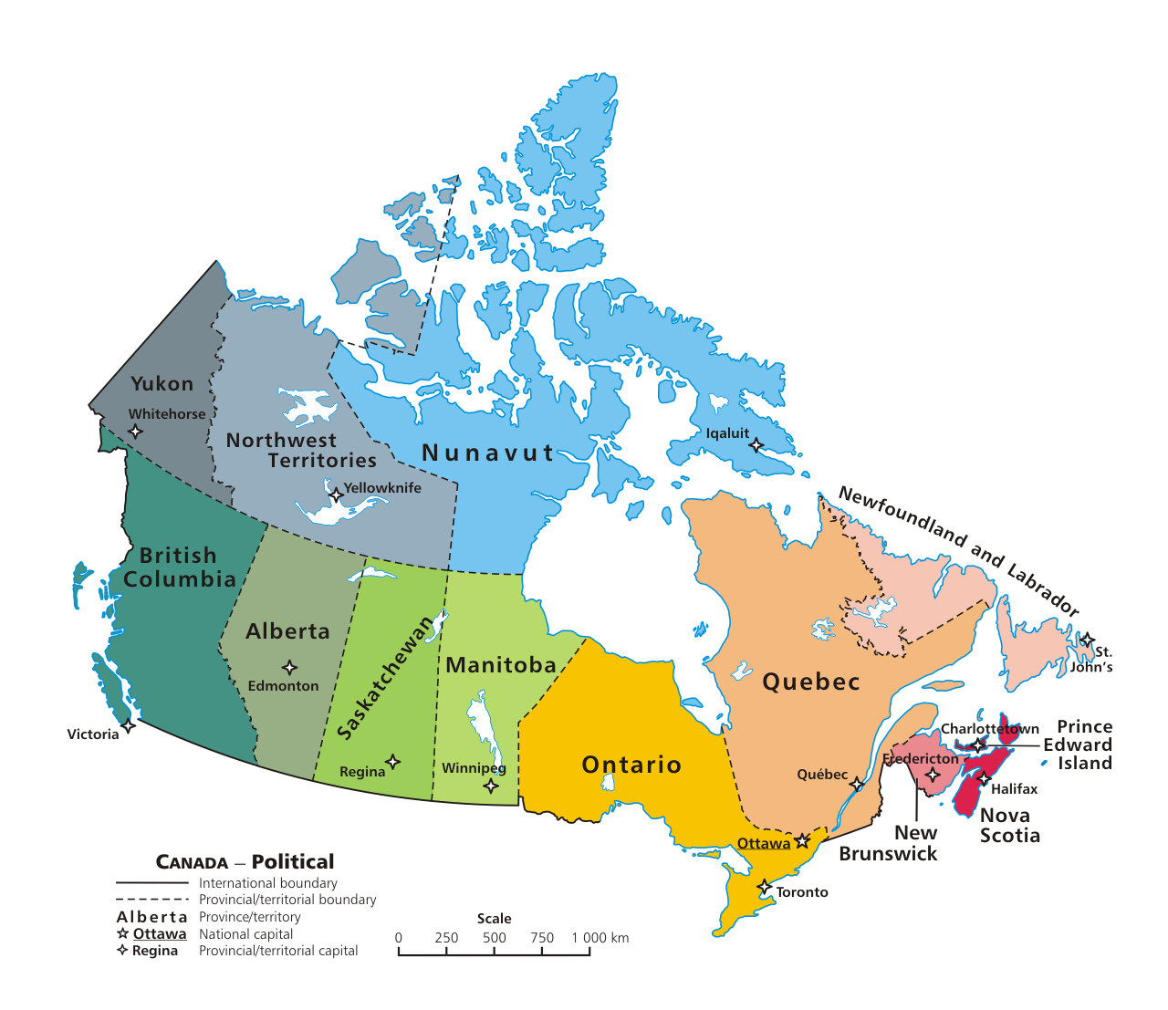





What sort of messages do humans send? (Levelt, Speaking, 1989)
Experiments have shown at least three different ways that knowledge can be stored in long-term memory:
visual/
spatial
logical/
propositional/
linguistic
procedural/
kinematic/
somatosensory
$$∀p∃q:Carries(p,q)$$
for x in range(0,10):
print(‘This is the %sth line’%(x))

Slide 5


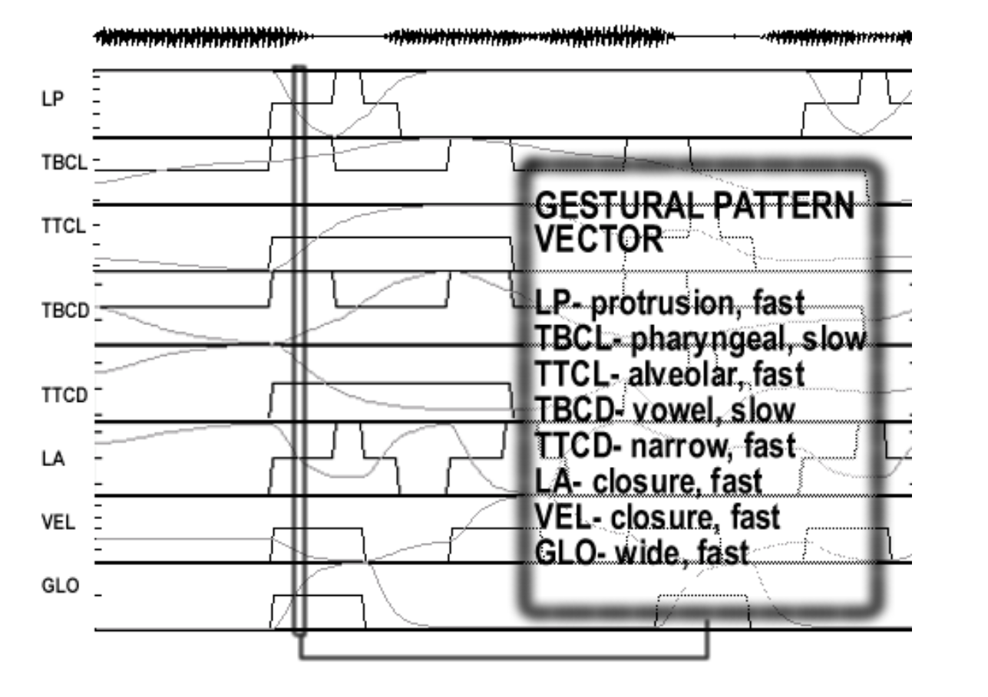
Speaking
visual/spatial
source knowledge
Experiments show that speaking consists of the following distinct mental activities, with no feedback from later to earlier activities:
Step 1: convert to propositional form. Experiments show that the starting sound and meaning of each word are known before the order of the words is known.
Step 2: fill in the pronunciation of each word
Step 3: plan a smooth articulatory trajectory
Step 4: speak
1. k…. o……….. b……….
2. the cat is on the bed
3.

Slide 6
Speech perception
Most structures of the ear: protect the basilar membrane
Basilar membrane: a mechanical continuous bank of band-pass filters
Inner hair cell: mechanoelectric transduction; half-wave rectification
Auditory nerve: dynamic range compression
Brainstem: source localization, source separation, echo suppression
Auditory cortex: continuous-to-discrete conversion, from acoustic spectra to probabilities of speech sound categories
Posterior Middle Temporal Gyrus: word sequence candidates compete with each other to see which one can be the most probable

Slide 7
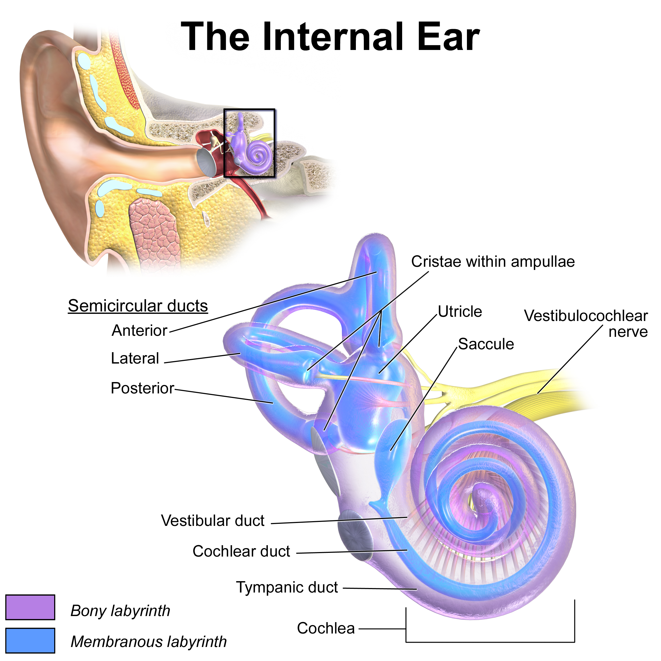
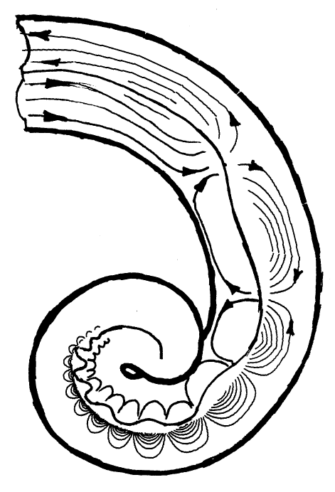

1. The main purpose of most of the structures of the ear is just to protect the basilar membrane.
2. The basilar membrane, down the center of the cochlea, is like a continuous xylophone: tuned to different frequencies at different locations
By Dicklyon (talk) (Uploads) - Own work, Public Domain, https://en.wikipedia.org/w/index.php?curid=12469498
Blausen.com staff (2014). "Medical gallery of Blausen Medical 2014". WikiJournal of Medicine 1(2). DOI:10.15347/wjm/2014.010. ISSN 2002-4436

Slide 8
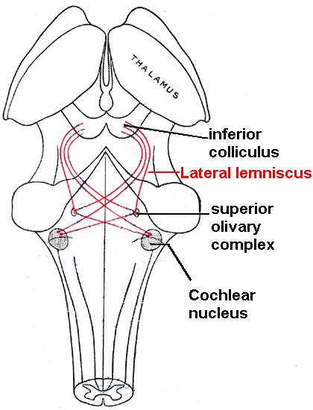
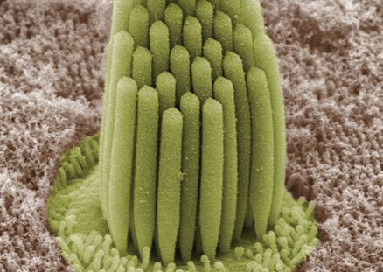
4. Dynamic range compression: each hair cell connected to ~10 neurons, with thresholds distributed so that
# cells that fire ~ log(signal amplitude)
By Bechara Kachar - http://irp.nih.gov/our-research/research-in-action/high-fidelity-stereocilia/slideshow, Public Domain, https://commons.wikimedia.org/w/index.php?curid=24468731
3. The basilar membrane is covered with little hair bundles.
When the membrane moves upward, pores in the tip of each hair cell open, depolarizing the cell.
When the membrane moves downward, no response.
So the hair cell is like a ReLU: y=max(0,x)
5. Neurons from the ear go to the brainstem, where:
Cochlear nucleus does echo cancellation.
Olivary complex, lateral lemniscus, & inferior colliculus do localization.

Slide 9
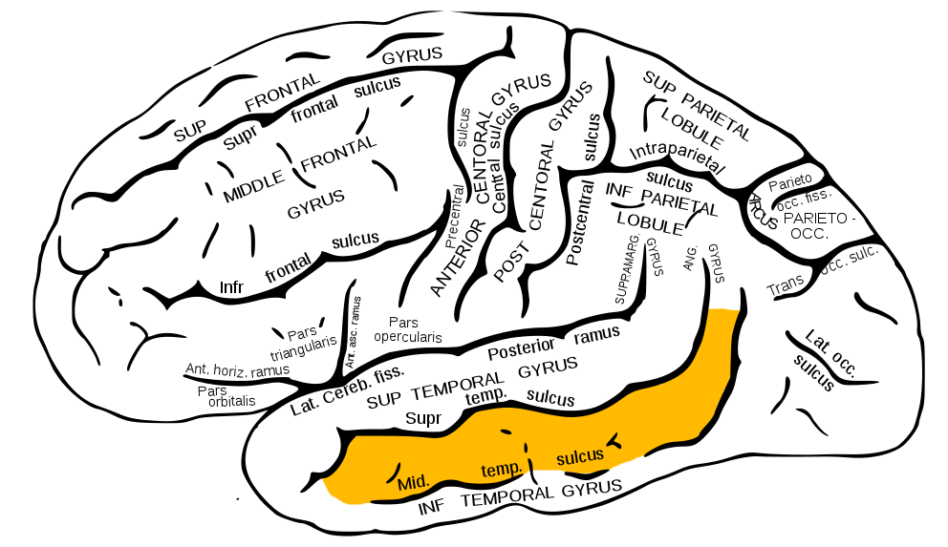
After the sound reaches the cortex: final processing (6. Mesgarani & Chang, 2012; 7. Hickok & Poeppel, 2007;)
Auditory cortex: continuous-to-discrete conversion, from acoustic spectra to probabilities of speech sound categories
Posterior Middle Temporal Gyrus: word sequence candidates compete with each other to see which one can be the most probable

Slide 10
Outline
Human speech processing
Modeling the ear: Fourier transforms and filterbanks
Speech-to-text-to-speech (S2T2S)
Hybrid DNN-HMM systems (*)
Recurrent neural nets (RNNs): Connectionist Temporal Classification, Trajectory nets
Sequence-to-sequence RNNs with attention
Languages other than English
Training and testing on 300 languages
Transfer learning: from languages with data, to languages without
Dialog systems for unwritten languages
Distorted speech
Motor disability
Second-language learners
(*): Underline shows which topic you need to understand for the exam.
Everything else in today’s lecture is considered optional background knowledge.

Slide 11
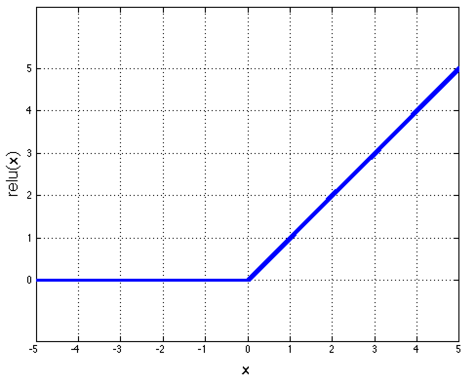
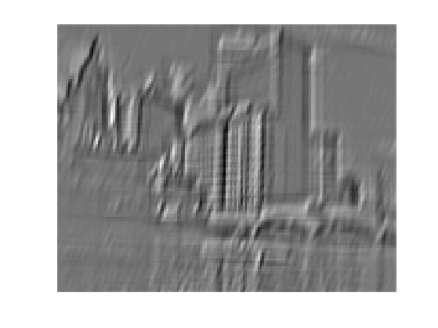
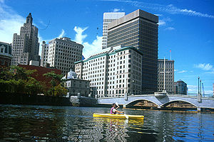
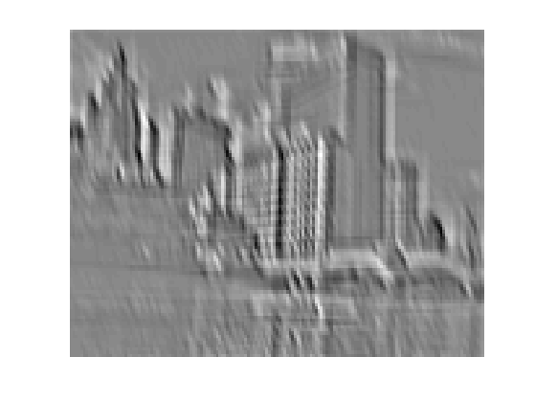
Reminder: Image Features You’ve seen this slide before, in lecture 24, on Deep Learning…
Feature maps
Image features are calculated by convolution, followed by ReLU.
Normalization
Spatial pooling
One layer of a convolutional neural network
Non-linearity
...
Convolution (Learned)
Input
Feature Map
Input Image

Slide 12
Speech features as computed by the ear
The basilar membrane is like convolution with a bank of bandpass filters
The hair cell performs half-wave rectification (ReLU)
=
...
Input
Feature Map
=

Slide 13
Artificial speech features
Option 1: Exact matching of the filter/rectify operations of the basilar membrane
Option 2: Learned filters, by applying a convolution directly to the input speech signal
Option 3: Fast Fourier transform of the input speech signal, then compute the magnitude

Slide 14
Artificial speech features: Experimental results
Option 1: Exact matching of the filter/rectify operations of the basilar membrane
Computationally expensive; results are sometimes better than options 2&3, but often not
Option 2: Learned filters, by applying a convolution directly to the input speech signal
Computationally cheap during test time, but very expensive during training
Usually turns out to be exactly the same accuracy as option #3 --- in fact, the convolution kernels that are learned usually turn out to look like the kernels of a Fourier transform!
Option 3: Fast Fourier transform of the input speech signal, then compute the magnitude

Slide 15
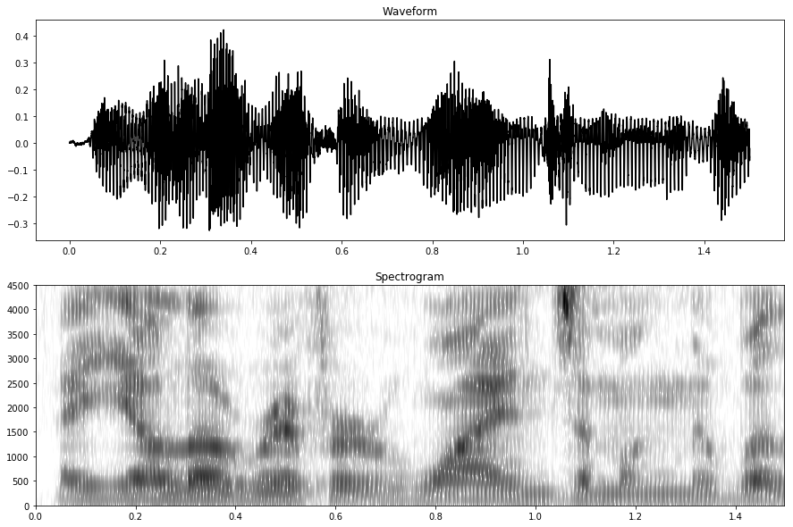
Artificial speech features: My recommendation
Spectrogram = log|X(f)| = log magnitude of the Fourier transform, computed with 25 millisecond windows, overlapping by 15 milliseconds

Slide 16
Speech synthesis from the spectrogram
Exact reconstruction is possible from the complex FFT, but not from the FFT magnitude
If you have the true FFT magnitude, and your windows overlap by at least 50%, then exact reconstruction is possible
But if you have synthetic FFT magnitude (e.g., generated by an HMM or a neural net), then it might not match any true speech signal.
If you have a synthetic FFT magnitude, you need to synthesize speech that is a “good match:”
Reconstruct a signal that matches the FFT with minimum squared error (Griffin-Lim algorithm)
Use a neural net to estimate the signal from the FFTM (e.g., wavenet)
Griffin-Lim
or
wavenet

Slide 17
Outline
Human speech processing
Modeling the ear: Fourier transforms and filterbanks
Speech-to-text-to-speech (S2T2S)
Hybrid DNN-HMM systems (*)
Recurrent neural nets (RNNs): Connectionist Temporal Classification, Trajectory nets
Sequence-to-sequence RNNs with attention
Languages other than English
Training and testing on 300 languages
Transfer learning: from languages with data, to languages without
Dialog systems for unwritten languages
Distorted speech
Motor disability
Second-language learners
(*): Underline shows which topic you need to understand for the exam.
Everything else in today’s lecture is considered optional background knowledge.

Slide 18
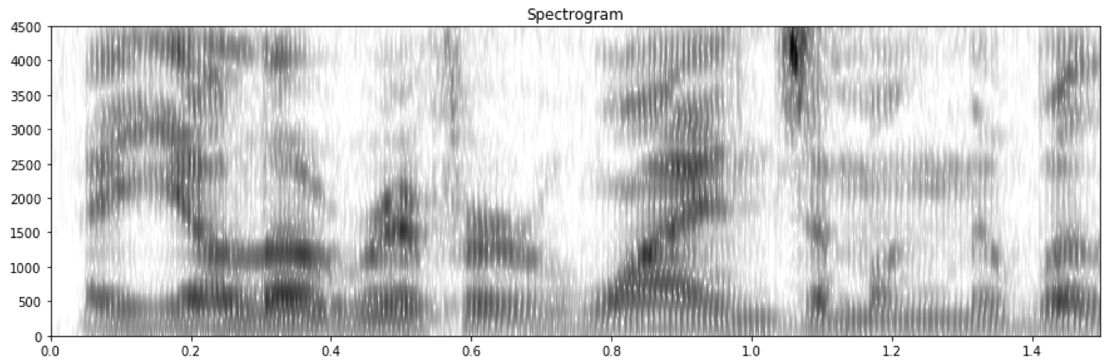

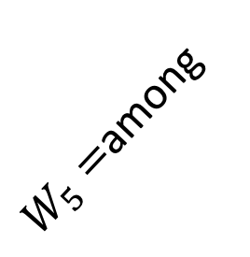

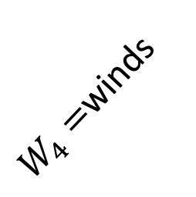

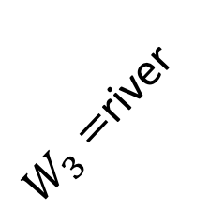

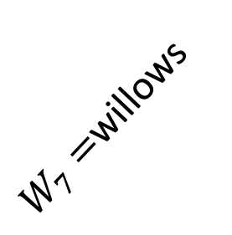
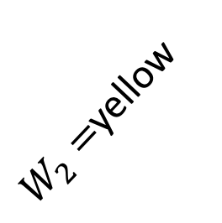

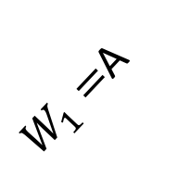
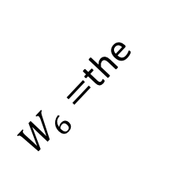
The speech-to-text problem
From a spectrogram input (sequence of T vector observations, $E_{1}$ to $E_{T}$), compute a word sequence output (sequence of L label outputs, $W_{1}$ to $W_{L}, L<T$)
$W_{1}=$A
$W_{2}=$yellow
$W_{3}=$river
$W_{4}=$winds
$W_{5}=$among
$W_{7}=$willows
$W_{6}=$the
$$E_{1}$$
$$…$$
$$E_{20}$$
$$…$$
$$E_{150}$$

Slide 19
A Sequence Model you Know: HMM You’ve seen this slide before, in lecture 20, on HMMs…
Markov assumption for state transitions
The current state is conditionally independent of all the other states given the state in the previous time step
P(Q_{t} | Q_{0:t-1}) = P(Q_{t} | Q_{t-1})
Markov assumption for observations
The evidence at time t depends only on the state at time t
P(E_{t} | Q_{0:t}, E_{1:t-1}) = P(E_{t} | Q_{t})
…
Q₀
Q₁
Q₂
Q_{t-1}
Q_{t}
E₁
E₂
E_{t-1}
E_{t}

Slide 20
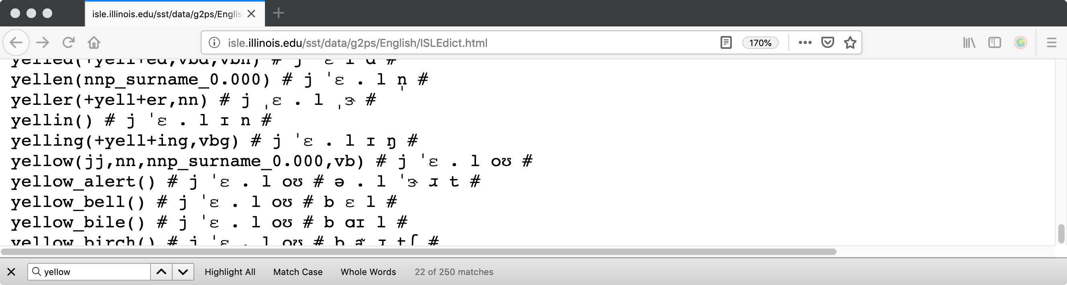
HMMs for Speech Recognition
Decide, in advance, how many states each word will have. For example, choosing # states = three times # phonemes usually works well. (Get phonemes from an online dictionary, like ISLEdict)
“yellow” = j ɛ l oʊ, 4 phonemes = 12 states
“winds” = w ɑɪ n d z, 5 phonemes = 15 states

Slide 21
HMMs for Speech Recognition
Decide, in advance, how many states each word will have. For example, choosing # states = three times # phonemes usually works well. (Get phonemes from an online dictionary, like ISLEdict)
“yellow” = j ɛ l oʊ, 4 phonemes = 12 states
“winds” = w ɑɪ n d z, 5 phonemes = 15 states
Pool together, across words, the HMM states that sound similar. For example, the 4th state in the word “winds” might be called “the 1st state of the phoneme ɑɪ, in words where that phoneme follows w and precedes n” (denoted Q=w-ɑɪ+n_1), and it would share parameters with all other words that have a similar-sounding ɑɪ.
Those pooled HMM-states are called senones. You’ll have more or less senones, depending on how you define „similar-sounding,” but most speech recognizers have about 3000-5000 of them.

Slide 22
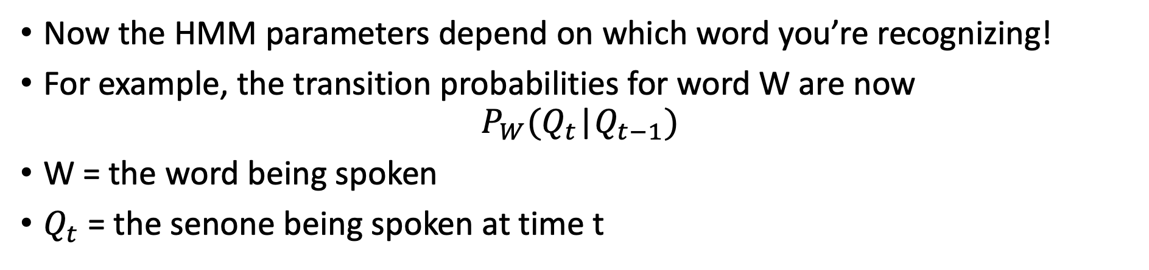
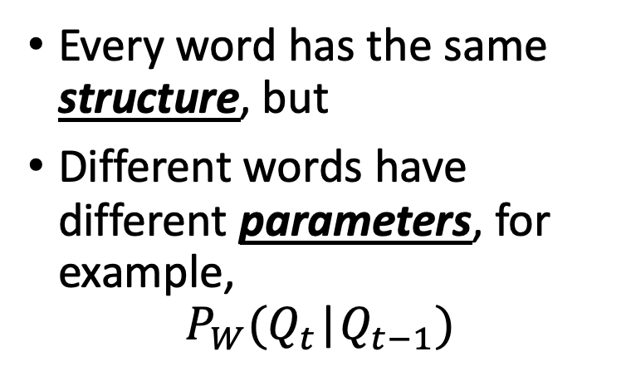
HMMs for Speech Recognition
Now the HMM parameters depend on which word you’re recognizing!
For example, the transition probabilities for word W are now
$$P_{W}(Q_{t}\text{|}Q_{t−1})$$
W = the word being spoken
$Q_{t}$ = the senone being spoken at time t
Every word has the same structure, but
Different words have different parameters, for example,
$$P_{W}(Q_{t}\text{|}Q_{t−1})$$
…
Q₀
Q₁
Q₂
Q_{t-1}
Q_{t}
E₁
E₂
E_{t-1}
E_{t}

Slide 23
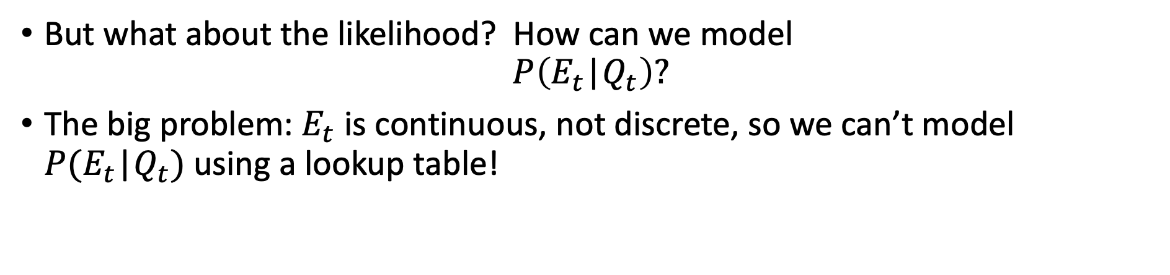
The Problem of Continuous Observations
But what about the likelihood? How can we model
$$P\left(E_{t}\text{|}Q_{t}\right)?$$
The big problem: $E_{t}$ is continuous, not discrete, so we can’t model $P(E_{t}\text{|}Q_{t})$ using a lookup table!
…
Q₀
Q₁
Q₂
Q_{t-1}
Q_{t}
E₁
E₂
E_{t-1}
E_{t}

Slide 24
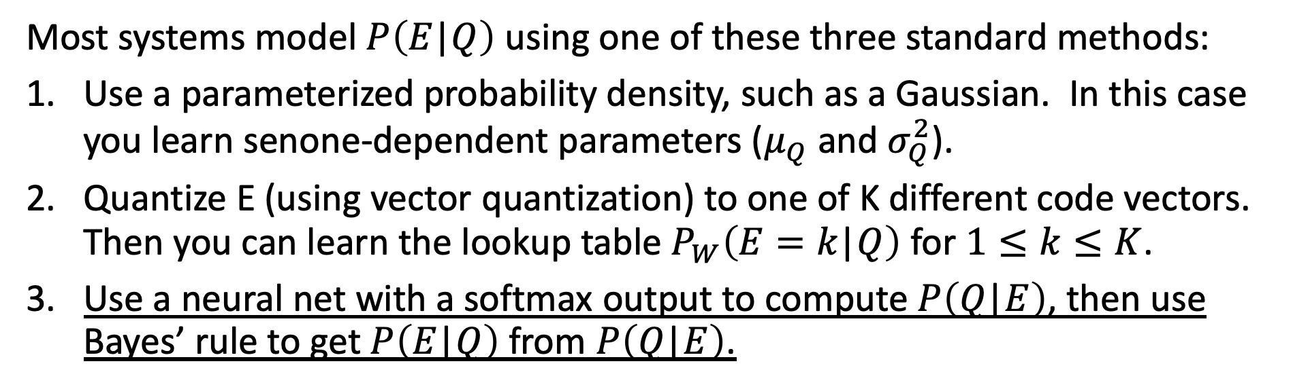
Solutions to the Problem of Continuous Observations
Most systems model $P\left(E\text{|}Q\right)$ using one of these three standard methods:
Use a parameterized probability density, such as a Gaussian. In this case you learn senone-dependent parameters ($μ_{Q}$ and $σ_{Q}^{2}$).
Quantize E (using vector quantization) to one of K different code vectors. Then you can learn the lookup table $P_{W}\left(E=k\text{|}Q\right)$ for $1≤k≤K$.
Use a neural net with a softmax output to compute $P\left(Q\text{|}E\right)$, then use Bayes’ rule to get $P\left(E\text{|}Q\right)$ from $P\left(Q\text{|}E\right)$.
…
Q₀
Q₁
Q₂
Q_{t-1}
Q_{t}
E₁
E₂
E_{t-1}
E_{t}

Slide 25
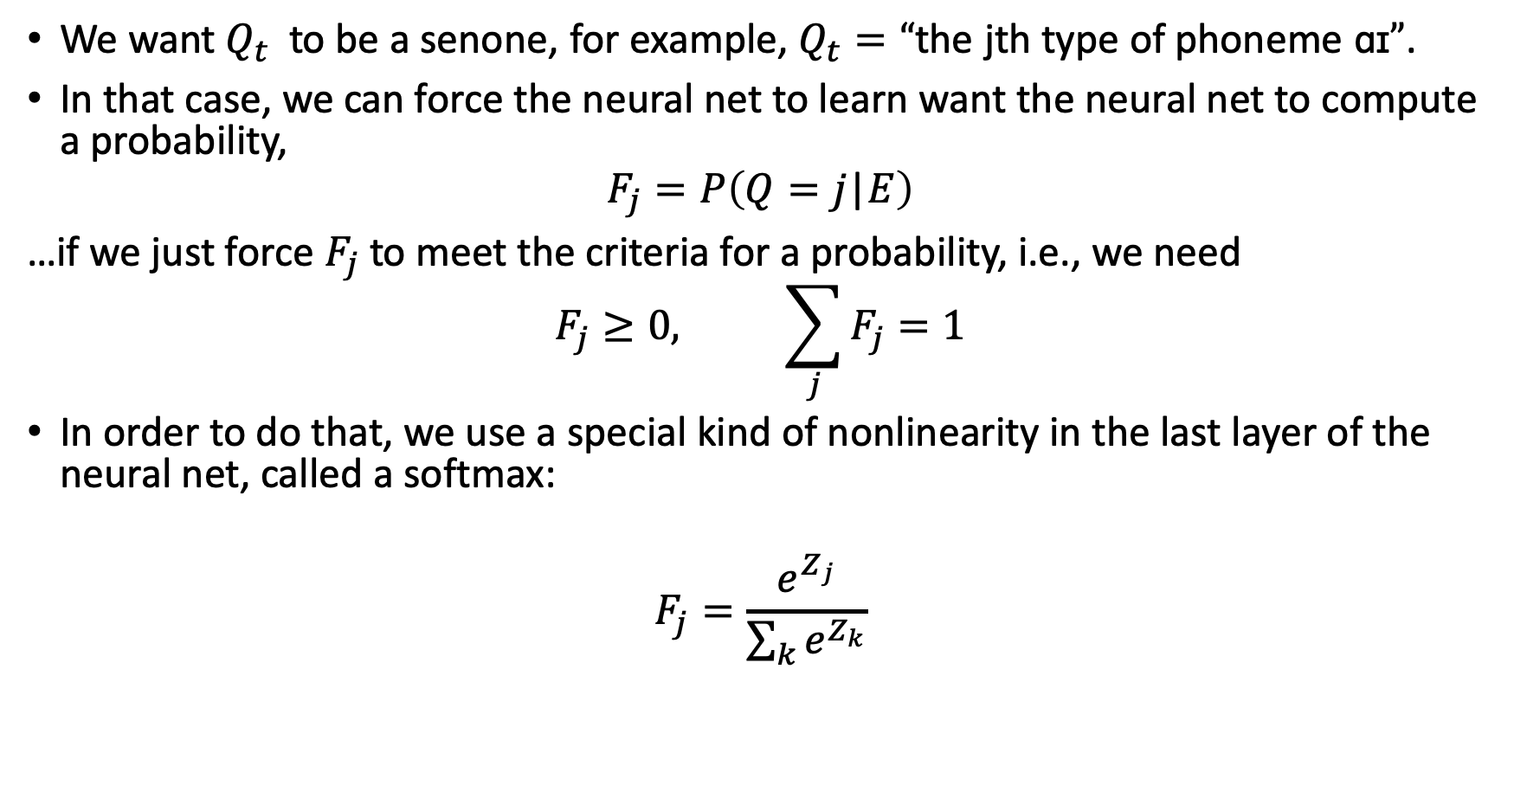
Classifier output: Softmax You’ve seen this slide before, in lecture 24, on Deep Learning….
We want $Q_{t}$ to be a senone, for example, $Q_{t}=“\text{the} \text{jth} \text{type} \text{of} \text{phoneme} \text{ɑɪ}”$.
In that case, we can force the neural net to learn want the neural net to compute a probability,
$$F_{j}=P\left(Q=j\text{|}E\right)$$
…if we just force $F_{j}$to meet the criteria for a probability, i.e., we need
$$F_{j}≥0, \sum_{j}{F_{j}}=1$$
In order to do that, we use a special kind of nonlinearity in the last layer of the neural net, called a softmax:
$$F_{j}=\frac{e^{Z_{j}}}{\sum_{k}{e^{Z_{k}}}}$$

Slide 26
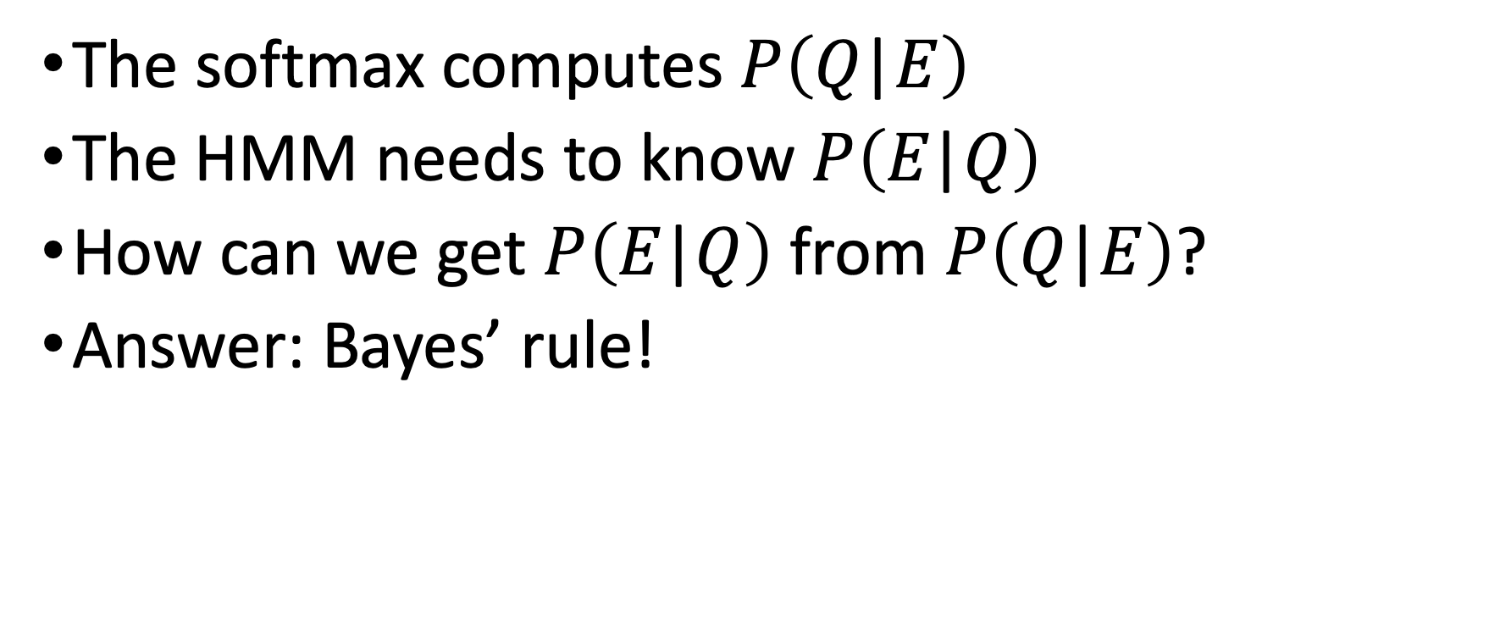
Hybrid DNN-HMM: the problem
The softmax computes $P\left(Q\text{|}E\right)$
The HMM needs to know $P\left(E\text{|}Q\right)$
How can we get $P\left(E\text{|}Q\right)$ from $P\left(Q\text{|}E\right)$?
Answer: Bayes’ rule!

Slide 27
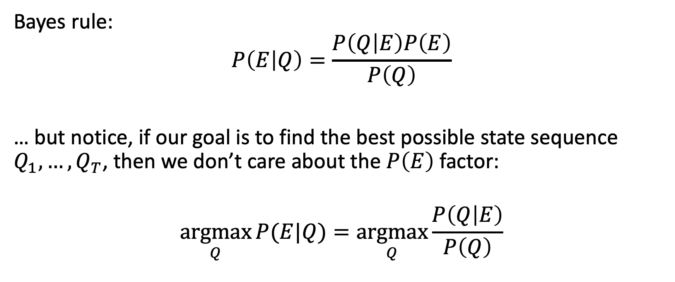
Estimating p(E|Q) from p(Q|E)
Bayes rule:
$$P\left(E | Q\right)=\frac{P\left(Q | E\right)P\left(E\right)}{P\left(Q\right)}$$
… but notice, if our goal is to find the best possible state sequence $Q_{1},…,Q_{T}$, then we don’t care about the $P\left(E\right)$ factor:
$$\underset{Q}{argmax}{P(E|Q)}=\underset{Q}{argmax}{\frac{P\left(Q | E\right)}{P\left(Q\right)}}$$

Slide 28
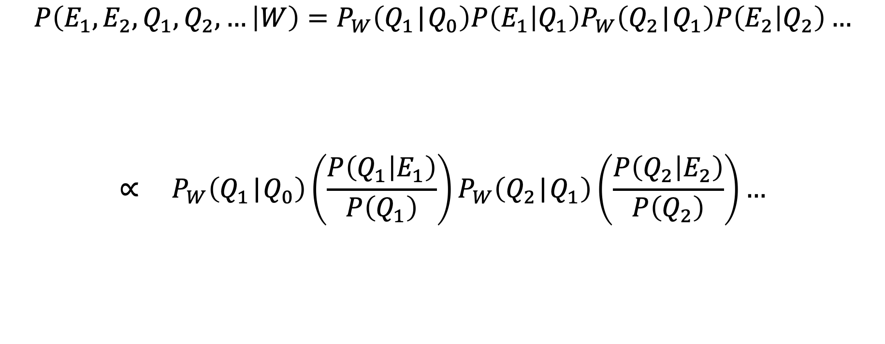
Hybrid DNN-HMM: the solution
$$P\left(E_{1}, E_{2},Q_{1}, Q_{2},… | W\right)=P_{W}\left(Q_{1}\text{|}Q_{0}\right)P\left(E_{1} | Q_{1}\right)P_{W}\left(Q_{2}\text{|}Q_{1}\right)P\left(E_{2} | Q_{2}\right)…$$
$$∝ P_{W}\left(Q_{1}\text{|}Q_{0}\right)\left(\frac{P\left(Q_{1} | E_{1}\right)}{P\left(Q_{1}\right)}\right)P_{W}\left(Q_{2}\text{|}Q_{1}\right)\left(\frac{P\left(Q_{2} | E_{2}\right)}{P\left(Q_{2}\right)}\right)…$$
From the neural net
HMM Parameters

Slide 29
Hybrid DNN-HMM: intuitive explanation
Prior probability, p(Q), tells how frequently HMM state Q is, in normal conversations, if we don’t hear the speech
DNN computes a posterior probability, p(Q|E), saying how probable Q is given the available evidence
If p(Q|E) > p(Q), that means that the evidence favors Q more than usual, so we should consider the possibility that this rare word has been spoken.
If p(Q|E) is still a small number, that doesn’t really matter; what really matters is whether p(Q|E) > p(Q)

Slide 30
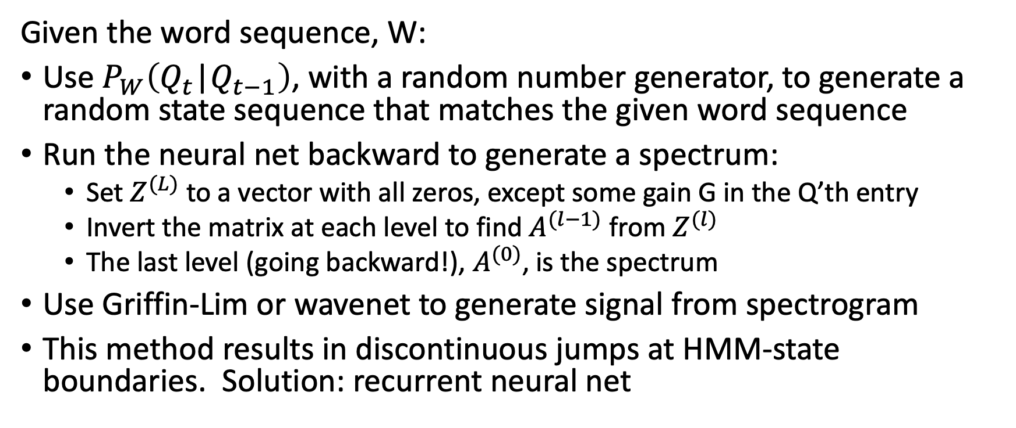
Speech synthesis using an HMM
Given the word sequence, W:
Use $P_{W}\left(Q_{t}\text{|}Q_{t−1}\right)$, with a random number generator, to generate a random state sequence that matches the given word sequence
Run the neural net backward to generate a spectrum:
Set $Z^{(L)}$ to a vector with all zeros, except some gain G in the Q’th entry
Invert the matrix at each level to find $A^{(l−1)}$ from $Z^{(l)}$
The last level (going backward!), $A^{(0)}$, is the spectrum
Use Griffin-Lim or wavenet to generate signal from spectrogram
This method results in discontinuous jumps at HMM-state boundaries. Solution: recurrent neural net

Slide 31
Outline
Human speech processing
Modeling the ear: Fourier transforms and filterbanks
Speech-to-text-to-speech (S2T2S)
Hybrid DNN-HMM systems (*)
Recurrent neural nets (RNNs): Connectionist Temporal Classification, Trajectory nets
Sequence-to-sequence RNNs with attention
Languages other than English
Training and testing on 300 languages
Transfer learning: from languages with data, to languages without
Dialog systems for unwritten languages
Distorted speech
Motor disability
Second-language learners
(*): Underline shows which topic you need to understand for the exam.
Everything else in today’s lecture is considered optional background knowledge.

Slide 32
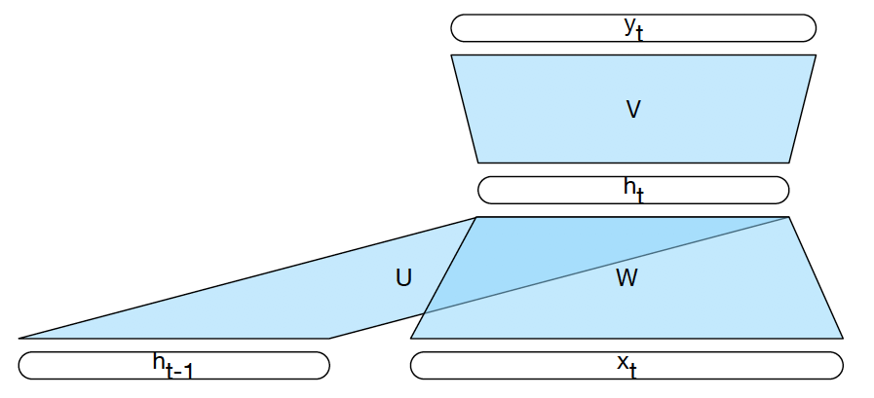
Basic RNNs
Each time step corresponds to a feedforward net where the hidden layer gets its input not just from the layer below but also from the activations of the hidden layer at the previous time step

Slide 33
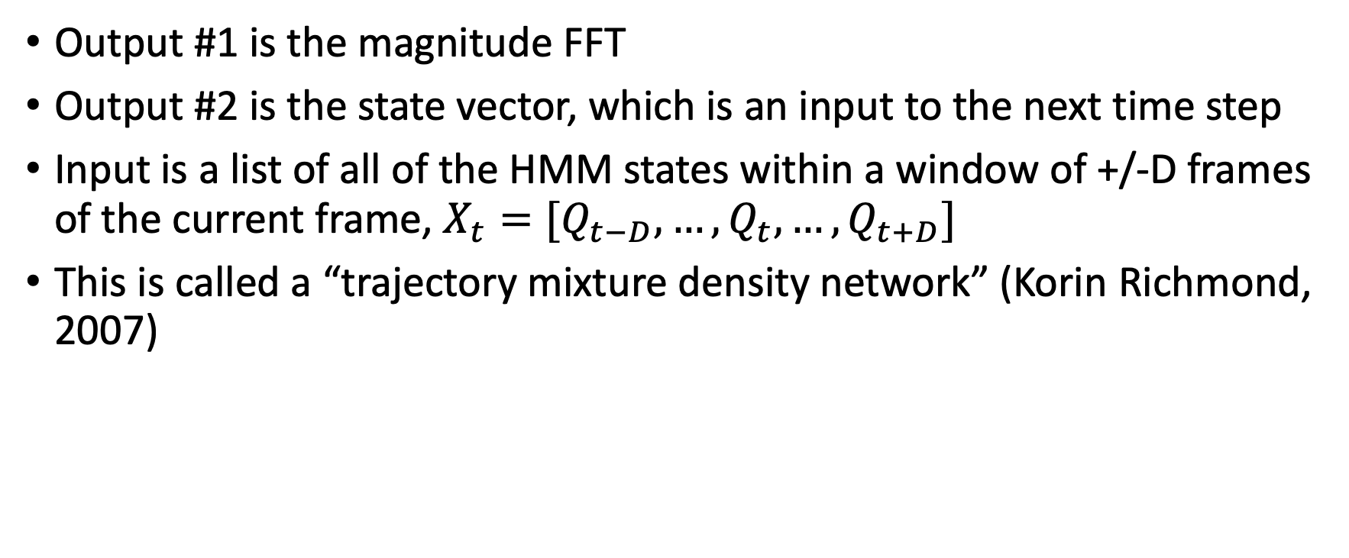
A recurrent net for speech synthesis
Output #1 is the magnitude FFT
Output #2 is the state vector, which is an input to the next time step
Input is a list of all of the HMM states within a window of +/-D frames of the current frame, $X_{t}=[Q_{t−D},…,Q_{t},…,Q_{t+D}]$
This is called a “trajectory mixture density network” (Korin Richmond, 2007)

Slide 34
A recurrent net for speech recognition
Output #1 is a softmax over
HMM states, Q, for DNN-HMM hybrid speech recognition
Words, if the RNN is being used by itself for stand-alone speech recognition
Output #2 is a state vector, which is fed back as input to the same neural net at time t+1

Slide 35
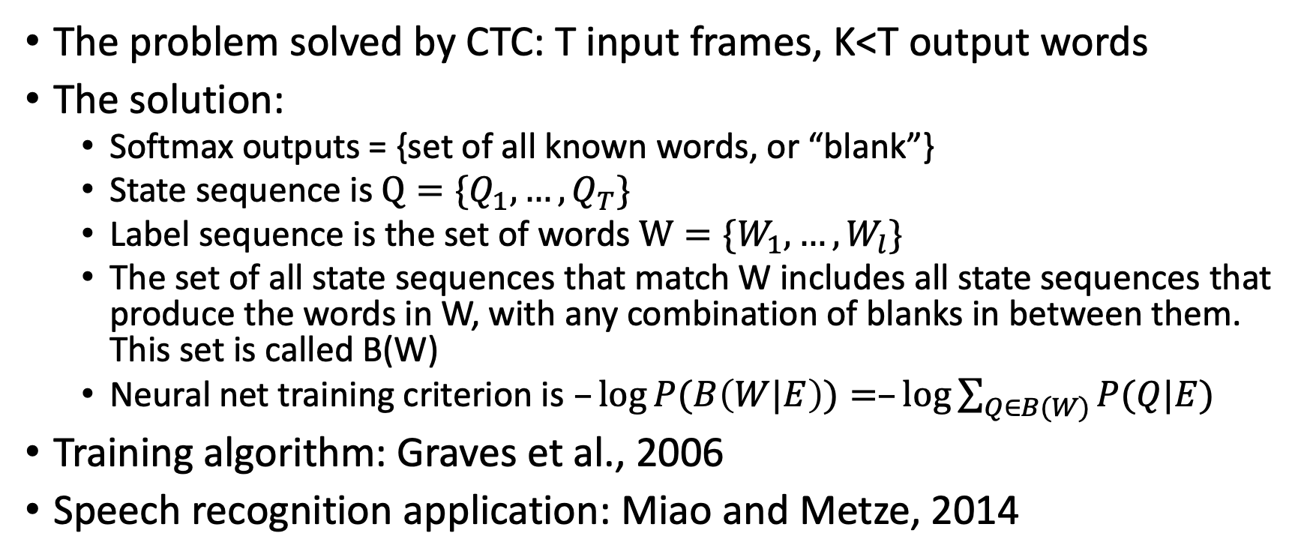
Connectionist temporal classification: Speech recognition using a stand-alone RNN
The problem solved by CTC: T input frames, K<T output words
The solution:
Softmax outputs = {set of all known words, or “blank”}
State sequence is $Q=\{Q_{1},…,Q_{T}\}$
Label sequence is the set of words $W=\{W_{1},…,W_{l}\}$
The set of all state sequences that match W includes all state sequences that produce the words in W, with any combination of blanks in between them. This set is called B(W)
Neural net training criterion is $–\log{P(B\left(W|E\right))}=–\log{\sum_{Q∈B(W)}{P(Q|E)}}$
Training algorithm: Graves et al., 2006
Speech recognition application: Miao and Metze, 2014

Slide 36
Outline
Human speech processing
Modeling the ear: Fourier transforms and filterbanks
Speech-to-text-to-speech (S2T2S)
Hybrid DNN-HMM systems (*)
Recurrent neural nets (RNNs): Connectionist Temporal Classification, Trajectory nets
Sequence-to-sequence RNNs with attention
Languages other than English
Training and testing on 300 languages
Transfer learning: from languages with data, to languages without
Dialog systems for unwritten languages
Distorted speech
Motor disability
Second-language learners
(*): Underline shows which topic you need to understand for the exam.
Everything else in today’s lecture is considered optional background knowledge.

Slide 37
Sequence-to-sequence with attention
Input encoder is an RNN
Output decoder is an RNN
Each cell of the output decoder takes, as input, a weighted summation of the input encoder hidden nodes vectors, concatenated to the previous output-time state vector, concatenated to a unit indicator showing which output was generated in the previous time
Weights for the weighted summation change, from one output-time to the next. The weights themselves are computed by another neural net.

Slide 38

Encoder-Decoder (seq2seq) model
Task: Read an input sequence and return an output sequence
Machine translation: translate source into target language
Dialog system/chatbot: generate a response
Reading the input sequence: RNN Encoder
Generating the output sequence: RNN Decoder
Encoder
Decoder
output
hidden
input

Slide 39
Outline
Human speech processing
Modeling the ear: Fourier transforms and filterbanks
Speech-to-text-to-speech (S2T2S)
Hybrid DNN-HMM systems (*)
Recurrent neural nets (RNNs): Connectionist Temporal Classification, Trajectory nets
Sequence-to-sequence RNNs with attention
Languages other than English
Training and testing on 300 languages
Transfer learning: from languages with data, to languages without
Dialog systems for unwritten languages
Distorted speech
Motor disability
Second-language learners
(*): Underline shows which topic you need to understand for the exam.
Everything else in today’s lecture is considered optional background knowledge.

Slide 40
Can speech recognition and speech synthesis be trained for any language?
As far as we know, the algorithms work for any language, as long as you have labeled training data
”Labeled data” = speech files, together with their text transcriptions
Having audio is not enough, because usually there is no transcription. Having text is not enough, because usually you don’t know how it sounds. You need matched text+audio.
In how many languages do we have such corpora?

Slide 41
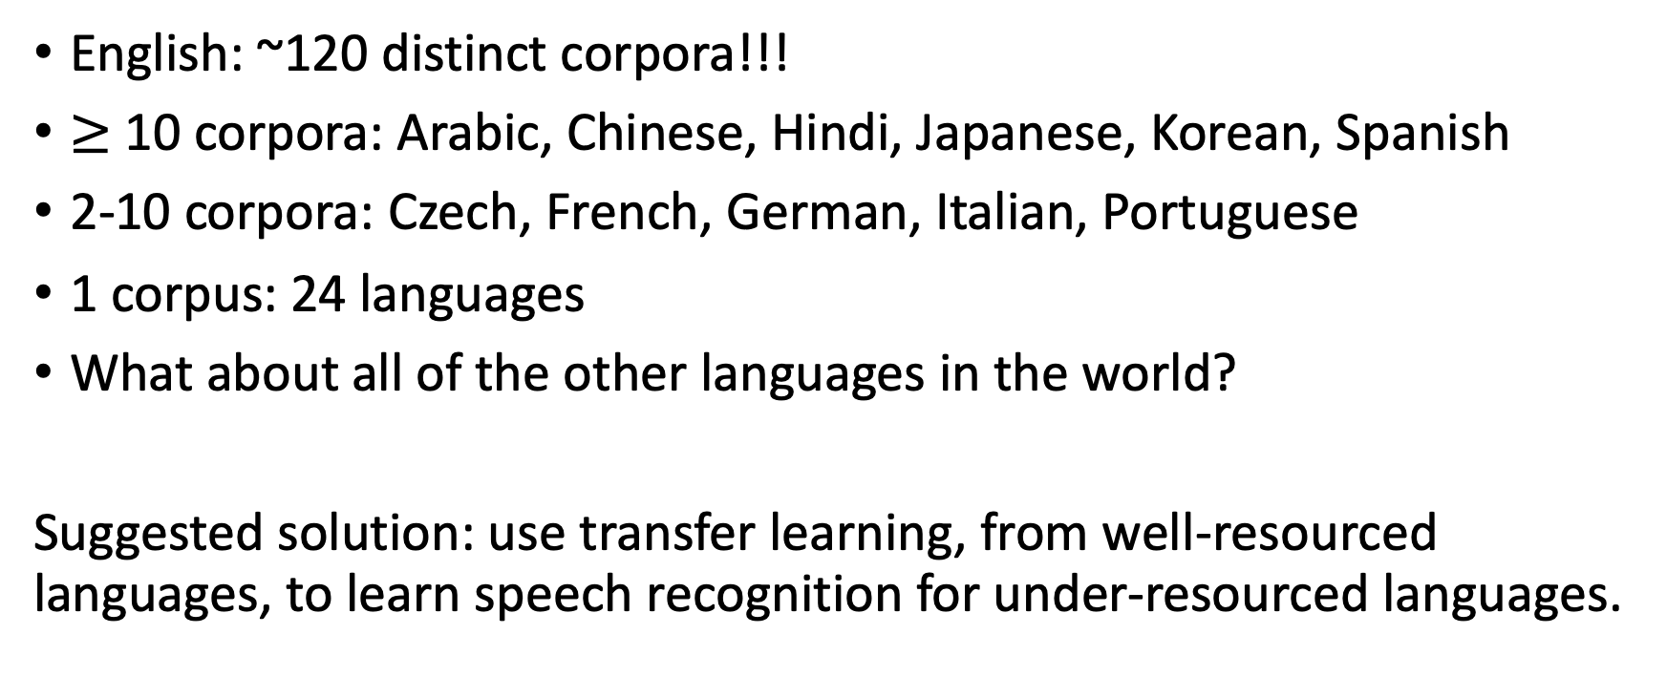
“Automatic Speech Recognition” corpora available from the Linguistic Data Consortium
English: ~120 distinct corpora!!!
$≥$ 10 corpora: Arabic, Chinese, Hindi, Japanese, Korean, Spanish
2-10 corpora: Czech, French, German, Italian, Portuguese
1 corpus: 24 languages
What about all of the other languages in the world?
Suggested solution: use transfer learning, from well-resourced languages, to learn speech recognition for under-resourced languages.

Slide 42


Every phoneme system in the world differentiates these two categories of phonemes:
Phonemes made with the mouth open,
e.g.,
Vowels,
Approximants,
(Fricatives)
Phonemes made with the mouth closed,
e.g.,
Clicks,
Plosives,
(Nasals, Taps, Trills)

Slide 43
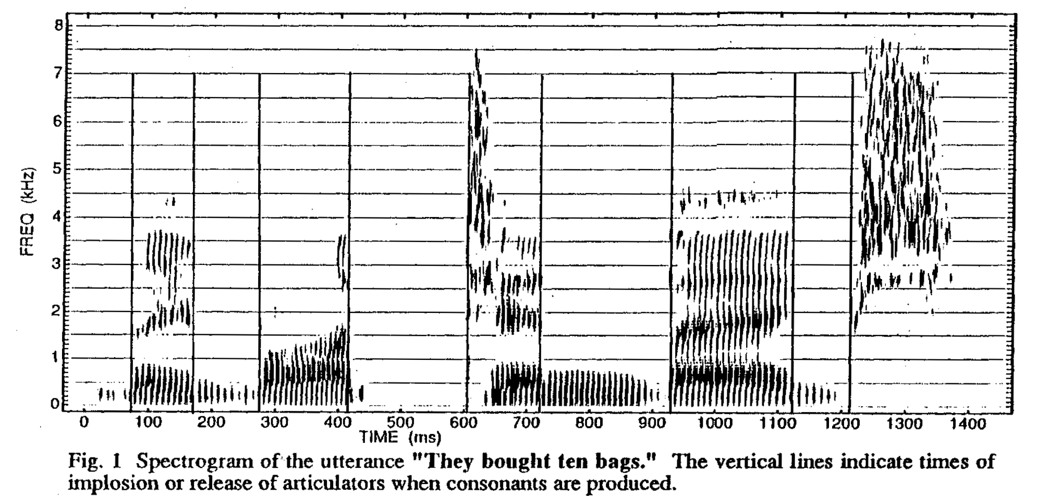
The acoustic consequences of mouth opening and closing
Acoustic Landmark = perceptually salient instantaneous marker of phoneme presence.
Vowel
Vowel
Plosive
Fricative
Plosive
Vowel
Nasal
Vowel
Plosive
Fricative
(Stevens, Manuel, Shattuck-Hufnagel & Liu, ICSLP1992).

Slide 44
Articulatory Features as Linguistic Universals
Articulatory features are designed to be a superset of the phoneme distinctions in every language (universal by design).
The universal features “mouth open” and “mouth closed” can be summarized by just two features: [sonorant] and [continuant]
[+continuant]: mouth is unobstructed along midline of the vocal tract
[+sonorant]: mouth is open in the sense that there is a low-acoustic-impedance shunt from vocal folds to air (though the shunt might go through the nose, or around the tongue tip)
 | [-sonorant] | [+sonorant]
[-continuant] | Plosives | Nasals, Flaps, Trills
[+continuant] | Fricatives | Vowels, Approximants

Slide 45
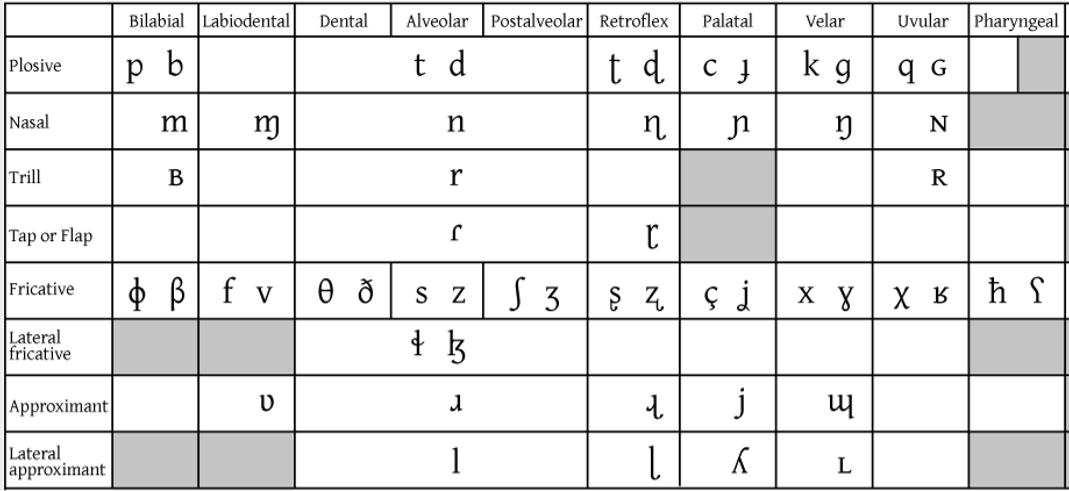
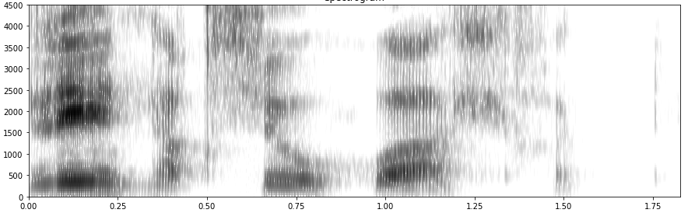

“Universal by design”
continuant | sonorant
- | -
- | +
+ | -
+ | +
+
+
-
+
+
+
-
-
+
-
+
+
+
-
+
+
+
-
+
+
-continuant
-sonorant
Yupik example courtesy Lane Schwartz: /li n̥ɑq su ʍɑ ɬɪk/

Slide 46
Landmarks as regularizers for training a DNN-HMM phone model
Train on English (TIMIT, 14 hours):
Train two DNNs, one for phones, one for landmarks. Result: phone models get better time alignment during training.
Test: phone error rate.
Adapt to Iban (Juan, Besacier & Rossato, 8 hours):
Automatic landmark detection, phones force-aligned, then adapt both DNNs from English to Iban.
Test: word error rate.

Slide 47
Multi-task learning (MTL)
MTL = Train one neural network on multiple tasks (1 set of inputs vs. multiple sets of labels). Can reduce overfitting, generalize better to testing data if
a) training data limited (under-resourced), or
b) the tasks compliment each other (e.g., landmark detection & phone recognition)

Slide 48
Experiments: 2 types of landmark definitions, 2 types of ASR
Two types of landmark definitions
Experiment 1: release/closure/middle notation
Experiment 2: change in value of the features [continuant] or [sonorant]
Two types of ASR
Experiment 1: TDNN-HMM hybrid
Experiment 2: CTC

Slide 49
Experiment 1: closure/release/middle landmark notation (from phoneme labels)
Landmark Type | Temporal midpoint of a…
V | Vowel
G | Glide
Landmark Type | At the end of a… | …and beginning of a…
Sc (Stop Closure) | Vowel or Glide | Stop Closure
Sr (Stop Release) | Stop Closure | Stop Release, Vowel or Glide
Fc (Fricative Closure) | Vowel or Glide | Fricative
Fr (Fricative Release) | Fricative or Affricate | Vowel or Glide
Nc (Nasal Closure) | Vowel or Glide | Nasal
Nr (Nasal Release) | Nasal | Vowel or Glide
MC (Manner Change) | Non-vowel, non-glide | Different type of non-vowel

Slide 50
Experiment 1: closure/release/middle landmark notation (from phoneme labels)

Slide 51
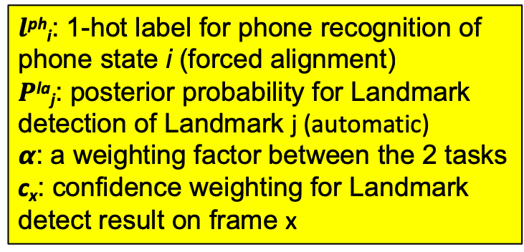
Migrate to the Iban language, step #1: Automatically generate landmark labels in Iban using TIMIT-trained landmark detectors
Migrate to Iban, step #2: Multi-task learning (MTL). Task 1 = phone labels, Task 2 = landmarks.
$l$^{ph}_{i}: 1-hot label for phone recognition of phone state i (forced alignment)
$P$^{la}_{j}: posterior probability for Landmark detection of Landmark j (automatic)
𝞪: a weighting factor between the 2 tasks
c_{x}: confidence weighting for Landmark detect result on frame x

Slide 52
Experiment 1 Results
Average ASR Error rate:
PER for TIMIT, WER for Iban
Some Iban training data was randomly left out to simulate a very-low-resource scenario

Slide 53
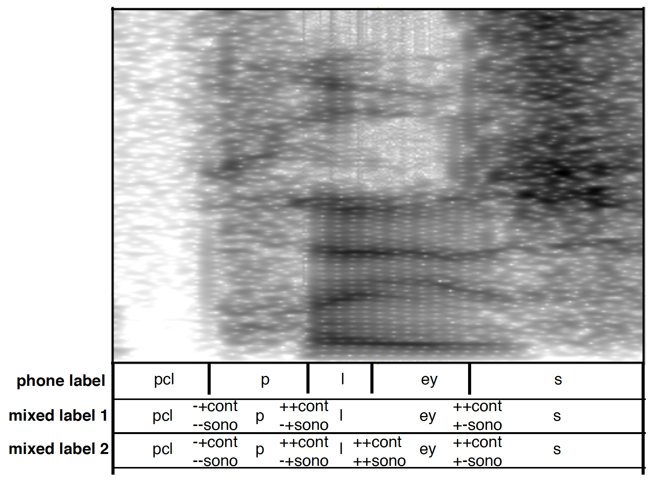
Experiment 2 notation: change in value of [continuant] or [sonorant]
Phone Label: CTC is trained to generate only the phone sequence, as given in TIMIT.
Mixed Label 1: CTC also generates a landmark label every time [continuant] or [sonorant] changes value.
Mixed Label 2: CTC generates a landmark label at every phone boundary, even if the values of [continuant] and [sonorant] don’t change.

Slide 54
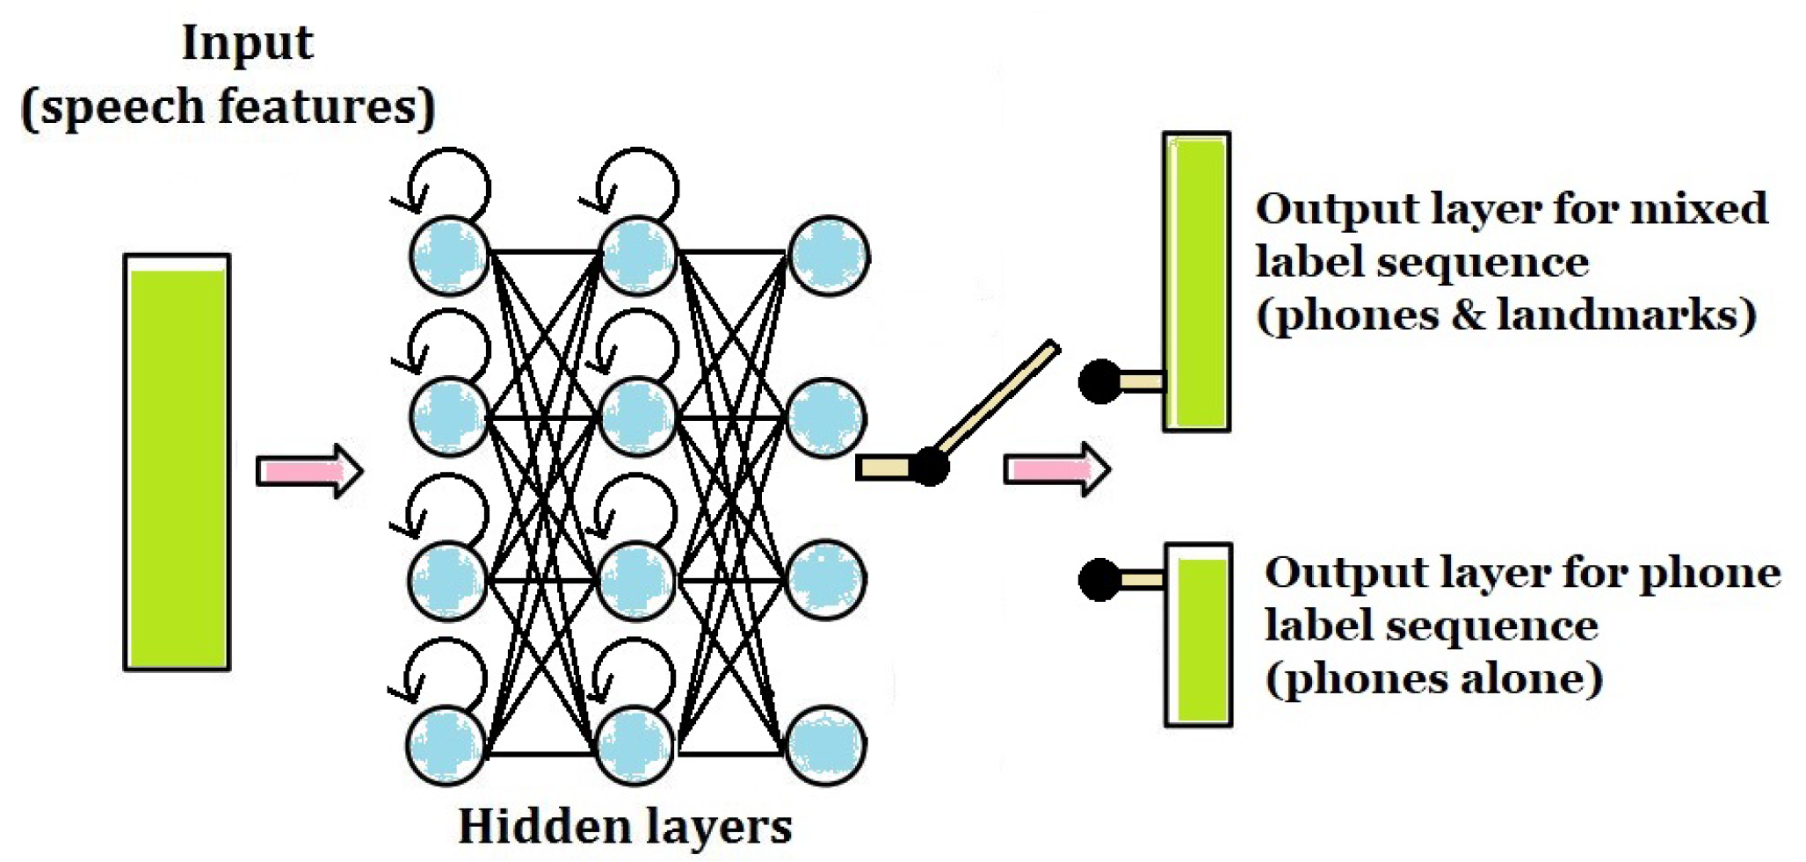
Mixed Label Training + Phone Finetuning
1. First, Train (until convergence) to reproduce the mixed label set.
2. Then “Finetune:” continue to train, using phone labels only.

Slide 55
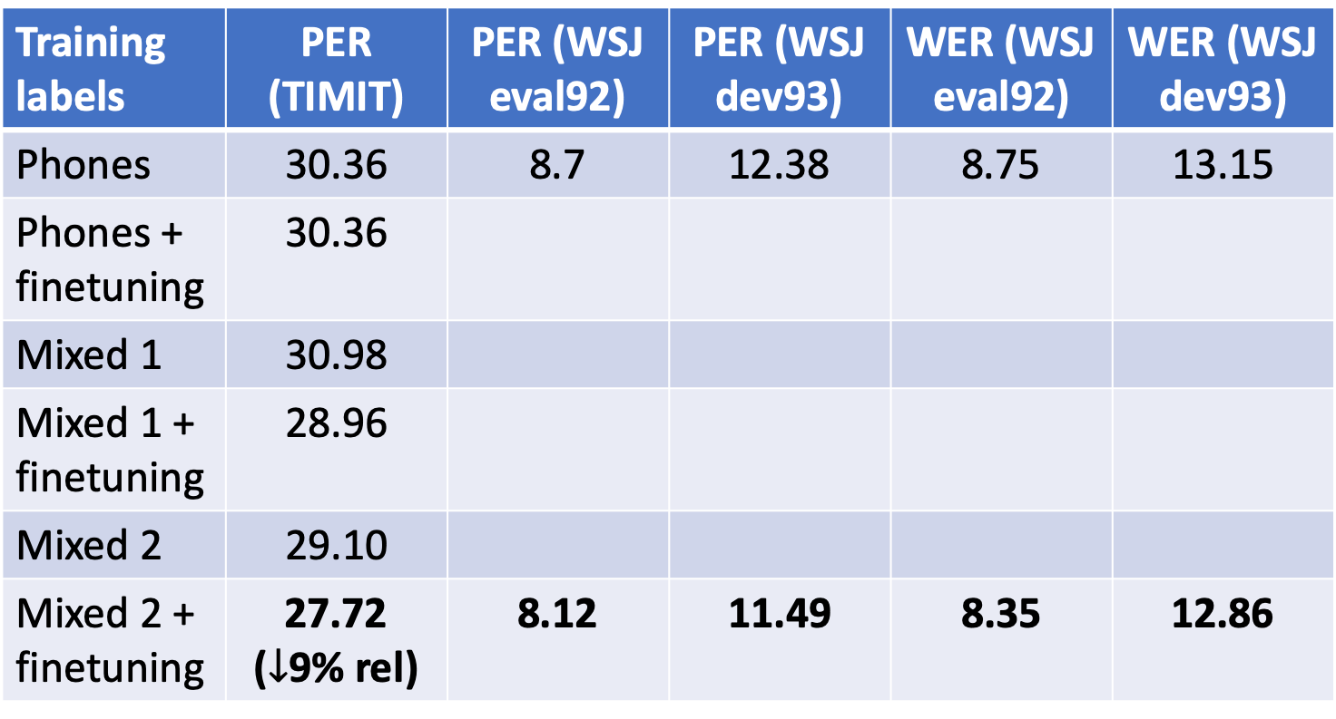
Experiment 2 results: PER and WER are reduced on both TIMIT and WSJ
Training labels | PER (TIMIT) | PER (WSJ eval92) | PER (WSJ dev93) | WER (WSJ eval92) | WER (WSJ dev93)
Phones | 30.36 | 8.7 | 12.38 | 8.75 | 13.15
Phones + finetuning | 30.36
Mixed 1 | 30.98
Mixed 1 + finetuning | 28.96
Mixed 2 | 29.10
Mixed 2 + finetuning | 27.72 ($↓$9% rel) | 8.12 | 11.49 | 8.35 | 12.86
Train to convergence using phone labels, then
Finetune until convergence using the same phone labels:
PER doesn’t change (confirmed experimentally).
These numbers not calculated because Mixed 2 + finetuning was best on TIMIT.

Slide 56
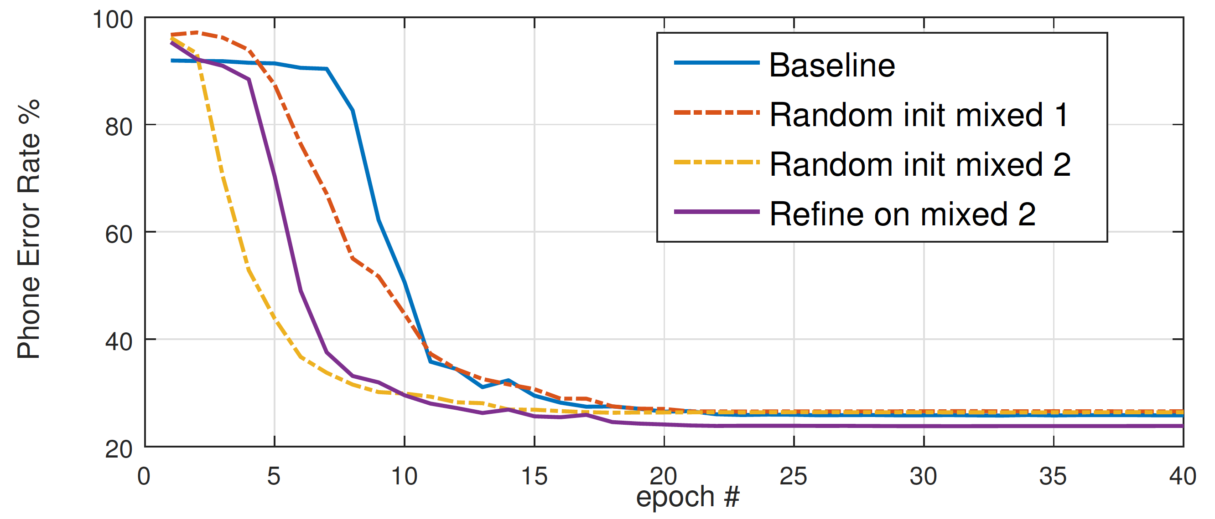
Experiment 2 results: CTC with mixed labels converges faster

Slide 57
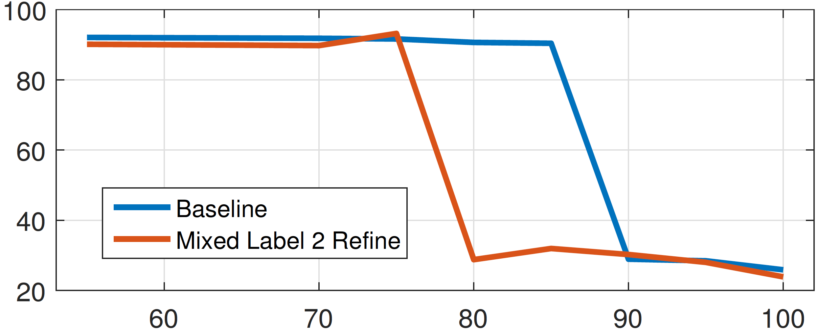
Experiment 2 results: with mixed labels, CTC can be trained using a smaller training corpus.
Phone Error Rate (Test Set)
Percentage of Training Dataset Used (100% = 14hrs)

Slide 58
Ongoing project: landmark-based ASR for 300 languages simultaneously
The CMU-Wilderness corpus: Bibles, read in about 300 languages, transcribed by Alan Black at CMU
General structure of the ongoing project:
Each student develops neural nets for a different type of landmark
We combine them all in a massively multilingual CTC-based system
Planned start: fall 2019, if students are interested

Slide 59
Outline
Human speech processing
Modeling the ear: Fourier transforms and filterbanks
Speech-to-text-to-speech (S2T2S)
Hybrid DNN-HMM systems (*)
Recurrent neural nets (RNNs): Connectionist Temporal Classification, Trajectory nets
Sequence-to-sequence RNNs with attention
Languages other than English
Training and testing on 300 languages
Transfer learning: from languages with data, to languages without
Dialog systems for unwritten languages
Distorted speech
Motor disability
Second-language learners

Slide 60

How many languages are there in the world?

Slide 61
Our goal: Speech technology for unwritten languages
Jelinek, 1976: speech recognition is defined as a transformation from speech to text.
The problem: most languages don’t have text.
About 50% of the world’s languages: no orthography has ever been defined.
About 40% of the world’s languages: orthography exists with multiple conflicting standards; native speakers type using a “chat alphabet” that has variable spelling.

Slide 62
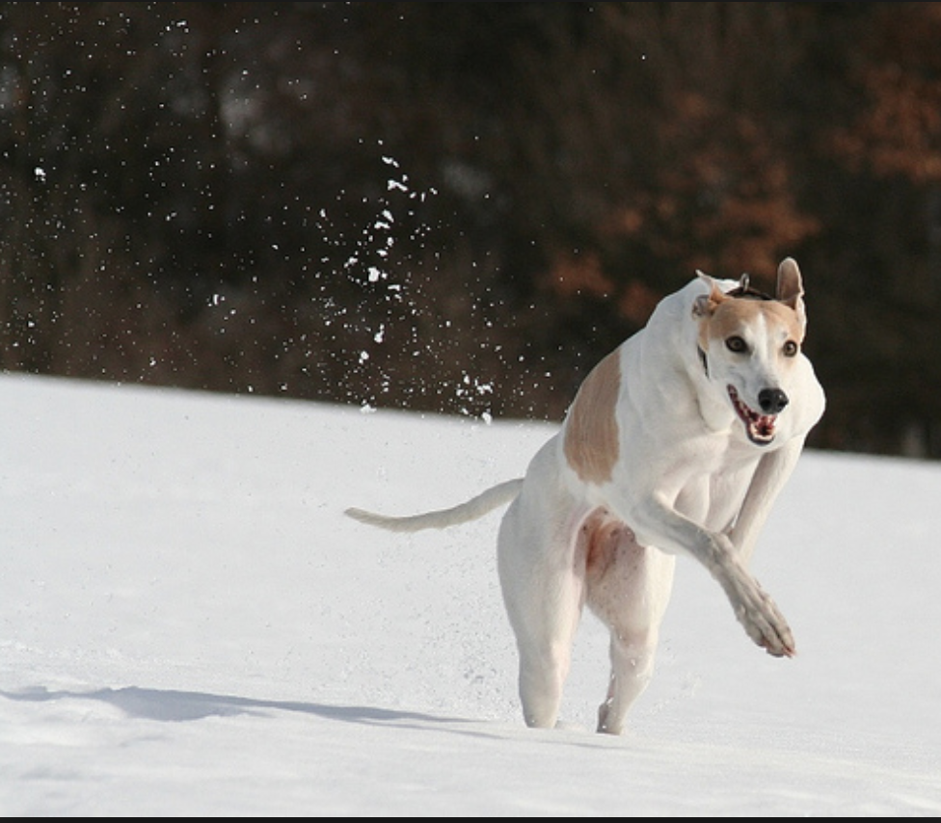
Datasets
Flickr8k: images downloaded by Hodosh, Hockenmaier & Young at UIUC in 2009, Turkers wrote captions for them
Flickr-Speech: Text transcripts read out loud by Turkers
https://groups.csail.mit.edu/sls/downloads/
D. Harwath and J. Glass, “Deep multimodal semantic embeddings for speech and images” in IEEE ASRU, Scottsdale, Arizona, USA, December 2015
Hasegawa-Johnson et al., 2017: throw away the text, keep only the audio.
-A brown and white dog is running through the snow
-A dog is running in the snow
-A dog running through snow
-A white and brown dog is running through a snow covered field
-The white and brown dog is running over the surface of the snow

Slide 63
image2speech system components
image representation: very large scale convolutional neural net, trained on imagenet classification
image-to-phone: neural machine translation! Sequence-to-sequence with attention
phones-to-speech: ClusterGen speech synthesis, audio frames selected using decision trees

Slide 64
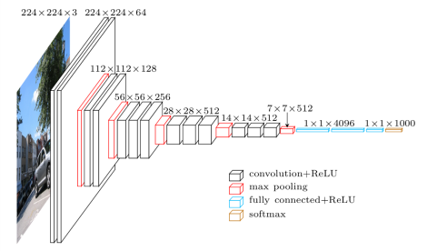
Image representation: CNNFEAT ${\vec{s}}_{mn}$
ImageNet = >500 images/noun of each of the nouns in WordNet.
VGG = 13-layer CNN + 2-layer FCN, trained on 14m images, covering the 1000 most numerous nouns, 92.7% top-5 test accuracy.
CNNFEAT: 196 feature vectors/image, 512d/vector, from the last CNN layer. Each receptive field covers about 40x40 pixels in the original 224x224 image.
VGGFEAT (used later in today’s talk, not right now): 1 vector/image, 4096d/vector, from penultimate FCN layer
Figure copied from Simonyan & Zisserman, 2014.

Slide 65
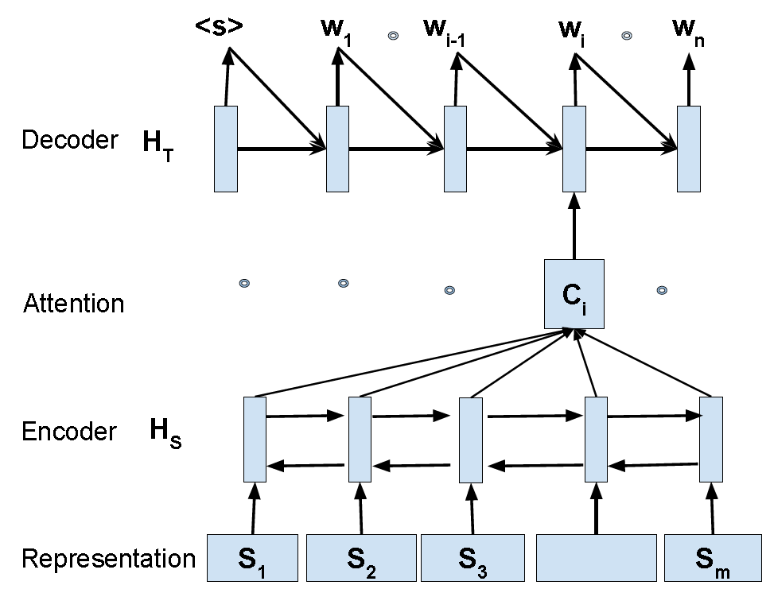
Images to phonemes = machine translation
“Representation:” 196 vectors/image
“Encoder:” PyramidalLSTM with one 128d state vector. Sequence is row-wise raster scan of the image.
“Attention:” StandardAttender, 128d input, 128d state vector, N hidden nodes
“Decoder:” MlpSoftmaxDecoder, 3 layers, 1024d hidden vectors
Output vocabulary: synthetic phones (MSCOCO), force-aligned phones (flickr8k), or acoustic unit discoveries (both)
Figure copied without permission from Duong, Anastasopoulos, Chiang, Bird & Cohn, NAACL-HLT 2016.

Slide 66
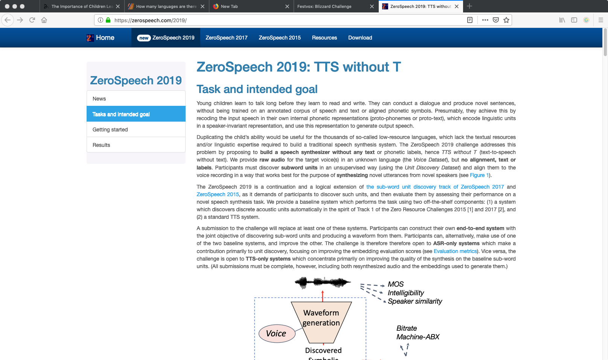
Phones to speech = ”TTS without the T”

Slide 67
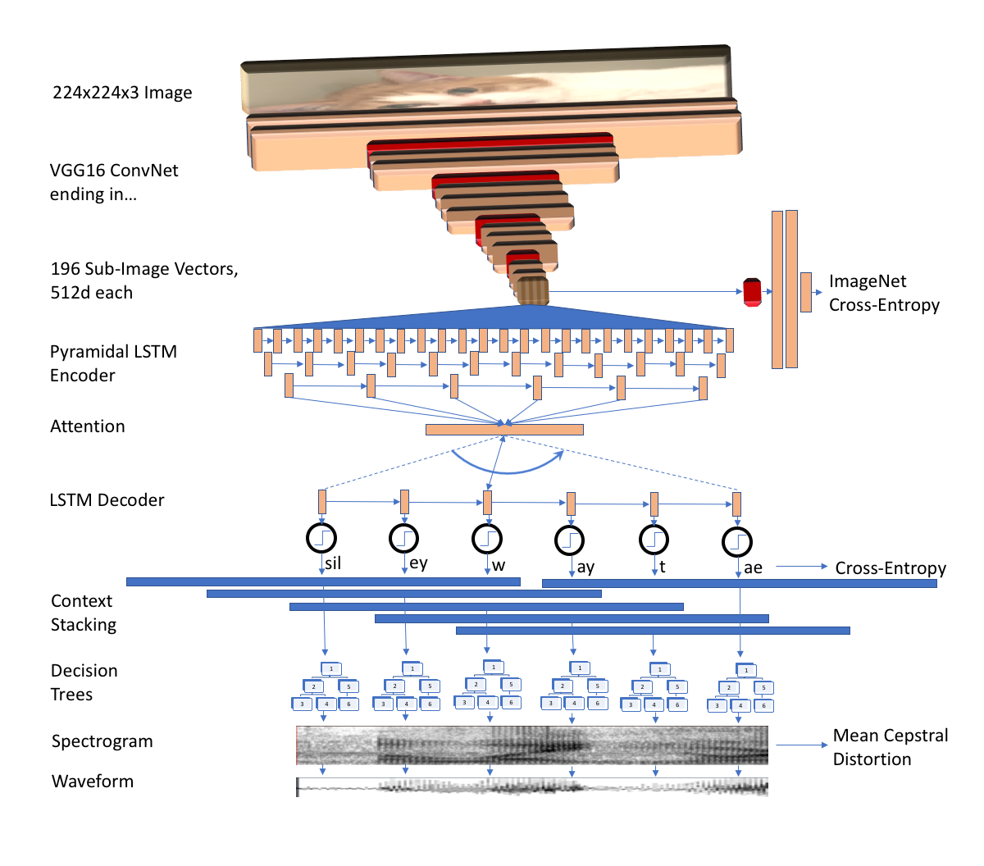
image2speech system overview

Slide 68

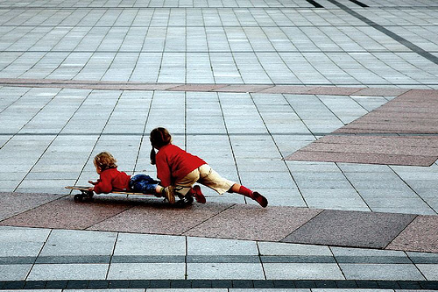

flickr8K: American phones
Reference 1: “The boy +um+ laying face down on a skateboard is being pushed along the ground by +laugh+ another boy.”
Reference 2: “Two girls +um+ play on a skateboard +breath+ in a court +laugh+ yard.”
Hypothesis (128d attender): SIL +BREATH+ SIL T UW M EH N AA R R AY D IX NG AX R EH D AE N W AY T SIL R EY S SIL
Hypothesis (64d attender): SIL +BREATH+ SIL T UW W IH M AX N W AO K IX NG AA N AX S T R IY T SIL
Reference 1: “A boy +laugh+ in a blue top +laugh+ is jumping off some rocks in the woods.”
Reference 2: “A boy +um+ jumps off a tan rock.”
Hypothesis (128d attender): SIL +BREATH+ SIL EY M AE N IH Z JH AH M P IX NG IH N DH AX F AO R EH S T SIL
Hypothesis (64d attender): SIL +BREATH+ SIL EY Y AH NG B OY W EY R IX NG AX B L UW SH ER T SIL IH Z R AY D IX NG AX HH IH L SIL
Images and Reference Texts: Hodosh, Young & Hockenmaier, 2013. Waveforms: Harwath and Glass, 2015

Slide 69
Outline
Human speech processing
Modeling the ear: Fourier transforms and filterbanks
Speech-to-text-to-speech (S2T2S)
Hybrid DNN-HMM systems (*)
Recurrent neural nets (RNNs): Connectionist Temporal Classification, Trajectory nets
Sequence-to-sequence RNNs with attention
Languages other than English
Training and testing on 300 languages
Transfer learning: from languages with data, to languages without
Dialog systems for unwritten languages
Distorted speech
Motor disability
Second-language learners

Slide 70
Types of motor disability
Diseases you’re born with, e.g., Cerebral Palsy
It’s hard to walk, to hold a pencil, or to type on a computer
Speech recognition is often faster than typing, but…
Speech is also distorted, because it’s hard to speak clearly
Diseases that get worse over time, e.g., Parkinson’s Disease
In the early and mid stages of the disease, speech is still perfectly intelligible, but…
Speech recognition stops working. For example, you’ve been using speech input on your cell phone all your life, but lately it’s been working less and less well.

Slide 71
Speaker adaptation of neural nets
Stack up all of the network weights in a vector w, then set w=Tv+w0
Actually nobody does that, because the weight vector is too huge, e.g., 5 million trained weights. Methods that have been used instead:
Gaussian i-vector: 40k-dimensional Gaussian supervector, reduced to 300-d i-vector, used as input to a neural net
Neural i-vector: 5000-d hidden node activation vector, averaged over all speech of that talker, then reduced to 300-d i-vector
Auxiliary network: trained to estimate the way a new speaker’s voice has shifted the hidden node activations
5-million-d weight vector might be useful with a large enough training database. Then the i-vector, v, might be 300-d

Slide 72
Adaptation to speakers with disability
Linear interpolation between
Big data (multi-speaker) and
Speaker-dependent (but small data)
Gives the set of speech recognizers that are likely to work best for this speaker.
(Sharma & Hasegawa-Johnson, 2011)
The set of all speakers without disability
i-vector for a speaker with CP,
but computed with a very small amount of data, so this estimate is probably kind of noisy

Slide 73
Outline
Human speech processing
Modeling the ear: Fourier transforms and filterbanks
Speech-to-text-to-speech (S2T2S)
Hybrid DNN-HMM systems (*)
Recurrent neural nets (RNNs): Connectionist Temporal Classification, Trajectory nets
Sequence-to-sequence RNNs with attention
Languages other than English
Training and testing on 300 languages
Transfer learning: from languages with data, to languages without
Dialog systems for unwritten languages
Distorted speech
Motor disability
Second-language learners

Slide 74
Automatic pronunciation scoring
P(audio|native speaker) vs. P(audio|non-native)
Might work well if we had lots of data from non-native speakers
Goodness of pronunciation (GoP):
P(audio|correct transcription) / P(audio| arbitrary phone sequence)

Slide 75
Landmark-based pronunciation scoring (Yoon, Sproat & H-J, 2010)
Identify the landmarks, first
Score whether each landmark was correctly vs. incorrectly pronounced
Use information about the speaker’s native language

Slide 76
Conclusions: research opportunities
Take advanced courses
Audio enhancement: CS 598PS
Speech and video recognition & synthesis: ECE 417
Download a software development recipe
Hybrid DNN-HMM: Kaldi (kaldi-asr.org)
Sequence-to-sequence with attention: XNMT (https://github.com/neulab/xnmt)
Create your own startup company!!
Dialog systems, e.g., for smart glasses, dishwashers, and everything else
Audio search for domains that don’t work yet (rap music?)
Join a research group
Landmark-based ASR in 300 languages; dialog system for unwritten languages
Speech interface for disability, or for second-language learners

