Slide 1
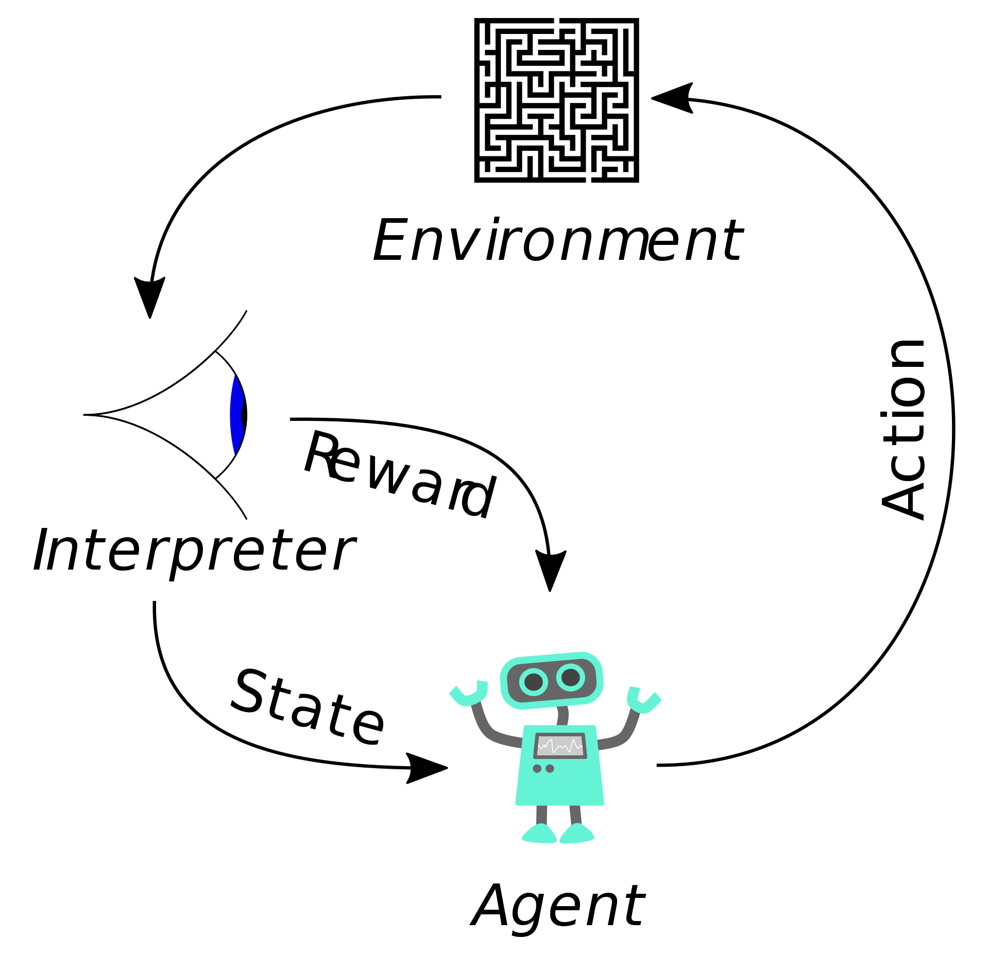
Deep Reinforcement Learning
CS440/ECE448 Lecture 24
Slides by Svetlana Lazebnik, 11/2017
Modified by Mark Hasegawa-Johnson, 4/2019
Image: Megajuice, CC0, https://commons.wikimedia.org/
w/index.php?curid=57895741

Slide 2
Last week: Q-learning for discrete s, a
So far, we’ve assumed a lookup table representation for utility function U(s) or action-utility function Q(s,a)
This does not work if the state space is really large or continuous

Slide 3

This time: Function approximation
Approximate $Q\left(s,a\right)$ by a parameterized function, that is, by a function $\hat{Q}(s, a;W)$ that depends on some matrix of trainable parameters, W.
Learn W by playing the game.

Slide 4
Outline
On-line Q-learning
How to make Q-learning converge to the best answer
How to make it converge more smoothly
Policy learning and actor-critic networks
Imitation learning

Slide 5
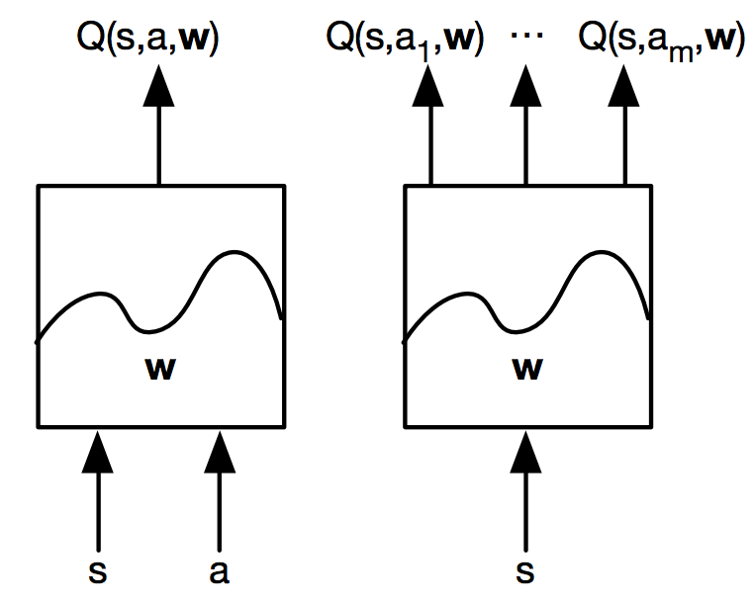
Deep Q learning
Train a deep neural network to output Q values:
Source: D. Silver

Slide 6
Deep Q learning
SARSA update: “nudge” Q(s,a) toward value we observe it to have in the most recent action:
Deep Q learning: train neural network weights, w, in order to minimize a loss function that penalizes differences between Q(local) and Q(predicted):
Q(local):
s’=state you actually reach by performing a in s,
a’=action you will actually perform there.
Q(predicted):
What the network predicts
for action a in state s

Slide 7
Deep Q learning
Regular TD update: “nudge” Q(s,a) towards the target
Deep Q learning: encourage estimate to match the target by minimizing squared error:
Compare to supervised learning:
  Key difference: the target in Q learning is not fixed – (s’,a’) is just one step ahead of (s,a)!
target
estimate

Slide 8
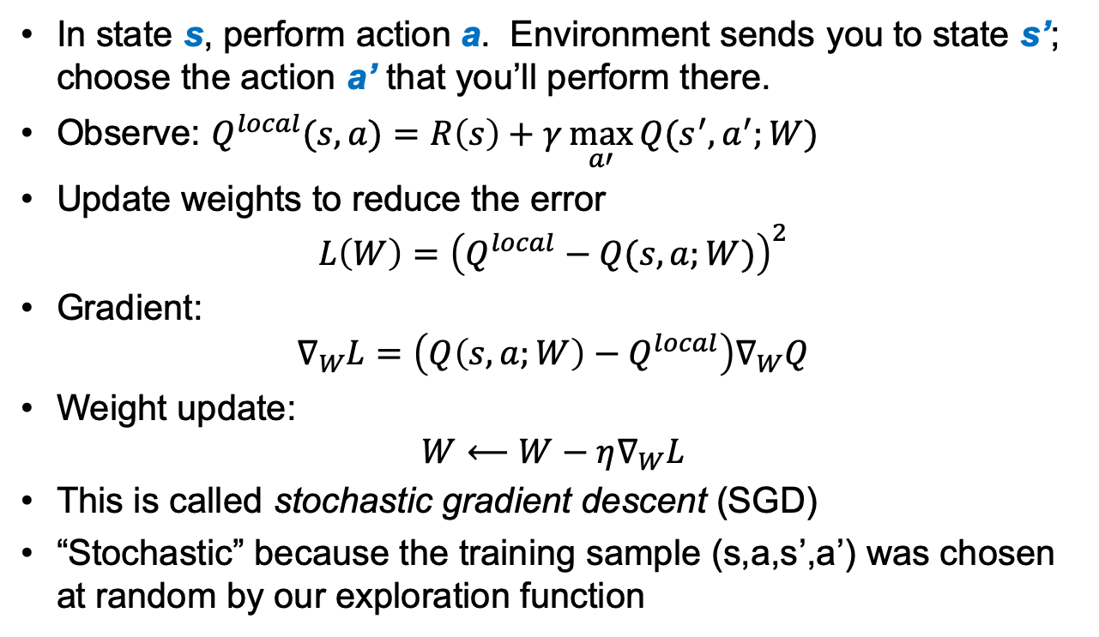
Online Q learning algorithm
In state s, perform action a. Environment sends you to state s’; choose the action a’ that you’ll perform there.
Observe: $Q^{local}(s,a)=R\left(s\right)+γ\max_{a′}{Q(s^{′},a^{′};W)}$
Update weights to reduce the error
$$L\left(W\right)={\left(Q^{local}−Q(s,a;W)\right)}^{2}$$
Gradient:
$$∇_{W}L=\left(Q\left(s,a;W\right)−Q^{local}\right)∇_{W}Q$$
Weight update:
$${W⟵W−η∇}_{W}L$$
This is called stochastic gradient descent (SGD)
“Stochastic” because the training sample (s,a,s’,a’) was chosen at random by our exploration function

Slide 9
Outline
On-line Q-learning
How to make Q-learning converge to the best answer
How to make it converge more smoothly
Policy learning and actor-critic networks
Imitation learning

Slide 10

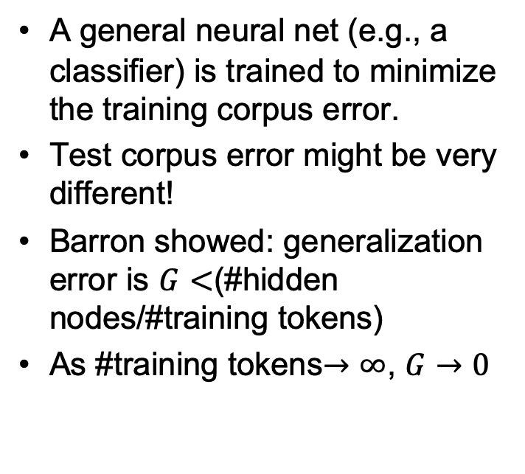


Convergence of neural networks
$$L$$
Training Corpus Error
A general neural net (e.g., a classifier) is trained to minimize the training corpus error.
Test corpus error might be very different!
Barron showed: generalization error is $G<$(#hidden nodes/#training tokens)
As #training tokens$→∞$, $G→0$
Test
Corpus Error
$$G$$
$$W$$
Training the neural net finds this set of weights by minimizing the training corpus error.

Slide 11
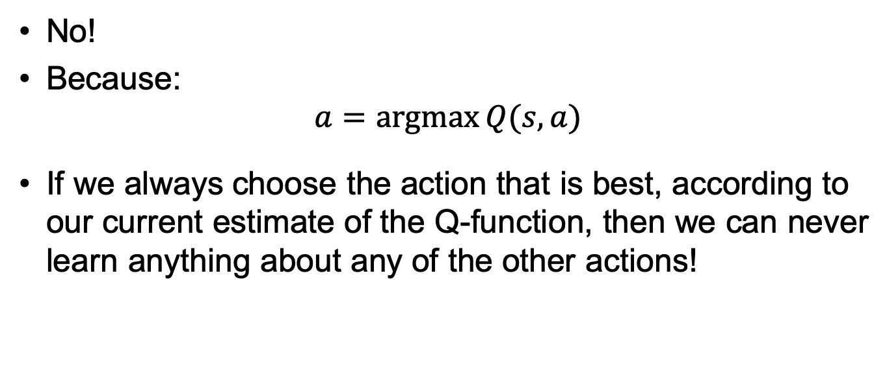
Does Q-learning Converge?
No!
Because:
$$a=\underset{}{argmax}{Q(s,a)}$$
If we always choose the action that is best, according to our current estimate of the Q-function, then we can never learn anything about any of the other actions!

Slide 12
Incorporating exploration (slide from last week)
Idea: explore more in the beginning, become more and more greedy over time
Standard (“greedy”) selection of optimal action:
Modified strategy:
exploration function
Number of times we’ve taken action a’ in state s
(optimistic reward estimate)

Slide 13
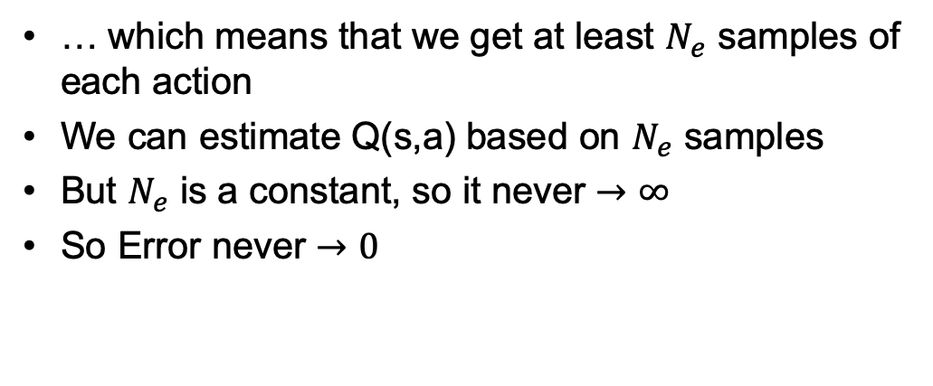
…but that doesn’t work either:
… which means that we get at least $N_{e}$ samples of each action
We can estimate Q(s,a) based on $N_{e}$ samples
But $N_{e}$ is a constant, so it never $→∞$
So Error never $→0$

Slide 14
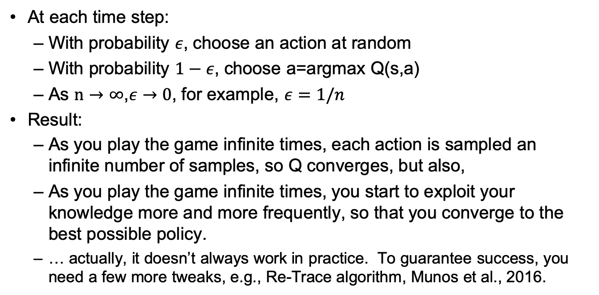
Epsilon-greedy exploration
At each time step:
  With probability $ε$, choose an action at random
  With probability $1−ε$, choose a=argmax Q(s,a)
  As $n→∞$,$ε→0$, for example, $ε=1/n$
Result:
  As you play the game infinite times, each action is sampled an infinite number of samples, so Q converges, but also,
  As you play the game infinite times, you start to exploit your knowledge more and more frequently, so that you converge to the best possible policy.
  … actually, it doesn’t always work in practice. To guarantee success, you need a few more tweaks, e.g., Re-Trace algorithm, Munos et al., 2016.

Slide 15
Outline
On-line Q-learning
How to make Q-learning converge to the best answer
How to make it converge more smoothly
Policy learning and actor-critic networks
Imitation learning

Slide 16
Dealing with training instability
Challenges
  Target values are not fixed
  Successive experiences are correlated and dependent on the policy
  Policy may change rapidly with slight changes to parameters, leading to drastic change in data distribution
Solutions
  Freeze target Q network
  Use experience replay
Mnih et al. Human-level control through deep reinforcement learning, Nature 2015

Slide 17
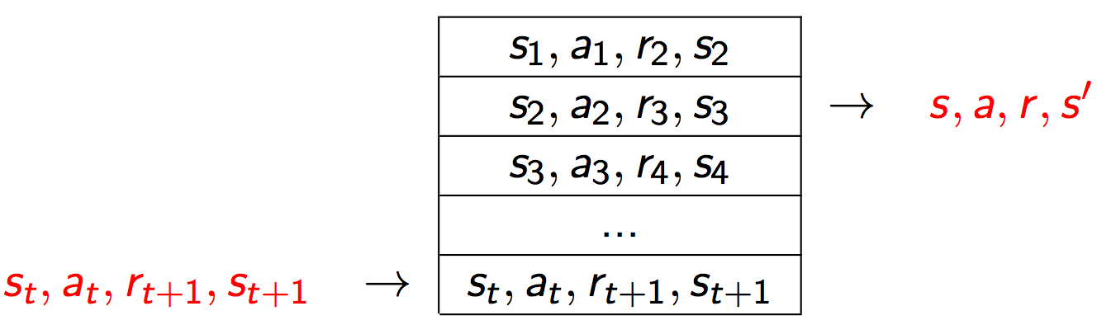
Experience replay
At each time step:
  Take action a_{t} according to epsilon-greedy policy
  Store experience (s_{t}, a_{t}, r_{t+1}, s_{t+1}) in replay memory buffer
  Randomly sample mini-batch of experiences from the buffer
Mnih et al. Human-level control through deep reinforcement learning, Nature 2015

Slide 18
Experience replay
At each time step:
  Take action a_{t} according to epsilon-greedy policy
  Store experience (s_{t}, a_{t}, r_{t+1}, s_{t+1}) in replay memory buffer
  Randomly sample mini-batch of experiences from the buffer
  Perform update to reduce objective function
Keep parameters of target network fixed during the entire mini-batch; only update between mini-batches
Mnih et al. Human-level control through deep reinforcement learning, Nature 2015

Slide 19
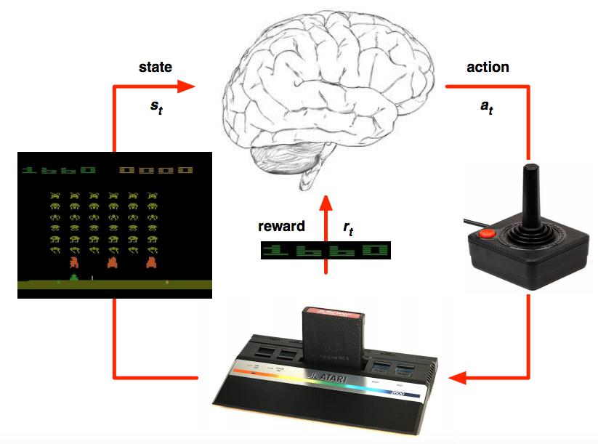
Deep Q learning in Atari
Mnih et al. Human-level control through deep reinforcement learning, Nature 2015

Slide 20
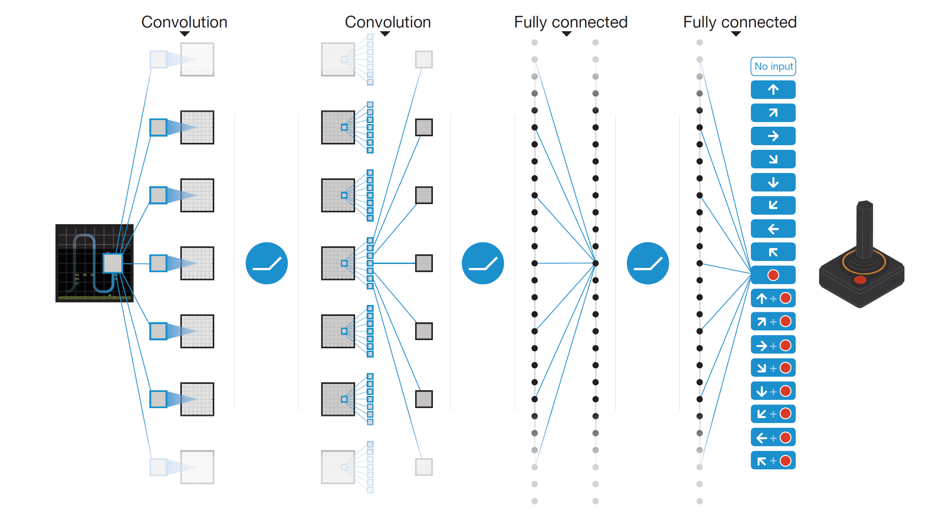
Deep Q learning in Atari
End-to-end learning of Q(s,a) from pixels s
Output is Q(s,a) for 18 joystick/button configurations
Reward is change in score for that step
Q(s,a₁)
Q(s,a₂)
Q(s,a₃)
.
.
.
.
.
.
.
.
.
.
.
Q(s,a₁₈)
Mnih et al. Human-level control through deep reinforcement learning, Nature 2015

Slide 21
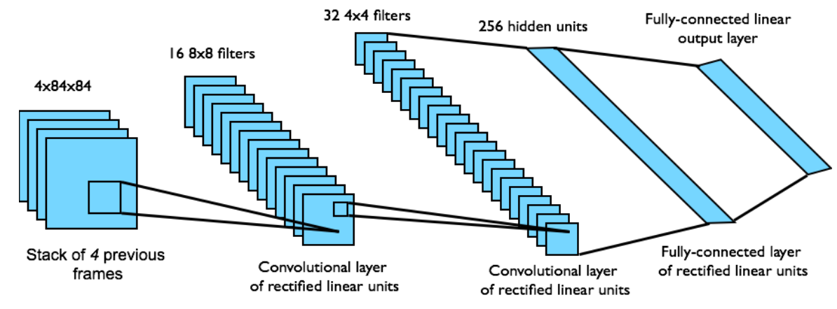
Deep Q learning in Atari
Input state s is stack of raw pixels from last 4 frames
Network architecture and hyperparameters fixed for all games
Mnih et al. Human-level control through deep reinforcement learning, Nature 2015

Slide 22
Outline
On-line Q-learning
How to make Q-learning converge to the best answer
How to make it converge more smoothly
Policy learning and actor-critic networks
Imitation learning

Slide 23
Policy gradient methods
Learning the policy directly can be much simpler than learning Q values
We can train a neural network to output stochastic policies, or probabilities of taking each action in a given state
Softmax policy:

Slide 24
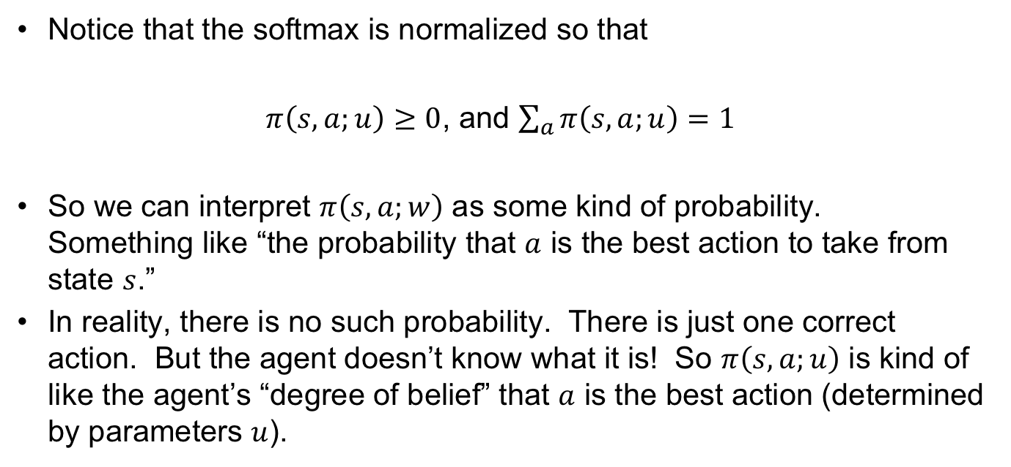
Policy gradient: the softmax function
Notice that the softmax is normalized so that
$π\left(s,a;u\right)≥0$, and $\sum_{a}{π\left(s,a;u\right)}=1$
So we can interpret $π\left(s,a;w\right)$ as some kind of probability. Something like “the probability that $a$ is the best action to take from state $s$.”
In reality, there is no such probability. There is just one correct action. But the agent doesn’t know what it is! So $π\left(s,a;u\right)$ is kind of like the agent’s “degree of belief” that $a$ is the best action (determined by parameters $u$).

Slide 25
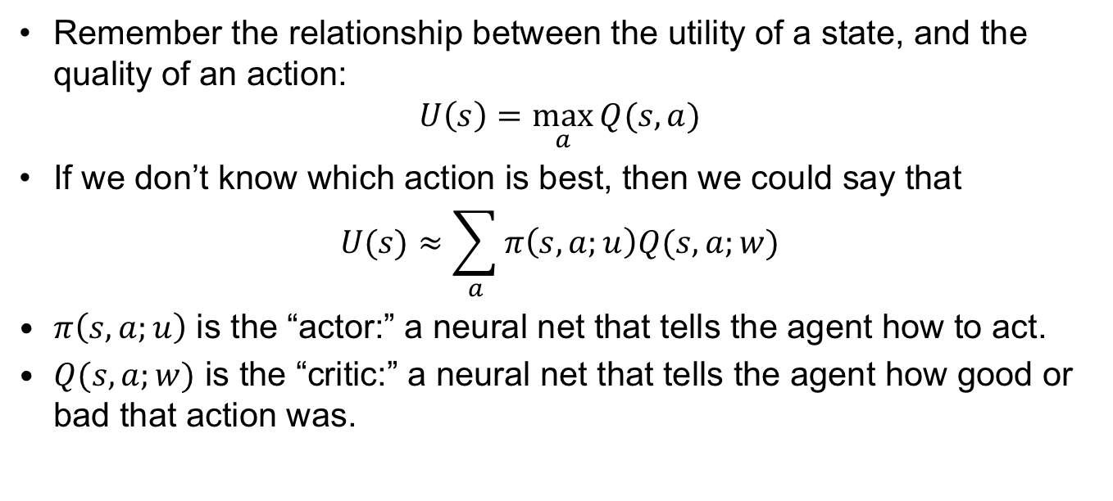
Actor-critic algorithm
Remember the relationship between the utility of a state, and the quality of an action:
$$U\left(s\right)=\max_{a}{Q(s,a)}$$
If we don’t know which action is best, then we could say that
$$U(s)≈\sum_{a}{π\left(s,a;u\right)Q(s,a;w)}$$
$π\left(s,a;u\right)$ is the “actor:” a neural net that tells the agent how to act.
$Q(s,a;w)$ is the “critic:” a neural net that tells the agent how good or bad that action was.

Slide 26
Actor-critic algorithm
Define objective function as total discounted reward:
The gradient for a stochastic policy is given by
Actor network update:
Critic network update: use Q learning (following actor’s policy)
Actor network
Critic network

Slide 27
Advantage actor-critic
The raw Q value is less meaningful than whether the reward is better or worse than what you expect to get
Introduce an advantage function that subtracts a baseline number from all Q values
  Estimate V using a value network
Advantage actor-critic:

Slide 28
Asynchronous advantage actor-critic (A3C)
Agent 1
Experience 1
Local updates
Agent 2
Experience 2
Local updates
U, π
.
.
.
Agent n
Experience n
Local updates
Asynchronously update global parameters
Mnih et al. Asynchronous Methods for Deep Reinforcement Learning. ICML 2016

Slide 29
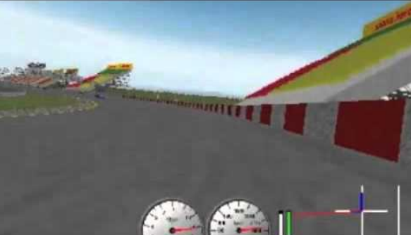
Asynchronous advantage actor-critic (A3C)
TORCS car racing simulation video
Mnih et al. Asynchronous Methods for Deep Reinforcement Learning. ICML 2016

Slide 30
Outline
On-line Q-learning
How to make Q-learning converge to the best answer
How to make it converge more smoothly
Policy learning and actor-critic networks
Imitation learning

Slide 31


Imitation learning
In some applications, you cannot bootstrap yourself from random policies
  High-dimensional state and action spaces where most random trajectories fail miserably
  Expensive to evaluate policies in the physical world, especially in cases of failure
Solution: learn to imitate sample trajectories or demonstrations
  This is also helpful when there is no natural reward formulation

Slide 32
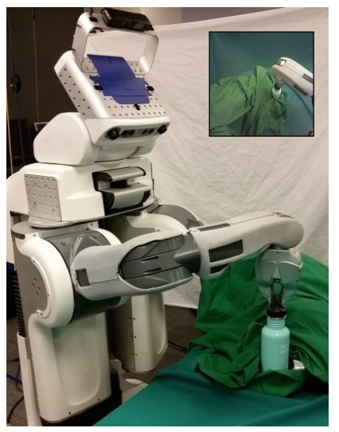
Learning visuomotor policies
Underlying state x: true object position, robot configuration
Observations o: image pixels
Two-part approach:
  Learn guiding policy π(a|x) using trajectory-centric RL and control techniques
  Learn visuomotor policy π(a|o) by imitating π(a|x)
S. Levine et al. End-to-end training of deep visuomotor policies. JMLR 2016

Slide 33
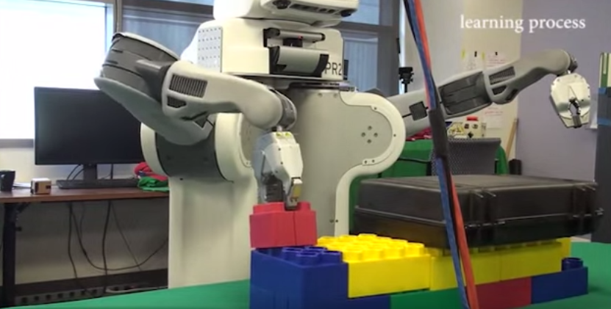
Learning visuomotor policies
Overview video, training video
S. Levine et al. End-to-end training of deep visuomotor policies. JMLR 2016

Slide 34
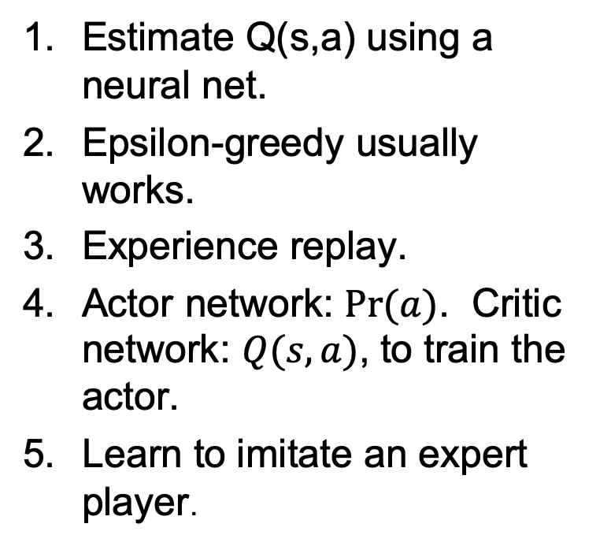
Conclusions
What is deep Q-learning?
How to make Q-learning converge to the best answer?
How to make it converge more smoothly?
What are policy learning and actor-critic networks?
What is imitation learning?
Estimate Q(s,a) using a neural net.
Epsilon-greedy usually works.
Experience replay.
Actor network: $Pr⁡(a)$. Critic network: $Q(s,a)$, to train the actor.
Learn to imitate an expert player.

