Slide 1
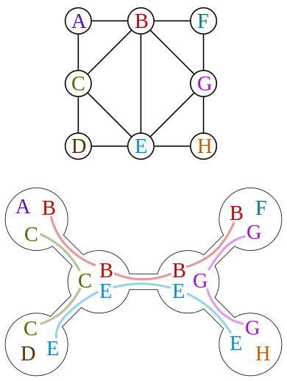
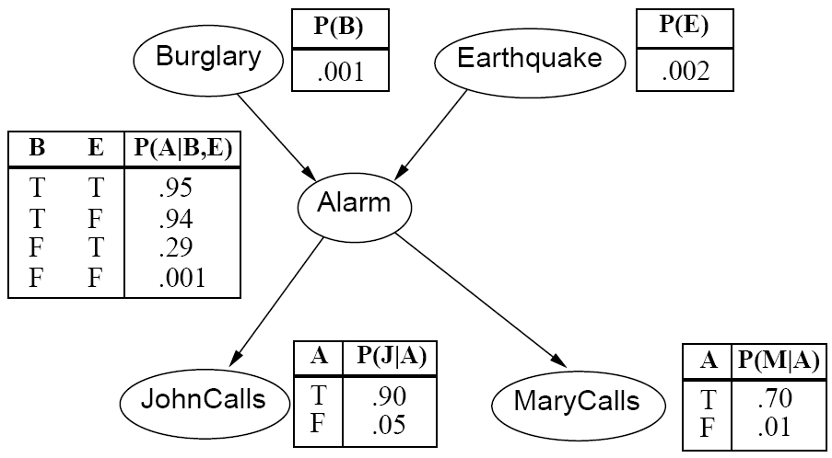
CS 440/ECE448 Lecture 19:
Bayes Net Inference
Mark Hasegawa-Johnson, 3/2019
Including slides by Svetlana Lazebnik, 11/2016

Slide 2
Bayes Network Inference & Learning
Bayes net is a memory-efficient model of dependencies among:
  Query variables: X
  Evidence (observed) variables and their values: E = e
  Unobserved variables: Y
Inference problem: answer questions about the query variables given the evidence variables
  This can be done using the posterior distribution P(X | E = e)
  The posterior can be derived from the full joint P(X, E, Y)
  How do we make this computationally efficient?
Learning problem: given some training examples, how do we learn the parameters of the model?
  Parameters = p(variable|parents), for each variable in the net
Notes:
2

Slide 3
Outline
Inference Examples
Inference Algorithms
  Trees: Sum-product algorithm
  Poly-trees: Junction tree algorithm
  Graphs: No polynomial-time algorithm
Parameter Learning

Slide 4
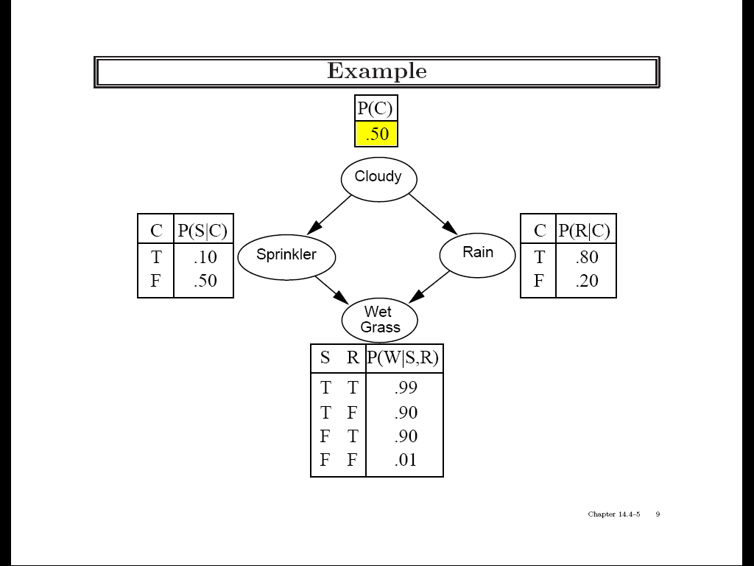
Practice example 1
Variables: Cloudy, Sprinkler, Rain, Wet Grass

Slide 5
Practice example 1
Given that the grass is wet, what is the probability that it has rained?

Slide 6
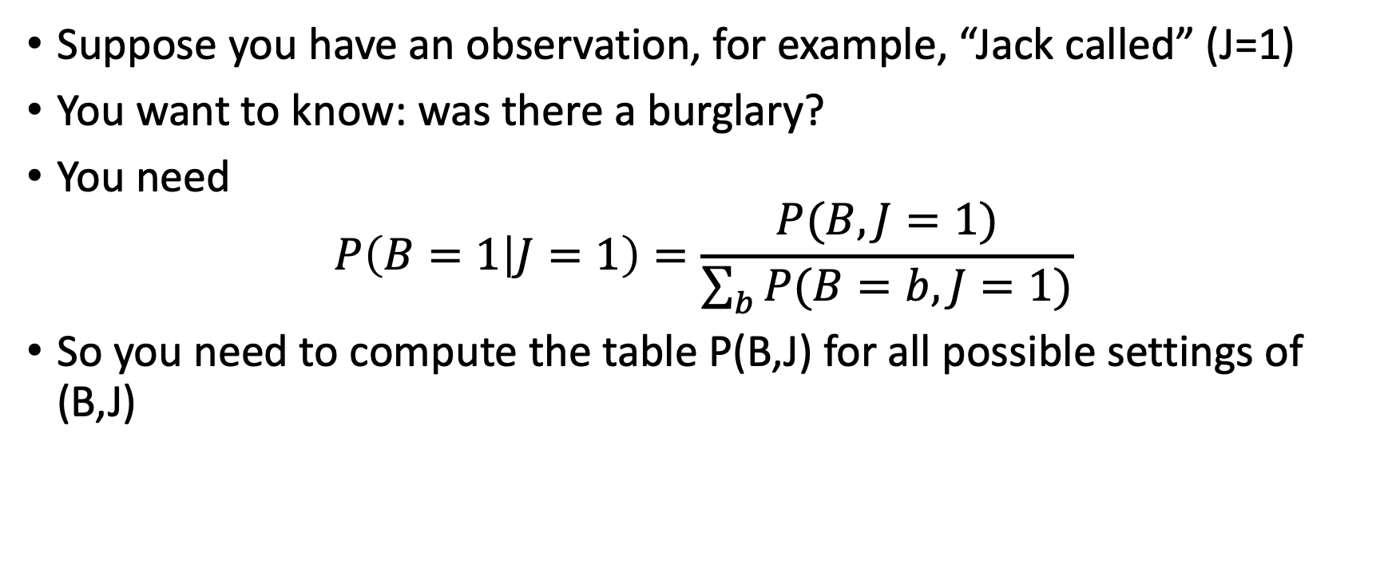
Practice Example #2
Suppose you have an observation, for example, “Jack called” (J=1)
You want to know: was there a burglary?
You need
$$P\left(B=1 | J=1\right)=\frac{P(B,J=1)}{\sum_{b}{P(B=b,J=1)}}$$
So you need to compute the table P(B,J) for all possible settings of (B,J)

Slide 7
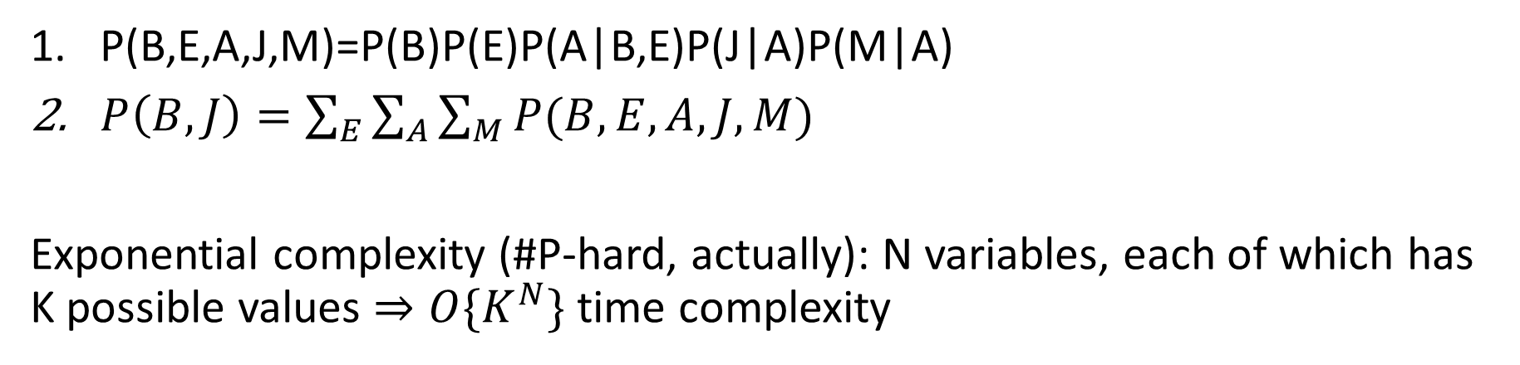
Bayes Net Inference:
The Hard Way
P(B,E,A,J,M)=P(B)P(E)P(A|B,E)P(J|A)P(M|A)
$P\left(B,J\right)=\sum_{E}{\sum_{A}{\sum_{M}{P(B,E,A,J,M)}}}$
Exponential complexity (#P-hard, actually): N variables, each of which has K possible values $⇒O\{K^{N}\}$ time complexity

Slide 8
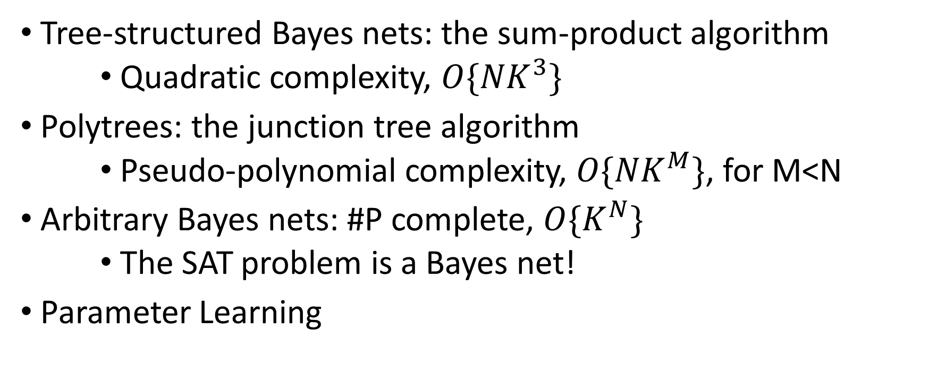
Is there an easier way?
Tree-structured Bayes nets: the sum-product algorithm
    Quadratic complexity, $O\{{NK}^{3}\}$
Polytrees: the junction tree algorithm
    Pseudo-polynomial complexity, $O\{{NK}^{M}\}$, for M<N
Arbitrary Bayes nets: #P complete, $O\{K^{N}\}$
    The SAT problem is a Bayes net!
Parameter Learning

Slide 9
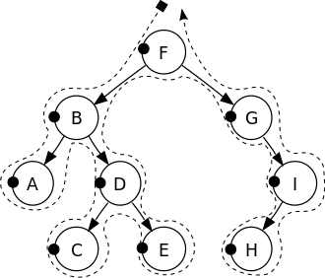
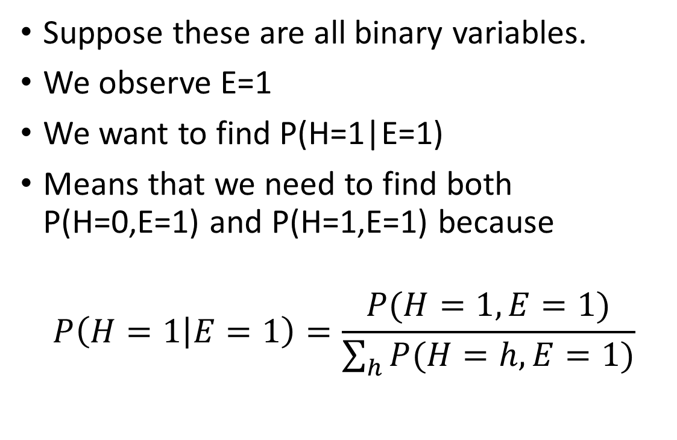
1. Tree-Structured Bayes Nets
Suppose these are all binary variables.
We observe E=1
We want to find P(H=1|E=1)
Means that we need to find both P(H=0,E=1) and P(H=1,E=1) because
$$P\left(H=1 | E=1\right)=\frac{P(H=1,E=1)}{\sum_{h}{P(H=h,E=1)}}$$

Slide 10
The Sum-Product Algorithm (Belief Propagation)
Find the only undirected path from the evidence variable to the query variable (EDBFGIH)
Find the directed root of this path P(F)
Find the joint probabilities of root and evidence: P(F=0,E=1) and P(F=1,E=1)
Find the joint probabilities of query and evidence: P(H=0,E=1) and P(H=1,E=1)
Find the conditional probability P(H=1|E=1)

Slide 11
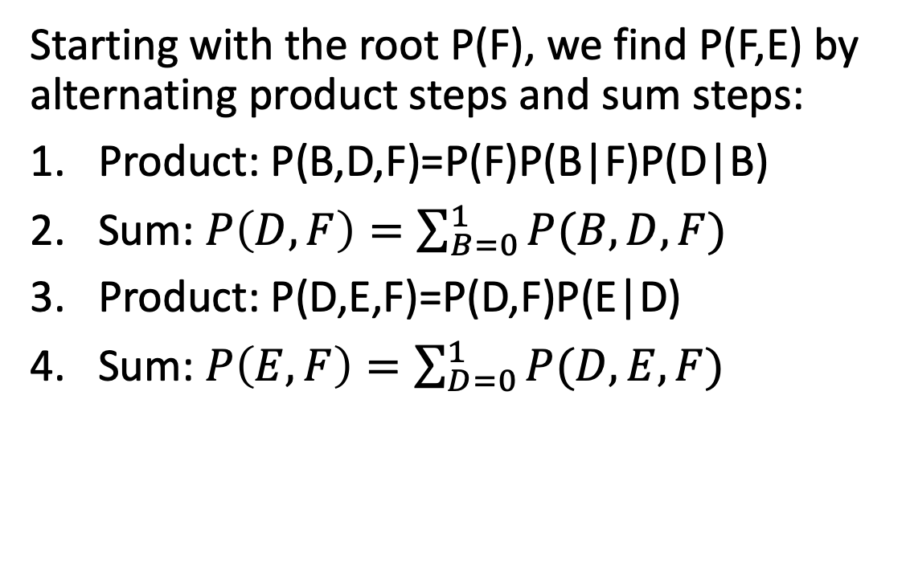
The Sum-Product Algorithm
The Sum-Product Algorithm (Belief Propagation)
Starting with the root P(F), we find P(F,E) by alternating product steps and sum steps:
Product: P(B,D,F)=P(F)P(B|F)P(D|B)
Sum: $P\left(D,F\right)=\sum_{B=0}^{1}{P(B,D,F)}$
Product: P(D,E,F)=P(D,F)P(E|D)
Sum: $P\left(E,F\right)=\sum_{D=0}^{1}{P(D,E,F)}$

Slide 12
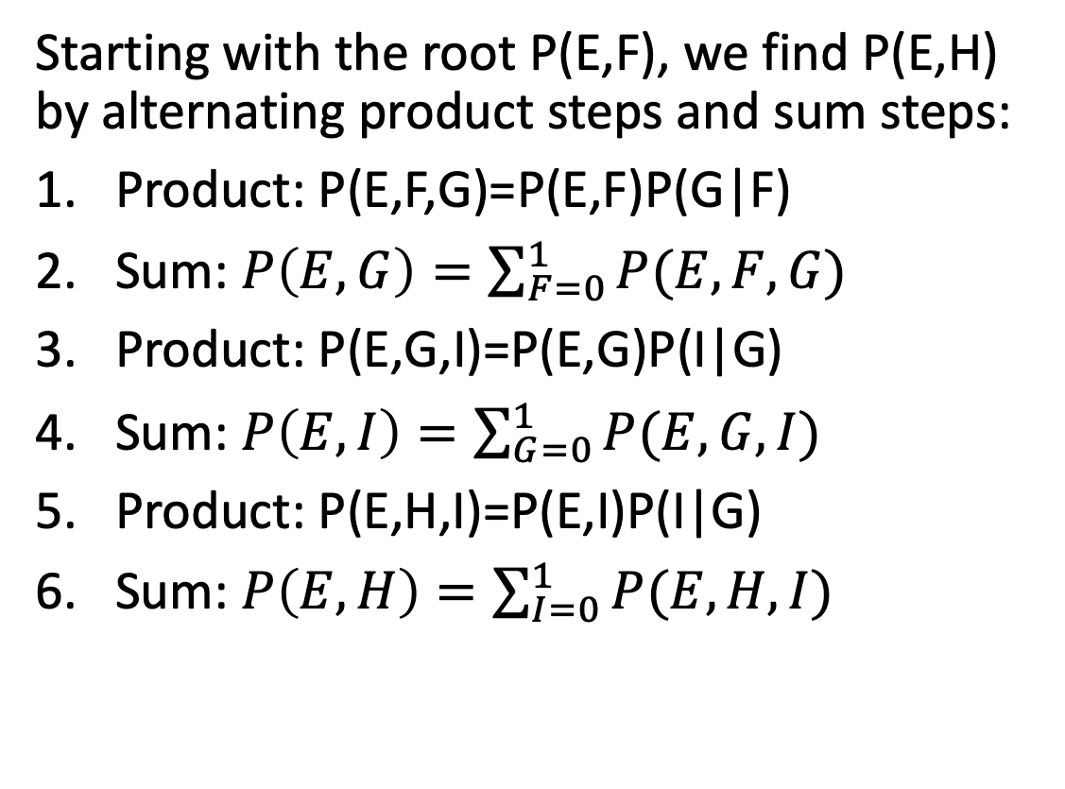
The Sum-Product Algorithm
The Sum-Product Algorithm (Belief Propagation)
Starting with the root P(E,F), we find P(E,H) by alternating product steps and sum steps:
Product: P(E,F,G)=P(E,F)P(G|F)
Sum: $P\left(E,G\right)=\sum_{F=0}^{1}{P(E,F,G)}$
Product: P(E,G,I)=P(E,G)P(I|G)
Sum: $P\left(E,I\right)=\sum_{G=0}^{1}{P(E,G,I)}$
Product: P(E,H,I)=P(E,I)P(I|G)
Sum: $P\left(E,H\right)=\sum_{I=0}^{1}{P(E,H,I)}$

Slide 13
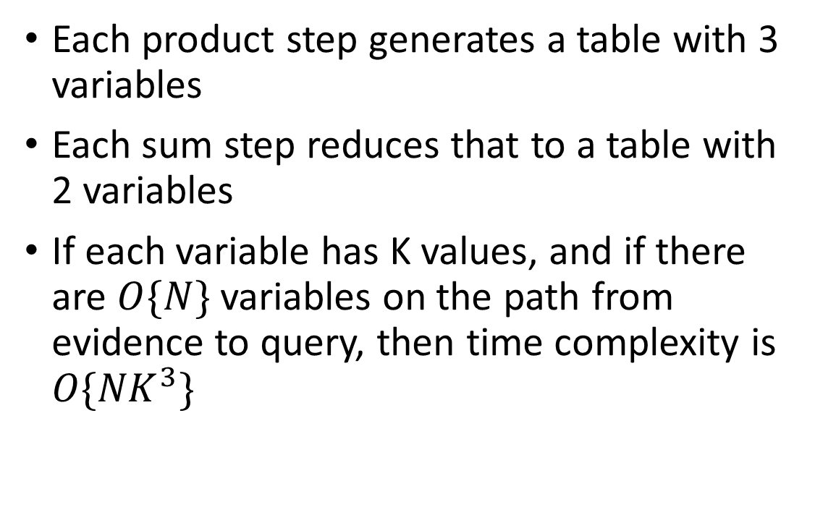
Time Complexity of Belief Propagation
Each product step generates a table with 3 variables
Each sum step reduces that to a table with 2 variables
If each variable has K values, and if there are $O\{N\}$ variables on the path from evidence to query, then time complexity is $O\{{NK}^{3}\}$

Slide 14
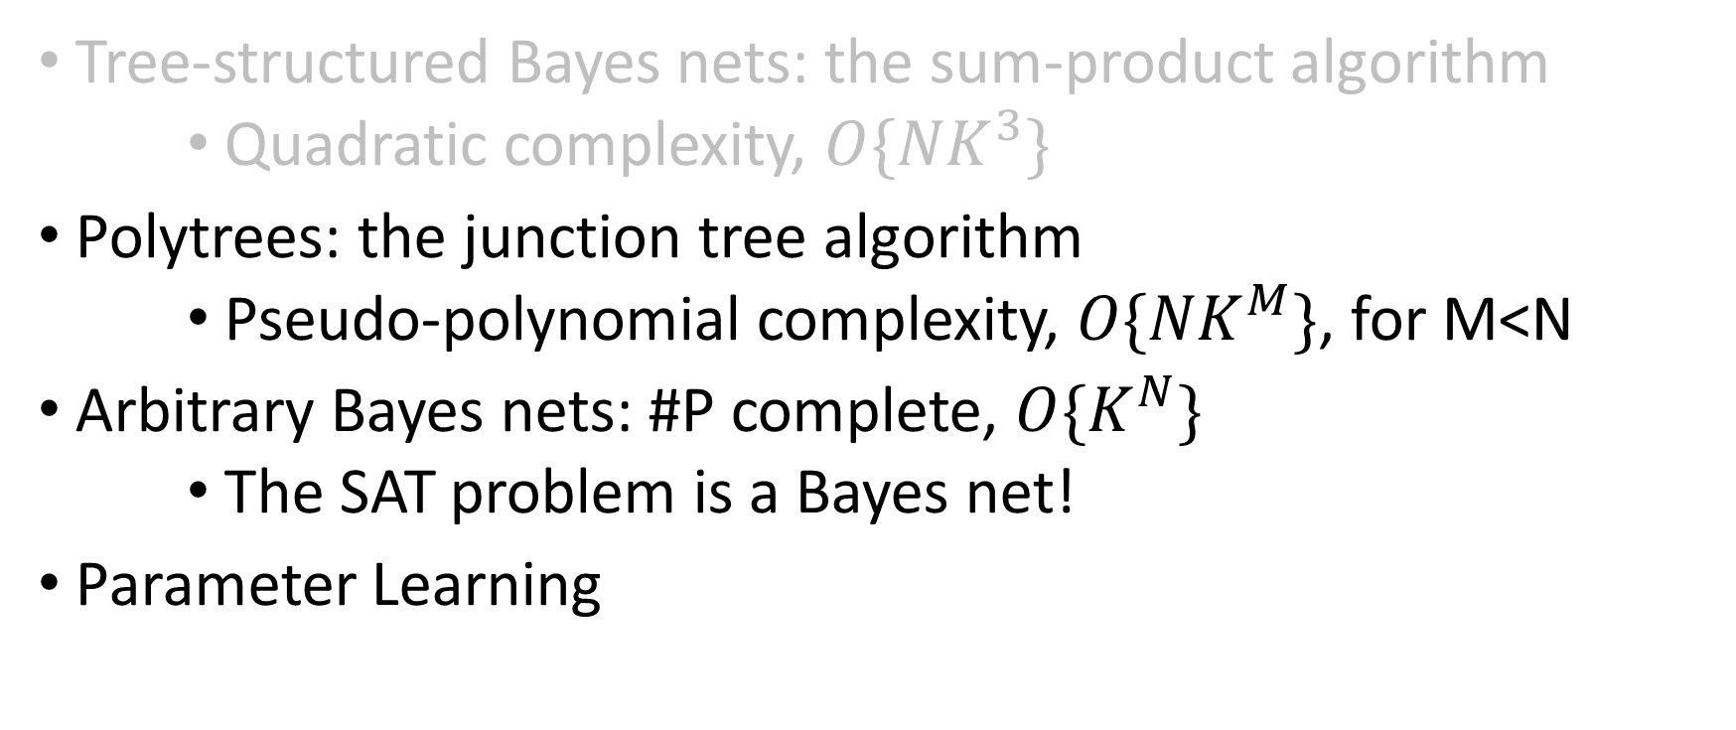
Time Complexity of Bayes Net Inference
Tree-structured Bayes nets: the sum-product algorithm
    Quadratic complexity, $O\{{NK}^{3}\}$
Polytrees: the junction tree algorithm
    Pseudo-polynomial complexity, $O\{{NK}^{M}\}$, for M<N
Arbitrary Bayes nets: #P complete, $O\{K^{N}\}$
    The SAT problem is a Bayes net!
Parameter Learning

Slide 15
2. The Junction Tree Algorithm
Moralize the graph (identify each variable’s Markov blanket)
Triangulate the graph (eliminate undirected cycles)
Create the junction tree (form cliques)
Run the sum-product algorithm on the junction tree

Slide 16
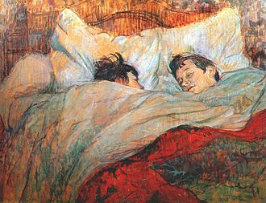
2.a. Markov Blanket
Suppose there is a Bayes net with variables A,B,C,D,E,F,G,H
The “Markov blanket” of variable F is D,E,G if
P(F|A,B,C,D,E,G,H)
= P(F|D,E,G)

Slide 17
2.a. Markov Blanket
A
B
Suppose there is a Bayes net with variables A,B,C,D,E,F,G,H
The “Markov blanket” of variable F is D,E,G if
P(F|A,B,C,D,E,G,H)
= P(F|D,E,G)
C
D
E
F
G
H

Slide 18
2.a. Markov Blanket
A
B
The “Markov blanket” of variable F is D,E,G if
P(F|A,B,C,D,E,G,H)
= P(F|D,E,G)
How can we prove that?
P(A,…,H) = P(A)P(B|A) …
Which of those terms include F?
C
D
E
F
G
H

Slide 19
2.a. Markov Blanket
A
B
Which of those terms include F?
Only these two:
P(F|D)
and
P(G|E,F)
C
D
E
F
G
H

Slide 20
2.a. Markov Blanket
A
B
The Markov Blanket of variable F includes only its immediate family members:
Its parent, D
Its child, G
The other parent of its child, E
Because P(F|A,B,C,D,E,G,H)
= P(F|D,E,G)
C
D
E
F
G
H

Slide 21
2.a. Moralization
A
B
“Moralization” =
If two variables have a child together, force them to get married.
Get rid of the arrows (not necessary any more).
Result: Markov blanket = the set of variables to which a variable is connected.
C
D
E
F
G
H

Slide 22
2.b. Triangulation
A
B
Triangulation = draw edges so that there is no unbroken cycle of length > 3.
There are usually many different ways to do this. For example, here’s one:
C
D
E
F
G
H

Slide 23
2.c. Form Cliques
A
AB
B
B
BCD
Clique = a group of variables, all of whom are members of each other’s immediate family.
Junction Tree = a tree in which
Each node is a clique from the original graph,
Each edge is an “intersection set,” naming the variables that overlap between the two cliques.
CD
C
D
CDF
CF
CEF
E
F
EF
G
EFG
G
H
GH

Slide 24
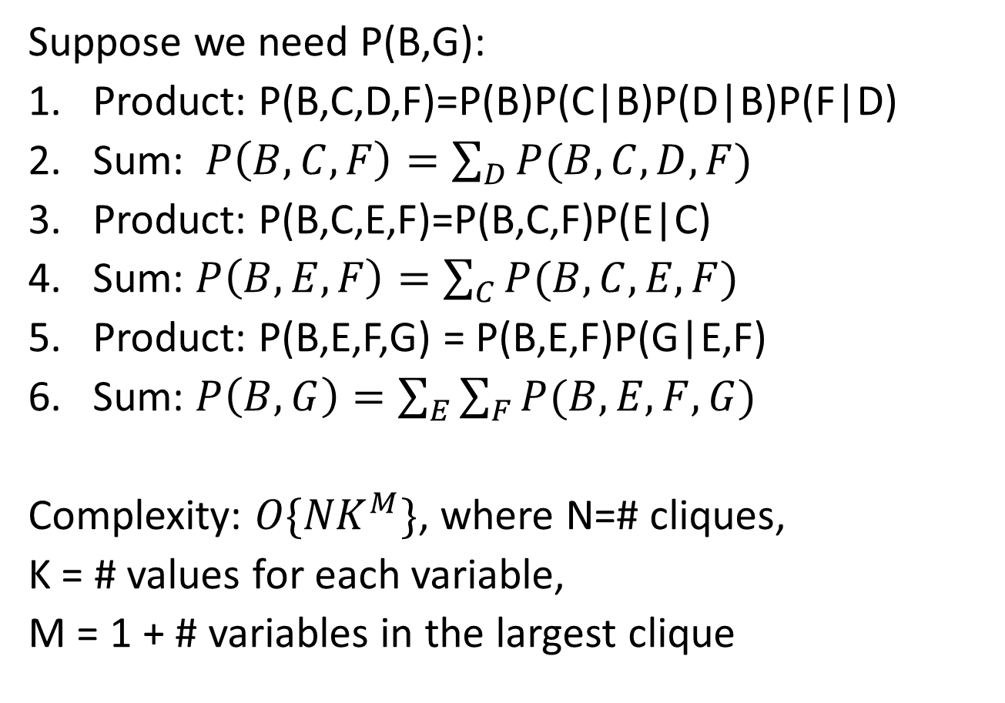
2.d. Sum-Product
Suppose we need P(B,G):
Product: P(B,C,D,F)=P(B)P(C|B)P(D|B)P(F|D)
Sum: $P\left(B,C,F\right)=\sum_{D}{P(B,C,D,F)}$
Product: P(B,C,E,F)=P(B,C,F)P(E|C)
Sum: $P\left(B,E,F\right)=\sum_{C}{P(B,C,E,F)}$
Product: P(B,E,F,G) = P(B,E,F)P(G|E,F)
Sum: $P\left(B,G\right)=\sum_{E}{\sum_{F}{P(B,E,F,G)}}$
Complexity: $O\{{NK}^{M}\}$, where N=# cliques,
K = # values for each variable,
M = 1 + # variables in the largest clique
B
C
D
E
F
G

Slide 25
Junction Tree: Sample Test Question
Consider the burglar alarm example.
Moralize this graph
Is it already triangulated? If not, triangulate it.
Draw the junction tree

Slide 26
Solution
B
E
Moralize this graph
A
J
M

Slide 27
Solution
B
E
b. Is it already triangulated?
Answer: yes. There is no unbroken cycle of length > 3.
A
J
M

Slide 28
Solution
c. Draw the junction tree
ABE
A
A
AJ
AM

Slide 29
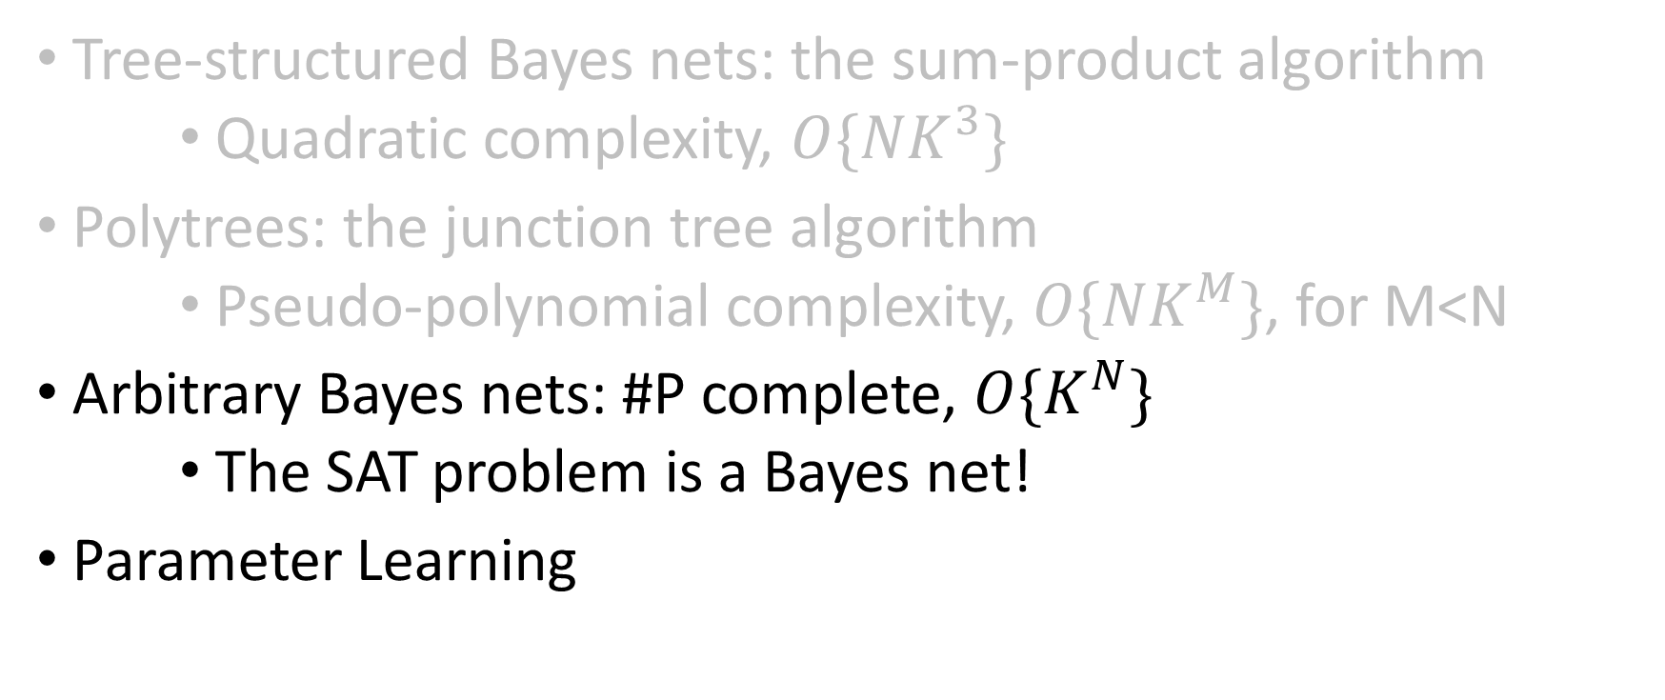
Time Complexity of Bayes Net Inference
Tree-structured Bayes nets: the sum-product algorithm
    Quadratic complexity, $O\{{NK}^{3}\}$
Polytrees: the junction tree algorithm
    Pseudo-polynomial complexity, $O\{{NK}^{M}\}$, for M<N
Arbitrary Bayes nets: #P complete, $O\{K^{N}\}$
    The SAT problem is a Bayes net!
Parameter Learning

Slide 30
Bayesian network inference
In full generality, NP-hard
  More precisely, #P-hard: equivalent to counting satisfying assignments
We can reduce satisfiability to Bayesian network inference
  Decision problem: is P(Y) > 0?

Slide 31
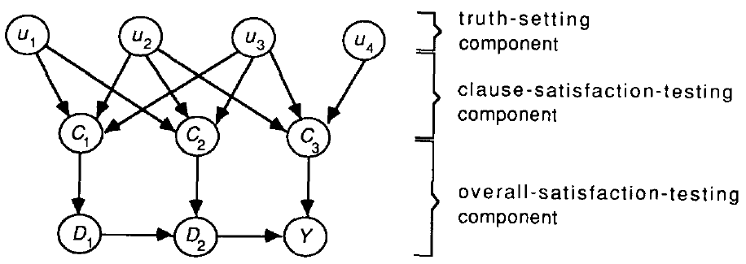
Bayesian network inference
In full generality, NP-hard
  More precisely, #P-hard: equivalent to counting satisfying assignments
We can reduce satisfiability to Bayesian network inference
  Decision problem: is P(Y) > 0?
C₁
C₂
C₃
G. Cooper, 1990

Slide 32
Bayesian network inference

Slide 33
Bayesian network inference
Why can’t we use the junction tree algorithm to efficiently compute Pr(Y)?

Slide 34
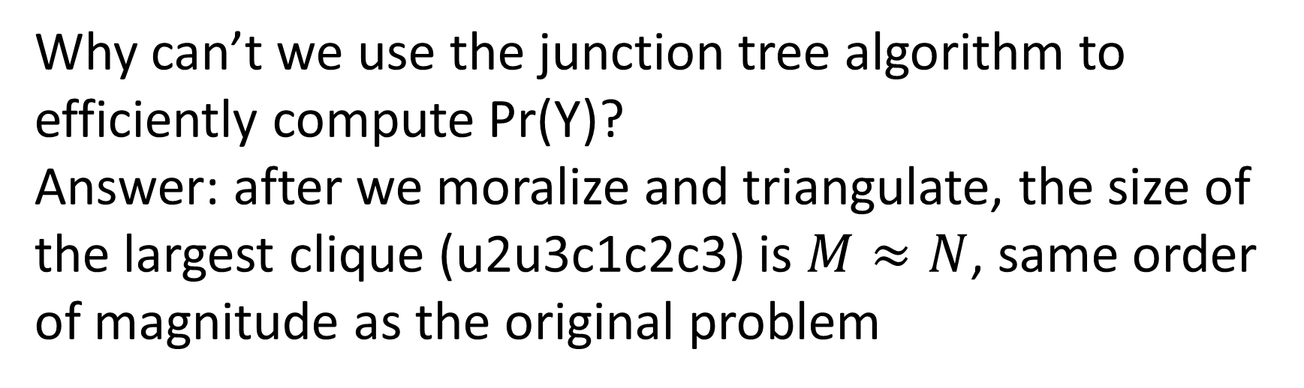
Bayesian network inference
Why can’t we use the junction tree algorithm to efficiently compute Pr(Y)?
Answer: after we moralize and triangulate, the size of the largest clique (u2u3c1c2c3) is $M≈N$, same order of magnitude as the original problem

Slide 35
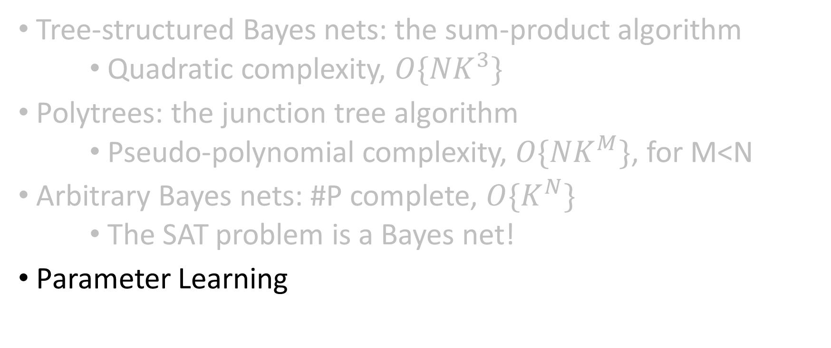
Time Complexity of Bayes Net Inference
Tree-structured Bayes nets: the sum-product algorithm
    Quadratic complexity, $O\{{NK}^{3}\}$
Polytrees: the junction tree algorithm
    Pseudo-polynomial complexity, $O\{{NK}^{M}\}$, for M<N
Arbitrary Bayes nets: #P complete, $O\{K^{N}\}$
    The SAT problem is a Bayes net!
Parameter Learning

Slide 36
Parameter learning
  Inference problem: given values of evidence variables E = e, answer questions about query variables X using the posterior P(X | E = e)
Learning problem: estimate the parameters of the probabilistic model P(X | E) given a training sample {(x₁,e₁), …, (x_{n},e_{n})}
Notes:
36

Slide 37
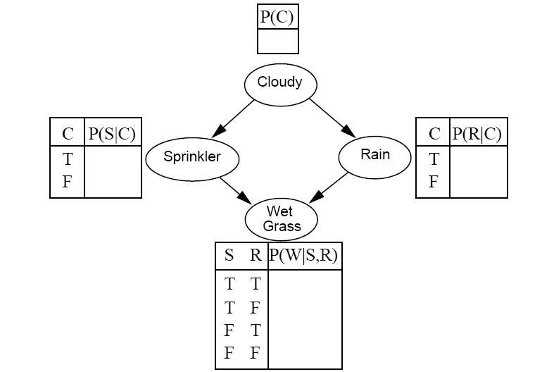
Parameter learning: complete data
Suppose we know the network structure (but not the parameters), and have a training set of complete observations
Training set
?
Sample | C | S | R | W
1 | T | F | T | T
2 | F | T | F | T
3 | T | F | F | F
4 | T | T | T | T
5 | F | T | F | T
6 | T | F | T | F
… | … | … | …. | …
?
?
?
?
?
?
?
?

Slide 38

Parameter learning
Suppose we know the network structure (but not the parameters), and have a training set of complete observations
Example:
$$P\left(S=T | C=T\right)=\frac{\#samples with S=T, C=T}{\# samples with C=T}=\frac{1}{4}$$
Training set
Sample | C | S | R | W
1 | T | F | T | T
2 | F | T | F | T
3 | T | F | F | F
4 | T | T | T | T
5 | F | T | F | T
6 | T | F | T | F
… | … | … | …. | …

Slide 39
Parameter learning
Suppose we know the network structure (but not the parameters), and have a training set of complete observations
  P(X | Parents(X)) is given by the observed frequencies of the different values of X for each combination of parent values

Slide 40
Parameter learning: missing data
Suppose we know the network structure (but not the parameters), and have a training set, but the training set is missing some observations.
Training set
?
Sample | C | S | R | W
1 | ? | F | T | T
2 | ? | T | F | T
3 | ? | F | F | F
4 | ? | T | T | T
5 | ? | T | F | T
6 | ? | F | T | F
… | … | … | …. | …
?
?
?
?
?
?
?
?

Slide 41
Missing data: the EM algorithm
The EM algorithm starts (“Expectation Maximization”) starts with an initial guess for each parameter value.
We try to improve the initial guess, using the algorithm on the next two slides:
  E-step
  M-step
Training set
0.5?
Sample | C | S | R | W
1 | ? | F | T | T
2 | ? | T | F | T
3 | ? | F | F | F
4 | ? | T | T | T
5 | ? | T | F | T
6 | ? | F | T | F
… | … | … | …. | …
0.5?
0.5?
0.5?
0.5?
0.5?
0.5?
0.5?
0.5?

Slide 42

Missing data: the EM algorithm
E-Step (Expectation): Given the model parameters, replace each of the missing numbers with a probability (a number between 0 and 1) using
$$P\left(C=1 | S,R,W\right)=\frac{P(C=1,S,R,W)}{P\left(C=1,S,R,W\right)+P(C=0,S,R,W)}$$
Training set
0.5?
Sample | C | S | R | W
1 | 0.5? | F | T | T
2 | 0.5? | T | F | T
3 | 0.5? | F | F | F
4 | 0.5? | T | T | T
5 | 0.5? | T | F | T
6 | 0.5? | F | T | F
… | … | … | …. | …
0.5?
0.5?
0.5?
0.5?
0.5?
0.5?
0.5?
0.5?

Slide 43

Missing data: the EM algorithm
M-Step (Maximization): Given the missing data estimates, replace each of the missing model parameters using
$$P\left(Variable=T | Parents=value\right)=\frac{E[\# times Variable=T,Parents=value]}{E[\#times Parents=value]}$$
Training set
0.5
Sample | C | S | R | W
1 | 0.5? | F | T | T
2 | 0.5? | T | F | T
3 | 0.5? | F | F | F
4 | 0.5? | T | T | T
5 | 0.5? | T | F | T
6 | 0.5? | F | T | F
… | … | … | …. | …
0.5
0.5
0.5
0.5
1.0
1.0
0.5
0.0

Slide 44
Missing data: the EM algorithm
Iterate back and forth between E-step and M-step until the model converges.
Training set
0.5
Sample | C | S | R | W
1 | 0.5? | F | T | T
2 | 0.5? | T | F | T
3 | 0.5? | F | F | F
4 | 0.5? | T | T | T
5 | 0.5? | T | F | T
6 | 0.5? | F | T | F
… | … | … | …. | …
0.5
0.5
0.5
0.5
1.0
1.0
0.5
0.0

Slide 45
Summary: Bayesian networks
Structure
Parameters
Inference
Learning

