Slide 1
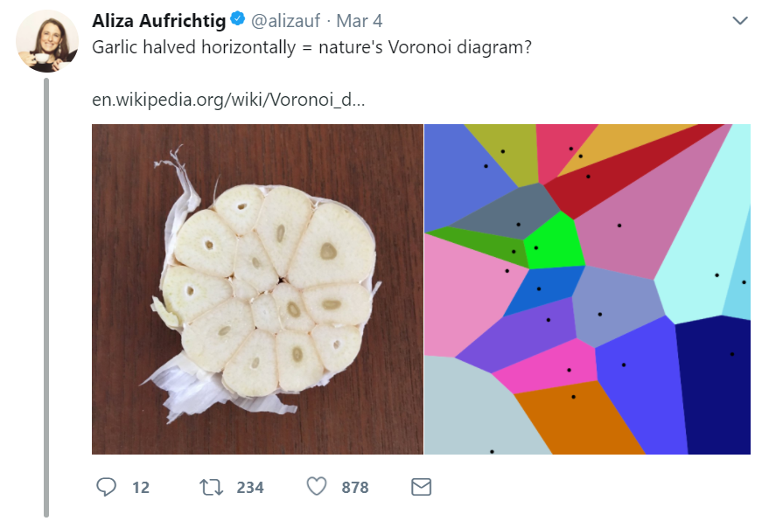
Polychotomizers: One-Hot Vectors, Softmax, and Cross-Entropy
Mark Hasegawa-Johnson, 3/9/2019. CC-BY 3.0: You are free to share and adapt these slides if you cite the original.

Slide 2
Outline
Dichotomizers and Polychotomizers
Dichotomizer: what it is; how to train it
Polychotomizer: what it is; how to train it
One-Hot Vectors: Training targets for the polychotomizer
Softmax Function
A differentiable approximate argmax
How to differentiate the softmax
Cross-Entropy
Cross-entropy = negative log probability of training labels
Derivative of cross-entropy w.r.t. network weights
Putting it all together: a one-layer softmax neural net

Slide 3
Outline
Dichotomizers and Polychotomizers
Dichotomizer: what it is; how to train it
Polychotomizer: what it is; how to train it
One-Hot Vectors: Training targets for the polychotomizer
Softmax Function
A differentiable approximate argmax
How to differentiate the softmax
Cross-Entropy
Cross-entropy = negative log probability of training labels
Derivative of cross-entropy w.r.t. network weights
Putting it all together: a one-layer softmax neural net

Slide 4
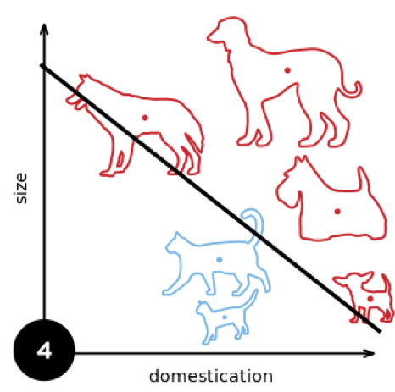
Dichotomizer: What is it?
Dichotomizer = a two-class classifier
From the Greek, dichotomos = “cut in half”
First known use of this word, according to Merriam-Webster: 1606
Example: a classifier that decides whether an animal is a dog or a cat (Elizabeth Goodspeed, 2015 https://en.wikipedia.org/wiki/Perceptron)

Slide 5
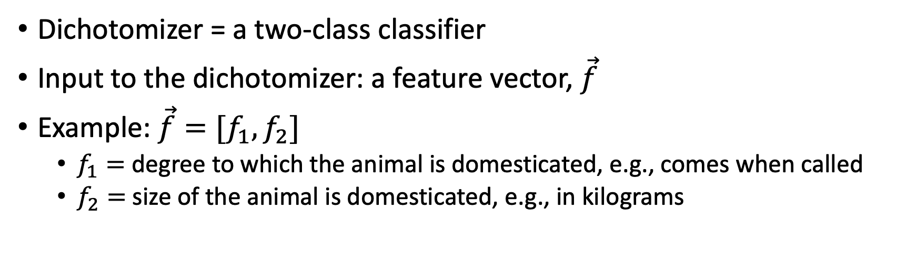
Dichotomizer: Example
Dichotomizer = a two-class classifier
Input to the dichotomizer: a feature vector, $\vec{f}$
Example: $\vec{f}=[f_{1},f_{2}]$
$f_{1}=$ degree to which the animal is domesticated, e.g., comes when called
$f_{2}=$ size of the animal is domesticated, e.g., in kilograms

Slide 6
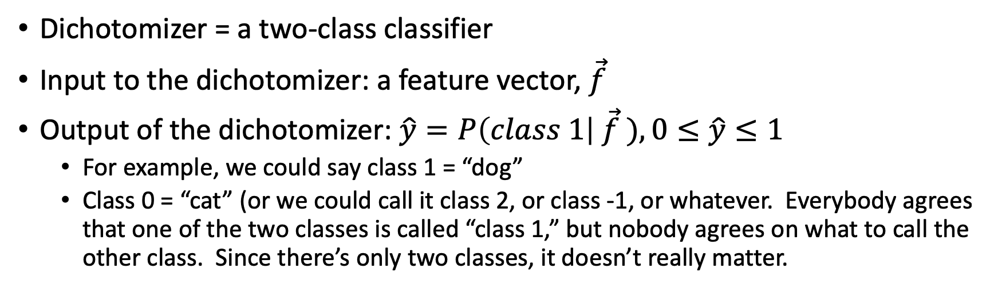
Dichotomizer: Example
Dichotomizer = a two-class classifier
Input to the dichotomizer: a feature vector, $\vec{f}$
Output of the dichotomizer: $\hat{y}=P\left(class 1\right| \vec{f} ), 0≤\hat{y}≤1$
For example, we could say class 1 = “dog”
Class 0 = “cat” (or we could call it class 2, or class -1, or whatever. Everybody agrees that one of the two classes is called “class 1,” but nobody agrees on what to call the other class. Since there’s only two classes, it doesn’t really matter.

Slide 7
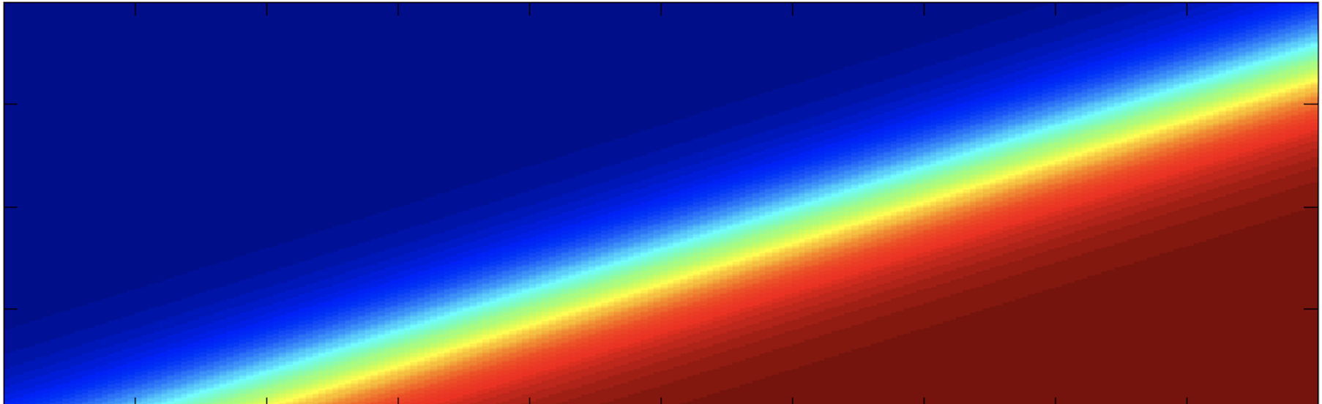
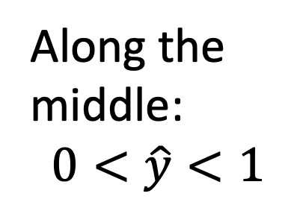
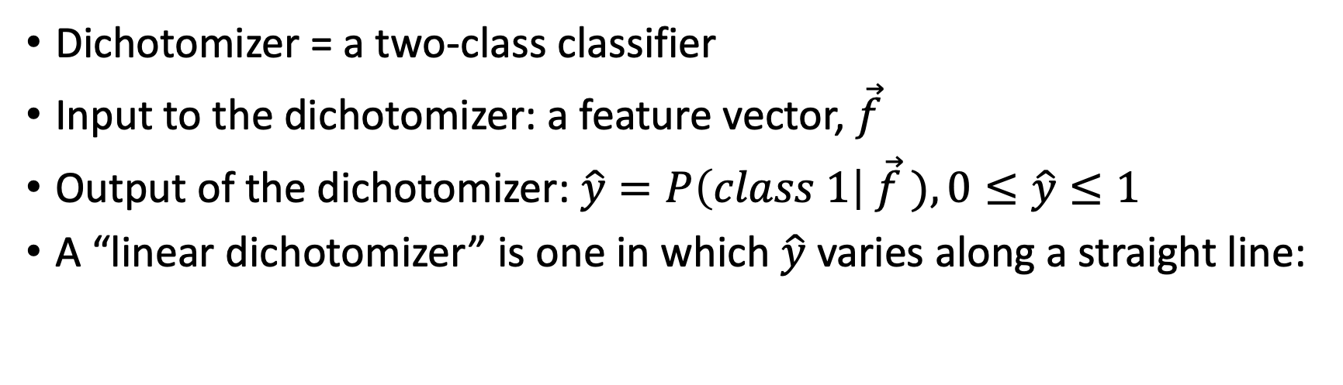
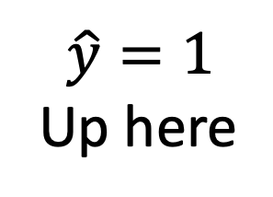
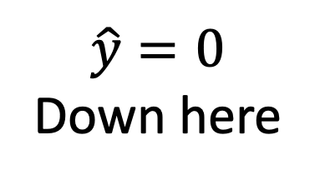
Linear Dichotomizer
Dichotomizer = a two-class classifier
Input to the dichotomizer: a feature vector, $\vec{f}$
Output of the dichotomizer: $\hat{y}=P\left(class 1\right| \vec{f} ), 0≤\hat{y}≤1$
A “linear dichotomizer” is one in which $\hat{y}$ varies along a straight line:
$$\hat{y}=1$$
Up here
Along the
middle:
$$0<\hat{y}<1$$
$$\hat{y}=0$$
Down here

Slide 8
Training a Dichotomizer
Training database = n training tokens
Example: n=6 training examples
$$\hat{y}=1$$
Up here
Along the
middle:
$$0<\hat{y}<1$$
$$\hat{y}=0$$
Down here

Slide 9
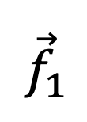
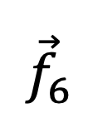
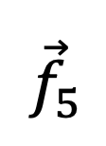
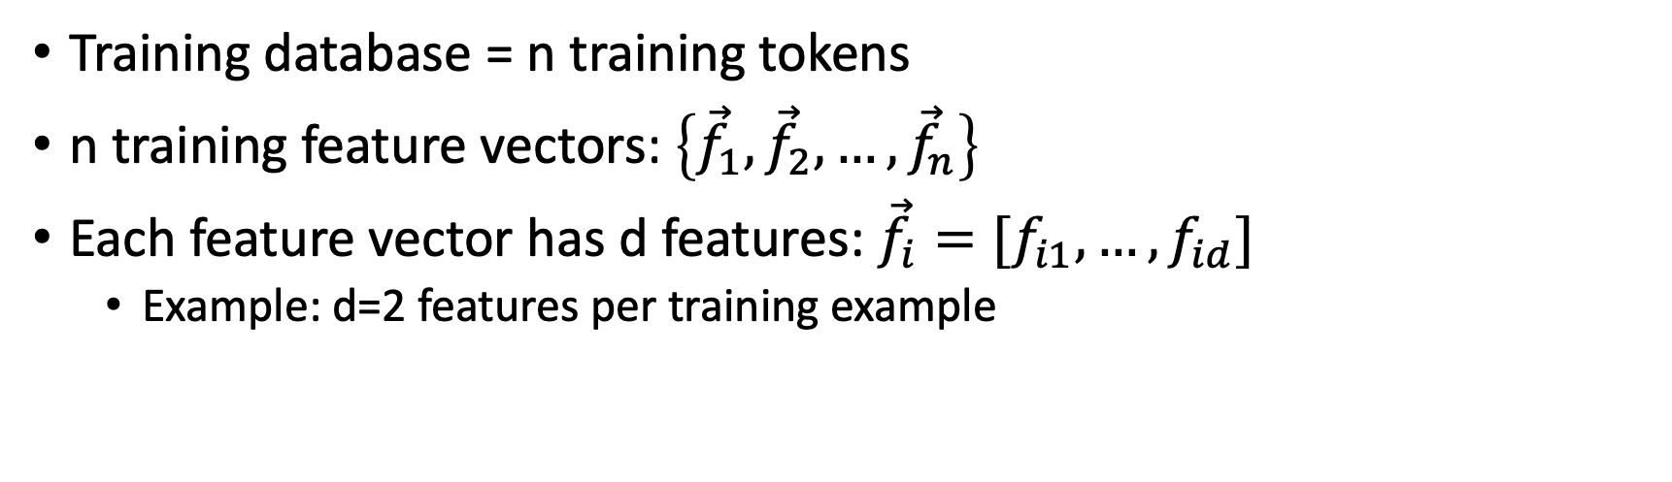
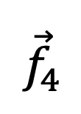
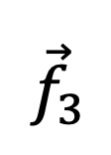
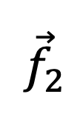
Training a Dichotomizer
Training database = n training tokens
n training feature vectors: $\left\{{\vec{f}}_{1},{\vec{f}}_{2},…,{\vec{f}}_{n}\right\}$
Each feature vector has d features: ${\vec{f}}_{i}=[f_{i1},…,f_{id}]$
Example: d=2 features per training example
$${\vec{f}}_{1}$$
$$\hat{y}=1$$
Up here
$${\vec{f}}_{3}$$
$${\vec{f}}_{4}$$
$${\vec{f}}_{2}$$
Along the
middle:
$$0<\hat{y}<1$$
$${\vec{f}}_{6}$$
$${\vec{f}}_{5}$$
$$\hat{y}=0$$
Down here

Slide 10
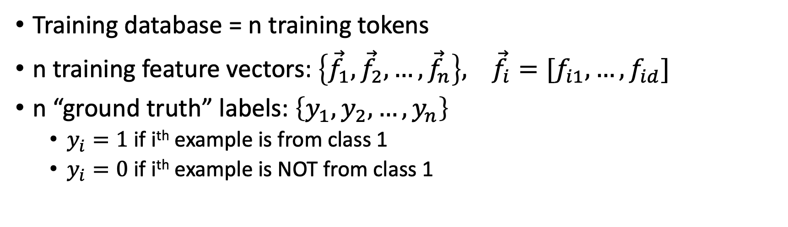
Training a Dichotomizer
Training database = n training tokens
n training feature vectors: $\left\{{\vec{f}}_{1},{\vec{f}}_{2},…,{\vec{f}}_{n}\right\}, {\vec{f}}_{i}=[f_{i1},…,f_{id}]$
n “ground truth” labels: $\left\{y_{1},y_{2},…,y_{n}\right\}$
$y_{i}=1$ if i^{th} example is from class 1
$y_{i}=0$ if i^{th} example is NOT from class 1
$${\vec{f}}_{1}$$
$$\hat{y}=1$$
Up here
$${\vec{f}}_{3}$$
$${\vec{f}}_{4}$$
$${\vec{f}}_{2}$$
Along the
middle:
$$0<\hat{y}<1$$
$${\vec{f}}_{6}$$
$${\vec{f}}_{5}$$
$$\hat{y}=0$$
Down here

Slide 11
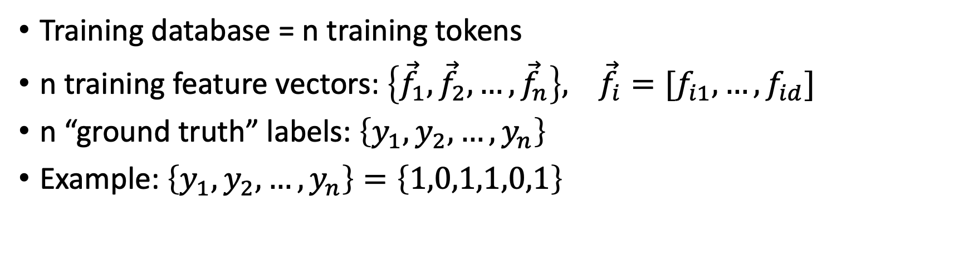
Training a Dichotomizer
Training database = n training tokens
n training feature vectors: $\left\{{\vec{f}}_{1},{\vec{f}}_{2},…,{\vec{f}}_{n}\right\}, {\vec{f}}_{i}=[f_{i1},…,f_{id}]$
n “ground truth” labels: $\left\{y_{1},y_{2},…,y_{n}\right\}$
Example: $\left\{y_{1},y_{2},…,y_{n}\right\}=\left\{1,0,1,1,0,1\right\}$
$${\vec{f}}_{1}$$
$$\hat{y}=1$$
Up here
$${\vec{f}}_{3}$$
$${\vec{f}}_{4}$$
$${\vec{f}}_{2}$$
Along the
middle:
$$0<\hat{y}<1$$
$${\vec{f}}_{6}$$
$${\vec{f}}_{5}$$
$$\hat{y}=0$$
Down here

Slide 12
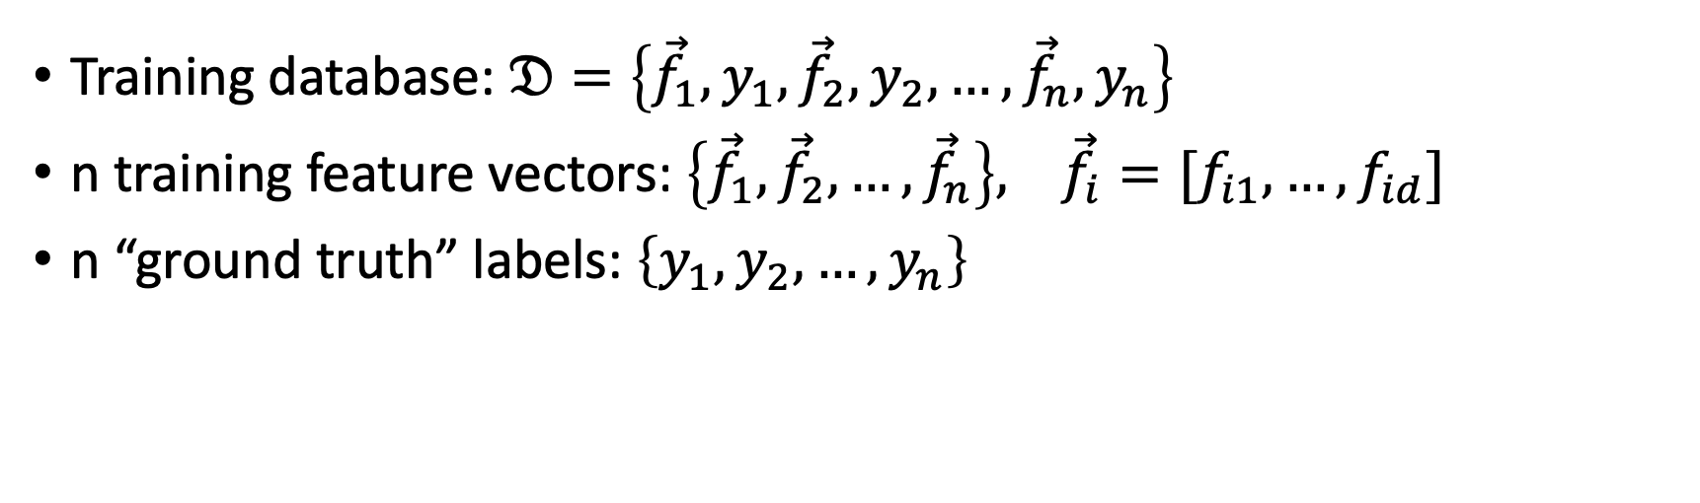
Training a Dichotomizer
Training database: $𝔇=\left\{{\vec{f}}_{1},y_{1},{\vec{f}}_{2},y_{2},…,{\vec{f}}_{n},y_{n}\right\}$
n training feature vectors: $\left\{{\vec{f}}_{1},{\vec{f}}_{2},…,{\vec{f}}_{n}\right\}, {\vec{f}}_{i}=[f_{i1},…,f_{id}]$
n “ground truth” labels: $\left\{y_{1},y_{2},…,y_{n}\right\}$
$${\vec{f}}_{1}$$
$$\hat{y}=1$$
Up here
$${\vec{f}}_{3}$$
$${\vec{f}}_{4}$$
$${\vec{f}}_{2}$$
Along the
middle:
$$0<\hat{y}<1$$
$${\vec{f}}_{6}$$
$${\vec{f}}_{5}$$
$$\hat{y}=0$$
Down here

Slide 13
Outline
Dichotomizers and Polychotomizers
Dichotomizer: what it is; how to train it
Polychotomizer: what it is; how to train it
One-Hot Vectors: Training targets for the polychotomizer
Softmax Function
A differentiable approximate argmax
How to differentiate the softmax
Cross-Entropy
Cross-entropy = negative log probability of training labels
Derivative of cross-entropy w.r.t. network weights
Putting it all together: a one-layer softmax neural net

Slide 14
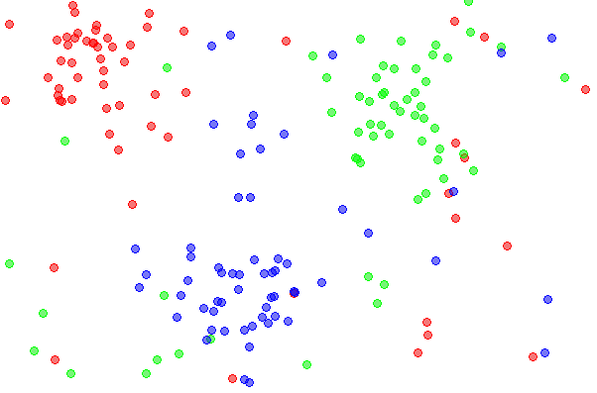
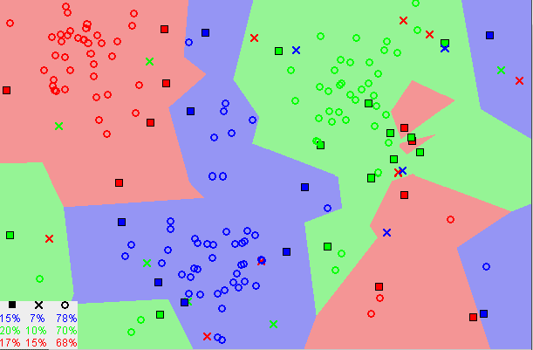
Polychotomizer: What is it?
Polychotomizer = a multi-class classifier
From the Greek, poly = “many”
Example: classify dots as being purple, red, or green (E.M. Mirkes, KNN and Potential Energy applet, 2011, CC-BY 3.0, https://en.wikipedia.org/wiki/K-nearest_neighbors_algorithm)

Slide 15
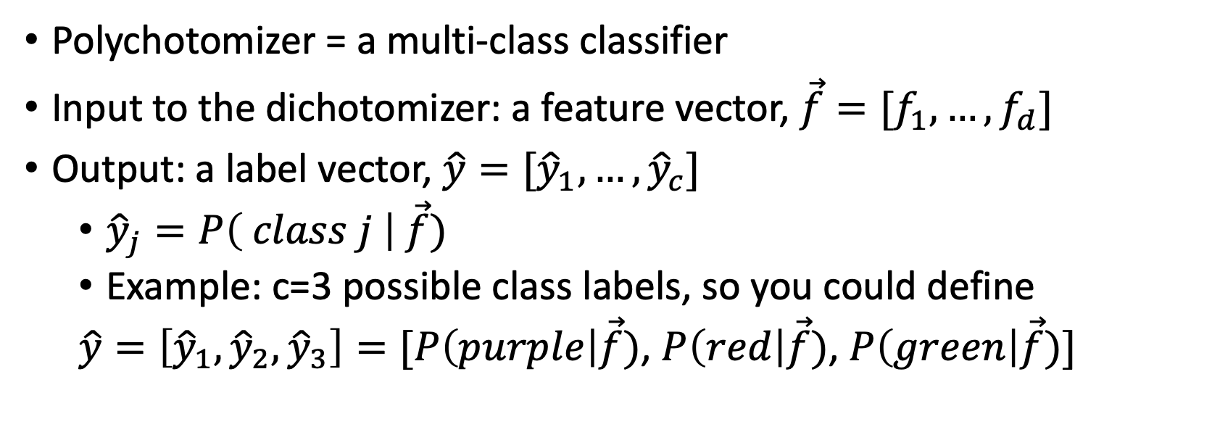
Polychotomizer: What is it?
Polychotomizer = a multi-class classifier
Input to the dichotomizer: a feature vector, $\vec{f}=[f_{1},…,f_{d}]$
Output: a label vector, $\hat{y}=[{\hat{y}}_{1},…,{\hat{y}}_{c}]$
${\hat{y}}_{j}=P\left( class j \right| \vec{f})$
Example: c=3 possible class labels, so you could define
$\hat{y}=\left[{\hat{y}}_{1},{\hat{y}}_{2},{\hat{y}}_{3}\right]=[P\left(purple\right|\vec{f})$, $P\left(red\right|\vec{f})$, $P\left(green\right|\vec{f})]$

Slide 16
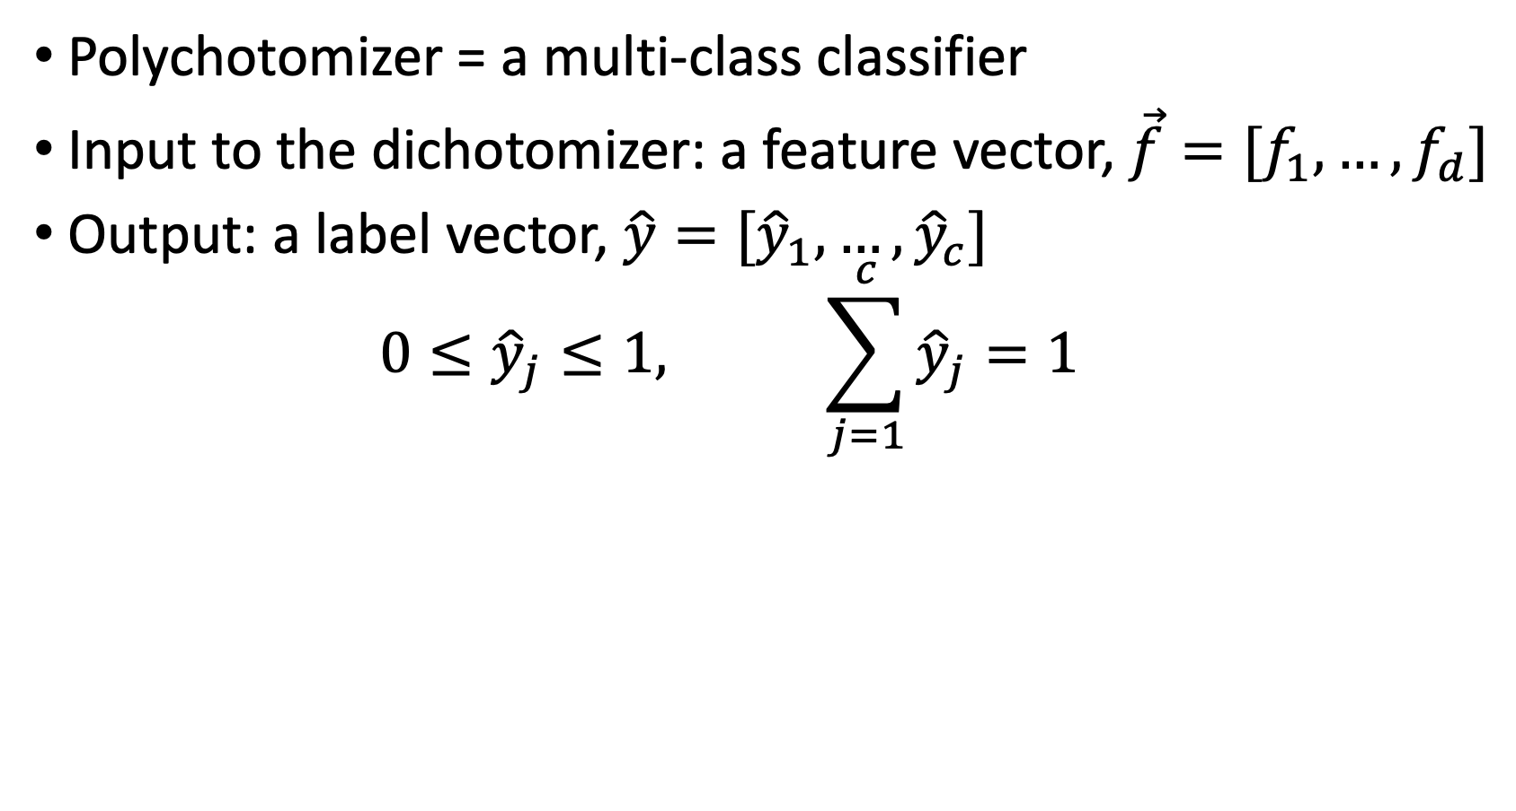
Polychotomizer: What is it?
Polychotomizer = a multi-class classifier
Input to the dichotomizer: a feature vector, $\vec{f}=[f_{1},…,f_{d}]$
Output: a label vector, $\hat{y}=[{\hat{y}}_{1},…,{\hat{y}}_{c}]$
$$0≤{\hat{y}}_{j}≤1, \sum_{j=1}^{c}{{\hat{y}}_{j}}=1$$

Slide 17
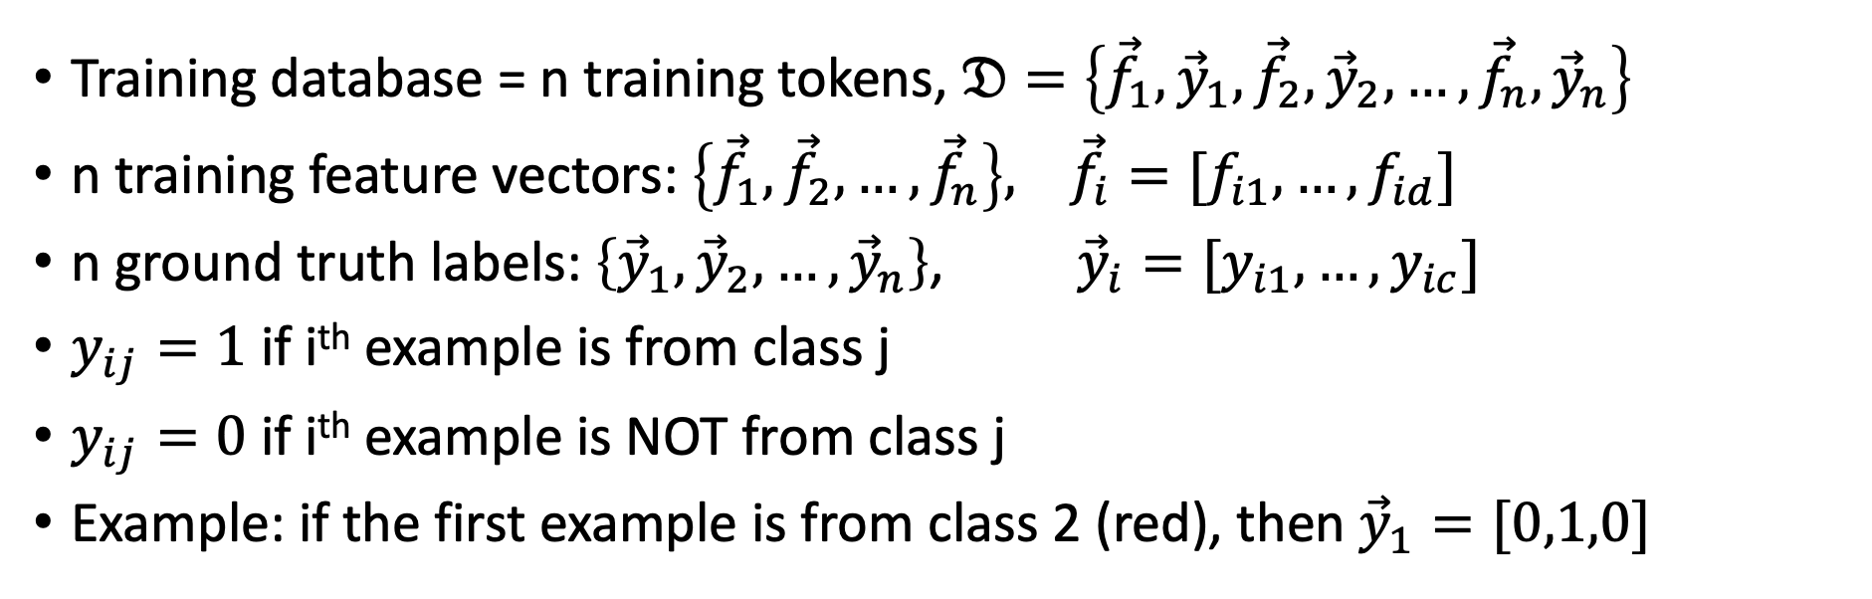
Training a Polychotomizer
Training database = n training tokens, $𝔇=\left\{{\vec{f}}_{1},{\vec{y}}_{1},{\vec{f}}_{2},{\vec{y}}_{2},…,{\vec{f}}_{n},{\vec{y}}_{n}\right\}$
n training feature vectors: $\left\{{\vec{f}}_{1},{\vec{f}}_{2},…,{\vec{f}}_{n}\right\}, {\vec{f}}_{i}=[f_{i1},…,f_{id}]$
n ground truth labels: $\left\{{\vec{y}}_{1},{\vec{y}}_{2},…,{\vec{y}}_{n}\right\}$, ${\vec{y}}_{i}=[y_{i1},…,y_{ic}]$
$y_{ij}=1$ if i^{th} example is from class j
$y_{ij}=0$ if i^{th} example is NOT from class j
Example: if the first example is from class 2 (red), then ${\vec{y}}_{1}=[0,1,0]$

Slide 18
Outline
Dichotomizers and Polychotomizers
Dichotomizer: what it is; how to train it
Polychotomizer: what it is; how to train it
One-Hot Vectors: Training targets for the polychotomizer
Softmax Function
A differentiable approximate argmax
How to differentiate the softmax
Cross-Entropy
Cross-entropy = negative log probability of training labels
Derivative of cross-entropy w.r.t. network weights
Putting it all together: a one-layer softmax neural net

Slide 19
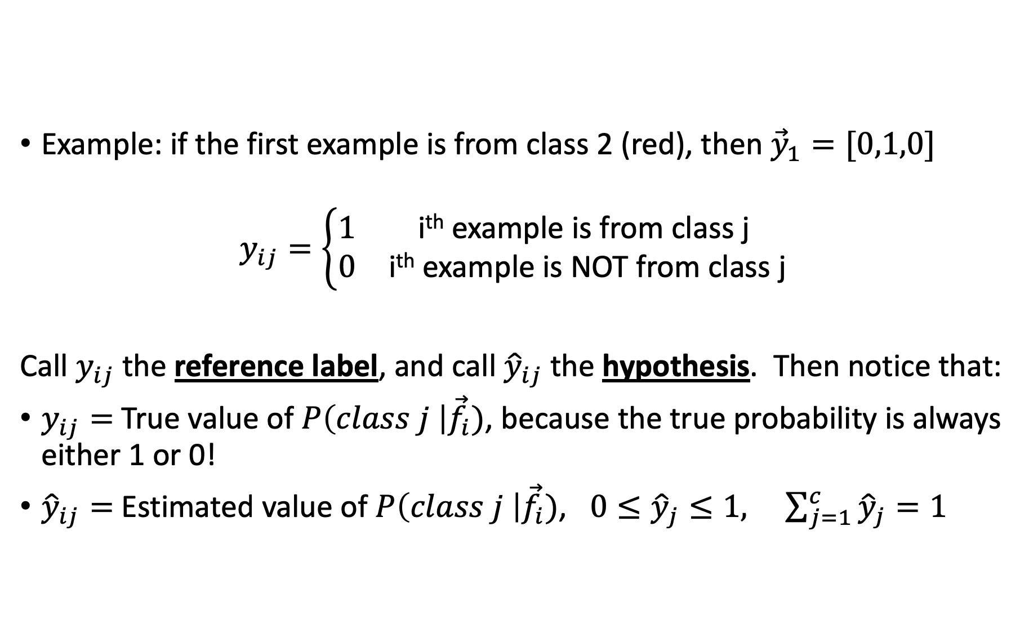
One-Hot Vector
Example: if the first example is from class 2 (red), then ${\vec{y}}_{1}=[0,1,0]$
$$y_{ij}=\left\{\begin{matrix}1 & \text{i}\text{th} \text{example} \text{is} \text{from} \text{class} \text{j} \\ 0 & \text{i}\text{th} \text{example} \text{is} \text{NOT} \text{from} \text{class} \text{j}\end{matrix}\right.$$
Call $y_{ij}$ the reference label, and call ${\hat{y}}_{ij}$ the hypothesis. Then notice that:
$y_{ij}=$ True value of $P\left(class j \right|{\vec{f}}_{i})$, because the true probability is always either 1 or 0!
${\hat{y}}_{ij}=$ Estimated value of $P\left(class j \right|{\vec{f}}_{i})$, $0≤{\hat{y}}_{j}≤1, \sum_{j=1}^{c}{{\hat{y}}_{j}}=1$

Slide 20
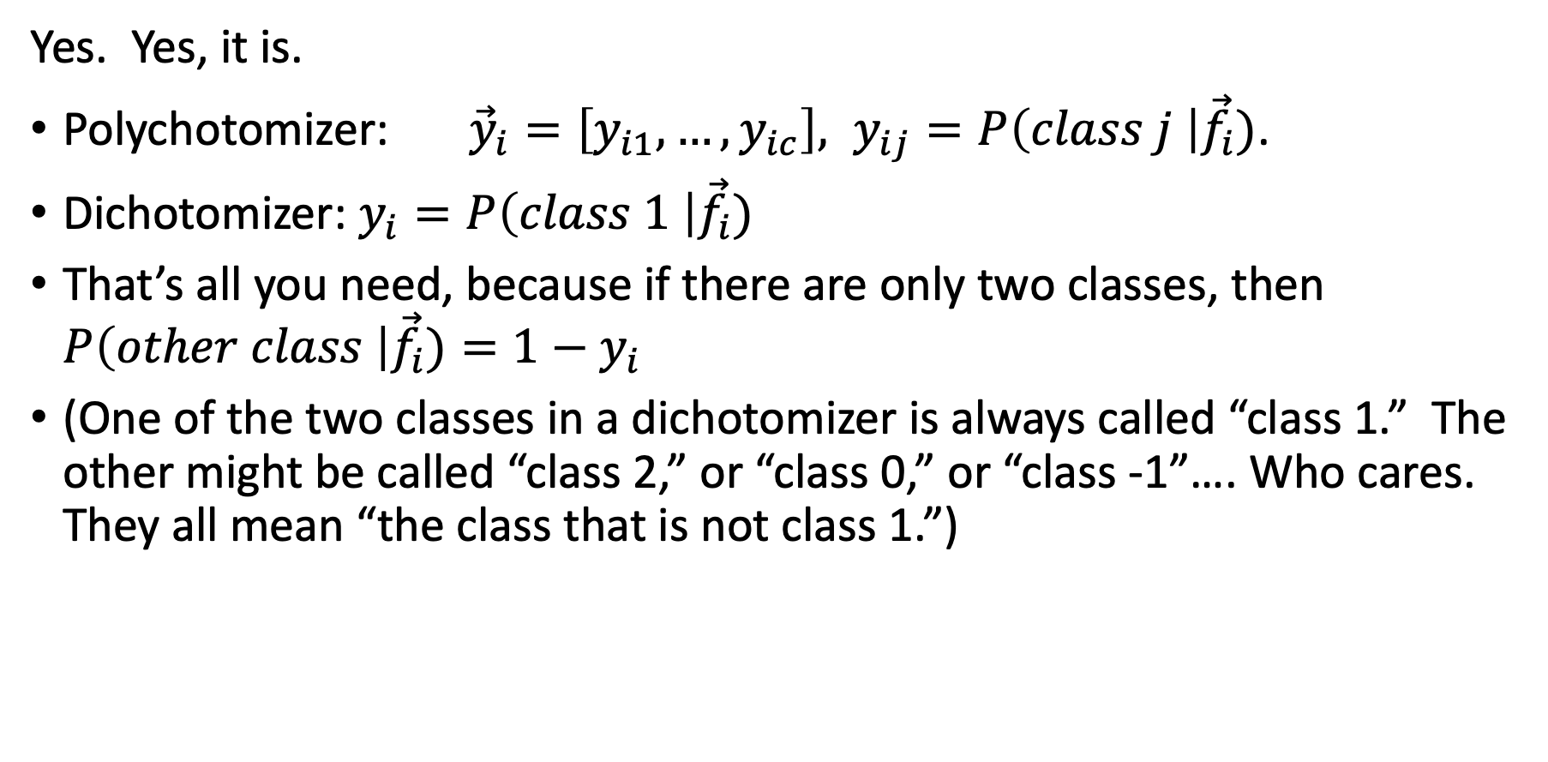
Wait. Dichotomizer is just a Special Case of Polychotomizer, isn’t it?
Yes. Yes, it is.
Polychotomizer: ${\vec{y}}_{i}=\left[y_{i1},…,y_{ic}\right], y_{ij}=P\left(class j \right|{\vec{f}}_{i})$.
Dichotomizer: $y_{i}=P\left(class 1 \right|{\vec{f}}_{i})$
That’s all you need, because if there are only two classes, then $P\left(other class \right|{\vec{f}}_{i})=1−y_{i}$
(One of the two classes in a dichotomizer is always called “class 1.” The other might be called “class 2,” or “class 0,” or “class -1”…. Who cares. They all mean “the class that is not class 1.”)

Slide 21
Outline
Dichotomizers and Polychotomizers
Dichotomizer: what it is; how to train it
Polychotomizer: what it is; how to train it
One-Hot Vectors: Training targets for the polychotomizer
Softmax Function
A differentiable approximate argmax
How to differentiate the softmax
Cross-Entropy
Cross-entropy = negative log probability of training labels
Derivative of cross-entropy w.r.t. network weights
Putting it all together: a one-layer softmax neural net

Slide 22
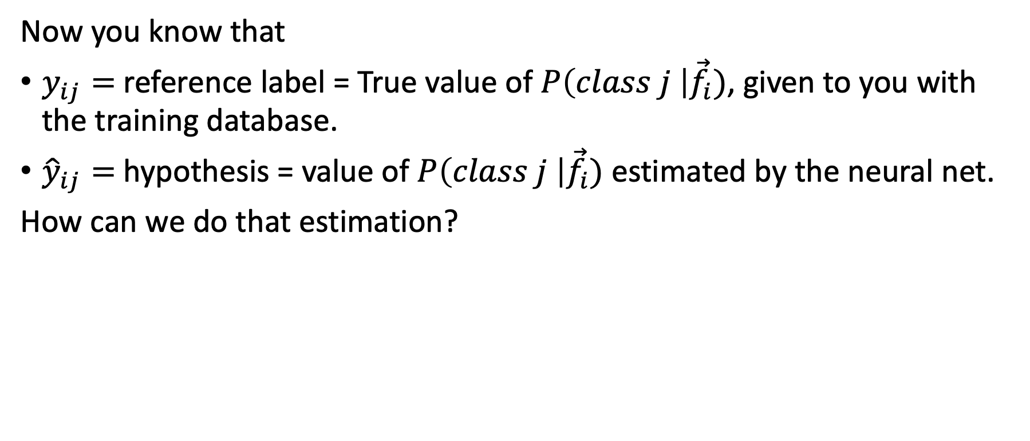
OK, now we know what the polychotomizer should compute. How do we compute it?
Now you know that
$y_{ij}=$ reference label = True value of $P\left(class j \right|{\vec{f}}_{i})$, given to you with the training database.
${\hat{y}}_{ij}=$ hypothesis = value of $P\left(class j \right|{\vec{f}}_{i})$ estimated by the neural net.
How can we do that estimation?

Slide 23
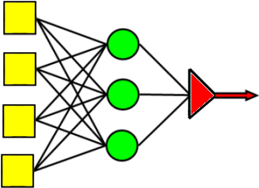
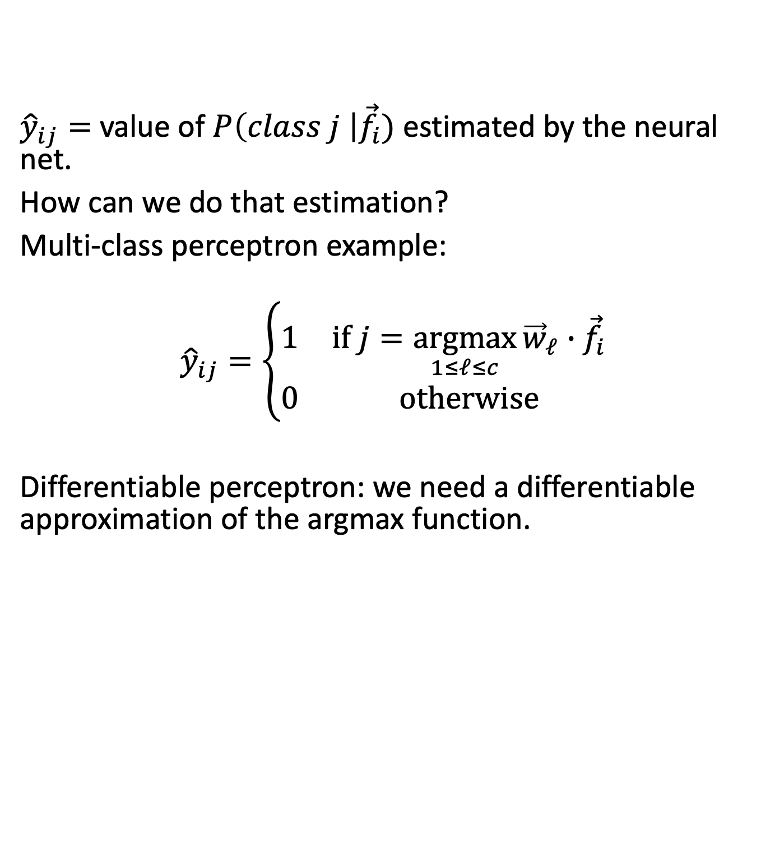
OK, now we know what the polychotomizer should compute. How do we compute it?
${\hat{y}}_{ij}=$ value of $P\left(class j \right|{\vec{f}}_{i})$ estimated by the neural net.
How can we do that estimation?
Multi-class perceptron example:
$${\hat{y}}_{ij}=\left\{\begin{matrix}1 & if j=\underset{1≤ℓ≤c}{argmax}{{\vec{w}}_{ℓ}∙{\vec{f}}_{i}} \\ 0 & otherwise\end{matrix}\right.$$
Differentiable perceptron: we need a differentiable approximation of the argmax function.
Max
Perceptrons w/ weights w_{c}
Inputs

Slide 24
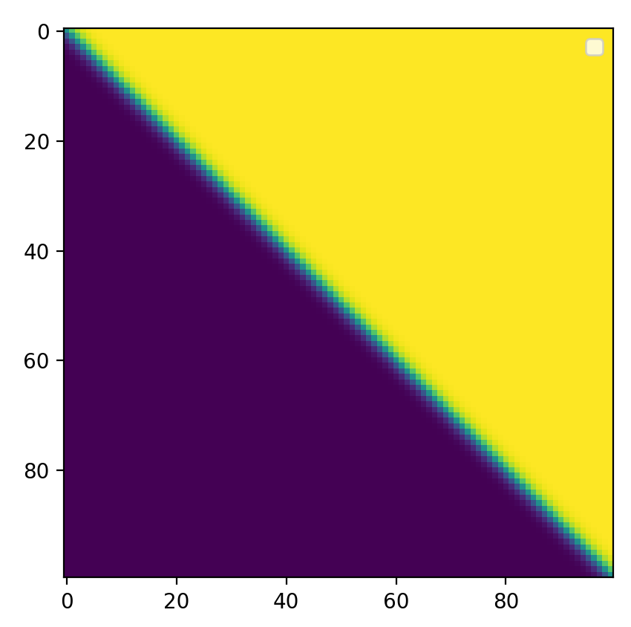
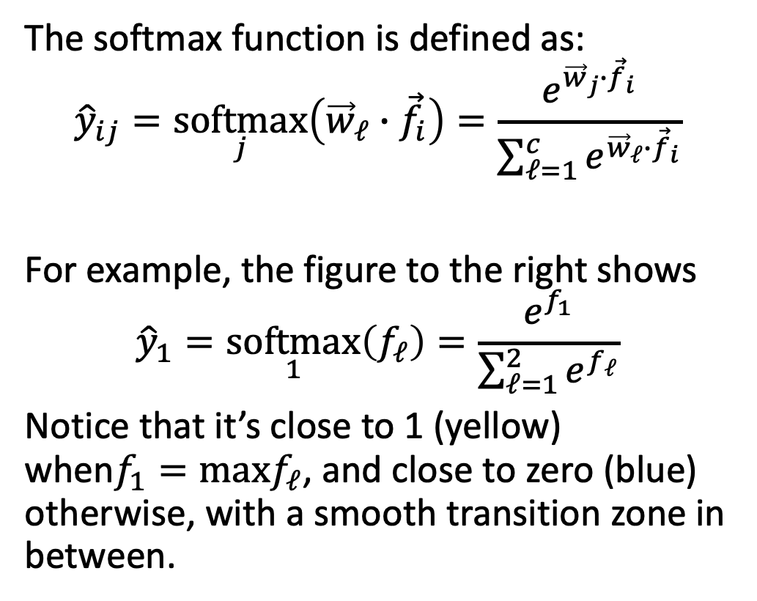
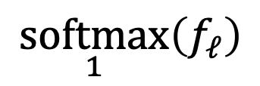
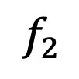

Softmax = differentiable approximation of the argmax function
$$\underset{1}{softmax}\left(f_{ℓ}\right)$$
The softmax function is defined as:
$${\hat{y}}_{ij}=\underset{j}{softmax}\left({\vec{w}}_{ℓ}∙{\vec{f}}_{i}\right)=\frac{e^{{\vec{w}}_{j}∙{\vec{f}}_{i}}}{\sum_{ℓ=1}^{c}{e^{{\vec{w}}_{ℓ}∙{\vec{f}}_{i}}}}$$
For example, the figure to the right shows
$${\hat{y}}_{1}=\underset{1}{softmax}\left(f_{ℓ}\right)=\frac{e^{f_{1}}}{\sum_{ℓ=1}^{2}{e^{f_{ℓ}}}}$$
Notice that it’s close to 1 (yellow) when$f_{1}=maxf_{ℓ}$, and close to zero (blue) otherwise, with a smooth transition zone in between.
$$f_{2}$$
$$f_{1}$$

Slide 25

Softmax = differentiable approximation of the argmax function
$$\underset{1}{softmax}\left(f_{ℓ}\right)$$
The softmax function is defined as:
$${\hat{y}}_{ij}=\underset{j}{softmax}\left({\vec{w}}_{ℓ}∙{\vec{f}}_{i}\right)=\frac{e^{{\vec{w}}_{j}∙{\vec{f}}_{i}}}{\sum_{ℓ=1}^{c}{e^{{\vec{w}}_{ℓ}∙{\vec{f}}_{i}}}}$$
Notice that this gives us
$$0≤{\hat{y}}_{ij}≤1, \sum_{j=1}^{c}{{\hat{y}}_{ij}}=1$$
Therefore we can interpret ${\hat{y}}_{ij}$ as an estimate of $P\left(class j \right|{\vec{f}}_{i})$.
$$f_{2}$$
$$f_{1}$$

Slide 26
Outline
Dichotomizers and Polychotomizers
Dichotomizer: what it is; how to train it
Polychotomizer: what it is; how to train it
One-Hot Vectors: Training targets for the polychotomizer
Softmax Function
A differentiable approximate argmax
How to differentiate the softmax
Cross-Entropy
Cross-entropy = negative log probability of training labels
Derivative of cross-entropy w.r.t. network weights
Putting it all together: a one-layer softmax neural net

Slide 27
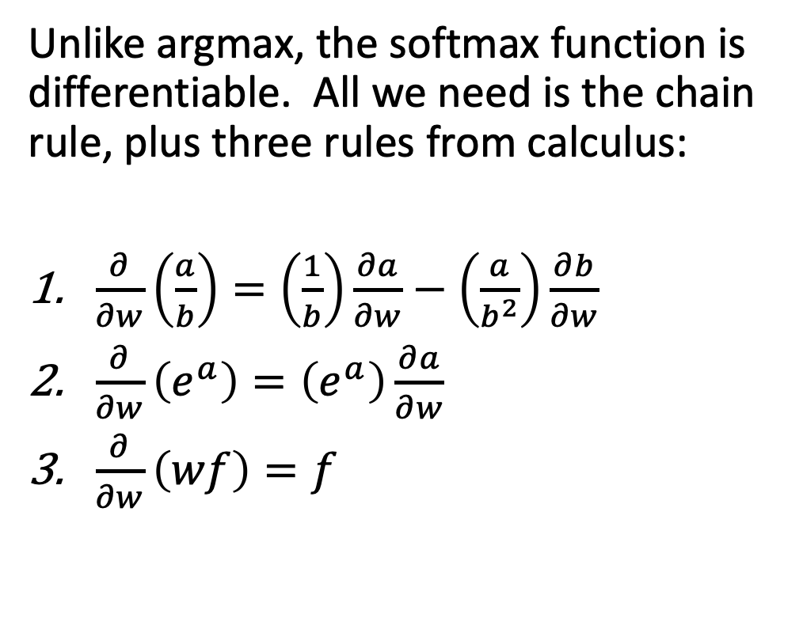
How to differentiate the softmax: 3 steps
$$\underset{1}{softmax}\left(f_{ℓ}\right)$$
Unlike argmax, the softmax function is differentiable. All we need is the chain rule, plus three rules from calculus:
$\frac{∂}{∂w}\left(\frac{a}{b}\right)=\left(\frac{1}{b}\right)\frac{∂a}{∂w}−\left(\frac{a}{b^{2}}\right)\frac{∂b}{∂w}$
$\frac{∂}{∂w}\left(e^{a}\right)=\left(e^{a}\right)\frac{∂a}{∂w}$
$\frac{∂}{∂w}\left(wf\right)=f$
$$f_{2}$$
$$f_{1}$$

Slide 28
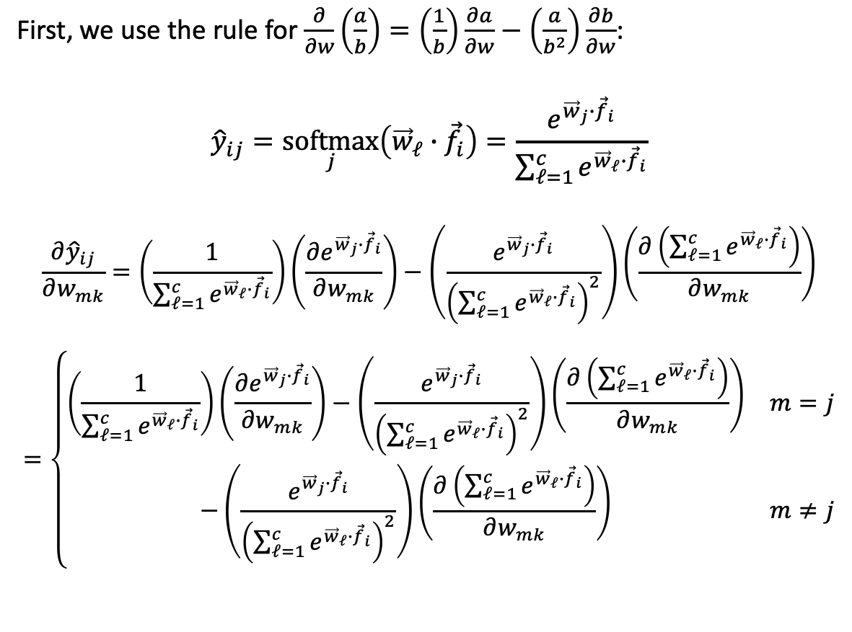
How to differentiate the softmax: step 1
$$\underset{1}{softmax}\left(f_{ℓ}\right)$$
First, we use the rule for $\frac{∂}{∂w}\left(\frac{a}{b}\right)=\left(\frac{1}{b}\right)\frac{∂a}{∂w}−\left(\frac{a}{b^{2}}\right)\frac{∂b}{∂w}$:
$${\hat{y}}_{ij}=\underset{j}{softmax}\left({\vec{w}}_{ℓ}∙{\vec{f}}_{i}\right)=\frac{e^{{\vec{w}}_{j}∙{\vec{f}}_{i}}}{\sum_{ℓ=1}^{c}{e^{{\vec{w}}_{ℓ}∙{\vec{f}}_{i}}}}$$
$$\frac{∂{\hat{y}}_{ij}}{∂w_{mk}}=\left(\frac{1}{\sum_{ℓ=1}^{c}{e^{{\vec{w}}_{ℓ}∙{\vec{f}}_{i}}}}\right)\left(\frac{∂e^{{\vec{w}}_{j}∙{\vec{f}}_{i}}}{∂w_{mk}}\right)−\left(\frac{e^{{\vec{w}}_{j}∙{\vec{f}}_{i}}}{{\left(\sum_{ℓ=1}^{c}{e^{{\vec{w}}_{ℓ}∙{\vec{f}}_{i}}}\right)}^{2}}\right)\left(\frac{∂\left(\sum_{ℓ=1}^{c}{e^{{\vec{w}}_{ℓ}∙{\vec{f}}_{i}}}\right)}{∂w_{mk}}\right)$$
$$=\left\{\begin{matrix}\left(\frac{1}{\sum_{ℓ=1}^{c}{e^{{\vec{w}}_{ℓ}∙{\vec{f}}_{i}}}}\right)\left(\frac{∂e^{{\vec{w}}_{j}∙{\vec{f}}_{i}}}{∂w_{mk}}\right)−\left(\frac{e^{{\vec{w}}_{j}∙{\vec{f}}_{i}}}{{\left(\sum_{ℓ=1}^{c}{e^{{\vec{w}}_{ℓ}∙{\vec{f}}_{i}}}\right)}^{2}}\right)\left(\frac{∂\left(\sum_{ℓ=1}^{c}{e^{{\vec{w}}_{ℓ}∙{\vec{f}}_{i}}}\right)}{∂w_{mk}}\right) & m=j \\ −\left(\frac{e^{{\vec{w}}_{j}∙{\vec{f}}_{i}}}{{\left(\sum_{ℓ=1}^{c}{e^{{\vec{w}}_{ℓ}∙{\vec{f}}_{i}}}\right)}^{2}}\right)\left(\frac{∂\left(\sum_{ℓ=1}^{c}{e^{{\vec{w}}_{ℓ}∙{\vec{f}}_{i}}}\right)}{∂w_{mk}}\right) & m≠j\end{matrix}\right.$$
$$f_{2}$$
$$f_{1}$$

Slide 29
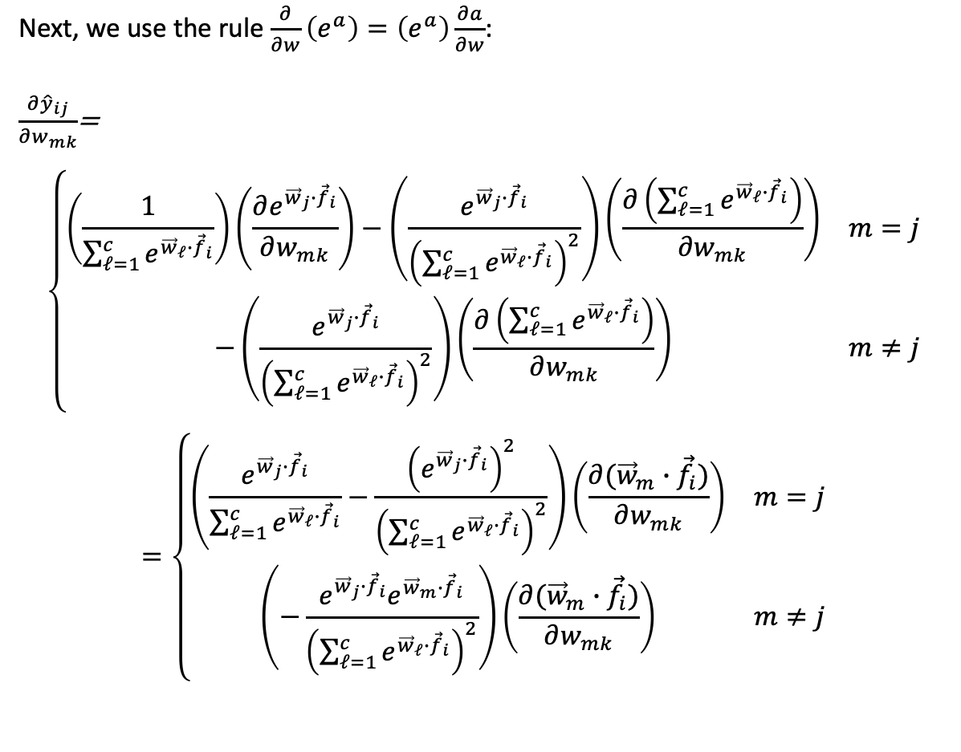
How to differentiate the softmax: step 2
$$\underset{1}{softmax}\left(f_{ℓ}\right)$$
Next, we use the rule $\frac{∂}{∂w}\left(e^{a}\right)=\left(e^{a}\right)\frac{∂a}{∂w}$:
$\frac{∂{\hat{y}}_{ij}}{∂w_{mk}}$=
$$\left\{\begin{matrix}\left(\frac{1}{\sum_{ℓ=1}^{c}{e^{{\vec{w}}_{ℓ}∙{\vec{f}}_{i}}}}\right)\left(\frac{∂e^{{\vec{w}}_{j}∙{\vec{f}}_{i}}}{∂w_{mk}}\right)−\left(\frac{e^{{\vec{w}}_{j}∙{\vec{f}}_{i}}}{{\left(\sum_{ℓ=1}^{c}{e^{{\vec{w}}_{ℓ}∙{\vec{f}}_{i}}}\right)}^{2}}\right)\left(\frac{∂\left(\sum_{ℓ=1}^{c}{e^{{\vec{w}}_{ℓ}∙{\vec{f}}_{i}}}\right)}{∂w_{mk}}\right) & m=j \\ −\left(\frac{e^{{\vec{w}}_{j}∙{\vec{f}}_{i}}}{{\left(\sum_{ℓ=1}^{c}{e^{{\vec{w}}_{ℓ}∙{\vec{f}}_{i}}}\right)}^{2}}\right)\left(\frac{∂\left(\sum_{ℓ=1}^{c}{e^{{\vec{w}}_{ℓ}∙{\vec{f}}_{i}}}\right)}{∂w_{mk}}\right) & m≠j\end{matrix}\right.$$
$$=\left\{\begin{matrix}\left(\frac{e^{{\vec{w}}_{j}∙{\vec{f}}_{i}}}{\sum_{ℓ=1}^{c}{e^{{\vec{w}}_{ℓ}∙{\vec{f}}_{i}}}}−\frac{{\left(e^{{\vec{w}}_{j}∙{\vec{f}}_{i}}\right)}^{2}}{{\left(\sum_{ℓ=1}^{c}{e^{{\vec{w}}_{ℓ}∙{\vec{f}}_{i}}}\right)}^{2}}\right)\left(\frac{∂({\vec{w}}_{m}∙{\vec{f}}_{i})}{∂w_{mk}}\right) & m=j \\ \left(−\frac{e^{{\vec{w}}_{j}∙{\vec{f}}_{i}}e^{{\vec{w}}_{m}∙{\vec{f}}_{i}}}{{\left(\sum_{ℓ=1}^{c}{e^{{\vec{w}}_{ℓ}∙{\vec{f}}_{i}}}\right)}^{2}}\right)\left(\frac{∂({\vec{w}}_{m}∙{\vec{f}}_{i})}{∂w_{mk}}\right) & m≠j\end{matrix}\right.$$
$$f_{2}$$
$$f_{1}$$

Slide 30
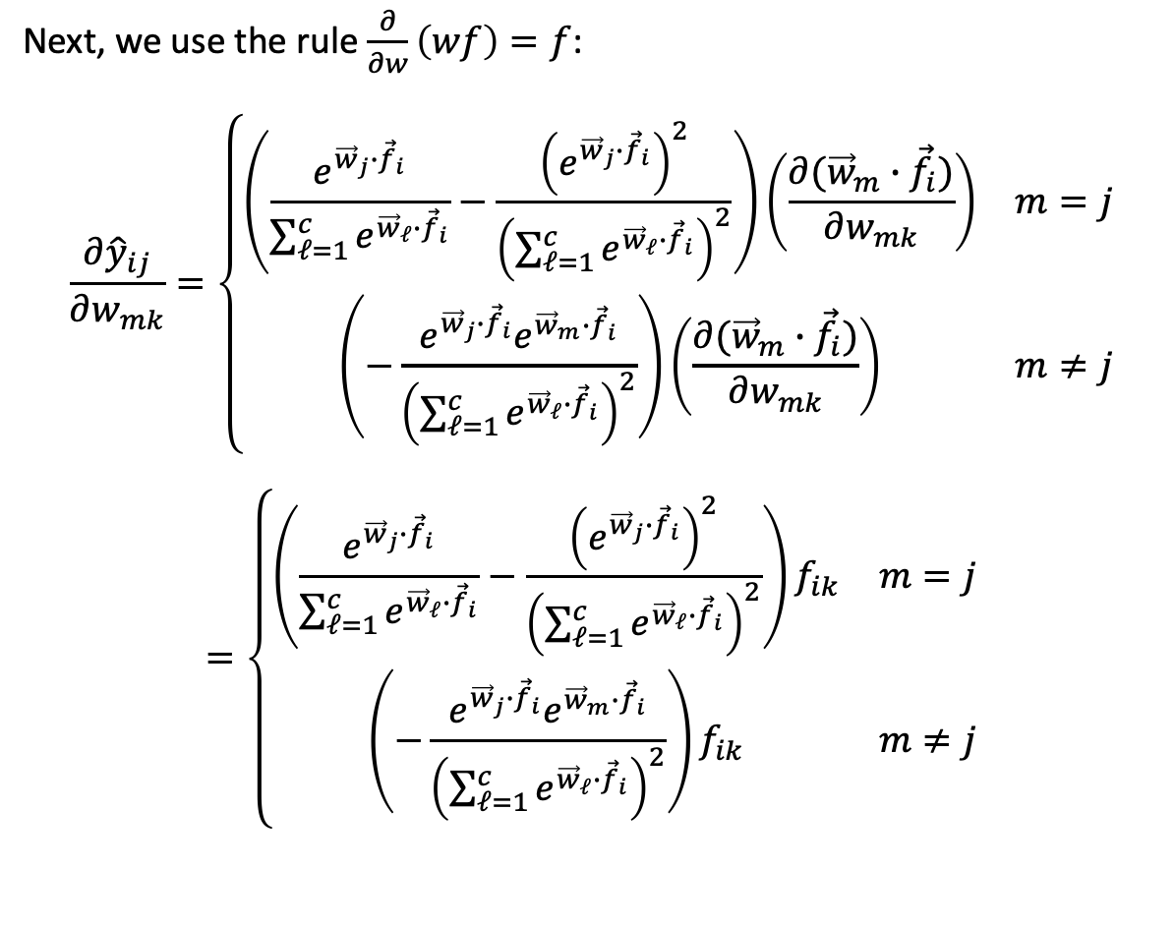
How to differentiate the softmax: step 3
$$\underset{1}{softmax}\left(f_{ℓ}\right)$$
Next, we use the rule $\frac{∂}{∂w}\left(wf\right)=f$:
$$\frac{∂{\hat{y}}_{ij}}{∂w_{mk}}=\left\{\begin{matrix}\left(\frac{e^{{\vec{w}}_{j}∙{\vec{f}}_{i}}}{\sum_{ℓ=1}^{c}{e^{{\vec{w}}_{ℓ}∙{\vec{f}}_{i}}}}−\frac{{\left(e^{{\vec{w}}_{j}∙{\vec{f}}_{i}}\right)}^{2}}{{\left(\sum_{ℓ=1}^{c}{e^{{\vec{w}}_{ℓ}∙{\vec{f}}_{i}}}\right)}^{2}}\right)\left(\frac{∂({\vec{w}}_{m}∙{\vec{f}}_{i})}{∂w_{mk}}\right) & m=j \\ \left(−\frac{e^{{\vec{w}}_{j}∙{\vec{f}}_{i}}e^{{\vec{w}}_{m}∙{\vec{f}}_{i}}}{{\left(\sum_{ℓ=1}^{c}{e^{{\vec{w}}_{ℓ}∙{\vec{f}}_{i}}}\right)}^{2}}\right)\left(\frac{∂({\vec{w}}_{m}∙{\vec{f}}_{i})}{∂w_{mk}}\right) & m≠j\end{matrix}\right.$$
$$=\left\{\begin{matrix}\left(\frac{e^{{\vec{w}}_{j}∙{\vec{f}}_{i}}}{\sum_{ℓ=1}^{c}{e^{{\vec{w}}_{ℓ}∙{\vec{f}}_{i}}}}−\frac{{\left(e^{{\vec{w}}_{j}∙{\vec{f}}_{i}}\right)}^{2}}{{\left(\sum_{ℓ=1}^{c}{e^{{\vec{w}}_{ℓ}∙{\vec{f}}_{i}}}\right)}^{2}}\right)f_{ik} & m=j \\ \left(−\frac{e^{{\vec{w}}_{j}∙{\vec{f}}_{i}}e^{{\vec{w}}_{m}∙{\vec{f}}_{i}}}{{\left(\sum_{ℓ=1}^{c}{e^{{\vec{w}}_{ℓ}∙{\vec{f}}_{i}}}\right)}^{2}}\right)f_{ik} & m≠j\end{matrix}\right.$$
$$f_{2}$$
$$f_{1}$$

Slide 31
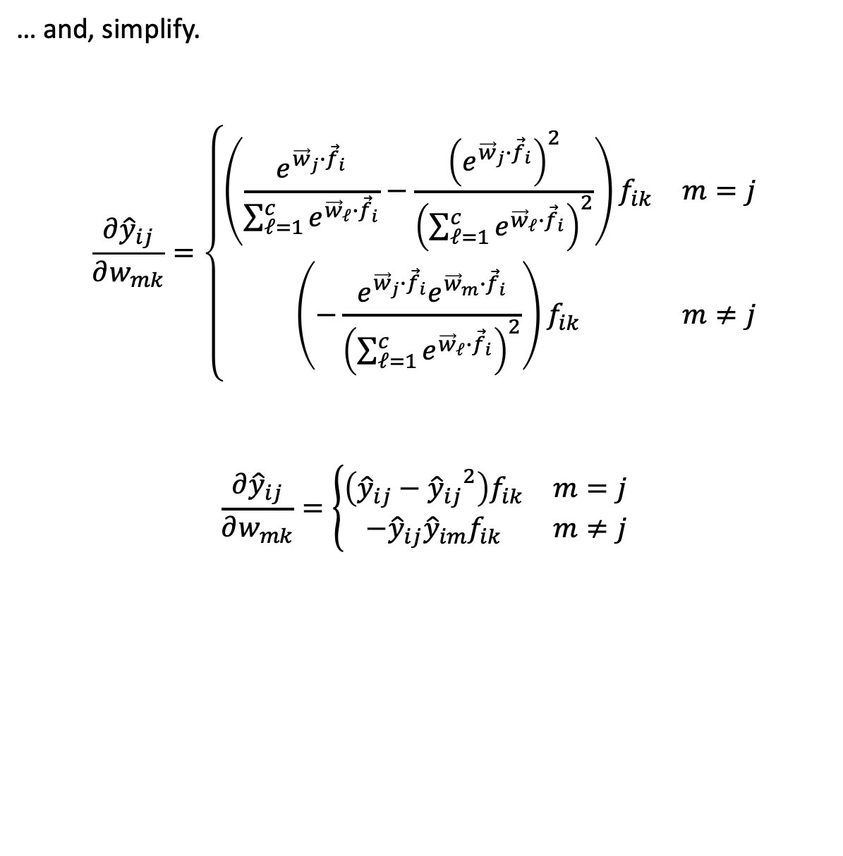
Differentiating the softmax
$$\underset{1}{softmax}\left(f_{ℓ}\right)$$
… and, simplify.
$$\frac{∂{\hat{y}}_{ij}}{∂w_{mk}}=\left\{\begin{matrix}\left(\frac{e^{{\vec{w}}_{j}∙{\vec{f}}_{i}}}{\sum_{ℓ=1}^{c}{e^{{\vec{w}}_{ℓ}∙{\vec{f}}_{i}}}}−\frac{{\left(e^{{\vec{w}}_{j}∙{\vec{f}}_{i}}\right)}^{2}}{{\left(\sum_{ℓ=1}^{c}{e^{{\vec{w}}_{ℓ}∙{\vec{f}}_{i}}}\right)}^{2}}\right)f_{ik} & m=j \\ \left(−\frac{e^{{\vec{w}}_{j}∙{\vec{f}}_{i}}e^{{\vec{w}}_{m}∙{\vec{f}}_{i}}}{{\left(\sum_{ℓ=1}^{c}{e^{{\vec{w}}_{ℓ}∙{\vec{f}}_{i}}}\right)}^{2}}\right)f_{ik} & m≠j\end{matrix}\right.$$
$$\frac{∂{\hat{y}}_{ij}}{∂w_{mk}}=\left\{\begin{matrix}\left({\hat{y}}_{ij}−{{\hat{y}}_{ij}}^{2}\right)f_{ik} & m=j \\ −{\hat{y}}_{ij}{\hat{y}}_{im}f_{ik} & m≠j\end{matrix}\right.$$
$$f_{2}$$
$$f_{1}$$

Slide 32
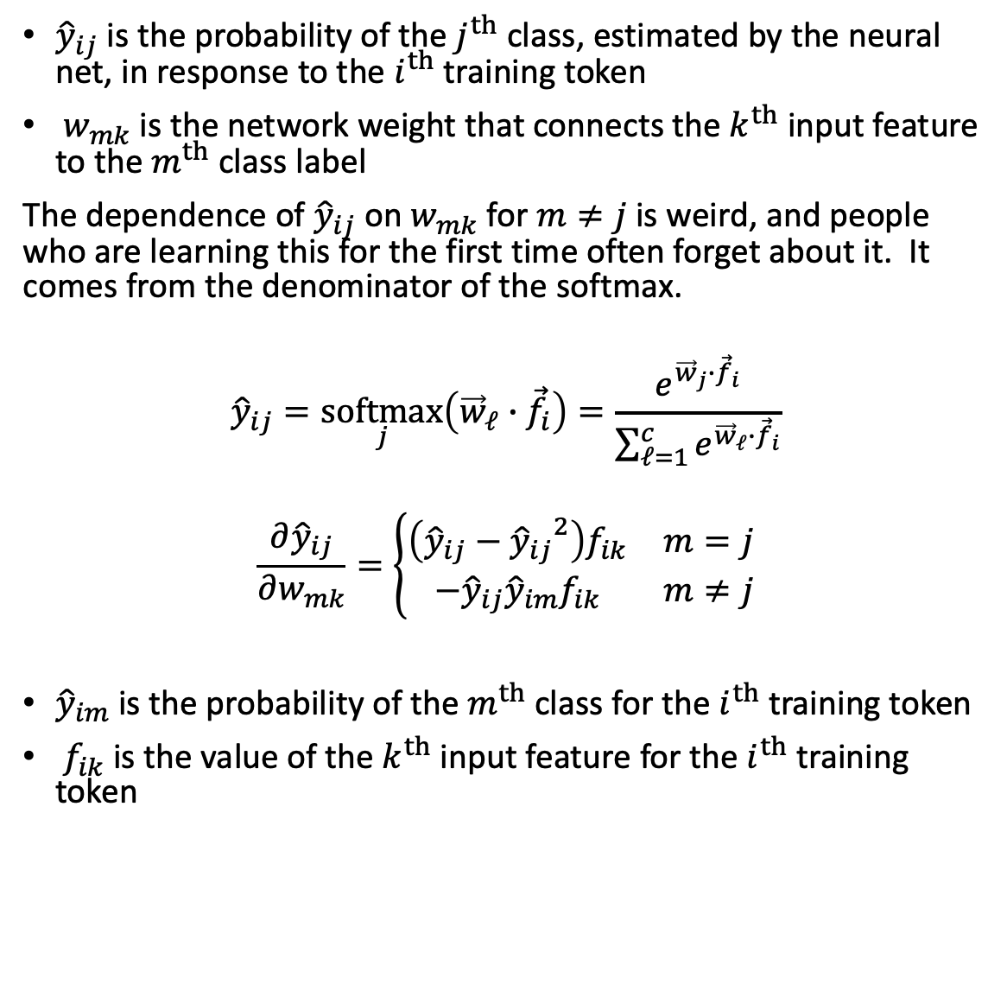
Recap: how to differentiate the softmax
${\hat{y}}_{ij}$ is the probability of the $j^{th}$ class, estimated by the neural net, in response to the $i^{th}$ training token
$w_{mk}$ is the network weight that connects the $k^{th}$ input feature to the $m^{th}$ class label
The dependence of ${\hat{y}}_{ij}$ on $w_{mk}$ for $m≠j$is weird, and people who are learning this for the first time often forget about it. It comes from the denominator of the softmax.
$${\hat{y}}_{ij}=\underset{j}{softmax}\left({\vec{w}}_{ℓ}∙{\vec{f}}_{i}\right)=\frac{e^{{\vec{w}}_{j}∙{\vec{f}}_{i}}}{\sum_{ℓ=1}^{c}{e^{{\vec{w}}_{ℓ}∙{\vec{f}}_{i}}}}$$
$$\frac{∂{\hat{y}}_{ij}}{∂w_{mk}}=\left\{\begin{matrix}\left({\hat{y}}_{ij}−{{\hat{y}}_{ij}}^{2}\right)f_{ik} & m=j \\ −{\hat{y}}_{ij}{\hat{y}}_{im}f_{ik} & m≠j\end{matrix}\right.$$
${\hat{y}}_{im}$ is the probability of the $m^{th}$ class for the $i^{th}$ training token
$f_{ik}$ is the value of the $k^{th}$ input feature for the $i^{th}$ training token
$$\underset{1}{softmax}\left(f_{ℓ}\right)$$
$$f_{2}$$
$$f_{1}$$

Slide 33
Outline
Dichotomizers and Polychotomizers
Dichotomizer: what it is; how to train it
Polychotomizer: what it is; how to train it
One-Hot Vectors: Training targets for the polychotomizer
Softmax Function: A differentiable approximate argmax
Cross-Entropy
Cross-entropy = negative log probability of training labels
Derivative of cross-entropy w.r.t. network weights
Putting it all together: a one-layer softmax neural net

Slide 34
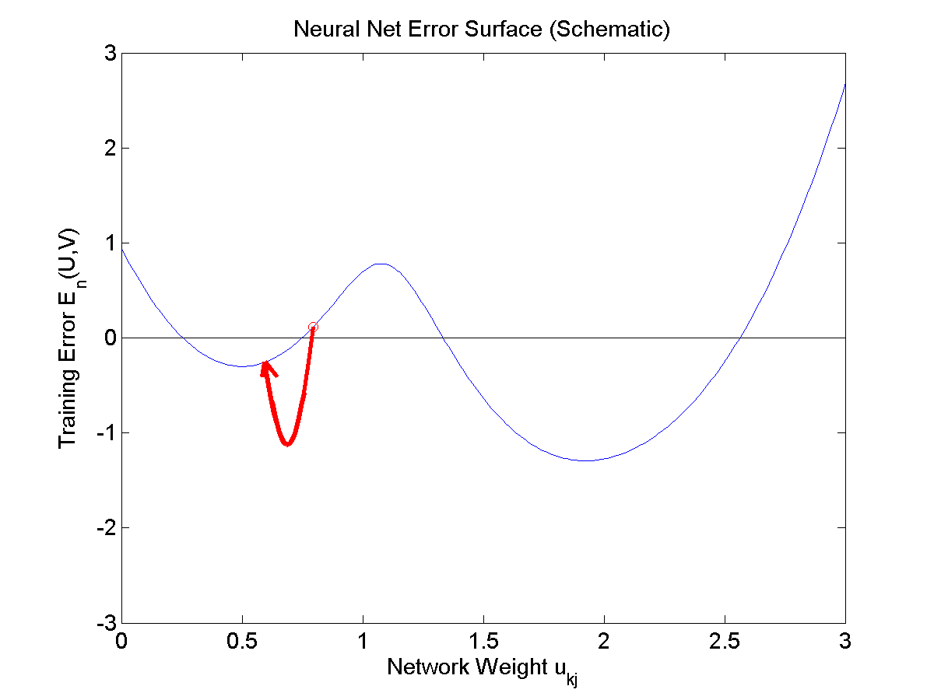
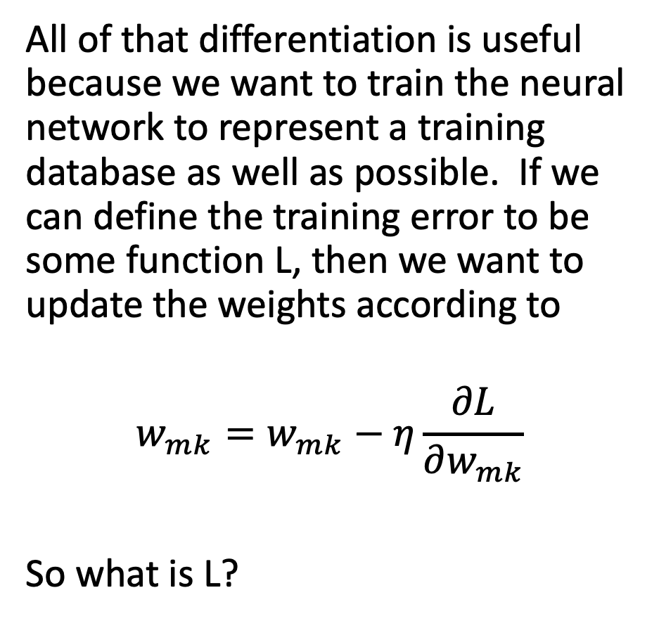
Training a Softmax Neural Network
All of that differentiation is useful because we want to train the neural network to represent a training database as well as possible. If we can define the training error to be some function L, then we want to update the weights according to
$$w_{mk}=w_{mk}−η\frac{∂L}{∂w_{mk}}$$
So what is L?

Slide 35
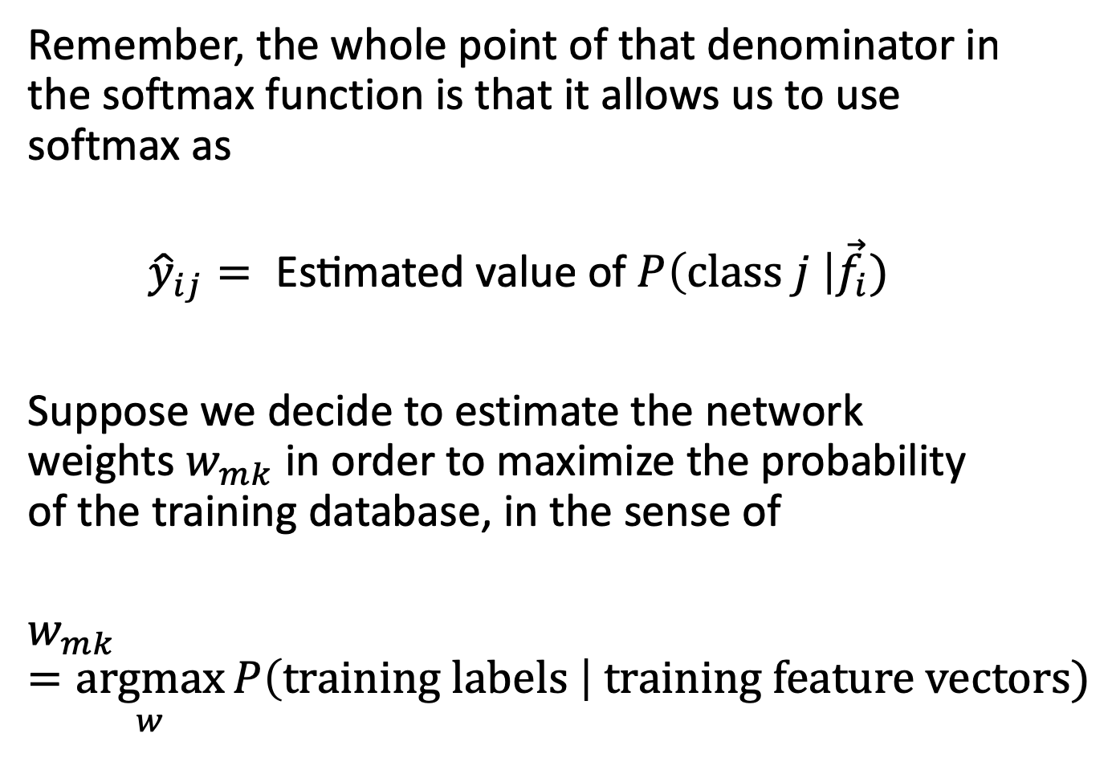
Training: Maximize the probability of the training data
Remember, the whole point of that denominator in the softmax function is that it allows us to use softmax as
$${\hat{y}}_{ij}= \text{Estimated} \text{value} \text{of} P\left(class j \right|{\vec{f}}_{i})$$
Suppose we decide to estimate the network weights $w_{mk}$ in order to maximize the probability of the training database, in the sense of
$$w_{mk}=\underset{w}{argmax}{P\left(training labels \right| training feature vectors)}$$

Slide 36
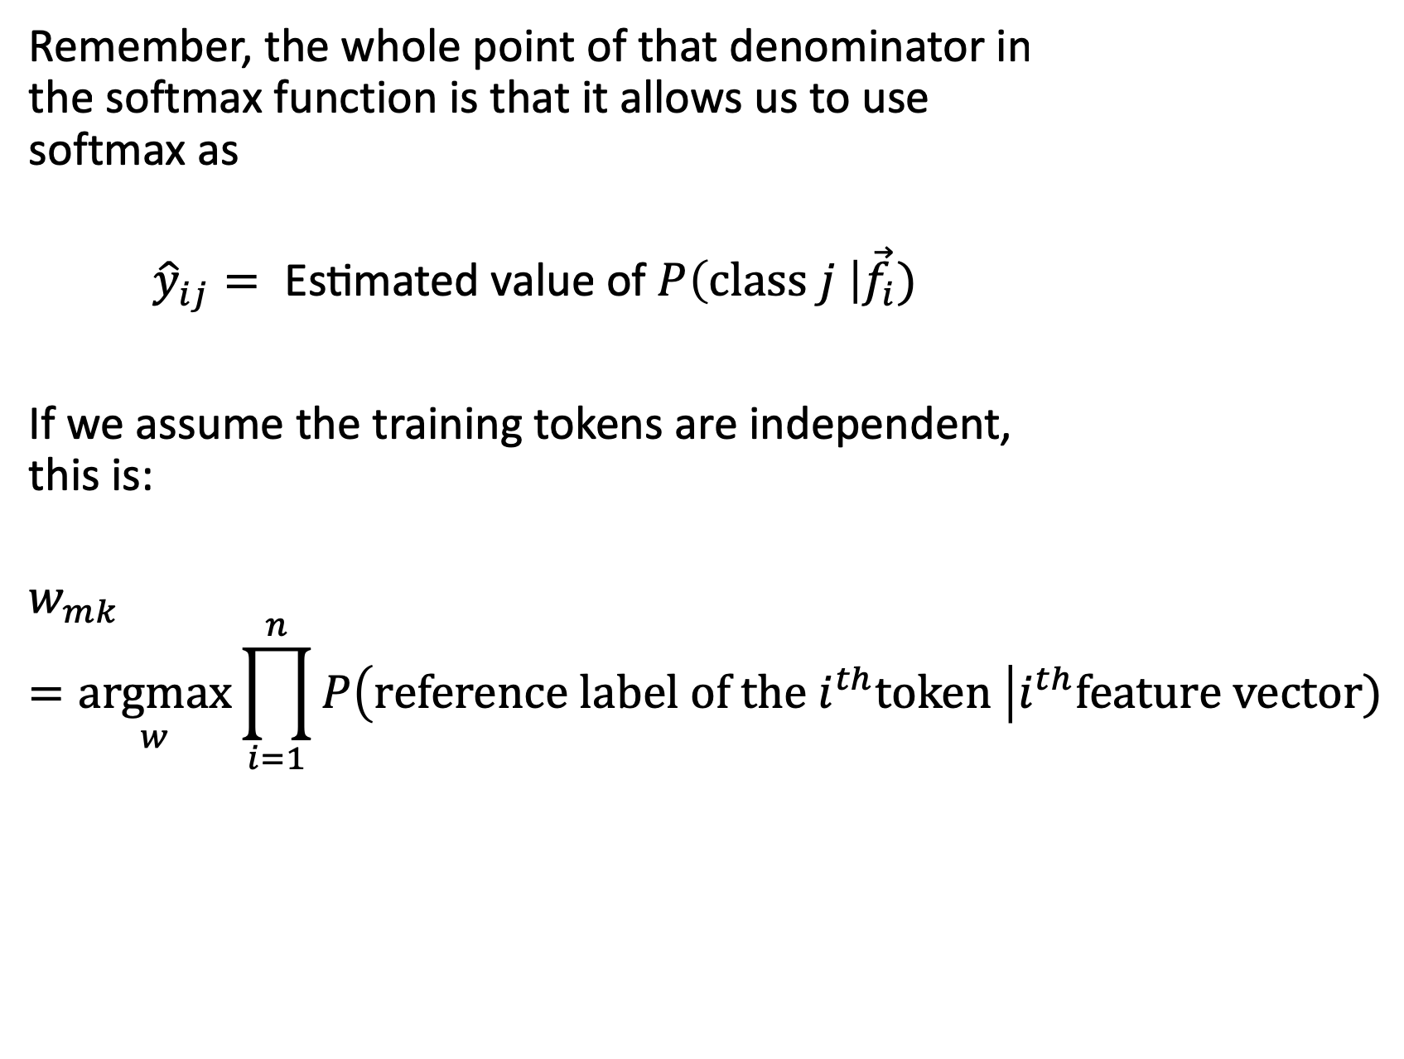
Training: Maximize the probability of the training data
Remember, the whole point of that denominator in the softmax function is that it allows us to use softmax as
$${\hat{y}}_{ij}= \text{Estimated} \text{value} \text{of} P\left(class j \right|{\vec{f}}_{i})$$
If we assume the training tokens are independent, this is:
$$w_{mk}=\underset{w}{argmax}{\prod_{i=1}^{n}{P\left(reference label of the i^{th}token \right|i^{th}feature vector)}}$$

Slide 37
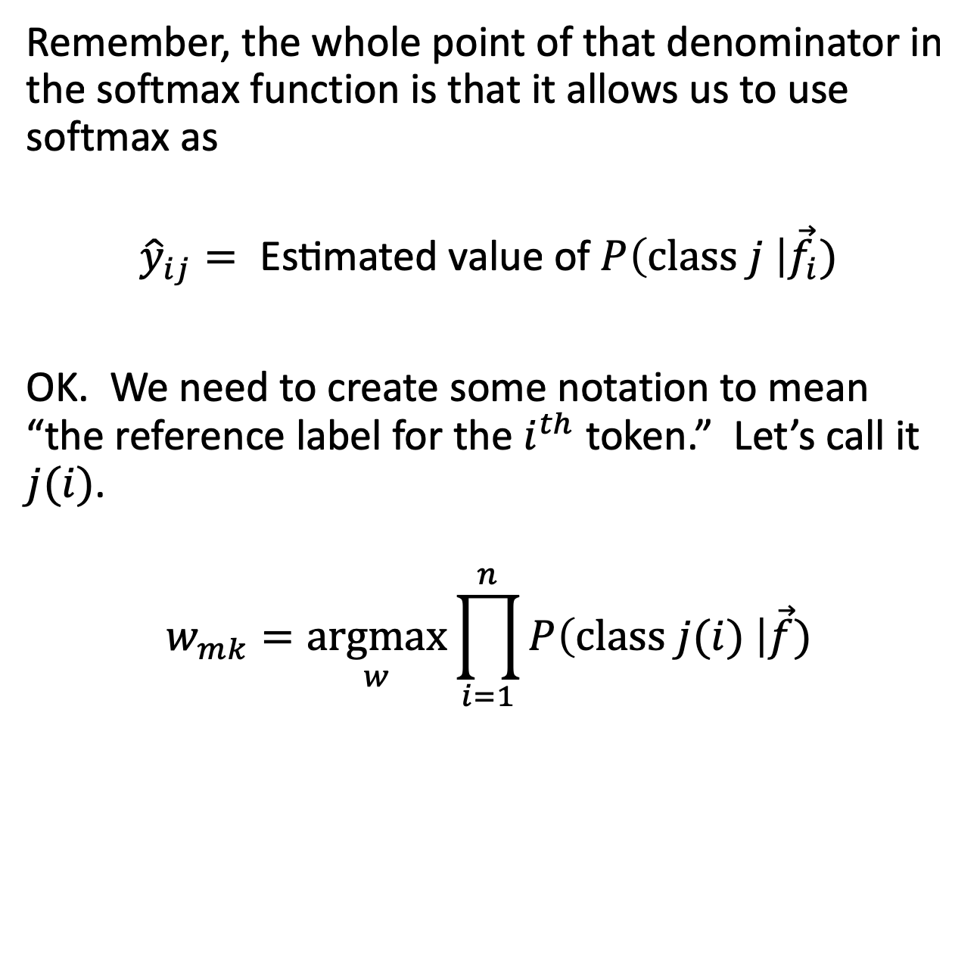
Training: Maximize the probability of the training data
Remember, the whole point of that denominator in the softmax function is that it allows us to use softmax as
$${\hat{y}}_{ij}= \text{Estimated} \text{value} \text{of} P\left(class j \right|{\vec{f}}_{i})$$
OK. We need to create some notation to mean “the reference label for the $i^{th}$ token.” Let’s call it $j(i)$.
$$w_{mk}=\underset{w}{argmax}{\prod_{i=1}^{n}{P\left(class j(i) \right|\vec{f})}}$$

Slide 38
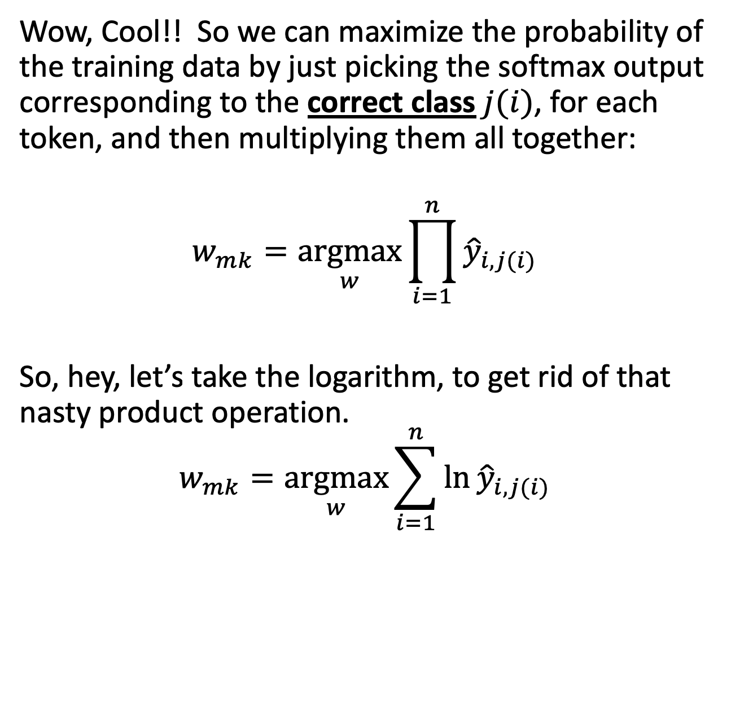
Training: Maximize the probability of the training data
Wow, Cool!! So we can maximize the probability of the training data by just picking the softmax output corresponding to the correct class $j(i)$, for each token, and then multiplying them all together:
$$w_{mk}=\underset{w}{argmax}{\prod_{i=1}^{n}{{\hat{y}}_{i,j(i)}}}$$
So, hey, let’s take the logarithm, to get rid of that nasty product operation.
$$w_{mk}=\underset{w}{argmax}{\sum_{i=1}^{n}{\ln{{\hat{y}}_{i,j(i)}}}}$$

Slide 39
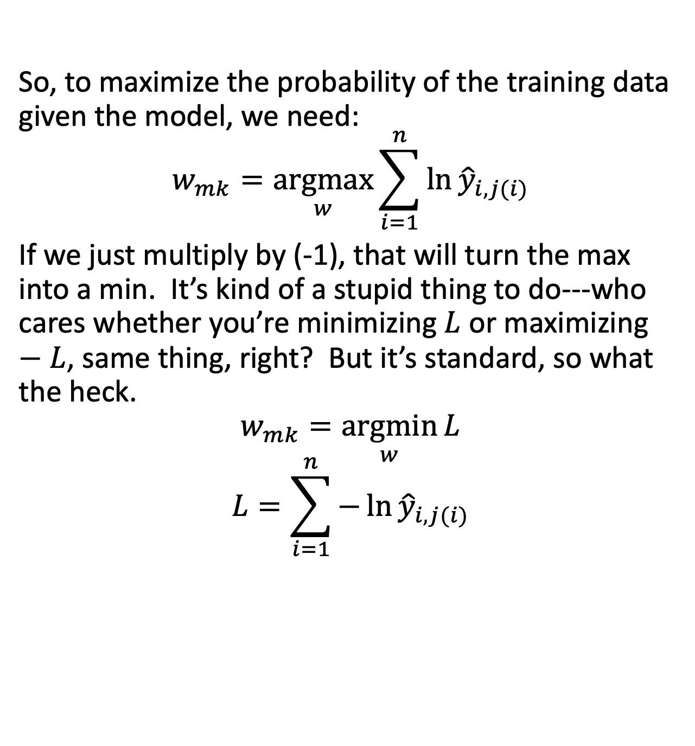
Training: Minimizing the negative log probability
So, to maximize the probability of the training data given the model, we need:
$$w_{mk}=\underset{w}{argmax}{\sum_{i=1}^{n}{\ln{{\hat{y}}_{i,j(i)}}}}$$
If we just multiply by (-1), that will turn the max into a min. It’s kind of a stupid thing to do---who cares whether you’re minimizing $L$ or maximizing $−L$, same thing, right? But it’s standard, so what the heck.
$$w_{mk}=\underset{w}{argmin}{L}$$
$$L=\sum_{i=1}^{n}{−\ln{{\hat{y}}_{i,j(i)}}}$$

Slide 40
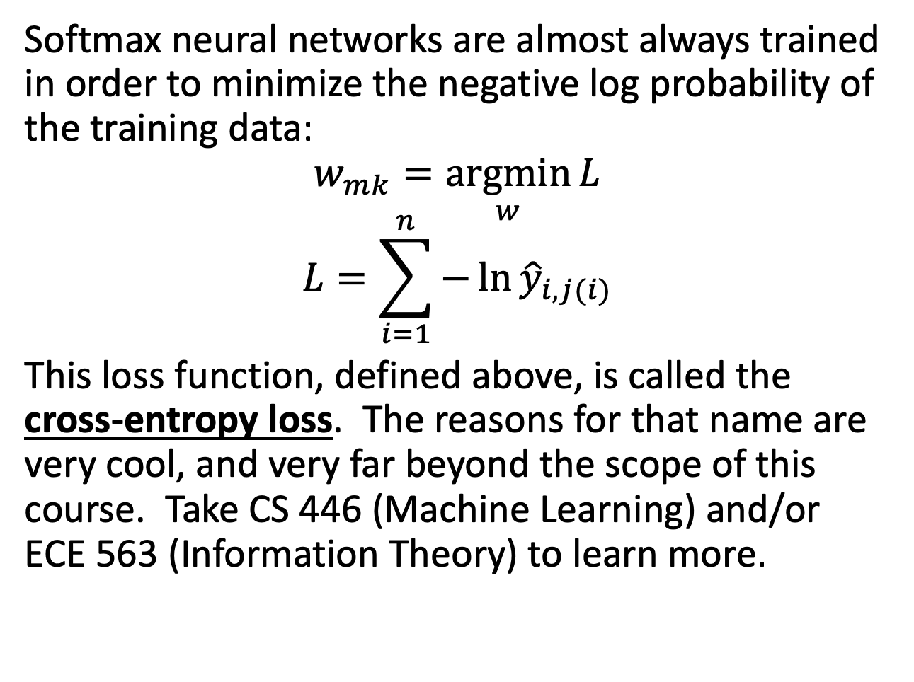
Training: Minimizing the negative log probability
Softmax neural networks are almost always trained in order to minimize the negative log probability of the training data:
$$w_{mk}=\underset{w}{argmin}{L}$$
$$L=\sum_{i=1}^{n}{−\ln{{\hat{y}}_{i,j(i)}}}$$
This loss function, defined above, is called the cross-entropy loss. The reasons for that name are very cool, and very far beyond the scope of this course. Take CS 446 (Machine Learning) and/or ECE 563 (Information Theory) to learn more.

Slide 41
Outline
Dichotomizers and Polychotomizers
Dichotomizer: what it is; how to train it
Polychotomizer: what it is; how to train it
One-Hot Vectors: Training targets for the polychotomizer
Softmax Function: A differentiable approximate argmax
Cross-Entropy
Cross-entropy = negative log probability of training labels
Derivative of cross-entropy w.r.t. network weights
Putting it all together: a one-layer softmax neural net

Slide 42
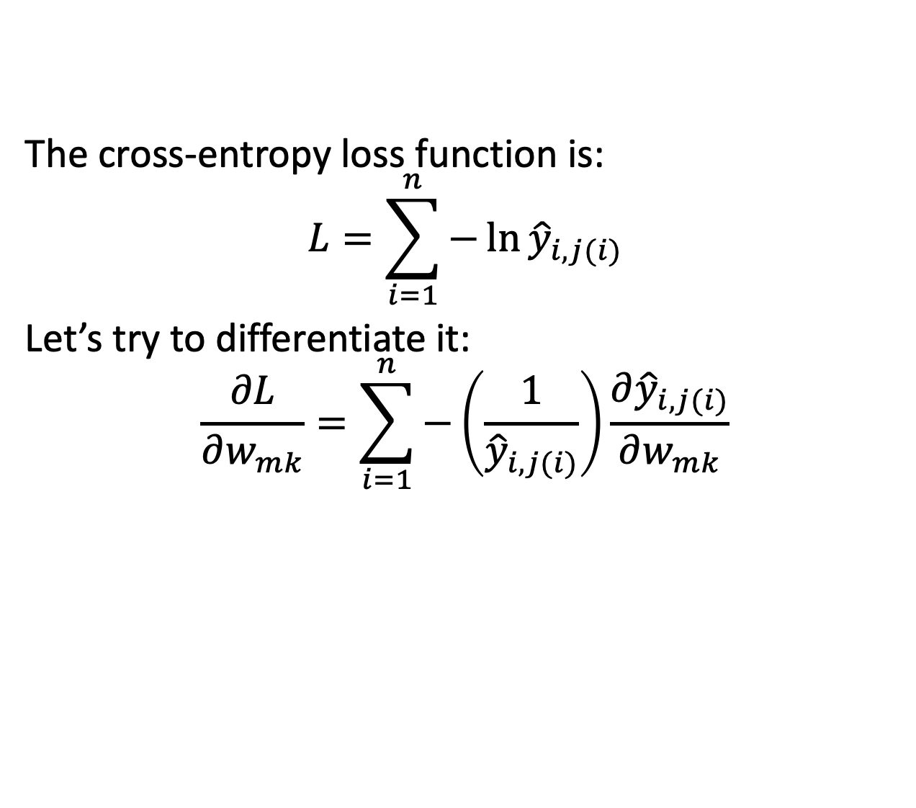
Differentiating the cross-entropy
The cross-entropy loss function is:
$$L=\sum_{i=1}^{n}{−\ln{{\hat{y}}_{i,j(i)}}}$$
Let’s try to differentiate it:
$$\frac{∂L}{∂w_{mk}}=\sum_{i=1}^{n}{−\left(\frac{1}{{\hat{y}}_{i,j(i)}}\right)\frac{∂{\hat{y}}_{i,j(i)}}{∂w_{mk}}}$$

Slide 43
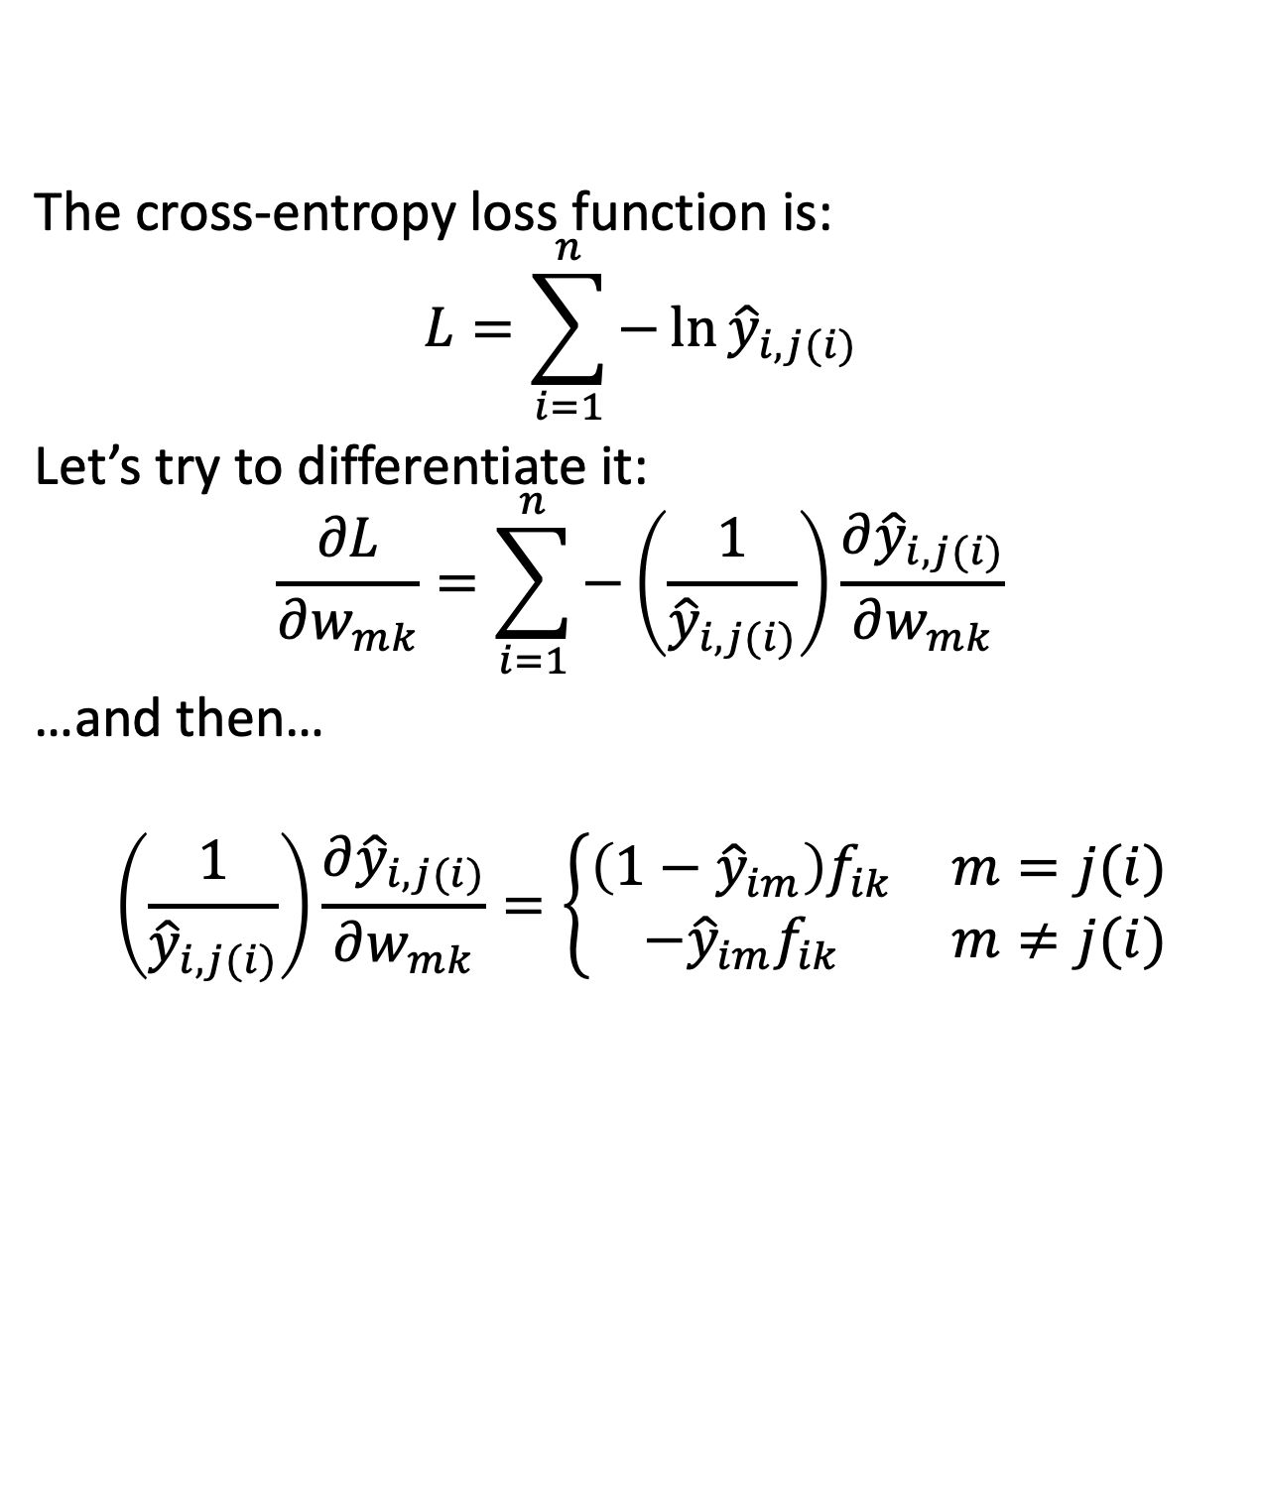
Differentiating the cross-entropy
The cross-entropy loss function is:
$$L=\sum_{i=1}^{n}{−\ln{{\hat{y}}_{i,j(i)}}}$$
Let’s try to differentiate it:
$$\frac{∂L}{∂w_{mk}}=\sum_{i=1}^{n}{−\left(\frac{1}{{\hat{y}}_{i,j(i)}}\right)\frac{∂{\hat{y}}_{i,j(i)}}{∂w_{mk}}}$$
…and then…
$$\left(\frac{1}{{\hat{y}}_{i,j(i)}}\right)\frac{∂{\hat{y}}_{i,j(i)}}{∂w_{mk}}=\left\{\begin{matrix}\left(1−{\hat{y}}_{im}\right)f_{ik} & m=j(i) \\ −{\hat{y}}_{im}f_{ik} & m≠j(i)\end{matrix}\right.$$

Slide 44

Differentiating the cross-entropy
Let’s try to differentiate it:
$$\frac{∂L}{∂w_{mk}}=\sum_{i=1}^{n}{−\left(\frac{1}{{\hat{y}}_{i,j(i)}}\right)\frac{∂{\hat{y}}_{i,j(i)}}{∂w_{mk}}}$$
…and then…
$$\left(\frac{1}{{\hat{y}}_{i,j(i)}}\right)\frac{∂{\hat{y}}_{i,j(i)}}{∂w_{mk}}=\left\{\begin{matrix}\left(1−{\hat{y}}_{im}\right)f_{ik} & m=j(i) \\ −{\hat{y}}_{im}f_{ik} & m≠j(i)\end{matrix}\right.$$
… but remember our reference labels:
$$y_{ij}=\left\{\begin{matrix}1 & \text{i}\text{th} \text{example} \text{is} \text{from} \text{class} \text{j} \\ 0 & \text{i}\text{th} \text{example} \text{is} \text{NOT} \text{from} \text{class} \text{j}\end{matrix}\right.$$

Slide 45

Differentiating the cross-entropy
Let’s try to differentiate it:
$$\frac{∂L}{∂w_{mk}}=\sum_{i=1}^{n}{−\left(\frac{1}{{\hat{y}}_{i,j(i)}}\right)\frac{∂{\hat{y}}_{i,j(i)}}{∂w_{mk}}}$$
…and then…
$$\left(\frac{1}{{\hat{y}}_{i,j(i)}}\right)\frac{∂{\hat{y}}_{i,j(i)}}{∂w_{mk}}=\left\{\begin{matrix}\left(y_{im}−{\hat{y}}_{im}\right)f_{ik} & m=j(i) \\ \left(y_{im}−{\hat{y}}_{im}\right)f_{ik} & m≠j(i)\end{matrix}\right.$$
… but remember our reference labels:
$$y_{ij}=\left\{\begin{matrix}1 & \text{i}\text{th} \text{example} \text{is} \text{from} \text{class} \text{j} \\ 0 & \text{i}\text{th} \text{example} \text{is} \text{NOT} \text{from} \text{class} \text{j}\end{matrix}\right.$$

Slide 46

Differentiating the cross-entropy
Let’s try to differentiate it:
$$\frac{∂L}{∂w_{mk}}=\sum_{i=1}^{n}{−\left(\frac{1}{{\hat{y}}_{i,j(i)}}\right)\frac{∂{\hat{y}}_{i,j(i)}}{∂w_{mk}}}$$
…and then…
$$\left(\frac{1}{{\hat{y}}_{i,j(i)}}\right)\frac{∂{\hat{y}}_{i,j(i)}}{∂w_{mk}}=\left(y_{im}−{\hat{y}}_{im}\right)f_{ik}$$

Slide 47

Differentiating the cross-entropy
Let’s try to differentiate it:
$$\frac{∂L}{∂w_{mk}}=\sum_{i=1}^{n}{\left({{\hat{y}}_{im}−y}_{im}\right)f_{ik}}$$

Slide 48

Differentiating the cross-entropy
Let’s try to differentiate it:
$$\frac{∂L}{∂w_{mk}}=\sum_{i=1}^{n}{\left({{\hat{y}}_{im}−y}_{im}\right)f_{ik}}$$
Interpretation:
Increasing $w_{mk}$ will make the error worse if
${\hat{y}}_{im}$ is already too large, and $f_{ik}$ is positive
${\hat{y}}_{im}$ is already too small, and $f_{ik}$ is negative

Slide 49

Differentiating the cross-entropy
Let’s try to differentiate it:
$$\frac{∂L}{∂w_{mk}}=\sum_{i=1}^{n}{\left({{\hat{y}}_{im}−y}_{im}\right)f_{ik}}$$
Interpretation:
Our goal is to make the error as small as possible. So if
${\hat{y}}_{im}$ is already too large, then we want to make ${w_{mk}f}_{ik}$ smaller
${\hat{y}}_{im}$ is already too small , then we want to make ${w_{mk}f}_{ik}$ larger
$$w_{mk}=w_{mk}−η\frac{∂L}{∂w_{mk}}$$

Slide 50
Outline
Dichotomizers and Polychotomizers
Dichotomizer: what it is; how to train it
Polychotomizer: what it is; how to train it
One-Hot Vectors: Training targets for the polychotomizer
Softmax Function: A differentiable approximate argmax
Cross-Entropy
Cross-entropy = negative log probability of training labels
Derivative of cross-entropy w.r.t. network weights
Putting it all together: a one-layer softmax neural net

Slide 51

Summary: Training Algorithms You Know
Naïve Bayes with Laplace Smoothing:
$$P\left(f_{k}=x | class j\right)=\frac{\left(\#tokens of class j with f_{k}=x\right)+1}{\left(\#tokens of class j\right)+\left(\#possible values of{ f}_{k}\right)}$$
Multi-Class Perceptron: If token ${\vec{f}}_{i}$ of class j is misclassified as class m, then
$${\vec{w}}_{j}={\vec{w}}_{j}+η{\vec{f}}_{i}$$
$${\vec{w}}_{m}={\vec{w}}_{m}−η{\vec{f}}_{i}$$
Softmax Neural Net: for all weight vectors (correct or incorrect),
$${\vec{w}}_{m}={\vec{w}}_{m}−η∇_{{\vec{w}}_{m}}L$$
$$={\vec{w}}_{m}−η\left({{\hat{y}}_{im}−y}_{im}\right){\vec{f}}_{i}$$

Slide 52

Summary: Perceptron versus Softmax
Softmax Neural Net: for all weight vectors (correct or incorrect),
$${\vec{w}}_{m}={\vec{w}}_{m}−η\left({{\hat{y}}_{im}−y}_{im}\right){\vec{f}}_{i}$$
Notice that, if the network were adjusted so that
$${\hat{y}}_{im}=\left\{\begin{matrix}1 & network thinks the correct class is m \\ 0 & otherwise\end{matrix}\right.$$
Then we’d have
$$\left({{\hat{y}}_{im}−y}_{im}\right)=\left\{\begin{matrix}−2 & correct class is m, but network is wrong \\ 2 & network guesses m, but {it}^{′}s wrong \\ 0 & otherwise\end{matrix}\right.$$

Slide 53

Summary: Perceptron versus Softmax
Softmax Neural Net: for all weight vectors (correct or incorrect),
$${\vec{w}}_{m}={\vec{w}}_{m}−η\left({{\hat{y}}_{im}−y}_{im}\right){\vec{f}}_{i}$$
Notice that, if the network were adjusted so that
$${\hat{y}}_{im}=\left\{\begin{matrix}1 & network thinks the correct class is m \\ 0 & otherwise\end{matrix}\right.$$
Then we get the perceptron update rule back again (multiplied by 2, which doesn’t matter):
$${\vec{w}}_{m}=\left\{\begin{matrix}{\vec{w}}_{m}+2η{\vec{f}}_{i} & correct class is m, but network is wrong \\ {\vec{w}}_{m}−2η{\vec{f}}_{i} & network guesses m, but {it}^{′}s wrong \\ {\vec{w}}_{m} & otherwise\end{matrix}\right.$$

Slide 54

Summary: Perceptron versus Softmax
So the key difference between perceptron and softmax is that, for a perceptron,
$${\hat{y}}_{ij}=\left\{\begin{matrix}1 & network thinks the correct class is j \\ 0 & otherwise\end{matrix}\right.$$
Whereas, for a softmax,
$$0≤{\hat{y}}_{ij}≤1, \sum_{j=1}^{c}{{\hat{y}}_{ij}}=1$$

Slide 55


Summary: Perceptron versus Softmax
…or, to put it another way, for a perceptron,
$${\hat{y}}_{ij}=\left\{\begin{matrix}1 & if j=\underset{1≤ℓ≤c}{argmax}{{\vec{w}}_{ℓ}∙{\vec{f}}_{i}} \\ 0 & otherwise\end{matrix}\right.$$
Whereas, for a softmax network,
$${\hat{y}}_{ij}=\underset{j}{softmax}\left({\vec{w}}_{ℓ}∙{\vec{f}}_{i}\right)$$
Argmax or Softmax
Perceptrons w/ weights ${\vec{w}}_{ℓ}$
Inputs

